Slide 1
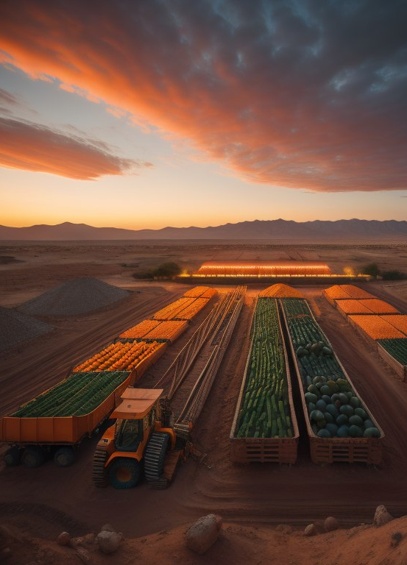
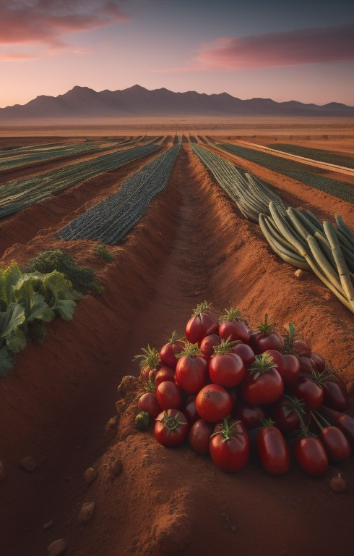
“Organizing Agricultural Production”
Jordan University of Science and Technology
College of Computer Sciences & Information Technology
A project submitted
in partial fulfillment of the requirements for the degree of
Bachelor in Software Engineering
by
Ibrahim Raid Ibrahim Hajras (145978)
Hesham Ahmed Mohammad alqaoud(146496)
Supervised by
Dr. Zakaria AL SHARA

Slide 2
Chapter 1 : Introduction
One of the main problems faced by farmers is the absence of agricultural production organizations.
Here we mean that there is no organization for the production of various plant crops, especially vegetables.
More in detail, there is no guide for farmers on what and when to plant a specific crop, including the presence of an abundance of some agricultural products. This leads to a decrease in their prices because of the large supply in an unorganized way, which in turn leads to huge losses for farmers producing these crops and thus leads to an increase in the prices of those products, which causes a burden on the consumers’ budget. Therefore, to economize consumers budgets and minimize farmers losses, the idea of organizing agricultural production in Jordan must be worked on.
Create an electronic application to regulate the production of agricultural crops in Jordan and supervise it by specialists who ensure that the instructions for the cultivated crops and their planting times are followed and that the weather conditions are favorable.

Slide 3
1.1 Overview Work will be done to activate a special application under the name Organizing Agricultural Production, and the application will contain a set of instructions for farmers and set the goal of the application to help farmers know the suitable crop for cultivation. He developed several information about agricultural crops, how they are available in Jordan, their seasons, cultivation, etc., and reformed the marketing process inside Jordan and Observing weather and weather conditions in all regions of Jordan. 1.2 Project Motivation We came up with this idea due to there is no guide for farmers on what and when to plant a specific crop, including the presence of an abundance amounts of some agricultural products. This project is one of the planning projects which proposed a new idea for Jordan such Organizing Agricultural Production, importance of the project Improving and maintaining agricultural products and their availability in all markets on an ongoing basis and Giving each agricultural product its right in the markets and Developing agriculture in Jordan in general.

Slide 4
1.3 Problem Statement The lack of structure in agricultural output, namely the cultivation of diverse plant crops, particularly vegetables, in Jordan, is the issue this project seeks to address. The biggest problem is the lack of instructions for farmers on what and when to grow a specific crops, and not observing weather and weather conditions in all city of Jordan. which causes several issues. This includes an overstock of some agricultural goods that lowers prices because of an unchecked growth in supply, resulting in large losses for farmers. Contrarily, poor production management can result in a shortage of some agricultural products or their unavailability at certain times of the year, raising costs and straining customers' budgets. 1.4 Project Aim and Objectives The aim of the " Organizing Agricultural Production " project is to address the problem of unregulated agricultural production in Jordan. The project aims to develop and implement application that will provide farmers with guidance on what to plant and when to plant it, based on the local weather and soil conditions, in order to optimize crop yields and reduce losses. The platform will also allow for better coordination between farmers, distributors, and consumers, and will ultimately contribute to a more stable and sustainable agricultural sector in Jordan.

Slide 5
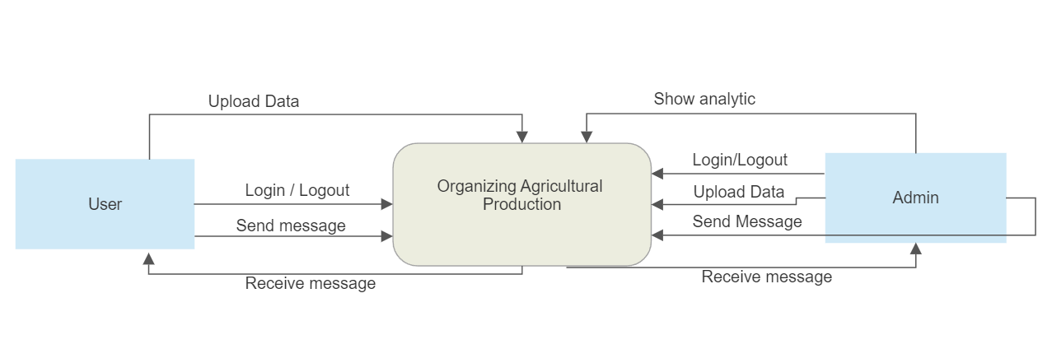
Chapter 2 : Planning phase
2.1 Scope of the project
•It the application is a tool for analyzing agricultural crop production quantities, their availability in the market, and the quantities consumed during the annual seasons (winter and summer) in previous years for each region in Jordan. It also monitors the weather conditions in all regions across Jordan.
•The farmer can see the cultivated quantity in dunums for each crop in the current season for each region in Jordan, and to give the farmer some advice about agriculture, the Ministry of Agriculture in Jordan.
• One of our project’s features is that it shows the percentage required of each crop in the months of the year and the percentage of the number of farmers who will plant each crop and monitor Weather in all cities Jordan.
Figure 1 shows the context diagram for the system. Farmers can login and logout, then can upload data about how much they will plant and which kind of plant they will plant, and they can send messages and receive messages. The Ministry of Agriculture in Jordan(Admin) ) can show analytics about crops and send messages and receive messages with farmers.

Slide 6
2.2 Project risks and Product risks
various issues arise in our system, and these issues are as follows:
• Data accuracy.
• A farmer can add land, this land is accessed using the coordinates of a location installed on those lands; if the coordinates are incorrect, there is a problem.
• To access and benefit from system functions, this system necessitates the user's requirement for Internet access.
• Requires Regular Maintenance.
These are only a few of the issues that can arise in the system and must be addressed.
2.3 Feasibility study
Through discussion and after extensive investigation and analysis, our team feels that this system is practicable. We discussed the constraints of available time, resources, and budget to build this system.
1. Financial Feasibility:
We believe that this project does not have any financial risks because it does not offer any product and the only financial requirement is the cost of hiring a development team to implement it, the project is financially viable.
2.Technical Feasibility:
Our team believes that this project requires technologies reachable for every developer. which are: Android Studio: we will use this technology to implement the system using language dart with framework (flutter) The previous language is used to implement the project’s Frontend, in addition the Backend of the project which we will use (PHP) to implement. Data Base: We will use (MySQL) to design the required database. The project is technically feasible.
3.Legally Feasibility: We need the approval of the Ministry of Agriculture.

Slide 7
CHAPTER 3: Related Existing System
- distinguish project from other existing systems.
Advantages | AGMRI | Tend | Agworld | Organizing agricultural production(our project)
View the proportions of crops grown in country | ✔ | ✖ | ✖ | ✔
Notifications and Alerts | ✔ | ✖ | ✖ | ✔
communicate with each other(farmers) | ✖ | ✖ | ✖ | ✔
Provide analyzes about crops in the last years | ✖ | ✖ | ✖ | ✔
Provide what the market needs of crops | ✖ | ✖ | ✖ | ✔
monitored weather in every day | ✖ | ✖ | ✖ | ✔
optimize productivity and streamline operations about crops | ✔ | ✔ | ✔ | ✔
support a lot of languages | ✖ | ✖ | ✖ | ✔
Generate reports about crops and weather every day | ✖ | ✖ | ✖ | ✔

Slide 8
CHAPTER 4: Requirement Engineering and Analysis
4.1 Used Techniques
Brainstorming
This helped us when we thought of providing new ideas or solutions to problems that faced our farmers in the last few years.
Monitoring
For three months, we asked the farmers about the results that confirm the problem that we identified by using Brainstorming.
We asked the farmers in Jordan about the problem to collect as much information as possible.
Group interview
Our collaborative team engaged in weekly interviews to explore innovative solutions to this problem, this approach allowed us to gather diverse perspectives from various stakeholders.

Slide 9
4.2 Functional Requirement & Modelling
Actor (User) | Functional Requirement
1 | The system shall allow the user to log in with his information to the system, if he is singed up before
2 | The system shall allow the user to see their profile
3 | The system shall allow the user to update their profile.
4 | The system shall allow the user to change password by E-mail or phone number when they forgot it.
5 | The system shall allow the user to see the list of cultivated land for each crops and city.
6 | The system shall allow the user to Post messages and add comments on other posts.
7 | The system shall allow track and display the quantity of vegetables and fruits produced per city in Jordan.
8 | The system shall allow Farmers should be able to add, update, and delete information about the crops they want to grow.
9 | The system shall allow Farmers should be able to see weather condition every day
10 | the system shall allow help and support services to both users .
11 | the system shall allow user switch language in Application

Slide 10
Actor (Admin) | Functional Requirement
1 | The system shall allow the admin to see their profile.
2 | The system shall allow the admin to see the list of available and cultivate land
3 | The system shall allow the admin to check cultivate land
4 | The system shall allow the admin to send Emails to the users
5 | The system shall allow the admin to generate reports
6 | The system shall allow the admin to Post messages
7 | The system shall allow the admin to add, update and remove data
8 | The system shall allow the admin to comment to other messages
9 | The system shall allow the admin to modify land
10 | the system shall allow the admin switch language in Application

Slide 11
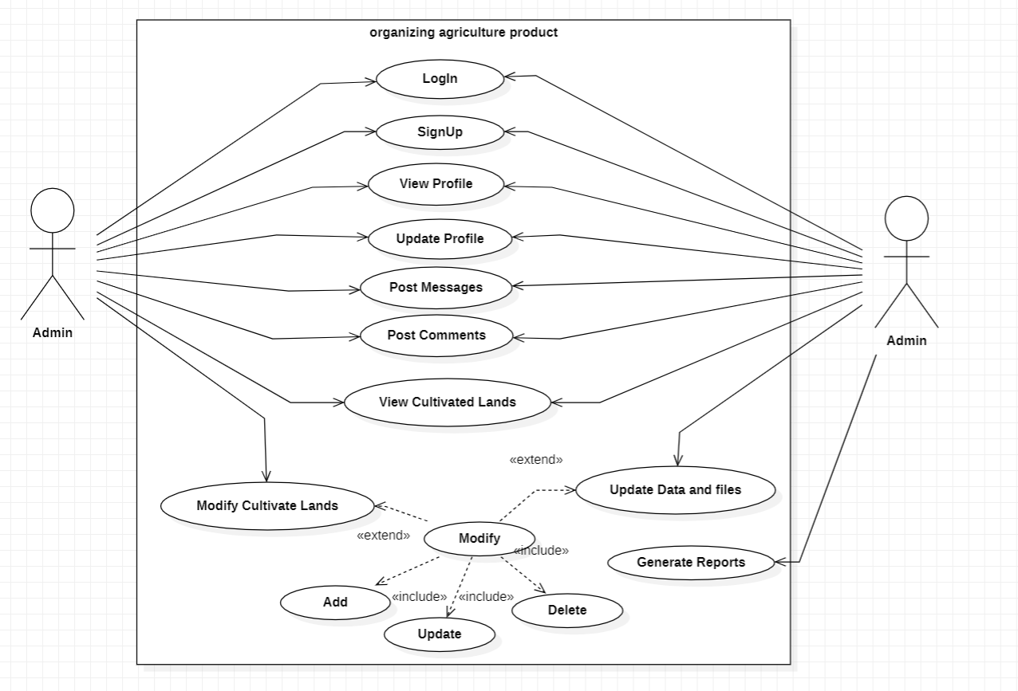
4.2.1 Use Case Diagram

Slide 12
4.2.2 Use Cases: Description & Details
1. view cultivated lands and crop percentage
 | view cultivated lands and crop percentage
Actor(s) | User, Admin
Precondition | The actors enter to the home page.
Normal flow | 1.The actors click on “show analytic” button. 2.The system shows the cultivated lands and crop percentage.
Post condition | Available analytic page displayed successfully.
Exception | If the Internet interrupt from the user, the system cannot show the available analytic.
2.Update my profile
 | Update my profile
Actor(s) | User, Admin.
Precondition | The Actors logged in.
Normal flow | Actors shall go to the profile page. 2. Actors shall click on “Edit profile” button. 3. Actors can change their personal information. 4. Actors can confirm the new information by click on “Change” button.
Post condition | The profile has been updated successfully.
Exception | If the edited information has wrong format looks like Email the system ask to enter the wrong information again or save the old info

Slide 13
4.4 Nonfunctional Requirements: Quality & Constraints
Nonfunctional Requirements | Explain | Use Technics
Performance | The app should be responsive and perform efficiently to handle many users and data. | 1.Optimize-Network-Requests: -lower the payload size by compressing data or using more efficient data formats like JSON instead of XML. -Implement intelligent caching mechanisms to avoid redundant requests and serve cached data when appropriate.
Reliability | The app should be available and reliable, with minimal downtime and the ability to recover from failures. | 1.Automated Testing: -Implement automated testing for both your Flutter app and PHP backend. we will Use unit tests, integration tests, and end-to-end tests to verify the reliability and functionality of your codebase. -we will write test cases that cover various scenarios, including edge cases, error conditions, and data inconsistencies, to ensure robustness and reliability.
Security | The app should ensure the confidentiality, integrity, and privacy of user data, including authentication and access control measures. | 1.Protection Against Cross-Site Scripting (XSS) and Cross-Site Request Forgery (CSRF): Implement measures on the server-side (PHP) to prevent XSS attacks by sanitizing user-generated content, using output encoding, and applying Content Security Policy (CSP) headers to restrict the execution of malicious scripts. lower CSRF attacks by implementing CSRF tokens and validating them on each request to ensure that requests originated from your application and are not forged.
Usability | The app should be user-friendly, intuitive, and accessible to users with different levels of technical expertise. | 1.Intuitive and Consistent User Interface: we will design a user interface (UI) that is intuitive and easy to navigate. and use familiar UI patterns and adhere to platform-specific design guidelines (e.g., Material Design for Android, Cupertino for iOS) to provide a consistent and familiar experience. and sure clear and concise labeling of buttons, menus, and navigation elements to help users understand their purpose and functionality.
Scalability | The app should be able to accommodate an increasing number of users and data without compromising performance. | we will use technologies such as load balancers and reverse proxies to distribute incoming requests across multiple servers, ensuring even load distribution and increasing the capacity to handle more concurrent users. Implement caching mechanisms (such as Redis or Memcached) to reduce database load and improve response times for frequently accessed data.
Availability | The app should be accessible to users with minimal downtime, ensuring uninterrupted service. | 1.Design for Redundancy: Implement redundancy at various levels of your application architecture to minimize the impact of failures. This includes redundant servers, load balancers, databases, and network infrastructure. we will send across multiple servers or data centers to ensure that if one component fails, the application can continue to function

Slide 14
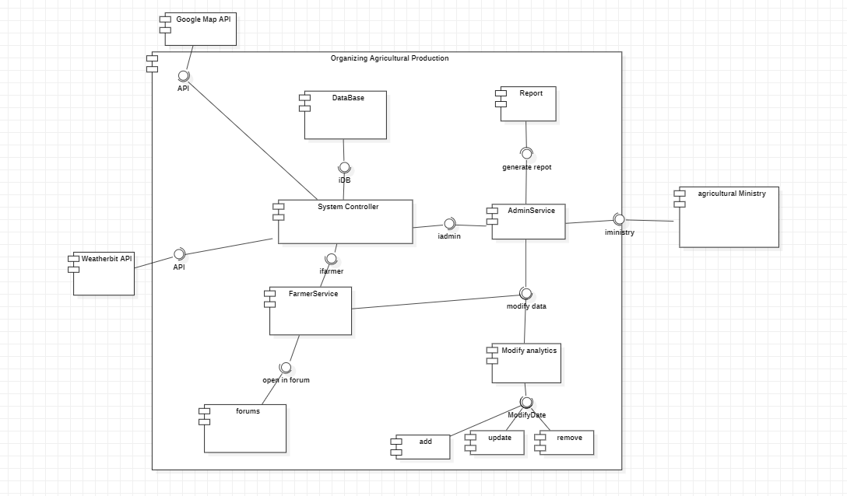
CHAPTER 5: Architecture & Design
shows the Logical View.
5.1 Software Architecture

Slide 15
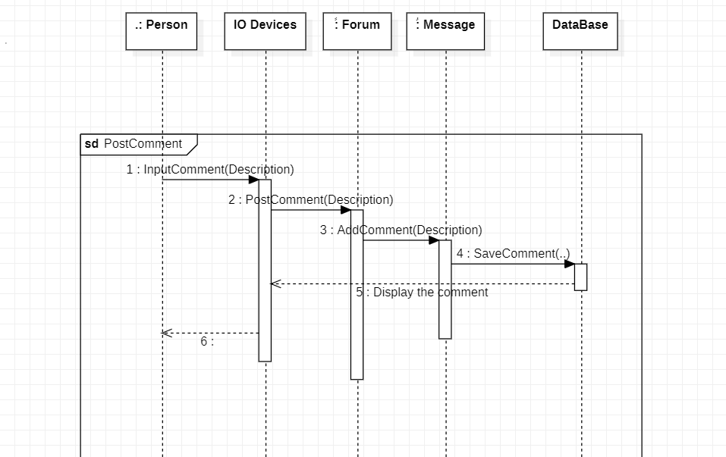
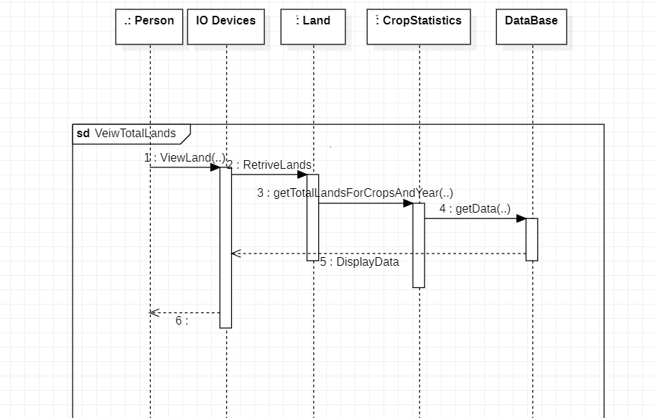
5.2 Software Detailed Design
5.2.1 Use Cases Internal Interactions
Post Comment
View Total Lands

Slide 16
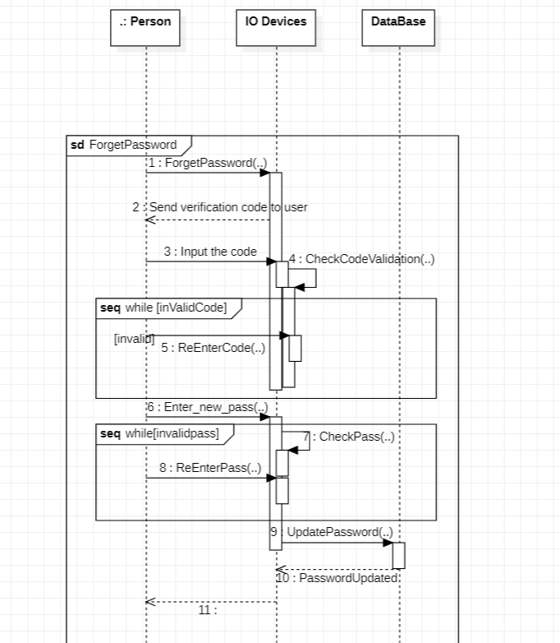
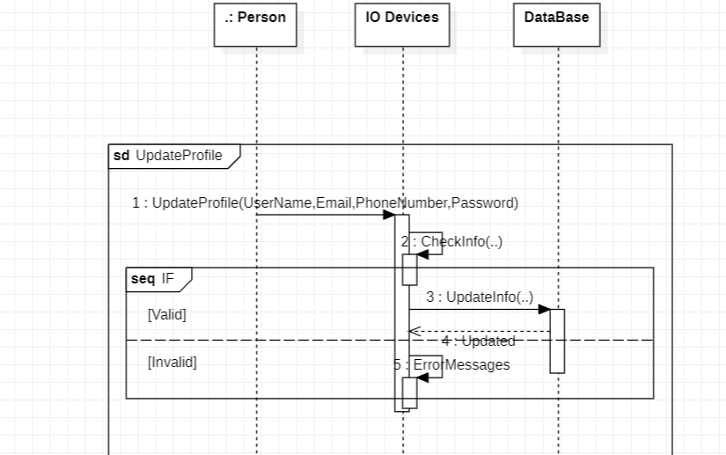
Forget Password
Update Data

Slide 17
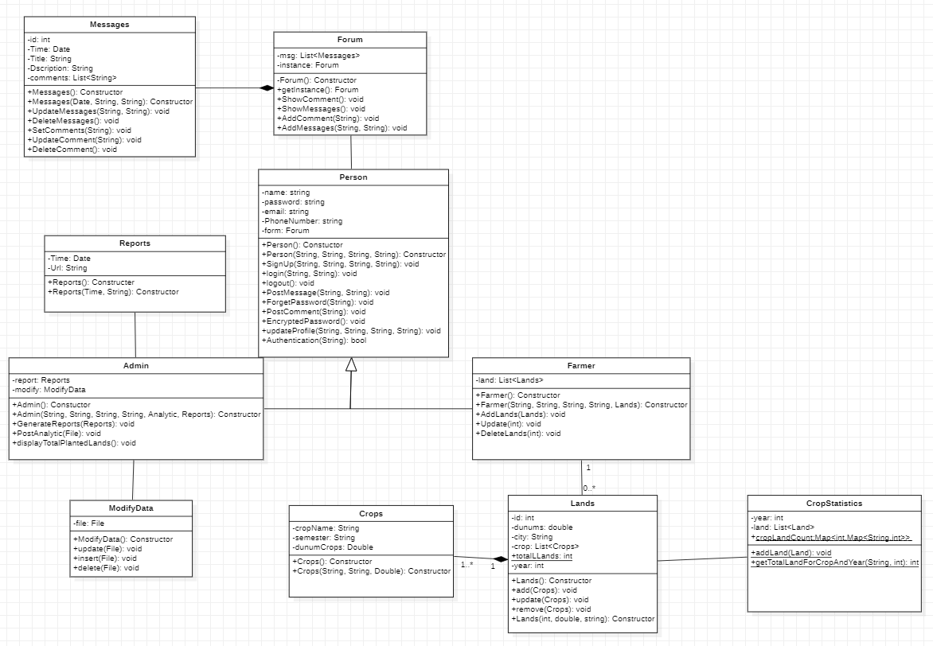
5.2.2 Class Diagram

Slide 18
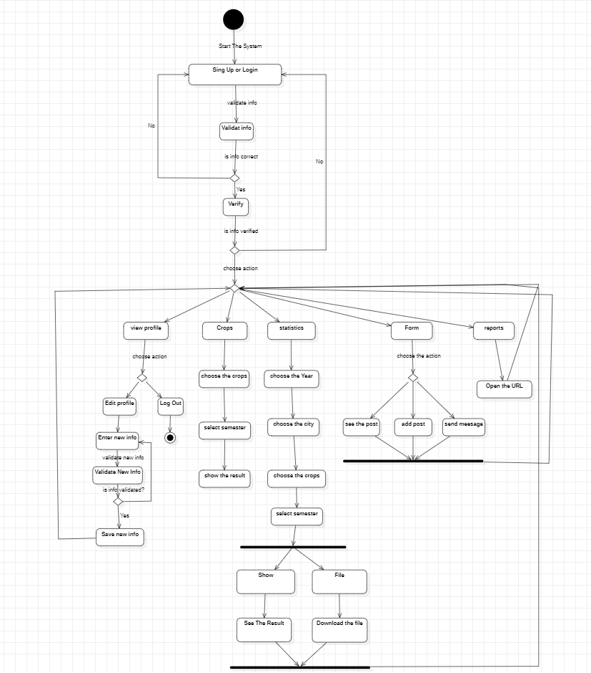
5.2.3 State transition Diagram

Slide 19
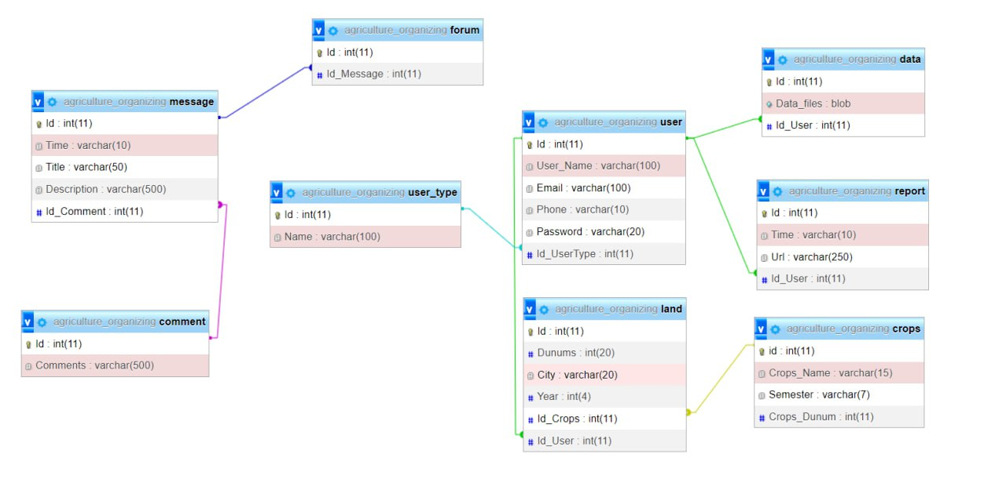
5.2.4 Data Storage Organization

Slide 20
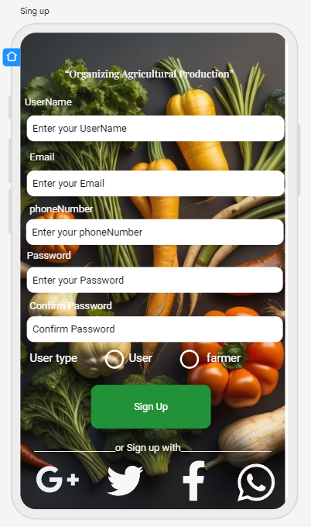
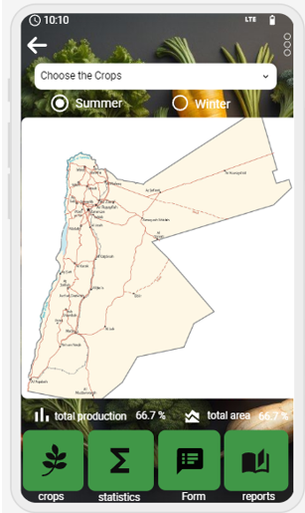
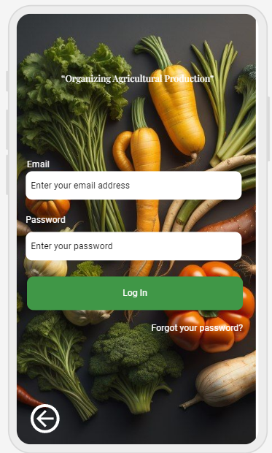
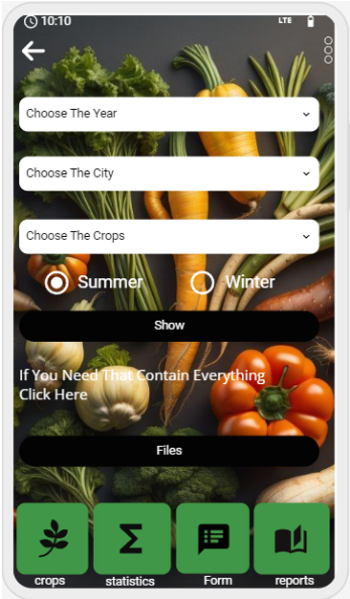
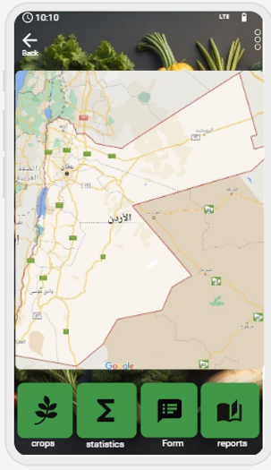
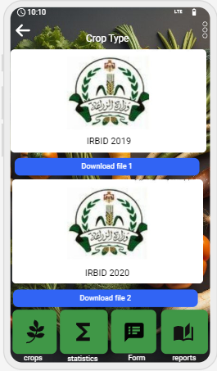
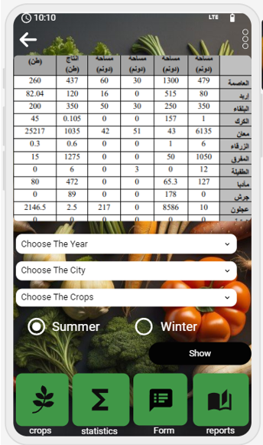
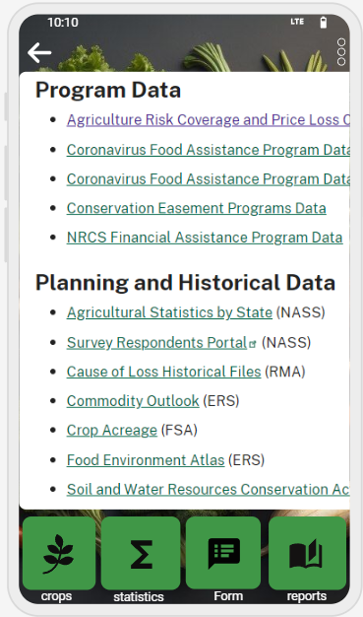
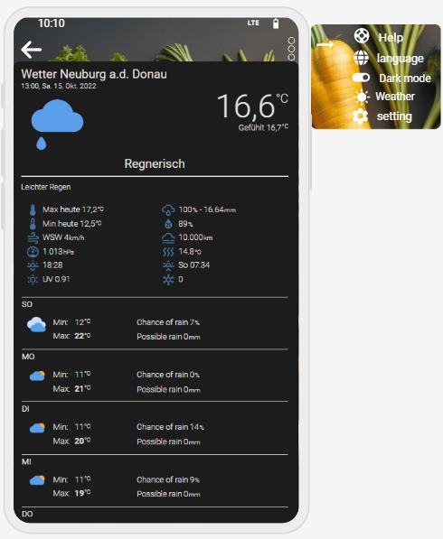
CHAPTER 6: Implementation Plan & Prototyping
6.1 Prototyping
The tools, third-party apps, and languages required to build app organizing agriculture production.
1-Front End: Dart with framework Flutter
2-Back End : PHP
3-DataBase : Myphp Admin
4- Third-party apps : Google Maps and WeatherBit

Slide 21
CHAPTER 7: Testing Plan
1.Log in for User
Test cases for log in
Conditions | Valid Partitions | Tag | Invalid Partitions | Tag | Valid Boundaries | Tag | Invalid Boundaries | Tag
E-Mail | 8 to 30Chars Special Chars 0 to 9 Digits | VP1 VP2 VP3 | Lees than 8 more than 20 Invalid char Null | IP1 IP2 IP3 IP4 | 8 Chars 30 Chars Special Chars | VB1 VB2 VB3 | 7 Chars 31 Chars 0 char | IB1 IB2 IB3
Password | 8 to 20 digit and Char Valid digits and Chars | VP4 VP5 | Less than 8 digits and chars More than 20 digits and chars Nonnumeric Non-symbol Noncapital letter Null | IP5 IP6 IP7 IP8 IP9 IP10 | 8 digits 20 digits | VB4 VB5 | 7 digits 21 digits | IB4 IB5
Test case | Description | Expected outcome | Tag covered
1 | E-Mail: hjres333@gmail.com Password: Ibra1234* | Log-in Successfully | VP1, VP2, VP3, VP4,VP5, ,VB1,VB3,VB4,
2 | E-Mail:ibra& Password: 1234567 | Error Message | IP1,IP3,IB1,IP5, IB4,IP8,IP9.

Slide 22
Test cases for Sing up
Test case | Description | Expected outcome | Tag covered
1 | FullName: Ibrahim Hajras E-Mail: hjres333@gmail.com PhoneNumber:0781771234 password: Ibra1234* Confirm Password: Ibra1234* | Log-in Successfully | VP1, VP2, VP3, VP4,VP5, ,VB1,VB3,VB4,
2 | FullName: ibra E-Mail : hjres PhoneNumber: 0781771234H Password: ibra12 Confirm Password: ibra123 | Error Message | IP5,IB1,IP4, IB4,IP9,IP10, IB8,IP11,IP14, IP15,IB9,IP17, IP20,IP21,IB11.
3. Lands - Crops.
Conditions | Valid Partition | Tag | Invalid Partition | Tag | Valid Boundary | Tag | Invalid Boundary | Tag
Dunums Or Dunums Crops | More than 0 | Vp1 | Less than 0 Equal 0 | IP1 IP2 | 1 N/A | VB1 | 0 | IB1
Test case for lands
4.Crops type and Name City
Name city :
all options (Irbid , Ajloun , Jerash , Mafraq , Balqa , Amman ,Zarqa , Madaba , Karak , Tafilah , Ma'an, Aqaba) in the dropdown list are visible and readable.
that users can select an option from the dropdown list.
the options are displayed in a consistent and uniform manner.
Crops type:
all options (Tomatoes, cucumbers, potatoes, cabbage, peppers, cauliflower, zucchini, beans, Fababean , eggplant) in the dropdown list are visible and readable.
that users can select an option from the dropdown list.
the options are displayed in a consistent and uniform manner.
Test case | Description | Expected outcome | Tag covered
1 | Number of Dunums = 10 | add Successfully | VP1
2 | Number of dunums = 0 | Error Message | IP1 , IB1

Slide 23
Conclusions In conclusion, the proposed system has been developed with a farmers-centered approach, considering the specific needs and requirements of the farmers. The system encompasses various aspects that cater to the needs of all farmers who will utilize it. Whether individuals have small or large farms, this system will prove to be beneficial and valuable to them. By addressing the concerns and requirements of farmers, we have ensured that the system is inclusive and relevant to a wide range of farmers. Through the implementation of our "Organizing Agricultural Production" project, we aspire to empower farmers, enhance productivity, and contribute to the overall growth and development of Jordan's agricultural sector.

