Slide 1
Data, ground truth and experiment setup
Weekly update 1 of 5 · week of Nov 9
THIS UPDATE IN THREE NUMBERS
292
78
15.5%
buildings with an enclosure A1–A3 reference value (Benke et al. 2025)
median kgCO₂e/m² floor area; range 0.5–514
of all enclosure carbon comes from XPS insulation alone

Slide 2
Ground truth: enclosure A1–A3 per m² of floor area
55,807
243 + 49
19%
material rows: Shell – Enclosure, stage A1–A3
new construction + renovations
median share of whole-building A–C carbon
Source: harmonized North American WBLCA dataset (Benke et al. 2025, CC BY 4.0), 48 early-stage features per project.
Normalization: conditioned floor area; renovated + added GFA for renovations. This reproduces the dataset's own normalization for all 292 projects.
Scope: the enclosure includes windows, doors and roofs. The unit is per m² of floor area, because wall area is missing for most projects (the proposal planned per m² of wall).
Week 1 · Data & setup

Slide 3
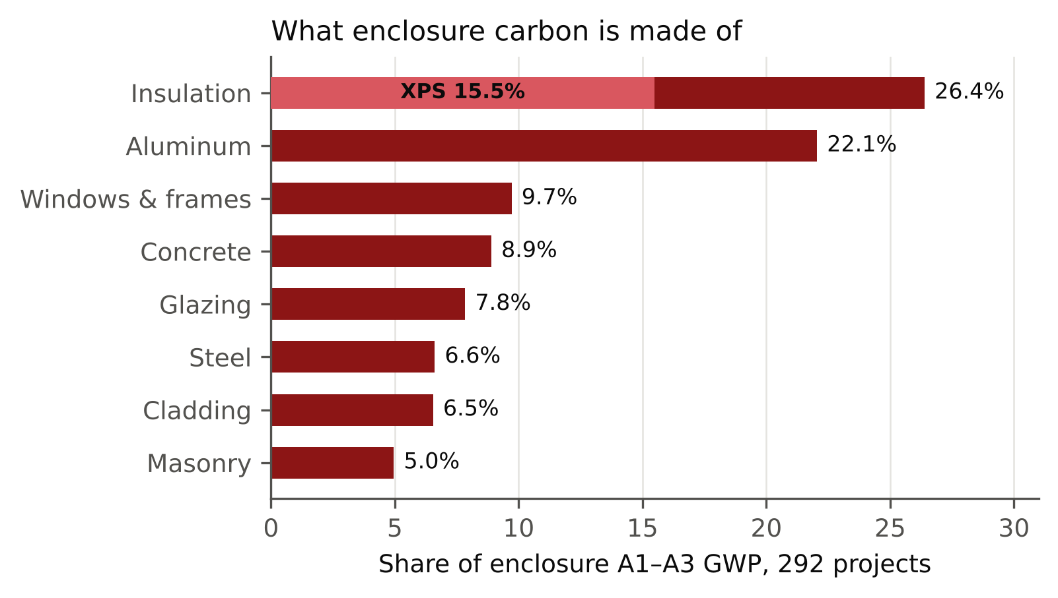
What enclosure carbon is made of
Insulation (26.4%) and aluminum (22.0%) dominate.
XPS: 43.6 kgCO₂e/kg, against 1.2 for mineral wool and 3.1 for polyiso: the HFC-blown product that Tally and One Click LCA modelled in the assessment years.
149 of 292 projects contain XPS.
Data quality: 10 new-construction projects have no fenestration GWP at all, several with a WWR of 0.5–0.7. They are flagged, and results are reported with and without them.
Week 1 · Data & setup

Slide 4
Climate vs use: use matters more (proposal RQ1)
53.6
87.2
157.2
median kgCO₂e/m², multifamily (44 projects)
median, office (41)
median, transportation hubs (9)
Use differs significantly across 9 uses (Kruskal–Wallis p = 2.7×10⁻⁷). New construction with complete references, 233 projects.
Climate does not reach significance (p = 0.26): warm zones 80.6, zone 4 85.9, cold zones 95.1.
Per m² of floor area, use (glazing share, envelope-to-floor ratio) shapes enclosure carbon more than climate (insulation).
Week 1 · Data & setup

Slide 5
LLM experiment protocol
48 features per building
Task file: system prompt, glossary, 48–49 buildings
Claude Opus 5.5 subagent, medium effort; no web, code or ground truth
Answer: RANGE low – high → midpoint
Metrics against the reference LCA
3 runs × 292 buildings = 876 estimates per prompt. Seeded shuffles; identical chunks across prompt versions, so comparisons are paired building by building.
Metrics: ±20% coverage (Wilson CI), RMSE, median APE, median |log(est/ref)|, bias (geometric mean of est/ref), CV across runs.
Parser change: a lower bound of 0 is accepted. Renovations that leave the envelope untouched have reference values near zero, and the course parser would have dropped exactly those answers.
Week 1 · Data & setup

Slide 6
Next update
Coming next
Input we'd like
Baseline results with a plain prompt (the model's own knowledge, prompt v1).
Error analysis: where the model under- and overestimates, and why.
Is per m² of floor area acceptable as the functional unit, instead of per m² of wall?
Keep the 10 flagged incomplete references in the main metrics (we report both ways)?
Week 1 · Data & setup

Slide 7
Baseline (prompt v1) and error analysis
Weekly update 2 of 5 · week of Nov 16
THIS UPDATE IN THREE NUMBERS
19.5%
0.75
0.46
of estimates fall within ±20% of the reference LCA
bias: estimates are about 25% low on average
log–log slope: every building is pulled toward a typical value

Slide 8
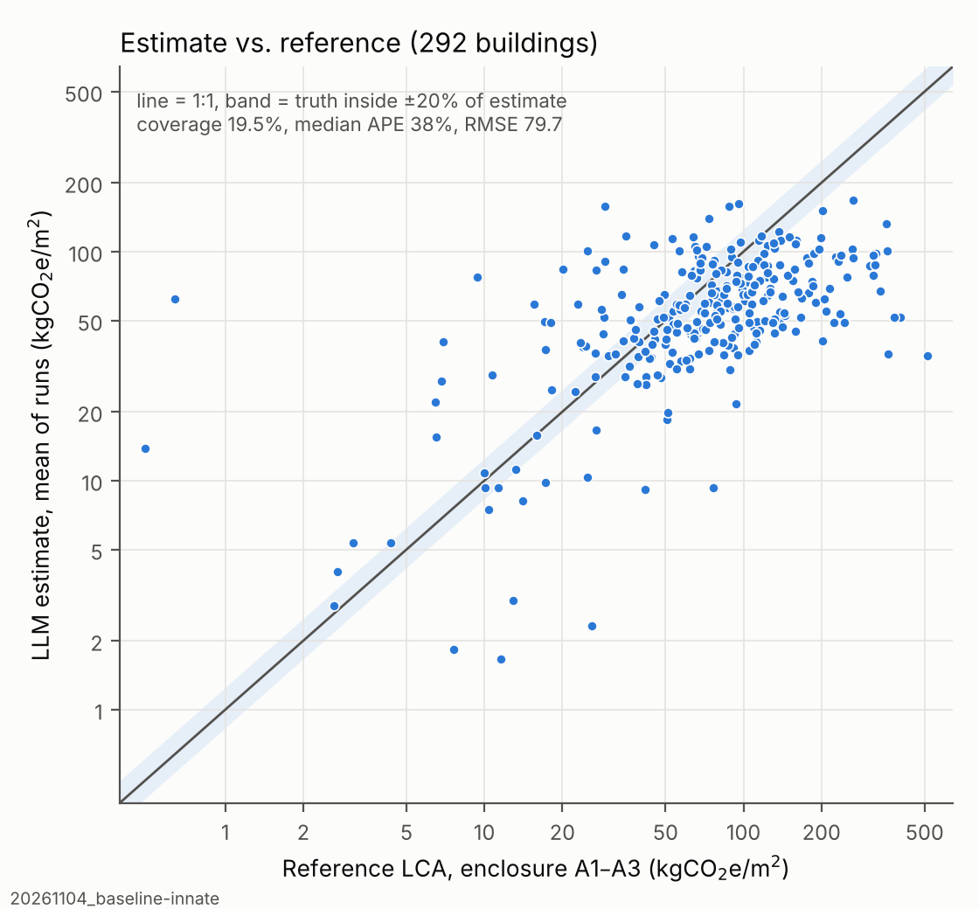
Baseline: a plain prompt, the model's own knowledge
Coverage 19.5% (CI 15.4–24.5%), RMSE 79.7, median APE 37.9%, CV 19.0% across runs.
63% of buildings are underestimated beyond the band; 17.5% are overestimated.
The 20 largest errors, all underestimates, carry 68% of the squared error.
Week 2 · Baseline & error analysis

Slide 9
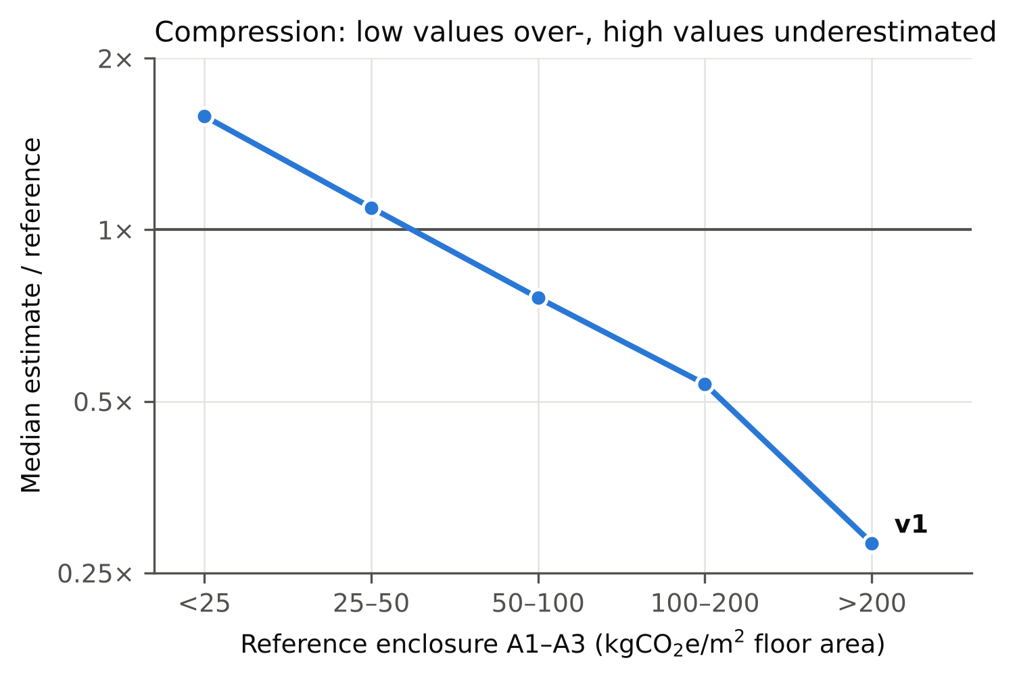
Main pattern: compression, not uniform underestimation
Below 25 kgCO₂e/m²: overestimated 1.58×. Above 200: estimated at 0.28×.
The model leans on geometry: the envelope-to-floor ratio correlates 0.62 with the log estimate but only 0.39 with the log reference.
What it misses is carbon per m² of envelope (r = −0.79 with the log error). That is set by assembly and material choices, and no feature describes the wall assembly.
Week 2 · Baseline & error analysis

Slide 10
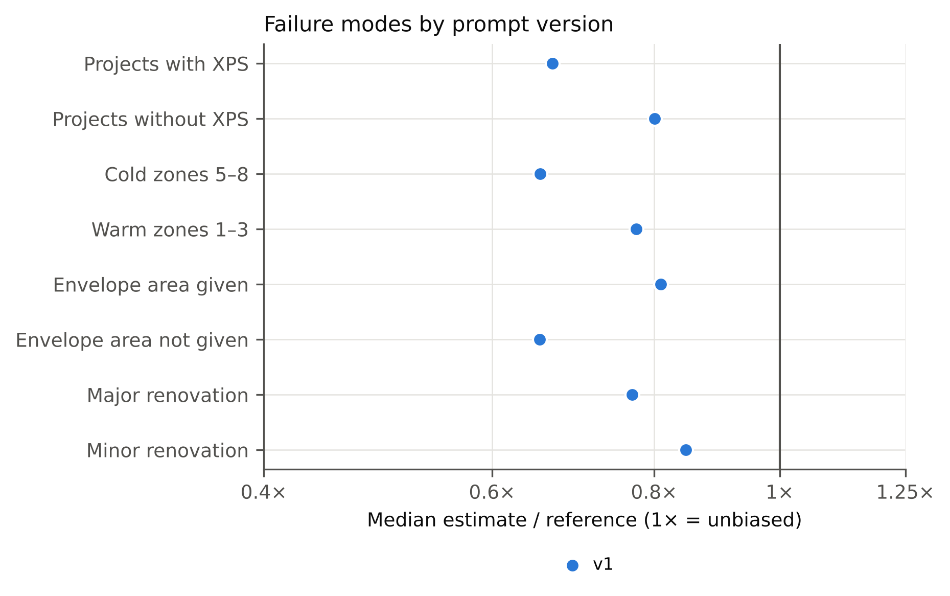
Why the model underestimates
HFC-blown XPS is never considered: 0.6% of answers mention XPS. Ratio 0.67 with XPS vs 0.80 without; removing XPS from the reference moves 0.72 → 0.84, about half the bias.
The climate gap is an insulation effect: cold zones 0.65, warm 0.77. XPS is in 65–68% of zone 5A/5B projects but 26–33% of zone 3B/3C.
Missing envelope area: 0.81 when given, 0.65 when the model must estimate it.
Curtain-wall tail and renovations: single projects reach 300 from curtain wall alone; 60% of major renovations are underestimated.
Scope wording was narrower than the dataset's enclosure (11% of enclosure GWP is tagged "Superstructure" in the source tool).
Week 2 · Baseline & error analysis

Slide 11
Why the model overestimates
3.09×
10
Fit-outs
median estimate/reference for the 10 incomplete references
projects with no fenestration GWP, flagged
and minor renovations: envelope scope unknown from the features
The largest overestimates trace back to incomplete reference LCAs, not to the model.
The remaining overestimates are mostly fit-outs and minor renovations, where the extent of envelope work is not described by any feature.
Flagged projects: 27, 35, 66, 74, 80, 91, 141, 217, 234, 264.
Week 2 · Baseline & error analysis

Slide 12
Next update
Coming next
Input we'd like
Prompt v2: add the missing knowledge. A scope matching the dataset, a component take-off, named high-carbon materials, and a renovation rule.
Rerun 3 × 292 and compare paired with v1.
Feedback on the error taxonomy before we revise the prompt.
Any domain knowledge you would add to the prompt?
Week 2 · Baseline & error analysis

Slide 13
Adding knowledge: v2 and documents
Weekly update 3 of 5 · week of Nov 23
THIS UPDATE IN THREE NUMBERS
13.8%
15.1%
0.61
run-to-run CV (v1 19.0%): more consistent
coverage (v1 19.5%): less accurate
bias with envelope documents in context (v1 0.72): worse

Slide 14
What prompt v2 changed
1
Scope
2
Component take-off
3
High-carbon materials
Written to match the dataset's enclosure definition.
Areas → assemblies → intensities → total.
HFC-blown XPS "ten times or more" the GWP of other insulation per unit R; aluminum curtain wall 100–200 kgCO₂e/m².
4
No anchoring
5
Renovation rule
6
BEST value
Estimating from a "typical building" is ruled out.
Count only the materials of the envelope work.
A best estimate is requested alongside the range.
Week 3 · Adding knowledge

Slide 15
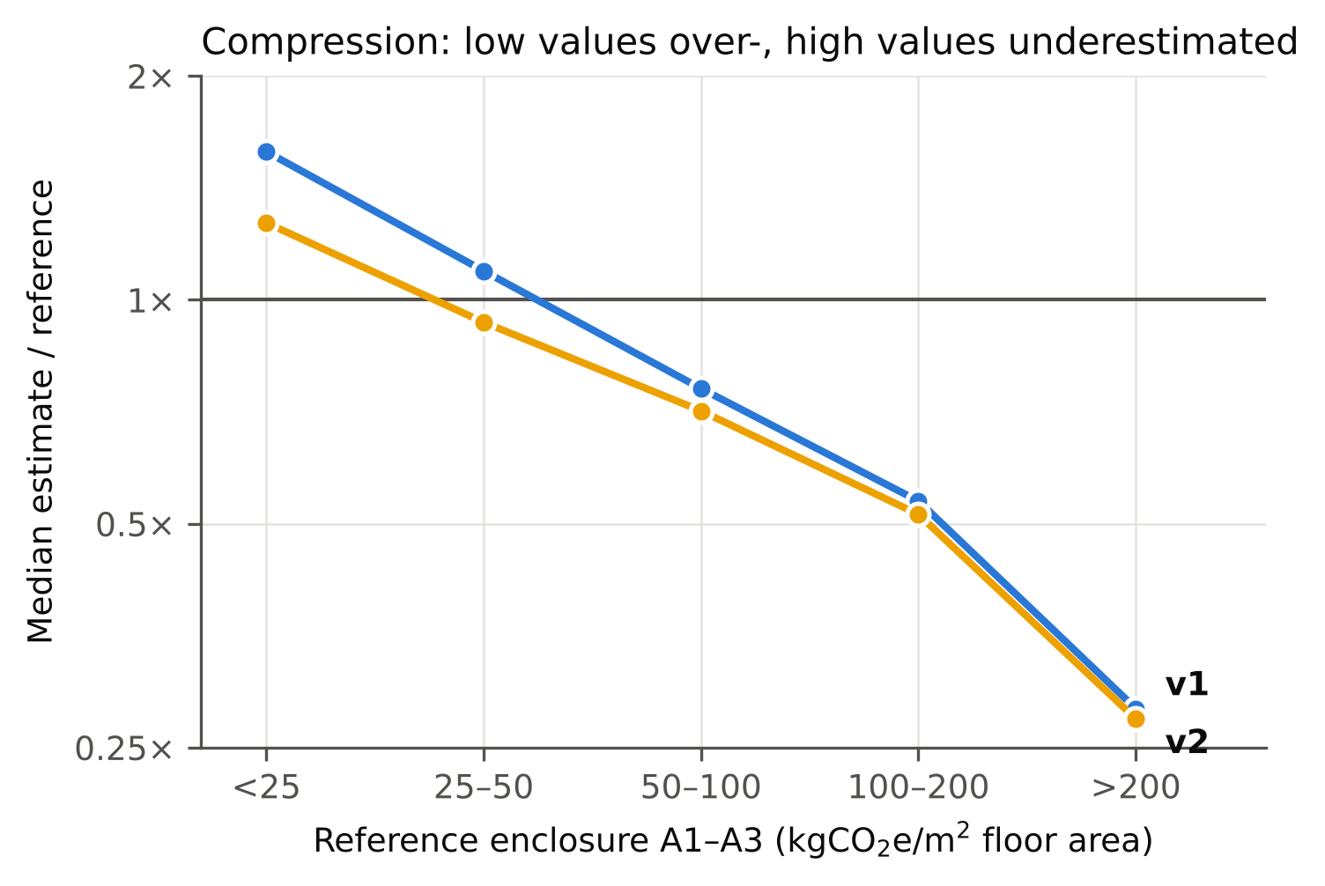
Results: v2 vs v1 (292 buildings, 3 runs each)
Prompt | Coverage | RMSE | Med. APE | Med. |log| | Bias | CV
v1 | 19.5% | 79.7 | 37.9% | 0.456 | 0.75 | 19.0%
v2 | 15.1% | 81.0 | 44.3% | 0.563 | 0.67 | 13.8%
v2 errors are significantly larger (Wilcoxon p < 0.0001).
Compression eased (slope 0.46 → 0.55), but the whole curve shifted down.
More consistent across runs: CV 19.0% → 13.8%.
Week 3 · Adding knowledge

Slide 16
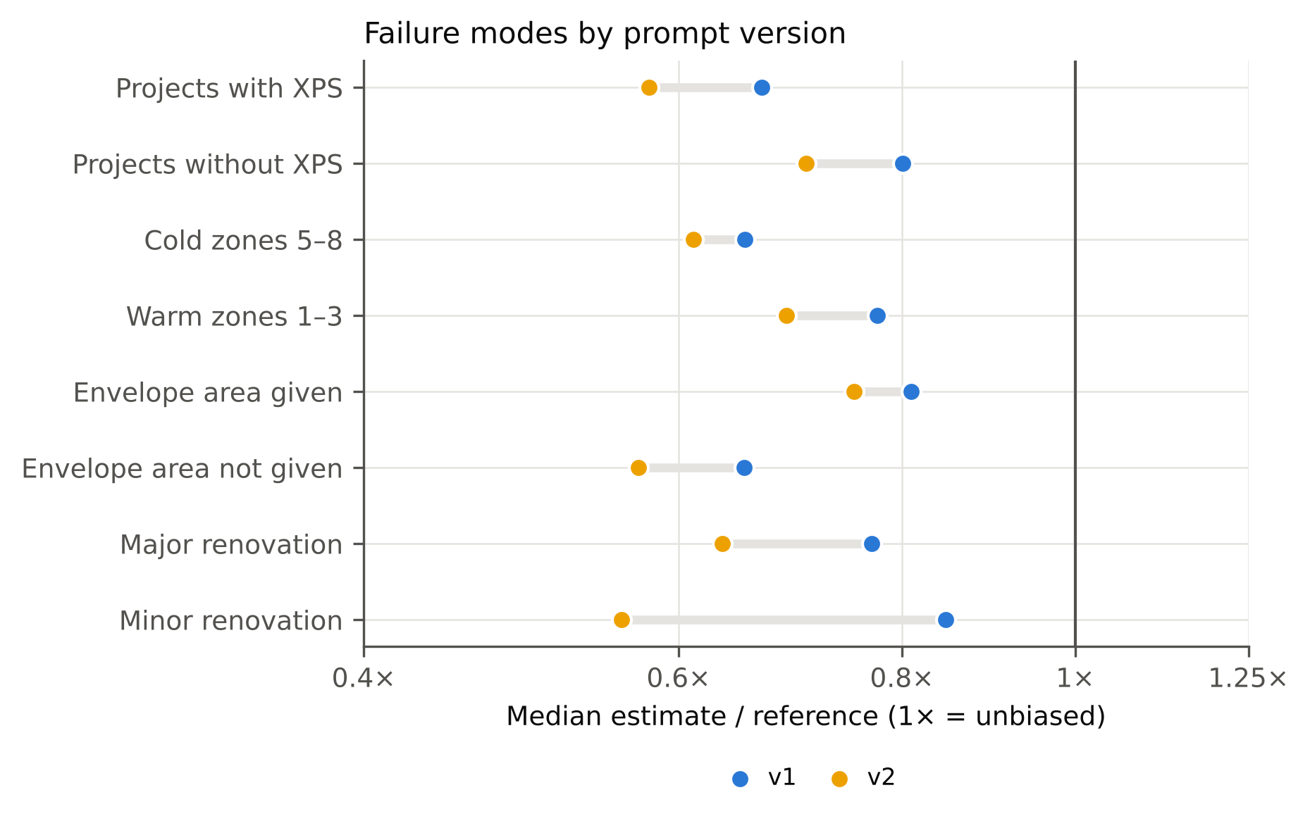
Why v2 got worse
The facts were repeated, not applied. XPS was named 50× more often, but 89% of answers still assumed polyiso roofs; the median roof intensity stayed at 35 kgCO₂e/m².
The take-offs were too light. Bottom-up intensities came out at 66.8 per m² of envelope, against 86.7 in the reference.
A subtracting rule hurt. "Count only new materials" dropped minor renovations from 0.85 to 0.56.
Week 3 · Adding knowledge

Slide 17
Second way to add knowledge: envelope documents in context
Condition (run 0) | Coverage | Med. |log| | Bias | RMSE
v1 (innate) | 17.8% | 0.519 | 0.72 | 81.2
v1 + 4 envelope docs | 15.8% | 0.609 | 0.61 | 85.3
Why
The documents were read: 22% of answers cite them, mostly for the low end of a range.
But they describe today's low-carbon products (HFO foams, recent EPDs, modern glazing); the reference LCAs used period tool data.
XPS mentions fell to 0%; the XPS-project ratio fell 0.64 → 0.50.
Docs: RDH 2025 wall assemblies, CLF 2023 material baselines, Arup facades/glass, UBC fenestration (30k characters each); v1 task text unchanged.
Worse: log error +0.090 (Wilcoxon p < 0.001); bias 0.72 → 0.61.
Week 3 · Adding knowledge

Slide 18
Lesson for prompt design
Qualitative knowledge, as instructions or as documents, gets repeated, not applied. To move the numbers, give numbers, at the step where the model chooses them.
This is the design principle behind prompt v3.
Week 3 · Adding knowledge

Slide 19
Next update
Coming next
Input we'd like
Prompt v3: sourced quantitative anchors. A table of external A1–A3 intensities per m² of component, placed at the decision step.
Held-out check on buildings not used for the prompt diagnostics.
Sources for intensities: CLF baselines, PCI and Kawneer EPDs, RDH studies. None from the ground-truth dataset or the CLF WBLCA benchmark (leakage). Any to add or avoid?
Week 3 · Adding knowledge

Slide 20
Prompt v3 and a held-out check
Weekly update 4 of 5 · week of Nov 30
THIS UPDATE IN THREE NUMBERS
25.0%
0.86
12.5%
coverage (v1 19.5%, v2 15.1%)
bias (v1 0.75): half of the underestimate removed
run-to-run CV (v1 19.0%)

Slide 21
What prompt v3 adds (on top of the v2 scope and method)
1
Sourced intensity table
2
XPS modelling convention
A1–A3 per m² of component, compiled by a separate research subagent from external sources (CLF 2025 baselines, PCI, Kawneer, RDH); excludes the ground-truth dataset. Placed at the step where numbers are chosen.
LCA tools of the period often used HFC-blown XPS for roofs.
3
Sanity check
4
Renovation rule
Roughly 50 kgCO₂e/m² of envelope as a cross-check of the total.
Rewritten so that it no longer subtracts by default.
Week 4 · Prompt v3 & held-out

Slide 22
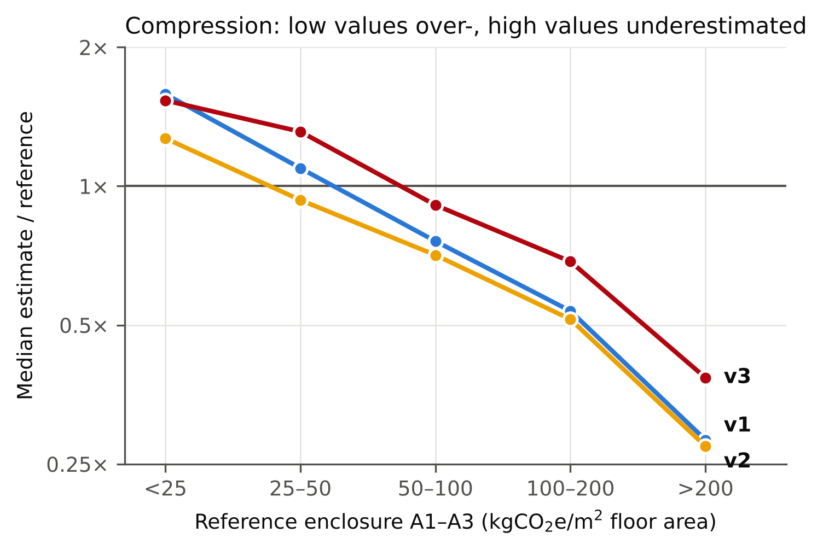
Results: all three prompts (292 buildings, 3 runs each)
Prompt | Coverage | RMSE | Med. APE | Med. |log| | Bias | CV
v1 | 19.5% | 79.7 | 37.9% | 0.456 | 0.75 | 19.0%
v2 | 15.1% | 81.0 | 44.3% | 0.563 | 0.67 | 13.8%
v3 | 25.0% | 76.0 | 40.0% | 0.426 | 0.86 | 12.5%
v3 vs v2: significant (p = 0.002). v3 vs v1: consistent but borderline (McNemar p = 0.085, Wilcoxon p = 0.053).
HFC-XPS is now considered in 96% of answers for projects with XPS.
Unbiased now: the non-XPS part (0.99), buildings with a given envelope area (0.99), warm zones (0.98).
Week 4 · Prompt v3 & held-out

Slide 23
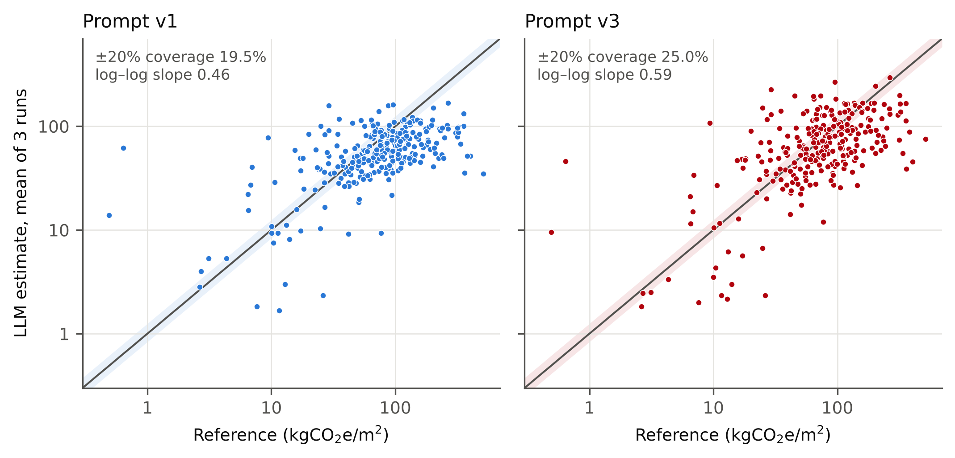
What is still wrong
Compression at the top: 0.38 above 200 kgCO₂e/m².
Light enclosures are overestimated more (1.31 in the 25–50 bin).
Renovations remain hard: the extent of envelope work is not in the features.
Week 4 · Prompt v3 & held-out

Slide 24
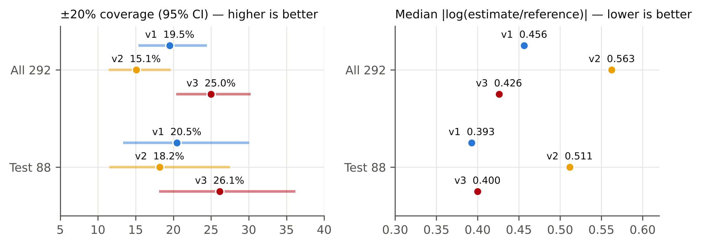
Held-out check: 88 test buildings
No external test set fits: the CLF benchmark probably shares source models; CarbEnMats has 172 European buildings, a different element definition and no geometry.
Split: 88 test / 204 dev, stratified on project type × climate (seed 226). It was assigned after the runs, so we re-ran every diagnostic on dev only, and all findings replicate (slope 0.44, XPS 14.7%, area effect 0.79 vs 0.65, polyiso 89%).
Test: v3 26.1% vs v1 20.5% coverage, RMSE 69.2 vs 74.1, bias 0.86 vs 0.75. Median |log| unchanged (0.400 vs 0.393); not significant at this size (p = 0.41).
Week 4 · Prompt v3 & held-out

Slide 25
Next update
Coming next
Input we'd like
Feature study: which inputs does the model actually need?
LEED v5: what the accuracy means for MRp2 and MRc2.
Final deliverables: paper, final prompt, poster.
Is the post-hoc split with dev-only replication acceptable, or should we collect additional projects?
Week 4 · Prompt v3 & held-out

Slide 26
Features, LEED v5 and deliverables
Weekly update 5 of 5 · week of Dec 7
THIS UPDATE IN THREE NUMBERS
10
7×
≈ 6%
early-design features are as good as all 48
prompt content moved the error 7× more than any feature set
of whole-building carbon from a 30% enclosure cut

Slide 27
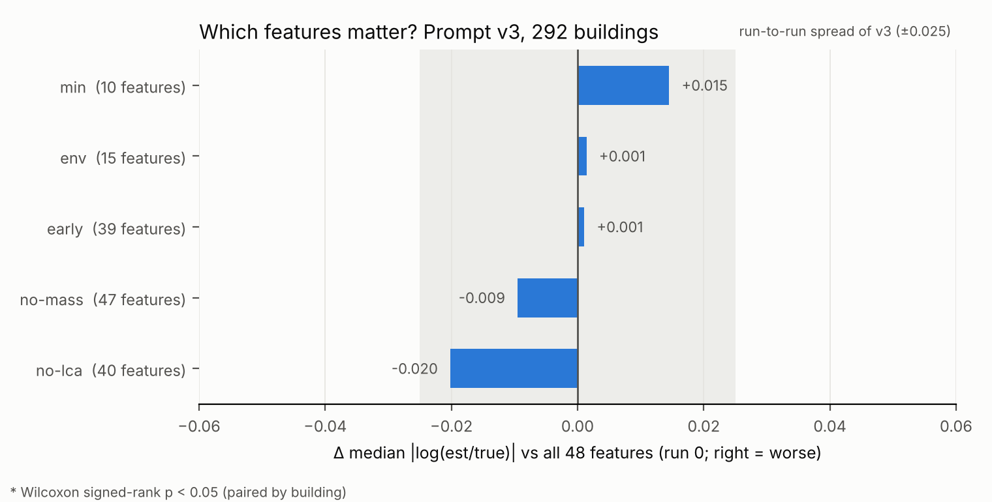
Feature study: 10 inputs are enough (v3, run 0)
Set | n | Coverage | Med. |log| | Δ | p | Bias
all | 48 | 24.3% | 0.461 | – | – | 0.86
early | 39 | 21.6% | 0.462 | +0.001 | 0.13 | 0.88
env | 15 | 19.9% | 0.463 | +0.001 | 0.33 | 0.93
min | 10 | 25.3% | 0.476 | +0.015 | 0.81 | 0.81
no-lca | 40 | 25.3% | 0.441 | −0.020 | 0.57 | 0.90
no-mass | 47 | 22.6% | 0.452 | −0.009 | 0.92 | 0.85
No set differs significantly from all 48; every difference is within v3's run-to-run spread (±0.025).
The model does not depend on mass_total or other LCA-derived fields.
One run per set; 7 of 9 planned ablations were stopped to limit cost.
Week 5 · Features, LEED & deliverables

Slide 28
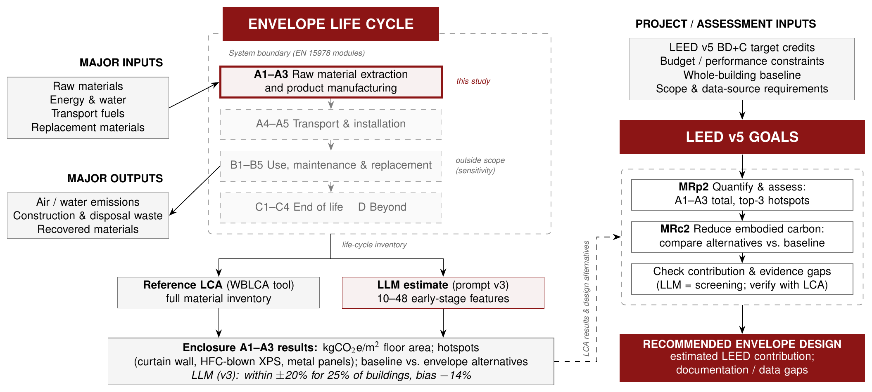
Where the estimate fits in LEED v5
The study boundary is A1–A3. A reference LCA and the LLM estimate both produce enclosure results that feed MRp2 (quantify, hotspots) and MRc2 (reduce against a baseline). The LLM screens; an LCA documents.
Week 5 · Features, LEED & deliverables

Slide 29
LEED v5: screening yes, credit documentation no
1
MRp2: hotspots
2
MRc2: reductions
3
Option 1: dilution
Answers name the reference top-1 hotspot in 95% of cases (chance at the same count: 61%), but list ~7 categories, not a ranked top 3. Bias is small (−14%). Suited to screening; ask for a ranked top 3.
CV 12.5%, median error ≈ 35–40%, coverage 1 in 4: as large as typical documented reductions. Cannot document a credit-level reduction. Paired comparison of alternatives is the promising, untested use.
The enclosure is a median 19% of whole-building A–C, so a 30% enclosure cut ≈ 6% of the building. Envelope choices work best together with structure, or via Option 2 EPDs.
Week 5 · Features, LEED & deliverables

Slide 30
Deliverables and limitations
1
Final prompt (v3)
2
Paper, reports, poster
Full text in the paper's appendix, with the sourced intensity table.
ICML-style paper, English and Chinese reports, PPT poster; all code and results in the GitHub repo.
3
Limitations
4
Future work
Answers in one task file share a context; post-hoc split; v3–v1 gain borderline with 3 runs; feature study and document condition one run each; per m² floor area; uneven reference quality; one model.
Assembly-type inputs; paired alternative comparison; a ranked top-3 hotspot output for MRp2; an external test set.
Week 5 · Features, LEED & deliverables

Slide 31
Wrap-up
Take-aways
Input we'd like
An LLM's error is structured: compression and material blind spots, which error analysis can locate.
Sourced numbers at the decision step work; qualitative knowledge does not.
For LEED v5: screening and comparison, verified by an LCA.
Feedback on the paper and poster before final submission.
Interest in the assembly-type follow-up?
Week 5 · Features, LEED & deliverables

