Slide 1


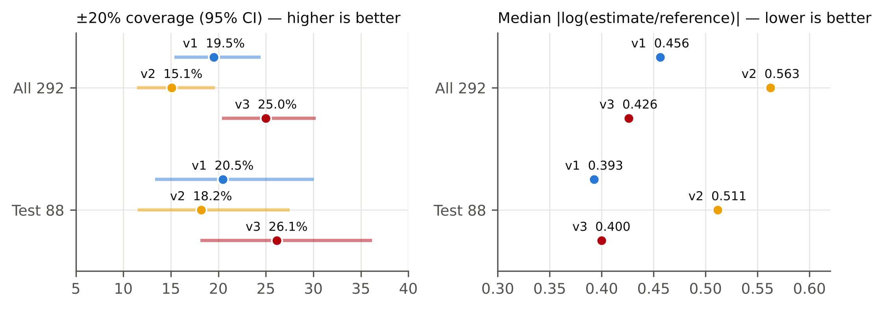
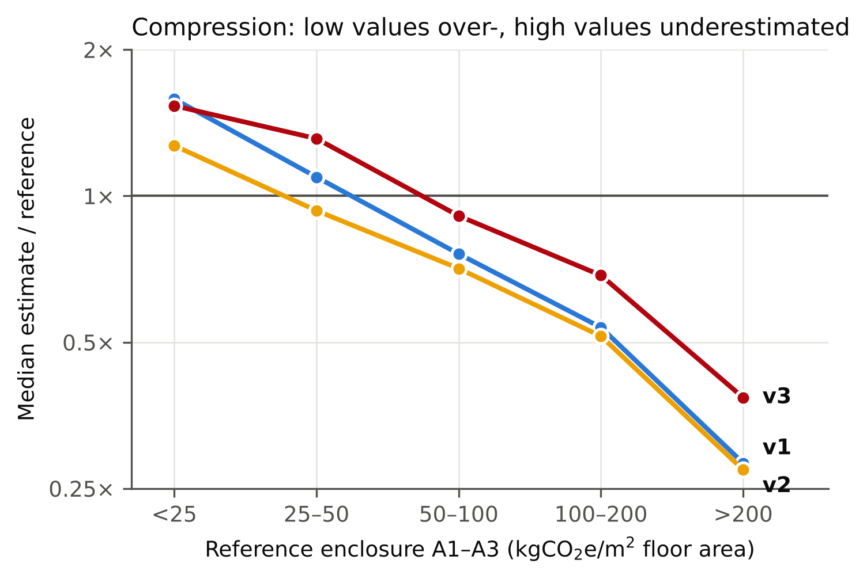
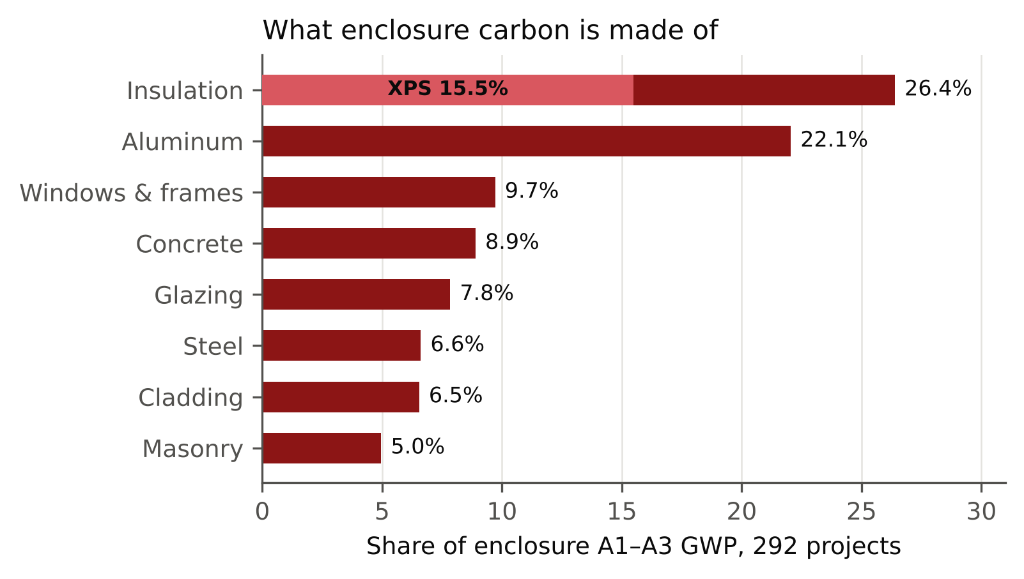
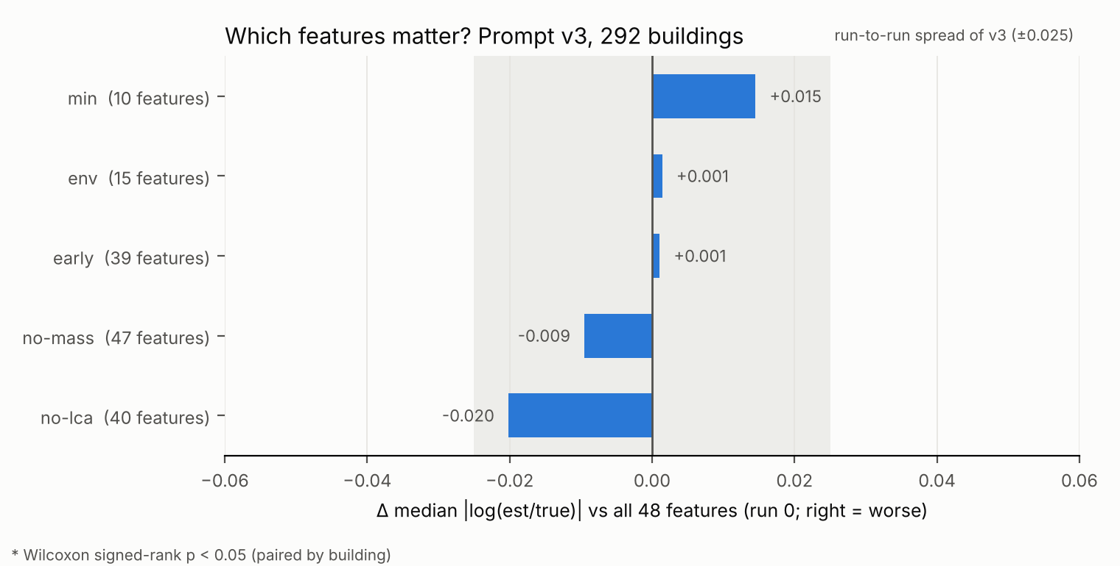
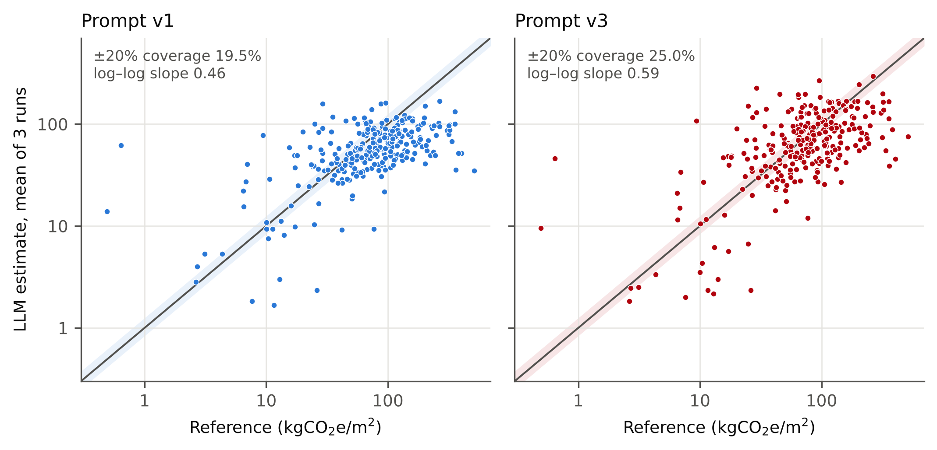
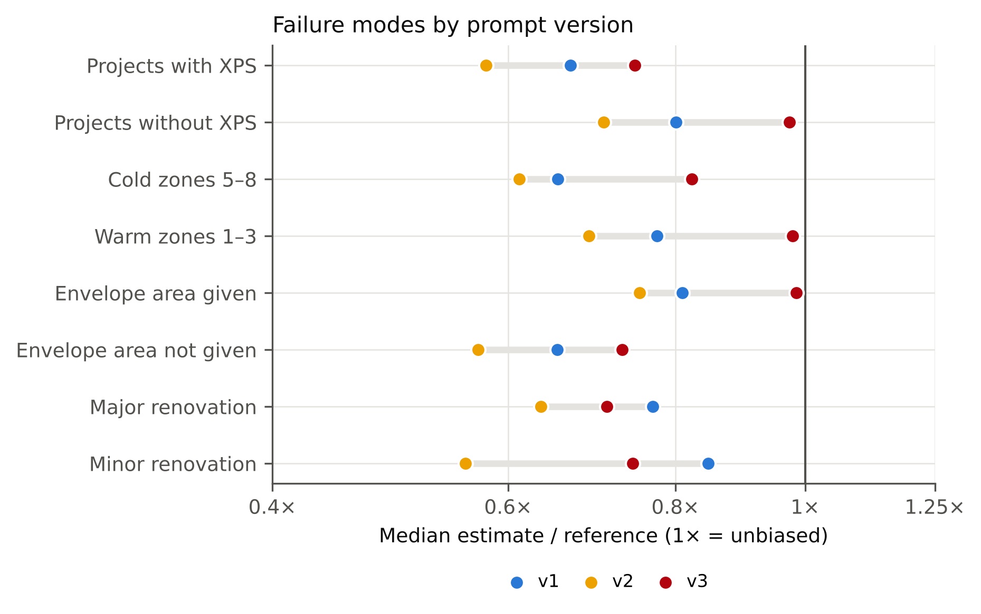
Can an LLM estimate the embodied carbon of a building enclosure?
Error analysis and prompt design for early-stage A1–A3 estimates on 292 North American buildings
George Zheng · Zixuan Zhao · Heshan Chen · Fei Cheng · Jamie Liu | CEE226 · Group 8 · November 2026
Question
Baseline: why the model fails
Three prompts
Held-out test & features
Exterior-envelope choices lock in much of a building's embodied carbon at schematic design, when no LCA exists yet. Can a large language model, given only early-stage features, estimate the cradle-to-gate (A1–A3) embodied carbon of the enclosure, and which prompt design makes it better?
19.5%
0.46
0.75
Prompt | Coverage | RMSE | |log| med. | Bias | CV
● v1 plain | 19.5% | 79.7 | 0.456 | 0.75 | 19.0%
● v2 method | 15.1% | 81.0 | 0.563 | 0.67 | 13.8%
● v3 anchors | 25.0% | 76.0 | 0.426 | 0.86 | 12.5%
within ±20% (prompt v1)
log–log slope (1 = ideal)
estimate / reference
v2: scope + step-by-step take-off + named materials
Data & ground truth
More consistent, but less accurate: 89% of answers still assumed polyiso roofs (roof intensity stayed at 35), bottom-up intensities were low (67 vs. 87 per m² of envelope), and "count only new materials" pushed renovations down.
All 292: v3 vs. v1 McNemar p = 0.085, Wilcoxon p = 0.053; vs. v2 p = 0.002.
292 US/Canadian projects, harmonized WBLCA dataset (Benke et al., Sci. Data 2025): 928k material rows, 48 early-stage features.
Test 88: v3 26.1% vs. 20.5% coverage, RMSE 69 vs. 74, not significant (p = 0.41). Every finding behind v2/v3 replicates on the 204 dev buildings.
Ground truth: OmniClass Shell – Enclosure, stage A1–A3, kgCO2e per m² floor area. Median 78, range 0.5–514.
v3: quantitative anchors where numbers are chosen
10 new buildings have no window/glazing data at all: incomplete reference LCAs, flagged.
Component A1–A3 table from EPDs and CLF baselines (walls, glazing, roofs by insulation type, aluminum).
Feature study: 10 early-design inputs are as good as all 48, and removing mass_total does not hurt. All differences are within run-to-run noise.
The model compresses every building toward ~50–60 kgCO2e/m²: light enclosures are overestimated, heavy ones underestimated 3–4×.
Tool convention: legacy models often use HFC XPS, so include that case.
Per-envelope sanity check, and a renovation rule that no longer subtracts.
Takeaways
XPS insulation is 15.5% of all enclosure carbon (43.6 kgCO2e/kg: the HFC-blown product in Tally / One Click LCA of the period).
Estimate vs. reference (line 1:1, band ±20%). v3 lifts the cloud toward the diagonal; the top end stays compressed.
LLMs give usable early-stage enclosure estimates for hotspot screening (¼ within ±20%, bias −14%), but not reliable building-level credit predictions.
Method
Root causes, from 876 reasoning texts
The error is structured (compression, material blind spots), so error analysis on the model's reasoning shows which prompt fix to make.
48 features + glossary
→
Prompt v1 / v2 / v3
→
Claude Opus 5.5 subagents
→
RANGE low–high
→
Compare with reference LCA
HFC-blown XPS is never considered: it is mentioned in 0.6% of answers, yet it explains about half of the bias (est/ref 0.72 → 0.84 when XPS is removed from the reference) and the cold-climate gap.
3 runs × 292 buildings per prompt; seeded shuffles and identical chunks allow paired comparisons.
v3 removes the bias for buildings without XPS (0.97), with a given envelope area (0.99) and in warm zones (0.98).
The ceiling is information, not prompting: adding assembly type to the inputs is the next step.
Envelope area: 0.81 when given, 0.65 when the model has to estimate it.
Lesson. Qualitative knowledge in a prompt is repeated but not applied. Sourced numbers at the decision step move the estimate.
Subagents read only their task file: no web, no code, no ground truth.
Curtain-wall tail and renovations scoped too narrowly.
Final prompt (v3, excerpt)
Metrics: ±20% coverage, RMSE, |log(est/ref)|, bias (geometric mean), run-to-run CV.
The intensity per m² of envelope drives the error (r = −0.79), and no feature describes the wall assembly.
1. Areas: bldg_therm_env_area, or take off roof,
walls and glazing (bldg_wwr).
2. Assemblies: name insulation type and thickness;
LCA models often use HFC-blown XPS on roofs.
3. A1-A3 per m2 of component, e.g. metal panel
wall 70-110, unitized CW 150-210, roof+polyiso
20-28, roof+HFC XPS 85-110 (up to 335-410).
4. Check: < ~50 per m2 envelope -> missing items.
5. Range incl. higher-carbon options; no anchoring.
6. Renovations: don't assume envelope is kept.
RANGE_kgCO2e_per_m2: <low> - <high>
Held-out test set: 88 buildings (stratified, seed 226).
Data: Benke et al. (2025) Sci. Data 12, doi:10.1038/s41597-025-05216-0 (CC BY 4.0). Intensities: CLF North American Material Baselines 2023/2025, PCI, Kawneer and RDH EPDs. Model: Claude Opus 5.5 (medium effort), Claude Code subagents. Full prompts, code and model answers: github.com/HeshanChen/CEE226LCA

