Slide 1

IT204: WEB PROGRAMMING
lecture 2: HTML
Part 2
Internet & World Wide Web How to Program, 5/e Chapter 2

Slide 2
OUTLINE
Tag for Formatting the text.
Special Characters and Horizontal Rules
Images
Lists
Tables

Slide 3
Tag for Formatting the text

Slide 4
TAG for Formatting text
<u> text</u> | underlined text | text
<em>text</em> | italic text | text
<strong>text</strong> | Bold text | text
<sub>text</sub> | subscript text | _{text}
<sup>text</sup> | Superscript text | ^{text}
<small>text</small> | Small text
<strike>Strike that out</strike> | strikeout the text inside the tag | Text

Slide 5
Special Characters and Horizontal Rules

Slide 6
Special Characters and Horizontal Rules
HTML provides character entity references (in the form &code;) for representing special characters that cannot be rendered otherwise
The code can be:
Word abbreviations
Numbers
Decimal
Hexadecimal

Slide 7
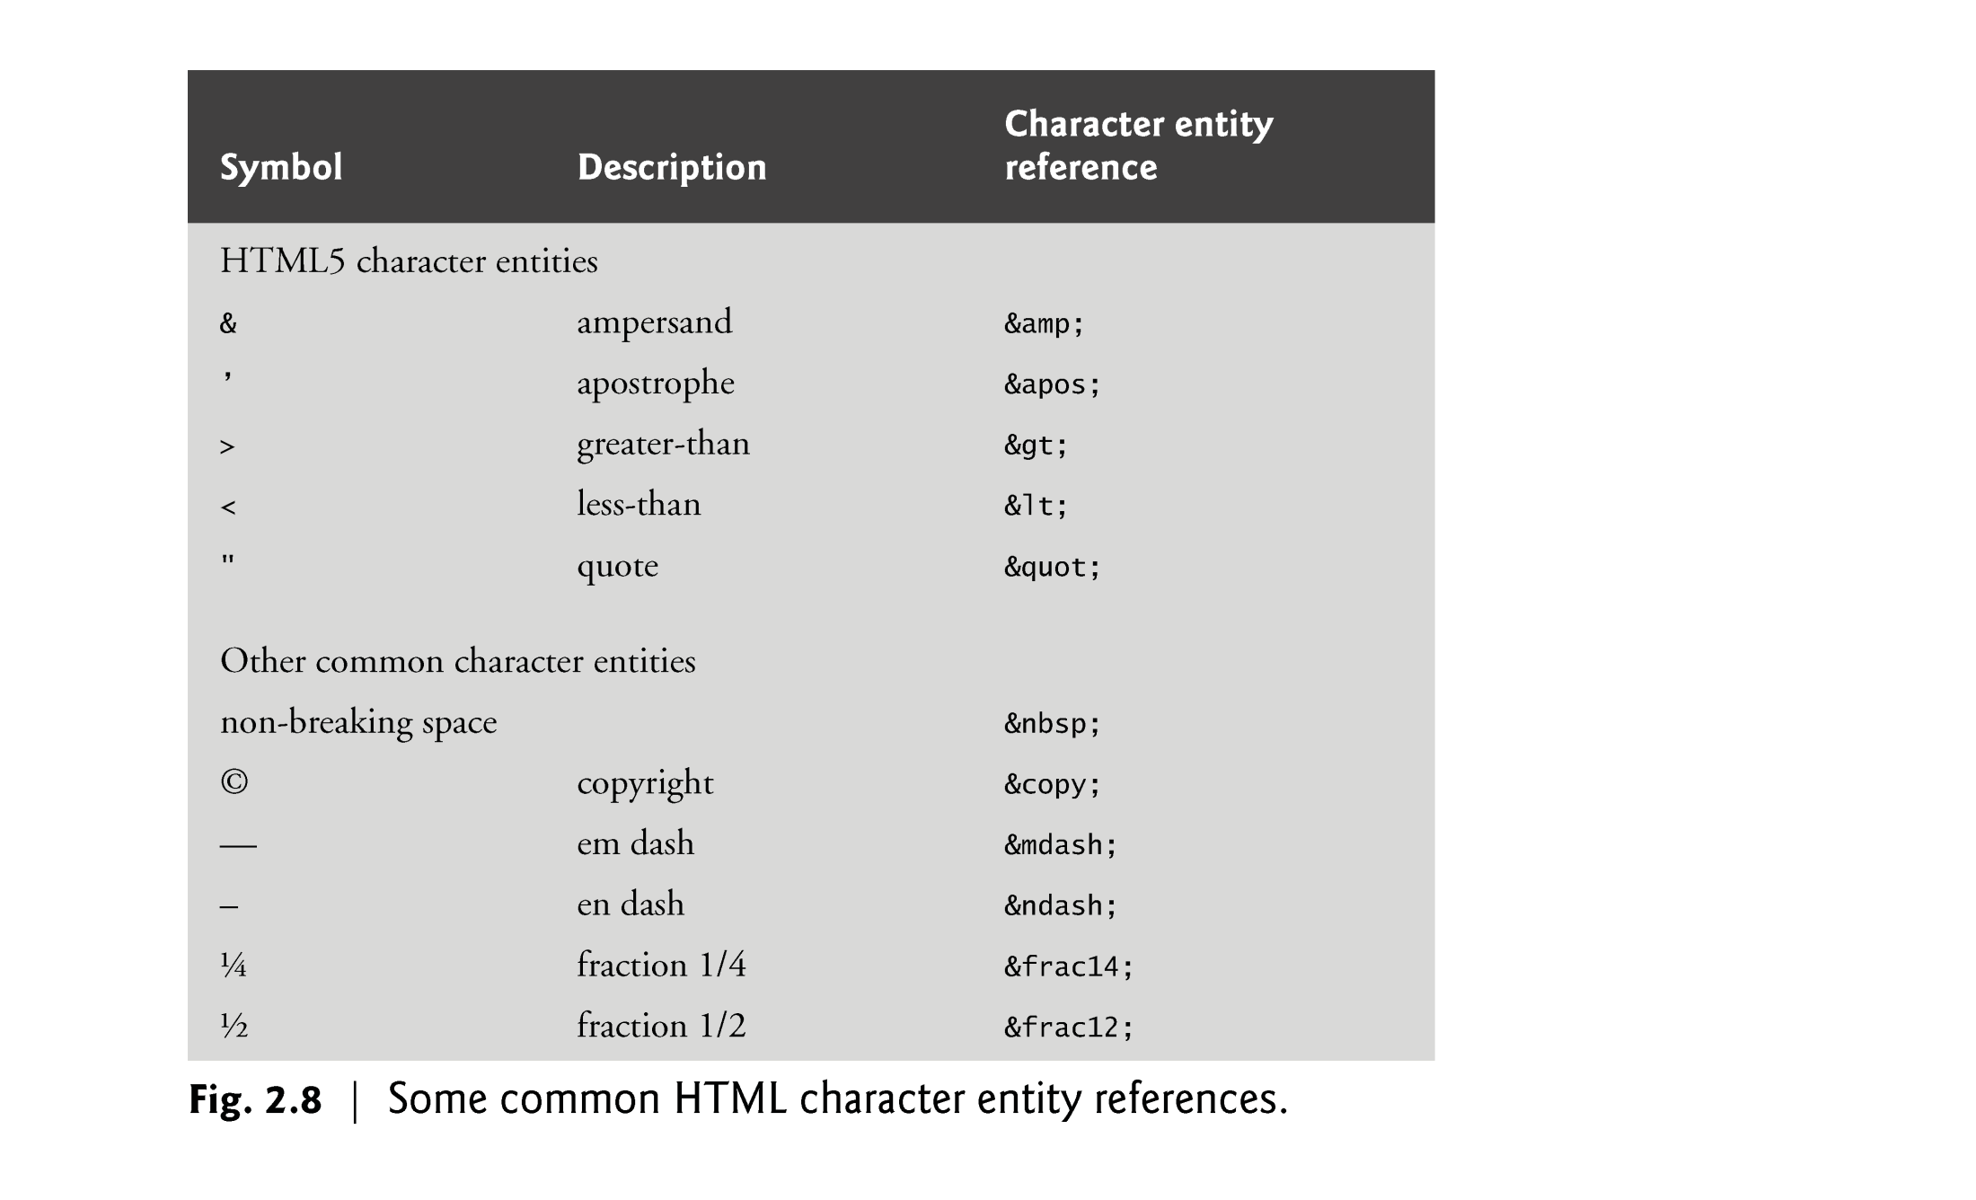

Slide 8
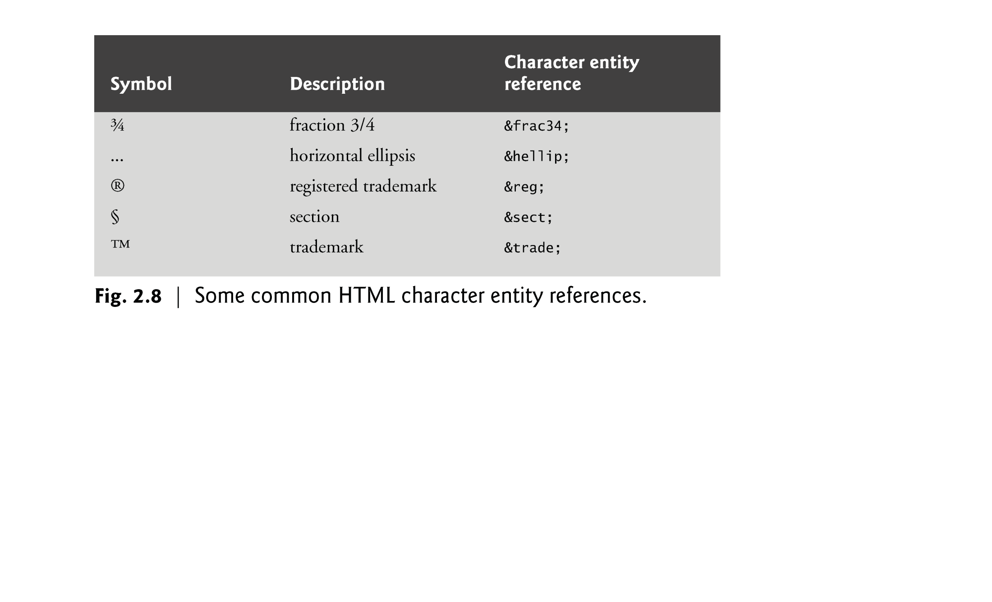

Slide 9
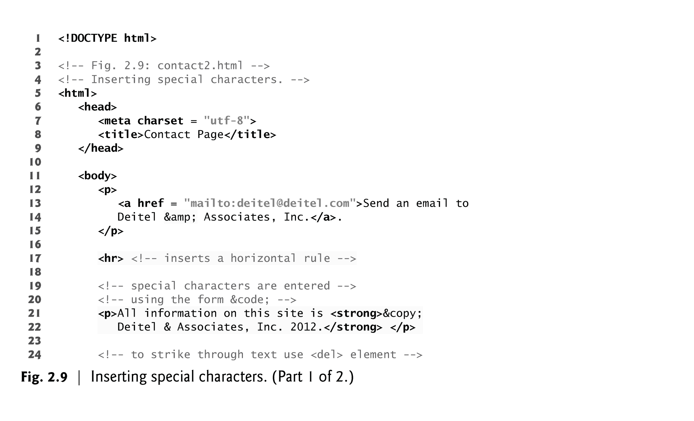
2.8 Special Characters and Horizontal Rules (Cont.)
Figure 2.9 demonstrates how to use special characters in an HTML document.

Slide 10
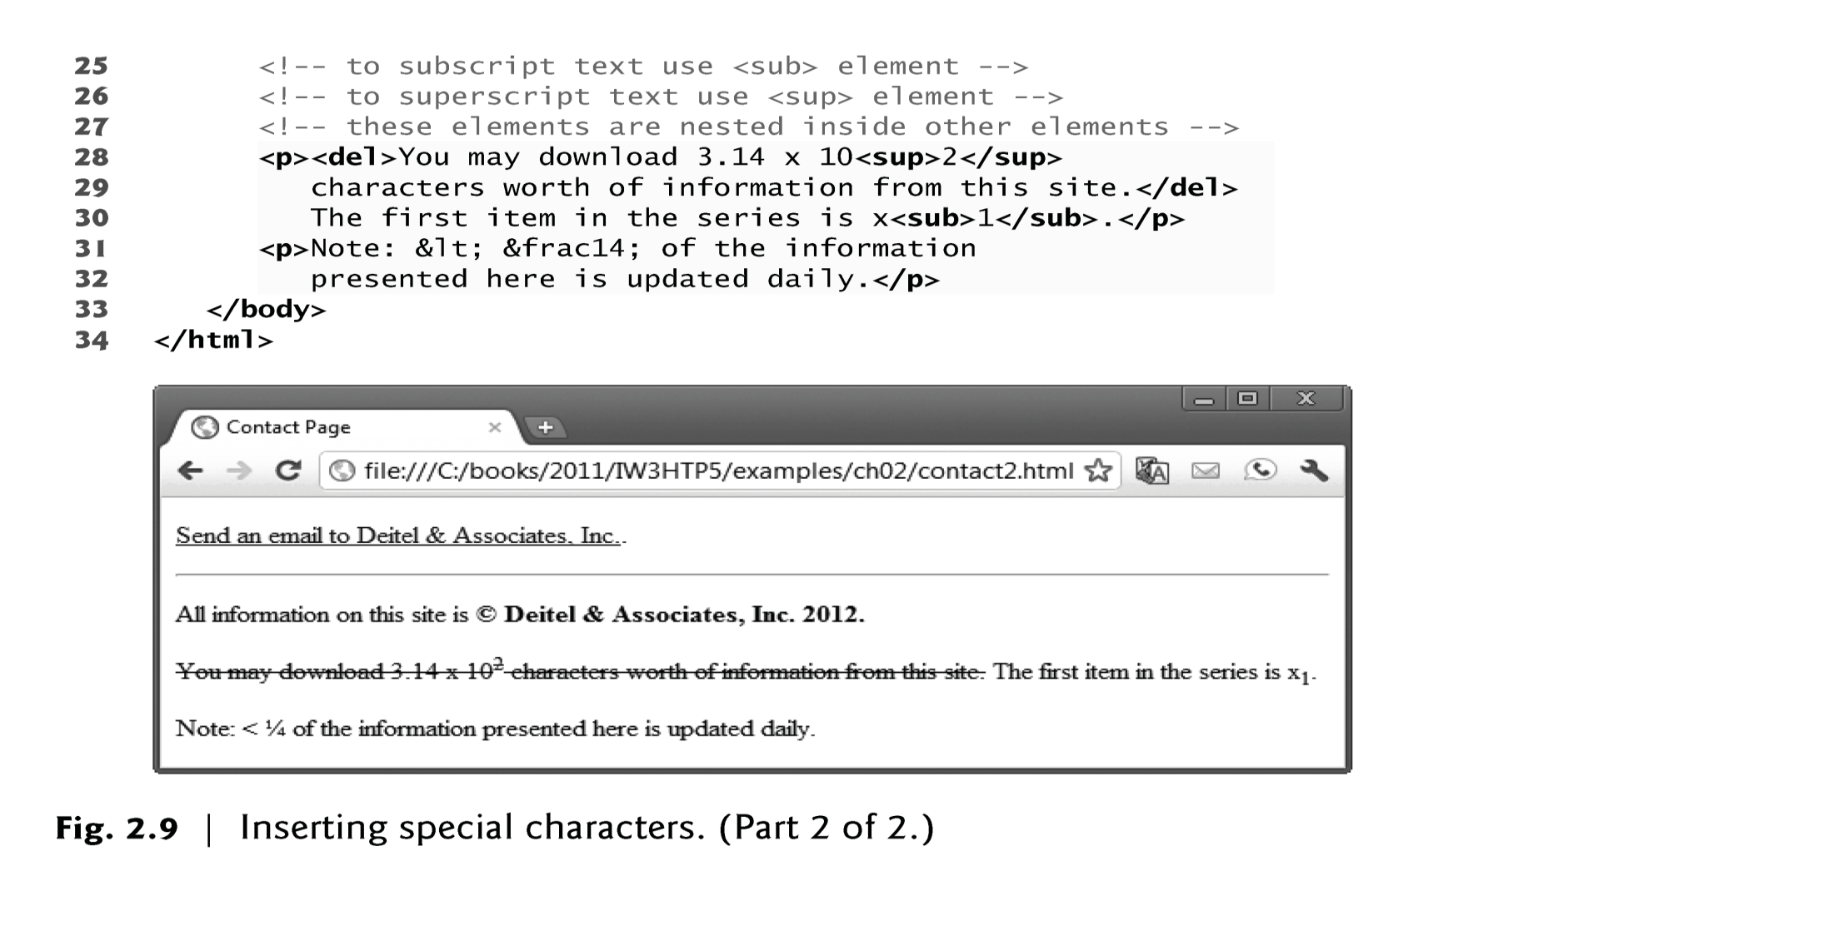

Slide 11
2.8 Special Characters and Horizontal Rules (Cont.)
A horizontal rule, indicated by the <hr> tag renders a horizontal line with extra space above and below it in most browsers.

Slide 12
Images

Slide 13
2.7 Images
The most popular image formats used by web developers today are PNG (Portable Network Graphics) and JPEG (Joint Photographic Experts Group).

Slide 14
2.7 Images (cont.)
The img element’s src attribute specifies an image’s location
Every img element must have an alt attribute, which contains text that is displayed if the client cannot render the image
The alt attribute makes web pages more accessible to users with disabilities, especially vision impairments
Width and height are optional attributes
If omitted, the browser uses the image’s actual width and height Images are measured in pixels

Slide 15
2.7 Images (Cont.)
alt Attribute
A browser may not be able to render an image.
If a browser cannot render an image, the browser displays the alt attribute’s value.
The alt attribute is also important for accessibility—speech synthesizer software can speak the alt attribute’s value so that a visually impaired user can understand what the browser is displaying. For this reason, the alt attribute should describe the image’s contents.

Slide 16
2.7 Images (Cont.)
Void Elements
Some HTML elements (called void elements) contain only attributes and do not mark up text (i.e., text is not placed between a start and an end tag).
You can terminate void elements (such as the img element) by using the forward slash character (/) inside the closing right angle bracket (>) of the start tag.
For example, lines 15–16 of Fig. 2.6 could be written as follows:
<img src = "jhtp.png" width = "92" height = "120"
alt = "Java How to Program book cover" />

Slide 17
2.7 Images (Cont.)
Using Images as Hyperlinks
By using images as hyperlinks, you can create graphical web pages that link to other resources.
In Fig. 2.7, we create five different image hyperlinks.
Clicking an image in this example takes the user to a corresponding web.

Slide 18
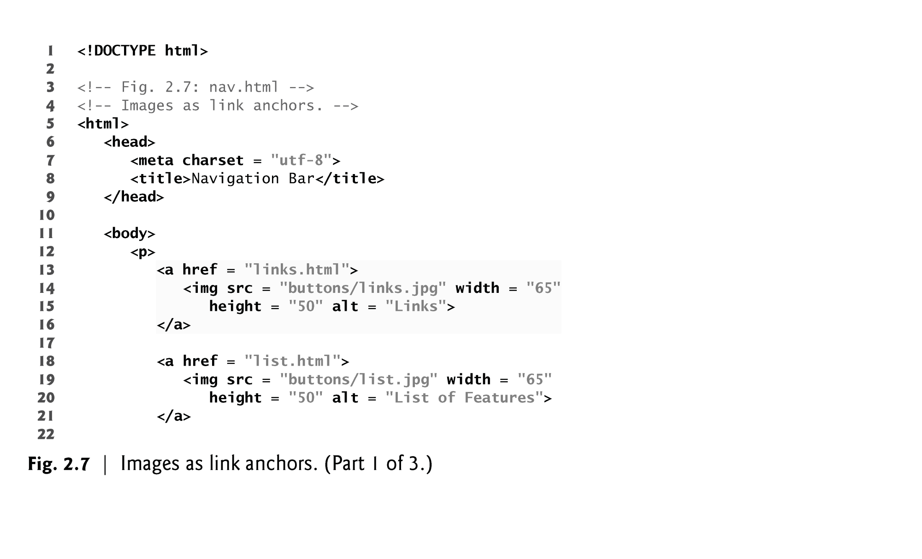

Slide 19
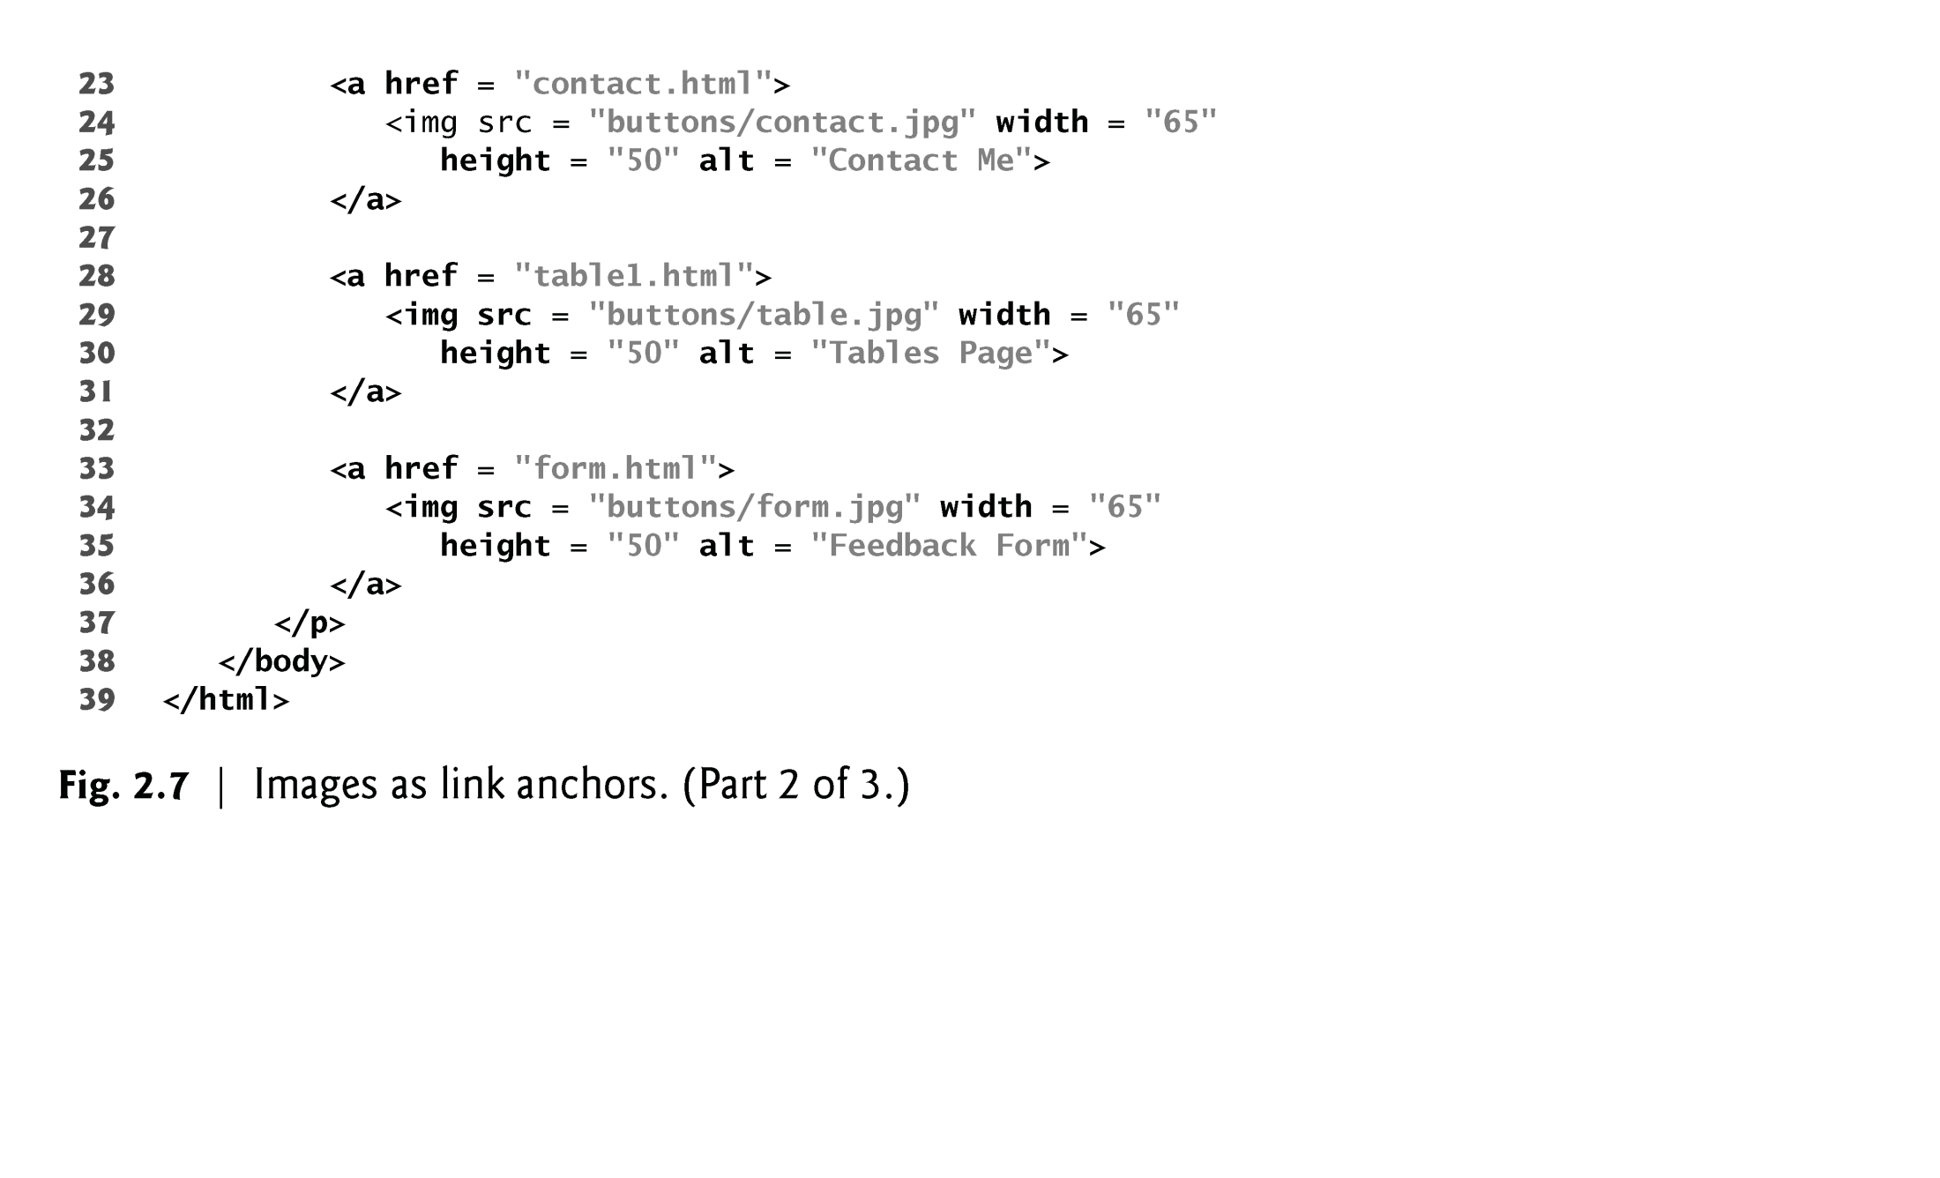

Slide 20
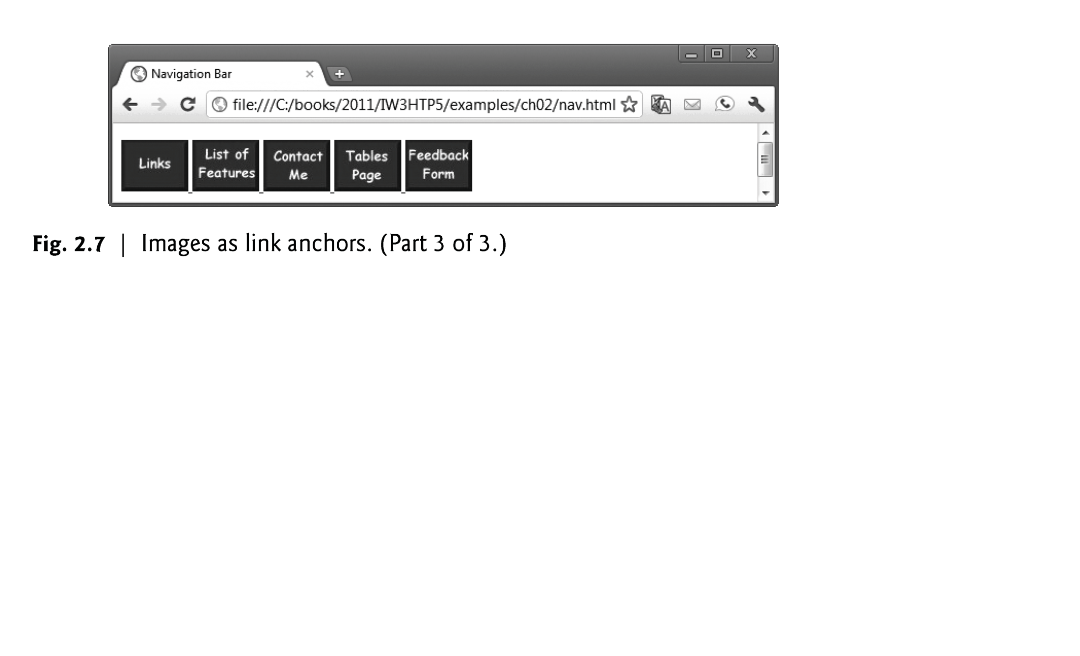

Slide 21
2.9 Lists
Unordered list element ul
creates a list in which each item in the list begins with a bullet symbol (typically a disc)
Each entry is an li (list item) element. Most web browsers render these elements with a line break and a bullet symbol at the beginning of the line.

Slide 22
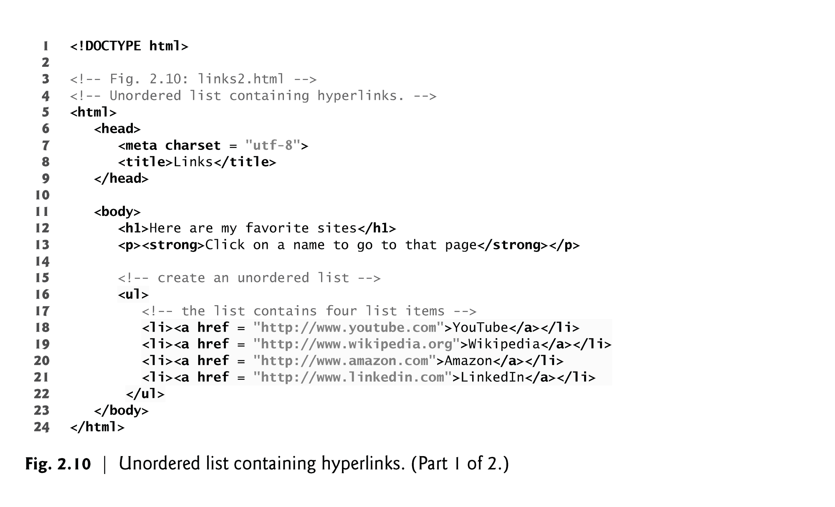

Slide 23
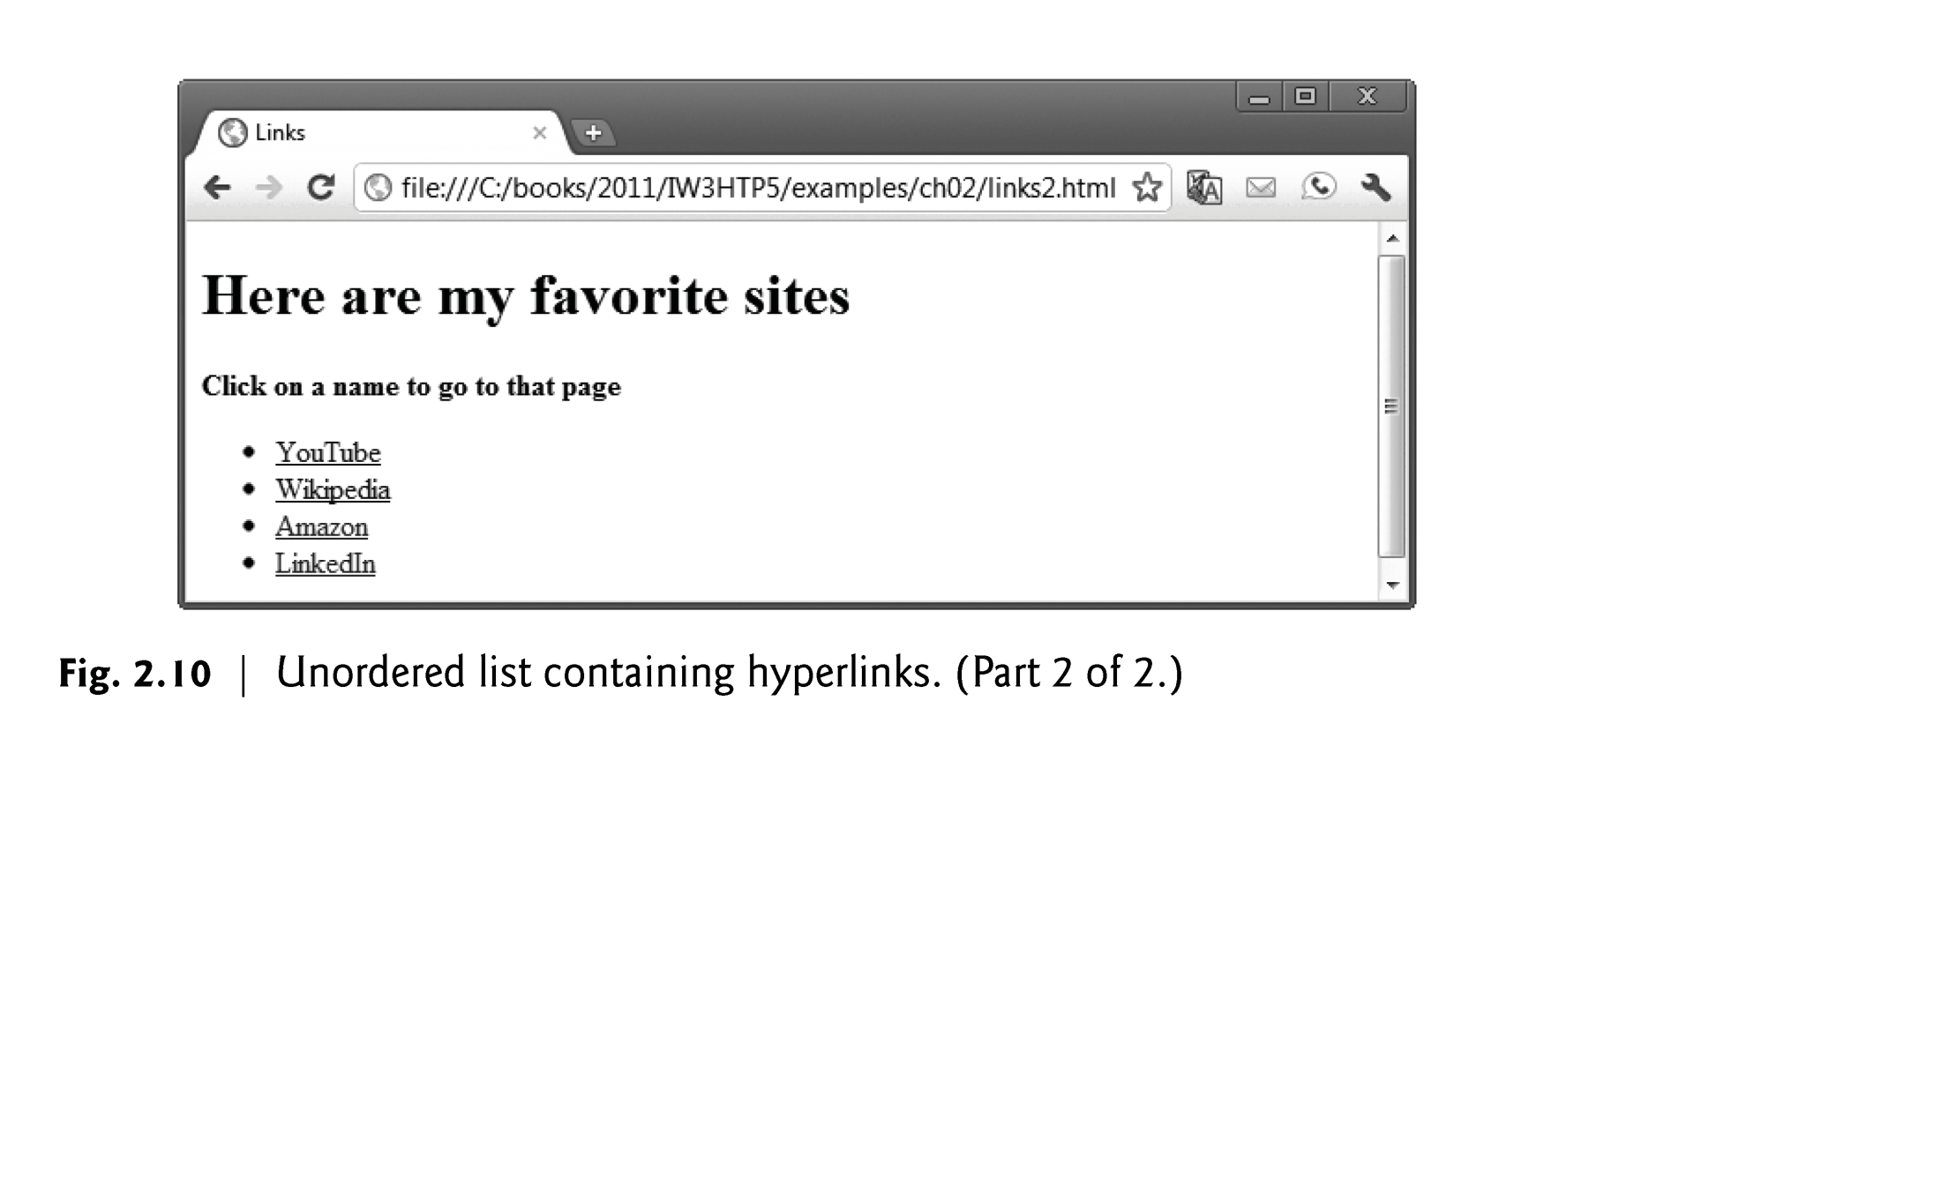

Slide 24
2.9 Lists (Cont.)
Nested Lists
Lists may be nested to represent hierarchical relationships, as in a multi-level outline.
Figure 2.11 demonstrates nested lists and ordered lists.
The ordered-list element ol creates a list in which each item begins with a number.

Slide 25
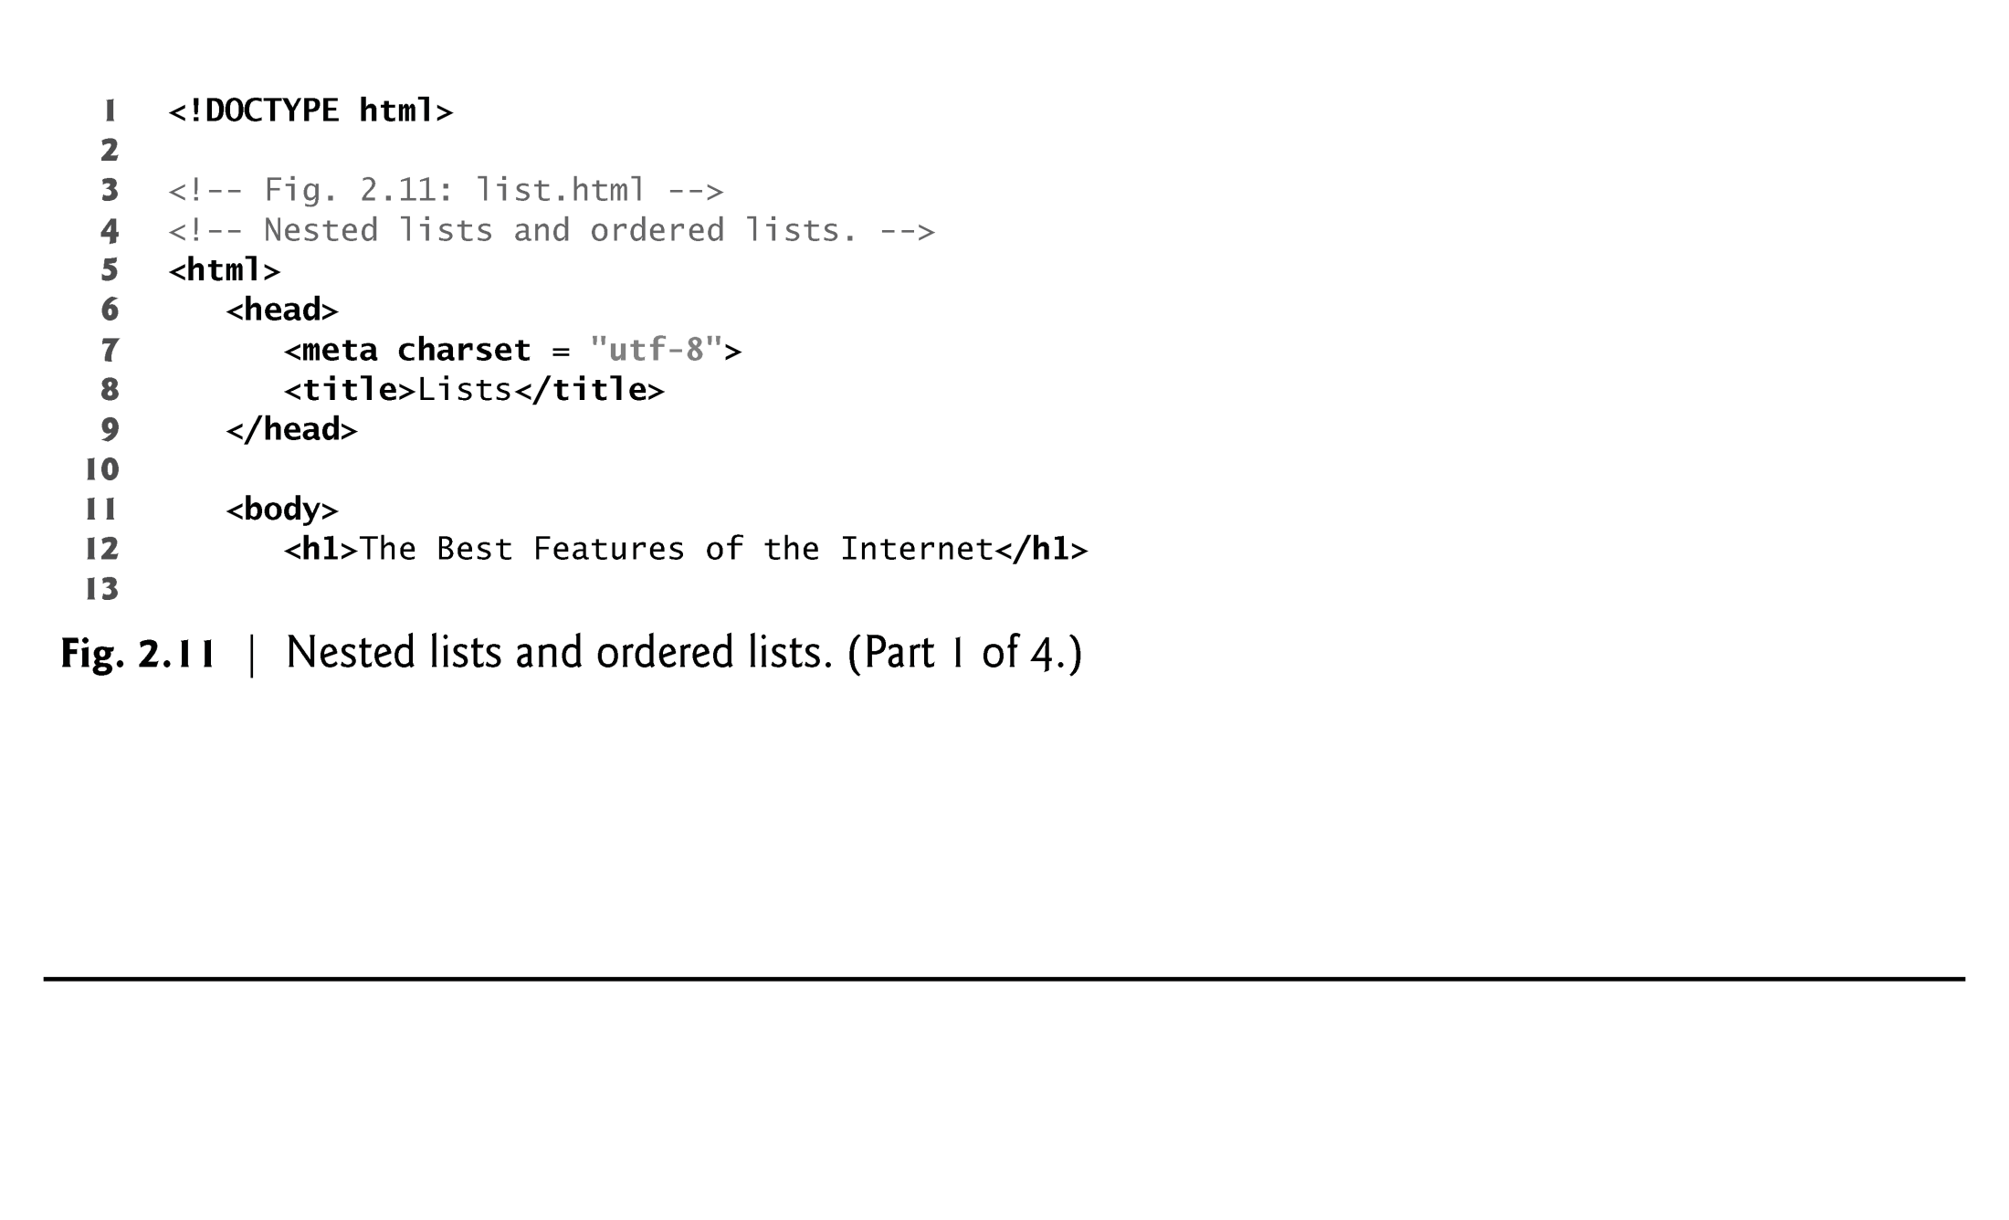

Slide 26
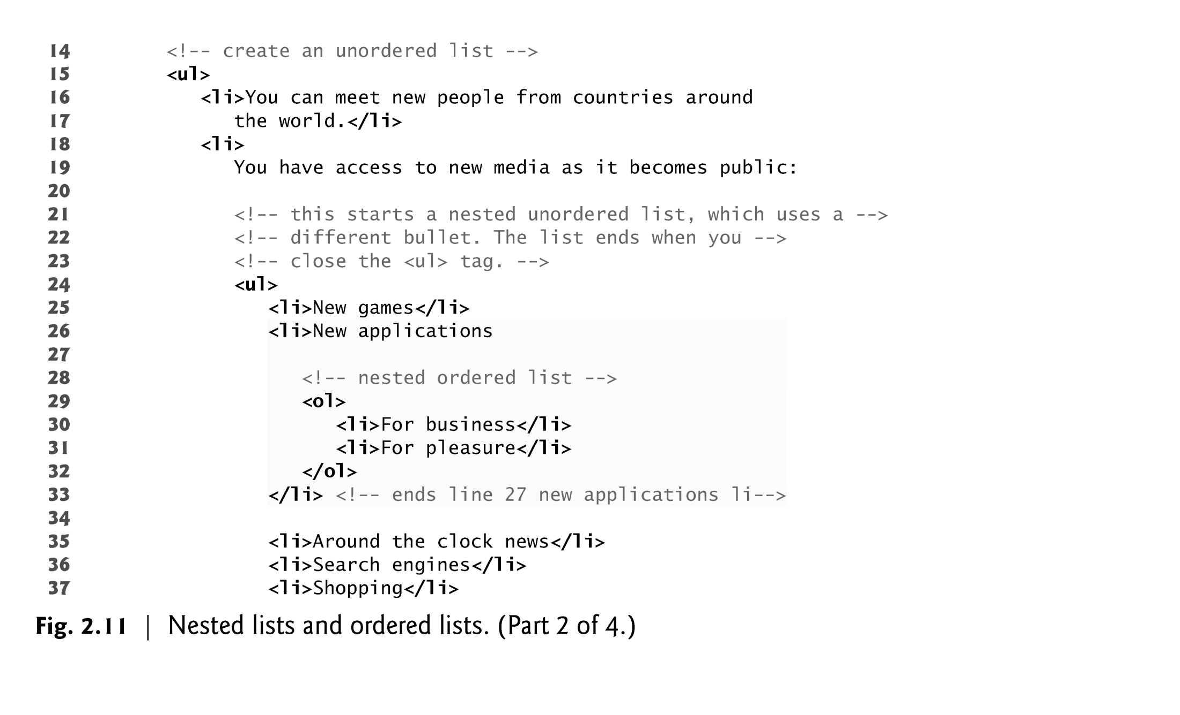

Slide 27
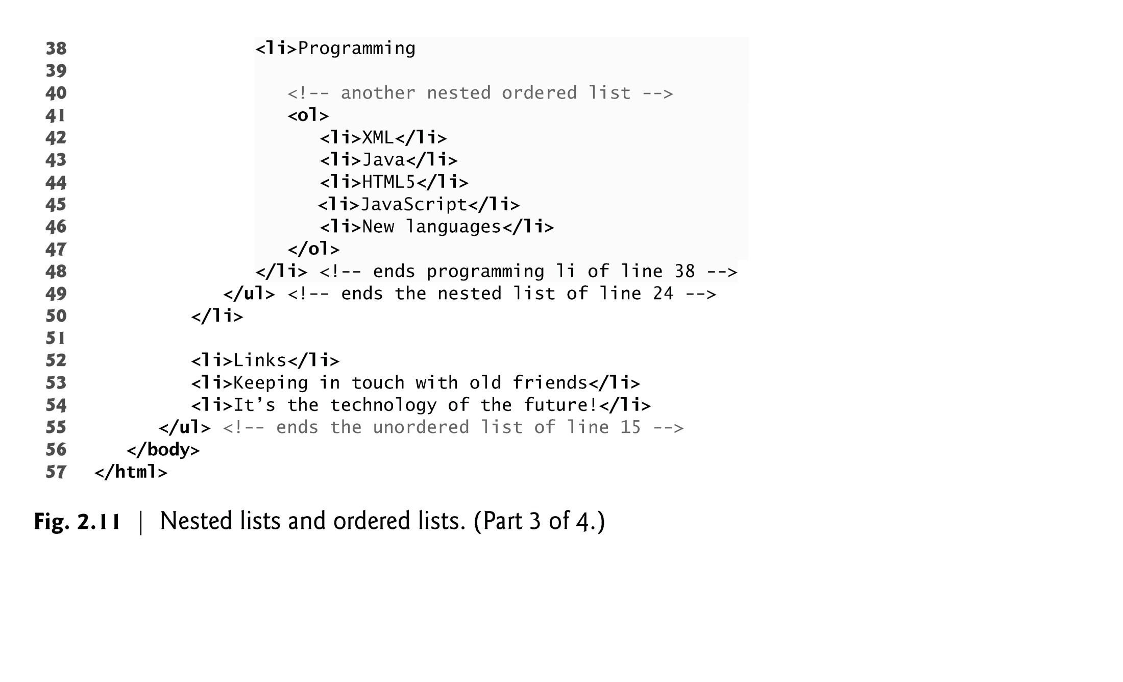

Slide 28
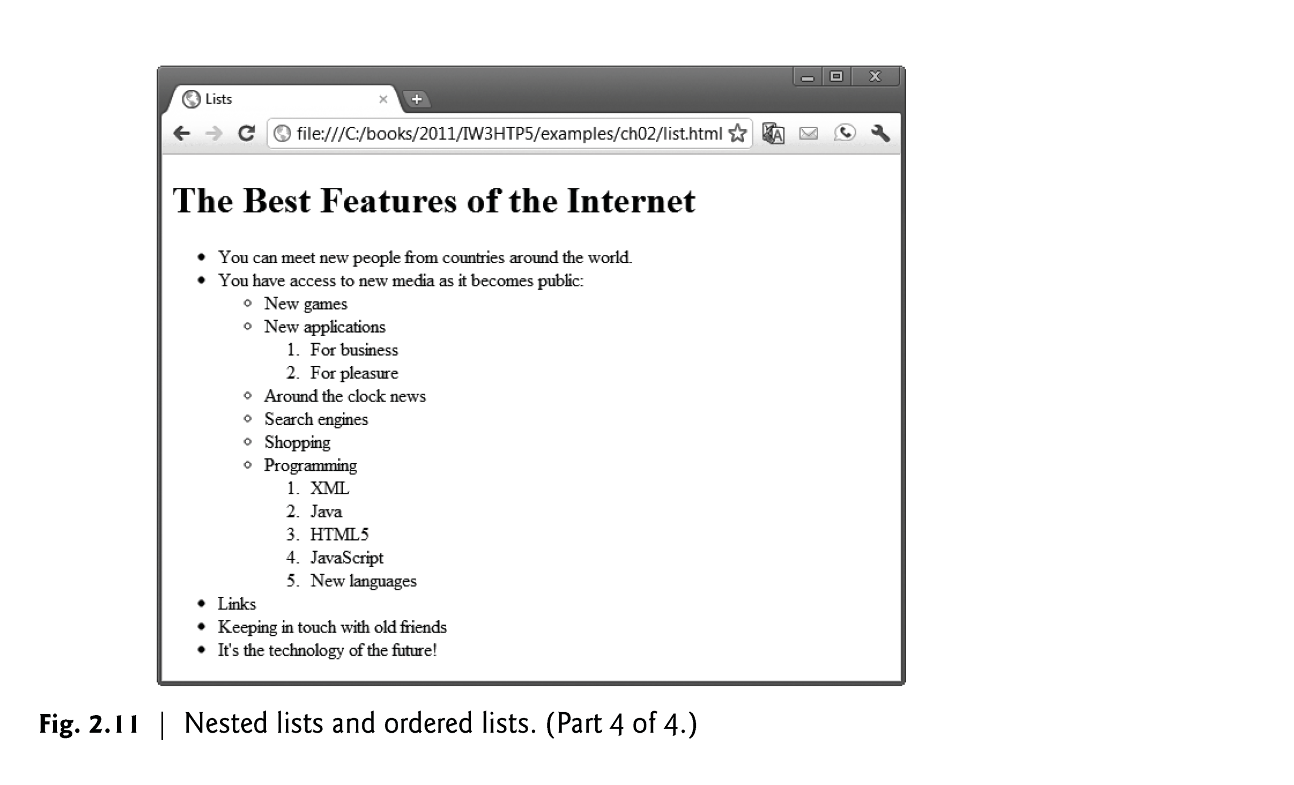

Slide 29
Table

Slide 30
2.10 Tables
Tables are frequently used to organize data into rows and columns.
The table element defines an HTML table
The summary attribute summarizes the table’s contents and is used by speech devices to make the table more accessible to users with visual impairments.
The caption element specifies a table’s title.
It’s good practice to include a general description of a table’s information in the table element’s summary attribute—one of the many HTML features that make web pages more accessible to users with disabilities.
Speech devices use this attribute to make the table more accessible to users with visual impairments.

Slide 31
2.10 Tables (Cont.)
A table can be split into three distinct sections:
Head (thead element)
Table titles
Column headers
Body (tbody element)
Primary table data
Table Foot (tfoot element)
Calculation results
Footnotes
Above body section in the code, but displays at the bottom in the page

Slide 32
2.10 Tables (Cont.)
tr Element
Defines individual table rows
Element th
Defines a header cell
Td Element
Contains table data elements

Slide 33
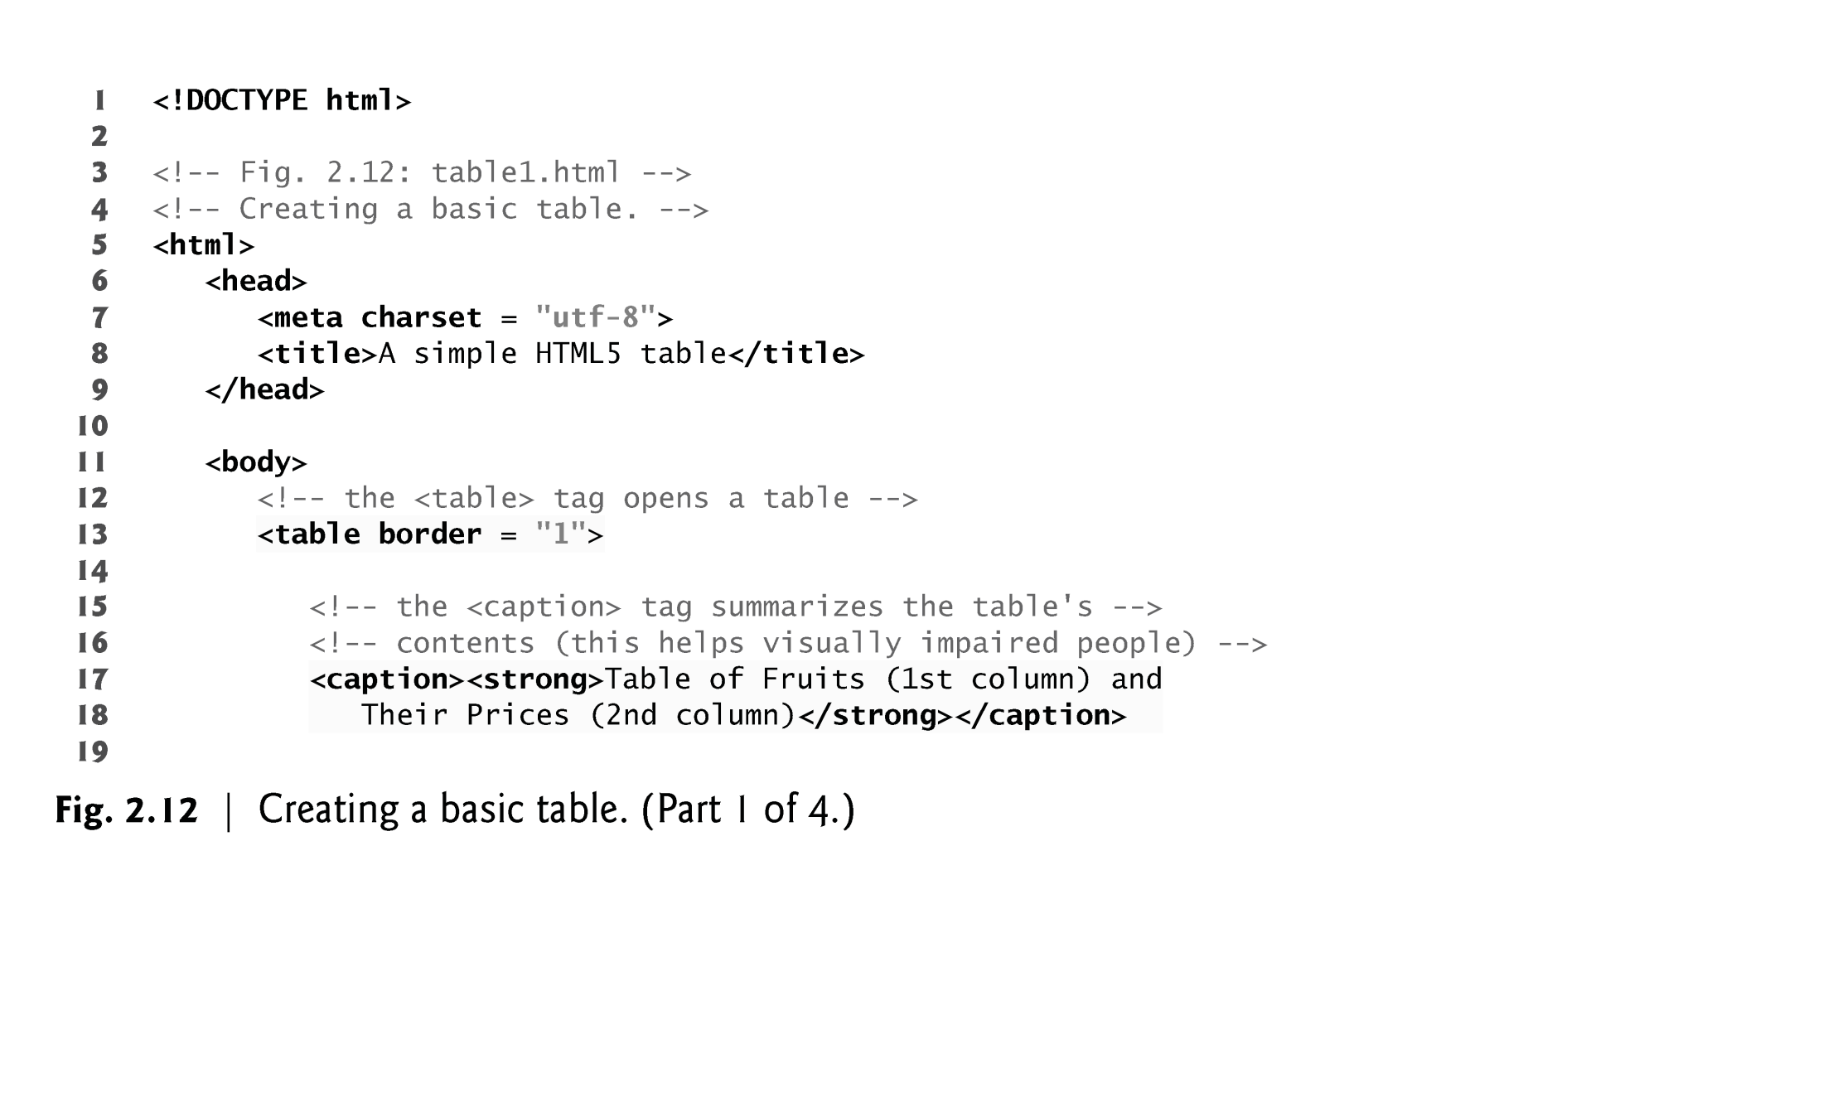

Slide 34
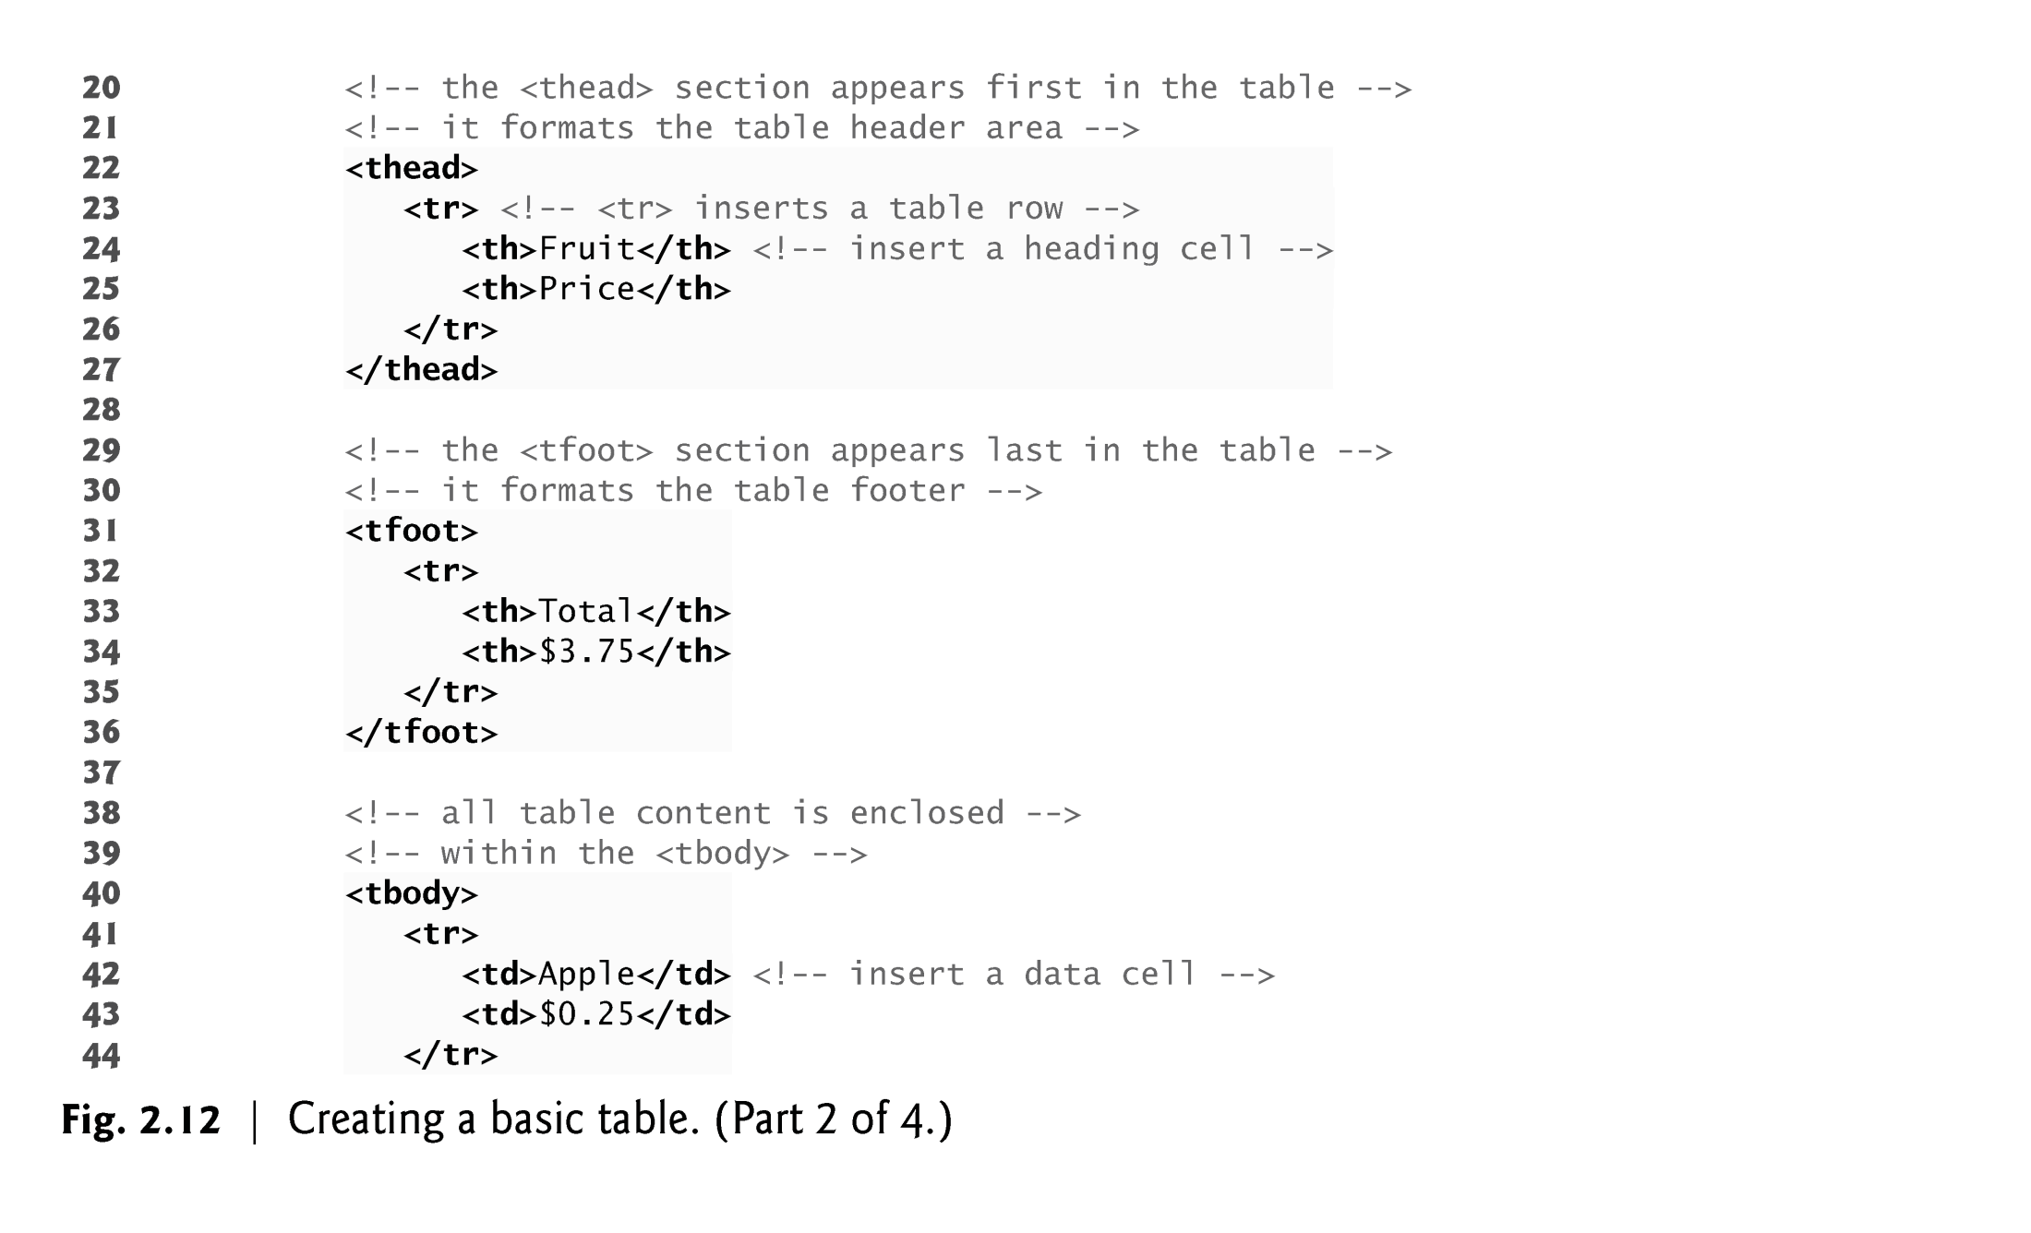

Slide 35
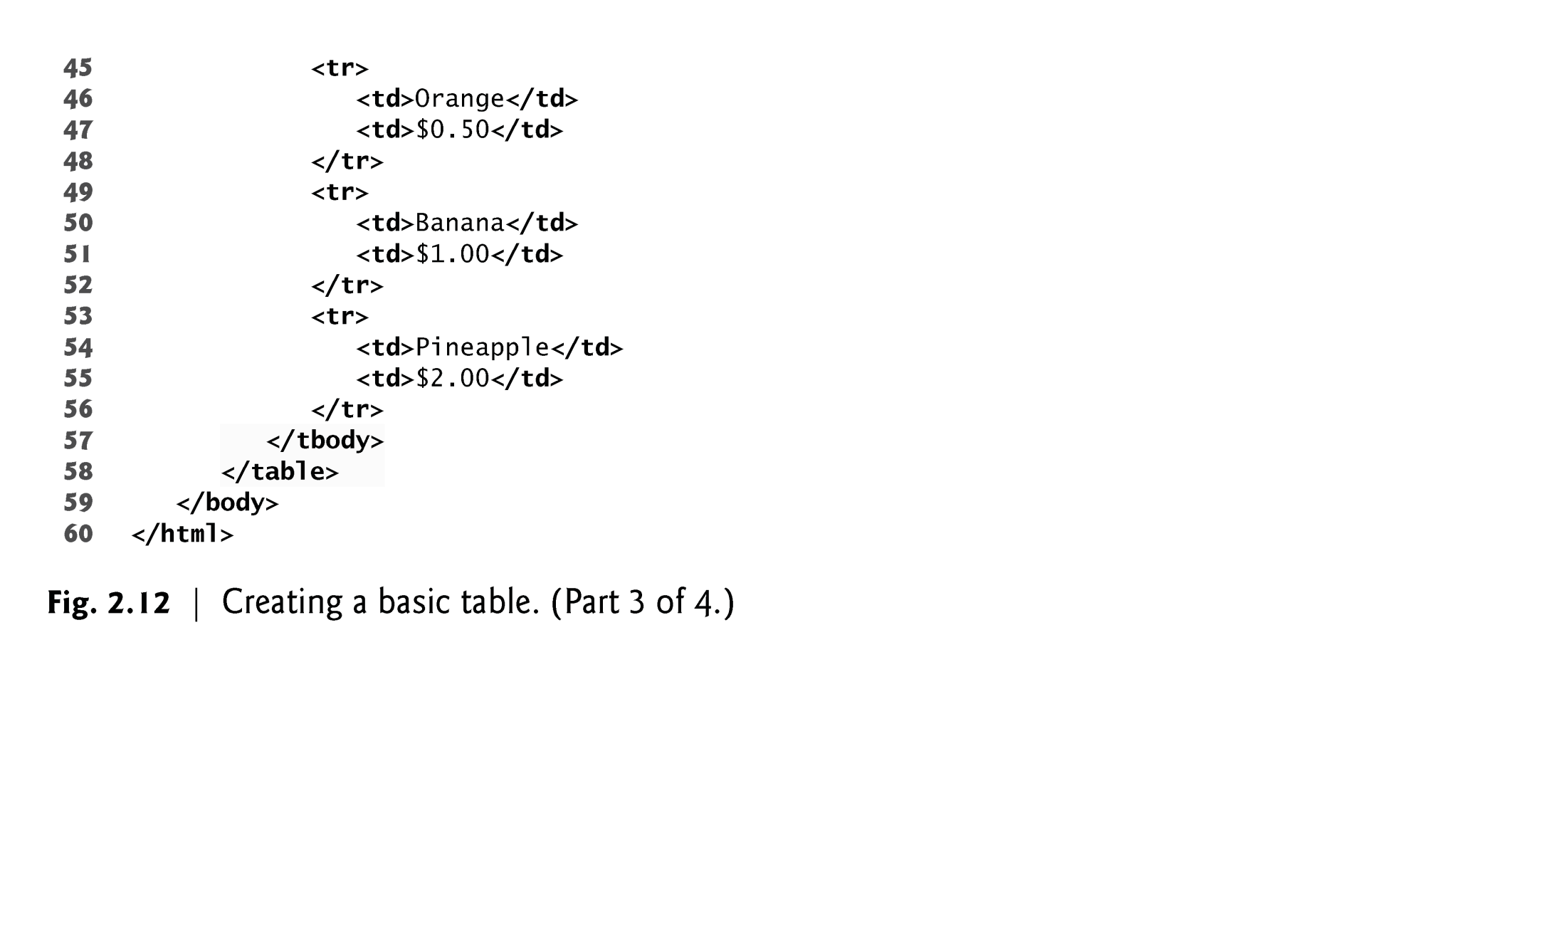

Slide 36
