Slide 1

Applications of GIS
Week 10
Some more demonstrations
Q&A for A4

Slide 2
Assignment 4 Quick Recap
The State government for an Australian state has contracted you to perform a risk analysis for a natural disaster of either floods or bushfires.
Need to find out where is it at most risk of a bushfire or flood.
Need to make a model of the real world with various constraints, that represents this risk

Slide 3
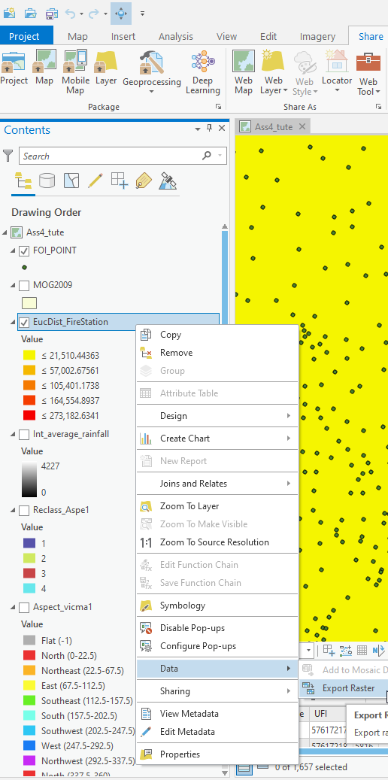
Sharing your data between group members
Top tab: Share
Layer Package: everything in the layer (vector or raster), including all referenced data. Will keep styling Map Package: everything in the map, including all referenced data. Will keep styling and everything
Project package: : everything in the project, including all referenced data. Will keep styling and everything.
Could just copy across whole Geodatabase where data is stored (e.g. Assignment_4.gdb)
Could export rasters (or vectors) to new Geodatabase, right click on layer, export raster
Could save rasters as Geotiff, right click on layer, export data, select folder to output, change file name to RASTER_NAME.tif
Can also use Copy Raster tool

Slide 4
Polygon to Raster
Euclidian Distance Tool
Example past fires.
Polygon layer converted into raster with season date as Value. The Reclassify Tool was then used to give hazard values according to when the area was last burnt. According to the table below.
Computes the straight line distance from data to everywhere else.
From:
Fire brigades
Roads
Electricity Lines
Public Transport
Season Burnt | Hazard Value
1903 – 1968 | 100
1968 – 1993 | 80
1993 – 2013 | 10

Slide 5
Polygons: Make Hazard Value first
Other Polygon Datasets
Land Use
How to define?
https://www.agriculture.gov.au/abares/aclump/land-use/alum-classification
Add Land Use layer to map
Add new field in attribute table, called Hazard value
Select by Attributes
Select the Land Use descriptions or Land Cover descriptions that you want to give a certain hazard value to.
Calculate attributes, give score for selected rows into Hazard field
Polygon to raster, value, Hazard field
Already classified
Vegetation
Tree Density
Geology type
Flood extents
Population density

Slide 6
Combing Tree Density Dataset
Option 1: Don’t necessarily need to combine them, can add together separately in raster calculator when making hazard map. Note keep in mind to compensate for null values with condition statement (explained later).
Option 2: Raster Calculator
If you want to add the overlapping values.
Use Raster Calculator and use the following function:
Con(IsNull("scattered"),0,"scattered")+Con(IsNull("medium"),0,"medium")+Con(IsNull("dense"),0,"dense")
Then use Reclassify, with equal intervals.

Slide 7
Combing Tree Density Dataset
Option 3: Mosaic Dataset
Click on the Catalogue tab button (if not on the right, it is the little yellow box next to the red toolbox)
Go to your Geodatabase > Right click on your Geodatabase > New > Mosaic Dataset…
Set your parameters and coordinate system of this dataset and click Ok.
Then in the Catalogue window again, Right Click on the Mosaic dataset you just made, in your Geodatabase > Add Rasters
Choose your three Tree Density rasters (scattered, medium, dense) then Click Ok. Will make a new mosaic of all three tree rasters.
In catalogue window again. Right Click on the Mosaic Dataset in your Geodatabase > click Export > Raster to Different Format… > choose save location and type (ESRI GRID or TIFF)
This will result in combined tree raster

Slide 8
Combing your raster layers
Option 1: Raster Calculator
You will most likely be combing layers that are continuous and discontinuous for your whole state.
Continuous = there is data present for every location within your state (no holes)
might include: slope, aspect, distance to fire brigades, distance to rivers, temperature, rainfall
Discontinuous = there are locations of NoData within your state (there are holes)
Might include: land use, tree density, national parks, industry
Use conditional statement in Raster Calculator equation to turn NoData values into 0 which can be used in equation properly.
Con(condition, true value, false value)
Con(is data Null?, if so then 0, if not then raster value)

Slide 9
Combing your raster layers
Use a similar equation to this:
"Slope" + "Aspect" + 'distance to FB" + "temperature" + "distance to rivers" + "rainfall" +
Con(IsNull("landuse"),0,"landuse")+Con(IsNull("tree_density"),0,"tree_density")+Con(IsNull("parks"),0,"parks")
+ Con(IsNull("industry"),0,"indsutry")
Then use Reclassify, with equal intervals.
Note: you may want to weight certain rasters, just multiply them by a percent e.g. 0.8*slope + 0.6*aspect ….
The weight can either just be a relative percent or they can add up to 1, either method is fine.

Slide 10
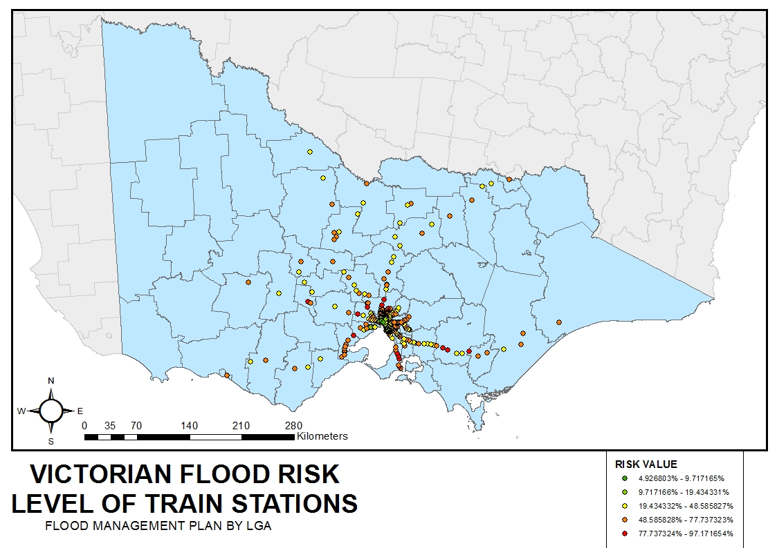
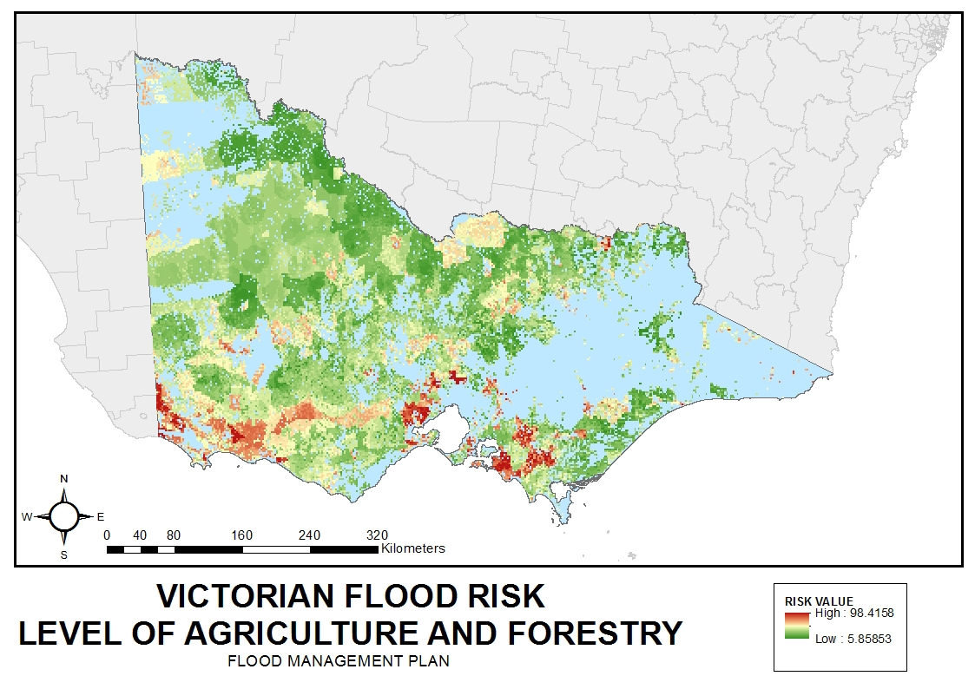
Creating elements at risk layers/ maps
Points
Extract Values to Points tool
Extract the hazard values to your points
Right click data and change symbology to the same as your Hazard/ risk layers
Change symbol if needed
Select properties to change the size of the symbol
Lines
Use the buffer tool to create a buffer around the line
Clip Raster for hazard map to the buffer raster
Change symbology to the same as hazard maps
Polygons
Polygon to raster tool
Might need to combine polygons (e.g. Tree density - See slides above)
Clip Raster for hazard map to the raster of polygon areas
Change symbology to the same as hazard maps

Slide 11
Combing your raster layers
Option 2: Weighted Overlay (sum) Tool
You can also add together your raster layers with the Weighted Overlays Tool.
Choose your scale range, can also make your own scale range.
Add your rasters.
The %influence must add up to 100.
Option 2: Weighted Sum Tool
Add raster together with Weighted Sum Tool.
Choose rasters.
Uses relative weighting method (doesn't have to add up to 1).
Weighting factors can be percent or integer numbers, doesn't matter too much as will Reclassify.
Then use Reclassify, with equal intervals.

