Slide 1
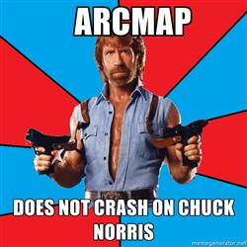
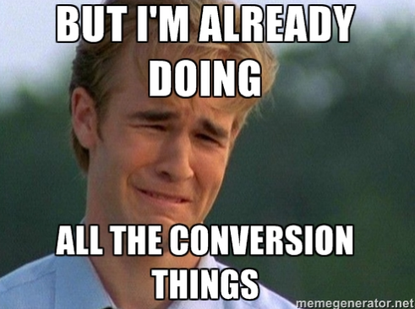
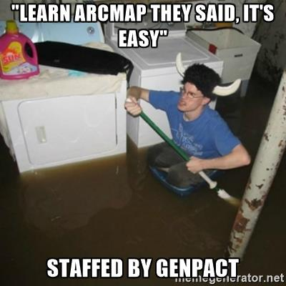
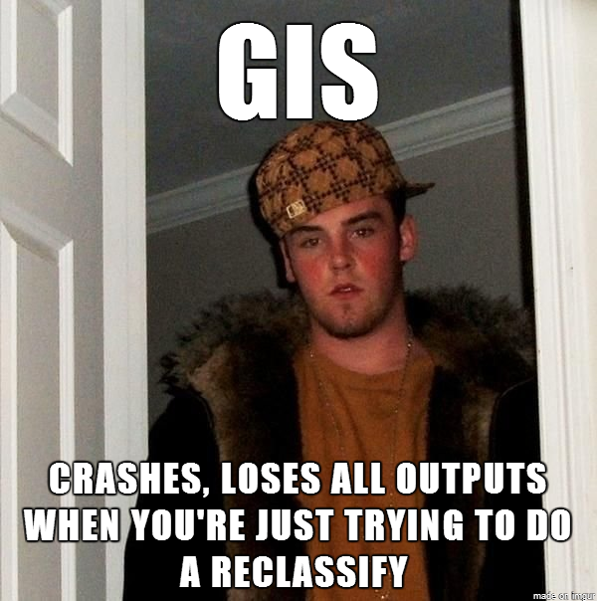
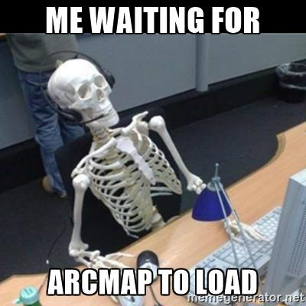
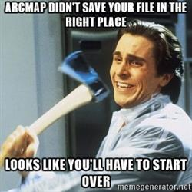
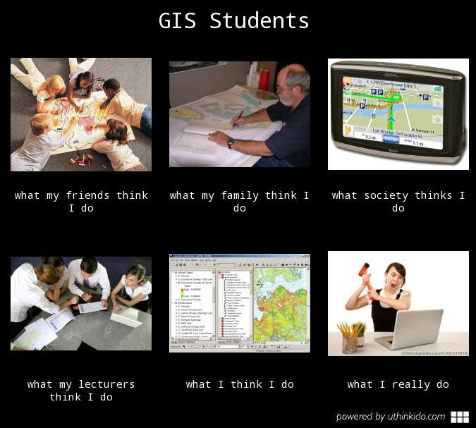
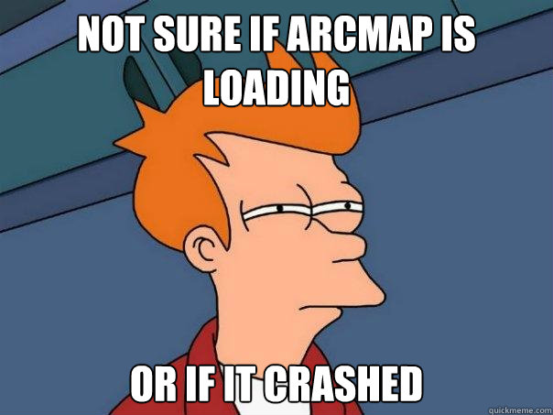
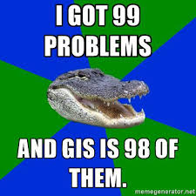
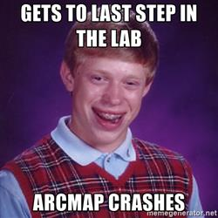
Some ArcGIS Memes!!
Fortunately not as relevant anymore in ArcGIS Pro but still funny

Slide 2

Applications of GIS
Week 12
Last week!!!
Q&A for A4

Slide 3
What to do this week?
General feedback A3
Mostly working on A4 and asking some final questions to finish off the assignment
Running through what is required for the report
How to present your data
How to show your learnings

Slide 4
Some feedback A3
In general everyone did very well
Groups who got the best scores delved a bit deeper into the analysis and explanation of analysis. They explained the impacts of their analysis, proposed alternative analysis methods and then conducted these alternative methods. Groups who also looked at and analysed additional relevant contains also achieved good grades. This will apply for the next assignment.
Some groups struggled with the literature review, make sure you are referencing reliable sources, mostly peer-reviewed articles, government documents or text books.
The literature review should reflect relevant methodologies that other research has implemented and you can use to inform you analysis, or background information to give reasoning to the constraints you have chosen.
Discussion's were good overall although make sure you link your results back to sections of the literature review, did you achieve the expected outputs? What recommendations come out of these results?

Slide 5
In your report make sure to
Include background information about what makes bushfires or floods worse and how this included in your model
Reason why each constraint is included in your model
Make your maps look professional
Talk about your maps
Which areas are at most risk?
Who is at most risk?
Which industries should take action?
Which towns need to take more action over others?
What are your recommendations and where should they be implemented?
What constraint impacts the model the most
What changed might you make in future analysis?
What additional data might be good?
What are the limitations of your analysis?

Slide 6
For a great semester!! Enjoy your well deserved break and good luck in the exam

