Slide 1
GEOM20013: WEEK 2 TUTORIAL

Slide 2
Todays Tutorial
Our Plan
Demonstration ​
Making a Map
Working on A1 (Online Esri Modules)​

Slide 3
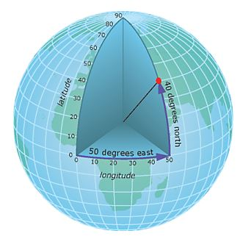
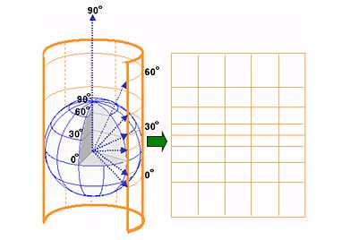
Coordinate Reference Systems
Geographic
Coordinate System
Projected
Coordinate System

Slide 4
Maps
Maps We like!
https://www.submarinecablemap.com/
https://maps.esri.com/rc/cable/index.html
https://www.jasondavies.com/maps/transition/
https://thetruesize.com

Slide 5
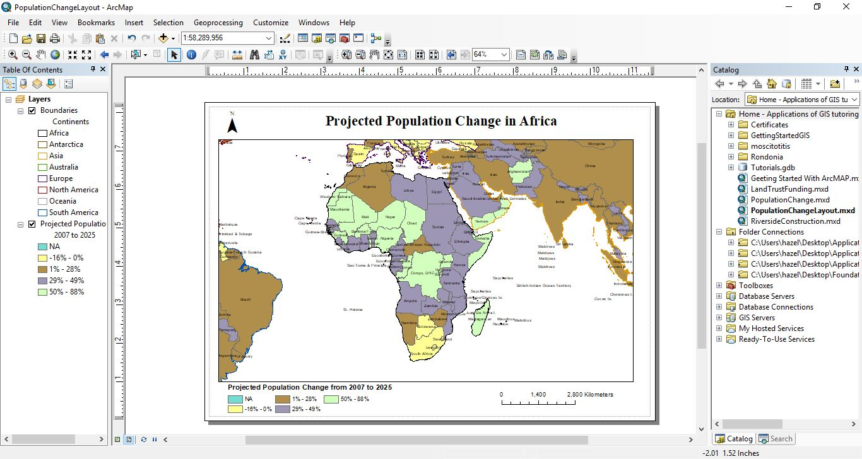
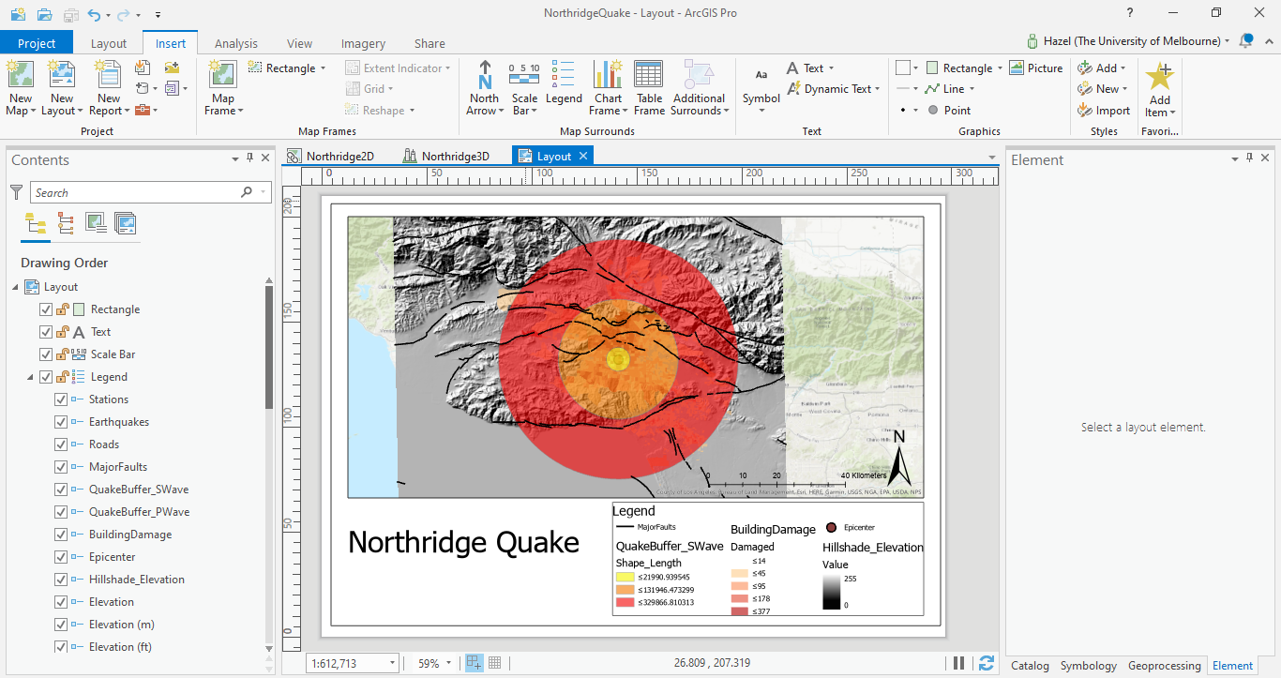
Making a Map (Demo)

Slide 6
Making a Map
Remember:
Border
Orientation
Legend
Title
Scale

