Slide 1
GEOM20013: WEEK 5 TUTORIAL

Slide 2
Assignment 3
Assignment 3 Overview
Victorian Rail Authority (VRA) are proposing new high-speed rail.
They have 4 proposed alignments, you have to decided the most appropriate one based on your analysis.
There is not necessarily one correct answer, how you conduct your analysis, your justifications and quality of report are what will be marked.
Are provided with the alignments and DEM datasets
Analysis required:
new rail cannot be built on a slope steeper than 25 degrees
track cannot follow a path prone to flooding

Slide 3
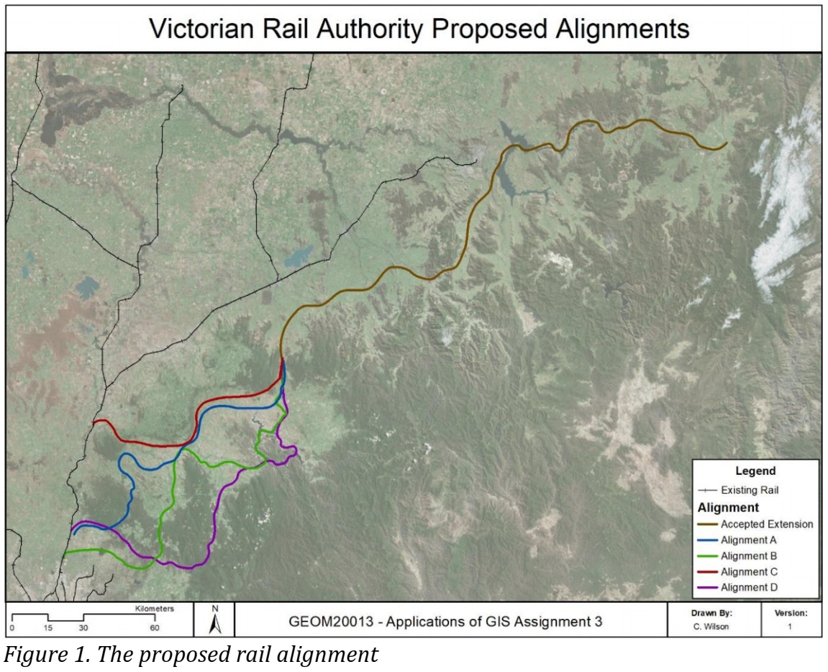
A3: Proposed Alignments

Slide 4
Additional Analysis
Additional Data Examples
Waterways
Vegetation
Townships
Existing infrastructure
Additional Analysis Options
Flooding, water crossings
Protected vegetation, vegetation clearing
Potential major stops, potential for new major townships along route, property acquisitions
Crossing of existing infrastructure, re-engineering of existing infrastructure

Slide 5
Sourcing additional data
Additional data examples
Rivers: https://www.data.vic.gov.au/data/dataset/modified-rivers
Rainfall: http://www.bom.gov.au/climate/how/newproducts/IDCmrgrids.shtml
Data is in an ASCII format. Use the ASCII to Raster tool to convert to a raster and visualise for analysis
Roads: https://vicroadsopendata-vicroadsmaps.opendata.arcgis.com/datasets/vicroads-declared-roads
Additional data sources:
Geoscience Australia: http://www.ga.gov.au/
Vic Government: https://www.data.vic.gov.au/
AURIN: https://aurin.org.au/
Further resources can be found under the ‘Additional Information and Resources’ tab in the LMS

Slide 6
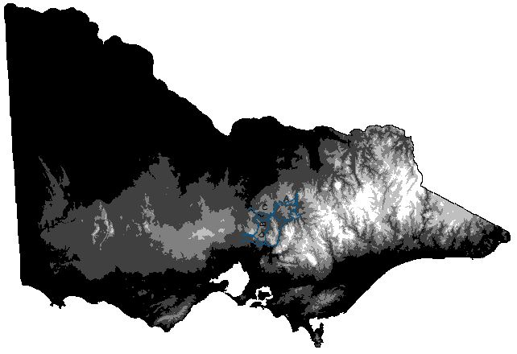
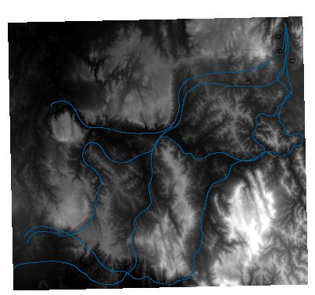
Tools Demonstration
Clip
Alters the size of the raster to the extents of another feature and helps with reducing the processing time in further raster analysis

Slide 7
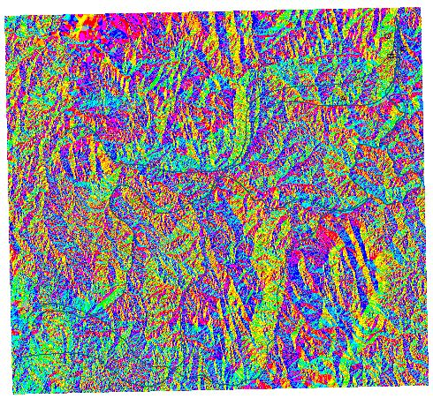
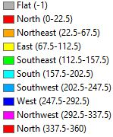
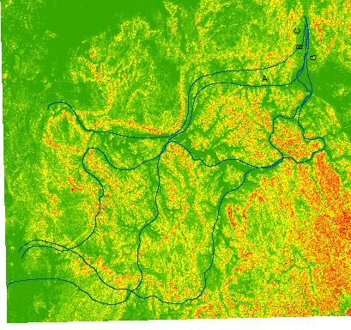
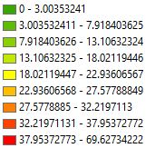
Tools Demonstration
Aspect
Determines the direction of the slope
Slope
Calculates the change in elevation from neighbouring cells

Slide 8
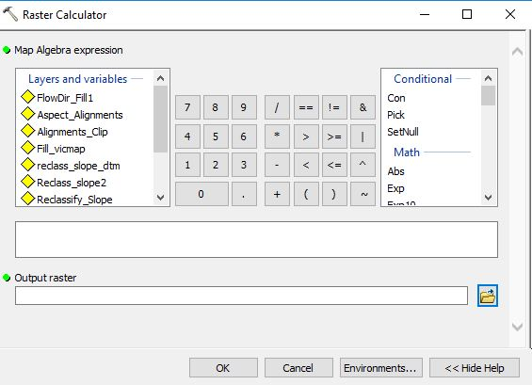
Tools Demonstration
Reclassify
Changes the values in a raster to suit the required analysis
Raster Calculator
Executes Map Algebra expressions and outputs a raster

Slide 9
Further Information
Further tools and information can be found in workflow the LMS:
Assessment -> A3 Decision Making in GIS -> Workflow

