Slide 1

Post Quantum Communication framework for IoT devices
CS65: Mini Project Work - Zeroth Review Presentation
Department of Computer Science and Engineering
Team:
1MS21CS013 – Amogh AN
1MS21CS027 – Archit Kumar Kiran
1MS21CS042 – Chris Biju
1MS21CS053 – Het Rutul Joshi
Guide:
Dr. Sangeetha V
Associate Professor
CSE

Slide 2
Agenda
Problem Statement
Objective & Scope of the Proposed Project
Hardware & Software to be used
What contribution to society would the project make?
References

Slide 3
Introduction
What is Post-Quantum Communication for IoT Devices?
IoT devices are essential in today’s interconnected world, but their security is a growing concern. Traditional cryptographic algorithms are vulnerable to attacks from quantum computers.
Post-quantum cryptographic algorithms offer a solution to secure IoT communications against future quantum threats.

Slide 4
Why Post-Quantum Communication for IoT Devices?
1.IoT Security Priority: Protecting sensitive IoT data is crucial.
2.Quantum Threats to Cryptography: RSA and ECC face risks from quantum computing.
3.Post-Quantum Security: New algorithms resist quantum attacks, securing data.
4.Enhancing IoT Security: Vital for resource-limited IoT devices.

Slide 5
How Post-Quantum Communication Works for IoT Devices?
Post-quantum algorithms use mathematical problems believed to be hard for quantum computers. (Lattice-based and hash-function algorithms)
They replace or augment existing cryptographic protocols in IoT devices.
Implementation of these algorithms ensures secure communication channels resistant to quantum attacks, safeguarding user data and privacy.

Slide 6
Motivation
Future-Proof Security
IoT Growth and Vulnerabilities
Regulatory Compliances
Trust and Reliabilty
Technological Innovation

Slide 7
Problem Statement
Current Methodology
Most IoT devices currently use traditional cryptographic algorithms such as RSA and ECC for securing communication.
Proposed Methodology
To develop a communication framework using quantum-safe algorithms and also to ensure optimisation for the IoT device infrastructure.

Slide 8
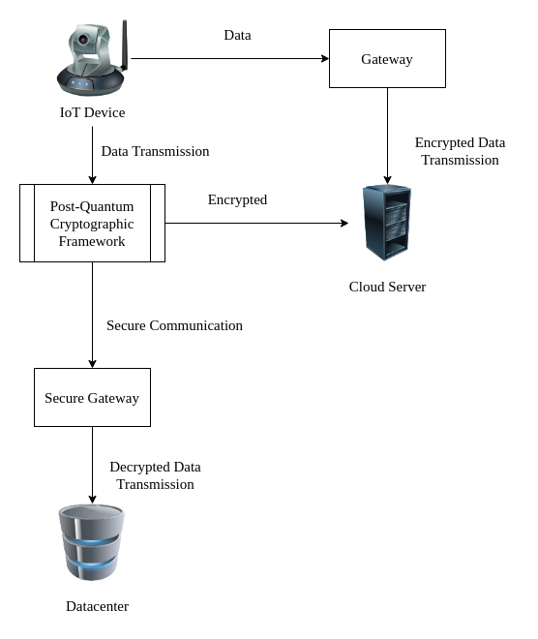

Slide 9
Project Objectives
Develop a robust and secure post-quantum communication framework suitable for resource-constrained IoT devices.
To integrate the framework into existing IoT infrastructures to enhance security, hardware re-usability and resilience.
Implement and evaluate the performance and security of the framework against various threats including quantum based attacks.
Optimize the communication framework for efficiency, responsiveness, and compatibility with diverse IoT devices, platforms, and communication protocols.

Slide 10
SRS
Hardware tools: Single board computers and Micro-controllers to simulate and setup a IoT Test Lab (e.g., Raspberry Pi, Arduino), sensors, actuators.
Software tools: Programming languages (e.g., Python, C), cryptographic libraries (e.g., liboqs), communication protocols (e.g., MQTT, CoAP), simulation tools (e.g., Contiki, Cooja), post-quantum libraries(e.g., CRYSTALS-Kyber).

Slide 11
Contributions to Society
The project aims to address the emerging threat of quantum attacks on IoT systems by developing a robust post-quantum communication framework.
By enhancing the security and resilience of IoT devices against future quantum threats, the project will contribute to safeguarding sensitive data and ensuring the integrity and privacy of IoT deployments across various sectors, including healthcare, smart cities, and industrial automation.
A secure and reliable communication framework lays the foundation for the proliferation of IoT technologies.

Slide 12
References
A[1]Aleksandrova, E. B., Shtyrkina, A. A., & Yarmak, A. V. (2020). Post-Quantum Group-Oriented authentication in IoT. Nonlinear Phenomena in Complex Systems, 23(4), 405–413. https://doi.org/10.33581/1561-4085-2020-23-4-405-413
[2]Ashraaf, A. (2024). Analysis of Post Quantum Cryptography Algorithms concerning their applicability to IoT devices. -. https://doi.org/10.31224/3471
[3]Coston, I., Plotnizky, E., & Nojoumian, M. (2024). Comprehensive Study of IoT Vulnerabilities and Countermeasures. -. https://doi.org/10.2139/ssrn.4695812
[4]Fernández‐Caramés, T. M. (2020). From Pre-Quantum to Post-Quantum IoT Security: A survey on Quantum-Resistant Cryptosystems for the Internet of Things. IEEE Internet of Things Journal, 7(7), 6457–6480. https://doi.org/10.1109/jiot.2019.2958788
[5]Herbst, S., De Maio, V., & Brandić, I. (2024). Streaming IoT data and the Quantum Edge: A Classic/Quantum Machine Learning use case. arXiv (Cornell University). https://doi.org/10.48550/arxiv.2402.15542
[6]Kaushik, A., Vadlamani, L. S. S., Hussain, M. M., Sahay, M., Singh, R., Singh, A. K., Indu, S., Goswami, P., & Kousik, N. G. V. (2022). Post quantum public and private key cryptography optimized for IoT security. Wireless Personal Communications, 129(2), 893–909. https://doi.org/10.1007/s11277-022-10162-w
[7]Lee, J., Kim, D., Lee, H., Lee, Y., & Cheon, J. H. (2019). RLizard: Post-Quantum Key Encapsulation Mechanism for IoT Devices. IEEE Access, 7, 2080–2091. https://doi.org/10.1109/access.2018.2884084
[8]Liu, T., Ramachandran, G. S., & Jurdak, R. (2024). Post-Quantum Cryptography for Internet of Things: A Survey on Performance and Optimization. arXiv (Cornell University). https://doi.org/10.48550/arxiv.2401.17538
[9]Mamatha, G., Dimri, N., & Sinha, R. (2024). Post-Quantum Cryptography: Securing digital communication in the Quantum Era. arXiv (Cornell University). https://doi.org/10.48550/arxiv.2403.11741
[10]Premila, T. R., Janaki, N., Govindasamy, P., & Ganesh, E. N. (2024). Cryptography using the Internet of Things. In BENTHAM SCIENCE PUBLISHERS eBooks (pp. 167–181). https://doi.org/10.2174/9789815179514124010016

Slide 13
Thank You

