Slide 1

TEAM SYNTAX

Slide 2
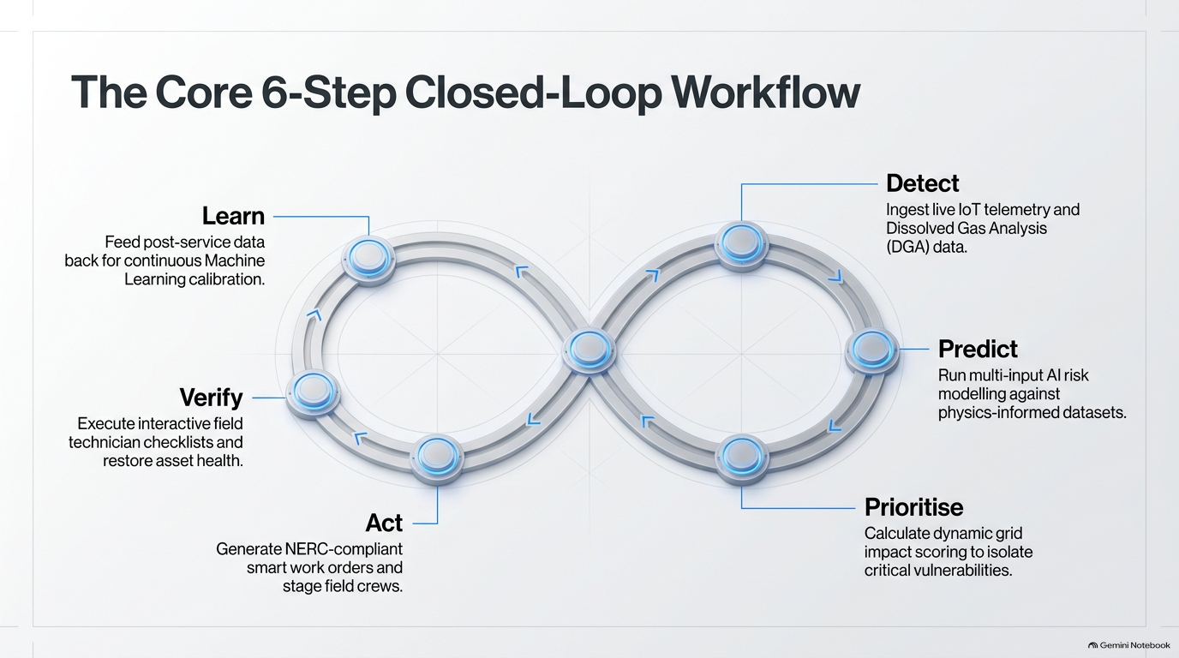
TEAM SYNTAX

Slide 3
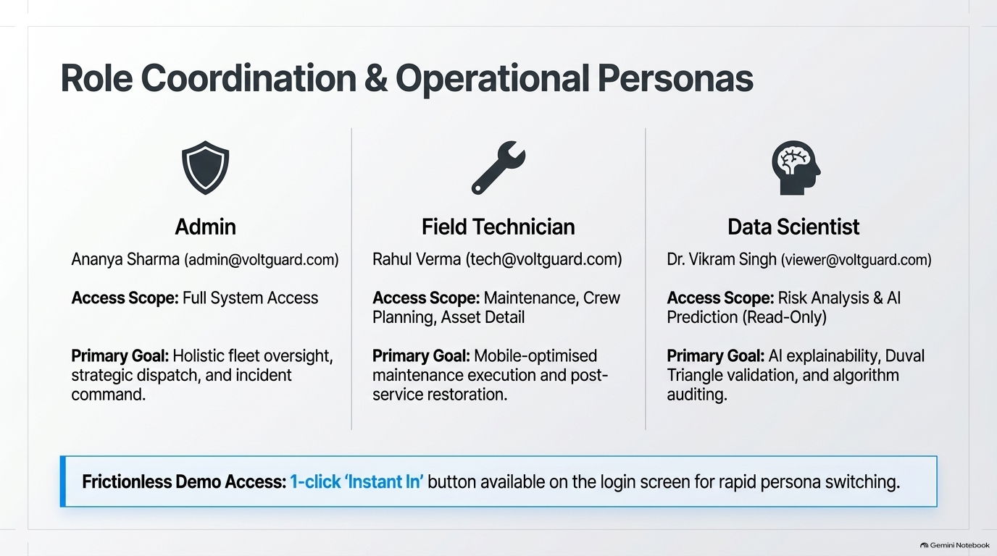
TEAM SYNTAX

Slide 4
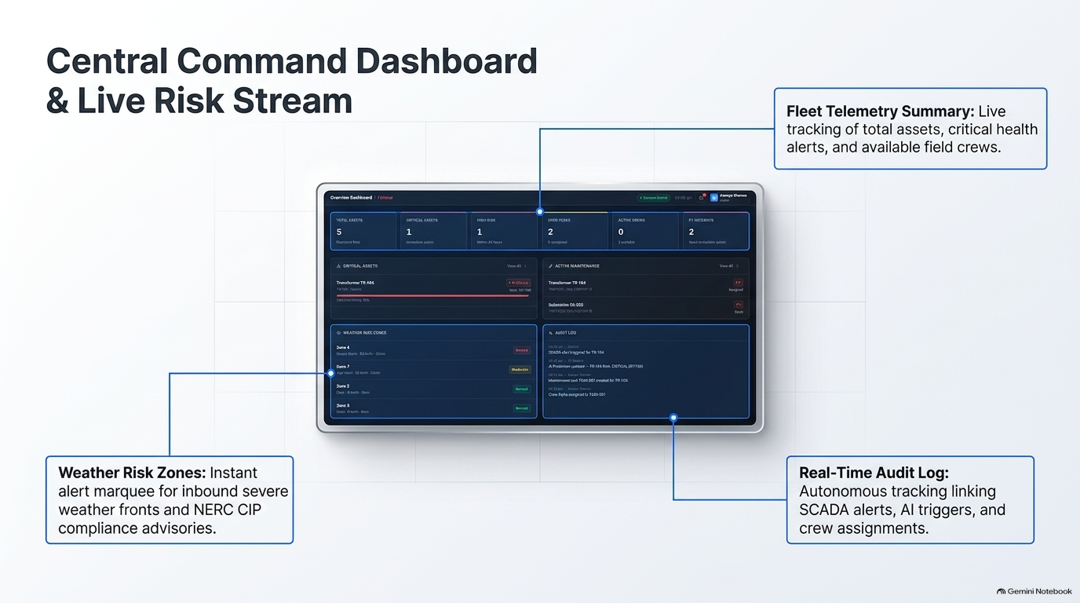
TEAM SYNTAX

Slide 5
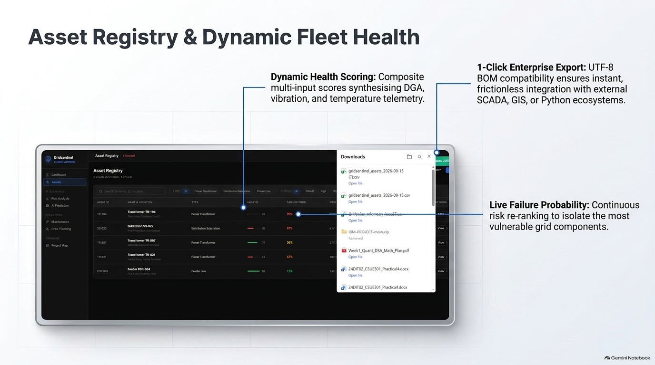
TEAM SYNTAX

Slide 6
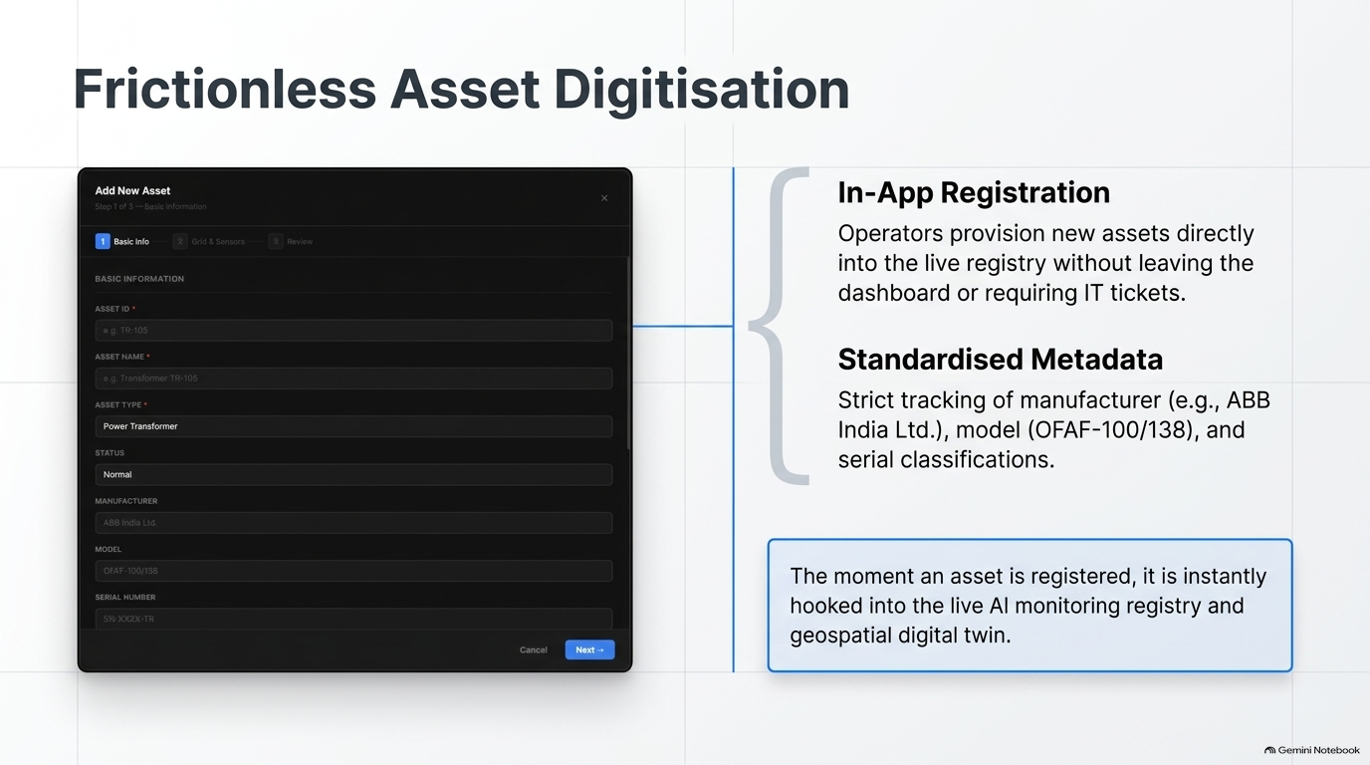
TEAM SYNTAX

Slide 7
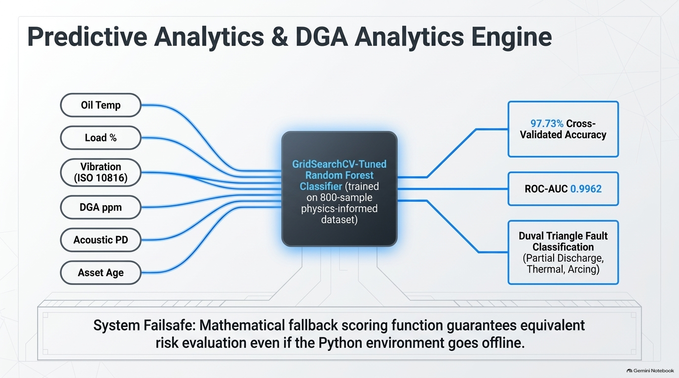
TEAM SYNTAX

Slide 8
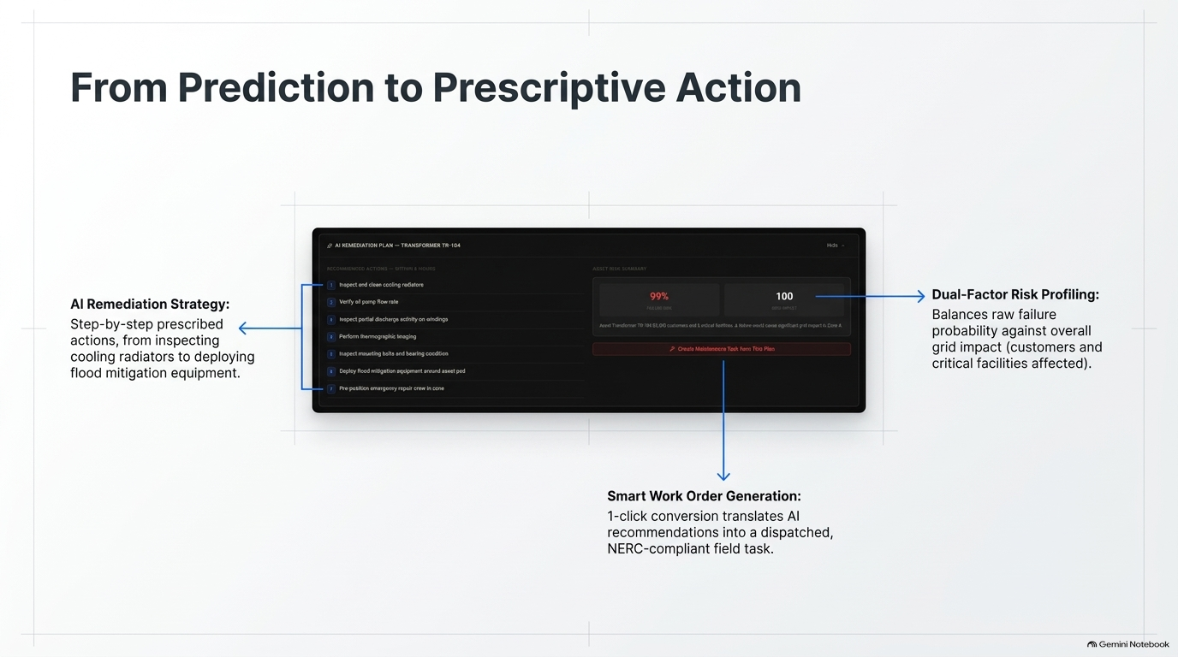
TEAM SYNTAX

Slide 9
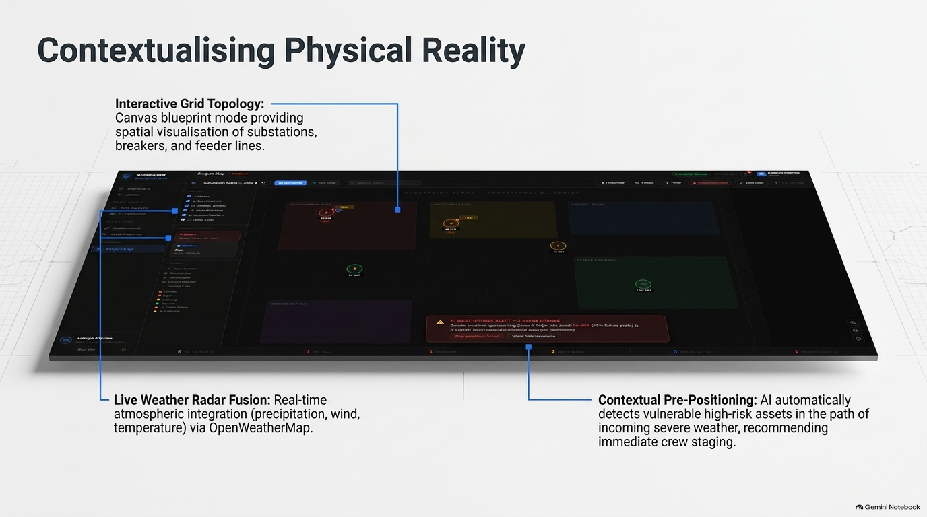
TEAM SYNTAX

Slide 10
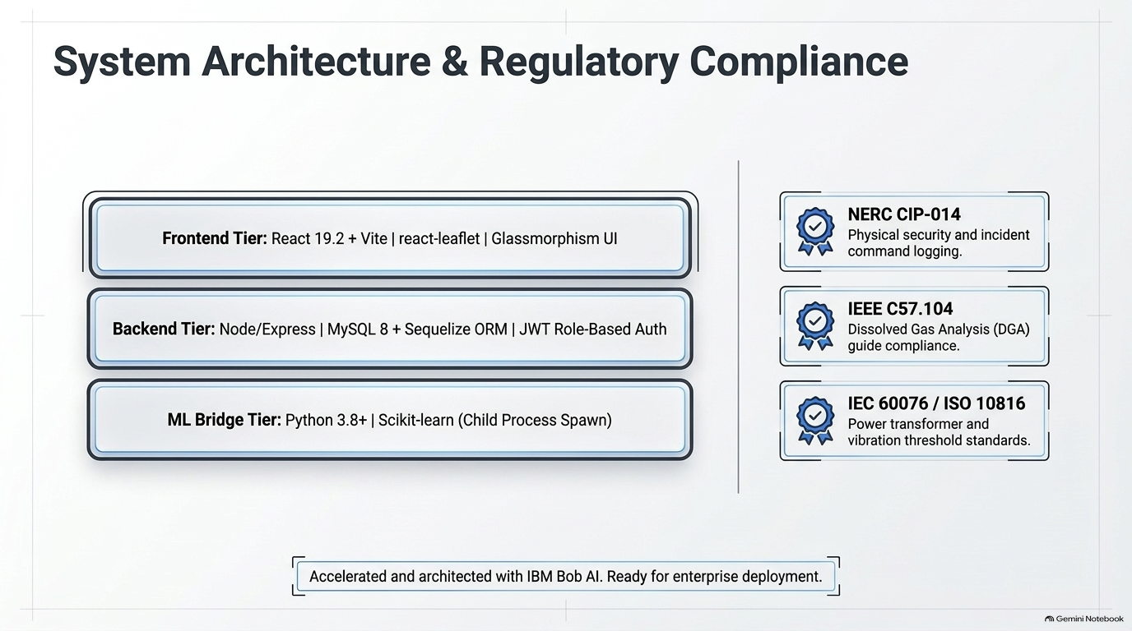
TEAM SYNTAX

