Slide 1

🚨 HACKATHON ROUND 2 FINALIST PITCH | TRACK: SMART SAFETY & IOT
SafeGuard SOS
Autonomous Emergency Dispatch & Edge Telemetry Ecosystem
Our Ideation: Traditional safety apps fail because they assume ideal conditions (5G data, unlocked screens, calm victims). We envisioned an autonomous, zero-friction safety pipeline that triggers without screen interaction, requires ZERO app install for responders, and delivers tamper-proof forensic evidence.
👥 TEAM: PIXEL PERFECT (TEAM ID: SM083)
HET PATEL (240410149035) • RUDRA PATEL (240410149043) • PRITAM PATEL (240410149047) • VEDANSHU PATEL (240410149044)

Slide 2
TEAM PIXEL PERFECT (SM083) | HACKATHON ROUND 2
Slide 02: The Critical Problem — Why Safety Apps Fail Under Duress
1. High Panic Latency
Cognitive overload during attacks/accidents
• Victims cannot unlock screens or dial numbers under physical assault.
• Over 70% of victims are physically unable to articulate GPS coordinates.
• Single-button apps still require unlocking the OS first.
2. The Connectivity Trap
Single-point-of-failure infrastructure
• Most apps fail completely when 4G/5G data drops in basements or transit.
• Cloud-only dispatch stalls when backend webhooks timeout.
• WhatsApp/VoIP deep links fail without active internet.
3. Tampered Evidence
Zero forensic custody during crimes
• Perpetrators often smash or discard victim phones immediately.
• Audio and photo evidence captured unencrypted is lost or inaccessible.
• Families and guardians have no immediate access to locked incident evidence.

Slide 3
TEAM PIXEL PERFECT (SM083) | HACKATHON ROUND 2
Slide 03: The SafeGuard Solution — Multi-Vector Resilient Ecosystem
Multi-Modal Emergency Triggers
Trigger anywhere, anytime without friction
• One-touch instant SOS button with 3-second abort timer.
• Continuous accelerometer-based fall & crash impact detection.
• Hardware volume key sequences & Smartwatch BLE wrist trigger.
Resilient Multi-Channel Dispatch
Zero Single Point of Failure (SPOF)
• Direct background SIM SMS sent over cellular bands (No internet needed).
• International E.164 WhatsApp auto deep-link bridge.
• Automated siren activation + silent dispatch modes.
Zero-Install Responder Web Portal
Instant situational awareness for contacts & police
• Responders open an ephemeral live map on any mobile browser.
• No app installation required for parents or emergency responders.
• 1-Click routing directly into Google Maps / Apple Maps.
AES-256 Encrypted Evidence Vault
Tamper-proof black-box incident recording
• Automatic ambient microphone audio recording on trigger.
• Encrypted local storage with PIN / Biometric security lock.
• Emergency Medical ID broadcast (Blood group, allergies, conditions).

Slide 4
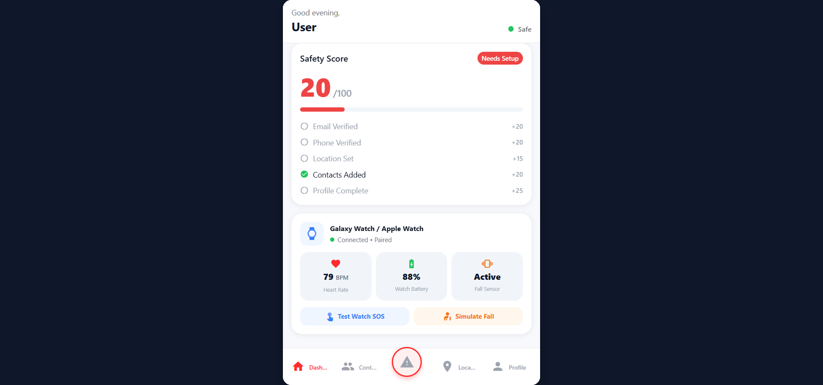
TEAM PIXEL PERFECT (SM083) | HACKATHON ROUND 2
Slide 04: What MVP We Achieved — Operational Round 2 Capabilities
Active SOS & Telephony Engine
Verified on Android hardware & Web
• 3s countdown with abort modal & haptics.
• Audible pulse siren with instant silent toggle.
• Native Android SEND_SMS direct SIM dispatch.
• WhatsApp wa.me link with E.164 normalization.
• Medical ID transmission (Blood, allergies).
Evidence Vault & Wearables
Secure evidence & peripheral layer
• AES-256 encrypted vault for audio & media.
• Ambient audio recording during active SOS.
• Smartwatch BLE scanning & discovery.
• Family Circle real-time status dashboard.

Slide 5
TEAM PIXEL PERFECT (SM083) | HACKATHON ROUND 2
Slide 05: Transparent Engineering Analysis — Intentional Fallback Matrix
1. Geolocation: Last-Known Location Fallback
Prevents satellite GPS stall delays
• Current Behavior: Transmits immediate verified Last Known Coordinates.
• Why it's a Fallback: Prevents 15-second satellite acquisition stalls in basements/elevators so the SOS fires without delay.
2. Connectivity: Native SIM SMS Fallback
Graceful degradation when data is down
• Current Behavior: WhatsApp deep-links require internet.
• Why it's a Fallback: If offline, SafeGuard automatically falls back to direct native cellular SIM SMS.
3. Evidence Vault: Master Passkey Access
Cryptographic local protection
• Current Behavior: Audio files are strongly encrypted in the vault.
• Why it's a Fallback: Requires family/guardian to enter passkey to prevent attacker tampering at the scene.
4. Sensor & Hardware Baseline Thresholds
Conservative calibration to avoid false alarms
• Current Behavior: High G-force impact threshold & in-app volume 3-tap.
• Why it's a Fallback: Eliminates accidental false dispatches during normal running or minor phone handling.

Slide 6
TEAM PIXEL PERFECT (SM083) | HACKATHON ROUND 2
Slide 06: System Architecture — Modular, Reactive & Edge-Optimized
Mobile & Web Client
Cross-Platform Frontend
• React Native 0.79 & Expo SDK 53.
• TypeScript for strict type safety.
• Expo Router 5 dynamic routing.
• Expo Sensors (Accelerometer @ 100ms polling interval).
Backend & Realtime Edge
Supabase Cloud Infrastructure
• PostgreSQL database with Row-Level Security (RLS).
• Realtime WebSocket channels for live geolocation broadcasting.
• Encrypted buckets for evidence backup.
• Serverless Edge Functions for multi-channel SMS webhooks.
Native Hardware Bridges
Android OS & Sensor Hooks
• Android Telephony SMSManager for direct SIM SMS.
• Web Audio API & Native Audio Recorder for ambient mic capture.
• BLE Watch Connectivity layer for smartwatch sync.
• Local SQLite / AsyncStorage for offline incident caching.

Slide 7
ENGINEERING CHOKE-POINTS
Slide 07: Where It Chokes — Honest Stress-Test Bottlenecks & Gaps
1. Cold-Start Latency
Bundle initialization delay
• Takes too much time to initialize JS bundle on sudden launch under duress.
2. Static Geolocation
Telemetry continuity gap
• Transmits static Last Known Location rather than continuous live dynamic stream.
3. Offline WhatsApp Limit
Internet dependency
• WhatsApp deep-links fail without data; relies solely on single-channel SIM SMS.
4. Evidence Vault Decryption Barrier
Local key access constraint
• Audio files are heavily encrypted locally; guardians cannot access recordings remotely without physical access and knowing the victim's device passkey.
5. OS Lock-Screen Hook & High Fall Force
OS background event & sensor calibration limits
• Android OS blocks 3-tap volume key events when phone screen is locked; fall detection sensitivity threshold is too high (requires intense collision spike).

Slide 8
FINAL ROUND COMMITMENT
Slide 08: 24-Hour Final Sprint Roadmap — Solving Choking Issues
1. < 800ms Startup
Cold Boot Fix
• Headless asset pre-warming.
• Lazy bundle imports.
• Eliminates render bottlenecks.
2. Live GPS Stream
Continuous Stream
• WebSocket 5s updates.
• Live speed & heading.
• Polyline breadcrumbs.
3. Lock-Screen Hook
Background Service
• Android Accessibility Background Service.
• 3-tap volume on locked OS screen.
4. Adaptive Fall Curve
Kinematic Dual-Stage
• Free-fall weightlessness detection.
• Secondary impact vector curve for slips.
5. Key Escrow
Guardian Remote Access
• Asymmetric public/private key escrow.
• Parents decrypt audio remotely.

Slide 9
TEAM PIXEL PERFECT (SM083) | HACKATHON ROUND 2
Slide 09: Competitive Advantage — Why SafeGuard SOS Wins
Evaluation Metric | Stock OS SOS (Apple/Google) | Commercial Safety Apps | SafeGuard SOS
Zero-Install Web Tracking | ❌ Static SMS link only | ❌ Requires app install | ✅ Live Web Portal (Google Maps)
Offline SMS Dispatch | ✅ Native SMS | ❌ Fails without 4G/5G | ✅ Direct SIM SMS + Cloud Sync
Incident Evidence Capture | ❌ None | ❌ Manual photo only | ✅ Auto Ambient Audio + AES Vault
Fall / Motion Detection | ⚠️ Watch / High-end only | ❌ None | ✅ Cross-Platform Sensor Engine
Emergency Medical ID | ⚠️ Lock screen card | ❌ Paid subscription | ✅ Integrated Direct Broadcast

Slide 10
TEAM PIXEL PERFECT (SM083) | HACKATHON ROUND 2
Slide 10: Market Opportunity & Scale — B2B and B2C Scalability
1. Campus & Women Safety
Direct B2C & B2B Institutional
• University campus security integration.
• Rapid peer-to-peer buddy dispatch.
• High demand for discreet, zero-panic trigger tools.
• Freemium consumer tier for basic safety.
2. Lone Workers & Fleets
Enterprise Workplace Compliance
• Delivery riders, night-shift personnel, and field technicians.
• Automated crash & fall incident telemetry.
• Centralized dispatcher web dashboard.
• B2B SaaS subscription per seat.
3. Eldercare & Assisted Living
Passive Health & Fall Monitoring
• Wearable BLE and phone accelerometer fall monitoring for elderly seniors.
• Immediate family circle notifications with medical history payloads.
• Peace of mind for caregivers.

Slide 11
🎯 HACKATHON ROUND 2 CONCLUSION
Engineered for Reality. Ready for the 24-Hour Final.
We stress-tested the boundaries, identified our exact choke points, and established a concrete engineering plan to deliver an impenetrable production safety network.
👥 TEAM: PIXEL PERFECT | TEAM ID: SM083
Het Patel (240410149035) • Rudra Patel (240410149043) • Pritam Patel (240410149047) • Vedanshu Patel (240410149044)
🚀 Open for Questions & Live Sensor Demonstration

