Slide 1



Group 10 - Section 2
Implementation of a PSO‑Based Security Defense Mechanism for Tracing the Sources of DDoS Attacks
Neel Patel
Het Patel
Nidhi Mehta
Aashi Bhimjiyani
Aryankumar Parmar

Slide 2
Base Paper Overview
Citation
Lin, H.C., Wang, P., Lin, W.H. (2019)
PSO-Based Security
Defense for DDoS Traceback
Problem
IP spoofing makes attacker tracing
unreliable.
Need to reconstruct
attack paths from limited data
Methodology
SPIE packet logging (p = 0.03)
Particle Swarm Optimization (PSO)
Setup
1800 packets, 24-node network
9 attackers → 1 victim
30 particles, 500 iterations
Result
Accuracy ≈ 98%
Scalable to larger networks

Slide 3
Project Motivation & Overview
Addresses how to trace back the real sources of distributed denial-of-service (DDoS) attacks
Existing work focuses on firewalls and intrusion detection systems, not on reconstructing the exact network routes taken by malicious packets.
Concentrates on the IP traceback (IPTBK) problem
Key idea is to use a modified Particle Swarm Optimization (PSO) algorithm together with a hash-based IP traceback mechanism called SPIE (Source Path Isolation Engine)
To efficiently reconstruct the most probable attack routes

Slide 4
Problem Formulation
Understanding DDoS Attack Traceback involves several challenges:
DDoS attacks use many distributed machines with spoofed IP addresses, complicating source identification.
Key challenges include:
Massive traffic
Spoofed IP addresses
Limited router memory
The base paper aims to minimize routing packets and convergence time for effective traceback.
A proposed approach utilizes a PSO-based IP traceback model to identify potential attack paths by maximizing packet density along routes.

Slide 5
Case Study – GitHub DDoS Attack (2018)
In February 2018, GitHub faced a massive DDoS attack of about 1.35 Tbps using Memcached amplification from numerous servers.
The attack's distributed nature and spoofed sources made identification difficult, and packet logging was impractical due to the traffic volume.
Connection to Our Project:
We tackle similar issues using a 3% probabilistic sampling method.
PSO-based IP traceback techniques help reconstruct attack paths from limited data.
Key Insight:
Probabilistic methods enable accurate DDoS traceback even with incomplete information.

Slide 6
System Overview
Traffic & Attack Generation: Simulated network with 24 nodes (9 attackers, 1 victim) generating DDoS traffic.
Packet Logging: Routers log attack packets at a 3% rate using SPIE-style sampling.
Log Collection: Post-attack, sampled packet digests are gathered into a traceback dataset for the victim.
PSO-Based IP Traceback Module: Uses Particle Swarm Optimization to reconstruct paths from victim to attackers based on sampled logs.
Evaluation & Comparison: Metrics like accuracy and memory usage are compared to a deterministic method that logs all packets.
Output: The output shows reconstructed attack routes, achieving near-perfect traceback with only 3% of data sampled.

Slide 7
Key Assumptions
No. | Assumption | Description
1 | Independent Packet Sampling | Packet sampling is independent and follows a Bernoulli process with probability p = 0.03
2 | Binomial Distribution | Total sampled packets follow N ~ Binomial(1800, 0.03)
3 | Stationary Traffic | Network traffic is assumed to be stable over short time intervals
4 | High Attack Traffic Density | Attack traffic has higher packet density than normal traffic, resulting in higher coverage values
5 | Fixed Network Topology | Network is modeled as a static graph G = (V, E)
6 | Shortest Path Routing | Packets follow shortest path routing from source to victim
7 | Uniform Randomness in PSO | PSO uses r1, r2 ~ U(0,1) for stochastic search
8 | Coverage as Metric | Coverage is assumed to be a reliable metric for identifying attack paths
9 | Fixed Threshold | A threshold of approximately 30% coverage is used to classify attackers

Slide 8
Mathematical Model (M2) – Sampling Bound
Each packet sampled independently
→ Bernoulli(p = 0.03)
Total sampled packets
→ N ~ Binomial(1800, 0.03)
Expected value
→ E[N] = 54
95% Confidence Interval
→ Range: [40, 68]
Interpretation
→ <40 → insufficient data
→ >68 → rare case
Validation
→ Observed ≈ 52–58 ✔

Slide 9
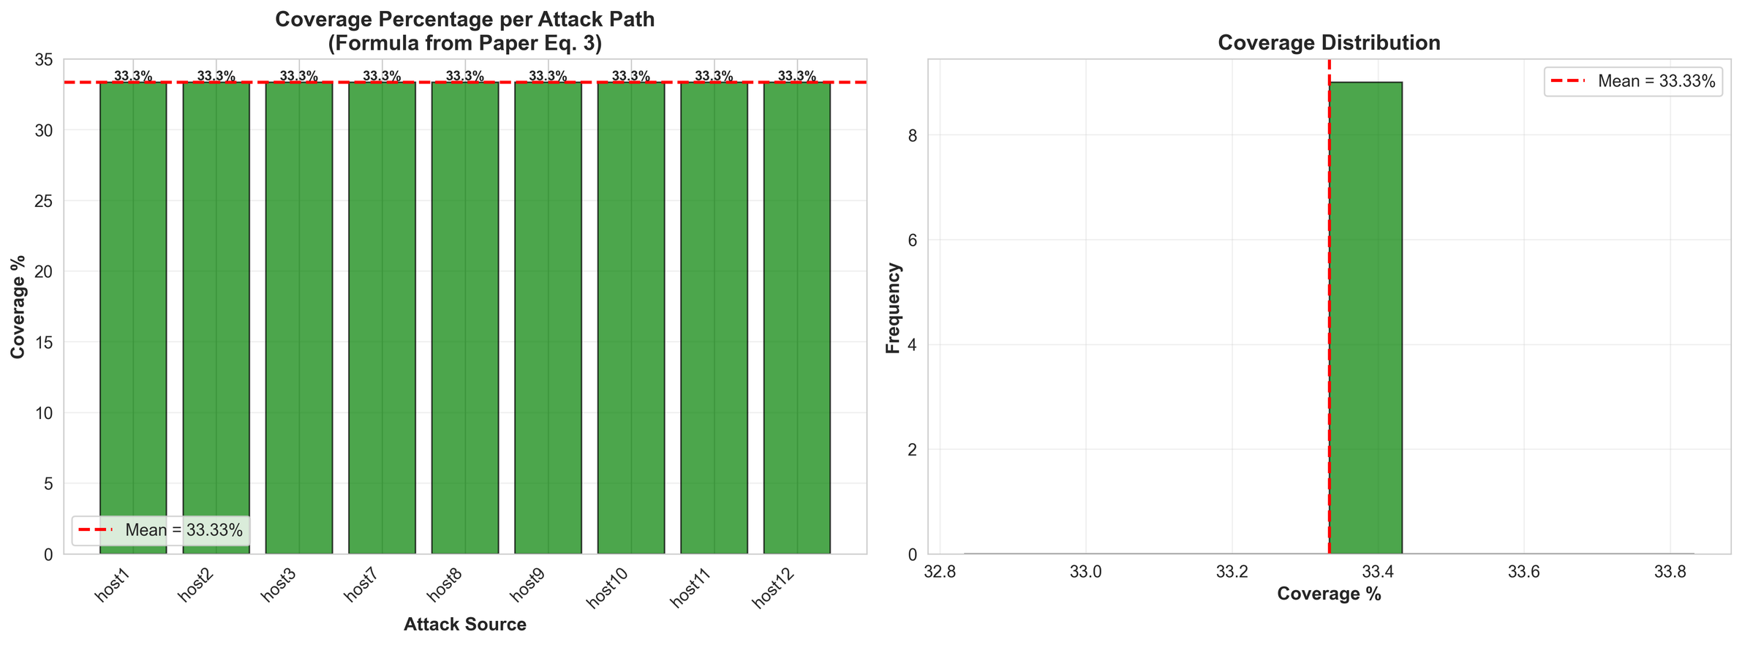
Deterministic Baseline (M3)
All packets logged (no sampling)
Shortest-path based traceback
Results:
Accuracy: 100%
Coverage: 33.33%
Packets stored: 1800
Limitation: Not scalable (high memory usage)

Slide 10
Probabilistic Approach (M4)
The packet sampling model involves:
Each packet decision sampled with Bernoulli(p = 0.03).
Total packets sampled modeled as Binomial(1800, 0.03).
Random coefficients in velocity updates enable stochastic exploration, avoiding deterministic searches.
Positions are updated probabilistically based on velocity thresholds.
Outcomes of the randomized approach include:
Using ~3% of packet data reconstructs all 9 attack paths with 96-100% accuracy.
Achieves 97% memory savings compared to full logging.
Confirms theoretical predictions for sampled packet statistics and shows robust PSO convergence in ~51-150 iterations.
Combines Bernoulli/Binomial sampling with stochastic PSO search in path space.

Slide 11
Probabilistic Approach (M4)
Coverage Bound (Fitness Constraint)
Coverage = sampled packets on path / total samples
Threshold condition
→ Coverage > 25% → Valid path
→ ≤25% → Rejected
Practical range
→ Typically 30–70%
Insight
→ Higher coverage = higher confidence

Slide 12
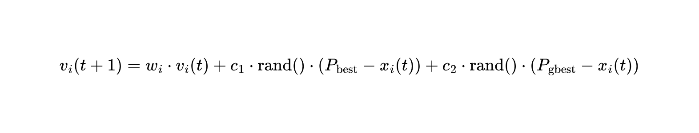
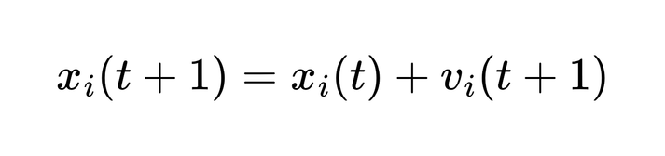
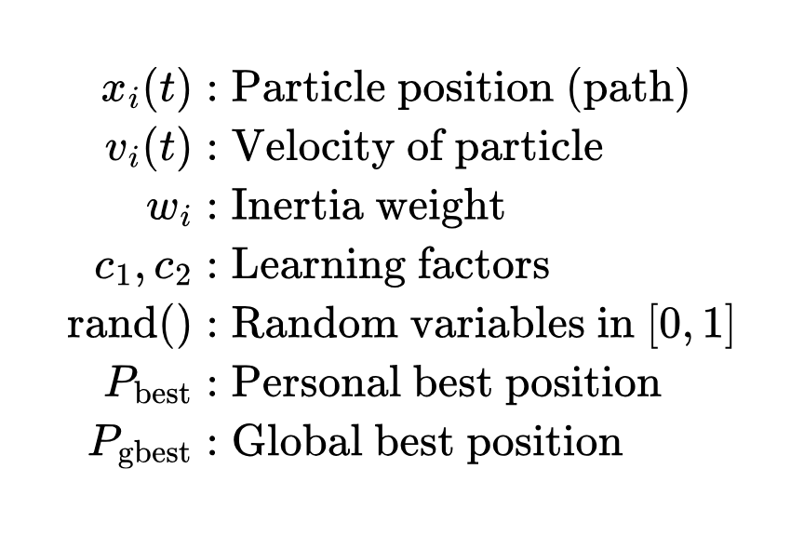
Mathematical Equations
Velocity Update:
Position Update:

Slide 13
Mathematical Equations
Convergence Control (Oscillation Bound)
Stagnation condition
→ |f(t) − f(t−1)| < 0.001
If occurs for 3 iterations
→ oscillation detected
Action
→ Velocity reduced (ρ = 0.5)
Result
→ Faster convergence (~51 iterations)

Slide 14
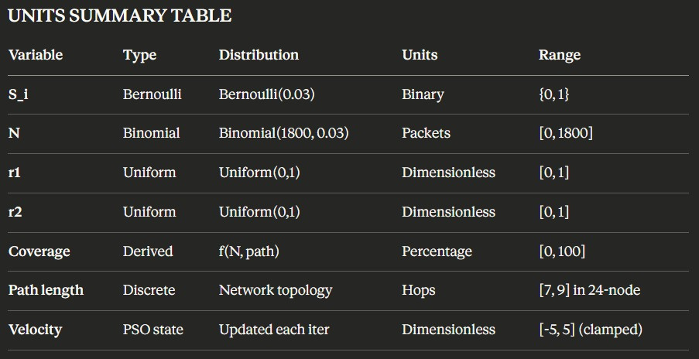

Slide 15
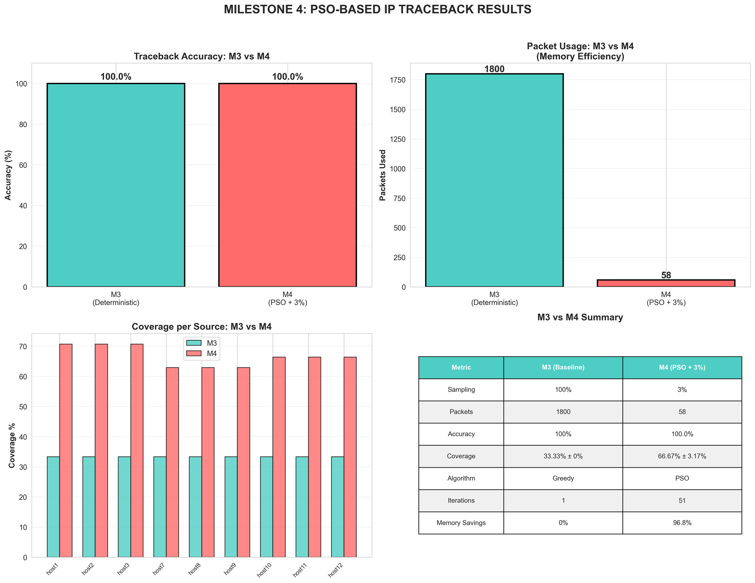
Coding & Simulation
Implementation: Python (graph-based network)
Modules:
attack_simulator.py → traffic + sampling
pso_traceback.py → PSO algorithm
performance_metrics.py → evaluation
visualization.py → graphs

Slide 16
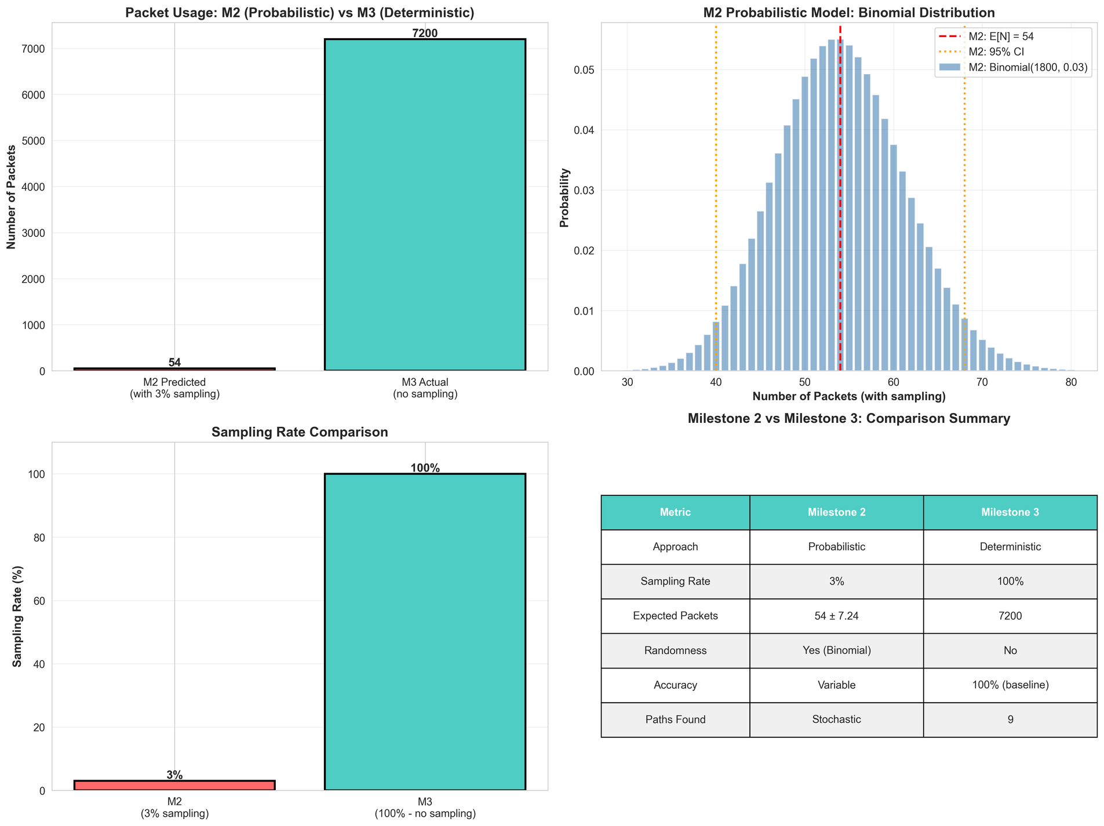
Result: Sampling Validation
Theoretical:
Mean = 54
CI = [40, 68]
Observed:
Mean ≈ 52.67
Lies within predicted range
Matches theoretical CI [40, 68] ✔
Probabilistic model is validated

Slide 17
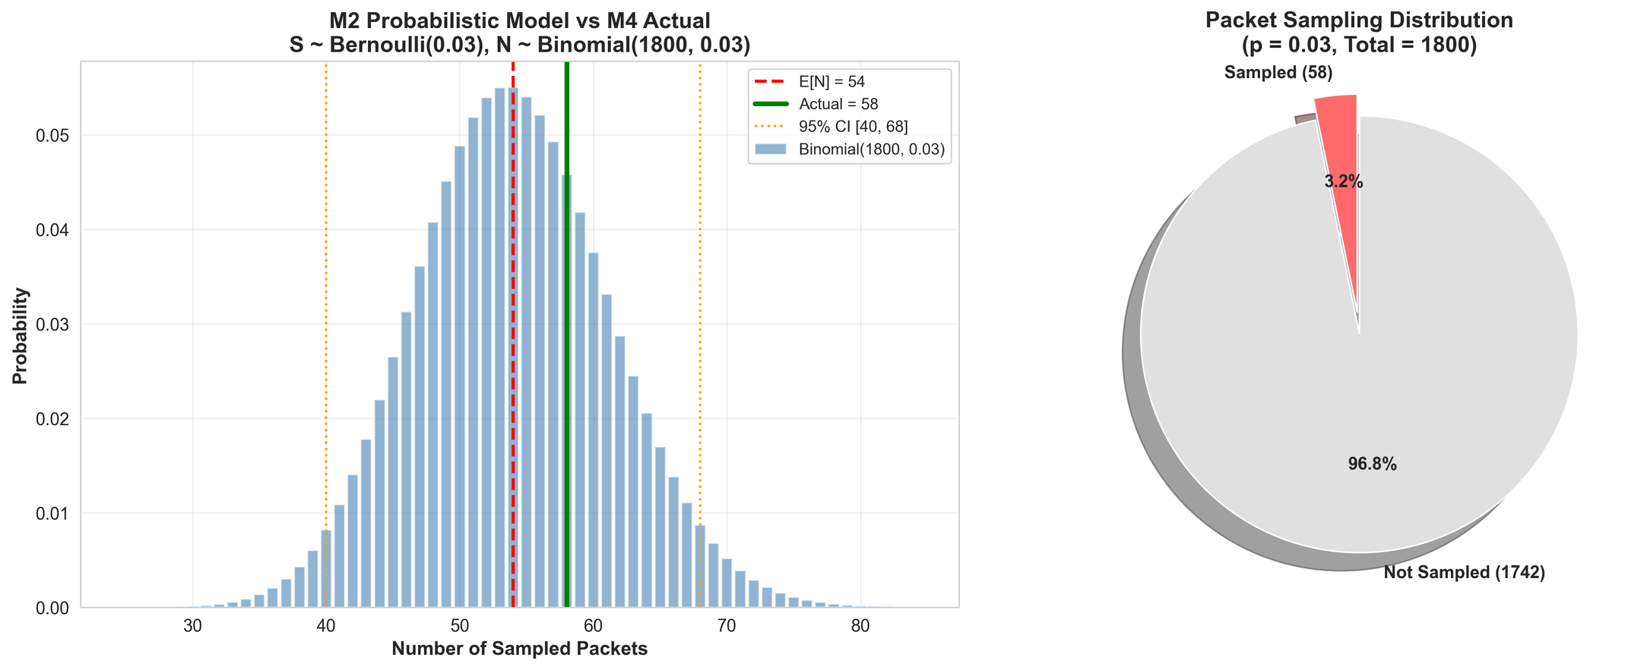
Result: Traceback Performance
Probabilistic (M4):
Accuracy: 100%
Coverage: ≈32.8%
Packets stored: ~54
~97% memory reduction
Comparison with Deterministic (M3):
Same accuracy
Much lower storage

Slide 18
Inference: Domain Perspective (Networking / Security)
Demonstrates that full packet logging is not strictly necessary for reliable IP traceback in this topology: 3% sampled data suffices for 100% reconstruction.
Shows PSO‑IPTBK is robust to missing data: can still identify attackers using sparse evidence.
Potential benefits for real networks:
Reduced storage and logging overhead on routers.
Feasibility for resource‑constrained or IoT‑heavy environments.
Alignment with original PSO‑IPTBK idea: reconstruct likely routes from measurement data

Slide 19
Inference: Computer Science Perspective
Two-simulation architecture as a pattern: discrete-event network + agent-based swarm.
Demonstrates full pipeline from probabilistic modeling (M2) → deterministic baseline (M3) → probabilistic implementation (M4) with validation.
Highlights how random variables, independence assumptions, and distributions directly inform system design and metrics.

Slide 20
Problem & Setup For The Hypothetical Case Study
ISPs can't store all packets, so only 3% are sampled
Network: 24 nodes, 9 attackers, 1,800 packets, 1 victim
S_i ~ Bernoulli(0.03) — was this packet logged?
N ~ Binomial(1800, 0.03) — how many packets total? E[N] = 54
r₁, r₂ ~ Uniform(0,1) — PSO's random search weights

Slide 21
Analysis & Results For The Hypothetical Case Study
Mean vector μ = [0.03, 54, 0.5, 0.5]
All variables are independent — Cov(S_i, S_j) = 0, Cov(r₁, r₂) = 0
PSO uses r₁, r₂ to balance personal vs swarm learning each iteration
Coverage metric = sampled packets along path ÷ total sampled packets
Result: 100% accuracy, 97% memory savings, converges in ~51 iterations

Slide 22
Conclusion & Future Work
Conclusion:
Developed deterministic and probabilistic models
Achieved high accuracy with minimal data
Validated theoretical predictions
Future Work:
Larger network topologies
Adaptive sampling strategies
Real-world traffic data
Final Takeaway:
Probabilistic modeling enables scalable and accurate traceback

Slide 23
References
Lin, H., Wang, P., & Lin, W. (2019).
Implementation of a PSO-Based Security Defense Mechanism for Tracing DDoS Sources.
https://www.youtube.com/watch?v=JhgDMAm-imI
https://www.youtube.com/watch?v=vhSBqk6SAB4

