Slide 1
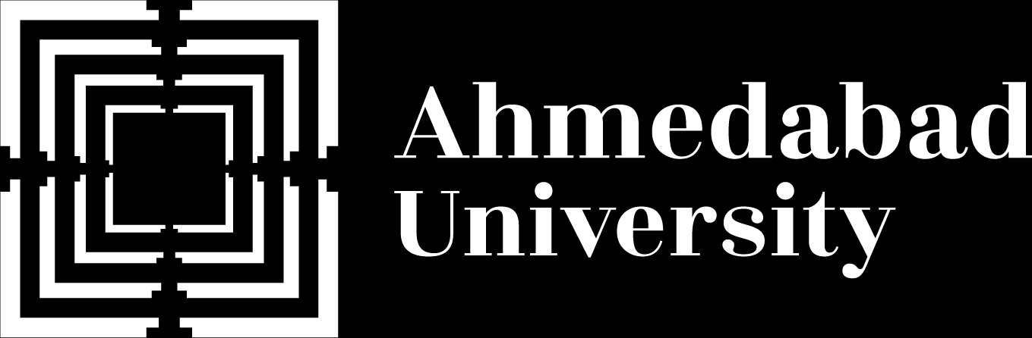
Name: Het Patel
Student ID: AU2440266
Institute: Ahmedabad University
Program: B.Tech CSE
Domain: uGLAD for Conditional Independence Graph Recovery
Milestone 2: Implementation, Validation and Initial Results
B.Tech Computer Science Engineering, School of Engineering and Applied Sciences

Slide 2
What This Talk Covers
From the problem to the first measured results.
Problem
Model
Learning
Inference
Validation
Results

Slide 3
1 · The Problem
Which variables are directly linked?
X
Z
Y
X and Y are linked only through Z, so there is no edge between them.

Slide 4
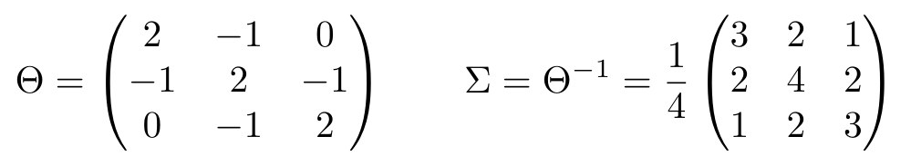
1 · Correlation Misleads
Meaning: X1 and X3 are correlated, but not directly linked.
Why: The zero in Θ shows it. The covariance Σ hides it.
Terms: Θ precision matrix · Σ covariance · P partial correlation.

Slide 5
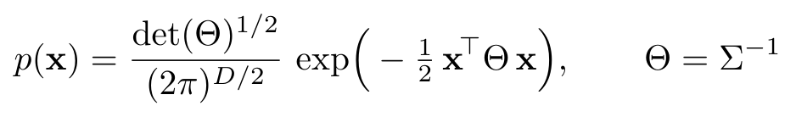
2 · The Model
Meaning: All structure sits in Θ. A zero entry means no edge.
Why: Θij is the only place where xi and xj meet in the density.
Terms: x one sample · D variables · Θ precision · Σ covariance.

Slide 6
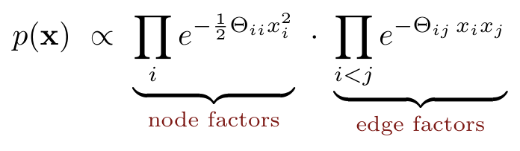
2 · The Model as Factors
Meaning: One factor per node and one per edge.
Why: If Θij = 0 the edge factor is 1, so the edge is gone.
Terms: Θii weight of a node · Θij weight of an edge.
In code: GaussianGraphicalModel · .node_log_factor · .edge_log_factor · .log_density

Slide 7
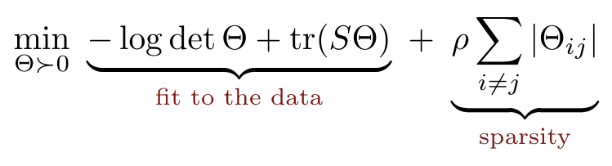
3 · Learning: The Objective
Meaning: Fit the data, but keep Θ sparse.
Why: S cannot be inverted when M < D, and its inverse has no zeros.
Terms: S sample covariance · Θ ≻ 0 positive definite · ρ penalty strength.

Slide 8
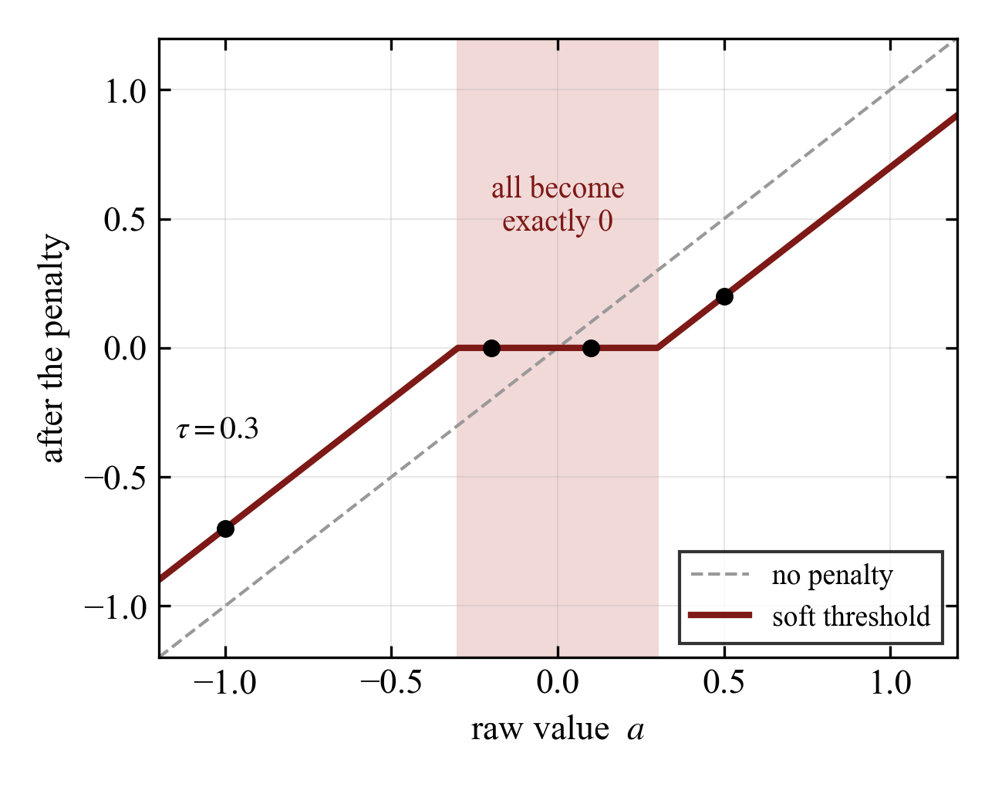

3 · Why the Penalty Gives Zeros
Meaning: Values inside the shaded band become exactly 0.
Why: This turns a dense matrix into a sparse graph.
Terms: a raw value · τ penalty.

Slide 9
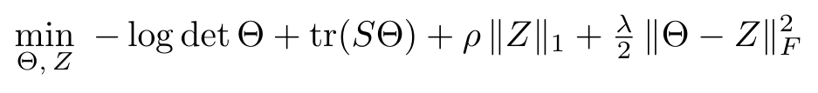
3 · Solving It: Split in Two
Meaning: Θ handles the fit. Z handles the sparsity.
Why: Each of the two steps then has a simple exact answer.
Terms: Z copy of Θ · λ coupling weight · F Frobenius norm.

Slide 10
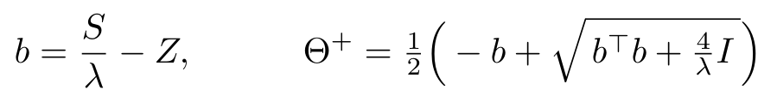
3 · The Θ Step
Meaning: An exact answer for Θ, with no loop.
Why: Set the gradient to zero and solve the matrix quadratic.
Terms: b helper matrix · I identity · λ coupling weight.

Slide 11

3 · The Z Step and What Is Learned
Meaning: Each entry gets its own learned threshold.
Why: A fixed ρ is replaced by a network, so no tuning by hand.
Terms: fρ: 3→3→3→1 network · fλ: 2→3→1 network · 42 weights in total.

Slide 12
3 · uGLAD: Unroll 15 Steps
Fifteen repeats of the two steps, stacked like layers.
S
Layer 1
Layer 2
...
Layer 15
Graph
The same two small networks sit inside every layer.

Slide 13

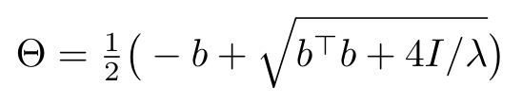




3 · One Layer, Step by Step
Step 1
Step 2
Step 3
Helper matrix
Exact Θ step
Features per entry
mix data and last answer
closed form
three numbers
Step 4
Step 5
Step 6
Learned threshold
Soft threshold
Next coupling weight
small network
exact zeros appear
small network

Slide 14
3 · Training Without Labels
Meaning: Train on how well Θ̂ explains the data.
Why: In practice there is no true graph to learn from.
CV mode: train on part of the rows, keep the epoch that is best on the rest.
Terms: Θ̂ output of layer 15 · S sample covariance.

Slide 15
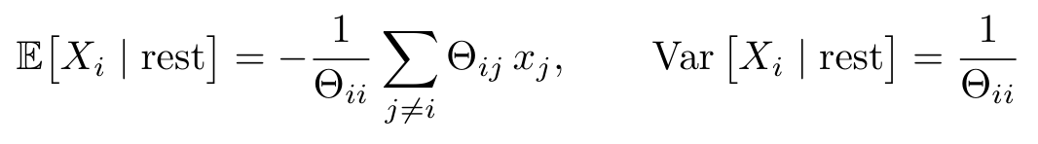
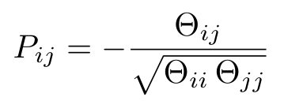
4 · Inference
Meaning: Predict one variable from all others, exactly.
Why: The model is Gaussian, so no sampling is needed.
Terms: Θii, Θij entries of the learned Θ · P strength of a direct link.

Slide 16
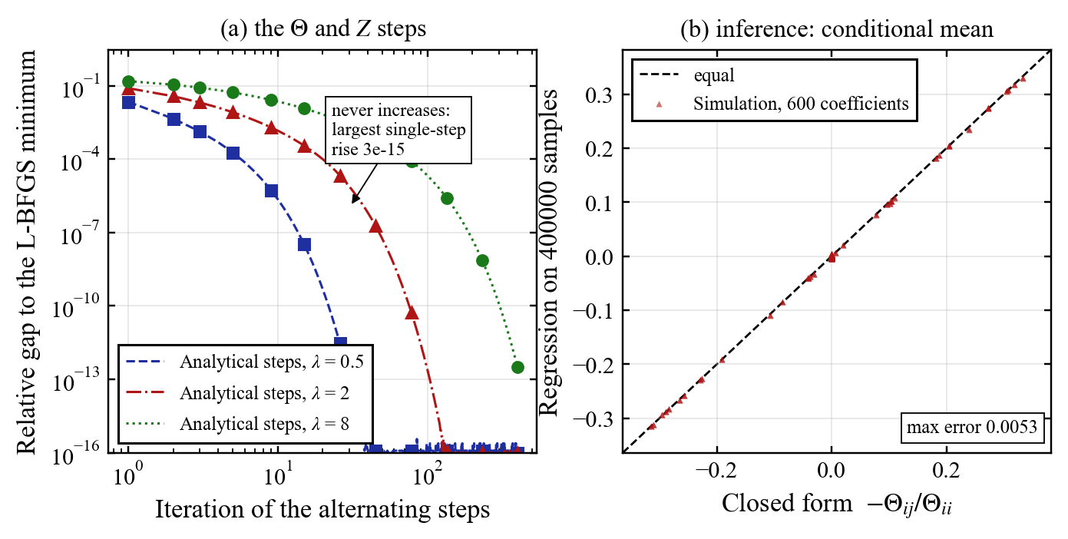
5 · Validation: Maths Against References
The formulas agree with independent references.
Fig. 1: (a) The alternating steps never increase their objective (largest rise 3e-15) and reach the L-BFGS minimum. (b) Closed form against regression on 400000 samples: largest difference 0.0053.

Slide 17
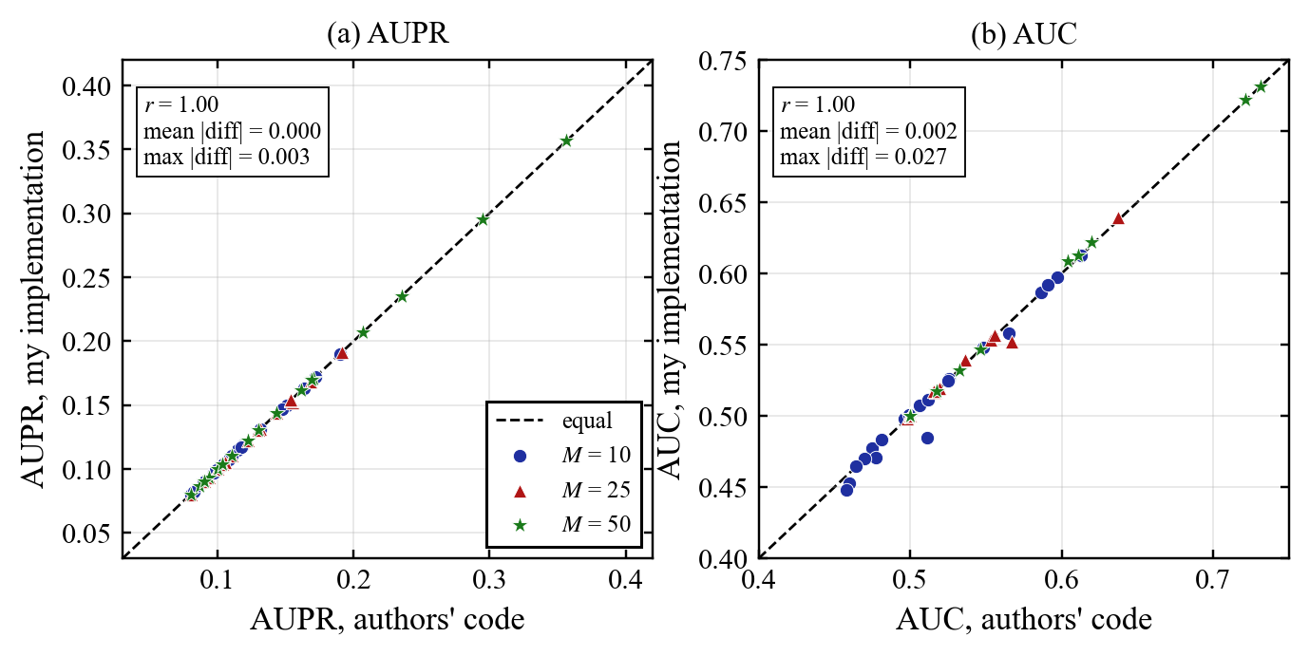
5 · Validation: My Code and the Authors' Code
Same datasets, same seeds, same ranking.
Fig. 2: My implementation against the authors' code on 60 datasets. AUPR correlation 1.00, largest difference 0.003.

Slide 18

6 · Dataset
Data: Synthetic Gaussian, the paper's protocol, the authors' generator.
Size: D = 25 variables, p = 0.1, about 30 true edges out of 300 pairs.
Samples: M = 10, 25, 50 · 20 graphs each · seed 2026 + graph index.
Terms: W edge values · A random graph · c shifts the smallest eigenvalue to 1.

Slide 19
6 · Baseline and KPIs
Baseline
SGLCV
(graphical lasso, CV)
Method
uGLAD
authors' code and mine
Reference
True model
best possible
Graph
AUPR, AUC
Learning
held-out likelihood,
42 parameters, time
Inference
conditional prediction
error, query time
A random ranking gives AUPR ≈ 0.10 and AUC = 0.50.

Slide 20
7 · Live Demo
Data, two learners, scores and queries in one run.
python demo.py
One run in the experiment setting. It shows the pipeline works. It is not a benchmark.

Slide 21
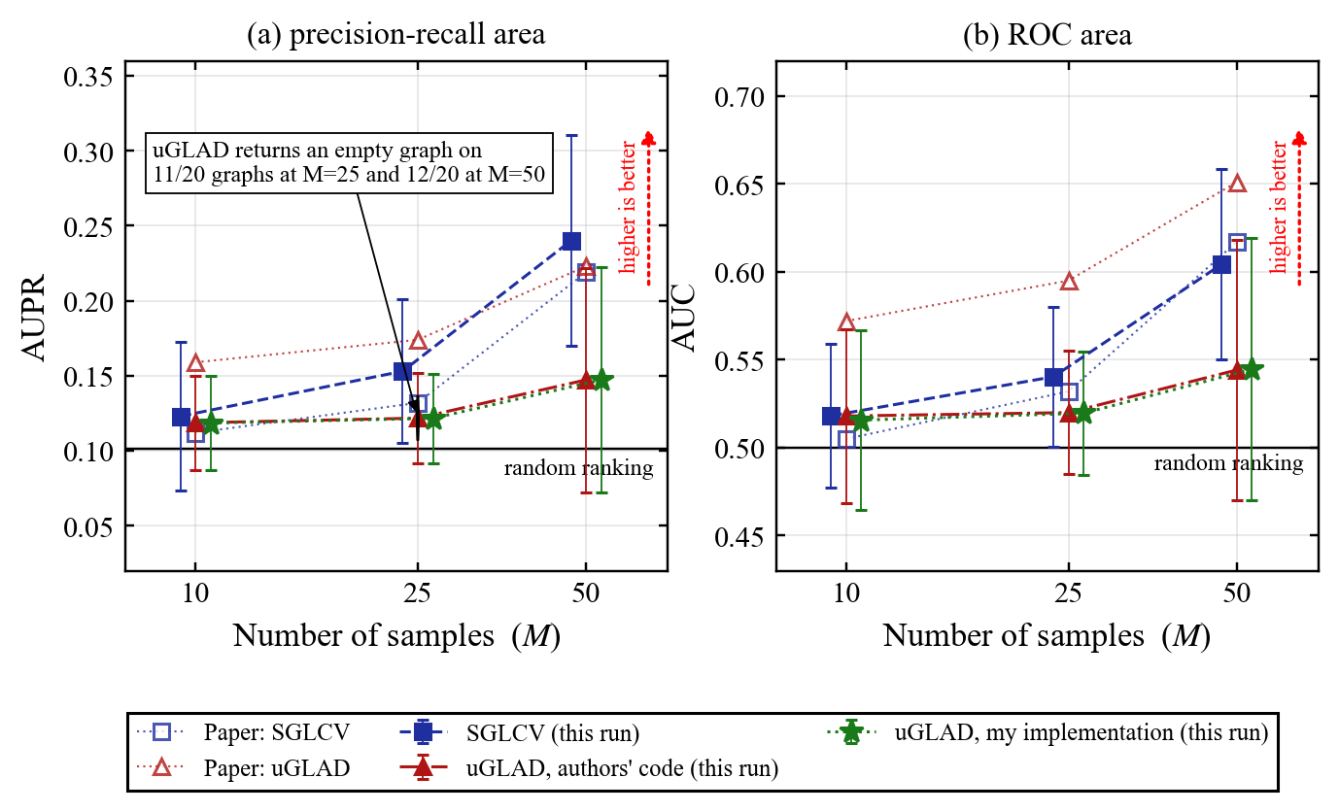
7 · Result 1: Edge Recovery
SGLCV matches the paper. uGLAD at default settings does not.
Fig. 3: Mean ± one standard deviation over 20 graphs. uGLAD minus SGLCV (AUPR): -0.004, -0.031, -0.093 at M = 10, 25, 50 (paired t = -0.5, -3.3, -4.9).

Slide 22
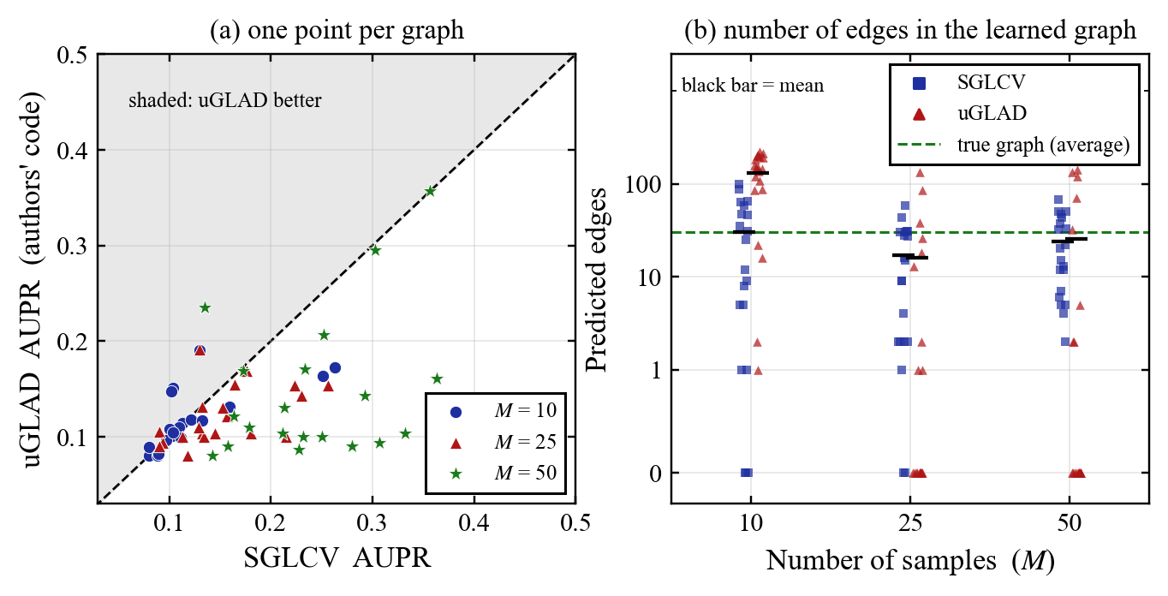
7 · Result 2: Graph by Graph
At M = 25 and 50 about half of the uGLAD graphs are empty.
Fig. 4: (a) uGLAD is above the line on 7, 2, 1 of 20 graphs at M = 10, 25, 50. (b) Empty uGLAD graphs: 0, 11, 12 of 20. Empty SGLCV graphs: 3, 2, 0.

Slide 23
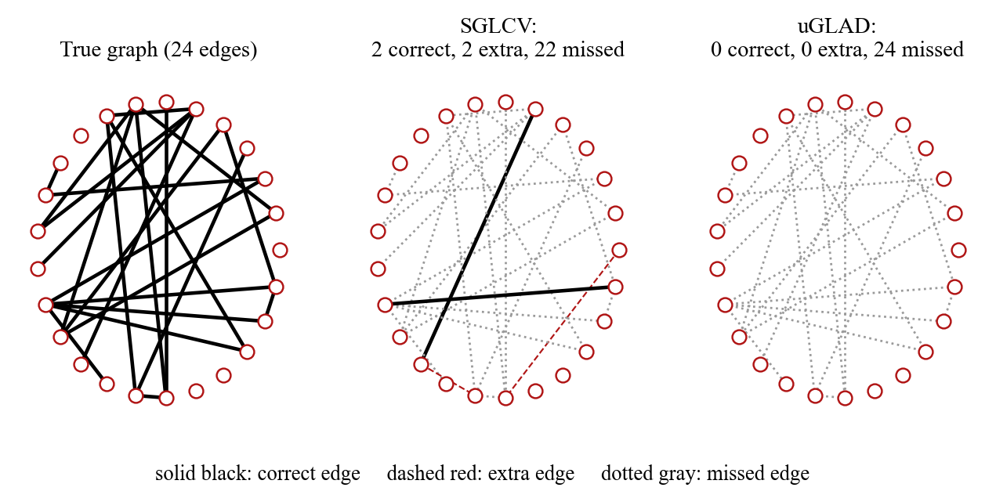
7 · Result 3: One Recovered Graph
First graph at the largest M. It was not picked.
Fig. 5: M = 50, graph 0. SGLCV: 2 correct, 2 extra, 22 missed. uGLAD: 0 correct, 0 extra, 24 missed.

Slide 24
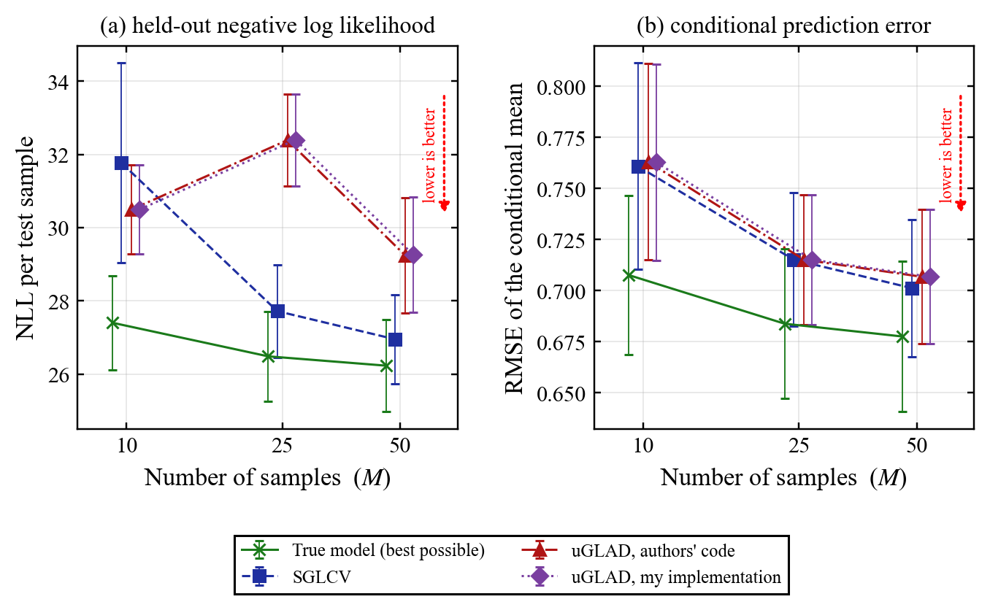
7 · Result 4: Likelihood and Prediction
Prediction error is close to the true model for every method.
Fig. 6: At M = 50 the likelihood gap to the true model is 0.7 (SGLCV) and 3.0 (uGLAD); the prediction error gap is 0.023 and 0.029.

Slide 25
7 · Table 1 Against the Paper
Mean ± standard deviation over 20 graphs. Paper values from [1].
AUPR | M = 10 | M = 25 | M = 50
SGLCV, paper | 0.112 ± 0.013 | 0.132 ± 0.012 | 0.219 ± 0.085
SGLCV, this run | 0.123 ± 0.050 | 0.153 ± 0.048 | 0.240 ± 0.070
uGLAD, paper | 0.159 ± 0.029 | 0.174 ± 0.018 | 0.223 ± 0.062
uGLAD, authors' code | 0.119 ± 0.031 | 0.122 ± 0.030 | 0.147 ± 0.075
uGLAD, my code | 0.119 ± 0.031 | 0.122 ± 0.030 | 0.147 ± 0.075
AUC | M = 10 | M = 25 | M = 50
SGLCV, paper | 0.505 ± 0.007 | 0.532 ± 0.031 | 0.617 ± 0.083
SGLCV, this run | 0.518 ± 0.041 | 0.540 ± 0.040 | 0.604 ± 0.054
uGLAD, paper | 0.572 ± 0.027 | 0.595 ± 0.044 | 0.651 ± 0.021
uGLAD, authors' code | 0.518 ± 0.050 | 0.520 ± 0.035 | 0.544 ± 0.074
uGLAD, my code | 0.516 ± 0.051 | 0.520 ± 0.035 | 0.545 ± 0.075
SGLCV is reproduced. uGLAD at the default settings is below the published numbers.

Slide 26
8 · What I Learned
Three findings from the first experiment.
SGLCV is reproduced
within one standard deviation
uGLAD at defaults:
tie at M = 10,
behind at M = 25, 50
My code matches
the authors' code
on 60 datasets

Slide 27
8 · Limits
These results are preliminary.
Only the paper's
Table 1 setting
20 graphs, default
settings of the code
Paper's training
details not given

Slide 28
8 · Planned for M3
The plan may change as I learn more.
Training length
and learning rate
Larger M and the
PC, GES, hill climbing
baselines
A cut-off rule
for the graph
Noise and
missing data
Significance tests
over more graphs

Slide 29
References
[1] H. Shrivastava, U. Chajewska, R. Abraham, X. Chen, uGLAD: A Deep Learning Model to Recover Conditional Independence Graphs, NeurIPS 2022 GLFrontiers Workshop.
[2] H. Shrivastava et al., GLAD: Learning Sparse Graph Recovery, ICLR 2020.
[3] J. Friedman, T. Hastie, R. Tibshirani, Sparse inverse covariance estimation with the graphical lasso, Biostatistics 9(3), 2008.
[4] Authors' code: github.com/Harshs27/uGLAD (version 2.0.0).
[5] F. Pedregosa et al., Scikit-learn: Machine Learning in Python, JMLR 12, 2011.
[6] A. Paszke et al., PyTorch: An Imperative Style, High-Performance Deep Learning Library, NeurIPS 2019.

