Slide 1
Name: Het Patel
Student ID: AU2440266
Institute: Ahmedabad University
Date: 13th September 2026
Program: B.Tech CSE
Domain: uGLAD for
Conditional Independence Graph Recovery
B.Tech Computer Science Engineering, School of Engineering and Applied Sciences

Slide 2
What This Talk Covers
Five parts, building from basics to our plan.
Motivation
Representation
Learning &
Inference
Literature
& SOTA
Our Plan
2

Slide 3
What Is a Graphical Model
Nodes are variables.
Edges are direct relationships between them.
A
C
B
3

Slide 4
The Real Problem
We often do not know which links are real.
Structure discovery finds them from data alone.
?
?
?
4

Slide 5
Correlation Lies
A affects B. B affects C.
So A and C look linked, with no direct link.
not a real link
A
B
C
Fig. 1: A and C only look related. There is no direct A to C link.
5

Slide 6
Conditional Independence, Defined
Two variables are independent once everything else is known.
X is independent of Y given Z
6

Slide 7
A Conditional Independence Graph
Keep an edge only if it survives conditioning.
X1
X5
X2
X4
X3
Fig. 2: X1 and X4 have no edge. They are conditionally independent.
7

Slide 8
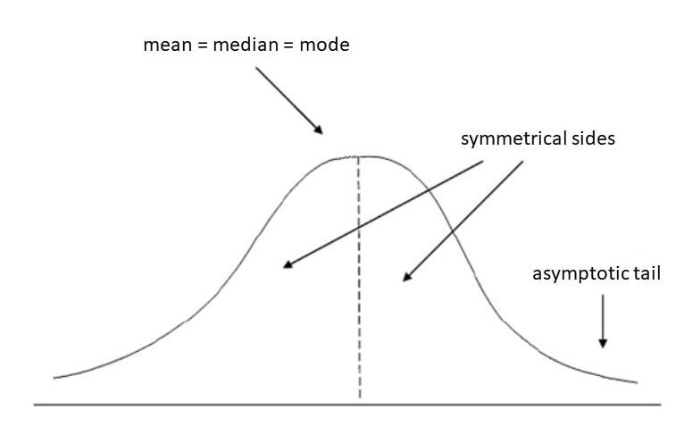
Why Assume Gaussian Data
Gaussian data makes independence exactly computable.
This is the assumption uGLAD relies on.
Fig. 3: A Gaussian distribution, symmetric around its mean.
8

Slide 9
The Covariance Matrix
It captures every pairwise link.
Direct and indirect links, mixed together.
σ11
σ12
σ13
σ21
σ22
σ23
σ31
σ32
σ33
Fig. 4: The covariance matrix Sigma.
9

Slide 10
The Precision Matrix
Invert the covariance matrix.
Call the result Theta.
inverse
Σ
Θ
Fig. 5: Theta equals Sigma inverse.
10

Slide 11
The Key Fact
A zero in Theta means direct independence.
That entry becomes a missing edge.
θ11
θ12
0
θ21
θ22
θ23
0
θ32
θ33
Fig. 6: Zero entries mark conditional independence.
11

Slide 12
A Worked Example
Theta13 = 0.
So X1 and X3 are independent given X2.
1.4
-0.6
0
-0.6
1.2
-0.5
0
-0.5
1.1
X1
X2
X3
Fig. 7: No X1 to X3 edge. The chain X1-X2-X3 explains it all.
12

Slide 13
Partial Correlation
This gives the strength and direction of a direct link.
Pij = - Θij / sqrt( Θii · Θjj )
13

Slide 14
The Problem, Restated
Recover a sparse Theta from samples X.
That is conditional independence graph recovery.
Data X
Θ
14

Slide 15
Classical Solution: Graphical Lasso
Balance two goals: fit the data, and stay sparse.
minimize fit(Θ) + ρ · sparsity(Θ)
15

Slide 16
Solving the Lasso
Block Coordinate Descent finds one best answer.
For a fixed rho, the answer is guaranteed.
Data X
Σ̂
Solve
(fixed ρ)
Θ
Fig. 8: The classical graphical lasso pipeline.
16

Slide 17
The Catch
One rho value covers the entire matrix.
It rarely fits every entry well.
ρ
ρ
ρ
ρ
ρ
ρ
ρ
ρ
ρ
Fig. 9: The same rho, forced onto every entry.
17

Slide 18
A New Idea: Unroll the Algorithm
Turn each solver step into one learnable layer.
Classical
One fixed step, repeated many times.
Unrolled
L different steps, each learned from data.
18

Slide 19
GLAD's Architecture
A tiny network learns rho at every step.
Step 1
Step 2
Step 3
...
Step L
Fig. 10: Each step learns its own regularization values.
19

Slide 20
GLAD Needs Supervision
Training GLAD requires the correct answer.
The true Theta must be known in advance.
Predicted Θ
compare
True Θ*
Fig. 11: Training needs the true answer to compare against.
20

Slide 21
uGLAD Removes That Requirement
uGLAD trains on the input data alone.
No ground truth graph is ever needed.
Needs true Theta
Trains on data only
21

Slide 22
uGLAD's Training Signal
Minimize the same likelihood the classical solver used.
loss = - log |Θ| + trace( Σ̂ Θ )
22

Slide 23
Handling Missing Data
Run uGLAD on several subsets.
Combine them by majority sign and smallest size.
Θ subset
Θ subset
Consensus Θ
Θ subset
23

Slide 24
Where uGLAD Sits Among PGMs
PGMs split into directed and undirected models.
uGLAD works in the undirected family.
Bayesian Networks
(directed)
Markov Networks
(undirected)
Gaussian Graphical
Model (this project)
Fig. 12: Position of the Gaussian graphical model among PGMs.
24

Slide 25
Representation
Nodes are variables.
Edges exist only where Theta is nonzero.
Xi
Xj
Θij ≠ 0
Xi
Xj
Θij = 0
25

Slide 26
Learning
Structure and parameters are one object here.
Both live inside the matrix Theta.
Structure
Parameters
Θ
26

Slide 27
Inference
Gaussian models give closed form answers.
No sampling or approximation is needed.
General PGM
Gaussian PGM
Approximate
(MCMC, belief prop)
Exact
(matrix algebra)
27

Slide 28
Literature Summary
Ref | Work (venue, year) | Key contribution | Limitation w.r.t. our goal
[3] | Graphical lasso, Friedman et al., 2008 | Classical BCD solver for ℓ1-MLE | Fixed penalty, no learning
[2] | GLAD, Shrivastava et al., ICLR 2020 | Unrolled AM network, learned penalties | Needs supervision (true Θ)
[1] | uGLAD, Shrivastava et al., NeurIPS'22 WS | Unsupervised GLAD, consensus for missing data | Workshop paper, no formal convergence proof
[4] | Neural Graphical Models, ECSQARU 2023 | General dependency graphs, proper inference | Broader scope, more complex model
[5] | Neural Graph Revealers, ICML'23 WS | Graph recovery + probabilistic queries | Healthcare-specific validation
[6] | Survey, Shrivastava & Chajewska, 2022 | Positions uGLAD among CI-graph methods | Survey, not a comparator method
Still reading: GLAD, Neural Graphical Models, Neural Graph Revealers and the survey.
29

Slide 29
State of the Art: Causal Order
Microsoft Research, ICLR 2025.
Recovers causal graphs with the help of imperfect experts.
Imperfect
Expert
Ordering
Causal
Graph
30

Slide 30
What Causal Order Found
Asking for an ordering beats asking for edges.
Ordering is more robust to expert error.
Ask for
edges directly
Ask for an
ordering
fragile
robust
31

Slide 31
How It Relates to Our Work
Same evaluation language: SHD, precision, recall, F1.
Different graph type: directed versus undirected.
Causal Order
(directed)
uGLAD
(undirected)
Shared metrics:
SHD, Precision, Recall, F1
32

Slide 32
Candidate Baselines
One direct baseline, and three course-listed ones.
Graphical
Lasso
PC
GES
Hill
Climbing
Fig. 13: Graphical lasso is the direct match. The other three are course-listed.
33

Slide 33
Candidate Metrics
Four numbers, used across this whole literature.
SHD
Precision
Recall
F1
Fig. 14: SHD counts wrong edges. The other three grade edge quality.
34

Slide 34
Timeline
Weeks | Planned Work
Weeks 1-2 (through M1) | Define the problem as posed by uGLAD, review directly related papers, pick Causal Order as the current SOTA anchor.
Weeks 3-4 | Finish reading GLAD, Neural Graphical Models, Neural Graph Revealers and the survey. Reproduce uGLAD's public code.
Weeks 5-6 (to M2) | Finalize our specific research question. Build the baseline pipeline (graphical lasso, PC, GES, Hill Climbing).
Weeks 7-8 | Run initial experiments on synthetic Gaussian data against the chosen baselines.
Weeks 9-10 (to M3) | Extend to noise and missing data. Begin statistical analysis across multiple seeds.
Weeks 11-12 (to M4) | Consolidate results, revisit SOTA positioning, write the final analysis.
35

Slide 35
References
[1] H. Shrivastava, U. Chajewska, R. Abraham, and X. Chen, “uGLAD: A Deep Learning Model to Recover Conditional Independence Graphs,” Microsoft Research, NeurIPS 2022 Workshop on New Frontiers in Graph Learning.
[2] H. Shrivastava, X. Chen, B. Chen, G. Lan, S. Aluru, H. Liu, and L. Song, “GLAD: Learning Sparse Graph Recovery,” ICLR, 2020.
[3] J. Friedman, T. Hastie, and R. Tibshirani, “Sparse inverse covariance estimation with the graphical lasso,” Biostatistics, vol. 9, no. 3, pp. 432-441, 2008.
[4] H. Shrivastava and U. Chajewska, “Neural Graphical Models,” ECSQARU, 2023.
[5] H. Shrivastava and U. Chajewska, “Neural Graph Revealers,” ICML Workshop on ML for Multimodal Healthcare Data, 2023.
[6] H. Shrivastava and U. Chajewska, “Methods for Recovering Conditional Independence Graphs: A Survey,” arXiv:2211.06829, 2022.
[7] A. Vashishtha, A. G. Reddy, A. Kumar, S. Bachu, V. Balasubramanian, and A. Sharma, “Causal Order: The Key to Leveraging Imperfect Experts in Causal Inference,” ICLR, 2025.
[8] D. Mahajan, J. Gladrow, A. Hilmkil, C. Zhang, and M. Scetbon, “Amortized Inference of Causal Models via Conditional Fixed-Point Iterations,” TMLR, 2025.
36

