Slide 1
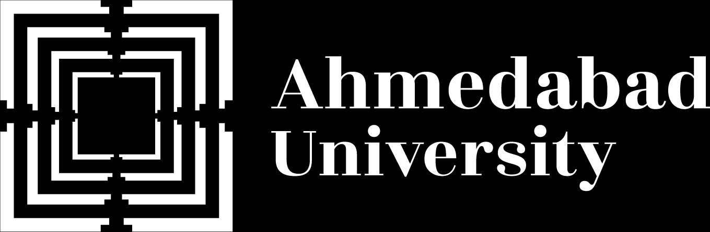
Name: Het Patel
Student ID: AU2440266
Institute: Ahmedabad University
Date: 12th November 2026
Program: B.Tech CSE
Domain: Rhino, deep temporal causal discovery
Can a Deep Temporal Causal Posterior Be Trusted?
B.Tech Computer Science Engineering, School of Engineering and Applied Sciences

Slide 2
What This Talk Covers
Five parts, from the base paper to our own plan.
Rhino
Basics
Rhino
Model
Paper
Results
The
Gap
Our
Plan
2

Slide 3
What We Want To Learn
Who drives whom, and after how long.
time t-2
time t-1
time t
X1
X1
X1
The data are several variables over time. The result is a graph.
X2
X2
X2
X3
X3
X3
Fig. 1: Black, lagged edges. Maroon, instantaneous edges (no cycle allowed).
3

Slide 4
Why It Is Hard
Real series have three awkward features.
Non-linear effects
An announcement acts on a price in a curved way.
Older methods handle one or two of them. Rhino aims at all three.
Instantaneous effects
Slow sampling folds a day of events into one step.
History-dependent noise
A student with recent good marks scores with little variation.
4

Slide 5
What Older Methods Miss
No earlier family covers all three features.
Rhino is built to close this niche, with a proof that the graph is identifiable.
Family | Examples | What it misses
Granger causality (incl. deep) | cMLP, cLSTM, TCDF, SRU | No instantaneous effects, fixed noise
Functional models | VAR-LiNGAM, DYNOTEARS | Linear, fixed noise
Constraint based | PCMCI+ | Equivalence class only, slow for many nodes
Rhino | this paper | Non-linear, instantaneous, history-dependent noise
5

Slide 6
Rhino In One Equation
A mean part plus a noise part.
X(i,t) = f( parents ) + g( lagged parents, noise )
The graph decides which parents each part may use.
f: neural network
non-linear lagged and instantaneous effects
g: spline flow
noise shaped by the history
Fig. 2: Rhino's structural equation model.
6

Slide 7
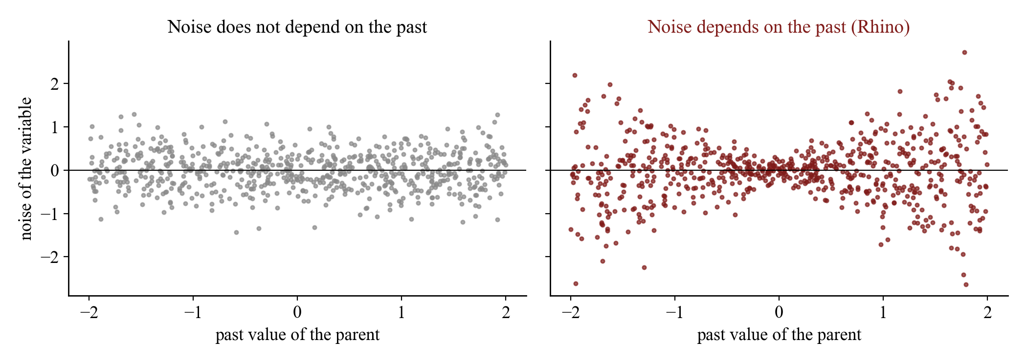
History-Dependent Noise
g lets the noise change with the past.
On the right the spread grows with the past value. A fixed-noise model cannot do this.
Fig. 3: Simulated illustration of fixed and history-dependent noise.
7

Slide 8
The Graph Is A Set Of Switches
A filled cell turns one parent on.
Learning the graph means learning which cells are on.
G0: instant. (DAG)
G1: lag 1
G2: lag 2
Fig. 4: The graph as one matrix per lag.
8

Slide 9
Learning A Distribution
Rhino learns a distribution over graphs.
Prior p(G)
sparse, acyclic
Likelihood
from f and g
q(G)
learned
Not one graph. It trains q(G) to explain the data while staying sparse and acyclic.
ELBO = E_q[ log p(X|G) + log p(G) ] + entropy of q
Acyclicity penalty, tightened by an augmented Lagrangian.
Gumbel-softmax gives gradients through graph samples.
Fig. 5: The training objective of Rhino.
9

Slide 10
What Rhino Outputs
Every possible edge gets a probability.
0.02
0.97
0.05
Rank entries
AUROC
The paper ranks them (AUROC) or rounds at 0.5 (F1).
0.03
0.10
0.91
0.88
0.04
0.01
Round at 0.5
one graph, F1
Fig. 6: Edge probabilities (illustrative values).
10

Slide 11
Why The Target Is Well Defined
In theory the true graph is unique.
Conditions
smooth functions, f non-linear, noise not degenerate
The paper proves Rhino is identifiable. In practice training stops at a local optimum.
Theorem 1
two graphs cannot give the same likelihood
Theorem 2
with infinite data the best fit is the true graph
11

Slide 12
How The Paper Tests Rhino
Three benchmarks, always scored against a known graph.
F1 on synthetic data, AUROC on DREAM3 and Netsim.
Synthetic
160 datasets
5 to 40 nodes, lag 2
75% mismatched to Rhino
DREAM3 genes
5 networks, 100 genes
21 time points
AUROC
Netsim brain
fMRI, 15 regions
200 time steps
AUROC
Fig. 7: Baselines: VAR-LiNGAM, PCMCI+, DYNOTEARS, cMLP, cLSTM, TCDF, SRU, eSRU.
12

Slide 13
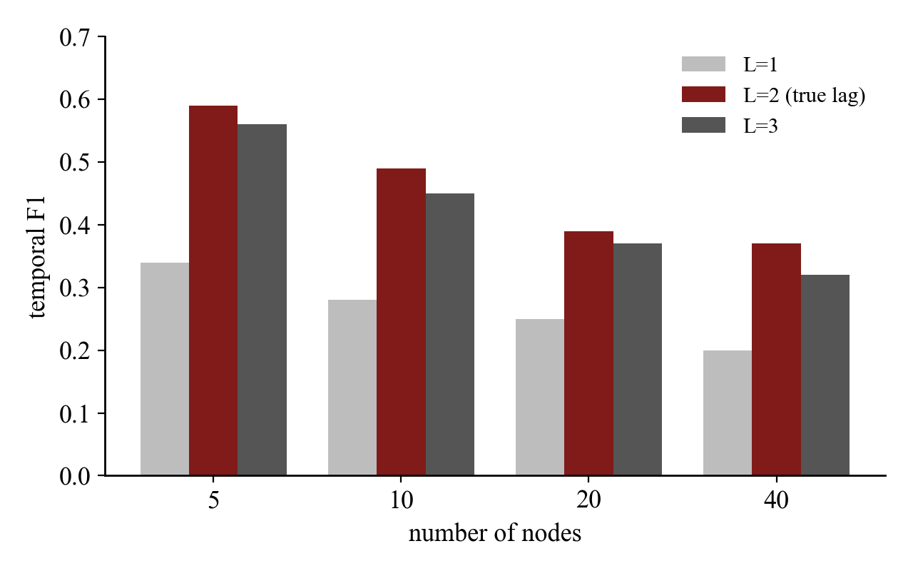
Paper Result 1: Synthetic Data
Best or close to best on synthetic data.
Especially in low dimension. A lag that is too long costs little.
Fig. 8: Paper, Table 1: temporal F1 by model lag (true lag is 2).
13

Slide 14
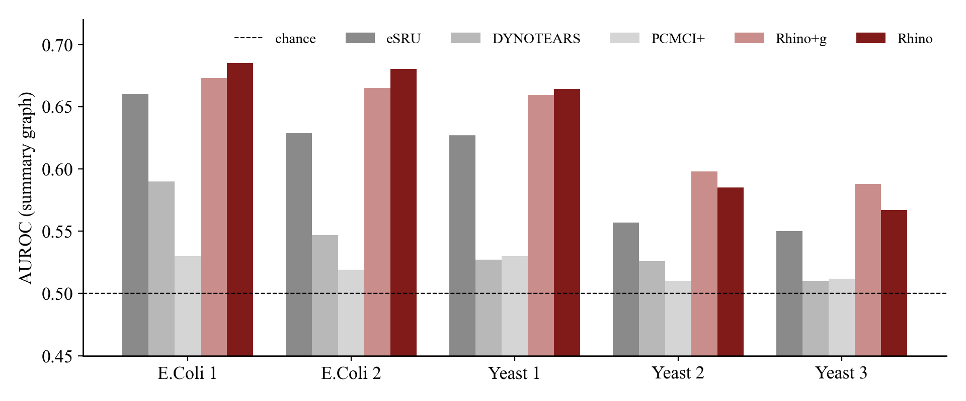
Paper Result 2: DREAM3
On gene networks Rhino has the top AUROC.
Rhino or Rhino+g wins all five networks, by small margins on two.
Fig. 9: Paper, Table 2: AUROC of the summary graph (subset of methods).
14

Slide 15
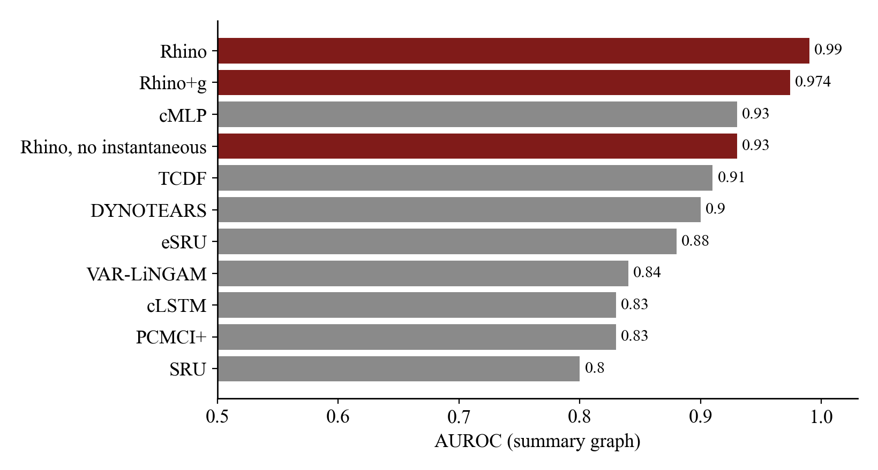
Paper Result 3: Netsim
On brain connectivity the AUROC is 0.99.
Without instantaneous effects it drops to 0.93.
Fig. 10: Paper, Table 3: AUROC of the summary graph.
15

Slide 16
What Our M3 Run Confirmed
We reproduced the accuracy story.
Nobody tested whether the probabilities can be trusted.
Claim of the paper | M3 reproduction
History-dependent noise helps | Reproduced
Robust to a longer lag, a shorter lag hurts | Reproduced in shape
Netsim AUROC 0.99 | 0.987 with the paper's steps
Best or competitive on synthetic data | Partly reproduced
Rhino+s close to Rhino | Not reproduced
Probabilities are well calibrated | Never tested
16

Slide 17
What The Paper Measures
The paper checks accuracy against a known graph.
The paper measures
AUROC and F1, with a known true graph
A real user has no true graph. They ask: how many of these edges are wrong?
A user asks
How many edges on my list are wrong?
Fig. 11: Accuracy is not the same as trust.
17

Slide 18
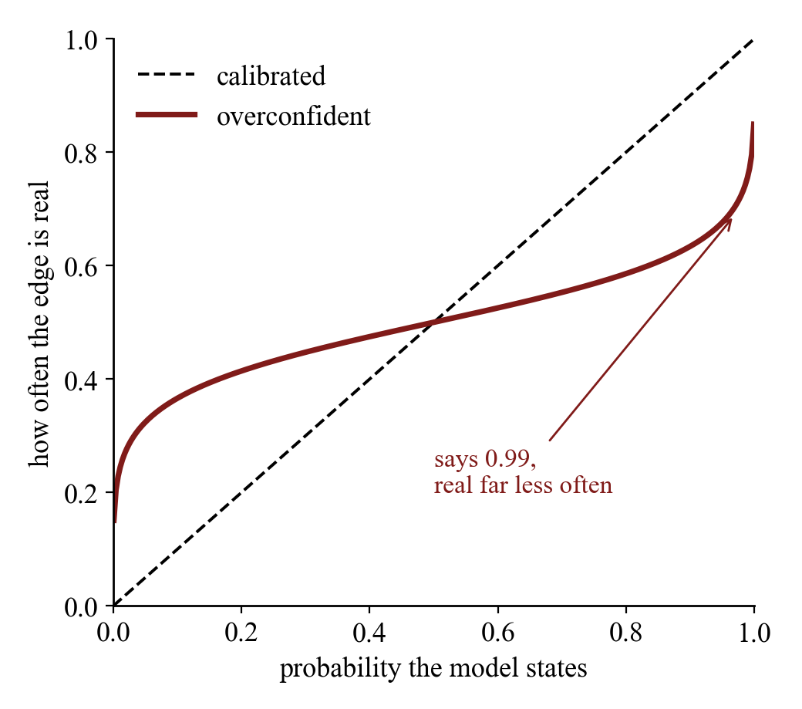
What A Trustworthy Probability Is
A probability should match how often it is right.
Among edges scored 0.9, about 9 in 10 should be real. This is called calibration.
Fig. 12: Schematic, not data.
18

Slide 19
A Warning Sign
Training made Rhino more decided, not more right.
AUROC falls
0.989 to 0.939
Netsim, M3 reproduction of the paper's Fig. 8, from the best step to the last.
Validation log-likelihood falls
-31.5 to -76.1
F1 of the rounded graph rises
0.088 to 0.538
19

Slide 20
Why We Suspect The Probabilities
Four reasons to suspect them.
The objective rewards likelihood, not good probabilities
Independent factors ignore dependence between edges
These are hypotheses that we test. They are not claims.
Long training can push logits to extremes
One run on small data, never checked against truth
20

Slide 21
Our Idea
Ask for an error budget, then choose the edges.
Given
edge probabilities p and a budget alpha
Keep the share of wrong edges below a budget alpha, and still find as many true edges as possible.
Choose
an edge set S with as many true edges as possible
Subject to
expected share of wrong edges <= alpha
Fig. 13: Selective temporal causal discovery.
21

Slide 22
Why It Is Logical
One identity explains when a posterior fails.
wrong share = promised error + overconfidence
Wrong share = promised error + overconfidence. If the probabilities are calibrated, the overconfidence is zero.
promised
overconfidence
promised error = mean of (1 - p) over the chosen edges
Fig. 14: Illustration with made-up proportions.
22

Slide 23
Why It Matters
Every edge you follow costs an experiment.
ok
ok
ok
ok
ok
ok
x
ok
ok
ok
Fig. 15: Ten chosen edges, one wrong: budget 0.1.
A budget turns a probability graph into a decision.
With trustworthy p
choose alpha and get the longest list within it
Without it
no way to choose how many edges to follow
23

Slide 24
Our Plan
A thin layer on a frozen Rhino.
Rhino (frozen, from M3)
No retraining. Labels are used only on calibration datasets.
1. Exact probabilities
read from the saved logits
2. Calibrate
temperature or a cutoff learned on other datasets
3. Select
Bayesian false discovery rule
24

Slide 25
How We Will Judge It
The key KPI is realised error against the budget.
Plus probability quality, power, and accuracy for the link to the paper.
KPI | Why
Realised share of wrong edges against budget | Is the promise true?
Brier, log-loss, calibration error | Quality of the probabilities
Power (share of true edges found) | The price of control
AUROC, F1 | Link to the paper
25

Slide 26
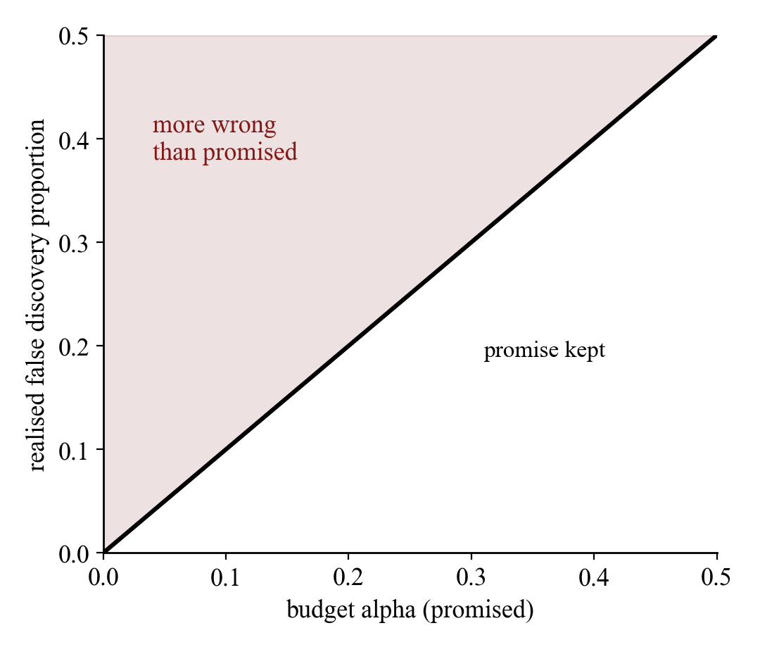
What We Expect
Control at moderate budgets, at a price in power.
Raw Rhino should break its budget. A repair should help. Real data may not transfer.
The learned cutoff was added after we saw the first repair, so it is exploratory.
Fig. 16: Schematic of the target, not a result.
26

Slide 27
Benefits And Costs
A useful but limited tool.
Benefits
A budget in the user's units
No retraining
Seconds of compute
Costs
Needs labelled graphs
Average guarantee only
Cannot fix a weak ranking
Strict budgets select nothing
We state both sides.
27

Slide 28
Baselines And Positioning
Not a better algorithm. A trust check of Rhino.
Baselines are what the paper suggests and the standard fix.
Raw posterior
round at 0.5 or Bayesian FDR
Temperature scaling
the standard fix
Learned cutoff
our direct repair
Oracle
uses the truth, a ceiling
Fig. 17: Rhino (Microsoft Research, ICLR 2023) is the anchor and is not changed.
28

Slide 29
Summary
Rhino ranks edges well. Can its probabilities be trusted?
Base paper
strong accuracy, a probability for every edge
That is our question. The plan on the previous slides is how we answer it.
The gap
accuracy is measured, trust is not
Our idea
error-controlled edge selection, a thin layer on Rhino
29

Slide 30
References
[1] W. Gong, J. Jennings, C. Zhang, N. Pawlowski, "Rhino: Deep Causal Temporal Relationship Learning with History-dependent Noise," ICLR, 2023.
[2] C. Geffner et al., "Deep End-to-end Causal Inference," arXiv:2202.02195, 2022.
[3] J. Runge, "Discovering contemporaneous and lagged causal relations in autocorrelated nonlinear time series datasets," UAI, 2020.
[4] R. Pamfil et al., "DYNOTEARS: Structure Learning from Time-Series Data," AISTATS, 2020.
[5] A. Hyvarinen, K. Zhang, S. Shimizu, P. Hoyer, "Estimation of a Structural Vector Autoregression Model Using Non-Gaussianity," JMLR, 2010.
[6] X. Zheng, B. Aragam, P. Ravikumar, E. Xing, "DAGs with NO TEARS: Continuous Optimization for Structure Learning," NeurIPS, 2018.
[7] C. Guo, G. Pleiss, Y. Sun, K. Weinberger, "On Calibration of Modern Neural Networks," ICML, 2017.
[8] M. Newton et al., "Detecting differential gene expression with a semiparametric hierarchical mixture method," Biostatistics, 2004.
[9] Y. Benjamini, Y. Hochberg, "Controlling the False Discovery Rate," J. R. Stat. Soc. B, 1995.
30

