Slide 1
Name: Het Patel
Student ID: AU2440266
Institute: Ahmedabad University
Date: 13th September 2026
Program: B.Tech CSE
Domain: Pinching Antenna Systems(PASS)
B.Tech Computer Science Engineering, School of Engineering and Applied Sciences

Slide 2
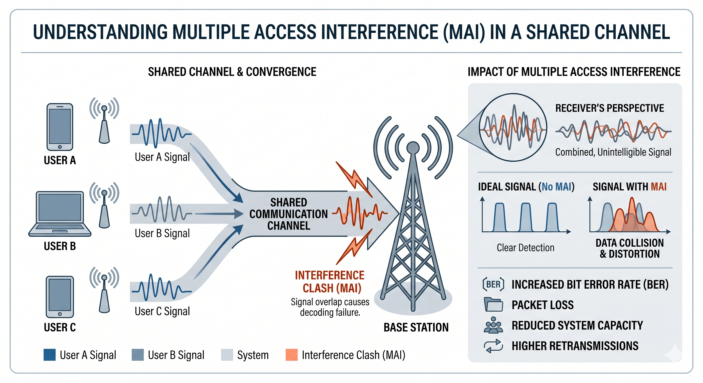
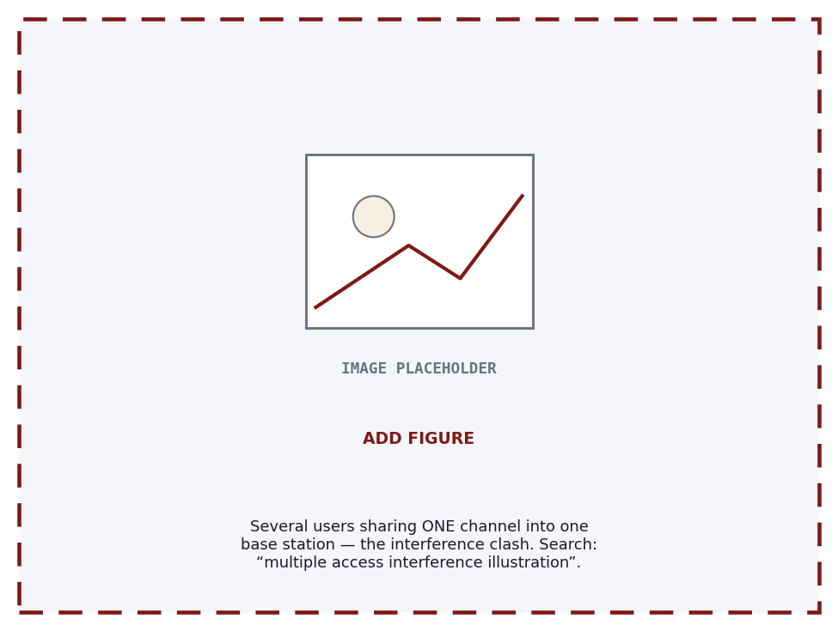
Domain & Motivation
One channel, many users
Many users must share the same time and frequency.
The real problem is the interference that it creates.
Every multiple-access scheme is an answer to it.
Fig. 1 Multiple Access Interference(Generated by Gemini)

Slide 3
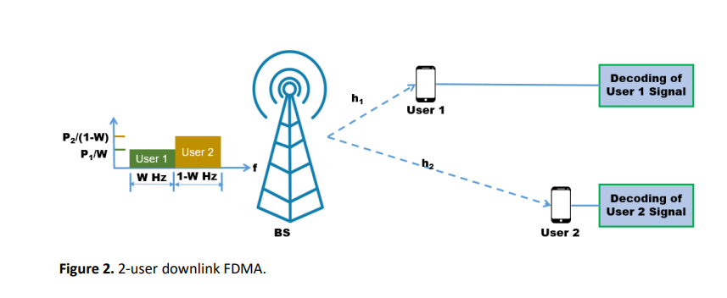
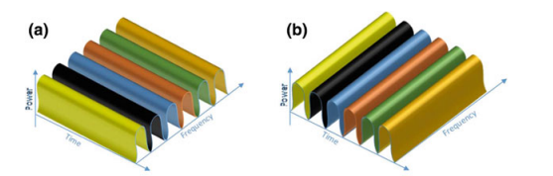
Domain & Motivation
Classic fix 1 : divide the channel
TDMA / FDMA give each user a private slot.
Clean and interference-free.
But capacity is capped by the number of slots.
Islam, S. M., et al. "Non-orthogonal multiple access (NOMA): How it meets 5G and beyond." arXiv preprint arXiv:1907.10001 (2019).
Fig. 2 TDMA & FDMA[9]

Slide 4
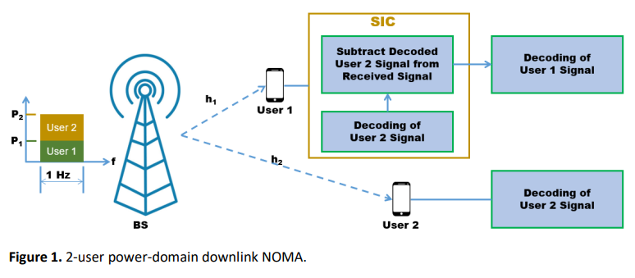
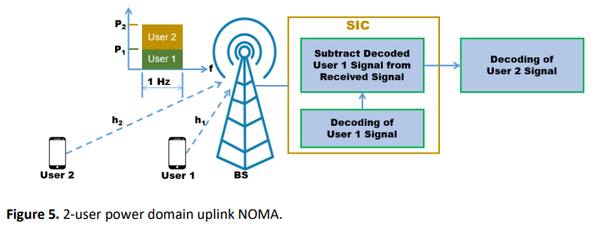
Domain & Motivation
Classic fix 2 : let users overlap
NOMA stacks users in the power domain.
The receiver peels them apart with SIC.
More users fit ,but interference grows.
Fig. 3 NOMA SIC[10]

Slide 5
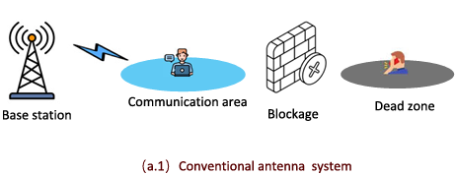
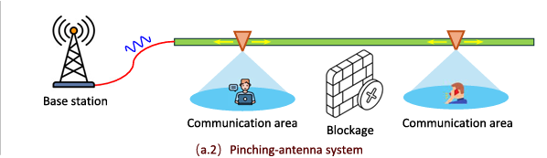
Domain & Motivation
A new control knob: pinching antennas
A small antenna slides along a waveguide.
Moving it reshapes the radio environment itself.
Now the channel is something we can design.
Fig. 4 PASS [2]

Slide 6
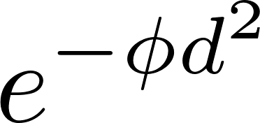
Where it sits in the standards
Band
Channel
Blockage
28 GHz mmWave
3GPP TR 38.901
model
3GPP FR2 / TR 38.815 (24.25–29.5 GHz) , most-assigned 5G trial band.
Standardised LoS/NLoS path-loss and LoS-probability, 0.5–100 GHz.
The paper’s LoS-blockage sits inside the 3GPP(TR 38.901) blockage paradigm.
Near-field
Origin
India
3GPP Release 19
NTT DOCOMO, 2022
An open lane
TR 38.901 now adds near-field propagation, exactly what PASS needs.
PASS prototyped in Japan; theory led by HKU, QMUL, Erlangen, Princeton.
No India-led core PASS paper yet.

Slide 7
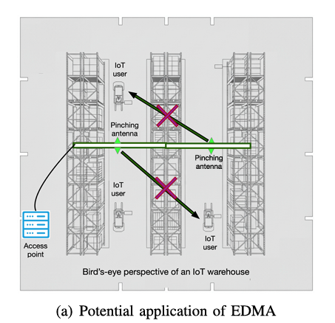
Domain & Motivation
Use the environment as the resource
EDMA adds a new axis beyond time, frequency, code, space and power.
Block the interfering paths on purpose, users separate by where they are.
Fig. 5(a) EDMA Network Model [1]

Slide 8
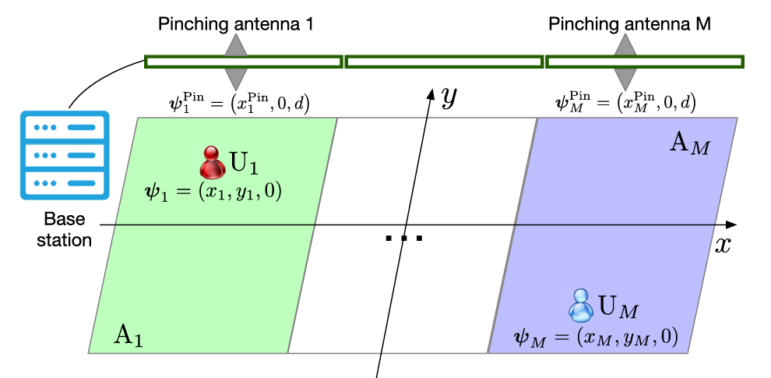
System & Network Model
First, the network model
The service area is split into M regions.
Each region holds one user and one pinching antenna.
Picture M private corridors, side by side.
Fig. 5(b) EDMA Network Model [1]

Slide 9
Problem Statement
One region, one user : EDMA stops at M users, but current network is built around massive connectivity.
Problem statement
EDMA serves at most one user per blockage-isolated segment, capping capacity at M.
Research objective
Overload each segment with K power-domain NOMA users and jointly design antenna positions + powers.
Fig. 5(b) EDMA Network Model [1]
Impact: interference handled by geometry, not heavy signal processing.

Slide 10
Literature Summary
Ref | Work (venue, year) | Key contribution | Limitation w.r.t. our goal
[1] | EDMA feasibility | Blockage partitions area into M isolated regions; golden-section (UL) + SCA (DL) antenna placement; closed-form gain over TDMA | One user per segment, capacity capped at M
[3] | NOMA uplink PASS | Joint power + single-antenna position, PSO / alternating optimization, with & without QoS | Single antenna, no segments → no blockage isolation
[4] | Multi-waveguide activation | Discrete antenna activation + NOMA; optimal SIC order, coalitional game + SCA power allocation | Interference handled by SIC only, not geometry
[5] | QoS-aware DL NOMA-PASS | QoS-constrained NOMA design for downlink pinching-antenna systems | Downlink only; no environment division
[6] | PASS: NOMA or OMA? | Two-user power-minimizing pinching beamforming compared under NOMA / FDMA / TDMA (SCA + fine-tuning) | Two users, single waveguide; no blockage isolation
[7] | SWANs | Segmented waveguide, per-segment feeds; SS/SA/SM protocols; tractable uplink multi-PA model | Single-user (OMA view) → no overloading
[8] | EDMA-NOMA env.-aware RA | Downlink user pairing + power via environment map (UBA-JPPA heuristic) | Downlink, heuristic; no uplink analysis, no closed-form rates
Research gap: no existing work overloads uplink EDMA segments with K NOMA users. The M → M×K lift, with blockage providing isolation for free, is unexplored.

Slide 11
Project Timeline
Weeks 1-2
Weeks 3
Weeks 4-5
Problem + SOTA
Feasibility Check
Rate Derivation
Define the problem, review EDMA, SWAN, and NOMA-PASS.
Check whether segment isolation still holds when K users share one segment.
Work out the closed-form uplink rate and verify it with Monte Carlo simulation.
Weeks 6
Weeks 7-8
Weeks 9-10
Baseline Comparison
Placement + Power
Report + Demo
Compare the proposed system against standard time-shared access (TDMA).
Design antenna placement and power allocation for the overloaded segments.
Finalize the report, results, and the final presentation with working code.

Slide 12
References
[1] Z. Ding, R. Schober, and H. V. Poor, “Environment Division Multiple Access (EDMA): A Feasibility Study via Pinching Antennas,” IEEE Transactions on Wireless Communications, vol. 25, pp. 15675–15690, 2026.
[2] Y. Xu et al., “Generalized Pinching-Antenna Systems: A Tutorial on Principles, Design Strategies, and Future Directions,” IEEE Communications Surveys & Tutorials, vol. 28, pp. 5872–5908, 2026, doi: 10.1109/COMST.2026.3674222.
[3] M. Zeng, J. Wang, X. Li, G. Wang, O. A. Dobre, and Z. Ding, “Sum Rate Maximization for NOMA-Assisted Uplink Pinching-Antenna Systems,” IEEE Wireless Communications Letters, vol. 15, 2026.
[4] K. Wang, Z. Ding, and G. K. Karagiannidis, “Antenna Activation and Resource Allocation in Multi-Waveguide Pinching-Antenna Systems,” IEEE Transactions on Wireless Communications, vol. 25, pp. 4070–4082, 2026.
[5] Y. Xu, Z. Ding, D. Cai, and V. W. S. Wong, “QoS-Aware NOMA Design for Downlink Pinching-Antenna Systems,” IEEE Transactions on Communications, vol. 73, no. 12, pp. 13611–13625, Dec. 2025.
[6] Q. Ren, X. Mu, S. Lin, and Y. Liu, “Pinching-Antenna Systems (PASS) Meet Multiple Access: NOMA or OMA?” IEEE Transactions on Vehicular Technology, 2026, doi: 10.1109/TVT.2026.3683670.
[7] C. Ouyang, H. Jiang, Z. Wang, Y. Liu, and Z. Ding, “Uplink and Downlink Communications in Segmented Waveguide-Enabled Pinching-Antenna Systems (SWANs),” IEEE Transactions on Communications, vol. 74, pp. 3688–3704, 2026.
[8] Y. Luo, “Environment-Aware Resource Allocation for Pinching-Antenna-Assisted EDMA-NOMA Systems,” arXiv:2606.18899, 2026.
[9] Vaezi, Mojtaba, Zhiguo Ding, and H. Vincent Poor, eds. Multiple access techniques for 5G wireless networks and beyond. Vol. 159. Berlin: Springer, 2019.
[10] Islam, S. M., et al. "Non-orthogonal multiple access (NOMA): How it meets 5G and beyond." arXiv preprint arXiv:1907.10001 (2019).
[11] S. Boyd and L. Vandenberghe, Convex Optimization. Cambridge, U.K.: Cambridge University Press, 2004.

