Slide 1
Two-Layer Uplink Multiple Access in Segmented Pinching-Antenna Systems
Milestone 2 | ECE 310 Wireless Communications
Name: Het Patel Student ID: AU2440266
Group: g10_research_pass_ind Category: Research Project
Institute: Ahmedabad University Program: B.Tech CSE
Date: 11th October 2026
Notes:
Hello, I am Het Patel from Ahmedabad University.
This is my Milestone 2 video for ECE 310.
My project is about uplink multiple access in segmented pinching-antenna systems.
In the next twenty minutes I will show the problem, the model, the method and my first results.

Slide 2
Where I started and what M2 adds
M1 recap
One user per region
EDMA uses blockage to keep regions apart. No beamforming and no joint processing.
But each region holds one user, so at most M users are served.
My question: can one region carry K users?
M2 delivers
Formulate
Model, assumptions, metrics, gap and research questions
M2 delivers
Reproduce
EDMA Table I with my own code
M2 delivers
Evaluate
Three first experiments on the overloaded uplink
M2 delivers
Position
Where the work stands against the closest papers
2
Notes:
In M1 I defined the problem.
EDMA uses blockage to keep regions apart. But it allows only one user per region.
So the number of served users is capped at M.
My question is whether one region can carry K users.
In M2 I did four things. I formulated the problem. I reproduced the EDMA paper with my own code. I ran three first experiments. And I placed my work against the state of the art.

Slide 3
Literature synthesis: three tools for interference
Time
TDMA and FDMA
Private slot for each user
No interference
Capacity capped by the number of slots
Power
NOMA with SIC
Users overlap in power
SIC removes them one by one
Interference grows with users
Geometry
EDMA
Blockage keeps regions apart
No signal processing needed
One user per region
Refs [10]
Refs [3] to [6], [10]
Refs [1]
Most pinching-antenna papers use power. EDMA uses geometry. SWAN adds one rule: one active antenna per segment, so a signal does not re-radiate through other antennas [2].
Repeated assumptions: ideal SIC, line-of-sight dominance, lossless waveguide.
3
Notes:
I grouped the literature by one question. How does each work keep users from interfering with each other?
There are three tools: time, power and geometry.
TDMA and FDMA use time. Each user gets a private slot, so there is no interference. But capacity is capped by the number of slots.
NOMA uses power. Users overlap and the receiver removes them with SIC. More users fit, but interference grows.
EDMA uses geometry. Blockage keeps regions apart without any signal processing.
Most pinching antenna papers use power. EDMA uses geometry. And SWAN adds one useful rule: one active antenna per segment, so signals do not re-radiate through the other antennas.

Slide 4
Technical gap
EDMA separates regions by blockage, but only for one user per region. Capacity is capped at M users. More users need more segments and more hardware.
Unknown 1
Does the isolation hold?
With K users in every region, every region leaks K times more. Does the far leakage stay negligible?
Unknown 2
What does the load deliver?
Once SIC separates the users inside a region, what does the extra load buy: sum rate, users, delay?
Without these answers nobody can decide how many users a region should carry or how many segments to build.
4
Notes:
This gives the gap.
EDMA shows that blockage can separate regions when each region has one user. It does not say what happens when each region has K users.
Two things are unknown. First, does the isolation still hold? Second, once SIC separates the users inside a region, what does the extra load deliver?
Without these answers nobody can decide how many users a region should carry or how many segments to build.

Slide 5
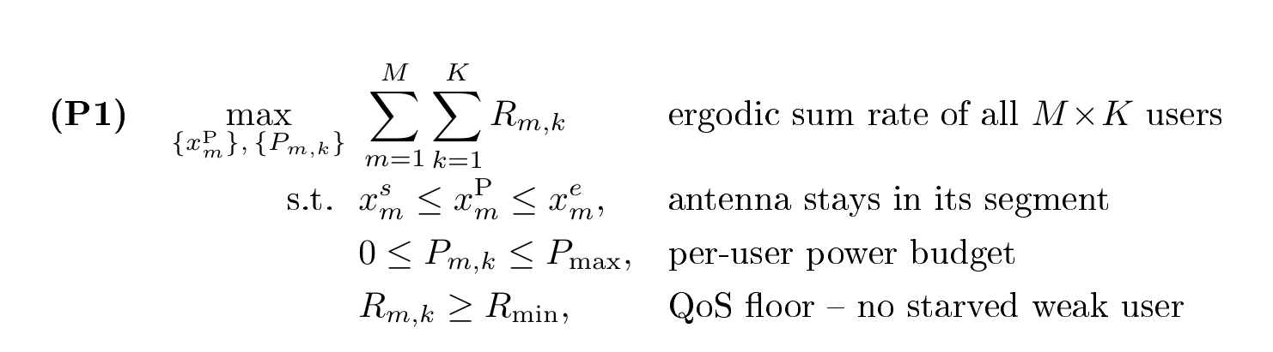
2 · Problem Formulation
The research problem, formally: joint antenna placement + NOMA power allocation over M segments.
Changed from EDMA [1]
EDMA optimizes only the M positions, we add M×K NOMA powers as joint variables.
New QoS floor Rₘᵢₙ .NOMA can starve the weak co-segment user, EDMA never could.

Slide 6
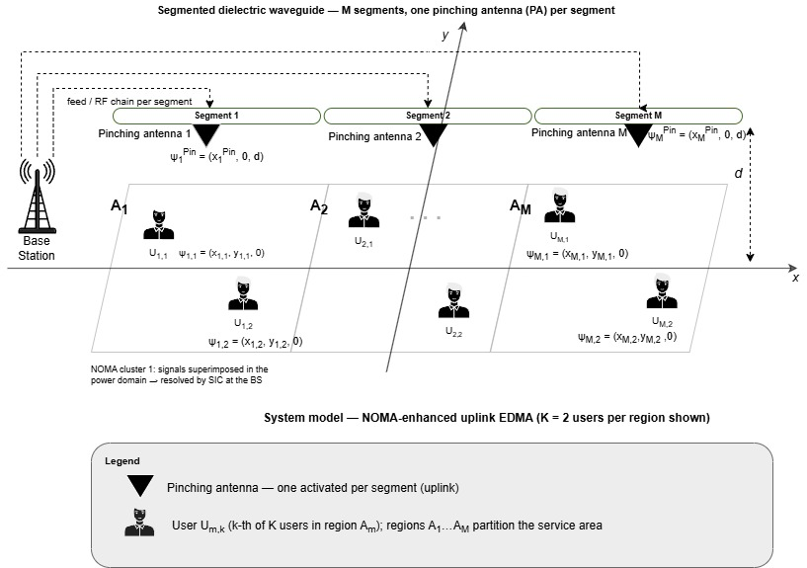
3 · Proposed Innovation
NOMA inside every EDMA segment . Stack K users per region, separated by power + SIC.
What is new?
First uplink framework that overloads blockage-isolated EDMA segments with power-domain NOMA.
Why should it work?
Blockage already kills inter-segment links ,so extra users add only intra-segment interference ,which SIC is designed to peel apart [3].
Fig. 2 NOMA-EDMA Network Model

Slide 7
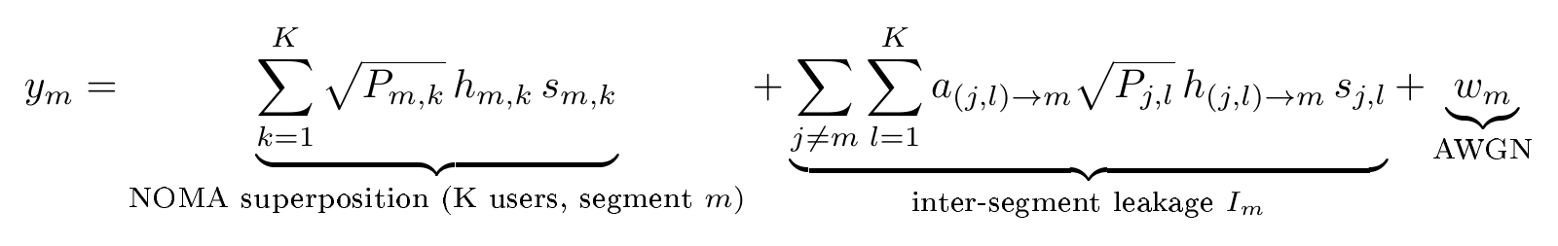
3 · Proposed Innovation
The key derivation, from received signal to per-user rate .
Step 1 · Uplink signal received at antenna Ψₘ

Slide 8
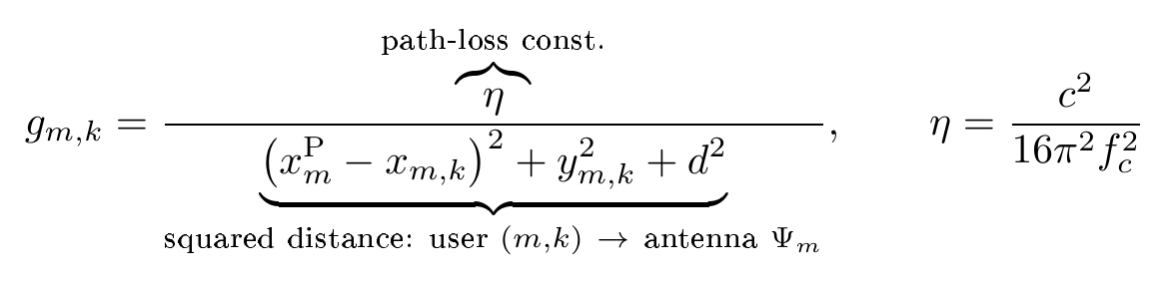
3 · Proposed Innovation
The key derivation, from received signal to per-user rate.
Step 1 · Uplink signal received at antenna Ψₘ
Step 2 · Channel gain of user (m,k) , each of the K users has its own distance, so its own gain

Slide 9
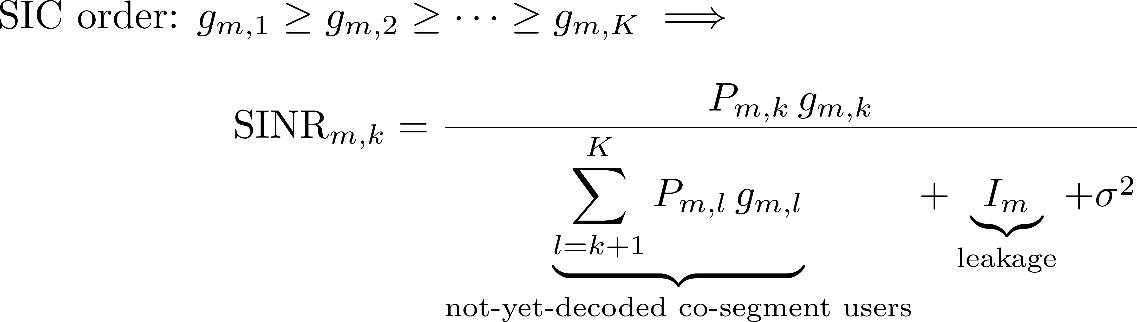
3 · Proposed Innovation
The key derivation, from received signal to per-user rate.
Step 1 · Uplink signal received at antenna Ψₘ
Step 2 · Channel gain of user (m,k) , each of the K users has its own distance, so its own gain
Step 3 · SIC decoding + post-SIC SINR , the two new interference terms vs. EDMA

Slide 10
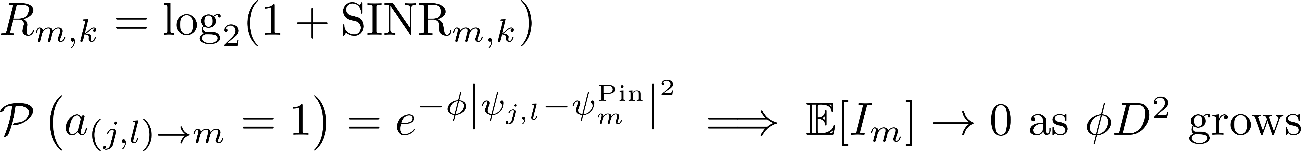
3 · Proposed Innovation
The key derivation, from received signal to per-user rate.
Step 1 · Uplink signal received at antenna Ψₘ
Step 2 · Channel gain of user (m,k), each of the K users has its own distance, so its own gain
Step 3 · SIC decoding + post-SIC SINR, the two new interference terms vs. EDMA
Step 4 · Achievable rate, and why blockage makes the leakage term vanish [1]

Slide 11
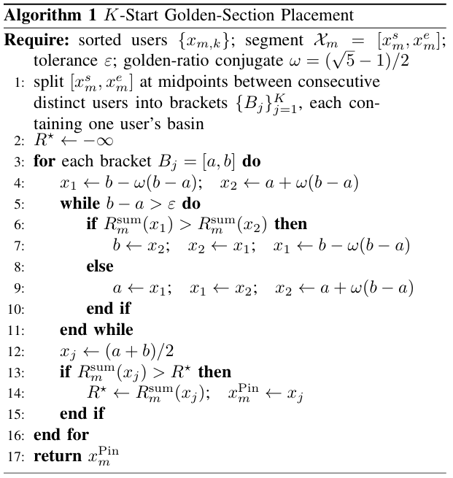
4 · New Algorithm / Workflow / System Design
Alternating optimization: golden-section for positions, QoS-aware power allocation for NOMA.
Why golden-section?
[1] proves each segment's single-user rate is unimodal in xₘᴾ . Golden-section is then exact, O(log 1/ε) per segment.
Honesty check (in progress)
Unimodality is proved in [1] for one user per segment; for the K-user NOMA objective I verify it numerically vs. exhaustive search before claiming exactness.
Fig. 3 K-Start Golden-Section Algorithm

Slide 12
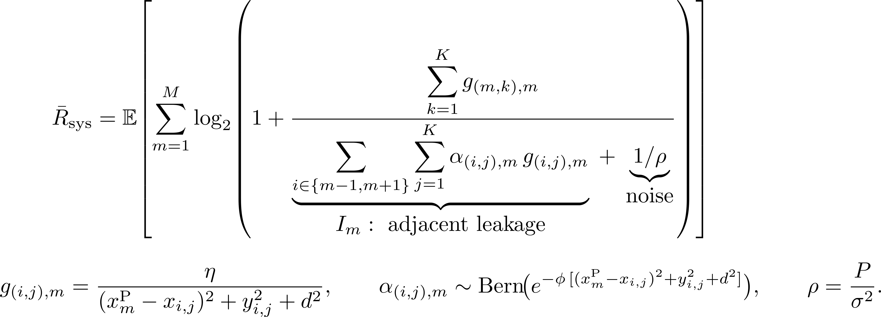
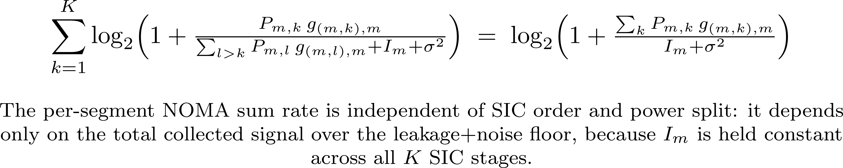
5 · Preliminary New Results
Baseline reproduced and validated, the NOMA-EDMA campaign is now running on top of it.

Slide 13
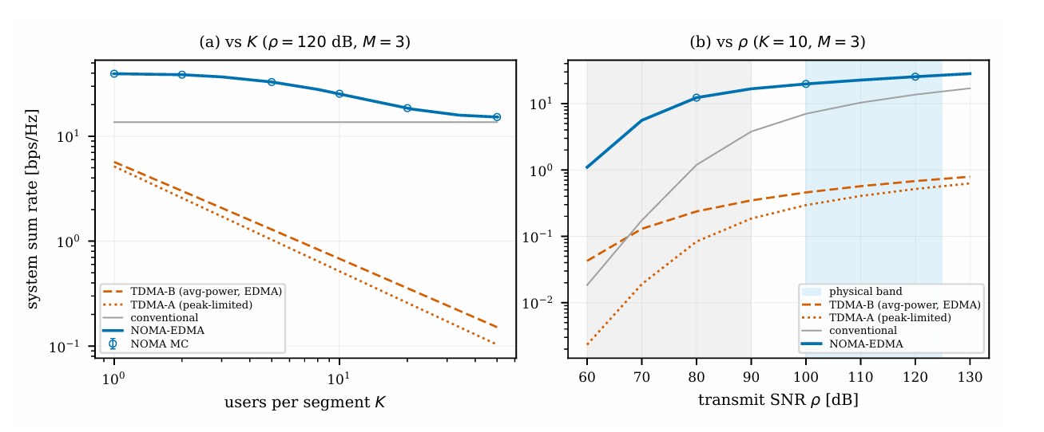
5 · Preliminary New Results
Baseline reproduced and validated, the NOMA-EDMA campaign is now running on top of it.
Fig. 4 System sum-rate dominance of NOMA-EDMA over orthogonal TDMA

Slide 14
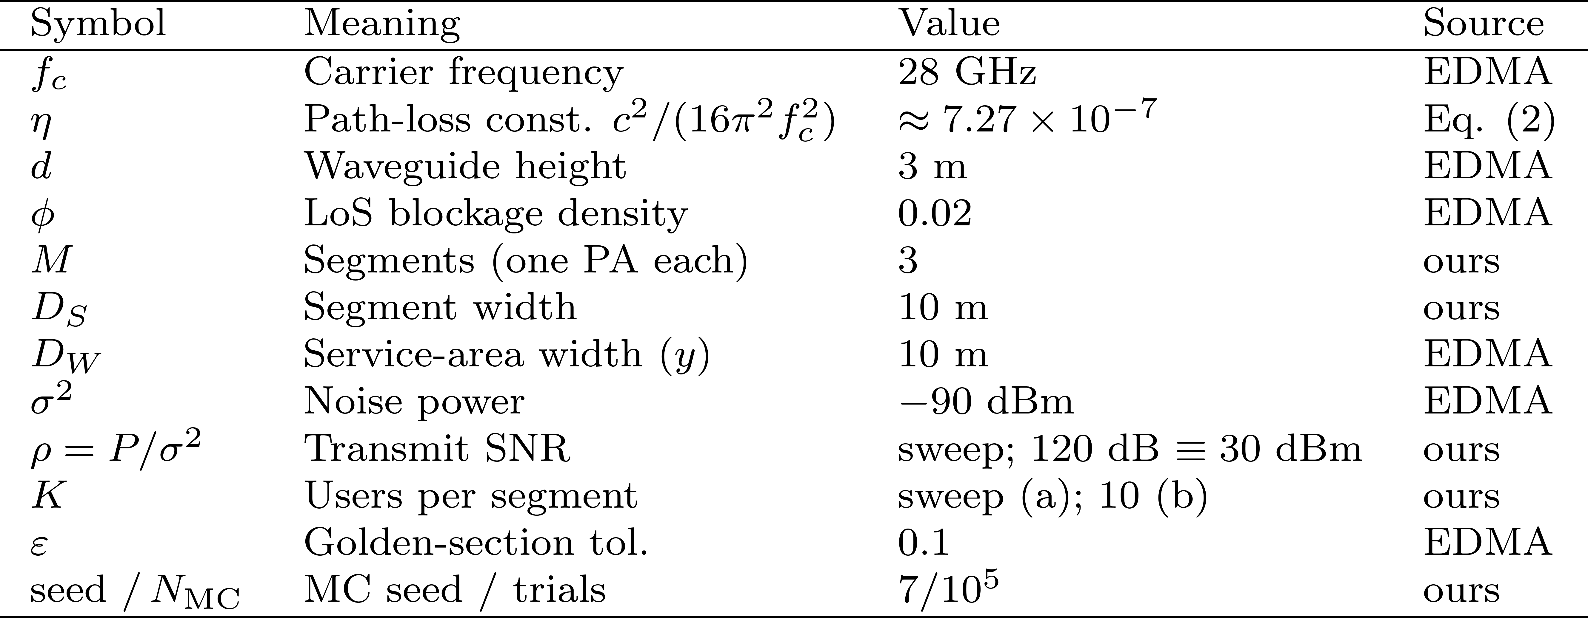
5 · Preliminary New Results
Baseline reproduced and validated, the NOMA-EDMA campaign is now running on top of it.
Fig. 4 System sum-rate dominance of NOMA-EDMA over orthogonal TDMA

Slide 15
Code walkthrough
src/channel.py
Channel
Free-space gain and the LoS blockage probability
src/geometry.py
Geometry
Antenna position and random user drops
src/analytic.py
Closed forms
Leakage bound, ergodic rate integral, K*, Gamma(K), orthogonal rates
src/montecarlo.py
Simulation
Samplers for the leakage ratio, the ergodic rate and the EDMA system rate
config/params.yaml and tests/
Settings and checks
Every physical value in one file. 72 automated tests
experiments/
Experiments
Four scripts that make every table and figure
Python, NumPy, SciPy, Matplotlib. Fixed seeds.
9
Notes:
[On screen: open the Code folder in the editor. Show src, then config, tests and experiments.]
Now a short walk through the code. I will show the files and not read all of them.
The code has five modules in src. The file channel.py has two functions. One gives the free-space gain. The other gives the probability that a link is line of sight.
The file geometry.py places the antenna and drops random users.
[On screen: open src/analytic.py and scroll to ergodic_rate_exact.]
The file analytic.py has the closed forms. It has the leakage bound. It has the ergodic rate function. This function builds the two Laplace transforms g and h and then integrates over z. It uses the limit at z equal to zero, and it extends the upper limit until the tail is small. The same file has K star, the gain of loading and the two orthogonal benchmark rates.
The file montecarlo.py has the samplers. One samples the far to adjacent ratio. One simulates the ergodic rate. One simulates the EDMA system rate that I used for the baseline.
[On screen: open config/params.yaml and then the tests folder.]
The file params.yaml holds every physical value, so nothing is hard coded. The tests folder has 72 tests. They check the closed forms against numerical integrals, the samplers against the closed forms and the published EDMA numbers.
The experiments folder has the four scripts that make every table and figure in the report.

Slide 16
SOTA positioning
Work | Setting | Interference handled by | Several users per region? | Rate analysis
EDMA [1] | Uplink, downlink | Blockage between regions | No, one user | Closed-form gain over TDMA
SWAN [2] | Uplink, downlink | One active antenna per segment | No, orthogonal access | Tractable uplink model
NOMA-PASS uplink [3] | Uplink, one waveguide | SIC and power control | Yes, no segments | Optimisation algorithms
EDMA with NOMA [14] | Downlink | Blockage map and SIC | Yes | Heuristic, simulation
This work (EPMA) | Uplink | Blockage between regions and SIC inside regions | Yes, K per region | Closed integral, Monte Carlo
Closest strong work: EDMA. I reproduced it and I keep its environment layer.
My step: the overloaded uplink analysis. Leakage bound for every K, exact rate, crossover load and an honest comparison.
Not claimed: a sum-rate gain from loading, or that nobody else has combined EDMA and NOMA.
16
Notes:
Here is my position against the state of the art.
EDMA is the closest and strongest work. It is my baseline and I reproduced it. It has one user per region.
SWAN gives my one-antenna-per-segment model. NOMA-PASS uplink gives the power layer, but on one waveguide without segments.
A concurrent preprint combines EDMA and NOMA for the downlink with a heuristic method and simulations.
My work is the uplink analysis. It gives the leakage bound for every K, the exact rate, the crossover load and an honest comparison with orthogonal access.
I do not claim that EPMA raises the sum rate. My results show that it does not.

Slide 17
References
[1] Z. Ding, R. Schober, and H. V. Poor, “Environment Division Multiple Access (EDMA): A Feasibility Study via Pinching Antennas,” IEEE Transactions on Wireless Communications, vol. 25, pp. 15675–15690, 2026.
[2] Y. Xu et al., “Generalized Pinching-Antenna Systems: A Tutorial on Principles, Design Strategies, and Future Directions,” IEEE Communications Surveys & Tutorials, vol. 28, pp. 5872–5908, 2026, doi: 10.1109/COMST.2026.3674222.
[3] M. Zeng, J. Wang, X. Li, G. Wang, O. A. Dobre, and Z. Ding, “Sum Rate Maximization for NOMA-Assisted Uplink Pinching-Antenna Systems,” IEEE Wireless Communications Letters, vol. 15, 2026.
[4] K. Wang, Z. Ding, and G. K. Karagiannidis, “Antenna Activation and Resource Allocation in Multi-Waveguide Pinching-Antenna Systems,” IEEE Transactions on Wireless Communications, vol. 25, pp. 4070–4082, 2026.
[5] Y. Xu, Z. Ding, D. Cai, and V. W. S. Wong, “QoS-Aware NOMA Design for Downlink Pinching-Antenna Systems,” IEEE Transactions on Communications, vol. 73, no. 12, pp. 13611–13625, Dec. 2025.
[6] Q. Ren, X. Mu, S. Lin, and Y. Liu, “Pinching-Antenna Systems (PASS) Meet Multiple Access: NOMA or OMA?” IEEE Transactions on Vehicular Technology, 2026, doi: 10.1109/TVT.2026.3683670.
[7] C. Ouyang, H. Jiang, Z. Wang, Y. Liu, and Z. Ding, “Uplink and Downlink Communications in Segmented Waveguide-Enabled Pinching-Antenna Systems (SWANs),” IEEE Transactions on Communications, vol. 74, pp. 3688–3704, 2026.
[8] Y. Luo, “Environment-Aware Resource Allocation for Pinching-Antenna-Assisted EDMA-NOMA Systems,” arXiv:2606.18899, 2026.
[9] S. Boyd and L. Vandenberghe, Convex Optimization. Cambridge, U.K.: Cambridge University Press, 2004.

