Slide 1


NASA SPACE APP CHALLENGE 2025 Challenge-Will it Rain on my parade? Subjects-Coding, Data Analysis , Data visualization , Forecast, Software, Weather ,Web Development Team Name- Team Coders App Name- orbitWx(plan your day with confidence.)

Slide 2
Challenge Description:
People want to know weather chances for outdoor plans (vacations, hikes, fishing, etc.).
Instead of short-term forecasts, this app uses historical NASA data to show probabilities of certain weather conditions.
Helps users plan ahead and avoid extreme weather periods.
NASA provides decades of global data — temperature, rainfall, wind speed, dust, snow, cloud cover, etc.
Models can analyze seasonal patterns and extreme condition probabilities.
Objective:
Develop a personalized app that uses NASA Earth observation data to show the likelihood of “very hot,” “very cold,” “very windy,” “very wet,” or “very uncomfortable” weather for a specific location and time.
App can indicate if risks (e.g., heat waves, heavy rain) are increasing over time.

Slide 3
Challenge Solution:
Input Location User selects city / coordinates / pin drop.
App fetches NASA microclimate data for that exact point.
Input Time Choose month, day, or future date.
Analyzes historical weather trends for that specific period.
Show Condition desired parameter: Very Hot / Very Wet / Very Windy / Very Cold.
Output Probability Displays likelihood (%) of chosen extreme condition.
Based on decades of NASA Earth observation data
Generate Results Probability Output: e.g., 60% chance of extreme heat.
Bar Chart: Shows probability for each condition.
Bell Curve: Displays historical temperature distribution.
Export Report Generates a personalized PDF summary with charts & insights.
User can download or share the report instantly.

Slide 4
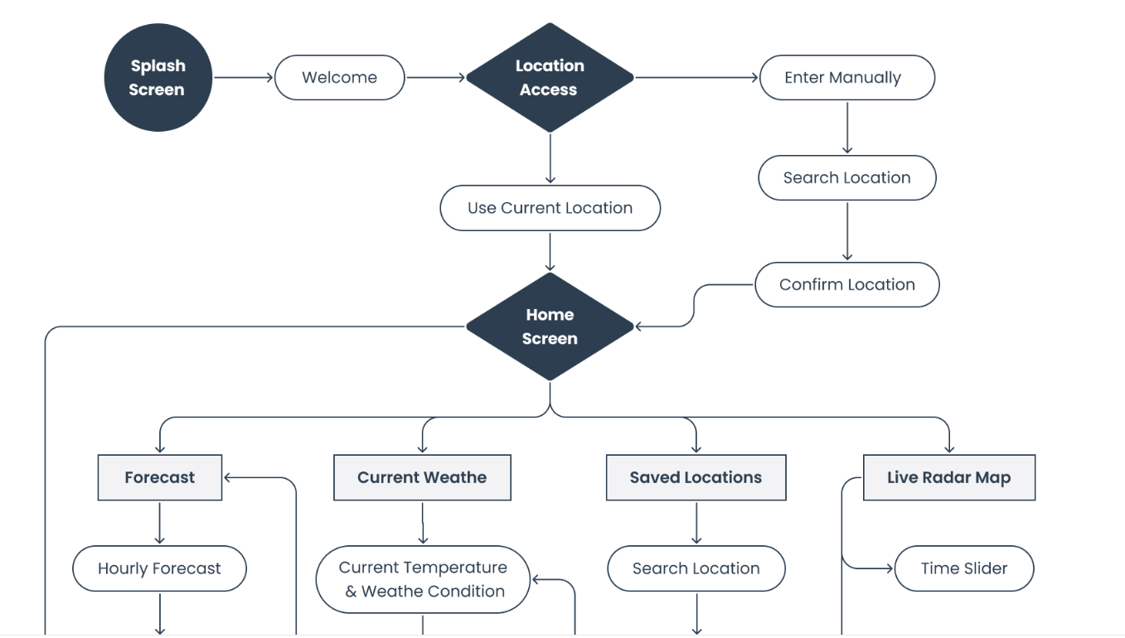


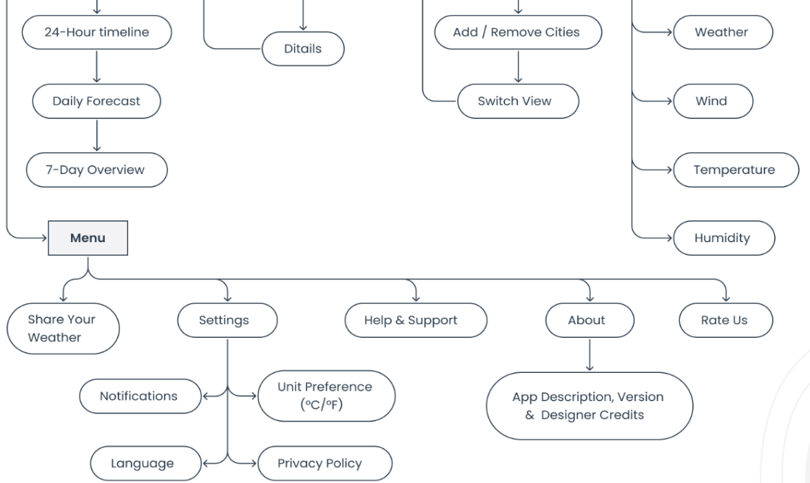


TECHNICAL APPROACH
Frontend: Flutter (Android + iOS)
Backend :Fast API,Pydantic
(Python)
weather forecast:
NASA earth observation
Live location for weather:
Giovanni

Slide 5
IMPACT AND BENEFITS
Impact
Awareness & Education – Raises public understanding of weather unpredictability and its effects on daily life, events, or climate change.
Preparedness – Equips individuals/communities with tools to anticipate and adapt to disruptions (whether literal rain or metaphorical obstacles).
Innovation & Solutions – Encourages new systems, apps, or approaches to forecast, plan, and mitigate risks.
Community Resilience – Strengthens collaboration and collective action when facing disruptions.
Cultural Shift – Helps normalize adaptability and optimism in the face of uncertainty.
Benefits
Practical: Fewer disruptions to events, better planning, reduced costs from cancellations or damages.
Social: Stronger community trust, participation, and shared responsibility.
Personal: Increased confidence, reduced anxiety about uncertainty.
Economic: Savings through efficient planning, new opportunities for weather-tech innovation.
Environmental: More sustainable choices by planning around climate impacts.

Slide 6
https://drive.google.com/file/d/1jQp9_JZnfU6JDFzegSUMXNCRKRhQ_h3V/view?usp=sharing – screen recorder of our app

Slide 7

GES DISC OPeNDAP server (Hyrax): The Goddard Earth Sciences Data and Information Services Center (GES DISC) Open-source Project for a Network Data Access Protocol (OPeNDAP) server provides access to many different data variables and provides an interface for data acquisition and sub setting.
Giovanni: Giovanni provides access to multiple datasets and variables, and provides output in data maps and time-series.
Data Rods for Hydrology: Data Rods for Hydrology provides several different hydrological variables and will display time series for a specific location.
Worldview: Worldview provides imagery and data links for numerous variables of interest.
Earth data Search: Earth data search provides an interface to search for and access data from all NASA Earth science data centers. The data can be filtered by keywords, processing level, data formats etc.
Data access Tutorials: These tutorials provide step-by-step instructions on how to find, request, download, and open data files from NASA data center archives. These tutorials are provided in Jupiter Notebooks, which can be directly downloaded from the page or opened in the GitHub environment.
Space Agency Partner Resources
Brazilian Space Agency (AEB)
Center for Weather Forecast and Climate Studies (CPTEC) at the Brazilian National Institute for Space Exploration (INPE): The Center for Weather Forecast and Climate Studies (CPTEC) provides high-resolution weather forecasts, climate monitoring, and environmental modeling for Brazil and South America. Using advanced numerical models and satellite data, CPTEC generates short to long-term forecasts, severe weather alerts, and climate trend analyses. Its platform offers public access to dynamic maps, time series, and predictive simulations, supporting sectors such as agriculture, civil defense, and energy planning. All information is continuously updated and available through interactive tools for data exploration and visualization.

