Slide 1

Unit – 3 Probability Distribution
Probability & Statistics (P&S)
DU # 2301HS402
CO3:
At the end of this Unit, students will be able to use probability distribution.
Mr. Dhvanik H. Zala
Department of Humanities & Science
dhvanik.zala@darshan.ac.in
82385 88865

Slide 2

Looping
Topics of Unit 3
Discrete Probability Distributions
Binomial Distribution
Poisson Distribution
Continuous Probability Distributions
Exponential Distribution
Normal Distribution

Slide 3

Looping
Outline of Unit 3
Introduction
Discrete Probability Distributions
Method 1 – Binomial Distribution
Method 2 – Poisson Distribution
Continuous Probability Distributions
Method 3 – Exponential Distribution
Method 4 – Normal Distribution

Slide 4
Introduction
Have you ever wondered:
How many defective items might appear in a factory today?
How long will we wait before the next call arrives?
Why do marks, heights and measurement errors follow a pattern?
All these questions involve uncertainty, and the language used to understand this uncertainty is called probability distributions.

Slide 5
What is a Probability Distribution?
A probability distribution is not just a formula. It is a mathematical story of how uncertainty behaves.
It answers questions like:
What outcomes are possible?
How often does each outcome occur?
How is uncertainty spread?
Is randomness jumpy or smooth?
Are extreme values rare or common?
Different situations give different stories of uncertainty.

Slide 6
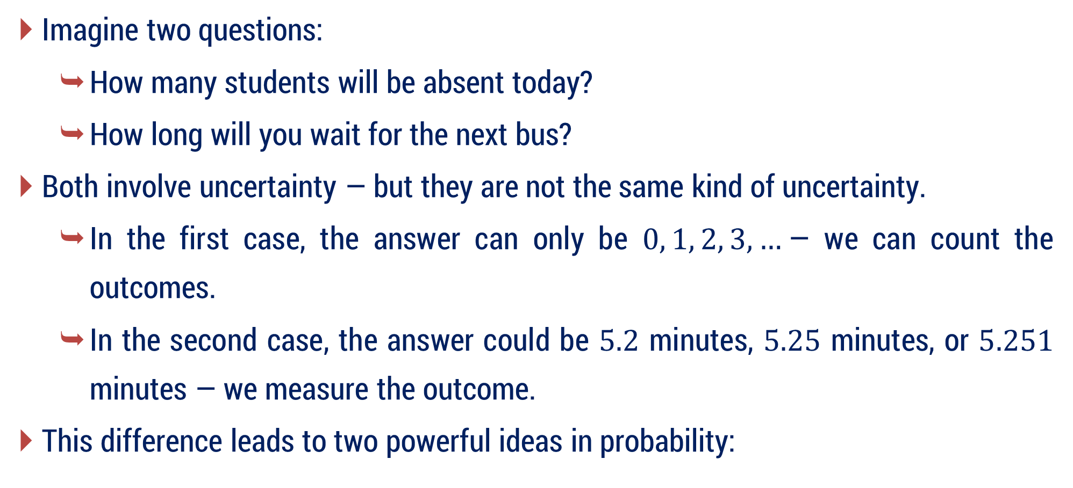
PMF vs PDF
Imagine two questions:
How many students will be absent today?
How long will you wait for the next bus?
Both involve uncertainty — but they are not the same kind of uncertainty.
In the first case, the answer can only be $0, 1, 2, 3, …$— we can count the outcomes.
In the second case, the answer could be $5.2$ minutes, $5.25$ minutes, or $5.251$ minutes — we measure the outcome.
This difference leads to two powerful ideas in probability:

Slide 7
Discrete Probability Distributions (PMF)
When outcomes are countable, we use discrete distributions, described by a Probability Mass Function (PMF).
PMF tells us the probability of each exact value of a random variable.
To model such countable situations in practice, we study two important discrete probability distributions:
Binomial Distribution – counts successes in repeated trials (like number of heads in coin tosses)
Poisson Distribution – counts rare events (like phone calls, accidents, or system failures)

Slide 8
Continuous Probability Distributions (PDF)
When outcomes can take any value within an interval, we use continuous distributions, described by a Probability Density Function (PDF).
PDF describes how probability is spread over an interval, not at a single point.
To model such continuous random variables, this unit focuses on two widely used continuous distributions:
Exponential Distribution – answers “How long do we wait?”
Normal Distribution – explains why most natural data cluster around an average.

Slide 9
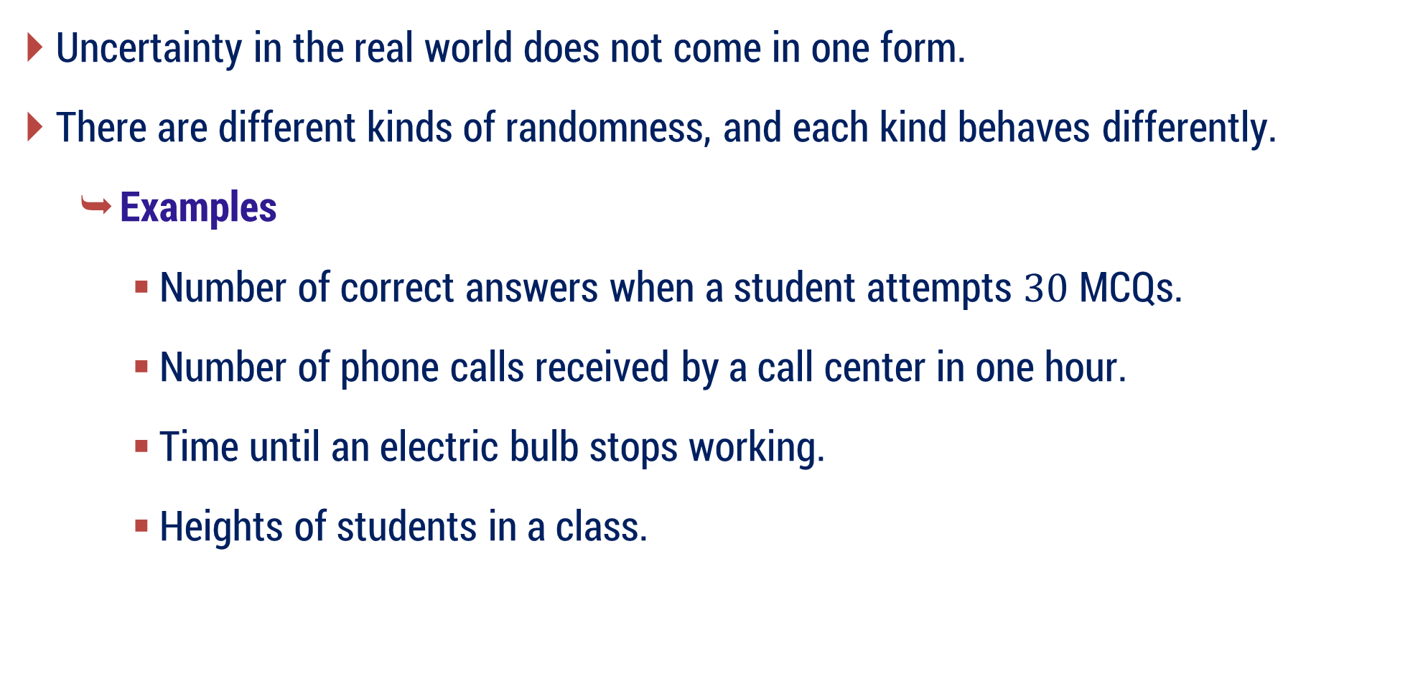
Why do we need different distributions?
Uncertainty in the real world does not come in one form.
There are different kinds of randomness, and each kind behaves differently.
Examples
Number of correct answers when a student attempts $30$ MCQs.
Number of phone calls received by a call center in one hour.
Time until an electric bulb stops working.
Heights of students in a class.

Slide 10
Why do we need different distributions?
Because randomness behaves differently in different situations, we need different probability distributions to model it correctly.
These four distributions represent the four most common ways uncertainty appears in the real world.
Different probability distributions exist because randomness itself has different forms, and each form needs its own mathematical description.

Slide 11
Method 1 Binomial Distribution

Slide 12
Bernoulli’s Trial
A Bernoulli’s Trial is the most basic random experiment in probability. It models situations where each experiment has only two possible outcomes and nothing more.
A Bernoulli’s trial is a random experiment that satisfies all of the following conditions:
Exactly two possible outcomes:
Success (S)
Failure (F)
Important
“Success” does not mean something good.
It simply means the outcome we are interested in.

Slide 13
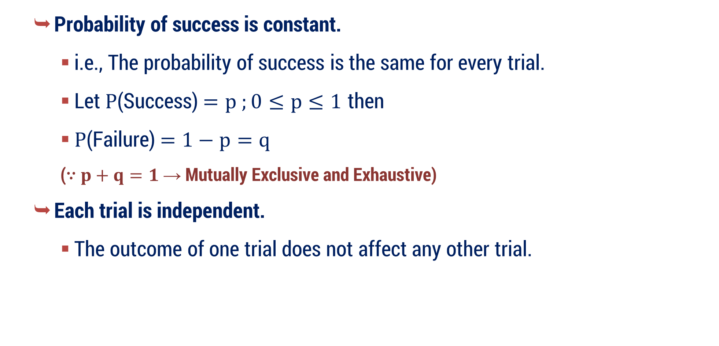
Bernoulli’s Trial
Probability of success is constant.
i.e., The probability of success is the same for every trial.
Let $P$(Success)$=p ;0≤p≤1$ then
$P$(Failure)$=1−p=q$
($\text{∵} p+q=1$ → Mutually Exclusive and Exhaustive)
Each trial is independent.
The outcome of one trial does not affect any other trial.

Slide 14

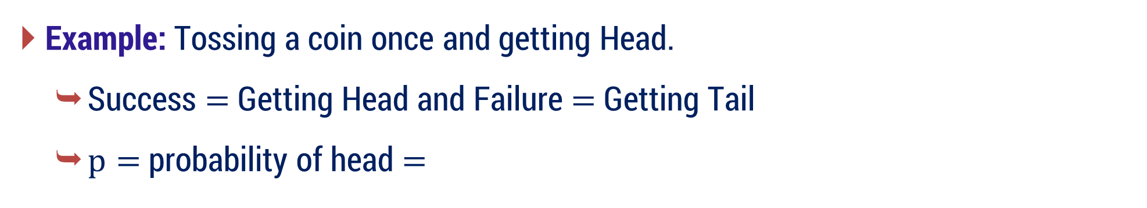
Bernoulli’s Trial
Example: Tossing a coin once and getting Head.
Success $=$ Getting Head and Failure $=$ Getting Tail
$p=$ probability of head $=$
$$1/{ 2 }$$
Why This is a Bernoulli Trial ?
The experiment is done only once.
There are only two possible outcomes:
Head (success) and Tail (failure)
The probability of getting Head is fixed.
Hence, tossing a coin once is a Bernoulli trial.

Slide 15
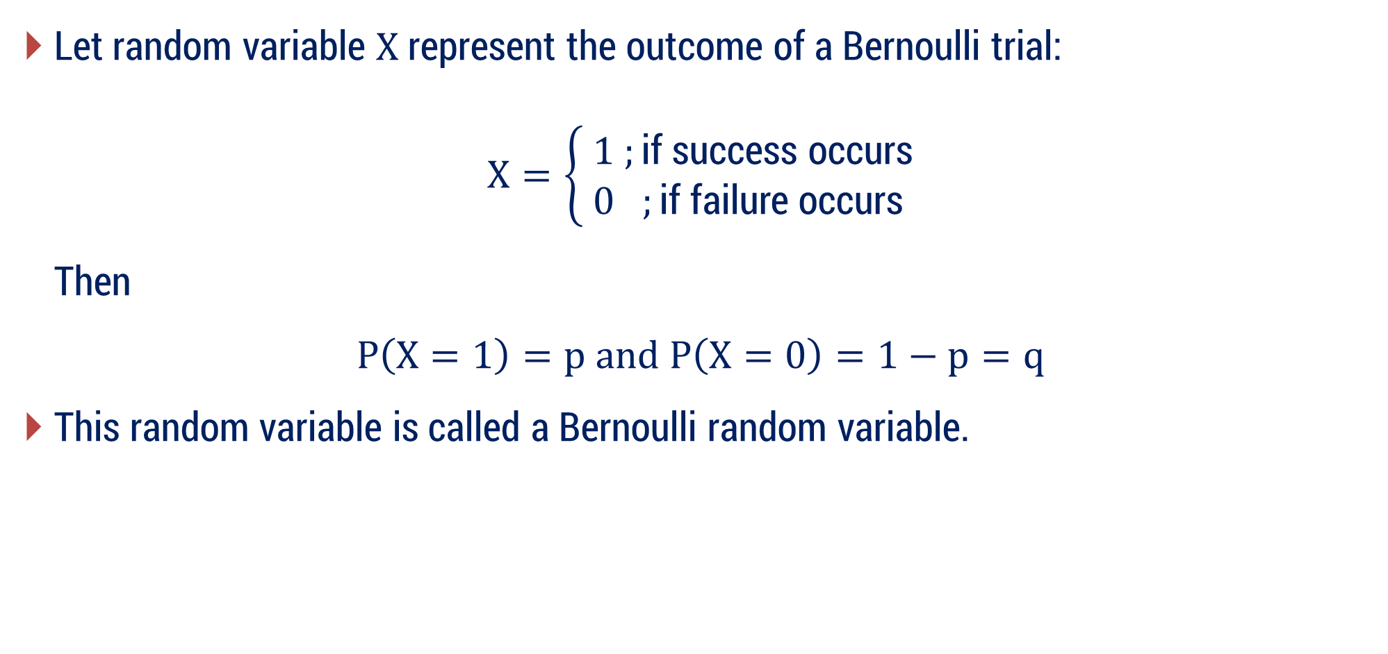
Bernoulli Random Variable
Let random variable $X$ represent the outcome of a Bernoulli trial:
$$X=\left\{\begin{aligned} 1 ;\text{if} \text{success} \text{occurs} \\ 0 ;\text{if} \text{failure} \text{occurs}\end{aligned}\right.$$
Then
$$P\left(X=1\right)=p and P\left(X=0\right)=1−p=q$$
This random variable is called a Bernoulli random variable.

Slide 16
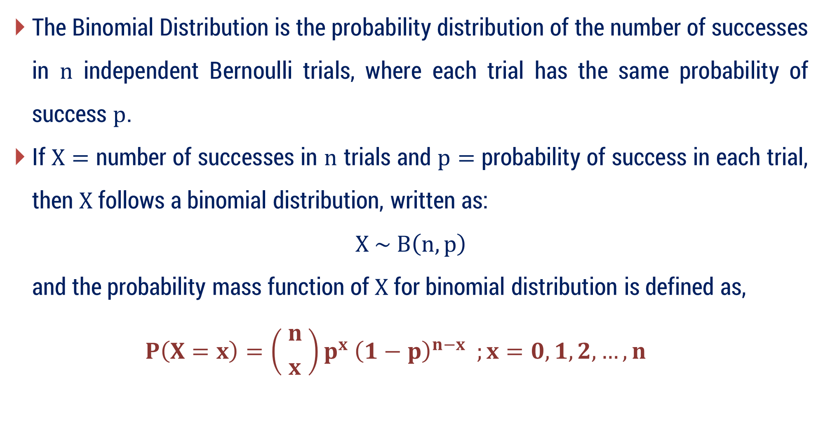
Binomial Distribution
The Binomial Distribution is the probability distribution of the number of successes in $n$ independent Bernoulli trials, where each trial has the same probability of success $p$.
If $X=$ number of successes in $n$ trials and $p=$ probability of success in each trial, then $X$ follows a binomial distribution, written as:
$$X \sim B\left(n, p\right)$$
and the probability mass function of $X$ for binomial distribution is defined as,
$$P\left(X=x\right)=\left( {n \atop x} \right)p^{x} {\left(1−p\right)}^{n−x} ;x=0, 1, 2,…, n$$

Slide 17
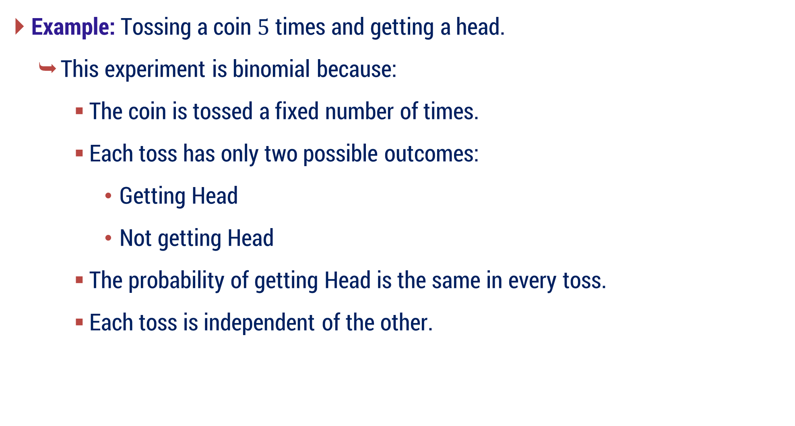
Binomial Distribution
Example: Tossing a coin $5$ times and getting a head.
This experiment is binomial because:
The coin is tossed a fixed number of times.
Each toss has only two possible outcomes:
Getting Head
Not getting Head
The probability of getting Head is the same in every toss.
Each toss is independent of the other.

Slide 18
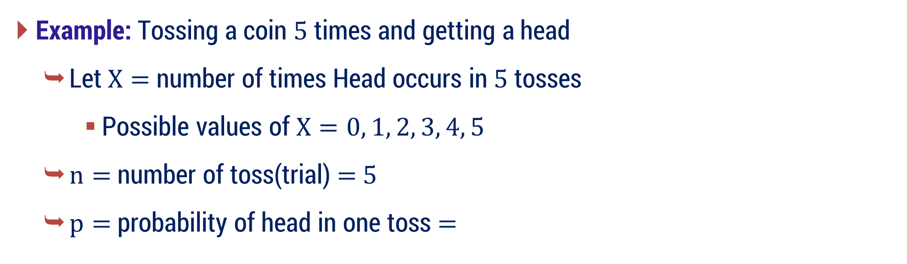




Binomial Distribution : How to define $X, n, p$and$q$
Example: Tossing a coin $5$ times and getting a head
Let $X=$ number of times Head occurs in $5$ tosses
Possible values of $X=0, 1, 2, 3, 4, 5$
$n=$ number of toss(trial) = 5
$p=$ probability of head in one toss $=$
$$1/{ 2 }$$
$∴q=1−p$
$$∴q=1−\frac{1}{ 2 }$$
$$=\frac{1}{ 2 }$$

Slide 19
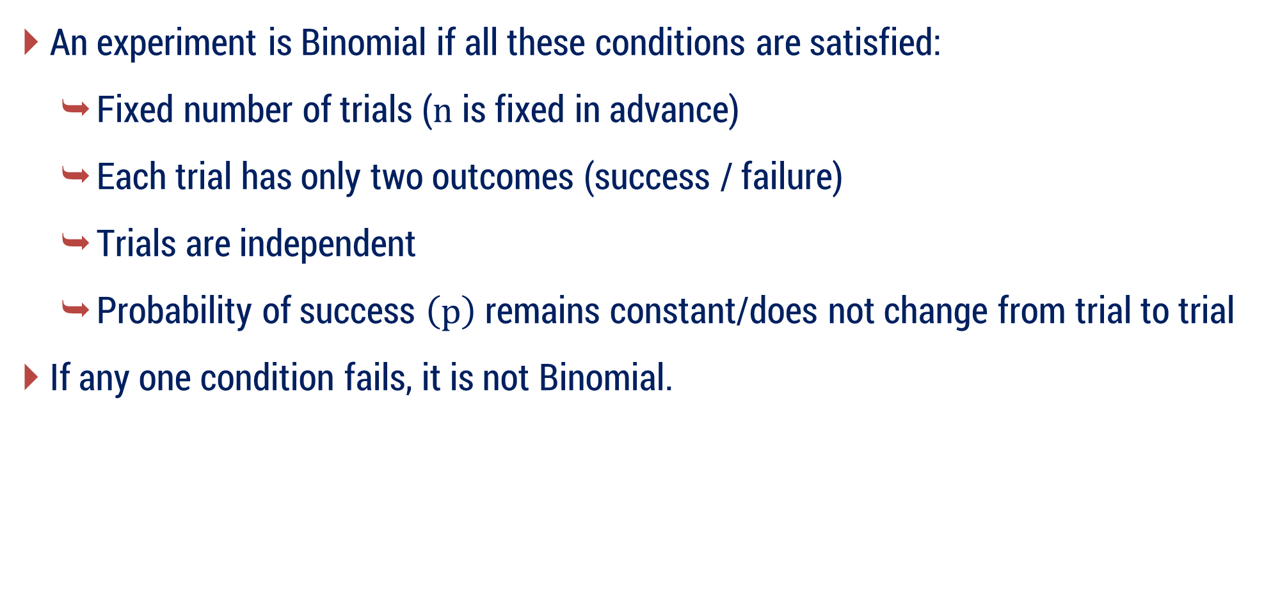
Conditions for a Binomial Experiment – Remember !
An experiment is Binomial if all these conditions are satisfied:
Fixed number of trials ($n$ is fixed in advance)
Each trial has only two outcomes (success / failure)
Trials are independent
Probability of success $\left(p\right)$ remains constant/does not change from trial to trial
If any one condition fails, it is not Binomial.

Slide 20
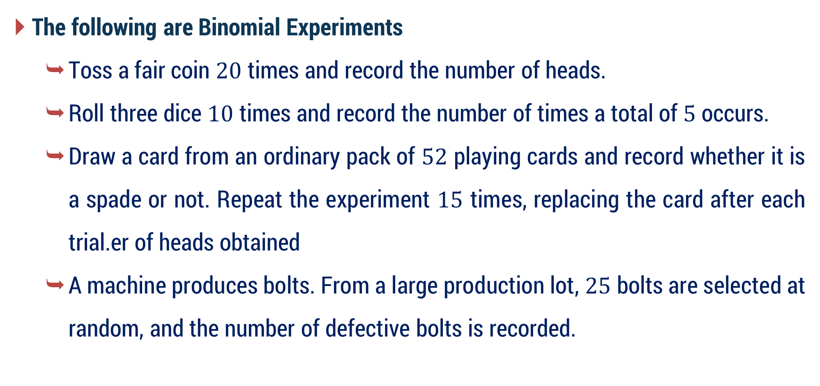
Binomial Distribution
The following are Binomial Experiments
Toss a fair coin $20$ times and record the number of heads.
Roll three dice $10$ times and record the number of times a total of $5$ occurs.
Draw a card from an ordinary pack of $52$ playing cards and record whether it is a spade or not. Repeat the experiment $15$ times, replacing the card after each trial.er of heads obtained
A machine produces bolts. From a large production lot, $25$ bolts are selected at random, and the number of defective bolts is recorded.

Slide 21
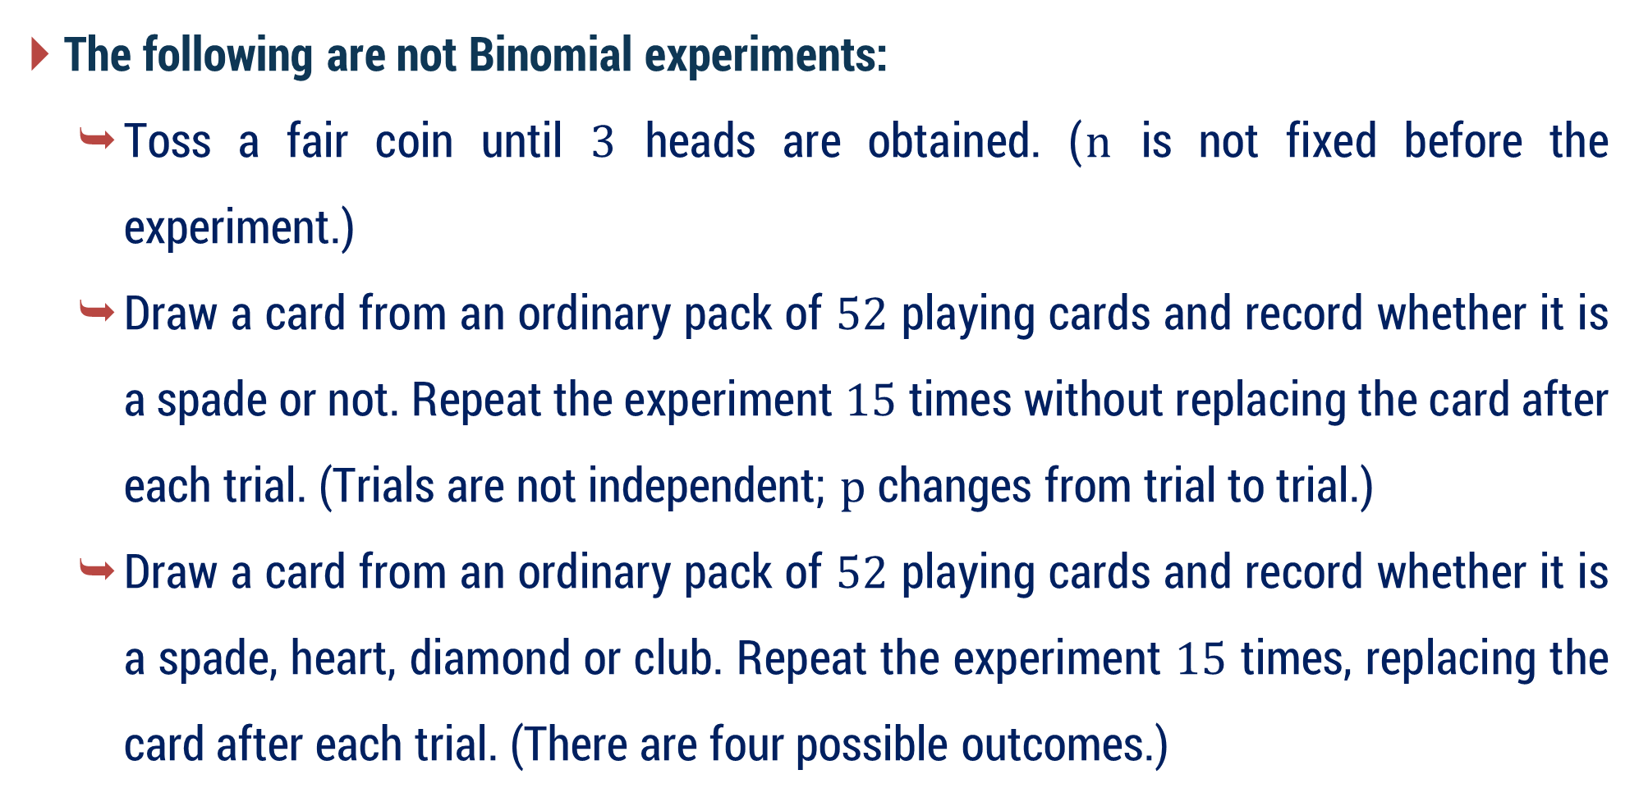
Binomial Distribution
The following are not Binomial experiments:
Toss a fair coin until $3$ heads are obtained. ($n$ is not fixed before the experiment.)
Draw a card from an ordinary pack of $52$ playing cards and record whether it is a spade or not. Repeat the experiment $15$ times without replacing the card after each trial. (Trials are not independent; $p$ changes from trial to trial.)
Draw a card from an ordinary pack of $52$ playing cards and record whether it is a spade, heart, diamond or club. Repeat the experiment $15$ times, replacing the card after each trial. (There are four possible outcomes.)

Slide 22
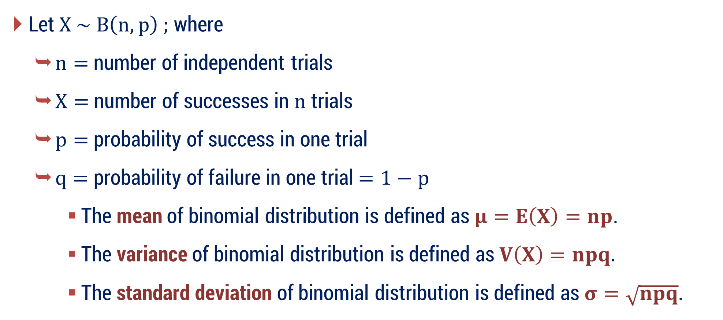
Properties of Binomial Distribution
Let $X \sim B\left(n, p\right) ;$ where
$n=$ number of independent trials
$X=$ number of successes in $n$ trials
$p=$ probability of success in one trial
$q=$ probability of failure in one trial $=1−p$
The mean of binomial distribution is defined as$μ=E\left(X\right)=np$.
The variance of binomial distribution is defined as $V\left(X\right)=npq.$
The standard deviation of binomial distribution is defined as $σ=\sqrt{npq}$.

Slide 23
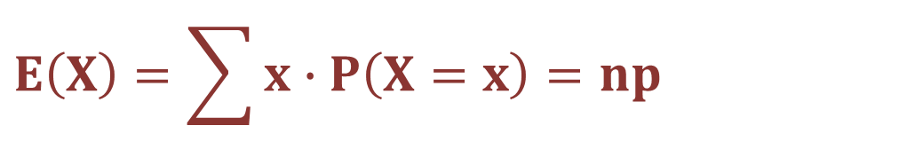
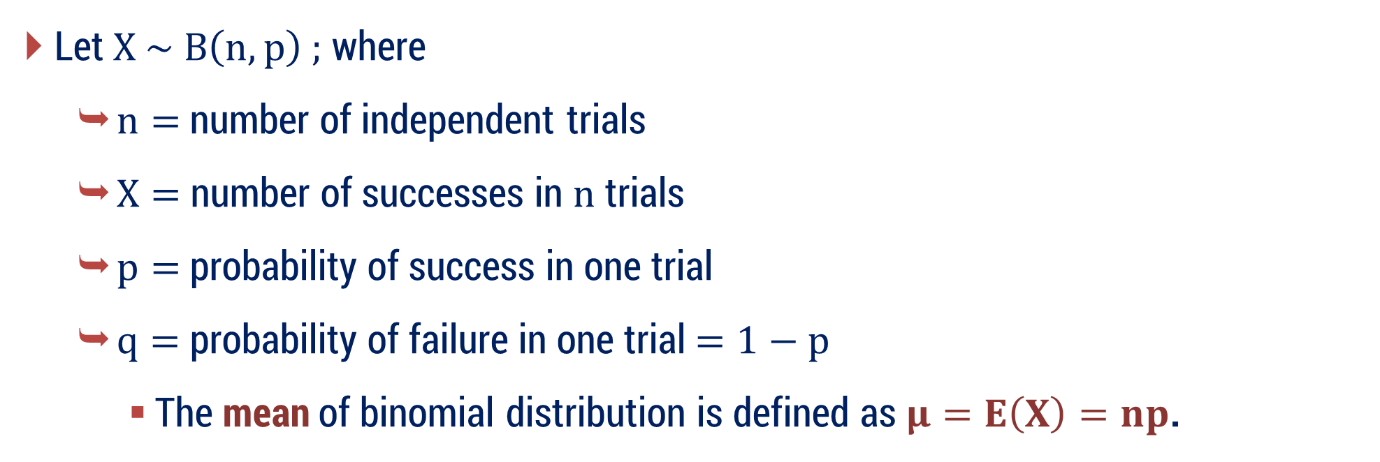
Properties of Binomial Distribution
Let $X \sim B\left(n, p\right) ;$ where
$n=$ number of independent trials
$X=$ number of successes in $n$ trials
$p=$ probability of success in one trial
$q=$ probability of failure in one trial $=1−p$
The mean of binomial distribution is defined as$μ=E\left(X\right)=np$.
$$E\left(X\right)=\sum{x}∙P\left(X=x\right)=np$$
The variance of binomial distribution is defined as $V\left(X\right)=npq$.
The standard deviation of binomial distribution is defined as $σ=\sqrt{npq}$

Slide 24
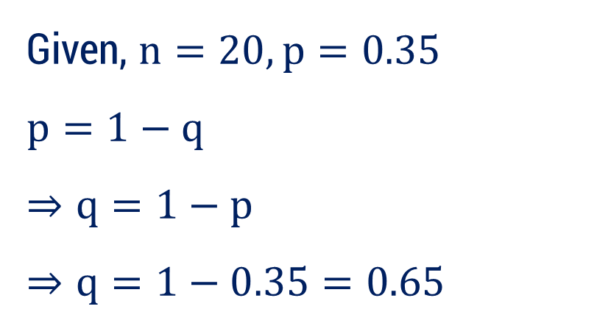

Method 1 ⇝ Example 1
For the binomial distribution with $n=20,p=0.35$. Find mean, variance and standard deviation.
Given, $n=20,p=0.35$
$$p=1−q$$
$$⇒q=1−p$$
$$⇒q=1−0.35=0.65$$
Solution:

Slide 25
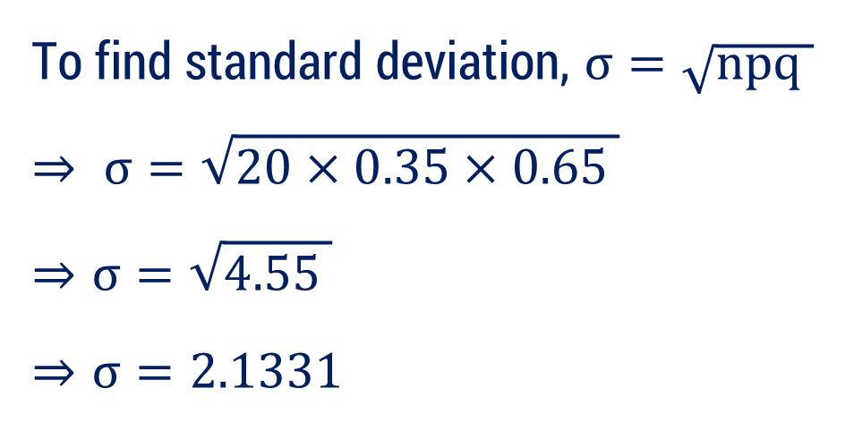
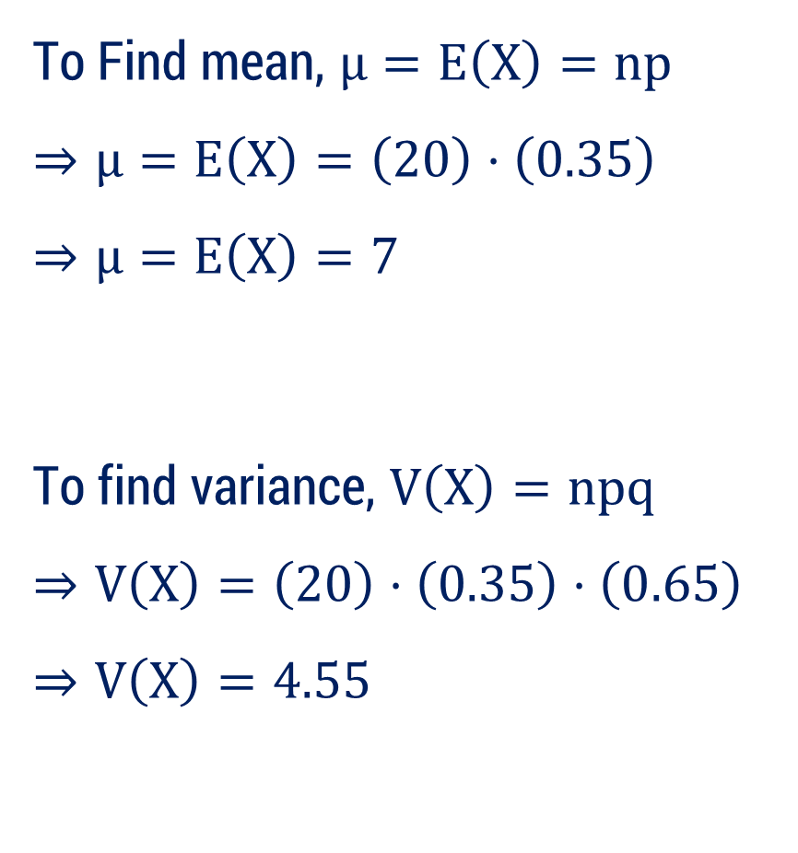
Method 1 ⇝ Example 1 (Continue)
To Find mean, $μ=E\left(X\right)=np$
$$⇒μ=E\left(X\right)=\left(20\right)⋅\left(0.35\right)$$
$$⇒μ=E\left(X\right)=7$$
To find variance, $V\left(X\right)=npq$
$$⇒V\left(X\right)=\left(20\right)⋅\left(0.35\right)⋅\left(0.65\right)$$
$$⇒V\left(X\right)=4.55$$
To find standard deviation, $σ=\sqrt{npq }$
$$⇒ σ=\sqrt{20×0.35×0.65 }$$
$$⇒σ=\sqrt{4.55 }$$
$$⇒σ=2.1331$$

Slide 26

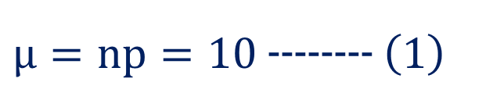
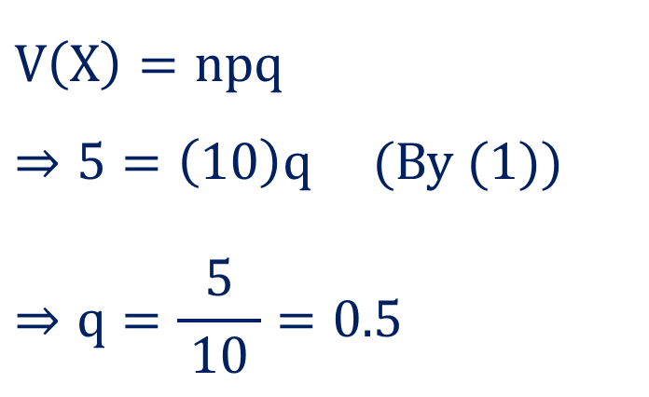
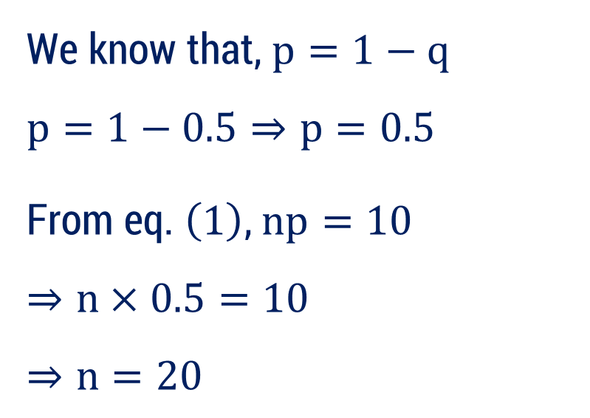
Method 1 ⇝ Example 2
Obtain the binomial distribution function for which mean is $10$ and variance is $5$.
Given, $μ=10$, $V\left(X\right)=5$
We know that, $p=1−q$
$$p=1−0.5⇒p=0.5$$
From eq. $\left(1\right)$, $np=10$
$$⇒n×0.5=10$$
$$⇒n=20$$
Solution:
$μ=np=10$ -------- $\left(1\right)$
Now,
$$V\left(X\right)=npq$$
$⇒5=\left(10\right)q$ (By (1))
$$⇒q=\frac{5}{ 10 }=0.5$$

Slide 27

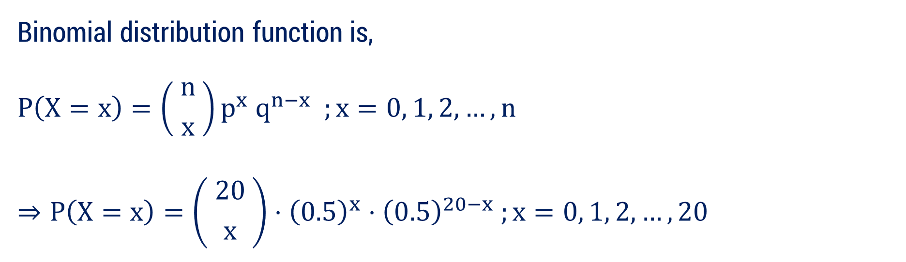


Method 1 ⇝ Example 2 (Continue)
Binomial distribution function is,
$$P\left(X=x\right)=\left( {n \atop x} \right)p^{x} q^{n−x} ;x=0, 1, 2,…, n$$
$$⇒P\left(X=x\right)=\left( {20 \atop x} \right)⋅{\left(0.5\right)}^{x}{⋅\left(0.5\right)}^{20−x} ;x=0, 1, 2,…,20$$
$$n=20$$
$$p=0.5$$
$$q=0.5$$

Slide 28
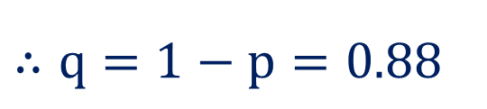
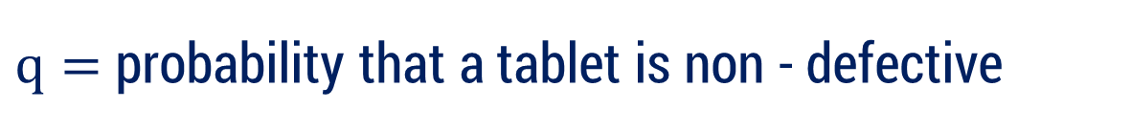
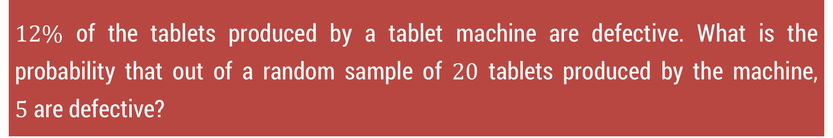


Method 1 ⇝ Example 5
$12\%$ of the tablets produced by a tablet machine are defective. What is the probability that out of a random sample of $20$ tablets produced by the machine, $5$ are defective?
Solution:
Let $X=$ No. of defective tablets in a random sample of $20$ tablets
From the given data, $X$ follows a binomial distribution.
Here, $n=$ No. of tablets $=20$
$p=$ probability that a tablet is defective $=12\%=0.12$
$q=$ probability that a tablet is non - defective
$$P\left(X=5\right)= ?$$
$$∴q=1−p=0.88$$

Slide 29
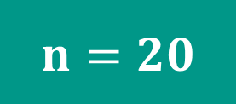

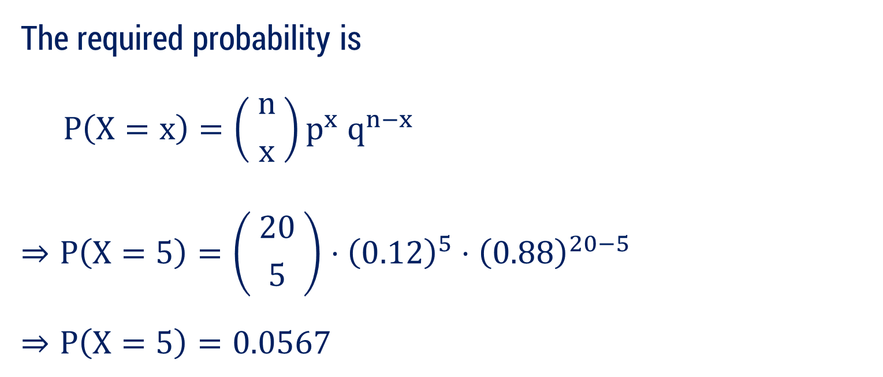

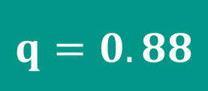

Method 1 ⇝ Example 5 (Continue)
The required probability is
$$P\left(X=x\right)=\left( {n \atop x} \right)p^{x} q^{n−x}$$
$$⇒P\left(X=5\right)=\left( {20 \atop 5} \right)⋅{\left(0.12\right)}^{5}⋅{\left(0.88\right)}^{20−5}$$
$$⇒P\left(X=5\right)=0.0567$$
$$P\left(X=5\right)= ?$$
$$x=5$$
$$n=20$$
$$p=0.12$$
$$q=0.88$$

Slide 30


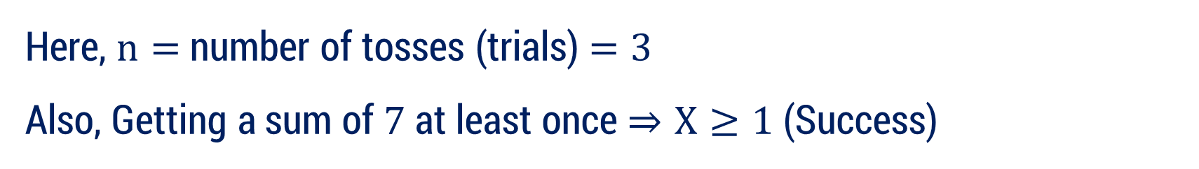

Method 1 ⇝ Example 11
Find probability of getting a sum of $7$ at least once in $3$ tosses of a pair of dice.
Solution:
Let $X=$ number of times the sum $7$ appears in $3$ tosses of a pair of dice
Possible Values of $X=0, 1, 2, 3$
From the given data, $X$ follows a binomial distribution.
Here, $n=$number of tosses (trials) $=3$
Also, Getting a sum of $7$ at least once $⇒X≥1$ (Success)
$p=$ Probability of getting sum $7$ in one toss
$$P\left(X≥1\right)= ?$$
Now, total outcomes when two dice are thrown$= 36$

Slide 31


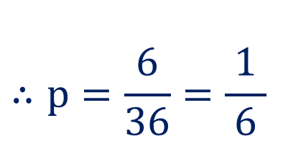
Method 1 ⇝ Example 11 (Continue)
$p=$ Probability of getting sum $7$ in one toss
Now, total outcomes when two dice are thrown$= 36$
Favourable outcomes for sum $7$:$\left(1, 6\right), \left(6, 1\right), \left(2, 5\right), \left(5, 2\right), \left(3, 4\right), \left(4, 3\right)$
$$∴p=\frac{6}{36}=\frac{1}{ 6 }$$
$$∴q=1−\frac{1}{ 6 }=\frac{5}{ 6 }$$

Slide 32
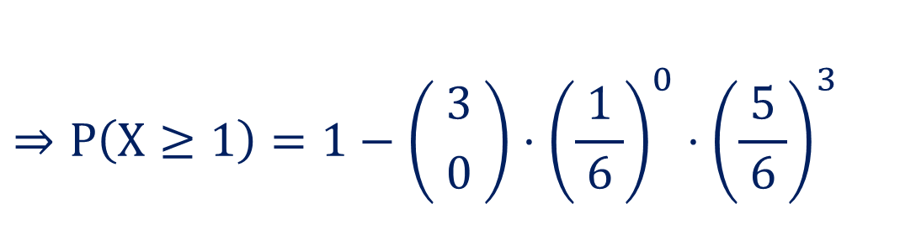
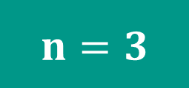

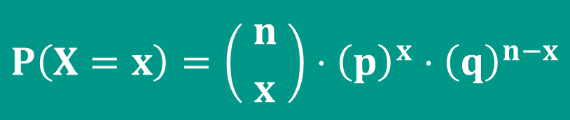

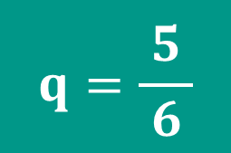
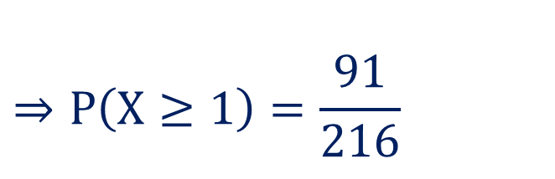
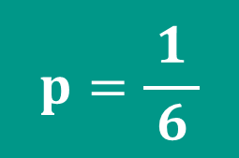
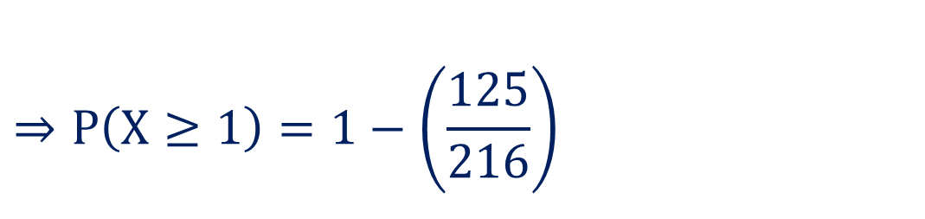
Method 1 ⇝ Example 11 (Continue)
The required probability is
$$P\left(X=x\right)=\left( {n \atop x} \right)⋅{\left(p\right)}^{x}⋅{\left(q\right)}^{n−x}$$
$$P\left(X≥1\right)=1−P\left(X<1\right)$$
$$⇒P\left(X≥1\right)=1−P\left(X=0\right)$$
$$n=3$$
$$⇒P\left(X≥1\right)=1−\left( {3 \atop 0} \right)⋅{\left(\frac{1}{ 6 }\right)}^{0}⋅{\left(\frac{5}{ 6 }\right)}^{3}$$
$$p=\frac{1}{ 6 }$$
$$⇒P\left(X≥1\right)=1−\left(\frac{125}{216}\right)$$
$$q=\frac{5}{ 6 }$$
$$⇒P\left(X≥1\right)=\frac{91}{216}$$

Slide 33


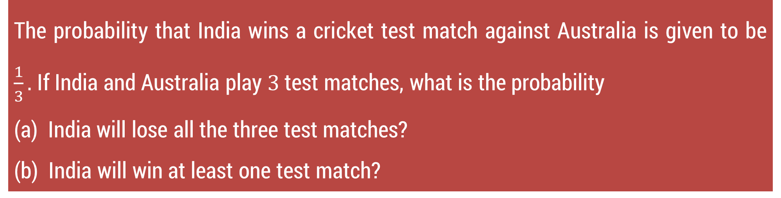



Method 1 ⇝ Example 14
The probability that India wins a cricket test match against Australia is given to be $\frac{1}{3}.$If India and Australia play $3$ test matches, what is the probability
(a) India will lose all the three test matches?
(b) India will win at least one test match?
$$X=0$$
$$X≥1$$
Solution:
Let $X=$ number of test matches won by India out of $3.$
So, $X=0, 1, 2, 3$
$$P\left(X=0\right)= ?$$
From the given data, $X$ follows a binomial distribution.
Here, $n=$Number of test matches played (trials) $=3$
$$P\left(X≥1\right)= ?$$

Slide 34

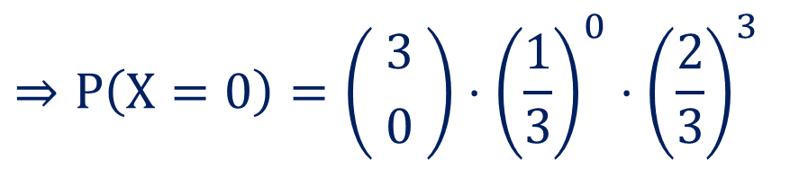
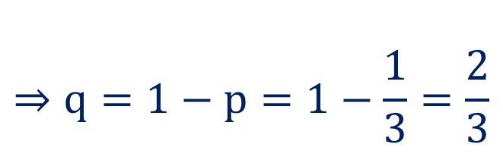
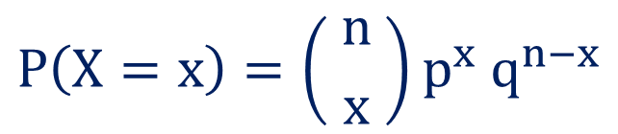
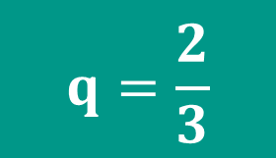
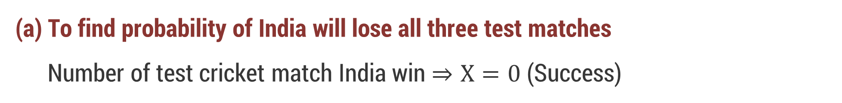

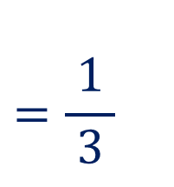

Method 1 ⇝ Example 14 (Continue)
$$=\frac{1}{ 3 }$$
$p=$ Probability that India wins a test match against Australia
$$P\left(X=0\right)= ?$$
$$⇒q=1−p=1−\frac{1}{3}=\frac{2}{3}$$
$$n=3$$
$$p=\frac{1}{3}$$
(a) To find probability of India will lose all three test matches
Number of test cricket match India win $⇒X=0$ (Success)
$$q=\frac{2}{3}$$
From Binomial distribution,
$$P\left(X=x\right)=\left( {n \atop x} \right)p^{x} q^{n−x}$$
$$⇒P\left(X=0\right)=\left( {3 \atop 0} \right)⋅{\left(\frac{1}{3}\right)}^{0}⋅{\left(\frac{2}{3}\right)}^{3}$$

Slide 35

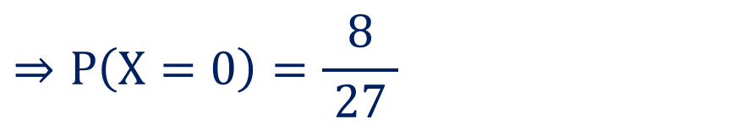
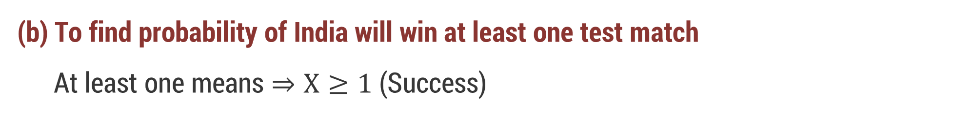



Method 1 ⇝ Example 14 (Continue)
$$⇒P\left(X=0\right)=\left( {3 \atop 0} \right)⋅{\left(\frac{1}{3}\right)}^{0}⋅{\left(\frac{2}{3}\right)}^{3}$$
$$P\left(X≥1\right)= ?$$
$$n=3$$
$$⇒P\left(X=0\right)=\frac{8}{ 27 }$$
$$p=\frac{1}{3}$$
(b) To find probability of India will win at least one test match
At least one means $⇒X≥1$ (Success)
$$q=\frac{2}{3}$$
$$P\left(X≥1\right)=1−P\left(X<1\right)$$
$$⇒P\left(X≥1\right)=1−P\left(X=0\right)$$

Slide 36




Method 1 ⇝ Example 14 (Continue)
$$⇒P\left(X≥1\right)=1−P\left(X=0\right)$$
$$⇒P\left(X≥1\right)=1−\frac{8}{ 27 }$$
$$P\left(X=0\right)=\frac{8}{27}$$
$$⇒P\left(X≥1\right)=\frac{19}{ 27 }$$

Slide 37



Method 1 ⇝ Example 21
By assuming equal probabilities for boys & girls. Out of $800$ families with $4$ children each, how many would you expect to have
(a) $2$ boys and $2$ girls? (b) at least $1$ boy?
(c) at most $2$ girls? (d) no girl?
Solution:
Let $X=$ number of boys in one family ( or number of girls in one family )
$⇒$ $X=0, 1, 2, 3, 4$
From the given data, $X$ follows a binomial distribution.
Here, $n=$ Number of children in one family $=4$

Slide 38






Method 1 ⇝ Example 21 (Continue)
 From the data, by assuming equal probabilities for boys and girls
So, Probability of a boy $=$ Probability of a girl
$$=\frac{1}{ 2 }$$
$∴p=$ Probability of a boy
$$∴q=\frac{1}{2}$$
Also, total number of families $N=800$
 Note that, if an event occurs with probability $P\left(X=x\right)$ for one family, then
Expected number of such families out of $800=800×P\left(X=x\right)$

Slide 39









Method 1 ⇝ Example 21 (Continue)
(a) Expected number of families with $2$ boys and $2$ girls
$$X=2$$
From Binomial distribution,
$$n=4$$
$$P\left(X=2\right)=\left( {4 \atop 2} \right)⋅{\left(\frac{1}{2}\right)}^{2}⋅{\left(\frac{1}{2}\right)}^{2}$$
$$p=\frac{1}{2}$$
$$⇒P\left(X=2\right)=\frac{3}{8}$$
$$q=\frac{1}{2}$$
$$=800×\frac{3}{8}=300$$
 Expected Number
$$=N×P(X=2)$$
If we look at $800$ families with $4$ children each, then on average, about $300$ families will have exactly $2$ boys and $2$ girls.

Slide 40






Method 1 ⇝ Example 21 (Continue)
(b) Expected number of families with at least $1$ boy
$$X≥1$$
$$\text{At} \text{least} \text{one} \text{means} ⇒X≥1$$
$$n=4$$
$$P\left(X≥1\right)=1−P\left(X<1\right)$$
$$p=\frac{1}{2}$$
$$⇒P\left(X≥1\right)=1−P\left(X=0\right)$$
$$⇒P\left(X≥1\right)=1−\left( {4 \atop 0} \right)⋅{\left(\frac{1}{2}\right)}^{0}⋅{\left(\frac{1}{2}\right)}^{4}$$
$$q=\frac{1}{2}$$
$$⇒P\left(X≥1\right)=1−\frac{1}{ 16 }$$

Slide 41





Method 1 ⇝ Example 21 (Continue)
(b) Expected number of families with at least 1 boy
$$X≥1$$
$$⇒P\left(X≥1\right)=1−\frac{1}{ 16 }$$
$$n=4$$
$$p=\frac{1}{2}$$
$$⇒P\left(X≥1\right)=\frac{15}{ 16 }$$
$$q=\frac{1}{2}$$
 Expected Number
$$=N×P(X≥1)$$
$$=800×\frac{15}{ 16 }$$
$$=750$$

Slide 42





Method 1 ⇝ Example 21 (Continue)
(c) Expected number of families with at most 2 girls
$$X≥2$$
At most $2$ girls means:
$0$ girls $⇒4$ boys
$1$ girl $⇒3$ boys
$2$ girls $⇒2$ boys
That is equivalent to at least $2$ boys: $X≥2$
$$n=4$$
$$p=\frac{1}{2}$$
$$q=\frac{1}{2}$$
$$P\left(X≥2\right)=$$
$$1−\left[ P\left(X=0\right)+P\left(X=1\right) \right]$$
$$P\left(X=0\right)=\frac{1}{16}$$
$$⇒P\left(X≥2\right)=1−\left[\frac{1}{ 16 }+\left( {4 \atop 1} \right)⋅{\left(\frac{1}{2}\right)}^{1}⋅{\left(\frac{1}{2}\right)}^{3}\right]$$

Slide 43







Method 1 ⇝ Example 21 (Continue)
(c) Expected number of families with at most 2 girls
$$1−\left[\frac{1}{ 16 }+\left( {4 \atop 1} \right)⋅{\left(\frac{1}{2}\right)}^{1}⋅{\left(\frac{1}{2}\right)}^{3}\right]$$
$$⇒P\left(X≥2\right)=$$
$$=1−\left[\frac{1}{ 16 }+\frac{4}{ 16 }\right]$$
 Expected Number
$$=N×P(X≥1)$$
$$⇒P\left(X≥2\right)=\frac{11}{ 16 }$$
$$=800×\frac{11}{ 16 }$$
$$=550$$

Slide 44







Method 1 ⇝ Example 21 (Continue)
(d) Expected number of families with no girl
$$X=4$$
No girls means $X=4$
$$n=4$$
$$P\left(X=4\right)=\left( {4 \atop 4} \right)⋅{\left(\frac{1}{2}\right)}^{4}⋅{\left(\frac{1}{2}\right)}^{0}$$
$$p=\frac{1}{2}$$
$$⇒P\left(X=4\right)=\frac{1}{ 16 }$$
$$q=\frac{1}{2}$$
 Expected Number
$$=N×P(X=4)$$
$$=800×\frac{1}{ 16 }$$
$$=50$$

Slide 45






Method 1 ⇝ Example 23
Find the probability that in five tosses of a fair die, $3$ will appear twice, at most once, and at least two times.
Solution:
Let $X=$ Number of times $3$ appears in in $5$ tosses
$⇒$ $X=0, 1, 2, 3, 4, 5$
From the given data, $X$ follows a binomial distribution.
Here, $n=$ Number of tosses $=5$
$p=$ probability of getting a $3$ on a toss
$$∴p=\frac{1}{ 6 }$$
$$⇒q=\left(1−p\right)=1−\frac{1}{ 6 }=\frac{5}{ 6 }$$

Slide 46








Method 1 ⇝ Example 23 (Continue)
(a) Probability that 3 appears exactly twice
$$X=2\text{ (}\text{Success}\text{)}$$
$$P\left(X=2\right)=?$$
From Binomial distribution,
$$n=5$$
$$P\left(X=2\right)=\left( {5 \atop 2} \right)⋅{\left(\frac{1}{6}\right)}^{2}⋅{\left(\frac{5}{6}\right)}^{3}$$
$$p=\frac{1}{ 6 }$$
$$⇒P\left(X=2\right)=\frac{625}{3888}$$
$$q=\frac{5}{ 6 }$$
$$⇒P\left(X=2\right)=0.1608$$

Slide 47




Method 1 ⇝ Example 23 (Continue)
(b) Probability that $3$ appears at most once
$$X≤1\text{ (}\text{Success}\text{)}$$
$$P\left(X≤1\right)=?$$
From Binomial distribution,
$$n=5$$
$$P\left(X≤1\right)=P\left(X=0\right)+P\left(X=1\right)$$
$$p=\frac{1}{ 6 }$$
$$⇒P\left(X≤1\right)=\left( {5 \atop 0} \right)⋅{\left(\frac{1}{ 6 }\right)}^{0}⋅{\left(\frac{5}{ 6 }\right)}^{5}+\left( {5 \atop 1} \right)⋅{\left(\frac{1}{ 6 }\right)}^{1}⋅{\left(\frac{5}{ 6 }\right)}^{4}$$
$$q=\frac{5}{ 6 }$$
$$⇒P\left(X≤1\right)=0.4019+0.4019$$
$$⇒P\left(X≤1\right)=0.8038$$

Slide 48





Method 1 ⇝ Example 23 (Continue)
(c) Probability that $3$ appears at least twice
$$X≥2\text{ (}\text{Success}\text{)}$$
$$P\left(X≥2\right)=?$$
From Binomial distribution,
$$n=5$$
$$P\left(X≥2\right)=1−P\left(X<2\right)$$
$$p=\frac{1}{ 6 }$$
$$⇒P\left(X≥2\right)=1−P\left(X≤1\right)$$
$$⇒P\left(X≥2\right)=1−0.8038$$
$$q=\frac{5}{ 6 }$$
$$⇒P\left(X≥2\right)=0.1962$$

Slide 49
Method 2 Poisson Distribution

Slide 50
Introduction
Poisson distribution answers one simple but powerful question:
How many times will a certain event occur in a fixed interval?
Interval can be:
Time (per minute, per hour, per day)
Space (per square meter, per kilometer)
Volume / area / length

Slide 51

Introduction
Example
Number of phone calls received in $10$ minutes.
Number of accidents at a crossing in one day.
number of defects in $1$ meter of cloth.
Number of customers entering a shop in $1$ hour.
Here,
time, length, area → these are continuous
number of occurrences/events → this is countable

Slide 52
Introduction
Here,
time, length, area → these are continuous
but number of occurrences → this is countable
Poisson is not modeling the interval.
Poisson is modeling the count of events inside the interval.
So, the random variable is discrete.

Slide 53

Poisson Distribution
Let $X=$ number of event occurs in a fixed interval. Then $X$ follows Poisson distribution, written as:
$$X \sim P\left(λ\right)$$
and the probability mass function of $X$ is defined as,
$$P\left(X=x\right)=\frac{ e^{−λ} λ^{x} }{x !}; x=0,1,2,3,…$$
where $λ=$average number of events in the fixed interval
Poisson distribution answers the question: If events occur randomly at an average rate $λ$, how many times will the event occur in a fixed interval?

Slide 54

Poisson Parameter $λ$
Example : Suppose
a call center receives $2$ calls per minute on average
Time interval $=1$ minute
$λ=2$
$P\left(X=0\right)$ → probability of no calls in $1$ minute
$P(X=1)$ → probability of exactly $1$ call in $1$ minute
$P\left(X=2\right)$ → probability of exactly $2$ calls in $1$ minute
$P\left(X≥1\right)$ → probability of at least one call in $1$ minute
So, the Poisson answer predicts call load.

Slide 55








Poisson Parameter $λ$
Example: 1 – Interval $=$ Time
Rate $r$ $=$ $5$ events per minute
Interval (Time) $L=10$ seconds
$$∴L=\frac{10}{60}$$
$$=\frac{1}{ 6 } \text{minute}$$
$$\left[ 1\min{=}60 Seconds\right]$$
$$∴λ=r×L$$
$$∴λ=\frac{5}{\text{minute}}×\frac{1}{ 6 }\text{minute}$$
$$=\frac{5}{ 6 }$$
→ average no. of events in $10$ seconds

Slide 56





Poisson Parameter $λ$
Example: 2 – Interval $=$ Space
Rate $r$ $=$ $3$ defects per meter
Interval (Length) $L=2$ meters
Units are same
$$∴λ=r×L$$
$$∴λ=\frac{3}{\text{m}\text{eter}}×2 \text{meter}$$
$$=6$$
→ average no. of defects in $2$ meters

Slide 57





Poisson Parameter $λ$
Example: 3 – Interval $=$ Time
Rate $r$ $=$ $12$ events per hours
Interval (Time) $L=30$ minutes
$∴L=0.5$ hours
$$∴λ=r×L$$
$$∴λ=12×0.5$$
$$=6$$

Slide 58

Poisson Parameter $λ$
Formula:
If events occur at an average rate $r$ per unit, then the Poisson parameter for an interval of length $L$ is $λ=r×L.$
i.e. If Rate $=r$ events per unit
Interval $=L$ unit
$$∴λ=\frac{r}{unit}×L unit=r×L→\text{unit} \text{less}$$
Before computing $λ$, express the interval length in the same unit as the denominator of the given rate.

Slide 59

Why Poisson Distribution Exist?
Poisson distribution is the limiting case of Binomial distribution.
When
Number of trials $n→∞$
Probability of success $p→0$
But $np=λ$ remains finite
$$∴B\left(n, p\right)→Poisson\left(λ\right)$$
This explains why Poisson is called “distribution of rare events”.

Slide 60

Interpretation of $λ$
A tap is dripping water.
Drops fall randomly
But on average, the tap gives $r$ drops per minute
This average speed of dripping does not change.
We observe the tap for $L$ minutes.
On average, the total number of drops collected in $L$ minutes is
$$λ=r×L$$
​This number does not depend on how closely we watch the tap.

Slide 61


Interpretation of $λ$ - Zoom In: divide time into tiny pieces
Divide the $L$ minutes into $n$ very small time slots
Length of each slot: ​
$$ΔL=\frac{L}{ n }$$
Each slot is so small that at most one drop can occur
As we make pieces smaller:
drops look very rare in one slot
but the number of slots increases – trials becomes large​

Slide 62



Interpretation of $λ$ - Zoom In: divide time into tiny pieces
As we make pieces smaller:
drops look very rare in one slot
but the number of slots increases – trials becomes large ​
Because the time is tiny:
Probability of one drop $≈$ average number of drops
$$p≈r∆L$$
$$p≈r\frac{ L }{n}$$

Slide 63




Interpretation of $λ$ - Zoom In: divide time into tiny pieces
$$p≈r\frac{ L }{n}$$
As we zoom in more: $n→∞$
So, $p→0$
$$np=n\left(r\frac{ L }{n}\right)=r×L=λ$$
But
We cut time into smaller and smaller pieces,
so, drops become rarer in each piece, but the tap’s average flow stays the same.
That average flow is $λ$.

Slide 64

Meaning of “trial” in Poisson
In Binomial:
Trial $=$ one coin toss
Clearly defined, countable
In Poisson:
Trial $=$ a very small sub-interval
So small that: Probability of one event is very tiny
Probability of two or more events is almost zero
Trials are not physical actions — they are conceptual divisions

Slide 65

Meaning of “trial” in Poisson
Suppose: On average $30$ calls per hour
We imagine:
Divide $1$ hour into $3600$ seconds
Each second $=$ one tiny trial
For each second:
Probability of a call $≈$ very small
Mostly $0$ calls
Occasionally $1$ call
Never $2$ calls in the same second.
These seconds are the “trials” in Poisson.

Slide 66

Assumptions Behind Poisson Distribution
Poisson distribution works only if all these conditions are satisfied:
We count events in a fixed interval
Events occur randomly
Events occur independently
Average rate $λ$ is constant
Two events cannot occur at exactly the same instant

Slide 67

Properties of Poisson Distribution
The random variable $X$ should be discrete.
The number of trials $n$ is very large.
The probability of success $p$ is very small (very close to zero).
The occurrences are rare.

Slide 68

Properties of Poisson Distribution
The mean and variance of the Poisson distribution with parameter $λ$ are defined as mean$μ=E(X)=λ=np \&$variance$V\left(X\right)=σ^{2}=λ$
Generalized formula of Poisson distribution to obtain mean is,
$$λ=\sum{x∙P\left(X=x\right)}, x=0,1,2,3,…$$

Slide 69


Method 2 ⇝ Example 1
For Poisson variant $X$, if $P\left(X=3\right)=P(X=4)$, then find $P\left(X=0\right).$
$$\text{We} \text{know} \text{that}\text{,} P\left(X=x\right)=\frac{ e^{−λ} λ^{x} }{x !}; x=0,1,2,3,…$$
Solution:
$$\text{Given} P\left(X=3\right)=P\left(X=4\right)$$
$$⇒\frac{ e^{−λ} λ^{3} }{3 !}=\frac{ e^{−λ} λ^{4} }{4 !}$$
$$⇒\frac{ 4! }{3!}=\frac{ e^{−λ} λ^{4} }{e^{−λ} λ^{3}}$$
$$⇒λ=4$$
To find $P\left(X=0\right)$
$$P\left(X=0\right)=\frac{ e^{−4}× 4^{0} }{0 !}$$
$$⇒P\left(X=0\right)= e^{−4}$$

Slide 70


Method 2 ⇝ Example 3
The number of page requests that arrive at a Web server is a Poisson random variable. Its probability distribution is as follows:
Number of x requests/sec. | 0 | 1 | 2 | 3 | 4 | 5 | 6
Probability $\left(x\right)$ | 0.368 | 0.368 | 0.184 | 0.061 | 0.015 | 0.003 | 0.001
Find the mean and variance of this probability distribution.
Solution:
$$\text{M}\text{ean} λ=\sum_{x=0}^{6}{x∙p(x)}=$$
$$\left[0×p\left(0\right)\right]+\left[1×p\left(1\right)\right]+\left[2×p\left(2\right)\right]+…+\left[6×p\left(6\right)\right]$$

Slide 71




Method 2 ⇝ Example 3 (Continue)
$$\text{M}\text{ean} λ=\sum_{x=0}^{6}{x∙p(x)}=$$
$$\left[0×p\left(0\right)\right]+\left[1×p\left(1\right)\right]+\left[2×p\left(2\right)\right]+…+\left[6×p\left(6\right)\right]$$
$$⇒λ=\left[0×0.368\right]+\left[1×0.368\right]+\left[2×0.184\right]+\left[3×0.061\right]$$
$$+ \left[4×0.015\right] +\left[5×0.003\right]+\left[6×0.001\right]$$
$$⇒λ=0+0.368+0.368+0.183+0.060+0.015+0.006$$
$$⇒λ=1$$
$\text{A}\text{lso},$Variance $=λ=1$

Slide 72






Method 2 ⇝ Example 7
In sampling a large number of parts manufactured by a machine, the mean number of defectives in a sample of $20$ is $2$. Out of $1000$ such samples, how many would be expected to contain exactly two defective parts?
Solution:
Let $X$ $=$ Number of defective parts in a sample of $20$
Given, $λ=2 \& n=20$
and number of parts (samples) $N=1000$.
From the given data, $X$ follows a Poisson distribution.
Number of defective parts $X=2$
$$P\left(X=2\right)= ?$$

Slide 73











Method 2 ⇝ Example 7 (Continue)
The required probability is
$$x=2$$
$$P\left(X=x\right)=\frac{ e^{−λ} λ^{x} }{x !}$$
$$λ=2$$
$$N=1000$$
$$⇒P\left(X=2\right)=\frac{ e^{−2} ×{(2)}^{2} }{2 !}$$
$$P\left(X=2\right)= ?$$
$$⇒P\left(X=2\right)=0.2707$$
 Expected Number
$$=N×P\left(X=1\right)$$
$$=1000×0.2707$$
$$=270.7$$
$$≈271$$
Out of $1000$ such samples $271$ samples have exactly $2$ defective parts.

Slide 74






Method 2 ⇝ Example 9
Potholes on a highway can be serious problems. The past experience suggests that there are, on an average, $2$ potholes per mile after a certain amount of usage. It is assumed that Poisson process applies to random variable “no. of potholes”. What is the probability that no more than $4$ potholes will occur in a given section of $5$ miles?
Solution:
Here, Average potholes $r=2$ per mile
Length of highway section $L=5$ miles
So, the mean number of potholes in $5$ miles is
$$λ=2×5=10$$
Let $X=$ number of potholes in $5$ miles
$$P\left(X≤4\right)=?$$
$$⇒X=0, 1, 2, 3, …$$

Slide 75





Method 2 ⇝ Example 9 (Continue)
Since a Poisson process applies:
$$X∼Poisson(λ=10)$$
$$P\left(X≤4\right)= ?$$
The required probability is
$$P\left(X≤4\right)=$$
$$P\left(X=0\right)+P\left(X=1\right)+P\left(X=2\right)+P\left(X=3\right)+P\left(X=4\right)$$
$$=\sum_{x=0}^{4}{\frac{ e^{−λ} λ^{x} }{x !}}$$
$$=e^{−10}\sum_{x=0}^{4}{\frac{ {10}^{x} }{x !}}$$

Slide 76


Method 2 ⇝ Example 9 (Continue)
$$⇒P\left(X≤4\right)=e^{−10}\sum_{x=0}^{4}{\frac{ {10}^{x} }{x !}}$$
$$P\left(X≤4\right)= ?$$
$$⇒P\left(X≤4\right)=e^{−10}\left[ \frac{{10}^{0}}{0!}+\frac{{10}^{1}}{1!}+\frac{{10}^{2}}{2!}+\frac{{10}^{3}}{3!}+\frac{{10}^{4}}{4!}\right]$$
$$⇒P\left(X≤4\right)=\left(0.0000454\right)\left[1+10+50+166.67+416.67\right]$$
$$⇒P\left(X≤4\right)≈0.0293$$

Slide 77





Method 2 ⇝ Example 17
The probability that a person catch corona virus is $0.001$. Find the probability that out of $3000$ persons exactly $3$, more than $2$ persons will catch the corona virus.
Solution:
Let $X=$ number of persons who catch corona virus
Here, $n=$ number of persons $=3000$
$p=$ Probability that one person catches corona virus $=0.001$
From the given data, $X$ follows a Poisson distribution.
 Mean $λ=np$
$$∴ λ=\left(3000\right)\left(0.001\right)$$
$$∴ λ=3$$

Slide 78







Method 2 ⇝ Example 17 (Continue)
(a) Probability that exactly $3$ persons catch the virus
$$P\left(X=3\right)= ?$$
From the Poisson distribution,
$$λ=3$$
$$P\left(X=x\right)=\frac{ e^{−λ} λ^{x} }{x !}$$
$$⇒P\left(X=3\right)=\frac{ e^{−3} 3^{3} }{3 !}$$
$$\left[ e^{−3}≈0.0498 \right]$$
$$⇒P\left(X=3\right)=0.2240$$

Slide 79




Method 2 ⇝ Example 17 (Continue)
(b) Probability that more than 2 persons catch the virus
$$P\left(X>2\right)= ?$$
$$P\left(X>2\right)=1−P\left(X≤2\right)$$
$$λ=3$$
$$⇒P\left(X>2\right)=1−\left[P\left(X=0\right)+P\left(X=1\right)+P\left(X=2\right)\right]$$
$$⇒P\left(X>2\right)=1−e^{−3}\left[ \frac{ 3^{0}}{0!}+\frac{ 3^{1} }{1!}+\frac{ 3^{2} }{2!} \right]$$
$$\left[ e^{−3}≈0.0498 \right]$$
$$⇒P\left(X>2\right)=0.5767$$

Slide 80





Method 2 ⇝ Example 20
Suppose $1\%$ of the items made by machine are defective. In a sample of $100$ items find the probability that the sample contains all good, $1$ defective and at least $3$ defectives.
Solution:
Let random variable $X$ $=$ number of defective items in the sample
Here, $n$ $=$ number of items in the sample $=100$
and $p$ $=$ Probability that an item is defective $=1\%=0.01$
From the given data, $X$ follows a Poisson distribution.
 Mean $λ=np$
$$∴ λ=100×0.01$$
$$=1$$

Slide 81






Method 2 ⇝ Example 20 (Continue)
(a) Probability that the sample contains all good items
Here, the sample contains all good items, it means sample does not have any defective item $⇒X=0$
$$P\left(X=0\right)= ?$$
The required probability is
$$λ=1$$
$$P\left(X=x\right)=\frac{ e^{−λ} λ^{x} }{x !}$$
$$⇒P\left(X=0\right)=\frac{ e^{−1} {\left(1\right)}^{0} }{0!}$$
$$⇒P\left(X=0\right)≈0.3679$$

Slide 82




Method 2 ⇝ Example 20 (Continue)
(b) Probability that the sample contains exactly $1$ defective
The required probability is
$$P\left(X=x\right)=\frac{ e^{−λ} λ^{x} }{x !}$$
$$P\left(X=1\right)= ?$$
$$λ=1$$
$$⇒P\left(X=1\right)=\frac{ e^{−1} {\left(1\right)}^{1} }{1!}$$
$$⇒P\left(X=1\right)≈0.3679$$

Slide 83





Method 2 ⇝ Example 20 (Continue)
(c) Probability that the sample contains at least $3$ defectives
The required probability is
$$P\left(X≥3\right)=1−P\left(X<3\right)$$
$$P\left(X≥3\right)= ?$$
$$⇒P\left(X≥3\right)=1−P\left(X≤2\right)$$
$$λ=1$$
$$⇒P\left(X≥1\right)=1−P\left(X=0\right)+P\left(X=1\right)+P\left(X=2\right)$$
$$⇒P\left(X≥1\right)=1−e^{−1}\left[ \frac{{\left(1\right)}^{0}}{0!}+\frac{{\left(1\right)}^{1}}{1!}+\frac{{\left(1\right)}^{2}}{2!} \right]$$
$$⇒P\left(X≥1\right)=0.0803$$

Slide 84
Method 3 Exponential Distribution

Slide 85
What is the Exponential Distribution?
Exponential Distribution answers one fundamental question:
How long will I have to wait from now until the next event occurs?
This simply means:
Starting from now, how much time will pass before one event occurs?

Slide 86
How long will I have to wait from now until the next event occurs?
Example : 1 - Waiting for a Phone Call
You put your phone on the table.
It is silent.
At this moment, you look at the clock and say I’m going to observe now.
That moment is Now.
The random experiment starts at now.

Slide 87

How long will I have to wait from now until the next event occurs?
Now your phone is silent.
You start looking now
Nothing happens for $30$ seconds
Suddenly → Ring
That ring is the event.
Not
how many calls today
how many calls per hour
Just this one ring. So, Event $=$ Phone rings (incoming call)
An event is: An event is something specific we are waiting for.

Slide 88

How long will I have to wait from now until the next event occurs?
Before now:
Maybe the phone rang $1$ minute ago
Maybe it rang $10$ times today
We completely ignore the past.
Next means:
The very first ring that happens after you start observing (after Now).
Next means: the first event that occurs after the moment you start observing.

Slide 89
How long will I have to wait from now until the next event occurs?
So:
You are not waiting for the “second” ring
You are not counting calls
You are waiting for the first ring after now
That is the next event.
Now
First event after Now

Slide 90

How long will I have to wait from now until the next event occurs?
You start counting time:
Maybe it rings after $10$ seconds
Maybe after $2$ minutes
Maybe after $15$ minutes
This time duration is unknown before it happens.
That time gap is what we are asking about.
Waiting time = time from Now until the phone rings

Slide 91
Why is this waiting time Random?
You cannot control:
When someone decides to call you
Whether it will be soon or late
So, the waiting time could be:
Short
Long
Very long
That uncertainty makes it random.

Slide 92
What exactly is random here?
That uncertainty makes it random.
Hence, waiting time is a random variable.
Now
(waiting)
Event
Random length
That random length is the random variable.

Slide 93



Summary
Now $\left(t=0\right)$
Time
Observation starts
Event (Phone Rings)
Waiting Time $\left(T\right)$
The experiment starts at now
Time flows continuously
We wait for the first phone ring
The time gap $T$ is the outcome
$T=$ Waiting time until the phone rings

Slide 94
Example : 2 - Waiting for Internet to Reconnect
Imagine the situation
You are in a hostel / university / home
Internet suddenly disconnects
Router starts trying to reconnect automatically
You are just waiting and watching
At this moment
Internet is off
You do not know when it will come back
This moment is NOW and The random experiment starts NOW.

Slide 95

Example : 2 - Waiting for Internet to Reconnect
From NOW onwards:
Internet may reconnect in $10$ seconds
Or $30$ seconds
Or $2$ minutes
Before it happens:
The exact reconnection time is unknown
Different trials give different waiting times
This uncertainty is what makes the waiting time random.

Slide 96
Example : 2 - Waiting for Internet to Reconnect
We ask only one simple question:
Starting from NOW, how much time will pass before the internet reconnects for the first time?
Key words:
Starting from NOW
First reconnection
Time until event.
This leads to the Exponential Distribution.

Slide 97

Example : 2 - Waiting for Internet to Reconnect
Why exponential distribution is natural here?
Suppose:
You have already waited $40$ seconds
Internet has still not come back
Now ask yourself:
Does the router know that I have already waited $40$ seconds? - No
From your point of view:
The chance that it reconnects in the next $10$ seconds does not depend on how long you already waited

Slide 98

Example : 2 - Waiting at a Traffic Signal
From your point of view:
The chance that it reconnects in the next $10$ seconds does not depend on how long you already waited
This is exactly the memoryless property:
$$P\left(X>s+t ∣ X>s\right)=P\left(X>t\right)$$
Only Exponential distribution satisfies this property.

Slide 99

Example : 2 - Waiting for Internet to Reconnect
Let
$X=$ waiting time (in seconds) until the internet reconnects
Clearly, $X≥0$ (waiting time cannot be negative)
$X$ is continuous (reconnection can happen at any instant)
Now we ask a probability question:
What is the probability that the internet reconnects within the next $60$ seconds?
Mathematically : $P\left(X≤60\right)$
For this we need PDF of Exponential Distribution.

Slide 100



Exponential Distribution
A continuous random variable $X$ assuming non-negative values is said to have an Exponential Distribution with parameter $θ>0$, if its probability density function is given by
$$f\left(X=x\right)=\left\{\begin{aligned}θ{∙e}^{−θx} &; x≥0 \\ \\ 0 &; otherwise\end{aligned}\right.$$
Here, $θ$ is the rate parameter.
Large $θ$ → events happen quickly → short waiting time
Small $θ$ → events happen slowly → long waiting time

Slide 101
Exponential Distribution
The Exponential Distribution is used to model waiting time.
It answers questions like:
How long will I wait until a bus arrives?
How long until a machine fails?
How long until the next phone call comes?
How long until a customer arrives?

Slide 102

Exponential Distribution
Key points:
It does not count how many events happen.
It measures how much time you wait until the first event happens.
Example : Phone calls arrive randomly.
Number of calls in $1$ hour → Poisson
Time you wait until the next call → Exponential
So, Poisson counts events while exponential measures the gaps between them.

Slide 103

Exponential Distribution
Suppose your phone receives $r$ calls in one hour on average.
Now think:
If calls come very often, you won’t wait much — the phone rings quickly.
If calls come rarely, you will wait longer before it rings.
So, when we say:
On average, $r$ calls come in one hour
it automatically means:
$$\text{On} \text{average}\text{, }\text{one} \text{call} \text{takes} \text{about} \frac{1}{ r } \text{hour} \text{to} \text{arrive}$$

Slide 104

Exponential Distribution
it automatically means:
$$\text{On} \text{average}\text{, }\text{one} \text{call} \text{takes} \text{about} \frac{1}{ r } \text{hour} \text{to} \text{arrive}$$
That time from now until the next phone call is the waiting time.
That is why the
$$\text{Mean} \text{of} \text{the} \text{Exponential} \text{distribution}=\frac{1}{ r }$$

Slide 105

Exponential Distribution
$$\text{Mean} \text{of} \text{the} \text{Exponential} \text{distribution}=\frac{1}{ r }$$
$r$ tells how fast events are coming and
$$\frac{1}{ r } \text{tells} \text{how} \text{long} \text{you} \text{usually} \text{wait} \text{for} \text{one} \text{event}\text{.}$$
Exponential distribution → gives waiting time
Mean of exponential → gives average of many waiting times

Slide 106

Exponential Distribution
$\text{Exponential} \text{distribution} \text{is} \text{just} \text{a} \text{mathematical} \text{way} \text{of} \text{describing} \text{this} \text{waiting} \text{time}\text{.}$
$θ \text{tells} \text{us} \text{how} \text{fast} \text{the} \text{waiting} \text{ends}\text{ — }\text{in} \text{other} \text{words}\text{, }\text{how} \text{busy} \text{the} \text{process} \text{F}\text{eels} \text{while} \text{we} \text{are} \text{waiting}\text{.}$
Larger $θ$ → shorter waiting → feels busier
Smaller $θ$ → longer waiting → feels quieter
$r \text{tells} \text{us} \text{how} \text{many} \text{events} \text{occur} \text{in} \text{a} \text{given} \text{time}\text{ — }\text{that} \text{is}\text{, }\text{how} \text{busy} \text{the} \text{P}\text{rocess} \text{is} \text{when} \text{we} \text{count} \text{events}\text{.}$
$\text{Larger} \text{r}\text{ → }\text{more} \text{events}\text{ → }\text{actually} \text{busier}$
$\text{Smaller} \text{r}\text{ → }\text{fewer} \text{events}\text{ → }\text{actually} \text{quieter}$

Slide 107



Exponential Distribution
$\text{Since} \text{both} \text{describe} \text{the} \text{same} \text{busyness}\text{, }\text{they} \text{are} \text{taken} \text{equal}\text{.}$
$∴θ=r$ per unit
$$Mean=\frac{1}{ θ }=\frac{1}{ r } unit$$
$$Variance=\frac{1}{ θ^{2} }=\frac{1}{ r^{2} }{\left(unit\right)}^{2}$$

Slide 108





How do we find probabilities?
Since $X≥0$ is continuous random variable,
$$P\left(a≤X≤b\right)=\int_{a}^{b}{θ}e^{−θx} dx$$
But we usually use the CDF : $F\left(X\right)=P\left(X≤x\right)$
$$P\left(X≤x\right)=\int_{−∞}^{0}{f\left(t\right)}dt+\int_{0}^{x}{f\left(t\right)}dt$$

Slide 109




How do we find probabilities?
$$P\left(X≤x\right)=\int_{−∞}^{0}{f\left(t\right)}dt+\int_{0}^{x}{f\left(t\right)}dt$$
$$\int_{−∞}^{0}{0}dt=0$$
Since, waiting time cannot be negative.
$$∴P\left(X≤x\right)=\int_{0}^{x}{f\left(t\right)}dt$$
$$∴P\left(X≤x\right)=\int_{0}^{x}{θ{∙e}^{−θt}}dt$$

Slide 110








How do we find probabilities?
$$∴P\left(X≤x\right)=\int_{0}^{x}{θ{∙e}^{−θt}}dt$$
$$∴P\left(X≤x\right)=1−e^{−θx}$$
Now$, P\left(X>x\right)=1−P\left(X≤x\right)$
$$P\left(a≤X≤b\right)=$$
$$P\left(X≥a\right)−P\left(X≥b\right)$$
$$=e^{−aθ}−e^{−bθ}$$
$$∴P\left(X>x\right)=1−\left(1−e^{−θx}\right)$$
$$∴P\left(X>x\right)=e^{−θx}$$

Slide 111

The Memoryless Property – The Heart of Exponential distribution
A continuous random variable $X$ is memoryless if for all $s,t≥0$,
$P(X>s+t∣X>s)=P\left(X>t\right)$
In simple words:
The future waiting time does not depend on how long you already waited.
Here, $s=$ time you have already waited
So, $s$ means “past waiting time”.
$t=$ extra time you may still have to wait
So, $t$ means “future waiting time”.

Slide 112

The Memoryless Property – The Heart of Exponential distribution
Meaning
​Left-hand side: $P\left(X>s+t ∣ X>s\right)$
Given that I have already waited $s$ time units and the event has not occurred, what is the probability that I must wait at least $t$ more time units?
Right-hand side: $P\left(X>t\right)$
What is the probability that, starting fresh from NOW, I have to wait at least $t$ time units?
Here, $s$ is the time already waited and $t$ is the extra time to wait.
Memoryless property means that past waiting does not affect future waiting.

Slide 113

Example - Customer Arrival
Statement
If no customer arrives for $30$ minutes, the probability of a customer arriving in the next $5$ minutes is the same as when the shop first opened.
What is the random variable?
$X=$ time until next customer arrives
What is known?
No customer has arrived in $30$ minutes
Mathematically: $X>30$

Slide 114

Example - Customer Arrival
What is being asked?
What is the probability no customer arrives for the next $5$ minutes?
That is: $P\left(X>35 ∣ X>30\right)$
Memoryless says:
$$P(X>35∣X>30)=P\left(X>5\right)$$
Same chance as waiting $5$ minutes from the opening time.

Slide 115








Method 3 ⇝ Example 1
The lifetime T of an alkaline battery is exponentially distributed with $θ=0.05$ per hour. What are mean and standard deviation of batteries lifetime?
Solution:
Given, $θ=0.05$ per hour
S.D. $=\sqrt{Variance}$
$$⇒S.D.=\sqrt{\frac{1}{θ^{2}}}$$
$$⇒S.D.=\frac{1}{ θ }=\frac{1}{0.05 }=20 \text{hours}$$
Now, Mean
$$=\frac{1}{θ}$$
$⇒$ Mean
$$=\frac{1}{0.05}$$
$⇒$ Mean
$=20$hours

Slide 116



Method 3 ⇝ Example 2
A random variable has an exponential distribution with probability density function
$$f\left(X=x\right)=\left\{\begin{aligned}\frac{ 1 }{5}e^{−\left(\frac{x}{ 5 }\right)}&; x≥0 \\ \\ 0 &; otherwise\end{aligned}\right.$$
$Find \left(a\right) P\left(X>5\right), \left(b\right) P\left(3≤X≤6\right)$, (c) Mean (d) Variance
Solution:
$$\text{Comapring} \text{the} \text{given} \text{PDF} \text{with}$$
$$f\left(X=x\right)=\left\{\begin{aligned}θ{∙e}^{−θx} &; x≥0 \\ \\ 0 &; otherwise\end{aligned}\right.$$
$$⇒θ=\frac{1}{ 5 } per unit$$

Slide 117












Method 3 ⇝ Example 2 (Continue)
(a) Find $P\left(X>5\right)$
(b) Find $P\left(3≤X≤6\right)$
$$P\left(X>x\right)=e^{−θx}$$
$$\text{We} \text{know} \text{that}, P\left(a≤X≤b\right)=e^{−aθ}−e^{−bθ}$$
Here$, a=3$and$b=6$
$$⇒P\left(X>5\right)=e^{−\frac{1}{ 5 } × 5}$$
$$∴P\left(3≤X≤6\right)=e^{−3 × \frac{ 1 }{5}}−e^{−6 × \frac{1}{ 5 }}$$
$$⇒P\left(X>5\right)=e^{−1}$$
$$∴P\left(3≤X≤6\right)=e^{−\left(0.6\right)}−e^{−\left(1.2\right)}$$
$$⇒P\left(X>5\right)=0.3679$$
$$∴P\left(3≤X≤6\right)=0.5488−0.3012$$
$$∴P\left(3≤X≤6\right)=0.2476$$

Slide 118






Method 3 ⇝ Example 2 (Continue)
(c) Find Mean
(d) Find Variance
$$\text{Mean}=\frac{1}{ θ }$$
$$\text{Variance}=\frac{1}{θ^{2}}$$
$$⇒\text{Mean}=\frac{1}{ 1/{ 5 } }$$
$$⇒\text{Variance}=\frac{1}{ {\left(1/{ 5 }\right)}^{2}}$$
$$⇒\text{Mean}=5 unit$$
$$⇒\text{Variance}=25 {\left(unit\right)}^{2}$$

Slide 119


Method 3 ⇝ Example 9
The time between breakdowns of a particular machine follows an exponential distribution with a mean of $17$ days. Calculate the probability that a machine breakdowns in $15$ days period.
Meaning of the question
Look at the machine after a breakdown (stops working / fails / becomes non-functional)
Start a clock Measure how many days pass until the next breakdown
That waiting time is a random variable
On average, that waiting time is $17$ days
Starting from now, what is the chance that at least one breakdown happens within the next $15$ days?

Slide 120




Method 3 ⇝ Example 9
The time between breakdowns of a particular machine follows an exponential distribution with a mean of $17$ days. Calculate the probability that a machine breakdowns in $15$ days period.
Solution:
Let $X=$ number of days until the next breakdown of machine occurs
Given that $X$ follows an exponential distribution.
Here, mean $=17$ day
$$⇒θ=\frac{1}{ Mean}=\frac{1}{ 17 } \text{per} \text{day}$$
$$P\left(X≤15\right)= ?$$

Slide 121







Method 3 ⇝ Example 9 (Continue)
From the Exponential distribution,
$$P(X≤x)=1−e^{−θx}$$
$$x=15$$
$$⇒P\left(X≤15\right)=1−e^{−\left(\frac{1}{ 17 } × 15\right)}$$
$$θ=\frac{1}{ 17 }$$
$$⇒P\left(X≤15\right)=1−0.4138$$
$$P\left(X≤15\right)=?$$
$$⇒P\left(X≤15\right)=0.5862$$
There is approximately a $58.6\%$ chance that the machine will experience at least one breakdown within the next $15$ days.

Slide 122


Method 3 ⇝ Example 10
The lifetime $T$ of an alkaline battery is exponentially distributed with $θ=0.05$ per hour.
(a) What are the probabilities for battery to last between $10$ & $15$ hours?
(b) What are the probabilities for the battery to last more than $20$ hours?
Meaning of the question
We are talking about one alkaline battery. The battery works for some time and then dies.
That working time is not fixed — it is random.
The average behavior of this lifetime is described by an exponential distribution.
The battery has a failure rate $θ=0.05$per hour
This means: In each hour, the battery has a $5\%$ chance (on average) of failing.

Slide 123

Method 3 ⇝ Example 10
The lifetime $T$ of an alkaline battery is exponentially distributed with $θ=0.05$ per hour.
(a) What are the probabilities for battery to last between $10$ & $15$ hours?
(b) What are the probabilities for the battery to last more than $20$ hours?
Solution:
Let $T$ $=$ The lifetime of an alkaline battery (in hours)
From the data, $T$ follows an exponential distribution
Here, $θ=0.05$ per hour

Slide 124







Method 3 ⇝ Example 10 (Continue)
(a) Probability that battery lasts between $10$ and $15$ hours
$$a=10$$
From the Exponential distribution,
$$P\left(a≤T≤b\right)=e^{−aθ}−e^{−bθ}$$
$$b=15$$
$$⇒P\left(10≤T≤15\right)=e^{−\left(10\right)\left(0.05\right)}−e^{−\left(15\right)\left(0.05\right)}$$
$$θ=0.05$$
$$⇒P\left(10≤T≤15\right)=e^{−0.5}−e^{−0.75}$$
$$P\left(10≤T≤15\right)= ?$$
$$⇒P\left(10≤T≤15\right)=0.6065−0.4724$$
$$⇒P\left(10≤T≤15\right)=0.1341$$

Slide 125






Method 3 ⇝ Example 10 (Continue)
(b) Probability that battery lasts more than $20$ hours
From the Exponential distribution,
$$P\left(T>x\right)=e^{−θx}$$
$$θ=0.05$$
$$⇒P\left(T>20\right)=e^{−\left(0.05\right)\left(20\right)}$$
$$P\left(T>20\right)= ?$$
$$⇒P\left(T>20\right)=e^{−1}$$
$$⇒P\left(T>20\right)=0.3679$$

Slide 126


Method 3 ⇝ Example 13
In a large corporate computer network, user log on to the system can be modeled as a Poisson process with a mean of $25$ log on per hour.
(a) What is the probability that there are no log on in an interval of $6$ min.?
(b) What is the probability that time until next log on is between $2$ & $3$ min.?
Meaning of the question
We are looking at a big corporate computer network.
Many users log in to a company’s computer system.
These logins happen randomly, not at fixed times.
On average, $25$ users log in every hour $=$ Rate $r$ per hour
Such random arrivals are modeled by a Poisson process.

Slide 127

Method 3 ⇝ Example 13
In a large corporate computer network, user log on to the system can be modeled as a Poisson process with a mean of $25$ log on per hour.
(a) What is the probability that there are no log on in an interval of $6$ min.?
(b) What is the probability that time until next log on is between $2$ & $3$ min.?
What is a Random Variable here?
Random Variable $=$ a number whose value depends on chance.
Here:
Number of logins in a time interval -
Time, we wait until the next login -
Poisson Distribution
Exponential Distribution

Slide 128






Method 3 ⇝ Example 13
In a large corporate computer network, user log on to the system can be modeled as a Poisson process with a mean of $25$ log on per hour.
(a) What is the probability that there are no log on in an interval of $6$ min.?
(b) What is the probability that time until next log on is between $2$ & $3$ min.?
Solution:
Here, rate $r=25$ per hour
(a) Probability of no log on in $6$ minutes
Let $X=$ number of logins in $6$ minutes
$$⇒X=0, 1, 2, 3, …$$
$$P\left(X=0\right)= ?$$
From the given data, $X$ follows a Poisson distribution.

Slide 129









Method 3 ⇝ Example 13 (Continue)
Here, rate $r=25$ per hour
$$P\left(X=0\right)= ?$$
Interval length $L=6$ Minutes
$$λ=2.5$$
$$∴L=\frac{6}{ 60 }=0.1 \text{hour}$$
$∴$ Poisson Parameter$λ=r×L$
$∴$ $λ=25×0.1$
$∴$ $λ=2.5$
$$P\left(X=x\right)=\frac{e^{−λ}λ^{x}}{x!}$$
The required probability is

Slide 130



Method 3 ⇝ Example 13 (Continue)
$$P\left(X=x\right)=\frac{e^{−λ}λ^{x}}{x!}$$
$$P\left(X=0\right)= ?$$
The required probability is
$$λ=2.5$$
$$⇒P\left(X=0\right)=\frac{ e^{−2.5}×{\left(2.5\right)}^{0} }{0!}$$
$$⇒P\left(X=0\right)=0.0821$$

Slide 131







Method 3 ⇝ Example 13 (Continue)
(b) Probability that time until next log on is between $2$ and $3$ minutes
If events follow a Poisson process, then waiting time until the next event follows an Exponential distribution.
 Let $T=$ time (in minutes) until the next login
So, $T$ follows an Exponential distribution.
$$P\left(2<T<3\right)= ?$$
Since $r=25$ per hour,
$$θ=\frac{25}{ 60 }$$
$θ=25$ per hour
$$⇒θ=\frac{25}{ 60 } \text{per} \text{minute}$$

Slide 132






Method 3 ⇝ Example 13 (Continue)
 The required probability is
$$P\left(2<T<3\right)= ?$$
$$P\left(a≤T≤b\right)=e^{−aθ}−e^{−bθ}$$
$$θ=\frac{25}{ 60 }$$
$$⇒P\left(2≤T≤3\right)=e^{−\left(2\right)\left(\frac{25}{ 60 }\right)}−e^{−\left(3\right)\left(\frac{25}{ 60 }\right)}$$
$$a=2$$
$$⇒P\left(2≤T≤3\right)=0.4346−0.2865$$
$$b=3$$
$$⇒P\left(2≤T≤3\right)=0.1481$$

Slide 133



Method 3 ⇝ Example 13 (Continue) – Another Method
(a) Probability of no log on in $6$ minutes
Exponential does not count events.
So, it cannot directly answer:
How many logins happened in $6$ minutes?
That is a count question, so the natural RV is Poisson.
You can derive part (a) using exponential indirectly,
because:
In a Poisson process,
No events in time $t$ ⇔ waiting time $>t$

Slide 134




Method 3 ⇝ Example 13 (Continue) – Another Method
(a) Probability of no log on in $6$ minutes
$$θ=\frac{25}{ 60 }$$
 Let $T=$ time (in minutes) until the next login
So, $T$ follows an Exponential distribution.
$$P\left(no login in 6 minutes\right)=P\left(T>6\right)$$
$$⇒P\left(T>6\right)=e^{−\left(6\right)\left(\frac{25}{ 60 }\right)}$$
$$⇒P\left(T>6\right)=e^{−2.5}$$
$$⇒P\left(T>6\right)=0.0821$$
which is same as $P\left(X=0\right)$ for Poisson.

Slide 135


Method 3 ⇝ Example 18
The income tax of a man is exponentially distributed with $f\left(x\right)=\frac{ 1 }{ 3 }e^{−\left(\frac{ x }{ 3 }\right)};x>0.$
What is the probability that his income will exceed Rs.$17000$? Assume that the income tax is levied at the rate of $15\%$ on the income above Rs.$15000$.
Meaning of the Question
The income tax amount of a man is a random quantity
It follows an Exponential distribution
Its probability density function is
$$f\left(x\right)=\frac{ 1 }{ 3 }e^{−\left(\frac{ x }{ 3 }\right)};x>0$$

Slide 136


Method 3 ⇝ Example 18
The income tax of a man is exponentially distributed with $f\left(x\right)=\frac{ 1 }{ 3 }e^{−\left(\frac{ x }{ 3 }\right)};x>0.$
What is the probability that his income will exceed Rs.$17000$? Assume that the income tax is levied at the rate of $15\%$ on the income above Rs.$15000$.
Meaning of the Question
This means:
The random variable is income tax, not income
We are asked about income exceeding $₹17,000$
Tax rule:$15\%$ tax is charged only on income above $₹15,000$
So, first we must convert income into tax, then find the probability.

Slide 137



Method 3 ⇝ Example 18
The income tax of a man is exponentially distributed with $f\left(x\right)=\frac{ 1 }{ 3 }e^{−\left(\frac{ x }{ 3 }\right)};x>0.$
What is the probability that his income will exceed Rs.$17000$? Assume that the income tax is levied at the rate of $15\%$ on the income above Rs.$15000$.
Solution:
Let $X=$ income tax (in thousands of rupees)
From the data, $X$ follows an Exponential distribution.
$$\text{Comapring} \text{the} \text{given} \text{PDF} \text{with}$$
$$f\left(X=x\right)=\left\{\begin{aligned}θ{∙e}^{−θx} &; x≥0 \\ \\ 0 &; otherwise\end{aligned}\right.$$
$$⇒θ=\frac{1}{ 3 } per thousand rupees$$

Slide 138






Method 3 ⇝ Example 18 (Continue)
 Given that, if income is above 15000 then income tax is levied at the rate of 15%.
i.e., Only income above $₹15,000$ is taxed.
So, taxable income: $17000−15000=2000$
Tax $=15\%×2000$
$∴$ Tax $=300$
$∴$ Tax $=0.3$ thousand rupees
[ If income exceeds $₹17,000,$then tax must exceed$₹300$ ]
Question : What is the probability that his income will exceed $₹17000 ?$
i.e., What is the probability that income tax $>₹300=0.3$ thousand rupees?
i.e., $P\left(X>0.3\right)$?

Slide 139






Method 3 ⇝ Example 18 (Continue)
 The required probability is
$$θ=\frac{1}{ 3 }$$
$$P\left(X>x\right)=e^{−θx}$$
$$⇒P\left(X>0.3\right)=e^{−\left(\frac{1}{ 3 }\right)\left(0.3\right)}$$
$$P\left(X>0.3\right)= ?$$
$$⇒P\left(X>0.3\right)=e^{−0.1}$$
$$⇒P\left(X>0.3\right)=0.9048$$
So, there is about a $90.4\%$ chance that his income exceeds $₹17, 000$.

Slide 140
Method 4 Normal Distribution

Slide 141
Introduction
We already know:
Binomial → count of success/failure
Poisson → count of rare events
Exponential → waiting time
But real-life data is NOT always:
Just success/failure
Just number of events
Just waiting time

Slide 142
Introduction
Instead, real life gives us things like:
Heights of students
Marks in an exam
Errors in measurements
CPU response times
Noise in signals
IQ,
blood pressure,
temperature

Slide 143
Introduction
These values:
Are continuous
Come from many small causes together
Are not fixed outcomes
Which distribution handles this kind of data?
That’s where Normal Distribution is born.

Slide 144


Bell shape Curve
A mathematical model that describes how values naturally spread around an average when many small random factors act together.
In simple language:
Most values stay near the average
Few values go far away
Extreme values are rare
That natural “spread” creates a bell shape.

Slide 145

Why does the bell shape appear everywhere?
Example: Marks of $1000$ students
Each student’s mark depends on:
Understanding
Memory
Sleep
Health
Stress
Teaching quality
Question difficulty
Luck

Slide 146
Why does the bell shape appear everywhere?
Each factor is small, but together they decide the final mark
When many small independent effects add up, the result always tends to a Normal Distribution.
This is not coincidence.
This is a law of nature.

Slide 147
The Central Limit Theorem
The most important idea in statistics:
When many independent random variables are added, their sum tends to follow a Normal Distribution — regardless of the original distribution.

Slide 148

Why Binomial Distribution becomes Normal?
Binomial Distribution is used when:
Fixed number of trials (n)
Each trial has two outcomes (success/failure)
Probability of success $=p$ (constant)
Trials are independent
Example:
Tossing a coin
Pass/Fail result
Defective/Non-defective item

Slide 149

Why Binomial Distribution becomes Normal?
When:
Number of trials n is large
Probability $p$ is not very close to $0$ or $1$
Then:
Many $0$s and $1$s are added together
Each trial contributes a small random effect
No single trial dominates the result
Visit : https://www.geogebra.org/m/q5H4sxcE

Slide 150

Why Poisson becomes Normal?
Poisson Distribution is used when:
Counting number of events
In a fixed time or space
Events occur randomly & independently
Examples:
Calls per minute
Defects per meter
Packets arriving per second
Parameter: $λ =$ average number of events

Slide 151

Why Poisson becomes Normal?
When:
Average number of events $λ$ increases
Then:
Events are no longer rare
Random fluctuations balance out
Distribution becomes:
Less skewed
More symmetric
Smooth and bell-shaped and
Shape starts looking like Normal.

Slide 152

Why Poisson becomes Normal?
Central Limit Theorem idea:
Poisson counts many small random event chances
When events are frequent, their total behaves like a sum of many small random variables
Large $λ$ Poisson ≈ Normal Distribution
Visit : https://homepage.divms.uiowa.edu/~mbognar/applets/pois.html

Slide 153
Why sum of Exponentials becomes Normal?
Exponential Distribution models:
Waiting time until the next event
Time between consecutive events
Examples:
Time until next arrival
Time until failure
Time until packet drop
Property:
Right-skewed
Memoryless

Slide 154

Why sum of Exponentials becomes Normal?
Exponential describes one waiting time only.
It is always skewed.
When many independent waiting times are added, then
small variations cancel out
Extremes become rare
Balance appears
By Central Limit Theorem:
$T_{1}+T_{2}+⋯+T_{n}$ $≈$ Normal
Single wait $=$ Exponential
Many waits added $=$ Normal
Visit : https://www.geogebra.org/m/rGXMGrV4

Slide 155
Galton Board
Also Visit : https://www.mathsisfun.com/data/quincunx.html

Slide 156

Normal Distribution
A continuous random variable $X$ is said to follow a Normal Distribution with mean μ and variance $σ^{2}$, written as $X \sim N\left(μ, σ^{2}\right)$, if its probability density function is given by,
$$f\left(x\right)=\frac{ 1 }{σ \sqrt{2π } } \exp\left[ −\frac{ 1 }{2}{\left(\frac{x−μ }{σ }\right)}^{2} \right]$$
where, $−∞<x<∞,−∞<\text{μ}<∞ \& σ>0$
Here, $μ$ (mean) & $σ^{2}$ (variance) are known as parameters of the distribution.
The curve representing the normal distribution is called the normal curve.

Slide 157






Normal Distribution
Let $X$ be a normal random variable with mean $μ$ and standard deviation $σ$.
The probability of $X$ lying in the interval $\left(x_{1},x_{2}\right)$ is given by,
$$P\left(x_{1}≤X≤x_{2}\right)=\int_{x_{1}}^{x_{2}}{\frac{ 1 }{σ \sqrt{2π } } \exp\left[ −\frac{ 1 }{2 }{\left(\frac{x−μ }{σ }\right)}^{2} \right]}dx$$
$x_{1}$ $x_{2}$
Hence, the probability is equal to the area under the normal curve between coordinates $X=x_{1}$ & $X=x_{2}$ respectively.
$$f(x)$$

Slide 158

What problem do we face with a Normal random variable?
A Normal random variable is written as
$$X∼N\left(μ,σ^{2}\right)$$
Now imagine this:
Heights of students → $X∼N\left(165, 102\right)$
CPU response time → $Y∼N\left(200, 252\right)$
Exam scores → $W∼N\left(60, 152\right)$
But the problem is
Each normal distribution has different $μ$ and $σ$,

Slide 159

What problem do we face with a Normal random variable?
But the problem is
Each normal distribution has different $μ$ and $σ$, so each has
Different curves
Different probability calculations
Infinite varieties
If we directly compute probabilities every time, we’d need:
Separate tables
Separate integrals
Separate formulas and that would be a nightmare

Slide 160

What problem do we face with a Normal random variable?
Note that
All Normal distributions have the same bell shape
They only differ in location $\left(μ\right)$ and scale $\left(σ\right)$
So, the natural question is:
Can we shift and rescale any normal variable so that all normals look identical?
Yes — and that new variable is $Z$.

Slide 161



What does “standardizing” actually mean?
Standardizing is a two-step physical operation:
Step 1: Shift $X−μ$
This moves the center to $0$
Step 2: Scale
$$\frac{X−μ}{σ}$$
​
This makes the spread exactly $1$

Slide 162


What does “standardizing” actually mean?
So, we define:​
$$Z=\frac{X−μ}{σ}$$
​
This new variable is called the Standard Normal Variable.
Every normal variable becomes this same universal curve after standardization.
So,
Real-life normal distributions differ in mean and spread.
$Z$-score standardization removes these differences by rescaling data, so all normal distributions map to the same standard normal form without changing their relative structure​.
Visit : https://www.desmos.com/calculator/0x3rpqtgrx

Slide 163


Standard Normal Variable
A standard normal variable $Z$ is a normal random variable with: $Z∼N\left(0, 1\right)$
That means:
Mean $E\left(Z\right)=0$
Standard deviation $σ\left(Z\right)=1$
It is defined as
$$Z=\frac{X−μ}{σ}$$

Slide 164



Standard Normal Variable
If $X∼N\left(μ,σ^{2}\right)$then it can be converted into a standard normal variable using
$$Z=\frac{ X−μ }{σ }$$
This conversion helps us easily evaluate probabilities such as
$$P\left(x_{1}≤X≤x_{2}\right)$$
using standard normal tables.
PDF of Standard Normal Variable $Z$ is
$$f(z)=\frac{1}{\sqrt{2π}}e^{−\frac{1}{2} z^{2}} ; −∞<z<∞$$

Slide 165





Normal to Standard Normal
Any normal variable $X$ can be converted into a standard normal variable $Z$.
This is done because probability tables are available only for $Z∼N\left(0,1\right)$.
So, $P\left(x_{1}≤X≤x_{2}\right)=P\left(z_{1}≤Z≤z_{2}\right)$
$$z_{1}=\frac{ x_{1}−μ }{σ }$$
$$z_{2}=\frac{ x_{2}−μ }{σ }$$
where,
and
$z_{1}$ $z_{2}$
This probability is equal to area under the standard normal curve between the coordinates at $Z=z_{1}$ and $Z=z_{2}$.

Slide 166


Methods for Finding the Probability (area) from $Z−$Table
The normal curve represents the probability density of a normal distribution.
The total area under the curve (from $−∞$ to $+∞$) is $1$.

Slide 167

Methods for Finding the Probability (area) from $Z−$Table
The curve is symmetric about the mean $μ$ (or $Z=0$).
The probability(area) to the right side of $X=μ$ is $0.5$and it is denoted by $P\left(X≥μ\right)=0.5$
The probability(area) to the left side of $X=μ$ is also $0.5$ and it is denoted by $P\left(X≤μ\right)=0.5$

Slide 168

Important Cases
Case : (1)
Area between $Z=0 to Z=z_{1},$ which can be represented as $P\left(0≤Z≤z_{1}\right)$
Example: To find the value of $P\left(0≤Z≤1.43\right)$.
Step $1$: Split $1.43$ as $1.4+0.03$
Step $2$: Find $1.4$ in first column and $0.03$ in first row in $Z$ – table

Slide 169






Method 4 ⇝ $Z$ – Table
$$−∞$$
$$0$$
$$z_{1}$$
$$∞$$
$$1.43$$
$$=$$
$$1.4+0.03$$

Slide 170

Important Cases
Case : (1)
Area between $Z=0 to Z=z_{1},$ which can be represented as $P\left(0≤Z≤z_{1}\right)$
Example: To find the value of $P\left(0≤Z≤1.43\right)$.
Step $1$: Split $1.43$ as $1.4+0.03$
Step $2$: Find $1.4$ in first column and $0.03$ in first row in $Z$ – table
Step $3$: Intersection of that row and column is answer of $P\left(0≤Z≤1.43\right)$
So, $P\left(0≤Z≤1.43\right)=0.4236$

Slide 171






Important Cases : Remark
Area between $Z=−z_{1}$ to $Z=0$, which can be represented as$P\left(−z_{1}≤Z≤0\right).$
So, $P\left(−z_{1}≤Z≤0\right)=P\left(0≤Z≤z_{1}\right)$ as normal distribution is symmetric about $x –$axis.
That is, $P\left(0≤Z≤1.43\right)=P\left(−1.43≤Z≤0\right)=0.4236$
$$−z_{1}$$
$$0$$
$$0$$
$$z_{1}$$

Slide 172


Important Cases
Case : (2)
Area between $Z=−∞ to Z=z_{1},$ which can be represented as $P\left(Z≤z_{1}\right)$
Now, $P\left(Z≤z_{1}\right)=P\left(−∞≤Z≤0\right)+P\left(0≤Z≤z_{1}\right)$
Since, $P\left(−∞≤Z≤0\right)=0.5$ and $P\left(0≤Z≤z_{1}\right)$ can be found by using case – (1)

Slide 173









Important Cases : Remark
Area between $Z=−z_{1} to Z=∞$ which can be represented as $P\left(Z≥−z_{1}\right)$
Also, $P\left(Z≥−z_{1}\right)=P\left(Z≤z_{1}\right)$ as normal distribution is symmetric about $x$ – axis.
$$−∞$$
$${−z}_{1}$$
$$0$$
$$∞$$
$$−∞$$
$$0$$
$$z_{1}$$
$$∞$$

Slide 174





Important Cases : Remark
Area between $Z=−z_{1} to Z=∞$ which can be represented as $P\left(Z≥−z_{1}\right)$
Also, $P\left(Z≥−z_{1}\right)=P\left(Z≤z_{1}\right)$ as normal distribution is symmetric about $x$ – axis.
Example: $P\left(Z≥−1.43\right)=$
$$P\left(Z≤1.43\right)$$
$$=P\left(−∞≤Z≤0\right)+P\left(0≤Z≤1.43\right)$$
$$=0.5+0.4236$$
$$⇒P\left(Z≤1.43\right)=0.9236$$
From $Z$–Table
$$P\left(0≤Z≤1.43\right)=0.4236$$

Slide 175










Important Cases
Case : (3)
Area between $Z=−∞ to Z={−z}_{1},$ which can be represented as $P\left(Z≤{−z}_{1}\right)$
Now, $P\left(Z≤−z_{1}\right)=P\left(−∞≤Z≤0\right)−P\left(−z_{1}≤Z≤0\right)$
$$=0.5−P\left(0≤Z≤z_{1}\right)$$
$$\text{can} \text{be} \text{solve}\text{d} \text{by} \text{using} \text{case}\text{ – (1)}$$
$$−∞$$
$${−z}_{1}$$
$$0$$
$$−∞$$
$$0$$
$${−z}_{1}$$
$$0$$

Slide 176



Important Cases : Remark
Area between $Z=z_{1} to Z=∞$ which can be represented as $P\left(Z≥z_{1}\right)$
Also, $P\left(Z≥z_{1}\right)=P\left(Z≤{−z}_{1}\right)$ as normal distribution is symmetric about $x$ – axis.
$$−∞$$
$$0$$
$$z_{1}$$
$$∞$$
$$−∞$$
$${−z}_{1}$$
$$0$$
$$∞$$

Slide 177





Important Cases : Remark
Area between $Z=z_{1} to Z=∞$ which can be represented as $P\left(Z≥z_{1}\right)$
Also, $P\left(Z≥z_{1}\right)=P\left(Z≤{−z}_{1}\right)$ as normal distribution is symmetric about $x$ – axis.
Example: $P\left(Z≥1.43\right)=$
$$P\left(Z≤−1.43\right)$$
$$=P\left(−∞≤Z≤0\right)−P\left(−1.43≤Z≤0\right)$$
$$=P\left(−∞≤Z≤0\right)−P\left(0≤Z≤1.43\right)$$
$$=0.5−0.4236$$
From $Z$–Table
$$P\left(0≤Z≤1.43\right)=0.4236$$
$$⇒P\left(Z≥1.43\right)=0.0764$$

Slide 178



Important Cases
Case : (4)
Area between $Z=z_{1} to Z=z_{2},$ which can be represented as $P\left(z_{1}≤Z≤z_{2}\right)$
$$P\left(z_{1}≤Z≤z_{2}\right)=P\left(0≤Z≤z_{2}\right)−P\left(0≤Z≤z_{1}\right)$$
$$\text{Note} \text{that}\text{, }P\left(0≤Z≤z_{1}\right) \text{\& }P\left(0≤Z≤z_{2}\right) \text{can} \text{be} \text{found} \text{by} \text{using} \text{case}\text{ – (1)}$$
$$=$$

Slide 179











Important Cases : Remark
Area between $Z={−z}_{2} to Z=−z_{1}$ which can be represented as
$$P\left(−z_{2}≤Z≤−z_{1}\right)$$
Also, $\left(−z_{2}≤Z≤−z_{1}\right)=P\left(z_{1}≤Z≤z_{2}\right)$as normal distribution is symmetric about $x$ – axis.
$$−∞$$
$${−z}_{2}$$
$${−z}_{1}$$
$$0$$
$$∞$$
$$−∞$$
$$0$$
$$z_{1}$$
$$z_{2}$$
$$∞$$

Slide 180




Important Cases : Remark
Area between $Z={−z}_{2} to Z=−z_{1}$ which can be represented as $P\left(−z_{2}≤Z≤−z_{1}\right)$
Also,$\left(−z_{2}≤Z≤−z_{1}\right)=P\left(z_{1}≤Z≤z_{2}\right)$as normal distribution is symmetric about $x$ – axis.
Example: $P\left(−2≤Z≤−1.43\right)=$
$$P\left(1.43≤Z≤2\right)$$
$$=P\left(0≤Z≤2\right)−P\left(0≤Z≤1.43\right)$$
$$=0.4772−0.4236$$
$$⇒P\left(1.43≤Z≤2\right)=0.0536$$

Slide 181



Important Cases
Case : (5)
Area between $Z={−z}_{1} to Z=z_{2},$ which can be represented as $P\left(−z_{1}≤Z≤z_{2}\right)$
$$P\left(−z_{1}≤Z≤z_{2}\right)=P\left(−z_{1}≤Z≤0\right)+P\left(0≤Z≤z_{2}\right)$$
$$\text{Note} \text{that}\text{, }P\left(−z_{1}≤Z≤0\right) \text{\& }P\left(0≤Z≤z_{2}\right) \text{can} \text{be} \text{found} \text{by} \text{using} \text{C}\text{ase}\text{ – }\text{(1)}$$
$$=$$

Slide 182





Method 4 ⇝ Example 4
If $X$ is normally distributed and the mean of $X$ is $12$ and the SD is $4$. Find out the probability of the following.
$$\left(a\right) X≥20, \left(b\right) X≤20, \left(c\right) 0≤X≤12$$
$$\left[ P\left(0<Z<2\right)=0.4772, P\left(0<Z<3\right)=0.4987 \right]$$
Solution:
From the data, $X$ follows a normal distribution.
Given, $μ=12$ and $σ=4$
(a) To find $\left(X≥20\right)$
$$Z=\frac{ X−μ }{σ }$$
Let

Slide 183








Method 4 ⇝ Example 4 (Continue)
(a) To find $\left(X≥20\right)$
$$Z=\frac{ X−μ }{σ }$$
Let
$$μ=12$$
$$=P\left(\frac{ X−μ }{σ }≥\frac{ 20−μ }{σ }\right)$$
Now, $P\left(X≥20\right)$
$$σ=4$$
$$=P\left(Z≥\frac{ 20−12 }{4 }\right)$$
$$∴P\left(X≥20\right)= P\left(Z≥2\right)$$

Slide 184














Method 4 ⇝ Example 4 (Continue)
Now, $P\left(X≥20\right)=P\left(Z≥2\right)$
$$P\left(0<Z<∞\right)=0.5$$
$$=P\left(0<Z<∞\right)−P\left(0<Z<2\right)$$
$$P\left(0<Z<2\right)=0.4772$$
$$⇒P\left(X≥20\right)=0.5−0.4772$$
$$⇒P\left(X≥20\right)=0.0228$$
$$=$$
$$−$$
$$0$$
$$2$$
$$0$$
$$∞$$
$$0$$
$$2$$

Slide 185








Method 4 ⇝ Example 4 (Continue)
(b) To find $\left(X≤20\right)$
$$Z=\frac{ X−μ }{σ }$$
Let
$$μ=12$$
$$=P\left(\frac{ X−μ }{σ }≤\frac{ 20−μ }{σ }\right)$$
$$σ=4$$
Now, $P\left(X≤20\right)$
$$=P\left(Z≤\frac{ 20−12 }{4 }\right)$$
$$= P\left(Z≤2\right)$$

Slide 186











Method 4 ⇝ Example 4 (Continue)
Now, $P\left(X≤20\right)=P\left(Z≤2\right)$
$$P\left(0<Z<∞\right)=0.5$$
$$=P\left(0<Z<∞\right)+P\left(0<Z<2\right)$$
$$P\left(0<Z<2\right)=0.4772$$
$$⇒P\left(X≥20\right)=0.5+0.4772$$
$$⇒P\left(X≥20\right)=0.9772$$
$$−∞$$
$$2$$
$$−∞$$
$$0$$
$$0$$
$$2$$

Slide 187








Method 4 ⇝ Example 4 (Continue)
(c) To find $\left(0≤X≤12\right)$
$$Z=\frac{ X−μ }{σ }$$
Let
$$μ=12$$
$$=P\left(\frac{ 0−μ }{σ }≤\frac{ X−μ }{σ }≤\frac{ 12−μ }{σ }\right)$$
Now, $P\left(0≤X≤12\right)$
$$σ=4$$
$$=P\left(\frac{ 0−12 }{4 }≤Z≤\frac{ 12−12 }{4}\right)$$
$$=P\left(−3≤Z≤0\right)$$
$$=P\left(0≤Z≤3\right)$$

Slide 188





Method 4 ⇝ Example 4 (Continue)
$$∴P\left(0≤X≤12\right)=$$
$$P\left(−3≤Z≤0\right)$$
$$P\left(0≤Z≤3\right)=0.4987$$
$$=P\left(0≤Z≤3\right)$$
$$⇒P\left(0≤X≤12\right)=0.4987$$

Slide 189


Method 4 ⇝ Example 8
For a random variable having the normal distribution with $μ=18.2$ and $σ=1.25$, find the probabilities that it will take on a value
(a) less than $16.5$ (b) between $16.5$ and $18.8$
$$\left[ P\left(0<Z<1.36\right)=0.4131, P\left(0<Z<0.48\right)=0.1844 \right]$$
Solution:
From the data, $X$ follows a normal distribution.
Given, $μ=18.2$ and $σ=1.25$
(a) Find the probability of $X$ takes the value less than $16.5$
$$Z=\frac{ X−μ }{σ }$$
Let

Slide 190








Method 4 ⇝ Example 8 (Continue)
(a) Find the probability of $X$ takes the value less than $16.5$
$$Z=\frac{ X−μ }{σ }$$
Let
$$=P\left(\frac{ X−μ }{σ }≤\frac{ 16.5−μ }{σ }\right)$$
$$μ=18.2$$
Now, $P\left(X≤16.5\right)$
$$σ=1.25$$
$$=P\left(\frac{ X−μ }{σ }≤\frac{ 16.5−18.2 }{1.25 }\right)$$
$$P\left(0≤X≤16.5\right)=?$$
$$∴P\left(X≤16.5\right)=P\left(Z≤−1.36\right)$$

Slide 191




Method 4 ⇝ Example 8 (Continue)
$$∴P\left(X≤16.5\right)=P\left(Z≤−1.36\right)$$
$$P(Z<1.36)=0.4131$$
$$⇒P\left(X<1.36\right)=P\left(−∞<Z<0\right)−P\left(−1.36<Z<0\right)$$
$$⇒P\left(X<1.36\right)=P\left(−∞<Z<0\right)−P\left(0<Z<1.36\right)$$
$$⇒P\left(X<1.36\right)=0.5−0.4131=0.0869$$
$−1.36$ $0$ $−∞$ $0$ $−1.36$ $0$

Slide 192







Method 4 ⇝ Example 8 (Continue)
(b) Find the probability of $X$ takes the value between $16.5$ and $18.8$
$$Z=\frac{ X−μ }{σ }$$
$$P\left(16.5≤X≤18.8\right)=?$$
Let
$$μ=18.2$$
Now, $P\left(16.5≤X≤18.8\right)$
$$σ=1.25$$
$$=P\left(\frac{ 16.5−18.2 }{1.25 }≤\frac{ X−μ }{σ }≤\frac{ 18.8−18.2 }{1.25 }\right)$$
$$=P\left(−1.36≤Z≤0.48\right)$$

Slide 193












Method 4 ⇝ Example 8 (Continue)
$$P\left(16.5≤X≤18.8\right)=P\left(−1.36≤Z≤0.48\right)$$
$$P(0<Z<1.36)=0.4131$$
$$=P\left(−1.36<Z<0\right)+P(0<Z<0.48)$$
$$P(0<Z<0.48)=0.1844$$
$$=P\left(0<Z<1.36\right)+P\left(0<Z<0.48\right)$$
$$=0.4131+0.1844$$
$$=0.5975$$
$$−1.36$$
$$0.48$$
$$−1.36$$
$$0$$
$$0$$
$$0$$
$$0.48$$

Slide 194



Method 4 ⇝ Example 9
The compressive strength of the sample of cement can be modelled by normal distribution with mean $6000 kg/cm^{2}$and standard deviation $100 kg/cm^{2}$.
(a) What is the probability that a sample strength is less than $6250 kg/cm^{2}$?
(b) What is probability if sample strength is between $5800$ and $5900 kg/cm^{2}$?
(c) What strength is exceeded by $95\%$ of the samples?
$$[ P\left(0<Z<2.5\right)=0.4938, P\left(0<Z<1\right)=0.3413, P\left(0<Z<2\right)=0.4772,$$
$$P\left(0<Z<1.65\right)=0.4505 ]$$
Solution:
Here, $X=$ compressive strength of the sample of cement $\left({kg}/{cm^{2}}\right)$
From the data, $X$ follows a normal distribution.
Given, $μ=6000$ $kg/cm^{2}$ and $σ=100$ $kg/cm^{2}$

Slide 195
Method 4 ⇝ Example 9 ⇝ Meaning
Compressive strength means how much pushing force a material can handle before it breaks.
Imagine:
You press a chalk piece between your fingers → it breaks easily
You press a stone → it doesn’t break
The stone has higher compressive strength.
For cement (or concrete):
Compressive strength tells us how strong the cement is when loads press down on it, like in buildings, bridges, or pillars.

Slide 196







Method 4 ⇝ Example 9 (Continue)
(a) Find the probability that a sample strength is less than $6250$
$$Z=\frac{ X−μ }{σ }$$
Let
$$P\left(−∞<X<6250\right)= ?$$
Now, $P\left(−∞≤X≤6250\right)$
$$μ=6000$$
$$=P\left(−∞≤\frac{ X−μ }{σ }≤\frac{ 6250−6000 }{100 }\right)$$
$$σ=100$$
$$=P\left(−∞≤Z≤2.5\right)$$

Slide 197










Method 4 ⇝ Example 9 (Continue)
$$P\left(X≤6250\right)=P(Z<2.5)$$
$$=P\left(−∞<Z<0\right)+P(0<Z<2.5)$$
$$P(0<Z<2.5)=0.4938$$
$$=0.5+0.4938$$
$$⇒P\left(X≤6250\right)=0.9938$$
$$P\left(−∞<Z<0\right)$$
$$=0.5$$
$$−∞$$
$$0$$
$$2.5$$
$$−∞$$
$$0$$
$$0$$
$$2.5$$

Slide 198









Method 4 ⇝ Example 9 (Continue)
(b) Find the probability that a sample strength is between $5800$ and $5900$
$$Z=\frac{ X−μ }{σ }$$
Let
$$P\left(5800<X<5900\right)= ?$$
Now, $P\left(5800≤X≤5900\right)$
$$μ=6000$$
$$=P\left(\frac{ 5800−μ}{σ}≤\frac{ X−μ }{σ }≤\frac{ 5800−μ}{σ}\right)$$
$$σ=100$$
$$=P\left(\frac{ 5800−6000}{100}≤Z≤\frac{ 5800−6000}{100}\right)$$
$$=P\left(−2≤Z≤−1\right)$$
$$=P\left(1≤Z≤2\right)$$

Slide 199










Method 4 ⇝ Example 9 (Continue)
$$P\left(5800≤X≤5900\right)=P\left(1<Z<2\right)$$
$$P(0<Z<1)=0.3413$$
$$=P\left(0<Z<2\right)−P\left(0<Z<1\right)$$
$=0.4772−0.3413$
$$P(0<Z<2)=0.4772$$
$$⇒P\left(5800≤X≤5900\right)=0.1359$$
$$0$$
$$1$$
$$2$$
$$0$$
$$2$$
$$0$$
$$1$$

Slide 200





Method 4 ⇝ Example 9 (Continue)
(c) Find the sample strength is exceeded by $95\%$
Here, we have to find
the strength value 𝐱 such that 𝟗𝟓% of the cement samples are stronger than 𝐱.
So, mathematically $P\left(X=strength>x\right)=0.95$
$$∴P\left(X>x\right)=0.95$$
$$∴P\left(\frac{X−μ}{σ}>\frac{x−μ}{σ}\right)=0.95$$
$$\text{; }\text{where} \frac{x−μ}{σ}=z_{1}$$
$$∴P\left(Z>z_{1}\right)=0.95$$

Slide 201












Method 4 ⇝ Example 9 – For Understanding Only
$$\text{; }\text{where} \frac{x−μ}{σ}=z_{1}$$
$$∴P\left(Z>z_{1}\right)=0.95$$
Curve $− 1$
Curve $−2$
$$z_{1}$$
$$0$$
$$∞$$
$$0$$
$$z_{1}$$
$$∞$$
For which curve $P\left(Z>z_{1}\right)=0.95$ is true? :
Curve $− 1$

Slide 202












Method 4 ⇝ Example 9 (Continue)
$$\text{; }\text{where} \frac{x−μ}{σ}=z_{1}$$
$$∴P\left(Z>z_{1}\right)=0.95$$
$$∴P\left(z_{1}<Z<0\right)+P\left(0<Z<∞\right)=0.95$$
$$∴P\left(z_{1}<Z<0\right)+0.5=0.95$$
$$=$$
$$z_{1}$$
$$0$$
$$∞$$
$$z_{1}$$
$$0$$
$$∞$$
$$z_{1}$$
$$0$$
$$∞$$

Slide 203






Method 4 ⇝ Example 9 (Continue)
$$\text{; }\text{where} \frac{x−μ}{σ}=z_{1}$$
$$∴P\left(Z>z_{1}\right)=0.95$$
$$∴P\left(z_{1}<Z<0\right)+P\left(0<Z<∞\right)=0.95$$
$$∴P\left(z_{1}<Z<0\right)+0.5=0.95$$
$$∴P\left(z_{1}<Z<0\right)=0.95−0.5$$
$$∴P\left(z_{1}<Z<0\right)=0.45$$
$$\left(1\right)$$
Given that, $P\left(0<Z<1.65\right)=0.4505$
$$≈0.45$$

Slide 204









Method 4 ⇝ Example 9 (Continue)
$$∴P\left(z_{1}<Z<0\right)=0.45$$
$$\left(1\right)$$
Given that $P\left(0<Z<1.65\right)=0.4505$
$$≈0.45$$
$$∴P\left(−1.65<Z<0\right)=0.45$$
$$\left(2\right)$$
Comparing $\left(1\right)$ and $\left(2\right)$,
$$z_{1}=−1.65$$
$$\text{Now}\text{,} \frac{x−μ}{σ}=z_{1}$$

Slide 205








Method 4 ⇝ Example 9 (Continue)
$$\text{Now}, \frac{x−μ}{σ}=z_{1}$$
$$μ=6000$$
$$∴\frac{x−6000}{100}=−1.65$$
$$σ=100$$
$$z_{1}=−1.65$$
$$∴x=\left[\left(−1.65\right)×100\right]+6000$$
$$∴x=5835 {kg}/{cm^{2}}$$
$$\text{Therefore}\text{, }\text{the} \text{strength} \text{value} \text{exceeded} \text{by} 95\% \text{of} \text{the} \text{cement} \text{samples} \text{is} 5835\frac{kg}{{cm}^{2}}.$$
$$\text{Only} 5\% \text{of} \text{samples} \text{have} \text{strength} \text{less} \text{than} \text{this} \text{value}\text{.}$$

Slide 206


Method 4 ⇝ Example 10
A sample of $100$ dry battery cell tested & found that average life is $12$ hours & standard deviation $3$ hours. Assuming data to be normally distributed what percentage of battery cells are expected to have life ,
more than $15$ hrs.? (b) less than $6$ hrs.? (c) between $10$ & $14$ hrs.?
$$\left[ P\left(0<Z<1\right)=0.3413, P\left(0<Z<2\right)=0.4772, P\left(0<Z<0.67\right)=0.2486 \right]$$
Solution:
Let $X=$ life of a randomly selected dry battery cell in hours
From the data, $X$ follows a normal distribution.
Given, $μ=12$ and $σ=3$

Slide 207








Method 4 ⇝ Example 10 (Continue)
(a) Find the percentage of cells with life more than $15$ hours
$$Z=\frac{ X−μ }{σ }$$
Let
$$P\left(X>15\right)= ?$$
$$=P\left(\frac{X−μ}{σ}>\frac{15−μ}{σ}\right)$$
Now, $P\left(X>15\right)$
$$μ=12$$
$$=P\left(Z>\frac{15−12}{3}\right)$$
$$σ=3$$
$$=P\left(Z>1\right)$$

Slide 208














Method 4 ⇝ Example 10 (Continue)
$$P\left(X>15\right)=P(Z>1)$$
$$=P\left(0<Z<∞\right)−P(0<Z<1)$$
$$P(0<Z<∞)=0.5$$
$$=0.5−0.3413$$
$$⇒P\left(X>15\right)=0.1587$$
$$P(0<Z<1)=0.3413$$
$$⇒P\left(X>15\right)=15.87\%$$
$$=$$
$$−$$
$$0$$
$$1$$
$$∞$$
$$0$$
$$∞$$
$$0$$
$$1$$

Slide 209




Method 4 ⇝ Example 10 (Continue)
(b) Find the percentage of cells with life less than $6$ hours
$$Z=\frac{ X−μ }{σ }$$
Let
$$P\left(X<6\right)= ?$$
$$=P\left(\frac{X−μ}{σ}<\frac{6−μ}{σ}\right)$$
Now, $P\left(X<6\right)$
$$μ=12$$
$$=P\left(Z<\frac{6−12}{3}\right)$$
$$σ=3$$
$$∴P\left(X<6\right)=P\left(Z<−2\right)$$

Slide 210












Method 4 ⇝ Example 10 (Continue)
$$∴P\left(X<6\right)=P\left(Z<−2\right)$$
$$=P\left(−∞<Z<0\right)−P(−2<Z<0)$$
$$P\left(−∞<Z<0\right)=0.5$$
$$=0.5−0.4772$$
$$=0.0228$$
$$P\left(−2<Z<0\right)=0.4772$$
$$⇒P\left(X<6\right)=2.28\%$$
$$−∞$$
$$−2$$
$$0$$
$$−∞$$
$$0$$
$$−2$$
$$0$$

Slide 211






Method 4 ⇝ Example 10 (Continue)
(c) Find the Percentage of cells with life between $10$ and $14$ hours
$$Z=\frac{ X−μ }{σ }$$
$$P\left(10<X<14\right)= ?$$
Let
$$=P\left(\frac{10−μ}{σ}<\frac{X−μ}{σ}<\frac{14−μ}{σ}\right)$$
$$μ=12$$
Now, $P\left(10<X<14\right)$
$$σ=3$$
$$=P\left(\frac{10−12}{3}<Z<\frac{14−12}{3}\right)$$
$$∴P\left(10<X<14\right)=P\left(−0.67<Z<0.67\right)$$

Slide 212











Method 4 ⇝ Example 10 (Continue)
$$∴P\left(10<X<14\right)=P\left(−0.67<Z<0.67\right)$$
$$P\left(0<Z<0.67\right)=0.2468$$
$$=P\left(−0.67<Z<0\right)+P\left(0<Z<0.67\right)$$
$=P\left(0<Z<0.67\right)+P\left(0<Z<0.67\right)$
$$=0.2486+0.2486$$
$$=0.4972$$
$$⇒P\left(10<X<14\right)=49.72\%$$
$$−0.67$$
$$0$$
$$0.67$$
$$−0.67$$
$$0$$
$$0$$
$$0.67$$

Slide 213


Method ⇝ Example 15
Assuming that the diameters of 1000 brass plugs taken consecutively from a machine form a normal distribution with mean 0.7515 cm and standard deviation 0.002 cm. Find the number of plugs likely to be rejected if the approved diameter is 0.752$±$0.004 cm.
$$\left[ P\left(−∞<Z<1.75\right)=0.4599, P\left(−∞<Z<2.25\right)=0.4878 \right]$$
Brass Plugs

Slide 214

Method ⇝ Example 15 ⇝ Meaning
A machine produces brass plugs continuously, and the diameter of each plug is measured.
Due to small manufacturing variations, the diameters follow a normal distribution with a mean of $0.7515 cm$ and a standard deviation of $0.002 cm$.
According to quality standards, only plugs with diameters between $0.748 cm$ and $0.756 cm$ (i.e., $0.752 ± 0.004 cm$) are accepted.
Out of $1000$ plugs produced, we estimate how many will be rejected by using probabilities from the standard normal distribution.

Slide 215

Method ⇝ Example 15 ⇝ Meaning
Approved diameter:
$$0.752±0.004$$
That means:
Lower limit $=0.752−0.004=0.748$
Upper limit $= 0.752+0.004=0.756$
A plug is accepted if
$$0.748≤X≤0.756$$
A plug is rejected if
$X<0.748$ or $X>0.756$

Slide 216



Method ⇝ Example 15
Assuming that the diameters of 1000 brass plugs taken consecutively from a machine form a normal distribution with mean 0.7515 cm and standard deviation 0.002 cm. Find the number of plugs likely to be rejected if the approved diameter is 0.752$±$0.004 cm.
$$\left[ P\left(0<Z<1.75\right)=0.4599, P\left(0<Z<2.25\right)=0.4878 \right]$$
Solution:
Let $X=$ diameter (in cm) of a randomly selected brass plug
From the data, $X$ follows a normal distribution.
Number of brass plugs $n=1000$
Given Mean $μ=0.7515$ cm and $σ=0.002$ cm

Slide 217







Method 4 ⇝ Example 15 (Continue)
Find the probability of plugs with approved diameter $X=0.752±0.004$ cm.
Lower limit $=0.752−0.004=0.748$
Upper limit $= 0.752+0.004=0.756$
$$P\left(0.748<X<0.756\right)= ?$$
$$μ=0.7515$$
$$Z=\frac{ X−μ }{σ }$$
Let
$$σ=0.002$$
Now, $P\left(0.748<X<0.756\right)$
$$=P\left(\frac{0.748−μ}{σ}<\frac{X−μ}{σ}<\frac{0.756−μ}{σ}\right)$$

Slide 218



Method 4 ⇝ Example 15 (Continue)
Now, $P\left(0.748<X<0.756\right)$
$$P\left(0.748<X<0.756\right)= ?$$
$$=P\left(\frac{0.748−μ}{σ}<\frac{X−μ}{σ}<\frac{0.756−μ}{σ}\right)$$
$$μ=0.7515$$
$$=P\left(\frac{0.748−0.7515}{0.002}<Z<\frac{0.756−0.7515}{0.002}\right)$$
$$σ=0.002$$
$$=P\left(−1.75<Z<2.25\right)$$
$$∴P\left(0.748<X<0.756\right)=P\left(−1.75<Z<2.25\right)$$

Slide 219




Method 4 ⇝ Example 15 (Continue)
$$∴P\left(0.748<X<0.756\right)=P\left(−1.75<Z<2.25\right)$$
$$=P\left(−1.75<Z<0\right)+P\left(0<Z<2.25\right)$$
$$=P\left(0<Z<1.75\right)+P\left(0<Z<2.25\right)$$
$$=0.4599+0.4878$$
$$P\left(0<Z<1.75\right)=0.4599$$
$$∴P\left(0.748<X<0.756\right)=0.9477$$
$$P\left(0<Z<2.25\right)=0.4878$$

Slide 220



Method 4 ⇝ Example 15 (Continue)
$$∴P\left(0.748<X<0.756\right)=0.9477$$
If you pick one brass plug at random from the machine, the chance that it will be selected is $0.9477$ (about $94.77\%$).
$$∴P\left(rejected\right)=1−P\left(selected\right)$$
$$∴P\left(rejected\right)=1−0.9477$$
$$∴P\left(rejected\right)=0.0523$$
If you pick one brass plug at random from the machine, the chance that it will be rejected is $0.0523$ (about $5.23\%$).

Slide 221



Method 4 ⇝ Example 15 (Continue)
Number of Plugs Rejected (Out of 1000)
$$=1000×0.0523$$
$$=52.3$$
Since we cannot reject a fraction of a plug,
Number of plugs likely to be rejected $≈52$

Slide 222





Method ⇝ Example 17
In an examination, minimum 40 marks for passing and 75 marks for distinction are required. In this examination 45% students passed and 9% obtained distinction. Find average marks and standard deviation of this distribution of marks.
$$\left[ P\left(0<Z<0.125\right)=0.05, P\left(0<Z<1.34\right)=0.4099 \right]$$
Solution:
Let $X=$ marks obtained by a student
Assume $X$ follows normal distribution with mean $=μ$ and standard deviation $=σ$
$$μ= ?$$
$$σ= ?$$

Slide 223






Method 4 ⇝ Example 17 (Continue)
Given, $45\%$ students passed in the exam, for which minimum $40$ marks are required.
That is, $\left(X≥40\right)=45\%$
$$⇒P\left(X≥40\right)=0.45$$
$$Z=\frac{ X−μ }{σ }$$
$$⇒P\left(\frac{ X−μ }{σ } ≥\frac{ 40−μ }{σ }\right)=0.45$$
$$\text{; }\text{where} \frac{40−μ}{σ}=z_{1}$$
$$⇒P\left(Z≥z_{1}\right) =0.45$$

Slide 224












Method 4 ⇝ Example 17 ⇝ For Understanding Only
$$\text{; }\text{where} \frac{40−μ}{σ}=z_{1}$$
$$⇒P\left(Z≥z_{1}\right) =0.45$$
Curve $− 1$
Curve $− 2$
$$z_{1}$$
$$0$$
$$∞$$
$$0$$
$$z_{1}$$
$$∞$$
For which curve $P\left(Z≥z_{1}\right)=0.45$ is true? :
Curve $− 2$

Slide 225











Method 4 ⇝ Example 17 (Continue)
$$\text{; }\text{where} \frac{40−μ}{σ}=z_{1}$$
$$⇒P\left(Z≥z_{1}\right) =0.45$$
$$⇒P\left(0<Z<∞\right)−P\left(0<Z<z_{1}\right) =0.45$$
$$⇒0.5−P\left(0<Z<z_{1}\right) =0.45$$
$$⇒P\left(0<Z<z_{1}\right) =0.5−0.45$$
$$=$$
$$−$$
$$0$$
$$z_{1}$$
$$∞$$
$$0$$
$$z_{1}$$
$$∞$$
$$0$$
$$z_{1}$$
$$∞$$

Slide 226





Method 4 ⇝ Example 17 (Continue)
$$\text{; }\text{where} \frac{40−μ}{σ}=z_{1}$$
$$⇒P\left(Z≥z_{1}\right) =0.45$$
$$⇒P\left(0<Z<∞\right)−P\left(0<Z<z_{1}\right) =0.45$$
$$⇒0.5−P\left(0<Z<z_{1}\right) =0.45$$
$$⇒P\left(0<Z<z_{1}\right)=0.5−0.45$$
$$⇒P\left(0<Z<z_{1}\right)=0.05$$
$$\left(1\right)$$
$$\left(2\right)$$
Also, given that $P\left(0<Z<0.125\right)=0.05$
$$z_{1}=0.125$$
Comparing $\left(1\right)$ and $\left(2\right)$,

Slide 227





Method 4 ⇝ Example 17 (Continue)
$$\text{Now}, \frac{40−μ}{σ}=z_{1}$$
$$z_{1}=0.125$$
$$∴\frac{40−μ}{σ}=0.125$$
$$∴\left(0.125\right)σ+μ=40$$
$$\left(3\right)$$

Slide 228





Method 4 ⇝ Example 17 (Continue)
Also, $9\%$ students obtained distinction, for which minimum $75$ marks are required.
That is, $\left(X≥75\right)=9\%$
$$⇒P\left(X≥75\right)=0.09$$
$$Z=\frac{ X−μ }{σ }$$
$$⇒P\left(\frac{ X−μ }{σ }≥\frac{ 75−μ }{σ }\right)=0.09$$
$$\text{; }\text{where} \frac{75−μ}{σ}=z_{2}$$
$$⇒P\left(Z≥z_{2}\right) =0.09$$

Slide 229






Method 4 ⇝ Example 17 ⇝ For Understanding Only
$$\text{; }\text{where} \frac{75−μ}{σ}=z_{2}$$
$$∴P\left(Z≥z_{2}\right)=0.09$$
Curve $− 1$
Curve $− 2$
$$z_{2}$$
$$0$$
$$∞$$
$$0$$
$$z_{2}$$
$$∞$$
For which curve $P\left(Z≥z_{2}\right)=0.09$ is true? :
Curve $− 2$

Slide 230













Method 4 ⇝ Example 17 (Continue)
$$\text{; }\text{where} \frac{75−μ}{σ}=z_{2}$$
$$∴P\left(Z≥z_{2}\right)=0.09$$
$$∴P\left(0<Z<∞\right)−P\left(0<Z<z_{2}\right)=0.09$$
$$∴0.5−P\left(0<Z<z_{2}\right)=0.09$$
$$=$$
$$−$$
$$0$$
$$z_{2}$$
$$∞$$
$$0$$
$$z_{2}$$
$$∞$$
$$0$$
$$z_{2}$$
$$∞$$

Slide 231







Method 4 ⇝ Example 17 (Continue)
$$\text{; }\text{where} \frac{75−μ}{σ}=z_{2}$$
$$∴P\left(Z≥z_{2}\right)=0.09$$
$$∴P\left(0<Z<∞\right)−P\left(0<Z<z_{2}\right)=0.09$$
$$∴0.5−P\left(0<Z<z_{2}\right)=0.09$$
$$∴P\left(0<Z<z_{2}\right)=0.41$$
$$\left(4\right)$$
Given that $P\left(0<Z<1.34\right)=0.4099$
$$\left(5\right)$$
$$≈0.41$$
Comparing $\left(4\right)$ and $\left(5\right)$,
$$z_{2}=1.34$$

Slide 232

















Method 4 ⇝ Example 17 (Continue)
$$z_{2}=\frac{75−μ}{σ}$$
Now,
$$∴1.34=\frac{75−μ}{σ}$$
$$∴\left(1.34\right)σ+μ=75$$
$$\left(6\right)$$
Solving equations $\left(5\right)$ and $\left(6\right)$
Put $σ=28.81$ in equation $\left(5\right)$
$$\left(0.125\right)σ+μ=40$$
$$\left(0.125\right)\left(28.81\right)+μ=40$$
$$\left(1.34\right)σ+μ=75$$
$$⇒ μ=40−3.6013$$
$$−$$
$$−$$
$$−$$
$$\left(1.215\right)σ=35$$
$$⇒σ=28.81$$
$$⇒ μ=36.40$$

Slide 233
Probability & Statistics (P&S)
DU # 2301HS402
THANK YOU
Mr. Dhvanik H. Zala
Department of Humanities & Science
dhvanik.zala@darshan.ac.in
82385 88865

