Slide 1

Unit: 4.2 Inferential Statistics – I
Probability & Statistics (P&S)
DU # 2301HS402
CO4:
At the end of this unit, students will be able to execute regression equation and population parameter for large sample.
Mr. Dhvanik H. Zala
Department of Humanities and Science
dhvanik.zala@darshan.ac.in
8238588865

Slide 2

Looping
Topics of Unit 4.2
Hypothesis Testing
Types of Sampling
Parameter and Statistic
Basic Concepts of Tests of Significance

Slide 3

Looping
Topics of Unit 4.2 (Continue)
Hypothesis Testing for Large Samples – I
Test for Single Proportion
Test for Difference Between Two Proportion

Slide 4

Looping
Outline of Unit 4.2
Hypothesis Testing for Large Sample
Test for Single Proportion
Test for difference between Proportion

Slide 5
Hypothesis Testing - I

Slide 6
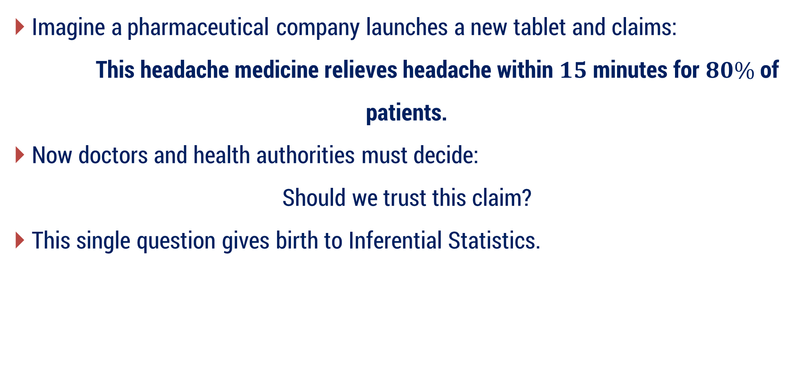
Understanding Hypothesis
Imagine a pharmaceutical company launches a new tablet and claims:
This headache medicine relieves headache within $15$ minutes for $80\%$ of patients.
Now doctors and health authorities must decide:
Should we trust this claim?
This single question gives birth to Inferential Statistics.

Slide 7
Question
We cannot test every patient in the world…So how can we check whether this claim is true?
We move to Population and Sample.

Slide 8
1 - Understanding Population
The medicine will be used by many people — maybe lakhs or millions.
All people who may take this medicine form the Population.
So,
Population = All headache patients who may use the medicine
But here comes the problem:
Testing every patient is impossible
Too costly
Too time-consuming

Slide 9
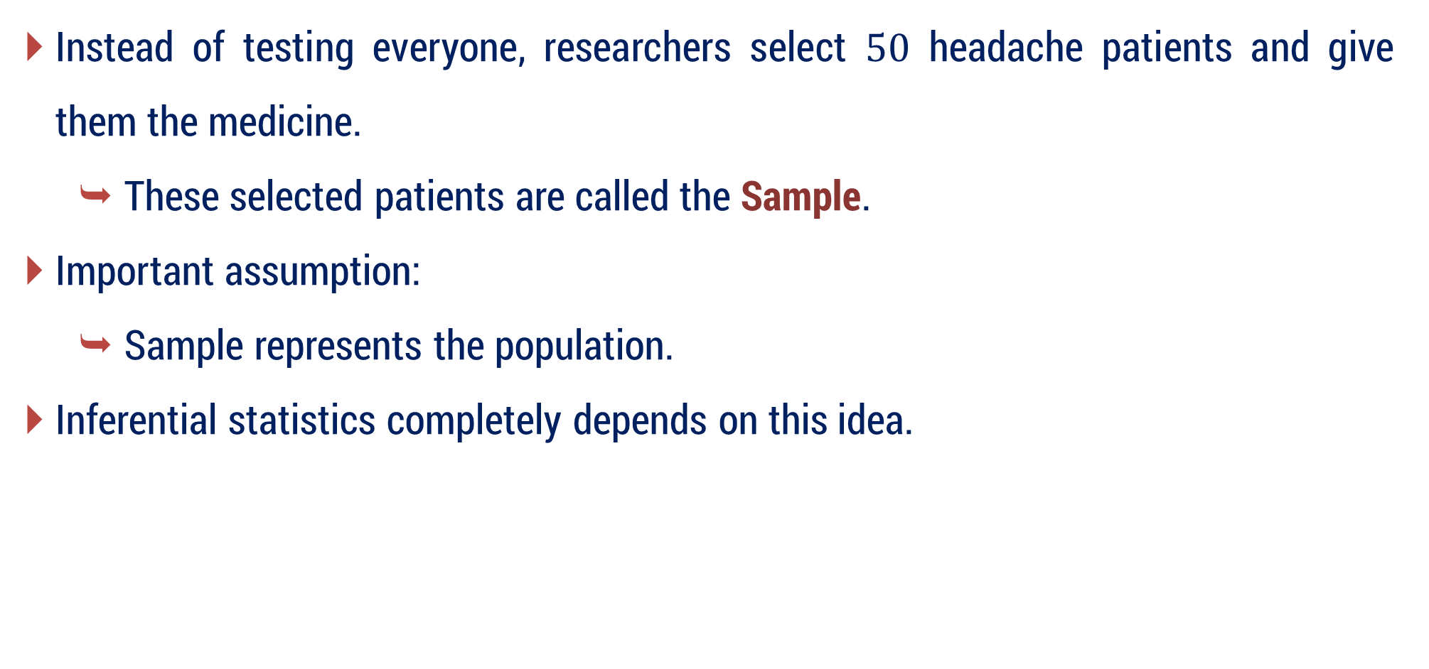
2 - Taking a Sample
Instead of testing everyone, researchers select $50$ headache patients and give them the medicine.
These selected patients are called the Sample.
Important assumption:
Sample represents the population.
Inferential statistics completely depends on this idea.

Slide 10
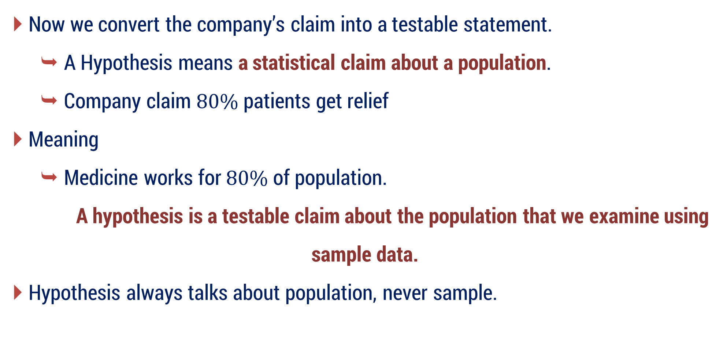
3 - Forming a Hypothesis
Now we convert the company’s claim into a testable statement.
A Hypothesis means a statistical claim about a population.
Company claim $80\%$ patients get relief
Meaning
Medicine works for $80\%$ of population.
A hypothesis is a testable claim about the population that we examine using sample data.
Hypothesis always talks about population, never sample.

Slide 11
4 - Why do we need hypothesis?
Because real life decisions cannot rely on belief.
Without hypothesis:
Any company can make claims
Any policy can be accepted blindly
Any AI model performance claim may be fake
Hypothesis gives scientific decision making.
It converts belief → evidence-based conclusion.

Slide 12
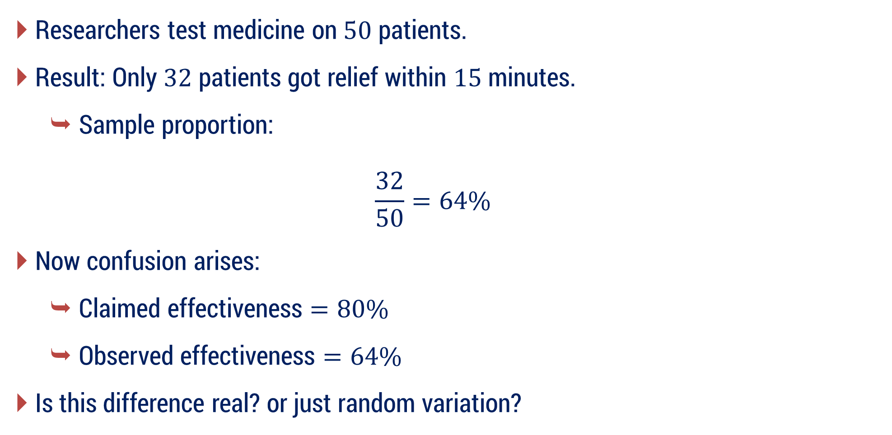
5 - Performing Experiment (Sample Study)
Researchers test medicine on $50$ patients.
Result: Only $32$ patients got relief within $15$ minutes.
Sample proportion:
$$\frac{32}{50}=64\%$$
Now confusion arises:
Claimed effectiveness $=80\%$
Observed effectiveness $=64\%$
Is this difference real? or just random variation?

Slide 13
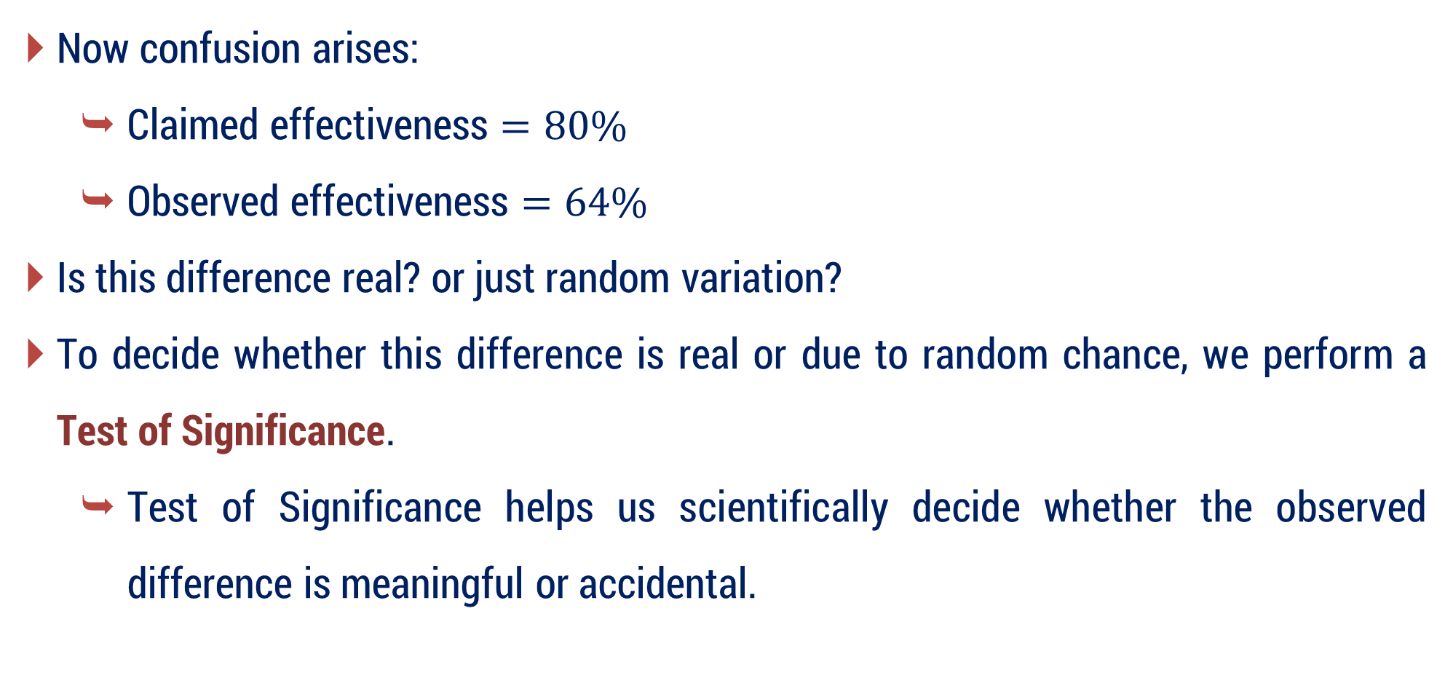
5 - Performing Experiment (Sample Study)
Now confusion arises:
Claimed effectiveness $=80\%$
Observed effectiveness $=64\%$
Is this difference real? or just random variation?
To decide whether this difference is real or due to random chance, we perform a Test of Significance.
Test of Significance helps us scientifically decide whether the observed difference is meaningful or accidental.

Slide 14
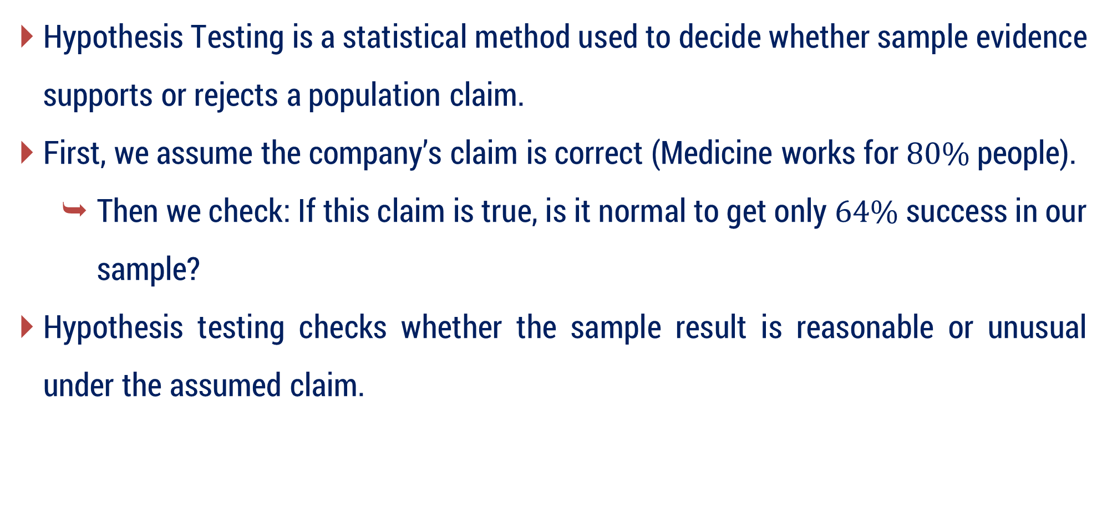
6 - What is Hypothesis Testing?
Hypothesis Testing is a statistical method used to decide whether sample evidence supports or rejects a population claim.
First, we assume the company’s claim is correct (Medicine works for $80\%$ people).
Then we check: If this claim is true, is it normal to get only $64\%$ success in our sample?
Hypothesis testing checks whether the sample result is reasonable or unusual under the assumed claim.

Slide 15
7 - What actually is being tested?
We are not testing:
the whole population
individual people
the sample itself
We are actually testing:
Whether the sample result supports or contradicts the population claim (hypothesis).

Slide 16
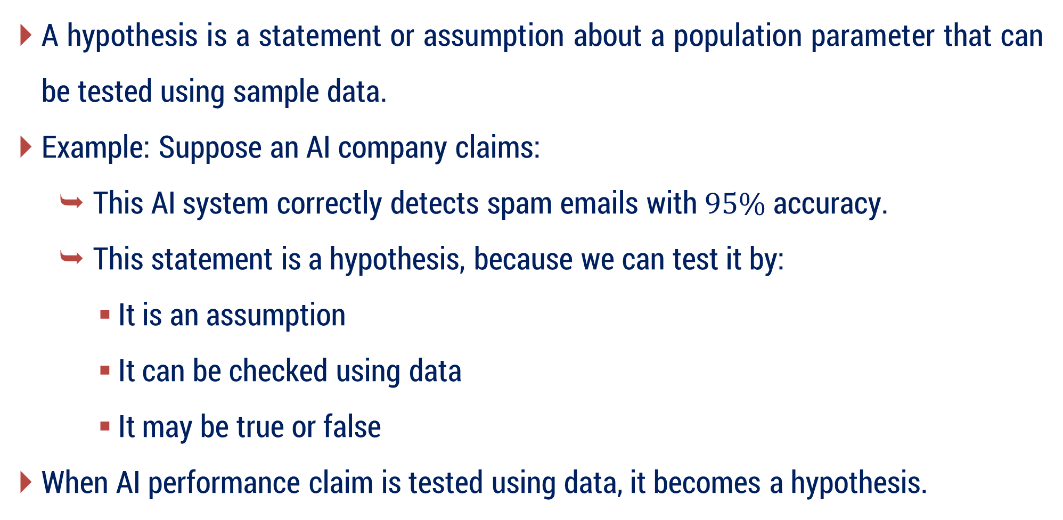
What is Hypothesis ?
A hypothesis is a statement or assumption about a population parameter that can be tested using sample data.
Example: Suppose an AI company claims:
This AI system correctly detects spam emails with $95\%$ accuracy.
This statement is a hypothesis, because we can test it by:
It is an assumption
It can be checked using data
It may be true or false
When AI performance claim is tested using data, it becomes a hypothesis.

Slide 17
Introduction
Many problems in engineering required to decide which of two competing claims for statements about parameter is true.
Statements are known as Hypothesis, and
The decision-making procedure is known as hypothesis testing.
This is one of the most useful aspects of statistical inference, because many types of decision-making problem, tests or experiments in the engineering world can be formulated as hypothesis testing problems.

Slide 18

Population OR Universe
People of Gujarat is POPULATION.

Slide 19
Population OR Universe
An aggregate(overall) of objects under study is known as Population OR Universe.
The complete group of all items or individuals that we want to study is called Population (or Universe).
It is a collection of individual items, their characteristics, or results that can be expressed using numbers.
i.e., gathering information about objects or their qualities in numerical form.

Slide 20
Population OR Universe
A universe containing a finite number of individuals or members is known as a finite universe.
Example:
The universe of the weight of students in a particular class.
All students in a school – if you're studying test scores.
A universe with infinite number of members is known as an infinite universe.
Example:
The universe of stars
Set of points in real line

Slide 21
Hypothetical Universe
A hypothetical universe is the collection of all possible outcomes or situations under consideration for a study or experiment.
Hypothetical universe means all possible ways in which an event can occur.
Outcome 5
Outcome 1
Hypothetical Universe
Outcome 4
Outcome 2
Outcome 3

Slide 22
Hypothetical Universe
Example:
Event: Rolling a six-sided die.
1
6
2
Hypothetical Universe
5
3
4

Slide 23



Sampling
People of Rajkot is SAMPLE.
Sample size “ n ”
Large sample : $n≥30$
Small sample : $n<30$
People of Gujarat is POPULATION.

Slide 24
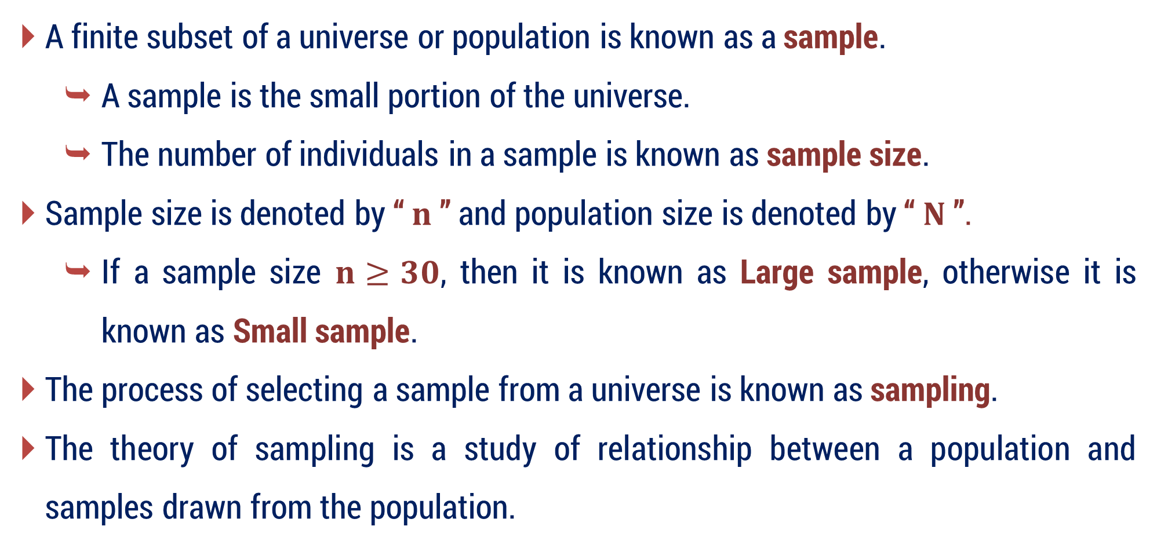
Sampling
A finite subset of a universe or population is known as a sample.
A sample is the small portion of the universe.
The number of individuals in a sample is known as sample size.
Sample size is denoted by “ $n$ ” and population size is denoted by “ $N$ ”.
If a sample size $n≥30$, then it is known as Large sample, otherwise it is known as Small sample.
The process of selecting a sample from a universe is known as sampling.
The theory of sampling is a study of relationship between a population and samples drawn from the population.

Slide 25
Sampling
The fundamental object of sampling is to get as much information as possible of the whole universe by examining only a part of it.
Sampling is a quite often used in our day-to-day life.
Example:
In a shop we assess the quality of sugar, rice or any commodity by taking only a handful of it from the bag and then decide whether to purchase it or not.

Slide 26
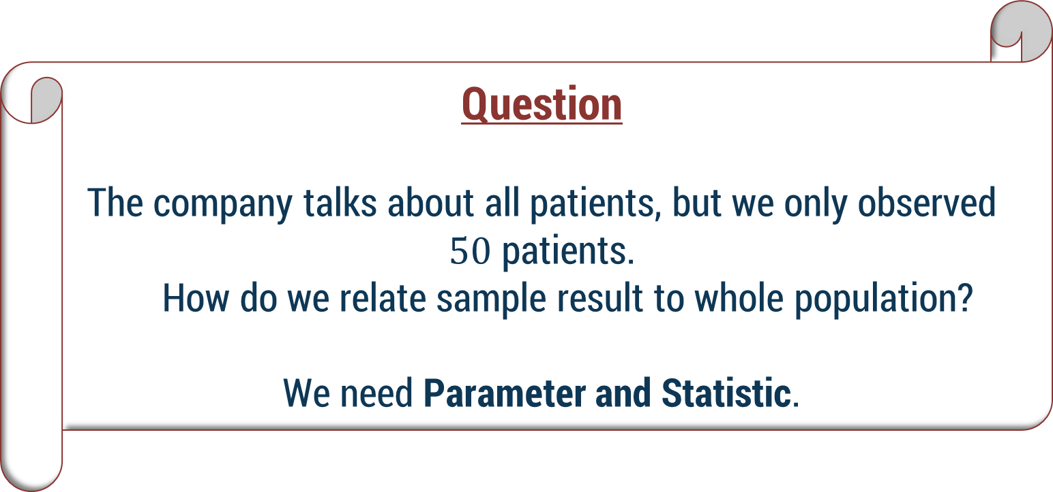
Question
The company talks about all patients, but we only observed $50$ patients.
How do we relate sample result to whole population?
We need Parameter and Statistic.

Slide 27












Parameter and Statistics
The statistical constants of population are known as parameter.
The statistical constants of sample are known as statistic.
Notations for statistical constants are as below:
Statistical Constant | For sample | For Population
No. of elements (Size)
$$n$$
$$N$$
Proportion
$$p$$
$$P$$
Mean
$$\overline{x}$$
$$μ$$
Standard Deviation
$$s$$
$$σ$$
Variance
$$s^{2}$$
$$σ^{2}$$
Correlation Coefficient
$$r$$
$$ρ$$

Slide 28
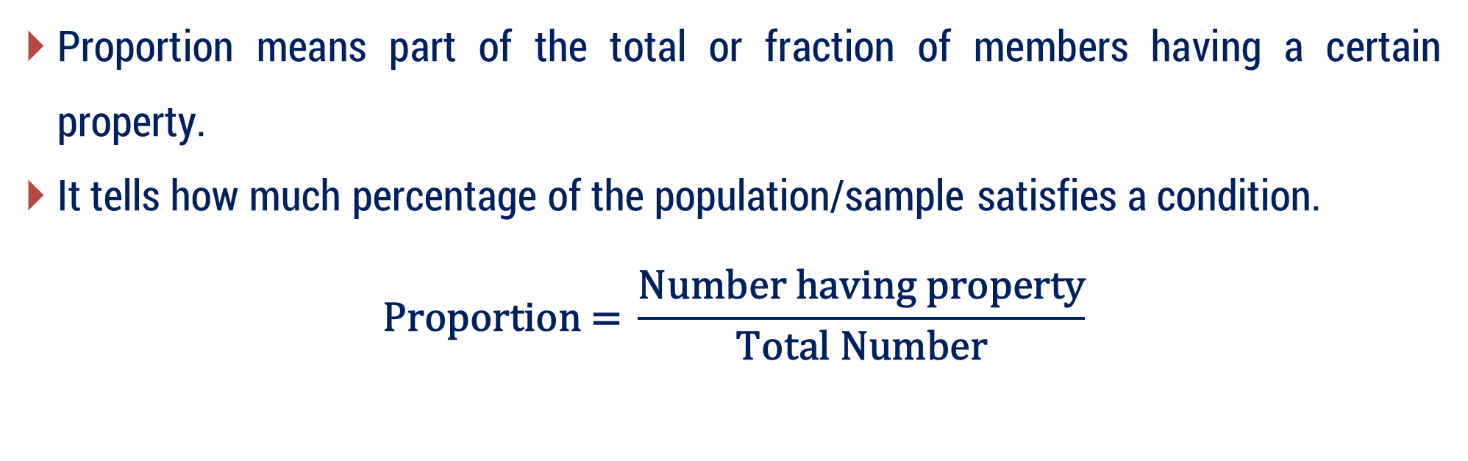
Parameter and Statistics
Proportion means part of the total or fraction of members having a certain property.
It tells how much percentage of the population/sample satisfies a condition.
$$\text{Proportion} \text{=} \frac{\text{Number} \text{having} \text{property}}{\text{Total} \text{N}\text{umber}}$$

Slide 29
Hypothesis Testing as a Courtroom Trial
Imagine we are in a court of law.
Judge → Statistician / Doctor
Pharmaceutical Company → Accused Claim / Hypothesis
Patients → Population
Sample Data → Evidence
Final Judgment → Statistical Decision

Slide 30

Step 1: The Company Makes a Claim
Company says:
Our medicine works for $80\%$ of patients.
In court language: The accused claims innocence.

Slide 31
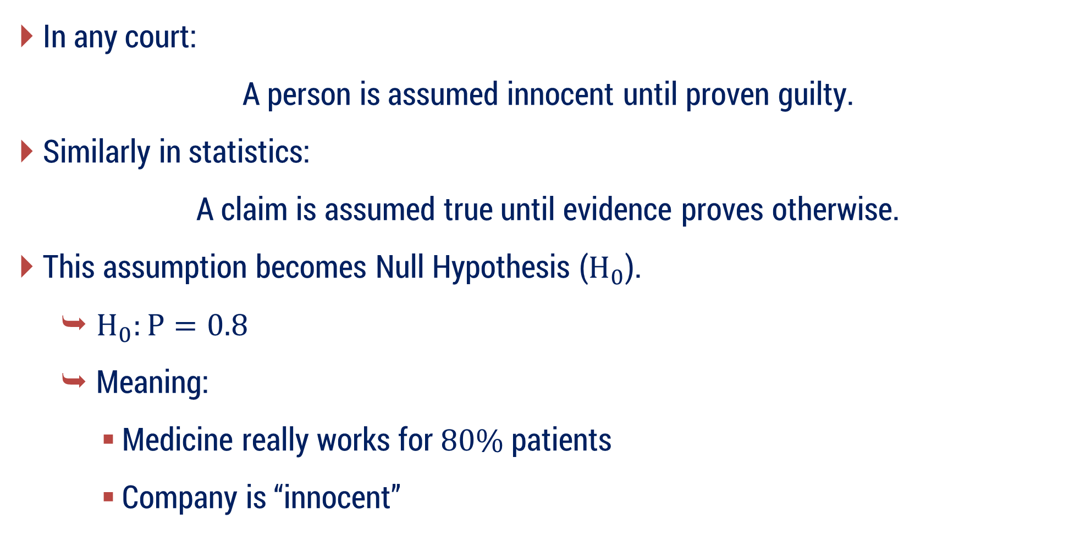
Step 2: Court Rule
In any court:
A person is assumed innocent until proven guilty.
Similarly in statistics:
A claim is assumed true until evidence proves otherwise.
This assumption becomes Null Hypothesis ($H_{0}$).
$H_{0}:P=0.8$
Meaning:
Medicine really works for $80\%$ patients
Company is “innocent”

Slide 32
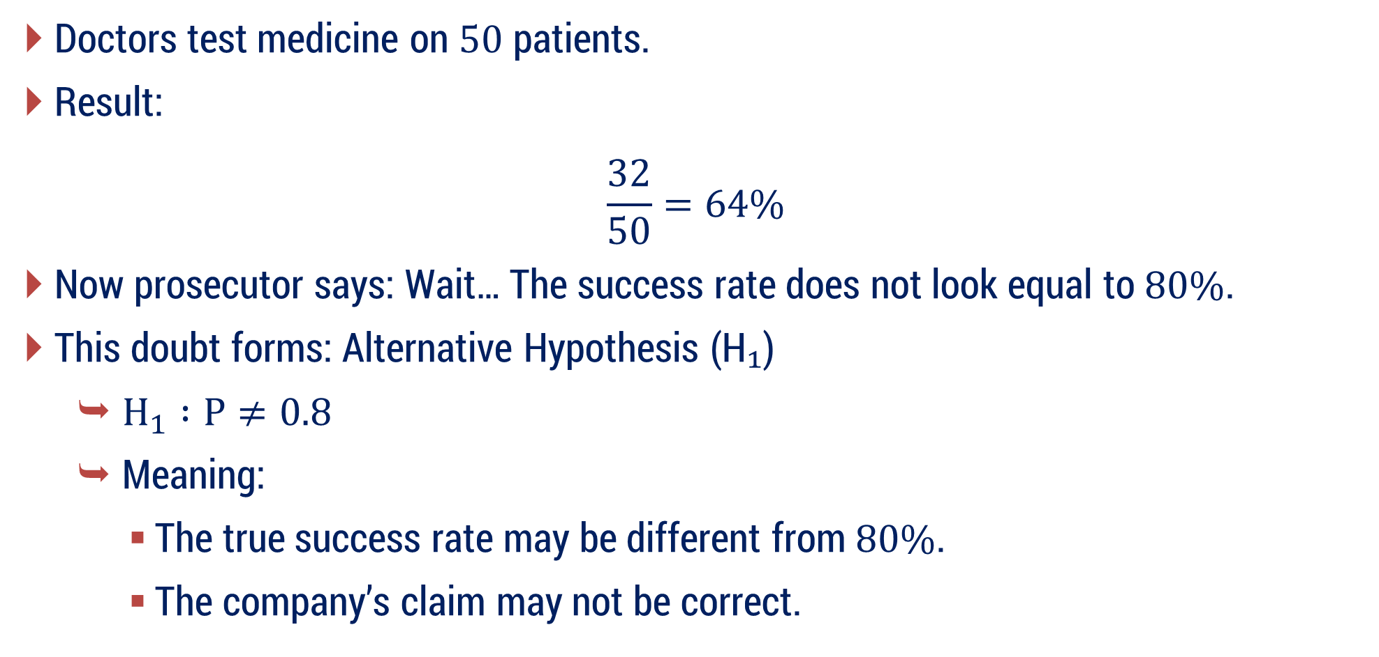
Step 3: Prosecutor Raises Doubt
Doctors test medicine on $50$ patients.
Result:
$$\frac{32}{50}=64\%$$
Now prosecutor says: Wait… The success rate does not look equal to $80\%$.
This doubt forms: Alternative Hypothesis (H₁)
$H_{1} :P≠0.8$
Meaning:
The true success rate may be different from $80\%$.
The company’s claim may not be correct.

Slide 33

Step 4: Judge’s Question (Core of Hypothesis Testing)
Judge asks:
If the company is truly innocent $\left(p = 0.8\right)$, could this $64\%$ result simply be due to random chance?
This is exactly what hypothesis testing tries to answer.

Slide 34
Step 5: Final Decision Rule
Case 1: Evidence is Weak
Difference may happen due to randomness.
Court Decision:
Not enough proof
Do not Reject H₀.
Meaning:
Claim continues
Company treated as innocent

Slide 35
Step 5: Final Decision Rule
Case 2: Evidence is Strong
Difference too large to ignore.
Court Decision:
Claim unlikely true.
so, reject H₀.
Meaning: Company claim doubtful
We never prove a claim true — we only check whether evidence is strong enough to reject it.

Slide 36
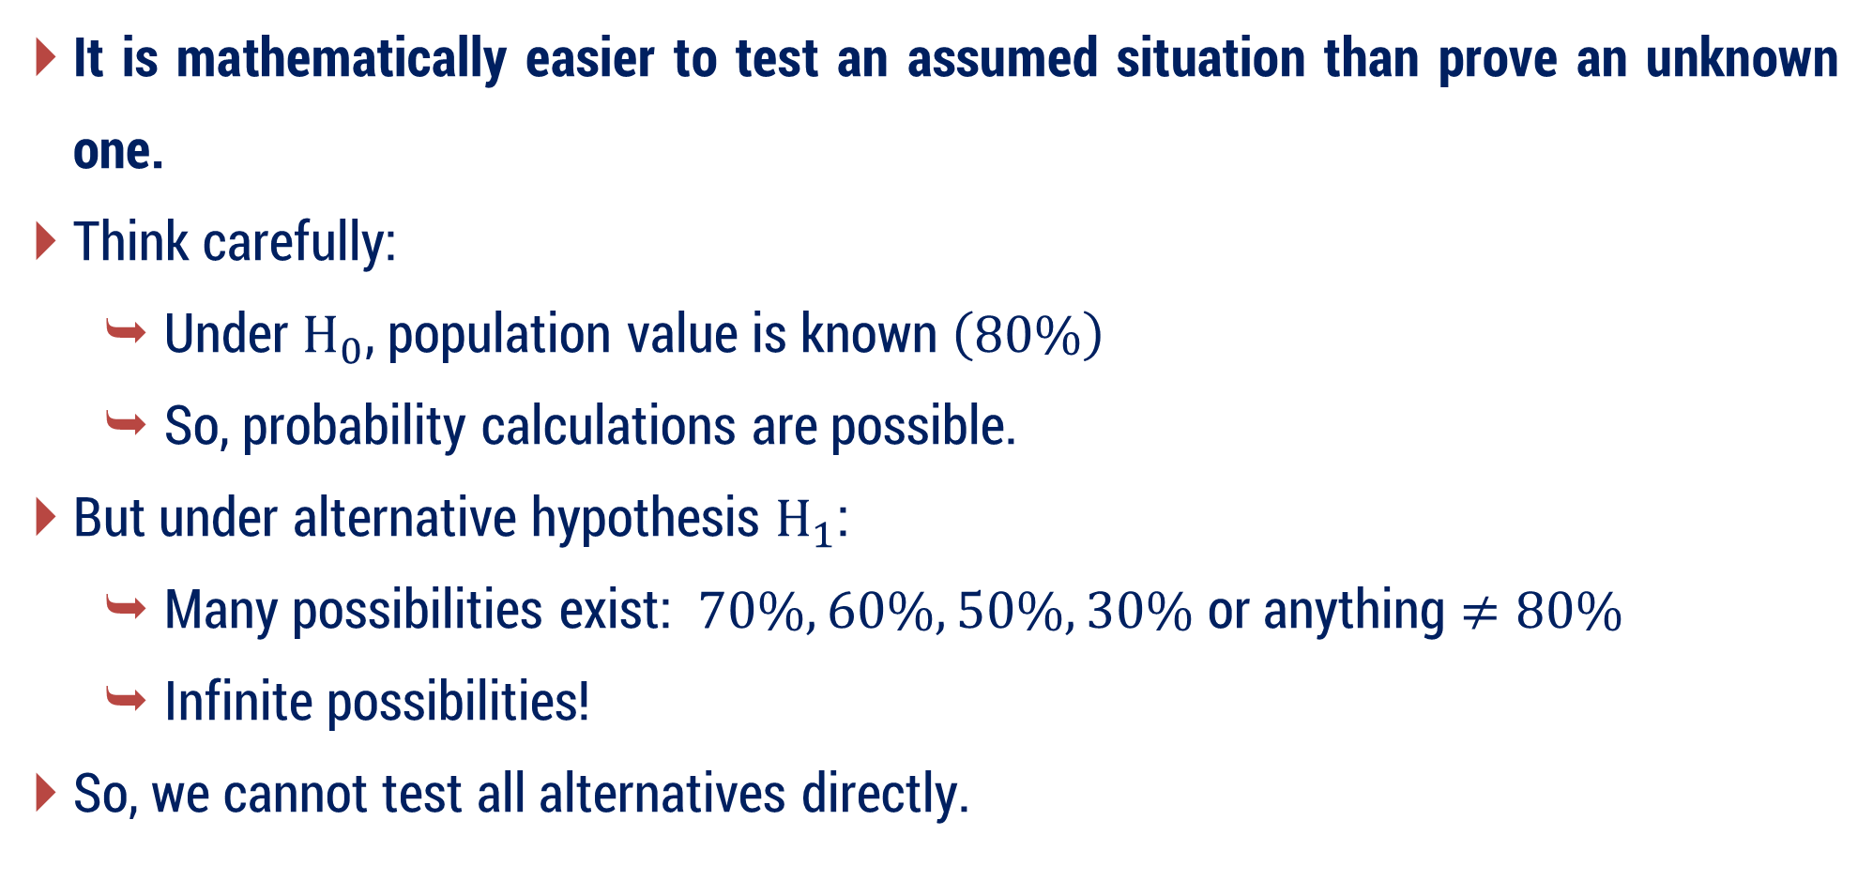
Why don’t we prove alternative hypothesis directly?
It is mathematically easier to test an assumed situation than prove an unknown one.
Think carefully:
Under $H_{0}$​, population value is known $\left(80\%\right)$
So, probability calculations are possible.
But under alternative hypothesis $H_{1}$:
Many possibilities exist: $70\%, 60\%, 50\%, 30\%$ or anything $≠80\%$
Infinite possibilities!
So, we cannot test all alternatives directly.

Slide 37
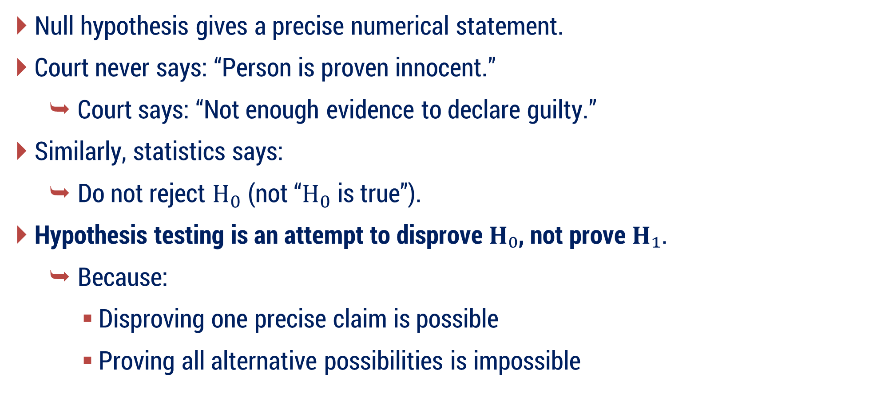
Why don’t we prove alternative hypothesis directly?
Null hypothesis gives a precise numerical statement.
Court never says: “Person is proven innocent.”
Court says: “Not enough evidence to declare guilty.”
Similarly, statistics says:
Do not reject $H_{0}$ ​(not “$H_{0}$ is true”).
Hypothesis testing is an attempt to disprove $H₀$, not prove $H₁$.
Because:
Disproving one precise claim is possible
Proving all alternative possibilities is impossible

Slide 38
Mapping Table
Court Trial | Hypothesis Testing
Accused innocent | Null hypothesis is true
Lawyer suspicion | Alternative hypothesis
Evidence | Sample data
Judge decision | Statistical test
Guilty verdict | Reject H₀
Not guilty | Do not reject H₀

Slide 39
Question
Before testing the claim, what assumption should we start with?
Null Hypothesis

Slide 40
Null Hypothesis
Null Hypothesis is a statistical statement about a population parameter which is assumed to be true unless sufficient sample evidence suggests otherwise.
Null Hypothesis is the statement that assumes there is no change, no difference, or that the claimed situation is true.
Null Hypothesis means:
Nothing unusual is happening
Everything is normal
The original claim continues to hold
It represents the status quo (default belief).

Slide 41
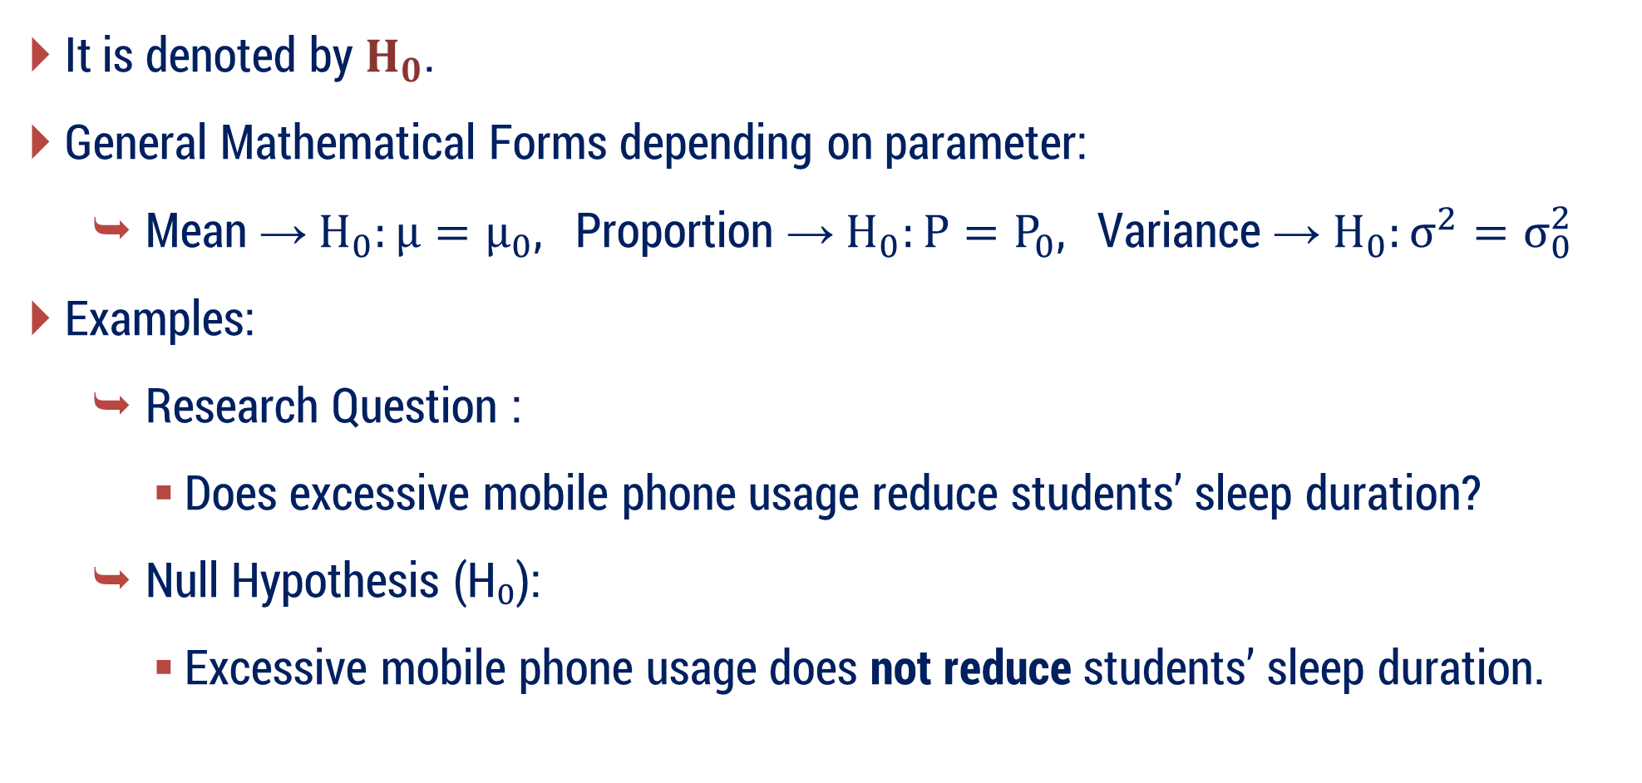
Null Hypothesis
It is denoted by $H_{0}$.
General Mathematical Forms depending on parameter:
Mean → $H_{0}:μ=μ_{0}$, ​ Proportion → $H_{0}:P=P_{0}$, ​ Variance → $H_{0}:σ^{2}=σ_{0}^{2}$
Examples:
Research Question :
Does excessive mobile phone usage reduce students’ sleep duration?
Null Hypothesis (H₀):
Excessive mobile phone usage does not reduce students’ sleep duration.

Slide 42
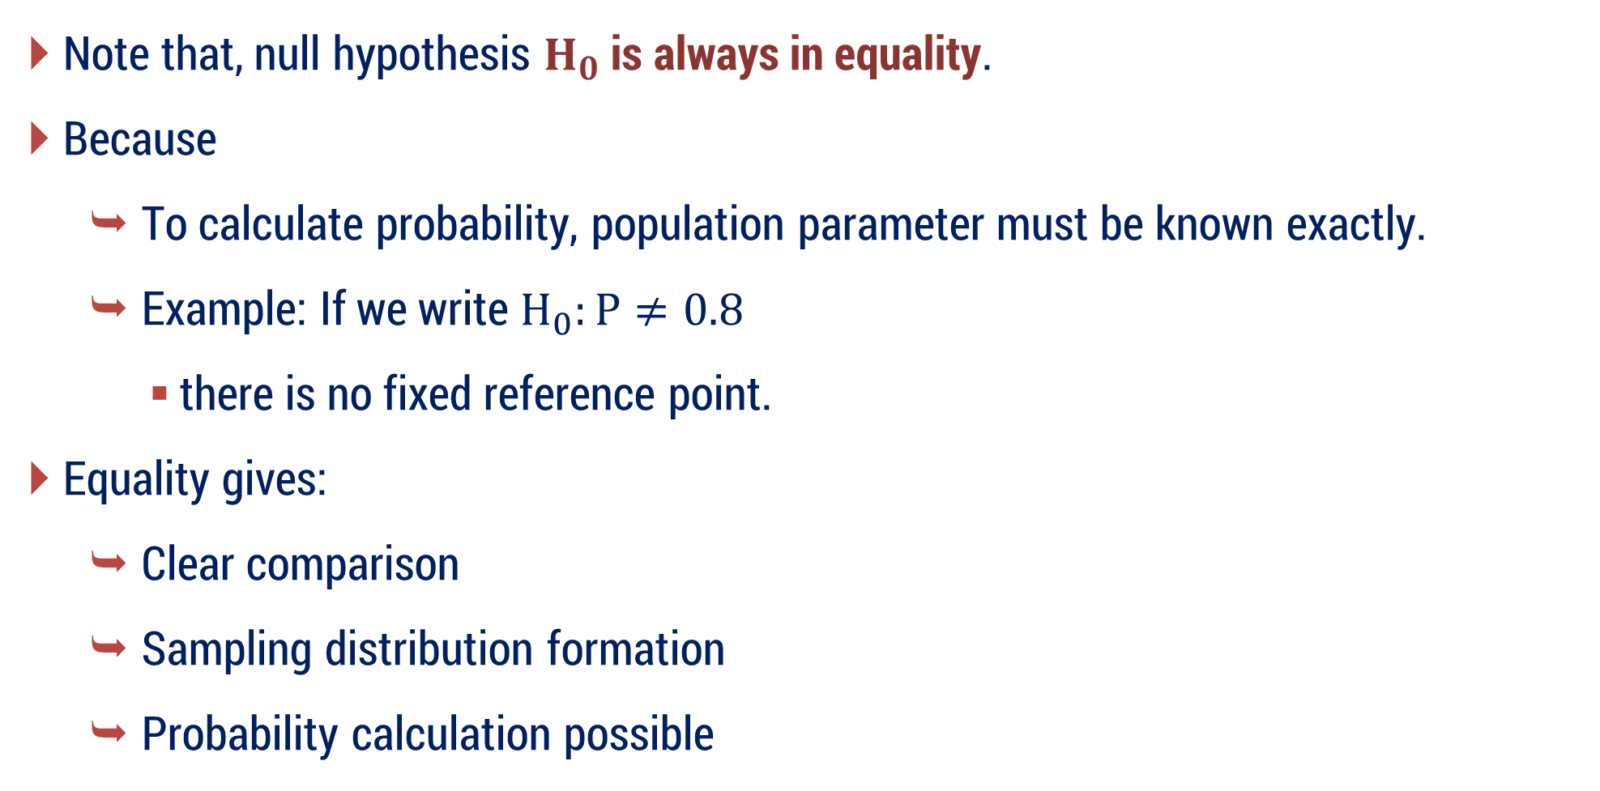
Null Hypothesis
Note that, null hypothesis $H_{0}$ is always in equality.
Because
To calculate probability, population parameter must be known exactly.
Example: If we write $H_{0}:P≠0.8$
there is no fixed reference point.
Equality gives:
Clear comparison
Sampling distribution formation
Probability calculation possible

Slide 43
Why is it called Null Hypothesis?
Because it represents:
No new effect
No improvement
No difference from claimed value
So “Null” = Zero change / Status quo.

Slide 44
Question
In statistics, we do not assume only one possibility.
Along with the claim, we also consider its opposite.
That opposite statement is the Alternative Hypothesis.

Slide 45
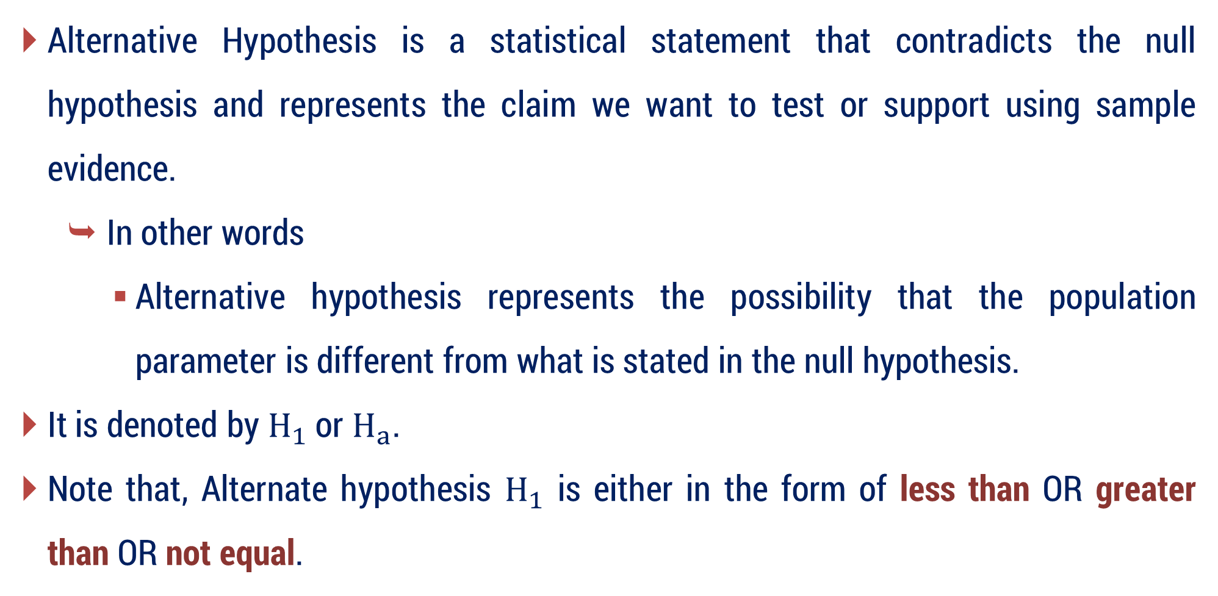
Alternative Hypothesis
Alternative Hypothesis is a statistical statement that contradicts the null hypothesis and represents the claim we want to test or support using sample evidence.
In other words
Alternative hypothesis represents the possibility that the population parameter is different from what is stated in the null hypothesis.
It is denoted by $H_{1}$ or $H_{a}$.
Note that, Alternate hypothesis $H_{1}$ is either in the form of less than OR greater than OR not equal.

Slide 46
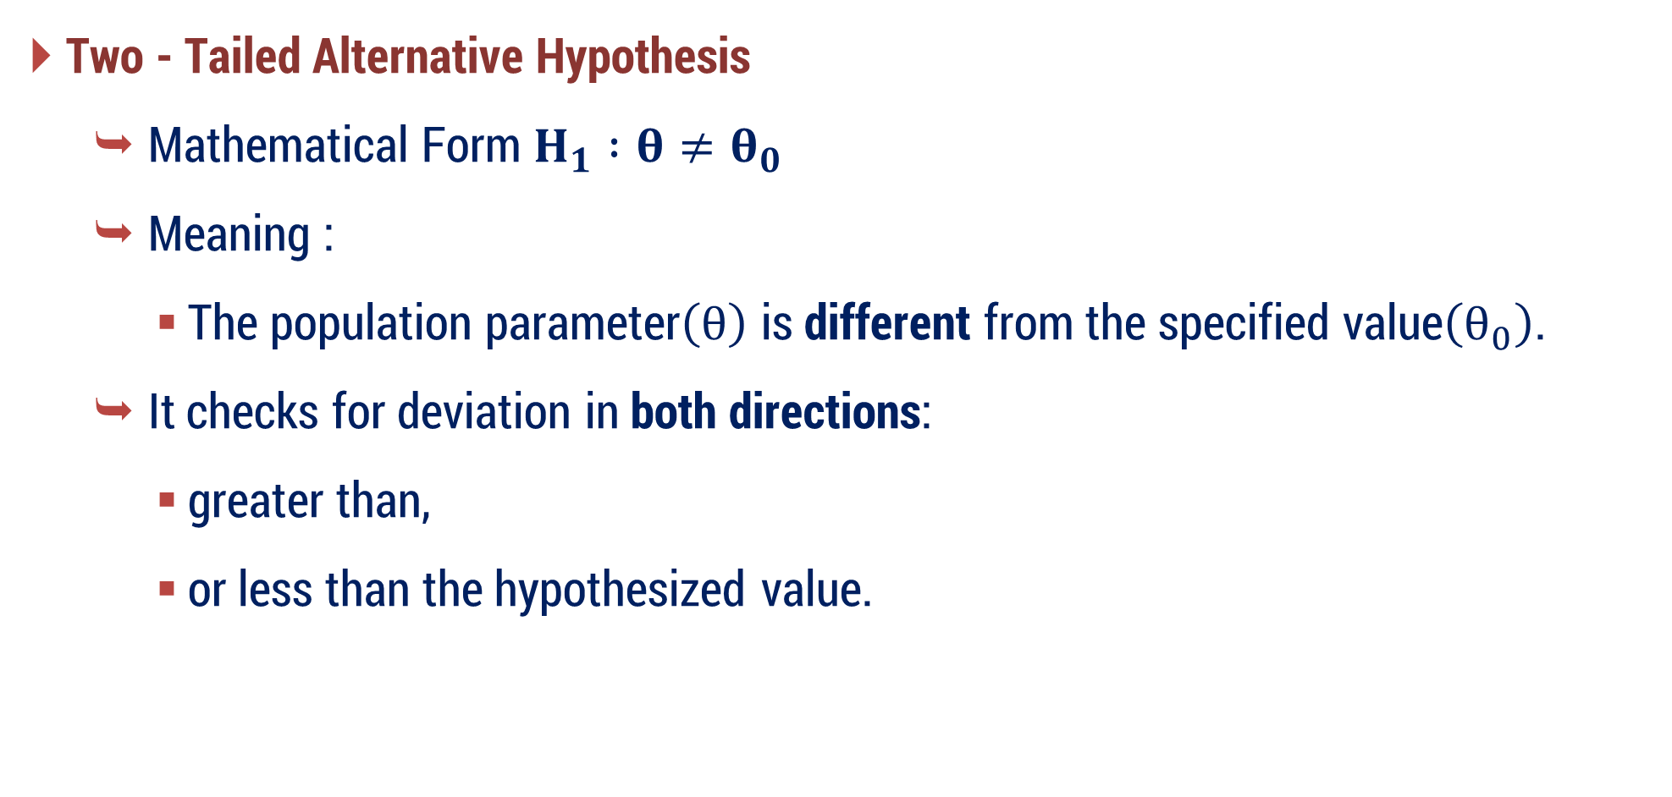
Types of Alternative Hypothesis
Two - Tailed Alternative Hypothesis
Mathematical Form $H_{1} :θ≠θ_{0}$ ​
Meaning :
The population parameter$\left(θ\right)$ is different from the specified value$\left(θ_{0}\right)$.
It checks for deviation in both directions:
greater than,
or less than the hypothesized value.

Slide 47
Types of Alternative Hypothesis
Two - Tailed Alternative Hypothesis
Research Question
Does a new teaching method change students’ academic performance?
Null Hypothesis (H₀)
The new teaching method does not affect students’ academic performance.
Alternative Hypothesis (H₁)
The new teaching method affects students’ academic performance.
Meaning: Performance may increase or decrease.

Slide 48
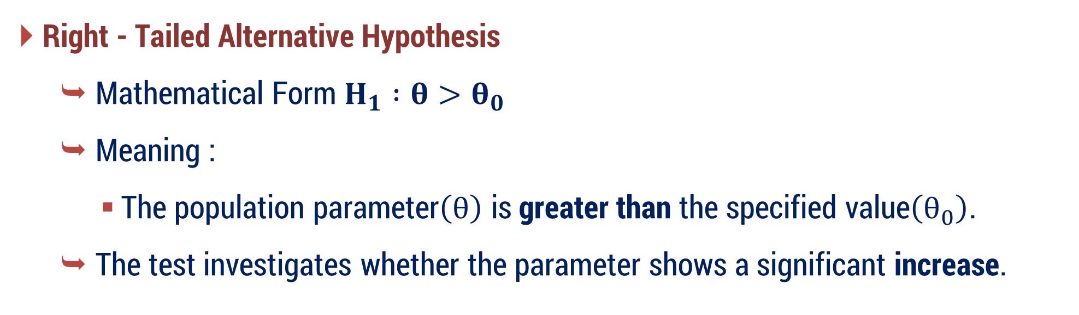
Types of Alternative Hypothesis
Right - Tailed Alternative Hypothesis
Mathematical Form $H_{1} :θ>θ_{0}$ ​
Meaning :
The population parameter$\left(θ\right)$ is greater than the specified value$\left(θ_{0}\right)$.
The test investigates whether the parameter shows a significant increase.

Slide 49
Types of Alternative Hypothesis
Right - Tailed Alternative Hypothesis
Research Question
Does regular coding practice improve programming skills?
Null Hypothesis (H₀)
Regular coding practice does not improve programming skills.
Alternative Hypothesis (H₁)
Regular coding practice improves programming skills.
Meaning: We are checking only increase/improvement.

Slide 50
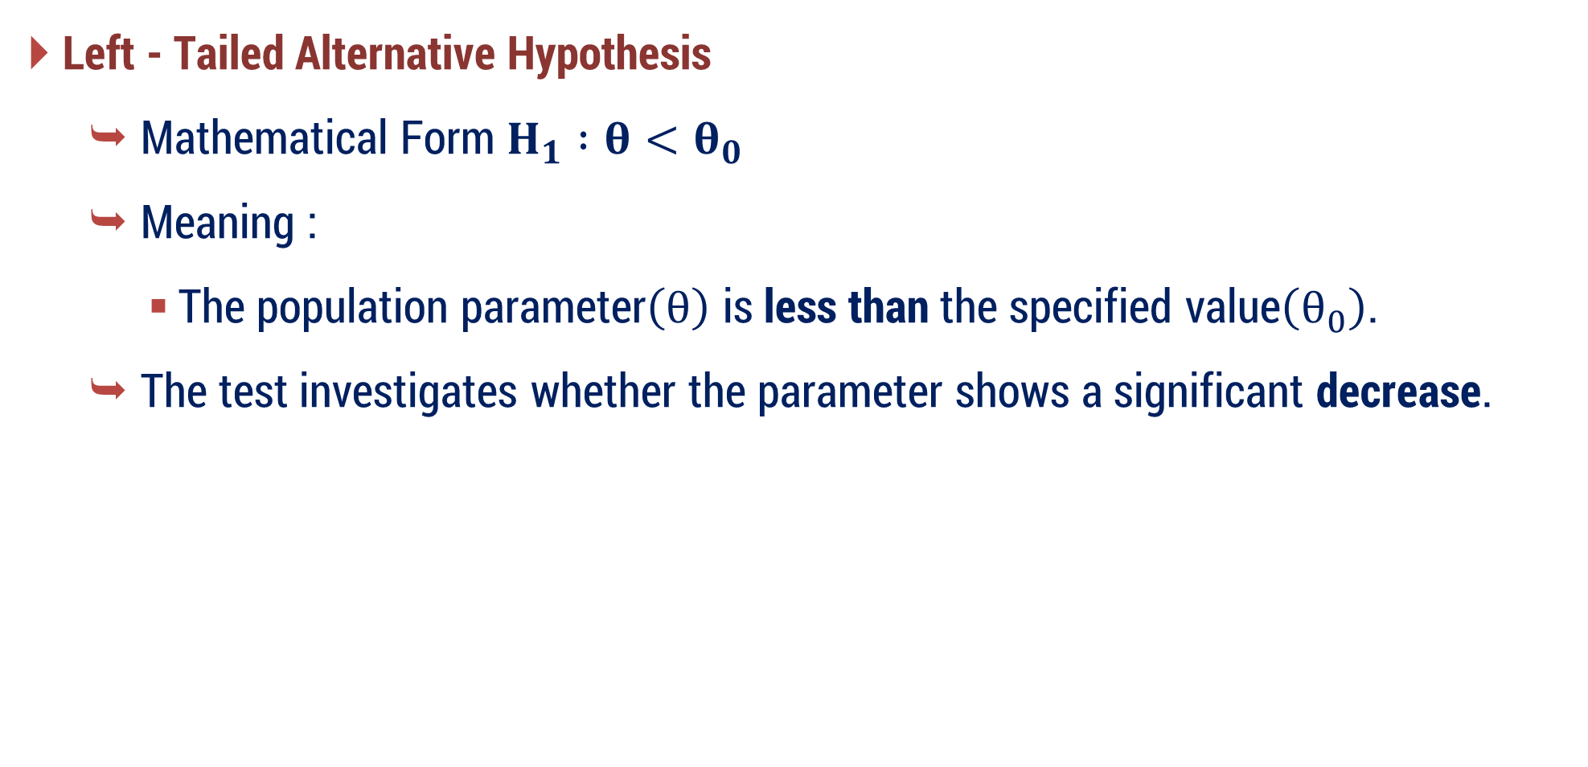
Types of Alternative Hypothesis
Left - Tailed Alternative Hypothesis
Mathematical Form $H_{1} :θ<θ_{0}$ ​
Meaning :
The population parameter$\left(θ\right)$ is less than the specified value$\left(θ_{0}\right)$.
The test investigates whether the parameter shows a significant decrease.

Slide 51
Types of Alternative Hypothesis
Left - Tailed Alternative Hypothesis
Research Question
Does prolonged screen time reduce students’ concentration level?
Null Hypothesis (H₀)
Prolonged screen time does not reduce concentration level.
Alternative Hypothesis (H₁)
Prolonged screen time reduces concentration level.
Meaning: We are checking only decrease.

Slide 52

Why normal distribution appears in hypothesis testing?
In hypothesis testing, we do not test the population directly.
Instead, we test sample statistics like sample mean or proportion.
According to the Central Limit Theorem, when the sample size is sufficiently large:
Distribution of sample mean becomes approximately Normal even if the original population is not normal.

Slide 53
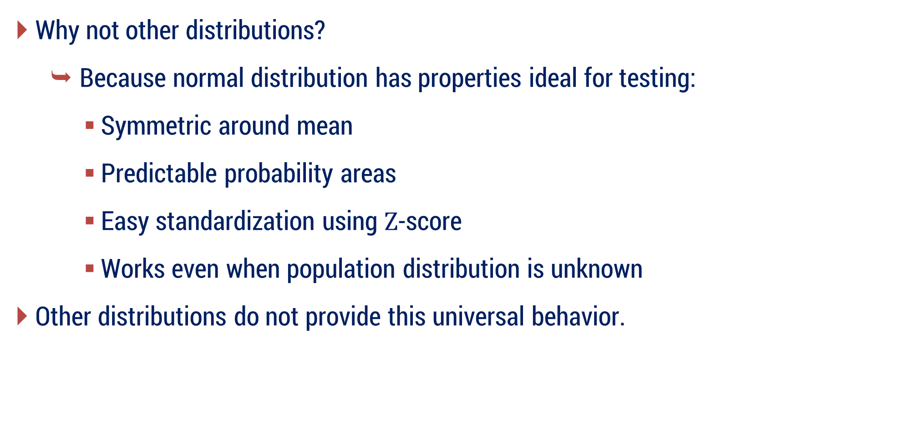
Why normal distribution appears in hypothesis testing?
Why not other distributions?
Because normal distribution has properties ideal for testing:
Symmetric around mean
Predictable probability areas
Easy standardization using $Z$-score
Works even when population distribution is unknown
Other distributions do not provide this universal behavior.

Slide 54
Question
When we make decisions using only sample data, is there a chance of making mistakes? — Yes
This leads to Errors due to Sampling.

Slide 55
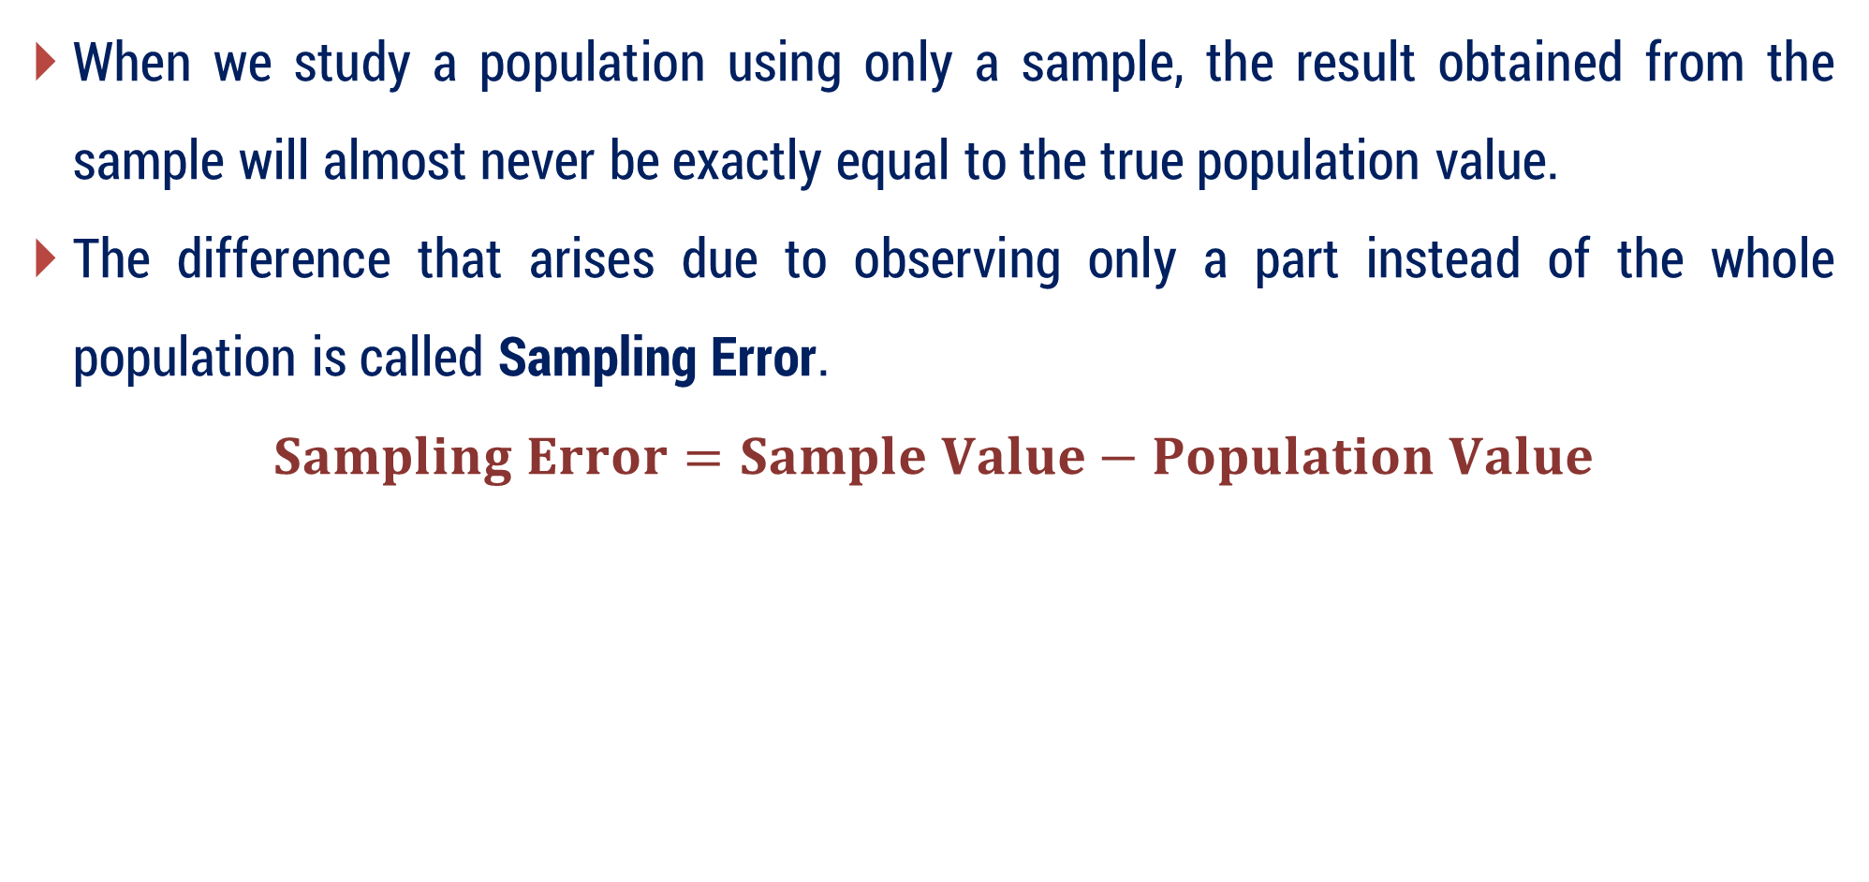
Errors in Sampling
When we study a population using only a sample, the result obtained from the sample will almost never be exactly equal to the true population value.
The difference that arises due to observing only a part instead of the whole population is called Sampling Error.
$$Sampling Error=Sample Value−Population Value$$

Slide 56
Question
Because of Sampling Error, the result of one sample may be slightly different from another sample.
How much variation can occur in sample results?
This variation is measured using Standard Error.

Slide 57
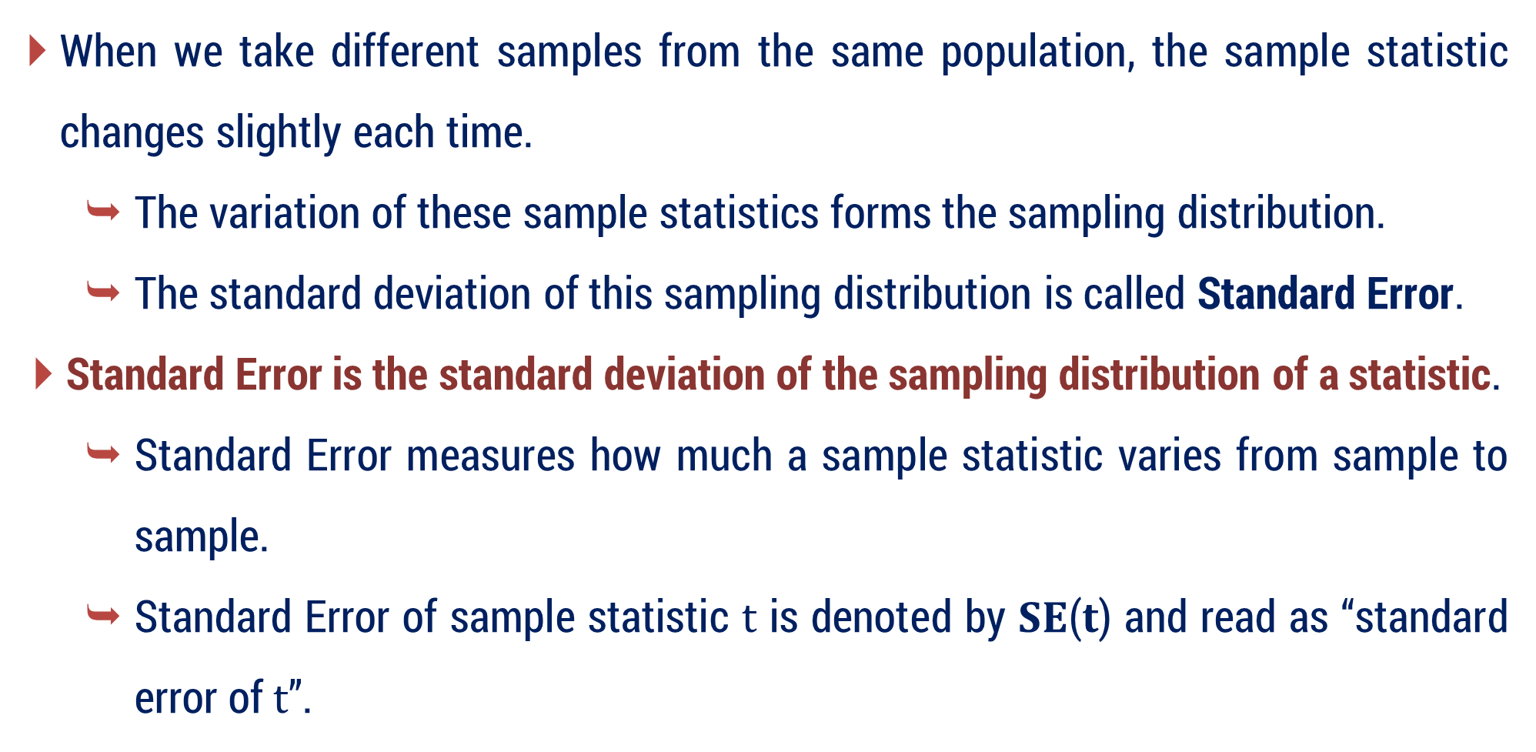
Standard Error
When we take different samples from the same population, the sample statistic changes slightly each time.
The variation of these sample statistics forms the sampling distribution.
The standard deviation of this sampling distribution is called Standard Error.
Standard Error is the standard deviation of the sampling distribution of a statistic.
Standard Error measures how much a sample statistic varies from sample to sample.
Standard Error of sample statistic $t$ is denoted by 𝐒𝐄(𝐭) and read as “standard error of $t$”.

Slide 58
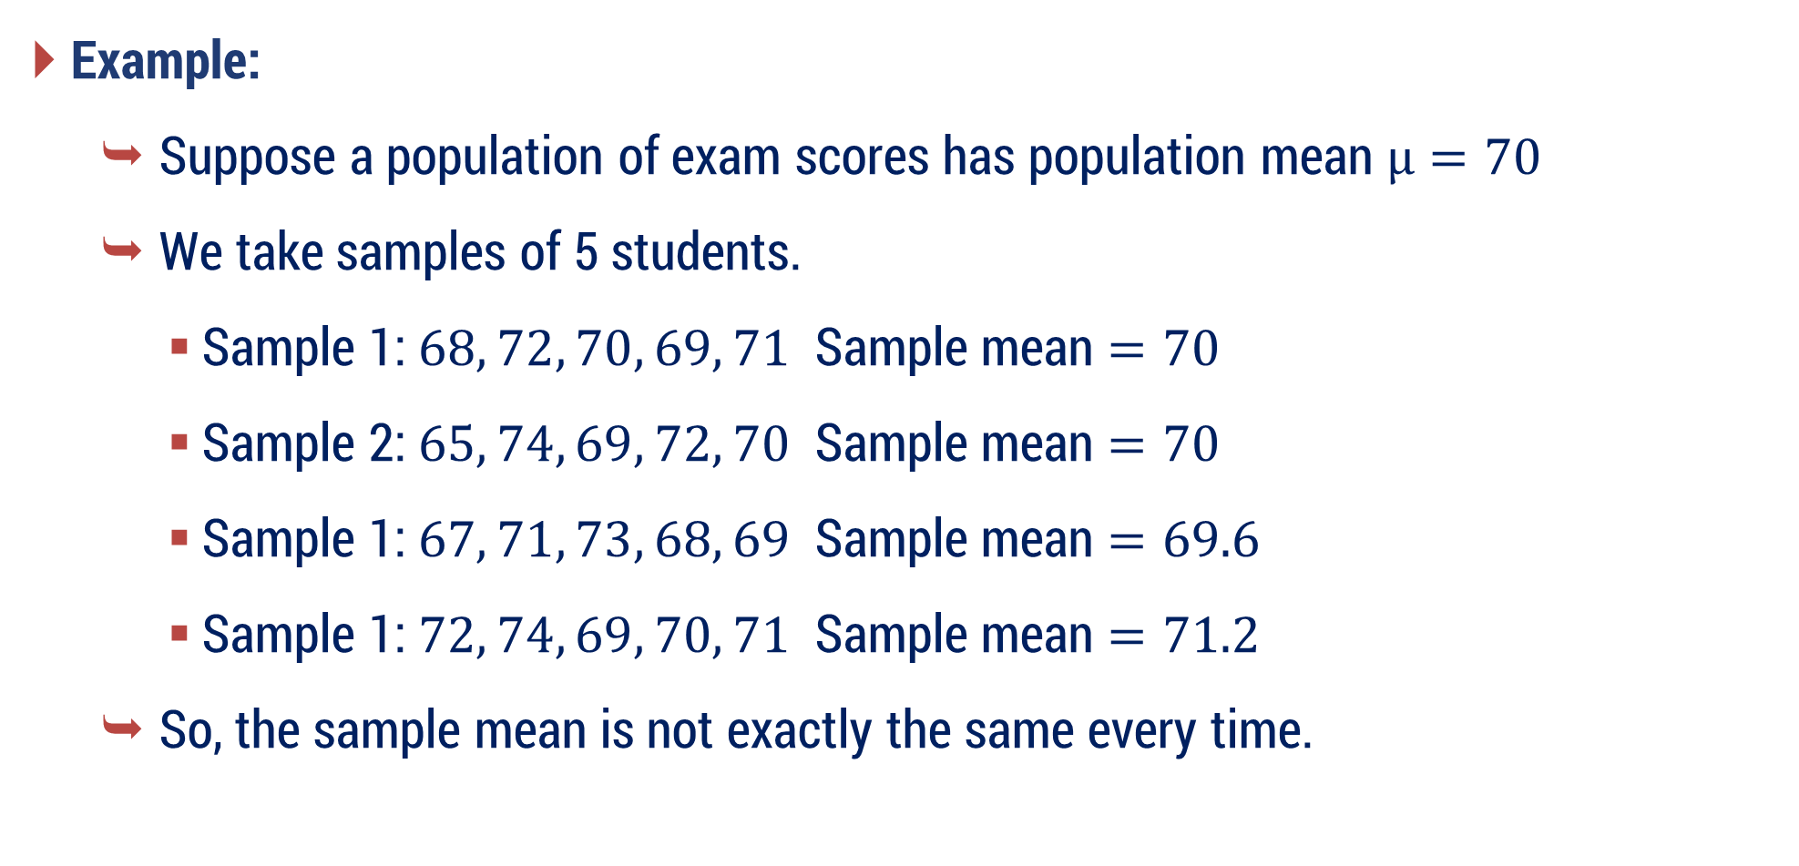
Standard Error
Example:
Suppose a population of exam scores has population mean $μ=70$
We take samples of 5 students.
Sample 1: $68, 72, 70, 69, 71$ Sample mean $=70$
Sample 2: $65, 74, 69, 72, 70$ Sample mean $=70$
Sample 1: $67, 71, 73, 68, 69$ Sample mean $=69.6$
Sample 1: $72, 74, 69, 70, 71$ Sample mean $=71.2$
So, the sample mean is not exactly the same every time.

Slide 59
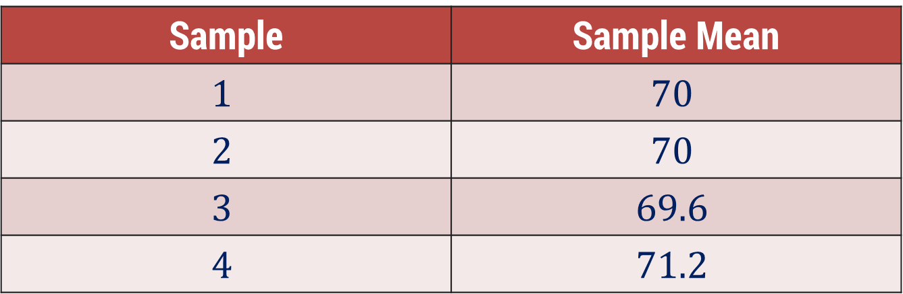
Standard Error
Example:
These sample means form the sampling distribution.
Sampling Distribution:
Sample | Sample Mean
$$1$$ | $$70$$
$$2$$ | $$70$$
$$3$$ | $$69.6$$
$$4$$ | $$71.2$$
These values vary slightly around the population mean $\left(70\right)$.
The standard deviation of these sample means is called Standard Error.

Slide 60
Standard Error
Core idea
Standard Error measures how much a sample statistic varies from sample to sample due to random sampling.
Relation with population parameter
Since the sampling distribution of the statistic is centered at the true population parameter, the sample statistics fluctuate around that true value.
Final Interpretation
Standard Error measures the variability of a sample statistic from sample to sample and indicates how close it is likely to be to the true population parameter.

Slide 61
Standard Error
Important Idea
Small SE → sample mean is very close to population mean (more reliable).
Large SE → sample mean may be far from population mean (less reliable).
Think like this:
Standard Deviation (SD) → variation among individual data values
Standard Error (SE) → variation of sample statistics

Slide 62

Standard Error
If population standard deviation is unknown (which usually happens):
$$SE= \frac{s}{\sqrt{n }}$$
where, $s=$ Sample standard deviation

Slide 63
Question
Once the normal variation is understood, we need a way to decide whether the observed difference is real or just due to chance.
This leads to the concept of a Test Statistic.

Slide 64
Test Statistics
A Test Statistic is a numerical value calculated from sample data which helps us decide whether to accept or reject the Null Hypothesis (H₀) in hypothesis testing.
In simple words:
Test Statistic measures how far our sample result is from what we expect under the null hypothesis.
The test statistic tells:
How many standard errors away the sample result is from the claimed population value.
So, it converts the problem into a standard measurable scale.

Slide 65
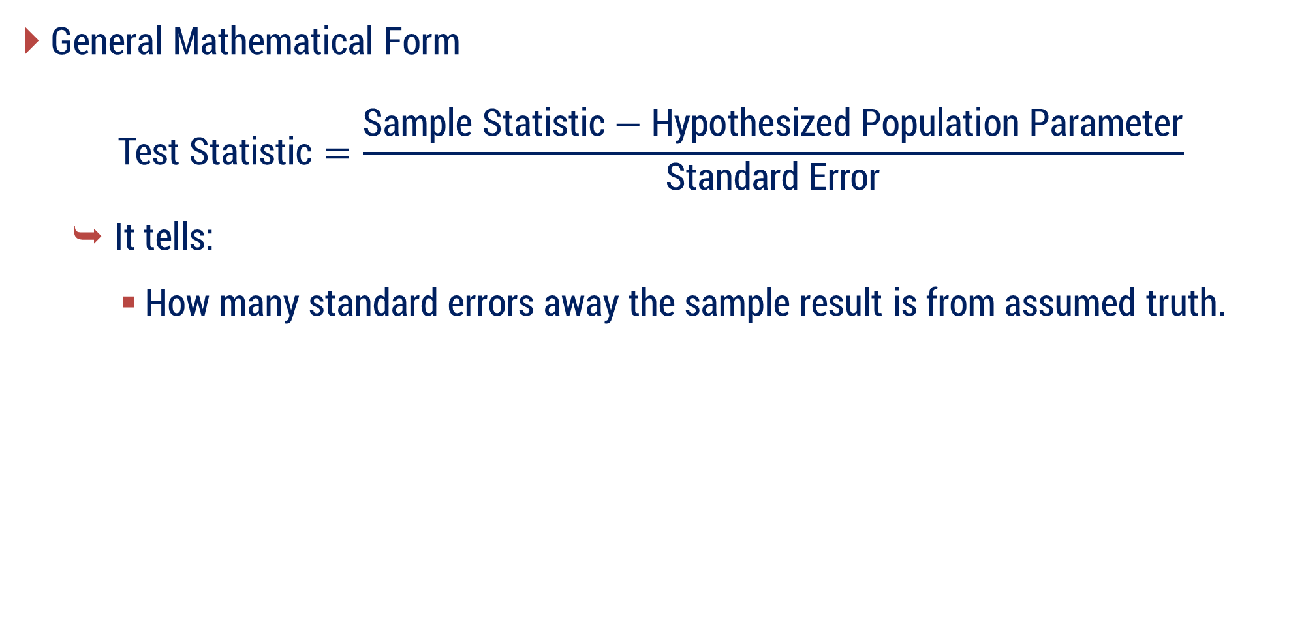
Test Statistics
General Mathematical Form
$$\text{Test} \text{Statistic}=\frac{\text{Sample} \text{Statistic}−\text{Hypothesized} \text{Population} \text{Parameter}\text{​}}{\text{S}\text{tandard} \text{E}\text{rror}}$$
It tells:
How many standard errors away the sample result is from assumed truth.

Slide 66

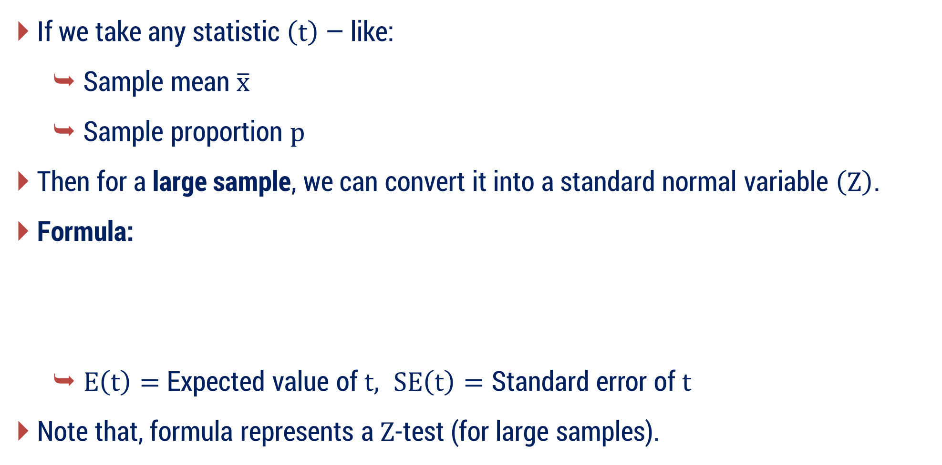

Test Statistics
If we take any statistic $\left(t\right)$ — like:
Sample mean $\overline{x}$
Sample proportion $p$ ​
Then for a large sample, we can convert it into a standard normal variable $\left(Z\right)$.
Formula:
$E\left(t\right)=$ Expected value of $t, SE\left(t\right)=\text{Standard} \text{error} \text{of} t$
Note that, formula represents a $Z$-test (for large samples).
$$Z=\frac{t−E(t)}{SE(t)}$$
$$\sim N\left(0, 1\right)$$

Slide 67
Question
While making decisions using sample data, what kinds of mistakes can occur?
This introduces Type – I and Type – II Errors

Slide 68
Type-I and Type-II Errors
Whenever we perform Hypothesis Testing, we are making a decision under uncertainty.
Because decisions are based on sample data, mistakes are possible.
These decision mistakes are called:
Type – I Error
Type – II Error

Slide 69
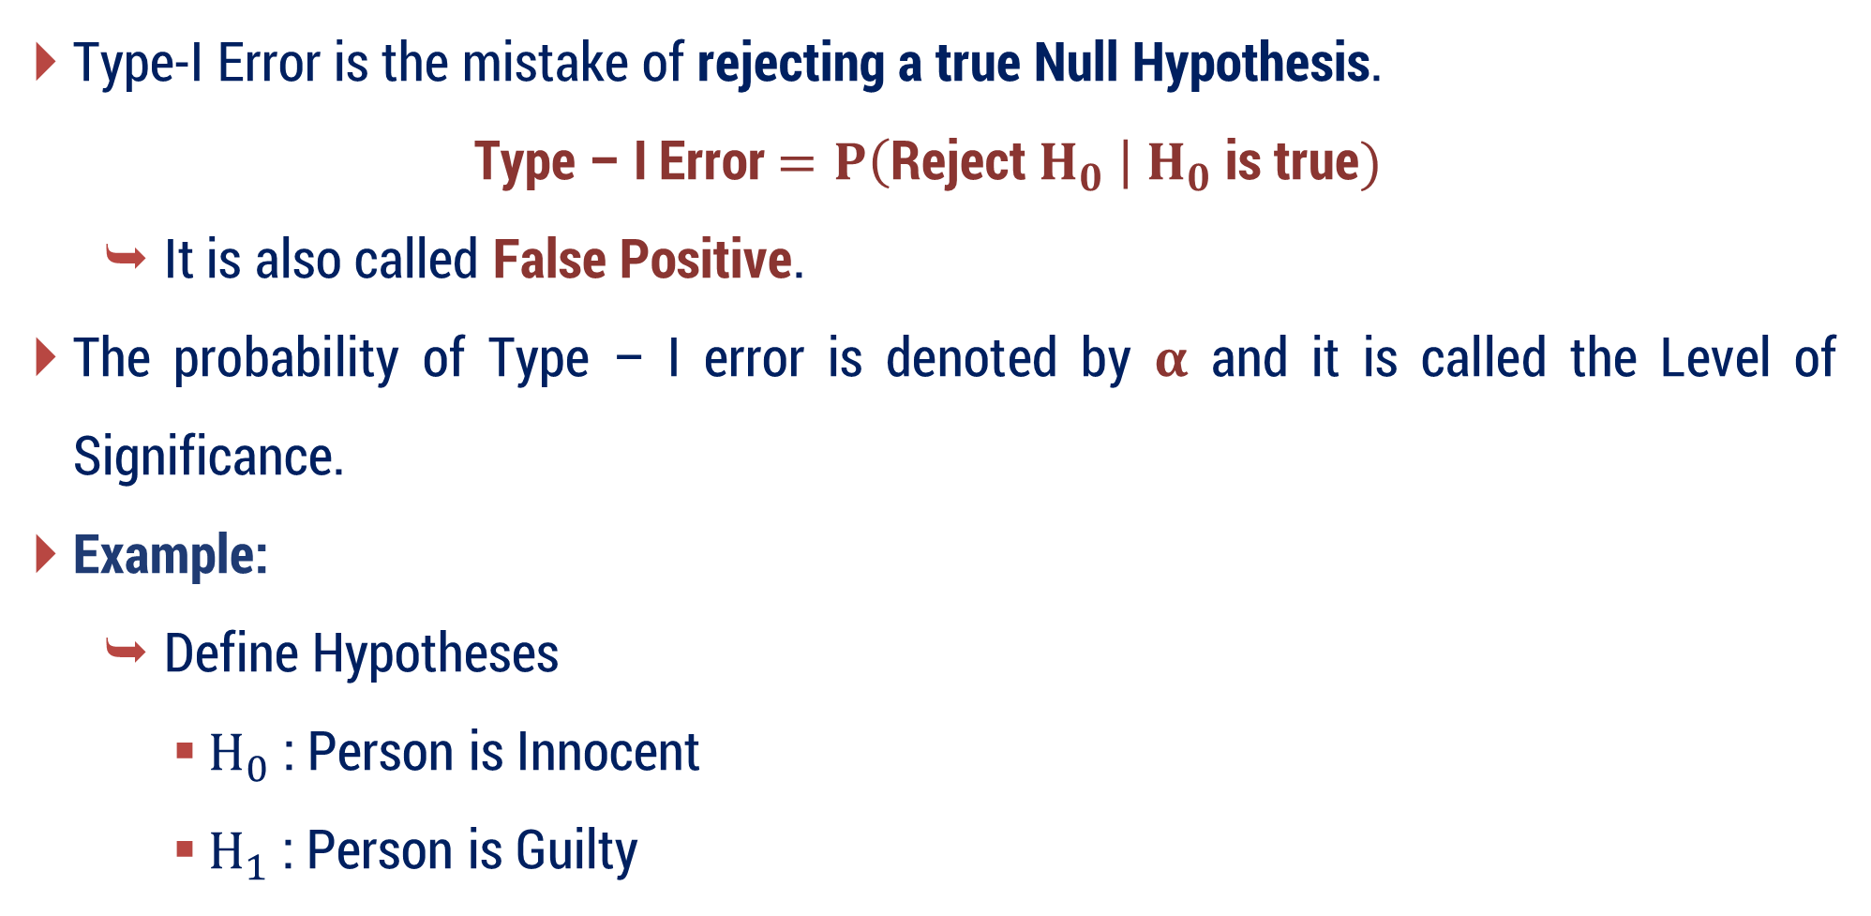
Type-I Error
Type-I Error is the mistake of rejecting a true Null Hypothesis.
Type – I Error $=P\left(\text{Reject} H_{0} \right| H_{0} \text{is} \text{true})$
It is also called False Positive.
The probability of Type – I error is denoted by $α$ and it is called the Level of Significance.
Example:
Define Hypotheses
$H_{0}$ : Person is Innocent
$H_{1}$ : Person is Guilty

Slide 70
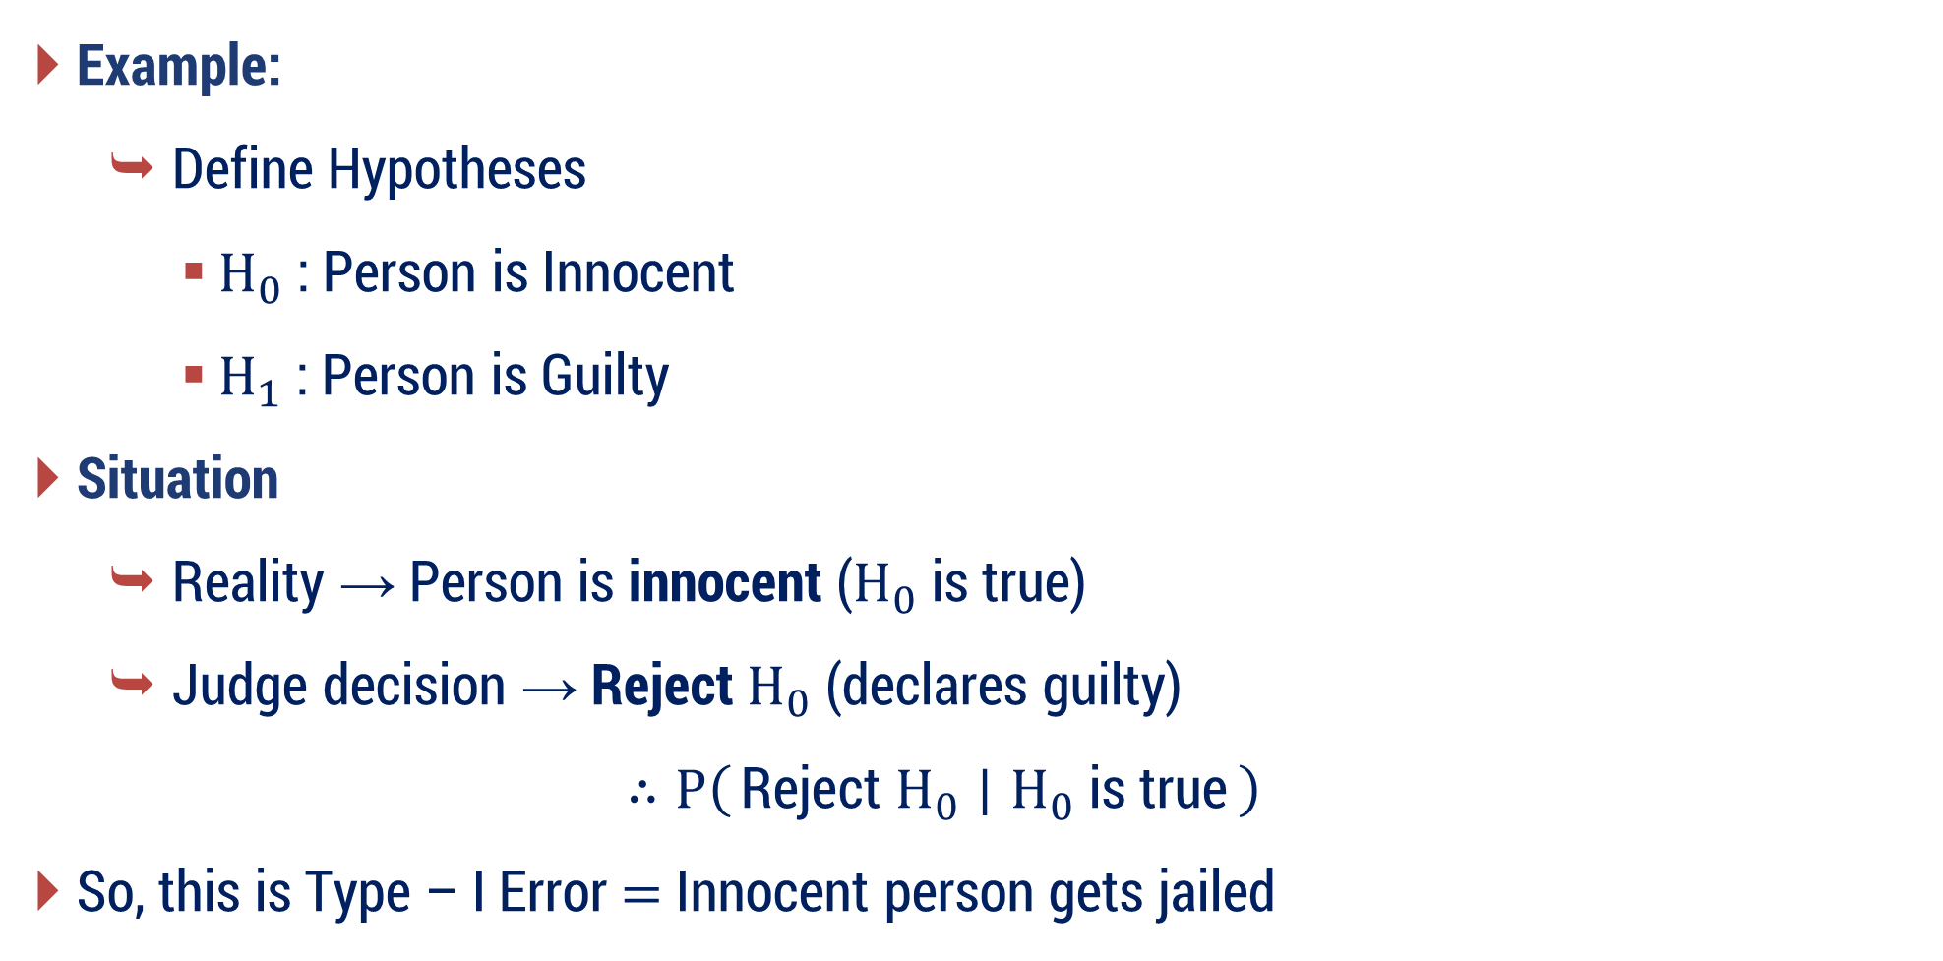
Type-I Error
Example:
Define Hypotheses
$H_{0}$ : Person is Innocent
$H_{1}$ : Person is Guilty
Situation
Reality → Person is innocent ($H_{0}$ is true)
Judge decision → Reject $H_{0}$ (declares guilty)
$$∴P\left(\text{Reject} H_{0}​ ∣ H_{0}​ \text{is} \text{true}\right)$$
So, this is Type – I Error $=$ Innocent person gets jailed

Slide 71
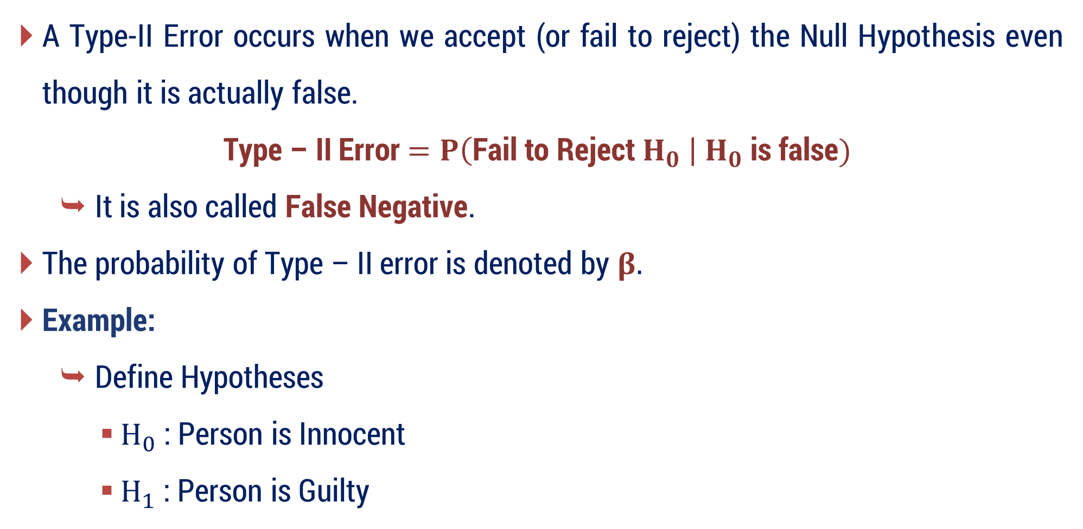
Type-II Error
A Type-II Error occurs when we accept (or fail to reject) the Null Hypothesis even though it is actually false.
Type – II Error $=P\left(\text{Fail} \text{to} \text{Reject} H_{0} \right| H_{0} \text{is} \text{false})$
It is also called False Negative.
The probability of Type – II error is denoted by $β.$
Example:
Define Hypotheses
$H_{0}$ : Person is Innocent
$H_{1}$ : Person is Guilty

Slide 72
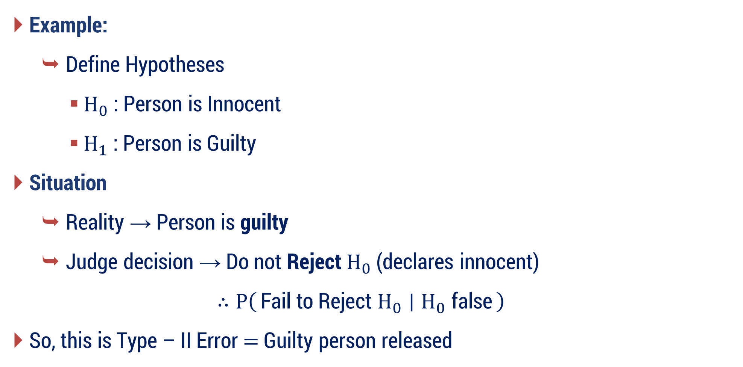
Type-II Error
Example:
Define Hypotheses
$H_{0}$ : Person is Innocent
$H_{1}$ : Person is Guilty
Situation
Reality → Person is guilty
Judge decision → Do not Reject $H_{0}$ (declares innocent)
$$∴P\left(\text{Fail} \text{to} \text{Reject} H_{0}​ ∣ H_{0}​ \text{false}\right)$$
So, this is Type – II Error $=$ Guilty person released

Slide 73
Simple Word Trick
Focus on the word Positive / Negative.
Positive → Test says something is present
Negative → Test says nothing is present
Now add False.
False Positive → Detecting something that is not actually there.
False Negative → Missing something that actually exists.

Slide 74
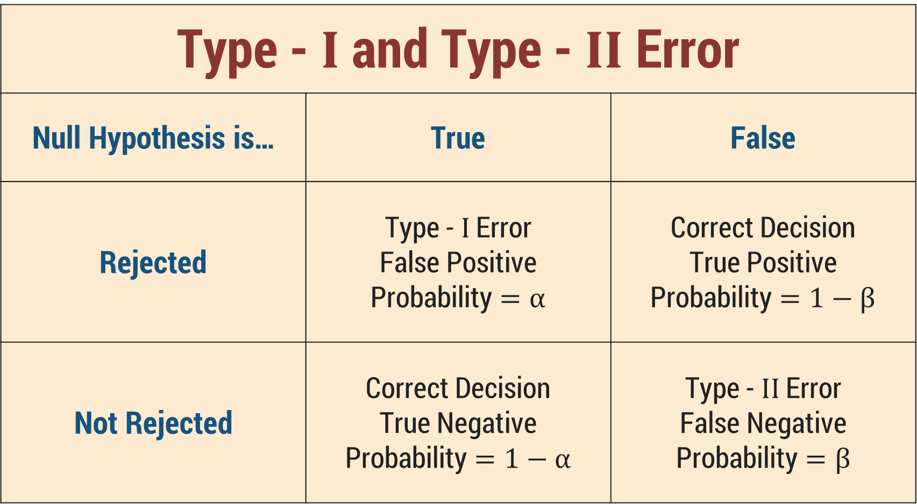
Summary
Type - $I$ and Type - $II$ Error
Null Hypothesis is… | True | False
Rejected | Type - $I$ Error False Positive Probability $=α$ | Correct Decision True Positive Probability $=1−β$
Not Rejected | Correct Decision True Negative Probability $=1−α$ | Type - $II$ Error False Negative Probability $=β$

Slide 75
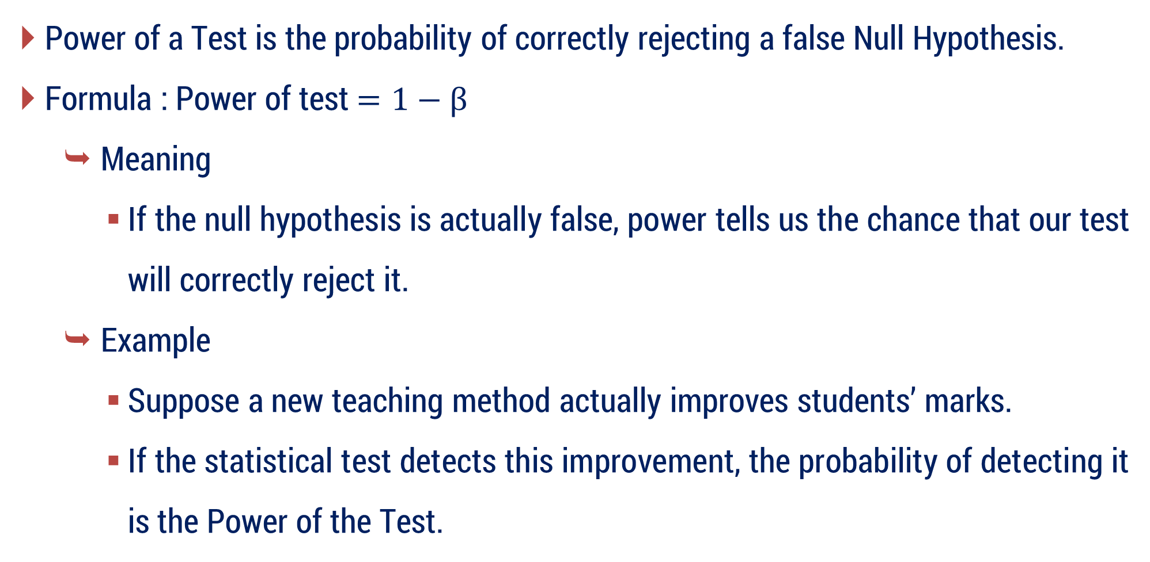
Power of the Test
Power of a Test is the probability of correctly rejecting a false Null Hypothesis.
Formula : Power of test $=1−β$
Meaning
If the null hypothesis is actually false, power tells us the chance that our test will correctly reject it.
Example
Suppose a new teaching method actually improves students’ marks.
If the statistical test detects this improvement, the probability of detecting it is the Power of the Test.

Slide 76
Question
Since mistakes cannot be completely avoided, how much wrong decision risk are we ready to accept?
This introduces Level of Significance.

Slide 77
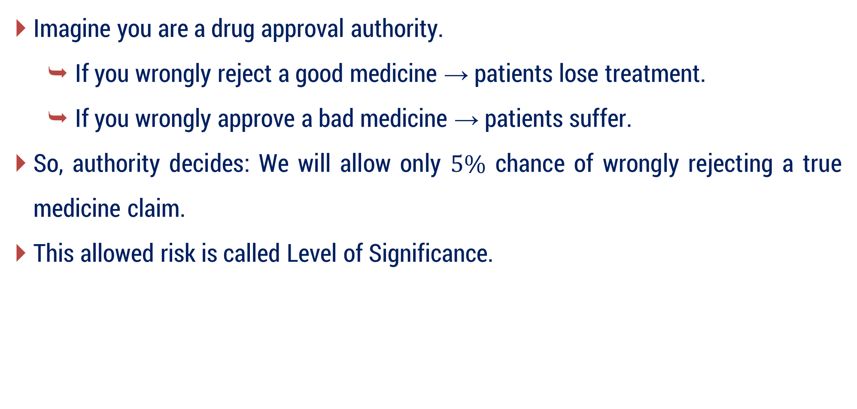
Level of Significance
Imagine you are a drug approval authority.
If you wrongly reject a good medicine → patients lose treatment.
If you wrongly approve a bad medicine → patients suffer.
So, authority decides: We will allow only $5\%$ chance of wrongly rejecting a true medicine claim.
This allowed risk is called Level of Significance.

Slide 78
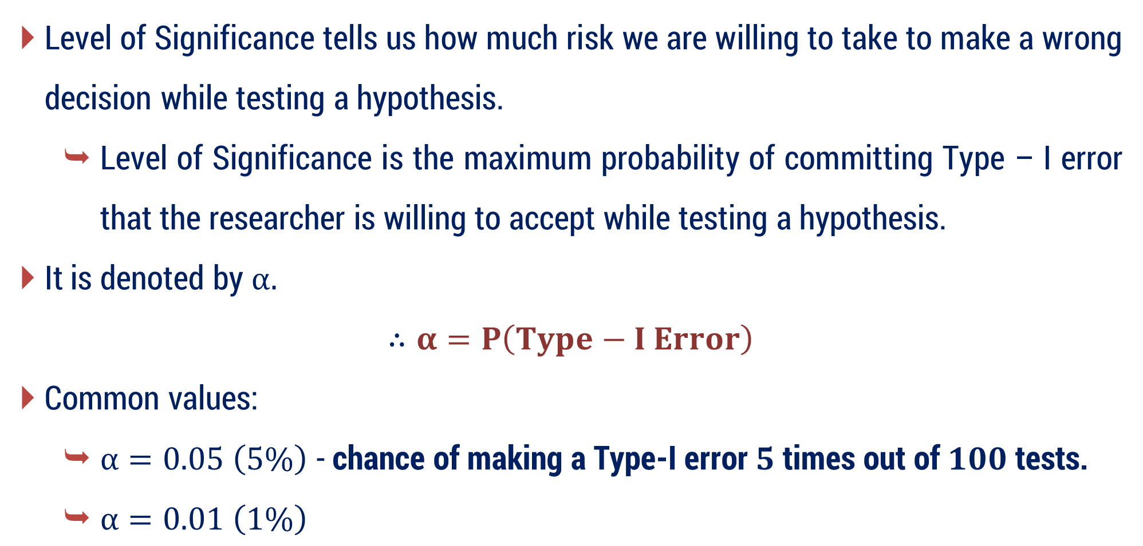
Level of Significance
Level of Significance tells us how much risk we are willing to take to make a wrong decision while testing a hypothesis.
Level of Significance is the maximum probability of committing Type – I error that the researcher is willing to accept while testing a hypothesis.
It is denoted by $α.$
$$∴α=P\left(Type−I Error\right)$$
Common values:
$α=0.05 \left(5\%\right)$ - chance of making a Type-I error $5$ times out of $100$ tests.
$α=0.01 \left(1\%\right)$

Slide 79
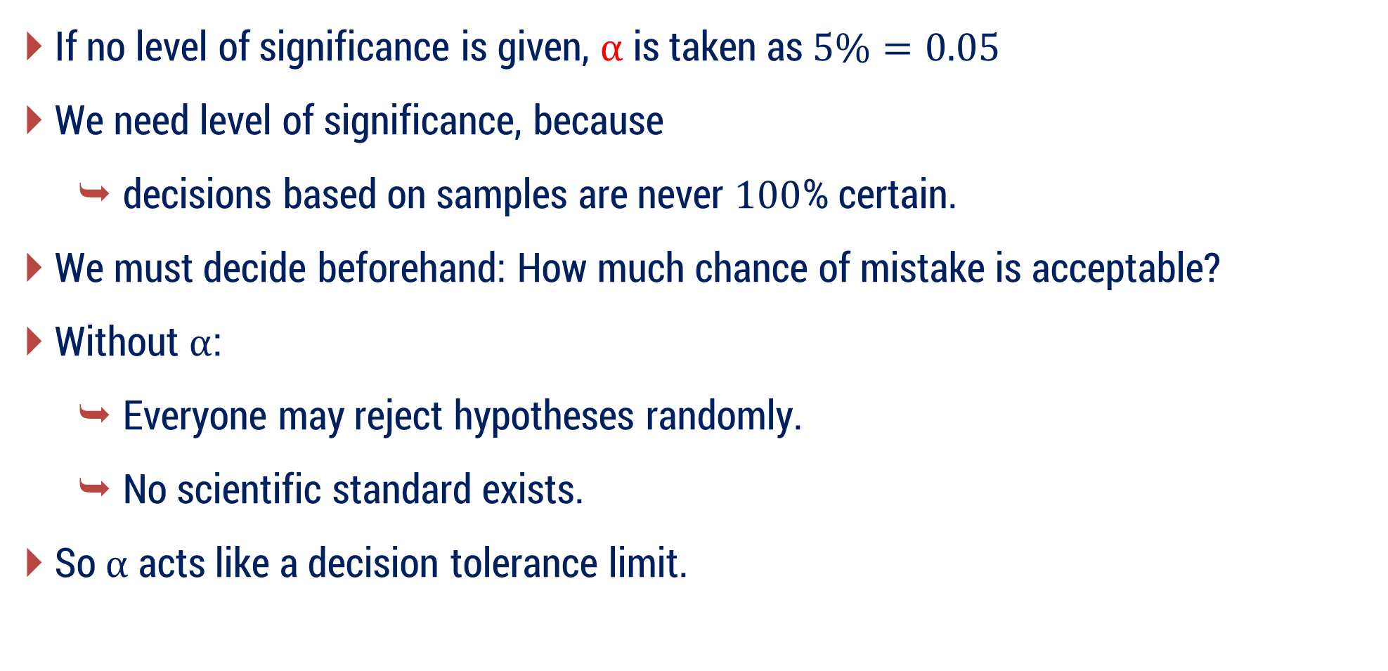
Level of Significance
If no level of significance is given, $α$ is taken as $5\%=0.05$
We need level of significance, because
decisions based on samples are never $100$% certain.
We must decide beforehand: How much chance of mistake is acceptable?
Without $α$:
Everyone may reject hypotheses randomly.
No scientific standard exists.
So $α$ acts like a decision tolerance limit.

Slide 80
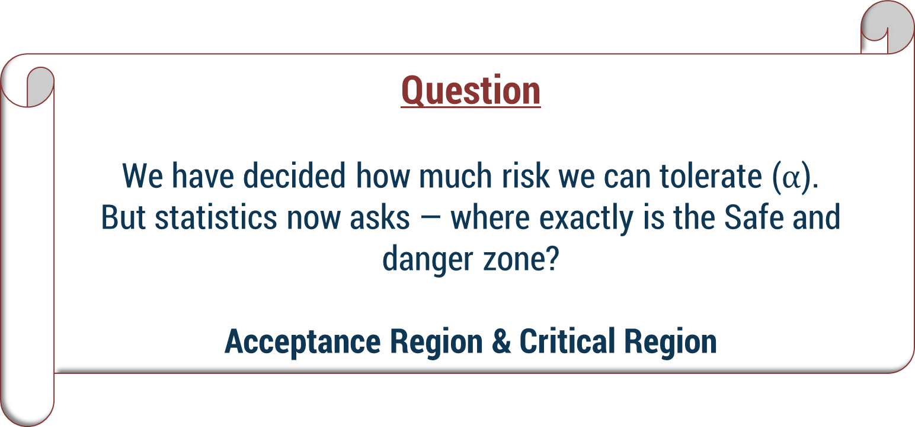
Question
We have decided how much risk we can tolerate ($α$).
But statistics now asks — where exactly is the Safe and danger zone?
Acceptance Region & Critical Region

Slide 81
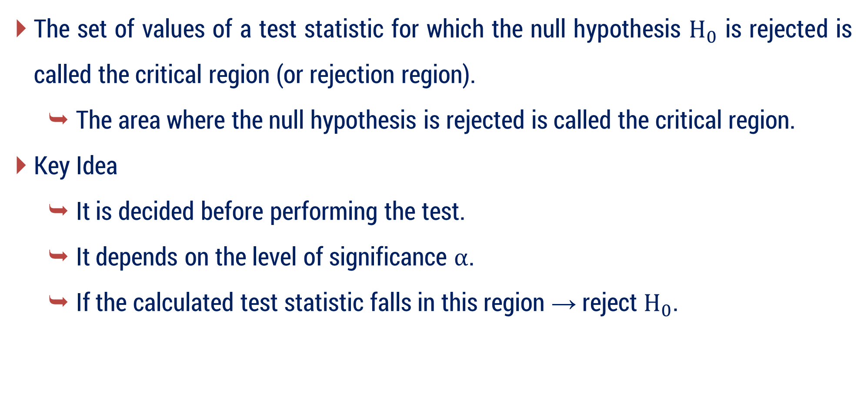
Critical Region
The set of values of a test statistic for which the null hypothesis $H_{0}$​ is rejected is called the critical region (or rejection region).
The area where the null hypothesis is rejected is called the critical region.
Key Idea
It is decided before performing the test.
It depends on the level of significance $α$.
If the calculated test statistic falls in this region → reject $H_{0}$​.

Slide 82


Critical Region
To understand the critical region, consider the standard normal distribution curve shown in the figure. The curve represents the distribution of the test statistic ($Z$).
The center of the curve represents the value assumed under the null hypothesis $H_{0}$.
Here, level of significance $α=5\%(0.05)$ (for two tailed test)
Rejection Region
(Critical Region)
Rejection Region
(Critical Region)
$$μ=0$$

Slide 83
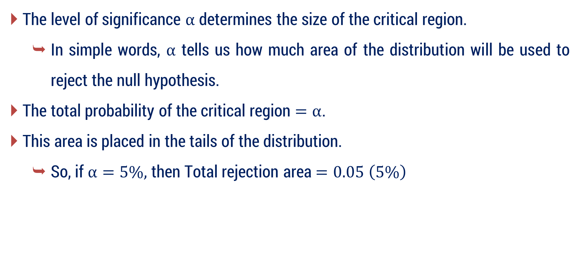
Role of Level of Significance in Critical Region
The level of significance $α$ determines the size of the critical region.
In simple words, $α$ tells us how much area of the distribution will be used to reject the null hypothesis.
The total probability of the critical region $=α$.
This area is placed in the tails of the distribution.
So, if $α=5\%,$ then Total rejection area $=0.05 \left(5\%\right)$

Slide 84


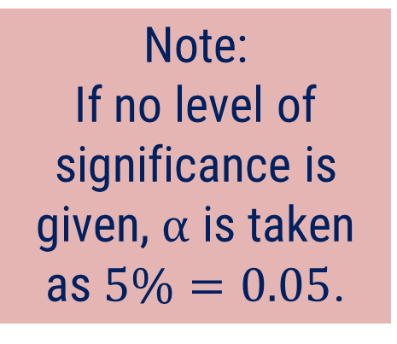
Acceptance Region
The region under the normal curve which is not covered by the rejection region is known as Acceptance Region.
If level of significance $α=5\%\left(0.05\right)$ (for two tailed test)
Note:
If no level of significance is given, $α$ is taken as $5\%=0.05$.
Acceptance
Region
$$μ=0$$

Slide 85







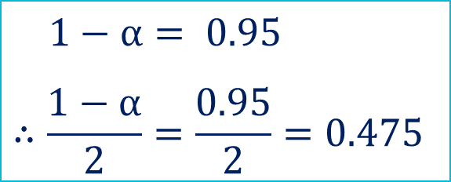


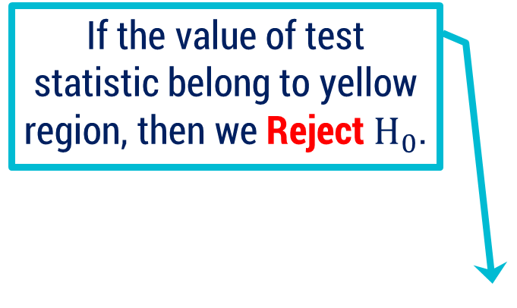
Graphical representation
Two tailed test
L.O.S $α=5\% \left(0.05\right)$
$$1−α= 0.95$$
$$∴\frac{1−α}{2}=\frac{0.95}{2}=0.475$$
If the value of test statistic belong to this region, then we accept null hypothesis.
If the value of test statistic belong to yellow region, then we Reject$H_{0}$.
$$1−α= 0.95$$
$$0.475$$
$$0.475$$
$$\frac{α}{2}=0.025$$
Acceptance
Region
$$\frac{α}{2}=0.025$$
Rejection Region
(Critical Region)
Rejection Region
(Critical Region)
$$−1.96$$
$$μ=0$$
$$1.96$$
Critical point
Critical point

Slide 86






Graphical representation
Right tailed test
L.O.S $α=5\% \left(0.05\right)$
If the value of test statistic belong to yellow region, then we Reject$H_{0}$.
If the value of test statistic belong to this region, then we accept null hypothesis.
$$1−α= 0.95$$
Acceptance
Region
$$α=0.05$$
Rejection Region
(Critical Region)
$$μ=0$$
$$1.645$$
Critical point

Slide 87
Question
Instead of only accepting or rejecting an assumption, can we estimate a range where the true situation is likely to lie?
This leads to Confidence Interval.

Slide 88

Confidence Interval
A Confidence Interval (CI) is a range of values used to estimate an unknown population parameter based on sample data, with a certain level of confidence.
Instead of estimating the population value by a single number, we estimate it by giving a range in which the true value is likely to lie.
Mathematically,
Confidence Interval $=$ Statistic $±$ (Critical Value $×$ Standard Error)

Slide 89

Confidence Interval
Example
Suppose you ask $10$ students about exam difficulty and get:
Average difficulty $=7/10$
Can we say the difficulty for all students is exactly $7$? No — another group may give $6$ or $8$.
Hence, Confidence Interval is Needed.

Slide 90

Confidence Interval
Instead of giving one fixed value, we give a range like:
Actual difficulty is likely between $6.5$ and $7.5$
This range shows:
uncertainty in data
reliability of result
possible variation
A confidence interval is needed because sample results vary, so we estimate a reliable range for the true population value instead of a single guess.

Slide 91
Confidence Limit
The two endpoints of the confidence interval are called confidence limits.
Lower Confidence Limit (LCL) → smallest value of the interval
Upper Confidence Limit (UCL) → largest value of the interval
So,
Confidence Interval: The range in which the true population value is expected to lie.
Confidence Limits: The two boundary values of that range.

Slide 92

Confidence Level vs Level of Significance
When we make conclusions from sample data, two possibilities exist:
We may be correct
or we may make an error
These two together must add up to $100\%$.
Confidence level tells how confident we are that the true population value lies within the calculated interval.
Example:
$95\%$ confidence level means that in $100$ studies, about $95$ times the interval will contain the true population value.

Slide 93


Confidence Level vs Level of Significance
$$\text{Confidence} \text{Level} + α=1$$
Confidence Level → chance of being correct
$α$ (Significance Level) → chance of being wrong
Confidence Level | Level of significance
$$99\%$$ | $1\%$ error chance
$$95\%$$ | $5\%$ error chance
$$90\%$$ | $10\%$ error chance

Slide 94

Remark
Note that, Null Hypothesis $H_{0}$ is rejected when $\left| Z \right|>3$ without mentioning any level of significance.
That means:
A $Z$ - value beyond $±3$ is extremely rare.
So even without knowing $α$,
$∣Z∣ >3⇒$ Strong evidence against $H_{0}$

Slide 95

Critical Value Summary
Critical Value $$\left(Z_{α}\right)$$ | Level of Significance $\left(α\right)$
 | $$1\%$$ | $$5\%$$ | $$10\%$$
Two-Tailed Test | $$\left| Z_{α} \right|=2.58$$ | $$\left| Z_{α} \right|=1.96$$ | $$\left| Z_{α} \right|=1.645$$
Right-Tailed Test | $$Z_{α}=2.33$$ | $$Z_{α}=1.645$$ | $$Z_{α}=1.28$$
Left-Tailed Test | $$Z_{α}=−2.33$$ | $$Z_{α}=−1.645$$ | $$Z_{α}=−1.28$$
If calculated $Z$ crosses the critical value → Reject $H_{0}$​.

Slide 96

Steps for Testing of Statistical Hypothesis
Set up Null Hypothesis $H_{0}$
Set up Alternative Hypothesis $H_{1}$
Set up Level of Significance $α$
Apply Test Statistic
Set up Critical Region
Conclusion

Slide 97
Hypothesis Testing for Large Sample - I

Slide 98
Method – 5 Test for single Proportion

Slide 99
Test for a Single Proportion
A Test for Single Proportion simply means:
we check whether a claimed percentage is true or not using one sample.
Example:
Suppose a medicine company says:
80% patients get relief within 15 minutes.
Now we cannot check all patients in the world.
So, what do we do?
We take one small group (sample) of patients
Observe how many actually get relief

Slide 100

Test for a Single Proportion
So, what do we do?
We take one small group (sample) of patients
Observe how many actually get relief
Then check:
Is the real percentage significantly different from $80\%$ or not?
This checking process is called Test for Single Proportion.
Test for Single Proportion = Testing a percentage using one sample.

Slide 101

Conditions to Use Test for Single Proportion (Z-test)
You can use this method when the following conditions are satisfied:
The variable has two outcomes (success/failure).
This is because proportion is defined as
$\text{Proportion} \text{=} \frac{\text{Number} \text{of} \text{Sucsesses}}{\text{Total} \text{observations}}$ ​
A population proportion claim $P$​ is given.
The sample is random and observations are independent.
The sample size is large, satisfying $nP≥5$ and $nQ≥5$ ; $Q=1−P$
This condition ensures the binomial distribution is approximately normal, allowing us to use the $Z$-test.

Slide 102

Test for a Single Proportion – Motivation
Suppose a company claims: $80\%$ customers like their product
So, population proportion: $P=0.80$
We want to check: Is this claim true for the population?
Since population cannot be checked completely, we take one sample.
Consider a sample of size $n$ with proportion $p$ taken from population with proportion $P$.

Slide 103


Test for a Single Proportion – Notation
Symbol | Meaning
$$P$$ | Claimed population proportion
$$Q=1−P$$ | Failure proportion
$$n$$ | Sample size
$$p$$ | Sample proportion
Example:
Claim: $P=0.80$
Sample size $n=100$
Success $X=72$

Slide 104



Test for a Single Proportion – Example
Example:
Claim: $P=0.80$
Sample size $n=100$
Success $X=72$
$$p=\frac{72}{100}=0.72$$
Now question arises:
Is difference between $0.80$ and $0.72$ important or just random?
For answering this we need Standard Error.

Slide 105


Test for a Single Proportion – Standard Error
Consider a sample $X$ of size $n$ with proportion $p$ taken from population with proportion $P$ of size $N$.
This test is used to find the significant difference between proportion of sample $p$ & proportion of population $P$.
In this test,
$$SE\left(p\right)=\left\{\begin{aligned}& \sqrt{\frac{ PQ }{ n } } ; when P is known \\ & \\ & \sqrt{\frac{ pq }{ n } } ; when P is unknown\end{aligned}\right.$$

Slide 106

Test for a Single Proportion – Test Statistic
Now next question naturally comes:
Our sample differs$\left(p−P\right)$ by $0.08$ — is that large or small?
To answer this → we need Test Statistic.
Formula for Test Statistic
When population proportion P is known
$$Z=\frac{ p−P }{ \sqrt{\frac{ P Q }{ n } } }$$
where$, Q=1−P$

Slide 107

Test for a Single Proportion – Meaning of Z Statistic
$Z$ tells:
How many standard errors away the sample result is from the claim.
Now question:
How do we decide whether the difference is significant or just due to chance?
That leads to Critical Value / Confidence Limit.
Because we create a safe region around population claim.
This region represents: differences allowed due to chance.

Slide 108



Confidence Limits for Population Proportion
For confidence intervals, population proportion $P$ is unknown, so we estimate it using the sample proportion $p$.
$$=p±Z_{α} \sqrt{\frac{pq}{n}}$$
$$p±Z_{α} SE\left(p\right)$$
where, $Z_{α}=$ Critical value at level of significance $α$
Why Needed?
We construct a confidence interval around the sample proportion to estimate the true population proportion. The interval represents the range of plausible values of the population proportion considering sampling variability.

Slide 109

Simple Rule for Hypotheses
If the question gives a claim → put the claim in $H_{0}$.
Example
Claim: $45\%$ voters prefer the candidate
$H_{0} :P=0.45$
$H_{1} :P≠0.45$

Slide 110

Simple Rule for Hypotheses
If the question asks to check something (prove / support something) → Put that statement in $H_{1}$.
Question: Does the data support that majority are smokers?
Majority means $P>0.5$
So, $H_{1}:P>0.5$
$H_{0}:P=0.5$

Slide 111

Method 5 ⇝ Example 1
In a random sample of $160$ worker exposed to a certain amount of radiation, $24$ experienced some ill effects. Construct a $95\%$ confidence interval for the corresponding true percentage. $\left( \left| Z_{0.05} \right|=1.96 \right)$

Slide 112

Method 5 ⇝ Example 1 ⇝ Meaning
We observe $160$ workers who were exposed to radiation (means they came in contact with radiation while working, like in medical labs, nuclear plants, etc.).
Out of them, $24$ workers got some health problems.
Now we want to estimate the real percentage of all workers who might get ill effects from this radiation.
But since we only checked $160$ workers (a sample) and not all workers, we cannot know the exact percentage.
So, we find a $95\%$ confidence interval, which means: We find a range of percentages where the true percentage of affected workers is likely to be.

Slide 113








Method 5 ⇝ Example 1
In a random sample of $160$ worker exposed to a certain amount of radiation, $24$ experienced some ill effects. Construct a $95\%$ confidence interval for the corresponding true percentage. $\left( \left| Z_{0.05} \right|=1.96 \right)$
Solution:
$$n=160$$
$$=\frac{24}{160}$$
Success
$p=$Sample proportion of workers experienced some ill effects
Now, $q=1−p$
$$=0.85$$
$$=0.15$$
Here, Confidence Limit $=95\%$
So, Level of Significance $=5\%$
Hence, $\left| Z_{α} \right|=\left| Z_{0.05} \right|=1.96$

Slide 114










Method 5 ⇝ Example 1(Continue)
$95\%$ confidence limits
Lower Limit : $0.15−0.0553$
$$=0.0947$$
$$p±Z_{α} SE\left(p\right)$$
Upper Limit : $0.15+0.0553$
$$=0.2053$$
$$=p±1.96\sqrt{\frac{ p q }{ n } }$$
$∴$ Confidence Interval $=\left[0.0947 , 0.2053\right]$
We are $95\%$ confident that the true percentage of workers experiencing ill effects lies between $0.0947$ and $0.2053.$
$$=0.15±1.96\sqrt{\frac{ \left(0.15\right)\left(0.85\right)}{160} }$$
$$=0.15±0.0553$$

Slide 115

Method 5 ⇝ Example 2
A political party claims that $45\%$ of the voters in an election district prefer its candidate. A sample of $200$ voters include $80$ who prefer this candidate. Test if the claim is valid at the $5\%$ significance level.$\left( \left| Z_{0.05} \right|=1.96 \right)$

Slide 116

Method 5 ⇝ Example 2 ⇝ Meaning
A political party claims that $45\%$ of the voters in an election district support its candidate.
To check whether this claim is correct or not, we take a sample of $200$ voters from that district.
In this sample, $80$ voters say they support the candidate.
Now we want to statistically test whether the party’s claim of $45\%$ support is reasonable or not based on this sample.

Slide 117

Method 5 ⇝ Example 2 ⇝ Meaning
The $5\%$ level of significance $\left(α = 0.05\right)$ means:
We allow a $5\%$ chance of making a wrong decision when testing the claim.
In other words, we are $95\%$ confident about our decision.
Using the sample of $200$ voters, check whether the claim that $45\%$ of voters support the candidate is correct, allowing a $5\%$ chance of error.

Slide 118








Method 5 ⇝ Example 2
A political party claims that $45\%$ of the voters in an election district prefer its candidate. A sample of $200$ voters include $80$ who prefer this candidate. Test if the claim is valid at the $5\%$ significance level.$\left( \left| Z_{0.05} \right|=1.96 \right)$
Solution:
$P=$ Population proportion
$$=0.45$$
$$∴Q=1−P=0.55$$
$$n=200$$
$$\frac{80}{200}$$
$$p=$$
$$=0.4$$
Given that, $\left| Z_{α} \right|=\left| Z_{0.05} \right|=1.96$

Slide 119


















Method 5 ⇝ Example 2(Continue)
$H_{0} :$
$P=0.45$
Critical Value :
$$\left| Z_{0.05} \right|=1.96$$
asked to verify that $45\%$ is valid or not
Conclusion :
$H_{1} :$
$P≠0.45$
$$\left| Z \right|=1.42$$
$$<$$
$$1.96=\left| Z_{0.05} \right|$$
$L.O.S =5\%$
$∴$ Accept $H_{0}$.
Test : Since, $P is known$.
Hence, the claim $(45\%)$ is valid at the $5\%$ level of significance.
$$Z=\frac{ p−P }{ \sqrt{\frac{ P Q }{ n } } }$$
$$=\frac{ 0.4−0.45 }{ \sqrt{\frac{ \left(0.45\right)\left(0.55\right)}{ 200 } } }$$
$=−1.42$
$$−1.96$$
$$1.96$$

Slide 120

Method 5 ⇝ Example 3
A certain cubical die was thrown $9000$ times and $5$ or $6$ was obtained $3240$ times. On the assumption of certain throwing, do the data indicate an unbiased die? $\left( \left|Z_{0.05}\right|=1.96 \right)$

Slide 121

Method 5 ⇝ Example 3 ⇝ Meaning
A cubical die (a normal $6$-sided die) was thrown $9000$ times.
In these throws, the numbers $5$ or $6$ appeared $3240$ times.
For a fair (unbiased) die, each number has the same probability.
So, the probability of getting $5$ or $6$ is:
$$​P\left(5 or 6\right)=\frac{2}{ 6 }=\frac{1}{ 3 }=0.33$$
Now we want to check whether the die is unbiased (fair) or not.
So, we are checking whether the probability is equal to $\frac{1}{ 3 }$ or different from $\frac{1}{ 3 }$.

Slide 122











Method 5 ⇝ Example 3
A certain cubical die was thrown $9000$ times and $5$ or $6$ was obtained $3240$ times. On the assumption of certain throwing, do the data indicate an unbiased die? $\left( \left|Z_{0.05}\right|=1.96 \right)$
Solution:
$$n=9000$$
$$∴Q=1−P$$
Since the die is assumed to be unbiased, the probability of each face is
$$∴Q=0.67$$
$$1/6$$
$$p=\frac{ 3240 }{9000}$$
So, the probability of obtaining $5$ or $6$ is
$$=0.36$$
$$P=\frac{ 2 }{6}$$
$$=\frac{ 1 }{3}$$
$$=0.33$$

Slide 123

















Method 5 ⇝ Example 3(Continue)
$H_{0} :$
$P=0.33$
(die is unbiased)
Critical Value :
$$\left| Z_{0.05} \right|=1.96$$
$H_{1} :$
$P≠0.33$
(die is biased)
Conclusion :
$L.O.S =5\%$
$$\left| Z \right|=6.05$$
$$>$$
$$3$$
Test :
$∴$ Reject $H_{0}$
$$Z=\frac{ p−P }{ \sqrt{\frac{ P Q }{ n } } }$$
Hence, The die is biased at $5\%$ level of significance.
$$\left(P is known\right)$$
$$=\frac{ 0.36−0.33 }{ \sqrt{\frac{ \left(0.33\right)\left(0.67\right)}{ 9000 } } }$$
$=6.05$
$$−1.96$$
$$1.96$$

Slide 124

Method 5 ⇝ Example 6
A manufacturer claimed that at least $95\%$ of the equipment which he supplied to a factory conformed to specification. An examination of a sample of $200$ pieces of equipment revealed that $18$ were faulty. Test this claim at $5\%$ level of significance. $\left( Z_{0.05}=−1.645 \right)$

Slide 125

Method 5 ⇝ Example 6 ⇝ Meaning
A manufacturer claims that at least $95\%$ of the equipment he supplies meet the required specifications (i.e., they are not faulty).
To check this claim, a sample of $200$ pieces of equipment is inspected.
In this sample, $18$ pieces are found to be faulty, which means $182$ pieces meet the specifications.
Now we want to test whether the manufacturer’s claim that at least $95\%$ of the equipment are good is reasonable or not, using hypothesis testing at the $5\%$ level of significance.

Slide 126

Method 5 ⇝ Example 6 ⇝ Meaning
Idea of Hypotheses:
Because the claim says “at least $95\%$”, we test it like this:
Null Hypothesis $\left(H_{0}\right)$: $P≥0.95$
(The proportion of equipment that meet specifications is at least $95\%$, so the manufacturer's claim is correct.)
Alternative Hypothesis $(H₁):P<0.95$
(The proportion of good equipment is less than $95\%$, so the claim is not correct.)

Slide 127

Method 5 ⇝ Example 6 ⇝ Meaning
Idea of Hypotheses:
Even though the claim is $P≥0.95$, in calculations we always test the boundary value.
The boundary value of $P≥0.95$ is $0.95$.
So, we take $H_{0}=0.95$

Slide 128






Method 5 ⇝ Example 6
A manufacturer claimed that at least $95\%$ of the equipment which he supplied to a factory conformed to specification. An examination of a sample of $200$ pieces of equipment revealed that $18$ were faulty. Test this claim at $5\%$ level of significance. $\left( Z_{0.05}=−1.645 \right)$
Solution:
$$P=0.95$$
$$∴Q=1−P=0.05$$
$$n=200$$
$$=\frac{200−18}{200}$$
$p=$Sample proportion of good equipment
$$=0.91$$

Slide 129














Method 5 ⇝ Example 6(Continue)
$H_{0} :$
$P=0.95$
Critical Value :
$$Z_{0.05}=−1.645$$
$H_{1} :$
$P<0.95$
(left tailed test)
Conclusion :
$L.O.S =5\%$
$$Z=−2.59$$
$$<$$
$$Z_{0.05}=−1.645$$
Test :
$∴$ Reject $H_{0}$.
Hence, the manufacturer’s claim is not valid at the $5\%$ level of significance.
$$Z=\frac{ p−P }{ \sqrt{\frac{ P Q }{ n } } }$$
$$\left(P is known\right)$$
$$=\frac{ 0.91−0.95 }{ \sqrt{\frac{ \left(0.95\right)\left(0.05\right)}{ 200 } } }$$
$=−2.59$
$−1.645$

Slide 130

Method 5 ⇝ Example 8
The fatality rate of typhoid patients is believed to be $17.26\%$. In a certain year $640$ patients suffering from typhoid were treated in a metropolitan hospital and only $63$ patients died. Can you consider the hospital efficient at $1\%$ level of significance? $\left( Z_{0.01}=−2.33 \right)$

Slide 131

Method 5 ⇝ Example 8 ⇝ Meaning
It is generally believed that $17.26\%$ of typhoid patients die from the disease.
This percentage is called the fatality rate.
Fatality rate means the percentage of patients who die from a disease among those who have that disease.
For example, if the fatality rate is $17.26\%$, it means about $17$ out of $100$ typhoid patients may die.

Slide 132

Method 5 ⇝ Example 8 ⇝ Meaning
Now in a metropolitan hospital, during a certain year:
$640$ typhoid patients were treated
Only $63$ patients died
Note that, $63$ deaths seem fewer than expected because
Usual fatality rate of typhoid $=17.26\%$
Number of patients treated in the hospital $=640$
So, the expected number of deaths (if the hospital performs normally) would be: $640×0.1726≈110640×0.1726≈11$0
So, about $110$ patients are expected to die according to the usual fatality rate.

Slide 133

Method 5 ⇝ Example 8 ⇝ Meaning
Since $63$ deaths seem fewer than expected, we want to check whether the hospital is performing better than usual.
What the question asks: Can you consider the hospital efficient?
A hospital is efficient if fewer patients die than the usual fatality rate $17.26\%$
So, for the hospital to be efficient, the death rate must be less than $17.26\%.$
Null Hypothesis $H_{0}​:p=0.1726$ (The hospital has the usual death rate.)
Alternative Hypothesis $H_{1} ​:p<0.1726$ (The hospital has a lower death rate, so it is more efficient.)

Slide 134






Method 5 ⇝ Example 8
The fatality rate of typhoid patients is believed to be $17.26\%$. In a certain year $640$ patients suffering from typhoid were treated in a metropolitan hospital and only $63$ patients died. Can you consider the hospital efficient at $1\%$ level of significance? $\left( Z_{0.01}=−2.33 \right)$
Solution:
$$P=0.1726$$
$$∴Q=1−P=0.8274$$
$$n=640$$
$$=\frac{63}{640}$$
$p=$Sample proportion
$$=0.0984$$

Slide 135














Method 5 ⇝ Example 8(Continue)
$H_{0} :$
$$P=0.1726$$
Critical Value :
$$Z_{0.01}=−2.33$$
$H_{1} :$
$$P<0.1726$$
(left tailed test)
Conclusion :
$$<$$
$$Z_{0.01}=−2.33$$
$L.O.S =1\%$
$$Z=−4.97$$
$∴$ Reject $H_{0}$.
Test :
$$Z=\frac{ p−P }{ \sqrt{\frac{ P Q }{ n } } }$$
i.e., The hospital is efficient at $1\%$ LOS.
$$\left(P is known\right)$$
i.e., the hospital can be considered efficient in treating typhoid patients.
$$=\frac{0.0984−0.1726}{ \sqrt{\frac{ \left(0.1726\right)\left(0.8274\right)}{ 640 } } }$$
$=−4.97$
$$−2.33$$

Slide 136


Method 5 ⇝ Example 9
In a sample of $400$ parts manufactured by a factory; the number of defective parts found to be$30$. The company, however, claims that at most $5\%$ of their product is defective. Is the claim tenable? $\left( Z_{0.05}=1.645 \right)$
A factory claims that at most $5\%$ of its products are defective.
This means the company believes that the population proportion of defective parts is not more than $0.05$ $(5\%)$.
To check this claim, a sample of $400$ parts is taken from the factory production.

Slide 137

Method 5 ⇝ Example 9 ⇝ Meaning
To check this claim, a sample of $400$ parts is taken from the factory production.
In this sample, $30$ parts are found defective.
Now we want to determine whether the sample evidence supports the company’s claim or not.
Here the word tenable means acceptable, reasonable, or supported by the data.
So, the question is asking:
Based on the sample of $400$ parts, can the company's claim that at most $5\%$ of the products are defective be accepted (tenable), or should it be rejected?

Slide 138

Method 5 ⇝ Example 9 ⇝ Idea about Hypotheses
Let P be the population proportion of defective parts.
The company claims that at most $5\%$ of the products are defective,
i.e., $P≤0.05$
Null Hypothesis $H_{0} :P=0.05$
This represents the company’s claim that the defective proportion does not exceed $5\%$. (This represents the boundary of the claim $P≤0.05$)
Alternative Hypothesis $H_{1} :P>0.05$
This means the proportion of defective parts is greater than $5\%$, so the company’s claim is not true.

Slide 139







Method 5 ⇝ Example 9
In a sample of $400$ parts manufactured by a factory; the number of defective parts found to be$30$. The company, however, claims that at most $5\%$ of their product is defective. Is the claim tenable? $\left( Z_{0.05}=1.645 \right)$
Solution:
$$n=400$$
$$=\frac{30}{400}$$
$p=$Sample proportion
$$=0.075$$
$$P=0.05$$
$$∴Q=1−P=0.95$$

Slide 140














Method 5 ⇝ Example 9(Continue)
$H_{0} :$
$$P=0.05$$
Critical Value :
$$Z_{0.05}=1.645$$
$H_{1} :$
$$P>0.05$$
(Right tailed test)
Conclusion :
$L.O.S =5\%$
$$Z=2.29$$
$$>$$
$$Z_{0.05}=1.645$$
Test :
$∴$ Reject $H_{0}$.
Hence, the company’s claim is not tenable at the $5\%$ level of significance.
$$Z=\frac{ p−P }{ \sqrt{\frac{ P Q }{ n } } }$$
$$\left(P is known\right)$$
$$=\frac{0.075−0.05}{ \sqrt{\frac{ \left(0.05\right)\left(0.95\right)}{ 400 } } }$$
$=2.29$
$1.645$

Slide 141

Method 5 ⇝ Example 11
In a big city, $325$ men out of $600$ were found to be smokers. Does information support the conclusion that the majority of men in this city are smokers?
$$\left( Z_{0.05}=1.645 \right)$$

Slide 142

Method 5 ⇝ Example 11 ⇝ Meaning
A survey is conducted in a big city where $600$ men are selected, and it is found that $325$ of them are smokers.
Let $P$ represent the population proportion of men who are smokers in the city. The question asks whether the majority of men in the city are smokers.
Here, majority means more than $50\%$.
Therefore, the reference proportion becomes $0.5=50\%$
So, we test whether the population proportion of smokers $P$ is greater than $0.5$.
Thus, the question is asking: Does the sample data provide enough evidence to conclude that more than $50\%$ of men in the city are smokers?

Slide 143

Method 5 ⇝ Example 11 ⇝ Idea about Hypotheses
We want to check whether the majority of men in the city are smokers.
Majority means more than $50\%$.
So, the claimed proportion is $0.5$.
Null Hypothesis $H_{0} :P=0.5$
This means $50\%$ of men in the city are smokers (no majority).
Alternative Hypothesis $H_{1} :P>0.5$
This means more than $50\%$ of men are smokers, i.e., the majority of men in the city are smokers.

Slide 144







Method 5 ⇝ Example 11
In a big city, $325$ men out of $600$ were found to be smokers. Does information support the conclusion that the majority of men in this city are smokers?
$$\left(Z_{0.05}=1.645 \right)$$
Solution:
Here, $n=600$
$$=\frac{325}{600}$$
$p=$Sample proportion
$$=0.5417$$
$$P=0.5$$
$$∴Q=1−P=0.5$$

Slide 145














Method 5 ⇝ Example 11(Continue)
$H_{0} :$
$$P=0.5$$
Critical Value :
$$Z_{0.05}=1.645$$
$H_{1} :$
$$P>0.5$$
(Right tailed test)
Conclusion :
$$Z=2.09$$
$$>$$
$$Z_{0.05}=1.645$$
$L.O.S =5\%$
Test :
$∴$ Reject $H_{0}$.
Hence, majority of men in the city are smokers at $5\%$ LOS.
$$Z=\frac{ p−P }{ \sqrt{\frac{ P Q }{ n } } }$$
$$\left(P is known\right)$$
$$=\frac{0.5417−0.5}{ \sqrt{\frac{ \left(0.5\right)\left(0.5\right)}{ 600 } } }$$
$=2.04$
$1.645$

Slide 146
Method – 6 Test for Difference of Proportions

Slide 147

Test for Difference of Proportions
The Test for Difference of Proportions is a hypothesis test used to compare two population proportions $P_{1}$and $P_{2}$​ using the sample proportions $p_{1}$ and $p_{2}$​.
It helps us test whether the two population proportions are equal or different.
It is a hypothesis test for two independent samples.
Sometimes we have two groups, and we want to know whether their percentages (proportions) are different.
Examples:
Percentage of defective products produced by two machines
Percentage of students passing in two different classes

Slide 148

Test for Difference of Proportions
Examples:
Percentage of defective products produced by two machines
Percentage of students passing in two different classes
The test answers this question:
Is the difference between two sample proportions $p_{1}$ and $p_{2}$ large enough to conclude that the population proportions $P_{1}$ and $P_{2}$ are different?
or
Is the observed difference real, or is it only due to random sampling fluctuation?

Slide 149
Why do we need this test?
In real life we often compare two groups.
Examples:
Defective items produced by two machines
Pass percentage in two classes
Success rate of two medicines
We want to know: Are the two populations really different?

Slide 150

Notation
Suppose we take two samples.
Symbol | Meaning
$$n_{1}$$ | Size of Sample $1$
$$n_{2}$$ | Size of Sample $2$
$$x_{1}$$ | Success in Sample $1$
$$x_{2}$$ | Success in Sample $2$
$$p_{1}=\frac{x_{1}}{n_{1}}$$ | Sample proportion $1$
$$p_{2}=\frac{x_{2}}{n_{2}}$$ | Sample proportion $2$
$$P_{1}$$ | Population Proportion $1$
$$P_{2}$$ | Population Proportion $2$

Slide 151


Test for a Difference of Proportion
Consider two samples $X_{1}$ and $X_{2}$ of sizes $n_{1}$ & $n_{2}$ with sample proportion $p_{1}$ & $p_{2}$ respectively, taken from two population proportions $P_{1}$ & $P_{2}$.
This test is used to test whether the population proportions $P_{1}$ & $P_{2}$ are significantly different using the sample proportions $p_{1}$ & $p_{2}.$
In this test,
$$SE\left(t\right)=\left\{\begin{aligned}&\sqrt{\frac{P_{1}Q_{1} }{n_{1 }}+\frac{ P_{2}Q_{2} }{n_{2 }}}; P_{1}, P_{2} are known \\ & \\ &\sqrt{pq\left(\frac{ 1 }{n_{1 }}+\frac{ 1 }{n_{2 }}\right)}; P_{1}, P_{2} are unknown\end{aligned}\right.$$

Slide 152





Test for a Difference of Proportion
Formula for Test Statistics
When population proportions are known
When population proportions are unknown
$$Z=\frac{ P_{1}−P_{2} }{ \sqrt{\frac{ P_{1}Q_{1} }{{ n}_{1 }}+\frac{ P_{2}Q_{2} }{{ n}_{2 }} } }$$
$$Z=\frac{ p_{1}−p_{2} }{ \sqrt{pq\left(\frac{ 1 }{{ n}_{1 }}+\frac{ 1 }{{ n}_{2 }}\right) } }$$
$$where,Q_{1}= 1−P_{1}$$
$$where, p=\frac{ n_{1}p_{1}+n_{2}p_{2} }{ n_{1}+n_{2} } and$$
$q=1−p$
$$Q_{2}= 1−P_{2}$$

Slide 153



Confidence limits for difference of Proportions
$$\left(p_{1}−p_{2}\right)±Z_{α} SE$$
Since population proportions $P_{1} ​,P_{2}$​ are unknown, they are estimated by sample proportions $p_{1} ​,p_{2}$.
Hence the standard error uses $p_{1}$​ and $p_{2}$​ instead of $P_{1}$​ and $P_{2}$.
$$\left(p_{1}−p_{2}\right)±Z_{α} \sqrt{\frac{p_{1}q_{1}}{n_{1}}+\frac{p_{2}q_{2}}{n_{2}}}$$
where, $Z_{α}=$ Critical value at level of significance $α$

Slide 154

Idea about Hypotheses
Usually we test:
$H_{0} :P_{1}=P_{2}$ or $P_{1}−P_{2}=0$ ​(No difference between population proportions)
$H_{1} :P_{1}≠P_{2}$ ​ or $P_{1}−P_{2}≠0$ (or $>$ or $<$ depending on the question)
Note that,
Significant difference → Real difference
No significant difference → Difference due to chance

Slide 155

Method 6 ⇝ Example 1
A random sample of $300$ shoppers at a supermarket includes $204$ who regularly uses cents off coupons. In another sample of $500$ shoppers at a supermarket includes $75$ who regularly uses cents off coupons. Obtain $95\%$ confidence limits for the difference in the populations. $\left( \left| Z_{0.05} \right|=1.96 \right)$

Slide 156

Method 6 ⇝ Example 1⇝ Meaning
Two different supermarkets (or two populations of shoppers) are considered.
We take two samples:
Sample $1$ : $n_{1}=300$ shoppers, $204$ use coupons regularly
Sample $2$ : $n_{2}=500$ shoppers, $75$ use coupons regularly
The question asks:
Estimate the difference between the population proportions of coupon users in the two supermarkets.

Slide 157

Method 6 ⇝ Example 1⇝ Meaning
Since we only have sample data, we calculate a $95\%$ confidence interval for
$$P_{1}−P_{2}$$
where
$P_{1}=$ true proportion of coupon users in population $1$
$P_{2}=$ true proportion of coupon users in population $2$
So, the goal is:
Find a range that likely contains the true difference $P_{1}−P_{2}$.

Slide 158








Method 6 ⇝ Example 1
A random sample of $300$ shoppers at a supermarket includes $204$ who regularly uses cents off coupons. In another sample of $500$ shoppers at a supermarket includes $75$ who regularly uses cents off coupons. Obtain $95\%$ confidence limits for the difference in the populations. $\left( \left| Z_{0.05} \right|=1.96 \right)$
Solution:
Sample 1
Sample 2
$$n_{1}=300$$
$$n_{2}=500$$
$$p_{1}=\frac{204}{300}$$
$$p_{2}=\frac{75}{500}$$
$$=0.68$$
$$=0.15$$
$$q_{1}=1−p_{1}=0.32$$
$$q_{2}=1−p_{2}=0.85$$

Slide 159








Method 6 ⇝ Example 1(Continue)
$$\left(p_{1}−p_{2}\right)±Z_{α} SE$$
$95\%$ confidence limits
$$=\left(p_{1}−p_{2}\right)±1.96\sqrt{\frac{p_{1}q_{1}}{n_{1}}+\frac{p_{2}q_{2}}{n_{2}}}$$
Calculation
$$\left(p_{1}−p_{2}\right)=$$
$$\left(0.68−0.15\right)$$
$$=0.53$$
$$\sqrt{\frac{p_{1}q_{1}}{n_{1}}+\frac{p_{2}q_{2}}{n_{2}}}$$
$$=\sqrt{\frac{\left(0.68\right)\left(0.32\right)}{300}+\frac{\left(0.15\right)\left(0.85\right)}{500}}$$
$$=0.0313$$

Slide 160






Method 6 ⇝ Example 1(Continue)
$$∴\left(p_{1}−p_{2}\right)±1.96\sqrt{\frac{p_{1}q_{1}}{n_{1}}+\frac{p_{2}q_{2}}{n_{2}}}$$
$$=0.53±1.96\left(0.0313\right)$$
Lower Limit : $0.53−1.96\left(0.0313\right)$
$$=0.4687$$
Upper Limit : $0.53+1.96\left(0.0313\right)$
$$=0.5913$$
$∴$ Confidence Interval $=\left[0.4687, 0.5913\right]$
$$i.e., 0.4587≤P_{1}−P_{2}≤0.5913$$

Slide 161



Method 6 ⇝ Example 1(Continue) ⇝ Interpretation
Confidence Statement
We are $95\%$ confident that the true difference in proportions of coupon users between the two populations lies between $46.87\%$ and $59.13\%$.
Meaning
$0.4587≤P_{1}−P_{2}≤0.5913$
Both limits are greater than $0$.
$$∴P_{1}−P_{2}>0$$
$$∴P_{1}>P_{2}$$

Slide 162


Method 6 ⇝ Example 1(Continue) ⇝ Interpretation
$$∴P_{1}>P_{2}$$
Hence, the first supermarket has a higher proportion of coupon users than the second supermarket.
Practical Meaning
The proportion of coupon users in the first population is about 46.9% to 59.1% higher than in the second population.
$$0.4587≤P_{1}−P_{2}≤0.5913$$
$$∴{0.4587+P_{1}<P}_{1}<0.5913+P_{2}$$
$$∴P_{1}=P_{2}+\left(0.4587 to 0.5913\right)$$

Slide 163

Method 6 ⇝ Example 2
Random samples of $400$ men and $600$women were asked whether they would like to have a flyover near their residence. $200$ men and $325$ women were in favor of the proposal. Test the hypothesis that proportions of men and women in favor of the proposal are same at $5\%$ level of significance. $\left( \left| Z_{0.05} \right|=1.96 \right)$

Slide 164

Method 6 ⇝ Example 2 ⇝ Meaning
A survey is conducted about building a flyover near people's houses.
Two groups were asked:
$400$ men
$600$ women
Their responses:
$200$ men said Yes (they support the flyover)
$325$ women said Yes (they support the flyover)

Slide 165

Method 6 ⇝ Example 2 ⇝ Meaning
What are we actually testing?
More clearly, from the sample we got:
Men supporting $=200$ out of $400 (50\%)$
Women supporting $=325$ out of $600 \left(≈54.2\%\right)$
Now we test:
Is this difference $\left(50\% vs 54.2\%\right)$ just due to random sampling?
Or does it mean men and women actually think differently in the population?

Slide 166

Method 6 ⇝ Example 2 ⇝ Idea about Hypotheses
Null Hypothesis $H_{0} :P_{1}=P_{2}$
The proportion of men and women who support the flyover is the same.
So, any difference we see in the sample (200/400 and 325/600) is only due to chance or sampling variation.
​Alternative Hypothesis $H_{1} :P_{1}≠P_{2}$
The proportion of men and women who support the flyover is different in the population.
So, the difference we see in the sample is real and not due to chance.​

Slide 167







Method 6 ⇝ Example 2
Random samples of $400$ men and $600$women were asked whether they would like to have a flyover near their residence. $200$ men and $325$ women were in favor of the proposal. Test the hypothesis that proportions of men and women in favor of the proposal are same at $5\%$ level of significance. $\left( \left| Z_{0.05} \right|=1.96 \right)$
Solution:
Sample of Men
Sample of Women
$$n_{1}=400$$
$$n_{2}=600$$
$$p_{1}=\frac{200}{400}$$
$$p_{2}=\frac{325}{600}$$
$$=0.5$$
$$=0.5416$$

Slide 168















Method 6 ⇝ Example 2(Continue)
$H_{0} :$
$$P_{1}=P_{2}$$
(i.e., there is no significant difference in proportion of men and women in favor of the proposal)
$H_{1} :$
$$P_{1}≠P_{2}$$
(Two tailed test)
$$=\frac{ \left(400\right)\left(0.5\right)+\left(600\right)\left(0.5416\right)}{ 400+600 }$$
$L.O.S =5\%$
Test :
$$\left(P is not known\right)$$
$=0.525$
$$Z=\frac{ p_{1}−p_{2} }{ \sqrt{pq\left(\frac{ 1 }{{ n}_{1 }}+\frac{ 1 }{{ n}_{2 }}\right) } }$$
$$q=1−p$$
$$=1−0.525$$
$$=0.475$$
$$∴Z=\frac{ 0.5−0.5416 }{ \sqrt{\left(0.525\right)\left(0.475\right)\left(\frac{ 1 }{400}+\frac{ 1 }{600}\right) } }$$
$$p=\frac{ n_{1}p_{1}+n_{2}p_{2} }{ n_{1}+n_{2} }$$
$=−1.28$

Slide 169






Method 6 ⇝ Example 2(Continue)
Critical Value :
$$\left| Z_{0.05} \right|=1.96$$
Conclusion :
$$<$$
$$\left| Z_{0.05} \right|=1.96$$
$$\left| Z \right|=1.28$$
$$−1.96$$
$$1.96$$
$∴$ Accept $H_{0}.$
Therefore, at the $5\%$ level of significance, there is no significant difference in opinion between men and women in favor of the proposal.

Slide 170

Method 6 ⇝ Example 4
On the basis of their total scores, $200$ candidates of a civil service examination are divided into two groups, the upper $30\%$ and the remaining $70\%$. Consider the first question of examination. Among the first group, $40$ had the correct answer, whereas among the second group, $80$ had the correct answer. On the basis of these results, can one conclude that the first question is not good at discriminating ability of the type being examined here? $\left( \left| Z_{0.05} \right|=1.96 \right)$

Slide 171

Method 6 ⇝ Example 4 ⇝ Meaning
There are $200$ candidates in a civil service exam.
Based on their total marks, they are divided into two groups:
Upper $30\%$ (top students)
Remaining $70\%$ (other students)
So,
Upper group $=30\%$of$200=60$ students
Remaining group $=70\%$of$200=140$ students

Slide 172

Method 6 ⇝ Example 4 ⇝ Meaning
Now we look at Question – $1$ of the exam.
Group | Students | Correct Answer
Top $30\%$ students | $$60$$ | $$40$$
Remaining $70\%$ students | $$140$$ | $$80$$
The idea is simple: A good question should be solved by more top students.
So, we check:
Did top students answer correctly more often?
or did both groups perform almost the same?

Slide 173

Method 6 ⇝ Example 4 ⇝ Meaning
Actual Meaning
If top students perform much better, the question is good (it can identify strong students).
If both groups perform almost the same, the question is not good for testing ability.
So, the test checks:
Based on the given results, can we conclude that Question $1$ cannot properly distinguish between strong and weak students?

Slide 174

Method 6 ⇝ Example 4 ⇝ Idea about Hypotheses
Null Hypothesis $H_{0}​ :P_{1}=P_{2}$
​The proportion of students answering correctly in both groups is the same.
So, the question does not discriminate between strong and weak students.
That means the question is not good for testing ability.
Alternative Hypothesis $H_{1}​ :P_{1}≠P_{2}$
The proportion of correct answers in the top group is higher than in the other group.
This means the question can distinguish between good and weak students.
So, the question is good for testing ability.

Slide 175








Method 6 ⇝ Example 4
On the basis of their total scores, $200$ candidates of a civil service examination are divided into two groups, the upper $30\%$ and the remaining $70\%$. Consider the first question of examination. Among the first group, $40$ had the correct answer, whereas among the second group, $80$ had the correct answer. On the basis of these results, can one conclude that the first question is not good at discriminating ability of the type being examined here? $\left( \left| Z_{0.05} \right|=1.96 \right)$
Solution:
$$n_{1}=30 \% of 200$$
$$=60$$
Sample 2
$$n_{2}=70 \% of 200$$
$$=140$$
Sample 1
$$p_{1}=\frac{40}{60}$$
$$p_{2}=\frac{80}{140}$$
$$=0.6666$$
$$=0.5714$$

Slide 176













Method 6 ⇝ Example 4(Continue)
$H_{0} :$
$$P_{1}=P_{2}$$
(i.e., The question does not differentiate between the top $30\%$ and the remaining $70\%$)
$H_{1} :$
$$P_{1}≠P_{2}$$
(Two tailed test)
$$=\frac{ \left(60\right)\left(0.666\right)+\left(140\right)\left(0.5714\right)}{ 60+140 }$$
$L.O.S. =5\%$
Test :
$$\left(P is not known\right)$$
$=0.6$
$$Z=\frac{ p_{1}−p_{2} }{ \sqrt{pq\left(\frac{ 1 }{{ n}_{1 }}+\frac{ 1 }{{ n}_{2 }}\right) } }$$
$$q=1−p$$
$$=1−0.59978$$
$$=0.4$$
$$∴Z=\frac{ 0.666−0.5714 }{ \sqrt{\left(0.6\right)\left(0.4\right)\left(\frac{ 1 }{60}+\frac{ 1 }{140}\right) } }$$
$$p=\frac{ n_{1}p_{1}+n_{2}p_{2} }{ n_{1}+n_{2} }$$
$=1.25$

Slide 177






Method 6 ⇝ Example 4(Continue)
Critical Value :
$$\left| Z_{0.05} \right|=1.96$$
Conclusion :
$$\left| Z \right|=1.25$$
$$<$$
$$\left| Z_{0.05} \right|=1.96$$
$$−1.96$$
$$1.96$$
$∴$ Accept $H_{0}$.
Hence, At the $5\%$ level of significance, we conclude that the first question is not good at discriminating the ability of the students.

Slide 178

Method 6 ⇝ Example 6
In two large populations, there are $30\%$ and $25\%$ fair haired people respectively. Is this difference likely to be hidden in samples of $1200$ and $900$ respectively from the two populations? $\left( \left| Z_{0.05} \right|=1.96 \right)$

Slide 179

Method 6 ⇝ Example 6 ⇝ Meaning
Fair-haired means people who have light-colored hair (blonde or light brown hair).
Now the problem says:
In Population $1$, $30\%$ people have fair hair.
In Population $2$, $25\%$ people have fair hair.
So, there is a $5\%$ difference between the two populations.
Samples are taken:
$1200$ people from Population $1$
$1900$ people from Population $2$

Slide 180

Method 6 ⇝ Example 6 ⇝ Meaning
The question asks:
When we take these samples, will this $5\%$ difference still be noticeable?
or Can this difference disappear (be hidden) due to sampling variation?
In simple words:
Is the difference between $30\%$ and $25\%$ real or can it be hidden when we take samples?

Slide 181

Method 6 ⇝ Example 6 ⇝ Idea about Hypotheses
Null Hypothesis $H_{0}​ :P_{1}=P_{2}$
The proportion of fair-haired people in both populations is the same.
So, the difference $30\%$ and $25\%$ is not important and may be hidden in samples.
Alternative Hypothesis $H_{1}​ :P_{1}≠P_{2}$
The proportion of fair-haired people in the two populations is different.
So, the difference is real and will not be hidden in samples.

Slide 182












Method 6 ⇝ Example 6
In two large populations, there are $30\%$ and $25\%$ fair haired people respectively. Is this difference likely to be hidden in samples of $1200$ and $900$ respectively from the two populations? $\left( \left| Z_{0.05} \right|=1.96 \right)$
Solution:
Sample 1
Sample 2
$$n_{1}=1200$$
$$n_{2}=900$$
$$P_{1}=$$
Proportion of fair-haired people
in the first population
$$P_{2}=$$
Proportion of fair-haired people
in the second population
$$=30 \%$$
$$=0.3$$
$$=25 \%$$
$$=0.25$$
$$Q_{1}=1−P_{1}$$
$$=0.7$$
$$Q_{2}=1−P_{2}$$
$$=0.75$$

Slide 183







Method 6 ⇝ Example 6(Continue)
$H_{0} :$
$$P_{1}=P_{2}$$
(i.e., The difference in population proportions is likely to be hidden in
sampling)
$H_{1} :$
$$P_{1}≠P_{2}$$
(two tailed test)
$L.O.S =5\%$
Test :
$$\left(P is known\right)$$
$$∴Z=\frac{ 0.3−0.25}{ \sqrt{\frac{ \left(0.3\right)\left(0.7\right)}{1200}+\frac{\left(0.25\right)\left(0.75\right)}{900}} }$$
$$Z=\frac{ P_{1}−P_{2} }{ \sqrt{\frac{ P_{1}Q_{1} }{{ n}_{1 }}+\frac{ P_{2}Q_{2} }{{ n}_{2 }} } }$$
$=2.56$

Slide 184






Method 6 ⇝ Example 6(Continue)
Critical Value :
$$\left| Z_{0.05} \right|=1.96$$
Conclusion :
$$\left| Z \right|=2.56$$
$$>$$
$$\left| Z_{0.05} \right|=1.96$$
$∴$ Reject $H_{0}$.
$$−1.96$$
$$1.96$$
At the $5\%$ level of significance, the difference between the two populations is significant and is not likely to be hidden in the samples.

Slide 185

Method 6 ⇝ Example 8
In a certain city A, $100$ men in a sample of $400$ are found to be smokers. In another city B, $300$ men in a sample of $800$ are found to be smokers. Does this indicate that there is greater proportion of smokers in B than in A?$\left( Z_{0.05}=−1.645 \right)$

Slide 186

Method 6 ⇝ Example 8 ⇝ Meaning
Two cities are being compared:
City A : Sample $=400$ men, Smokers $=100$
City B : Sample $=800$ men, Smokers $=300$
The question asks:
Is the proportion of smokers in City B greater than in City A?
or Is the difference just due to chance in sampling?
So, we are checking whether City B really has more smokers than City A in the population.

Slide 187

Method 6 ⇝ Example 8 ⇝ Idea about Hypotheses
Let $P_{1}=$ proportion of smokers in City A and $P_{2}=$ proportion of smokers in City B
Null Hypothesis $H_{0} :​P_{1}=P_{2}$
​The proportion of smokers in City A and City B is the same.
So, any difference seen in the samples is only due to chance.
Alternative Hypothesis $H_{1} :​P_{2}>P_{1}$
​The proportion of smokers in City B is greater than in City A.
So, City B really has more smokers.

Slide 188







Method 6 ⇝ Example 8
In a certain city A, $100$ men in a sample of $400$ are found to be smokers. In another city B, $300$ men in a sample of $800$ are found to be smokers. Does this indicate that there is greater proportion of smokers in B than in A?$\left( Z_{0.05}=−1.645 \right)$
Solution:
Sample 1
Sample 2
$$n_{1}=400$$
$$n_{2}=800$$
$$p_{1}=\frac{100}{400}$$
$$p_{2}=\frac{300}{800}$$
$$=0.25$$
$$=0.375$$

Slide 189










Method 6 ⇝ Example 8(Continue)
$H_{0} :$
$$P_{1}=P_{2}$$
(The proportion of smokers in City A and City B is the same.)
$H_{1} :$
$$P_{1}<P_{2}$$
(Left-tailed test)
$L.O.S. =5\%$
$$=\frac{ \left(400\right)\left(0.25\right)+\left(800\right)\left(0.375\right)}{ 400+800 }$$
Test :
$$\left(P is not known\right)$$
$=0.3333$
$$Z=\frac{ p_{1}−p_{2} }{ \sqrt{pq\left(\frac{ 1 }{{ n}_{1 }}+\frac{ 1 }{{ n}_{2 }}\right) } }$$
$$q=1−p$$
$$=1−0.3333$$
$$=0.6667$$
$$∴Z=\frac{ 0.25−0.375 }{ \sqrt{\left(0.3333\right)\left(0.6667\right)\left(\frac{ 1 }{400}+\frac{ 1 }{800}\right) } }$$
$$p=\frac{ n_{1}p_{1}+n_{2}p_{2} }{ n_{1}+n_{2} }$$
$=−4.34$

Slide 190







Method 6 ⇝ Example 8(Continue)
Critical Value :
$$Z_{0.05}=−1.645$$
Conclusion :
$$Z=−4.34$$
$$<$$
$$Z_{0.05}=−1.645$$
$∴$ Reject $H_{0}$.
$−1.645$
Hence, at the $5\%$ level of significance, there is a greater proportion of smokers in City B than in City A.

Slide 191

Method 6 ⇝ Example 11
A question in a true-false is considered to be smart if it discriminates between intelligent person (IP) and average person (AP). Suppose $205$ out of $250$ IP’s and $137$ out of $250$ AP’s answer a quiz question correctly. Test of $0.01$ level of significance whether for the given question, proportion of correct answers can be expected to be at least $15\%$ higher among IP’s than among the APs.
$$\left( Z_{0.01}=2.33 \right)$$

Slide 192

Method 6 ⇝ Example 11 ⇝ Meaning
A true–false question is called smart if it can separate intelligent students from average students.
This means:
More intelligent persons should answer the question correctly than average persons.
Average person $=$ a person with normal or moderate intelligence (not very intelligent).
Here, average persons are used as the reference group to compare with intelligent persons.

Slide 193

Method 6 ⇝ Example 11 ⇝ Meaning
Given Data
Intelligent Persons (IP): $250$ people, $205$ correct answers
Average Persons (AP): $250$ people, $137$ correct answers
The question asks: Do intelligent persons answer the question correctly at least $15\%$ more than average persons?
i.e., $P_{1}≥P_{2}+0.15$ or $P_{1}−P_{2}≥0.15$
where
$P_{1}=$ proportion of correct answers of Intelligent Persons (IP)
$P_{2}=$proportion of correct answers of Average Persons (AP)

Slide 194

Method 6 ⇝ Example 11 ⇝ Meaning
i.e., $P_{1}≥P_{2}+0.15$ or $P_{1}−P_{2}≥0.15$
where
$P_{1}=$ proportion of correct answers of Intelligent Persons (IP)
$P_{2}=$proportion of correct answers of Average Persons (AP)
Meaning: The proportion of correct answers of IP should be at least $15\%$ greater than that of AP.
If the difference is $15\%$ or more, the question is good (smart).
If the difference is less than $15\%$, the question is not good at distinguishing ability.

Slide 195

Method 6 ⇝ Example 11 ⇝ Idea about Hypotheses
Null Hypothesis $H_{0} :P_{1}−P_{2}=0.15$ $\left(P_{1}−P_{2}≥0.15\right)$
The proportion of correct answers among IP is $15\%$ higher than AP.
Alternative Hypothesis $H_{1} :​P_{1}−P_{2}<0.15$
The difference is less than $15\%$.
So, the question does not discriminate well.

Slide 196







Method 6 ⇝ Example 11
A question in a true-false is considered to be smart if it discriminates between intelligent person (IP) and average person (AP). Suppose $205$ out of $250$ IP’s and $137$ out of $250$ AP’s answer a quiz question correctly. Test of $0.01$ level of significance whether for the given question, proportion of correct answers can be expected to be at least $15\%$ higher among IP’s than among the AP’s.
$$\left( Z_{0.01}=2.33 \right)$$
Solution:
Sample 1 for IP’s
Sample 2 for AP’s
$$n_{2}=250$$
$$p_{1}=\frac{205}{250}$$
$$n_{1}=250$$
$$=0.82$$
$$p_{2}=\frac{137}{250}$$
$$=0.548$$

Slide 197











Method 6 ⇝ Example 11(Continue)
$H_{0} :$
$$P_{1}−P_{2}=0.15$$
(The proportion of correct answers among IP is $15\%$ higher than AP.)
$H_{1} :$
$$​P_{1}−P_{2}<0.15$$
(the question does not discriminate well.)
$L.O.S =1\%$
$$=\frac{ \left(250\right)\left(0.82\right)+\left(250\right)\left(0.548\right)}{ 250+250 }$$
$=0.699$
Test :
$$\left(P is not known\right)$$
$$Z=\frac{ p_{1}−p_{2} }{ \sqrt{pq\left(\frac{ 1 }{{ n}_{1 }}+\frac{ 1 }{{ n}_{2 }}\right) } }$$
$$q=1−p$$
$$=1−0.699$$
$$=0.301$$
$$∴Z=\frac{ 0.82−0.548}{ \sqrt{\left(0.699\right)\left(0.301\right)\left(\frac{ 1 }{250}+\frac{ 1 }{250}\right) } }$$
$$p=\frac{ n_{1}p_{1}+n_{2}p_{2} }{ n_{1}+n_{2} }$$
$=6.63$

Slide 198







Method 6 ⇝ Example 11(Continue)
Critical Value :
$$Z_{0.01}=2.33$$
Conclusion :
$$>$$
$$Z_{0.01}=2.33$$
$$Z=6.63$$
$∴$ Reject $H_{0}.$
$$2.33$$
At the $1\%$ level of significance, the proportion of correct answers among IP is not at least $15\%$ higher than AP.
Therefore, the question is not good at discriminating ability.

Slide 199

Probability & Statistics (P&S)
DU # 2301HS402
THANK YOU
Prof. Prashant Bakotiya
Department of Humanities and Science
prashant.bakotiya@darshan.ac.in
9979421867

