Slide 1

Unit: 5 Inferential Statistics – II
Probability & Statistics (P&S)
DU # 2301HS402
CO5: At the end of this unit, students will be able to,
determine population parameters for large and small samples.
Prof. Prashant Bakotiya
Department of Humanities and Science
prashant.bakotiya@darshan.ac.in
9979421867

Slide 2

Looping
Topics of Unit 5
Hypothesis Testing for Large Sample – II :
Test for Single Mean
Test for Difference between two Mean
Test for Difference between two Standard Deviation
Hypothesis Testing for Small Sample :
t – test for single Mean
t – test for Difference between two Mean

Slide 3

Looping
Topics of Unit 5 - Continue
F-test for Equality of Two Population Variances.
Chi – Square Test : Goodness of Fit
Chi – Square Test : Independence of Attributes

Slide 4
Method – 1 Test for Single Mean

Slide 5
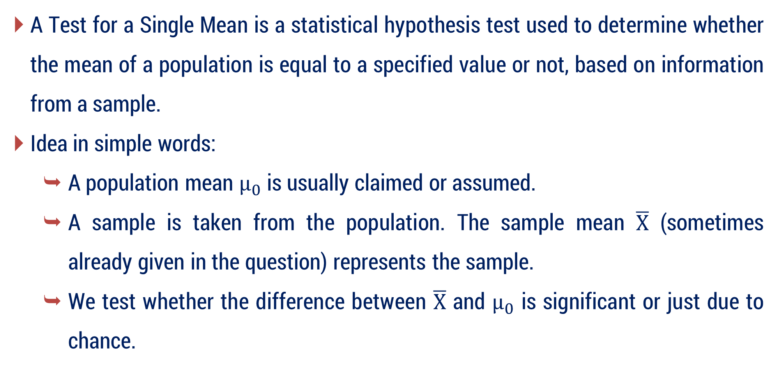
Test for Single Mean
A Test for a Single Mean is a statistical hypothesis test used to determine whether the mean of a population is equal to a specified value or not, based on information from a sample.
Idea in simple words:
A population mean $μ_{0}$​ is usually claimed or assumed.
A sample is taken from the population. The sample mean $\overline{X}$ (sometimes already given in the question) represents the sample.
We test whether the difference between $\overline{X}$ and $μ_{0}$​ is significant or just due to chance.

Slide 6

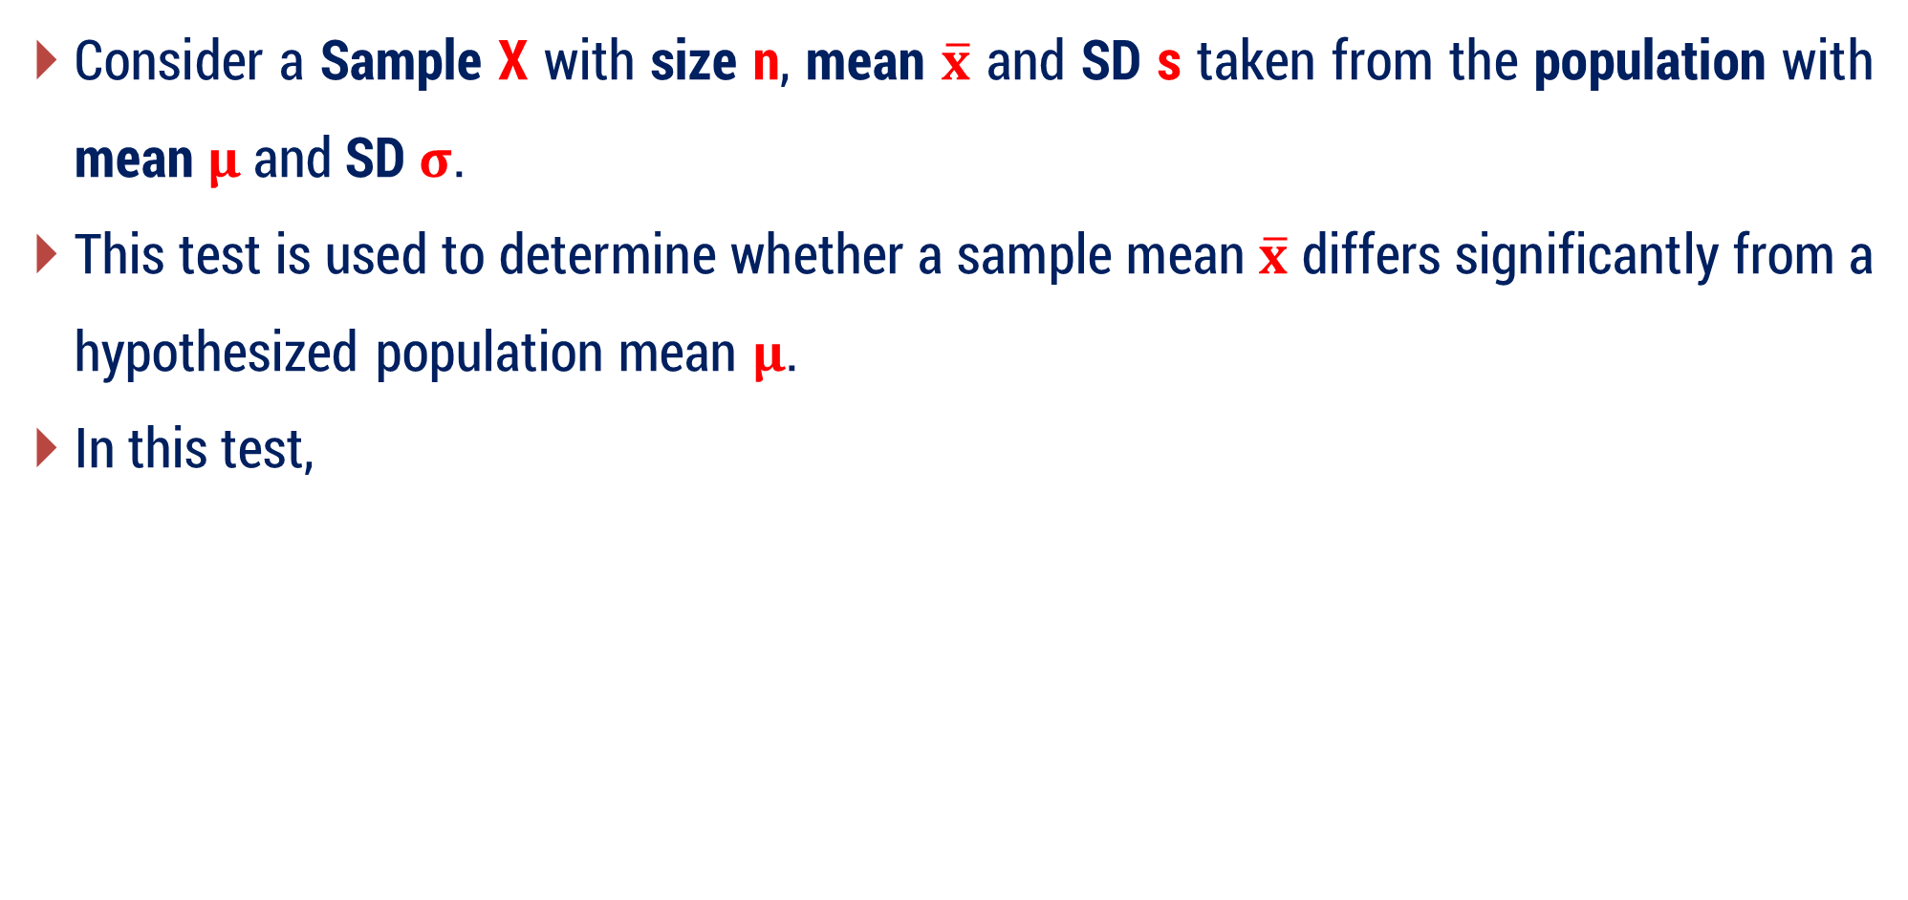
Test for Single Mean
Consider a Sample X with size n, mean $\overline{x}$ and SD s taken from the population with mean $μ$ and SD $σ$.
This test is used to determine whether a sample mean $\overline{x}$ differs significantly from a hypothesized population mean $μ$.
In this test,
$$SE\left(t\right)=\left\{\begin{aligned}& \frac{σ}{\begin{aligned}& \\ &\sqrt{n } \end{aligned}} ; σ is known \\ & \\ & \frac{s}{\begin{aligned}& \\ &\sqrt{n } \end{aligned}} ; σ is unknown\end{aligned}\right.$$

Slide 7



Test for Single Mean
Formula for Test Statistics
When population SD $σ$ is known
When population SD $σ$ is unknown
$$Z=\frac{ \overline{ x }−μ }{\begin{aligned}& \\ &\frac{σ}{\begin{aligned}& \\ &\sqrt{n } \end{aligned}}\end{aligned}}$$
$$Z=\frac{ \overline{ x }−μ }{\begin{aligned}& \\ &\frac{s}{\begin{aligned}& \\ &\sqrt{n } \end{aligned}}\end{aligned}}$$

Slide 8
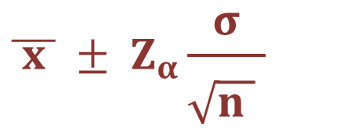

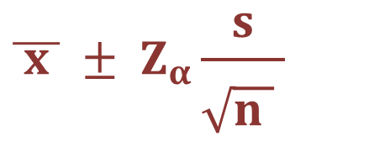
Confidence Limits
$$\overline{ x } ± Z_{α}SE$$
where, $Z_{α}=$ Critical value at level of Significance$α.$
If population SD is known :
$$\overline{ x } ± Z_{α}\frac{σ}{\begin{aligned}& \\ &\sqrt{n } \end{aligned}}$$
If population SD is unknown then, we can estimate using sample SD $s$.
$$\overline{ x } ± Z_{α}\frac{s}{\begin{aligned}& \\ &\sqrt{n } \end{aligned}}$$

Slide 9
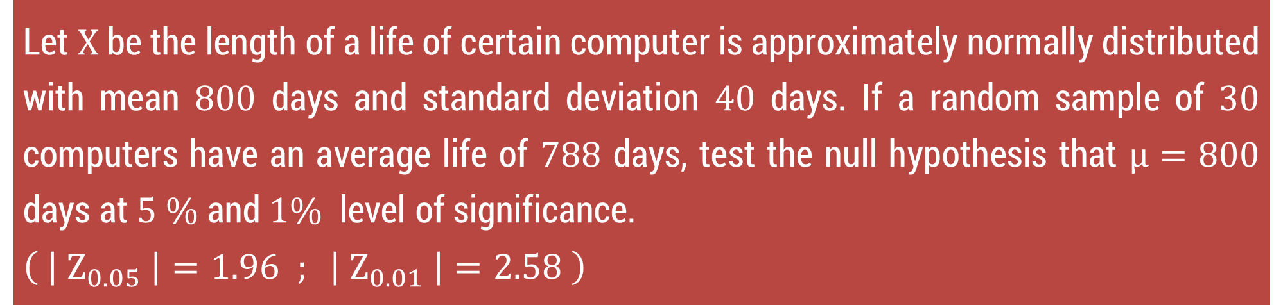
Method 1 ⇝ Example 1
Let $X$ be the length of a life of certain computer is approximately normally distributed with mean $800$ days and standard deviation $40$ days. If a random sample of $30$ computers have an average life of $788$ days, test the null hypothesis that $μ=800$ days at $5 \%$ and $1\%$ level of significance.
$$\left( \left| Z_{0.05} \right|=1.96 ; \left| Z_{0.01} \right|=2.58 \right)$$

Slide 10
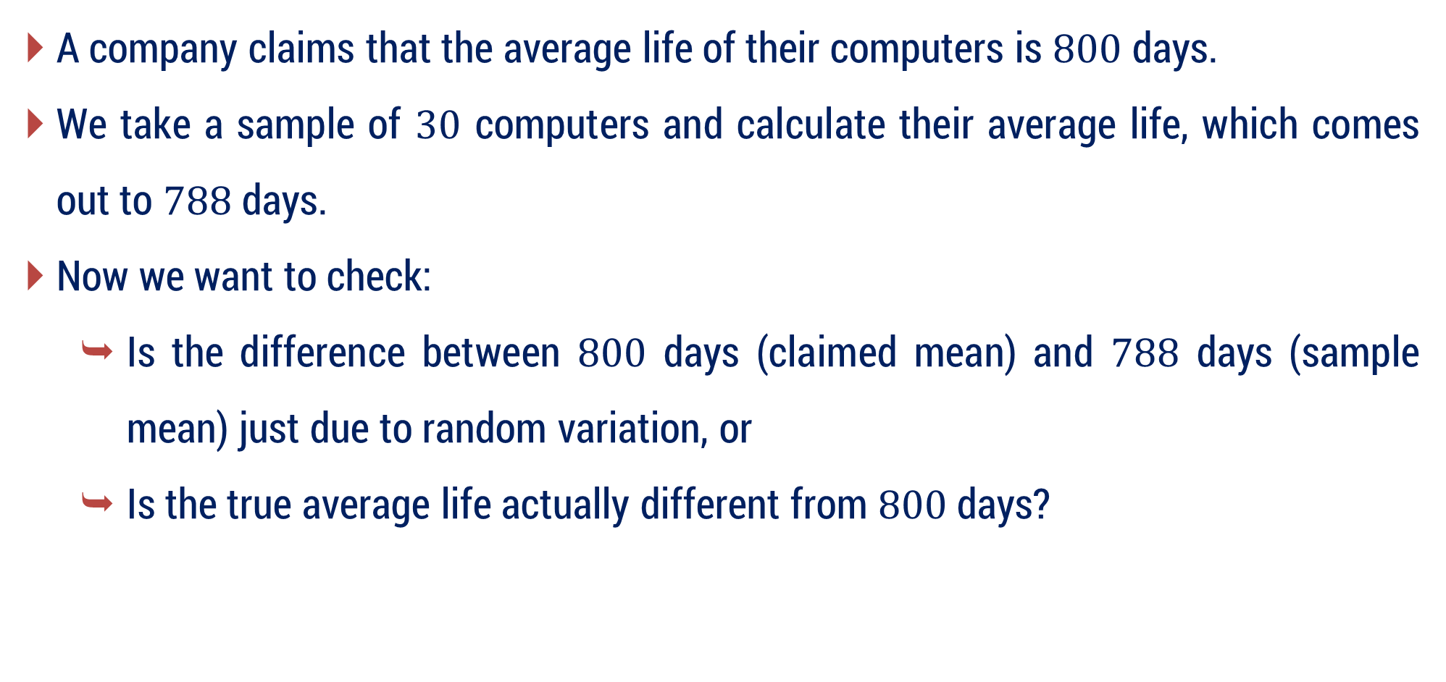
Method 1 ⇝ Example 1 ⇝ Meaning
A company claims that the average life of their computers is $800$ days.
We take a sample of $30$ computers and calculate their average life, which comes out to $788$ days.
Now we want to check:
Is the difference between $800$ days (claimed mean) and $788$ days (sample mean) just due to random variation, or
Is the true average life actually different from $800$ days?

Slide 11

Method 1 ⇝ Example 1 ⇝ Idea about Hypotheses
Null Hypothesis $H_{0} :μ=800$
The true average life of computers is $800$ days.
Alternative Hypothesis $H_{1} :μ≠800$
The true average life is different from $800$ days.

Slide 12
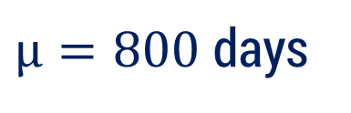



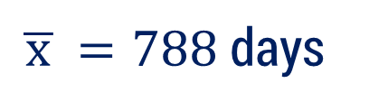



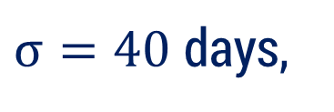

Method 1 ⇝ Example 1
Let $X$ be the length of a life of certain computer is approximately normally distributed with mean $800$ days and standard deviation $40$ days. If a random sample of $30$ computers have an average life of $788$ days, test the null hypothesis that $μ=800$ days at $5 \%$ and $1\%$ level of significance.
$$\left( \left| Z_{0.05} \right|=1.96 ; \left| Z_{0.01} \right|=2.58 \right)$$
Solution:
Here, $μ=800$ days,
$σ=40$ days,
$n=30,$
$\overline{ x }=788$ days
$H_{0} :$
$μ=800$ days
$H_{1} :$
$μ≠800$ days
$L.O.S. =5\% \& 1\%$

Slide 13
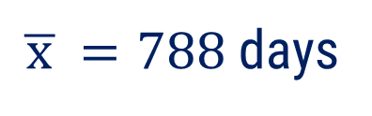
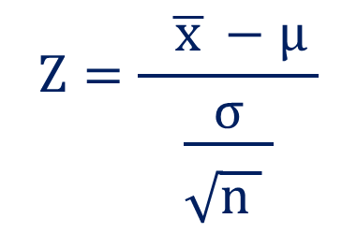
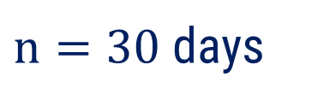

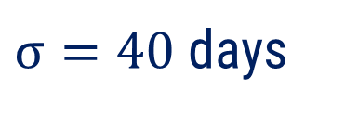

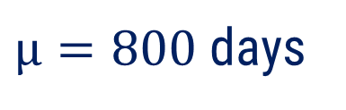
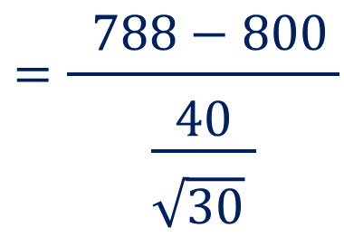
Method 1 ⇝ Example 1(Continue)
$$Z=\frac{ \overline{ x }−μ }{\begin{aligned}& \\ &\frac{σ}{\begin{aligned}& \\ &\sqrt{n } \end{aligned}}\end{aligned}}$$
$μ=800$ days
$Test$ :
$n=30$ days
$σ=40$ days
$$=\frac{ 788−800 }{\begin{aligned}& \\ &\frac{40}{\begin{aligned}& \\ &\sqrt{30} \end{aligned}}\end{aligned}}$$
$\overline{ x }=788$ days
$$=−1.6432$$

Slide 14



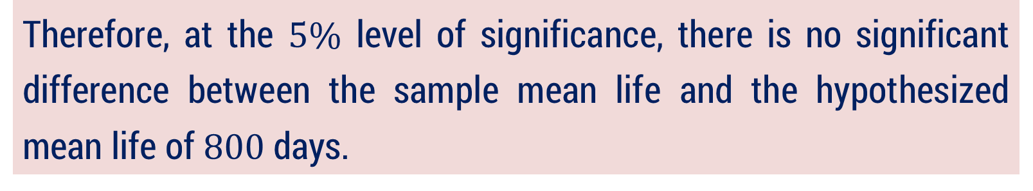





Method 1 ⇝ Example 1(Continue)
Critical Value :
$$\left| Z_{0.05} \right|=1.96$$
Conclusion :
For, $α=5\%$
$$<$$
$$1.96=| Z_{0.05} |$$
Here, $\left| Z \right| =1.6432$
$$−1.96$$
$$1.96$$
$∴$ accept $H_{0 }.$
Therefore, at the $5\%$ level of significance, there is no significant difference between the sample mean life and the hypothesized mean life of $800$ days.

Slide 15


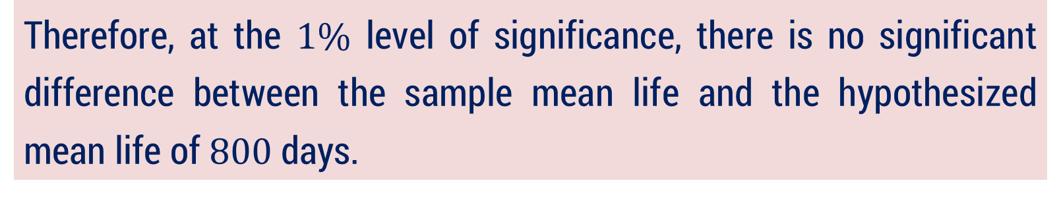






Method 1 ⇝ Example 1(Continue)
Critical Value :
$$\left| Z_{0.01} \right|=2.58$$
Conclusion :
$$<$$
For, $α=1\%$
Here, $\left| Z \right| =1.6432$
$$2.58=| Z_{0.01} |$$
$$−2.58$$
$$2.58$$
$∴$ accept $H_{0}.$
Therefore, at the $1\%$ level of significance, there is no significant difference between the sample mean life and the hypothesized mean life of $800$ days.

Slide 16
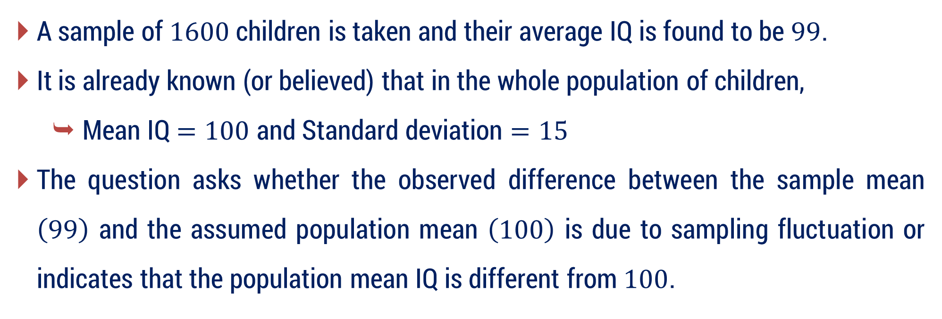
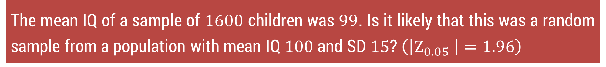
Method 1 ⇝ Example 4 ⇝ Meaning
The mean IQ of a sample of $1600$ children was $99$. Is it likely that this was a random sample from a population with mean IQ $100$ and SD $15$? $\left(\left|Z_{0.05} \right|=1.96\right)$
A sample of $1600$ children is taken and their average IQ is found to be $99$.
It is already known (or believed) that in the whole population of children,
Mean IQ $=100$ and Standard deviation $=15$
The question asks whether the observed difference between the sample mean $\left(99\right)$ and the assumed population mean $\left(100\right)$ is due to sampling fluctuation or indicates that the population mean IQ is different from $100$.

Slide 17

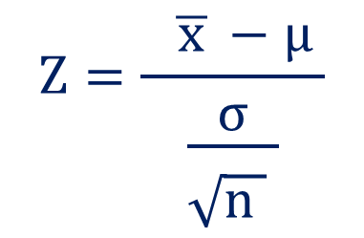









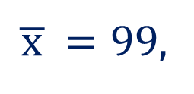
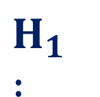
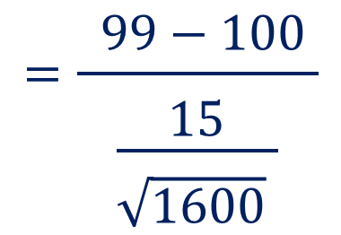
Method 1 ⇝ Example 4
The mean IQ of a sample of $1600$ children was $99$. Is it likely that this was a random sample from a population with mean IQ 100 and SD $15$? $\left(\left|Z_{0.05} \right|=1.96\right)$
Solution:
Here, $n=1600$,
$\overline{ x }=99$,
$μ=100,$
$σ=15$
$H_{0} :$
$$μ=100$$
$H_{1} :$
$$μ≠100$$
$$L.O.S. =5\%=0.05$$
$$Z=\frac{ \overline{ x }−μ }{\begin{aligned}& \\ &\frac{σ}{\begin{aligned}& \\ &\sqrt{n } \end{aligned}}\end{aligned}}$$
$$=\frac{ 99−100 }{\begin{aligned}& \\ &\frac{15}{\begin{aligned}& \\ &\sqrt{1600} \end{aligned}}\end{aligned}}$$
$Test$ :
$$=− 2.6667$$

Slide 18




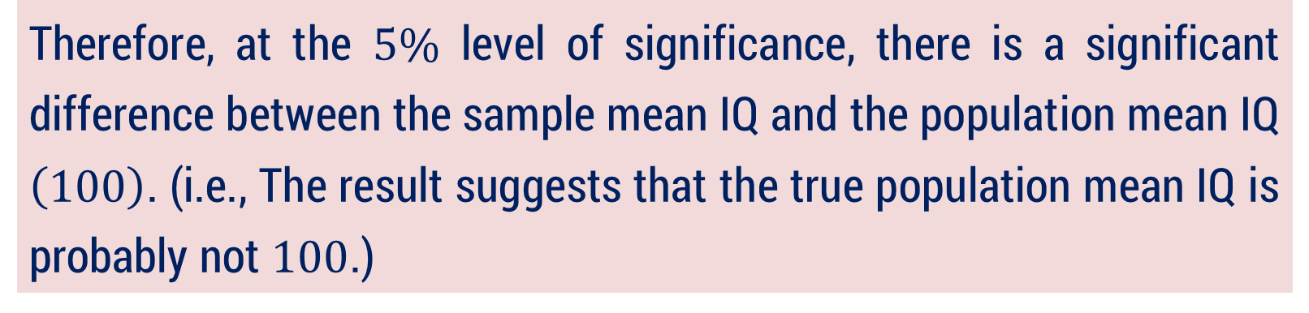


Method 1 ⇝ Example 4(Continue)
Critical Value :
$$\left| Z_{0.05} \right|=1.96$$
Conclusion :
For, $α=5\%$
Here, $\left| Z \right| =2.6667$
$$>$$
$$1.96=\left| Z_{0.05} \right|$$
$$−1.96$$
$$1.96$$
$∴$ reject $H_{0 }.$
Therefore, at the $5\%$ level of significance, there is a significant difference between the sample mean IQ and the population mean IQ $\left(100\right)$. (i.e., The result suggests that the true population mean IQ is probably not $100$.)

Slide 19
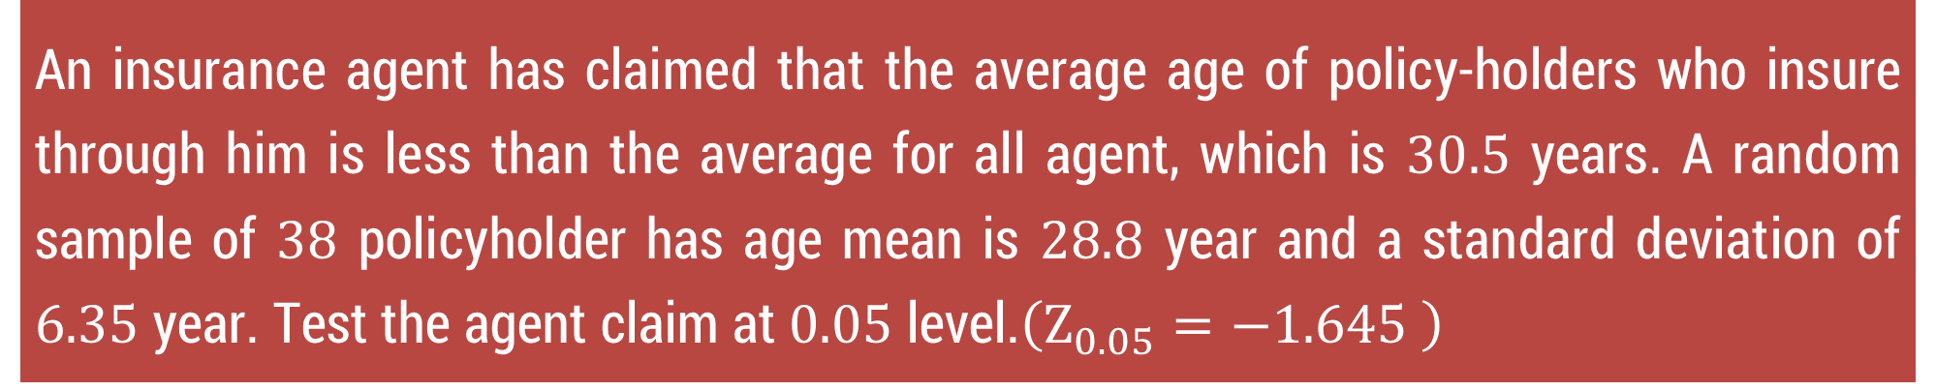
Method 1 ⇝ Example 7
An insurance agent has claimed that the average age of policy-holders who insure through him is less than the average for all agent, which is $30.5$ years. A random sample of $38$ policyholder has age mean is $28.8$ year and a standard deviation of $6.35$ year. Test the agent claim at $0.05$ level.$\left(Z_{0.05}=−1.645 \right)$

Slide 20
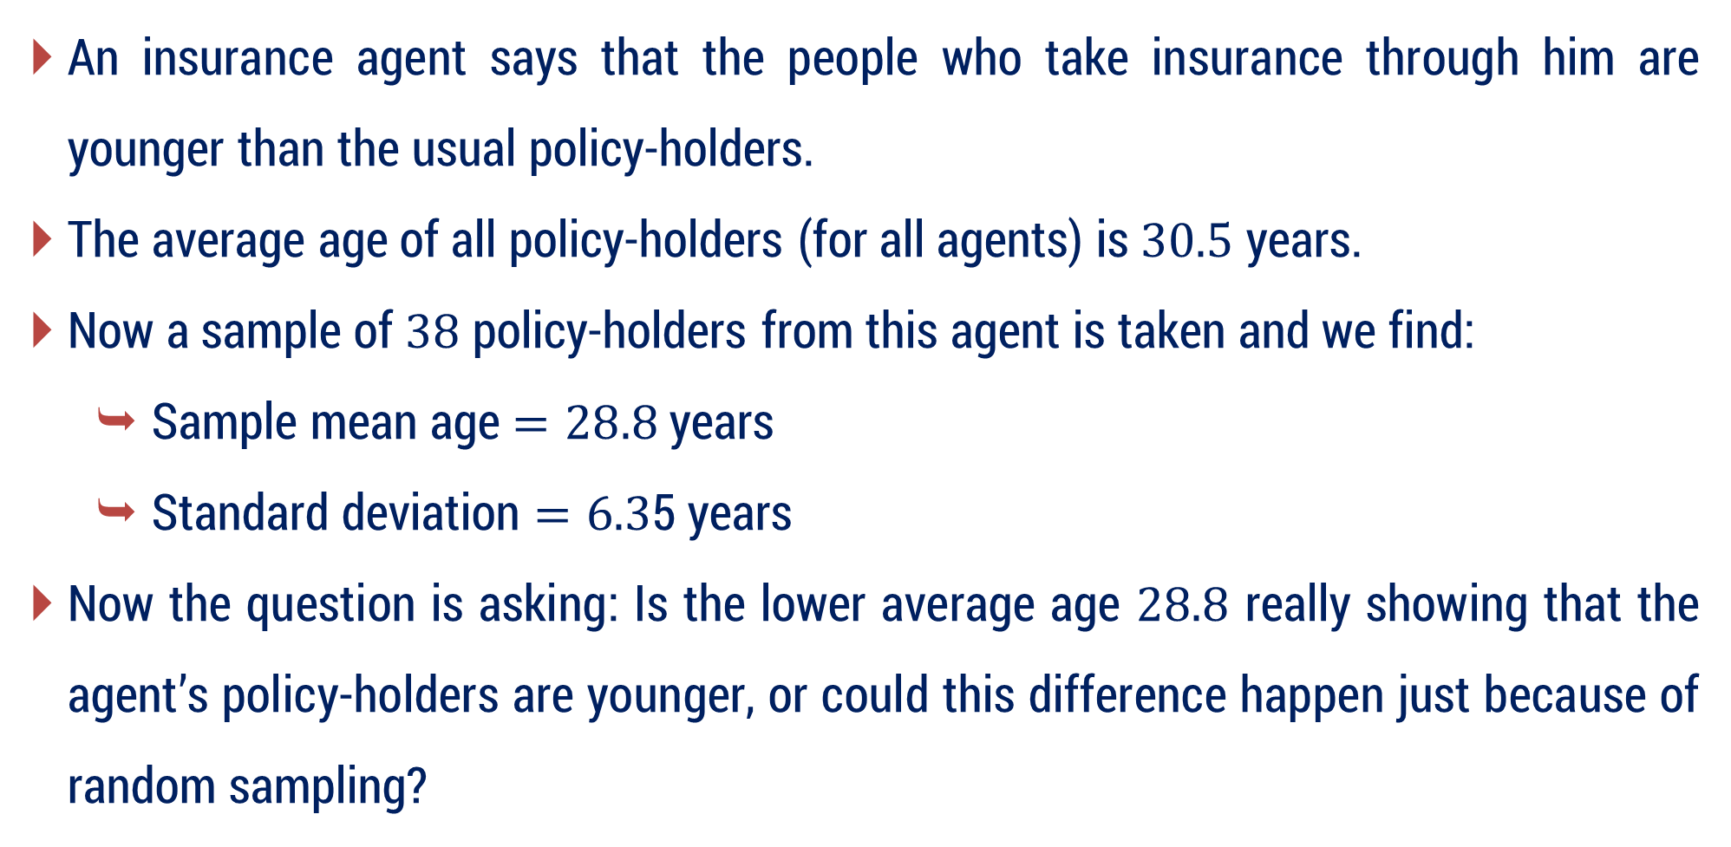
Method 1 ⇝ Example 7 ⇝ Meaning
An insurance agent says that the people who take insurance through him are younger than the usual policy-holders.
The average age of all policy-holders (for all agents) is $30.5$ years.
Now a sample of $38$ policy-holders from this agent is taken and we find:
Sample mean age $=28.8$ years
Standard deviation $=6.3$5 years
Now the question is asking: Is the lower average age $28.8$ really showing that the agent’s policy-holders are younger, or could this difference happen just because of random sampling?

Slide 21
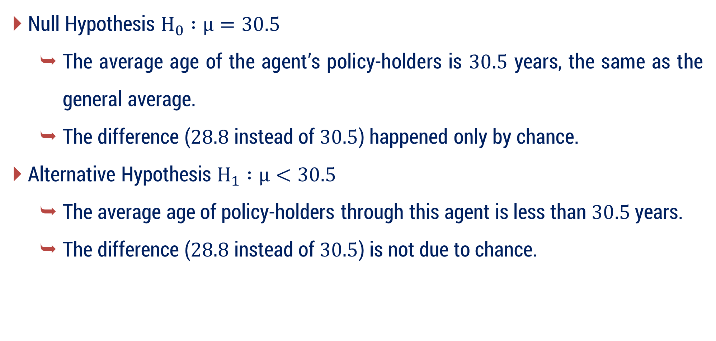
Method 1 ⇝ Example 7 ⇝ Idea about Hypotheses
Null Hypothesis $H_{0} :μ=30.5$
The average age of the agent’s policy-holders is $30.5$ years, the same as the general average.
The difference ($28.8$ instead of $30.5$) happened only by chance.
Alternative Hypothesis $H_{1} :μ<30.5$
The average age of policy-holders through this agent is less than $30.5$ years.
The difference ($28.8$ instead of $30.5$) is not due to chance.

Slide 22





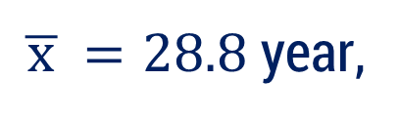

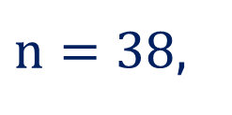

Method 1 ⇝ Example 7
An insurance agent has claimed that the average age of policy-holders who insure through him is less than the average for all agent, which is $30.5$ years. A random sample of $38$ policyholder has age mean is $28.8$ year and a standard deviation of $6.35$ year. Test the agent claim at $0.05$ level.$\left(Z_{0.05}=−1.645 \right)$
Solution:
Here, $μ=30.5$ year,
$n=38$,
$\overline{ x }=28.8$ year,
$s=6.35$ year
$H_{0} :$
$$μ=30.5$$
$H_{1} :$
$$μ<30.5$$
$L.O.S. =5\%$

Slide 23


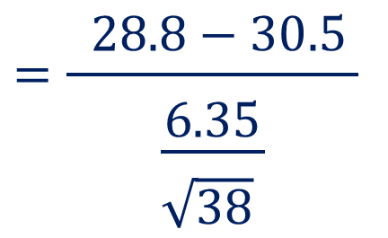
Method 1 ⇝ Example 7(Continue)
$$Z=\frac{ \overline{ x }−μ }{\begin{aligned}& \\ &\frac{σ}{\begin{aligned}& \\ &\sqrt{n } \end{aligned}}\end{aligned}}$$
$$μ=30.5 \text{year}$$
$$n=38$$
$$\overline{ x }=28.8 \text{year}$$
$$s=6.35 \text{year}$$
$Test$ :
$$=\frac{ 28.8−30.5 }{\begin{aligned}& \\ &\frac{6.35}{\begin{aligned}& \\ &\sqrt{38} \end{aligned}}\end{aligned}}$$
$$=−1.6503$$

Slide 24




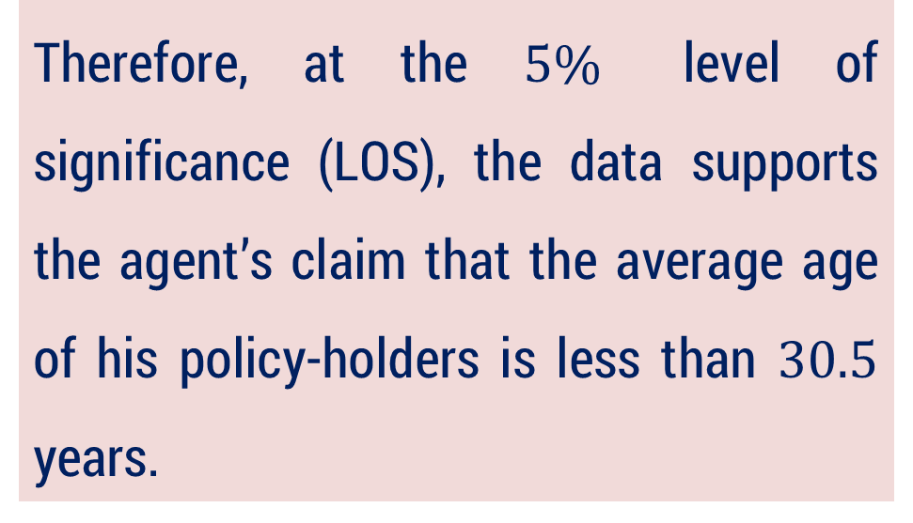



Method 1 ⇝ Example 7(Continue)
Conclusion :
For, $α=5\%$
$$<$$
Here, $Z=−1.6503$
$${−1.645=Z}_{0.05}$$
$∴$ We reject $H_{0 }.$
Therefore, at the $5\%$ level of significance (LOS), the data supports the agent’s claim that the average age of his policy-holders is less than $30.5$ years.
Critical
Region
$$Z_{0.05}=−1.645$$
$$Z=−1.6503$$

Slide 25
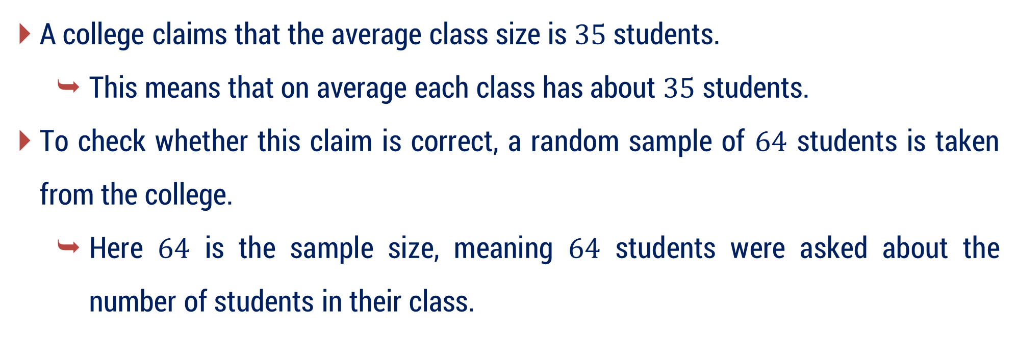
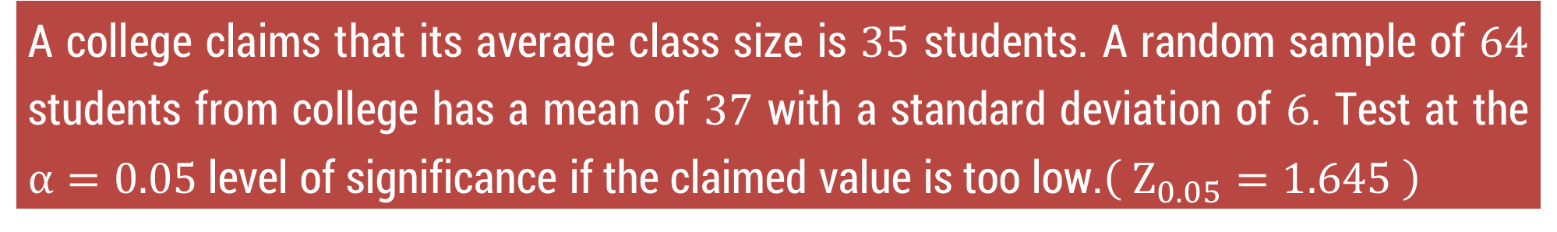
Method 1 ⇝ Example 10 ⇝ Meaning
A college claims that its average class size is $35$ students. A random sample of $64$ students from college has a mean of $37$ with a standard deviation of $6$. Test at the $α=0.05$ level of significance if the claimed value is too low.$\left( Z_{0.05}=1.645 \right)$
A college claims that the average class size is $35$ students.
This means that on average each class has about $35$ students.
To check whether this claim is correct, a random sample of $64$ students is taken from the college.
Here $64$ is the sample size, meaning $64$ students were asked about the number of students in their class.

Slide 26
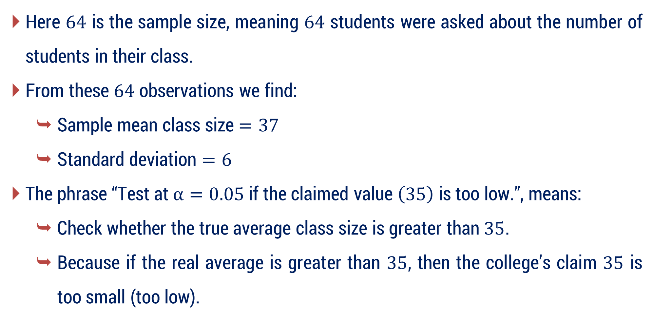
Method 1 ⇝ Example 10 ⇝ Meaning
Here $64$ is the sample size, meaning $64$ students were asked about the number of students in their class.
From these $64$ observations we find:
Sample mean class size $=37$
Standard deviation $=6$
The phrase “Test at $α=0.05$ if the claimed value $\left(35\right)$ is too low.”, means:
Check whether the true average class size is greater than $35$.
Because if the real average is greater than $35$, then the college’s claim $35$ is too small (too low).

Slide 27
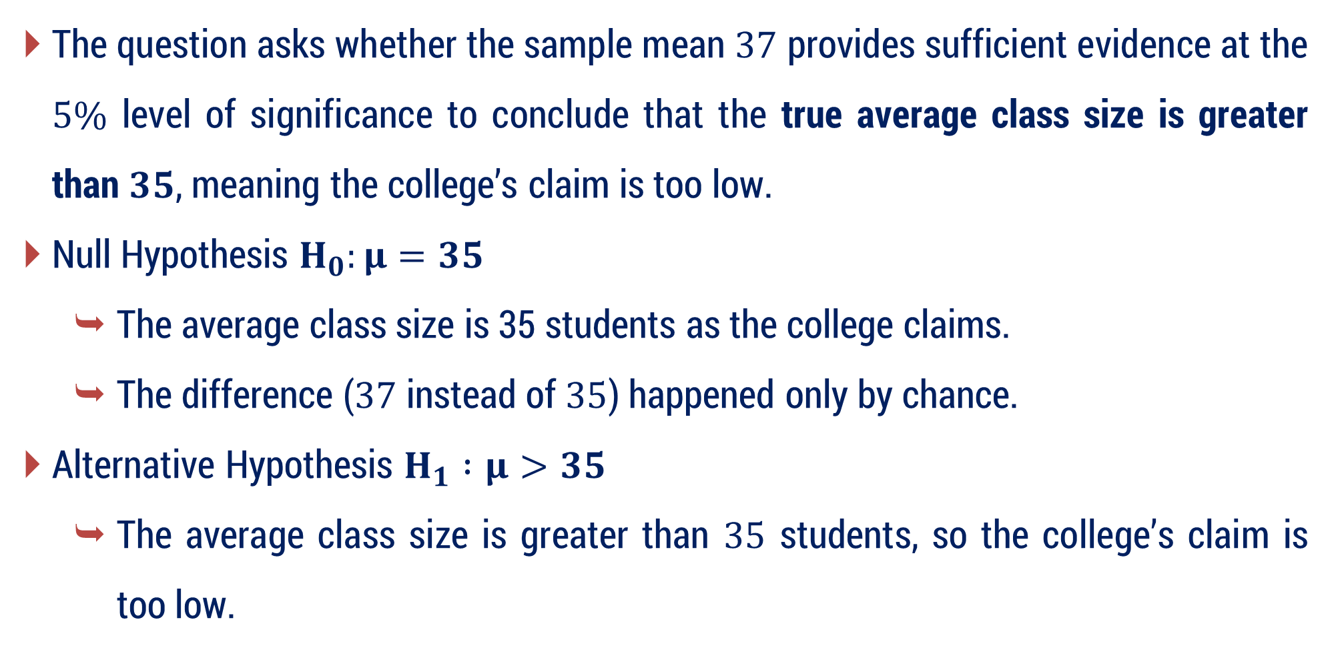
Method 1 ⇝ Example 10 ⇝ Idea about Hypotheses
The question asks whether the sample mean $37$ provides sufficient evidence at the $5\%$ level of significance to conclude that the true average class size is greater than $35$, meaning the college’s claim is too low.
Null Hypothesis $H_{0}:μ=35$
The average class size is 35 students as the college claims.
The difference ($37$ instead of $35$) happened only by chance.
Alternative Hypothesis $H_{1} :μ>35$
The average class size is greater than $35$ students, so the college’s claim is too low.

Slide 28

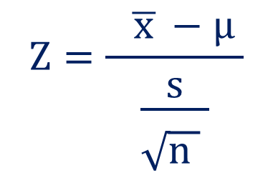
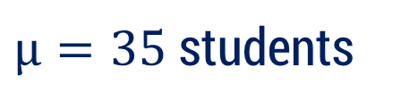
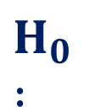

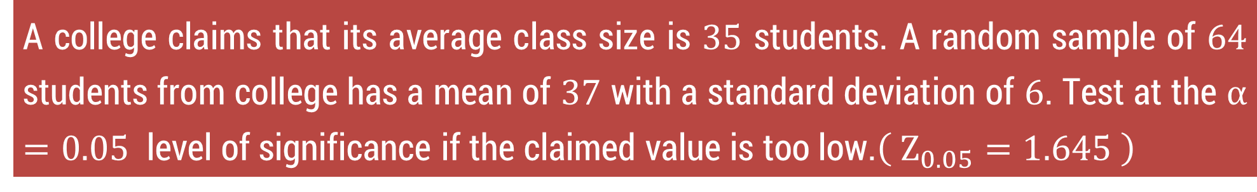
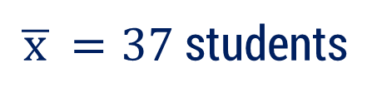






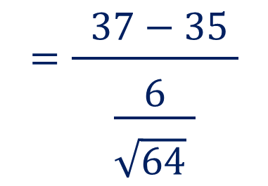
Method 1 ⇝ Example 10
A college claims that its average class size is $35$ students. A random sample of $64$ students from college has a mean of $37$ with a standard deviation of $6$. Test at the $α=0.05$ level of significance if the claimed value is too low.$\left( Z_{0.05}=1.645 \right)$
Solution:
$μ=35$ students
$n=64$
$\overline{ x }=37$ students
$s=6$ students
$H_{0} :$
$μ=35$
$μ>35$
Is the actual class size bigger than what the college claims (35 students)?
$H_{1} :$
$L.O.S. =5\%$
$$Z=\frac{ \overline{ x }−μ }{\begin{aligned}& \\ &\frac{s}{\begin{aligned}& \\ &\sqrt{n } \end{aligned}}\end{aligned}}$$
$$=\frac{ 37−35 }{\begin{aligned}& \\ &\frac{6}{\begin{aligned}& \\ &\sqrt{64} \end{aligned}}\end{aligned}}$$
$Test$ :
$$=2.67$$

Slide 29




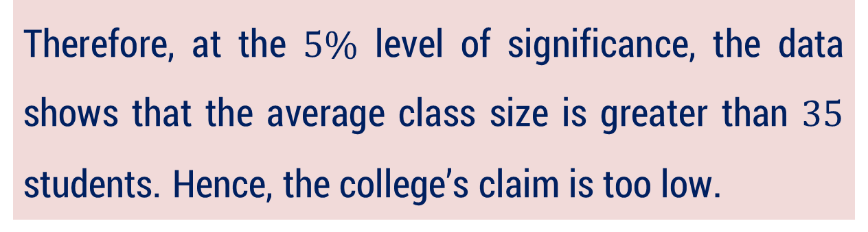


Method 1 ⇝ Example 10(Continue)
Critical Value :
$$Z_{0.05}=1.645$$
Conclusion :
$$Z=2.67$$
$$>$$
$${1.645=Z}_{0.05}$$
$∴$ reject $H_{0}$.
$$1.645$$
Therefore, at the $5\%$ level of significance, the data shows that the average class size is greater than $35$ students. Hence, the college’s claim is too low.

Slide 30
Method – 2 Test for Difference of Mean

Slide 31
What is Test for Difference of Means ?
Test for Difference of Means is a statistical test used to determine whether the means (averages) of two populations are significantly different or not.
In simple words:
It checks whether the difference between two sample averages happened by chance or it represents a real difference between populations.

Slide 32
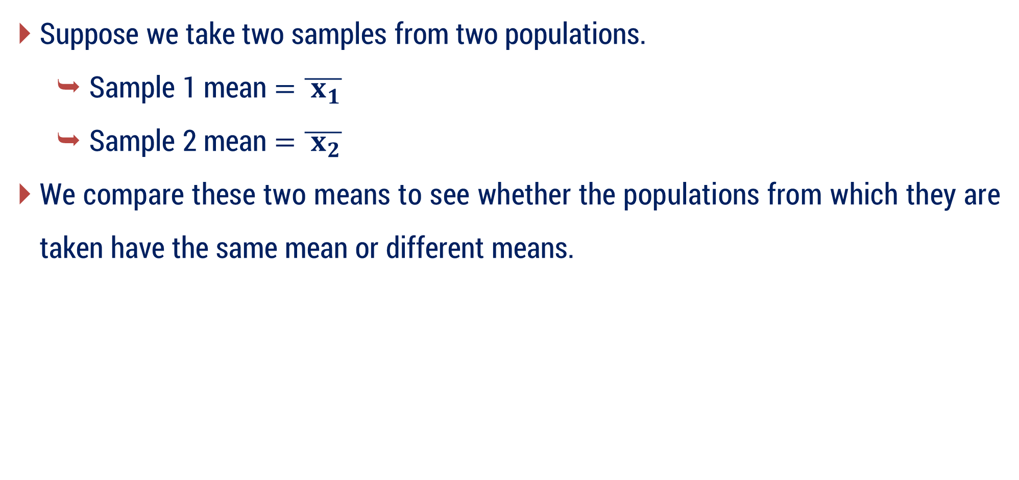
Basic Idea
Suppose we take two samples from two populations.
Sample 1 mean $=\overline{{ x}_{1}}$ ​
Sample 2 mean $=\overline{{ x}_{2}}$ ​
We compare these two means to see whether the populations from which they are taken have the same mean or different means.

Slide 33


Test for Difference of Mean
Consider a two sample $X_{1}$ and $X_{2}$ size $n_{1}$ and $n_{2}$, mean $\overline{{ x}_{1}}$ and $\overline{{ x}_{2}}$ SD $s_{1}$ and $s_{2}$ respectively taken from two different population with size $N_{1}$ and $N_{2}$, mean ${ μ}_{1}$and${ μ}_{2}$ and SD $σ_{1}$ and $σ_{2}$.
This test is used to find significant difference between sample mean $\overline{{ x}_{1}}$ and $\overline{{ x}_{2}}$.
In this test,
$$SE\left(t\right)=\left\{\begin{aligned}& \sqrt{\frac{{σ_{1}}^{2}}{n_{1}}+\frac{{σ_{2}}^{2}}{n_{2}}} ; \text{if} \text{Population} \text{SDs} \text{are} \text{known} \\ & \\ &\sqrt{\frac{{s_{1}}^{2}}{n_{1}}+\frac{{s_{2}}^{2}}{n_{2}}} ;\text{if} \text{Population} \text{SDs} \text{are} \text{un}\text{known}\end{aligned}\right.$$

Slide 34


Test for Difference of Mean
Formula for Test Statistics
When if Population SDs are known
When if Population SDs are unknown
$$Z=\frac{ \overline{ x_{1}}−\overline{ x_{2}}}{\begin{aligned}& \\ &\sqrt{\frac{{{ σ}_{1}}^{2} }{n_{1}}+\frac{{ σ_{2}}^{2} }{n_{2}}}\end{aligned}}$$
$$Z=\frac{\overline{ x_{1}}−\overline{ x_{2}}}{\begin{aligned}& \\ &\sqrt{\frac{{{ s}_{1}}^{2} }{n_{1}}+\frac{ {s_{2}}^{2} }{n_{2}}}\end{aligned}}$$

Slide 35


Test for Difference of Mean
General Form : $\left( \overline{ x_{1}}−\overline{ x_{2}} \right)± Z_{α} SE$
If Population SDs are known,
$$\left( \overline{ x_{1}}−\overline{ x_{2}} \right)± Z_{α}\sqrt{\frac{{σ_{1}}^{2}}{n_{1}}+\frac{{σ_{2}}^{2}}{n_{2}}}$$
If Population SDs are unknown, replace $σ_{1},σ_{2}$​ with sample SDs $s_{1},s_{2}$ ​:
$$\left( \overline{ x_{1}}−\overline{ x_{2}} \right)± Z_{α}\sqrt{\frac{{s_{1}}^{2}}{n_{1}}+\frac{{s_{2}}^{2}}{n_{2}}}$$

Slide 36













Method 2 ⇝ Example 1
Test the significance of the difference between the means of two normal population with the same standard deviation given from the following data
 | Size | Mean | SD
Sample I | $$100$$ | $$64$$ | $$6$$
Sample II | $$200$$ | $$67$$ | $$8$$
$$\left( \left|Z_{0.05}\right|=1.96 \right)$$
Solution:
$$n_{1}=100$$
$$\overline{ x_{1}}=64$$
$$s_{1}=6$$
$$n_{2}=200$$
$$\overline{ x_{2}}=67$$
$$s_{2}=8$$
$H_{0} :$
$$μ_{1}=μ_{2}$$
$H_{1} :$
$$μ_{1}≠μ_{2}$$
$L.O.S. =5\%$

Slide 37










Method 2 ⇝ Example 1 (Continue)
$$Z=\frac{ \overline{ x_{1}}−\overline{ x_{2}}}{\begin{aligned}& \\ &\sqrt{\frac{{{ s}_{1}}^{2} }{n_{1}}+\frac{{ s_{2}}^{2} }{n_{2}}}\end{aligned}}$$
$$n_{1}=100$$
$Test$ :
$$n_{2}=200$$
$$\overline{ x_{1}}=64$$
$$\overline{ x_{2}}=67$$
$$=\frac{ 64−67 }{\begin{aligned}& \\ &\end{aligned}\sqrt{\frac{36}{ 100 }+\frac{64}{ 200 }}}$$
$$s_{1}=6$$
$$s_{2}=8$$
$$=−3.6380$$

Slide 38





Method 2 ⇝ Example 1 (Continue)
Critical Value :
$$\left| Z_{0.05} \right|=1.96$$
Conclusion :
$$>$$
$$1.96=Z_{0.05}$$
$$\left| Z \right|=3.6380$$
$$−1.96$$
$$1.96$$
$∴$ reject $H_{0}$.
At $5\%$ level of significance, there is a significant difference between the means of the two samples.

Slide 39

Method 2 ⇝ Example 5
In a random sample of $100$ light bulbs manufactured by a company A, the mean lifetime of light bulb is $1190$ hours with standard deviation of $90$ hours. Also, in a random sample of $75$ light bulbs manufactured by company B, the mean lifetime of light bulb is $1230$ hours with standard deviation of $120$ hours. Is there a difference between the mean lifetime of the two brands of light bulbs at a significance level of $0.05$ and $0.01$? $\left(\left| Z_{0.05} \right|=1.96 \right)$ $\left(\left| Z_{0.01}\right|=2.58 \right)$

Slide 40

Method 2 ⇝ Example 5 ⇝ Meaning
Two companies A and B manufacture light bulbs.
We take samples of bulbs from both companies and calculate their average lifetime.
Company A sample mean lifetime $=1190$ hours
Company B sample mean lifetime $=1230$ hours
Now the question is asking: Is the difference in the average lifetimes ($1190$ and $1230$ hours) real, or is it only due to random sampling?
In other words, we want to check whether both companies actually produce bulbs with the same average lifetime or different average lifetimes.

Slide 41
Method 2 ⇝ Example 5 ⇝ Meaning
The question asks “Is there a difference between the mean lifetimes?
“Difference” can happen in two ways:
Mean of A greater than mean of B
Mean of A less than mean of B
Since both possibilities are allowed, we must check both sides of the distribution.
Therefore, we use a two-tailed test.

Slide 42

Method 2 ⇝ Example 5 ⇝ Idea about Hypotheses
Null Hypothesis $H_{0} :μ_{1}=μ_{2}$
There is no difference between the mean lifetimes of light bulbs of company A and company B.
This means that if we observe any difference between the sample means, it is only due to sampling variation (chance).
Alternative Hypothesis $H_{1} :μ_{1}≠μ_{2}$
There is a difference between the mean lifetime of bulbs of the two companies.
This means that the difference between the sample means is real and not only due to sampling variation.

Slide 43











Method 2 ⇝ Example 5
In a random sample of $100$ light bulbs manufactured by a company A, the mean lifetime of light bulb is $1190$ hours with standard deviation of $90$ hours. Also, in a random sample of $75$ light bulbs manufactured by company B, the mean lifetime of light bulb is $1230$ hours with standard deviation of $120$ hours. Is there a difference between the mean lifetime of the two brands of light bulbs at a significance level of $0.05$ and $0.01$? $\left(\left| Z_{0.05} \right|=1.96 \right)$ $\left(\left| Z_{0.01}\right|=2.58 \right)$
Solution:
Company A
Company B
$H_{0} :$
$$μ_{1}=μ_{2}$$
$$n_{1}=100$$
$$n_{2}=75$$
$H_{1} :$
$$μ_{1}≠μ_{2}$$
$\overline{ x_{1}}=1190$hrs
$\overline{ x_{2}}=1230$hrs
$L.O.S.=5\% \& 1\%$
$s_{1}=90$hrs
$s_{2}=120$ hrs

Slide 44











Method 2 ⇝ Example 5 (Continue)
$$Z=\frac{ \overline{ x_{1}}−\overline{ x_{2}}}{\begin{aligned}& \\ &\sqrt{\frac{{{ s}_{1}}^{2}}{n_{1}}+\frac{{{ s}_{2}}^{2}}{n_{2}}}\end{aligned}}$$
$$n_{1}=100$$
$Test$ :
$$n_{2}=75$$
$$\overline{ x_{1}}=1190$$
$$\overline{ x_{2}}=1230$$
$$=\frac{ 1190−1230 }{\begin{aligned}& \\ &\end{aligned}\sqrt{\frac{ 8100 }{ 100 }+\frac{ 14400 }{ 75 }}}$$
$$s_{1}=90$$
$$s_{2}=120$$
$$=\frac{ −40}{\begin{aligned}& \\ &\end{aligned}16.5227 }$$
$$=−2.4209$$

Slide 45

Method 2 ⇝ Example 5 (Continue)
Critical Value :
$$\left| Z_{0.05} \right|=1.96$$
Conclusion :
$$>$$
For, $α=5\%$
$$\left| Z \right| =2.4209$$
$$1.96=\left| Z_{0.05} \right|$$
$$−1.96$$
$$1.96$$
$∴$ reject $H_{0 }$.
At $5\%$ level of significance, there is a significant difference between the mean lifetimes of bulbs manufactured by companies A and B..

Slide 46
Method 2 ⇝ Example 5 (Continue)
Critical Value :
$$\left| Z_{0.01} \right|=2.58$$
Conclusion :
$$<$$
For, $α=1\%$
$$\left| Z \right| =2.4209$$
$$2.58=\left| Z_{0.01} \right|$$
$$−2.58$$
$$2.58$$
$∴$ accept $H_{0 }$.
At $1\%$ level of significance, there is no significant difference between the mean lifetimes of bulbs manufactured by companies A and B.

Slide 47
Method 2 ⇝ Example 9
A company A manufactured tube lights and claims that its tube lights are superior than its main competitor company B. The study showed that a sample of $40$ tube lights manufactured by company A has a mean lifetime of $647$ hours of continuous use with a standard deviation of $27$ hours, while a sample of $40$ tube lights manufactured by company B had a mean lifetime $638$ hours of continuous use with a standard deviation of $31$ hours. Does this substantiate the claim of company A that their tube lights are superior than manufactured by company B at $0.05$ level of significance? $\left( Z_{0.05}=1.645 \right)$

Slide 48
Method 2 ⇝ Example 9 ⇝ Meaning
Company A says that its tube lights are superior (better) than those of company B.
Here “better” means longer lifetime.
From samples we observe:
Company A average lifetime $=647$ hours
Company B average lifetime $=638$ hours
The sample data shows that the mean life of tube lights from company A is $9$ hours more than that of company B.
But the question is asking: Is this difference really because A is better, or could it just be due to sampling variation (chance)?

Slide 49
Method 2 ⇝ Example 9 ⇝ Meaning
Note that,
When we say: The claim of company A is substantiated.
It means:
There is enough statistical evidence to prove that company A’s tube lights are superior, and the observed difference may be due to sampling variation.
Substantiated $=$ proved or supported by evidence.

Slide 50
Method 2 ⇝ Example 9 ⇝ Idea about Hypotheses
Null Hypothesis $H_{0} :μ_{1}=μ_{2}$
The tube lights of company A are not superior to those of company B.
If we observe any difference between the sample means, it is only due to sampling variation.
Alternative Hypothesis $H_{1} :μ_{1}>μ_{2}$
The mean lifetime of tube lights of company A is greater than company B, so A's tube lights are superior.
Because the claim is “A is superior”, this is a right-tailed test.

Slide 51
Method 2 ⇝ Example 9
A company A manufactured tube lights and claims that its tube lights are superior than its main competitor company B. The study showed that a sample of $40$ tube lights manufactured by company A has a mean lifetime of $647$ hours of continuous use with a standard deviation of $27$ hours, while a sample of $40$ tube lights manufactured by company B had a mean lifetime $638$ hours of continuous use with a standard deviation of $31$ hours. Does this substantiate the claim of company A that their tube lights are superior than manufactured by company B at $0.05$ level of significance? $\left( Z_{0.05}=1.645 \right)$
Solution:
Company A
$$n_{1}=40$$
$$\overline{ x_{1}}=647$$
$$s_{1}=27$$
Company B
$$n_{2}=40$$
$$\overline{ x_{2}}=638$$
$$s_{2}=31$$

Slide 52
Method 2 ⇝ Example 9 (Continue)
$H_{0} :$
$$μ_{1}=μ_{2}$$
$$n_{1}=40$$
$H_{1} :$
$$μ_{1}>μ_{2}$$
$\overline{ x_{1}}=64$7
$L.O.S. =5\%$
$$s_{1}=27$$
$$n_{2}=40$$
$$Z=\frac{ \overline{ x_{1} }−\overline{ x_{2} }}{\begin{aligned}& \\ &\sqrt{\frac{{ s_{1}}^{2}}{n_{1}}+\frac{{ s_{2}}^{2}}{n_{2}}}\end{aligned}}$$
$$\overline{ x_{2}}=638$$
$Test$ :
$$s_{2}=31$$
$$=\frac{ 647−638 }{\begin{aligned}& \\ &\end{aligned}\sqrt{\frac{ 729 }{ 40 }+\frac{ 961 }{ 40 }}}$$
$$=1.3846$$

Slide 53




Method 2 ⇝ Example 9 (Continue)
Critical Value :
$$Z_{0.05}=1.645$$
Conclusion :
$$<$$
$$Z =1.3846$$
$${1.645=Z}_{0.05}$$
$$1.645$$
$∴$ accept $H_{0}$.
Hence, at $5\%$ LOS, the claim of company A is not substantiated.
(the observed difference may be due to sampling variation.)

Slide 54


Method 2 ⇝ Example 10 ⇝ Meaning
The average of marks scored by $32$ boys is $72$ with standard deviation $8$ while that of $36$ girls is $70$ with standard deviation $6$. Test at $1\%$ level of significance whether the boys perform better than the girls.$\left( Z_{0.01}=1.645 \right)$
We have marks of two groups of students:
$32$ boys → average marks $72$
$36$ girls → average marks $70$
From the sample, boys scored $2$ marks more than girls.
But the question is asking: Are boys really performing better than girls, or is this difference only due to sampling variation (chance)?

Slide 55

Method 2 ⇝ Example 10 ⇝ Idea about Hypotheses
Null Hypothesis $H_{0} :μ_{1}=μ_{2}$
The average marks of boys and girls are the same, or boys are not better than girls.
If we see any difference in sample means, it is only due to sampling variation.
Alternative Hypothesis $H_{1} :μ_{1}>μ_{2}$
The average marks of boys are greater than those of girls, so boys perform better than girls.

Slide 56











Method 2 ⇝ Example 10
The average of marks scored by $32$ boys is $72$ with standard deviation $8$ while that of $36$ girls is $70$ with standard deviation $6$. Test at $1\%$ level of significance whether the boys perform better than the girls.$\left( Z_{0.01}=1.645 \right)$
Solution:
$$n_{1}=32$$
$$\overline{ x_{1}}=72$$
$$s_{1}=8$$
$$n_{2}=36$$
$$\overline{ x_{2}}=70$$
$$s_{2}=6$$
$H_{0} :$
$$μ_{1}=μ_{2}$$
$H_{1} :$
$$μ_{1}>μ_{2}$$
$L.O.S. =1\%$

Slide 57




Method 2 ⇝ Example 10 (Continue)
$Test$ :
$$Z=\frac{ \overline{ x_{1} }−\overline{ x_{2} }}{\begin{aligned}& \\ &\sqrt{\frac{{{ s}_{1}}^{2}}{n_{1}}+\frac{{{ s}_{2}}^{2}}{n_{2}}}\end{aligned}}$$
$$=\frac{ 72−70 }{\begin{aligned}& \\ &\end{aligned}\sqrt{\frac{ 64 }{32}+\frac{ 36 }{36}}}$$
$$=1.1547$$

Slide 58







Method 2 ⇝ Example 10 (Continue)
Critical Value :
$$Z_{0.01}=2.33$$
Conclusion :
$$<$$
$$Z =1.1547$$
$${2.33=Z}_{0.01}$$
$∴$ accept $H_{0 }.$
$$2.33$$
Hence, at $1\%$ level of significance, there is not enough statistical evidence to say that boys perform better than girls.
(The difference in the sample means may be due to sampling variation only.)

Slide 59
Method – 3 Test for Difference of Standard Deviation

Slide 60

What is Test for Difference of Standard Deviations (Large Sample)?
Test for Difference of Standard Deviations (Large Sample) is a statistical test used to determine whether the standard deviations of two populations are significantly different when the sample sizes are large (usually $n_{1}≥30 and n_{2}≥30$).
In this method, we compare the sample standard deviations $s_{1}$​ and $s_{2}$​ to check whether the observed difference between them is real (population difference) or just due to random sampling error.
For large samples, the test statistic follows the standard normal distribution (Z–distribution).

Slide 61
Why do we need this test?
When we collect samples from two populations, their sample standard deviations are usually different.
But this difference may occur because of two reasons:
Random sampling fluctuation
Even if population standard deviations are equal, the sample values may differ slightly.
Actual population difference
The populations may truly have different variability.

Slide 62
Why do we need this test?
So, the problem is:
How do we know whether the difference in standard deviations is real or just due to chance?
This is why we use the Test for Difference of Standard Deviations.
This test helps us decide statistically whether the difference is significant.

Slide 63


Example
Suppose a company creates two AI models to predict students’ exam marks.
They test both models on many students (large sample).
AI Model | Average Prediction Error | Standard Deviation
Model $A$ | $5$ Marks | $$2$$
Model $A$ | $5$ Marks | $$8$$
Both models make average error = 5 marks, so their accuracy looks similar.
But the standard deviations are different:
Model A $\left(SD=2\right)$: Predictions are stable and consistent.
Model B $\left(SD=8\right)$: Predictions vary a lot (sometimes very accurate, sometimes very wrong).

Slide 64
Example
So, we ask an important question:
Is this difference in variability real, or did it happen just by chance because of the sample?
To answer this, we use the Test for Difference of Standard Deviations (Large Sample).
This test checks:
Whether AI Model A is truly more consistent than Model B, or
The difference happened only because of random sampling.

Slide 65


Test for Difference of Standard Deviation
Consider a two sample $X_{1}$ and $X_{2},$ with size $n_{1}$ and $n_{2}$, SD $s_{1}$ and $s_{2}$ respectively taken from two different population with size $N_{1}$ and $N_{2}$ and SD $σ_{1}$ and $σ_{2}$.
This test is used to find significant difference between sample SD $s_{1}$and $s_{2}$.
In this test,
$$SE\left(t\right)=\left\{\begin{aligned}& \sqrt{\frac{{σ_{1}}^{2}}{{2n}_{1}}+\frac{{σ_{2}}^{2}}{{2n}_{2}}};\text{When} \text{population} \text{SDs} \text{are} \text{known} \\ & \\ &\sqrt{\frac{{s_{1}}^{2}}{{2n}_{1}}+\frac{{s_{2}}^{2}}{{2n}_{2}}};\text{When} \text{population} \text{SDs} \text{are} \text{un}\text{known} \end{aligned}\right.$$

Slide 66


Test for Difference of Standard Deviation
Formula for Test Statistics
When population SDs are known
When population SDs are unknown
$$Z=\frac{ s_{1}−s_{2}}{\begin{aligned}& \\ &\sqrt{\frac{{{ σ}_{1}}^{2} }{2n_{1}}+\frac{{{ σ}_{2}}^{2} }{{2n}_{2}}}\end{aligned}}$$
$$Z=\frac{s_{1}−s_{2}}{\begin{aligned}& \\ &\sqrt{\frac{{{ s}_{1}}^{2} }{{2n}_{1}}+\frac{{ { s}_{2}}^{2} }{{2n}_{2}}}\end{aligned}}$$

Slide 67



Test for Difference of Standard Deviation
Confidence Limits $=\left(s_{1}−s_{2}\right)± Z_{α} SE$
If population SDs are known :
$$\left(s_{1}−s_{2}\right)± Z_{α}\sqrt{\frac{{{ σ}_{1}}^{2} }{2n_{1}}+\frac{{{ σ}_{2}}^{2} }{{2n}_{2}}}$$
If population SDs are unknown :
$$\left(s_{1}−s_{2}\right)± Z_{α}\sqrt{\frac{{{ s}_{1}}^{2} }{2n_{1}}+\frac{{{ s}_{2}}^{2} }{{2n}_{2}}}$$

Slide 68


Method 3 ⇝ Example 1⇝ Meaning
The SD of a random sample of $900$ members is $4.6$ and that of another independent sample of $1600$ members is $4.8$. Examine if the two samples could have been drawn from the same population? $\left( \left| Z_{0.05} \right|=1.96 \right)$
Suppose we take two large groups of people from some population.
Sample $1 :n_{1}=900$ members, SD $s_{1}=4.6$
Sample $2 :n_{2}=1600$ members, SD $s_{2}=4.8$
Now the question asks: Are these two samples taken from the same population (having the same population standard deviation), or are they from different populations?

Slide 69

Method 3 ⇝ Example 1⇝ Meaning
In simple words:
If both samples come from the same population, their standard deviations should be almost the same.
If the difference between $4.6$ and $4.8$ is too large, then they probably come from different populations.

Slide 70

Method 3 ⇝ Example 1⇝ Idea about Hypotheses
Null Hypothesis $H_{0} :σ_{1}=σ_{2}$
The population standard deviations are equal.
Any difference between $4.6$ and $4.8$ happened by chance.
Alternative Hypothesis $H_{1} :σ_{1}≠σ_{2}$
The population standard deviations are different.
So, the two samples do not come from the same population.

Slide 71













Method 3 ⇝ Example 1
The SD of a random sample of $900$ members is $4.6$ and that of another independent sample of $1600$ members is $4.8$. Examine if the two samples could have been drawn from the same population? $\left( \left| Z_{0.05} \right|=1.96 \right)$
Solution:
$$n_{1}=900$$
$$s_{1}=4.6$$
$$n_{2}=1600$$
$$s_{2}=4.8$$
$H_{0} :$
$$σ_{1}=σ_{2}$$
$H_{1} :$
$$σ_{1}≠σ_{2}$$
$L.O.S =0.05\%$
$$Z=\frac{ s_{1}−s_{2}}{\begin{aligned}& \\ &\sqrt{\frac{{{ s}_{1}}^{2}}{{ 2n}_{1} }+\frac{{{ s}_{2}}^{2} }{ 2n_{2} }}\end{aligned}}$$
$$=\frac{ 4.6−4.8 }{\begin{aligned}& \\ &\end{aligned}\sqrt{\frac{ 21.1600 }{1800}+\frac{ 23.040 }{3200}}}$$
$Test$ :
$$=−1.4527$$

Slide 72





Method 3 ⇝ Example 1 (Continue)
Critical Value :
$$\left| Z_{0.05} \right|=1.96$$
Conclusion :
$$<$$
$$\left| Z \right| =1.4527$$
$$1.96=|Z_{0.05}|$$
$$−1.96$$
$$1.96$$
$∴$ accept $H_{0 }$.
At $5\%$ LOS, the difference between the two sample SDs is not significant.
Hence, the two samples could have been drawn from the same population.

Slide 73











Method 3 ⇝ Example 4
Random samples drawn from two countries gave the following data relating to the heights of adult males: $\left( \left| Z_{0.05} \right|=1.96 \right)$
 | Country A | Country B
Standard Deviation | $$2.58$$ | $$2.50$$
Number in samples | $$1000$$ | $$1200$$
Solution:
$$n_{1}=1000$$
$$n_{2}=1200$$
$$s_{1}=2.58$$
$$s_{2}=2.50$$
$H_{0} :$
$$σ_{1}=σ_{2}$$
$H_{1} :$
$$σ_{1}≠σ_{2}$$
$L.O.S =5\%$

Slide 74









Method 3 ⇝ Example 4 (Continue)
$$Z=\frac{ s_{1}−s_{2}}{\begin{aligned}& \\ &\sqrt{\frac{ { s_{1}}^{2} }{{2n}_{1}}+\frac{ {s_{2}}^{2} }{2n_{2}}}\end{aligned}}$$
$$n_{1}=1000$$
$Test$ :
$$n_{2}=1200$$
$$s_{1}=2.58$$
$$s_{2}=2.50$$
$$=\frac{ 2.58−2.50}{\begin{aligned}& \\ &\end{aligned}\sqrt{\frac{ 6.6564 }{2000}+\frac{ 6.2500 }{2400}}}$$
$$Z_{0.05}=1.96$$
$$=1.0387$$

Slide 75







Method 3 ⇝ Example 4 (Continue)
Critical Value :
$$Z_{0.05}=1.645$$
Conclusion :
$$<$$
$$\left| Z \right| =1.0387$$
$$1.96=|Z_{0.05}|$$
$∴$ accept $H_{0 }$.
$$1.645$$
At $5\%$ level of significance, the difference between the standard deviations is not significant.
[ Hence, the heights of adult males in Country A and Country B have approximately the same variability (SD). ]

Slide 76
Hypothesis Testing for Small Sample

Slide 77

Introduction
If the sample size is large $\left(n≥30\right)$, then the sampling distribution of the statistic is approximately normal.
But if the sample size is small $\left(n<30\right)$, the methods used for large samples may not be appropriate.
For estimating population parameters and testing hypotheses with small samples, the following distributions are commonly used:
Student’s t – distribution
Snedecor’s F – distribution
Chi – Square distribution

Slide 78

Degree of Freedom
Degree of Freedom (DOF) means the number of values that are free to vary (change) while calculating a statistic, after some restrictions are applied.
Example:
Imagine you have three numbers $\left(x_{1}, x_{2}, x_{3}\right)$ and you are told their average (mean) must be $10$.
You can choose any value for the first number $(e.g., x_{1}= 8)$.
You can choose any value for the second number $(e.g., x_{2}=12)$.
However, the third number cannot be anything you want.
To keep the mean at $10$, the sum must be $30$.

Slide 79

Degree of Freedom
To keep the mean at $10$, the sum must be $30$.
$$∴x_{3}=30−8−12=10$$
In this case, you had the "freedom" to choose $2$ numbers, but the last one was fixed by the constraint (the mean).
i.e., First value → free, Second value → free but Third value → fixed
Therefore, degree of freedom $=3−1=2$

Slide 80

Notation and General Formula
Notation
The standard notation for degrees of freedom is: $df$
Alternatively, the Greek letter $ν$(nu) is often used in mathematical statistics.
General Formula
$df=n−k$
$n=$ Total number of observations (sample size).
$k=$ Number of estimated parameters (constraints).

Slide 81

Degree of Freedom in Small Sample Tests
In small sample tests, population variance is unknown, so we estimate it using sample variance.
While calculating sample variance, one degree of freedom is lost.
One degree of freedom is lost because one value becomes dependent on the others after calculating the sample mean.
Therefore, the test statistic follows a t-distribution with $\left(n−1\right)$ degrees of freedom.
Degree of Freedom is used to find the correct critical value from the t-table, which determines the critical region.

Slide 82

Steps for Testing of Statistical Hypothesis
Set up Null Hypothesis $H_{0}$.
Set up Alternative Hypothesis $H_{1}$.
Set up level of significance $α$.
Apply test statistic.
Set up critical region and Find Appropriate degree of freedom.
Conclusion.

Slide 83

Conclusion
Compare the computed value of $t$ with critical value $t_{α, v}$.
If$\left| t \right|>\left| t_{α, v} \right|$, we reject $H_{0}$ and conclude that there is significant difference.
If$\left| t \right|<\left|{ t}_{α, v} \right|$, we accept $H_{0}$ and conclude that there is no significant difference.

Slide 84
Method – 4 t – Test for Single Mean
Student’s t-test

Slide 85

t - Test for Single Mean
A t–test for single mean is a statistical test used to check whether the mean of a sample is significantly different from a given population mean.
In simple words:
We use this test to decide whether the average value of a sample really represents the population mean or not.
This test is mainly used when:
Sample size is small ($n<30$)
Population standard deviation $\left(σ\right)$ is not known
Instead of $σ$, we use sample standard deviation $\left(s\right)$.

Slide 86
Why this test is called “Student’s t-test”?
The test was developed by William Sealy Gosset.
He published it under the name “Student”.
That’s why it is called Student’s t-test.

Slide 87


t - Test for Single Mean
Consider a Sample X, with size n and mean $\overline{x}$ taken from a normal population with mean $μ$ and unknown variance $σ^{2}$.
This test is used to check whether there is a significant difference between the sample mean $\overline{x}$ and the population mean $μ$ when the population variance $σ^{2}$ is unknown and the sample size is small..
In this test,
$$SE\left(t\right)=\frac{S}{\begin{aligned}& \\ &\sqrt{n } \end{aligned}} ;where S=\sqrt{ \frac{ 1 }{ n−1 }⋅\sum_{i=1}^{n}{{\left(x_{i}−\overline{x}\right)}^{2}} }$$

Slide 88



t - Test for Single Mean
Biased Estimator
$$s^{2}=\frac{ 1 }{n}⋅\sum_{i=1}^{n}{{\left(x_{i}−\overline{x}\right)}^{2}}$$
Unbiased Estimator
$$S^{2}=\frac{ 1 }{n−1}⋅\sum_{i=1}^{n}{{\left(x_{i}−\overline{x}\right)}^{2}}$$
In the t-test we use $S$, the unbiased estimator.

Slide 89



Relation between $s$ and $S$
Biased Estimator
$$s^{2}=\frac{ 1 }{n}⋅\sum_{i=1}^{n}{{\left(x_{i}−\overline{x}\right)}^{2}}$$
$$⇒\sum_{i=1}^{n}{{\left(x_{i}−\overline{x}\right)}^{2}}=n⋅s^{2}$$
Unbiased Estimator
$$S^{2}=\frac{ 1 }{n−1}⋅\sum_{i=1}^{n}{{\left(x_{i}−\overline{x}\right)}^{2}}$$
$$⇒\sum_{i=1}^{n}{{\left(x_{i}−\overline{x}\right)}^{2}}=\left(n−1\right)⋅S^{2}$$
$$∴n⋅s^{2}=\left( n−1 \right)⋅S^{2}$$

Slide 90




Relation between $s$ and $S$
$$∴n⋅s^{2}=\left( n−1 \right)⋅S^{2}$$
$$⇒ \frac{s^{2}}{n−1}=\frac{S^{2}}{n}$$
$$⇒ \frac{s}{\sqrt{n−1}}=\frac{S}{\sqrt{n }}$$
$$⇒S=s\sqrt{\frac{n}{n−1}}$$

Slide 91



t - Test for Single Mean
Formula for Test Statistics
$$t=\frac{ \overline{ x }−μ }{\begin{aligned}& \\ &\frac{S}{\begin{aligned}& \\ &\sqrt{n } \end{aligned}}\end{aligned}}$$
where
$$S=\sqrt{ \frac{ 1 }{ n−1 }⋅\sum_{i=1}^{n}{{\left(x_{i}−\overline{x}\right)}^{2}} }$$
and $df=n−1$

Slide 92



t - Test for Single Mean
If the problem gives biased SD $s$, convert it to unbased SD $S$ using
$$S=s\sqrt{\frac{n}{n−1}}$$
and use
$$t=\frac{x−μ}{\frac{S}{\sqrt{n}}}$$
Remark
If the question does not specify whether the standard deviation is biased or unbiased, we assume it is the usual sample standard deviation, i.e., the biased standard deviation $s.$

Slide 93



Confidence Limits
$$=\overline{ x } ± t_{α, n−1}\frac{S}{\sqrt{n}}$$
Confidence Limits $=\overline{ x } ± t_{α,v} SE$
Where, $t_{α,v}=$ Critical value at level of Significance $α$ &
degree of freedom $ν=n−1$.
Interpretation:
We are $\left(1 − α\right) × 100\%$ confident that the true population mean $μ$ lies within these limits.

Slide 94


Method 4 ⇝ Example 1 ⇝ Meaning
A random sample of size $16$ has $53$ as mean. The sum of squares of the deviation from mean is $135$. Can this sample be regarded as taken from population having $56$ as mean? $\left(\left| t_{0.05, 15} \right|=2.1314\right)$
You took a small sample $\left(n=16\right)$ and found:
Sample mean $=53$ and Claimed population mean $=56$
Now the question is:
Is this difference ($53$ vs $56$) just due to random chance? OR
Is it a real difference (meaning the population mean is not $56$)?

Slide 95

Method 4 ⇝ Example 1 ⇝ Idea about Hypotheses
Null Hypothesis $H_{0} :μ=56$
The average of the population is $56$, i.e., the sample is taken from a population having mean $56$.
If we see any difference between sample mean and population mean, it is only due to sampling variation.
Alternative Hypothesis $H_{1} :μ≠56$
Sample does not come from that population.
The difference is real (not just due to sampling variation).

Slide 96











Method 4 ⇝ Example 1
A random sample of size $16$ has $53$ as mean. The sum of squares of the deviation from mean is $135$. Can this sample be regarded as taken from population having $56$ as mean? $\left(\left| t_{0.05, 15} \right|=2.1314\right)$
Solution:
$$\sum_{i=1}^{n}{{\left(x_{i}−\overline{x}\right)}^{2}}=135$$
$n=16<30$
$$\overline{ x }=53$$
$μ=56$
$H_{0} :$
$$μ=56$$
$H_{1} :$
$$μ≠56$$
$L.O.S =5\%$
$df=n−1=15$

Slide 97











Method 4 ⇝ Example 1 (Continue)
$$S=\sqrt{ \frac{ 1 }{n−1}⋅\sum_{i=1}^{n}{{\left(x_{i}−\overline{x}\right)}^{2}} }$$
$$\sum_{i=1}^{n}{{\left(x_{i}−\overline{x}\right)}^{2}}=135$$
$$=\sqrt{ \frac{ 1 }{15}⋅135}$$
$$=3$$
$$\overline{ x }=53$$
$n=16$
$Test$ :
$μ=56$
$$t=\frac{ \overline{ x }−μ }{\begin{aligned}& \\ &\frac{S}{\begin{aligned}& \\ &\sqrt{n } \end{aligned}}\end{aligned}}$$
$$=\frac{ 53−56 }{\begin{aligned}& \\ &\frac{3}{\begin{aligned}& \\ &\sqrt{16 } \end{aligned}}\end{aligned}}$$
$$=−4$$

Slide 98






Method 4 ⇝ Example 1 (Continue)
Critical Value :
$$\left| t_{0.05, 15} \right|=2.1314$$
Conclusion :
$$>$$
$$2.1314=\left| t_{0.01, 15} \right|$$
$$\left| t \right|=4$$
$∴$ reject $H_{0}.$
Therefore, at the $5\%$ level of significance with $df=15$, the sample cannot be regarded as taken from a population with mean $56$.

Slide 99


Method 4 ⇝ Example 4 ⇝ Meaning
The heights of $10$ males of a given locality are found to be $175, 168, 155, 170, 152, 170, 175, 160, 160$ and $165$ cm. Based on this sample, find the $95\%$ confidence limits for the heights of males in that locality.
$$\left(\left| t_{0.05, 9} \right|=2.2622 \right)$$
You measured the heights of $10$males, but you want to know the average height of all males in that locality. Since you cannot measure everyone, you use this sample to estimate the true average height.
The question is asking: Between which two values does the true average height of all males lie, with $95\%$ confidence?

Slide 100







Method 4 ⇝ Example 4
The heights of $10$ males of a given locality are found to be $175, 168, 155, 170, 152, 170, 175, 160, 160$ and $165$ cm. Based on this sample, find the $95\%$ confidence limits for the heights of males in that locality.
$$\left(\left|t_{0.05, 9} \right|=2.2622 \right)$$
Solution:
$n=10<30$
$\overline{ x }=165 cm$ & $S=8.0139 cm$
(In calculator, $S=sx$)
$95 \%$ Confidence Limits
$$=\overline{ x } ± t_{α,v} SE(t)$$
$$=\overline{ x } ±t_{0.05, 9}\frac{S}{\begin{aligned}& \\ &\sqrt{n } \end{aligned}}$$

Slide 101








Method 4 ⇝ Example 4 (Continue)
$$=\overline{ x } ±t_{0.05, 9}\frac{S}{\begin{aligned}& \\ &\sqrt{n } \end{aligned}}$$
Therefore, at the $95\%$ level of confidence with $9$ degrees of freedom, the true mean height lies between $159.2670 cm$ and $170.7330 cm$.
$$=165 ± 2.2622 \frac{8.0139}{\begin{aligned}& \\ &\sqrt{10} \end{aligned}}$$
$$=165 ±5.7329$$
Lower Limit : $165−5.7329$
$$=159.2670 cm$$
Upper Limit : $165+5.7329$
$$=170.7329 cm$$
$∴$ Confidence Interval $=\left[159.2670 cm, 170.7329 cm\right]$

Slide 102














Method 4 ⇝ Example 6
Ten individuals were chosen random from a normal population and their heights were found to be in inches $63, 63, 66, 67, 68, 69, 70, 70, 71 and 71.$ Test the hypothesis that the mean height of the population is $66$ inches. $\left(\left| t_{0.05, 9} \right|=2.2622\right)$
Solution:
$n=10<30$
$μ=66$ inch
$\overline{ x }=67.8 \text{cm}$ & $S=3.0111$ cm
$H_{0} :$
$$μ=66$$
(using calculator)
$L.O.S =5\%$
$H_{1} :$
$$μ≠66$$
$df=n−1=9$
$$t=\frac{ \overline{ x }−μ }{\begin{aligned}& \\ &\frac{S}{\begin{aligned}& \\ &\sqrt{n } \end{aligned}}\end{aligned}}$$
$$=\frac{ 67.8−66 }{\begin{aligned}& \\ &\frac{3.0111}{\begin{aligned}& \\ &\sqrt{10 } \end{aligned}}\end{aligned}}$$
$Test$ :
$$=1.8904$$

Slide 103






Method 4 ⇝ Example 6 (Continue)
Critical Value :
$$\left| t_{0.05, 9} \right|=2.2622$$
Conclusion :
$$\left| t \right|=1.8904$$
$$<$$
$$2.2622=\left| t_{0.05, 9} \right|$$
$∴$ accept $H_{0}$.
Therefore, at the $5\%$ level of significance with $df=9$, there is no significant difference between the sample mean height and the population mean.

Slide 104

Method 4 ⇝ Example 10
A soap manufacturing company was distributing a particular brand of soap through large number of retail shops. Before a heavy advertisement campaign, the mean sales per week per shop was $140$ dozen. After the campaign, a sample of $26$ shops was taken and the mean sales was found to be $147$ dozen with standard deviation $16$. Can you consider the advertisement effective? $\left( t_{0.05, 25}=1.7081 \right)$

Slide 105

Method 4 ⇝ Example 10 ⇝ Meaning
The company already knows that before advertisement, the average sales per shop were $140$ dozen.
This is treated as the true (population) average.
After spending money on advertisement, they again check sales, but this time only for a sample of $26$ shops, and they find the average sales to be $147$ dozen.
Now the important question is: Can you consider the advertisement effective?
i.e., Is the increase from $140$ to $147$ real and meaningful, or just a coincidence?
Effective $=$ Increase is real, not random

Slide 106

Method 4 ⇝ Example 10 ⇝ Idea about Hypotheses
Null Hypothesis $H_{0} :μ=140$
Sales are still around $140$ — increase to $147$ is just luck or random variation
Alternative Hypothesis $H_{1} :μ>140$
Sales have actually increased after advertisement, not just by chance.

Slide 107










Method 4 ⇝ Example 10
A soap manufacturing company was distributing a particular brand of soap through large number of retail shops. Before a heavy advertisement campaign, the mean sales per week per shop was $140$ dozen. After the campaign, a sample of $26$ shops was taken and the mean sales was found to be $147$ dozen with standard deviation $16$. Can you consider the advertisement effective? $\left( t_{0.05, 25}=1.7081 \right)$
Solution:
$n=26<30$
$μ=140$ dozen
$\overline{ x }=147$ dozen
$s \left(biased\right)=16$ dozen
$H_{0} :$
$$μ=140$$
$L.O.S =5\%$
$H_{1} :$
$$μ>140$$
$df=n−1=25$

Slide 108












Method 4 ⇝ Example 10 (Continue)
Since, $s$ is biased
$Test$ :
$μ=140$
$$\overline{ x }=147$$
$$S=s\sqrt{\frac{n}{n−1}}$$
$$t=\frac{ \overline{ x }−μ }{\begin{aligned}& \\ &\frac{S}{\begin{aligned}& \\ &\sqrt{n } \end{aligned}}\end{aligned}}$$
$n=26$
$$s=16$$
$$=16∙\sqrt{\frac{26}{25}}$$
$$=\frac{ 147−140 }{\begin{aligned}& \\ &\frac{16.3169}{\begin{aligned}& \\ &\sqrt{26 } \end{aligned}}\end{aligned}}$$
$$=16.3169$$
$$=2.1875$$

Slide 109







Method 4 ⇝ Example 10 (Continue)
Critical Value :
$$\left| t_{0.05, 25} \right|=1.7081$$
Conclusion :
$${1.7081=t}_{0.05, 25}$$
$$>$$
$$t=2.1875$$
$∴$ reject $H_{0}.$
$$t_{α}=1.7081$$
Therefore, at the $5\%$ level of significance with $df=25$, the advertisement is effective as the increase in mean sales is significant

Slide 110
Method – 5 t – Test for Difference of Mean

Slide 111
t - Test for difference of Mean
t - Test for difference of mean is a statistical test used to check:
Whether the difference between two sample means is significant or not when:
Sample size is small
Population variance is unknown
This test answers:
Is the observed difference between two sample means real, or just due to random variation?

Slide 112

t - Test for difference of Mean
Consider two independent samples ${\text{X}}_{1}$ and ${\text{X}}_{2}$ of sizes $n_{1}$ and $n_{2}$, having sample means $\overline{x}$ and $\overline{y}$ respectively, drawn from two populations with means $μ_{1}$ and $μ_{2}$.
This test is used to determine whether there is a significant difference between the two population means $μ_{1}$​ and $μ_{2}$​, based on the sample means.
The test is performed under the assumption that the population variances are equal, i.e., $σ_{1}^{2}=σ_{2}^{2}=σ^{2}$

Slide 113

Assumption for this test
The test is performed under the assumption that the population variances are equal, i.e., $σ_{1}^{2}=σ_{2}^{2}=σ^{2}$
We want to compare two means
For that we need:
$$t=\frac{\text{difference} \text{of} \text{means}}{\text{standard} \text{error}}$$
Here, standard error depends on variance, but we don’t know: $σ_{1}^{2}, σ_{2}^{2}$

Slide 114

Assumption for this test
Instead of handling two unknown variances, they said
Let’s assume both are same $σ_{1}^{2}=σ_{2}^{2}$
because
Small samples do not give reliable separate variance estimates.
Assuming equal variances allows us to combine them into one pooled estimate.
This pooled variance follows the Student's t-distribution, making testing possible.
So, we can combine both samples and get one better estimate.

Slide 115



t - Test for difference of Mean
In this test,
$$SE=S⋅\sqrt{ \frac{1}{n_{1}} + \frac{1}{n_{2}} }$$
$$\&$$
$$df=n_{1}+n_{2}−2$$

Slide 116


Formula for Test Statistics
When sample Standard Deviations $s_{1} ​,s_{2}$​ are given
$$; S=\sqrt{ \frac{ n_{1}s_{1}^{ 2}+n_{2}s_{2}^{ 2} }{ n_{1}+n_{2}−2 } }$$
$$t=\frac{ \overline{ x }−\overline{ y }}{\begin{aligned}& \\ &S \sqrt{\frac{1}{ n_{1} }+\frac{1}{ n_{2} }}\end{aligned}}$$

Slide 117





Formula for Test Statistics
When row data are given
$$S=\sqrt{ \frac{ 1 }{ n_{1}+n_{2}−2 }⋅\left[ \sum_{i=1}^{n}{{\left(x_{i}−\overline{ x }\right)}^{2}}+\sum_{i=1}^{n}{{\left(y_{i}−\overline{ y }\right)}^{2}} \right] }$$
because
$$⇒n_{1}s_{1}^{2}=\sum_{i=1}^{n}{{\left(x_{i}−\overline{ x }\right)}^{2}}$$
$$s_{1}^{2}=\frac{\sum_{i=1}^{n}{{\left(x_{i}−\overline{ x }\right)}^{2}}}{n_{1}}$$
$$⇒n_{2}s_{2}^{2}=\sum_{i=1}^{n}{{\left(y_{i}−\overline{ y }\right)}^{2}}$$
$$s_{2}^{2}=\frac{\sum_{i=1}^{n}{{\left(y_{i}−\overline{ y }\right)}^{2}}}{n_{1}}$$

Slide 118




Confidence Limits
Confidence Limits $=\left(\overline{x }−\overline{ y }\right)± t_{α, v} SE$
$$=\left(\overline{x }−\overline{ y }\right)± t_{α, v}∙S\sqrt{\frac{1}{ n_{1} }+\frac{1}{ n_{2} }}$$
where,
$$S=\sqrt{ \frac{ n_{1}s_{1}^{ 2}+n_{2}s_{2}^{ 2} }{ n_{1}+n_{2}−2 } }$$
$$ν=n_{1}+n_{2}−2$$
We are $\left(1−α\right)×100\%$ confident that the true difference between population means $\left(μ_{1}−μ_{2}\right)$ lies within these limits.

Slide 119

Confidence Limits
Lower Limit $≤μ_{1}−μ_{2}≤$ Upper Limit
Case $0$ lies inside interval
Example: $\left(−2.5, 3.1\right)$
Interpretation:
$0$ is a possible value
So, $μ_{1}−μ_{2}=0$ is possible
Means both means may be equal
If $0$ lies within the confidence interval, there is no significant difference between the means.

Slide 120


Method 5 ⇝ Example 1
Two types of batteries are tested for their length of life and the following data are obtained:
Is there a significant difference in the two means? Find $95$% confidence limits for the difference in means. $\left( \left| t_{0.05, 15} \right|=2.1314 \right)$
 | No. of Samples | Mean life in hours | Variance
Type A | $$9$$ | $$600$$ | $$121$$
Type B | $$8$$ | $$640$$ | $$144$$

Slide 121

Method 5 ⇝ Example 1 ⇝ Meaning
In this question, two types of batteries (Type A and Type B) are tested to see how long they last.
So, the sample averages are different:
Type A average life $=600$ hours
Type B average life $=640$ hours
Now the important question is: Is this difference of $40$ hours real? Or Did it happen just because we tested only a small number of batteries?
The question also asks us to find $95\%$ confidence limits, which give the possible range of the true difference between the two battery types.

Slide 122

Method 5 ⇝ Example 1 ⇝ Idea about Hypotheses
Null Hypothesis $H_{0} :μ_{A}=μ_{B}$
The average life of both battery types is actually the same.
The difference $600$ vs $640$ hours happened only due to random sampling.
Alternative Hypothesis $H_{1} :μ_{A}≠μ_{B}$
The average life of the two battery types is truly different.
The difference we observed is real, not due to chance.

Slide 123

Method 5 ⇝ Example 1 ⇝ Meaning of $95\%$ Confidence Limits
The $95\%$ confidence interval tells us:
The range in which the true difference between the mean lives of the two battery types is likely to lie with $95\%$ confidence.
Interpretation rule:
If the interval contains $0$ → No significant difference
If the interval does not contain $0$ → Significant difference

Slide 124

Why containing 0 means no significant difference
Suppose the confidence interval is: $\left(−10, 50\right)$
This interval contains $0$.
This means the true difference could be:
$−10$hours, $5$ hours, $20$ hours, or $0$ hours
Since $0$ is possible, $μ_{1}−μ_{2}=0$
it means the two means might actually be equal.
Therefore, we cannot confidently say there is a real difference.
So, we say: No significant difference

Slide 125

Method 5 ⇝ Example 1
Two types of batteries are tested for their length of life and the following data are obtained:
Is there a significant difference in the two means? Find $95$% confidence limits for the difference in means. $\left( \left| t_{0.05, 15} \right|=2.1314 \right)$
 | No. of Samples | Mean life in hours | Variance
Type A | $$9$$ | $$600$$ | $$121$$
Type B | $$8$$ | $$640$$ | $$144$$

Slide 126














Method 5 ⇝ Example 1 (Continue)
Solution:
 | No. of Samples | Mean life in hours | Variance
Type A | 9 | 600 | 121
Type B | 8 | 640 | 144
Type - A
Type - B
$$n_{A}=9$$
$$n_{B}=8$$
$${\overline{x}}_{A}=600$$
$${\overline{x}}_{B}=640$$
$${s_{A}}^{2}=121$$
$${s_{B}}^{2}=144$$
$H_{0} :$
$$μ_{A}=μ_{B}$$
$$df=n_{1}+n_{2}−2$$
$H_{1} :$
$$μ_{A}≠μ_{B}$$
$$=9+8−2$$
$L.O.S =5\%$
$$=15$$

Slide 127













Method 5 ⇝ Example 1 (Continue)
$$S=\sqrt{ \frac{ n_{A}s_{A}^{ 2}+n_{B} s_{B}^{ 2} }{ n_{1}+n_{2}−2 } }$$
$$=\sqrt{ \frac{ \left(9\right)\left(121\right)+\left(8\right)\left(144\right)}{ 15 } }$$
Type - A
$$=12.2229$$
$$n_{A}=9$$
$${\overline{x}}_{A}=600$$
$$t=\frac{{\overline{x}}_{A}−{\overline{x}}_{B}}{\begin{aligned}& \\ &S \sqrt{\frac{1}{ n_{1} }+\frac{1}{ n_{2} }}\end{aligned}}$$
$${s_{A}}^{2}=121$$
$Test$ :
Type - B
$$n_{B}=8$$
$${\overline{x}}_{B}=640$$
$$=\frac{ 600−640}{\begin{aligned}& \\ &\left(12.2229\right) \sqrt{\frac{1}{ 9 }+\frac{1}{ 8 }}\end{aligned}}$$
$$=−6.7348$$
$${s_{B}}^{2}=144$$

Slide 128






Method 5 ⇝ Example 1 (Continue)
Critical Value :
$$\left| t_{0.05, 15} \right|=2.1314$$
Conclusion :
$$\left| t \right|=6.7348$$
$$>$$
$$2.1314=\left| t_{0.05, 15} \right|$$
$∴$reject $H_{0}$.
At $5\%$ level of significance with $df=15$, there is no significant difference between the mean lifetimes of Type A and Type B batteries..

Slide 129









Method 5 ⇝ Example 1 (Continue)
$$\left({\overline{x}}_{A}−{\overline{x}}_{B}\right)± t_{α, v}⋅ S \sqrt{\frac{1}{ n_{1} }+\frac{1}{ n_{2} }}$$
$95\%$ Confidence limit
$$\begin{aligned}& \\ &\left(12.2229\right) \sqrt{\frac{1}{ 9 }+\frac{1}{ 8 }}\end{aligned}$$
$$=\left(600−640\right)±\left(2.1314\right)⋅$$
$$=−40±12.6586$$
Lower Limit : $−40−12.6586$
$$=−52.6589$$
Upper Limit : $−40+12.6586$
$$=−27.3144$$
$∴$ Confidence Interval $=\left[−52.6589 , −27.3411\right]$

Slide 130


Method 5 ⇝ Example 4
The following data represents the biological values of protein from cow’s milk and buffalo’s milk at a certain level:
Examine if the average values of protein in the two samples significantly differ. $\left( \left| t_{0.05, 10} \right|=2.2281 \right)$
Cow’s Milk | $$1.82$$ | $$2.02$$ | $$1.88$$ | $$1.61$$ | $$1.81$$ | $$1.54$$
Buffalo’s Milk | $$2.00$$ | $$1.83$$ | $$1.86$$ | $$2.03$$ | $$2.19$$ | $$1.88$$

Slide 131











Method 5 ⇝ Example 4 (Continue)
Solution:
Cow’s Milk $\left(x\right)$ | $$1.82$$ | $$2.02$$ | $$1.88$$ | $$1.61$$ | $$1.81$$ | $$1.54$$
Buffalo’s Milk $\left(y\right)$ | $$2.00$$ | $$1.83$$ | $$1.86$$ | $$2.03$$ | $$2.19$$ | $$1.88$$
Cow’s Milk Sample (Sample 1)
Buffalo’s Milk Sample (Sample 2)
$$n_{1}=6$$
$$n_{2}=6$$
$$\overline{ x }=1.78$$
$$\overline{ y }=1.9650$$
$$s_{1}^{ 2}=0.0261$$
[ In calculator find $s_{1}$ and $s_{2}$ using
Shift $→2$ $→2\left(σx\right)$ ]
$$s_{2}^{ 2}=0.0154$$
$$∴df \left(v\right)=n_{1}+n_{2}−2$$
$$=6+6−2$$
$$=10$$

Slide 132








Method 5 ⇝ Example 4 (Continue)
$H_{0} :$
$$μ_{cow}=μ_{buffalo}$$
$H_{1} :$
$$μ_{cow}≠μ_{buffalo}$$
$L.O.S=5\%$
$$S=\sqrt{ \frac{ n_{1}s_{1}^{ 2}+n_{2}s_{2}^{ 2} }{ n_{1}+n_{2}−2 } }$$
$$=\sqrt{ \frac{ \left(6\right)\left(0.0261\right)+\left(6\right)\left(0.0154\right)}{ 10 } }$$
$$=0.1578$$

Slide 133




Method 5 ⇝ Example 4 (Continue)
$Test$ :
$$t=\frac{\overline{x}−\overline{y}}{\begin{aligned}& \\ &S \sqrt{\frac{1}{ n_{1} }+\frac{1}{ n_{2} }}\end{aligned}}$$
$$=\frac{ 1.78−1.97}{\begin{aligned}& \\ &\left(0.1578\right) \sqrt{\frac{1}{ 6 }+\frac{1}{ 6 }}\end{aligned}}$$
$$=−2.0855$$

Slide 134






Method 5 ⇝ Example 4 (Continue)
Critical Value :
$$\left| t_{0.05, 10} \right|=2.2281$$
Conclusion :
$$\left| t \right|=2.0855$$
$$<$$
$$2.2281=\left| t_{0.05, 10} \right|$$
$∴$We accept $H_{0}$.
At $5\%$ level of significance with $df=10$, there is no significant difference between the mean protein values of cow’s milk and buffalo’s milk.

Slide 135


Method 5 ⇝ Example 8 ⇝ Meaning
The mean height and SD height of $8$ randomly chosen soldiers are $166.9$ cm and $2.29$ cm respectively. The corresponding values of $6$ randomly chosen sailors are $107.3$ cm and $8.50$ cm respectively. Based on this data, can we conclude that soldiers are, in general, shorter than sailors? $\left(t_{0.05, 12}=−1.7823 \right)$
Who are Soldiers and Sailors?
Soldiers $=$ People working in the army (land forces)
Sailors $=$ People working in the navy (sea forces)
So basically, we are comparing heights of two different groups of people.

Slide 136

Method 5 ⇝ Example 8 ⇝ Meaning
We have two groups:
Soldiers → average height $=166.9$ cm
Sailors → average height $=107.3$ cm
Question is asking:
Can we say that soldiers are generally shorter than sailors?
i.e., $μ_{soldiers}<μ_{sailors}$

Slide 137

Method 5 ⇝ Example 8 ⇝ Idea about Hypotheses
Null Hypothesis $H_{0} :μ_{1}=μ_{2}$
Soldiers are not shorter than sailors.
Any observed difference in sample means happened by chance.
Alternative Hypothesis $H_{1} :μ_{1}<μ_{2}$
The average height of soldiers is less than sailors.
Soldiers are shorter than sailors.
The difference is real and significant.

Slide 138








Method 5 ⇝ Example 8
The mean height and SD height of $8$ randomly chosen soldiers are $166.9$ cm and $2.29$ cm respectively. The corresponding values of $6$ randomly chosen sailors are $107.3$ cm and $8.50$ cm respectively. Based on this data, can we conclude that soldiers are, in general, shorter than sailors? $\left(t_{0.05, 12}=−1.7823 \right)$
Solution:
Sample – 1 (Soldiers)
Sample – 2 (Sailors)
$$n_{1}=8$$
$$n_{2}=8$$
$$\overline{ x }=166.9 cm$$
$$\overline{ y }=107.3 cm$$
$$s_{1}=2.29 cm$$
$$s_{2}=8.50 cm$$
$$⇒s_{1}^{ 2}=5.2441$$
$$⇒s_{1}^{ 2}=72.2500$$

Slide 139











Method 5 ⇝ Example 8 (Continue)
$H_{0} :$
$$μ_{soldiers}=μ_{sailors}$$
$L.O.S =5\%$
$$df =n_{1}+n_{2}−2$$
$H_{1} :$
$$μ_{soldiers}<μ_{sailors}$$
$$=8+6−2$$
$$=12$$
$$S=\sqrt{ \frac{ n_{1}s_{1}^{ 2}+n_{2} s_{2}^{ 2} }{ n_{1}+n_{2}−2 } }$$
$$=\sqrt{ \frac{ \left(8\right)\left(5.2441\right)+\left(6\right)\left(72.2500\right)}{ 12 } }$$
$$=6.2945$$

Slide 140










Method 5 ⇝ Example 8 (Continue)
$Test$ :
$$t=\frac{\overline{x}−\overline{y}}{\begin{aligned}& \\ &S \sqrt{\frac{1}{ n_{1} }+\frac{1}{ n_{2} }}\end{aligned}}$$
$$=\frac{ 166.9−107.3}{\begin{aligned}& \\ &\left(6.2945\right) \sqrt{\frac{1}{ 8 }+\frac{1}{ 6 }}\end{aligned}}$$
$$=17.5325$$
Critical Value :
$$\left| t_{0.05, 12} \right|=−1.7823$$
Conclusion :
$$t=17.5325$$
$$>$$
$$−1.7823=t_{0.05, 12}$$
$∴$We reject $H_{0}$.
At $5\%$ level of significance with $df=12$, there is no evidence to conclude that soldiers are shorter than sailors.

Slide 141


Method 5 ⇝ Example 10
Samples of two types of electric bulbs were tested for length of life and the following data were obtained.
Is the difference in the means sufficient to warrant that type $1$ bulbs are superior to type $2$ bulbs? $\left( t_{0.05, 13}=1.7709 \right)$
 | Size | Mean | SD
Sample 1 | $$8$$ | $$1234 hr$$ | $$36 hr$$
Sample 2 | $$7$$ | $$1036 hr$$ | $$40 hr$$

Slide 142

Method 5 ⇝ Example 10 ⇝ Meaning
Two types of electric bulbs are tested:
Type $1$ bulbs → Mean life $=1234 hr$
Type $2$ bulbs → Mean life $=1036 hr$
Warrant $=$ Strong enough proof / justify
So, the question means: Do we have enough statistical evidence to prove that Type 1 bulbs are superior (last longer) ?

Slide 143

Method 5 ⇝ Example 10 ⇝ Idea about Hypotheses
Null Hypothesis $H_{0} :μ_{1}=μ_{2}$
The mean life of Type 1 and Type 2 bulbs is same
Type 1 bulbs are not superior
Any observed difference is due to chance.
Alternative Hypothesis $H_{1} :μ_{1}>μ_{2}$
Type 1 bulbs are superior than type 2 bulbs.
The difference is real and significant.

Slide 144











Method 5 ⇝ Example 10 (Continue)
Solution:
 | Size | Mean | SD
Sample 1 | 8 | 1234 hr | 36 hr
Sample 2 | 7 | 1036 hr | 40 hr
Sample - 1
Sample - 2
$$n_{1}=8$$
$$n_{2}=7$$
${\overline{x}}_{1}=1234$ hr
${\overline{x}}_{2}=1036$ hr
${s_{1}}^{2}=1296$ hr
${s_{2}}^{2}=1600$ hr
$$μ_{1}=μ_{2}$$
$$df =n_{1}+n_{2}−2$$
$H_{0} :$
$H_{1} :$
$$μ_{1}>μ_{2}$$
(right tailed test)
$$=8+7−2$$
$L.O.S =5\%$
$$=13$$

Slide 145







Method 5 ⇝ Example 10 (Continue)
$$S=\sqrt{ \frac{ n_{1}s_{1}^{ 2}+n_{1} s_{1}^{ 2} }{ n_{1}+n_{2}−2 } }$$
$$=\sqrt{ \frac{ \left(8\right)\left(1296\right)+\left(7\right)\left(1600\right)}{ 13 } }$$
$$=40.7318$$
$Test$ :
$$t=\frac{{\overline{x}}_{1}−{\overline{x}}_{2}}{\begin{aligned}& \\ &S \sqrt{\frac{1}{ n_{1} }+\frac{1}{ n_{2} }}\end{aligned}}$$
$$=\frac{ 1234−1036}{\begin{aligned}& \\ &\left(40.7318\right) \sqrt{\frac{1}{ 8 }+\frac{1}{ 7 }}\end{aligned}}$$
$$=9.3924$$

Slide 146






Method 5 ⇝ Example 10 (Continue)
Critical Value :
$$\left| t_{0.05, 13} \right|=1.7709$$
Conclusion :
$$t=9.3924$$
$$>$$
$$t_{0.05, 13} =1.7709$$
$∴$We reject $H_{0}$
At $5\%$ level of significance with $df=13$, there is sufficient evidence to conclude that Type 1 bulbs are superior to Type 2 bulbs.

Slide 147
Method – 6 F – Test for Equality of Two Population Variances

Slide 148
F - Test for Ratio of Variance
F-Test is a statistical test used to compare two population variances using the ratio of sample variances.
In simple words:
It checks whether two datasets have same consistency (spread)
Not about average (mean), but about variation
Example :
Two classes may have same average marks
But one class may be more consistent
F-test tells: Are they equally consistent or not?

Slide 149

F - Test for Ratio of Variance
F-test uses the F-distribution to test whether two population variances are equal by comparing the ratio of sample variances.
The F-distribution is a probability distribution of the ratio:
$$F=\frac{{ S}_{1}^{2} }{S_{2}^{2}}$$
It was developed by Ronald A. Fisher.
Variance measures spread, and we want to compare relative spread, not absolute difference.
The ration $F$ tells us how many times one variance is larger than the other.

Slide 150

Why not difference $S_{1}^{2}−S_{2}^{2}$?
Difference depends on units and scale → not reliable for comparison
Ratio is unit-free (dimensionless) → more meaningful
$S_{1}^{2}−S_{2}^{2}$​ does not follow any standard distribution like normal distribution.
So, we cannot decide critical values.
Ratio follows F-distribution, which allows hypothesis testing.
We use difference when its distribution is known (means), but for variances only ratio gives a standard distribution (F), so we use ratio instead of difference.

Slide 151

F - Test for Ratio of Variance
Consider two Samples ${\text{X}}_{1}$ and ${\text{X}}_{2}$ of sizes $n_{1}$ and $n_{2}$ and of mean $\overline{x}$ and $\overline{y}$ respectively taken from two different population of sizes ${\text{N}}_{1}$ & ${\text{N}}_{2}$and mean $μ$and standard deviation $σ$.
This test is used to find significant difference between population standard deviations $σ_{1}$ and $σ_{2}$ using unbiased estimates of SDs $S_{1}$ and $S_{2}$.
In this case,
Degree of freedom : $df=n−1$

Slide 152




F-Test Statistic
If $S_{1}>S_{2}$
$$S_{1}=\sqrt{ \frac{ 1 }{ n_{1}−1 }⋅\sum_{i=1}^{n}{{\left( x_{i}−\overline{ x } \right)}^{2}} }$$
$$F=\frac{ {\left( S_{1} \right)}^{2} }{ {\left( S_{2} \right)}^{2} }$$
where,
If $S_{1}>S_{2}$
$$S_{2}=\sqrt{ \frac{ 1 }{ n_{2}−1 }⋅\sum_{i=1}^{n}{{\left( y_{i}−\overline{ y } \right)}^{2}} }$$
$$F=\frac{ {\left( S_{2} \right)}^{2} }{ {\left( S_{1} \right)}^{2} }$$
Note : Always put the larger variance in the numerator.

Slide 153


Critical Region in F-Test
F – distribution is:
Always positive
Right-skewed
So, rejection usually happens in the right tail.
Notation: $F_{α} \left({df}_{1}​,{df}_{2}\right)$ is the tabulated critical value of $F$ corresponding to significance level $α$ and given degrees of freedom, used to define the rejection region.

Slide 154



F - Test for Ratio of Variance
Relationship between sample SD “ s ” & estimates of SD “ S ” is
$$n⋅s^{2}=\left( n−1 \right)⋅S^{2}$$
$$⇒S^{2}=\frac{n⋅s^{2}}{ n−1 }$$
$$So, {S_{1}}^{2}=\frac{n_{1}⋅s_{1}^{ 2}}{ n_{1}−1 } ; {S_{2}}^{2}=\frac{n_{2}⋅s_{2}^{ 2}}{ n_{2}−1 }$$

Slide 155


Method 6 ⇝ Example 1
In a laboratory experiment two samples gave the following results:
Test the equality of sample variances at $5\%$ level of significance.
$$\left(F_{0.05}\left( 11, 9 \right)=3.10 \right)$$
Sample no. | Size | Mean | Variance
I | $$10$$ | $$15$$ | $$90$$
II | $$12$$ | $$14$$ | $$108$$

Slide 156













Method 6 ⇝ Example 1 (Continue)
Solution:
Sample no. | Size | Mean | Variance
I | $$10$$ | $$15$$ | $$90$$
II | $$12$$ | $$14$$ | $$108$$
Sample - 1
Sample - 2
$$n_{1}=10$$
$$n_{2}=12$$
$${\overline{x}}_{1}=15$$
$${\overline{x}}_{2}=14$$
$${s_{1}}^{2}=90$$
$${s_{2}}^{2}=108$$
$${S_{1}}^{2}=\frac{n_{1}⋅s_{1}^{ 2}}{ n_{1}−1 }$$
$$=\frac{10⋅90}{ 10−1 }$$
$$=100$$
$${S_{2}}^{2}=\frac{n_{2}⋅s_{2}^{ 2}}{ n_{2}−1 }$$
$$=\frac{12⋅108}{ 12−1 }$$
$$=117.8182$$

Slide 157








Method 6 ⇝ Example 1 (Continue)
$H_{0} :$
$${σ_{1}}^{2}={σ_{2}}^{2}$$
[ i.e., The variances of the two populations are equal ]
$H_{1} :$
$${σ_{1}}^{2}≠{σ_{2}}^{2}$$
[ i.e., The variances of the two populations are not equal ]
$L.O.S =5\%$
$$df =\left(n_{2}−1 ,n_{1}−1\right)$$
$$=\left(12−1 ,10−1\right)$$
$$=\left(11 ,9\right)$$

Slide 158










Method 6 ⇝ Example 1 (Continue)
$Test$ :
$$F=\frac{ {\left( S_{2} \right)}^{2} }{ {\left( S_{1} \right)}^{2} }$$
$$=\frac{ 117.8182}{ 100 }$$
$$=1.1782$$
Critical Value :
$$F_{0.05}\left( 11, 9\right)=3.10$$
Conclusion :
$$<$$
$$F=1.1782$$
$$F_{0.05}\left( 11, 9 \right)=3.10$$
$∴$ We accept $H_{0}$.
At $5\%$ level of significance, there is no significant difference between the variances. Hence, the population variances can be considered equal.

Slide 159


Method 6 ⇝ Example 4
The time taken by workers in performing a job by method I and method II is given below.
Do the data show that the variances of time distribution in a population from which these samples are drawn do not differ significantly?
$$\left(F_{0.05}\left( 6, 4 \right)=6.16 \right)$$
Method 1 | $$20$$ | $$16$$ | $$26$$ | $$27$$ | $$22$$ | $$−$$ | $$−$$
Method 2 | $$27$$ | $$33$$ | $$42$$ | $$35$$ | $$32$$ | $$34$$ | $$38$$

Slide 160














Method 6 ⇝ Example 4 (Continue)
Solution:
Method 1 | $$20$$ | $$16$$ | $$26$$ | $$27$$ | $$22$$ | $$−$$ | $$−$$
Method 2 | $$27$$ | $$33$$ | $$42$$ | $$35$$ | $$32$$ | $$34$$ | $$38$$
Method - 1
Method - 2
$$n_{1}=5$$
$$n_{2}=7$$
$${S_{1}}^{2}=20.2$$
$${S_{2}}^{2}=22.2857$$
[ In calculator find $S_{1}$ and $S_{2}$ using
Shift $→2$ $→3\left(sx\right)$ ]
$H_{0} :$
$${σ_{1}}^{2}={σ_{2}}^{2}$$
[ i.e., Data do not differ significantly ]
$H_{1} :$
$${σ_{1}}^{2}≠{σ_{2}}^{2}$$
[ i.e., Data differ significantly ]
$L.O.S =5\%$
$$=\left(6 , 4\right)$$
$$df \left(v\right)=\left(n_{2}−1 ,n_{1}−1\right)$$
$$=\left(7−1 ,5−1\right)$$

Slide 161







Method 6 ⇝ Example 4 (Continue)
$Test$ :
$$F=\frac{ {\left( S_{2} \right)}^{2} }{ {\left( S_{1} \right)}^{2} }$$
$$=\frac{ 22.2857}{ 20.2}$$
$$=1.1033$$
Critical Value :
$$F_{0.05}\left( 6, 4 \right)=6.16$$
Conclusion :
$$F=1.1033<F_{0.05}\left( 6, 4 \right)=6.16$$
$∴$ We accept $H_{0}.$
At $5\%$ level of significance, there is no significant difference between the variances. Hence, the population variances can be considered equal.

Slide 162


Method 6 ⇝ Example 8
Two random samples gave the following data:
Can we conclude that the two samples have been drawn from the same normal population? $\left( F_{0.05}\left( 24, 15 \right)=2.29 ;\left| t_{0.05, 39} \right|=2.0227 \right)$
Sample no. | Size | Mean | Variance
I | $$16$$ | $$9.6$$ | $$40$$
II | $$25$$ | $$16.5$$ | $$42$$

Slide 163

Method 6 ⇝ Example 8
Here, the question asks:
Can we say both samples come from the same normal population?
We know that $N∼\left(μ,σ^{2}\right)$
i.e., a normal distribution has two parameters: mean $\left(μ\right)$ and variance $\left(σ^{2}\right)$.
So, it is necessary to check whether:
$H_{0}$ is accepted in F-test (for equality of variances), and
$H_{0}$​ is accepted in t-test (for equality of means)
If $H_{0}$​ is accepted in both tests, then we can conclude that both samples are drawn from the same normal population.

Slide 164

Method 6 ⇝ Example 8 ⇝ Which test should be performed first?
Which test should be performed first?
Always perform the F-test first. Because F-test checks the equality of variances.
If population variances are equal, then $H_{0}$​ is accepted and we can apply the pooled t-test.
Since in t-test, we assume that $σ_{1}^{2}=σ_{2}^{2}$
If in F-test, $H_{0}$​ is rejected → $σ_{1}^{2}≠σ_{2}^{2}$
That means variances are different and therefore, t-test is not required.
The two samples cannot come from the same normal population.

Slide 165











Method 6 ⇝ Example 8 (Continue)
Solution:
F - test
Sample no. | Size | Mean | Variance
I | $$16$$ | $$9.6$$ | $$40$$
II | $$25$$ | $$16.5$$ | $$42$$
Sample - 1
Sample - 2
$$n_{1}=16$$
$$n_{2}=25$$
$${\overline{x}}_{1}=9.6$$
$${\overline{x}}_{2}=16.5$$
$${s_{1}}^{2}=40$$
$${s_{2}}^{2}=42$$
$${S_{1}}^{2}=\frac{n_{1}⋅s_{1}^{ 2}}{ n_{1}−1 }$$
$$=\frac{16⋅40}{ 16−1 }$$
$$=42.6667$$
$${S_{2}}^{2}=\frac{n_{2}⋅s_{2}^{ 2}}{ n_{2}−1 }$$
$$=\frac{25⋅42}{ 25−1 }$$
$$=43.75$$

Slide 166











Method 6 ⇝ Example 8 (Continue)
$H_{0} :$
$${σ_{1}}^{2}={σ_{2}}^{2}$$
[ i.e., The variances of the two populations are equal ]
$H_{1} :$
$${σ_{1}}^{2}≠{σ_{2}}^{2}$$
[ i.e., The variances of the two populations are not equal ]
$L.O.S =5\%$
$$df =\left(n_{2}−1 ,n_{1}−1\right)$$
$$=\left(7−1 ,5−1\right)$$
$$=\left(6 ,4\right)$$
$Test$ :
$$F=\frac{ {\left( S_{2} \right)}^{2} }{ {\left( S_{1} \right)}^{2} }$$
$$=\frac{ 43.75 }{ 42.6667 }$$
$$=1.0254$$

Slide 167


Method 6 ⇝ Example 8 (Continue)
Critical Value :
$$F_{0.05}\left(24, 15\right)=2.29$$
Conclusion :
$$F=1.0254<2.29=F_{0.05}\left(24, 15\right)$$
$∴$ We accept $H_{0}.$
At $5\%$ level of significance, there is no significant difference between the variances.
Hence, population variances can be considered equal.

Slide 168















Method 6 ⇝ Example 8 (Continue)
t - test
Sample no. | Size | Mean | Variance
I | $$16$$ | $$9.6$$ | $$40$$
II | $$25$$ | $$16.5$$ | $$42$$
Sample - 1
Sample - 2
$$n_{1}=16$$
$$n_{2}=25$$
$${\overline{x}}_{1}=9.6$$
$${\overline{x}}_{2}=16.5$$
$${s_{1}}^{2}=40$$
$${s_{2}}^{2}=42$$
$H_{0} :$
$$μ_{1}=μ_{2}$$
$$df=n_{1}+n_{2}−1$$
$H_{1} :$
$$μ_{1}≠μ_{2}$$
(two tailed test)
$$=16+25−2$$
$$=39$$
$L.O.S =5\%$

Slide 169







Method 6 ⇝ Example 8 (Continue)
$$S=\sqrt{ \frac{ n_{1}s_{1}^{ 2}+n_{2}s_{2}^{ 2} }{ n_{1}+n_{2}−2 } }$$
$$=\sqrt{ \frac{ \left(16\right)\left(40\right)+\left(25\right)\left(42\right)}{ 39 } }$$
$$=6.5828$$
$Test$ :
$$t=\frac{{\overline{x}}_{1}−{\overline{x}}_{2}}{\begin{aligned}& \\ &S \sqrt{\frac{1}{ n_{1} }+\frac{1}{ n_{2} }}\end{aligned}}$$
$$=\frac{ 9.6−16.5}{\begin{aligned}& \\ &\left(6.5828\right) \sqrt{\frac{1}{ 16 }+\frac{1}{ 25 } }\end{aligned}}$$
$$=−3.2745$$

Slide 170






Method 6 ⇝ Example 8 (Continue)
Critical Value :
$$\left| t_{0.05, 39} \right|=2.0227$$
Conclusion :
$$\left| t \right|=3.2745$$
$$<$$
$$\left| t_{0.05, 39} \right|=2.0227$$
$∴$We reject $H_{0}$
At $5\%$ level of significance, there is significant difference between mean of two population.
Since means are different, the two samples do not come from the same normal population.

Slide 171


Method 6 ⇝ Example 10
Two nicotine contents in two random samples of tobacco are given below:
Can we say that two samples came from the same normal population?
$$\left(F_{0.05}\left( 5, 4 \right)=6.26 ; \left| t_{0.05,9} \right|=2.2622 \right)$$
Sample 1 | $$21$$ | $$24$$ | $$25$$ | $$26$$ | $$27$$ | $$−$$
Sample 2 | $$22$$ | $$27$$ | $$28$$ | $$30$$ | $$31$$ | $$36$$

Slide 172













Method 6 ⇝ Example 10 (Continue)
Solution:
F - test
Sample 1 | $$21$$ | $$24$$ | $$25$$ | $$26$$ | $$27$$ | $$−$$
Sample 2 | $$22$$ | $$27$$ | $$28$$ | $$30$$ | $$31$$ | $$36$$
Sample - 1
Sample - 2
$$n_{1}=5$$
$$n_{2}=6$$
$${S_{1}}^{2}=5.3$$
$${S_{2}}^{2}=21.6$$
[ In calculator find $S_{1}$ and $S_{2}$ using
Shift $→2$ $→3\left(sx\right)$ ]
$H_{0} :$
$${σ_{1}}^{2}={σ_{2}}^{2}$$
[ i.e., The variances of the two populations are equal ]
$H_{1} :$
$${σ_{1}}^{2}≠{σ_{2}}^{2}$$
[ i.e., The variances of the two populations are not equal ]
$L.O.S =5\%$
$$df=\left(n_{2}−1 ,n_{1}−1\right)$$
$$=\left(6−1 ,5−1\right)$$
$$=\left(5, 4\right)$$

Slide 173






Method 6 ⇝ Example 10 (Continue)
$Test$ :
$$F=\frac{ {\left( S_{2} \right)}^{2} }{ {\left( S_{1} \right)}^{2} }$$
$$=\frac{ 21.6 }{ 5.3 }$$
$$=4.0755$$
Critical Value :
$$F_{0.05}\left(5, 4\right)=6.26$$
Conclusion :
$$F=4.0755<2.29=F_{0.05}\left(5, 4\right)=6.26$$
$∴$ We accept $H_{0}$.
At $5\%$ level of significance, there is no significant difference between the variances.
Hence, population variances can be considered equal.

Slide 174









Method 6 ⇝ Example 10 (Continue)
t - test
Sample 1 | $$21$$ | $$24$$ | $$25$$ | $$26$$ | $$27$$ | $$−$$
Sample 2 | $$22$$ | $$27$$ | $$28$$ | $$30$$ | $$31$$ | $$36$$
Sample - 1
Sample - 2
$$n_{1}=5$$
$$n_{2}=6$$
$${\overline{x}}_{1}=24.6$$
$${\overline{x}}_{2}=29$$
$${s_{2}}^{2}=18$$
[ In calculator find $s_{1}$ and $s_{2}$ using
Shift $→2$ $→2\left(σx\right)$ ]
$${s_{1}}^{2}=4.24$$
$H_{0} :$
$$μ_{1}=μ_{2}$$
$$df=n_{1}+n_{2}−1$$
$H_{1} :$
$$μ_{1}≠μ_{2}$$
(two tailed test)
$$=5+6−2$$
$L.O.S =5\%$
$$=9$$

Slide 175







Method 6 ⇝ Example 10 (Continue)
$$S=\sqrt{ \frac{ n_{1}s_{1}^{ 2}+n_{2}s_{2}^{ 2} }{ n_{1}+n_{2}−2 } }$$
$$=\sqrt{ \frac{ \left(5\right)\left(4.24\right)+\left(6\right)\left(18\right)}{ 9 } }$$
$$=3.7889$$
$Test$ :
$$t=\frac{{\overline{x}}_{1}−{\overline{x}}_{2}}{\begin{aligned}& \\ &S \sqrt{\frac{1}{ n_{1} }+\frac{1}{ n_{2} }}\end{aligned}}$$
$$=\frac{ 24.6−29}{\begin{aligned}& \\ &\left(3.7889\right) \sqrt{\frac{1}{ 5 }+\frac{1}{ 6 } }\end{aligned}}$$
$$=−1.9178$$

Slide 176






Method 6 ⇝ Example 10 (Continue)
Critical Value :
$$\left| t_{0.05, 9} \right|=2.2622$$
Conclusion :
$$\left| t \right|=1.9178$$
$$>$$
$$\left| t_{0.05, 9} \right|=2.2622$$
$∴$We accept $H_{0}$
At $5\%$ level of significance, there is no significant difference between mean of two population.
Since means are same, the two samples are from the same normal population.

Slide 177
Chi – Square Test

Slide 178

What is Chi-Square ?
Chi-square is a statistical method used to check whether what we observe in real life is close to what we expect theoretically.
In simple words, the Chi-square test measures how far reality is from expectation.
Example: You toss a fair coin $100$ times.
Expected: $50$ Heads, $50$ Tails But you actually get: $60$ Heads, $40$ Tails
Now the question is: Is this difference normal (just luck)? Or is the coin biased?
Chi-square helps answer this!

Slide 179

What are Observed and Expected Values?
Observed Values (O)
These are actual values obtained from data.
They represent:
Real-world results
What actually happened
Example: You surveyed $100$ people about preference between Tea and Coffee:
Tea lovers $=70$
Coffee lovers $=30$
These $70, 30$ are Observed Values.

Slide 180

What are Observed and Expected Values?
Expected Values (E)
These are the values you expect based on theory, assumption, or hypothesis.
Ideal or predicted values
Based on logic or probability
Example:
If we assume people equally like tea and coffee:
Expected Tea lovers $=50$
Expected Coffee lovers $=50$
These $50, 50$ are Expected Values.

Slide 181

How do we measure the difference?
We already know:
Observed Value (O) $=$ what we actually got
Expected Value (E) $=$ what we think should happen
But simple difference (O − E) is not enough because we need a relative (scaled) comparison, not just absolute difference,
Example:
A difference of $5$ is big if expected is $10$.
But small if expected is $100$.
So, we need a standardized way.

Slide 182



Chi-Square Test
We use this formula:
​
$$χ^{2}=\sum{\frac{{\left(O−E\right)}^{2}}{E}}$$
$O=$ Observed value
$E=$ Expected value
The Greek letter $χ$ (Chi) is used to represent this statistic.
​We use ${\left(O−E\right)}^{2}$ because:
To remove negative signs
To give more weight to larger differences
So, bigger errors get more importance.
Division by $E$ standardizes the difference.
Hence the name Chi-Square ($χ^{2}$) Test.

Slide 183

Chi-Square Distribution and Its Role in Hypothesis Testing
After performing the Chi-Square Test, we need to decide:
Should we accept or reject the null hypothesis $H_{0}$​?
For this decision, we require a critical value or critical region.
These critical values are obtained from the Chi-Square Distribution.
The Chi-Square Distribution is a probability distribution which is formed as:
$χ^{2}=Z_{1}^{2}+Z_{2}^{2}+⋯+Z_{k}^{2}$
where:
each $Z_{i}$ follows standard normal distribution $N\left(0, 1\right)$
$k=$ degrees of freedom

Slide 184

Chi-Square Distribution and Its Role in Hypothesis Testing
Chi-Square Distribution is
always Non-Negative as $χ^{2}≥0$
Right-Skewed Distribution
Depends on Degrees of Freedom
Critical Value Notation : $χ_{α, df}^{2}$

Slide 185
Chi-Square Test for Categorical Data
Chi-square is used for categorical data (non-numerical data).
It works with frequencies (counts), not measurements
What is Categorical Data?
Data that is divided into groups (categories)
Examples:
Tea / Coffee
Male / Female
Yes / No

Slide 186

Chi-Square Test for Categorical Data
Chi-Square uses frequencies (counts).
Example:
Tea → $60$ students
Coffee → $40$ students
These numbers are called Frequencies (Counts).
Chi-Square is used for categorical data because:
Data is divided into categories
We count number of observations
It compares Observed vs Expected frequencies

Slide 187
When do we use Chi-Square?
Goodness of Fit Test
Checks whether data fits a given distribution.
Example:
Is a die fair?
Are outcomes equally likely?
Test of Independence
Checks whether two variables are related or not.
Example:
Is gender related to product choice?
Is smoking related to disease?

Slide 188
When do we use Chi-Square?
Test of Homogeneity
Checks whether different populations behave similarly.
Example:
Do students from different colleges have same preferences?

Slide 189
Why do we need Chi-Square (χ²) Test ?
To Compare Reality vs Expectation
When Data is Categorical
To Test Independence (Relationship Between Variables)
Example
Gender vs Product Choice
Education vs Employment
Smoking vs Disease
Chi-square helps answer:
Are they related? Or completely independent?

Slide 190
Why do we need Chi-Square (χ²) Test ?
To Test Goodness of Fit
No Need of Population Parameters
In many cases:
Population mean is unknown
Population variance is unknown
Other tests fail here.
Chi-square works without needing population parameters
Widely Used in Research & Real : Life Surveys, Medical research, Market analysis

Slide 191

Chi-Square Statistic
If $χ^{2}=0$,
Observed frequencies $=$ Expected frequencies
Means perfect match (no difference)
As the value of $χ^{2}$ increases:
The discrepancy between observed and expected frequencies increases
That means data does not fit the expectation well.
Discrepancy means the difference between observed and expected values.

Slide 192



Chi-Square Statistic
If
$f_{o_{1}},f_{o_{2}},…,f_{o_{n}}$be the observed frequencies and
$f_{e_{1}},f_{e_{2}},…,f_{e_{n}}$ be the corresponding expected frequencies
then $χ^{2}$ is defined by,
$$χ^{2}=\frac{{\left(f_{o_{1}}−f_{e_{1}}\right)}^{2}}{f_{e_{1}}}+\frac{{\left(f_{o_{2}}−f_{e_{2}}\right)}^{2}}{f_{e_{2}}}+…+\frac{{\left(f_{o_{n}}−f_{e_{n}}\right)}^{2}}{f_{e_{n}}}$$
$$χ^{2}=\sum_{\begin{aligned}& \\ &i = 1 \end{aligned}}^{n}{\frac{{\left(f_{o_{i}}−f_{e_{i}}\right)}^{2}}{f_{e_{i}}}}$$

Slide 193

Conditions for validity of $χ^{2}$ test:
Observations must be independent (one observation should not affect another).
Total sample size should be large.
$N=\sum{f_{i}}≥50$ (recommended, not strict)
Each expected frequency should be at least $5$.
$$f_{e_{i}}≥5$$
If any expected frequency is less than $5$, combine (pool) it with neighboring categories, so that the new expected frequency becomes $≥5$.
After pooling, adjust the degrees of freedom accordingly.

Slide 194




Conditions for validity of $χ^{2}$ test:
Category | Observed (O) | Expected (E)
$$A$$ | $$10$$ | $$8$$
$$B$$ | $$12$$ | $$6$$
$$C$$ | $$3$$ | $$2$$
$$D$$ | $$5$$ | $$4$$
Expected frequencies for $C=2$ and $D=4$.
Both are less than $5$
So, Combine categories C and D
Category | Observed (O) | Expected (E)
$$A$$ | $$10$$ | $$8$$
$$B$$ | $$12$$ | $$6$$
$$C+D$$ | $$3+5=8$$ | $$2+4=6$$
Number of categories reduced from $4$ → $3$
So, Degrees of Freedom $3−1=2$

Slide 195
Applications of $χ^{2}$ test
Goodness of Fit
When to use:
When you want to check whether observed frequencies follow a specific theoretical distribution.
We compare observed frequencies with expected frequencies.
Example: You roll a fair die 60 times and want to check if all faces appear equally often.

Slide 196
Applications of $χ^{2}$ test
Independence of Attributes:
When to use:
When you want to see To check whether two categorical variables are associated or independent
Data is arranged in a contingency table
Example: Check whether gender (Male/Female) and product preference (A/B) are independent.

Slide 197

Working Rule for Chi – Square Test
Set up Null Hypothesis $H_{0}$.
Set up Alternative Hypothesis $H_{1}$.
Set up level of significance $α$.
Find appropriate $f_{e}$ and apply test statistic.
Find appropriate degree of freedom and set up critical region.
Conclusion

Slide 198

Conclusion
Compare the computed value of $χ^{2}$ with critical value $χ_{α, v}$ .
If$χ^{2}>χ_{α, v}$ , we reject $H_{0}$ and conclude that there is significant difference.
If$χ^{2}<χ_{α, v}$ , we accept $H_{0}$ and conclude that there is no significant difference.

Slide 199
Method – 7 Chi – Square Test: Goodness of Fit

Slide 200

Degree of Freedom
In Goodness of Fit test, we compare:
Observed frequency (O)
Expected frequency (E)
But…
expected frequencies are not fully free, because:
$$∑O=∑E=N$$
So, one constraint already exists → reduces DOF by $1$

Slide 201

Degree of Freedom
General Formula $ν=n−1−$ (number of estimated parameters)
Meaning:
$n=$ number of categories
$−1$ → because total frequency is fixed
subtract more → if we estimate parameters from data

Slide 202

Degree of Freedom for Goodness of Fit
General Data (No Distribution)
$v=n−1$
Expected Frequency
$$f_{e}=mean=\frac{ \sum{x_{i}} }{n}$$

Slide 203





Degree of Freedom for Binomial Distribution
Expected Frequency
$$f_{e}=N⋅P\left( x \right) ;$$
$$P\left( x \right)=\left({n \atop x}\right)⋅p^{x}⋅q^{ n − x}$$
$x=$Observed data $\left(x_{i}\right)$
$n=$Total Observation
$N=$Sum of observed frequency

Slide 204

Degree of Freedom for Binomial Distribution
Case 1: $p$ is given
$ν=n−1$
as no parameter estimated
Case 2: $p$ is not given
Restrictions:
Total frequency: $\sum{f}=N$
Mean matching (due to estimating $p$): $\text{Observed} \text{mean}=np$
Total $=2$ restrictions
$ν=n−2$

Slide 205







Degree of Freedom for Poisson Distribution
Expected Frequency : $f_{e}=N⋅P\left( x \right)$
DOF : $ν=n−2$
Why?
$1$ constraint: total frequency
$1$ estimated parameter: $λ$
Total reduction $=2$
$$P\left( x \right)=\frac{ e^{− λ}⋅λ^{x} }{x !}$$
$x=$Observed data $\left(x_{i}\right)$
$N=$Sum of observed frequency
$$λ=\frac{\sum{x_{i}}}{N}$$

Slide 206




Degree of Freedom for Normal Distribution
Expected Frequency
$$f_{e}=N⋅area between Z_{x_{i}} and Z_{x_{i + 1}}$$
$$Z=\frac{X−μ}{σ}$$
$\overline{x}=$ Sample Mean (Given in Data OR Manually calculate from data)
$μ=$ Population Mean ( Given in Data )
$σ=$ Population SD ( Given in Data )

Slide 207


Degree of Freedom for Normal Distribution
DOF : $ν=n−3$
Why?
$1$ constraint: total frequency
$2$ estimated parameter: $μ, σ$
Total reduction $=2$

Slide 208

Chi – Square Test: Goodness of Fit
Formula for Test of Significance
$$χ^{2}=\sum_{\begin{aligned}& \\ &i = 1 \end{aligned}}^{n}{\frac{{\left(f_{o_{i}}−f_{e_{i}}\right)}^{2}}{f_{e_{i}}}}$$

Slide 209










Method 7 ⇝ Example 1
Suppose that a die is tossed $120$ times and the recorded data is as follows:
Test the hypothesis that the die is unbiased at $α=0.05.$ $\left({χ^{2}}_{0.05, 5}=11.070 \right)$
Face Observed | $$1$$ | $$2$$ | $$3$$ | $$4$$ | $$5$$ | $$6$$
Frequency | $$20$$ | $$22$$ | $$17$$ | $$18$$ | $$19$$ | $$24$$
Solution:
$$n=6$$
$$N=120$$
$L.O.S =5\%$
$H_{0} :$
Die is unbiased
$$df=n−1$$
$$=6−1$$
$H_{1} :$
Die is Biased
$$=5$$

Slide 210













Method 7 ⇝ Example 1 (Continue)
$$\frac{{\left(f_{o_{i}}−f_{e_{i}}\right)}^{2}}{f_{e_{i}}}$$
Test :
No. Obtained
$$f_{0_{i}}$$
$$f_{e}=N⋅P$$
$$χ^{2}=\sum_{\begin{aligned}& \\ &i = 1 \end{aligned}}^{n}{\frac{{\left(f_{o_{i}}−f_{e_{i}}\right)}^{2}}{f_{e_{i}}}}$$
1
20
120$⋅\frac{1}{6}=20$
0
22
120$⋅\frac{1}{6}=20$
0.2
2
$$=1.7$$
3
17
120$⋅\frac{1}{6}=20$
0.45
120$⋅\frac{1}{6}=20$
0.2
4
18
19
120$⋅\frac{1}{6}=20$
0.05
5
24
120$⋅\frac{1}{6}=20$
0.8
$$χ^{2}=\sum_{\begin{aligned}& \\ &i = 1 \end{aligned}}^{n}{\frac{{\left(f_{o_{i}}−f_{e_{i}}\right)}^{2}}{f_{e_{i}}}}$$
$$=1.7$$
6

Slide 211






Method 7 ⇝ Example 1 (Continue)
Critical Value :
$${χ^{2}}_{0.05, 5}=11.070$$
Conclusion :
$$χ^{2}=1.7$$
$$<$$
$${χ^{2}}_{0.05, 5}=11.070$$
$∴$ We accept $H_{0}$.
At the $5\%$ level of significance, there is no significant difference between the observed and expected frequencies. Hence, the die can be considered unbiased.

Slide 212


Method 7 ⇝ Example 2 ⇝ Meaning
Theory predicts that the proportion of beans in the four group A, B, C, D should be
$9 :3 :3 :1.$ In an experiment among $1600$ beans, the numbers in the four groups were $882, 313, 287$ and $118$. Do the experimental results support the theory? $\left( {χ^{2}}_{0.05, 3}=7.815 \right)$
Theory says beans should appear in ratio $9:3:3:1$ and Total beans $=1600$
But in reality (experiment), we got: $882, 313, 287$ and $118$
We want to check:
Are the experimental results close enough to the theory? OR
Is the difference just due to randomness OR something is wrong?

Slide 213

Method 7 ⇝ Example 2 ⇝ Idea about Hypothesis
Null Hypothesis (H₀) : Theory is correct.
The ratio $9 : 3 : 3 : 1$ is true.
Any difference is just due to chance (random variation).
Alternative Hypothesis (H₁) : Theory is not correct.
The ratio is wrong.
Differences are too large to ignore.

Slide 214







Method 7 ⇝ Example 4
Theory predicts that the proportion of beans in the four group A, B, C, D should be
$9 :3 :3 :1.$ In an experiment among $1600$ beans, the numbers in the four groups were $882, 313, 287$ and $118$. Do the experimental results support the theory? $\left( {χ^{2}}_{0.05, 3}=7.815 \right)$
Solution:
$H_{0} :$
The data follows the ratio $9 : 3 : 3 : 1$
$$df=n−1$$
$$=4−1$$
$H_{1} :$
The data does not follow the ratio.
$$=3$$
$L.O.S =5\%$

Slide 215












Method 7 ⇝ Example 4 (Continue)
$$\frac{{\left(f_{o_{i}}−f_{e_{i}}\right)}^{2}}{f_{e_{i}}}$$
$f_{e}$ Calculation :
Group
$$f_{0_{i}}$$
$$f_{e}=N⋅P$$
Proportion of bean is given $9 : 3 : 3 : 1$
A
882
16$00⋅\frac{9}{16}=900$
0.36
Divided into four Groups
A B C & D
B
313
16$00⋅\frac{3}{16}=300$
0.56
Calculate total parts in ratio:
$$9+3+3+1=16$$
C
287
16$00⋅\frac{3}{16}=300$
0.56
16$00⋅\frac{1}{16}=100$
3.24
Proportion of each group:
A : $\frac{9}{16}$ , B : $\frac{3}{16}$ , C : $\frac{3}{16}$ , D : $\frac{1}{16}$
D
118
Test:
$$χ^{2}=\sum_{\begin{aligned}& \\ &i = 1 \end{aligned}}^{n}{\frac{{\left(f_{o_{i}}−f_{e_{i}}\right)}^{2}}{f_{e_{i}}}}$$
= 4.72

Slide 216





Method 7 ⇝ Example 4 (Continue)
Critical Value :
$${χ^{2}}_{0.05, 3}=7.815$$
Conclusion :
$$χ^{2}=4.72$$
$$<$$
$${χ^{2}}_{0.05, 3}=7.815$$
$∴$ We accept $H_{0}.$
At the $5\%$ level of significance, the data supports the given ratio $\left(9 : 3 : 3 : 1\right)$.

Slide 217


Method 7 ⇝ Example 6
Records taken of the number of male and female births in $830$ families having four children are as follows:
Test whether data are consistent with hypothesis that the binomial law holds and the chance of male birth is equal to that of female birth.$\left( {χ^{2}}_{0.05, 4}=9.488 \right)$
No. of male birth | $$0$$ | $$1$$ | $$2$$ | $$3$$ | $$4$$
No. of female birth | $$4$$ | $$3$$ | $$2$$ | $$1$$ | $$0$$
No. of families | $$32$$ | $$178$$ | $$290$$ | $$236$$ | $$94$$

Slide 218

Method 7 ⇝ Example 6 ⇝ Meaning
We have $830$ families, each having $4$ children.
For each family, we count:
how many boys (male births)
how many girls (female births)
The question says:
Check whether data follows binomial law and probability of boy $=$ probability of girl.

Slide 219

Method 7 ⇝ Example 6 ⇝ Idea about Hypotheses
Null Hypothesis (H₀) : Births follow binomial distribution.
Probability of boy $=$ probability of girl $=½$
Data should match theoretical binomial values.
Alternative Hypothesis (H₁) : Births does not follow binomial distribution.
Probability of boy $≠$ probability of girl
Observed data is too different from expected.

Slide 220

Method 7 ⇝ Example 6
Records taken of the number of male and female births in $830$ families having four children are as follows:
Test whether data are consistent with hypothesis that the binomial law holds and the chance of male birth is equal to that of female birth.$\left( {χ^{2}}_{0.05, 4}=9.488 \right)$
No. of male birth | $$0$$ | $$1$$ | $$2$$ | $$3$$ | $$4$$
No. of female birth | $$4$$ | $$3$$ | $$2$$ | $$1$$ | $$0$$
No. of families | $$32$$ | $$178$$ | $$290$$ | $$236$$ | $$94$$

Slide 221







Method 7 ⇝ Example 6 (Continue)
Solution:
If both are equally likely, then $P(male)=P(female)$
$$∴p=0.5$$
$H_{0} :$
Date follows the binomial distribution with $p=0.5$
$H_{1} :$
Date does not follow the binomial distribution with $p=0.5$
$L.O.S =5\%$
$$df=n−1$$
$$=5−1$$
$$=4$$

Slide 222





Method 7 ⇝ Example 6 (Continue)
$$\frac{{\left(f_{o_{i}}−f_{e_{i}}\right)}^{2}}{f_{e_{i}}}$$
$f_{e}$ Calculation :
No. of male birth
$$f_{0}$$
$$f_{e}=N⋅P$$
Binomial Distribution
$$P\left(x\right)= \left({n \atop x}\right)p^{x}q^{n−x}$$
0
32
51.875
1
178
$x=0$ , $n=4$
$$P\left(0\right)= \left({4 \atop 0}\right){\left(\frac{1}{2}\right)}^{0}{\left(\frac{1}{2}\right)}^{4−0}$$
$=0.0625$
2
290
3
236
4
94
$$∴N∙P=830∙0.0625$$
$=51.875$

Slide 223



Method 7 ⇝ Example 6 (Continue)
$$\frac{{\left(f_{o_{i}}−f_{e_{i}}\right)}^{2}}{f_{e_{i}}}$$
$f_{e}$ Calculation :
No. of male birth
$$f_{0}$$
$$f_{e}=N⋅P$$
Binomial Distribution
$$p\left(x\right)= \left({n \atop x}\right)p^{x}q^{n−x}$$
0
32
51.875
1
178
207.5
$x=1$ , $n=4$
$$P\left(1\right)= \left({4 \atop 1}\right){\left(\frac{1}{2}\right)}^{1}{\left(\frac{1}{2}\right)}^{4−1}$$
$=0.25$
2
290
3
236
4
94
$$∴N∙P=830∙0.25$$
$$=207.5$$

Slide 224


Method 7 ⇝ Example 6 (Continue)
$$\frac{{\left(f_{o_{i}}−f_{e_{i}}\right)}^{2}}{f_{e_{i}}}$$
$f_{e}$ Calculation :
No. of male birth
$$f_{0}$$
$$f_{e}=N⋅P$$
Binomial Distribution
$$p\left(x\right)= \left({n \atop x}\right)p^{x}q^{n−x}$$
0
32
51.875
1
178
207.5
$x=2$ , $n=4$
$$P\left(2\right)= \left({4 \atop 2}\right){\left(\frac{1}{2}\right)}^{2}{\left(\frac{1}{2}\right)}^{4−2}$$
$=0.375$
2
290
311.25
3
236
4
94
$$∴N∙P=830∙0.375$$
$$=311.25$$

Slide 225

Method 7 ⇝ Example 6 (Continue)
$$\frac{{\left(f_{o_{i}}−f_{e_{i}}\right)}^{2}}{f_{e_{i}}}$$
$f_{e}$ Calculation :
No. of male birth
$$f_{0}$$
$$f_{e}=N⋅P$$
Binomial Distribution
$$p\left(x\right)= \left({n \atop x}\right)p^{x}q^{n−x}$$
0
32
51.875
1
178
207.5
$x=3$ , $n=4$
$$P\left(3\right)= \left({4 \atop 3}\right){\left(\frac{1}{2}\right)}^{3}{\left(\frac{1}{2}\right)}^{4−3}$$
$=0.25$
2
290
311.25
3
236
207.5
4
94
$$∴N∙P=830∙0.25$$
$$=207.5$$

Slide 226


Method 7 ⇝ Example 6 (Continue)
$$\frac{{\left(f_{o_{i}}−f_{e_{i}}\right)}^{2}}{f_{e_{i}}}$$
$f_{e}$ Calculation :
No. of male birth
$$f_{0}$$
$$f_{e}=N⋅P$$
Binomial Distribution
$$p\left(x\right)= \left({n \atop x}\right)p^{x}q^{n−x}$$
0
32
51.875
1
178
207.5
$x=4$ , $n=4$
$$P\left(4\right)= \left({4 \atop 4}\right){\left(\frac{1}{2}\right)}^{4}{\left(\frac{1}{2}\right)}^{4−4}$$
$=0.0625$
2
290
311.25
3
236
207.5
4
94
51.875
$$∴N∙P=830∙0.0625$$
$$=51.875$$

Slide 227


Method 7 ⇝ Example 6 (Continue)
No. of male birth
$$\frac{{\left(f_{o_{i}}−f_{e_{i}}\right)}^{2}}{f_{e_{i}}}$$
Test:
$$f_{0}$$
$$f_{e}=N⋅P$$
$$χ^{2}=\sum_{\begin{aligned}& \\ &i = 1 \end{aligned}}^{n}{\frac{{\left(f_{o_{i}}−f_{e_{i}}\right)}^{2}}{f_{e_{i}}}}$$
0
32
51.875
7.6148
1
178
207.5
4.1940
$$=53.2023$$
2
290
311.25
1.4508
3
236
207.5
5.7361
4
94
51.875
34.2075
53.2023

Slide 228






Method 7 ⇝ Example 6
Critical Value :
$${χ^{2}}_{0.05, 4}=9.488$$
Conclusion :
$$χ^{2}=53.2023$$
$$>$$
$${χ^{2}}_{0.05, 4}=9.488$$
$∴$ We reject $H_{0}.$
Hence, At the $5\%$ level of significance, the data is not consistent with binomial distribution with $p=0.5$

Slide 229

Method 7 ⇝ Example 8
Suppose that during $400$ five-minute intervals the air-traffic control of an airport received $0, 1, 2,… or 13$ radio messages with respective frequencies of $3, 15, 47, 76, 68, 74, 46, 39, 15, 9, 5, 2, 0 and 1.$ Test at $0.05$ level of significance, the hypothesis that the number of radio messages received during $5−$minute interval follows Poisson distribution with $λ=4.6.$ $\left( {χ^{2}}_{0.05, 8}=15.507 \right)$

Slide 230

Method 7 ⇝ Example 8 ⇝ Meaning
We observe an airport for $400$-time intervals.
Each interval $=5$ minutes
In each $5$-minute interval, we count
How many radio messages were received.
Example:
Sometimes $0$ messages, Sometimes $1, 2, 3, …$ up to $13$ messages
And we are given how many times each occurred (frequencies).
The question says: Test whether number of messages follows Poisson distribution with $λ=4.6$

Slide 231

Method 7 ⇝ Example 10 ⇝ Idea about Hypothesis
Null Hypothesis (H₀) : The data follows a Poisson distribution with $λ=4.6$.
Observed data and expected data are almost the same (no big difference).
Alternative Hypothesis (H₁) : The data does not follow Poisson distribution with $λ=4.6$.
There is a big difference between observed and expected.

Slide 232








Method 7 ⇝ Example 8
Suppose that during $400$ five-minute intervals the air-traffic control of an airport received $0, 1, 2,… or 13$ radio messages with respective frequencies of $3, 15, 47, 76, 68, 74, 46, 39, 15, 9, 5, 2, 0 and 1.$ Test at $0.05$ level of significance, the hypothesis that the number of radio messages received during $5−$minute interval follows Poisson distribution with $λ=4.6.$ $\left( {χ^{2}}_{0.05, 8}=15.507 \right)$
Solution:
Total Interval$N=400$
$H_{0} :$
Data follows Poisson distribution with $λ=4.6$
$H_{1} :$
Data does not follow Poisson distribution
$L.O.S =5\%$
$df=n−2$
$=10−2$
$$=8$$

Slide 233

In Calculator
To find $P\left(x\right)=\frac{e^{−λ}⋅λ^{x}}{x!}$ for different $x$
Step : 1 $→$ Store the value of $λ$
Type $4.6 → Shift → RCL →A$
Step : 2 Enter value of $x$
Type 0 $→Press=$
Step : 3 Type $P\left(x\right)$ (for $A$ press ALPHA and then press $A$)
Type $( →Shift→ln→\left(−A\right)$ $→A→^→Ans→)→÷→Ans!$
($e^\left(−A\right)A^Ans$) $÷Ans!$

Slide 234








Method 7 ⇝ Example 8 (Continue)
$$N=400$$
$$λ=4.6$$
No. of Massage
(x)
$$\frac{{\left(f_{o_{i}}−f_{e_{i}}\right)}^{2}}{f_{e_{i}}}$$
New$f_{0}$
$$P\left(x\right)=\frac{e^{−λ}⋅λ^{x}}{x!}$$
New$f_{e}$
$$f_{0}$$
$$f_{e}=N⋅P$$
0
3
0.0101
4.0207
18
22.5161
0.8928
1
15
0.0462
18.4954
2
47
47
0.1063
42.5394
42.5394
0.4720
3
76
76
0.1631
65.2270
65.2270
1.7889
4
68
68
0.1875
75.0111
75.0111
0.6533
5
74
74
0.1725
69.0102
69.0102
0.3623

Slide 235


Method 7 ⇝ Example 8 (Continue)
$$N=400$$
$$λ=4.6$$
No. of Massage
(x)
$$\frac{{\left(f_{o_{i}}−f_{e_{i}}\right)}^{2}}{f_{e_{i}}}$$
New$f_{0}$
$$P\left(x\right)=\frac{e^{−λ}⋅λ^{x}}{x!}$$
New$f_{e}$
$$f_{0}$$
$$f_{e}=N⋅P$$
6
46
46
0.1323
52.9078
52.9078
0.9000
7
39
39
0.0869
34.7680
34.7680
0.5172
8
15
15
0.0500
19.9916
19.9916
1.2456

Slide 236


Method 7 ⇝ Example 8 (Continue)
No. of Massage
New$f_{0}$
$$\frac{{\left(f_{o_{i}}−f_{e_{i}}\right)}^{2}}{f_{e_{i}}}$$
$$P\left(x\right)=\frac{e^{−λ}⋅λ^{x}}{x!}$$
New$f_{e}$
$$f_{0}$$
$$f_{e}=N⋅P$$
9
9
0.0255
10.2179
10
5
0.0118
4.7002
11
2
17
0.0049
1.9656
17.9038
0.0456
12
0
0.0019
0.7535
13
1
0.0007
0.2666

Slide 237











Method 7 ⇝ Example 8 (Continue)
$$χ^{2}=\sum_{\begin{aligned}& \\ &i = 1 \end{aligned}}^{n}{\frac{{\left(f_{o_{i}}−f_{e_{i}}\right)}^{2}}{f_{e_{i}}}}$$
Test :
$$=7.2440$$
Critical Value :
$${χ^{2}}_{0.05, 8}=15.507$$
Conclusion :
$$χ^{2}=7.2440$$
$$<$$
$${χ^{2}}_{0.05, 8}=15.507$$
$∴$ We accept $H_{0}$.
Hence, At the $5\%$ level of significance, the number of massage follows Poisson Distribution with $λ=4.6$
7.2240

Slide 238


Method 7 ⇝ Example 10
The following table indicates $(a)$ the frequencies of a given distribution with $(b)$ the frequencies of the normal distribution having the same mean, standard deviation and the total frequency as in $(a)$.
Apply the $χ^{2}$ - test of goodness of fit. $\left( {χ^{2}}_{0.05, 4}=9.488 \right)$
$$\left(a\right)$$ | $$1$$ | $$2$$ | $$3$$ | $$4$$ | $$5$$ | $$6$$
$$\left(b\right)$$ | $$20$$ | $$22$$ | $$17$$ | $$18$$ | $$19$$ | $$24$$

Slide 239

Method 7 ⇝ Example 10 ⇝ Meaning
You are given two rows of data:
(a) → Observed frequencies (real data)
(b) → Expected frequencies (theoretical data)
Reality = Observed frequencies
Theory = Expected (normal distribution) frequencies
Question asks to check whether the real data (observed) fits well with the normal distribution (expected) or not.
$$\left(a\right)$$ | $$1$$ | $$2$$ | $$3$$ | $$4$$ | $$5$$ | $$6$$
$$\left(b\right)$$ | $$20$$ | $$22$$ | $$17$$ | $$18$$ | $$19$$ | $$24$$

Slide 240
Method 7 ⇝ Example 10 ⇝ Idea about Hypothesis
Null Hypothesis (H₀) : The data follows a normal distribution.
Observed data and expected data are almost the same (no big difference).
Alternative Hypothesis (H₁) : The data does not follow a normal distribution.
There is a big difference between observed and expected.

Slide 241

Method 7 ⇝ Example 10 ⇝ Idea about Degree of Freedom
The problem states that the normal distribution has the "same mean and standard deviation" as the given data.
This means the researchers had to perform two extra steps using the observed data before they could even fill out row (b):
Calculate the Mean from row (a). (Uses $1$ df)
Calculate the Standard Deviation from row (a). (Uses $1$ df)
$ν=n−1−$ (number of estimated parameters)
$$∴ν=6−1−2=3$$

Slide 242


Method 7 ⇝ Example 10
The following table indicates $(a)$ the frequencies of a given distribution with $(b)$ the frequencies of the normal distribution having the same mean, standard deviation and the total frequency as in $(a)$.
Apply the $χ^{2}$ - test of goodness of fit. $\left( {χ^{2}}_{0.05, 4}=9.488 \right)$
$$\left(a\right)$$ | $$1$$ | $$2$$ | $$3$$ | $$4$$ | $$5$$ | $$6$$
$$\left(b\right)$$ | $$20$$ | $$22$$ | $$17$$ | $$18$$ | $$19$$ | $$24$$

Slide 243






Method 7 ⇝ Example 10 (Continue)
Solution:
$$\frac{{\left(f_{o_{i}}−f_{e_{i}}\right)}^{2}}{f_{e_{i}}}$$
$$f_{0}$$
$$f_{e}$$
$H_{0} :$
Data follows normal distribution.
$H_{1} :$
Data does not follow normal distribution.
1
20
18.05
$L.O.S =5\%$
2
22
18.18
3
17
11.52
4
18
10.88
5
19
10.31
6
24
13.50

Slide 244








Method 7 ⇝ Example 10 (Continue)
Test :
$$χ^{2}=\sum_{\begin{aligned}& \\ &i = 1 \end{aligned}}^{n}{\frac{{\left(f_{o_{i}}−f_{e_{i}}\right)}^{2}}{f_{e_{i}}}}$$
$$=82.44$$
Critical Value :
$${χ^{2}}_{0.05, 4}=9.488$$
Conclusion :
$$χ^{2}=82.44$$
$$>$$
$${χ^{2}}_{0.05,4}=9.488$$
$∴$ We reject $H_{0}$.
Hence, At the $5\%$ level of significance, the data does not follow a Normal Distribution.

Slide 245
Method – 8 Chi – Square Test: Independence of Attributes

Slide 246
Chi - Square Test : Independence of Attributes
Attributes = categories (not numbers)
Examples:
Gender (Male / Female)
Preference (Tea / Coffee)
Result (Pass / Fail)
Independence means one attribute does not affect the other.
The Chi-Square Test of Independence is used to check whether two categorical variables are independent or related. Or Is there a connection between two categories?

Slide 247
Why do we need Chi - Square Test : Independence of Attributes?
We need Chi-Square Test of Independence because:
Data may show patterns, but they can be misleading
This test helps us verify truth scientifically
It tells whether two attributes are:
Independent (no relation) OR
Dependent (related)

Slide 248


What is a Contingency Table?
A contingency table is a table used to show the relationship between two (or more) categorical variables. It displays how data is distributed across different categories.
Suppose we collect data on: Gender (Male, Female), Preference (Tea, Coffee)
 | Tea | Coffee | Total
Male | $$30$$ | $$20$$ | $$50$$
Female | $$20$$ | $$30$$ | $$50$$
Total | $$50$$ | $$50$$ | $$100$$
This is a $2×2$ contingency table.
The word “contingency” simply means “Depending on something else”.

Slide 249

What is a Contingency Table?
Let A and B be two attributes of the population. A can be divided into $m$ categories $A_{1},A_{2},…,A_{m}$ and B can be divided into $n$ categories $B_{1},B_{2},{…B}_{n}$.
The data can be shown in the form of a two-way table with $m$ rows and$n$ columns, as in a bivariate frequency distribution. This two-way frequency table for attributes is known as $m×n$ contingency table.
The frequency of observations belonging to both categories$A_{i}$and$B_{j}$ simultaneously is shown in the cell at $i^{th}$ row and $j^{th}$ column and denoted by $(A_{i} B_{j})$. Similarly $(A_{i})$ and ${(B}_{j})$ denote the frequency of items belonging to categories $A_{i}$ and $B_{j}$ respectively and N is the total frequency.

Slide 250


























Chi - Square Test : Independence of Attributes
Contingency Table
Attributes
$$B_{1}$$
$$B_{2}$$
$$B_{3}$$
$$B_{4}$$
Total
$$A_{1}$$
$$\left(A_{1}{ B}_{1}\right)$$
$$\left(A_{1}{ B}_{2}\right)$$
$$\left(A_{1}{ B}_{3}\right)$$
$$\left(A_{1}{ B}_{4}\right)$$
$$\left(A_{1}\right)$$
$$A_{2}$$
$$\left(A_{2}{ B}_{1}\right)$$
$$\left(A_{2}{ B}_{2}\right)$$
$$\left(A_{2}{ B}_{3}\right)$$
$$\left(A_{2}{ B}_{4}\right)$$
$$\left(A_{2}\right)$$
$$A_{3}$$
$$\left(A_{3}{ B}_{1}\right)$$
$$\left(A_{3}{ B}_{2}\right)$$
$$\left(A_{3}{ B}_{3}\right)$$
$$\left(A_{3}{ B}_{4}\right)$$
$$\left(A_{3}\right)$$
Total
$$\left(B_{1}\right)$$
$$\left(B_{2}\right)$$
$$\left(B_{3}\right)$$
$$\left(B_{4}\right)$$
N

Slide 251


Degree of Freedom for Independence of Attributes
Degree of Freedom
$$v=\left(Number of row−1\right)×\left(Number of column−1\right)$$
Expected Frequencies
$$f_{e ( A_{i} B_{j} )}=\frac{ \left(Total of i^{th} column \right) \left( Total of j^{th} row \right)}{Total of all frequnecy}=\frac{ \left(A_{i}\right) \left(B_{j}\right) }{N}$$

Slide 252
Chi - Square Test : Independence of Attributes
Formula for Test of Significance
$$χ^{2}=\sum_{\begin{aligned}& \\ &i = 1 \end{aligned}}^{n}{\frac{{\left(f_{o_{i}}−f_{e_{i}}\right)}^{2}}{f_{e_{i}}}}$$

Slide 253


Method 8 ⇝ Example 1
$1000$ students at college level were graded according to their IQ and the economic conditions of their home. Use $χ^{2}$ test to find out whether there is any association between condition at home and IQ. $\left( {χ^{2}}_{0.05, 1}=3.841 \right)$
Economic Condition | IQ
 | High | Low
Rich | $$460$$ | $$140$$
Poor | $$240$$ | $$160$$

Slide 254

Method 8 ⇝ Example 1 ⇝ Meaning
We have $1000$ students.
Each student is classified based on two things:
Economic Condition at home : Rich, Poor
IQ Level : High, Low
The data is given in a contingency table.
We need to check: Is there any relationship between economic condition and IQ?
In simple words: Does being rich or poor affect IQ?

Slide 255
Method 8 ⇝ Example 1 ⇝ Idea about Hypothesis
Null Hypothesis (H₀) : There is no association (no relationship).
Economic condition and IQ are independent.
Being rich or poor does not affect IQ.
Alternative Hypothesis (H₁) : There is association (relationship exists).
Economic condition and IQ are dependent.
Being rich or poor does affect IQ.

Slide 256




Method 8 ⇝ Example 1 (Continue)
Solution:
$H_{0} :$
Economic condition and IQ are independent (no association).
$H_{1} :$
Economic condition and IQ are dependent (association exists).
$L.O.S =5\%$
Economic Condition | IQ |  | Total
 | High | Low
Rich | $$460$$ | $$140$$ | $$600$$
Poor | $$240$$ | $$160$$ | $$400$$
Total | $$700$$ | $$300$$ | $$N=1000$$

Slide 257








Method 8 ⇝ Example 1 (Continue)
Solution:
Economic Condition | IQ |  | Total
 | High | Low
Rich | 460 | 140 | 600
Poor | 240 | 160 | 400
Total | 700 | 300 | 1000
$$f_{e}=\frac{ \left(A_{i}\right) \left(B_{j}\right) }{N}$$
$$\frac{{\left(f_{o}−f_{e}\right)}^{2}}{f_{e}}$$
$$f_{0}$$
$$\frac{\text{600} ×\text{ 700}}{1000}$$
460
= 420
3.81
$$\frac{\text{600} × \text{3}\text{00}}{1000}$$
140
= 180
8.89
$$\frac{\text{4}\text{00} ×\text{ 700}}{1000}$$
240
= 280
5.71
$$\frac{\text{4}\text{00} × \text{3}\text{00}}{1000}$$
$$χ^{2}=\sum_{\begin{aligned}& \\ &i = 1 \end{aligned}}^{n}{\frac{{\left(f_{o}−f_{e}\right)}^{2}}{f_{e}}}$$
160
= 120
13.33
= 31.74

Slide 258







Method 8 ⇝ Example 1 (Continue)
Test :
$$χ^{2}=\sum_{\begin{aligned}& \\ &i = 1 \end{aligned}}^{n}{\frac{{\left(f_{o}−f_{e}\right)}^{2}}{f_{e}}}$$
$$=31.74$$
Critical Value :
$${χ^{2}}_{0.05, 1}=3.841$$
Conclusion :
$$χ^{2}=31.74$$
$$>$$
$${χ^{2}}_{0.05, 1}=3.841$$
$∴$ We reject $H_{0}.$
Hence, economic condition and IQ are not independent at $5\%$ level of significance.

Slide 259


Method 8 ⇝ Example 3
Test the hypothesis at $5\%$ level of significance that the presence or absence of hypertension is independent of smoking habits from the following data of 1$80$ persons. $\left( {χ^{2}}_{0.05, 2}=5.991 \right)$
 | Non Smokers | Moderate Smokers | Heavy Smokers
HT | $$21$$ | $$36$$ | $$30$$
No HT | $$48$$ | $$26$$ | $$19$$

Slide 260

Method 8 ⇝ Example 3 ⇝ Meaning
We have data of $180$ persons.
Each person is classified based on two things:
Hypertension (HT) :
HT (has hypertension), No HT (does not have hypertension)
Smoking Habit :
Non-smoker, Moderate smoker, Heavy smoker
We need to check:
Is hypertension related to smoking habits? Or Does smoking affect hypertension?

Slide 261

Method 8 ⇝ Example 3 (Continue)
Solution:
$H_{0} :$
Hypertension and smoking habits are independent.
$H_{1} :$
Hypertension and smoking habits are dependent.
$L.O.S =5\%$
 | Non Smokers | Moderate Smokers | Heavy Smokers | Total
HT | $$21$$ | $$36$$ | $$30$$ | $$87$$
No HT | $$48$$ | $$26$$ | $$19$$ | $$93$$
Total | $$69$$ | $$62$$ | $$49$$ | $$N=180$$

Slide 262





Method 8 ⇝ Example 3 (Continue)
Solution:
 | Non Smokers | Moderate Smokers | Heavy Smokers | Total
HT | 21 | 36 | 30 | 87
No HT | 48 | 26 | 19 | 93
Total | 69 | 62 | 49 | 180
$$f_{e}=\frac{ \left(A_{i}\right) \left(B_{j}\right) }{N}$$
$$\frac{{\left(f_{o}−f_{e}\right)}^{2}}{f_{e}}$$
$$f_{0}$$
$$\frac{\text{87} × \text{69}}{180}$$
21
= 33.35
4.57
$$\frac{\text{87} × \text{62}}{180}$$
36
= 29.96
1.21
$$\frac{\text{87} × \text{49}}{180}$$
30
= 23.68
1.68

Slide 263



Method 8 ⇝ Example 3 (Continue)
Solution:
 | Non Smokers | Moderate Smokers | Heavy Smokers | Total
HT | 21 | 36 | 30 | 87
No HT | 48 | 26 | 19 | 93
Total | 69 | 62 | 49 | 180
$$f_{e}=\frac{ \left(A_{i}\right) \left(B_{j}\right) }{N}$$
$$\frac{{\left(f_{o}−f_{e}\right)}^{2}}{f_{e}}$$
$$f_{0}$$
$$\frac{\text{93} × \text{69}}{180}$$
48
= 35.65
4.27
$$\frac{\text{93} × \text{62}}{180}$$
26
= 32.03
1.13
$$\frac{\text{93} × \text{49}}{180}$$
19
= 25.31
1.57

Slide 264










Method 8 ⇝ Example 3 (Continue)
Test :
$$χ^{2}=\sum_{\begin{aligned}& \\ &i = 1 \end{aligned}}^{n}{\frac{{\left(f_{o}−f_{e}\right)}^{2}}{f_{e}}}$$
$$=14.43$$
Critical Value :
$${χ^{2}}_{0.05, 2}=5.991$$
Conclusion :
$$χ^{2}=14.43$$
$$>$$
$${χ^{2}}_{0.05, 2}=5.991$$
$∴$ We reject $H_{0}.$
= 14.43
At $5\%$ level of significance, smoking habits and hypertension are not independent (they are related).

Slide 265
Probability & Statistics (P&S)
DU # 2301HS402
THANK YOU
Prof. Prashant Bakotiya
Department of Humanities and Science
prashant.bakotiya@darshan.ac.in
9979421867

