Slide 1

Unit – 1 Descriptive Statistics
Probability & Statistics (PS)
DU # 2301HS402
CO1:
At the end of this unit, students will be able to Calculate Examples on Basic Statistics
Prof. Vasudev Barjadiya
Department of Humanities & Science
vasudev.barjadiya@darshan.ac.in
901 64 27 200

Slide 2

Topics
Introduction to Frequency Distributions
Measure of Central Tendency
Measure of Variability
Moments
Measures of Skewness
Kurtosis Based on Moments
Looping

Slide 3

Outline
Introduction to Frequency Distributions
Ungrouped Data
Grouped Data
Measure of Central Tendency
Mean
Median
Mode
Looping

Slide 4

Outline
Measure of Variability
Range
Standard Deviation
Variance
Coefficient of Variation
Mean Deviation
Moments
Moment About Mean
Moment About Assumed Mean
Moments About Zero
Looping

Slide 5

Outline
Measures of Skewness
Karl Pearson’s Method
Method of Moment
Kurtosis Based on Moments
Looping

Slide 6
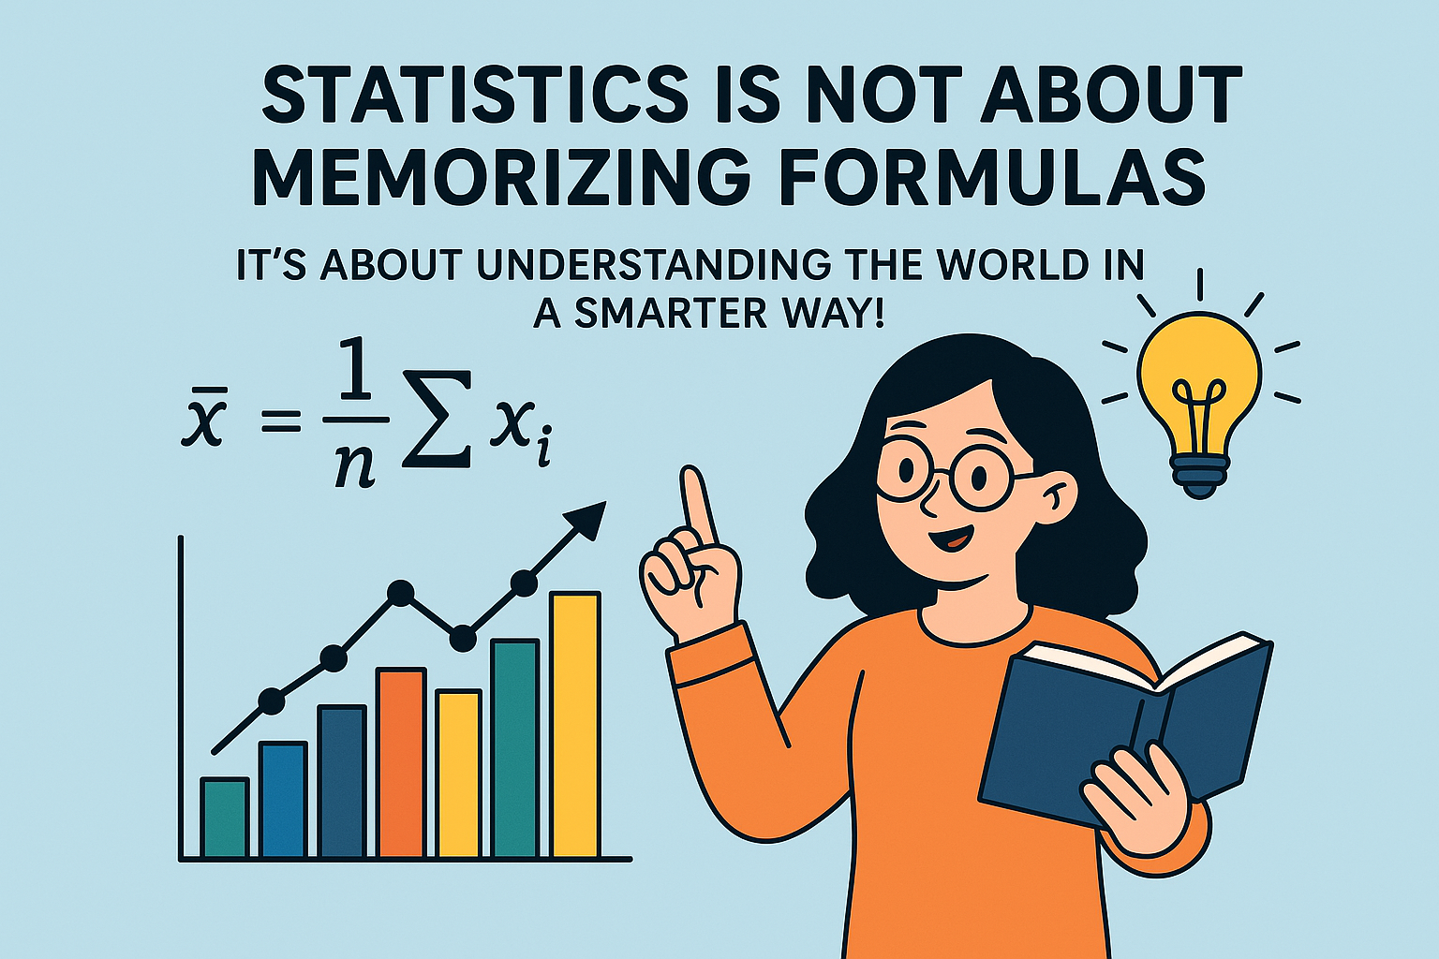

Slide 7
Introduction to Statistics
How does Netflix recommend movies? —
How does Google detect spam? —
Why does ChatGPT work? —
How do companies analyze user data? —
Statistics
Statistics
Statistics + Probability
Statistics

Slide 8
Introduction to Statistics
Imagine you’re standing in the middle of a busy city — hundreds of cars rushing by, people hurrying to work, birds flying above, and thousands of unseen interactions happening every second. Now, what if someone asked you:
“How busy is this city, really?”
You could never count everything — every car, every person, every step. But you could collect data, analyze patterns and draw conclusions that reflect the bigger picture.
That’s exactly what Statistics does.
Statistics is the science of collecting, organizing, analyzing, and interpreting data to make decisions.

Slide 9
Origin of the Word “Statistics”
The word comes from:
Latin: status → meaning state or condition
Italian: statista → meaning statesman – a person who runs the government
German: statistik → meaning science of the state
It referred to the systematic collection of facts for the government:
Births
Deaths
Land records
Originally, statistics was used by kings and governments to understand population, wealth, land, and taxes.

Slide 10
What is Statistics?
Statistics is the science of collecting, organizing, analyzing, and interpreting data to make informed decisions. It turns raw numbers into meaningful information — helping us understand what’s really happening beneath the surface.
It’s the reason doctors predict disease outbreaks, businesses forecast sales, scientists test hypotheses, and governments plan budgets. Without statistics, we would be lost in a world of unorganized facts — numbers with no meaning.
Statistics is the art of learning from data.

Slide 11
What is Data?
Data = Any information collected for analysis / Raw facts or observations.
Examples
Marks of students: $23, 45, 67, 89, 45, 23$
Heights of players: $160 cm, 170 cm, 175 cm$
Number of likes on Instagram posts → $1.4 M. 2.5 K, 40 M$
Colors of cars: Red, Blue, White, Red
Data can be numbers, text, images, audio, sensor output… anything that carries information.

Slide 12
How Data Converts into Frequency?
Frequency = How many times a value appears.
Data alone looks messy.
Frequency helps us count how often each value occurs.
Example: Suppose data = $23, 45, 23, 67, 45, 23, 89$
Value | Frequency
$$23$$ | $3$ times
$$45$$ | $2$ times
$$67$$ | $1$ time
$$89$$ | $1$ time
So here, frequency is just the count of repetition.

Slide 13
Why convert data → frequency?
You test your website 50 times and record the loading times:
1.2s, 1.3s, 1.5s, 1.3s, 2.0s, 1.2s, 2.5s, 2.1s, 1.2s, 1.3s … (50 readings)
This is RAW DATA.
Why raw data is difficult?
You cannot see trends
You cannot understand performance
You cannot find how often a value occurs
You cannot make decisions
Raw data is like your Whatsapp chat backup—big and unorganized.

Slide 14
Frequency Distribution (Grouping the data)
Frequency Distribution = A table that summarizes the entire data in a clean and meaningful format.
When we have large data and many values are close to each other, listing every number becomes messy.
So, we group the data into class intervals, like this:
Class Interval (sec) | Frequency (f)
1.0 – 1.5 | 30
1.6 – 2.0 | 22
2.1 – 2.5 | 15
This is a frequency distribution table.

Slide 15
Why do we need a Frequency Distribution?
Makes large data easy to read
Instead of dealing with 100 numbers, now just 3 groups.
Shows clear performance levels
1.0 – 1.5 sec = 30 times (Fast zone)
1.6 – 2.0 sec = 20 times (Medium zone)
2.1 – 2.5 sec = 10 times (Slow zone)
Helps in decision-making
If most times are in 1.0–1.5 sec → Your website is performing well.
If slow times increase → You must optimize backend or database queries.
Class Interval (sec) | Frequency (f)
1.0 – 1.5 | 30
1.6 – 2.0 | 22
2.1 – 2.5 | 15

Slide 16
Introduction
There are two types of statistics :
(1) Descriptive Statistics ( Unit – 1 )
Descriptive statistics refers to the quantitative methods used to summarize a set of observations.
This includes mean, median, mode, range, variance, standard deviation, etc.
(2) Inferential Statistics ( Unit – 4 & 5 )
Inferential statistics draw conclusions and make predictions about a population based on a sample using techniques like hypothesis testing and regression.

Slide 17
Descriptive Statistics
Descriptive Statistics is a branch of statistics that describes and summarizes data in a simple and meaningful way.
It does NOT make predictions or generalizations.
It simply tells what the data is showing.
It answers questions like:
What is the average score of the class?
What is the highest and lowest mark?
How spread out are the marks?
Which value occurs most frequently?

Slide 18
Descriptive Statistics
Population and sample are the two sources of data in descriptive statistics.
When we have data for the entire group, we calculate descriptive statistics for the whole population.
When the population is too large, we take a sample — a smaller group.
Then we apply descriptive statistics to this sample.
Example
A company wants to know the coding performance of 10,000 job applicants.
Impossible to test all → so they take a sample of 200.

Slide 19



Descriptive Statistics
A data set is a collection of observations from a sample or entire population.
This data set is summarized and organized by Descriptive Statistics.
Population
Sample

Slide 20
Descriptive Statistics
Descriptive Statistics
Distribution
Measure of central Tendency
Measure of Variability
Range
Ungrouped Distribution
Mean
Standard Deviation
Grouped Distribution
Median
Mean Deviation
Mode
Moments , Skewness and Kurtosis

Slide 21
Method 1 Frequency Distributions

Slide 22
Frequency Distribution
A frequency distribution is a simple way to show how often each value or group of values appears in a set of data.
Types of Frequency Distribution :
There are two types of frequency distribution which is
Frequency distribution of ungrouped data
Frequency distribution of grouped data

Slide 23
Frequency Distribution of Ungrouped or Row Data
The ungrouped frequency distribution is a type of frequency distribution that displays the frequency of each individual data value.
For example:
Marks of $10$ students are $10, 25, 26, 35, 3, 8, 19, 29, 30, 18.$

Slide 24
Frequency Distribution of Grouped Data
Discrete Frequency Distribution
A discrete frequency distribution is a type of frequency distribution that shows each number and the number of times it appears in a list.
For example:
Data of students using library during exam time.
No. reading hours $\left(x_{i}\right)$ | $$1$$ | $$2$$ | $$3$$ | $$4$$ | $$5$$ | $$6$$
No. of students$\left(f_{i}\right)$ | $$4$$ | $$7$$ | $$8$$ | $$9$$ | $$10$$ | $$2$$

Slide 25
Frequency Distribution of Grouped Data
Continuous Frequency Distribution
A continuous frequency distribution is a series in which the data are classified into different class intervals.
For example:
Data of students using library during exam time.
No. reading hours | $$0−2$$ | $$3−5$$ | $$6−8$$ | $$9−11$$
No. of students$\left(f_{i}\right)$ | $$11$$ | $$7$$ | $$8$$ | $$0$$

Slide 26
Continuous Frequency Distribution: Class Intervals
No. reading hours | $$0−2$$ | $$3−5$$ | $$6−8$$ | $$9−11$$
No. of students$\left(f_{i}\right)$ | $$11$$ | $$7$$ | $$8$$ | $$0$$
Lower Bound & Upper Bound
For the class$x_{i}−x_{i+1}$,
lower bound is$x_{i}$and
upper bound is$x_{i+1}$.

Slide 27
Continuous Frequency Distribution: Class Intervals
There are two types of class interval
Exclusive Class
If classes of frequency distributions are $0−2, 2−4, 4−6, …$such classes are known as exclusive classes.
Here, upper bound is excluded from class interval.
Inclusive Class
If classes of frequency distributions are $0−2, 3−5, 6−8, …$ such classes are known as inclusive classes.
Here, upper bound is included in class interval.

Slide 28
Continuous Frequency Distribution: Class Intervals
While dealing with inclusive classes, we will convert them into exclusive classes.
To convert follow these steps:
Step 1: Find Value of Gap
$$\text{G}\text{ap}=\frac{\text{Lower} \text{bound} \text{of} \text{next} \text{class}−\text{Upper} \text{bound} \text{of} \text{current} \text{class}}{2}$$
Step 2: Adjust Class Intervals
Subtract gap from the lower bound and add gap to the upper bound.

Slide 29
Continuous Frequency Distribution: Class Intervals
Inclusive classes
$$0−2$$
$$3−5$$
$$6−8$$
Exclusive classes
$$0.5−2.5$$
$$2.5−5.5$$
$$5.5−8.5$$
Step 1: Find Value of Gap
Step 2: Adjust Class Intervals
$$3$$
$$−$$
$$2$$
$$0−0.5=−0.5$$
Gap
$$=$$
$$=$$
$$0.5$$
$$2$$
$$2+0.5=2.5$$
Step 1: Find Value of Gap
$$\text{G}\text{ap}=\frac{\text{Lower} \text{bound} \text{of} \text{next} \text{class}−\text{Upper} \text{bound} \text{of} \text{current} \text{class}}{2}$$
Step 2: Adjust Class Intervals
Subtract gap from the lower bound and add gap to the upper bound.

Slide 30
Continuous Frequency Distribution: Class Length
A difference between upper bound and lower bound is known as class length of an exclusive class.
It is denoted by $c$ and defined as
$$c= Upper Bound − Lower Bound =x_{i+1}−x_{i}$$
For example:
Class
$$3−5$$
$$5−7$$
$$7−9$$
Class length
$$c$$
$$=$$
$$5−3$$
$$=2$$

Slide 31
Continuous Frequency Distribution: Mid-Point of Class
The Mid-Point of Class or Class Mark is the middle value of a class interval.
It is denoted by $x_{i}$.
It is calculated as follow:
$$x_{i}=\frac{ Upper Bound+ Lower Bound }{2 }$$
For example:
Class
$$3−5$$
$$5−7$$
$$7−9$$
$$x_{i}$$
$$\frac{ 3+5 }{2}$$
$$\frac{ 7+9 }{2}$$
$$4$$
$$x_{1}=$$
$$=4$$
$$x_{3}=$$
$$=8$$
$$6$$
$$\frac{ 5+7 }{2}$$
$$x_{2}=$$
$$=6$$
$$8$$

Slide 32
Method 2 Measure of Central Tendency

Slide 33
What is a Measure of Central Tendency?
Imagine you have a group of numbers.
Maybe these numbers are:
Marks of students
Execution times of code
Daily users of an app
Temperatures in a city or number of likes you get per post
When you have many numbers, looking at each one is confusing.
So, we ask a simple question:
Can we represent all these numbers with one single value that tells us the overall behavior of the data?

Slide 34
What is a Measure of Central Tendency?
Can we represent all these numbers with one single value that tells us the overall behavior of the data?
That “one single value” is called the: Measure of Central Tendency (also called Measures of Average)
It tells us where the center of the data lies.
Centre → the middle or balancing point
Tendency → the direction in which data gathers

Slide 35
Why do we need Measure of Central Tendency?
We use it because:
Data can be huge, confusing, scattered.
Instead of reading all values, we want one representative number.
Example: Marks of 60 students → instead of telling all marks, we say:
“The average mark is 72.”
This one value gives a quick summary of the entire class.

Slide 36
Measure of Central Tendency
The central tendency of a distribution is an estimate of the center of a distribution of values.
There are three measures to estimate central tendency which is
Mean$\left( \overline{x} \right)$ - Average Value
Median $\left( M \right)$ - Exact Middle Value
Mode $( Z )$ - Most Frequent Value
Height of students in a class (cm)
175
170
Mean
161
165
159
159
Mode
Median
159
161

Slide 37
Measure of Central Tendency
Types of Averages
Mathematical Averages
Positional Averages
Commercial Averages
Arithmatic
Mean $\left(\overline{ x }\right)$
Moving
Average
Median $\left(M\right)$
Geometric
Mean $\left(G\right)$
Progressive
Average
Harmonic
Mean $\left(\overline{ x }\right)$
Composite
Average
Mode $\left(Z\right)$

Slide 38
Method 2.1 Mean

Slide 39
Mean
The mean means average.
Mean is denoted by “ $\overline{x}$ ” and read as “$x$ bar”.
Table of different formulae of mean is as follow.

Slide 40
Mean
Method | Ungrouped Data (Individual data) | Discrete Grouped Data ($x_{i}$ & $f_{i}$) | Continuous Grouped Data (Class & $f_{i}$)
Direct Method
$$\frac{\sum{x_{i}}}{n}$$
$$\frac{\sum{f_{i}x_{i}}}{\sum{f_{i}}}$$
$x_{i}=$ the individual observations
$x_{i}=$ midpoints of class intervals in Continuous Grouped data
$n=$total number of observations in ungrouped data.
$f_{i}=$ the frequency of $x_{i}$

Slide 41
Mean
Method | Ungrouped Data (Individual data) | Discrete Grouped Data ($x_{i}$ & $f_{i}$) | Continuous Grouped Data (Class & $f_{i}$)
Direct Method
$$\frac{\sum{x_{i}}}{n}$$
$$\frac{\sum{f_{i}x_{i}}}{\sum{f_{i}}}$$
$\sum{x_{i}}=$ sum of all observations
$\sum{f_{i}x_{i}}=$sum of product of observations and frequencies
$\sum{f_{i}}=$ sum of frequencies

Slide 42
Method 2.1 ⇝ Example 1
Ungrouped Data
Find the mean of data $10.2, 9.5, 8.3, 9.7, 9.5, 11.1, 7.8, 8.8, 9.5, 10.$
1
2
3
4
5
6
7
8
9
10
Solution:
Here, total number of observations are
$$n=10$$
Direct method
$$\overline{x}=\frac{\sum{x_{i}} }{n }$$
$$\overline{x}=\frac{10.2+9.5+8.3+9.7+9.5+11.1+7.8+8.8+9.5+10}{10}$$
$$⇒$$
$$\overline{x}=\frac{94.4 }{10 }$$
$$⇒$$
$$⇒$$
$$\overline{x}=9.44$$

Slide 43
Using Calculator – For Ungrouped Data
Step – 1 : Clear Memory
Press SHIFT
Press CLR  Key 1(Mcl)
Press $=$ (This ensures any previous statistical data is completely cleared.)
Step – 2 : Enter SD Mode (Statistics Mode)
Press MODE
Press 2 (This selects the SD mode.)
Display Check: A small SD indicator should appear on the top of the display.

Slide 44
Using Calculator – For Ungrouped Data
Step – 3 : Enter a data point, then press M+.
Using example data: 10, 12, 13, 16
Type 10, then press M+. (Display shows Data = 1)
Type 12, then press M+. (Display shows Data = 2) and so on.
Step – 3.1 : Displaying the Sums of Frequencies
Press SHIFT
Press 1 (The S-SUM key)
Display Check: The display shows options: 1: $\sum{x^{2}}$ 2: $\sum{x}$ 3: $n$
Press 2 (This corresponds to $\sum{x}$)
Press $=$
Result: The calculator displays the sum of $x$ (observations).

Slide 45
Using Calculator – For Ungrouped Data
Step – 4 : Access Statistical Variables (S-VAR)
Press SHIFT
Press 2 (The S-VAR key)
Step – 5 : Select Mean $\left(\overline{x}\right)$
Press 1
Display Check: The display will show $\overline{x}$.
Step – 6 : Get Result
Press $=$
The calculator will display the mean. (For the example data, the result is 12.75.)

Slide 46
Method 2.1 ⇝ Example 2
Discrete Grouped Data
Find the mean for following data:
Marks obtained
Number of students
$$20$$
$$9$$
$$25$$
$$50$$
$$40$$
$$80$$
$$6$$
$$4$$
$$16$$
$$7$$
$$8$$
$$2$$
Solution:
Direct method
$$\overline{x}=\frac{\sum{f_{i}x_{i}} }{\sum{f_{i}}}$$

Slide 47
Method 2.1 ⇝ Example 2 (Continue)
Discrete Grouped Data
$$x_{i}$$ | $$f_{i}$$
-----
$$f_{i} x_{i}$$
$$\overline{x}=\frac{\sum{f_{i}x_{i}} }{\sum{f_{i}}}$$
$$20$$
$$6$$
$$20×6=120$$
$$9$$
$$4$$
$$36$$
$$\overline{x}=\frac{1386 }{43 }$$
$$25$$
$$16$$
$$400$$
$$⇒$$
$$50$$
$$7$$
$$350$$
$$40$$
$$8$$
$$320$$
$$⇒$$
$$\overline{x}=32.23$$
$$80$$
$$2$$
$$160$$
$$\sum{f_{i}}$$
$$\sum{f_{i}}x_{i}$$
$$=43$$
$$=1386$$

Slide 48
Using Calculator – For Grouped Data
Step – 1 : Clear Memory
Press SHIFT
Press CLR  Key 1 (Mcl)
Press $=$ (This ensures any previous statistical data is completely cleared.)
Step – 2 : Enter SD Mode (Statistics Mode)
Press MODE
Press 2 (This selects the SD mode.)
Display Check: A small SD indicator should appear on the top of the display.

Slide 49
Using Calculator – For Grouped Data
Marks obtained
Number of students
$$20$$
$$9$$
$$25$$
$$50$$
$$40$$
$$80$$
$$6$$
$$4$$
$$16$$
$$7$$
$$8$$
$$2$$
Step – 3 : [Data Value]  SHIFT  COMMA (,)  [Frequency]  M+
Data Entry | Keystrokes | Calculator Display | Explanation
First Entry | 20  SHIFT  COMMA (,)  6  M+ | Data $n=1$ | This is Entry 1. The calculator correctly stores the value 10 occurring 3 times.
Second Entry | 9  SHIFT  COMMA (,)  4  M+ | Data $n=2$ | This is Entry 2. The calculator stores the value 15 occurring 2 times.
After last entry the display shows the sum of frequencies $\sum{f_{i}.}$

Slide 50
Using Calculator – For Grouped Data
Marks obtained
Number of students
$$20$$
$$9$$
$$25$$
$$50$$
$$40$$
$$80$$
$$6$$
$$4$$
$$16$$
$$7$$
$$8$$
$$2$$
Step – 4 :
Press SHIFT
Press 1 (The S-SUM key)
Display Check: The display shows options: 1: $\sum{x^{2}}$ 2: $\sum{x}$ 3: $n$
Press 2 (This corresponds to $\sum{x}$)
Press $=$
Result: The calculator displays $\sum{f_{i}x_{i}}=$sum of product of observations and frequencies

Slide 51
Mean
Method | Ungrouped Data (Individual data) | Discrete Grouped Data ($x_{i}$ & $f_{i}$) | Continuous Grouped Data (Class & $f_{i}$)
Assumed Mean Method
$$A+\frac{\sum{d_{i}}}{n}$$
$$A+\frac{\sum{f_{i}d_{i}}}{\sum{f_{i}}}$$
$A$ can be any value from${ x}_{i}$.
$d_{i}=x_{i}−A$
$d_{i}$ is called the deviation of an observation from the assumed mean.
(It is known as assumed mean value.)

Slide 52
Mean
Method | Ungrouped Data (Individual data) | Discrete Grouped Data ($x_{i}$ & $f_{i}$) | Continuous Grouped Data (Class & $f_{i}$)
Assumed Mean Method
$$A+\frac{\sum{d_{i}}}{n}$$
$$A+\frac{\sum{f_{i}d_{i}}}{\sum{f_{i}}}$$
$\sum{d_{i}}=$ sum of all deviations
$\sum{f_{i}d_{i}}=$sum of product of deviations and frequencies
$\sum{f_{i}}=$ sum of frequencies

Slide 53
Mean
Method | Ungrouped Data (Individual data) | Discrete Grouped Data ($x_{i}$ & $f_{i}$) | Continuous Grouped Data (Class & $f_{i}$)
Step Deviation Method
$$A+\frac{ \sum{f_{i}u_{i}}}{\sum{f_{i}}}×c$$
$$\text{−−−−−}$$
$$\text{−−−−−}$$
$c=$Class Length
$$ u_{i}=\frac{x_{i}−A}{c}$$
$u_{i}$ is called the step deviation of an observation from the assumed mean.
$\sum{f_{i}u_{i}}=$sum of product of step deviations and frequencies
$\sum{f_{i}}=$ sum of frequencies

Slide 54
Method 2.1 ⇝ Example 3
Continuous Grouped Data
Find the mean using direct method, assumed mean method and step deviation method:
Marks obtained
Number of students
$$0−10$$
$$10−20$$
$$20−30$$
$$30−40$$
$$40−50$$
$$5$$
$$10$$
$$40$$
$$20$$
$$25$$
Solution:
Direct Method
Assumed mean method
Step Deviation Method
$$\overline{x}=\frac{\sum{f_{i}x_{i}} }{\sum{f_{i}}}$$
$$\overline{x}=A+\frac{ \sum{f_{i} d_{i} }}{\sum{f_{i}}}$$
$$\overline{x}=A+\frac{ \sum{f_{i} u_{i} }}{\sum{f_{i}}}×c$$

Slide 55
Method 2.1 ⇝ Example 3 (Continue)
Continuous Grouped Data
Direct Method
$$Class$$ | $$f_{i}$$
$$x_{i}$$
$$f_{i}x_{i}$$
$$\overline{x}=\frac{\sum{f_{i}x_{i}} }{\sum{f_{i}}}$$
$$0−10$$
$$5$$
$$5$$
$$5×5=25$$
$$10−20$$
$$10$$
$$15$$
$$150$$
$$\overline{x}=\frac{3000 }{100 }$$
$$20−30$$
$$40$$
$$25$$
$$1000$$
$$⇒$$
$$30−40$$
$$20$$
$$35$$
$$700$$
$$40−50$$
$$25$$
$$45$$
$$1125$$
$$⇒ \overline{x}=30$$
$$\sum{f_{i}}=100$$
$$\sum{f_{i}}x_{i}=3000$$
$$\frac{ 0+10 }{2}$$
$$x_{1}=$$
$$=5$$

Slide 56
Method 2.1 ⇝ Example 3 (Continue)
Continuous Grouped Data
Assumed mean method
$$Class$$ | $$f_{i}$$ | $$x_{i}$$
$$d_{i}=x_{i}−A$$
$$f_{i}d_{i}$$
$$0−10$$
$$5$$
$$5$$
$$5−25=−20$$
$$5×\left(−20\right)=−100$$
$$10−20$$
$$10$$
$$15$$
$$−10$$
$$−100$$
$$20−30$$
$$40$$
$$25$$
$$=A$$
$$0$$
$$0$$
$$30−40$$
$$20$$
$$35$$
$$10$$
$$200$$
$$40−50$$
$$25$$
$$45$$
$$20$$
$$500$$
$$\sum{f_{i}}=100$$
$$\sum{f_{i}d_{i}}=500$$
$$\overline{x}=A+\frac{ \sum{f_{i} d_{i} }}{\sum{f_{i}}}$$
$$+\frac{ 500}{100}$$
$$⇒$$
$$\overline{x}=25$$
$$⇒$$
$$\overline{x}=30$$

Slide 57
Method 2.1 ⇝ Example 3 (Continue)
Continuous Grouped Data
Step Deviation Method
Class length
$$c=10−0=10$$
$$Class$$ | $$f_{i}$$ | $$x_{i}$$
$$u_{i}$$
$$f_{i}u_{i}$$
$$0−10$$
$$5$$
$$5$$
$$−2$$
$$−10$$
$$10−20$$
$$10$$
$$15$$
$$−1$$
$$−10$$
$$u_{1}=\frac{x_{1}−A}{c}$$
$$20−30$$
$$40$$
$$25$$
$$=A$$
$$0$$
$$0$$
$$30−40$$
$$20$$
$$35$$
$$1$$
$$20$$
$$=\frac{5−25}{10}$$
$$40−50$$
$$25$$
$$45$$
$$2$$
$$50$$
$$\sum{f_{i}}=100$$
$$\sum{f_{i} u_{i} }=50$$
$$=−2$$
$$\overline{x}=A+\frac{ \sum{f_{i} u_{i} }}{\sum{f_{i}}}×c$$
$$+\frac{ 50}{100}$$
$$⇒$$
$$\overline{x}=25$$
$$×10$$
$$⇒$$
$$\overline{x}=25$$
$$+5$$
$$=30$$

Slide 58
Remarks
Whenever class length is equal $u_{i}$ will follow a certain pattern:
$$Class$$ | $$x_{i}$$
$$u_{i}$$
$$0−10$$
$$5$$
$$−2$$
$$10−20$$
$$15$$
$$−1$$
$$20−30$$
$$25$$
$$=A$$
$$0$$
$$30−40$$
$$35$$
$$1$$
$$40−50$$
$$45$$
$$2$$

Slide 59
Method 2.1 ⇝ Example 4
Continuous Grouped Data
Find the missing frequency $f_{1}$​ and $f_{2}$​ in the table given below, it is given that the mean of the given frequency distribution is $50$.
Class |  |  |  |  |  | Total
f |  |  |  |  |  | 100
$$0−20$$
$$20−40$$
$$40−60$$
$$60−80$$
$$80−100$$
$$17$$
$$f_{1}$$
$$32$$
$$f_{2}$$
$$19$$
Solution:
Given that,
$$\sum{f_{i}}=100$$
$$\overline{x}=50$$
$$c=20−0=20$$
Step Deviation Method
$$\overline{x}=A+\frac{ \sum{f_{i} u_{i} }}{\sum{f_{i}}}×c$$

Slide 60
Method 2.1 ⇝ Example 4 (Continue)
Continuous Grouped Data
$$Class$$ | $$f_{i}$$
$$x_{i}$$
$$u_{i}$$
$$f_{i}u_{i}$$
$$0−20$$
$$17$$
$$10$$
$$−1$$
$$−17$$
$$20−40$$
$$f_{1}$$
$$A=$$
$$30$$
$$0$$
$$0$$
$$40−60$$
$$32$$
$$50$$
$$1$$
$$32$$
$$60−80$$
$$f_{2}$$
$$70$$
$$2$$
$$2f_{2}$$
$$80−100$$
$$19$$
$$90$$
$$3$$
$$57$$
$$\sum{f_{i}=}68+f_{1}\text{+}f_{2}$$
$$\sum{f_{i}u_{i}}=72+2f_{2}$$
We have,
$$\overline{x}=50$$
$$\sum{f_{i}}=100$$
Calculation will be easier if we assume value of ‘$A$’ against missing frequency.
$$c=20$$

Slide 61
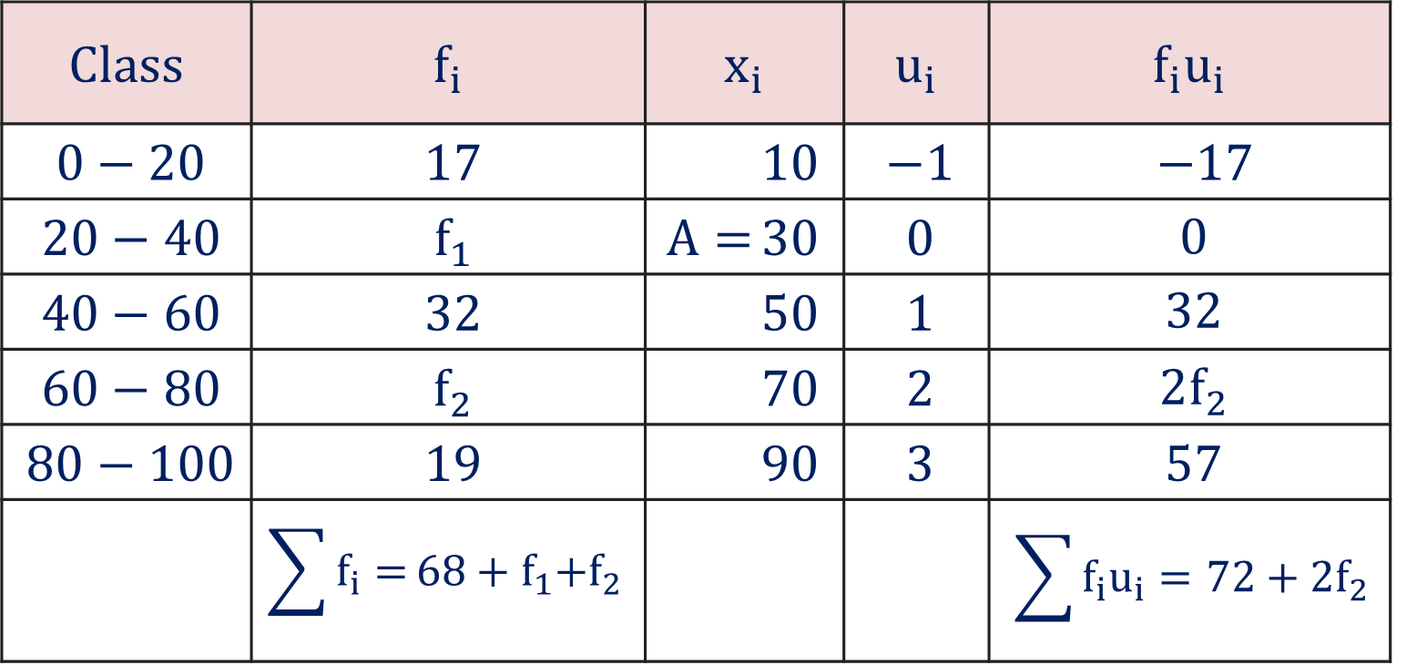
Method 2.1 ⇝ Example 4 (Continue)
Continuous Grouped Data
$$\overline{x}=A+\frac{ \sum{f_{i} u_{i} }}{\sum{f_{i}}}×c$$
$$+ \frac{ 72+2f_{2} }{100}$$
$$⇒$$
$$50=$$
$$30$$
$$×20$$
$$5$$
$$= \frac{ 72+2f_{2}}{5}$$
$$⇒$$
$$50−30$$
We have,
$$⇒$$
$$20×5$$
$$=72+2f_{2}$$
$$\overline{x}=50$$
$$=\frac{ 28 }{2}$$
$$⇒$$
$$f_{2}$$
$$=14$$
$$\sum{f_{i}}=100$$
$$c=20$$

Slide 62




Method 2.1 ⇝ Example 4 (Continue)
Continuous Grouped Data
Now,
$$68+f_{1}\text{+} f_{2}$$
$$=100$$
$$⇒$$
$$68+f_{1}\text{+} 14$$
$$=100$$
$$⇒$$
$$f_{1}$$
$$=100−82$$
$$⇒$$
$$f_{1}=18$$
We have,
$$\overline{x}=50$$
$$f_{2}$$
$$=14$$
$$\sum{f_{i}}=100$$
$$c=20$$

Slide 63

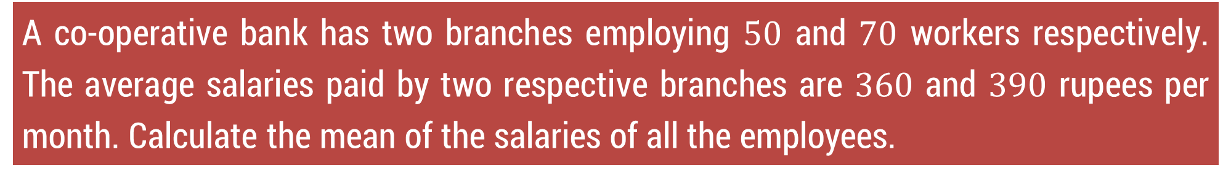







Method 2.1 ⇝ Example 5
A co-operative bank has two branches employing $50$ and $70$ workers respectively. The average salaries paid by two respective branches are $360$ and $390$ rupees per month. Calculate the mean of the salaries of all the employees.
Solution:
Branch 1:
Branch 2:
No. of workers
$$f=50$$
No. of workers
$$g=70$$
Average salary
$$\overline{x}=360$$
Average salary
$$\overline{y}=390$$
Total salary paid by branch 1
Total salary paid by branch 2
$$f×\overline{x} =50×360$$
$$g×\overline{y} =70×390$$
$$=18000$$
$$=27300$$

Slide 64
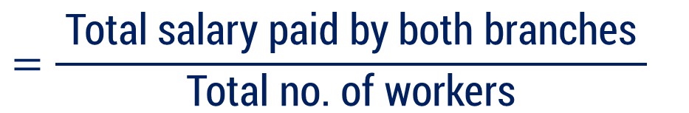






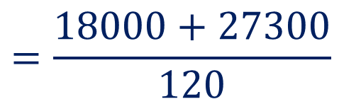
Method 2.1 ⇝ Example 5 (Continue)
Branch 1:
Branch 2:
No. of workers
$$f=50$$
No. of workers
$$g=70$$
Total salary paid by branch 1
$$=18000$$
Total salary paid by branch 2
$$=27300$$
Total no. of workers
$$=120$$
$$=\frac{ \text{Total} \text{salary} \text{paid} \text{by} \text{both} \text{branches} }{\text{Total} \text{no}\text{. }\text{of} \text{workers}}$$
Mean salary of all workers
$$=\frac{18000+27300}{120}$$
$$=377.5$$

Slide 65
Method 2.2 Median

Slide 66

Median
The median is the value found at the exact middle of the set of values.
Median is denoted by capital letter “$M$”.
To compute the median, list all observations in ascending order and then locate the value in the center of the sample.

Slide 67




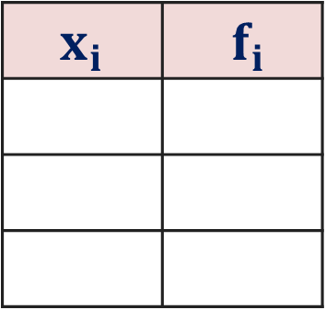












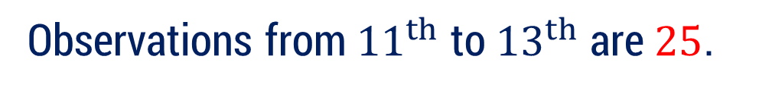






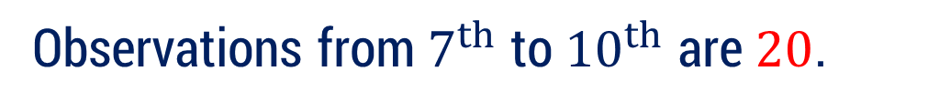






Median: Cumulative Frequency
Cumulative Frequency
Cumulative frequency $cf_{i}$ is the sum of all previous frequencies up to a given observation or class.
For example:
What does $cf$ means?
$$x_{i}$$ | $$f_{i}$$
$$cf_{i}$$
$$9$$
$$9$$
$$9$$
$$9$$
$$9$$
$$9$$
$$9$$
$$6$$
$$6$$
First $6$ observations are $9$.
$$20$$
$$4$$
$$6$$
$$+ 4$$
$$=10$$
$$20$$
$$20$$
$$20$$
$$20$$
$$25$$
$$3$$
$$6$$
$$+ 4$$
$$+ 3$$
$$=13$$
Observations from $7^{th}$ to ${10}^{th}$ are $20$.
Observations from ${11}^{th}$ to ${13}^{th}$ are $25$.

Slide 68



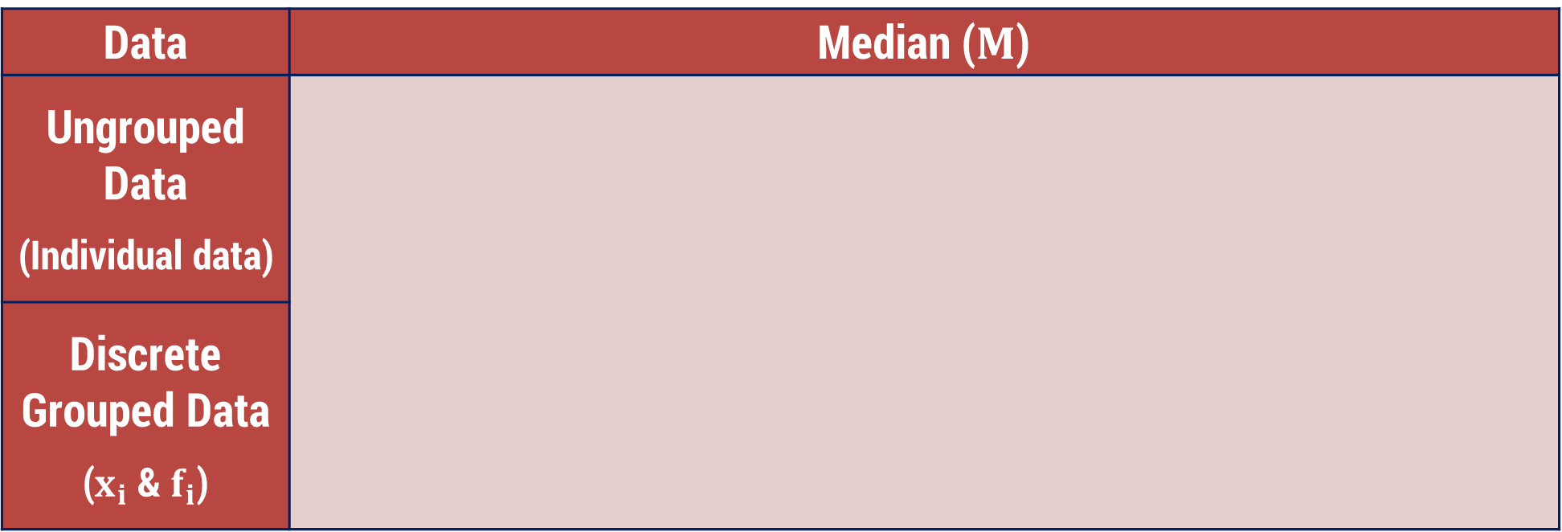
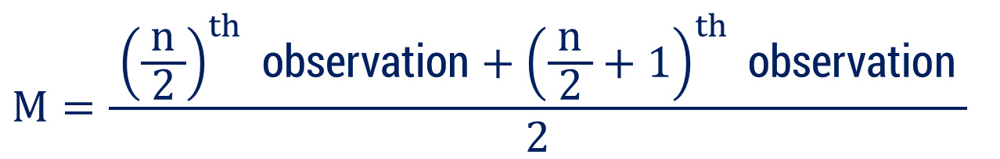
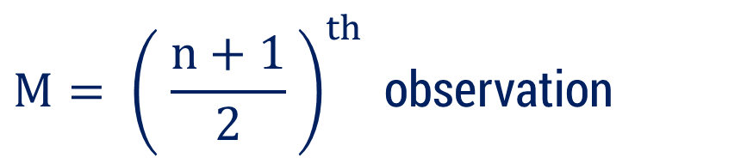

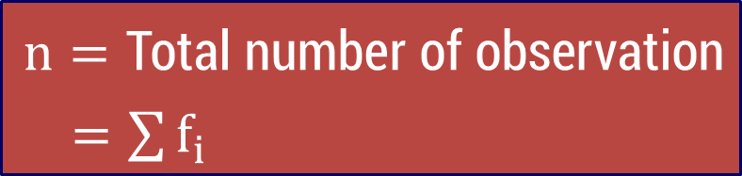
Median
Data | Median ($M$)
Ungrouped Data (Individual data)
Discrete Grouped Data ($x_{i}$ & $f_{i}$)
$$n=\text{odd}$$
$$n=\text{Total} \text{number} \text{of} \text{observation}$$
$=\sum{f_{i}}$
$$M= {\left( \frac{n+1}{2} \right)}^{th} \text{o}\text{bservation}$$
$$⇒$$
$$n=\text{even}$$
$$M=\frac{ {\left(\frac{n}{ 2 }\right)}^{th} \text{observation}+{\left(\frac{n}{ 2 }+1\right)}^{th} \text{observation} }{2}$$
$$⇒$$
Before calculating the median for ungrouped or discrete grouped data, arrange the data in ascending or descending order.
In case of discrete data first we should calculate cumulative frequency.

Slide 69

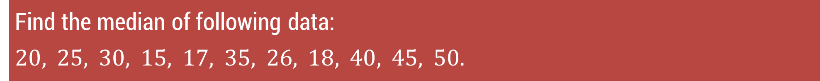
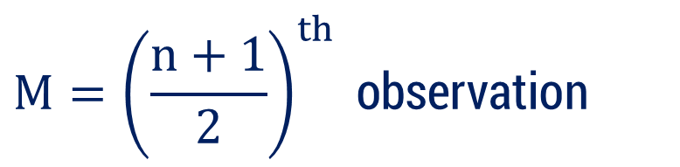


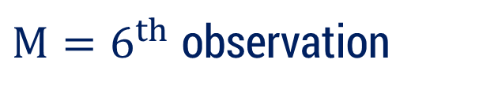


Method 2.2 ⇝ Example 1
Ungrouped Data
Find the median of following data:
$$20, 25, 30, 15, 17, 35, 26, 18, 40, 45, 50.$$
Solution:
To compute the median,
arrange all observations in ascending order
$$15, 17, 18, 20, 25, 26, 30, 35, 40, 45, 50$$
1
2
3
4
5
6
7
8
9
10
11
Here$,$
$$n=11$$
(odd)
$$M={\left(\frac{n+1}{2}\right)}^{th} \text{observation}$$
$$⇒$$
$M=6^{th}$ observation
$$⇒$$
$$M=26$$

Slide 70
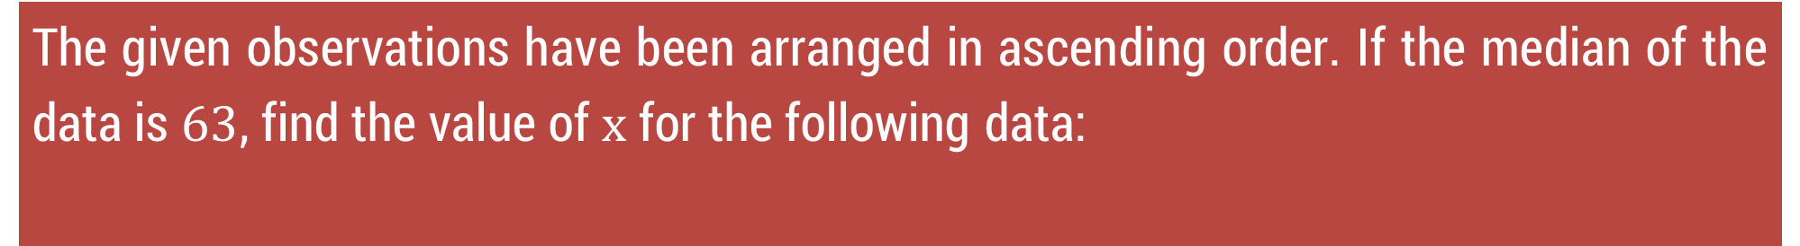
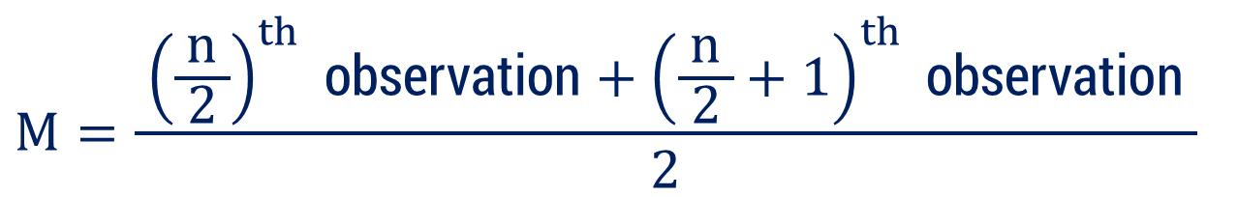


Method 2.2 ⇝ Example 2
Ungrouped Data
The given observations have been arranged in ascending order. If the median of the data is $63$, find the value of $x$ for the following data:
$$29, 32, 48, 50, x, x+2, 72, 78, 84, 95$$
Solution:
Given that,
$$M=63$$
$$n=10$$
(even)
So,
$$M=\frac{ {\left(\frac{n}{ 2 }\right)}^{th} \text{observation}+{\left(\frac{n}{ 2 }+1\right)}^{th} \text{observation} }{2}$$

Slide 71









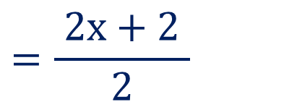
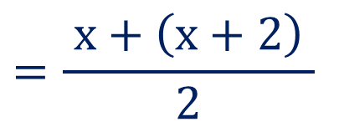

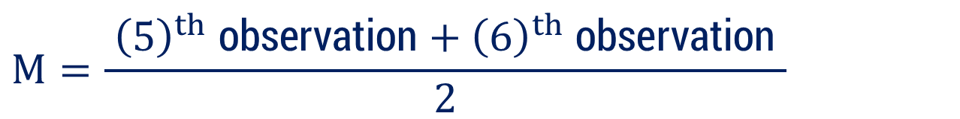

Method 2.2 ⇝ Example 2 (Continue)
Ungrouped Data
$$29, 32, 48, 50, x, x+2, 72, 78, 84, 95$$
1
2
3
4
5
6
$$M=63$$
$$M=\frac{ {\left(\frac{n}{ 2 }\right)}^{th} \text{observation}+{\left(\frac{n}{ 2 }+1\right)}^{th} \text{observation} }{2}$$
$$M=\frac{ {\left(5\right)}^{th} \text{observation}+{\left(6\right)}^{th} \text{observation} }{2}$$
$$⇒$$
$$=\frac{ x+\left(x+2\right) }{2}$$
$$⇒$$
$$63$$
$$=\frac{ 2x+2 }{2}$$
$$⇒$$
$$63$$
$$⇒$$
$$63 =x+1$$
$$⇒$$
$$x =62$$

Slide 72












Method 2.2 ⇝ Example 3
Discrete Grouped Data
Calculate the median for the following data:
Marks | 20 | 9 | 25 | 50 | 40 | 80
No. of students | 6 | 4 | 16 | 7 | 8 | 2
Solution:
Arrange the data in ascending order of marks.
Marks
No. of students
$$9$$
$$20$$
$$25$$
$$40$$
$$50$$
$$80$$
$$4$$
$$6$$
$$16$$
$$8$$
$$7$$
$$2$$

Slide 73


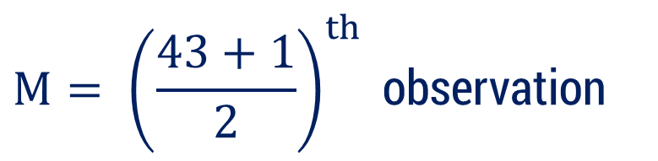





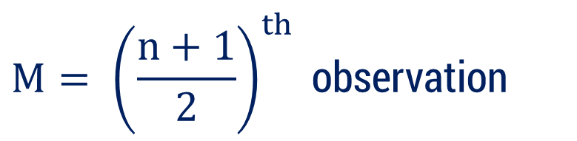

















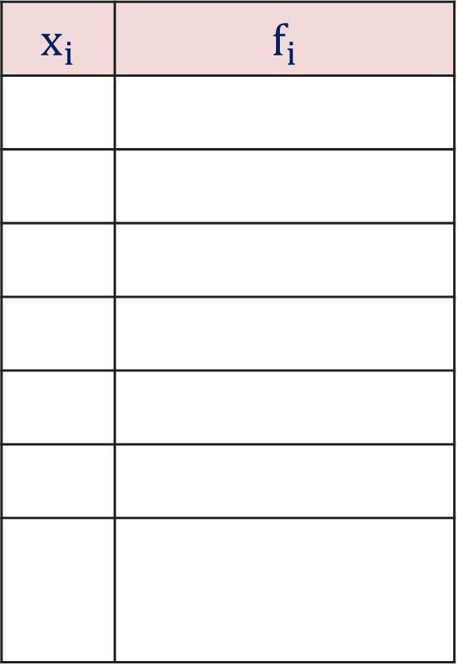







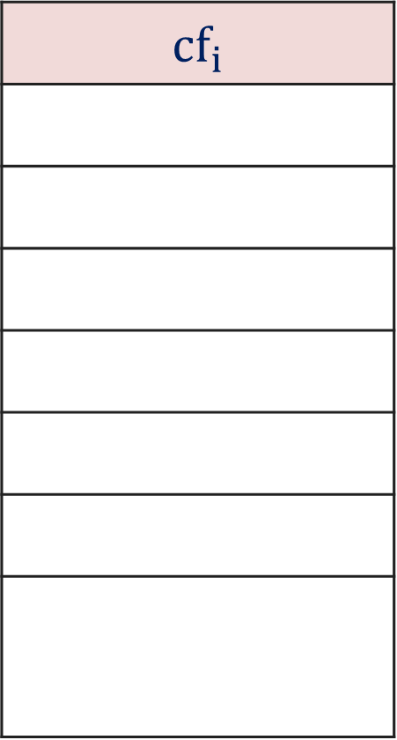
Method 2.2 ⇝ Example 3 (Continue)
Discrete Grouped Data
$$x_{i}$$ | $$f_{i}$$
$$cf_{i}$$
Here,
$$n=43$$
(odd)
$$9$$
$$4$$
$$4$$
$$M= {\left(\frac{n+1}{2}\right)}^{th} \text{observation}$$
$$⇒$$
$$20$$
$$6$$
$$4+6$$
$$=10$$
$$25$$
$$16$$
$$10+16$$
$$=26$$
$$40$$
$$8$$
$$26+8$$
$$=34$$
$$M= {\left(\frac{43+1}{2}\right)}^{th} \text{observation}$$
$$⇒$$
$$50$$
$$7$$
$$34+7$$
$$=41$$
$$80$$
$$2$$
$$41+2$$
$$=43$$
$$⇒$$
$$M= {\left(22\right)}^{th} \text{observation}$$
$$\sum{f_{i}=}n=43$$
$$⇒$$
$$M=25$$

Slide 74
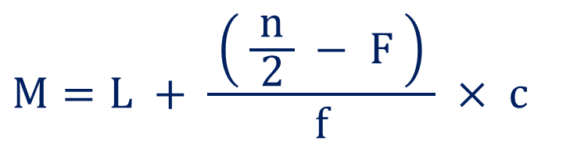
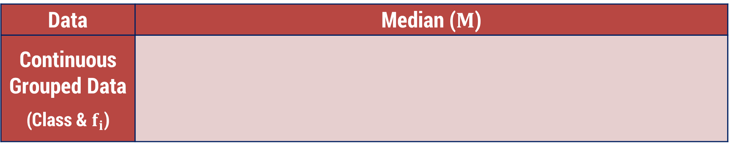
Median
Data | Median ($M$)
Continuous Grouped Data (Class & $f_{i}$)
$$M=L + \frac{ \left( \frac{n}{ 2 } − F \right) }{f} × c$$
Note that answer of median will belong to median class
$$\text{Median} \text{class}=\text{Class} \text{whose} \text{cumulative} \text{frequency} \text{with} \text{property}\min\left\{cf | cf≥\frac{n}{ 2 }\right\}$$
$$L= \text{Lower} \text{boundary} \text{point} \text{of} \text{the} \text{median} \text{class}$$
$$n= \text{Total} \text{number} \text{of} \text{observation}\text{ (}\text{sum} \text{of} \text{the} \text{frequencies}\text{)}$$
$$F= \text{Cumulative} \text{frequency} \text{of} \text{the} \text{class} \text{preceding} \text{the} \text{median} \text{class}$$
$$f = \text{The} \text{frequency} \text{of} \text{the} \text{median} \text{class}$$
$$c=\text{Class} \text{length}$$

Slide 75


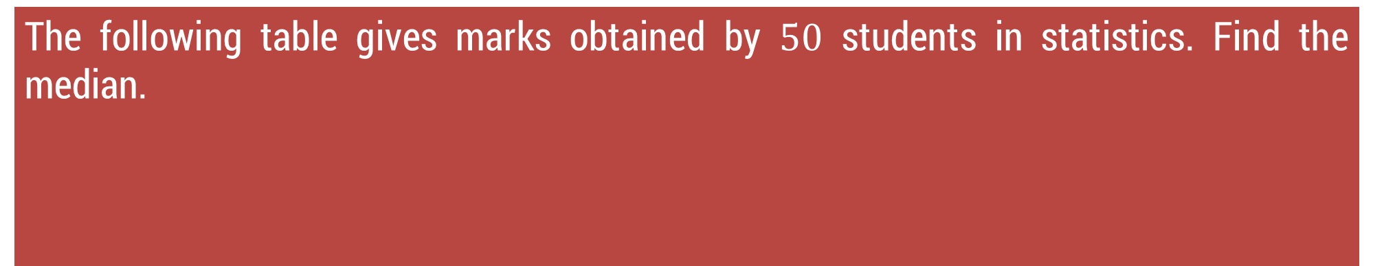








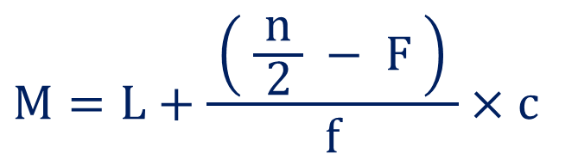
Method 2.2 ⇝ Example 4
Continuous Grouped Data
The following table gives marks obtained by $50$ students in statistics. Find the median.
Marks
No. of students
$$0−10$$
$$10−20$$
$$20−30$$
$$30−40$$
$$40−50$$
$$16$$
$$12$$
$$18$$
$$3$$
$$1$$
Solution:
Formula to calculate median is
$$M=L+\frac{ \left( \frac{n}{ 2 } − F \right) }{f}×c$$

Slide 76







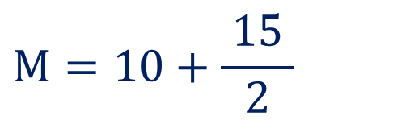








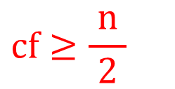









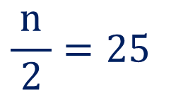
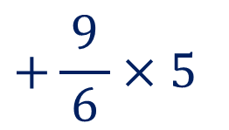

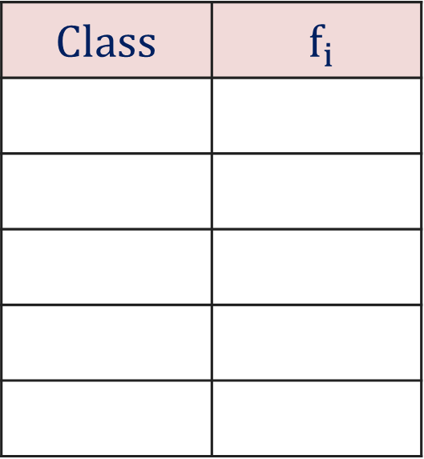










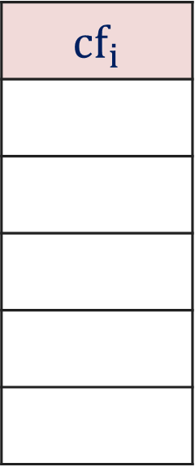






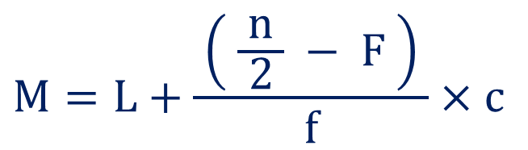
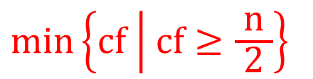

Method 2.2 ⇝ Example 4 (Continue)
Continuous Grouped Data
$$Class$$ | $$f_{i}$$
$$cf_{i}$$
$$M=L+\frac{ \left( \frac{n}{ 2 } − F \right) }{f}×c$$
$$0−10$$
$$16$$
$$16$$
$$10−20$$
$$12$$
$$28$$
$$\min\left\{cf | cf≥\frac{n}{ 2 }\right\}$$
$$25$$
$$16$$
$$5$$
$$+\frac{ \left( 25−16 \right) }{12}$$
$$20−30$$
$$18$$
$$46$$
$$⇒$$
$$M=$$
$$10$$
$$×10$$
$$cf≥\frac{n}{ 2 }$$
$$12$$
$$30−40$$
$$3$$
$$49$$
$$6$$
$$40−50$$
$$1$$
$$50$$
$$+\frac{ 9 }{6}×5$$
$$⇒$$
$$M=10$$
$$\sum{f_{i}}$$
$$\frac{n}{ 2 }=25$$
$$=n$$
$$=50$$
$$⇒$$
$$M=10+\frac{ 15 }{2}$$
$$⇒$$
Median class :
$$10−20$$
$$⇒$$
$$L=10$$
$$f$$
$$=12$$
$$F$$
$$=16$$
$$c=10$$
$$⇒$$
$$M=17.5$$

Slide 77




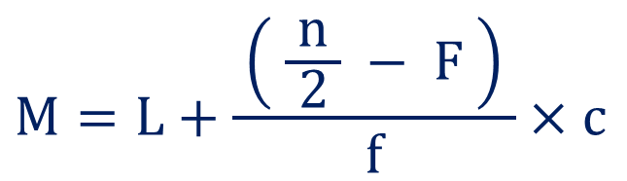












Method 2.2 ⇝ Example 5
Continuous Grouped Data
The median of $60$ observations (following data) is $28.5$. Find $x$ and $y$
Marks
No. of students
$$0−10$$
$$10−20$$
$$20−30$$
$$30−40$$
$$40−50$$
$$50−60$$
$$5$$
$$x$$
$$20$$
$$15$$
$$y$$
$$5$$
Solution:
Given that
$$\sum{f_{i}}$$
$$M=28.5$$
$$=n=60$$
Formula to calculate median is
$$M=L+\frac{ \left( \frac{n}{ 2 } − F \right) }{f}×c$$

Slide 78












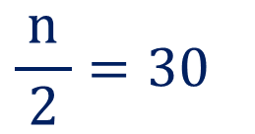





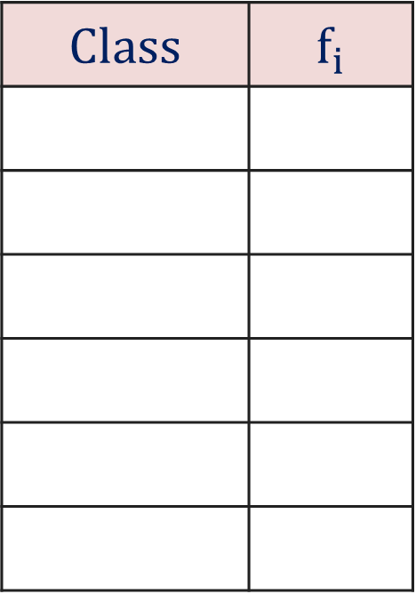







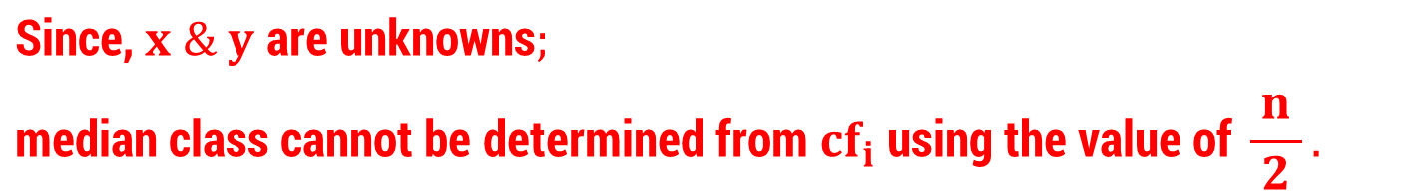



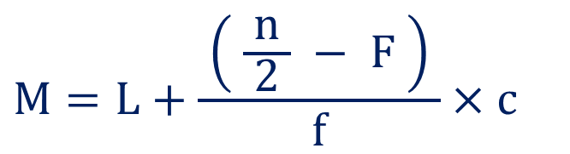



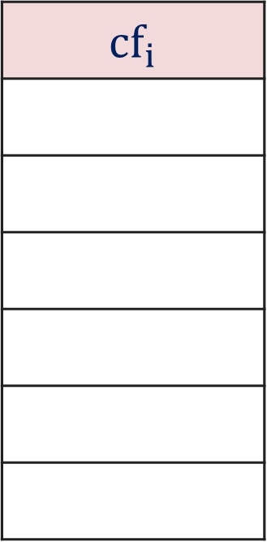
Method 2.2 ⇝ Example 5 (Continue)
Continuous Grouped Data
$$Class$$ | $$f_{i}$$
$$cf_{i}$$
$$M=L+\frac{ \left( \frac{n}{ 2 } − F \right) }{f}×c$$
$$M=28.5$$
$$\sum{f_{i}}$$
$$0−10$$
$$5$$
$$5$$
$$=n=60$$
$$10−20$$
$$x$$
$$5+x$$
$$\frac{n}{ 2 }=30$$
$$⇒$$
$$20−30$$
$$20$$
$$25+x$$
Median class :
$$20−30$$
$$30−40$$
$$15$$
$$40+x$$
$$⇒$$
$$L=20$$
$$40−50$$
$$y$$
$$40+x+y$$
$$f$$
$$=20$$
$$50−60$$
$$5$$
$$45+x+y$$
$$F$$
$$=5+x$$
$$\text{Since}\text{, }x \& y \text{are} \text{unknown}\text{s};$$
$$\text{median} \text{class} \text{cannot} \text{be} \text{determined} \text{from} {cf}_{i} \text{using} \text{the} \text{value} \text{of} \frac{n}{ 2 }.$$
$$c=10$$
It will be determined by answer of Median.

Slide 79



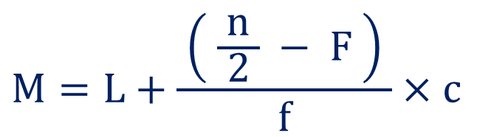








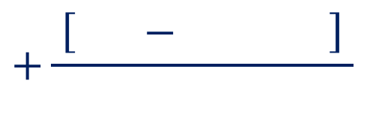
















Method 2.2 ⇝ Example 5 (Continue)
Continuous Grouped Data
$$M=L+\frac{ \left( \frac{n}{ 2 } − F \right) }{f}×c$$
$$M=28.5$$
$$\sum{f_{i}}$$
$$=n=60$$
$$30$$
$$\left(5+x\right)$$
$$\frac{n}{ 2 }=30$$
$$+\frac{ \left[ 30−\left(5+x\right) \right] }{20}$$
$$20$$
$$×10$$
$$⇒$$
$$28.5=$$
$$20$$
$$L=20$$
$$=\frac{ 30−5−x }{2}$$
$$30−5−x$$
$$⇒$$
$$28.5−20$$
$$f$$
$$=20$$
$$2$$
$$⇒$$
$$8.5×2$$
$$=25−x$$
$$F$$
$$=5+x$$
$$c=10$$
$$⇒$$
$$x$$
$$=25−17$$
$$⇒$$
$$x$$
$$=8$$

Slide 80




































Method 2.2 ⇝ Example 5 (Continue)
Continuous Grouped Data
$$\sum{f_{i}}$$
$$Class$$ | $$f_{i}$$
$$cf_{i}$$
$$=n=60$$
$$0−10$$
$$5$$
$$5$$
$$45+x+y$$
$$=60$$
$$x$$
$$=8$$
$$10−20$$
$$x$$
$$5+x$$
$$⇒$$
$$45+8+y$$
$$=60$$
$$20−30$$
$$20$$
$$25+x$$
$$30−40$$
$$15$$
$$40+x$$
$$⇒$$
$$y$$
$$=60$$
$$− 53$$
$$40−50$$
$$y$$
$$40+x+y$$
$$⇒$$
$$y$$
$$=7$$
$$50−60$$
$$5$$
$$45+x+y$$

Slide 81

Why Do We Need Cumulative Frequency in Discrete Data for Median?
Median is always based on position, not on the value
$$\text{Median}=\text{value} \text{of} \text{the}{\left(\frac{N}{ 2 }\right)}^{th} or {\left(\frac{ N+1 }{2}\right)}^{th}\text{observation}$$ (depending on even or odd total frequency).
So, first we need to know:
$$\text{Where} \text{is} \text{the} \frac{ N }{2} \text{observation} \text{located}\text{?}$$
This requires knowing how many observations are covered till each value.
That is exactly what cumulative frequency tells.

Slide 82




Why Do We Need Cumulative Frequency in Discrete Data for Median?
Example:
Data $= 10, 10, 10, 10, 20, 20, 20, 30, 30$
Here the 5th value is clearly $20.$
But in an exam, you cannot write all values like this if frequency is huge (like 60, 90, 120…).
So, we need a shortcut which is Cumulative Frequency.
$$x$$ | $$f$$
$$10$$ | $$4$$
$$20$$ | $$3$$
$$30$$ | $$2$$
This means:
Value $10$ appears $4$ times
Value $20$ appears $3$ times
Value $30$ appears $2$ times
Median $=$ middle value/observation Total $=4 + 3 + 2 = 9$ $\text{Middle}=\frac{ \left(9 + 1\right) }{2} = 5^{th} \text{value}$
So, we need to find: What is the 5th value in the entire data?

Slide 83




Why Do We Need Cumulative Frequency in Discrete Data for Median?
Make CF:
$$x$$ | $$f$$ | CF
$$10$$ | $$4$$ | $$4$$
$$20$$ | $$3$$ | $$4+3=7$$
$$30$$ | $$2$$ | $$7+2=9$$
CF tells:
Up to $10$ we covered $4$ observations
Up to $20$ we covered $7$ observations
Up to $30$ we covered $9$ observations
We want the 5th observation.
Now check:
CF $= 4$→ 5th observation not reached yet
CF $= 7$ → 5th observation lies here
Therefore, median $=20$
We need cumulative frequency in discrete data because median $=$ middle-position value, and cumulative frequency tells exactly in which row that position lies.

Slide 84
Method 2.3 Mode

Slide 85

Mode
The mode is the most frequently occurring value in the set.
Mode is denoted by capital letter “$Z$”.
The mode is not necessarily unique, like mean and median.
Data set with one mode is known as unimodal.
We can have data with two modes (bi-modal) or
more than two modes (multi-modal) .

Slide 86

Mode
Data | Mode ($Z$)
Ungrouped Data (Individual data)
Discrete Grouped Data ($x_{i}$ & $f_{i}$)
Most repeated observation among given data
Observation against the highest frequency

Slide 87





Method 2.3 ⇝ Example 1
Ungrouped Data
Find the mode of following data:
$$\left(a\right) 2, 4, 2, 5, 7, 2, 4, 8, 9.$$
$$\left(b\right) 2, 8, 4, 6, 10, 12, 4, 8, 14, 16.$$
Solution:
$$\left(a\right) 2, 4, 2, 5, 7, 2, 4, 8, 9$$
Unimodal dataset
Here,
most repeated observation is $2$.
So,
$$Z=2$$
$$\left(b\right) 2, 8, 4, 6, 10, 12, 4, 8, 14, 16$$
Bimodal dataset
Here,
most repeated observations are $4$ and $8$.
$$Z=4,$$
So,
$$8$$

Slide 88





Method 2.3 ⇝ Example 2
Discrete Grouped Data
Find the mode of following data:
x | 11 | 22 | 33 | 44
f | 15 | 20 | 19 | 10
Solution:
x | 11 | 22 | 33 | 44
f | 15 | 20 | 19 | 10
For Discrete Grouped Data
Mode $\left(Z\right)$
$=$ Observation against the highest frequency
Here,
highest frequently in given data is
$$20$$
$$⇒$$
$$Z=22$$

Slide 89




Mode
Data | Mode ($Z$)
Continuous Grouped Data (Class & $f_{i}$)
Note that answer of mode will belong to modal class
$$Z=L+\left(\frac{ f_{1}−f_{0} }{ 2f_{1}−f_{0}−f_{2} }\right)×c$$
$$\text{Modal} \text{class}=\text{A} \text{class} \text{with} \text{highest} \text{frequency}$$
$L =$Lower boundary of modal class
$f_{1}$ $=$ Frequency of the modal class
(Highest frequency)
$f_{0}$ $=$ Frequency of the class before the modal class
$f_{2}$ $=$ Frequency of the class after the modal class
$c =$Class length

Slide 90





















Method 2.3 ⇝ Example 3
Continuous Grouped Data
Find the mode of following data:
Class
f
$$0−10$$
$$10−20$$
$$20−30$$
$$30−40$$
$$40−50$$
$$3$$
$$5$$
$$7$$
$$10$$
$$12$$
$$50−60$$
$$60−70$$
$$70−80$$
$$80−90$$
$$90−100$$
$$15$$
$$12$$
$$6$$
$$2$$
$$8$$
Solution:
Formula for the Mode
$$Z=L+\left(\frac{f_{1}−f_{0}}{ 2f_{1}−f_{0}−f_{2} }\right)×c$$

Slide 91


















































Method 2.3 ⇝ Example 3 (Continue)
Continuous Grouped Data
$$Class$$ | $$f_{i}$$
Modal class:
$$Z=L+\left(\frac{f_{1}−f_{0}}{ 2f_{1}−f_{0}−f_{2} }\right)×c$$
$$0−10$$
$$3$$
$$50−60$$
$$10−20$$
$$5$$
$$L=50$$
$$20−30$$
$$7$$
$$15$$
$$12$$
$$f_{0}$$
$$=12$$
$$+\left(\frac{15−12}{ 2\left(15\right)−12−12 }\right)$$
$$⇒$$
$$Z=$$
$$50$$
$$×10$$
$$30−40$$
$$10$$
$$15$$
$$12$$
$$12$$
$$f_{1}$$
$$=15$$
$$40−50$$
$$12$$
$$f_{2}$$
$$=12$$
$$+\left(\frac{3}{ 30−24 }\right)×10$$
$$50−60$$
$$15$$
$$⇒$$
$$Z=50$$
$$c=10$$
$$60−70$$
$$12$$
$$70−80$$
$$6$$
$$5$$
$$+ \frac{ 30 }{6}$$
$$⇒$$
$$Z=50$$
$$80−90$$
$$2$$
$$90−100$$
$$8$$
$$⇒$$
$$Z=55$$

Slide 92


























Method 2.3 ⇝ Example 4
Continuous Grouped Data
Obtain the mean, mode and median for the following information:
x | < 10 | < 20 | < 30 | < 40 | < 50 | < 60
f | 12 | 30 | 57 | 77 | 94 | 100
Solution:
$$30$$
$$10$$
$$20$$
$$30$$
$$40$$
$$50$$
$$60$$
$$12$$
$$57$$
Class
$$f_{i}$$
$$0−10$$
$$10−20$$
$$20−30$$
$$30−40$$
$$40−50$$
$$50−60$$
$$30−12$$
$$=$$
$$18$$
$$57−30$$
$$=$$
$$12$$
$$27$$
$$20$$
$$17$$
$$6$$

Slide 93

































Method 2.3 ⇝ Example 4 (Continue)
Continuous Grouped Data
Mean (Direct Method)
$$Class$$ | $$f_{i}$$
$$x_{i}$$ | $$f_{i}x_{i}$$
$$\overline{x}=\frac{\sum{f_{i}x_{i}} }{\sum{f_{i}}}$$
$$0−10$$
$$12$$
$$5$$
$$60$$
$$10−20$$
$$18$$
$$15$$
$$270$$
$$\overline{x}=\frac{2800 }{100 }$$
$$⇒$$
$$20−30$$
$$27$$
$$25$$
$$675$$
$$30−40$$
$$20$$
$$35$$
$$700$$
$$⇒$$
$$\overline{x}=28$$
$$40−50$$
$$17$$
$$45$$
$$765$$
$$50−60$$
$$6$$
$$55$$
$$330$$
$$\sum{f_{i}}=100$$
$$\sum{f_{i}}x_{i}=2800$$

Slide 94




























Method 2.3 ⇝ Example 4 (Continue)
Continuous Grouped Data
Median
$$Class$$ | $$f_{i}$$
$$cf_{i}$$
Median class :
$$M=L+\frac{ \left( \frac{n}{ 2 } − F \right) }{f}×c$$
$$0−10$$
$$12$$
$$12$$
$$20−30$$
$$10−20$$
$$18$$
$$30$$
$$L=20$$
$$20−30$$
$$27$$
$$57$$
$$M=20+\frac{ \left(50−30\right) }{27}×10$$
$$f$$
$$=27$$
$$⇒$$
$$30−40$$
$$20$$
$$77$$
$$F$$
$$=30$$
$$40−50$$
$$17$$
$$94$$
$$⇒$$
$$M=20+7.41$$
$$c=10$$
$$50−60$$
$$6$$
$$100$$
$$⇒$$
$$M=27.41$$
$$\sum{f_{i}}$$
$$\frac{n}{ 2 }=50$$
$$=$$
$$n$$
$$=100$$
$$⇒$$

Slide 95


















Method 2.3 ⇝ Example 4 (Continue)
Continuous Grouped Data
Mode
$$Z=L+\left(\frac{f_{1}−f_{0}}{ 2f_{1}−f_{0}−f_{2} }\right)×c$$
$$Class$$ | $$f_{i}$$
Modal class:
$$0−10$$
$$12$$
$$20−30$$
$$Z=20+\left(\frac{27−18}{ 2\left(27\right)−18−20 }\right)×10$$
$$10−20$$
$$18$$
$$L=20$$
$$⇒$$
$$20−30$$
$$27$$
$$f_{0}$$
$$=18$$
$$30−40$$
$$20$$
$$f_{1}$$
$$=27$$
$$Z=20+\left(\frac{9}{ 54−38 }\right)×10$$
$$⇒$$
$$40−50$$
$$17$$
$$f_{2}$$
$$=20$$
$$50−60$$
$$6$$
$$c=10$$
$$Z=20+\left(\frac{9}{ 16 }\right)×10$$
$$⇒$$
$$⇒$$
$$Z=25.63$$

Slide 96

Relation Between Mean, Median, and Mode
The relation between the mean, median, and mode is given by the formula:
$$Z=3M−2\overline{x}$$
Where,
$$\overline{x}= Mean, M= Median, Z= Mode$$
It helps to estimate one measure of central tendency when the other two are known.
This relation is only useful for unimodal frequency distributions.

Slide 97









Method 2.3 ⇝ Example 5
If mean is $16$ and median is $20$. Calculate the mode.
Solution:
Given that,
$M=20$,
$$\overline{x}=16$$
We know that,
$$Z=3M−2\overline{x}$$
$$⇒$$
$$Z$$
$$=3(20)$$
$$− 2(16)$$
$$⇒$$
$$Z=28$$

Slide 98
Why do we need Mean, Median, and Mode?
MEAN — The Fair Average
Significance
Shows the overall level or general trend of the data.
Most useful when all values are roughly similar (no extreme highs/lows).
When it is useful?
When data is stable, smooth and does not have outliers.
Example:
Five friends buy juice and spend: ₹10, ₹20, ₹20, ₹30, ₹120

Slide 99

Why do we need Mean, Median, and Mode?
Example:
Five friends buy juice and spend: ₹10, ₹20, ₹20, ₹30, ₹120
$$\text{Mean}=\frac{10+20+20+30+120}{5}=40$$
This tells: If all five spent equally, each would have spent ₹40.
But notice:
One friend spent ₹120 (too high). This pulls the average up and makes mean misleading.
That's why we need Median.

Slide 100
Why do we need Mean, Median, and Mode?
MEDIAN — The Middle Position (Resistant to Outliers)
Significance
Median tells the central value of the data.
NOT affected by outliers (very high/low values).
When it is useful?
When data has extreme values, skewness, or big variations.
Amounts: 10, 20, 20, 30, 120 Middle value = 20 → Median = ₹20

Slide 101
Why do we need Mean, Median, and Mode?
Amounts: 10, 20, 20, 30, 120 Middle value = 20 → Median = ₹20
This tells: A typical person spends around ₹20.
More realistic than mean ₹40.

Slide 102
Why do we need Mean, Median, and Mode?
MODE — The Most Popular Choice
Significance:
Shows what is common, popular, or trending.
Useful for categorical data (colors, brands, sizes, etc.).
Also used in analyzing network packets, user preferences, ML feature engineering, etc.
When it is useful?
When you want to know the popular choice.

Slide 103
Why do we need Mean, Median, and Mode?
Examples:
Most common programming language used by developers
Most common screen size of smartphones
Most frequent error code in a system log
Most common marks in a class test
Students' favorite programming language: Python, Java, Python, C, Python, C++
Mode = Python
This tells: Python is the most preferred language.

Slide 104
Method 3 Measure of Variability

Slide 105
What is a Measure of Variability?
A measure of variability (or dispersion) is a single number that tells us how much the data values differ from each other and from the centre (mean/median).
Low variability → data values are close together, very consistent.
High variability → data values are spread out, more unpredictable.
Central Tendency = “What is a typical value?” Variability = “How much do the values deviate from that typical value?”
Mean tells us where the centre of the data is.
Measures of variability tell us how much the data are scattered around that centre.

Slide 106

Why central tendency alone is NOT enough
You run two backend servers, A and B. Both have the same average response time $=200 ms$, but…
Server A : Response times (ms): $198, 201, 200, 202, 199$
Mean $=200$ → Low Variability
Server A → Very Stable
Server B : Response times (ms): 50, 100, 200, 350, 500
Mean $=200$
But huge fluctuations → High Variability
Server B → Highly Unstable

Slide 107

Why central tendency alone is NOT enough
Batsman A Scores: $45, 50, 52, 48, 55$
Average $=50$
Low Variability
Batsman A → Very consistent
Batsman B Scores: $0, 100, 10, 120, 20$
Average $=50$
High Variability
Batsman B → Hits centuries but also gets out cheaply
Which batsman is more reliable?
A is dependable
B is risky (either big score or failure)
Both have same mean, but very different consistency.

Slide 108
Why do we need measures of variability?
To compare consistency between groups
Two classes / algorithms / systems can have same mean but different variability.
The one with lower variability is usually more reliable
To understand risk and uncertainty
In finance: two investments may give same average return, but one fluctuates a lot → higher risk.
In performance (latency, response time) higher variability means more risk of delay.

Slide 109
Why do we need measures of variability?
To detect outliers
If most data are close to the mean and one value is far away, a measure of variability helps to flag it as unusual.
To make fair decisions
Suppose two training methods for students:
Same final mean score,
But one method has less variability (weak students also improved).
Then that method is more equitable and effective.

Slide 110







Measure of Variability
It refers to the spread of the values around the central tendency.
It is known as Measure of Dispersion. (Variation)
For example:
$−5, 0, 5$ and $−50, 0, 50$ both have the same mean $0$ but clearly the data given in the second case much more widely dispersed than those in the first case.
So, measures of central tendency are not sufficient for having some idea about dispersion.
$$−5$$
$$0$$
$$5$$
$$−50$$
$$0$$
$$50$$

Slide 111
Measure of Variability
Measures of dispersion gives the idea about the degree to which numerical data tend to spread about an average.
There are certain measures of variability,
Range
Standard Deviation
Coefficient of Variation
Variance
Mean Deviation

Slide 112

Range
Range is simply the highest value minus the lowest value of a set of data values.
For example:
Range of $−5, 0, 5$
$\text{Range}=\text{Highest} \text{value}−\text{L}\text{owest} \text{value}$
$=5−\left(−5\right)$
$=10$

Slide 113





Standard Deviation
Standard Deviation (SD) is a measure that tells you how spread out the data values are from the mean (average).
Small SD → values are close to the mean
Large SD → values are widely spread out
It is denoted by “$σ$" and read as “sigma”.
It is defined as follow:
$$σ=\sqrt{\frac{ {\sum{\left(x_{i}−\overline{ x }\right)}}^{2} }{n} }$$
Lower value of $σ$
Higher value of $σ$

Slide 114





Standard Deviation
Method | Ungrouped Data (Individual data) | Discrete Grouped Data ($x_{i}$ & $f_{i}$) | Continuous Grouped Data (Class & $f_{i}$)
Direct Method
Assumed Mean Method
$$\sqrt{ \frac{\sum{x_{i}^{2}} }{n }−{\left(\frac{ \sum{x_{i}} }{n }\right)}^{2} }$$
$$\sqrt{ \frac{\sum{f_{i}x_{i}^{2}} }{\sum{f_{i}} }−{\left(\frac{ \sum{f_{i}x_{i}} }{\sum{f_{i}}}\right)}^{2} }$$
$$\sqrt{ \frac{\sum{d_{i}^{2}} }{n }−{\left(\frac{ \sum{d_{i}} }{n }\right)}^{2} }$$
$$\sqrt{ \frac{\sum{f_{i}d_{i}^{2}} }{\sum{f_{i}} }−{\left(\frac{ \sum{f_{i}d_{i}} }{\sum{f_{i}}}\right)}^{2} }$$

Slide 115










Method 3 ⇝ Example 1
Ungrouped Data
Find the standard deviation for the following data:
, , , , , , ,
$$6$$
$$7$$
$$10$$
$$12$$
$$13$$
$$4$$
$$8$$
$$12$$
Solution:
Total number of observations are
$$n=8$$
We will calculate standard deviation using direct method
$$σ=\sqrt{ \frac{ \sum{x_{i}^{2}} }{n }−{\left(\frac{ \sum{x_{i}} }{n }\right)}^{2} }$$

Slide 116




























Method 3 ⇝ Example 1 (Continue)
Ungrouped Data
$$x_{i}$$
$$x_{i}^{2}$$
$$σ=\sqrt{ \frac{ \sum{x_{i}^{2}} }{n }−{\left(\frac{ \sum{x_{i}} }{n }\right)}^{2} }$$
$$n=8$$
$$6$$
$$36$$
$$7$$
$$49$$
$$10$$
$$100$$
$$σ=\sqrt{ \frac{722 }{8 }−{\left(\frac{ 72 }{8}\right)}^{2} }$$
$$12$$
$$144$$
$$\frac{722 }{8 }$$
$${\left(\frac{ 72 }{8}\right)}^{2}$$
$$⇒$$
$$13$$
$$169$$
$$4$$
$$16$$
$$8$$
$$64$$
$$⇒$$
$$σ=3.0414$$
$$12$$
$$144$$
$$\sum{x_{i}}=72$$
$$\sum{x_{i}^{2}}=722$$

Slide 117











Method 3 ⇝ Example 2
Discrete Grouped Data
Find the standard deviation for the following distribution:
x
f
$$2$$
$$4$$
$$6$$
$$8$$
$$10$$
$$3$$
$$4$$
$$2$$
$$1$$
$$6$$
Solution:
Using direct method to calculate S.D.:
$$σ=\sqrt{ \frac{ \sum{f_{i}x_{i}^{2}} }{\sum{f_{i}} }−{\left(\frac{ \sum{f_{i}x_{i}} }{\sum{f_{i}}}\right)}^{2} }$$

Slide 118
































Method 3 ⇝ Example 2 (Continue)
Discrete Grouped Data
$$x$$ | $$f_{i}$$
$$f_{i}x_{i}$$ | $$f_{i}x_{i}^{2}$$
$$σ=\sqrt{ \frac{ \sum{f_{i}x_{i}^{2}} }{\sum{f_{i}} }−{\left(\frac{ \sum{f_{i}x_{i}} }{\sum{f_{i}}}\right)}^{2} }$$
$$2$$
$$3$$
$$6$$
$$12$$
$$4$$
$$4$$
$$16$$
$$64$$
$$σ=\sqrt{ \frac{ 812 }{16}−{\left(\frac{ 102 }{16}\right)}^{2} }$$
$${\left(\frac{ 102 }{16}\right)}^{2}$$
$$6$$
$$2$$
$$12$$
$$72$$
$$\frac{ 812 }{16}$$
$$⇒$$
$$8$$
$$1$$
$$8$$
$$64$$
$$10$$
$$6$$
$$60$$
$$600$$
$$\sum{f_{i}}=16$$
$$\sum{f_{i}x_{i}}=102$$
$$\sum{f_{i}x_{i}^{2}}=812$$
$$⇒$$
$$σ=3.1795$$

Slide 119


Standard Deviation
Method | Ungrouped Data (Individual data) | Discrete Grouped Data ($x_{i}$ & $f_{i}$) | Continuous Grouped Data (Class & $f_{i}$)
Step Deviation Method
$$\sqrt{\frac{ \sum{ f_{i}u_{i}^{2}} }{ \sum{ f_{i}}}−{\left(\frac{ \sum{ f_{i}u_{i}} }{ \sum{f_{i}} }\right)}^{2} }×c$$
-----
-----

Slide 120

Variance
Variance is expectation (average) of the squared deviations about mean.
It informally measures how far a set of (random) numbers are spread out from their mean.
It is denoted by capital letter “$V$” and defined as $V=σ^{2}$.

Slide 121















Method 3 ⇝ Example 3
Continuous Grouped Data
Find the standard deviation and variance for the following distribution
Class
f
$$0−10$$
$$10−20$$
$$20−30$$
$$30−40$$
$$40−50$$
$$50−60$$
$$60−70$$
$$6$$
$$14$$
$$10$$
$$8$$
$$1$$
$$3$$
$$8$$
Solution:
Using step deviation method to calculate S.D.:
$$σ=\sqrt{ \frac{ \sum{f_{i}u_{i}^{2}} }{\sum{f_{i}} }−{\left(\frac{ \sum{f_{i}u_{i}} }{\sum{f_{i}}}\right)}^{2}}×c$$

Slide 122



















































Method 3 ⇝ Example 3 (Continue)
Continuous Grouped Data
$$Class$$ | $$f_{i}$$
$$x_{i}$$
$$u_{i}$$
$$f_{i}u_{i}$$ | $$f_{i}u_{i}^{2}$$
$$c=10$$
$$0−10$$
$$6$$
$$5$$
$$−3$$
$$−18$$
$$54$$
$$10−20$$
$$14$$
$$15$$
$$−2$$
$$−28$$
$$56$$
$$20−30$$
$$10$$
$$25$$
$$−1$$
$$−10$$
$$10$$
$$30−40$$
$$8$$
$$35$$
$$=A$$
$$0$$
$$0$$
$$0$$
$$40−50$$
$$1$$
$$45$$
$$1$$
$$1$$
$$1$$
$$50−60$$
$$3$$
$$55$$
$$2$$
$$6$$
$$12$$
$$60−70$$
$$8$$
$$65$$
$$3$$
$$24$$
$$72$$
$$\sum{f_{i}}=50$$
$$\sum{f_{i}u_{i}}=−25$$
$$\sum{f_{i}u_{i}^{2}}=205$$

Slide 123












Method 3 ⇝ Example 3 (Continue)
Continuous Grouped Data
$$c=10$$
$$σ=\sqrt{ \frac{ \sum{f_{i}u_{i}^{2}} }{\sum{f_{i}} }−{\left(\frac{ \sum{f_{i}u_{i}} }{\sum{f_{i}}}\right)}^{2}}×c$$
Now,
$$\text{Vaiance} V=$$
$$σ^{2}$$
$$\sum{f_{i}}=50$$
$$⇒$$
$$V=385$$
$$σ=\sqrt{ \frac{ 205 }{50}−{\left(\frac{ −25 }{50}\right)}^{2} }×10$$
$$\sum{f_{i}u_{i}}=−25$$
$$⇒$$
$$\sum{f_{i}u_{i}^{2}}=205$$
$$⇒$$
$$σ=19.6214$$

Slide 124

Coefficient of Variation
The Coefficient of Variation is the ratio of the standard deviation to the mean and shows the extent of variability in relation to the mean of the population.
Coefficient of Variance is defined as
$$C.V.=\frac{ σ }{\overline{x}}×100$$
If $C.V.$ is high, then it is less consistent. Similarly, if $C.V.$ is less, then it is more consistent.
The higher the Coefficient of Variation, the greater the dispersion.

Slide 125

















Method 3 ⇝ Example 4
The arithmetic means of runs scored by three batsmen $A, B$ and $C$ in the same series of $10$ innings, are $50, 48$ and $12$ respectively. The standard deviations of their runs are $15, 12 and 2$ respectively. Who is the most consistent of the three?
Solution:
For Batsman $A$:
For Batsman $B$:
For Batsman $C$:
$${\overline{x}}_{A}$$
$$=50$$
$${\overline{x}}_{B}$$
$$=48$$
$${\overline{x}}_{C}$$
$$=12$$
$$σ_{A}$$
$$=15$$
$$σ_{B}$$
$$=12$$
$$σ_{C}$$
$$=2$$
To determine the most consistent batsman,
we need to compare the coefficient of variation (CV) for each batsman.
$$C.V.=\frac{ σ }{ \overline{x} }×100$$

Slide 126




























Method 3 ⇝ Example 4 (Continue)
For Batsman $A$:
For Batsman $B$:
For Batsman $C$:
$${\overline{x}}_{A}$$
$$=50$$
$$σ_{A}$$
$$=15$$
$${\overline{x}}_{B}$$
$$=48$$
$$σ_{B}$$
$$=12$$
$${\overline{x}}_{C}$$
$$=12$$
$$σ_{C}$$
$$=2$$
$$C.V.=\frac{ σ }{ \overline{x} }×100$$
$$C.V._{A}=\frac{ σ_{A} }{ {\overline{x}}_{A} }×100$$
$$C.V._{B}=\frac{ σ_{B} }{ {\overline{x}}_{B} }×100$$
$$C.V._{C}=\frac{ σ_{C} }{ {\overline{x}}_{C} }×100$$
$$=\frac{ 15 }{50}×100$$
$$=\frac{ 12 }{48}×100$$
$$=\frac{ 2 }{ 12 }×100$$
$$=30\%$$
$$=25\%$$
$$=16.6667\%$$
Here,
$$C.V._{C} < C.V._{B} < C.V._{A}$$
So, Batsman $C$ is the most consistent.
Batsman $C$ has the lowest coefficient of variation.

Slide 127






















Method 3 ⇝ Example 5
Ungrouped Data
Two machines $A$, $B$ are used to fill a mixture of cement concrete in a beam. Find the standard deviation of each machine & comment on the performances of two machines.
A
B
$$32$$
$$28$$
$$47$$
$$63$$
$$71$$
$$39$$
$$10$$
$$60$$
$$96$$
$$14$$
$$19$$
$$31$$
$$48$$
$$53$$
$$67$$
$$90$$
$$10$$
$$72$$
$$40$$
$$80$$
Solution:
To determine the performance of the two machines,
we will calculate the Coefficient of Variation (CV)
$$C.V.=\frac{ σ }{ \overline{x} }×100$$

Slide 128
























































Method 3 ⇝ Example 5 (Continue)
Ungrouped Data
$$A \left(x_{i}\right)$$
$$x_{i}^{2}$$
$$B \left(y_{i}\right)$$
$$y_{i}^{2}$$
$$n=10$$
$$32$$
$$1024$$
$$19$$
$$361$$
$$\sum{x_{i}}=460$$
$$\sum{x_{i}^{2}}=27660$$
$$28$$
$$784$$
$$31$$
$$961$$
$$47$$
$$2209$$
$$48$$
$$2304$$
$$=\frac{ \sum{x_{i}} }{n}$$
$$63$$
$$3969$$
$$53$$
$$2809$$
$${\overline{ x }}_{A}$$
$$=46$$
$$71$$
$$5041$$
$$67$$
$$4489$$
$$39$$
$$1521$$
$$90$$
$$8100$$
$$\sum{y_{i}}=510$$
$$\sum{y_{i}^{2}}=32308$$
$$10$$
$$100$$
$$10$$
$$100$$
$$60$$
$$3600$$
$$72$$
$$5184$$
$$96$$
$$9216$$
$$40$$
$$1600$$
$$=\frac{ \sum{y_{i}} }{n}$$
$${\overline{ x }}_{B}$$
$$=51$$
$$14$$
$$196$$
$$80$$
$$6400$$
$$C.V.=\frac{ σ }{ \overline{x} }×100$$

Slide 129



















Method 3 ⇝ Example 5 (Continue)
Ungrouped Data
Now,
and
$$σ_{A}=\sqrt{ \frac{ \sum{x_{i}^{2}} }{n}−{\left(\frac{ \sum{x_{i}} }{n}\right)}^{2} }$$
$$σ_{B}=\sqrt{ \frac{ \sum{y_{i}^{2}} }{n}−{\left(\frac{ \sum{y_{i}} }{n}\right)}^{2} }$$
$$\sum{x_{i}^{2}}=27660$$
$$\sum{x_{i}}=460$$
$$σ_{A}=\sqrt{ \frac{ 27660 }{10}−{\left(\frac{ 460 }{10}\right)}^{2} }$$
$$σ_{B}=\sqrt{ \frac{ 32308 }{10}−{\left(\frac{ 510 }{10}\right)}^{2} }$$
$$⇒$$
$$⇒$$
$$\sum{y_{i}}=510$$
$$⇒$$
$$σ_{A}=25.4951$$
$$⇒$$
$$σ_{B}=25.0958$$
$$\sum{y_{i}^{2}}=32308$$
$$n=10$$
$${\overline{ x }}_{A}$$
$$=46$$
$${\overline{ x }}_{B}$$
$$=51$$

Slide 130














Method 3 ⇝ Example 5 (Continue)
Ungrouped Data
$$C.V._{A}=\frac{ σ_{A} }{ {\overline{ x }}_{A} }×100$$
$$C.V._{B}=\frac{ σ_{B} }{ {\overline{ x }}_{B} }×100$$
$$n=10$$
$${\overline{ x }}_{A}$$
$$=46$$
$$=\frac{ 25.4951 }{ 46 }×100$$
$$=\frac{ 25.0958 }{51}×100$$
$${\overline{ x }}_{B}$$
$$=51$$
$$σ_{A}=25.4951$$
$$=55.42\%$$
$$=49.21\%$$
$$σ_{B}=25.0958$$
Here, ${C.V.}_{B}<{C.V.}_{A}.$
So, there is less variability in the performance of the machine $B$.

Slide 131

Method 3 ⇝ Example 6
An analysis of monthly wages paid to the workers of two firms $A$ and $B$ belonging to the same industry gives the following results:
 | Firm A | Firm B
Number of workers | 500 | 600
Average daily wage | 186 | 175
Variance of distribution of wages | 81 | 100
(1) Which firm has a larger wage bill?
(2) In which firm, is there greater variability in individual wages?
Calculate average daily wages of all the workers in the firms A & B taken together.
Solution:

Slide 132








Method 3 ⇝ Example 6 (Continue)
 | Firm A | Firm B
Number of workers | 500 | 600
Average daily wage | 186 | 175
Variance of distribution of wages | 81 | 100
Firm $A$:
Firm $B$:
Number of workers:
$$n_{A}=500$$
Number of workers:
$$n_{B}=600$$
Average daily wage:
$${\overline{x}}_{A}=186$$
Average daily wage:
$${\overline{x}}_{B}=175$$
Variance:
$$V_{A}=σ_{A}^{2}=81$$
Variance:
$$V_{B}=σ_{B}^{2}=100$$

Slide 133
















Method 3 ⇝ Example 6 (Continue)
Firm $A$:
$$n_{A}=500$$
$${\overline{x}}_{A}=186$$
$$V_{A}=σ_{A}^{2}=81$$
Firm $B$:
$$n_{B}=600$$
$${\overline{x}}_{B}=175$$
$$V_{B}=σ_{B}^{2}=100$$
(1) Which firm has a larger wage bill?
The wage bill is the total wages paid by each firm, calculated as:
Wage bill of Firm $A$
$$=n_{A}×{\overline{x}}_{A} ​$$
$$=500×186 ​$$
$$=93000$$
Wage bill of Firm $B$
$$=n_{B}×{\overline{x}}_{B} ​$$
$$=600×175 ​$$
$$=105000$$
Firm B has a larger wage bill.

Slide 134













Method 3 ⇝ Example 6 (Continue)
Firm $A$:
$$n_{A}=500$$
$${\overline{x}}_{A}=186$$
$$V_{A}=σ_{A}^{2}=81$$
$$⇒$$
$$σ_{A}=9$$
$$⇒$$
$$σ_{B}=10$$
Firm $B$:
$$n_{B}=600$$
$${\overline{x}}_{B}=175$$
$$V_{B}=σ_{B}^{2}=100$$
(2) In which firm, is there greater variability in individual wages?
$$C.V.=\frac{ σ }{ \overline{x} }×100$$
We measure variability using the Coefficient of Variation (CV):
For Firm $A$:
For Firm $B$:
$$C.V._{A}=\frac{ σ_{A} }{ {\overline{x}}_{A} }×100$$
$$C.V._{B}=\frac{ σ_{B} }{ {\overline{x}}_{B} }×100$$
Firm B has greater relative variability in wages
$$=\frac{ 9 }{ 186 }×100$$
$$=\frac{ 10 }{ 175 }×100$$
$$=4.8387\%$$
$$=5.7143\%$$

Slide 135







Method 3 ⇝ Example 6 (Continue)
Firm $A$:
$$n_{A}=500$$
$${\overline{x}}_{A}=186$$
$$V_{A}=σ_{A}^{2}=81$$
$$σ_{A}=9$$
Firm $B$:
$$n_{B}=600$$
$${\overline{x}}_{B}=175$$
$$V_{B}=σ_{B}^{2}=100$$
$$σ_{B}=10$$
Calculate average daily wages of all the workers in the firms A & B taken together.
Average of daily wages of all worker
$$=\frac{ \text{Total} \text{wage} \text{of} \text{both} \text{firms} }{\text{Total} \text{no}\text{. }\text{of} \text{workers}}$$
Wage bill of Firm $A$
$$=\frac{ 93000+105000 }{1100}$$
$$93000$$
Wage bill of Firm $B$
$$=180$$
$$105000$$

Slide 136
Mean Deviation
Mean Deviation is a statistical measure used to calculate the average of the absolute deviations from the central tendency of a given data set.

Slide 137







Mean Deviation
Method | Ungrouped Data (Individual data) | Grouped Data ($x_{i}$ & $f_{i}$) OR (Class & $f_{i}$)
M.D. about Mean $$MD\left( \overline{x} \right)$$
M.D. about Median $$MD\left( M \right)$$
M.D. about Mode $$MD\left( Z \right)$$
$$\frac{ \sum{\left| x_{i}−\overline{ x } \right| }}{n}$$
$$\frac{ \sum{f_{i} \left| x_{i}−\overline{ x } \right| }}{\sum{f_{i} }}$$
$$\frac{ \sum{\left| x_{i}−M \right| }}{n}$$
$$\frac{ \sum{f_{i} \left| x_{i}−M \right| }}{\sum{f_{i} }}$$
$$\frac{ \sum{\left| x_{i}−Z \right| }}{n}$$
$$\frac{ \sum{f_{i} \left| x_{i}−Z \right| }}{\sum{f_{i} }}$$

Slide 138











Method 3 ⇝ Example 7
Ungrouped Data
Find the mean deviation about the mean and median for the following data:
$$2,$$
$$4,$$
$$7,$$
$$8,$$
$$9$$
1
2
3
4
5
Solution:
Here, total number of observations are
$$n=5$$
Mean Deviation About Mean
$$\overline{x}=\frac{\sum{x_{i}} }{n }$$
$$\overline{x}=\frac{2+4+7+8+9 }{5}$$
$$⇒$$
$$⇒$$
$$\overline{x}=6$$

Slide 139


















Method 3 ⇝ Example 7 (Continue)
Ungrouped Data
Mean Deviation About Mean
$$x_{i}$$
$$\left|x_{i}−\overline{x}\right|=|x_{i}−6|$$
$$\overline{x}=6$$
$$n=5$$
$$2$$
$$4$$
$$MD\left(\overline{x}\right)=\frac{\sum{\left|x−\overline{x}\right|} }{n }$$
$$4$$
$$2$$
$$7$$
$$1$$
$$=\frac{ 12 }{5}$$
$$8$$
$$2$$
$$9$$
$$3$$
$$=2.4$$
$$\sum{\left|x−\overline{x}\right|}=12$$

Slide 140













Method 3 ⇝ Example 7
Ungrouped Data
Given data:
$$n=5$$
(Odd)
$$2,$$
$$4,$$
$$7,$$
$$8,$$
$$9$$
1
2
3
4
5
Median
Here, observations are already in ascending order.
$$M={\left(\frac{n+1}{2}\right)}^{th} \text{observation}$$
$$M={\left(\frac{5+1}{2}\right)}^{th} \text{observation}$$
$$⇒$$
$$⇒$$
$$M=3^{rd} \text{observation}$$
$$⇒$$
$$M=7$$

Slide 141












Method 3 ⇝ Example 7 (Continue)
Ungrouped Data
Mean Deviation About Median
$$x_{i}$$
$$\left|x_{i}−M\right|=|x_{i}−7|$$
$$M=7$$
$$n=5$$
$$2$$
$$5$$
$$MD\left(M\right)=\frac{\sum{\left|x−M\right|} }{n }$$
$$4$$
$$3$$
$$7$$
$$0$$
$$=\frac{11 }{5 }$$
$$8$$
$$1$$
$$9$$
$$2$$
$$=2.2$$
$$\sum{\left|x−M\right|}=11$$

Slide 142



Method 3 ⇝ Example 8
Ungrouped Data
Find mean deviation about the mean, median and mode for the following data:
x
f
$$5$$
$$10$$
$$15$$
$$20$$
$$25$$
$$7$$
$$4$$
$$6$$
$$3$$
$$5$$
Solution:

Slide 143
Method 3 ⇝ Example 8 (Continue)
Ungrouped Data
Mean Deviation About Mean
$$\overline{x}=\frac{\sum{f_{i}}x_{i}}{\sum{f_{i}}}$$
$$x_{i}$$ | $$f_{i}$$
$$f_{i}x_{i}$$
$$\left|x_{i}−\overline{x}\right|$$ | $$f_{i}\left|x_{i}−\overline{x}\right|$$
$$5$$
$$7$$
$$35$$
$$9$$
$$63$$
$$\overline{x}=\frac{350}{25 }$$
$$10$$
$$4$$
$$40$$
$$4$$
$$16$$
$$⇒$$
$$15$$
$$6$$
$$90$$
$$1$$
$$6$$
$$⇒$$
$$\overline{x}=14$$
$$20$$
$$3$$
$$60$$
$$6$$
$$18$$
$$25$$
$$5$$
$$125$$
$$11$$
$$55$$
$$\sum{f_{i}}=25$$
$$\sum{f_{i}x_{i}}=350$$
$$\sum{f_{i}\left|x_{i}−\overline{x}\right|}=158$$
$$MD\left(\overline{x}\right)=\frac{\sum{f_{i}\left|x_{i}−\overline{x}\right|} }{\sum{f_{i}}}$$
$$=\frac{158 }{25 }$$
$$=6.32$$

Slide 144
Method 3 ⇝ Example 8 (Continue)
Ungrouped Data
Mean Deviation About Median
$$x_{i}$$ | $$f_{i}$$
$${cf}_{i}$$
Here, observations are already in ascending order.
$$5$$
$$7$$
$$7$$
Here,
$$n=25$$
(odd)
$$10$$
$$4$$
$$11$$
$$M= {\left(\frac{n+1}{2}\right)}^{th} \text{observation}$$
$$15$$
$$6$$
$$17$$
$$20$$
$$3$$
$$20$$
$$M= {\left(\frac{25+1}{2}\right)}^{th} \text{observation}$$
$$25$$
$$5$$
$$25$$
$$⇒$$
$$\sum{f_{i}}=25$$
$$⇒$$
$$M= {\left(13\right)}^{th} \text{observation}$$
$$⇒$$
$$M=15$$

Slide 145
Method 3 ⇝ Example 8 (Continue)
Ungrouped Data
Mean Deviation About Median
$$x_{i}$$ | $$f_{i}$$
$$\left|x_{i}−M\right|$$ | $$f_{i}\left|x_{i}−M\right|$$
$$M=15$$
$$5$$
$$7$$
$$10$$
$$70$$
$$MD(M)=\frac{\sum{f_{i}\left|x_{i}−M\right|} }{\sum{f_{i}}}$$
$$10$$
$$4$$
$$5$$
$$20$$
$$15$$
$$6$$
$$0$$
$$0$$
$$20$$
$$3$$
$$5$$
$$15$$
$$MD(M)=\frac{155 }{25 }$$
$$⇒$$
$$25$$
$$5$$
$$10$$
$$50$$
$$\sum{f_{i}}=25$$
$$\sum{f_{i}\left|x_{i}−M\right|}=155$$
$$⇒$$
$$MD(M)=6.2$$

Slide 146
Method 3 ⇝ Example 8 (Continue)
Ungrouped Data
Mean Deviation About Mode
$$x_{i}$$ | $$f_{i}$$
$$\left|x_{i}−Z\right|$$ | $$f_{i}\left|x_{i}−Z\right|$$
$$Z=$$
$$\text{Observation} \text{against} \text{highest} \text{freq}\text{.}$$
$$5$$
$$7$$
$$0$$
$$0$$
$$10$$
$$4$$
$$5$$
$$20$$
$$Z=5$$
$$15$$
$$6$$
$$10$$
$$60$$
$$MD(Z)=\frac{\sum{f_{i}\left|x_{i}−Z\right|} }{\sum{f_{i}}}$$
$$20$$
$$3$$
$$15$$
$$45$$
$$25$$
$$5$$
$$20$$
$$100$$
$$\sum{f_{i}}=25$$
$$\sum{f_{i}\left|x_{i}−Z\right| }=225$$
$$MD(Z)=\frac{225 }{25 }$$
$$⇒$$
$$⇒$$
$$MD(Z)=9$$

Slide 147
Method 3 ⇝ Example 9
Continuous Grouped Data
Find mean deviation about the mean, median and mode for the following data:
Class
f
$$5−25$$
$$25−45$$
$$45−65$$
$$65−85$$
$$85−105$$
$$12$$
$$8$$
$$14$$
$$20$$
$$6$$
Solution:

Slide 148
Method 3 ⇝ Example 9 (Continue)
Continuous Grouped Data
Mean Deviation About Mean
$$Class$$ | $$f_{i}$$
$$x_{i}$$
$$f_{i}x_{i}$$
$$\overline{x}=\frac{\sum{f_{i}}x_{i}}{\sum{f_{i}}}$$
$$5−25$$
$$12$$
$$15$$
$$180$$
$$25−45$$
$$8$$
$$35$$
$$280$$
$$\overline{x}=\frac{3300}{60 }$$
$$45−65$$
$$14$$
$$55$$
$$770$$
$$⇒$$
$$65−85$$
$$20$$
$$75$$
$$1500$$
$$85−105$$
$$6$$
$$95$$
$$570$$
$$⇒$$
$$\overline{x}=55$$
$$\sum{f_{i}}=60$$
$$\sum{f_{i}}x_{i}=3300$$

Slide 149
Method 3 ⇝ Example 9 (Continue)
Continuous Grouped Data
Mean Deviation About Mean
$$Class$$ | $$f_{i}$$
$$x_{i}$$
$$\left|x_{i}−\overline{x} \right|$$ | $$f_{i}\left|x_{i}−\overline{x} \right|$$
$$\overline{x}=55$$
$$5−25$$
$$12$$
$$15$$
$$40$$
$$480$$
$$25−45$$
$$8$$
$$35$$
$$20$$
$$160$$
$$45−65$$
$$14$$
$$55$$
$$0$$
$$0$$
$$65−85$$
$$20$$
$$75$$
$$20$$
$$400$$
$$85−105$$
$$6$$
$$95$$
$$40$$
$$240$$
$$\sum{f_{i}}=60$$
$$\sum{f_{i}\left| x_{i}−\overline{ x }\right|}=1280$$
$$MD(\overline{x})=\frac{\sum{f_{i}\left| x_{i}−\overline{ x }\right|}}{\sum{f_{i}}}$$
$$=\frac{ 1280 }{60 }$$
$$=21.3333$$

Slide 150
Method 3 ⇝ Example 9 (Continue)
Continuous Grouped Data
Mean Deviation About Median
$$M=L+\frac{\left( \frac{n}{ 2 }−F \right)}{f}×c$$
$$Class$$ | $$f_{i}$$
$$x_{i}$$
$$cf_{i}$$
$$5−25$$
$$12$$
$$15$$
$$12$$
$$25−45$$
$$8$$
$$35$$
$$20$$
$$M=45+\frac{\left(30−20\right)}{14}×20$$
$$⇒$$
$$45−65$$
$$14$$
$$55$$
$$34$$
$$65−85$$
$$20$$
$$75$$
$$54$$
$$M=45+\frac{10}{14}×20$$
$$85−105$$
$$6$$
$$95$$
$$60$$
$$⇒$$
$$\sum{f_{i}}=60$$
$$⇒$$
$$M=59.2857$$
$$\frac{n}{ 2 }=30$$
$$L=45$$
$$f$$
$$=14$$
$$F$$
$$=20$$
$$c=20$$

Slide 151
Method 3 ⇝ Example 9 (Continue)
Continuous Grouped Data
Mean Deviation About Median
$$M=59.2857$$
$$Class$$ | $$f_{i}$$
$$x_{i}$$
$$\left|x_{i}−M\right|$$ | $$f_{i}\left|x_{i}−M\right|$$
$$5−25$$
$$12$$
$$15$$
$$44.2857$$
$$531.4284$$
$$25−45$$
$$8$$
$$35$$
$$24.2857$$
$$194.2856$$
$$45−65$$
$$14$$
$$55$$
$$4.2857$$
$$59.9998$$
$$65−85$$
$$20$$
$$75$$
$$15.7143$$
$$314.2860$$
$$85−105$$
$$6$$
$$95$$
$$35.7143$$
$$214.2858$$
$$\sum{f_{i}}=60$$
$$\sum{f_{i}\left| x_{i}−M\right|}=\text{1314.285}\text{6}$$
$$MD\left(M\right)=\frac{\sum{f_{i}\left|x_{i}−M\right|} }{\sum{f_{i}}}$$
$$=\frac{ 1314.2856 }{60}$$
$$=21.9048$$

Slide 152
Method 3 ⇝ Example 9 (Continue)
Continuous Grouped Data
Mean Deviation About Mode
$$Z=L+\left(\frac{f_{1}−f_{0}}{ 2f_{1}−f_{0}−f_{2} }\right)×c$$
$$Class$$ | $$f_{i}$$
$$x_{i}$$
$$5−25$$
$$12$$
$$15$$
$$25−45$$
$$8$$
$$35$$
$$Z=65+\left(\frac{20−14}{2\left(20\right)−14−6}\right)×20$$
$$45−65$$
$$14$$
$$55$$
$$⇒$$
$$65−85$$
$$20$$
$$75$$
$$85−105$$
$$6$$
$$95$$
$$Z=65+\left(\frac{6}{20}\right)×20$$
$$⇒$$
$$\sum{f_{i}}=60$$
$$⇒$$
$$Z=71$$
$$L=65$$
$$c=20$$
$$f_{0}$$
$$=14$$
$$f_{1}$$
$$=20$$
$$f_{2}$$
$$=6$$

Slide 153
Method 3 ⇝ Example 9 (Continue)
Continuous Grouped Data
Mean Deviation About Mode
$$Class$$ | $$f_{i}$$
$$x_{i}$$
$$\left|x_{i}−Z\right|$$ | $$f_{i}\left|x_{i}−Z\right|$$
$$Z=71$$
$$5−25$$
$$12$$
$$15$$
$$56$$
$$672$$
$$25−45$$
$$8$$
$$35$$
$$36$$
$$288$$
$$45−65$$
$$14$$
$$55$$
$$16$$
$$224$$
$$65−85$$
$$20$$
$$75$$
$$4$$
$$80$$
$$85−105$$
$$6$$
$$95$$
$$24$$
$$144$$
$$\sum{f_{i}}=60$$
$$\sum{f_{i}\left| x_{i}−Z\right|}=\text{1}\text{408}$$
$$MD\left(Z\right)=\frac{\sum{f_{i}\left|x−Z\right|} }{\sum{f_{i}}}$$
$$=\frac{1408}{60}$$
$$=23.4667$$

Slide 154
Method 4 Moments

Slide 155
Moments
Moment is the arithmetic mean of the various powers of the deviations of items from their assumed mean or actual mean or zero.
There are three types of moments which is
Moment about mean
Moment about assumed mean
Moment about zero

Slide 156
Moment About Mean
If deviations of data are taken from mean, then it is known as moment about mean.
It is also known as central moment .
It is denoted by “$μ_{r}$".
Moments about Mean | Ungrouped Data | Grouped Data
$$μ_{r}$$
$$\frac{ \sum{{\left( x_{i}−\overline{ x } \right)}^{r} }}{n}$$
$$\frac{ \sum{f_{i}{\left( x_{i}−\overline{ x }\right)}^{r} }}{\sum{f_{i} }}$$

Slide 157
Moment About Assumed Mean
If deviations of data are taken about any assumed value$(a)$ from $x_{i}$, then it is known as moment about assumed mean.
It is denoted by “$μ_{r}^{′}$’’.
Moments about Assumed Mean | Ungrouped Data | Grouped Data
$$μ_{r}^{′}$$
$$\frac{ \sum{{\left( x_{i}−a \right)}^{r} }}{n}$$
$$\frac{ \sum{f_{i}{\left( x_{i}−a \right)}^{r} }}{\sum{f_{i} }}$$

Slide 158
Moment About Zero
If deviations of data are taken about zero, it is known as moment about zero.
It is denoted by “$ν_{r}$”.
Moments about Zero | Ungrouped Data | Grouped Data
$$ν_{r}$$
$$\frac{ \sum{{x_{i}}^{r} }}{n}$$
$$\frac{ \sum{f_{i}{ x_{i}}^{r}}}{\sum{f_{i} }}$$

Slide 159
Moment
Remarks
Moments about mean
The first moment about the mean is always zero.
$$μ_{1}=\frac{ \sum{{\left( x_{i}−\overline{ x } \right)}^{1} }}{n}$$
$$− \frac{ n⋅\overline{ x } }{n}$$
$$⇒$$
$$μ_{1}=$$
$$\overline{ x }$$
$\sum{x_{i}}$
$−\sum{\overline{ x }}$
$$μ_{1}=\frac{ \sum{x_{i} }−\sum{\overline{ x }} }{n}$$
$$⇒$$
$$⇒$$
$$μ_{1}=$$
$$0$$
$$\frac{ \sum{x_{i} }}{n}$$
$$−\frac{ \sum{\overline{ x }} }{n}$$
$$⇒$$
$$μ_{1}=$$

Slide 160
Moment
Remarks
Moments about mean
The second moment about the mean is variance.
i.e.,
$$σ=\sqrt{ \frac{ \sum{{\left( x_{i}−\overline{ x } \right)}^{2} }}{n} }$$
$$V=μ_{2}=\frac{ \sum{{\left( x_{i}−\overline{ x } \right)}^{2} }}{n}$$
$$⇒$$
or
$$σ=\sqrt{ \frac{ \sum{f_{i}{\left( x_{i}−\overline{ x } \right)}^{2} }}{n} }$$
$$V=μ_{2}=\frac{ \sum{f_{i}{\left( x_{i}−\overline{ x } \right)}^{2} }}{n}$$
$$⇒$$

Slide 161
Moment
Remarks
Moments about zero
The first moment about zero is mean.
$$ν_{1}=\frac{ \sum{x_{i}} }{n}$$
$$=\overline{ x }$$

Slide 162
Method 4 ⇝ Example 1
Ungrouped Data
Find the first four moments about assumed mean $5$, actual mean and zero for the data $1, 3, 7, 9, 10.$
Solution:
Here,
$$n=5$$
$$μ_{r}^{′}=\frac{ \sum{{\left( x_{i}−a \right)}^{r} }}{n}$$
Moments About Assumed Mean:
Where,
$$a=5$$
$$μ_{r}=\frac{ \sum{{\left( x_{i}−\overline{ x } \right)}^{r} }}{n}$$
Moments About Mean:
$$ν_{r}=\frac{ \sum{{x_{i}}^{r} }}{n}$$
Moments About Zero:

Slide 163
Method 4 ⇝ Example 1 (Continue)
Ungrouped Data
Moments About Assumed Mean
$$n=5$$
$$a=5$$
$$x_{i}$$
$$x_{i}−a$$
$${\left(x_{i}−a\right)}^{2}$$
$${\left(x_{i}−a\right)}^{3}$$
$${\left(x_{i}−a\right)}^{4}$$
$$1$$
$$−4$$
$$16$$
$$−64$$
$$256$$
$$3$$
$$−2$$
$$4$$
$$−8$$
$$16$$
$$7$$
$$2$$
$$4$$
$$8$$
$$16$$
$$9$$
$$4$$
$$16$$
$$64$$
$$256$$
$$10$$
$$5$$
$$25$$
$$125$$
$$625$$
$$\sum{\left(x_{i}−a\right)}=5$$
$$\sum{{\left(x_{i}−a\right)}^{2}}=65$$
$$\sum{{\left(x_{i}−a\right)}^{3}}=125$$
$$\sum{{\left(x_{i}−a\right)}^{4}}=1169$$
$$μ_{r}^{′}=\frac{ \sum{{\left( x_{i}−a \right)}^{r} }}{n}$$

Slide 164
Method 4 ⇝ Example 1 (Continue)
Ungrouped Data
Moments About Assumed Mean
$$n=5$$
$$a=5$$
$$\sum{\left(x_{i}−a\right)}=5$$
$$\sum{{\left(x_{i}−a\right)}^{2}}=65$$
$$\sum{{\left(x_{i}−a\right)}^{3}}=125$$
$$\sum{{\left(x_{i}−a\right)}^{4}}=1169$$
$$μ_{1}^{′}=\frac{ \sum{\left( x_{i}−a \right) }}{n}$$
$$μ_{2}^{′}=\frac{ \sum{{\left( x_{i}−a \right)}^{2} }}{n}$$
$$μ_{3}^{′}=\frac{ \sum{{\left( x_{i}−a \right)}^{3} }}{n}$$
$$μ_{4}^{′}=\frac{ \sum{{\left( x_{i}−a \right)}^{4} }}{n}$$
$$μ_{1}^{′}=\frac{5}{ 5 }$$
$$μ_{2}^{′}=\frac{ 65 }{ 5 }$$
$$μ_{3}^{′}=\frac{ 125 }{ 5 }$$
$$μ_{4}^{′}=\frac{ 1169 }{ 5 }$$
$$⇒$$
$$⇒$$
$$⇒$$
$$⇒$$
$$⇒$$
$$μ_{1}^{′}=1$$
$$⇒$$
$$μ_{2}^{′}=13$$
$$⇒$$
$$μ_{3}^{′}=25$$
$$⇒$$
$$μ_{4}^{′}=233.8$$

Slide 165
Method 4 ⇝ Example 1 (Continue)
Ungrouped Data
Moments About Mean
$$n=5$$
$$x_{i}$$
$$x_{i}−\overline{x}$$
$${\left(x_{i}−\overline{x}\right)}^{2}$$
$${\left(x_{i}−\overline{x}\right)}^{3}$$
$${\left(x_{i}−\overline{x}\right)}^{4}$$
$$1$$
$$−5$$
$$25$$
$$−125$$
$$625$$
$$3$$
$$−3$$
$$9$$
$$−27$$
$$81$$
$$7$$
$$1$$
$$1$$
$$1$$
$$1$$
$$9$$
$$3$$
$$9$$
$$27$$
$$81$$
$$10$$
$$4$$
$$16$$
$$64$$
$$256$$
$$\sum{\left(x_{i}−\overline{x}\right)}=0$$
$$\sum{{\left(x_{i}−\overline{x}\right)}^{2}}=60$$
$$\sum{{\left(x_{i}−\overline{x}\right)}^{3}}=−60$$
$$\sum{{\left(x_{i}−\overline{x}\right)}^{4}}=1044$$
$$μ_{r}=\frac{ \sum{{\left( x_{i}−\overline{x} \right)}^{r} }}{n}$$
$$=\frac{\sum{x_{i}}}{n}$$
$$=\frac{ 30 }{5}$$
$$\overline{x}$$
$$=6$$

Slide 166
Method 4 ⇝ Example 1 (Continue)
Ungrouped Data
Moments About Mean
$$n=5$$
$$\overline{x}$$
$$=6$$
$$\sum{\left(x_{i}−\overline{x}\right)}=0$$
$$\sum{{\left(x_{i}−\overline{x}\right)}^{2}}=60$$
$$\sum{{\left(x_{i}−\overline{x}\right)}^{3}}=−60$$
$$\sum{{\left(x_{i}−\overline{x}\right)}^{4}}=1044$$
$$μ_{1}=\frac{ \sum{\left( x_{i}−\overline{x} \right) }}{n}$$
$$μ_{2}=\frac{ \sum{{\left( x_{i}−\overline{x} \right)}^{2} }}{n}$$
$$μ_{3}=\frac{ \sum{{\left( x_{i}−\overline{x} \right)}^{3} }}{n}$$
$$μ_{4}=\frac{ \sum{{\left( x_{i}−\overline{x} \right)}^{4} }}{n}$$
$$μ_{1}=\frac{0}{ 5 }$$
$$μ_{2}=\frac{ 60 }{ 5 }$$
$$μ_{3}=\frac{ −60 }{ 5 }$$
$$μ_{4}=\frac{ 1044 }{ 5 }$$
$$⇒$$
$$⇒$$
$$⇒$$
$$⇒$$
$$⇒$$
$$μ_{1}=0$$
$$⇒$$
$$μ_{2}=12$$
$$⇒$$
$$μ_{3}=−12$$
$$⇒$$
$$μ_{4}=208.8$$

Slide 167
Method 4 ⇝ Example 1 (Continue)
Ungrouped Data
Moments About Zero
$$n=5$$
$$x_{i}$$
$${x_{i}}^{2}$$
$${x_{i}}^{3}$$
$${x_{i}}^{4}$$
$$1$$
$$1$$
$$1$$
$$1$$
$$3$$
$$9$$
$$27$$
$$81$$
$$7$$
$$49$$
$$343$$
$$2401$$
$$9$$
$$81$$
$$729$$
$$6561$$
$$10$$
$$100$$
$$1000$$
$$10000$$
$$\sum{x_{i}}=30$$
$$\sum{{x_{i}}^{2}}=240$$
$$\sum{{x_{i}}^{3}}=2100$$
$$\sum{{x_{i}}^{4}}=19044$$
$$ν_{r}=\frac{ \sum{{x_{i}}^{r} }}{n}$$

Slide 168
Method 4 ⇝ Example 1 (Continue)
Ungrouped Data
Moments About Zero
$$n=5$$
$$\sum{x_{i}}=30$$
$$\sum{{x_{i}}^{2}}=240$$
$$\sum{{x_{i}}^{3}}=2100$$
$$\sum{{x_{i}}^{4}}=19044$$
$$ν_{1}=\frac{ \sum{x_{i} }}{n}$$
$$ν_{2}=\frac{ \sum{{x_{i}}^{2} }}{n}$$
$$ν_{3}=\frac{ \sum{{x_{i}}^{3} }}{n}$$
$$ν_{4}=\frac{ \sum{{x_{i}}^{4} }}{n}$$
$$ν_{1}=\frac{30}{ 5 }$$
$$ν_{2}=\frac{ 240 }{ 5 }$$
$$ν_{3}=\frac{ 2100 }{ 5 }$$
$$ν_{4}=\frac{ 19044 }{ 5 }$$
$$⇒$$
$$⇒$$
$$⇒$$
$$⇒$$
$$⇒$$
$$ν_{1}=6$$
$$⇒$$
$$ν_{2}=48$$
$$⇒$$
$$ν_{3}=420$$
$$⇒$$
$$ν_{4}=3808.8$$

Slide 169
Method 4 ⇝ Example 2
Ungrouped Data
Calculate the four moments about assumed mean $5$, actual mean and zero for following distribution
x
f
$$2$$
$$3$$
$$4$$
$$5$$
$$6$$
$$1$$
$$3$$
$$7$$
$$3$$
$$1$$
Solution:
$$μ_{r}^{′}=\frac{ \sum{{f_{i}\left( x_{i}−a \right)}^{r} }}{\sum{ f_{i}}}$$
Moments About Assumed Mean:
Where,
$$a=5$$
$$μ_{r}=\frac{ \sum{{f_{i}\left( x_{i}−\overline{ x } \right)}^{r} }}{\sum{ f_{i}}}$$
Moments About Mean:
$$ν_{r}=\frac{ \sum{{f_{i}x_{i}}^{r} }}{\sum{ f_{i}}}$$
Moments About Zero:
Here,
$\sum{ f_{i}}=15$

Slide 170
Method 4 ⇝ Example 2 (Continue)
Ungrouped Data
Moments About Assumed Mean
$\sum{ f_{i}}=15$
$$a=5$$
$$x_{i}$$
$$f_{i}$$
$$x_{i}−a$$
$$f_{i}\left(x_{i}−a\right)$$
$$f_{i}{\left(x_{i}−a\right)}^{2}$$
$$f_{i}{\left(x_{i}−a\right)}^{3}$$
$$f_{i}{\left(x_{i}−a\right)}^{4}$$
$$2$$
$$1$$
$$−3$$
$$−3$$
$$9$$
$$−27$$
$$81$$
$$3$$
$$3$$
$$−2$$
$$−6$$
$$12$$
$$−24$$
$$48$$
$$4$$
$$7$$
$$−1$$
$$−7$$
$$7$$
$$−7$$
$$7$$
$$5$$
$$3$$
$$0$$
$$0$$
$$0$$
$$0$$
$$0$$
$$6$$
$$1$$
$$1$$
$$1$$
$$1$$
$$1$$
$$1$$
$$\sum{f_{i}\left(x_{i}−a\right)}=−15$$
$$\sum{f_{i}{\left(x_{i}−a\right)}^{2}}=29$$
$$\sum{f_{i}{\left(x_{i}−a\right)}^{3}}=−57$$
$$\sum{f_{i}{\left(x_{i}−a\right)}^{4}}=137$$
$$μ_{r}^{′}=\frac{ \sum{{f_{i}\left( x_{i}−a \right)}^{r} }}{\sum{ f_{i}}}$$

Slide 171
Method 4 ⇝ Example 2 (Continue)
Ungrouped Data
Moments About Assumed Mean
$\sum{ f_{i}}=15$
$$a=5$$
$$\sum{f_{i}\left(x_{i}−a\right)}=−15$$
$$\sum{f_{i}{\left(x_{i}−a\right)}^{2}}=29$$
$$\sum{f_{i}{\left(x_{i}−a\right)}^{3}}=−57$$
$$\sum{f_{i}{\left(x_{i}−a\right)}^{4}}=137$$
$$μ_{1}^{′}=\frac{ \sum{f_{i}\left( x_{i}−a \right) }}{\sum{ f_{i}}}$$
$$μ_{2}^{′}=\frac{ \sum{f_{i}{\left( x_{i}−a \right)}^{2} }}{\sum{ f_{i}}}$$
$$μ_{3}^{′}=\frac{ \sum{f_{i}{\left( x_{i}−a \right)}^{3} }}{\sum{ f_{i}}}$$
$$μ_{4}^{′}=\frac{ \sum{f_{i}{\left( x_{i}−a \right)}^{4} }}{\sum{ f_{i}}}$$
$$μ_{1}^{′}=\frac{−15}{ 15 }$$
$$μ_{2}^{′}=\frac{ 29 }{ 15 }$$
$$μ_{3}^{′}=\frac{ −57 }{ 15 }$$
$$μ_{4}^{′}=\frac{ 137 }{ 15 }$$
$$⇒$$
$$⇒$$
$$⇒$$
$$⇒$$
$$⇒$$
$$μ_{1}^{′}=−1$$
$$⇒$$
$$μ_{2}^{′}=1.9333$$
$$⇒$$
$$μ_{3}^{′}=−3.8$$
$$⇒$$
$$μ_{4}^{′}=9.1333$$

Slide 172
Method 4 ⇝ Example 2 (Continue)
Ungrouped Data
Moments About Mean
$\sum{ f_{i}}=15$
$$x_{i}$$
$$f_{i}$$
$$f_{i}x_{i}$$
$$x_{i}−\overline{x}$$
$$f_{i}\left(x_{i}−\overline{x}\right)$$
$$f_{i}{\left(x_{i}−\overline{x}\right)}^{2}$$
$$f_{i}{\left(x_{i}−\overline{x}\right)}^{3}$$
$$f_{i}{\left(x_{i}−\overline{x}\right)}^{4}$$
$$2$$
$$1$$
$$2$$
$$−2$$
$$−2$$
$$4$$
$$−8$$
$$16$$
$$3$$
$$3$$
$$9$$
$$−1$$
$$−3$$
$$3$$
$$−3$$
$$3$$
$$4$$
$$7$$
$$28$$
$$0$$
$$0$$
$$0$$
$$0$$
$$0$$
$$5$$
$$3$$
$$15$$
$$1$$
$$3$$
$$3$$
$$3$$
$$3$$
$$6$$
$$1$$
$$6$$
$$2$$
$$2$$
$$4$$
$$8$$
$$16$$
$$\sum{f_{i}x_{i}}=60$$
$$\sum{f_{i}\left(x_{i}−\overline{x}\right)}=0$$
$$\sum{f_{i}{\left(x_{i}−\overline{x}\right)}^{2}}=14$$
$$\sum{f_{i}{\left(x_{i}−\overline{x}\right)}^{3}}=0$$
$$\sum{f_{i}{\left(x_{i}−\overline{x}\right)}^{4}}=38$$
$$=\frac{\sum{f_{i}x_{i}}}{\sum{f_{i}}}$$
$$=\frac{ 60 }{15}$$
$$μ_{r}=\frac{ \sum{f_{i}{\left( x_{i}−\overline{x} \right)}^{r} }}{\sum{ f_{i}}}$$
$$\overline{x}$$
$$=4$$

Slide 173
Method 4 ⇝ Example 2 (Continue)
Ungrouped Data
Moments About Mean
$\sum{ f_{i}}=15$
$$\overline{x}$$
$$=4$$
$$\sum{f_{i}\left(x_{i}−\overline{x}\right)}=0$$
$$\sum{f_{i}{\left(x_{i}−\overline{x}\right)}^{2}}=14$$
$$\sum{f_{i}{\left(x_{i}−\overline{x}\right)}^{3}}=0$$
$$\sum{f_{i}{\left(x_{i}−\overline{x}\right)}^{4}}=38$$
$$μ_{1}=\frac{ \sum{f_{i}\left( x_{i}−\overline{x} \right) }}{\sum{ f_{i}}}$$
$$μ_{2}=\frac{ \sum{f_{i}{\left( x_{i}−\overline{x} \right)}^{2} }}{\sum{ f_{i}}}$$
$$μ_{3}=\frac{ \sum{f_{i}{\left( x_{i}−\overline{x} \right)}^{3} }}{\sum{ f_{i}}}$$
$$μ_{4}=\frac{ \sum{f_{i}{\left( x_{i}−\overline{x} \right)}^{4} }}{\sum{ f_{i}}}$$
$$μ_{1}=\frac{0}{ 15 }$$
$$μ_{2}=\frac{ 14 }{ 15 }$$
$$μ_{3}=\frac{ 0 }{ 15 }$$
$$μ_{4}=\frac{ 38 }{ 15 }$$
$$⇒$$
$$⇒$$
$$⇒$$
$$⇒$$
$$⇒$$
$$μ_{1}=0$$
$$⇒$$
$$μ_{2}=0.9333$$
$$⇒$$
$$μ_{3}=0$$
$$⇒$$
$$μ_{4}=2.5333$$

Slide 174
Method 4 ⇝ Example 2 (Continue)
Ungrouped Data
Moments About Zero
$\sum{ f_{i}}=15$
$$x_{i}$$
$$f_{i}$$
$$f_{i}x_{i}$$
$$f_{i}x_{i}^{2}$$
$$f_{i}x_{i}^{3}$$
$$f_{i}x_{i}^{4}$$
$$2$$
$$1$$
$$2$$
$$4$$
$$8$$
$$16$$
$$3$$
$$3$$
$$9$$
$$27$$
$$81$$
$$243$$
$$4$$
$$7$$
$$28$$
$$112$$
$$448$$
$$1792$$
$$5$$
$$3$$
$$15$$
$$75$$
$$375$$
$$1875$$
$$6$$
$$1$$
$$6$$
$$36$$
$$216$$
$$1296$$
$$\sum{f_{i}x_{i}}=60$$
$$\sum{f_{i}x_{i}^{2}}=254$$
$$\sum{f_{i}x_{i}^{3}}=1128$$
$$\sum{f_{i}x_{i}^{4}}=5222$$
$$ν_{r}=\frac{ \sum{{x_{i}}^{r} }}{\sum{ f_{i}}}$$

Slide 175
Method 4 ⇝ Example 2 (Continue)
Ungrouped Data
Moments About Zero
$\sum{ f_{i}}=15$
$$\sum{f_{i}x_{i}}=60$$
$$\sum{f_{i}x_{i}^{2}}=254$$
$$\sum{f_{i}x_{i}^{3}}=1128$$
$$\sum{f_{i}x_{i}^{4}}=5222$$
$$ν_{1}=\frac{ \sum{x_{i} }}{\sum{ f_{i}}}$$
$$ν_{2}=\frac{ \sum{{x_{i}}^{2} }}{\sum{ f_{i}}}$$
$$ν_{3}=\frac{ \sum{{x_{i}}^{3} }}{\sum{ f_{i}}}$$
$$ν_{4}=\frac{ \sum{{x_{i}}^{4} }}{\sum{ f_{i}}}$$
$$ν_{1}=\frac{ 60 }{ 15 }$$
$$ν_{2}=\frac{ 254 }{ 15 }$$
$$ν_{3}=\frac{ 1128 }{ 15 }$$
$$ν_{4}=\frac{ 5222 }{ 15 }$$
$$⇒$$
$$⇒$$
$$⇒$$
$$⇒$$
$$⇒$$
$$ν_{1}=4$$
$$⇒$$
$$ν_{2}=16.9333$$
$$⇒$$
$$ν_{3}=75.2$$
$$⇒$$
$$ν_{4}=348.1333$$

Slide 176
Method 4 ⇝ Example 3
Continuous Grouped Data
Calculate the moments about assumed mean $25$, actual mean and zero for following distribution:
Class
f
0 – 10
10 – 20
20 – 30
30 – 40
1
3
4
2
Solution:
$$μ_{r}^{′}=\frac{ \sum{{f_{i}\left( x_{i}−a \right)}^{r} }}{\sum{ f_{i}}}$$
Moments About Assumed Mean:
Where,
$$a=25$$
$$μ_{r}=\frac{ \sum{{f_{i}\left( x_{i}−\overline{ x } \right)}^{r} }}{\sum{ f_{i}}}$$
Moments About Mean:
$$ν_{r}=\frac{ \sum{{f_{i}x_{i}}^{r} }}{\sum{ f_{i}}}$$
Moments About Zero:
Here,
$\sum{ f_{i}}=10$

Slide 177
Method 4 ⇝ Example 3 (Continue)
Continuous Grouped Data
Moments About Assumed Mean
$\sum{ f_{i}}=10$
$$a=25$$
$$Class$$
$$f_{i}$$
$$x_{i}$$
$$x_{i}−a$$
$$f_{i}\left(x_{i}−a\right)$$
$$f_{i}{\left(x_{i}−a\right)}^{2}$$
$$f_{i}{\left(x_{i}−a\right)}^{3}$$
$$f_{i}{\left(x_{i}−a\right)}^{4}$$
0 – 10
$$1$$
$$5$$
$$−20$$
$$−20$$
$$400$$
$$−8000$$
$$160000$$
10 – 20
$$3$$
$$15$$
$$−10$$
$$−30$$
$$300$$
$$−3000$$
$$30000$$
20 – 30
$$4$$
$$25$$
$$0$$
$$0$$
$$0$$
$$0$$
$$0$$
30 – 40
$$2$$
$$35$$
$$10$$
$$20$$
$$200$$
$$2000$$
$$20000$$
$$\sum{f_{i}\left(x_{i}−a\right)}=−30$$
$$\sum{f_{i}{\left(x_{i}−a\right)}^{2}}=900$$
$$\sum{f_{i}{\left(x_{i}−a\right)}^{3}}=−9000$$
$$\sum{f_{i}{\left(x_{i}−a\right)}^{4}}=210000$$
$$μ_{r}^{′}=\frac{ \sum{{f_{i}\left( x_{i}−a \right)}^{r} }}{\sum{ f_{i}}}$$

Slide 178
Method 4 ⇝ Example 3 (Continue)
Continuous Grouped Data
Moments About Assumed Mean
$\sum{ f_{i}}=10$
$$a=5$$
$$\sum{f_{i}\left(x_{i}−a\right)}=−30$$
$$μ_{1}^{′}=\frac{ \sum{f_{i}\left( x_{i}−a \right) }}{\sum{ f_{i}}}$$
$$μ_{1}^{′}=\frac{ −30 }{ 10 }$$
$$⇒$$
$$⇒$$
$$⇒$$
$$μ_{1}^{′}=−3$$
$$\sum{f_{i}{\left(x_{i}−a\right)}^{2}}=900$$
$$μ_{2}^{′}=\frac{ \sum{f_{i}{\left( x_{i}−a \right)}^{2} }}{\sum{ f_{i}}}$$
$$μ_{2}^{′}=\frac{ 900 }{10}$$
$$⇒$$
$$⇒$$
$$⇒$$
$$μ_{2}^{′}=90$$
$$\sum{f_{i}{\left(x_{i}−a\right)}^{3}}=−9000$$
$$μ_{3}^{′}=\frac{ \sum{f_{i}{\left( x_{i}−a \right)}^{3} }}{\sum{ f_{i}}}$$
$$μ_{3}^{′}=\frac{ −9000 }{10}$$
$$⇒$$
$$⇒$$
$$⇒$$
$$μ_{3}^{′}=−900$$
$$μ_{4}^{′}=\frac{ \sum{f_{i}{\left( x_{i}−a \right)}^{4} }}{\sum{ f_{i}}}$$
$$μ_{4}^{′}=\frac{ 210000 }{10}$$
$$\sum{f_{i}{\left(x_{i}−a\right)}^{4}}=210000$$
$$⇒$$
$$⇒$$
$$⇒$$
$$μ_{4}^{′}=21000$$

Slide 179
Method 4 ⇝ Example 3 (Continue)
Continuous Grouped Data
Moments About Mean
$\sum{ f_{i}}=10$
$$Class$$
$$f_{i}$$
$$x_{i}$$
$$f_{i}x_{i}$$
$$=\frac{\sum{f_{i}x_{i}}}{\sum{f_{i}}}$$
0 – 10
$$1$$
$$5$$
$$5$$
$$\overline{x}$$
10 – 20
$$3$$
$$15$$
$$45$$
20 – 30
$$4$$
$$25$$
$$100$$
$$=\frac{ 220 }{10}$$
30 – 40
$$2$$
$$35$$
$$70$$
$$\sum{f_{i}x_{i}}=220$$
$$=22$$
$$μ_{r}=\frac{ \sum{f_{i}{\left( x_{i}−\overline{x} \right)}^{r} }}{\sum{ f_{i}}}$$

Slide 180
Method 4 ⇝ Example 3 (Continue)
Continuous Grouped Data
Moments About Mean
$\sum{ f_{i}}=10$
$$\overline{x}$$
$$=22$$
$$Class$$
$$f_{i}$$
$$x_{i}$$
$$x_{i}−\overline{x}$$
$$f_{i}\left(x_{i}−\overline{x}\right)$$
$$f_{i}{\left(x_{i}−\overline{x}\right)}^{2}$$
$$f_{i}{\left(x_{i}−\overline{x}\right)}^{3}$$
$$f_{i}{\left(x_{i}−\overline{x}\right)}^{4}$$
0 – 10
$$1$$
$$5$$
$$−17$$
$$−17$$
$$289$$
$$−4913$$
$$83521$$
10 – 20
$$3$$
$$15$$
$$−7$$
$$−21$$
$$147$$
$$−1029$$
$$7203$$
20 – 30
$$4$$
$$25$$
$$3$$
$$12$$
$$36$$
$$108$$
$$324$$
30 – 40
$$2$$
$$35$$
$$13$$
$$26$$
$$338$$
$$4394$$
$$57122$$
$$\sum{f_{i}\left(x_{i}−\overline{x}\right)}=0$$
$$\sum{f_{i}{\left(x_{i}−\overline{x}\right)}^{2}}=810$$
$$\sum{f_{i}{\left(x_{i}−\overline{x}\right)}^{3}}=−1440$$
$$\sum{f_{i}{\left(x_{i}−\overline{x}\right)}^{4}}=148170$$
$$μ_{r}=\frac{ \sum{f_{i}{\left( x_{i}−\overline{x} \right)}^{r} }}{\sum{ f_{i}}}$$

Slide 181
Method 4 ⇝ Example 3 (Continue)
Continuous Grouped Data
Moments About Mean
$\sum{ f_{i}}=1\text{0}$
$$\overline{x}$$
$$=22$$
$$\sum{f_{i}\left(x_{i}−\overline{x}\right)}=0$$
$$μ_{1}=\frac{ \sum{f_{i}\left( x_{i}−\overline{x} \right) }}{\sum{ f_{i}}}$$
$$μ_{1}=\frac{ 0 }{ 10 }$$
$$⇒$$
$$⇒$$
$$⇒$$
$$μ_{1}=0$$
$$\sum{f_{i}{\left(x_{i}−\overline{x}\right)}^{2}}=810$$
$$μ_{2}=\frac{ \sum{f_{i}{\left( x_{i}−\overline{x} \right)}^{2} }}{\sum{ f_{i}}}$$
$$μ_{2}=\frac{ 810 }{10}$$
$$⇒$$
$$⇒$$
$$⇒$$
$$μ_{2}=81$$
$$\sum{f_{i}{\left(x_{i}−\overline{x}\right)}^{3}}=−1440$$
$$μ_{3}=\frac{ \sum{f_{i}{\left( x_{i}−\overline{x} \right)}^{3} }}{\sum{ f_{i}}}$$
$$μ_{3}=\frac{ −1440 }{10}$$
$$⇒$$
$$⇒$$
$$⇒$$
$$μ_{3}=−144$$
$$μ_{4}=\frac{ \sum{f_{i}{\left( x_{i}−\overline{x} \right)}^{4} }}{\sum{ f_{i}}}$$
$$μ_{4}=\frac{ 148170 }{10}$$
$$\sum{f_{i}{\left(x_{i}−\overline{x}\right)}^{4}}=148170$$
$$⇒$$
$$⇒$$
$$⇒$$
$$μ_{4}=14817$$

Slide 182
Method 4 ⇝ Example 3 (Continue)
Continuous Grouped Data
Moments About Zero
$\sum{ f_{i}}=1\text{0}$
$$Class$$
$$f_{i}$$
$$x_{i}$$
$$f_{i}x_{i}$$
$$f_{i}x_{i}^{2}$$
$$f_{i}x_{i}^{3}$$
$$f_{i}x_{i}^{4}$$
0 – 10
$$1$$
$$5$$
$$5$$
$$25$$
$$125$$
$$625$$
10 – 20
$$3$$
$$15$$
$$45$$
$$675$$
$$10125$$
$$151875$$
20 – 30
$$4$$
$$25$$
$$100$$
$$2500$$
$$62500$$
$$1562500$$
30 – 40
$$2$$
$$35$$
$$70$$
$$2450$$
$$85750$$
$$3001250$$
$$\sum{f_{i}x_{i}}=220$$
$$\sum{f_{i}x_{i}^{2}}=5650$$
$$\sum{f_{i}x_{i}^{3}}=158500$$
$$\sum{f_{i}x_{i}^{4}}=4716250$$
$$ν_{r}=\frac{ \sum{{x_{i}}^{r} }}{\sum{ f_{i}}}$$

Slide 183
Method 4 ⇝ Example 3 (Continue)
Continuous Grouped Data
Moments About Zero
$\sum{ f_{i}}=10$
$$\sum{f_{i}x_{i}}=220$$
$$ν_{1}=\frac{ \sum{f_{i}x_{i}} }{\sum{ f_{i}}}$$
$$ν_{1}=\frac{ 220 }{ 10 }$$
$$⇒$$
$$⇒$$
$$⇒$$
$$ν_{1}=22$$
$$\sum{f_{i}x_{i}^{2}}=5650$$
$$ν_{2}=\frac{ {\sum{f_{i}x_{i}}}^{2} }{\sum{ f_{i}}}$$
$$ν_{2}=\frac{ 5650 }{10}$$
$$⇒$$
$$⇒$$
$$⇒$$
$$ν_{2}=565$$
$$\sum{f_{i}x_{i}^{3}}=158500$$
$$ν_{3}=\frac{{ \sum{f_{i}x_{i}}}^{3} }{\sum{ f_{i}}}$$
$$ν_{3}=\frac{ 158500 }{10}$$
$$⇒$$
$$⇒$$
$$⇒$$
$$ν_{3}=15850$$
$$ν_{4}=\frac{{ \sum{f_{i}x_{i}}}^{4} }{\sum{ f_{i}}}$$
$$ν_{4}=\frac{ 4716250 }{10}$$
$$\sum{f_{i}x_{i}^{4}}=4716250$$
$$⇒$$
$$⇒$$
$$⇒$$
$$ν_{4}=471625$$

Slide 184
Method 5 Measures of Skewness

Slide 185
Skewness
Skewness means lack of symmetry.
Skewness is a statistical measure that describes the asymmetry of a data distribution.
A distribution is said to be symmetrical if its mean, median, and mode are equal.
A distribution is said to be asymmetrical or skewed if its mean, median, and mode are not equal.

Slide 186


Skewness
https://cdn.extendoffice.com/images/stories/excel-functions/skew-function/doc-skew-function-2.png
https://cdn.extendoffice.com/images/stories/excel-functions/skew-function/doc-skew-function-3.png

Slide 187
Types of Skewness
Positive skewness
The right tail is longer; the mass of the distribution is concentrated on the left.
Negative skewness
The left tail is longer; the mass of the distribution is concentrated on the right.

Slide 188
Skewness
The skewness value can be either positive or negative or zero or even undefined.
If skewness value is zero, then the distribution is known as symmetric.
If standard deviation is zero, then the skewness is not defined.
(Practically not feasible)

Slide 189

Types of Skewness
Negatively Skewed
Normal (No skew)
Positively Skewed
Negative Direction
Normal curve represents perfectly symmetrical distribution
Positive Direction
Mean $<$ Median $<$ Mode
Mean $=$ Median $=$ Mode
Mean $>$ Median $>$ Mode
https://www.biologyforlife.com/uploads/2/2/3/9/22392738/c101b0da6ea1a0dab31f80d9963b0368_orig.png

Slide 190
Measures of Skewness
The various measures of skewness are
Karl Pearson’s Coefficient of Skewness
Method of moments

Slide 191
Skewness
Karl Pearson’s Coefficient of Skewness
Karl Pearson’s coefficient of skewness is defined as
$$S_{k}=\frac{ \text{Mean}−\text{Mode} }{ \text{Standard} \text{Deviation} }=\frac{ \overline{x}−Z }{σ}$$

Slide 192
Method 5 ⇝ Example 1
Ungrouped Data
Compute the Karl Pearson’s coefficient of skewness for data:
$$25, 15, 23, 40, 27, 25, 23, 25, 20$$
1
2
3
4
5
6
7
8
9
Solution:
Karl Pearson’s Coefficient of Skewness
$$=\frac{ \text{Mean}−\text{Mode} }{ \text{Standard} \text{Deviation} }$$
$$=\frac{ \overline{x}−Z }{σ}$$
$$S_{k}$$
Here, total number of observations are
$$n=9$$
$$=\frac{\sum{x_{i}} }{n }$$
$$=\frac{223}{9}$$
Mean
$$\overline{x}$$
$$=24.7778$$
Mode
Here,
most repeated observation is $25$.
So,
$$Z=25$$

Slide 193
Method 5 ⇝ Example 1 (Continue)
Ungrouped Data
S.D.
$$x_{i}$$
$$x_{i}^{2}$$
$$σ=\sqrt{ \frac{ \sum{x_{i}^{2}} }{n }−{\left(\frac{ \sum{x_{i}} }{n }\right)}^{2} }$$
$$n=9$$
$$25$$
$$625$$
$$\overline{x}$$
$$=24.7778$$
$$15$$
$$225$$
$$Z=25$$
$$23$$
$$529$$
$$σ=\sqrt{ \frac{5887 }{9 }−{\left(\frac{ 223 }{9}\right)}^{2} }$$
$$40$$
$$1600$$
$$⇒$$
$$27$$
$$729$$
$$25$$
$$625$$
$$⇒$$
$$σ=6.3382$$
$$23$$
$$529$$
Now,
$$25$$
$$625$$
$$20$$
$$400$$
$$=\frac{ \overline{x}−Z }{σ}$$
$$=\frac{ 24.7778−25 }{6.3382 }$$
$$S_{k}$$
$$=−0.0351$$
$\sum{x_{i}}=223$
$\sum{x_{i}^{2}}=5887$

Slide 194
Method 5 ⇝ Example 2
Karl Pearson’s coefficient of skewness of a distribution is $0.32$, its standard deviation is $6.5$ and mean is $29.6$. Find the mode for the distribution.
Solution:
Given that,
$$\text{Karl} \text{Pearson}\text{’}\text{s} \text{coefficient} \text{of} \text{skewness} S_{k}=0.32$$
$$σ=6.5$$
$$\overline{x}=29.6$$
$$Z=?$$
$$=\frac{ \overline{x}−Z }{σ}$$
$$S_{k}$$
$$⇒$$
$$\left(0.32\right) 6.5$$
$$=29.6−Z$$
$$⇒$$
$$Z$$
$$=29.6−2.08$$
$$=\frac{ 29.6−Z }{6.5}$$
$$⇒$$
$$0.32$$
$$⇒$$
$$Z$$
$$=27.52$$

Slide 195
Method 5 ⇝ Example 3
$$\text{For} \text{a} \text{group} \text{of} 10 \text{items}\text{, } \sum{x}=452, \sum{x^{2}}=24270 \text{and} \text{mode} \text{is} 43.7 \text{then}\text{,}$$
find Karl Pearson’s coefficient of skewness.
Solution:
Given that,
$$\sum{x}=452$$
$$\sum{x^{2}}=24270$$
$$n=10$$
$$Z=43.7$$
Karl Pearson’s Coefficient of Skewness
$$=\frac{ \overline{x}−Z }{σ}$$
$$\text{Skewness}$$

Slide 196
Method 5 ⇝ Example 3 (Continue)
$$\sum{x}=452$$
$$\sum{x^{2}}=24270$$
$$n=10$$
$$Z=43.7$$
$$=\frac{ \overline{x}−Z }{σ}$$
$$=\frac{ \sum{x} }{n}$$
$$=\sqrt{ \frac{ \sum{x_{i}^{2}} }{n }−{\left(\frac{ \sum{x_{i}} }{n }\right)}^{2} }$$
$$\text{Skewness}$$
$$\overline{x}$$
$$σ$$
$$=\frac{ 45.2−43.7 }{19.5948}$$
$$=\frac{ 452 }{10}$$
$$=\sqrt{ \frac{ 24270 }{10 }−{\left(\frac{ 452 }{10 }\right)}^{2} }$$
$$=0.7655$$
$$=45.2$$
$$=19.5948$$

Slide 197
Method 5 ⇝ Example 4
From the marks scored by $100$ students in section A and $100$ students in section B of a class, the following measures were obtained
Determine which distribution of marks is more skewed.
Section A
$$μ_{A}=55$$
$$σ_{A}=15.4$$
$$\text{Mode}=58.72$$
Section B
$$μ_{B}=53$$
$$σ_{B}=15.4$$
$$\text{Mode}=48.83$$
Solution:
Using Karl Pearson’s Coefficient of Skewness
Skewness for Section A
$$=\frac{ 55−58.72 }{15.4}$$
$$\text{Skewness}$$
$$=$$
$$−0.2416$$

Slide 198
Method 5 ⇝ Example 4
Section B
$$μ_{B}=53$$
$$σ_{B}=15.4$$
$$\text{Mode}=48.83$$
Skewness for Section A
$$−0.2416$$
Skewness for Section B
$$=\frac{ 53−48.83 }{15.4}$$
$$\text{Skewness}$$
$$=0.2708$$
To compare skewness, we are ignoring the sign.
The magnitude of skewness for Section B $\left(0.2708\right)$
is greater than that for Section A $\left(0.2416\right)$.
Therefore, the distribution of marks in Section B is more skewed.

Slide 199
Skewness
Method of Moments
Measure of skewness can also be obtained from moment about mean and defined as
$$\text{Skewness}=β_{1}=\frac{ {\left(μ_{3}\right)}^{2} }{{\left(μ_{2}\right)}^{3} }$$

Slide 200
Method 5 ⇝ Example 5
Continuous Grouped Data
Prove that the skewness of the following data is $0.0390$ using method of moment.
Class
0 – 10
10 – 20
20 – 30
30 – 40
Frequency
1
3
4
2
Solution:
Using Method of Moments to calculate skewness
$$=\frac{ {\left(μ_{3}\right)}^{2} }{{\left(μ_{2}\right)}^{3} }$$
$$β_{1}$$
Where,
$μ_{2}$and $μ_{3}$ are second and third
moments about mean

Slide 201
Method 5 ⇝ Example 5 (Continue)
Continuous Grouped Data
Moments About Mean
$$Class$$
$$f_{i}$$
$$x_{i}$$
$$f_{i}x_{i}$$
$$=\frac{\sum{f_{i}x_{i}}}{\sum{f_{i}}}$$
0 – 10
$$1$$
$$5$$
$$5$$
$$\overline{x}$$
10 – 20
$$3$$
$$15$$
$$45$$
20 – 30
$$4$$
$$25$$
$$100$$
$$=\frac{ 220 }{10}$$
30 – 40
$$2$$
$$35$$
$$70$$
$$=22$$
$$\sum{f_{i}}=10$$
$$\sum{f_{i}x_{i}}=220$$
$$=\frac{ {\left(μ_{3}\right)}^{2} }{{\left(μ_{2}\right)}^{3} }$$
$$β_{1}$$

Slide 202
Method 5 ⇝ Example 5 (Continue)
Continuous Grouped Data
Moments About Mean
$$\overline{x}$$
$$=22$$
$$Class$$
$$f_{i}$$
$$x_{i}$$
$$x_{i}−\overline{x}$$
$$f_{i}{\left(x_{i}−\overline{x}\right)}^{2}$$
$$f_{i}{\left(x_{i}−\overline{x}\right)}^{3}$$
0 – 10
$$1$$
$$5$$
$$−17$$
$$289$$
$$−4913$$
10 – 20
$$3$$
$$15$$
$$−7$$
$$147$$
$$−1029$$
20 – 30
$$4$$
$$25$$
$$3$$
$$36$$
$$108$$
30 – 40
$$2$$
$$35$$
$$13$$
$$338$$
$$4394$$
$$\sum{f_{i}{\left(x_{i}−\overline{x}\right)}^{2}}=810$$
$$\sum{f_{i}{\left(x_{i}−\overline{x}\right)}^{3}}=−1440$$
$$\sum{f_{i}}=10$$
$$=\frac{ {\left(μ_{3}\right)}^{2} }{{\left(μ_{2}\right)}^{3} }$$
$$β_{1}$$

Slide 203
Method 5 ⇝ Example 5 (Continue)
Continuous Grouped Data
$$\sum{f_{i}}=10$$
Moments About Mean
$$\overline{x}$$
$$=22$$
$$\sum{f_{i}{\left(x_{i}−\overline{x}\right)}^{2}}=810$$
$$\sum{f_{i}{\left(x_{i}−\overline{x}\right)}^{3}}=−1440$$
$$=\frac{ {\left(μ_{3}\right)}^{2} }{{\left(μ_{2}\right)}^{3} }$$
$$β_{1}$$
$$μ_{2}=\frac{ \sum{f_{i}{\left( x_{i}−\overline{x} \right)}^{2} }}{\sum{ f_{i}}}$$
$$μ_{3}=\frac{ \sum{f_{i}{\left( x_{i}−\overline{x} \right)}^{3} }}{\sum{ f_{i}}}$$
$$=\frac{ {\left(−144\right)}^{2} }{{\left(81\right)}^{3} }$$
$$=\frac{ 810 }{10}$$
$$=\frac{ −1440 }{10}$$
$$=\frac{20736}{ 531441 }$$
$$=81$$
$$=−144$$
$$=0.0390$$

Slide 204
Method 6 Kurtosis

Slide 205
Introduction
Measures of central tendency providing a summary of the overall data.
Measures of dispersion estimate the spread or variability of data points around the central value.
Skewness depicts whether the data is evenly distributed or tends to lean towards one side.
Now the question arises: How do we measure the peakedness of the distribution?

Slide 206

Introduction
Two distributions can have the same mean, variance, and skewness—but look very different.
One might be sharply peaked like a mountain, the other flat like a hill.
Kurtosis tells us if a distribution is more peaked or more flat.
High kurtosis means a sharp peak and heavy tails;
low kurtosis means a flatter, more spread-out shape.

Slide 207

Introduction

Slide 208
Kurtosis
Kurtosis describes the amount of peakedness of a distribution.
It is denoted by “$β_{2}$” defined as
$$β_{2}=\frac{μ_{4}}{{\left(μ_{2}\right)}^{2} }$$
The greater the value of $β_{2}$, the more peaked is the distribution.

Slide 209

Kurtosis
https://analystprep.com/cfa-level-1-exam/wp-content/uploads/2019/08/page-64.png

Slide 210
Kurtosis
When the value of $β_{2}=3$, the curve is normal curve and the distribution is known as mesokurtic.
When the value of $β_{2}>3$, the curve is more peaked than normal curve and the distribution is known as leptokurtic.
When the value of $β_{2}<3$, the curve is less peaked than normal curve and the distribution is known as platykurtic.

Slide 211
Method 6 ⇝ Example 2
Continuous Grouped Data
Find out the kurtosis of the following data:
Class
0 – 10
10 – 20
20 – 30
30 – 40
40 – 50
f
10
20
40
20
10
Solution:
To compute Kurtosis
$$=\frac{ μ_{4} }{ {\left(μ_{2}\right)}^{2} }$$
$$β_{2}$$
Where,
$μ_{2}$and $μ_{4}$ are second and fourth
moments about mean

Slide 212
Method 6 ⇝ Example 2 (Continue)
Continuous Grouped Data
Moments About Mean
$$Class$$
$$f_{i}$$
$$x_{i}$$
$$f_{i}x_{i}$$
$$=\frac{\sum{f_{i}x_{i}}}{\sum{f_{i}}}$$
0 – 10
$$10$$
$$5$$
$$50$$
$$\overline{x}$$
10 – 20
$$20$$
$$15$$
$$300$$
20 – 30
$$40$$
$$25$$
$$1000$$
$$=\frac{ 2500 }{100}$$
30 – 40
$$20$$
$$35$$
$$700$$
40 – 50
$$10$$
$$45$$
$$450$$
$$=25$$
$$\sum{f_{i}}=100$$
$$\sum{f_{i}x_{i}}=2500$$
$$=\frac{ μ_{4} }{ {\left(μ_{2}\right)}^{2} }$$
$$β_{2}$$

Slide 213
Method 6 ⇝ Example 2 (Continue)
Continuous Grouped Data
Moments About Mean
$$\overline{x}$$
$$=25$$
$$Class$$
$$f_{i}$$
$$x_{i}$$
$$x_{i}−\overline{x}$$
$$f_{i}{\left(x_{i}−\overline{x}\right)}^{2}$$
$$f_{i}{\left(x_{i}−\overline{x}\right)}^{4}$$
0 – 10
$$10$$
$$5$$
$$−20$$
$$4000$$
$$1600000$$
10 – 20
$$20$$
$$15$$
$$−10$$
$$2000$$
$$200000$$
20 – 30
$$40$$
$$25$$
$$0$$
$$0$$
$$0$$
30 – 40
$$20$$
$$35$$
$$10$$
$$2000$$
$$200000$$
40 – 50
$$10$$
$$45$$
$$20$$
$$4000$$
$$1600000$$
$$\sum{f_{i}{\left(x_{i}−\overline{x}\right)}^{2}}=12000$$
$$\sum{f_{i}{\left(x_{i}−\overline{x}\right)}^{4}}=3600000$$
$$\sum{f_{i}}=100$$
$$=\frac{ μ_{4} }{ {\left(μ_{2}\right)}^{2} }$$
$$β_{2}$$

Slide 214
Method 6 ⇝ Example 2 (Continue)
Continuous Grouped Data
$$\overline{x}$$
$$=25$$
$$\sum{f_{i}}=100$$
Moments About Mean
$$\sum{f_{i}{\left(x_{i}−\overline{x}\right)}^{2}}=12000$$
$$\sum{f_{i}{\left(x_{i}−\overline{x}\right)}^{4}}=3600000$$
$$=\frac{ μ_{4} }{ {\left(μ_{2}\right)}^{2} }$$
$$β_{2}$$
$$μ_{2}=\frac{ \sum{f_{i}{\left( x_{i}−\overline{x} \right)}^{2} }}{\sum{ f_{i}}}$$
$$μ_{4}=\frac{ \sum{f_{i}{\left( x_{i}−\overline{x} \right)}^{4} }}{\sum{ f_{i}}}$$
$$=\frac{36000}{ {\left(120\right)}^{2} }$$
$$μ_{2}=\frac{ 12000 }{100}$$
$$μ_{4}=\frac{ 3600000 }{100}$$
$$=\frac{36000}{ 14400 }$$
$$μ_{2}=120$$
$$μ_{4}=36000$$
$$=2.5$$

Slide 215
Probability & Statistics (PS)
DU # 2301HS402
THANK YOU
Department of Humanities & Science
vasudev.barjadiya@darshan.ac.in
901 64 27 200

