Slide 1

Unit: 4 Inferential Statistics – I
Probability & Statistics (P&S)
DU # 2301HS402
CO4:
At the end of this unit, students will be able to execute regression equation and population parameter for large sample.
Prof. Prashant Bakotiya
Department of Humanities and Science
prashant.bakotiya@darshan.ac.in
9979421867

Slide 2

Looping
Topics of Unit 4
Correlation & Regression
Correlation Co-Efficient
Rank Correlation Co-Efficient
Linear Regression
Curve Fitting by Straight Line and Parabola(Least Square Method)
Hypothesis Testing
Types of Sampling
Parameter and Statistic
Basic Concepts of Tests of Significance

Slide 3

Looping
Topics of Unit 4 (Continue)
Hypothesis Testing for Large Samples – I
Test for Single Proportion
Test for Difference Between Two Proportion

Slide 4

Looping
Outline of Unit 4
Introduction
Correlation
Karl Pearson’s coefficient of correlation
Spearman’s coefficient of rank correlation
Regression
Linear Regression
Curve Fitting
Straight Line
Parabola

Slide 5

Looping
Outline of Unit 4
Hypothesis Testing for Large Sample
Test for Single Proportion
Test for difference between Proportion

Slide 6
Introduction

Slide 7
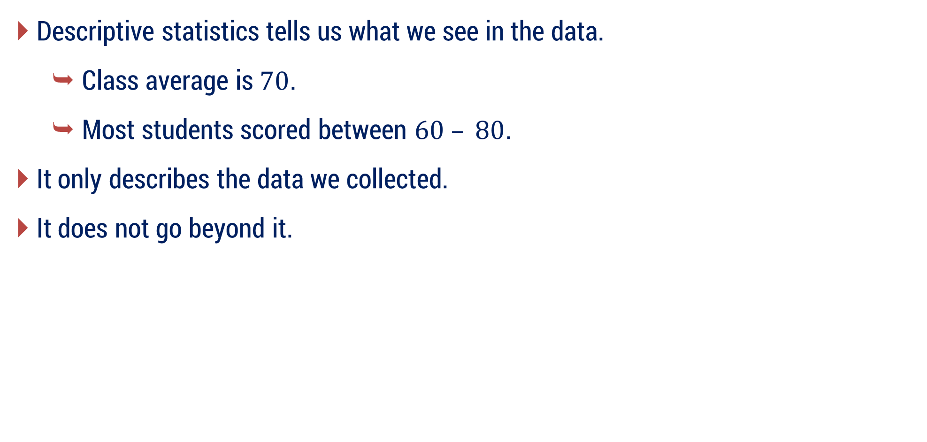
Introduction
Descriptive statistics tells us what we see in the data.
Class average is $70$.
Most students scored between $60 – 80$.
It only describes the data we collected.
It does not go beyond it.

Slide 8
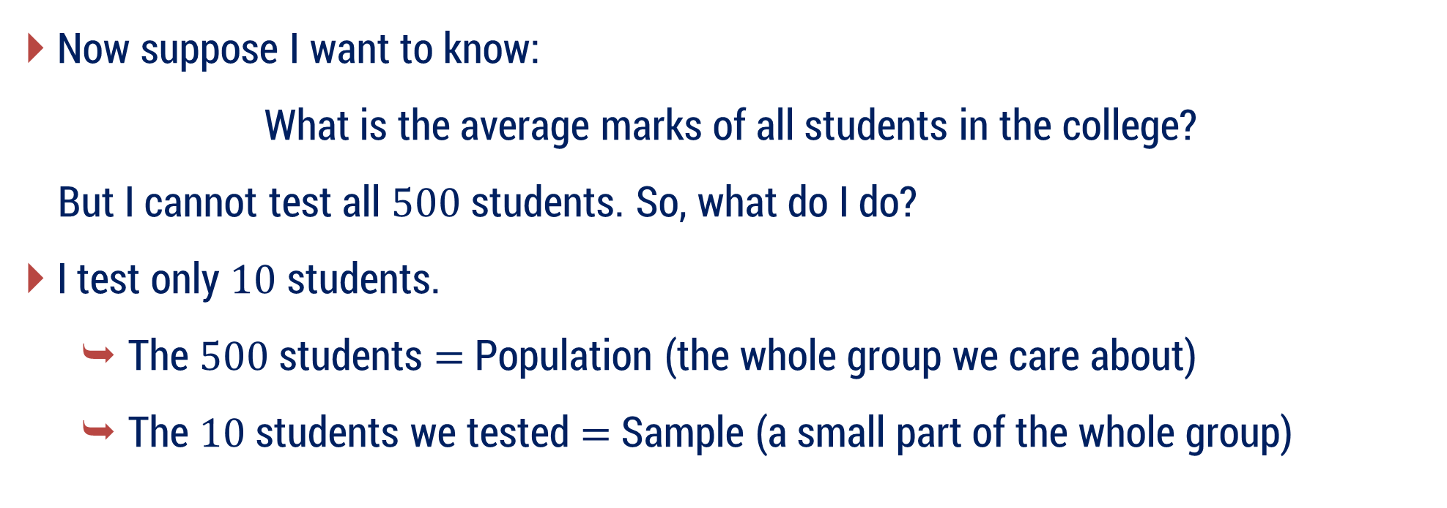
Introduction
Now suppose I want to know:
What is the average marks of all students in the college?
But I cannot test all $500$ students. So, what do I do?
I test only $10$ students.
The $500$ students $=$ Population (the whole group we care about)
The $10$ students we tested $=$ Sample (a small part of the whole group)

Slide 9

Introduction
The word Inferential comes from “infer.”
Infer means to conclude something using evidence.
So,
Inferential Statistics $=$ Using a sample to make conclusions about the population.

Slide 10
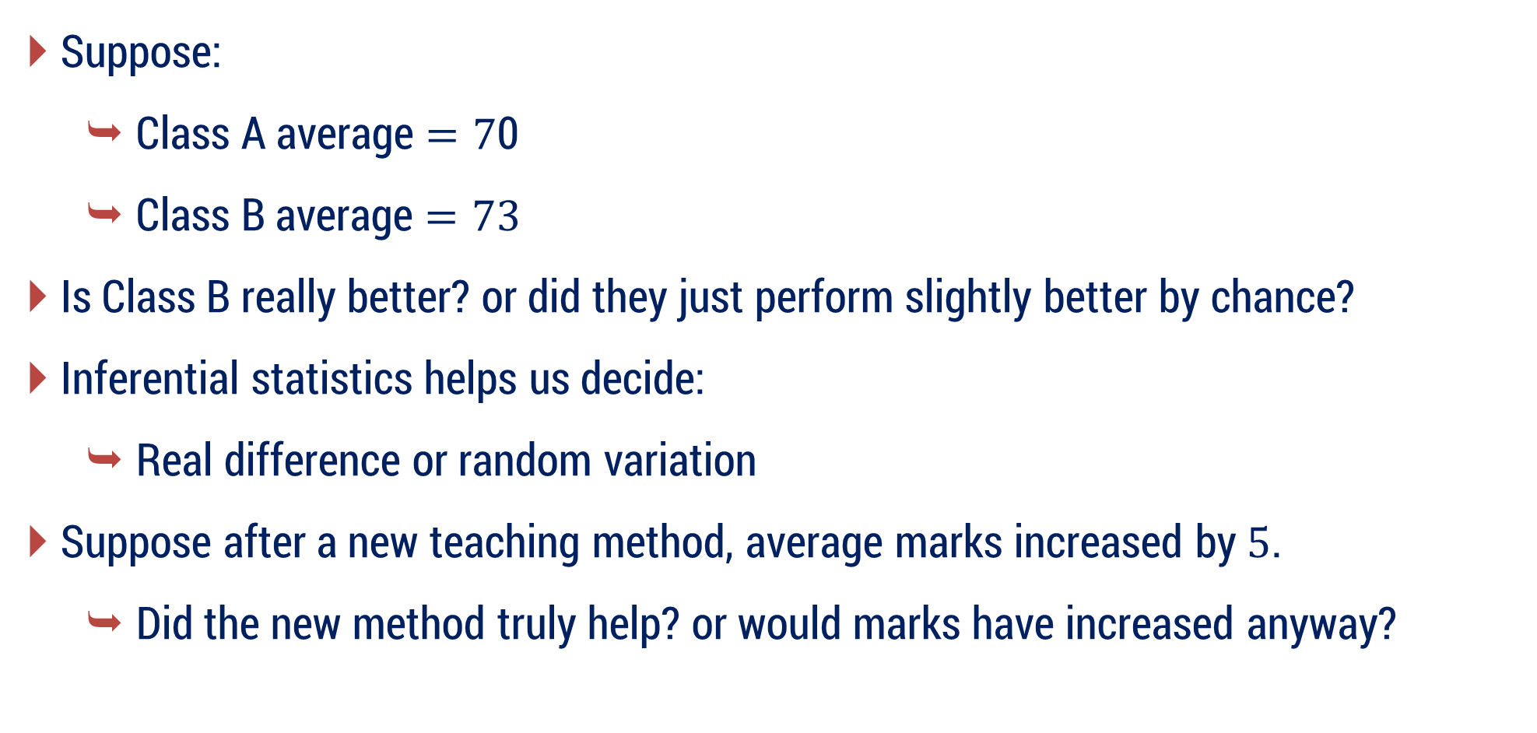
Introduction
Suppose:
Class A average $=7$0
Class B average $=73$
Is Class B really better? or did they just perform slightly better by chance?
Inferential statistics helps us decide:
Real difference or random variation
Suppose after a new teaching method, average marks increased by $5$.
Did the new method truly help? or would marks have increased anyway?

Slide 11
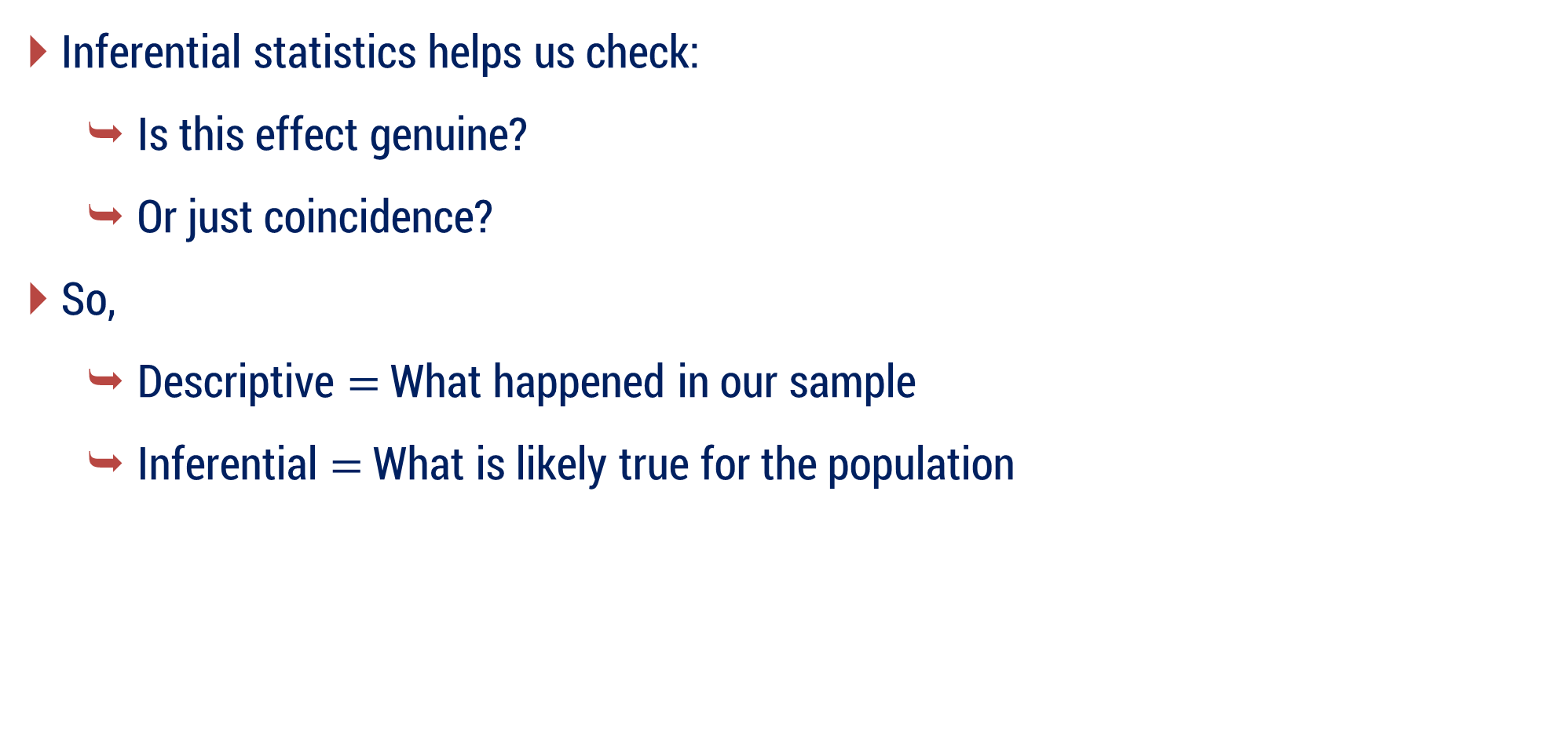
Introduction
Inferential statistics helps us check:
Is this effect genuine?
Or just coincidence?
So,
Descriptive $=$ What happened in our sample
Inferential $=$ What is likely true for the population

Slide 12
Applications
Google / YouTube / Instagram
When Instagram changes a feature, they don’t show it to all users immediately.
They test it on a small group of users (sample). Then they ask:
Did engagement increase?
Is the increase real? or
just random fluctuation?
This is called A/B Testing — Pure Inferential Statistics.

Slide 13
Applications
ChatGPT / Recommendation Systems
When Netflix recommends movies:
It does not know everything about you.
It uses:
Small observed data (sample behavior)
To predict your future choices (population behavior)
That’s inferential logic.
Without inferential statistics, AI is just data — not intelligence.

Slide 14
What is Inferential statistics?
In quantitative research,
after collecting data, the first step of statistical analysis is to describe characteristics of the responses, such as the average of one variable (e.g., age), or the relation between two variables (e.g., age and creativity).
After summarizing the data,
we use Inferential Statistics, which help us to decide whether your data confirms or refutes your statement/hypothesis or it can be generalizable to a larger population or not.

Slide 15
Correlation
Correlation Coefficient
Rank Correlation Coefficient
Regression
Linear Regression
Inferential Statistics
Hypothesis Testing
t – Test
Z - Test
Curve Fitting
Chi Square Test
F - Test

Slide 16
Correlation
Types of Correlation
Methods of Studying Correlation

Slide 17
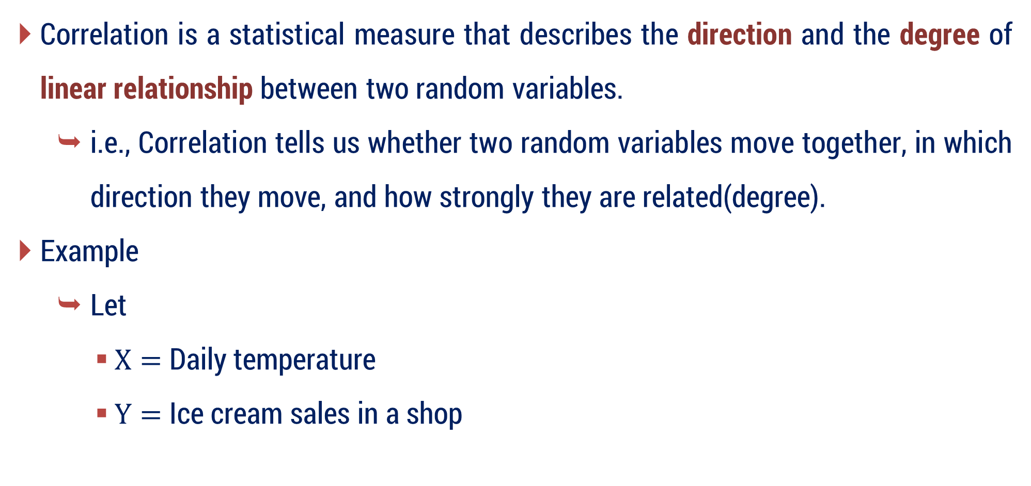
Introduction
Correlation is a statistical measure that describes the direction and the degree of linear relationship between two random variables.
i.e., Correlation tells us whether two random variables move together, in which direction they move, and how strongly they are related(degree).
Example
Let
$X=$ Daily temperature
$Y=$ Ice cream sales in a shop

Slide 18
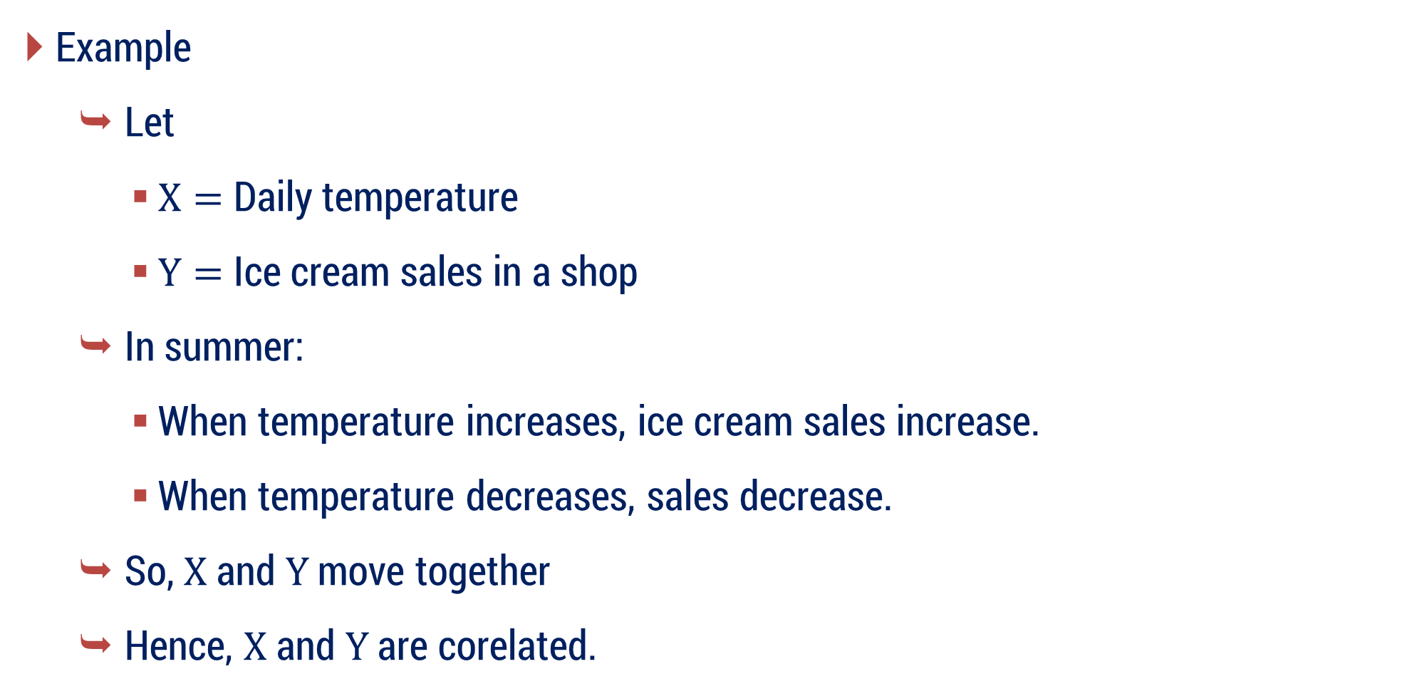
Introduction
Example
Let
$X=$ Daily temperature
$Y=$ Ice cream sales in a shop
In summer:
When temperature increases, ice cream sales increase.
When temperature decreases, sales decrease.
So, $X$ and $Y$ move together
Hence, $X$ and $Y$ are corelated.

Slide 19
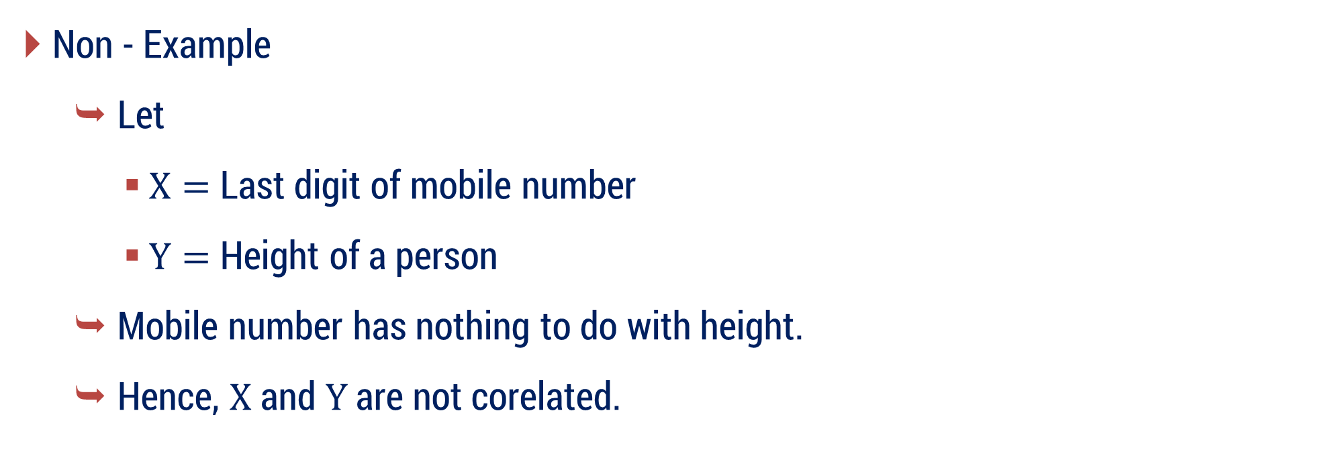
Introduction
Non - Example
Let
$X=$ Last digit of mobile number
$Y=$ Height of a person
Mobile number has nothing to do with height.
Hence, $X$ and $Y$ are not corelated.

Slide 20
Correlation vs Causation
Correlation means two things are related or move together.
When one thing changes, the other also changes.
But it does not tell us why they are changing.
Example:
In summer:
Ice cream sales increase
Sunglasses sales also increase
So, they are correlated.

Slide 21
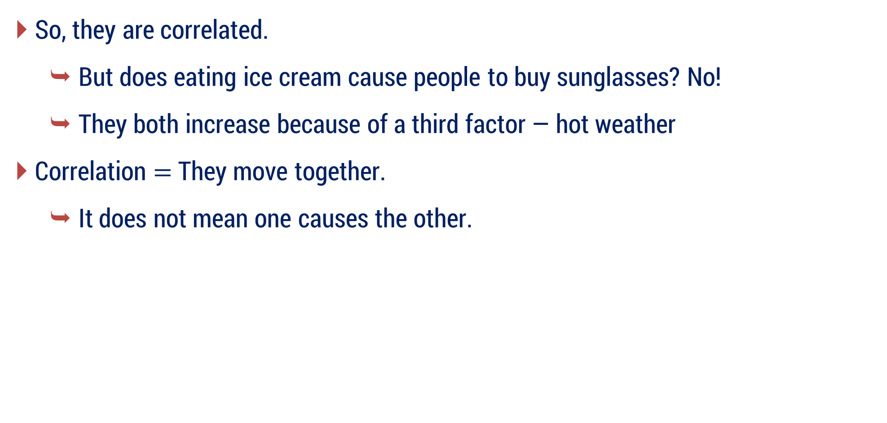
Correlation vs Causation
So, they are correlated.
But does eating ice cream cause people to buy sunglasses? No!
They both increase because of a third factor — hot weather
Correlation $=$ They move together.
It does not mean one causes the other.

Slide 22
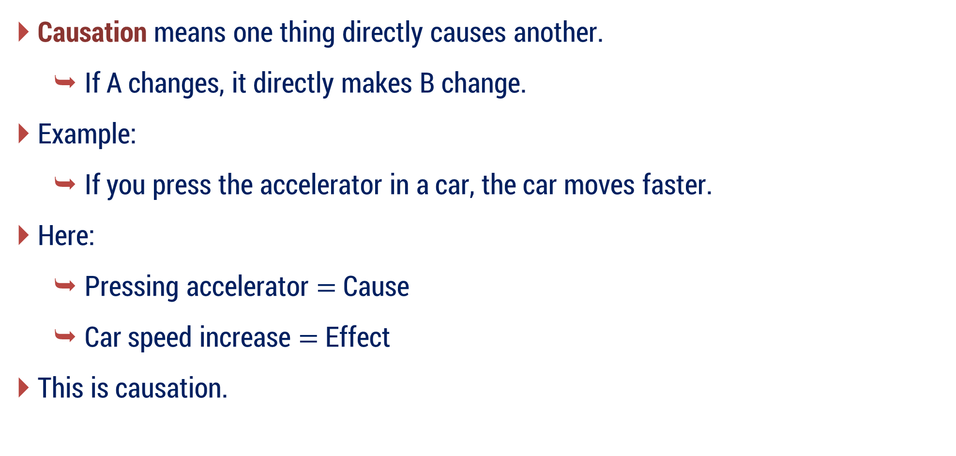
Correlation vs Causation
Causation means one thing directly causes another.
If A changes, it directly makes B change.
Example:
If you press the accelerator in a car, the car moves faster.
Here:
Pressing accelerator $=$ Cause
Car speed increase $=$ Effect
This is causation.

Slide 23
The Golden Rule
Correlation does not imply Causation.
Just because two things happen together doesn’t mean one caused the other.
Correlation = Two things happen together.
Causation = One thing makes the other happen.

Slide 24
Correlation
A data connecting two variables is called bivariate data.
Example:
Relationship between heights and weights.
Relationship between price and demand of commodity.
Relationship between age of husband and age of wife.

Slide 25
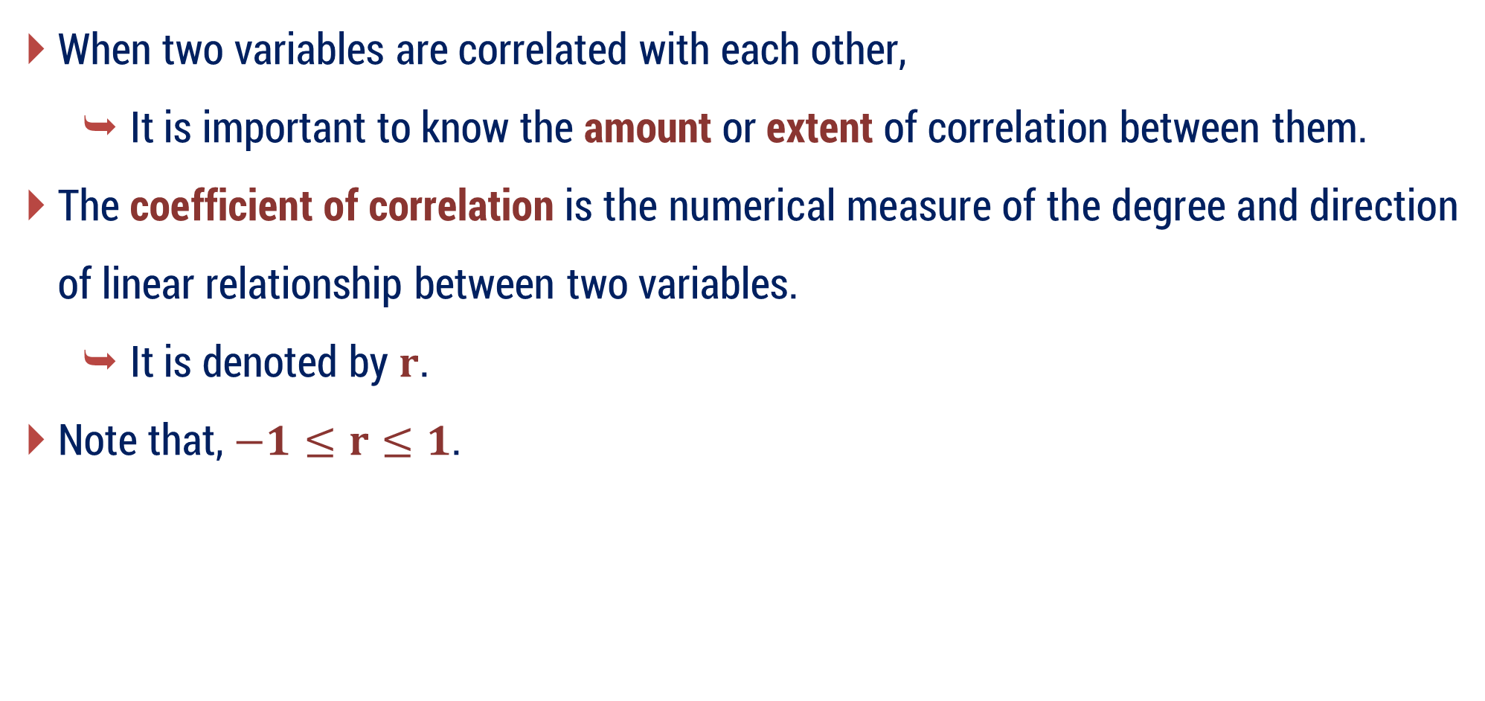
Coefficient of Correlation
When two variables are correlated with each other,
It is important to know the amount or extent of correlation between them.
The coefficient of correlation is the numerical measure of the degree and direction of linear relationship between two variables.
It is denoted by $r$.
Note that, $−1≤r≤1$.

Slide 26
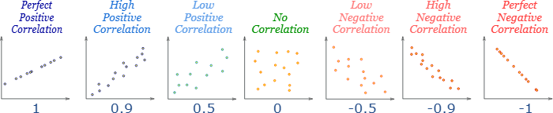
Types
Image Source: www.mathsisfun.com/

Slide 27
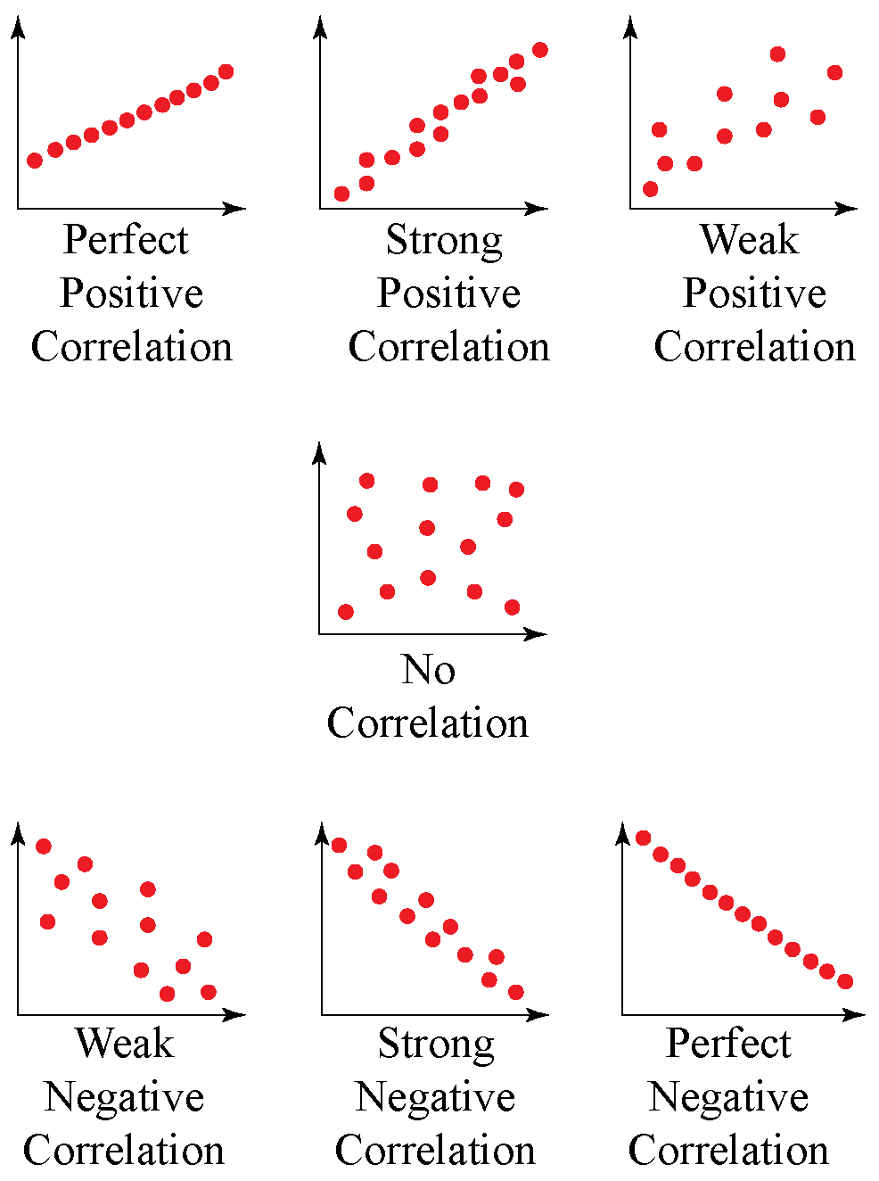
Image Source: www.cuemath.com/

Slide 28
Methods of Studying Correlation
Graphical Methods
Scatter Diagram
Simple Graph
Mathematical Methods
Karl Pearson’s coefficient of correlation
Spearman’s coefficient of rank correlation

Slide 29
Method – 1 Correlation Coefficient
Karl Pearson’s Coefficient of Correlation

Slide 30
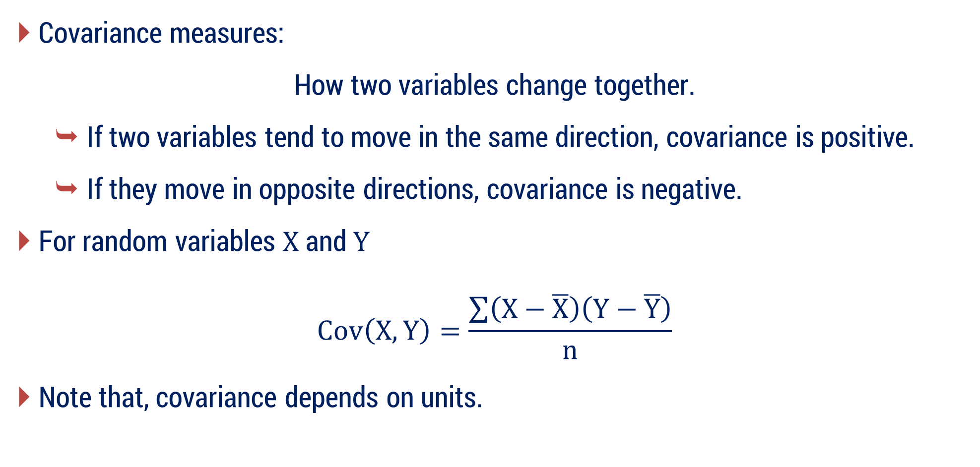
Covariance
Covariance measures:
How two variables change together.
If two variables tend to move in the same direction, covariance is positive.
If they move in opposite directions, covariance is negative.
For random variables $X$ and $Y$
$$Cov\left(X, Y\right)=\frac{\sum{\left(X−\overline{X}\right)\left(Y−\overline{Y}\right)}}{n}$$
Note that, covariance depends on units.

Slide 31
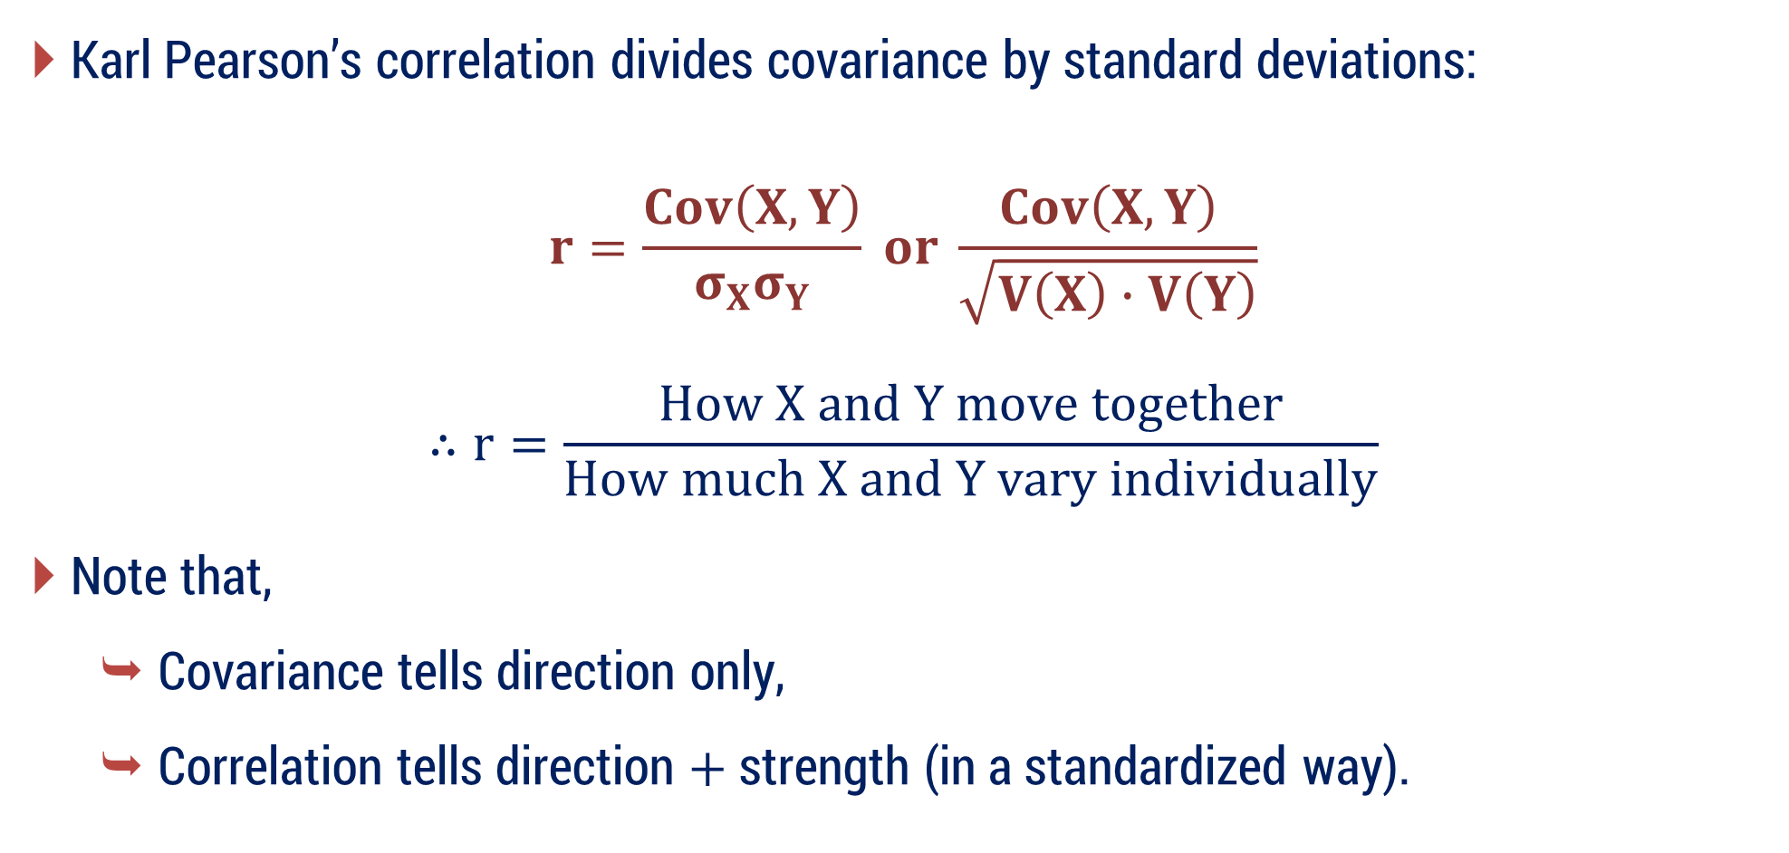
Covariance vs Correlation
Karl Pearson’s correlation divides covariance by standard deviations:
$$r=\frac{Cov\left(X, Y\right)}{σ_{X}σ_{Y}} or \frac{Cov\left(X, Y\right)}{\sqrt{V\left(X\right)∙V\left(Y\right)}}$$
$$∴r=\frac{How X and Y move together}{How much X and Y vary individually}$$
Note that,
Covariance tells direction only,
Correlation tells direction $+$ strength (in a standardized way).
$$​$$

Slide 32
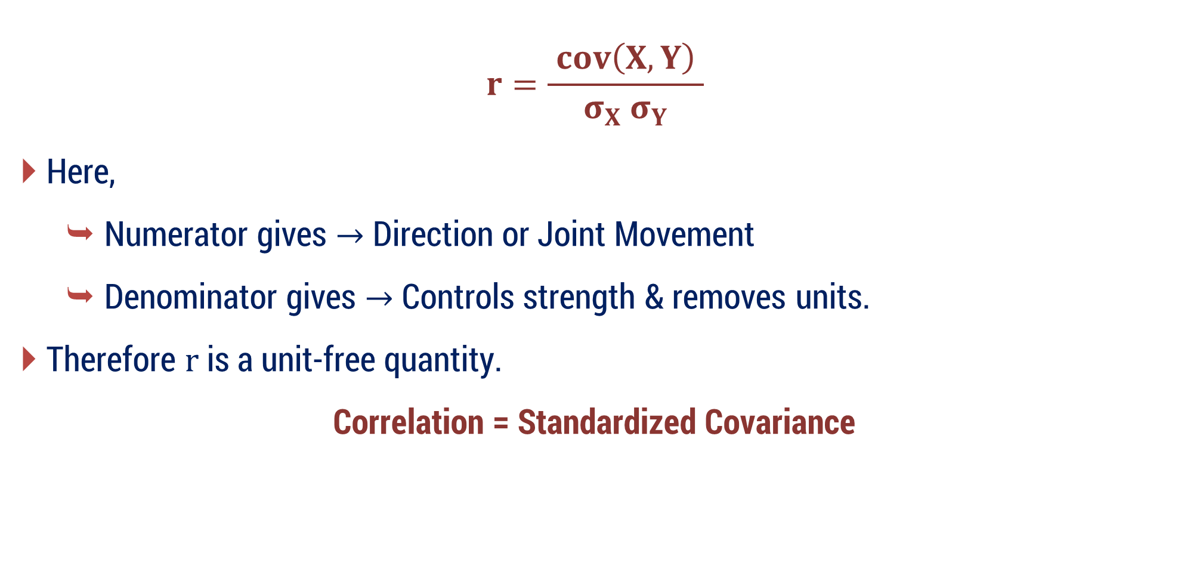
Karl Pearson’s Coefficient of Correlation
$$r=\frac{ cov\left(X, Y\right) }{σ_{X} σ_{Y}}$$
Here,
Numerator gives $→$ Direction or Joint Movement
Denominator gives $→$ Controls strength & removes units.
Therefore $r$ is a unit-free quantity.
Correlation = Standardized Covariance

Slide 33
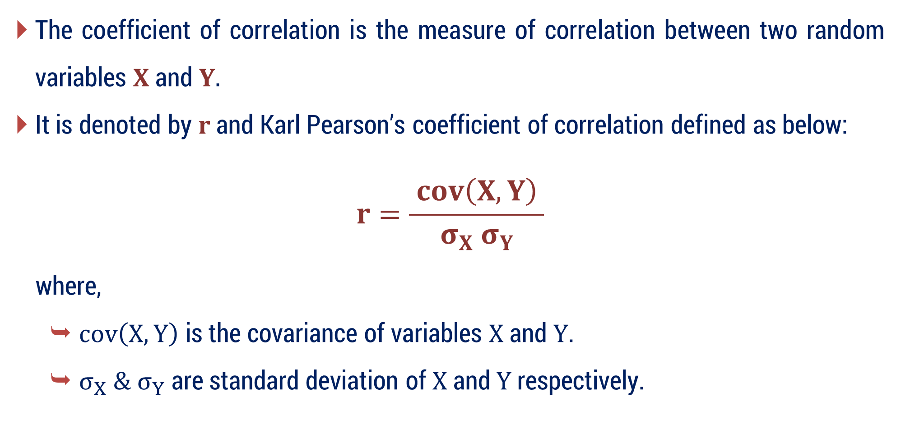
Karl Pearson’s Coefficient of Correlation
The coefficient of correlation is the measure of correlation between two random variables $X$ and $Y.$
It is denoted by $r$ and Karl Pearson’s coefficient of correlation defined as below:
$$r=\frac{ cov\left(X, Y\right) }{σ_{X} σ_{Y}}$$
where,
$cov\left(X, Y\right)$ is the covariance of variables $X$ and $Y$.
$σ_{X} \& σ_{Y}$ are standard deviation of $X$ and $Y$ respectively.

Slide 34

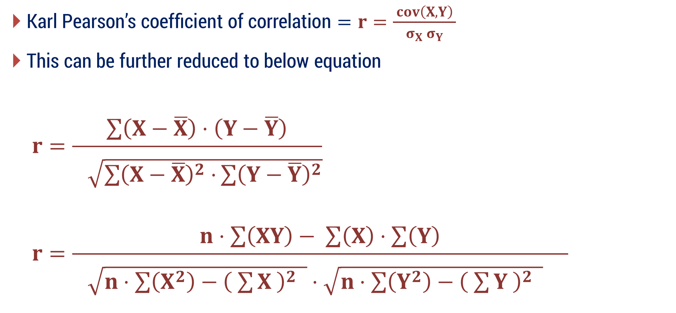
Karl Pearson’s Coefficient of Correlation
$\text{Karl} \text{Pearson}\text{’}\text{s} \text{coefficient} \text{of} \text{correlation}=r=\frac{ cov\left(X, Y\right) }{σ_{X} σ_{Y}}$
This can be further reduced to below equation
$$r=\frac{\sum{\left(X−\overline{X}\right)⋅\left(Y−\overline{Y}\right)}}{\begin{aligned} \\ \sqrt{\sum{{\left(X−\overline{X}\right)}^{2}⋅}\sum{{\left(Y−\overline{Y}\right)}^{2}}}\end{aligned}}$$
$$r=\frac{n⋅\sum{\left(XY\right)}− \sum{\left(X\right)}⋅\sum{\left(Y\right)}}{\begin{aligned} \\ \sqrt{n⋅\sum{\left(X^{2}\right)}−{\left( \sum{X} \right)}^{2} }⋅\sqrt{n⋅\sum{\left(Y^{2}\right)}−{\left( \sum{Y} \right)}^{2} } \end{aligned}}$$
$$cov\left(X, Y\right)=\frac{1}{n}⋅\sum{\left(x−\overline{x}\right)⋅\left(y−\overline{y}\right)}$$
$$σ_{X}=\sqrt{\frac{\sum{{\left(x−\overline{ x }\right)}^{2}}}{n}}$$
$${ σ}_{y}=\sqrt{\frac{\sum{{\left(y−\overline{ y }\right)}^{2}}}{n}}$$

Slide 35
Types
Image Source: www.mathsisfun.com/

Slide 36
Image Source: www.cuemath.com/

Slide 37

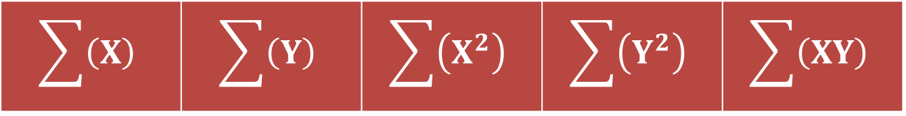
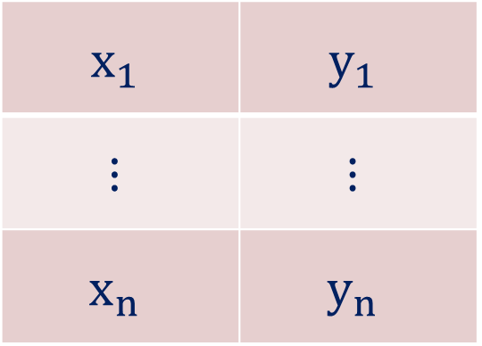
Procedure to find $r$ from the given values of $X$ & $Y$
Store the given data in the scientific calculator(fx-82MS).
Prepare the table with $5$ columns using the given values of $X$ & $Y$.
$$X$$ | $$Y$$ | $$X^{2}$$ | $$Y^{2}$$ | $$XY$$
$$x_{1}$$ | $$y_{1}$$
$$⋮$$ | $$⋮$$
$$x_{n}$$ | $$y_{n}$$
find
find
find
find
find
find
find
find
find
Sum of above data
$$\sum{\left(X\right)}$$ | $$\sum{\left(Y\right)}$$ | $$\sum{\left(X^{2}\right)}$$ | $$\sum{\left(Y^{2}\right)}$$ | $$\sum{\left(XY\right)}$$

Slide 38
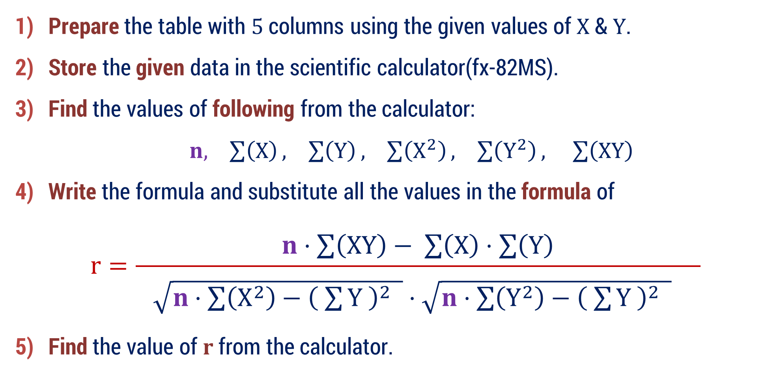
Procedure to find $r$ from the given values of $X$ & $Y$
Prepare the table with $5$ columns using the given values of $X$ & $Y$.
Store the given data in the scientific calculator(fx-82MS).
Find the values of following from the calculator:
$n, \sum{\left(X\right)}, \sum{\left(Y\right)}, \sum{\left(X^{2}\right)}, \sum{\left(Y^{2}\right)}, \sum{\left(XY\right)}$
Write the formula and substitute all the values in the formula of
$$r=\frac{n⋅\sum{\left(XY\right)}− \sum{\left(X\right)}⋅\sum{\left(Y\right)}}{\begin{aligned} \\ \sqrt{n⋅\sum{\left(X^{2}\right)}−{\left( \sum{Y} \right)}^{2} }⋅\sqrt{n⋅\sum{\left(Y^{2}\right)}−{\left( \sum{Y} \right)}^{2} } \end{aligned}}$$
Find the value of $r$ from the calculator.

Slide 39
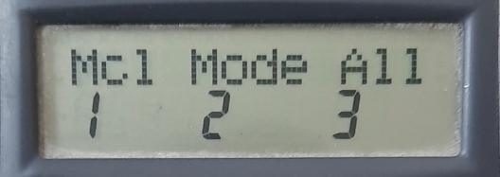
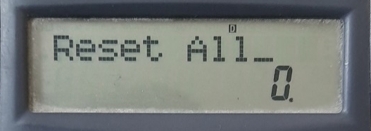

How to store given data in the calculator? (Reset Calc.)
General Step: Clear the memory of the calculator. (Do this step before starting any method)
Shift
Mode
Press 3
→All
2 times =

Slide 40
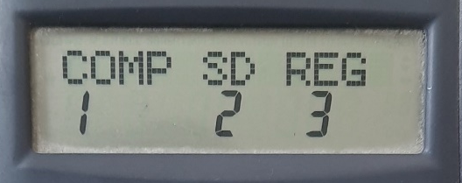
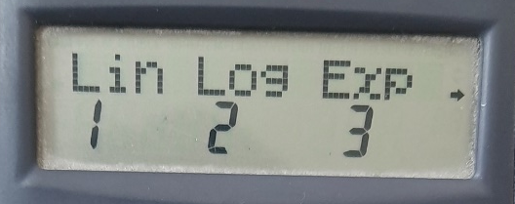
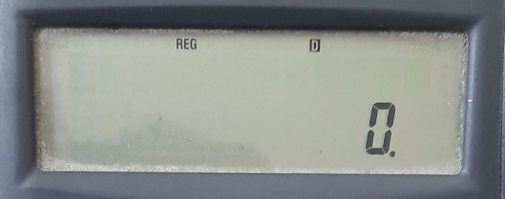
How to store given data in the calculator? (Mode Set)
Step-1: Change the mode into Regression $→$ Linear
Mode
Press 3
→ Reg
Press 1
→ Lin

Slide 41





How to store given data in the calculator? (Data Store)
Step-2: Store the given pairs of $x$ and $y$
1st value of $X$
1st value of 𝐗
,
1st value of $Y$
1st value of 𝐘
M+
2nd value of $X$
2nd value of 𝐗
,
2nd value of $Y$
2nd value of 𝐘
M+
$$⋮$$
$$⋮$$
$$⋮$$
$$⋮$$
Last value of $X$
Last value of 𝐗
,
Last value of $Y$
Last value of 𝐘
M+

Slide 42
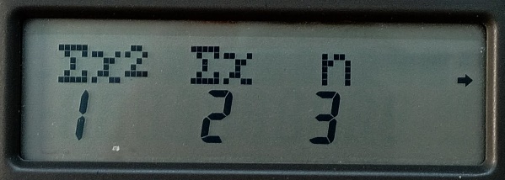
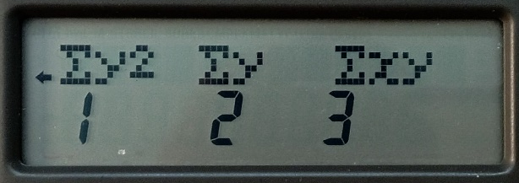
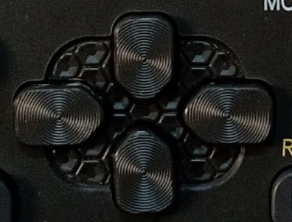
How to find required values (Summations) from the calculator?
Shift
1
Digit
=
Right side
Digit
=
1
Shift

Slide 43
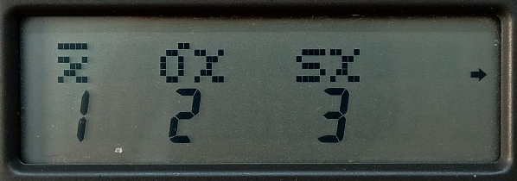
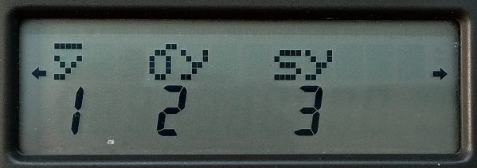
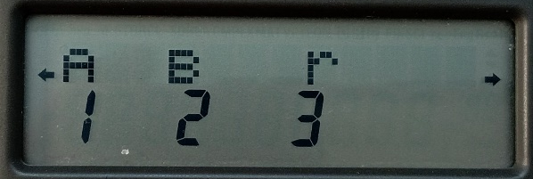
How to find required values (‘r’) from the calculator?
Shift
2
Right side 2 times
3
=

Slide 44
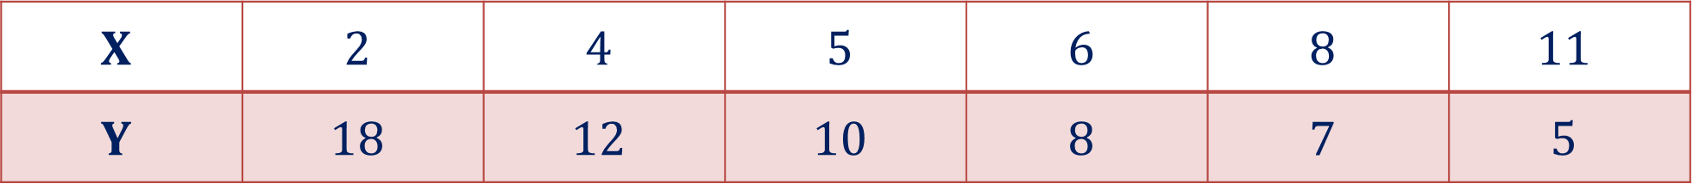
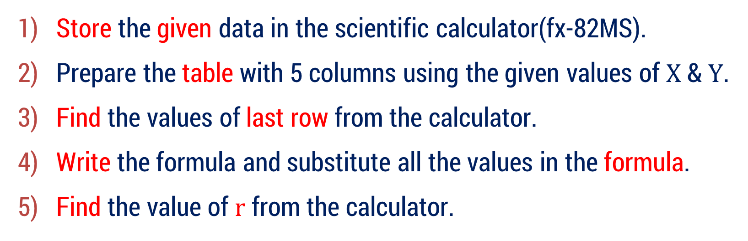
Method 1 ⇝ Example 1
Compute the coefficient of correlation between $X$ and $Y$ using the following data:
$$X$$ | $$2$$ | $$4$$ | $$5$$ | $$6$$ | $$8$$ | $$11$$
$$Y$$ | $$18$$ | $$12$$ | $$10$$ | $$8$$ | $$7$$ | $$5$$
Solution:
Store the given data in the scientific calculator(fx-82MS).
Prepare the table with 5 columns using the given values of $X$ & $Y$.
Find the values of last row from the calculator.
Write the formula and substitute all the values in the formula.
Find the value of $r$ from the calculator.

Slide 45
























Method 1 ⇝ Example 1(Continue)
$$X$$ | $$Y$$ | $$X^{2}$$ | $$Y^{2}$$ | $$XY$$
$$2$$ | $$18$$
$$4$$ | $$12$$
$$5$$ | $$10$$
$$6$$ | $$8$$
$$8$$ | $$7$$
$$11$$ | $$5$$
$$2^{2}=4$$
$${18}^{2}= 324$$
$$2×18=36$$
$$16$$
$$144$$
$$48$$
$$25$$
$$100$$
$$50$$
$$36$$
$$64$$
$$48$$
$$64$$
$$49$$
$$56$$
$$121$$
$$25$$
$$55$$
$$\sum{\left(X\right)}=36$$
$$\sum{\left(Y\right)}=60$$
$$\sum{\left(X^{2}\right)}=266$$
$$\sum{\left(Y^{2}\right)}=706$$
$$\sum{\left(XY\right)}=293$$

Slide 46

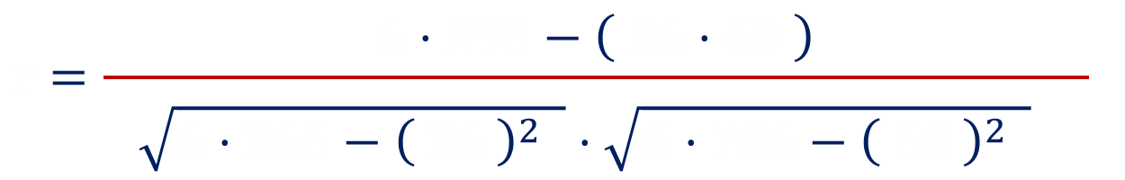
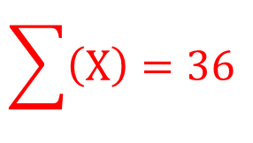
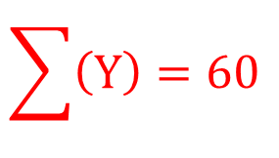
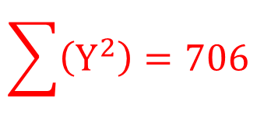


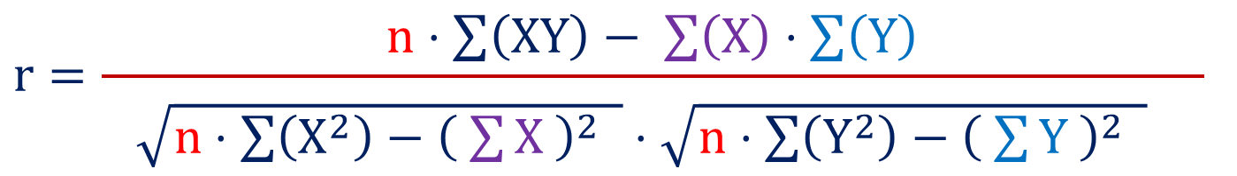


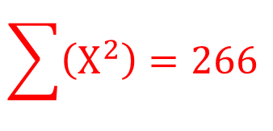


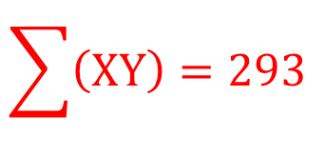





Method 1 ⇝ Example 1(Continue)
Let us substitute all the values in the formula to find the coefficient of correlation
$$n=6$$
$$r=\frac{n⋅\sum{\left(XY\right)}− \sum{\left(X\right)}⋅\sum{\left(Y\right)}}{\begin{aligned} \\ \sqrt{n⋅\sum{\left(X^{2}\right)}−{\left( \sum{X} \right)}^{2} }⋅\sqrt{n⋅\sum{\left(Y^{2}\right)}−{\left( \sum{Y} \right)}^{2} } \end{aligned}}$$
$$\sum{\left(X\right)}=36$$
$$\sum{\left(Y\right)}=60$$
$$6$$
$$293$$
$$36$$
$$60$$
$$r=\frac{6⋅293−\left( 36⋅60 \right)}{\begin{aligned} \\ \sqrt{6⋅266−{\left( 36 \right)}^{2} }⋅\sqrt{6⋅706−{\left( 60 \right)}^{2} } \end{aligned}}$$
$$\sum{\left(X^{2}\right)}=266$$
$$6$$
$$266$$
$$36$$
$$6$$
$$706$$
$$60$$
$$\sum{\left(Y^{2}\right)}=706$$
$$r=−0.9203$$
$$\sum{\left(XY\right)}=293$$
$$∴\text{The} \text{coefficient} \text{of} \text{correlation} =− 0.9203$$

Slide 47
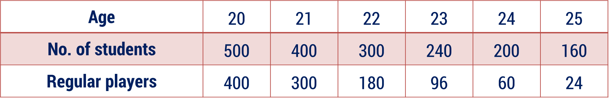

Method 1 ⇝ Example 6
Calculate Karl Pearson’s coefficient of correlation between age and Number of Regular Players.
Age | $$\text{20}$$ | $$\text{21}$$ | $$\text{22}$$ | $$\text{23}$$ | $$\text{24}$$ | $$\text{25}$$
No. of students | $$\text{500}$$ | $$\text{400}$$ | $$\text{300}$$ | $$\text{240}$$ | $$\text{200}$$ | $$\text{160}$$
Regular players | $$\text{400}$$ | $$\text{300}$$ | $$\text{180}$$ | $$\text{96}$$ | $$\text{60}$$ | $$\text{24}$$
Solution:
Let $X=$ Age and $Y=$ Regular Players

Slide 48






Method 1 ⇝ Example 2(Continue)
$$X$$ | $$Y$$ | $$X^{2}$$ | $$Y^{2}$$ | $$XY$$
20 | 400
21 | 300
22 | 180
23 | 96
24 | 60
25 | 24
400
160000
8000
441
90000
6300
484
32400
3960
529
32400
2208
576
3600
1440
625
576
600
$$\sum{\left(X\right)}=135$$
$$\sum{\left(Y\right)}=1060$$
$$\sum{\left(X^{2}\right)}=3055$$
$$\sum{\left(Y^{2}\right)}=295792$$
$$\sum{\left(XY\right)}=22508$$

Slide 49
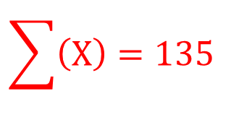

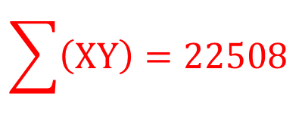
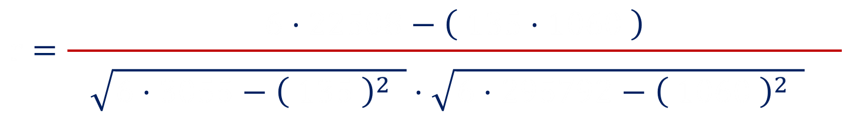



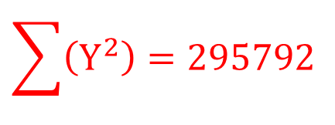


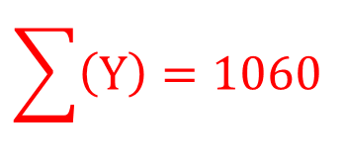







Method 1 ⇝ Example 2(Continue)
Let us substitute all the values in the formula to find the coefficient of correlation
$$n=6$$
$$r=\frac{n⋅\sum{\left(XY\right)}− \sum{\left(X\right)}⋅\sum{\left(Y\right)}}{\begin{aligned} \\ \sqrt{n⋅\sum{\left(X^{2}\right)}−{\left( \sum{X} \right)}^{2} }⋅\sqrt{n⋅\sum{\left(Y^{2}\right)}−{\left( \sum{Y} \right)}^{2} } \end{aligned}}$$
$$\sum{\left(X\right)}=135$$
$$\sum{\left(Y\right)}=1060$$
$$6$$
$$22508$$
$$135$$
$$1060$$
$$r=\frac{6⋅22508−\left( 135⋅1060 \right)}{\begin{aligned} \\ \sqrt{6⋅3055−{\left( 135 \right)}^{2} }⋅\sqrt{6⋅295792−{\left( 1060 \right)}^{2} } \end{aligned}}$$
$$\sum{\left(X^{2}\right)}=3055$$
$$6$$
$$3055$$
$$135$$
$$6$$
$$295792$$
$$1060$$
$$\sum{\left(Y^{2}\right)}=295792$$
$$r=−0.9738$$
$$\sum{\left(XY\right)}=22508$$
$$∴\text{The} \text{coefficient} \text{of} \text{correlation} =− 0.9738$$

Slide 50



Remark
Calculate Karl Pearson’s coefficient of correlation between age and Playing Habits.
Age | $$\text{20}$$ | $$\text{21}$$ | $$\text{22}$$ | $$\text{23}$$ | $$\text{24}$$ | $$\text{25}$$
No. of students | $$\text{500}$$ | $$\text{400}$$ | $$\text{300}$$ | $$\text{240}$$ | $$\text{200}$$ | $$\text{160}$$
Regular players | $$\text{400}$$ | $$\text{300}$$ | $$\text{180}$$ | $$\text{96}$$ | $$\text{60}$$ | $$\text{24}$$
Playing habits means, out of $100$ students of that age, how many play regularly?
At age $20$: Total students $=500$, Regular players $=400$
So, we ask: Out of $100$ students, how many play regularly?
$$\frac{400}{500}=0.8$$

Slide 51

Remark
Age $\left(X\right)$ | Total Students | Regular Players | Playing Habit$\left(Y\right)$
$$20$$ | $$500$$ | $$400$$ | $$0.8$$
$$21$$ | $$400$$ | $$300$$ | $$0.75$$
$$22$$ | $$300$$ | $$180$$ | $$0.6$$
$$23$$ | $$240$$ | $$96$$ | $$0.4$$
$$24$$ | $$200$$ | $$60$$ | $$0.3$$
$$25$$ | $$160$$ | $$24$$ | $$0.15$$

Slide 52



Method 1 ⇝ Example 9
$$\text{Determine} \text{the} \text{coefficient} \text{of} \text{correlation} \text{if} n=10, \overline{ x }=5.5, \overline{ y }=4,$$
$$\sum{x^{2}=385}, \sum{y^{2}=192}, \sum{{\left(x+y\right)}^{2}=947}.$$
Solution:
$$\text{W}\text{e} \text{have} n=10, \overline{ x }=5.5, \overline{ y }=4,$$
$$\sum{x^{2}=385}, \sum{y^{2}=192}, \sum{{\left(x+y\right)}^{2}=947}$$
$$∴\text{T}\text{o} \text{find} r\text{, }\text{we} \text{need} \text{to} \text{find}\sum{x}, \sum{y}, \sum{xy}$$

Slide 53










Method 1 ⇝ Example 9(Continue)
$$\text{We} \text{know} \text{that} \overline{ x }=\frac{ \sum{x }}{n}$$
$$\text{Similarly} \overline{ y }=\frac{ \sum{y }}{n}$$
$$\overline{ x }=5.5$$
$$\overline{ y }=4$$
$$⇒\sum{x}=\overline{ x }∙n$$
$$⇒\sum{y}=\overline{ y }∙n$$
$$⇒\sum{x}=5.5∙10$$
$$⇒\sum{y}=4∙10$$
$$⇒\sum{x}=55………(1)$$
$$⇒\sum{y}=40………(2)$$

Slide 54











Method 1 ⇝ Example 9(Continue)
$$\text{We} \text{have}\sum{{\left(x+y\right)}^{2}=947}$$
$$⇒2\sum{\left(xy\right)}=370$$
$$⇒\sum{\left(x^{2}+y^{2}+2xy\right)}=947$$
$$⇒\sum{\left(xy\right)}=185………(3)$$
$$⇒\sum{\left(x^{2}\right)}+\sum{\left(y^{2}\right)}+2\sum{\left(xy\right)}=947$$
$$\sum{\left(x^{2}\right)}=385$$
$$\sum{\left(y^{2}\right)}=192$$
$$⇒385+192+2\sum{\left(xy\right)}=947$$
$$385$$
$$192$$
$$⇒2\sum{\left(xy\right)}=947−385−192$$

Slide 55



















Method 1 ⇝ Example 9(Continue)
Let us substitute all the values in the formula to find the coefficient of correlation
$$n=10$$
$$r=\frac{n⋅\sum{\left(xy\right)}− \sum{\left(x\right)}⋅\sum{\left(y\right)}}{\begin{aligned} \\ \sqrt{n⋅\sum{\left(x^{2}\right)}−{\left( \sum{x} \right)}^{2} }⋅\sqrt{n⋅\sum{\left(y^{2}\right)}−{\left( \sum{y} \right)}^{2} } \end{aligned}}$$
$$\sum{\left(x\right)}=55$$
$$\sum{\left(y\right)}=40$$
$$10$$
$$185$$
$$55$$
$$40$$
$$r=\frac{10⋅185−\left( 55⋅40 \right)}{\begin{aligned} \\ \sqrt{10⋅385−{\left( 55 \right)}^{2} }⋅\sqrt{10⋅192−{\left( 40 \right)}^{2} } \end{aligned}}$$
$$\sum{\left(x^{2}\right)}=385$$
$$10$$
$$385$$
$$55$$
$$10$$
$$192$$
$$40$$
$$\sum{\left(y^{2}\right)}=192$$
$$r=−0.6812$$
$$\sum{\left(xy\right)}=185$$
$$\text{The} \text{coefficient} \text{of} \text{correlation} =− 0.6812$$

Slide 56



Method 1 ⇝ Example 12
$$\text{Given} \text{that} n=25, \sum{x=125}, \sum{x^{2}=650}, \sum{y=100}, \sum{y^{2}=460}$$
$$\text{and} \sum{xy=508}.\text{Later} \text{on}\text{, }\text{it} \text{was} \text{found} \text{that} \text{two} \text{of} \text{the} \text{points} \left(8, 12\right) \text{and} \left(6, 8\right)$$
$$\text{were} \text{wrongly} \text{entered} \text{as} \left(6, 14\right) \text{and} \left(8, 6\right). \text{Prove} \text{that} r=\frac{2}{ 3 }.$$
Solution:
$$\text{W}\text{e} \text{have} n=25, \sum{x=125}, \sum{x^{2}=650}$$
$$\sum{xy=508}, \sum{y=100}, \sum{y^{2}=460}$$

Slide 57









Method 1 ⇝ Example 12(Continue)
$$\text{It} \text{was} \text{found} \text{that} \text{two} \text{of} \text{the} \text{points} \left(8, 12\right) \text{and} \left(6, 8\right) \text{were} \text{wrongly} \text{entered} \text{as}$$
$$(6, 14) \text{and} (8, 6)$$
It means, In $x$, $6$ & $8$ were incorrect and $8$ & $6$ are correct.
It means, In $y$, $14$ & $6$ were incorrect and $12$ & $8$ are correct.
$$∴\text{Corrected} \sum{x}=125−6−8+8+6$$
$$− 6−8$$
$$+ 8+6$$
$$=125$$
$$∴\text{Corrected} \sum{y}=100−14−6+12+8$$
$$− 14−6$$
$$+ 12+8$$
$$=100$$

Slide 58
















Method 1 ⇝ Example 12(Continue)
$$∴\text{Corrected} \sum{x^{2}}=650−6^{2}−8^{2}+8^{2}+6^{2}$$
$$\text{Correct}$$
$\left(8, 12\right) \text{and} \left(6, 8\right)$
Incorrect
$(6, 14) \text{and} (8, 6)$
$$− 6^{2}−8^{2}$$
$$+ 8^{2}+6^{2}$$
$$=650$$
$$∴\text{Corrected} \sum{y^{2}}=460−{14}^{2}−6^{2}+{12}^{2}+8^{2}$$
$$− {14}^{2}−6^{2}$$
$$+ {12}^{2}+8^{2}$$
$$=436$$
$$∴\text{Corrected} \sum{xy}=508−\left(6∙14\right)−\left(8∙6\right)+\left(8∙12\right)+\left(6∙8\right)$$
$$6∙14$$
$$8∙6$$
$$8∙12$$
$$6∙8$$
$$=508−84−48+96+48$$
$$=520$$

Slide 59



















Method 1 ⇝ Example 12(Continue)
Let us substitute all the values in the formula to find the coefficient of correlation
$$n=25$$
$$r=\frac{n⋅\sum{\left(xy\right)}− \sum{\left(x\right)}⋅\sum{\left(y\right)}}{\begin{aligned} \\ \sqrt{n⋅\sum{\left(x^{2}\right)}−{\left( \sum{x} \right)}^{2} }⋅\sqrt{n⋅\sum{\left(y^{2}\right)}−{\left( \sum{y} \right)}^{2} } \end{aligned}}$$
$$\sum{\left(x\right)}=125$$
$$\sum{\left(y\right)}=100$$
$$25$$
$$520$$
$$125$$
$$100$$
$$r=\frac{25⋅520−\left( 125⋅100 \right)}{\begin{aligned} \\ \sqrt{25⋅650−{\left( 125 \right)}^{2} }⋅\sqrt{25⋅436−{\left( 100 \right)}^{2} } \end{aligned}}$$
$$\sum{\left(x^{2}\right)}=650$$
$$25$$
$$650$$
$$125$$
$$25$$
$$436$$
$$100$$
$$\sum{\left(y^{2}\right)}=436$$
$$r=\frac{500}{ 25∙30 }=\frac{20}{ 30 }=\frac{2}{ 3 }$$
$$\sum{\left(xy\right)}=520$$
$$\text{Hence} \text{Proved}\text{.}$$

Slide 60
Method – 2 Rank Correlation Coefficient
Spearman’s coefficient of rank correlation

Slide 61
Rank Correlation Coefficient
Rank Correlation Coefficient measures the degree and direction of association between two variables based on their ranks (positions) instead of their actual numerical values.
In simple words:
Instead of comparing actual numbers, we compare the order of the values.
Example:
Movies ranked by audience
Websites ranked by traffic
Research papers ranked by citations
In such cases, using normal correlation (like Pearson) is not suitable.

Slide 62
Why Do We Need Rank Correlation?
When exact values are not available
Sometimes we don’t have numerical data.
Example:
Beauty contest results
Customer satisfaction (Good, Average, Poor)
Movie ratings
Here we only know order, not exact numbers.
So, we rank them and use Rank Correlation

Slide 63
Why Do We Need Rank Correlation?
When data is qualitative (Non-Numerical)
Some variables are not measured in numbers.
Example:
Intelligence level (High, Medium, Low)
Performance (Excellent, Good, Average)
We cannot apply normal correlation directly.
So, we convert them into ranks and then measure relationship.

Slide 64
Why Do We Need Rank Correlation?
When data is not normally distributed
Karl Pearson’s correlation works best when:
Data is normally distributed
Relationship is linear
But in real life, data may:
Be skewed
Not follow normal distribution
Rank correlation works even when these conditions fail

Slide 65

Why Do We Need Rank Correlation?
When there are extreme values (Outliers)
Example:
Marks: $90, 85, 80, 75, 10$
Here $10$ is very small compared to others.
Pearson’s correlation gets heavily affected by extreme values.
But if we convert into ranks: $1, 2, 3, 4, 5$
Now extreme value effect reduces.
Rank correlation is more robust (less sensitive to outliers).

Slide 66
Why Do We Need Rank Correlation?
When relationship is monotonic (Not Strictly Linear)
Sometimes relationship is not perfectly linear but still moves in one direction.
Example:
As study hours increase → performance increases
But not in exact straight-line form.
Rank correlation still detects this relationship.

Slide 67

Coefficient of Rank Correlation
The coefficient of correlation between the two different ranks $x$ & $y$ is known as the coefficient of rank correlation between the characteristics $A$ and $B$.
It is denoted by $ρ.$
A characteristic means a quality, feature, or variable of an individual that can be measured or ranked.
It simply means measure of relationship between two variables after converting them into ranks.
Characteristic $=$ Variable

Slide 68

Coefficient of Rank Correlation
Example
Suppose movies are ranked by:
$X=$ Story quality
$Y=$ Music quality
Story quality → characteristic $1$
Music quality → characteristic $2$

Slide 69

Spearman’s Coefficient of Rank Correlation
Let $x$ and $y$ be the two different ranks of $n$ individual with two characteristics $A$ and $B$ respectively.
The Spearman’s coefficient of rank correlation defined as below:
$$ρ=1−\frac{ 6∙\sum{d^{2}} }{ n \left(n^{2}−1\right) }$$
Where, $d=$ Difference of ranks $=x_{i}−y_{i},$ $i=1, 2,…,n$
Note that, $\sum{d}=0$.

Slide 70

Spearman’s Coefficient of Rank Correlation
$$ρ=1−\frac{ 6∙\sum{d^{2}} }{ n \left(n^{2}−1\right) }$$
Meaning of Value
$ρ=+1$ → Perfect positive rank relation
The two rankings are identical.
If something is:
Rank 1 in List A → also Rank 1 in List B
Rank 2 in List A → also Rank 2 in List B …
Every position matches perfectly.

Slide 71

Spearman’s Coefficient of Rank Correlation
$$ρ=1−\frac{ 6∙\sum{d^{2}} }{ n \left(n^{2}−1\right) }$$
Meaning of Value
$ρ=0$ → No rank relation
The rankings do not follow any clear pattern.
If something is:
Rank 1 in List A → it could be any rank in List B
Rank 2 in List A → again random rank in List B …
There is no consistent agreement or disagreement.

Slide 72

Spearman’s Coefficient of Rank Correlation
$$ρ=1−\frac{ 6∙\sum{d^{2}} }{ n \left(n^{2}−1\right) }$$
Meaning of Value
$ρ=−1$ → Perfect negative rank relation
The second ranking is the complete reverse of the first.
If something is:
Rank 1 in List A → is last in List B
Rank 2 in List A → second last in List B
Rank 3 in List A → third last in List B
So, everything is reversed.

Slide 73
What do we conclude from rank correlation?
Rank correlation simply tells us:
Do two people (or two groups) think in a similar order?
Rank correlation tells:
Do two rankings think similarly?
How much do they agree?
Are they moving in same direction or opposite?
When rank changes in one list, does the other list change in the same way?

Slide 74



Procedure to find $ρ$ from the given values of $x$ & $y$
Prepare the table with $4$ columns using the given ranks.
$$x$$ | $$y$$ | $$d=x−y$$ | $$d^{2}$$
$$x_{1}$$ | $$y_{1}$$
$$⋮$$ | $$⋮$$
$$x_{n}$$ | $$y_{n}$$
find
find
find
find
find
find
$$\sum{\left(d^{2}\right)}$$

Slide 75

Procedure to find $ρ$ from the given values of $x$ & $y$
Prepare the table with $4$ columns using the given ranks.
Find the last row of the Table.
Identify $n=$ number of pairs of given data.
Substitute all the values in the formula of
$$ρ=1−\frac{ 6∙\sum{d^{2}} }{ n \left(n^{2}−1\right) }$$

Slide 76


Method 2 ⇝ Example 1
In a college, IT department has arranged one competition for IT students to develop an efficient program to solve a problem. Ten students took part in the competition and ranked by two judges given in the following table. Find the degree of agreement between the two judges using rank correlation coefficient.
1st judge | 3 | 5 | 8 | 4 | 7 | 10 | 2 | 1 | 6 | 9
2nd judge | 6 | 4 | 9 | 8 | 1 | 2 | 3 | 10 | 5 | 7
Solution:
Let, $x=$ Rank given by 1st judge
Let, $y=$ Rank given by 2nd judge

Slide 77


Method 2 ⇝ Example 1(Continue)
$$x$$ | $$y$$ | $$d=x−y$$ | $$d^{2}$$
3 | 6
5 | 4
8 | 9
4 | 8
7 | 1
10 | 2
2 | 3
1 | 10
6 | 5
9 | 7
-3
9
1
1
-1
1
-4
16
6
36
8
64
-1
1
-9
81
1
1
$$\sum{\left(d\right)=0}$$ | $$\sum{\left(d^{2}\right)}=214$$
2
4

Slide 78








Method 2 ⇝ Example 1(Continue)
Substitute all the values in the formula to find the coefficient of rank correlation
$$ρ=1−\frac{ 6∙\sum{d^{2}} }{\begin{aligned} \\ n \left(n^{2}−1\right) \end{aligned}}$$
$$n=10$$
$$214$$
$$ρ=1−\frac{ 6∙214 }{\begin{aligned} \\ 10 \left({10}^{2}−1\right) \end{aligned}}$$
$$\sum{\left(d^{2}\right)}=214$$
$$10$$
$$10$$
$$∴ρ=−0.2970$$
$$\text{The} \text{coefficient} \text{of} \text{rank} \text{correlation} =− 0.2970$$

Slide 79

Method 2 ⇝ Example 3
The competitions in a beauty contest are ranked by three judges. Use rank correlation to discuss which pair of judges has nearest approach to beauty.
1st judge | 1 | 5 | 4 | 8 | 9 | 6 | 10 | 7 | 3 | 2
2nd judge | 4 | 8 | 7 | 6 | 5 | 9 | 10 | 3 | 2 | 1
3rd judge | 6 | 7 | 8 | 1 | 5 | 10 | 9 | 2 | 3 | 4
Solution:
Nearest approach to beauty means which two judges think most similarly about who is beautiful?
Higher rank correlation $=$ more similar thinking
Lower or negative correlation $=$ different thinking

Slide 80



Method 2 ⇝ Example 3(Continue)
The competitions in a beauty contest are ranked by three judges. Use rank correlation to discuss which pair of judges has nearest approach to beauty.
1st judge | 1 | 5 | 4 | 8 | 9 | 6 | 10 | 7 | 3 | 2
2nd judge | 4 | 8 | 7 | 6 | 5 | 9 | 10 | 3 | 2 | 1
3rd judge | 6 | 7 | 8 | 1 | 5 | 10 | 9 | 2 | 3 | 4
Solution:
Let, $x=$ Rank given by 1st judge
Let, $y=$ Rank given by 2nd judge
Let, $z=$ Rank given by 3rd judge

Slide 81

Method 2 ⇝ Example 3(Continue)
$$x$$ | $$y$$ | $$z$$ | $$d_{xy}=x−y$$ | $$d_{yz}=y−z$$ | $$d_{xz}=x−z$$ | $$d_{xy}^{ 2}$$ | $$d_{yz}^{ 2}$$ | $$d_{xz}^{ 2}$$
1 | 4 | 6
5 | 8 | 7
4 | 7 | 8
8 | 6 | 1
9 | 5 | 5
6 | 9 | 10
10 | 10 | 9
7 | 3 | 2
3 | 2 | 3
2 | 1 | 4
-3
-2
-5
9
4
25
-3
1
-2
9
1
4
-3
-1
-4
9
1
16
2
5
7
4
25
49
4
0
4
16
0
16
-3
-1
-4
9
1
16
0
1
1
0
1
1
4
1
5
16
1
25
1
-1
0
1
1
0
1
-3
-2
1
9
4

Slide 82





Method 2 ⇝ Example 3(Continue)
$$d_{xy}^{ 2}$$ | $$d_{yz}^{ 2}$$ | $$d_{xz}^{ 2}$$
9 | 4 | 25
9 | 1 | 4
9 | 1 | 16
4 | 25 | 49
16 | 0 | 16
9 | 1 | 16
0 | 1 | 1
16 | 1 | 25
1 | 1 | 0
1 | 9 | 4
$$\sum{\left(d_{xy}^{ 2}\right)}=74$$ | $$\sum{\left(d_{yz}^{ 2}\right)}=44$$ | $$\sum{\left(d_{xz}^{ 2}\right)}=156$$
$$74$$
$$44$$
$$156$$

Slide 83








Method 2 ⇝ Example 3(Continue)
Now let us find the $ρ\left(\text{the} \text{coefficient} \text{of} \text{rank} \text{correlation}\right)$ for each $d.$
$$ρ_{xy}=1−\frac{ 6∙\sum{d_{xy}^{ 2}} }{\begin{aligned} \\ n \left(n^{2}−1\right) \end{aligned}}$$
$$n=10$$
$$\sum{\left(d_{xy}^{ 2}\right)}=74$$
$$74$$
$$ρ_{12}=1−\frac{ 6∙74 }{\begin{aligned} \\ 10 \left({10}^{2}−1\right) \end{aligned}}$$
$$10$$
$$10$$
$$⇒ρ_{xy}=0.5515$$

Slide 84




Method 2 ⇝ Example 3(Continue)
Now let us find the $ρ\left(\text{the} \text{coefficient} \text{of} \text{rank} \text{correlation}\right)$ for each $d.$
$$ρ_{yz}=1−\frac{ 6∙\sum{d_{yz}^{ 2}} }{\begin{aligned} \\ n \left(n^{2}−1\right) \end{aligned}}$$
$$n=10$$
$$\sum{\left(d_{yz}^{ 2}\right)}=44$$
$$44$$
$$ρ_{12}=1−\frac{ 6∙74 }{\begin{aligned} \\ 10 \left({10}^{2}−1\right) \end{aligned}}$$
$$10$$
$$10$$
$$⇒ρ_{yz}=0.7333$$

Slide 85




Method 2 ⇝ Example 3(Continue)
Now let us find the $ρ\left(\text{the} \text{coefficient} \text{of} \text{rank} \text{correlation}\right)$ for each $d.$
$$ρ_{xz}=1−\frac{ 6∙\sum{d_{xz}^{ 2}} }{\begin{aligned} \\ n \left(n^{2}−1\right) \end{aligned}}$$
$$n=10$$
$$\sum{\left(d_{xz}^{ 2}\right)}=156$$
$$156$$
$$ρ_{12}=1−\frac{ 6∙74 }{\begin{aligned} \\ 10 \left({10}^{2}−1\right) \end{aligned}}$$
$$10$$
$$10$$
$$⇒ρ_{xz}=0.0545$$

Slide 86




Method 2 ⇝ Example 3(Continue)
Now let us compare all $ρ$ to find nearest approach to beauty.
$$ρ_{xy}=0.5515,$$
$$ρ_{yz}=0.7333,$$
$$ρ_{xz}=0.0545$$
Here, $ρ_{xz}<ρ_{xy}<ρ_{yz}$
i.e., 2nd and 3rd judges have the highest correlation.
$$\text{Pair} \text{of}\text{ 2}\text{nd} \text{and}\text{ 3}\text{rd} \text{judge} \text{has} \text{nearest} \text{approach} \text{to} \text{beauty}\text{.}$$

Slide 87
Method 2 ⇝ Example 4
Find the rank correlation coefficient and comment on its value.
Roll No. | 1 | 2 | 3 | 4 | 5 | 6 | 7 | 8 | 9
Marks in Mathematics | 78 | 36 | 98 | 25 | 75 | 82 | 90 | 62 | 65
Marks in Chemistry | 84 | 51 | 91 | 60 | 68 | 62 | 86 | 58 | 53
Solution:
Here, against the roll no. Marks are given. To find out rank correlation, we need Rank.
So, we need to assign the rank to each roll no. for given characteristics.
i.e. marks in Mathematics & marks in Chemistry.

Slide 88


Method 2 ⇝ Example 4(Continue)
$$Roll No.$$ | $$Math.$$ | $$Chem.$$ | $$x$$ | $$y$$ | $$d=x−y$$ | $$d^{2}$$
1 | 78 | 84
2 | 36 | 51
3 | 98 | 91
4 | 25 | 60
5 | 75 | 68
6 | 82 | 62
7 | 90 | 86
8 | 62 | 58
9 | 65 | 53
Here, Highest Marks in Math. is 98.
Give rank 1.
4
3
1
1
8
9
-1
1
Here, 2nd Highest Marks in Math. is 90. Give rank 2.
1
1
0
0
9
6
3
9
5
4
1
1
Repeat the same for remaining.
3
5
-2
4
2
2
0
0
7
7
0
0
$$\sum{\left(d^{2}\right)}=20$$
6
8
-2
4

Slide 89







Method 2 ⇝ Example 4(Continue)
Substitute all the values in the formula to find the coefficient of rank correlation
$$ρ=1−\frac{ 6∙\sum{d^{2}} }{\begin{aligned} \\ n \left(n^{2}−1\right) \end{aligned}}$$
$$n=9$$
$$\sum{\left(d^{2}\right)}=20$$
$$20$$
$$ρ=1−\frac{ 6∙214 }{\begin{aligned} \\ 10 \left(0^{2}−1\right) \end{aligned}}$$
$$9$$
$$9$$
$$=0.8333$$
$$\text{The} \text{coefficient} \text{of} \text{rank} \text{correlation} = 0.8333$$
Comment: ρ shows that marks of Mathematics and Chemistry are
strongly related.

Slide 90
Tied Rank/Repeated Rank
In previous example,
If two or more students had obtained the same marks in Mathematics or Chemistry, what rank would you give to those students?
If there is a tie between the ranks, then it is known as tied rank.
In case of tie between individuals’ ranks,
the rank is divided among equal individuals.

Slide 91

Tied Rank/Repeated Rank
For Example:
If there is tie with two items at 4th rank, then give average rank 4.5 as rank to both items.
$$\text{Average} \text{rank}=\frac{ 4+5 }{2}=4.5$$
If there is tie with two items at 8th rank, then give average rank 8.5 as rank to both items.
$$\text{Average} \text{rank}=\frac{ 8+9 }{2}=8.5$$
Note: After tie at 4th rank, next rank is 6th rank.

Slide 92

Tied Rank/Repeated Rank
For Example:
If there is tie with three items at 2nd rank, then give average rank 3 as rank to all three items.
$$\text{Average} \text{rank}=\frac{ 2+3+4 }{3}=3$$
If there is tie with three items at 4th rank, then give average rank 5 as rank to all three items.
$$\text{Average} \text{rank}=\frac{ 4+5+6 }{3}=5$$
Note: After tie at 2nd rank, next rank is 5th rank.

Slide 93



Spearman’s Coefficient of Rank Correlation for Tied Rank
The Spearman’s coefficient of rank correlation for Tied Rank defined as below:
$$ρ=1−\frac{ 6∙\left[\begin{aligned} \\ \sum{d^{2}+\frac{ 1 }{ 12 }\left({m_{1}}^{3}−m_{1}\right)+\frac{ 1 }{ 12 }\left({m_{2}}^{3}−m_{2}\right)}+… \\ \end{aligned}\right]}{ n \left(n^{2}−1\right) }$$
where,
$d= \text{Difference} \text{of} \text{Ranks}=x_{i}−y_{i}$
$m_{i}=\text{number} \text{of} \text{times} \text{a} \text{data} \text{repeats}$
Note:
If any data $x_{i}$ is repeated $2$ times, then $m_{1}=2$
If any data $x_{j}$ is repeated $3$ times, then $m_{2}=3$
$$\frac{ 1 }{12 }\left({m_{1}}^{3}−m_{1}\right)$$
$$\frac{ 1 }{12 }\left({m_{2}}^{3}−m_{2}\right)$$

Slide 94

Method 2 ⇝ Example 6
Calculate coefficient of rank correlation by Spearman’s method from following:
Sales | 45 | 56 | 39 | 54 | 45 | 40 | 56 | 60 | 30 | 36
Cost | 40 | 36 | 30 | 44 | 36 | 32 | 45 | 42 | 20 | 36
Solution:
Here, Rank of given data is not given.
So, We need to assign the rank to each data by given characteristics
i.e., sales & cost.
Let $x=$ rank of sales and $y=$ rank of costs

Slide 95



Method 2 ⇝ Example 6(Continue)
$$Sales$$ | $$Cost$$ | $$x$$ | $$y$$ | $$d=x−y$$ | $$d^{2}$$
45 | 40
56 | 36
39 | 30
54 | 44
45 | 36
40 | 32
56 | 45
60 | 42
30 | 20
36 | 36
For Sales,
56 is repeated 2 times
at 2nd rank
2.5
Rank of 56
$$=\frac{ 2+3 }{2}=2.5$$
$$m_{1}=2$$
2.5
1

Slide 96


Method 2 ⇝ Example 6(Continue)
$$Sales$$ | $$Cost$$ | $$x$$ | $$y$$ | $$d=x−y$$ | $$d^{2}$$
45 | 40
56 | 36
39 | 30
54 | 44
45 | 36
40 | 32
56 | 45
60 | 42
30 | 20
36 | 36
For Sales,
45 is repeated 2 times
at 5th rank
5.5
2.5
Rank of 45
$$=\frac{ 5+6 }{2}=5.5$$
4
5.5
$$m_{2}=2$$
2.5
1

Slide 97


Method 2 ⇝ Example 6(Continue)
$$Sales$$ | $$Cost$$ | $$x$$ | $$y$$ | $$d=x−y$$ | $$d^{2}$$
45 | 40
56 | 36
39 | 30
54 | 44
45 | 36
40 | 32
56 | 45
60 | 42
30 | 20
36 | 36
For Cost,
36 is repeated 3 times
at 5th rank
5.5
4
2.5
6
8
9
Rank of 36
$$=\frac{ 5+6+7 }{3}=6$$
4
2
5.5
6
7
8
$$m_{3}=3$$
2.5
1
1
3
10
10
9
6

Slide 98


Method 2 ⇝ Example 6(Continue)
$$Sales$$ | $$Cost$$ | $$x$$ | $$y$$ | $$d=x−y$$ | $$d^{2}$$
45 | 40
56 | 36
39 | 30
54 | 44
45 | 36
40 | 32
56 | 45
60 | 42
30 | 20
36 | 36
5.5
4
1.5
2.25
2.5
6
-3.5
12.25
8
9
-1
1
4
2
2
4
5.5
6
-0.5
0.25
7
8
-1
1
2.5
1
1.5
2.25
1
3
-2
4
10
10
0
0
$$\sum{\left(d^{2}\right)}=36$$
9
6
3
9

Slide 99













Method 2 ⇝ Example 6(Continue)
Substitute all the values in the formula to find the coefficient of rank correlation
$$ρ=1−\frac{ 6∙\left[\begin{aligned} \\ \sum{d^{2}}+\frac{ 1 }{ 12 }\left({m_{1}}^{3}−m_{1}\right)+\frac{ 1 }{ 12 }\left({m_{2}}^{3}−m_{2}\right)+\frac{ 1 }{ 12 }\left({m_{3}}^{3}−m_{3}\right) \\ \end{aligned} \right]}{\begin{aligned} \\ n \left(n^{2}−1\right) \end{aligned}}$$
$$n=10$$
$$\sum{\left(d^{2}\right)}=36$$
$$=1−\frac{ 6∙\left[\begin{aligned} \\ 36+\frac{ 1 }{ 12 }\left(2^{3}−2\right)+\frac{ 1 }{ 12 }\left(2^{3}−2\right)+\frac{ 1 }{ 12 }\left(3^{3}−3\right) \\ \end{aligned}\right]}{\begin{aligned} \\ 10 \left({10}^{2}−1\right) \end{aligned}}$$
$$36$$
$$2^{3}−2$$
$$2^{3}−2$$
$$3^{3}−3$$
$$m_{1}=2$$
$$m_{2}=2$$
$$10$$
$$10$$
$$m_{3}=3$$

Slide 100










Method 2 ⇝ Example 6(Continue)
$$ρ=1−\frac{ 6∙\left[\begin{aligned} \\ 36+\frac{ \left(2^{3}−2\right) }{ 12 }+\frac{ \left(2^{3}−2\right) }{ 12 }+\frac{ \left(3^{3}−3\right) }{ 12 } \\ \end{aligned}\right]}{\begin{aligned} \\ 10 \left({10}^{2}−1\right) \end{aligned}}$$
$$ρ=1−\frac{ 6∙\left[\begin{aligned} \\ 36+\frac{ 6 }{ 12 }+\frac{ 6 }{ 12 }+\frac{ 24 }{ 12 } \\ \end{aligned}\right]}{\begin{aligned} \\ 10 \left(100−1\right) \end{aligned}}$$
$$6$$
$$6$$
$$24$$
$$ρ=1−\frac{ 6∙\left[\begin{aligned} \\ 36+\frac{ 1 }{ 2 }+\frac{ 1 }{ 2 }+2 \\ \end{aligned}\right]}{\begin{aligned} \\ 990 \end{aligned}}$$
$$\frac{ 1 }{ 2 }$$
$$\frac{ 1 }{ 2 }$$
$$2$$
$$990$$

Slide 101



Method 2 ⇝ Example 6(Continue)
$$⇒ρ=1−\frac{ 6∙\left[\begin{aligned} \\ 36+\frac{ 1 }{ 2 }+\frac{ 1 }{ 2 }+2 \\ \end{aligned}\right]}{\begin{aligned} \\ 990 \end{aligned}}$$
$$∴ρ=1−\frac{ 6∙\left[ 39 \right]}{\begin{aligned} \\ 990 \end{aligned}}$$
$$∴ρ=0.7636$$
$$\text{The} \text{coefficient} \text{of} \text{rank} \text{correlation} = 0.7636$$

Slide 102





Method 2 ⇝ Example 9
The coefficient of rank correlation of marks obtained by $10$ students in English and Economics was found to be $0.6$. It was later discovered that the difference in ranks in the two subjects obtained by one of the students was wrongly taken as $7$ instead of $1$. Find the correct coefficient of rank correlation.
Solution:
$$\text{Here}\text{,} n=10$$
$$\text{Incorrect} ρ=0.6$$
Incorrect difference $d=7$
Correct difference $d=1$

Slide 103







Method 2 ⇝ Example 9(Continue)
To find correct $ρ$, we follow below steps.
Step 1: Find incorrect $\sum{d^{2}}$ from given incorrect $ρ$.
Step 2: Update $\sum{d^{2}}$ by removing incorrect data and adding correct data.
Step 3: Find correct $ρ$, by using incorrect $\sum{d^{2}}$.
$$\text{Now}\text{, }ρ=1−\frac{ 6∙\sum{d^{2}} }{\begin{aligned} \\ n \left(n^{2}−1\right) \end{aligned}}$$
$$ρ=0.6$$
$$n=10$$
$$⇒0.6=1−\frac{ 6∙\sum{d^{2}} }{\begin{aligned} \\ 10 \left({10}^{2}−1\right) \end{aligned}}$$
$$⇒0.6=1−\frac{ 6∙\sum{d^{2}} }{\begin{aligned} \\ 990 \end{aligned}}$$
$$0.6$$

Slide 104














Method 2 ⇝ Example 5(Continue)
$$⇒0.6=1−\frac{ 6∙\sum{d^{2}} }{\begin{aligned} \\ 10 \left({10}^{2}−1\right) \end{aligned}}$$
$$⇒\sum{d^{2}}=66$$
$$⇒0.6=1−\frac{ 6∙\sum{d^{2}} }{\begin{aligned} \\ 990 \end{aligned}}$$
$$⇒\text{Corrected} \sum{d^{2}}=66−{\left(7\right)}^{2}+{\left(1\right)}^{2}$$
$$7$$
$$1$$
$$⇒\text{Corrected} \sum{d^{2}}=18$$
$$⇒\frac{ 6∙\sum{d^{2}} }{\begin{aligned} \\ 990 \end{aligned}}=1−0.6$$
$$\frac{ 6∙\sum{d^{2}} }{\begin{aligned} \\ 990 \end{aligned}}$$
$$0.6$$
$$\text{Incorrect} \text{difference} d=7$$
$$⇒6∙\sum{d^{2}}=0.4∙990$$
$$990$$
$$\text{Correct} \text{difference} d=1$$

Slide 105





Method 2 ⇝ Example 5(Continue)
$$\text{Now}\text{, }\text{corrected} ρ=1−\frac{ 6∙\sum{d^{2}} }{\begin{aligned} \\ n \left(n^{2}−1\right) \end{aligned}}$$
$$n=10$$
$$\text{Correct}\sum{d^{2}}=18$$
$$=1−\frac{ 6∙18 }{\begin{aligned} \\ 10 \left({10}^{2}−1\right) \end{aligned}}$$
$$=0.8909$$
$$\text{The} \text{corrected} \text{coefficient} \text{of} \text{rank} \text{correlation} = 0.8909$$

Slide 106
Regression
Types of Regression
Methods of Studying Regression

Slide 107

Regression
Regression is a statistical method used to study the relationship between variables and to predict the value of one variable based on another variable.
In simple words:
Regression tells us how much $Y$ changes when $X$ changes.
If correlation tells us:
Direction (positive/negative)
Strength (how strong)
Then regression tells us:
The exact mathematical relationship
How to predict future values

Slide 108

Why Do We Need Regression?
Correlation only answers: Are $X$ and $Y$ related?
But regression answers:
If X increases by $1$ unit, how much will $Y$ change?
If I know $X$, what will be the value of $Y$?
Regression is mainly used for:
Prediction
Estimation
Machine Learning models
Trend analysis
Decision making

Slide 109
Regression
Regression is the estimation or prediction of
unknown values of one variable
from known values of another variable.
Regression is defined as a method of estimating the value of one variable when the other variable is known and both are correlated.
Regression measures the nature and extent of correlation.

Slide 110
Types of Regression
Types of Regression
Simple
Regression
Multiple
Regression
Linear
Regression
Nonlinear
Regression

Slide 111

Types of Regression
The regression analysis for studying only two variables at a time is known as simple regression.
The regression analysis for studying more than two variables at a time is known as multiple regression.
Prediction of Income
Prediction of Income

Slide 112

Types of Regression
If the regression curve is a straight line, the regression is known as linear regression.
If the regression curve is not a straight line, the regression is known as nonlinear regression.

Slide 113
Methods of Studying Regression
Scatter Diagram
Least Square

Slide 114
Method – 3 Linear Regression
Line of Regression

Slide 115

Linear Regression
Linear Regression is a method used to predict the value of one variable using another variable by fitting a straight line.
It studies the relationship between:
Independent Variable ($X$) → Input / Predictor
Dependent Variable ($Y$) → Output / Response
Example:
Suppose:
$X=$ Hours studied
$Y=$ Marks obtained

Slide 116

Linear Regression
Example:
Suppose:
$X=$ Hours studied
$Y=$ Marks obtained
If hours increase, marks also increase.
We try to find a straight line that best represents this relationship.
That straight line is called the Regression Line.

Slide 117

Linear Regression
If the variables, which are highly correlated, are plotted on a graph then the points are around a straight line, the line is known as the line of regression.
If such a line exist then regression is called Linear Regression.

Slide 118
Types of Linear Regression
Line of Regression
of
$Y$ on $X$
Line of Regression
of
𝐘 on 𝐗
Line of Regression
of
$X$ on $Y$
Line of Regression
of
𝐗 on 𝐘

Slide 119

Line of Regression of Y on X
This line of regression gives the best prediction or estimation of $Y$ for given values of $X$.
Here,
$Y$ is dependent variable
$X$ is independent variable
We predict $Y$ using $X$.

Slide 120

Line of Regression of Y on X
Example:
Suppose:
$X=$ Hours studied
$Y=$ Marks obtained
If
Study hours increase → marks increase
Then we use Regression of $Y$ on $X$ to predict marks.

Slide 121

Line of Regression of Y on X
The line of regression of $Y$ on $X$ is
$$y−\overline{ y }=b_{yx} \left( x−\overline{ x }\right)$$
or
$$y=a+b_{yx}∙x$$
where,
$b_{yx}=r \frac{ σ_{Y} }{ σ_{X} } \text{is} \text{called} \text{the} \text{regression} \text{coefficient} \text{of} Y \text{on} X$
It tells how much $Y$ changes when $X$ changes by $1$ unit.
$r=\text{correlation} \text{coefficient}$
$a=$ Intercept (value of $y$ when $x=0$)

Slide 122

Line of Regression of Y on X

Slide 123

Line of Regression of X on Y
This line of regression gives the best prediction or estimation of $X$ for given values of $Y$.
Here,
$X$ is dependent variable
$Y$ is independent variable
We predict $X$ using $Y$.
Note :
In calculator : Store values $\left(y, x\right)$

Slide 124

Line of Regression of X on Y
Example:
Suppose:
$X=$ Hours studied
$Y=$ Marks obtained
If
we know marks and
we want to estimate how many hours were studied
Then
we use Regression of $X$ on $Y$.

Slide 125

Line of Regression of X on Y
The line of regression of $X$ on $Y$ is
$$x−\overline{ x }=b_{xy} \left( y−\overline{ y }\right)$$
or
$$x=a+b_{xy}∙y$$
where,
$b_{xy}=r \frac{ σ_{X} }{ σ_{Y} } \text{is} \text{called} \text{the} \text{regression} \text{coefficient} \text{of} y \text{on} x$
It tells how much $X$ changes when $Y$ changes by $1$ unit.
$r=\text{correlation} \text{coefficient}$
$a=$ Intercept (value of $X$ when $Y=0$)

Slide 126

Properties of Regression Coefficients
Both regression coefficients have the same sign as correlation.
If $r>0$ → both $b_{yx}$ and $b_{xy}$​ are positive
If $r<0$ → both $b_{yx}$ and $b_{xy}$​ are negative
Because both contain $r$ in their formula.
So, regression coefficients always have the same sign as correlation.

Slide 127


Properties of Regression Coefficients
Product of Regression Coefficients $=r^{2}$
$$b_{yx}×b_{xy}=r^{2}$$
Since $r^{2}>0,$ the product $b_{yx}×b_{xy}$​ is always positive.
Correlation is the Geometric Mean of Regression Coefficients
$$r=±\sqrt{ b_{yx}⋅ b_{xy} }$$
Take positive sign if correlation is positive.
Take negative sign if correlation is negative.

Slide 128

Properties of Regression Coefficients
If $r=0$, then both regression coefficients are zero.
because
$$b_{yx}=r\frac{σ_{y}}{σ_{x}} and b_{yx}=r\frac{σ_{x}}{σ_{y}}$$
If $r=0,$
$b_{yx}=0$ and $b_{xy}=0$
So, regression lines become: $Y=\overline{Y}$ and $X=\overline{X}$which are perpendicular lines.
i.e., Regression of Y on X → horizontal line
Regression of X on Y → vertical line

Slide 129


Properties of Regression Coefficients
What you see:
Scatter points randomly spread → no linear relationship
Horizontal line → $Y=\overline{Y}$ (best prediction of $Y$)
Vertical line → $X=\overline{X}$ (best prediction of $X$)
The two lines are perpendicular (90°)

Slide 130




Properties of Regression Coefficients
If $r=±1$, then both regression coefficients are Reciprocals.
If $r=−1$
$$b_{yx}=−\frac{σ_{y}}{σ_{x}} and b_{xy}=−\frac{σ_{x}}{σ_{y}}$$
If $r=1$
$$b_{yx}=\frac{σ_{y}}{σ_{x}} and b_{xy}=\frac{σ_{x}}{σ_{y}}$$
In all cases,
$$b_{yx}∙b_{xy}=1$$
→ The two regression lines coincide (same straight line).

Slide 131




Properties of Regression Coefficients
The line of regression of $Y$ on $X$ is
$$y−\overline{ y }=b_{yx} \left( x−\overline{ x }\right)$$
The line of regression of $X$ on $Y$ is
$$x−\overline{ x }=b_{xy} \left( y−\overline{ y }\right)$$
$$∴\left(x−\overline{x}\right)=\frac{1}{b_{yx}}\left(y−\overline{y}\right)$$
$$∴y−\overline{y}=b_{yx}\left(x−\overline{x}\right)$$
Thus, both regression lines coincide (same straight line) when $r=±1.$

Slide 132


Properties of Regression Coefficients
If $r=±1$, then both regression coefficients are Reciprocals.

Slide 133

Properties of Regression Coefficients
The correlation coefficient is less than or equal to the arithmetic mean of the regression coefficients.
$$r≤\frac{ b_{xy}+b_{yx} }{2 }$$
The correlation coefficient is equal to the geometric mean of the regression coefficients.
$$r=\sqrt{ b_{yx}⋅ b_{xy} }$$

Slide 134

Procedure to find line of regression from the given values of $x$ & $y$
Store the given data in the scientific calculator(fx-82MS).
Find the values of following from the calculator:
$$\overline{ x }, \overline{ y }, σ_{x}, σ_{y}, r$$
Substitute all the values in the formula and find the line of regression.
$$y−\overline{ y }=r\frac{ σ_{y} }{ σ_{x} }\left( x−\overline{ x }\right) or$$
$$x−\overline{ x }=r\frac{ σ_{x} }{ σ_{y} }\left( y−\overline{ y }\right)$$

Slide 135
How to store given data in the calculator? (Mode Set)
Step-1: Change the mode into Regression $→$ Linear
Mode
Press 3
→ Reg
Press 1
→ Lin

Slide 136
How to store given data in the calculator? (Data Store)
Step-2: Store the given pairs of $x$ and $y$
1st value of $X$
1st value of 𝐗
,
1st value of $Y$
1st value of 𝐘
M+
2nd value of $X$
2nd value of 𝐗
,
2nd value of $Y$
2nd value of 𝐘
M+
$$⋮$$
$$⋮$$
$$⋮$$
$$⋮$$
Last value of $X$
Last value of 𝐗
,
Last value of $Y$
Last value of 𝐘
M+

Slide 137

How to find required values ($\overline{x}, σ_{x}$) from the calculator?
Shift
2
Press 1
=
Shift
2
Press 1
=

Slide 138

How to find required values ($\overline{y}, σ_{y}$) from the calculator?
Shift
2
Right side 1 times
Press 1
=
Shift
2
Right side 1 times
Press 2
=

Slide 139
How to find required values ($r$) from the calculator?
Shift
2
Right side 2 times
Press 3
=

Slide 140
How to find required values ($A$) from the calculator?
Shift
2
Right side 2 times
Press 1
=

Slide 141
How to find required values ($B$) from the calculator?
Shift
2
Right side 2 times
Press 2
=

Slide 142




Method 3 ⇝ Example 1
Obtain the two lines of regression for the following data:
Sales (No. of tablets) | 190 | 240 | 250 | 300 | 310 | 335 | 300
Advertising expense (Rs.) | 5 | 10 | 12 | 20 | 20 | 30 | 30
Solution:
Let $X=$ Sales (number of tablets sold)
$Y=$ Advertising expense (in Rs.)
Here we want to find both lines of regression.
i.e.,
Line of regression of $Y$ on $X$ and
Line of regression of $X$ on $Y$

Slide 143













Method 3 ⇝ Example 1(Continue)
Regression Line of $Y$ on $X$ :
From the given data$\overline{ x }=275,$
$$σ_{x}=46.5219,$$
$$\text{From} \text{the} \text{given} \text{data} \overline{ y }=18.1429,$$
$$σ_{y}=8.9830,$$
$$r=0.9144$$
Now Regression Line of $Y$ on $X$ is
$$y−\overline{ y }=r\frac{ σ_{y} }{ σ_{x} }\left( x−\overline{ x } \right)$$
$$8.9830$$
$$⇒y−18.1429=0.9144 \frac{8.9830 }{ \begin{aligned} \\ 46.5219 \end{aligned}}\left(x−275\right)$$
$$18.1429$$
$$0.9144$$
$$275$$
$$46.5219$$

Slide 144



Method 3 ⇝ Example 1(Continue)
Regression Line of $Y$ on $X$ :
$$⇒y−18.1429=0.9144 \frac{8.9830}{\begin{aligned} \\ 46.5219\end{aligned}}\left( x−275 \right)$$
$$⇒y=0.1766 x−30.4221$$
$$30.4132$$
The Regression line of$Y \text{on} X \text{is} y=0.1766 x−30.4132$

Slide 145









Method 3 ⇝ Example 1(Continue)
Regression Line of $X$ on $Y$ :
From the given data$\overline{ x }=275,$
$$σ_{x}=46.5219,$$
$$\text{From} \text{the} \text{given} \text{data} \overline{ y }=18.1429,$$
$$σ_{y}=8.9830,$$
$$r=0.9144$$
Now, the Regression Line of $X$ on $Y$ is
$$x−\overline{ x }=r\frac{ σ_{x} }{ σ_{y} }\left( y−\overline{ y }\right)$$
$$46.5219$$
$$⇒x−275=0.9144 \frac{ 46.5219 }{\begin{aligned} \\ 8.9830\end{aligned}}\left( y−18.1429 \right)$$
$$275$$
$$0.9144$$
$$18.1429$$
$$8.9830$$

Slide 146

Method 3 ⇝ Example 1(Continue)
Regression Line of $X$ on $Y$ :
$$⇒x−275=0.9144 \frac{ 46.5219 }{\begin{aligned} \\ 8.9830\end{aligned}}\left( y−18.1429 \right)$$
$$\text{The} \text{Regression} \text{line} \text{of} X \text{on} Y \text{is} x=4.7356 y+189.0807$$

Slide 147


Method 3 ⇝ Example 2
A study of amount of rainfall and quantity of air pollution removed is given by bellow table.
(a) Find the equation of the regression line to predict the particulate removed from the amount of daily rainfall.
(b) Find the amount of particulate removed when daily rainfall is $4.8$.
Daily rainfall (0.01 cm) | $$4.3$$ | $$4.5$$ | $$5.9$$ | $$5.6$$ | $$6.1$$ | $$5.2$$ | $$3.8$$ | $$2.1$$ | $$7.5$$
Particulate removed unit | $$126$$ | $$121$$ | $$116$$ | $$118$$ | $$114$$ | $$118$$ | $$132$$ | $$141$$ | $$108$$

Slide 148

Method 3 ⇝ Example 2
PM (Particulate Matter) means very tiny solid or liquid particles present in the air.
These particles are so small that we cannot see most of them with our eyes.
Types of PM:
PM10 → Particles smaller than $10$ micrometers
PM2.5 → Very fine particles smaller than $2.5$ micrometers (more harmful)
Examples:
Dust, Smoke, Vehicle emissions, Industrial pollution, Ash
These particles are harmful because they can enter our lungs and cause health problems.

Slide 149
Method 3 ⇝ Example 2
What happens when it rains?
When rain falls:
Rain droplets collide with pollution particles in the air.
The particles stick to the water droplets.
Rain carries them down to the ground.
Air becomes cleaner.
This process is called wet deposition.
So, More rainfall → More pollution removed.

Slide 150

Method 3 ⇝ Example 2
A study of amount of rainfall and quantity of air pollution removed is given by bellow table.
(a) Find the equation of the regression line to predict the particulate removed from the amount of daily rainfall.
(b) Find the amount of particulate removed when daily rainfall is $4.8$.
Daily rainfall (0.01 cm) | $$4.3$$ | $$4.5$$ | $$5.9$$ | $$5.6$$ | $$6.1$$ | $$5.2$$ | $$3.8$$ | $$2.1$$ | $$7.5$$
Particulate removed unit | $$126$$ | $$121$$ | $$116$$ | $$118$$ | $$114$$ | $$118$$ | $$132$$ | $$141$$ | $$108$$
Solution:
Let, $X=$ Daily rainfall, $Y=$ Particulate matter removed unit
So, We have to find the regression line of $Y$ on $X$.

Slide 151






Method 3 ⇝ Example 2(Continue)
Regression Line of $Y$ on $X$ :
From the given data$\overline{ x }=5,$
$$σ_{X}=1.4629,$$
$$\text{From} \text{the} \text{given} \text{data} \overline{ y }=121.5556,$$
$$σ_{Y}=9.4529,$$
$$r=−0.9787$$
Now Regression Line of $Y$ on $X$ is
$$y−\overline{ y }=r\frac{ σ_{Y} }{ σ_{X} }\left( x−\overline{ x } \right)$$
$$⇒y−121.5556=\left(−0.9787\right)\frac{9.4529}{1.4629}\left(x−5\right)$$

Slide 152



Method 3 ⇝ Example 2(Continue)
Regression Line of $Y$ on $X$ :
$$⇒y−121.5556=\left(−0.9787\right)\frac{9.4529}{1.4629}\left(x−5\right)$$
$$⇒y=−6.3240 x+153.1755$$
$$153.1755$$
$$\text{The} \text{Regression} \text{line} \text{of} Y \text{on} X \text{is} y=−6.3240 x+153.1755$$

Slide 153

Method 3 ⇝ Example 2(Continue)
Image Source : https://www.statskingdom.com/linear-regression-calculator.html

Slide 154


Method 3 ⇝ Example 2(Continue) ⇝ For Understanding Only
When $x=0,$ then $y=153.1755$
Interpretation:
If there is no rainfall, the model predicts that about $153.18$ units of particulate matter are removed.
Practically, this could mean:
Some pollution settles naturally
Other environmental factors remove PM
It is the starting value of the regression line.
$$y=−6.3240 x+153.1755$$

Slide 155

Method 3 ⇝ Example 2(Continue) ⇝ For Understanding Only
The slope is $−6.3240$.
This means:
For every $1$ unit increase in rainfall, particulate matter removed decreases by $6.324$ units.
Notice the negative sign.
This tells us there is a negative relationship between rainfall and PM removed according to your data.
$$y=−6.3240 x+153.1755$$

Slide 156
Method 3 ⇝ Example 2(Continue) ⇝ For Understanding Only
According to this model:
More rainfall → Less particulate removed.
This is surprising because scientifically rainfall usually removes pollution.
So, this negative slope may indicate
The data behaves differently.
There may be measurement issues.
Other environmental factors are involved.
The relationship might be weak.
$$y=−6.3240 x+153.1755$$

Slide 157



Method 3 ⇝ Example 2(Continue)
(b) Find the amount of particulate removed when daily rainfall is $4.8$.
That means, we need to find $y$ when $x=4.8$
We have
$$y=−6.3240 x+153.1755$$
$$⇒y=−6.3240 (4.8)+153.1755$$
$$⇒y=122.8203$$
If daily rainfall is $4.8$ units, then approximately $122.9$ units of particulate matter will be removed from the air.

Slide 158


Other form of Regression Coefficient
$\text{Th}\text{e} \text{regre}\text{s}\text{sion} \text{coefficient} \text{of} Y \text{on} X \text{is}$
$$b_{yx}=r \frac{ σ_{Y} }{ σ_{X} }$$
$$⇒b_{yx}=\frac{ n\sum{xy}−\left( \sum{x} \right)\left( \sum{y} \right) }{\begin{aligned} \\ n\sum{x^{2}}−{\left( \sum{x} \right)}^{2} \end{aligned}}$$
$$b_{yx}=\frac{Cov\left(X, Y\right)}{V\left(X\right)}$$

Slide 159


Other form of Regression Coefficient
$\text{Th}\text{e} \text{regre}\text{s}\text{sion} \text{coefficient} \text{of} X \text{on} Y \text{is}$
$$b_{xy}=r \frac{ σ_{X} }{ σ_{Y} }$$
$$⇒b_{xy}=\frac{ n\sum{xy}−\left( \sum{x} \right)\left( \sum{y} \right) }{\begin{aligned} \\ n\sum{y^{2}}−{\left( \sum{y} \right)}^{2} \end{aligned}}$$
$$b_{xy}=\frac{Cov\left(X, Y\right)}{V\left(Y\right)}$$

Slide 160



Method 3 ⇝ Example 3
The following data regarding the height(y) and weight(x) of $100$ students are given:
$\sum{x}=15000, \sum{y}=6800, \sum{x^{2}}=2272500, \sum{y^{2}}=463025,$
$\sum{xy}=1022250.$Find the equation of regression line of height on weight.
Solution:
Here, $X=$ weight, $Y=$ height
So, We have to find the regression line of $Y$ on $X$.
$\text{W}\text{e} \text{have} n=100, \sum{x}=15000, \sum{y}=6800,$
$\sum{x^{2}=2272500}, \sum{y^{2}=463025}, \sum{xy=1022250}$

Slide 161








Method 3 ⇝ Example 3(Continue)
Regression Line of $Y$ on $X$ :
Now Regression Line of $Y$ on $X$ is
$$y−\overline{ y }=b_{yx} \left( x−\overline{ x }\right)………\left(1\right)$$
So, We need to find the values of $\overline{ x }, \overline{ y }, b_{yx}$ from the given data.
$$\text{We} \text{know} \text{that} \overline{ x }=\frac{ \sum{x }}{n}$$
$$⇒\overline{ x }=\frac{ 15000 }{100}$$
$$⇒\overline{ x }=150………(2)$$
$$\overline{ y }=\frac{ \sum{y }}{n}$$
$$⇒\overline{ y }=\frac{ 6800 }{100}$$
$$⇒\overline{ y }=68………(3)$$

Slide 162




















Method 3 ⇝ Example 3(Continue)
$$\text{Now} b_{yx}=\frac{ n∙\sum{xy}−\left( \sum{x} \right)∙\left( \sum{y} \right) }{\begin{aligned} \\ n∙\sum{x^{2}}−{\left( \sum{x} \right)}^{2} \end{aligned}}$$
$$n=100$$
$$\sum{\left(x\right)}=15000$$
$$100$$
$$1022250$$
$$15000$$
$$6800$$
$$⇒b_{yx}=\frac{ 100∙1022250−\left( 15000 \right)∙\left( 6800 \right) }{\begin{aligned} \\ 100∙2272500−{\left( 15000 \right)}^{2} \end{aligned}}$$
$$\sum{\left(y\right)}=6800$$
$$100$$
$$2272500$$
$$15000$$
$$\sum{\left(x^{2}\right)}=2272500$$
$$102225000$$
$$102000000$$
$$⇒b_{yx}=\frac{ 102225000 −102000000 }{\begin{aligned} \\ 227250000 −225000000 \end{aligned}}$$
$$\sum{\left(xy\right)}=1022250$$
$227250000$
$$225000000$$
$$⇒b_{yx}=0.1………(4)$$

Slide 163











Method 3 ⇝ Example 3(Continue)
$$\text{Substitute} \text{the} \text{vaules} \text{of} \text{equations} (2), (3), (4) \text{in} (1)$$
$$y−\overline{ y }=b_{yx} \left( x−\overline{ x }\right)$$
$$68$$
$$⇒y−68=0.1 \left( x−150\right)$$
$$0.1$$
$$150$$
$$0.1$$
$$⇒y−68=0.1 x−15$$
$$15$$
$$+ 68$$
$$⇒y=0.1 x−15+68$$
$$⇒y=0.1 x+53$$
$$\text{The} \text{Regression} \text{line} \text{of} \text{height}\text{(}\text{Y}\text{) }\text{on} \text{weight}\text{(}\text{X}\text{) }\text{is} y=0.1 x+53$$

Slide 164






Method 3 ⇝ Example 4
The data for advertising and sale given below. Correlation coefficient between prices is $0.8$. (a) Calculate the two regression lines.
(b) Find the likely sales when advertising expenditure is $15$ lakhs.
(c) What should be the advertising expenditure if the company wants to attain a sales target of $120$ lakhs?
 | Adv. Exp.(X) (Rs. lakh) | Sales(Y) (Rs. lakh)
Mean | $$10$$ | $$90$$
Standard deviation | $$3$$ | $$12$$
$$\overline{ x }=$$
$$\overline{ y }=$$
$$σ_{x}=$$
$$σ_{y}=$$

Slide 165







Method 3 ⇝ Example 4(Continue)
Solution:
From the given data$\overline{ x }=10,$
$$σ_{x}=3,$$
$$\text{From} \text{the} \text{given} \text{data} \overline{ y }=90,$$
$$σ_{y}=12,$$
$$r=0.8$$
Now Regression Line of Y on X is
$$∴y−\overline{ y }=r\frac{ σ_{y} }{ σ_{x} }\left( x−\overline{ x }\right)$$
$$⇒y−90=0.8 \frac{ 12 }{\begin{aligned} \\ 3\end{aligned}}\left( x−10\right)$$

Slide 166







Method 3 ⇝ Example 4(Continue)
$$⇒y−90=0.8 \frac{ 12 }{\begin{aligned} \\ 3\end{aligned}}\left( x−10\right)$$
$$3.2$$
$$⇒y−90=3.2 \left( x−10 \right)$$
$$⇒y−90=3.2x−3232$$
$$⇒y=3.2 x−32+90$$
$$+ 90$$
$$⇒y=3.2 x+58$$
$$\text{The} \text{Regression} \text{line} \text{of} \text{Y} \text{on} \text{X} \text{is} y=3.2 x+58$$

Slide 167







Method 3 ⇝ Example 4(Continue)
Solution:
From the given data$\overline{ x }=10,$
$$σ_{x}=3,$$
$$\text{From} \text{the} \text{given} \text{data} \overline{ y }=90,$$
$$σ_{y}=12,$$
$$r=0.8$$
Now Regression Line of X on Y is
$$∴x−\overline{ x }=r\frac{ σ_{x} }{ σ_{y} }\left( y−\overline{ y }\right)$$
$$3$$
$$⇒x−10=0.8 \frac{ 3 }{\begin{aligned} \\ 12 \end{aligned}}\left( y−90\right)$$
$$10$$
$$0.8$$
$$90$$
$$12$$

Slide 168









Method 3 ⇝ Example 4(Continue)
$$⇒x−10=0.8 \frac{ 3 }{\begin{aligned} \\ 12 \end{aligned}}\left( y−90\right)$$
$$⇒x−10=3.2 \left( y−90 \right)$$
$$0.2$$
$$⇒x−10=3.2 y−32$$
$$0.2$$
$$− 18$$
$$⇒x=0.2 y−18+90$$
$$+ 10$$
$$⇒x=0.2 y−8$$
$$\text{The} \text{Regression} \text{line} \text{of} \text{X} \text{on} \text{Y} \text{is} x=0.2 y−8$$

Slide 169





Method 3 ⇝ Example 4(Continue)
(b) Find the likely sales when advertising expenditure is $15$ lakhs.
That means, we need to find $y$ when $x =15$
We have regression line of $y$ on $x$
$$y=3.2 x+58$$
$$⇒y=3.2 (15)+58$$
$$⇒y=106$$
$$\text{W}\text{hen} \text{advertising} \text{expenditure} \text{is} 15 \text{lakhs}\text{, }\text{the} \text{likely} \text{sales} =106 \text{lakhs}$$

Slide 170





Method 3 ⇝ Example 4(Continue)
(c) What should be the advertising expenditure if the company wants to attain a sales target of $120$ lakhs?
That means, we need to find $x$ when $y =120$
We have regression line of $x$ on $y$
$$x=0.2 y−8$$
$$⇒x=0.2 \left(120\right)−8$$
$$⇒x=16$$
$$\text{W}\text{hen} \text{sales} \text{target} \text{is} 120 \text{lakhs}\text{, }\text{the} \text{advertising} \text{expenditure} =16 \text{lakhs}$$

Slide 171





Method 3 ⇝ Example 5
A study of prices of a certain commodity at Raipur and Kanpur yields the below data. Correlation coefficient between prices at Raipur and Kanpur is 0.774.
Estimate the most likely price at Raipur corresponding to the price of 3.052 per kilo at Kanpur.
 | Raipur (Rs) | Kanpur (Rs)
Average price/kg | 2.463 | 2.797
Standard deviation | 0.326 | 0.207
$$\overline{ x }=$$
$$\overline{ y }=$$
$$σ_{x}=$$
$$σ_{y}=$$
Solution:
Let us take, $X=$ Prices at Raipur, $Y=$ Prices at Kanpur
$∴$ We have to find the regression line of $X$ on $Y$.

Slide 172












Method 3 ⇝ Example 5(Continue)
Solution:
From the given data$\overline{ x }=2.463,$
$$σ_{x}=0.326,$$
$$\text{From} \text{the} \text{given} \text{data} \overline{ y }=2.797,$$
$$σ_{y}=0.207,$$
$$r=0.774$$
Now Regression Line of X on Y is
$$∴x−\overline{ x }=r\frac{ σ_{x} }{ σ_{y} }\left( y−\overline{ y }\right)$$
$$0.326$$
$$⇒x−2.463=0.774 \frac{ 0.326 }{\begin{aligned} \\ 0.207 \end{aligned}}\left( y−2.797\right)$$
$$2.463$$
$$0.774$$
$$2.797$$
$$0.207$$

Slide 173








Method 3 ⇝ Example 5(Continue)
$$⇒x−2.463=0.774 \frac{ 0.326 }{\begin{aligned} \\ 0.207 \end{aligned}}\left( y−2.797\right)$$
$$1.219$$
$$⇒x−2.463=1.219 \left( y−2.797\right)$$
$$1.219$$
$$3.4094$$
$$⇒x−2.463=1.219 y−3.4094$$
$$+ 2.463$$
$$⇒x=1.219 y−3.4094+2.463$$
$$⇒x=1.219 y−0.9464$$
$$\text{The} \text{Regression} \text{line} \text{of} \text{x} \text{on} \text{y} \text{is} x=1.219 y−0.9464$$

Slide 174




Method 3 ⇝ Example 5(Continue)
Estimate the most likely price at Raipur(x) corresponding to the price of 3.052 per kilo at Kanpur(y).
That means, we need to find $x$ when $y =3.052$
We have regression line of $x$ on $y$
$$x=1.219 y−0.9464$$
$$⇒x=1.219 \left(3.052\right)−0.9464$$
$$⇒x=2.7740$$
$$\text{W}\text{hen} \text{the} \text{price} \text{at} \text{Kanpur} \text{is} 3.052\text{, }\text{the} \text{price} \text{at} \text{Raipur} =2.7740$$

Slide 175
Curve Fitting
Least Square Method

Slide 176
Introduction
We come across many situations where we often require to find a relationship between two or more variables.
For example:
Weight and Height of a person,
Demand and Supply, etc.
This relation may be expresses by polynomial or exponential or logarithmic relationship.
In order to determine such relationship, first it is requiring to collect the data showing corresponding values of the variables under consideration.

Slide 177


Introduction
Suppose a set of $n$ points $\left(x_{1}, y_{1}\right), \left(x_{2}, y_{2}\right), ……, \left(x_{n}, y_{n}\right)$ be the given data of the variables $x$ and $y$.
If we plot the above data on a coordinate system($xy$ plan), then it forms a scatter diagram.

Slide 178
Introduction
From this diagram, it is sometimes possible to visualize a smooth curve approximating the data.
Such a curve is known as an approximating curve.

Slide 179

Introduction
If the data approximate well to a straight line, then we say that a linear relationship exists between the variables.
It is quite possible that the relationship of the form $y=f\left(x\right)$ between two variables x and y, giving the approximating curve which fit the given data of x and y.
Finding equations of approximating curve that fits given sets of data is known as curve fitting.
We will learn Least Square Method to find the equation of approximating curve.

Slide 180

Least Square Method
From the scatter diagram, It is possible to have more than one curve which is appropriate for the given data.
Least Square Method is used to find a curve which approximates the all plotted points.

Slide 181






Least Square Method
Let $\left(x_{1}, y_{1}\right), \left(x_{2}, y_{2}\right), ……, \left(x_{n}, y_{n}\right)$ be the given data.
Where x is independent variable
y is dependent variable.
Let us assume that $y = f\left(x\right)$ is the approximating curve.
$\left(x_{1}, y_{1}\right)$ is the actual point.
But curve is passing through $\left(x_{1},f\left(x_{1}\right)\right)$.
$$\left(x_{1}, y_{1}\right)$$
$$y=f\left(x\right)$$
$$\left(x_{1},f\left(x_{1}\right)\right)$$
$$X$$
$$Y$$

Slide 182

Least Square Method
The distance between $y_{1}$ and $f\left(x_{1}\right)$ is known as deviation or error or residual in the point $\left(x_{1}, y_{1}\right)$.
$$∴d_{1}=y_{1}−f\left(x_{1}\right)$$
In general, deviation in the point $\left(x_{i}, y_{i}\right)$ is $d_{i}=y_{i}−f\left(x_{i}\right)$
Deviation may be positive or negative or zero.
$$\left(x_{1}, y_{1}\right)$$
$$y=f\left(x\right)$$
$$\left(x_{1},f\left(x_{1}\right)\right)$$
$$X$$
$$Y$$

Slide 183

Least Square Method

Slide 184

Least Square Method
To give equal weightage to all deviations, we square each of these $d_{i}$.
To find the best fitting curve to given data, $D$ must be minimum.
Where $D={d_{1}}^{2}+{d_{2}}^{2}+…+{d_{n}}^{2}$
$$= \sum_{i=1}^{n}{d_{i}^{ 2}} D= \sum_{i=1}^{n}{{\left[{ y}_{i}−f\left(x_{i}\right) \right]}^{2}}$$
If $D=0$, then all $n$ points will lie on $y=f\left(x\right)$.
If $D≠0$, then We have to choose $y=f\left(x\right)$ such that $D$ is minimum.

Slide 185
Least Square Method
Using this method, we will find the two type of curves:
Linear Curve
Straight line
$$y=a+bx$$
𝐲=𝐚+𝐛𝐱
Quadratic Curve
Parabola
$$y=a+bx+{cx}^{2}$$
𝐲=𝐚+𝐛𝐱+〖𝐜𝐱〗^𝟐

Slide 186
Method – 4.1 Linear Curve Fitting
Fitting of Linear Curves or
Fitting a Straight Line

Slide 187

Linear Curve Fitting
Let, $\left(x_{1}, y_{1}\right), \left(x_{2}, y_{2}\right), ……, \left(x_{n}, y_{n}\right)$ be the set of $n$ values.
Let, the relation between $x$ and $y$ be $y=a+bx.$
To find the best fitting straight line to the given data,
we need to find the best values of $a$ & $b$ by solving two normal equations:
$$\sum{y }=na+b\sum{x}, \sum{xy}=a\sum{x}+b\sum{x^{2}}$$
By substituting the values of $a$ and $b$ in the $y=a+bx$, We will obtain the best fitting straight line to the given data.

Slide 188

Procedure to find best fitting straight line to the given data
Store the given data($n$ points) in the scientific calculator(fx-82MS).
Write the normal Equations.
Find $n, \sum{x}, \sum{y}, \sum{x^{2}}, \sum{xy}$
Substitute all values in the normal equations.
Find the values of $a$ & $b$ from the calculator.
Substitute the values of $a$ & $b$ in the best fitting straight line $y=a+bx$.

Slide 189















Method 4.1 ⇝ Example 1
Fit a straight line for the given pairs of $\left(x, y\right)$.
$$\left(1, 5\right), \left(2, 7\right), \left(3, 9\right), \left(4, 10\right), \left(5, 11\right)$$
Solution:
Normal Equations are:
From the given data$n=5$
$\sum{y }=na+b\sum{x}$
$\sum{x}=15$
$\sum{y}=42$
$\sum{xy}=a\sum{x}+b\sum{x^{2}}$
$\sum{x^{2}}=55$
$\sum{xy}=141$
Substitute these values in the Normal Equations
$$⇒\left\{\begin{aligned}042=5∙a+b∙15 \\ \\ ⇒376=a∙15+b∙55 \end{aligned}\right.$$
$$42$$
$$5$$
$$15$$
$$141$$
$$15$$
$$55$$

Slide 190











Method 4.1 ⇝ Example 1(Continue)
Substitute these values in the Normal Equations
$$⇒\left\{\begin{aligned}042=5∙a+b∙15 \\ \\ ⇒376=a∙15+b∙55 \end{aligned}\right.$$
$$42$$
$$5$$
$$15$$
$$141$$
$$15$$
$$55$$
Solving above equations, we get
$$a=3.9$$
$$b=1.5$$
Equation of straight-line $y=a+bx$
$$⇒y=3.9+1.5 x$$

Slide 191





Method 4.1 ⇝ Example 2
Fit a straight-line $y = ax+b$ to the following data:
$$x$$ | $$−2$$ | $$−1$$ | $$0$$ | $$1$$ | $$2$$
$$y$$ | $$1$$ | $$2$$ | $$3$$ | $$3$$ | $$4$$
Solution:
We want to find straight line $y=ax+b$
which is not in our standard form $y=a+bx$.
Normal Equations are:
$\sum{y }=na+b\sum{x}$
$\sum{xy}=a\sum{x}+b\sum{x^{2}}$

Slide 192
















Method 4.1 ⇝ Example 2(Continue)
From the given data$n=5$
Solving above equations, we have
$\sum{x}=0$
$\sum{y}=13$
$$a=2.6$$
$$b=0.7$$
$\sum{x^{2}}=10$
$\sum{xy}=7$
Equation of straight-line $y=a+bx$
$⇒$ $y=2.6+0.7x$
Substitute these values in the Normal Equations
$$⇒\left\{\begin{aligned}13=5∙a+b∙0 \\ \\ 07=a∙0+b∙10 \end{aligned}\right.$$
$$13$$
$$5$$
$$0$$
$$7$$
$$0$$
$$10$$

Slide 193




Method 4.1 ⇝ Example 2(Continue)
Equation of straight-line $y=a+bx$
$⇒$ $y=2.6+0.7x$
$$\left(1\right)$$
Since required equation is given as $y=ax+b$
compare it with equation $\left(1\right)$
$∴$ $y=0.7x+2.6$
Hence, the fitted straight line in the required form $y=ax+b$is$y=0.7 x+2.6$

Slide 194





Method 4.1 ⇝ Example 8
By method of least squares, fit a linear relation of the form $P=a+bW$ to the following data. Also estimate $P$, when $W$ is $150$; where $P$ is the pull required to lift a weight $W$.
$$P$$ | $$50$$ | $$70$$ | $$100$$ | $$120$$
$$W$$ | $$12$$ | $$15$$ | $$21$$ | $$25$$
Solution:
Note that, here $W$ is the independent variable.
Normal Equations are:
$\sum{P }=na+b\sum{W}$
$\sum{PW}=a\sum{W}+b\sum{W^{2}}$

Slide 195
















Method 4.1 ⇝ Example 8(Continue)
Here, $n=4$
Solving above equations, We have
$\sum{W}=73$
$\sum{P}=340$
$$W=−11.8005$$
$$P=5.3041$$
$\sum{W^{2}}=1435$
$\sum{WP}=6750$
Therefore, fitted relation
$$P=a+bW$$
Substitute these values in the Normal Equations
$$⇒P=−11.8005+5.3041 W$$
$$⇒\left\{\begin{aligned}0340=4∙a+b∙73 \\ \\ 6750=a∙73+b∙14\text{35} \end{aligned}\right.$$
$$340$$
$$4$$
$$73$$
$$6750$$
$$73$$
$$1435$$

Slide 196





Method 4.1 ⇝ Example 8(Continue)
Estimate $P$, when $W$ is 150.
That means, we need to find $P$ when $W=150$
We have
$$P=−11.8005+5.3041 W$$
$$⇒P=−11.8005+5.3041 W$$
$$⇒P=−11.8005+5.3041 \left(150\right)$$
$$⇒P=783.8145$$
$$\text{Pu}\text{ll} \text{required} \text{to} \text{lift} \text{a} \text{weight} \text{of} 150=783.8145$$

Slide 197
Method – 4.2 Quadratic Curve Fitting
Fitting of Quadratic Curves or
Fitting a Parabola

Slide 198

Quadratic Curve Fitting
Let, $\left(x_{1}, y_{1}\right), \left(x_{2}, y_{2}\right), ……, \left(x_{n}, y_{n}\right)$ be the set of $n$ values.
Let, the relation between $x$ and $y$ be $y=a+bx+cx^{2}.$
To find the best fitting parabola to the given data,
we need to find the best values of $a, b$ & $c$ by solving three normal equations:
$$\sum{y }=na+ b\sum{x} + c\sum{x^{2}}$$
$$\sum{xy }=a\sum{x} +b\sum{x^{2}} + c\sum{x^{3}}$$
$$\sum{x^{2}y }=a\sum{x^{2}}+b\sum{x^{3}} + c\sum{x^{4}}$$

Slide 199

Quadratic Curve Fitting
Let, $\left(x_{1}, y_{1}\right), \left(x_{2}, y_{2}\right), ……, \left(x_{n}, y_{n}\right)$ be the set of $n$ values.
Let, the relation between $x$ and $y$ be $y=a+bx+cx^{2}.$
To find the best fitting parabola to the given data,
we need to find the best values of $a, b$ & $c$ by solving three normal equations:
By substituting the values of $a, b$ and $c$ in the $y=a+bx+{cx}^{2}$, We will obtain the best fitting parabola to the given data.

Slide 200

Procedure to find best fitting parabola to the given data
Store the given data($n$ points) in the scientific calculator(fx-82MS).
Find the values of following from the calculator:
$n, \sum{x}, \sum{x^{2}}, \sum{x^{3}}, \sum{x^{4}}, \sum{y}, \sum{xy}, \sum{x^{2}y}\text{.}$
Substitute all values in the normal equations.
Find the values of $a, b$ & $c$ from the calculator.
Substitute the values of $a, b$ & $c$ in the best fitting parabola $y=a+bx+{cx}^{2}$.
How ?
How ?

Slide 201
How to store given data in the calculator?
Step-1: Clear the memory of the calculator
Shift
Mode
All(3)
=
Step-2: Change the mode into Regression ---> Quadratic
Mode
Reg(3)
Right side
Quad(3)

Slide 202





How to store given data in the calculator?
Step-3: Store the given pairs of $x$ and $y$
1st value of x
,
1st value of y
M+
2nd value of x
,
2nd value of y
M+
$$⋮$$
$$⋮$$
$$⋮$$
$$⋮$$
Last value of x
,
Last value of y
M+

Slide 203
How to find required values from the calculator?
Find Summation
Shift
1
Digit
=
Shift
1
Digit
=
Right Side

Slide 204
How to find required values from the calculator?
Find Variable
Shift
2
Digit
=
Shift
2
Digit
=
Right Side

Slide 205



Method 4.2 ⇝ Example 1
Fit a polynomial of degree two using least square method for the following experimental data. Also, estimate $y\left(2.4\right).$
$$x$$ | $$1$$ | $$2$$ | $$3$$ | $$4$$ | $$5$$
$$y$$ | $$5$$ | $$12$$ | $$26$$ | $$60$$ | $$97$$
$$\sum{y }=a n+b\sum{x}+c\sum{x^{2}}$$
$$\sum{xy }=a\sum{x}+b\sum{x^{2}}+c\sum{x^{3}}$$
$$\sum{x^{2}y }=a\sum{x^{2}}+b\sum{x^{3}}+c\sum{x^{4}}$$
Solution:
The Normal Equations are:

Slide 206
























Method 4.2 ⇝ Example 1(Continue)
From the given data$n=5$
$$0200=a∙5+b∙15+c∙55$$
$$∴0832=a∙15+b∙55+c∙225$$
$$∴3672=a∙55+b∙225+c∙979$$
$$200$$
$$5$$
$$15$$
$$55$$
$\sum{x}=15$
$\sum{y}=200$
$$832$$
$$15$$
$$55$$
$$225$$
$$3672$$
$$55$$
$$225$$
$$979$$
$\sum{x^{2}}=55$
$\sum{xy}=832$
Solving above equations, we have
$\sum{x^{3}}=225$
$\sum{x^{2}y}=3672$
$$a=10.4000$$
$\sum{x^{4}}=979$
$$b=−11.0857$$
Now, substitute these values in the Normal Equations
$$c=5.7143$$

Slide 207




Method 4.2 ⇝ Example 1(Continue)
Solving above equations, we have
$$a=10.4000$$
$$b=−11.0857$$
$$c=5.7143$$
Equation of parabola $y=a+bx+{cx}^{2}$
$$⇒y=10.4−11.0857 x+5.7143 x^{2}$$

Slide 208





Method 4.2 ⇝ Example 1(Continue)
Estimate $y(2.4)$.
That means, we need to find $y$ when $x =2.4$
We have
$$y=10.4−11.0857 x+5.7143 x^{2}$$
$$⇒y=10.4−11.0857 \left(2.4\right)+5.7143 {\left(2.4\right)}^{2}$$
Calculation in calculator
$$a+\left(b×2.4\right)+({c×2.4}^{2})$$
$$⇒y=16.7086$$
$$y\left(2.4\right) =16.7086$$

Slide 209


Method 4.2 ⇝ Example 4
Fit a second – degree parabola $y=ax^{2}+bx+c$ to the following data:
$$x$$ | $$−3$$ | $$−2$$ | $$−1$$ | $$0$$ | $$1$$ | $$2$$ | $$3$$
$$y$$ | $$12$$ | $$4$$ | $$1$$ | $$2$$ | $$7$$ | $$15$$ | $$30$$
Solution:
We want to fit parabola $y={ax}^{2}+bx+c$
which is not in our standard form $y=a+bx+{cx}^{2}$.

Slide 210









Method 4.2 ⇝ Example 4(Continue)
The Normal Equations are:
From the given data$n=7$
$$\sum{y }=a n+b\sum{x}+c\sum{x^{2}}$$
$$\sum{xy }=a\sum{x}+b\sum{x^{2}}+c\sum{x^{3}}$$
$$\sum{x^{2}y }=a\sum{x^{2}}+b\sum{x^{3}}+c\sum{x^{4}}$$
$$\sum{x}=0$$
$$\sum{y}=71$$
$$\sum{x^{2}}=28$$
$$\sum{xy}=82$$
$$\sum{x^{3}}=0$$
$$\sum{x^{2}y}=462$$
$$\sum{x^{4}}=196$$

Slide 211












Method 4.2 ⇝ Example 4(Continue)
From the given data$n=7$
Now, substitute all values in the Normal Equations
$$\sum{x}=0$$
$$\sum{y}=71$$
$$071=a∙7+b∙0+c∙28$$
$$∴082=a∙0+b∙28+c∙0$$
$$∴462=a∙28+b∙0+c∙196$$
$$\sum{x^{2}}=28$$
$$\sum{xy}=82$$
$$\sum{x^{3}}=0$$
Solving above equations, We have
$$\sum{x^{2}y}=462$$
$$a=1.6667$$
$$\sum{x^{4}}=196$$
$$b=2.9286$$
$$c=2.1190$$

Slide 212





Method 4.2 ⇝ Example 4(Continue)
Solving above equations, we have
$$a=1.6667$$
$$b=2.9286$$
$$c=2.1190$$
Equation of parabola $y=a+bx+cx^{2}$
$$⇒y=1.6667+2.9286 x+2.1190 x^{2}$$
$$\left(1\right)$$
Since required equation is given as ${ax}^{2}+bx+c$
compare it with equation $\left(1\right)$
$$⇒y=2.119 x^{2}+2.9286 x+1.6667$$

Slide 213



Method 4.2 ⇝ Example 6
Fit a relation of the form $R=a+bV+cV^{2}$ to the following data, where $V$ is the velocity in km/hr. and $R$ is the resistance in km/quintal. Estimate $R$ when $V= 90$.
$$V$$ | $$20$$ | $$40$$ | $$60$$ | $$80$$ | $$100$$ | $$120$$
$$R$$ | $$5.5$$ | $$9.1$$ | $$14.9$$ | $$22.8$$ | $$33.3$$ | $$46.0$$
Solution:
Note that, here $V$ is the independent variable.

Slide 214









Method 4.2 ⇝ Example 6(Continue)
The Normal Equations are:
From the given data$n=6$
(Replace $x→V$ and $y→R$ in the normal equations)
$\sum{V}=420$
$\sum{R}=131.6$
$$\sum{R}=a n+b\sum{V}+c\sum{V^{2}}$$
$$\sum{VR}=a\sum{V}+b\sum{V^{2}}+c\sum{V^{3}}$$
$$\sum{V^{2}R}=a\sum{V^{2}}+b\sum{V^{3}}+c\sum{V^{4}}$$
$\sum{V^{2}}=36400$
$\sum{VR}=12042$
$\sum{V^{3}}=3528000$
$\sum{V^{4}}=364000000$
$\sum{V^{2}R}=1211720$

Slide 215
















Method 4.2 ⇝ Example 6(Continue)
Now, substitute these values in the Normal Equations
$$000131.6=a∙6+b∙420+c∙36400$$
$$∴.0012042=a∙420+b∙36400+c∙3528000$$
$$∴.1211720=a∙36400+b∙3528000+c∙364000000$$
$$131.6$$
$$420$$
$$36400$$
$$12042$$
$$420$$
$$36400$$
$$3528000$$
$$1211720$$
$$36400$$
$$3528000$$
$$364000000$$
Solving above equations, We have
$$a=4.3500$$
$$b=0.0024$$
$$c=0.0029$$
Equation of parabola $R=a+bV+{cV}^{2}$
$$⇒R=4.35+0.0024 V+0.0029 V^{2}$$

Slide 216




Method 4.2 ⇝ Example 6(Continue)
Estimate $R$, when $V=90$.
Calculation in calculator
$$a+\left(b×90\right)+\left({c×90}^{2}\right)$$
That means, we need to find $R$ when $V =90$
We have
$$y=4.35+0.0024 x+0.0029 x^{2}$$
$$⇒R=4.35+0.0024 V+0.0029 V^{2}$$
$$⇒R=4.35+0.0024 \left(90\right)+0.0029 {\left(90\right)}^{2}$$
$$⇒R=27.8183$$
$$\text{When} V \text{is} 90 \text{km}\text{/}\text{hr}\text{, }R=27.8183 km/quintal$$

