Slide 1

Unit-01
Introduction to Python, Object and Data Structure
Python Programming(2301CS404)
Prof. Shruti R. Maniar
Computer Engineering Department
shruti.maniar@darshan.ac.in

Slide 2

Outline
Introduction to Python
Advantages of Python
Installing Python
User Interface and IDE
Program Structure
Indentation
Comments
Reading Input
Print Output
Data types
Tokens
Variables
String
List
Tuple
Set
Dictionary
Looping

Slide 3
Introduction to Python

Slide 4

Introduction to Python
Python is high-level, general-purpose programming language.
Python was developed by Guido van Rossum and first released in 1991.
Python is designed with a focus on simplicity, readability and ease of use.
Python follows multiple programming paradigm:
  Procedural Programming
  Functional Programming
  Object Oriented Programming
Python comes with a large standard library and strong community support.
Python is widely used in Web Development, Data Science & Machine Learning, Artificial Intelligence, Automation & Scripting, Cybersecurity, and general Software Development.
Latest version of python is 3.14.0 (as of Oct 2025)

Slide 5
Advantages of Python

Slide 6
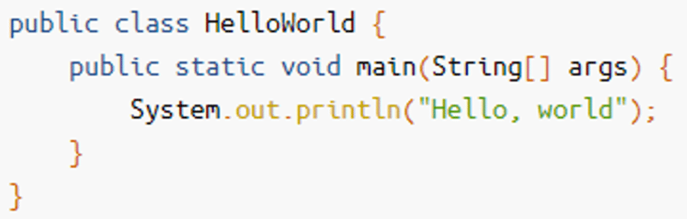
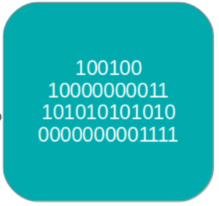
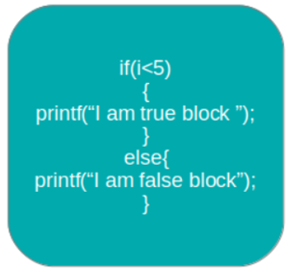
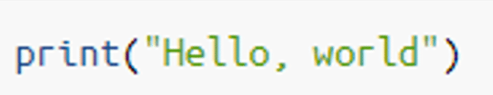
Advantages of Python
Easy to Read, Learn and Understand
  Code written in Python is simple and readable.
  Uses more English keywords.
  It has fewer syntax constructions than other languages.
High-Level Language
  Python is closer to human language than machine code (low-level language).
  We do not need to manually allocate/deallocate memory, as garbage collector takes care of unused memory automatically.
  This gives you the ability to program at a faster rate.
Java
Low-Level Language
Python
High-Level Language

Slide 7
How Garbage Collection is done?
When we write x = 10 , Python performs following steps internally:
Python creates an object for the value
  Python stores all data as objects, not as raw values.
  So, Python first creates an integer object with value 10 in memory.
A name binding happens (x → object)
  In Python, x is not a box that stores data.
  x is just a name (reference) pointing to the object 10.
  Python stores this mapping in a namespace (dictionary) for that scope.
Reference counting is used to manage object lifetime
  Python uses Reference Counting to track how many names refer to an object.
  If all references to an object are removed then reference count becomes zero, so now Python automatically deallocates it.

Slide 8
How Garbage Collection is done? - Example
x = 10
  Python creates (or reuses) an integer object 10 in memory.
  The name x is bound to this object.
y = x
  Python does not copy the value It simply creates another name y pointing to the same object 10.
  Reference count of object 10 becomes 2.
x = 20
  Python creates (or reuses) an integer object 20, now the name x is rebound to this new object.
  y remains unchanged, still pointing to 10.
  Reference count of object 10 becomes 1 and Reference count of object 20 becomes 1.
  The object 10 is not deleted, because y still refers to it.
  Only when no name refers to 10, it becomes eligible for garbage collection.
y = 5
  Now 10 has zero references Python will clean it up.
  This is how Garbage Collection is done.
namespace
object
x
10
binding
20
y
5
a namespace is simply a container that maps names to objects
Reference Count
of object 5:
1
1
1
2
0
Reference Count
of object 10:
0
Reference Count
of object 20:
1

Slide 9
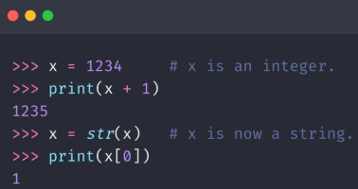
Advantages of Python
Easy to Read, Learn and Understand
  Code written in Python is simple and readable.
  Uses more English keywords.
  It has fewer syntax constructions than other languages.
High-Level Language
  Python is closer to human language than machine code (low-level language).
  We do not need to manually allocate/deallocate memory, as garbage collector takes care of unused memory automatically.
  This gives you the ability to program at a faster rate.
Dynamically Typed
  Python automatically assigns the data type during execution.
  The programmer doesn’t need to worry about declaring variables and their data types.
Automatic Data type Assignment

Slide 10
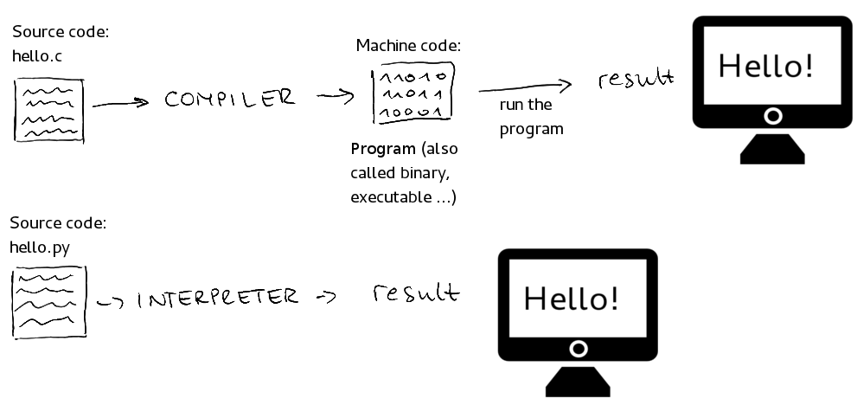
Advantages of Python (cont.)
Interpreted Language
  A program written in high-level language has to be either compiled or interpreted.
  Python is an interpreted language which means that Python directly executes the code line by line.
  In case of any error, it stops further execution and reports back the error which has occurred.
C : compiled language
Python : interpreted language

Slide 11
Advantages of Python (cont.)
Free and Open-Source
  Python is completely free to use and share because it is released under an OSI-approved open-source license.
  The Python Software Foundation (PSF) provides ready-to-install Python builds called CPython (C Implementation of Python) for all major operating systems.
  You can also download the CPython source code from the official Python website or its GitHub repository.
  If you want, you are allowed to modify the source code and redistribute it, as permitted by the CPython license.
Platform Independent and Portable
  In many languages like C/C++, you need to change your code to run the program on different platforms.
  That is not the same with Python. You only write once and run it anywhere.
  Python runs on all major operating systems like Microsoft Windows, Linux, and Mac OS X.
  The same Python source file can be executed across these platforms without modification.

Slide 12
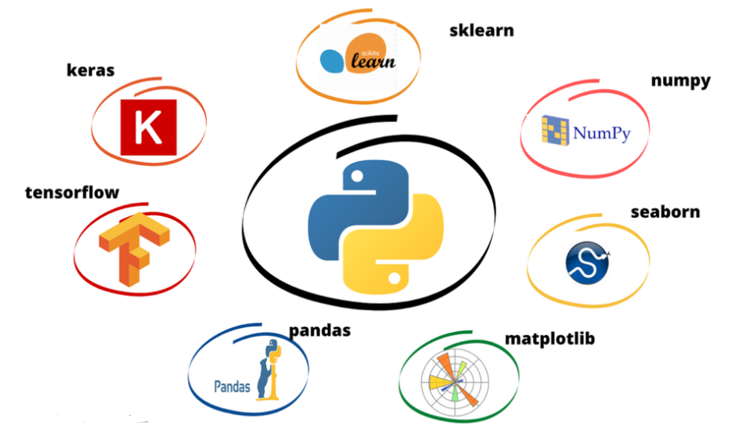
Advantages of Python(cont.)
Vast Libraries Support
  Python provides a huge standard library for common tasks like file handling, networking, and data processing.
  Thousands of external libraries (NumPy, Pandas, Django, etc.) are available for almost every domain.
  Library support helps in quick development without writing everything from scratch.
It’s Safe
  Python is considered safe because it doesn’t use pointers like C-based languages, which reduces many common programming errors.
  Also, Python never hides errors. If something goes wrong, it clearly shows an error message so you can understand what happened and fix it easily.

Slide 13
Installing Python

Slide 14
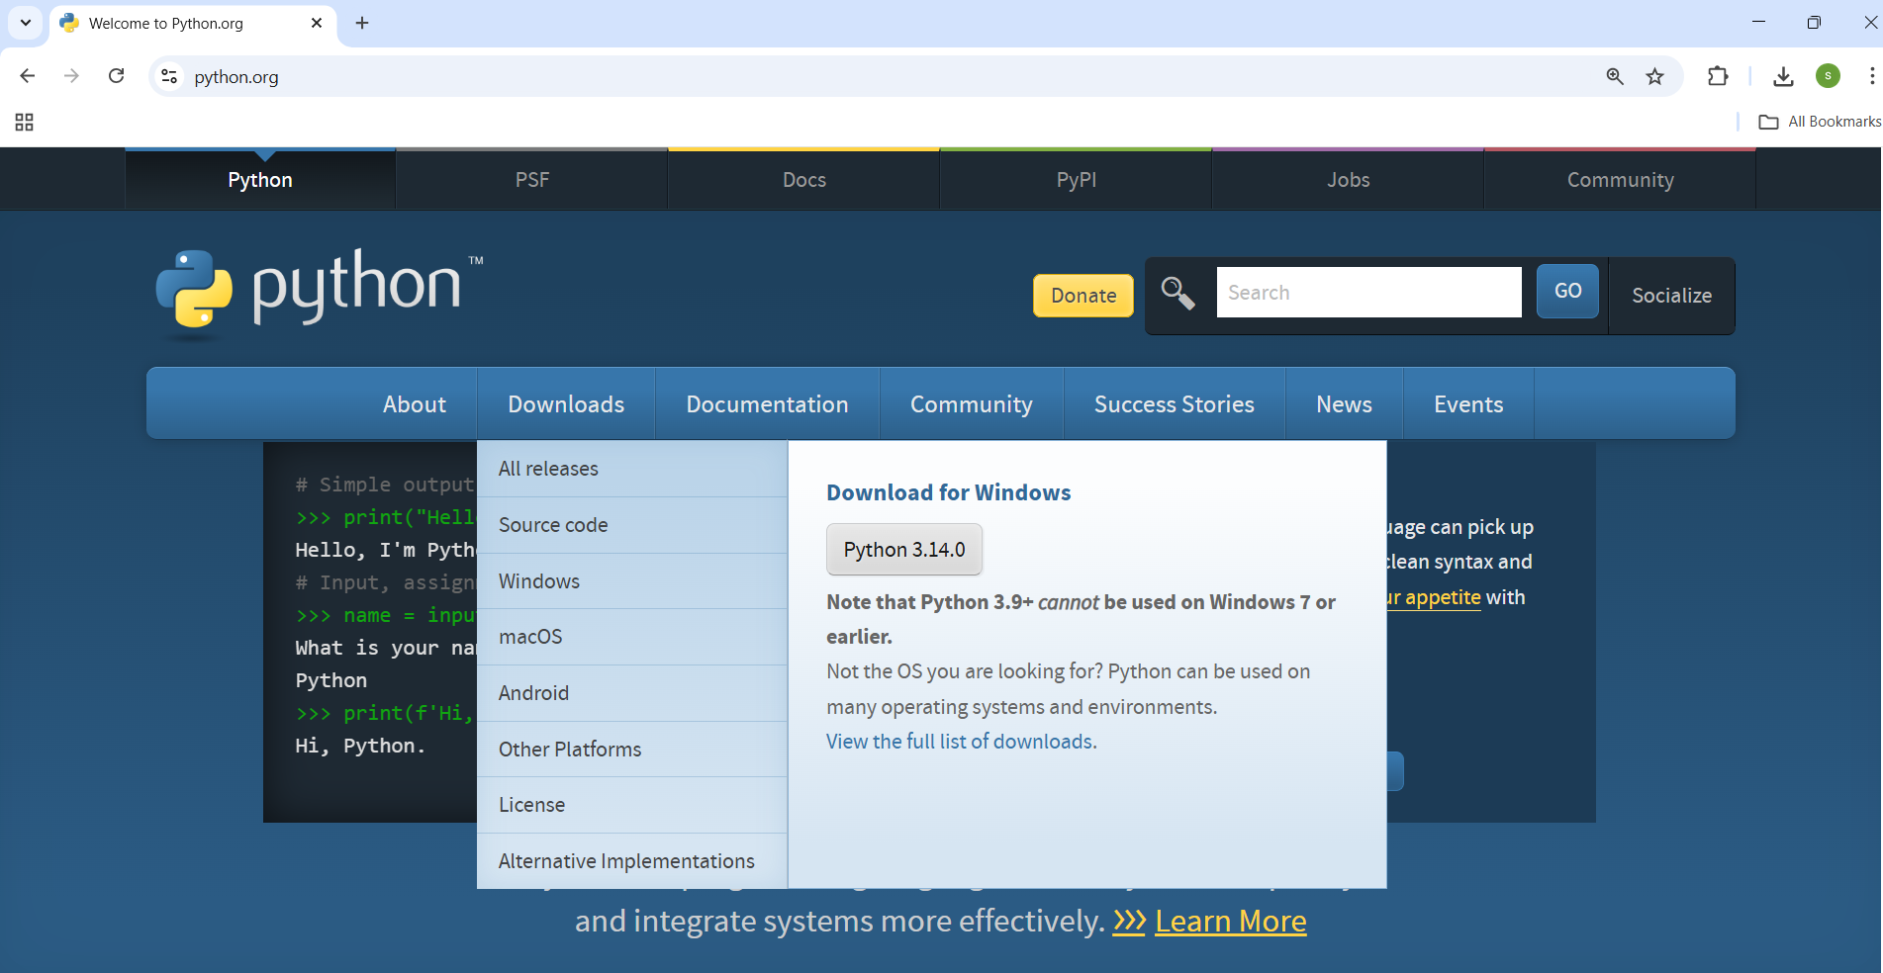
Installing Python for Windows
Download Python
Open your web browser.
Visit the official Python website: https://www.python.org
Hover on the 'Downloads' menu.
Click the latest version of python.(Python 3.14.0)

Slide 15
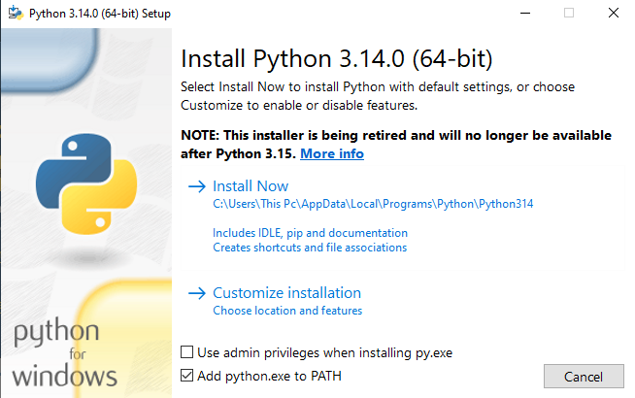
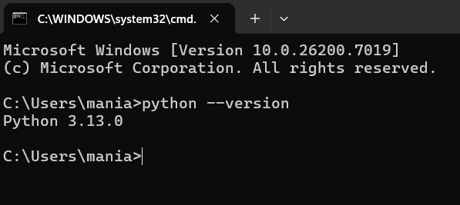
Installing Python for Windows
Run the Installer
After downloading, open the installer file.
Check the box that says 'Add python.exe to PATH’.
Click on 'Install Now’.
Verify Successful Installation
Open Command Prompt.
Type: python --version.
You should see the installed Python version displayed.

Slide 16
Installing Python for Linux
Update System Packages:
  Open the Terminal
  Run: sudo apt update
Install Python:
  Run: sudo apt install python3
Verify Python Installation:
  Check Python version:
  Run: python3 --version

Slide 17
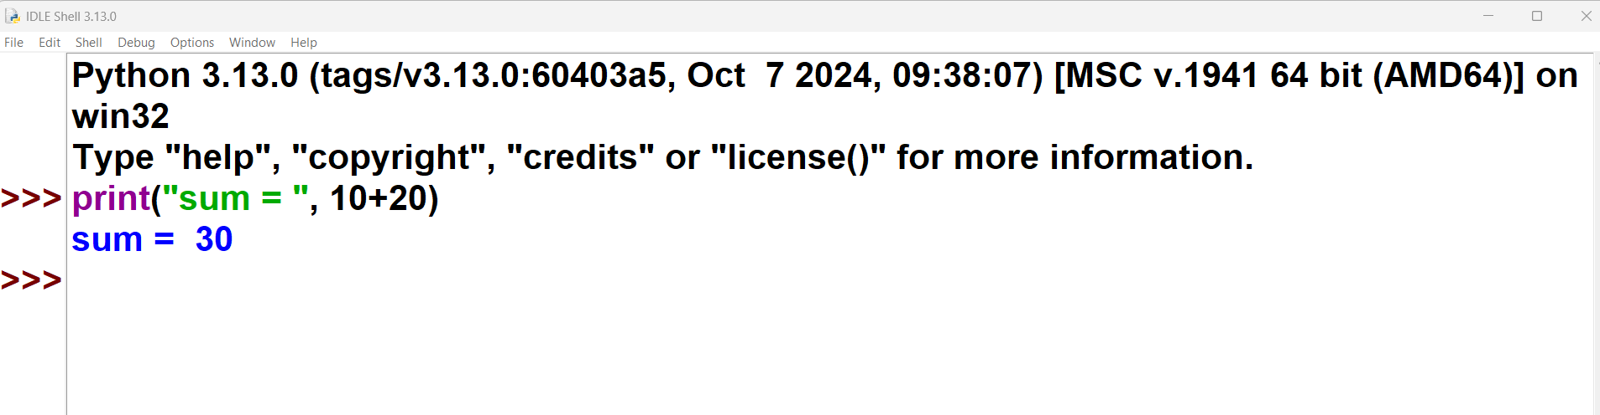
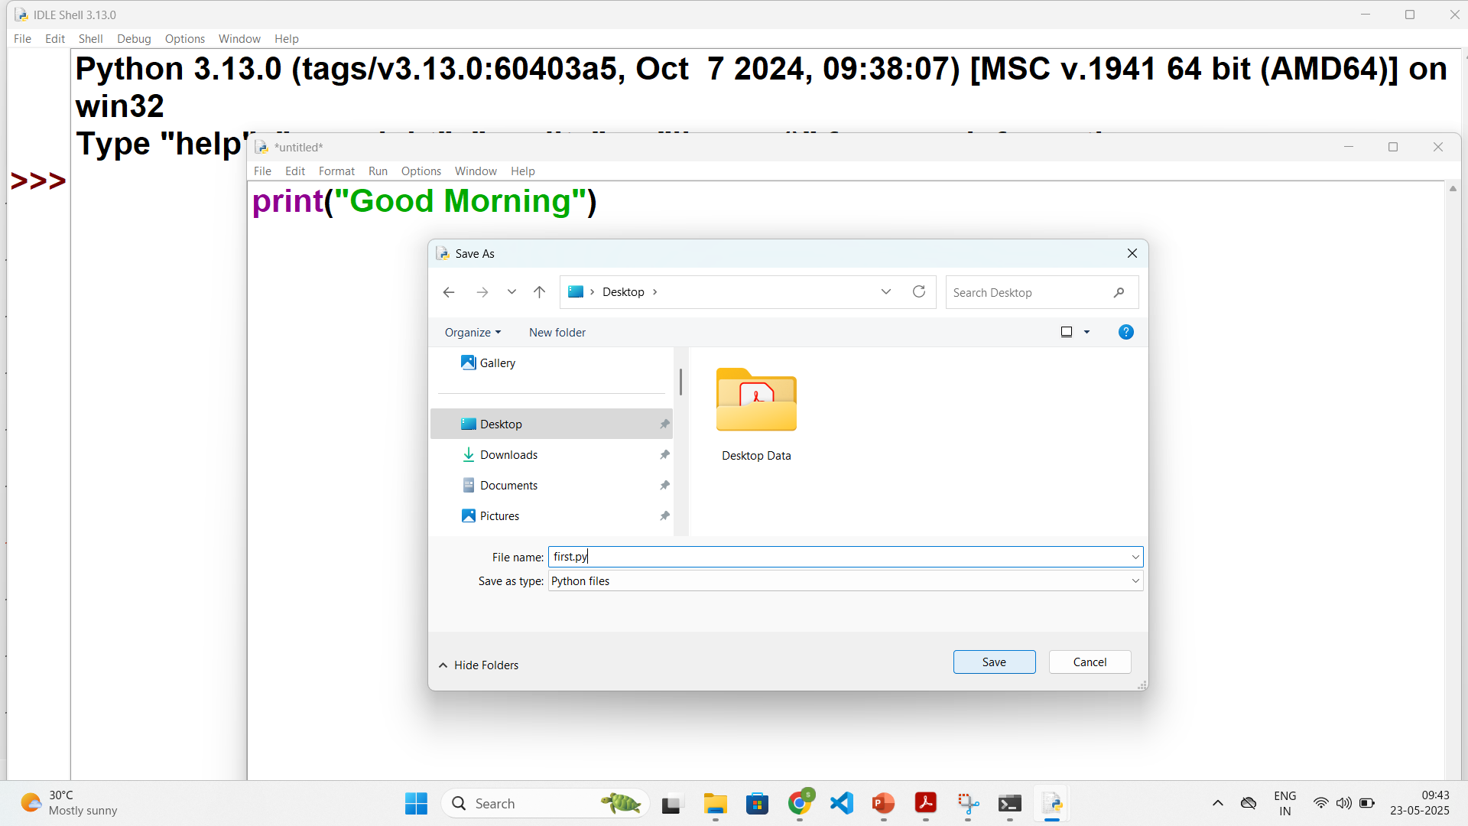
User Interface and IDE (Integrated Development Environment)
Python supports two modes of programming:
Interactive Mode
  The code is written directly at the Python prompt (>>>).
  The output is displayed immediately.
  The code written in this mode is not saved, so it has to be written each time.
  Thus it is preferred for experimentation purposes.
Script Mode
  The code is written in the file and then the file is run.
  The advantage of script mode is that the file can be saved for later use.
  To Save : IDLE -> File -> New File -> write code -> Save As -> .py extension
  To Run : Run -> Run Module OR (F5)
Interactive Mode Programming
File
Run
Script Mode Programming

Slide 18
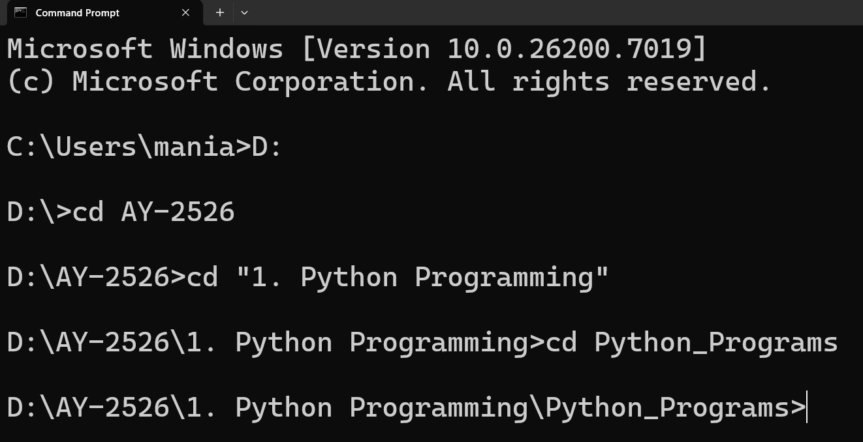
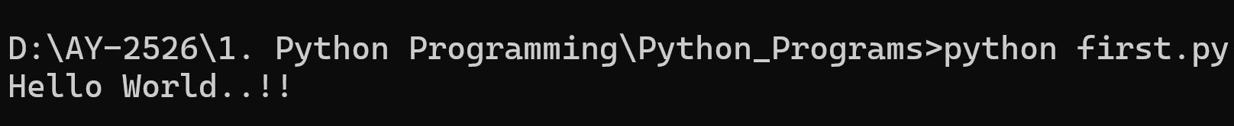
Hello World using Python
To write python programs, we can use any text editor also.
Create a new file in editor, save it as first.py (.py – file extension)
To run the python file open command prompt and change directory to where your python file is.
Next, run python command (python filename.py)
first.py
Python line does not end with ;
1
print("Hello World..!!")

Slide 19
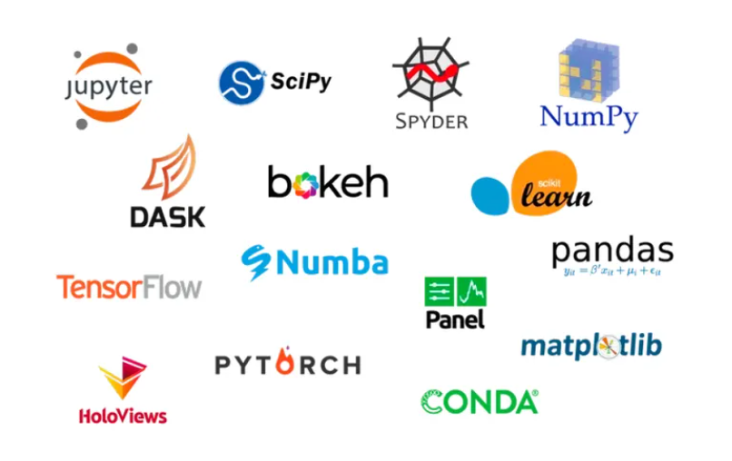
Anaconda for Python
Anaconda is a popular open-source distribution of the Python and R programming languages.
Anaconda comes packed with a suite of powerful tools designed to enhance your data science and machine learning workflow.
Following are some most useful ones:
  Jupyter Notebook
  Spyder
  Rstudio
  VS Code (Visual Studio Code)
  Anaconda Navigator
  TensorFlow, etc…
We will use Jupyter Notebook for doing interactive programming and getting immediate visualization.

Slide 20
Installing Anaconda

Slide 21

Installing Anaconda
Download Anaconda
Download Anaconda from Open official website: repo.anaconda.com

Slide 22
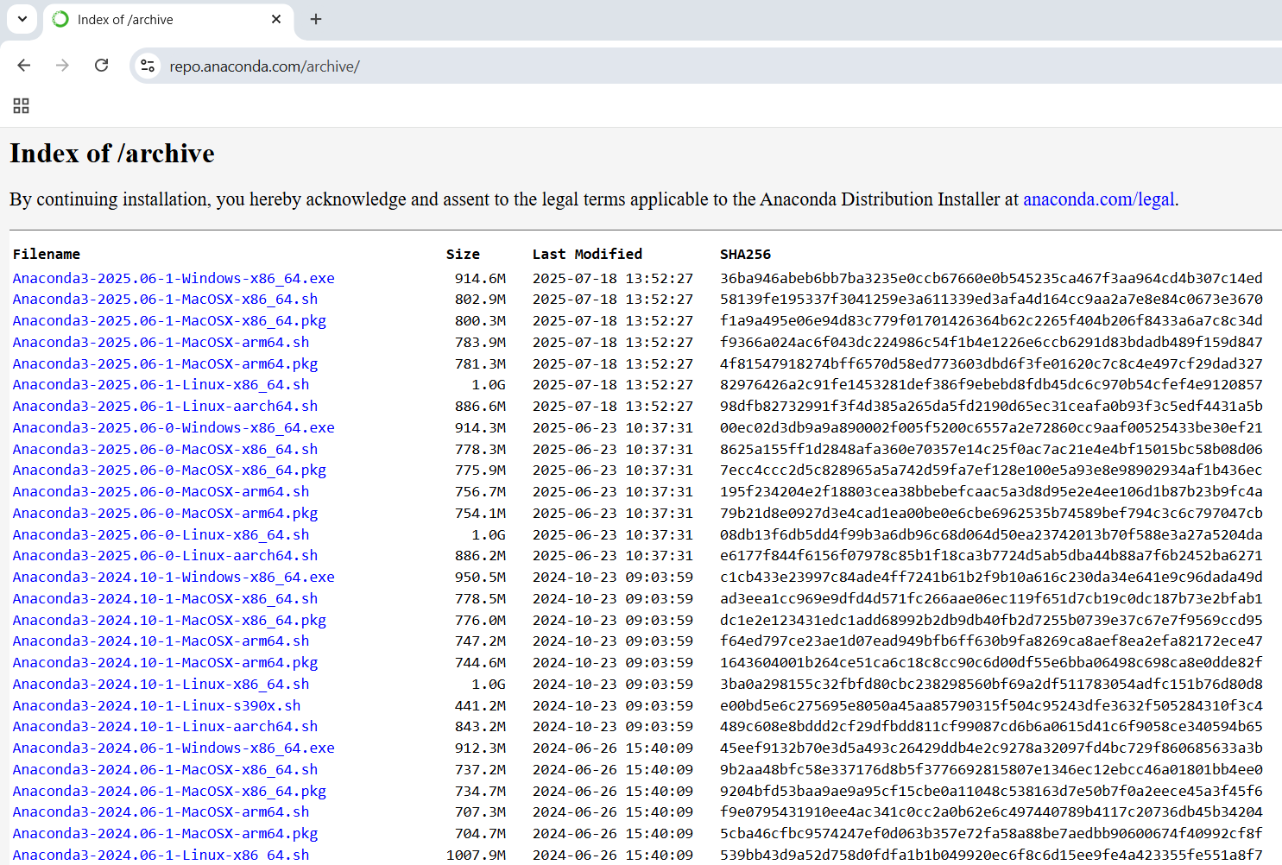
Installing Anaconda
Run the Installer
Download the suitable installer.
Open installer.
Click on Next.
Check Agree to License Agreement.
Select Installation Type:
  Just Me (recommended)
Choose installation location.
Select :
  Add to PATH environment variables.
Click on install.

Slide 23
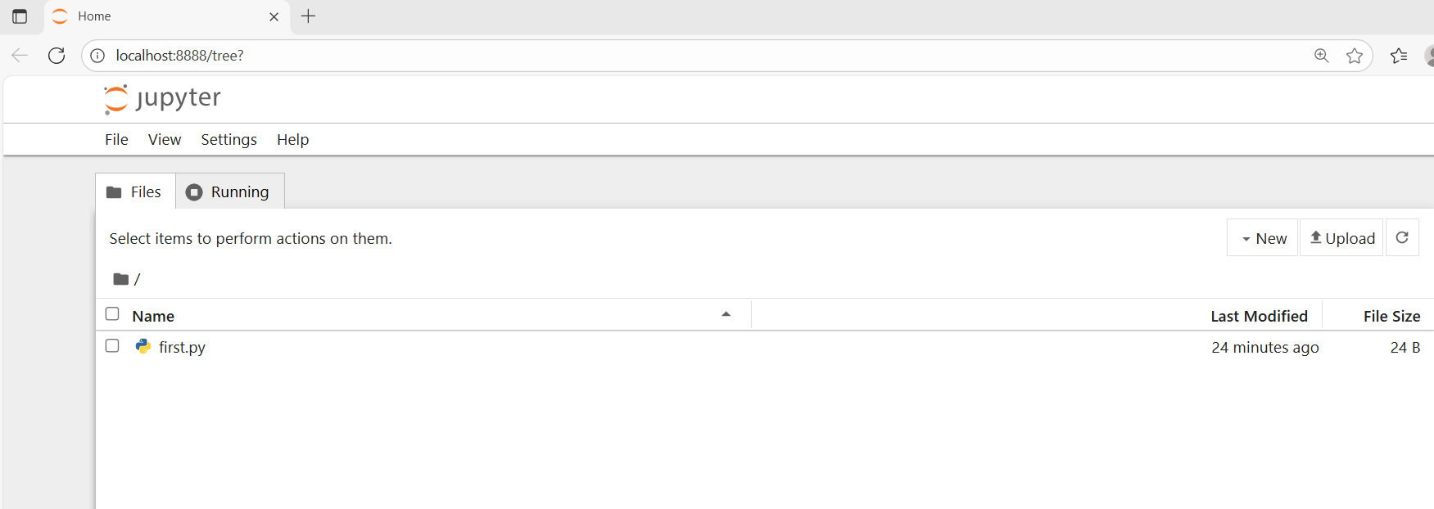
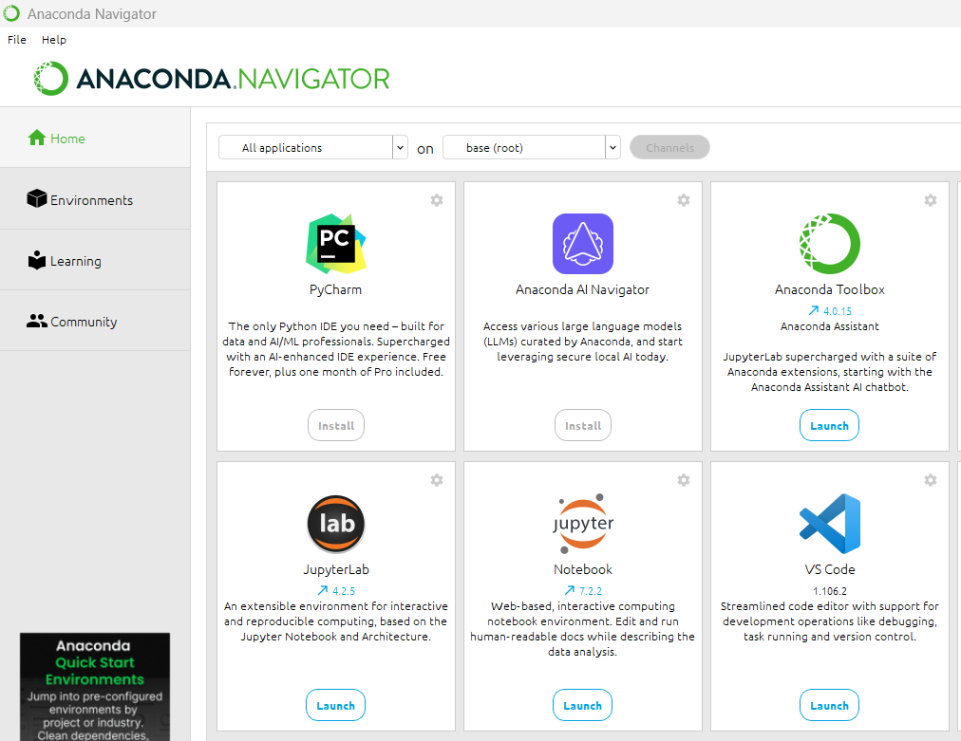
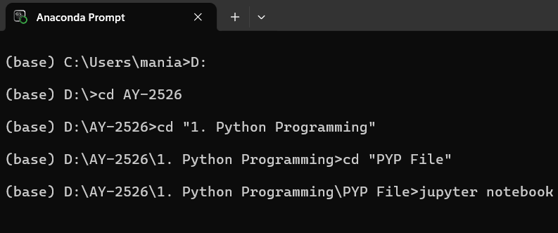
Installing Anaconda
Verify Successful Installation
Option 1: Using Anaconda Navigator
  Open Anaconda Navigator from the Start Menu
  Find Jupyter Notebook
  Click Launch.
  (It will open in your system’s default user folder)
Option 2: Using Anaconda Prompt
  Open Anaconda Prompt
  Navigate to the folder you want to use in Jupyter Notebook
  (Example: cd Desktop\Python)
  Type: jupyter notebook
  Press Enter to open Jupyter Notebook (By default, it opens in the default working directory).

Slide 24
Indentation

Slide 25
Indentation
Indentation means adding spaces or tabs at the beginning of a line to define the block of code.
In Python, indentation is mandatory.
The statements with the same indentation belong to the same group called a suite.
Most programming languages like C, C++, Java, etc. use curly braces {} to define/identify a block of code in the program, While in Python, it is done using the spaces or tabs, which is known as Indentation.
It is generally known as 4 space rule in PEP8 (Python Enhancement Proposal) documentation of rules for styling and designing the code for Python.
A colon (:) is mandatory after statements that begin a block of code.
Example.py
1
2
3
4
if Condition:
print("True")
else:
print("False")
IndentationError: unindent does not match any outer indentation level

Slide 26
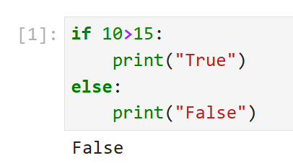
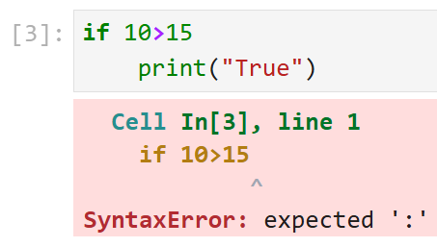
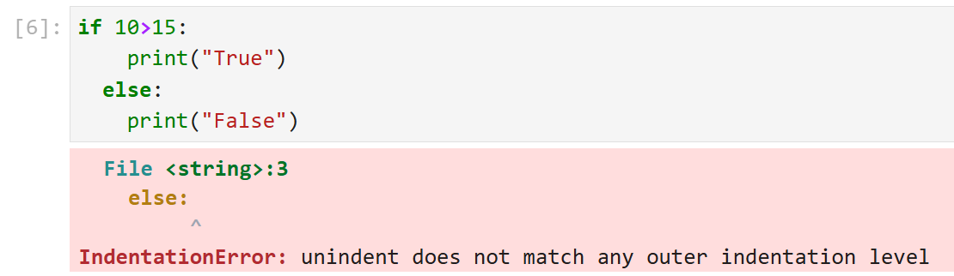
Indentation in Python

Slide 27
Printing Output

Slide 28
Printing Output
The print() function prints the specified message to the screen, or other standard output device. The object will be converted into a string before written to the screen.
Syntax
1
print(object(s), sep=‘ ‘, end=‘\n’, file=sys.stdout, flush=False)
Parameter Name | Description
Object(s) | One or more items to print. Can be string, number, variable, etc. Will be converted into string before printing.
sep | A string inserted between the objects (optional), Default : one space (‘ ‘)
end | A string to print at the end (optional), Default : '\n'
file | Where to send the output, Default : sys.stdout (the screen) output can be redirected to the file as well
flush | Flush the buffer? (True / False), Default : False

Slide 29
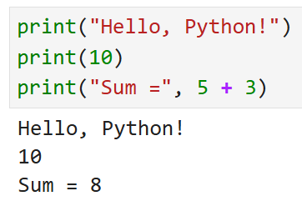

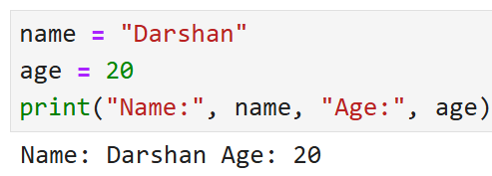
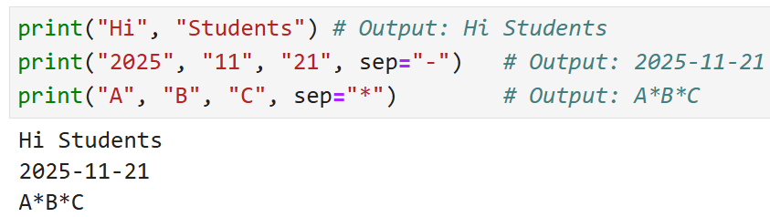
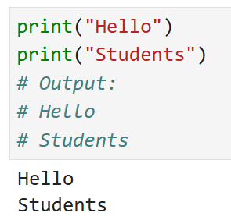
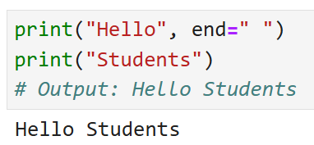
Printing Output
Basic Printing
Printing Multiple Values
Printing Variables
Default sep is space
Using sep (separator)
Using end
Default end is \n

Slide 30
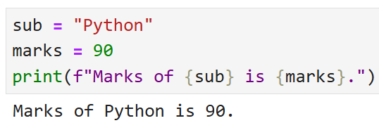
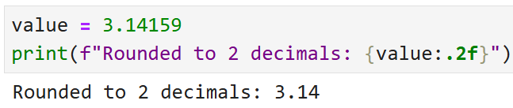
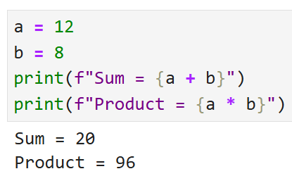
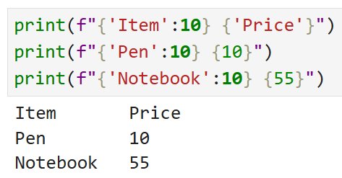
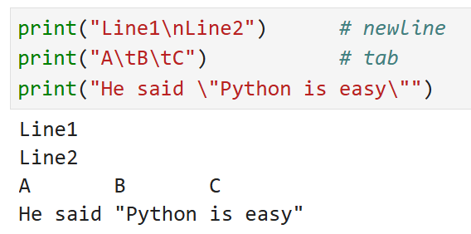
Printing Output (f-string)
f-strings are formatted string literals in Python.
These allow embedding variables and expressions inside strings using {} for clearer, faster, and more readable string formatting.
f-String Formatting
Decimal Formatting
Expressions Inside f-strings
Alignment
Escape Characters

Slide 31
Reading Input

Slide 32
Reding Input
For taking input from the user, input() is used.
The syntax of input function is as follows:
When input statement is executed, the prompt is displayed on the screen, and it waits for the user action.
Whatever you enter as input, the input() converts it into a string.
If you enter an integer value still input() function convert it into a string, that will need to be type casted.
Syntax
1
input([prompt])
Parameter Name | Description
prompt | A string to be displayed on the screen (optional)

Slide 33
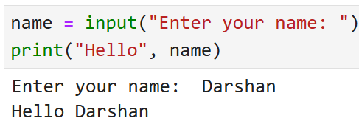
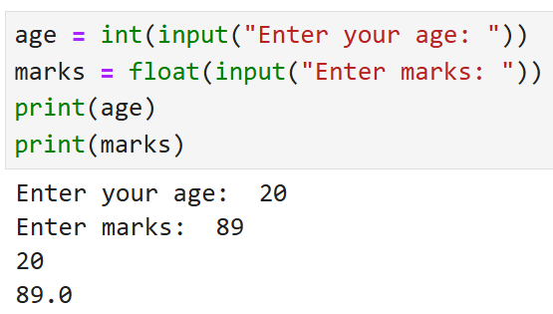
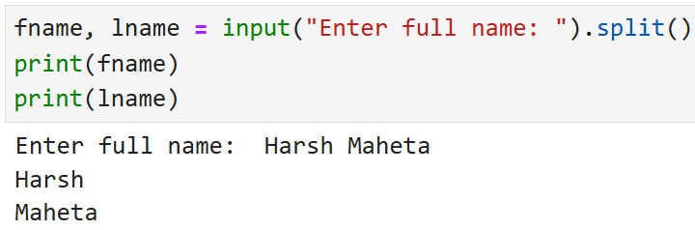
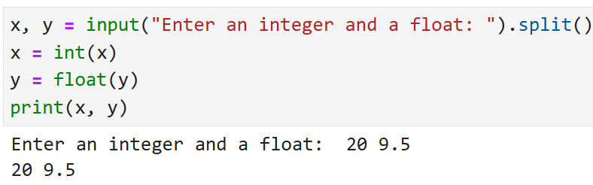
Reading Input
Basic usage
Converting input to a number
Taking two inputs in one line of same datatype
Taking two inputs in one line of different datatypes

Slide 34
Example
Example.py
Output
1
2
3
4
5
6
7
9
10
11
12
13
14
a = 4
str = input("Enter your name = ")
num = int(input("Enter Number = "))
print(4,5)
print("Hello","World")
print("Hello","World",sep="-")
print("Hello","DU",sep="-",end=" ")
print("Hello" + "DU ")
print("a = ", a,end=", ")
print("num = ", num)
print("your Name ="+ str)
print("Your Name ",str,sep="=")
Enter your name = ABC
Enter Number = 10
4 5
Hello World
Hello-World
Hello-DU HelloDU
a = 4, num = 10
your Name =ABC
Your Name =ABC

Slide 35
Program 1
WAP to develop simple calculator in python.
Example1.py
1
2
3
4
5
6
number1 = int(input("Enter first number: "))
number2 = int(input("Enter second number: "))
print(number1, "+", number2, "=", number1+number2)
print(number1, "*", number2, "=", number1*number2)
print(number1, "-", number2, "=", number1-number2)
print(number1, "/", number2, "=", number1/number2)
Output
Enter first number: 3
Enter second number: 3
3 + 3 = 6
3 * 3 = 9
3 - 3 = 0
3 / 3 = 1.0

Slide 36
Program 2
WAP to calculate simple interest.
Example2.py
1
2
3
4
5
P = int(input("Enter P: "))
R = int(input("Enter R: "))
T = int(input("Enter N: "))
Simple_interest = (P * R * T) / 100
print("The simple interest is:", Simple_interest)
Output
Enter P: 10000
Enter R: 5
Enter N: 1
The simple interest is: 500.0

Slide 37
Program 3
WAP to calculate area of circle.
Example3.py
1
2
3
4
PI = 3.14
r = float(input("Enter the radius of a circle:"))
area = PI * r * r
print("Area of a circle = %.2f" %area)
Output
Enter the radius of a circle:100
Area of a circle = 31400.00

Slide 38
Variable

Slide 39

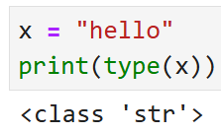
Variable
A Python variable is a named reference to a value stored in memory.
Unlike other programming languages, Python has no command for declaring a variable.
A variable is created the moment you first assign a value to it.
Python uses Dynamic Typing so,
  You do not need to specify the data type while creating a variable.
  Python automatically determines the data type based on the value assigned.
  You can reassign a new value of a different type:
We can check the current data type of the variable with type(variablename) in-built function.
Rules for Variable Name :
  Variable Name must begin with Letter or Underscore(_), it can not start with digit.
  Spaces and Special Characters(except underscore) are not allowed.
  Python Keywords are not allowed to be a Variable Name.
  Variable Names are case-sensitive.

Slide 40
Example of Variable
Example :
demo.py
1
2
3
4
5
6
7
8
9
10
x = 10
print(x)
print(type(x))
y = 123.456
print(y)
x = "darshan insitute of engneering and technology"
print(x)
print(type(x))
Reassign same variable to hold different data type
Run in terminal
1
python demo.py
Output
1
2
3
4
5
10
<class 'int'>
123.456
Darshan institute of engineering and technology
<class 'str'>

Slide 41
Datatypes

Slide 42
Type | Class | Description
Data Types
Integer | int | Whole number such as 0,1,5, -5 etc..
Float | float | Numbers with decimal points such as 1.5, 7.9, -8.2 etc..
Complex Number | complex | Complex number (real_part)+(imaginary_part)j such as 2 + 3j
String | str | Sequence of character (Ordered) such as “darshan”, ‘college’, “રાજકોટ” etc..
Boolean | bool | Logical values indicating Ture or False (T and F here are capital in python)
Data Structures
List | list | Ordered Sequence of objects, will be represented with square brackets [ ] Example : [ 18, “darshan”, True, 102.3 ]
Tuple | Tup | Ordered immutable sequence of objects, will be represented with round brackets ( ) Example : ( 18, “darshan”, True, 102.3 )
Set | Set | Unordered collection of unique objects, will be represented with the curly brackets { } Example : { 18, “darshan”, True, 102.3 }
Dictionary | Dict | Ordered key : value pair of objects , will be represented with curly brackets { } Example : { “college”: “darshan”, “code”: “054” }

Slide 43
Comments

Slide 44
Comments
In Python, comments are used to explain code and make it more readable.
They are ignored by the Python interpreter when the code is executed.
There are two main types of comments in Python:
Single-line Comments:
  These are created using the # symbol.
  Everything after the #, on that line is considered to be a comment.
Multi-line Comments:
  Python does not provide the option for multiline comments.
  However it can be achieved using multiple #.
  Or these can be done using string literals (‘ ‘ ’ or “ ” ”) as Python ignores those string literals that are not assigned to a variable.
''' This is Multiline Comment
that spans multiple lines
'''
print("Hello World..!!")
""" Another multiline comments
using triple quotes
"""
# This is Single-line Comment
print("Hello World..!!") #This comment is on the same line

Slide 45
Tokens

Slide 46
Tokens
In Python, a Token is the smallest unit of a program.
Tokens are the building blocks of a Python program. Here are the main types of tokens in Python:
Keywords : Reserved words that have special meaning and cannot be used as identifiers. Example : if, else, for, while, try, except, etc.
Identifiers: Names given to variables, functions, classes, and other objects.
Literals: Constant values used in programs. They can be of various types (string, numeric, boolean, etc..)
Delimiters: Symbols used to separate code elements. Example : (),[],{},:,.,; and comma(,).
Comments: Text added to the code for documentation purposes, which is ignored by the Python interpreter. Example : #, ’ ’ ’ ,” ” ”
Operators: Symbols that perform operations on one or more operands. Example : +,-,*,/,==, !=,etc.

Slide 47
Tokens
# This is a comment
x = 42 # x is identifier , 42 is literal
if x > 0: # if is keyword, > is operator, 0 is literal
print("x is positive") # print is function, "x is positive" is string literal

Slide 48
String

Slide 49
String in Python
String is Ordered Sequence of character such as “darshan”, ‘college’, “રાજકોટ” etc..
Strings are arrays of characters representing Unicode characters.
String can be represented as single, double or triple quotes.
String with triple Quotes allows multiple lines.
String in Python is immutable.
Square brackets can be used to access elements of the string, Ex. “Darshan”[1] = a, characters can also be accessed with reverse index like “Darshan”[-1] = n.
String index
x = " D a r s h a n "
index = 0 1 2 3 4 5 6
Reverse index = -7 -6 -5 -4 -3 -2 -1

Slide 50
String Slicing
We can get the substring in python using string slicing, we can specify start index, end index and steps (colon separated) to slice the string.
syntax
x = 'darshan institute of engineering and technology, rajkot, gujarat, INDIA'
subx = x[startindex:endindex:steps]
endindex will not be included in the substring
strslicedemo.py
1
2
3
4
5
6
7
8
9
10
11
x = 'darshan institute of engineering and technology, rajkot, gujarat, INDIA'
subx1 = x[0:7]
subx2 = x[49:55]
subx3 = x[66:]
subx4 = x[::2]
subx5 = x[::-1]
print(subx1)
print(subx2)
print(subx3)
print(subx4)
print(subx5)
Output : darshan
Output : rajkot
Output : INDIA
Output : drhnisiueo niern n ehooy akt uaa,IDA
Output : AIDNI ,tarajug ,tokjar ,ygolonhcet dna gnireenigne fo etutitsni nahsrad

Slide 51
String Methods
Python has lots of built-in methods that you can use on strings, we are going to cover some frequently used methods for string like
  len()
  count()
  title(), lower(), upper()
  istitle(), islower(), isupper()
  find(), rfind(), replace()
  index(), rindex()
  Methods for validations like
    isalpha(), isalnum(), isdecimal(), isdigit()
  strip(), lstrip(), rstrip()
  split()
  Etc..
Note : len() is not the method of the string but can be used to get the length of the string
lendemo.py
Output : 7 (length of “Darshan”)
1
2
x = "Darshan"
print(len(x))

Slide 52
String Methods (cont.)
count() method will returns the number of times a specified value occurs in a string.
  title(), lower(), upper() will returns capitalized, lower case and upper case string respectively.
countdemo.py
1
2
3
x = "Darshan"
ca = x.count('a')
print(ca)
Output : 2 (occurrence of ‘a’ in “Darshan”)
changecase.py
1
2
3
4
5
6
7
x = "darshan Institute, rajkot"
c = x.title()
l = x.lower()
u = x.upper()
print(c)
print(l)
print(u)
Output : Darshan Institute, Rajkot
Output : darshan institute, rajkot
Output : DARSHAN INSTITUTE, RAJKOT

Slide 53
String Methods (cont.)
  istitle(), islower(), isupper() will returns True if the given string is capitalized, lower case and upper case respectively.
  strip() method will remove whitespaces from both side of the string and returns the string.
  rstrip() and lstrip() will remove whitespaces from right and left side respectively.
checkcase.py
1
2
3
4
5
6
7
x = 'darshan institute, rajkot'
c = x.istitle()
l = x.islower()
u = x.isupper()
print(c)
print(l)
print(u)
Output : False
Output : True
Output : False
stripdemo.py
1
2
3
x = ' Darshan '
f = x.strip()
print(f)
Output : Darshan (without space)

Slide 54
String Methods (cont.)
find() method will search the string and returns the index at which they find the specified value
rfind() will search the string and returns the last index at which they find the specified value
  Note : find() and rfind() will return -1 if they are unable to find the given string.
  replace() will replace str1 with str2 from our string and return the updated string
finddemo.py
1
2
3
x = 'darshan institute, rajkot, india'
f = x.find('in')
print(f)
Output : 8 (occurrence of ‘in’ in x)
rfinddemo.py
1
2
3
x = 'darshan institute, rajkot, india'
r = x.rfind('in')
print(r)
Output : 27 (last occurrence of ‘in’ in x)
replacedemo.py
1
2
3
x = 'darshan institute, rajkot, india'
r = x.replace('india','INDIA')
print(r)
Output :
“darshan institute, rajkot, INDIA”

Slide 55
String Methods (cont.)
index() method will search the string and returns the index at which they find the specified value, but if they are unable to find the string it will raise an exception.
rindex() will search the string and returns the last index at which they find the specified value , but if they are unable to find the string it will raise an exception.
Note : find() and index() are almost same, the only difference is if find() is unable to find the string it will return -1 and if index() is unable to find the string it will raise an exception.
indexdemo.py
1
2
3
x = 'darshan institute, rajkot, india'
f = x.index('in')
print(f)
Output : 8 (occurrence of ‘in’ in x)
rindexdemo.py
1
2
3
x = 'darshan institute, rajkot, india'
r = x.rindex('in')
print(r)
Output : 27 (last occurrence of ‘in’ in x)

Slide 56
String Methods (cont.)
isalnum() method will return true if all the characters in the string are alphanumeric (i.e either alphabets or numeric).
isalpha() and isnumeric() will return true if all the characters in the string are only alphabets and numeric respectively.
isdecimal() will return true is all the characters in the string are decimal.
Note : isnumeric() and isdigit() are almost same, you suppose to find the difference as Home work assignment for the string methods.
isalnumdemo.py
1
2
3
x = 'darshan123'
f = x.isalnum()
print(f)
Output : True
isdecimaldemo.py
1
2
3
x = '123.5'
r = x.isdecimal()
print(r)
Output : False

Slide 57
String Formatting
str.format() is one of the string formatting methods in Python3, which allows multiple substitutions and value formatting.
This method lets us concatenate elements within a string through positional formatting.
We can specify multiple parameters to the function
strformat.py
1
2
3
4
x = '{} institute, rajkot'
y = x.format('darshan')
print(y)
print(x.format('ABCD'))
Output : darshan institute, rajkot
Inline function call
Output : ABCD institute, rajkot
strformat.py
1
2
3
4
x = '{} institute, {}'
y = x.format('darshan','rajkot')
print(y)
print(x.format('ABCD','XYZ'))
Output : darshan institute, rajkot
Inline function call
Output : ABCD institute, XYZ

Slide 58
String Formatting (cont.)
We can specify the order of parameters in the string
We can also specify alias within the string to specify the order
We can format the decimal values using format method
strformat.py
1
2
3
4
x = '{1} institute, {0}'
y = x.format('darshan','rajkot')
print(y)
print(x.format('ABCD','XYZ'))
Output : rajkot institute, darshan
Inline function call
Output : XYZ institute, ABCD
strformat.py
1
2
x = '{collegename} institute, {cityname}'
print(x.format(collegename='darshan',cityname='rajkot'))
Output : darshan institute, rajkot
strformat.py
1
2
3
per = (438 / 500) * 100
x = 'result = {r:3.2f} %'.format(r=per)
print(x)
Output : result = 87.60 %
width
precision

Slide 59
String Formatting
Python feature f-string (formatted string literal) provides easier way for string formatting and interpolation (the process of substituting values of variables into placeholders in a string).
We can use fstring to print the values of variables.
We can use f-string to evaluate expressions.
fstring.py
1
2
3
x = ‘Darshan’
y = ‘Rajkot’
print(f"{x} Institute , {y}.")
Output : Darshan Institute , Rajkot.
fstring.py
1
2
3
4
x = 25
y = 5
z = 1
print(f"{x} * {y} - {z} = {x*y-z}")
Output : 25 * 5 - 1 = 124

Slide 60
Example
Example.py
1
2
3
4
5
6
7
9
10
11
12
13
14
15
16
17
18
19
20
x2 = 'Hello'
y2 = 'Hello'
x3 = [1,2,3]
y3 = x3
x = 'Hello world'
y = {1:'a',2:'b'}
z = [1,2,3,4,5]
# Identity Operator
print("x2 is y2 = ",x2 is y2)
print("x3 is y3 = ",x3 is y3)
print("x2 is not y2 =",x2 is not y2)
# Membership Operator
print("'H' in x = ", 'H' in x)
print("'hello' not in x = ",'hello' not in x)
print("5 in z = ", 5 in z)
print("1 in y = ",1 in y)
Output
x2 is y2 = True
x3 is y3 = True
x2 is not y2 = False
'H' in x = True
'hello' not in x = True
5 in z = True
1 in y = True

Slide 61
Data Structures in Python

Slide 62
Data Structures in Python
There are four built-in data structures in Python - list, dictionary, tuple and set.
Lets explore all the data structures in detail…
Name | Type | Description
List | list | Ordered Sequence of objects, will be represented with square brackets [ ] Example : [ 18, “darshan”, True, 102.3 ]
Dictionary | dict | Ordered key : value pair of objects , will be represented with curly brackets { } Example : { “college”: “darshan”, “code”: “054” }
Tuple | tup | Ordered immutable sequence of objects, will be represented with round brackets ( ) Example : ( 18, “darshan”, True, 102.3 )
Set | set | Unordered collection of unique objects, will be represented with the curly brackets { } Example : { 18, “darshan”, True, 102.3 }

Slide 63
List
List is a mutable ordered sequence of objects, duplicate values are allowed inside list.
List will be represented by square brackets [ ].
Python does not have array, List can be used similar to Array.
We can use slicing similar to string in order to get the sub list from the list.
list.py
Output : institute (List index starts with 0)
1
2
3
4
5
6
my_list = ['darshan', 'institute', 'rkot']
print(my_list[1])
print(len(my_list))
my_list[2] = "rajkot"
print(my_list)
print(my_list[-1])
Output : 3 (length of the List)
Output : ['darshan', 'institute', 'rajkot']
Note : spelling of rajkot is updated
Output : rajkot (-1 represent last element)
list.py
1
2
my_list = ['darshan', 'institute', 'rajkot','gujarat','INDIA']
print(my_list[1:3])
Output : ['institute', 'rajkot']
Note : end index not included

Slide 64
List Methods
append() method will add element at the end of the list.
insert() method will add element at the specified index in the list
extend() method will add one data structure (List or any) to current List
appendlistdemo.py
1
2
3
my_list = ['darshan', 'institute', 'rajkot']
my_list.append('gujarat')
print(my_list)
Output : ['darshan', 'institute', 'rajkot', 'gujarat']
insertlistdemo.py
1
2
3
4
my_list = ['darshan', 'institute', 'rajkot']
my_list.insert(2,'of')
my_list.insert(3,'engineering')
print(my_list)
Output : ['darshan', 'institute', 'of', 'engineering', 'rajkot']
extendlistdemo.py
1
2
3
4
my_list1 = ['darshan', 'institute']
my_list2 = ['rajkot','gujarat']
my_list1.extend(my_list2)
print(my_list1)
Output : ['darshan', 'institute', ‘rajkot', ‘gujarat']

Slide 65
List Methods (cont.)
pop() method will remove the last element from the list and return it.
remove() method will remove first occurrence of specified element
clear() method will remove all the elements from the List
index() method will return first index of the specified element.
poplistdemo.py
1
2
3
4
my_list = ['darshan', 'institute','rajkot']
temp = my_list.pop()
print(temp)
print(my_list)
Output : rajkot
Output : ['darshan', 'institute‘]
removelistdemo.py
1
2
3
my_list = ['darshan', 'institute', 'darshan','rajkot']
my_list.remove('darshan')
print(my_list)
Output : ['institute', 'darshan', 'rajkot']
clearlistdemo.py
1
2
3
my_list = ['darshan', 'institute', 'darshan','rajkot']
my_list.clear()
print(my_list)
Output : []

Slide 66
List Methods (cont.)
count() method will return the number of occurrence of the specified element.
reverse() method will reverse the elements of the List
sort() method will sort the elements in the List
countlistdemo.py
1
2
3
my_list = ['darshan', 'institute', 'darshan','rajkot']
c = my_list.count('darshan')
print(c)
Output : 2
reverselistdemo.py
1
2
3
my_list = ['darshan', 'institute','rajkot']
my_list.reverse()
print(my_list)
Output : ['rajkot', ‘institute','darshan']
sortlistdemo.py
1
2
3
4
5
my_list = ['darshan', 'college','of','enginnering','rajkot']
my_list.sort()
print(my_list)
my_list.sort(reverse=True)
print(my_list)
Output : ['college', 'darshan', 'enginnering', 'of', 'rajkot']
Output : ['rajkot', 'of', 'enginnering', 'darshan', 'college']

Slide 67
List Comprehension
List comprehensions offer a way to create lists based on existing iterable. When using list comprehensions, lists can be built by using any iterable, including strings, list, tuples.
For example, if we want to create a list of characters from the string, we can use for loop like below example,
Syntax
ForLoop.py
[ expression for item in iterable ]
OR
[ expression for item in iterable if condition ]
1
2
3
4
5
mystr = 'darshan'
mylist = []
for c in mystr:
mylist.append(c)
print(mylist)
Example1.py
1
2
mylist = [c for c in 'darshan']
print(mylist)
Output
['d', 'a', 'r', 's', 'h', 'a', 'n']

Slide 68
List Comprehension (cont.)
Similarly, we can use list comprehensions in many cases where we want to create a list out of other iterable, let’s see another example of the use of List Comprehension.
Example (Using for loop):
ForLoop1.py
Example2.py
1
2
3
4
5
#list of square from 1 to 10
mylist = []
for i in range(1,11):
mylist.append(i**2)
print(mylist)
1
2
3
# list of square from 1 to 10
mylist = [ i**2 for i in range(1,11) ]
print(mylist)
Output
[1, 4, 9, 16, 25, 36, 49, 64, 81, 100]

Slide 69
Tuple
Tuple is a immutable ordered sequence of objects, duplicate values are allowed inside list.
Tuple will be represented by round brackets ( ).
Tuple is similar to List but List is mutable whereas Tuple is immutable.
tupledemo.py
1
2
3
4
5
Output : ('darshan', 'institute', 'of', 'engineering', 'of', 'rajkot')
my_tuple = ('darshan','institute','of','engineering','of','rajkot')
print(my_tuple)
print(my_tuple.index('engineering'))
print(my_tuple.count('of'))
print(my_tuple[-1])
Output : 3 (index of ‘engineering’)
Output : 2
Output : rajkot

Slide 70
Set
Set is a unordered collection of unique objects.
Set will be represented by curly brackets { }.
Set has many in-built methods such as add(), clear(), copy(), pop(), remove() etc.. which are similar to methods we have previously seen.
Only difference between Set and List is that Set will have only unique elements and List can have duplicate elements.
setdemo.py
1
2
my_set = {1,1,1,2,2,5,3,9}
print(my_set)
Output : {1, 2, 3, 5, 9}

Slide 71
Dictionary
Dictionary was unordered collection of key-value pair before Python 3.7 but after 3.7 it is ordered.
Dictionary will be represented by curly brackets { }. Dictionary is mutable.
syntax
my_dict = { 'key1':'value1', 'key2':'value2' }
Key value is seperated by :
Key value pairs is separated by ,
dictdemo.py
1
2
3
my_dict = {'college':"darshan", 'city':"rajkot",'type':"engineering"}
print(my_dict['college'])
print(my_dict.get('city'))
values can be accessed using key inside square brackets as well as using get() method
Output : darshan
rajkot

Slide 72
Dictionary Methods
keys() method will return list of all the keys associated with the Dictionary.
values() method will return list of all the values associated with the Dictionary.
items() method will return list of tuples for each key value pair associated with the Dictionary.
keydemo.py
1
2
my_dict = {'college':"darshan", 'city':"rajkot",'type':"engineering"}
print(my_dict.keys())
Output : ['college', 'city', 'type']
valuedemo.py
1
2
my_dict = {'college':"darshan", 'city':"rajkot",'type':"engineering"}
print(my_dict.values())
Output : ['darshan', 'rajkot', 'engineering']
itemsdemo.py
1
2
my_dict = {'college':"darshan", 'city':"rajkot",'type':"engineering"}
print(my_dict.items())
Output : [('college', 'darshan'), ('city', 'rajkot'), ('type', 'engineering')]

Slide 73
List vs. Tuple vs. Set vs. Dictionary
List | Tuple | Sets | Dictionaries
Ordered Data | Ordered Data | Unordered Data | Ordered Data
Mutable | immutable | mutable | mutable
Square braces.[] | Parenthesis () | Curly brackets {} | Curly brackets {key : value}
Duplicate elements allowed | Duplicate elements allowed | No Duplicate elements | No Duplicate key
append() | Element cannot be added | add() | update()
We can create a list using the list() function. | We can create a tuple using the tuple() function. | We can create a set using the set()function. | We can create a dictionary using the dict() function.
my_list = [5,6,7,8] | my_tuple = (5,6,7,8) | my_sets = {3,4,5,6} | my_dictionaries = {"name" : "XYZ", "rollno." : "101"}

Slide 74
Thank You

