Slide 1

Unit-02.1
Python Operators
Python Programming (2301CS404)
Prof. Shruti R. Maniar
Computer Engineering Department
shruti.maniar@darshan.ac.in

Slide 2

Outline
Arithmetic operators
Assignment operators
Comparison operators
Logical operators
Identity operators
Membership operators
Bitwise operators
Looping

Slide 3
Operators in Python
Operators are used to perform operations on variables and values.
We can segregate python operators in following groups :
  Arithmetic operators
  Assignment operators
  Comparison operators
  Logical operators
  Bitwise operators
  Identity operators
  Membership operators

Slide 4
Arithmetic Operators
Arithmetic Operators can be used with numeric values or variables to perform common mathematical operations.
Note : Consider A = 10 and B = 3
Imp. Point: Python does not support pre/post increment(++)/decrement(--) operators
Operator | Description | Example | Output
+ | Addition | A + B | 13
- | Subtraction | A - B | 7
/ | Division | A / B | 3.3333333333333335
* | Multiplication | A * B | 30
% | Modulus return the remainder | A % B | 1
// | Floor division returns the quotient | A // B | 3
** | Exponentiation | A ** B | 10 * 10 * 10 = 1000

Slide 5
Assignment Operators
Assignment Operators are used to assign values to variables.
Note : Consider A = 3, B = 5 and C = 0
Operator | Description | Example | Output
= | Assign | C = A + B | 8
+= | Add and Assign | A+=B | 8
-= | Subtract and Assign | A-=B | -2
*= | Multiply and Assign | A*=B | 15
/= | Divide and Assign | A/=B | 0.6
%= | Modulus and Assign | A%=B | 3
//= | Divide(floor) and Assign | A//=B | 0
**= | Power and Assign | A**=B | 243

Slide 6
Relational Operators
Relational Operators are used for comparing the values. It either returns True or False according to the condition.
Note : Consider A = 9, B = 5
Operator | Description | Example | Output
> | Greater than | A > B | True
< | Less than | A < B | False
== | Equal to | A == B | False
!= | Not Equal to | A != B | True
>= | Greater than or equal to | A >= B | True
<= | Less than or equal to | A <= B | False

Slide 7
Logical Operators
Logical Operators are used to perform logical operations on the values of variables. The value is either True or False. We can figure out the conditions by the result of the truth values.
Note : Consider A = 10 and B = 3
Operator | Description | Example | Output
and | Returns True if both statements are true | A > 5 and B < 5 | True
or | Returns True if one of the statements is true | A > 5 or B > 5 | True
not | Negate the result, returns True if the result is False | not ( A > 5 ) | False

Slide 8
Bitwise Operators
The Bitwise Operators are used to perform bitwise calculations on integers. The integers are first converted into binary and then operations are performed on bit by bit, hence the name Bitwise Operators. Then the result is returned in decimal format.
Note : Consider A = 10(binary - 1010) and B = 4(binary - 0100)
Operator | Description | Example | Output
& | Bitwise AND | A & B | 0
| | Bitwise OR | A | B | 14
~ | Bitwise NOT | ~A | -11
^ | Bitwise XOR | A ^ B | 14
>> | Bitwise right shift | A>>1 | 5
<< | Bitwise left shift | A<<1 | 20

Slide 9
Example
Example.py
1
2
3
4
5
6
7
9
10
11
12
13
14
15
16
17
18
19
20
21
22
23
24
25
x , y = 5,2
a,b = True,False
#Arithmetic operator
print('x // y =',x//y)
print('x ** y =',x**y)
#Assignemnt Operator
x+=5 # x = 10
y+=2 # y = 4
print('x y =',x,y)
#Comparison Operator
print('x >= y is',x>=y)
print('x <= y is',x<=y)
#Logical Operator
print('x and y is',a and b)
print('x or y is',a or b)
print('not x is',not a)
#Bitwise Operators
print('x & y is',x & y)
print('x | y is',x | y)
Output
x // y = 2
x ** y = 25
x y = 10 4
x >= y is True
x <= y is False
x and y is False
x or y is True
not x is False
x & y is 0
x | y is 14

Slide 10
Identity & Membership Operators
Identity Operator
  Note : consider A = [1,2], B = [1,2] and C=A
Membership Operator
  Note : consider A = 2 and B = [1,2,3]
Operator | Description | Example | Output
is | Returns True if both variables are the same object | A is B A is C | False True
is not | Returns True if both variables are different object | A is not B | True
Operator | Description | Example | Output
in | Returns True if a sequence with the specified value is present in the object | A in B | True
not in | Returns True if a sequence with the specified value is not present in the object | A not in B | False

Slide 11
Example
Example.py
1
2
3
4
5
6
7
9
10
11
12
13
14
15
16
17
18
19
20
x2 = 'Hello'
y2 = 'Hello'
x3 = [1,2,3]
y3 = x3
x = 'Hello world'
y = {1:'a',2:'b'}
z = [1,2,3,4,5]
# Identity Operator
print("x2 is y2 = ",x2 is y2)
print("x3 is y3 = ",x3 is y3)
print("x2 is not y2 =",x2 is not y2)
# Membership Operator
print("'H' in x = ", 'H' in x)
print("'hello' not in x = ",'hello' not in x)
print("5 in z = ", 5 in z)
print("1 in y = ",1 in y)
Output
x2 is y2 = True
x3 is y3 = True
x2 is not y2 = False
'H' in x = True
'hello' not in x = True
5 in z = True
1 in y = True

Slide 12
Unit-02.2
Conditional and Looping Statements
Python Programming (2301CS404)
Prof. Shruti R. Maniar
Computer Engineering Department
shruti.maniar@darshan.ac.in

Slide 13

Outline
if statement
if-else statement
nested if statement
elif statement
for loop statement
while loop statement
break
continue
pass
Looping

Slide 14
Introduction
The statements that help us to control the flow of execution in a program called control statements.
There are two types of control statements.
Branching Statement :
  The statements that help us to select some statements for execution and skip other statements.
  These statements are also called as decision making statements because they make decision based on some condition and select some statements for execution.
  if statement
  if-else statement
  nested if statement
  elif statement
  match case statement
Looping statements:
  The statements that help us to execute set of statements repeatedly are called as looping statements.
  for loop statement
  while loop statement

Slide 15
if statement
if statement is written using the if keyword followed by condition and colon(:) .
Code to execute when the condition is true will be ideally written in the next line with indentation (white space).
Python relies on indentation to define scope in the code (Other programming languages often use curly-brackets for this purpose).
Syntax
if statement ends with :
1
2
if some_condition :
# Code to execute when condition is true
Indentation (tab/whitespace) at the beginning
ifdemo.py
Output
1
2
3
4
x = 10
if x > 5 :
print("X is greater than 5")
1
X is greater than 5

Slide 16
if else statement
This is basically a “two-way” decision statement. This is used when we must choose between two alternatives.
Syntax
1
2
3
4
if some_condition :
# Code to execute when condition is true
else :
# Code to execute when condition is false
ifelsedemo.py
Output
1
2
3
4
5
6
x = 3
if x > 5 :
print("X is greater than 5")
else :
print("X is less than 5")
1
X is less than 5

Slide 17
Example of if else
Example1.py
Output
1
2
3
4
5
6
# Program checks if the number is positive or negative
num = int(input("Enter Number="))
if num >= 0:
print("Positive number")
else:
print("Negative number")
Enter Number = 5
Positive number
Example2.py
Output
1
2
3
4
5
6
# Program checks if the number is Odd or Even
num = int(input("Enter Number="))
if num % 2 == 0:
print("Even number")
else:
print("Odd number")
Enter Number = 4
Positive number

Slide 18
Nested if statement
An if-else statement is written within another if-else statement is called nested if statement.
Syntax
1
2
3
4
5
if some_condition1 :
  if some_condition2 :
  # Code to execute when condition is true
  else :
  # Code to execute when condition is false
Output
Enter a Number = 4
Positive number
Example1.py
1
2
3
4
5
6
7
9
num = float(input("Enter a number: "))
if num >= 0:
if num == 0:
print("Zero")
else:
print("Positive number")
else:
print("Negative number")

Slide 19
Example
Example1.py
Output
1
2
3
4
5
6
7
8
9
10
11
12
13
14
15
16
17
# find maximum number from three number
a = int(input("Enter A="))
b = int(input("Enter B="))
c = int(input("Enter C="))
if a>b:
if a>c:
g=a
else:
g=c
else:
if b>c:
g=b
else:
g=c
print("Greater = ",g)
Enter A=10
Enter B=9
Enter C=2
Greater = 10

Slide 20
if, elif and else statement
The elif is short for else if. It allows us to check for multiple expressions.
If the condition for if is False, it checks the condition of the next elif block and so on.
If all the conditions are False, the body of else is executed.
Only one block among the several if...elif...else blocks is executed according to the condition.
The if a block can have only one else block, but it can have multiple elif blocks.
This statement is alternative for nested if statement to overcome the complexity problem involved in nested if statement.

Slide 21
if, elif and else statement
Syntax
1
2
3
4
5
6
if some_condition_1 :
# Code to execute when condition 1 is true
elif some_condition_2 :
# Code to execute when condition 2 is true
else :
# Code to execute when both conditions are false
ifelifdemo.py
Output
1
2
3
4
5
6
7
8
x = 10
if x > 12 :
print("X is greater than 12")
elif x > 5 :
print("X is greater than 5")
else :
print("X is less than 5")
1
X is greater than 5

Slide 22
Example
Example1.py
Output
1
2
3
4
5
6
7
8
9
10
11
12
13
14
15
16
17
18
19
20
21
22
23
24
25
# Python Program to find Student Grade
english = float(input(" Please enter English Marks: "))
math = float(input(" Please enter Math score: "))
computers = float(input(" Please enter Computer Marks: "))
physics = float(input(" Please enter Physics Marks: "))
chemistry = float(input(" Please enter Chemistry Marks: "))
total = english + math + computers + physics + chemistry
percentage = (total / 500) * 100
print("Total Marks = %.2f" %total)
print("Marks Percentage = %.2f" %percentage)
if(percentage >= 90):
print("A Grade")
elif(percentage >= 80):
print("B Grade")
elif(percentage >= 70):
print("C Grade")
elif(percentage >= 60):
print("D Grade")
elif(percentage >= 40):
print("E Grade")
else:
print("Fail")
Please enter English Marks: 50
Please enter Math score: 50
Please enter Computer Marks: 50
Please enter Physics Marks: 50
Please enter Chemistry Marks: 50
Total Marks = 250.00
Marks Percentage = 50.00
E Grade

Slide 23
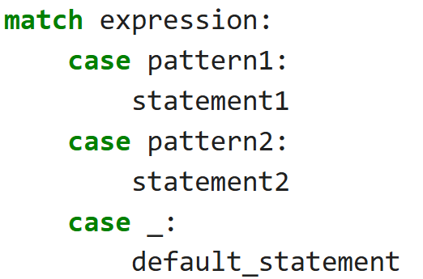
match case
match-case is a control flow statement.
It is similar to switch-case in C, C++, Java.
Used for pattern-based decision making.
match-case makes code: Cleaner, More readable and Structured.
  match → checks the expression
  case → checks pattern
  _ → default case (like else)
Python evaluates the expression after match.
It compares with each case.
First matching case executes.
No break statement required.
If no case matches → _ executes.

Slide 24
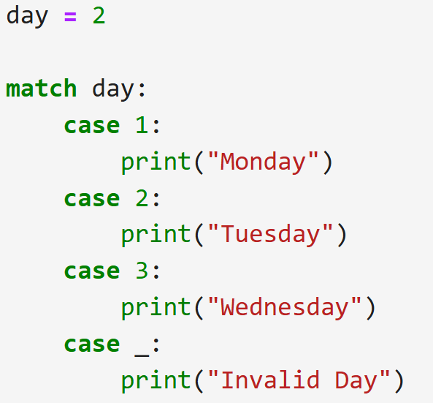
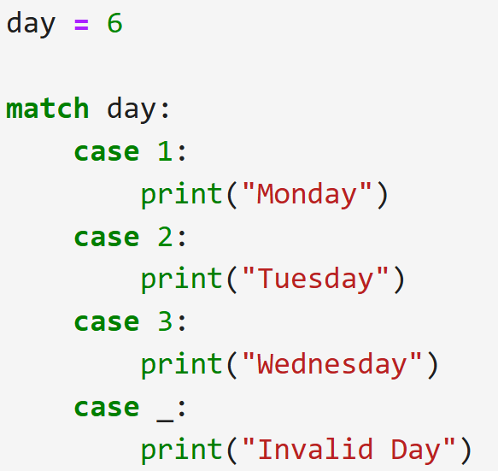
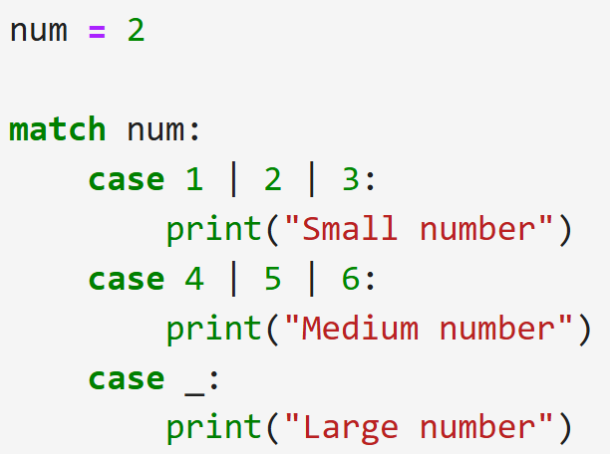



match case
input
input
input
output
output
output

Slide 25
for loop
Many objects in python are iterable, meaning we can iterate over every element in the object.
  such as every elements from the List, every characters from the string etc..
We can use for loop to execute block of code for each element of iterable object.
Syntax
For loop ends with :
1
2
for temp_item in iterable_object :
# Code to execute for each object in iterable
Indentation (tab/whitespace) at the beginning
fordemo1.py
Output :
1
2
3
4
fordemo2.py
Output :
2
4
6
8
1
2
3
my_list = [1, 2, 3, 4]
for list_item in my_list :
print(list_item)
1
2
3
4
my_list = [1,2,3,4,5,6,7,8,9]
for list_item in my_list :
if list_item % 2 == 0 :
print(list_item)

Slide 26
range() function
The range() function returns a sequence of numbers, starting from 0 by default, and increments by 1 (by default), and stops before a specified number.
Syntax
1
range(start, stop, step)
Example1.py
Example2.py
Example3.py
Example4.py
1
2
3
x = range(3, 6)
for n in x:
print(n)
1
2
3
x = range(3, 20, 2)
for n in x:
print(n)
1
2
3
x = range(20)
for n in x:
print(n)
1
2
3
x = reversed(range(20))
for n in x:
print(n)
Output
Output
Output
Output
3
4
5
3
5
. . .
19
0
1
. . .
19
19
18
. . .
0

Slide 27
for loop (tuple unpacking)
Sometimes we have nested data structure like List of tuples, and if we want to iterate with such list we can use tuple unpacking.
withouttupleunapacking.py
withtupleunpacking.py
1
2
3
my_list = [(1,2,3), (4,5,6), (7,8,9)]
for list_item in my_list :
print(list_item[1])
1
2
3
my_list = [(1,2,3), (4,5,6), (7,8,9)]
for a,b,c in my_list :
print(b)
Output :
2
5
8
This technique is known as tuple unpacking
Output :
2
5
8

Slide 28
for loop with else
The else block just after for/while is executed only when the loop is NOT terminated by a break statement.
Example1.py
Example2.py
1
2
3
4
for i in range(1, 4):
print(i)
else:
print("No Break")
1
2
3
4
5
for i in range(1, 4):
print(i)
break
else: # Not executed as there is a break
print("No Break")
Output
Output
1
2
3
No Break
1

Slide 29
Example
Example1.py
Output
1
2
3
4
5
#odd numbers between 1 to n
num = int(input("Enter Number = "))
for i in range(1,num+1):
if i % 2 != 0:
print(i)
Enter Number = 5
1
3
5
Example2.py
Output
1
2
3
4
5
6
#series 1 + 4 + 9 + 16 + 25 + 36 + ...n
num = int(input("Enter Number = "))
sum = 0
for i in range(1,num+1):
sum = sum + i**2
print("Sum=",sum)
Enter Number = 10
Sum= 385

Slide 30
Example
Example3.py
Output
1
2
3
4
5
6
# Find factorial of the given number
num = int(input("Enter Number = "))
fact = 1
for i in range(1,num+1):
fact = fact * i
print("Factorial =", fact )
Enter Number = 5
Factorial = 120
Example4.py
Output
1
2
3
4
5
6
7
8
9
#series 1 – 2 + 3 – 4 + 5 – 6 + 7 ... n
num = int(input("Enter Number = "))
sum = 0
for i in range(1,num+1):
if i % 2 == 0:
sum = sum - i
else:
sum = sum + i
print("Sum=",sum)
Enter Number = 10
Sum= -5

Slide 31
while loop
While loop will continue to execute block of code until some condition remains True.
For example,
  while felling hungry, keep eating
  while have internet pack available, keep watching videos
Syntax
while loop ends with :
1
2
while some_condition :
# Code to execute in loop
Output :
X is greater than 3
Indentation (tab/whitespace) at the beginning
withelse.py
1
2
3
4
5
6
x = 5
while x < 3 :
print(x)
x += 1 # x++ is invalid in python
else :
print("X is greater than 3")
whiledemo.py
Output :
0
1
2
1
2
3
4
x = 0
while x < 3 :
print(x)
x += 1 # x++ is invalid in python

Slide 32
Example
Example1.py
Output
1
2
3
4
5
6
7
#odd numbers between 1 to n
num = int(input("Enter Number = "))
i=0
while(i<=num):
if i % 2 != 0:
print(i)
i+=1
Enter Number = 5
1
3
5
Example2.py
Output
1
2
3
4
5
6
7
#series 1 + 4 + 9 + 16 + 25 + 36 + ...n
num = int(input("Enter Number = "))
sum = i = 0
while(i<=num):
sum = sum + i**2
i+=1
print("Sum=",sum)
Enter Number = 10
Sum= 385

Slide 33
Exercise programs
Do Following programs using for and while loop.
  WAP to find out sum of first and last digit of a given number
  WAP to find whether the given number is prime or not.
  WAP to find out prime numbers between given two numbers
  WAP to print given number in reverse order.
  WAP to check whether the given number is Armstrong or not.
  WAP to find the sum of 1 + (1+2) + (1+2+3) + (1+2+3+4)+ …+(1+2+3+4+….+n).

Slide 34
break keyword
Breaks out of the current closest enclosing loop.
break Statement is a loop control statement that is used to terminate the loop.
As soon as the break statement is encountered from within a loop, the loop iterations stop there, and control returns from the loop immediately to the first statement after the loop.
Basically, break statements are used in situations when we are not sure about the actual number of iterations for the loop or we want to terminate the loop based on some condition.
Syntax
1
break
breakdemo.py
Output :
0
1
1
2
3
4
5
for temp in range(5) :
if temp == 2 :
break
print(temp)

Slide 35
continue keyword
Goes to the top of the current closest enclosing loop.
continue statement is a loop control statement that forces to execute the next iteration of the loop while skipping the rest of the code inside the loop for the current iteration only i.e.
When the continue statement is executed in the loop, the code inside the loop following the continue statement will be skipped for the current iteration and the next iteration of the loop will begin.
Syntax
1
continue
continuedemo.py
Output :
0
1
3
4
1
2
3
4
5
for temp in range(5) :
if temp == 2 :
continue
print(temp)

Slide 36
pass keyword
Does nothing at all, will be used as a placeholder in conditions where you don’t want to write anything.
The pass statement is a null statement. But the difference between pass and comment is that comment is ignored by the interpreter whereas pass is not ignored.
Syntax
1
pass
passdemo.py
Output : (nothing)
1
2
for temp in range(5) :
pass

Slide 37
Unit-02.3
Functions
Python Programming(2301CS404)
Prof. Shruti R. Maniar
Computer Engineering Department
shruti.maniar@darshan.ac.in

Slide 38

Outline
Creating function
DOCSTRING
Types of arguments
Calling function
return statement
Scope of Variables
lambda expression
Recursion
Looping

Slide 39
Functions
Creating clean repeatable code is a key part of becoming an effective programmer.
A function is a block of code which only runs when it is called.
In Python a function is defined using the def keyword:
Syntax
ends with :
def function_name() :
#code to execute when function is called
Indentation (tab/whitespace) at the beginning
Output :
hello world
==============================
from darshan college
==============================
rajkot
Functiondemo.py
1
2
3
4
5
6
7
8
def seperator() :
print('==============================')
print("hello world")
seperator()
print("from darshan college")
seperator()
print("rajkot")

Slide 40
Function
There are two kinds of functions in Python.
Built-in Functions : Functions that are provided as part of Python - input(), print()...
User Defined Functions : Functions that we define ourselves and then use.
Then we treat the built-in function names as "new" reserved words (i.e. we avoid them as variable names)
In Python a function is some reusable code that takes arguments(s) as input, does some computation and then returns a result(s)
We call/invoke the function by using the function name, parenthesis and arguments in an expression
Function name
Functiondemo.py
Arguments
1
2
a = max(2,90)
print(a)

Slide 41
Function Name
Use a naming scheme, and use it consistently (camel case syntax).
For all names, avoid abbreviations, unless they are both standardized and widely used.
The name should describe the data’s meaning rather than its type (e.g., amount_due rather than money),
Functions and methods should have names that say what they do or what they return (depending on their emphasis), but never how they do it—since that might change.
All three functions below return the index position of the first occurrence of a name in a list of names, starting from the given starting index and using an algorithm that assumes the list is already sorted.
Functiondemo.py
1
2
3
def find(l, s, i=0): # BAD
def linear_search(l, s, i=0): # BAD
def first_index_of(sorted_name_list, name, start=0): # GOOD

Slide 42
DOCSTRING
Doc string helps us to define the documentation about the function within the function itself.
Unlike conventional source code comments, the docstring should describe what the function does, not how.
The docstrings can be accessed using the __doc__ method of the object or using the help function.
Syntax
Enclosed within triple quotes
def function_name() :
'''
DOCSTRING: explains the function
INPUT: explains input
OUTPUT: explains output
'''
#code to execute when function is called
Help.py
1
2
Function_name. __doc__
help(Function_name)

Slide 43
Function Types
Four kinds of functions can be created in Python: global functions, local functions, lambda functions, and methods.
Global functions
  Global objects (including functions) are accessible to any code in the same module (i.e., the same .py file) in which the object is created.
Local functions
  (also called nested functions) are functions that are defined inside other functions. These functions are visible only to the function where they are defined;
  They are especially useful for creating small helper functions that have no use elsewhere.
Lambda functions
  Lambda functions are expressions, so they can be created at their point of use;
  however, they are much more limited than normal functions.
Methods
  Methods are functions that are associated with a particular data type and can be used only in conjunction with the data type (when we cover object-oriented programming.)

Slide 44
Exercise
WAP to count simple interest using function.
WAP to find maximum number from given two numbers using function.
WAP that defines a function exchange to interchange the values of two variables, say x and y.

Slide 45
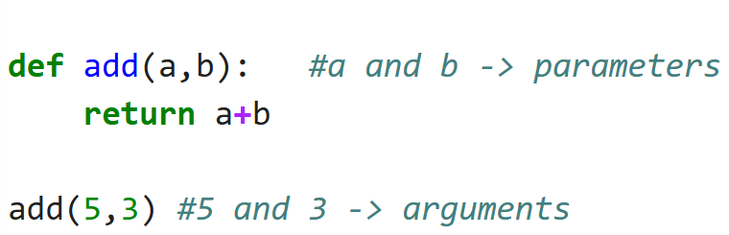
Function Arguments
Parameters:
  Parameters are variables listed in the function definition.
  They act as placeholders.
Arguments:
  Arguments are actual values passed to the function during function call.

Slide 46
Function Arguments
Positional Arguments
Keyword Arguments
Default Arguments
Variable Length Arguments
  Variable Length Positional Arguments
  Variable Length Keyword Arguments
Positional Only Arguments
Keyword Only Arguments

Slide 47
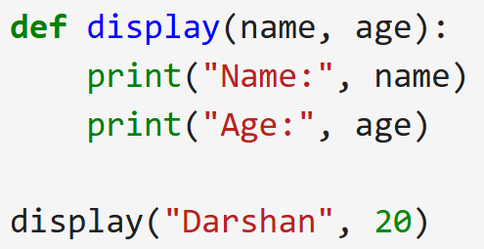
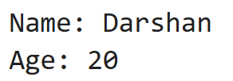
Positional Arguments
Positional arguments are the arguments passed to a function in correct positional order.
During a function call, values passed through arguments should be in the order of parameters in the function definition.
Order must match.
Number of arguments must match number of parameters,
Otherwise generates TypeError.
input.py
Demo.py
Output
1
2
3
4
5
def add_number(n1,n2):
print("Sum = ", n1+n2)
add_number(2,3)
add_number(3,5)
Sum = 5
Sum = 8
Output

Slide 48
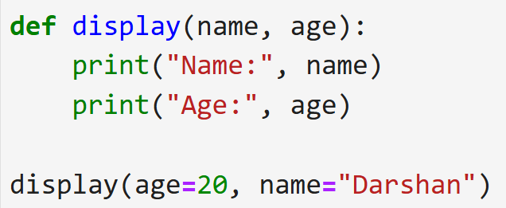
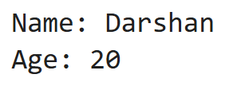
Keyword arguments
Arguments passed using parameter name = value format.
Order does not matter.
Parameter names must match exactly.
Cannot repeat same argument.
Demo.py
Demo.py
1
2
3
4
5
def subtract_number(n1,n2):
print("Subtraction = ", n1-n2)
subtract_number(20,10)
subtract_number(n2=20,n1=10) Keyword Arguments
Output
Output
Subtraction = 10
Subtraction = -10

Slide 49
Default arguments
A default argument is an argument that assumes a default value if a value is not provided in the function call for that argument.
Default arguments are values that are provided while defining functions.
The assignment operator = is used to assign a default value to the argument.
Default arguments become optional during the function calls.
If we provide a value to the default arguments during function calls, it overrides the default value.
Default parameters must come after non-default parameters.
Demo.py
Output
1
2
3
4
5
def add_number(n1,n2 = 10):
print("Sum = ", n1+n2)
add_number(2,3)
add_number(3)
Sum = 5
Sum = 13

Slide 50
Variable-length arguments
Variable-length arguments are also known as arbitrary arguments.
If we don’t know the number of arguments needed for the function in advance, we can use arbitrary arguments.
There are two types of variable length arguments:
Variable length positional arguments (*args)
  You may need to process a function for more arguments than you specified while defining the function.
  These arguments are called variable-length arguments and are not named in the function definition, unlike required and default arguments.
  An asterisk (*) is placed before the variable name that will hold the values of all non keyword variable arguments.
  This tuple remains empty if no additional arguments are specified during the function call.
Tuple representing variable length arguments
Syntax
def functionname([formal_args,] *args):
#code to execute when function is called

Slide 51
Variable-length arguments
Variable length positional arguments example
Demo.py
Output
1
2
3
4
5
6
7
8
def add_number(n1,*n):
  sum = n1
  for i in n:
  sum = sum + i
  print("Sum = ", sum)
add_number(2)
add_number(10,10,10,10)
Sum = 2
Sum = 40

Slide 52
Variable-length arguments
Variable-length keyword arguments (**kwargs)
  For Variable-length keyword argument, a double asterisk (**) is placed before a parameter in a function which can hold keyword variable-length arguments.
  Stored as dictionary.
  Must be written at last in parameter list.
Demo.py
Output
1
2
3
4
5
6
7
8
9
def add_Number(**a):
  sum = 0
  sum = a['a'] + a['b']
  print("Sum=",sum)
  for i in a.items():
  print(i)
  print(a)
add_Number(a=4,b=3,c=4)
Sum= 7
('a', 4)
('b', 3)
('c', 4)
{'a': 4, 'b': 3, 'c': 4}

Slide 53
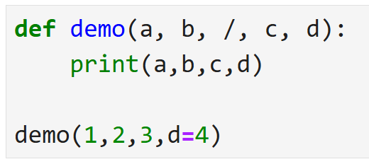
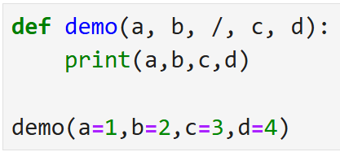
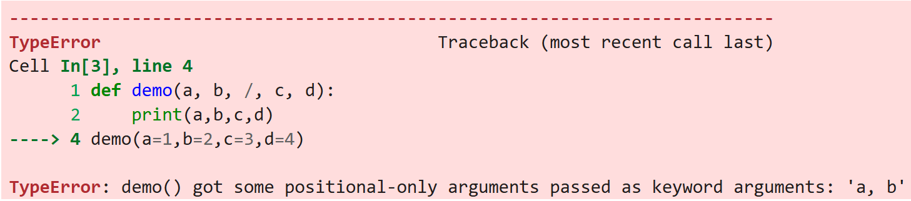

Positional Only arguments
A positional-only argument is a function parameter that must be passed by position, not by keyword.
A positional-only argument is defined using a / (forward slash) in the function definition.
Demo.py
Demo.py
Output
Output

Slide 54
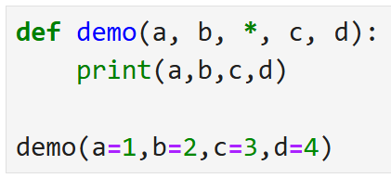
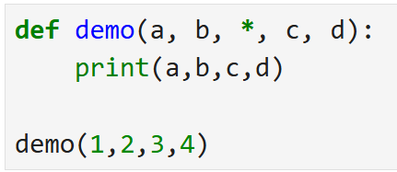
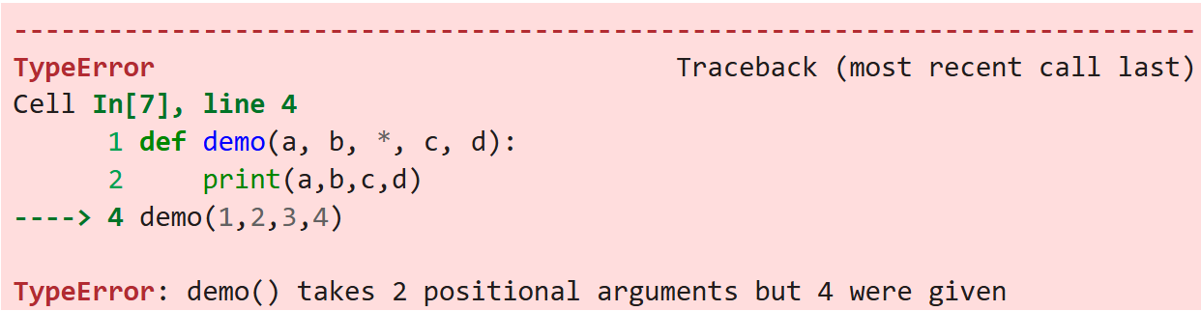
Keyword Only arguments
A keyword-only argument is a function parameter that must be passed using its parameter name and cannot be passed by position.
A keyword-only argument Is defined using * in the function definition.
Demo.py
Demo.py
Output
Output

Slide 55
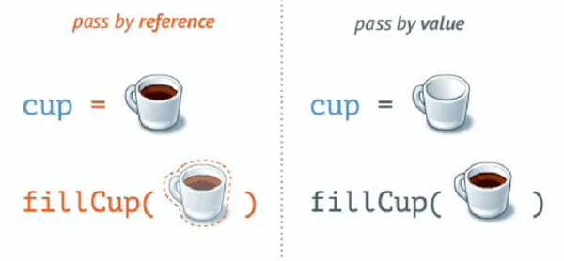
Pass by reference vs value
In call by value method, the value of the actual parameters is copied into the formal parameters.
In call by reference, the address of the variable is passed into the function call as the actual parameter.
In python value is passed as “Call by Object Reference” or “Call by assignment”.
When we pass whole numbers, strings or tuples to a function, the passing is like call-by-value because you can not change the value of the immutable objects being passed to the function.
Whereas passing mutable objects can be considered as call by reference because when their values are changed inside the function, then it will also be reflected outside the function.

Slide 56
Pass by reference vs value
CallByValue.py
CallByReference.py
1
2
3
4
5
6
7
8
9
# Call by Value
def modifiy_String(s):
  s = "Darshan University"
  print("Inside Function:", s)
str = "Darshan"
modifiy_String(str)
print("Outside Function:",str)
1
2
3
4
5
6
7
8
9
# Call by Reference
def add_more(list):
  list.append(50)
  print("Inside Function:", list)
list = [1,2,3,4,5]
add_more(list)
print("Outside Function:",list)
Output
Output
Inside Function: Darshan University
Outside Function: Darshan
Inside Function: [1, 2, 3, 4, 5, 50]
Outside Function: [1, 2, 3, 4, 5, 50]

Slide 57
Pass by reference vs value
def printA(a):
a = 3
def printList(a):
a.append(3)
x=2
printA(x)
print("A = ",x)
x= [1,2]
printList(x)
print("List",x)
Call by Value
Call by Reference
X
a
X
a
2
2
[1,2]

Slide 58
return Statement
return statement : return allows us to assign the output of the function to a new variable, return is use to send back the result of the function, instead of just printing it out.
A return statement is used to end the execution of the function call. The statements after the return statements are not executed.
If the return statement is without any expression, then the special value None is returned.
In python we can return multiple values from function using object, tuple, list, Dictionary.
returnDemo.py
1
2
3
4
5
6
7
def add_number(n1,n2) :
return n1 + n2
sum1 = add_number(5,3)
sum2 = add_number(6,1)
print(sum1)
print(sum2)
Output :
8
7

Slide 59
return Multiple values
returndemo.py
Output
1
2
3
4
5
6
7
8
9
10
11
def test():
  a=1
  b=2
  c=3
return a,b,c # return multiple values
x = test()
a,b,c = test()
print(x)
print(x[1])
print("a, b, c=",a,b,c)
(1, 2, 3)
2
a, b, c= 1 2 3

Slide 60
Exercise
WAP that define a function to find factorial of given number.
WAP that defines a function which returns 1 if the number is prime otherwise return 0.
WAP to generate Fibonacci series of N given number using function name fibbo.
WAP that defines a function to add first n numbers.

Slide 61
Scope of Variables
All variables in a program may not be accessible at all locations in that program. This depends on where you have declared a variable.
The scope of a variable determines the portion of the program where you can access a particular identifier. There are two basic scopes of variables in Python:
  Global variables
  Local variables
Variables that are defined inside a function body have a local scope, and those defined outside have a global scope.
This means that local variables can be accessed only inside the function in which they are declared.
whereas global variables can be accessed throughout the program body by all functions.
When we call a function, the variables declared inside it are brought into scope.

Slide 62
Scope of Variables (cont.)
Local.py
Output
1
2
3
4
5
6
7
8
total = 0
def sum( arg1, arg2 ):
  total = arg1 + arg2
  print ("Inside the function local total : ", total)
return total;
# Now you can call sum function
sum( 10, 20 );
print ("Outside the function global total : ", total)
Inside the function local total : 30
Outside the function global total : 0
Global.py
Output
1
2
3
4
5
6
7
8
9
total = 0
def sum( arg1, arg2 ):
  global total
  total = arg1 + arg2
  print ("Inside the function local total : ", total)
return total;
# Now you can call sum function
sum( 10, 20 );
print ("Outside the function global total : ", total)
Inside the function local total : 30
Outside the function global total : 30

Slide 63
lambda Function
We can use the lambda keyword to create small anonymous functions.
These functions are called anonymous because they are not declared in the standard manner by using the def keyword.
lambda forms can take any number of arguments but return just one value in the form of an expression. They cannot contain multiple expressions.
An anonymous function cannot be a direct call to print because lambda requires an expression.
lambda functions have their own local namespace and cannot access variables other than those in their parameter list and those in the global namespace.
Although it appears that lambda's are a one-line version of a function, they are not equivalent to inline statements in C or C++.

Slide 64
lambda Function (cont.)
Syntax
1
lambda arg1,arg2..argN: expression
The parameters are optional, and if supplied they are normally just comma- separated variable names, that is, positional arguments.
Lambda functions accept all kinds of arguments, just like normal def function
The expression can not contain branches or loops (although conditional expressions are allowed), and cannot have a return statement. The result of a lambda expression is an anonymous function.
When a lambda function is called it returns the result of computing the expression as its result.
Example.py
1
2
sum = lambda arg1,arg2: arg1 + arg2
print("Total",sum(5,5))
Output
Total 10

Slide 65
lambda Function (cont.)
Cube.py
Output
1
2
3
4
5
6
7
8
def cube(y):
  return y*y*y
lambda_cube = lambda y: y*y*y
# using the normally defined function
print(cube(5))
# using the lambda function
print(lambda_cube(5))
125
125
WithIfElse.py
Output
1
2
3
# Example of lambda function using if-else
Max = lambda a, b : a if(a > b) else b
print(Max(1, 2))
2
call.py
Output
1
2
# Lambda functions can be Immediately Invoked
print((lambda x: x*x)(3))
9

Slide 66
Exercise
WAP to find square of given number using lambda expression.
WAP to find simple interest using lambda function.
WAP to make simple calculator using lambda expression.

Slide 67
map
map() function returns a map object(which is an iterator) of the results after applying the given function to each item of a given iterable (list, tuple etc.)
Syntax
1
map(fun, iterable)
demo1.py
Output
1
2
3
4
5
6
7
def addition(n):
return n * n
numbers = [1, 2, 3, 4]
result = list(map(addition, numbers))
# result = list(map(lambda n:n*n,numbers))
print(result)
[1, 4, 9, 16]
demo2.py
Output
1
2
3
strdata = ["Darshan","University"]
lengthdata = list(map(len,strdata))
print(lengthdata)
[7, 10]

Slide 68
filter
To find out items based on a test function we can use a Filter.
For example, the following filter call picks out items in a sequence that are divide by 2:
demo1.py
Output
1
2
3
lista = [1,2,3,4,5,6,7,8,9,10]
ans = list(filter(lambda x: x % 2 == 0 ,lista))
print(ans)
[2, 4, 6, 8, 10]

Slide 69
Recursion
Any function which calls itself is called recursive function and such function calls are called recursive calls.
Recursion cannot be applied to all problems, but it is more useful for the tasks that can be defined in terms of a similar subtask.
It is idea of representing problem a with smaller problems.
Any problem that can be solved recursively can be solved iteratively.
When recursive function call itself, the memory for called function allocated and different copy of the local variable is created for each function call.
Some of the problem best suitable for recursion are
  Factorial
  Fibonacci
  Tower of Hanoi

Slide 70
Properties of Recursion
A recursive function can go infinite like a loop. To avoid infinite running of recursive function, there are two properties that a recursive function must have.
Base Case or Base criteria
  It allows the recursion algorithm to stop.
  A base case is typically a problem that is small enough to solve directly.
Progressive approach
  A recursive algorithm must change its state in such a way that it moves forward to the base case.

Slide 71
Recursion - factorial example
The factorial of a integer n, is product of
  n * (n-1) * (n-2) * …. * 1
Recursive definition of factorial
  n! = n * (n-1)!
  Example
    3! = 3 * 2 * 1
    3! = 3 * (2 * 1)
    3! = 3 * (2!)
Recursive trace
Final Ans 5 *24 = 120
Fact(5)
return 4 * 6 = 24
call
Fact(4)
return 3 * 2 = 6
call
Fact(3)
return 2 * 1 = 2
call
Fact(2)
call
return 1
Fact(1)

Slide 72
Examples
Factorial.py
Output
1
2
3
4
5
6
7
8
9
10
def recursive_factorial(n):
  if n == 1:
  return n
  else:
  return n * recursive_factorial(n-1)
# recursive function call
# user input
num = int(input("Enter the number="))
print("Factorial of number", num, "=", recursive_factorial(num))
Enter the number=5
Factorial of number 5 = 120
fibonacci.py
Output
1
2
3
4
5
6
7
8
9
def r_fibonacci(n):
  if n <= 1:
  return n
  else:
  return(r_fibonacci(n-1) + r_fibonacci(n-2))
n = 8
print("Fibonacci series:")
for i in range(n):
print(r_fibonacci(i))
Fibonacci series:
0
1
1
-
-
13

Slide 73
Exercise
Write a program to find factorial of a given number using recursion.
WAP to convert decimal number into binary using recursion.
WAP to use recursive calls to evaluate F(x) = x – x3/3! + x5/5! – x7/7! + … + xn/n!

