Slide 1

Unit-05
Object Oriented Programming with python
Python Programming(2301CS404)
Prof. Shruti R. Maniar
Computer Engineering Department
shruti.maniar@darshan.ac.in

Slide 2

Outline
Object Oriented Approach
Custom Classes: Attributes and Methods
Inheritance
Polymorphism
Abstract class
Abstract method
Looping

Slide 3
Introduction
Object-Oriented Programming (OOP) is a programming paradigm that uses objects to organize and structure the code.
Python is a multi-paradigm programming language because it supports both:
  Procedural Programming (C, Pascal, FORTRAN, etc.)
  Object-Oriented Programming (C++, C#, java, etc.)
In Python, everything is an object, and you can use OOP principles to create and manipulate these objects.
OOP concepts in Python :
  Class
  Objects
  Polymorphism
  Encapsulation
  Inheritance
  Data Abstraction

Slide 4
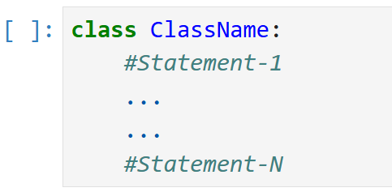
Class
A class is a blueprint or prototype, from which objects are created.
It defines the set of attributes (variables) and methods, that the objects created from the class will have.
It defines new datatype (primitive ones are not enough).
In Python, the class can be created as follows:
syntax
class className:
pass

Slide 5
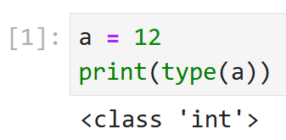
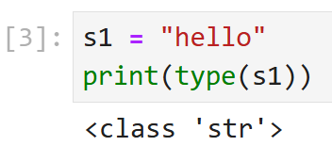
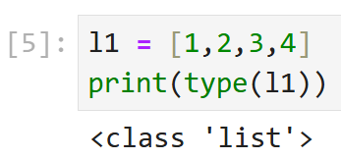
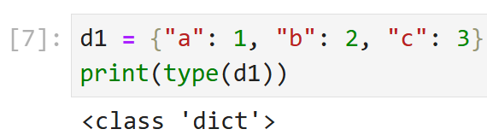
Objects
An object is an instance of a class.
The object is an entity that has a state and behavior associated with it.
The state of an object is stored in fields(variables), while methods(functions) describe the object's behavior.
As said earlier - everything is an object in Python, following are some examples:
The object/instance can be invoked as follows:
syntax
objectName = ClassName()

Slide 6






Example
Class
Car’s Blueprint
Attributes (Properties)
Company
Model
Color
Mfg. Year
Price
Fuel Type
Mileage
Gear Type
Power Steering
Anti-Lock braking system
Ob-1
Ob-2
Ob-3
Methods (Functions)
Start
Drive
Park
On_break
On_lock
On_turn
Honda City
Hyundai i20
Sumo Grand
Mercedes
Swift Dezire
Ob-4
Ob-5

Slide 7
The self
In Python, class methods must have an extra first parameter in the method definition.
We do not give a value for this parameter when we call the method. Python provides it.
If we have a method that takes no arguments, then we still have to have one parameter(self) in the method definition.
For Example: Method definition of MyClass : def my_method(self, par1, par2):
Method call : myobject.my_method(arg1, arg2)
Python converts the method call as : MyClass.my_method(myobject, arg1, arg2)
Example.py
OUTPUT
1
2
3
4
5
6
7
8
class Demo:
# Method of Class Demo
  def printMyName(self,name):
  print('My name is =',name)
object1 = Demo() # Object created
object1.printMyName("DIET") # Method Called
My name is = DIET

Slide 8
The __init__ method
The __init__ method is similar to constructors in C++ and Java.
It is called when object is created of the class.
This method is used to initialize object data members.
Example.py
OUTPUT
1
2
3
4
5
6
7
8
9
10
11
12
13
14
15
class Demo:
#class Attributes
  Name = ""
  #Constructor Method
  def __init__(self,n):
  self.Name = n
  # Method of Class Demo
  def printMyName(self):
  print('My name is =',self.Name)
object1 = Demo("DIET") # Object created
object1.printMyName() # Method Called
My name is = DIET

Slide 9
Example
Example.py
OUTPUT
1
2
3
4
5
6
7
8
9
10
11
12
13
14
# Write a Program to create Circle class and define findarea method to calculate area of circle.
class Circle:
  def __init__(self,r):
  self.r = r
  def findarea(self):
  return 3.14 * self.r * self.r
r = int(input("Enter radius="))
c = Circle(r)
area = c.findarea()
print("Area = ",area)
Enter radius=1
Area = 3.14

Slide 10
Example
Design and implement a Bank Account Management System using Object-Oriented Programming (OOP) in Python.
The system should allow users to :
  Create a bank account (Name, Account_Opening_Balance)
  Deposit money
  Withdraw money
    only if account holder has sufficient fund for withdrawal
    otherwise print “INSUFFICIENT BALANCE”

Slide 11
Types of Attributes

Slide 12
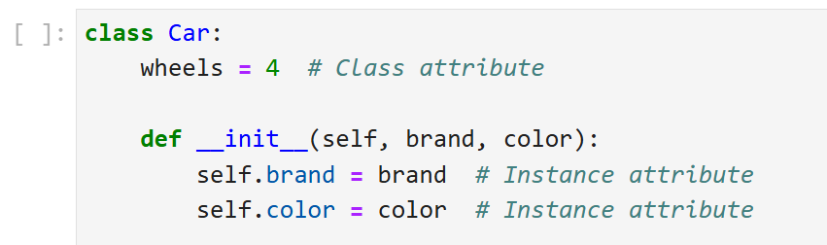
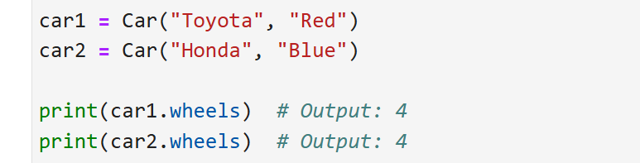
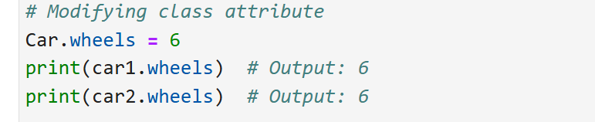
Class Attribute
Class attribute is a variable that is shared across all the objects/instances of the class.
It is defined within the class, but outside any methods.
Class attributes are defined at the class level (instead of object level).
So, they maintain the same value across all the instances.
The value could be modified using className.attributeName.
Example.py

Slide 13
Built-in class attributes
Python class also contains some built-in class attributes which provide information about the class.
attributes | Description
__dict__ | It provides the dictionary containing the information about the class namespace.
__doc__ | It contains a string which has the class documentation.
__module__ | It is used to access the module in which, this class is defined.

Slide 14
Example : built-in class attributes
Example.py
OUTPUT
1
2
3
4
5
6
7
8
9
10
11
12
13
class Student:
  ''' This is Student Class'''
  def __init__(self,rno,sname):
    self.rollno = rno
    self.studentName = sname
  def display(self):
  print(self.rollno, self.studentName)
s1 = Student(23,"ABC")
print(s1.__doc__)
print(s1.__dict__)
print(s1.__module__)
This is Student Class
{'rollno': 23, 'studentName': 'ABC'}
__main__

Slide 15
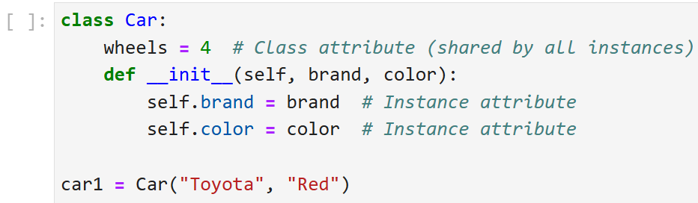
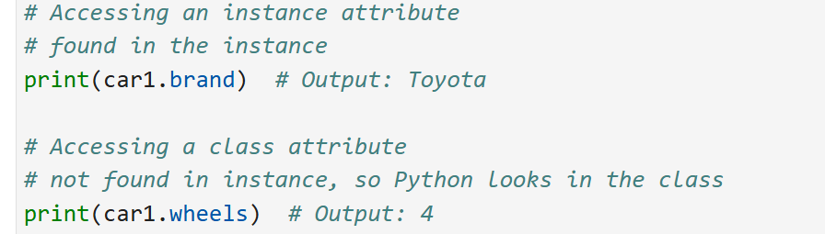
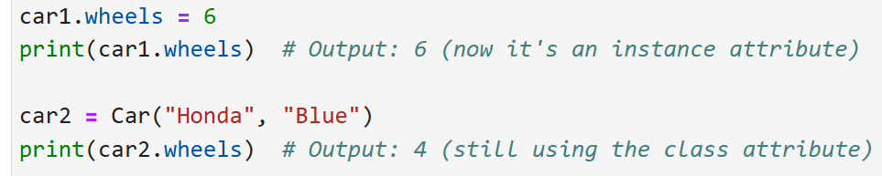
Instance Attribute
An Instance attribute is a variable that is specific to each instance/object of a class.
It is defined inside the __init__ method (or other instance methods) using self.
This means that each object will get its own copy of attribute.
If an attribute is not found in the instance, Python looks for it in the class (class attribute).
Example.py

Slide 16
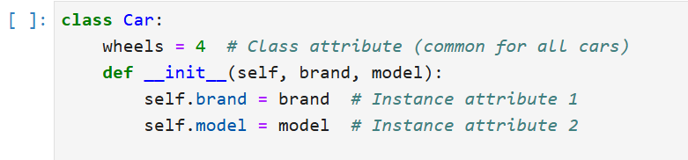
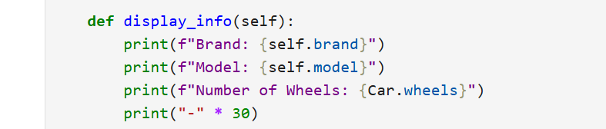
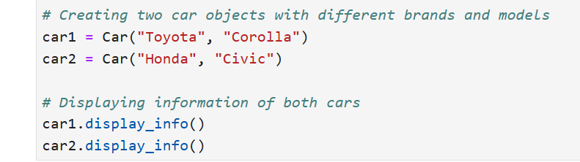
Example : class & instance attributes
Example.py
OUTPUT
Brand: Toyota
Model: Corolla
Number of Wheels: 4
------------------------------
Brand: Honda
Model: Civic
Number of Wheels: 4
------------------------------

Slide 17
Class Attributes vs Instance Attributes
Class Attributes | Instance Attributes
Class attributes are the variables defined directly in the class that are shared by all objects of the class. | Instance attributes are attributes or properties attached to an instance of a class. Instance attributes are defined in the constructor.
Shared across all the objects of a class. | Specific to an object.
Accessed using class name as well as using object with dot notation, e.g. classname.class_attribute or object.class_attribute | Accessed using object dot notation e.g. object.instance_attribute
Changing value will be reflected to all the objects if it changed using classname.class_attribute = value | Changing value of instance attribute will not be reflected to other objects.

Slide 18
Example : Class Attributes vs Instance Attributes
Example.py
OUTPUT
1
2
3
4
5
6
7
8
9
10
11
12
13
14
15
16
17
class Counter:
#Class Attribute
  count = 0
  def __init__(self):
  Counter.count = Counter.count + 1
s1 = Counter() # Object 1 created
s2 = Counter() # Object 2 created
print(s1.count) # Counter Value
print(s2.count) # Counter Value
print(Counter.count) # Counter value
Counter.count = 100 # Updating Class Attribute
print(s1.count)
print(s2.count)
2
2
2
100
100

Slide 19
Encapsulation
Access Modifiers

Slide 20
Encapsulation
Encapsulation means wrapping up properties and methods together inside a class and controlling access to them.
It protects data from direct manipulation by restricting access using Access Modifiers.
Access modifiers control how attributes and methods of a class can be accessed outside the class.
Python does not strictly enforce access modifiers like other programming languages c++ and java, but it uses naming conventions to indicate the level of access to the members of a class.
There are mainly three types of access modifiers in Python:
Public
Private
Protected

Slide 21
Access Modifiers
Public Access Modifier:
  The members of a class that are declared public, are accessible from any part of the program.
  All attributes and methods of a class are public by default.
Private Access Modifier:
  The members of a class that are declared private, are accessible within the class only.
  Data members of a class are declared private, by adding a double underscore ‘__’ symbol before the data member name.
  Python does not make variables truly private, Instead, it renames the variable internally this is called name mangling.
  For Example, __salary attribute of Employee can directly can’t be accessed outside the class, but can be accessed using _Employee__salary
Protected Access Modifier:
  The members of a class that are declared protected, are only accessible inside the class and to a class derived from it(child class).
  Data members of a class are declared protected, by adding a single underscore ‘_’ symbol before the data member name.

Slide 22
Example : Access Modifiers
Example.py
OUTPUT
1
2
3
4
5
6
7
8
9
10
11
12
13
14
15
16
17
18
19
class Date:
  def __init__(self,d,m,y):
    self.__d = d # Private
    self.__m = m # Private
    self.__y = y # Private
  #Private Method
  def __displaydate(self):
  print("{}-{}-{}".format(self.__d,self.__m,self.__y))
  # Public Method
  def display(self):
  self.__displaydate()
y1 = Date(10,10,2022)
y1.display()
y1.__displaydate() #AttributeError : object has no attribute ‘__displaydate’
y1.__m #AttributeError : object has no attribute ‘__m’
10-10-2022

Slide 23
Types of Methods

Slide 24
Types of Methods
We can classify the methods in the following 3 types:
Instance methods
  Instance methods are bound to instances and hence called as: instancename.method().
  The purpose of instance methods is to set or get details about instances (objects), and that is why they’re known as instance methods.
  They have one default parameter- self, which points to an instance of the class.
  Although you don’t have to pass that every time. You can change the name of this parameter but it is better to stick to the convention i.e self.
  In order to call an instance method, you’ve to create an object/instance of the class. With the help of this object, you can access any method of the class.
Class methods
  These methods act on class level.
  Class methods are the methods which act on the class variables.
  These methods are written using @classmethod decorator above them.

Slide 25
Types of Methods
Class methods:
  By default, the first parameter for class methods is “cls” which refers to the class itself.
  Without creating an instance of the class, you can call the class method with – Class_name.Method_name().
Static methods:
  Static methods can not access the class data.
  They are self-sufficient and can work on their own.
  They can not get or set the instance state or class state.
  In order to define a static method, we can use the @staticmethod decorator
  We do not need to pass any special or default parameters.
  We can call them using object/instance of the class or class name.

Slide 26
Types of Methods
Example.py
Example.py
1
2
3
4
5
6
7
8
9
10
11
12
13
14
15
16
17
18
class Student:
  firstname = "”
  #Instance Methods
  def method1(self,lname):
  self.lastname = lname
  @classmethod
  def classMethod(cls,fname):
  cls.firstname = fname
  @staticmethod
  def staticMethod(x):
  print(x)
  #Instance Methods
  def printData(self):
  print(self.firstname,self.lastname)
19
20
21
22
23
s1 = Student()
s1.method1(" Mehta ")
Student.classMethod(“Ajay")
Student.staticMethod(“Hello")
s1.printData()
OUTPUT
Hello
Ajay Mehta

Slide 27
Passing Object as function Arguments
Example.py
Example.py
1
2
3
4
5
6
7
8
9
10
11
12
13
14
15
16
17
18
class Time:
  #Constructor
  def __init__(self,h,m):
    self.h = h
    self.m = m
  #add Two Time Objects
  def addTime(self,t1,t2):
    self.h = t1.h + t2.h
    self.m = t1.m + t2.m
  # Display Time
  def displayTime(self):
  print(self.h,self.m)
t1 = Time(4,4)
t2 = Time(3,2)
t3 = Time(0,0)
19
20
21
22
t3.addTime(t1,t2)
t1.displayTime()
t2.displayTime()
t3.displayTime()
OUTPUT
4 4
3 2
7 6

Slide 28
Inheritance in Python
Inheritance is a feature of OOP that allows a class to inherit attributes and methods from another class.
A class from which features are derived, is called Parent Class (Base Class).
A class who derives features, is called Child Class (Derived Class).
This helps in code reusability, as we can create a class having the same attributes and methods without rewriting the existing code.
It represents real-world relationships.
Inheritance defines IS-A relationship between a Parent class and its Child class.
It is transitive in nature.
  For example : Multilevel Inheritance

Slide 29
Syntax
Syntax :
syntax
class A {
// code
}
class B extends A{
// code
}
class A:
-
-
class B(A):
-
-

Slide 30
Example
Example.py
Example.py
1
2
3
4
5
6
7
8
9
10
11
class Parent():
  def first(self):
  print('Parent Class’)
class Child(Parent):
  def second(self):
  print('Child Class’)
ob = Child()
ob.first()
ob.second()
1
2
3
4
5
6
7
8
9
10
11
12
13
14
15
16
17
18
class Person:
  def __init__(Self,fName,lName):
    Self.firstName = fName
    Self.lastName = lName
  def displayPerson(self):
  print(self.firstName,self.lastName)
class Student(Person):
  def __init__(Self, fName, lName,gYear):
  Self.graduateYear = gYear
Person.__init__(Self,fName, lName)
  def displayStudent(self):
  print(self.firstName,self.lastName,self.graduateYear)
ob = Student("Ajay", "Mehta", "2024")
ob.displayStudent()
OUTPUT
Parent Class
Child Class
OUTPUT
Ajay Mehta 2024

Slide 31
Inheritance Types
A
syntax
Single:
  When a child class inherits only a single parent class.
Multilevel:
  When a child class becomes a parent class for another child class.
class ParentClass:
-
-
class ChildClass(ParentClass):
-
-
B
A
syntax
class ParentClass:
-
-
class Child1(ParentClass):
-
-
class Child2(Child1):
-
-
B
C

Slide 32
Inheritance Types (cont.)
syntax
Multiple:
  When a child class inherits from more than
  one parent class.
Hierarchical :
  When a more then one chid is derived from parent class.
A
B
class ParentClass1:
-
-
class ParentClass2:
-
-
class ChildClass(ParentClass1, ParentClass2):
-
-
C
A
syntax
class ParentClass:
-
-
class Child1(ParentClass):
-
-
class Child2(ParentClass):
-
-
B
C

Slide 33
Inheritance Types (cont.)
Hybrid:
  This form combines more than one form of inheritance. Basically, it is a blend of more than one type of inheritance.
syntax
class ParentClass1:
-
-
class ParentClass2:
-
-
class ChildClass1(ParentClass1, ParentClass2):
-
-
class ChildClass2(ChildClass1):
-
-
class ChildClass3(ChildClass2):
-
-
A
B
C
D
E

Slide 34
Examples
Single.py
Multi.py
1
2
3
4
5
6
7
8
9
10
11
class A:
  def diplayA(self):
  print("Class A")
class B(A):
  def diplayB(self):
  print("Class B")
object = B()
object.diplayA()
object.diplayB()
1
2
3
4
5
6
7
8
9
10
11
12
13
14
15
16
class A:
  def diplayA(self):
  print("Class A")
class B(A):
  def diplayB(self):
  print("Class B")
class C(B):
  def diplayC(self):
  print("Class C")
object = C()
object.diplayA()
object.diplayB()
object.diplayC()
OUTPUT
Class A
Class B
OUTPUT
Class A
Class B
Class C

Slide 35
Examples
Multiple.py
Hierarchical.py
OUTPUT
1
2
3
4
5
6
7
8
9
10
11
12
13
14
15
16
class A:
  def diplayA(self):
  print("Class A")
class B:
  def diplayB(self):
  print("Class B")
class C(A,B):
  def diplayC(self):
  print("Class C")
object = C()
object.diplayA()
object.diplayB()
object.diplayC()
1
2
3
4
5
6
7
8
9
10
11
12
13
14
15
16
17
18
class A:
  def diplayA(self):
  print("Class A")
class B(A):
  def diplayB(self):
  print("Class B")
class C(A):
  def diplayC(self):
  print("Class C")
object1 = B()
object2 = C()
object1.diplayA()
object1.diplayB()
object2.diplayA()
object2.diplayC()
Class A
Class B
Class A
Class C
OUTPUT
Class A
Class B
Class C

Slide 36
Method Overriding
Method overriding allows a subclass or child class to provide a specific implementation of a method that is already provided by one of its super-classes or parent classes.
When a method in a subclass has the same name, same parameters or signature and same return type(or sub-type) as a method in its super-class, then the method in the subclass is said to override the method in the super-class.
If an object of a parent class is used to invoke the method, then the version in the parent class will be executed.
if an object of the subclass is used to invoke the method, then the version in the child class will be executed.

Slide 37
Example
Example1.py
Example1.py
1
2
3
4
5
6
7
8
9
10
11
12
class A:
  def display(self):
  print("Inside class A")
class B(A):
# Method override by Sublcass
  def display(self):
  print("Inside class B")
object1 = B()
object1.display()
1
2
3
4
5
6
7
8
9
10
11
12
13
14
class A:
  def display(self):
  print("Inside class A")
class B(A):
  # Method override by Sublcass
  def display(self):
  print("Inside class B")
object1 = A()
object1.display()
object2 = B()
object2.display()
OUTPUT
Inside class B
OUTPUT
Inside class A
Inside class B

Slide 38
Calling the Parent’s method
Parent class methods can also be called within the overridden methods. This can generally be achieved by two ways.
Using Classname
  Parent’s class methods can be called by using the Parent classname.method inside the overridden method.
Example1.py
OUTPUT
1
2
3
4
5
6
7
8
9
10
11
12
13
class A:
  def display(self):
  print("Inside class A")
class B(A):
  # Method override by Sublcass
  def display(self):
    #Calling Super Class Method
    A.display(self)
    print("Inside class B")
object1 = B()
object1.display()
Inside class A
Inside class B

Slide 39
Calling the Parent’s method
Using Super()
  Python super() function provides us the facility to refer to the parent class explicitly. It is basically useful where we have to call superclass functions.
Example1.py
OUTPUT
1
2
3
4
5
6
7
8
9
10
11
12
13
14
class A:
  def display(self):
  print("Inside class A")
class B(A):
  # Method override by Sublcass
  def display(self):
    #Calling Super Class Method
    super().display()
    print("Inside class B")
object1 = B()
object1.display()
Inside class A
Inside class B

Slide 40
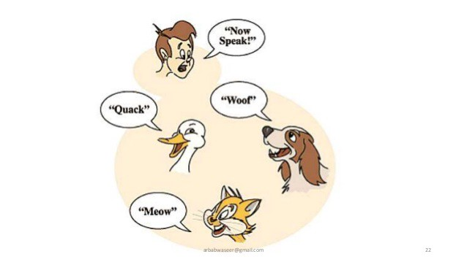
Polymorphism
If one task is performed in different ways, it is known as polymorphism.
OOP concept lets programmers use the same word to mean different things in different contexts.
Polymorphism is taken from the Greek words Poly (many) and morphism (forms).
Example1.py
Example2.py
1
2
3
4
5
6
7
num1 = 3
num2 = 4
print(num1+num2)
str1 = "Python "
str2 = "Programming"
print(str1+str2)
1
2
3
4
5
6
7
x1 = 3
x2 = 4
print(x1*x2)
x1 = "hi"
x2 = 2
print(x1*x2)

Slide 41
Method Overloading
The problem with method overloading in Python is that we may overload the methods but can only use the latest defined method.
In the above code, we have defined two display method, but we can only use the second display method, as python does not support method overloading.
Example1.py
1
2
3
4
5
6
7
8
def display():
print("Hello")
def display(name):
print(name)
#display() Error Message
display("Name")

Slide 42
Method Overloading
To overcome the above problem, we can use different ways to achieve the method overloading.
We need to write the method’s logic so that different code inside the function, executes depending on the parameter passes.
Example1.py
OUTPUT
1
2
3
4
5
6
7
8
9
10
11
class Shape:
  # function with two default parameters
  def area(self, a, b=0):
    if b > 0:
    print('Area of Rectangle is:', a * b)
    else:
    print('Area of Square is:', a ** 2)
square = Shape()
square.area(5)
square.area(1,2)
Area of Square is: 25
Area of Rectangle is: 2

Slide 43
Polymorphism with Function and Objects
We can create polymorphism with a function that can take any object as a parameter and execute its method without checking its class type.
Using this, we can call object actions using the same function instead of repeating method calls.
Example1.py
Example1.py
14
15
16
17
18
19
20
21
22
# normal function
def car_details(obj):
  obj.fuel_type()
  obj.max_speed()
honda = Honda()
skoda = Skoda()
car_details(honda)
car_details(skoda)
1
2
3
4
5
6
7
8
9
10
11
12
13
class Honda:
  def fuel_type(self):
  print("Petrol")
  def max_speed(self):
  print("Max speed 180")
class Skoda:
  def fuel_type(self):
  print("Diesel")
  def max_speed(self):
  print("Max speed is 220")
OUTPUT
Petrol
Max speed 180
Diesel
Max speed is 220

Slide 44
Abstract class
Python supports all the features of object-oriented programming including abstraction and abstract classes.
We cannot create an abstract class in Python directly. However, Python does provide a module that allows us to define abstract classes.
The module we can use to create an abstract class in Python is abc(abstract base class) module.
Abstract methods force the child classes to give the implementation of these methods in them and thus help us achieve abstraction as each subclass can give its own implementation.
A class containing one or more than one abstract method is called an abstract class.
Syntax
from abc import ABC
class <Abstract_Class_Name>(ABC):
# body of the class

Slide 45
Abstract class
we cannot create an instance or object of an abstract class in Python.
abstract classes are used to create a blueprint of our classes as they don't contain the method implementation.
This is a very useful capability, especially in situations where child classes should provide their own separate implementation.

Slide 46
Abstract Method
To define an abstract method we use the @abstractmethod decorator of the abc module.
It tells Python that the declared method is abstract and should be overridden in the child classes.
We just need to put this decorator over any function we want to make abstract, and the abc module takes care of the rest.
Syntax
from abc import ABC, abstractmethod
class <Abstract_Class_Name>(ABC):
  @abstractmethod
  def <abstract_method_name>(self,other_parameters):
  pass
Example.py
from abc import ABC, abstractmethod
class Demo(ABC):
  @abstractmethod
  def printName(self):
  pass

Slide 47
Example
Example1.py
OUTPUT
1
2
3
4
5
6
7
8
9
10
11
12
13
14
from abc import ABC,abstractmethod
class Shape(ABC):
  @abstractmethod
  def drawShape(self):
  pass
class Circle(Shape):
  def drawShape(self):
  print("Drawing a Circle")
a = Circle()
a.drawShape()
B = Shape()
Drawing a Circle
TypeError: Can't instantiate abstract class Shape without implementation of abstract method drawShape

