Slide 1
Software Group Project
Project: Smart Water Level Controller
ID of Students: i)20IT094 Het Patel
ii)20IT104 Pratham Patel
Councellor: Dr Parth Shah

Slide 2
What is Smart Water Level Controller?
It is a device that controls the water level of tanks present at the normal household of people.
Basically it refills the water tanks to its full capacity when the water reaches at the lowest level.
This device can be used for industrial as well as household purposes.
It also shows us the current water level of the tank.
No man power is required to operate the device.

Slide 3
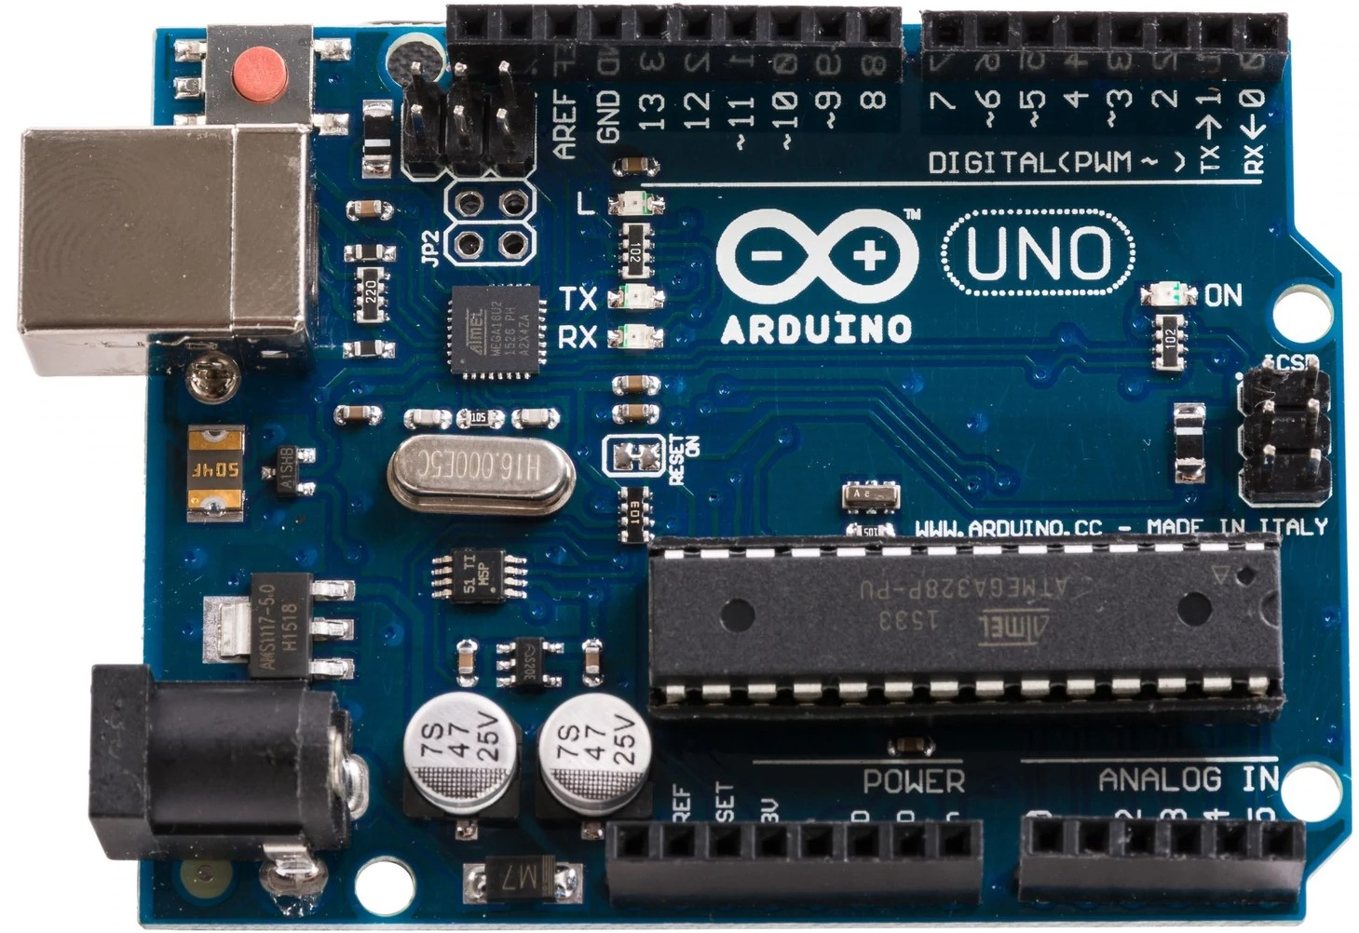
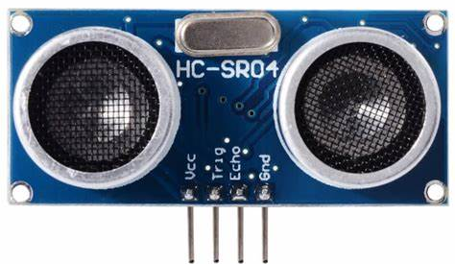
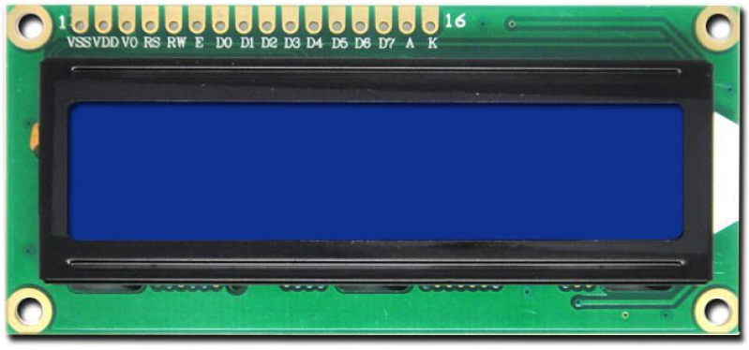
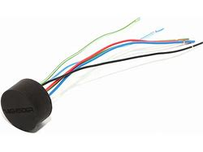
Hardware Used:
Arduino
Ultrasonic sensor
Display
Relay

Slide 4
Arduino:
Arduino/Genuino Uno is a microcontroller board based on the ATmega328P (datasheet). It has 14 digital input/output pins (of which 6 can be used as PWM outputs), 6 analog inputs, a 16 MHz quartz crystal, a USB connection, a power jack, an ICSP header and a reset button. It contains everything needed to support the microcontroller; simply connect it to a computer with a USB cable or power it with a AC-to-DC adapter or battery to get started.
Ultrasonic Sensor:
Ultrasonic sensors measure distance by using ultrasonic waves. The sensor head emits an ultrasonic wave and receives the wave reflected back from the target. Ultrasonic Sensors measure the distance to the target by measuring the time between the emission and reception.
Display:
Gives us the current percentage of water level present in the water tank.
6V Relay:
It is used here to turn on and off the water pump.

Slide 5
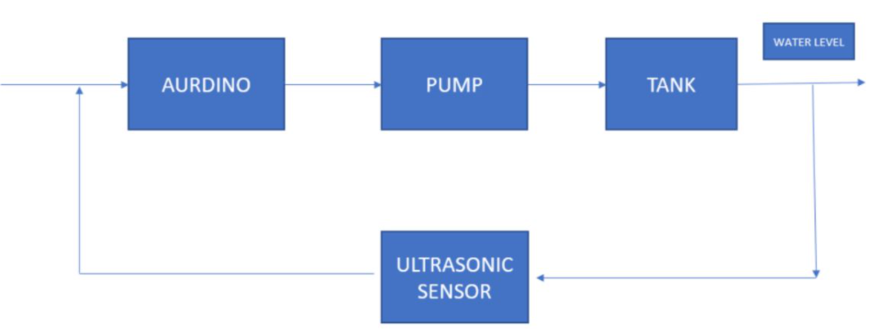
Working Of The Project
Here we use an ultrasonic sensor module to emit sound
wave into water tank and detect sound waves
Reflection (also known as echo). Time between emitting
and receiving the sound wave is measured by Arduino.
Here we know the overall length of water tank so we
determine the water level by subtracting the ultrasonic
Distance from tank’s length. After getting the water level the Arduino decides when to switch on the water pump and when to switch it off.

Slide 6
About The Project:
Scope Of The Project is as follows:
1. This project aims to design a smart water level management system that indicates the
water level in water tanks.
2. To avoid the unnecessary overflowing of water when there is no one available to switch
off the water pump.

Slide 7
Advantages
Prevents the tank from overflowing i.e chances of water being wasted are almost null.
Once installed does not require man power to operate.
Save user’s money as it is energy efficient turns off the water pump before the tank overflows .
Prevents unnecessary running of water pump.
Shows us the percentage of water level of our tank which ca be usefull when there is no power .
It has modular design which helps the user to buy/replace/connect parts of sensors in desired
length/type. It has some advantages - stock flexibility, sensor can be replaced by customer, no
need to recalibrate tank after the change of the sensor.

Slide 8
Conclusion
The proposed project consists of ultrasonic technique for water level management that acquires
The Measured water level and sends to the display unit . The data acquired by the sensor is then
transmitted To the microcontroller . The microcontroller then processes the data by calculating the
water level present at that instant of time and display the percentage on the display. The water
pump is connected to the Microcontroller so when it finds out that the water level is low in the tank
it turns on the water pump and then Turns the water pump off after the tank is full.

Slide 9
THANK YOU!!!

