Slide 1
IBM University Engagement Project Submission
“Exploring the Power of Agentic AI with IBM Granite and LangFlow”

Slide 2

Project Tile – The AI Game Strategy Advisor Agent
Domain of Project – Sports Analytics / Sports Technology
Student Name | Recent Passport Photo | Email ID | Mobile number [WhatsApp]
Dave Hetkumar Harshadbhai |  | hhdave2012@gmail.com | 7096032566

Slide 3
Problem Statement -
Problem Statement : The AI Game Strategy Advisor Agent
The Challenge
Modern sports teams rely heavily on strategy and tactical planning. However, analyzing past matches, opponent strategies, and player performance patterns requires extensive manual work by analysts and coaching staff. Many teams lack tools that can quickly analyze historical gameplay data and generate strategic insights.
The Objective
Build an AI-powered Game Strategy Advisor Agent that analyzes previous match data, team formations, and opponent strategies to recommend optimized game plans. The solution should:
Match Data Analysis (RAG) – Retrieve historical match data, formations, and tactical patterns.
Opponent Strategy Analysis – Detect patterns in opponent play styles, strengths, and weaknesses.
Tactical Recommendation Engine – Suggest optimal strategies such as formations, defensive setups, or attacking tactics.
Real-Time Strategic Insights – Provide quick recommendations before or during matches.
Multi-Agent System –
Match Analysis Agent (analyzes historical gameplay data)
Opponent Strategy Agent (identifies tactical patterns used by opposing teams)
Strategy Recommendation Agent (suggests optimal game plans)
Insight Explanation Agent (converts complex analysis into actionable coaching advice)
Visualization Dashboard – Show team formations, tactical comparisons, opponent weaknesses, and recommended strategies in a clear visual interface.

Slide 4
Proposed Solution -
Proposed Solution: AI-Powered Game Strategy Advisor Agent
The proposed solution is a multi-agent AI-powered Game Strategy Advisor Agent built using LangFlow, IBM watsonx.ai, and Granite Models to give coaches and analysts fast, data-driven tactical recommendations. The system addresses the manual effort in match analysis, opponent scouting, and tactical planning through an intelligent, modular architecture.
At its core, the solution uses a Retrieval-Augmented Generation (RAG) pipeline to fetch historical match records, team formations, and tactical patterns from a structured match database. This data is embedded and stored in a vector database, enabling the system to retrieve and summarize relevant tactical precedents using Granite models.
The system consists of four key agents:
Match Analysis Agent retrieves and analyzes historical gameplay data using RAG.
Opponent Strategy Agent identifies patterns in opponent play styles, strengths, and weaknesses.
Strategy Recommendation Agent suggests optimal formations, defensive setups, and attacking tactics.
Insight Explanation Agent converts complex tactical analysis into clear, actionable coaching advice.
The solution includes a visualization dashboard (built with Streamlit or React) that displays team formations, tactical comparisons, opponent weaknesses, and recommended strategies in a clear visual interface.
LangFlow is used to orchestrate agent workflows, while watsonx.ai ensures scalable model deployment, embeddings, and AI governance. Granite models power reasoning, pattern detection, and tactical recommendation.
Overall, this solution delivers an end-to-end intelligent strategy assistant that helps coaching staff make faster, more informed tactical decisions before and during matches.

Slide 5
Technology Used
Langflow platform -For designing and orchestrating multi-agent workflows visually
IBM Granite model - for eg – ibm-granite-3-2-8b – For natural language understanding, reasoning, and personalization
IBM Cloud – It provides the infrastructure to build, deploy, and scale the Game Strategy Advisor Agent efficiently. IBM Cloud enables a reliable, secure, and scalable environment for deploying the Game Strategy Advisor Agent.
RAG– RAG to fetch real data first, then generate intelligent answers, making the Game Strategy Advisor Agent more trustworthy and effective.
IBM Watsonx.ai - For model deployment, embeddings, and AI governance
Vector Database (FAISS/Chroma) – For RAG-based retrieval of match, formation, and tactical data

Slide 6
Langflow component Used -
1) Chat Input – Interface where coaches or analysts enter queries about matches, opponents, or tactical needs.
2) IBM watsonx AI Agent - Processes input using Granite models to generate tactical insights and strategy recommendations.
3) Name of IBM Granite model - Granite-4.0-8B-Instruct → Fast, efficient for real-time strategy recommendations
4) Chat output -Displays AI-generated responses such as recommended formations, tactical analysis, and coaching advice.
5) File component - Stores and retrieves match records, formations, and opponent data for analysis and tracking.
6) Vector Store component – For storing and retrieving embedded match and tactical data (RAG).

Slide 7

Role of Agentic AI in the solution
Role of Agentic AI in the Game Strategy Advisor Agent
Agentic AI enables the Game Strategy Advisor Agent to function as an intelligent, autonomous system rather than a simple chatbot. Using IBM watsonx.ai and IBM Granite models, it coordinates multiple specialized agents to deliver data-driven tactical guidance.
Each agent performs a specific role—such as retrieving match data, analyzing opponent tactics, generating strategy recommendations, and explaining insights—while working collaboratively. This multi-agent approach ensures efficient task execution and accurate results.
Agentic AI also brings context awareness, understanding context such as team formations, opponent tendencies, and match conditions to generate tailored recommendations. It supports real-time adaptation, continuously updating recommendations based on live match data and evolving opponent behavior.
Additionally, agents communicate with each other, enabling better decision-making and improved outcomes.
Overall, Agentic AI makes the system proactive, context-aware, and goal-driven, acting like a smart digital strategy coach that helps coaching staff make faster, better-informed tactical decisions.

Slide 8
Novelty and Uniqueness
The proposed Game Strategy Advisor Agent stands out by combining Agentic AI, RAG, and personalization into a single intelligent tactical system.
Multi-Agent Intelligence – Instead of a single chatbot, multiple specialized agents collaborate to deliver accurate and context-aware tactical guidance.
RAG-Based Accuracy – Integrates real-time match data retrieval with AI generation, reducing guesswork and ensuring trustworthy strategy recommendations.
Team-Specific Personalization – Tailors recommendations based on team strengths, player roster, and opponent tendencies.
Real-Time Feedback Loop – Continuously adapts recommendations based on live match data and opponent behavior.
Multi-Modal Input – Supports text and data-based match input for better usability during and between games.
Pre- and In-Match Focus – Goes beyond post-match review to provide actionable insights before and during matches.
Scalable & Enterprise-Ready – Built on IBM watsonx.ai with IBM Granite models, ensuring reliability and governance.
This makes the solution a smart, adaptive, and proactive digital strategy coach, not just a static match-reporting tool.

Slide 9
Git Hub Link
Git Hub URL : https://github.com/HetDave007/The-AI-Game-Strategy-Advisor-Agent/tree/main/game-strategy-advisor
·
·
·

Slide 10
Future Scope
1.Integration with Wearable & Player-Tracking Devices –
The system can be integrated with GPS trackers and wearable sensors to collect real-time player data such as speed, positioning, fatigue, and heart rate. This will enable the Game Strategy Advisor Agent to provide more accurate and dynamic tactical recommendations based on actual player performance during a match.
2.AI-Powered Voice Assistant & Multilingual Support –
Enhancing the system with a voice-enabled assistant and support for multiple languages will improve accessibility for coaching staff. Coaches can interact naturally in their preferred language, making the solution more inclusive and suitable for diverse teams and regions.
·
·
·

Slide 11
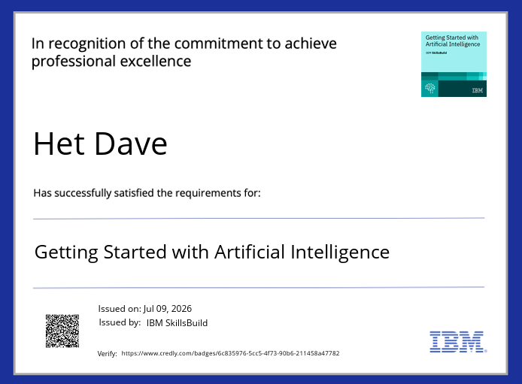
Certificates Earned:
Please add your credly certificate

Slide 12
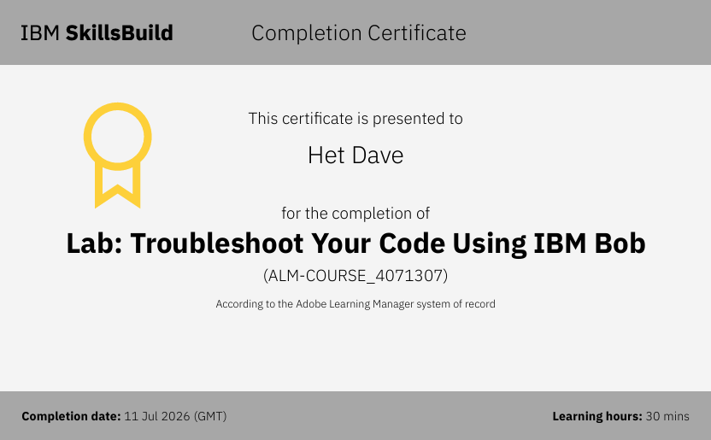
Certificates Earned:​
Add your IBM BOB Certificate

Slide 13


