Slide 1
🚗
REAL-TIME AI SAFETY SYSTEM
Driver Fatigue & Distraction
Detection System
YOLOv8 • MediaPipe Face Mesh • Custom CNN • Head-Pose Estimation • CARLA Simulation
Prepared for IBM Faculty Review

Slide 2
≡
OVERVIEW
Agenda
02
1
The Problem
Why fatigue & distraction detection matters on the road
2
System Architecture
How the full real-time pipeline fits together
3
The Two Models
YOLOv8 face detector + a from-scratch CNN eye classifier
4
Live Detection
Drowsiness logic and head-pose distraction detection
5
The Dashboard
A real, working desktop application — not just a demo script
6
Real-World Simulation
CARLA-driven vehicle response to the live driver state
DRIVER FATIGUE & DISTRACTION DETECTION
02 / 30

Slide 3
01
The Problem & Approach
Why this system exists, and what it sets out to solve

Slide 4
!
MOTIVATION
Problem Statement
04
1
Fatigue crashes are uniquely severe
No braking, no evasive action — drivers who fall asleep often don't react at all.
2
Distraction is just as dangerous
A driver can be wide awake and still look away from the road for critical seconds.
3
Existing solutions fall short
Specialized sensors are expensive; wearables are intrusive and often skipped.
4
A camera-only gap remains
Need a low-cost system that runs on a standard webcam and ordinary hardware.
DRIVER FATIGUE & DISTRACTION DETECTION
04 / 30

Slide 5
◎
GOALS
Project Objectives
05
1
Real-time, webcam-only monitoring
No specialized hardware — works on a standard laptop camera.
2
Independent risk signals
Track eye closure and head orientation as two separate, honest measurements.
3
Low false-positive design
Calibration + temporal confirmation so blinks and glances don't cry wolf.
4
A usable, live dashboard
Not a console script — a real desktop application someone could actually use.
5
A believable real-world payoff
Show the detection driving an actual simulated vehicle's behavior.
DRIVER FATIGUE & DISTRACTION DETECTION
05 / 30

Slide 6
02
System Design
How the pipeline is put together, end to end

Slide 7
⚙
ARCHITECTURE
System Architecture
07
Webcam Capture
OpenCV
Face Mesh
MediaPipe, 468 pts
Eye ROI + CNN
Open / Closed
Head Pose
solvePnP: yaw/pitch/roll
Drowsiness Logic
15-frame rule
Attention Logic
Calibrated + timed
Dashboard
Tkinter live UI
Vehicle Response
CARLA / fallback sim
Two independent signals — eye closure and head pose — run in parallel on the same camera feed and are combined into a Driver State without ever being blurred into one score.
DRIVER FATIGUE & DISTRACTION DETECTION
07 / 30

Slide 8
◆
STACK
Technology Stack
08
Component | Technology | Role
Object Detection | YOLOv8 (Ultralytics) | Face detector, transfer-learned
Facial Landmarks | MediaPipe Face Mesh | 468-point pretrained landmark model
Eye Classifier | PyTorch — Custom CNN | Open/closed classification, trained from scratch
Head Pose | OpenCV solvePnP | Yaw / pitch / roll from 6 landmarks
Desktop UI | Tkinter + Pillow | Live dashboard rendering
Audio Alerting | Pygame Mixer | Looped drowsiness alarm
Vehicle Simulation | CARLA 0.9.16 | Real-world use-case demonstration
Acceleration | CUDA GPU / CPU fallback | Automatic device selection
DRIVER FATIGUE & DISTRACTION DETECTION
08 / 30

Slide 9
▦
DATA
Dataset — Face Detection
09
13,386
TRAINING IMAGES
3,347
VALIDATION IMAGES
1
CLASS: FACE
YOLO
LABEL FORMAT
1
YOLO-format bounding boxes
Normalized coordinates, one label file per image.
2
Organized train/val split
dataset/faces/images and labels, split for honest evaluation.
3
Fine-tuned via transfer learning
Specializes a COCO-pretrained YOLOv8n for the single face class.
DRIVER FATIGUE & DISTRACTION DETECTION
09 / 30

Slide 10
👁
DATA
Dataset — Eye State Classification
10
24,000
CLOSED-EYE IMAGES
23,893
OPEN-EYE IMAGES
47,893
TOTAL (BALANCED)
2
CLASSES
1
Near-perfectly balanced classes
No class-imbalance correction needed for training.
2
PyTorch ImageFolder format
Two class folders — open/ and closed/ — under dataset/eyes/.
3
Powers the from-scratch CNN
Used to train EyeCNN, the core drowsiness-detection model.
DRIVER FATIGUE & DISTRACTION DETECTION
10 / 30

Slide 11
03
The Two Models
Transfer learning for faces, a from-scratch CNN for eyes

Slide 12
1
MODEL 1
YOLOv8n Face Detector
12
1
Base model
yolov8n.pt — the COCO-pretrained nano YOLOv8 variant.
2
Transfer learning
Fine-tuned on the project's own face dataset, not trained from scratch.
3
Why nano?
Chosen specifically for real-time speed on modest, non-server hardware.
4
Training script
training/train_face_detector.py, using the Ultralytics Python API.
DRIVER FATIGUE & DISTRACTION DETECTION
12 / 30

Slide 13
⚙
MODEL 1
Training Configuration
13
Hyperparameter | Value
Base Weights | yolov8n.pt (COCO-pretrained)
Epochs | 50 (early-stop patience = 10 — not triggered)
Image Size | 640 x 640
Batch Size | 16
Optimizer | Auto-selected, lr0 = 0.01
Augmentations | Mosaic, HSV jitter, horizontal flip, translate/scale
Device | GPU (CUDA)
DRIVER FATIGUE & DISTRACTION DETECTION
13 / 30

Slide 14
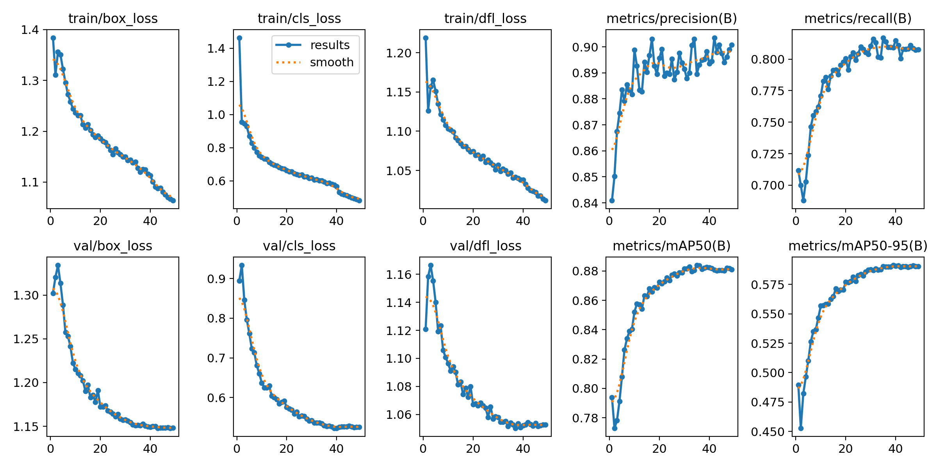
✓
MODEL 1
Results — Final Epoch (49/50)
14
0.90
PRECISION
0.81
RECALL
0.88
MAP@50
0.59
MAP@50-95
DRIVER FATIGUE & DISTRACTION DETECTION
14 / 30

Slide 15
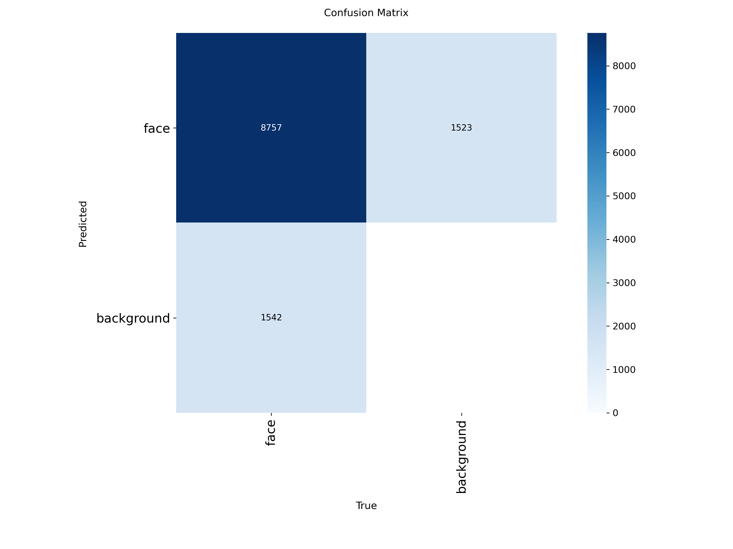
▦
MODEL 1
Confusion Matrix
15
Validation-set confusion matrix for the fine-tuned face detector
DRIVER FATIGUE & DISTRACTION DETECTION
15 / 30

Slide 16
2
MODEL 2
Eye State CNN — Trained From Scratch
16
Layer Block | Details
Conv Block 1 | Conv2d(1→32, 3x3) → BatchNorm → ReLU → MaxPool(2x2)
Conv Block 2 | Conv2d(32→64, 3x3) → BatchNorm → ReLU → MaxPool(2x2)
Conv Block 3 | Conv2d(64→128, 3x3) → BatchNorm → ReLU → MaxPool(2x2)
Classifier Head | Flatten → Linear(1152→256) → ReLU → Dropout(0.5) → Linear(256→2)
Input | 24x24 grayscale eye crop, normalized (mean/std = 0.5)
Output | 2-class softmax — open / closed
DRIVER FATIGUE & DISTRACTION DETECTION
16 / 30

Slide 17
⚙
MODEL 2
Training Configuration
17
Hyperparameter | Value
Epochs | 20
Batch Size | 32
Optimizer | Adam, lr = 0.001
Loss Function | CrossEntropyLoss
Train / Val Split | 80% / 20% (random split)
Checkpointing | Best validation-accuracy epoch saved
Inference Threshold | closed if P(closed) > 0.4 — lowered from 0.5 for sensitivity
DRIVER FATIGUE & DISTRACTION DETECTION
17 / 30

Slide 18
04
Live Detection & UX
From raw pixels to a real-time driver state, on screen

Slide 19
⏱
DETECTION LOGIC
Real-Time Drowsiness Detection
19
1
Extract eye regions every frame
MediaPipe landmarks crop a tight box around each eye.
2
Classify each eye independently
The CNN scores left and right eyes separately as open/closed.
3
Count consecutive closed frames
A counter increments only when BOTH eyes are closed.
4
15 frames triggers DROWSY ALERT
Looped audible alarm + a red border on the live video.
5
Instant reset on reopening
The moment either eye reopens, the counter resets and the alarm stops.
DRIVER FATIGUE & DISTRACTION DETECTION
19 / 30

Slide 20
👀
DETECTION LOGIC
Driver Attention & Distraction Detection
20
1
No extra model needed
Reuses the same MediaPipe landmarks already extracted for the eyes.
2
6 landmarks → solvePnP
Nose, chin, eye & mouth corners → yaw / pitch / roll in degrees.
3
5 direction classes
LOOKING LEFT / RIGHT / UP / DOWN, plus HEAD TILT for head roll.
4
A real bug, found & fixed
Pitch sits near ±180° for this model — required circular-safe smoothing and delta math to avoid a wraparound glitch.
DRIVER FATIGUE & DISTRACTION DETECTION
20 / 30

Slide 21
✔
DETECTION LOGIC
Calibration & False-Positive Protection
21
1
Per-driver calibration
A 2.5-second phase at session start averages the driver's own neutral head pose.
2
Relative, not absolute
Every reading is measured against that personal baseline, not an assumed 0°.
3
Temporal confirmation
A deviation must persist ≥1.5 seconds of wall-clock time before it's confirmed.
4
Live, honest feedback
Direction and a 'confirming…' timer update instantly — visibly responsive, never trigger-happy.
5
EMA smoothing
Filters out blinks, brief glances, and natural head jitter before they matter.
DRIVER FATIGUE & DISTRACTION DETECTION
21 / 30

Slide 22
⊕
DETECTION LOGIC
Combined Driver State
22
Eyes | Head Pose | Resulting Insight
Open | Forward | ATTENTIVE — normal driving
Open | Turned away (sustained) | DISTRACTED — looking away, still awake
Closed (sustained) | Forward | DROWSY — classic micro-sleep pattern
Closed (sustained) | Down | DROWSY / HIGH RISK — nodding off
Fatigue (AWAKE/DROWSY) and Attention (ATTENTIVE/DISTRACTED) are shown as two separate dashboard badges rather than one merged label — this is exactly what lets the system tell apart very different risk profiles instead of blurring them together.
DRIVER FATIGUE & DISTRACTION DETECTION
22 / 30

Slide 23
▤
THE APPLICATION
Real-Time Dashboard
23
1
A real desktop app, not a script
app.py, built with Tkinter — replaces the raw OpenCV preview window.
2
Guided start screen
Pipeline explainer + a Start button that activates only once models finish loading.
3
Full live sidebar
Fatigue badge, per-eye state, drowsiness meter, blinks, alerts, FPS — all at a glance.
4
Attention sidebar
ATTENTIVE/DISTRACTED badge, live yaw/pitch/roll, direction indicator, attention score.
5
End-of-session summary
A popup reports attentive/distracted time, event count, and attention rate.
DRIVER FATIGUE & DISTRACTION DETECTION
23 / 30

Slide 24
05
Real-World Simulation
Turning a detection signal into an actual vehicle response

Slide 25
🚗
REAL-WORLD USE CASE
Vehicle Response Simulation
25
1
The real payoff
The live Driver State drives an actual simulated vehicle's behavior — not just a log line.
2
Primary: CARLA
An open-source AV simulator — a real 3D vehicle in traffic, controlled by the app's live output.
3
Automatic fallback
A lightweight custom Tkinter simulation opens instantly if no CARLA server is reachable.
4
Zero-risk design
Same Driver State interface either way — no detection-logic changes needed to switch backends.
DRIVER FATIGUE & DISTRACTION DETECTION
25 / 30

Slide 26
⚠
REAL-WORLD USE CASE
Fatigue Level Escalation (CARLA)
26
Level | Trigger | Vehicle Response
1 | ≥ 15 consecutive closed frames | Audible beep (existing alarm)
2 | ≥ 30 consecutive closed frames | Vehicle speed reduced to 15 km/h
3 | ≥ 45 consecutive closed frames | Full stop — brake + handbrake
1
Waypoint-following control
CarlaBridge steers along the road via live waypoints, not a straight line.
2
20 Hz response loop
Reads the driver's fatigue level and adjusts throttle/brake 20 times per second.
DRIVER FATIGUE & DISTRACTION DETECTION
26 / 30

Slide 27
06
Wrap-Up
What's next, and what this project demonstrates

Slide 28
→
LOOKING AHEAD
Limitations & Future Work
28
1
YOLO detector underused
Trained but not yet wired in as a pre-crop step in the live loop.
2
Untested edge cases
Low light and eyewear (glasses/sunglasses) performance not yet formally evaluated.
3
CARLA needs its server
The bridge is real and tested — but needs the CARLA server running separately.
4
Clear next steps
Yawn detection, real CAN-bus integration, and multi-driver profile support.
DRIVER FATIGUE & DISTRACTION DETECTION
28 / 30

Slide 29
CONCLUSION
A Complete, Working Driver Monitoring System
Transfer learning (YOLOv8), a pretrained landmark model (MediaPipe), a from-scratch CNN, and solvePnP head-pose estimation — combined into a system that distinguishes ATTENTIVE, DISTRACTED, and DROWSY driver states in real time, with a live dashboard, audible alerting, and a demonstrated path to real vehicle response.

Slide 30
Thank You
Questions & Discussion

