Slide 1
🚗
REAL-TIME AI SAFETY SYSTEM
Driver Fatigue & Distraction
Detection System
YOLOv8 • MediaPipe Face Mesh • Custom CNN • Head-Pose Estimation • CARLA Simulation
Prepared for IBM Faculty Review

Slide 2
01
The Problem & Approach
Why this system exists, and what it sets out to solve

Slide 3
!
MOTIVATION
Problem Statement
03
1
Fatigue crashes are uniquely severe
No braking, no evasive action — drivers who fall asleep often don't react at all.
2
Distraction is just as dangerous
A driver can be wide awake and still look away from the road for critical seconds.
3
Existing solutions fall short
Specialized sensors are expensive; wearables are intrusive and often skipped.
4
A camera-only gap remains
Need a low-cost system that runs on a standard webcam and ordinary hardware.
DRIVER FATIGUE & DISTRACTION DETECTION
03 / 26

Slide 4
◎
GOALS
Project Objectives
04
1
Real-time, webcam-only monitoring
No specialized hardware — works on a standard laptop camera.
2
Independent risk signals
Track eye closure and head orientation as two separate, honest measurements.
3
Low false-positive design
Calibration + temporal confirmation so blinks and glances don't cry wolf.
4
A usable, live dashboard
Not a console script — a real desktop application someone could actually use.
5
A believable real-world payoff
Show the detection driving an actual simulated vehicle's behavior.
DRIVER FATIGUE & DISTRACTION DETECTION
04 / 26

Slide 5
02
System Design
How the pipeline is put together, end to end

Slide 6
⚙
ARCHITECTURE
System Architecture
06
Webcam Capture
OpenCV
Face Mesh
MediaPipe, 468 pts
Eye ROI + CNN
Open / Closed
Head Pose
solvePnP: yaw/pitch/roll
Drowsiness Logic
15-frame rule
Attention Logic
Calibrated + timed
Dashboard
Tkinter live UI
Vehicle Response
CARLA / fallback sim
Two independent signals — eye closure and head pose — run in parallel on the same camera feed and are combined into a Driver State without ever being blurred into one score.
DRIVER FATIGUE & DISTRACTION DETECTION
06 / 26

Slide 7
◆
STACK
Technology Stack
07
Component | Technology | Role
Object Detection | YOLOv8 (Ultralytics) | Face detector, transfer-learned
Facial Landmarks | MediaPipe Face Mesh | 468-point pretrained landmark model
Eye Classifier | PyTorch — Custom CNN | Open/closed classification, trained from scratch
Head Pose | OpenCV solvePnP | Yaw / pitch / roll from 6 landmarks
Desktop UI | Tkinter + Pillow | Live dashboard rendering
Audio Alerting | Pygame Mixer | Looped drowsiness alarm
Vehicle Simulation | CARLA 0.9.16 | Real-world use-case demonstration
Acceleration | CUDA GPU / CPU fallback | Automatic device selection
DRIVER FATIGUE & DISTRACTION DETECTION
07 / 26

Slide 8
▣
CORE COMPONENT
MediaPipe Face Mesh
08
1
468-point facial landmark model
A pretrained model from Google — not trained as part of this project.
2
Feeds both detection pipelines
The same landmark set crops each eye AND supplies the 6 points solvePnP uses for head pose.
3
Real-time on CPU
Light enough to run every single frame without needing a GPU, unlike the CNN and YOLO models.
4
A deliberate engineering choice
Landmark detection at this accuracy needs huge datasets — reusing a proven pretrained model beats reinventing it.
DRIVER FATIGUE & DISTRACTION DETECTION
08 / 26

Slide 9
▦
DATA
Dataset — Face Detection
09
13,386
TRAINING IMAGES
3,347
VALIDATION IMAGES
1
CLASS: FACE
YOLO
LABEL FORMAT
1
YOLO-format bounding boxes
Normalized coordinates, one label file per image.
2
Organized train/val split
dataset/faces/images and labels, split for honest evaluation.
3
Fine-tuned via transfer learning
Specializes a COCO-pretrained YOLOv8n for the single face class.
DRIVER FATIGUE & DISTRACTION DETECTION
09 / 26

Slide 10
👁
DATA
Dataset — Eye State Classification
10
24,000
CLOSED-EYE IMAGES
23,893
OPEN-EYE IMAGES
47,893
TOTAL (BALANCED)
2
CLASSES
1
Near-perfectly balanced classes
No class-imbalance correction needed for training.
2
PyTorch ImageFolder format
Two class folders — open/ and closed/ — under dataset/eyes/.
3
Powers the from-scratch CNN
Used to train EyeCNN, the core drowsiness-detection model.
DRIVER FATIGUE & DISTRACTION DETECTION
10 / 26

Slide 11
03
The Two Models
Transfer learning for faces, a from-scratch CNN for eyes

Slide 12
1
MODEL 1
YOLOv8n Face Detector
12
1
Base model
yolov8n.pt — the COCO-pretrained nano YOLOv8 variant.
2
Transfer learning
Fine-tuned on the project's own face dataset, not trained from scratch.
3
Why nano?
Chosen specifically for real-time speed on modest, non-server hardware.
4
Training script
training/train_face_detector.py, using the Ultralytics Python API.
DRIVER FATIGUE & DISTRACTION DETECTION
12 / 26

Slide 13
⚙
MODEL 1
Training Configuration
13
Hyperparameter | Value
Base Weights | yolov8n.pt (COCO-pretrained)
Epochs | 50 (early-stop patience = 10 — not triggered)
Image Size | 640 x 640
Batch Size | 16
Optimizer | Auto-selected, lr0 = 0.01
Augmentations | Mosaic, HSV jitter, horizontal flip, translate/scale
Device | GPU (CUDA)
DRIVER FATIGUE & DISTRACTION DETECTION
13 / 26

Slide 14
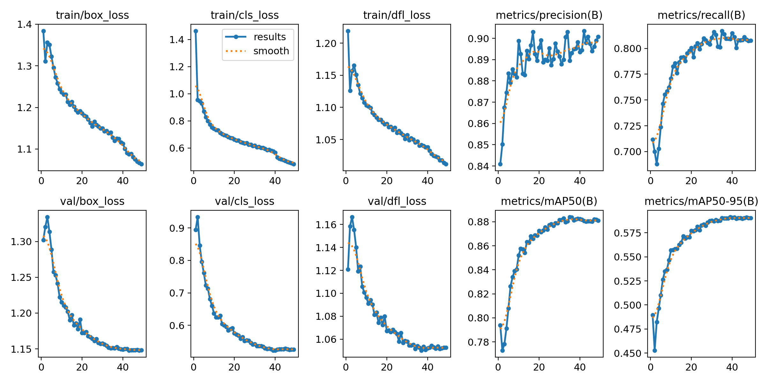
✓
MODEL 1
Results — Final Epoch (49/50)
14
0.90
PRECISION
0.81
RECALL
0.88
MAP@50
0.59
MAP@50-95
DRIVER FATIGUE & DISTRACTION DETECTION
14 / 26

Slide 15
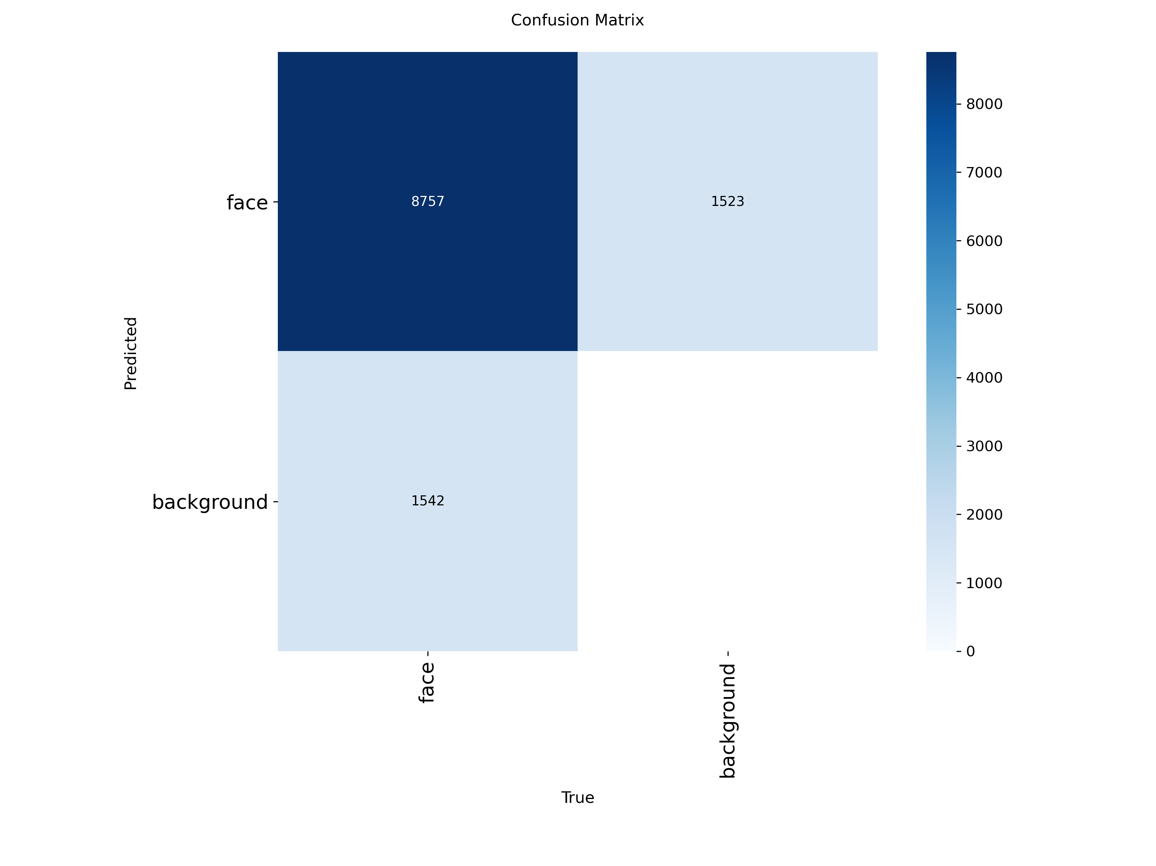
▦
MODEL 1
Confusion Matrix
15
Validation-set confusion matrix for the fine-tuned face detector
DRIVER FATIGUE & DISTRACTION DETECTION
15 / 26

Slide 16
2
MODEL 2
Eye State CNN — Trained From Scratch
16
Layer Block | Details
Conv Block 1 | Conv2d(1→32, 3x3) → BatchNorm → ReLU → MaxPool(2x2)
Conv Block 2 | Conv2d(32→64, 3x3) → BatchNorm → ReLU → MaxPool(2x2)
Conv Block 3 | Conv2d(64→128, 3x3) → BatchNorm → ReLU → MaxPool(2x2)
Classifier Head | Flatten → Linear(1152→256) → ReLU → Dropout(0.5) → Linear(256→2)
Input | 24x24 grayscale eye crop, normalized (mean/std = 0.5)
Output | 2-class softmax — open / closed
DRIVER FATIGUE & DISTRACTION DETECTION
16 / 26

Slide 17
⚙
MODEL 2
Training Configuration
17
Hyperparameter | Value
Epochs | 20
Batch Size | 32
Optimizer | Adam, lr = 0.001
Loss Function | CrossEntropyLoss
Train / Val Split | 80% / 20% (random split)
Checkpointing | Best validation-accuracy epoch saved
Inference Threshold | closed if P(closed) > 0.4 — lowered from 0.5 for sensitivity
DRIVER FATIGUE & DISTRACTION DETECTION
17 / 26

Slide 18
🔔
DETECTION LOGIC
Detecting Drowsiness — From Eyes to Beep
18
Eye Crop
MediaPipe landmarks
CNN Classifier
Open / Closed
Closed-Frame Counter
Increments while both eyes closed
≥ 15 Frames?
≈0.5-1 second threshold
BEEP + Alert
pygame alarm.wav, looped
1
Both eyes must agree
The counter only increments when LEFT and RIGHT are both classified closed — a single droopy eye doesn't trigger it.
2
Instant reset on reopening
The moment either eye reopens, the counter resets to zero and the alarm stops immediately.
3
Visual + audible together
A looped alarm.wav plays via pygame AND a red border flashes on the live video feed.
DRIVER FATIGUE & DISTRACTION DETECTION
18 / 26

Slide 19
04
Real-World Simulation
Turning a detection signal into an actual vehicle response

Slide 20
🚗
REAL-WORLD USE CASE
Vehicle Response Simulation
20
1
The real payoff
The live Driver State drives an actual simulated vehicle's behavior — not just a log line.
2
Primary: CARLA
An open-source AV simulator — a real 3D vehicle in traffic, controlled by the app's live output.
3
Automatic fallback
A lightweight custom Tkinter simulation opens instantly if no CARLA server is reachable.
4
Zero-risk design
Same Driver State interface either way — no detection-logic changes needed to switch backends.
DRIVER FATIGUE & DISTRACTION DETECTION
20 / 26

Slide 21
⚠
REAL-WORLD USE CASE
Fatigue Level Escalation (CARLA)
21
Level | Trigger | Vehicle Response
1 | ≥ 15 consecutive closed frames | Audible beep (existing alarm)
2 | ≥ 30 consecutive closed frames | Vehicle speed reduced to 15 km/h
3 | ≥ 45 consecutive closed frames | Full stop — brake + handbrake
1
Waypoint-following control
CarlaBridge steers along the road via live waypoints, not a straight line.
2
20 Hz response loop
Reads the driver's fatigue level and adjusts throttle/brake 20 times per second.
DRIVER FATIGUE & DISTRACTION DETECTION
21 / 26

Slide 22
05
Wrap-Up
Where the current model falls short, and what comes next

Slide 23
△
LOOKING AHEAD
Limitations of the Current Model
23
1
YOLO detector underused
Trained but not yet wired in as a pre-crop step in the live loop — MediaPipe does that job for now.
2
Untested edge cases
Low light and eyewear (glasses/sunglasses) performance not yet formally evaluated.
3
Frame-rate dependence
Eye-closure duration is measured in frame counts, so trigger timing shifts slightly with camera FPS.
4
CARLA needs its server
The bridge is real and tested — but needs the CARLA server running separately to produce a live 3D simulation.
DRIVER FATIGUE & DISTRACTION DETECTION
23 / 26

Slide 24
→
LOOKING AHEAD
Future Outcome & Roadmap
24
1
Yawn & nod detection
Extend the same landmark pipeline to catch yawning and head-nodding micro-sleep cues.
2
Real CAN-bus integration
Replace the CARLA bridge with an actual vehicle's control bus, using the same Driver State interface.
3
Multi-driver profiles
Store calibration baselines per driver so the system recognizes returning users instantly.
4
Field validation study
Formal accuracy testing across lighting conditions, eyewear, and diverse driver demographics.
DRIVER FATIGUE & DISTRACTION DETECTION
24 / 26

Slide 25
CONCLUSION
A Complete, Working Driver Monitoring System
Transfer learning (YOLOv8), a pretrained landmark model (MediaPipe), a from-scratch CNN, and solvePnP head-pose estimation — combined into a system that distinguishes ATTENTIVE, DISTRACTED, and DROWSY driver states in real time, with a live dashboard, audible alerting, and a demonstrated path to real vehicle response.

Slide 26
Thank You
Questions & Discussion

