Slide 1
CS5412 / Lecture 21 Apache Spark and RDDs
Kishore Pusukuri, Spring 2021

Slide 2
Recap
MapReduce
For easily writing applications to process vast amounts of data in-parallel on large clusters in a reliable, fault-tolerant manner
Takes care of scheduling tasks, monitoring them and re-executes the failed tasks
HDFS & MapReduce: Running on the same set of nodes → compute nodes and storage nodes same (keeping data close to the computation) → very high throughput
YARN & MapReduce: A single master resource manager, one slave node manager per node, and AppMaster per application

Slide 3
Today’s Topics
Motivation
Spark Basics
Spark Programming

Slide 4
History of Hadoop and Spark

Slide 5
Apache Spark
** Spark can connect to several types of cluster managers (either Spark’s own standalone cluster manager, Mesos or YARN)
Processing
Spark Stream
Spark SQL
Spark ML
Other Applications
Resource manager
Spark Core
(Standalone Scheduler)
Mesos etc.
Yet Another Resource Negotiator (YARN)
Data Ingestion Systems
e.g., Apache Kafka, Flume, etc
S3, Cassandra etc., other storage systems
Hadoop NoSQL Database (HBase)
Data Storage
Hadoop Distributed File System (HDFS)
Hadoop
Spark

Slide 6
Apache Hadoop Lacks Unified Vision
Sparse Modules
Diversity of APIs
Higher Operational Costs

Slide 7
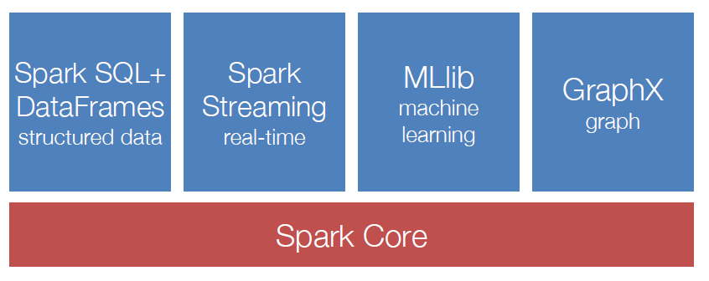
Spark Ecosystem: A Unified Pipeline
Note: Spark is not designed for IoT real-time. The streaming layer is used for continuous input streams like financial data from stock markets, where events occur steadily and must be processed as they occur. But there is no sense of direct I/O from sensors/actuators. For IoT use cases, Spark would not be suitable.

Slide 8
Key ideas
In Hadoop, each developer tends to invent his or her own style of work
With Spark, serious effort to standardize around the idea that people are writing parallel code that often runs for many “cycles” or “iterations” in which a lot of reuse of information occurs.
Spark centers on Resilient Distributed Dataset, RDDs, that capture the information being reused.

Slide 9
How this works
You express your application as a graph of RDDs.
The graph is only evaluated as needed, and they only compute the RDDs actually needed for the output you have requested.
Then Spark can be told to cache the reuseable information either in memory, in SSD storage or even on disk, based on when it will be needed again, how big it is, and how costly it would be to recreate.
You write the RDD logic and control all of this via hints

Slide 10
Motivation (1)
MapReduce: The original scalable, general, processing engine of the Hadoop ecosystem
Disk-based data processing framework (HDFS files)
Persists intermediate results to disk
Data is reloaded from disk with every query → Costly I/O
Best for ETL like workloads (batch processing)
Costly I/O → Not appropriate for iterative or stream processing workloads

Slide 11
Motivation (2)
Spark: General purpose computational framework that substantially improves performance of MapReduce, but retains the basic model
Memory based data processing framework → avoids costly I/O by keeping intermediate results in memory
Leverages distributed memory
Remembers operations applied to dataset
Data locality based computation → High Performance
Best for both iterative (or stream processing) and batch workloads

Slide 12
Motivation - Summary
Software engineering point of view
Hadoop code base is huge
Contributions/Extensions to Hadoop are cumbersome
Java-only hinders wide adoption, but Java support is fundamental
System/Framework point of view
Unified pipeline
Simplified data flow
Faster processing speed
Data abstraction point of view
New fundamental abstraction RDD
Easy to extend with new operators
More descriptive computing model

Slide 13
Today’s Topics
Motivation
Spark Basics
Spark Programming

Slide 14
Spark Basics(1)
Spark: Flexible, in-memory data processing framework written in Scala
Goals:
Simplicity (Easier to use):
Rich APIs for Scala, Java, and Python
Generality: APIs for different types of workloads
Batch, Streaming, Machine Learning, Graph
Low Latency (Performance) : In-memory processing and caching
Fault-tolerance: Faults shouldn’t be special case
Notes:
Scala is a functional programming language that runs in a JVM

Slide 15
Spark Basics(2)
There are two ways to manipulate data in Spark
Spark Shell:
Interactive – for learning or data exploration
Python or Scala
Spark Applications
For large scale data processing
Python, Scala, or Java
Notes:
We use some code snippets and spark shell in this class.

Slide 16
Spark Core: Code Base (2012)

Slide 17
Spark Shell
The Spark Shell provides interactive data exploration (REPL)
REPL: Repeat/Evaluate/Print Loop
Notes:
We use some code snippets and spark shell in this class.

Slide 18
Spark Fundamentals
Example of an application:
Spark Context
Resilient Distributed Data
Transformations
Actions

Slide 19
Spark Context (1)
Every Spark application requires a spark context: the main entry point to the Spark API
Spark Shell provides a preconfigured Spark Context called “sc”

Slide 20
Spark Context (2)
Standalone applications → Driver code → Spark Context
Spark Context holds configuration information and represents connection to a Spark cluster
Standalone Application (Drives Computation)
Notes:
Cluster manager -- mesos, yarn, spark core standalone manager

Slide 21
Spark Context (3)
Spark context works as a client and represents connection to a Spark cluster
Notes:
Uses a directed acyclic graph of RDDs → create a schedule of spark tasks ..with the help of cluster manager assigns those tasks to worker nodes

Slide 22
Spark Fundamentals
Example of an application:
Spark Context
Resilient Distributed Data
Transformations
Actions

Slide 23
Resilient Distributed Dataset (RDD)
The RDD (Resilient Distributed Dataset) is the fundamental unit of data in Spark: An Immutable collection of objects (or records, or elements) that can be operated on “in parallel” (spread across a cluster)
Resilient -- if data in memory is lost, it can be recreated
Recover from node failures
An RDD keeps its lineage information → it can be recreated from parent RDDs
Distributed -- processed across the cluster
Each RDD is composed of one or more partitions → (more partitions – more parallelism)
Dataset -- initial data can come from a file or be created

Slide 24
RDDs
Key Idea: Write applications in terms of transformations on distributed datasets. One RDD per transformation.
Organize the RDDs into a DAG showing how data flows.
RDD can be saved and reused or recomputed. Spark can save it to disk if the dataset does not fit in memory
Built through parallel transformations (map, filter, group-by, join, etc). Automatically rebuilt on failure
Controllable persistence (e.g. caching in RAM)

Slide 25
RDDs are designed to be “immutable”
Create once, then reuse without changes. Spark knows lineage → can be recreated at any time → Fault-tolerance
Avoids data inconsistency problems (no simultaneous updates) → Correctness
Easily live in memory as on disk → Caching → Safe to share across processes/tasks → Improves performance
Tradeoff: (Fault-tolerance & Correctness) vs (Disk Memory & CPU)

Slide 26
Creating a RDD
Three ways to create a RDD
From a file or set of files
From data in memory
From another RDD
Notes:
Created by starting with a file in Hadoop Distributed File System (HDFS) or an existing collection in the driver program
Similar to map or reduce… Map is similar to map reduce map.. Group-by is kind of reduce function.. There are other functions
May be persisted in memory for efficient reuse across parallel operations (caching)

Slide 27
Example: A File-based RDD
Notes:
mydata is a RDD… sc– the context.. Count is an action…

Slide 28
Spark Fundamentals
Example of an application:
Spark Context
Resilient Distributed Data
Transformations
Actions

Slide 29
RDD Operations
Two types of operations
Transformations: Define a new RDD based on current RDD(s)
Actions: return values

Slide 30
RDD Transformations
Set of operations on a RDD that define how they should be transformed
As in relational algebra, the application of a transformation to an RDD yields a new RDD (because RDD are immutable)
Transformations are lazily evaluated, which allow for optimizations to take place before execution
Examples: map(), filter(), groupByKey(), sortByKey(), etc.

Slide 31
Example: map and filter Transformations
Notes:
Talk about lineage here

Slide 32
RDD Actions
Apply transformation chains on RDDs, eventually performing some additional operations (e.g., counting)
Some actions only store data to an external data source (e.g. HDFS), others fetch data from the RDD (and its transformation chain) upon which the action is applied, and convey it to the driver
Some common actions
count() – return the number of elements
take(n) – return an array of the first n elements
collect()– return an array of all elements
saveAsTextFile(file) – save to text file(s)

Slide 33
Graph of RDDs
A collection of RDDs can be understood as a graph
Nodes in the graph are the RDDs, which means the code but also the actual data object that could would create at runtime when executed on specific parameters + data. Reminder: Hadoop is a “read only” model, so we can “materialize” an RDD any time we like.
Edges represent how data objects are accessed: RDD B might consume the object created by RDD A. This gives us a directed edge A → B

Slide 34
Lazy Execution of RDDs (1)
Data in RDDs is not processed until an action is performed

Slide 35
Lazy Execution of RDDs (2)
Data in RDDs is not processed until an action is performed

Slide 36
Lazy Execution of RDDs (3)
Data in RDDs is not processed until an action is performed

Slide 37
Lazy Execution of RDDs (4)
Data in RDDs is not processed until an action is performed

Slide 38
Lazy Execution of RDDs (5)
Data in RDDs is not processed until an action is performed
Output Action “triggers” computation, pull model

Slide 39
Opportunities This Enables
On-demand optimization: Spark can behave like a compiler by first building a potentially complex RDD graph, but then trimming away unneeded computations that for today’s purpose, won’t be used.
Caching for later reuse.
Graph transformations: A significant amount of effort is going into this area. It is a lot like compiler-managed program transformation and aims at simplifying and speeding up the computation that will occur.
Dynamic decisions about what to schedule and when. Concept: minimum adequate set of input objects: RDD can run if all its inputs are ready

Slide 40
Example: Mine error logs
Load error messages from a log into memory, then interactively search for various patterns:
lines = spark.textFile(“hdfs://...”) HadoopRDD
errors = lines.filter(lambda s: s.startswith(“ERROR”)) FilteredRDD
messages = errors.map(lambda s: s.split(“\t”)[2])
messages.cache()
messages.filter(lambda s: “foo” in s).count()
Result: full-text search of Wikipedia in 0.5 sec (vs 20 sec for on-disk data)

Slide 41
Key Idea: Elastic parallelism
RDDs operations are designed to offer embarrassing parallelism.
Spark will spread the task over the nodes where data resides, offers a highly concurrent execution that minimizes delays. Term: “partitioned computation” .
If some component crashes or even is just slow, Spark simply kills that task and launches a substitute.

Slide 42
RDD and Partitions (Parallelism example)

Slide 43
RDD Graph: Data Set vs Partition Views
Much like in Hadoop MapReduce, each RDD is associated to (input) partitions

Slide 44
RDDs: Data Locality
Data Locality Principle
Keep high-value RDDs precomputed, in cache or SDD
Run tasks that need the specific RDD with those same inputs on the node where the cached copy resides.
This can maximize in-memory computational performance.
Requires cooperation between your hints to Spark when you build the RDD, Spark runtime and optimization planner, and the underlying YARN resource manager.

Slide 45
RDDs -- Summary
RDD are partitioned, locality aware, distributed collections
RDD are immutable
RDD are data structures that:
Either point to a direct data source (e.g. HDFS)
Apply some transformations to its parent RDD(s) to generate new data elements
Computations on RDDs
Represented by lazily evaluated lineage DAGs composed by chained RDDs

Slide 46
Lifetime of a Job in Spark

Slide 47
Anatomy of a Spark Application
Cluster Manager (YARN/Mesos)

Slide 48
Typical RDD pattern of use
Instead of doing a lot of work in each RDD, developers split tasks into lots of small RDDs
These are then organized into a DAG.
Developer anticipates which will be costly to recompute and hints to Spark that it should cache those.

Slide 49
Why is this a good strategy?
Spark tries to run tasks that will need the same intermediary data on the same nodes.
If MapReduce jobs were arbitrary programs, this wouldn’t help because reuse would be very rare.
But in fact the MapReduce model is very repetitious and iterative, and often applies the same transformations again and again to the same input files.
Those particular RDDs become great candidates for caching.
MapReduce programmer may not know how many iterations will occur, but Spark itself is smart enough to evict RDDs if they don’t actually get reused.

Slide 50
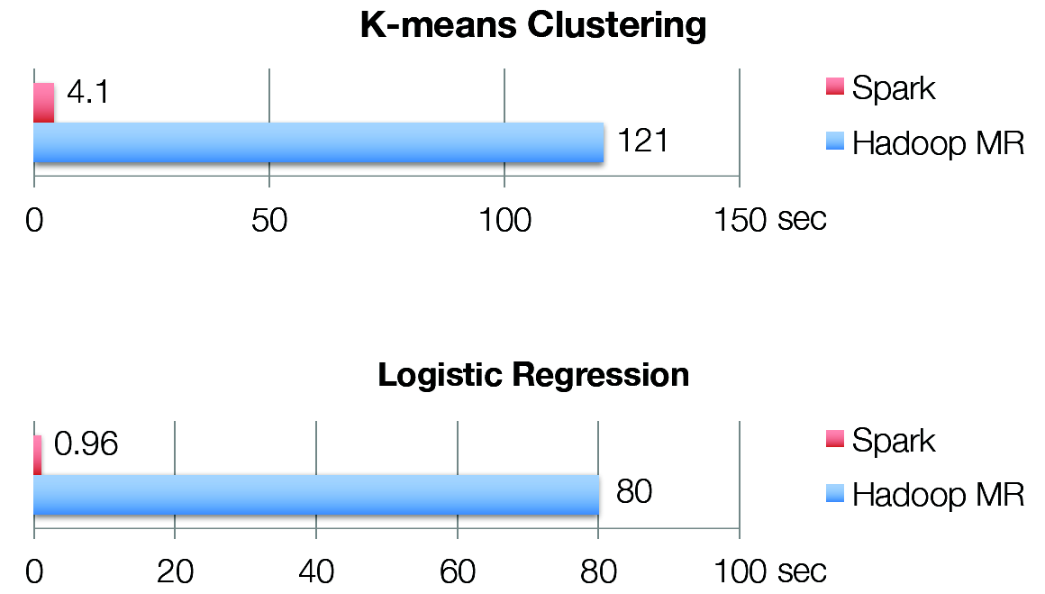
Iterative Algorithms: Spark vs MapReduce

Slide 51
Today’s Topics
Motivation
Spark Basics
Spark Programming

Slide 52
Spark Programming (1)
Creating RDDs
# Turn a Python collection into an RDD
sc.parallelize([1, 2, 3])
# Load text file from local FS, HDFS, or S3
sc.textFile(“file.txt”)
sc.textFile(“directory/*.txt”)
sc.textFile(“hdfs://namenode:9000/path/file”)
# Use existing Hadoop InputFormat (Java/Scala only)
sc.hadoopFile(keyClass, valClass, inputFmt, conf)

Slide 53
Spark Programming (2)
Basic Transformations
nums = sc.parallelize([1, 2, 3])
# Pass each element through a function
squares = nums.map(lambda x: x*x) // {1, 4, 9}
# Keep elements passing a predicate
even = squares.filter(lambda x: x % 2 == 0) // {4}

Slide 54
Spark Programming (3)
Basic Actions
nums = sc.parallelize([1, 2, 3])
# Retrieve RDD contents as a local collection
nums.collect() # => [1, 2, 3]
# Return first K elements
nums.take(2) # => [1, 2]
# Count number of elements
nums.count() # => 3
# Merge elements with an associative function
nums.reduce(lambda x, y: x + y) # => 6

Slide 55
Spark Programming (4)
Working with Key-Value Pairs
Spark’s “distributed reduce” transformations operate on RDDs of key-value pairs
Python: pair = (a, b)
pair[0] # => a
pair[1] # => b
Scala: val pair = (a, b)
pair._1 // => a
pair._2 // => b
Java: Tuple2 pair = new Tuple2(a, b);
pair._1 // => a
pair._2 // => b

Slide 56
Spark Programming (5)
Some Key-Value Operations
pets = sc.parallelize([(“cat”, 1), (“dog”, 1), (“cat”, 2)])
pets.reduceByKey(lambda x, y: x + y) # => {(cat, 3), (dog, 1)}
pets.groupByKey() # => {(cat, [1, 2]), (dog, [1])}
pets.sortByKey() # => {(cat, 1), (cat, 2), (dog, 1)}

Slide 57
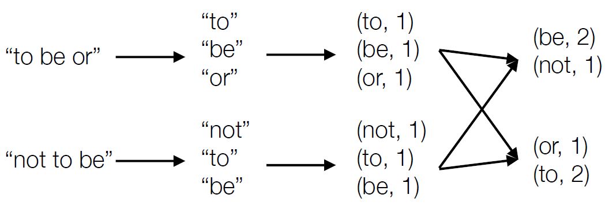
Example: Word Count
lines = sc.textFile(“hamlet.txt”)
counts = lines.flatMap(lambda line: line.split(“ “))
.map(lambda word: (word, 1))
.reduceByKey(lambda x, y: x + y)

Slide 58

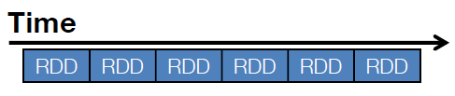
Example: Spark Streaming
Represents streams as a series of RDDs over time (typically sub second intervals, but it is configurable)
val spammers = sc.sequenceFile(“hdfs://spammers.seq”)
sc.twitterStream(...)
.filter(t => t.text.contains(“Santa Clara University”))
.transform(tweets => tweets.map(t => (t.user, t)).join(spammers))
.print()

Slide 59
Spark: Combining Libraries (Unified Pipeline)
# Load data using Spark SQL
points = spark.sql(“select latitude, longitude from tweets”)
# Train a machine learning model
model = KMeans.train(points, 10)
# Apply it to a stream
sc.twitterStream(...)
.map(lambda t: (model.predict(t.location), 1))
.reduceByWindow(“5s”, lambda a, b: a + b)

Slide 60
Spark: Setting the Level of Parallelism
All the pair RDD operations take an optional second parameter for number of tasks
words.reduceByKey(lambda x, y: x + y, 5)
words.groupByKey(5)
visits.join(pageViews, 5)

Slide 61
Summary
Spark is a powerful “manager” for big data computing.
It centers on a job scheduler for Hadoop (MapReduce) that is smart about where to run each task: co-locate task with data.
The data objects are “RDDs”: a kind of recipe for generating a file from an underlying data collection. RDD caching allows Spark to run mostly from memory-mapped data, for speed.
Online tutorials: spark.apache.org/docs/latest

