Slide 1
Switching
8.<number>

Slide 2

Figure 8.1 Switched network
8.<number>

Slide 3

Figure 8.2 Taxonomy of switched networks
8.<number>

Slide 4
8-1 CIRCUIT-SWITCHED NETWORKS
A circuit-switched network consists of a set of switches connected by physical links. A connection between two stations is a dedicated path made of one or more links. However, each connection uses only one dedicated channel on each link. Each link is normally divided into n channels by using FDM or TDM.
Topics discussed in this section:
Three Phases
Efficiency
Delay
Circuit-Switched Technology in Telephone Networks
8.<number>

Slide 5

Note
In circuit switching, the resources need to be reserved during the setup phase;
the resources remain dedicated for the entire duration of data transfer until the teardown phase.
8.<number>

Slide 6

Figure 8.6 Delay in a circuit-switched network
8.<number>

Slide 7
Note
Switching at the physical layer in the traditional telephone network uses
the circuit-switching approach.
8.<number>

Slide 8
A path in a digital circuit-switched network has a data rate of 1 Mbps. The exchange of 1000 bits is required for the setup and teardown phases. The distance between two parties is 3000 km. Answer the following questions if the propagation speed is 2 × 10⁸ m/s:
a. What is the total delay if 1000 bits of data are exchanged during the data transfer phase?
b. What is the total delay if 100,000 bits of data are exchanged during the data transfer phase?
c. What is the total delay if 1,000,000 bits of data are exchanged during the data transfer phase?
8.<number>

Slide 9
8-2 DATAGRAM NETWORKS
In data communications, we need to send messages from one end system to another. If the message is going to pass through a packet-switched network, it needs to be divided into packets of fixed or variable size. The size of the packet is determined by the network and the governing protocol.
Topics discussed in this section:
Routing Table
Efficiency
Delay
Datagram Networks in the Internet
8.<number>

Slide 10
Two Basic Forms of Packet Switching
Packets handled in two ways
  Datagram (covered in this section)
  Virtual circuit (covered in the next section)
8.<number>

Slide 11
Datagram
Each packet treated independently
Packets can take any practical route
Packets may arrive out of order
Packets may get lost or delayed
Up to receiver to re-order packets and recover from missing packets
8.<number>

Slide 12
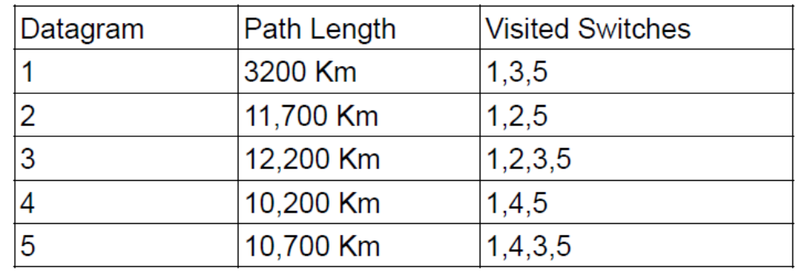
Five equal-size datagrams belonging to the same message leave for the destination one after another. However, they travel through different paths as shown in the following table
We assume that the delay for each switch (including waiting and processing) is 3, 10, 20, 7, and 20 ms respectively. Assuming that the propagation speed is 2×10⁸ m/s, find the order the datagrams arrive at the destination and the delay for each. Ignore any other delays in transmission.
8.<number>

Slide 13
Virtual Circuit
Preplanned route established before any packets sent
Call request and call accept packets establish connection (handshake)
Each packet contains a virtual circuit identifier instead of destination address
No routing decisions required for each packet
Clear request to drop circuit
Not a dedicated
8.<number>

Slide 14

Figure 8.7 A datagram network with four switches (routers)
8.<number>

Slide 15

Figure 8.8 Routing table in a datagram network
8.<number>

Slide 16
Note
A switch in a datagram network uses a routing table that is based on the destination address.
8.<number>

Slide 17
Note
The destination address in the header of a packet in a datagram network
remains the same during the entire journey of the packet.
8.<number>

Slide 18

Figure 8.9 Delay in a datagram network
8.<number>

Slide 19
Note
Switching in the Internet is done by using the datagram approach
to packet switching at
the network layer.
8.<number>

Slide 20
8-3 VIRTUAL-CIRCUIT NETWORKS
A virtual-circuit network is a cross between a circuit-switched network and a datagram network. It has some characteristics of both.
Topics discussed in this section:
Addressing
Three Phases
Efficiency
Delay
Circuit-Switched Technology in WANs
8.<number>

Slide 21

Figure 8.10 Virtual-circuit network
8.<number>

Slide 22
Addressing
In a virtual-circuit network, two types of addressing are involved: global and local (virtual-circuit identifier).
  Global Addressing:- an address that can be unique in the scope of the network or internationally.
    However, a global address in virtual-circuit networks is used only to create a virtual-circuit identifier.
  Local (VCI):- this identifier is actually used for data transfer.
    A VCI, unlike a global address, is a small number that has only switch scope; it is used by a frame between two switches. When a frame arrives at a switch, it has a VCI; when it leaves, it has a different VCl.
8.<number>

Slide 23

Figure 8.11 Virtual-circuit identifier
Figure 8.11 shows how the VCI in a data frame changes from one switch to another.
8.<number>

Slide 24

Figure 8.12 Switch and tables in a virtual-circuit network
8.<number>

Slide 25
Three phases
Three phases in a virtual-circuit network:
  Setup
  Data Transfer
  Teardown
In the setup phase, the source and destination use their global addresses to help switches make table entries for the connection.
In the teardown phase, the source and destination inform the switches to delete the corresponding entry.
Data transfer occurs between these two phases.
8.<number>

Slide 26

Figure 8.13 Source-to-destination data transfer in a virtual-circuit network
8.<number>

Slide 27

Figure 8.14 Setup request in a virtual-circuit network
8.<number>

Slide 28

Figure 8.15 Setup acknowledgment in a virtual-circuit network
8.<number>

Slide 29
Note
In virtual-circuit switching, all packets belonging to the same source and
destination travel the same path;
but the packets may arrive at the destination with different delays
if resource allocation is on demand.
8.<number>

Slide 30

Figure 8.16 Delay in a virtual-circuit network
8.<number>

Slide 31
Note
Switching at the data link layer in a switched WAN is normally
implemented by using
virtual-circuit techniques.
8.<number>

