Slide 1
Distance vector routing

Slide 2
DVR
Each router prepares its routing table. By their local knowledge. each router knows about-
All the routers present in the network
Distance to its neighboring routers

Slide 3
Each router exchanges its distance vector with its neighboring routers.
Each router prepares a new routing table using the distance vectors it has obtained from its neighbors.
This step is repeated for (n-2) times if there are n routers in the network.
After this, routing tables converge / become stable.

Slide 4
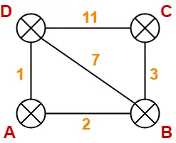
Consider-
There is a network consisting of 4 routers.
The weights are mentioned on the edges.
Weights could be distances or costs or delays.
Step-01:
Each router prepares its routing table using its local knowledge.
Routing table prepared by each router is shown-

Slide 5
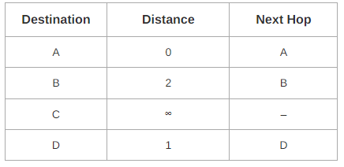
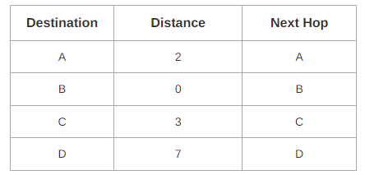
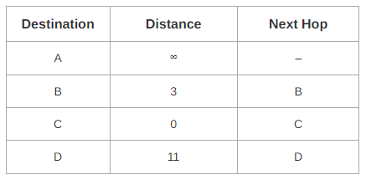
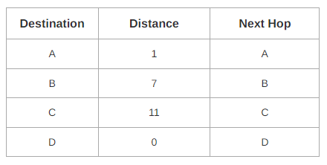
At Router A-
At Router B-
At Router C-
At Router D-

Slide 6
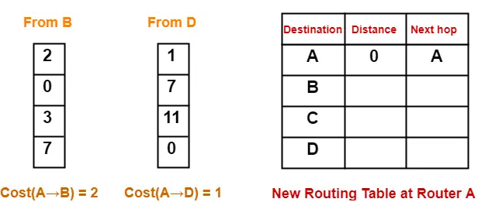
Step-02:
Each router exchanges its distance vector obtained in Step-01 with its neighbors.
After exchanging the distance vectors, each router prepares a new routing table.
At Router A-
Router A receives distance vectors from its neighbors B and D.
Router A prepares a new routing table as-
Cost of reaching destination B from router A = min { 2+0 , 1+7 } = 2 via B.
Cost of reaching destination C from router A = min { 2+3 , 1+11 } = 5 via B.
Cost of reaching destination D from router A = min { 2+7 , 1+0 } = 1 via D.

Slide 7
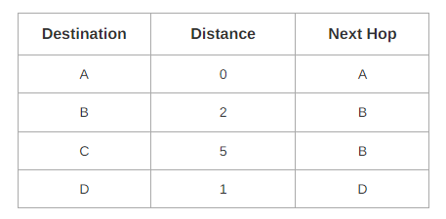
Thus, the new routing table at router A is-
At Router B-
Router B receives distance vectors from its neighbors A, C and D.
At Router C-
Router C receives distance vectors from its neighbors B and D.
At Router D-
Router D receives distance vectors from its neighbors A, B and C.

Slide 8
RIP
RIP is an intradomain routing protocol used inside an autonomous system.
It is a very simple protocol based on distance vector routing.
RIP implements distance vector routing directly with some considerations:
In an autonomous system, we are dealing with routers and networks (links). The routers have routing tables;
The destination in a routing table is a network, which means the first column defines a network address.
The metric used by RIP is the distance is defined as the number of links (networks) to reach the destination. The metric in RIP is called a hop count.
Infinity is defined as 16, which means that any route in an autonomous system using RIP cannot have more than 15 hops.
The next-node column defines the address of the router to which the packet is to be sent to reach its destination.

Slide 9
Figure 22.19 shows an autonomous system (AS) with seven networks and four routers.
The table of each router is also shown.
Lets look at the routing table for Rl. The table has seven entries to show how to reach each network in the AS.
Router Rl is directly connected to networks 130.10.0.0 and 130.11.0.0, which means that there are no next-hop entries for these two networks.
To send a packet to one of the three networks at the far left, router Rl needs to deliver the packet to R2.
The next-node entry for these three networks is the interface of router R2 with IP address 130.10.0.1.
To send a packet to the two networks at the far right, router Rl needs to send the packet to the interface of router R4 with IP address 130.11.0.1.

Slide 10
Link state routing (LSR)
IN LSR, each node in the domain has the entire network topology information including:
The list of nodes and links,
How they are connected, cost (metric), and condition of the links (up or down)
the node can use Dijkstra's algorithm to build a routing table.

Slide 12
No node can know the topology at the beginning or after a change somewhere in the network.
LSR algorithm initializes with a simple assumption that:
Initially, global knowledge about the topology is not clear, but each node has some partial knowledge: it knows the state (condition, and cost) of its links.
Afterwards, the whole topology can be compiled from the partial knowledge of each node.

Slide 14
Building Routing Tables
In LSR, four sets of actions are required to ensure that each node has the routing table showing the least-cost node to every other node.
Creation of link state packet (LSP)
Disseminate LSPs to every other router, called flooding
Formation of a shortest path tree for each node.
Calculation of a routing table based on the shortest path tree.
Creation of Link State Packet (LSP)
A link state packet can carry the node identity, the list of links, a sequence number, and age.
Via the node identity and the list of links, a node can create the topology map.
The sequence number, facilitates flooding and distinguishes new LSPs from old ones.
The age, prevents old LSPs from remaining in the domain for a long time.
LSPs are generated on two occasions:
Periodic updates
Triggered updates

Slide 15
Flooding of LSPs
After a node has prepared an LSP, it must be disseminated to all other nodes, not only to its neighbors.
The process is called flooding and based on the following:
The creating node sends a copy of the LSP out of each interface.
A node that receives an LSP compares it with the copy it may already have. If the newly arrived LSP is older than the one it has (found by checking the sequence number), it discards the LSP. If it is newer, the node does the following:
It discards the old LSP and keeps the new one.
It sends a copy of it out of each interface except the one from which the packet arrived. This guarantees that flooding stops somewhere in the domain (where a node has only one interface).

Slide 16
Formation of Shortest Path Tree: Dijkstra Algorithm
After receiving all LSPs, each node will have a copy of the whole topology.
However, the topology is not sufficient to find the shortest path to every other node; a shortest path tree is needed.

Slide 18
We make node A the root of the tree and move it to the tentative list. Our two lists are
Permanent list: empty Tentative list: A(O)
Node A has the shortest cumulative cost from all nodes in the tentative list.
We move A to the permanent list and add all neighbors of A to the tentative list. Our new lists are
Permanent list: A(O) Tentative list: B(5), C(2), D(3)
Node C has the shortest cumulative cost from all nodes in the tentative list. We move C to the permanent list.
Node C has three neighbors, but node A is already processed, which makes the unprocessed neighbors just B and E. B is already in the tentative list with a cumulative cost of 5.
Node A could also reach node B through C with a cumulative cost of 6. Since 5 is less than 6, we keep node B with a cumulative cost of 5 in the tentative list and do not replace it. Our new lists are
Permanent list: A(O), C(2) Tentative list: B(5), D(3), E(6)

