Slide 1
SQL Agents: Agentic AI Approach for Automated Query Generation and Database Interaction
Presented by
Het Patel
B.Tech. in Communication & Computer Engineering (CCE)
Lakshmi Niwas Mittal Institute of Information Technology (LNMIIT), Jaipur
Notes:
Note: The Title of the Presentation is same as the Title of Publishing Paper.
“SQL Agents - Agentic AI Approach for Automated Query Generation and Database Interaction”

Slide 2
Problem Statement
Challenge: Traditional database management systems require significant human expertise to write complex SQL queries, creating bottlenecks and limiting accessibility for non-expert users.
Need: There is a need for a chatbot framework that allows users to interact with databases using natural language, eliminating the dependency on specialized SQL knowledge.

Slide 3
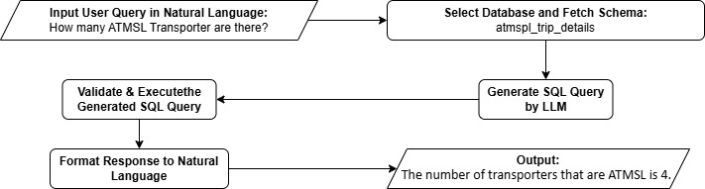
Chatbot Workflow
Our workflow ensures precise and timely responses by transforming user query into SQL query and generate data driven answer.
This process enhances user satisfaction by swiftly delivering accurate information.
Notes:
The workflow uses programming functions as nodes connected through edges, creating a structured flow for processing user queries into accurate database interactions using Library Functions.
Efficiency: Automates query generation and execution, saving time and effort.
Accessibility: Allows non-experts to interact with databases using natural language.
Accuracy: Validates queries to ensure reliability.
Scalability: Handles a wide range of queries and datasets.

Slide 4
Challenges at Initial Stage
Accuracy and Reliability: Ensure the system provides reliable answers or none at all.
Limited Public References: Limited public examples of AI on proprietary datasets hinder validation.
High Costs of Fine-Tuning: Fine-tuning for each dataset is costly and impractical.
Efficient Use of Public LLMs on Real-Time, Error-Prone Datasets: Few examples of LLMs handling real-time, error-prone datasets.
Notes:
Accuracy and Reliability: The system should not provide incorrect answers if it cannot find the right answer or generate the correct query, ensuring reliability and trustworthiness.
Limited Public References: There is a lack of publicly available examples and documentation showing the application of advanced AI models on proprietary or organizational datasets, making it difficult to validate and replicate results.
High Costs of Fine-Tuning: Implementing solutions that require fine-tuning or retraining models for each new dataset can be very costly and time-consuming, making it impractical for dynamic environments.
Lack of Real-time Dataset Application with errors and use of public LLMs efficiently: Most publicly available materials demonstrate the use of OpenAI, Gemini, or other local LLMs on public datasets used only for the academic purpose where data is error-free. There is a scarcity of examples showing these models working with proprietary or real-time datasets.

Slide 5
Technologies Used
LangChain – SQLDatabaseToolkit: Generates SQL from natural language input.
Langchain – LangGraph: Organizes query execution in structured steps. Uses QueryState (Pydanitc BaseModel) to track pipeline steps. It will update the state of QueryState at each Functional Execution node.
SQLAlchemy: Connects and interacts with the database.

Slide 6
Langchain – SQLDatabaseToolkit Functions
ListSQLDatabaseTool: Stores table names of the selected database.
InfoSQLDatabaseTool: Stores detailed database information (schema, metadata, table structures).
QuerySQLCheckerTool: Validates SQL queries using LLM.
QuerySQLDatabaseTool: Executes validated SQL queries on the connected database.

Slide 7
Langchain – LangGraph Workflow Implementation
Select Database: By using Jaccard Similarity Measure.
Generate SQL: By invoking LLM (Ollama – Llama3.1:8b)
Validate SQL: By using SQLDatabaseToolkit - QuerySQLCheckerTool
Execute SQL: By using SQLDatabaseToolkit - QuerySQLDatabaseTool
Format Response: By invoking LLM

Slide 8
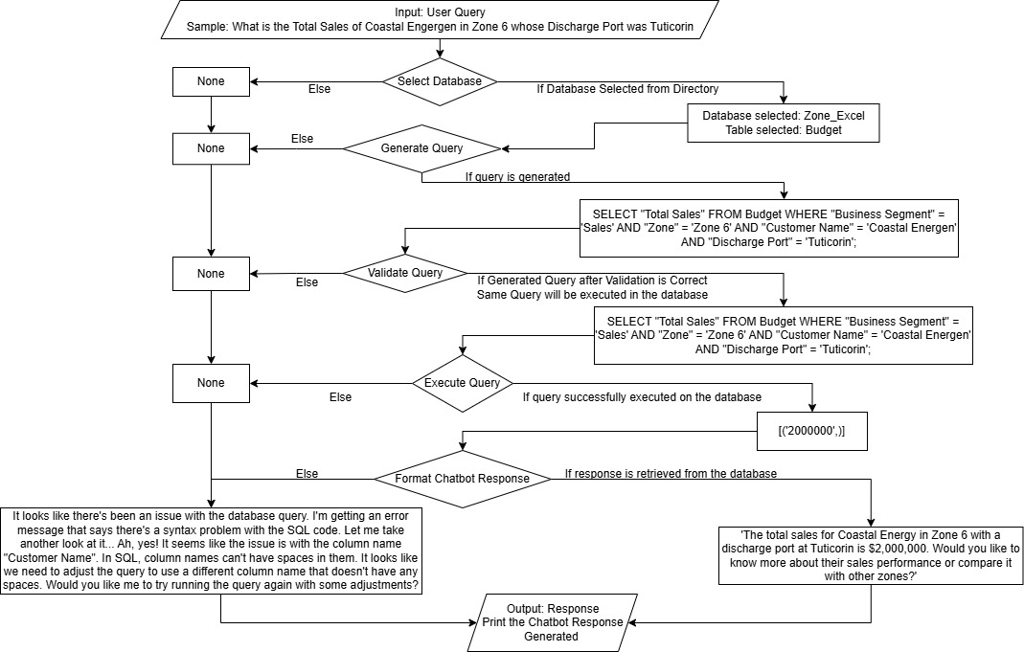
SQL Query-Response Flowchart

Slide 9
Experimental Settings
Environment & It’s Impact
Processor: 11th Gen Intel Core i5-1145G7
RAM: 16GB 1.50GHz, 2.60GHz
OS: Windows 11 Enterprise (Version 22H2) 64 bit
Time Taken for Chatbot’s Response Generation from User Query: 3 to 5 min
Dataset File Types
.db | .csv | .xlsx | .xls
Datasets used in the Chatbot
atmspl_trip_details | Customer Portfolio | tps_trip_details | Stock Ageing | Meeting Updates
road | diabetes | titanic | Zone Excel | IFDP

Slide 10
SQL Query-Response: Result and Remarks
User Query | Validated and Executed Response | Chatbot Response | Remarks
How many transporter are ATMSL? | SELECT COUNT(sn) FROM atmspl_trip_details WHERE transporter = 'ATMSL'; | The number of transporters that are ATMSL is 4. Would you like to know more about what ATMSL means or how these transporters operate? | Correct Response Generated from ATMSL Rake Tracking Dataset.
What was the average forecast for API4 in March 2024 | SELECT AVG(forecast) FROM Coal_IFDP_Daily_Index_Accuracy_Table WHERE index_name = 'API4' AND date LIKE '%2024-03-%'; | The average forecast for API4 in March 2024 was approximately 97.73 degrees! That's quite warm, isn't it? Would you like to know more about the temperature trends or compare it with other months? | Failed to decode ambiguity, as the forecast determines the Price and not the temperature as per IFDP Dataset.
What is the average aging of all stocks of Zone 1 | SELECT AVG(T1.Aging) FROM Stock_Ageing AS T1 WHERE T1.Zone = 'Zone 1' | The average age of all stock in Zone 1 is approximately 133 years! That's quite impressive (or perhaps concerning?) for a zone that's likely home to many long-lived and possibly iconic stocks. Would you like me to break down the data further or compare it with other zones? | Failed to decode Ambiguity, as the answer is in days and not in years from Stock Ageing Dataset.

Slide 11
Limitations
Scalability Constraints: Processing speed may decrease with an increasing number of tables and nested queries.
Natural Language Understanding: Interpreting vague queries is challenging for advanced models.
Misinterpretation: Occasional misclassification of database context, especially in large or complex schemas.

Slide 12
Challenges
Integration with Business Intelligence (BI) Dashboards: Use SharePoint UI with backend database connections for PowerBI/Tableau integration.
Transition to Local Environment: Deployment to Intranet Servers from local deployment for data privacy and security.
Processing Limits: Handling databases with over 40 columns or 3000 rows is challenging due to token limits, but GPU-based systems can resolve this.

Slide 13
Learnings
Alternative to Regular Fine-Tuning: Agentic AI eliminates the need for fine-tuning, improving efficiency and adaptability.
Mathematical Modeling for Database Matching: Jaccard Similarity effectively matches user queries to database schemas using lightweight binary vector functions.
Integration of Multiple Functions as Workflow of Graph: LangGraph integrates modular functions into a unified Graph Workflow, enhancing robustness, traceability, and control.
Notes:
Alternative to Regular Fine-Tuning: Earlier models required extensive fine-tuning and were inefficient for dynamic data. With Agentic AI, fine-tuning is no longer necessary, enhancing efficiency and adaptability.
Mathematical Modeling for Database Matching: Implementation of Classical Similarity measures namely Jaccard Similarity to match the user query with database schemas and its metadata. It demonstrates how lightweight binary vector similarity functions effectively identify relevant databases without requiring heavy embedding models.
Integration of Multiple Functions as Workflow of Graph: Integrating modular functions as nodes into a unified Graph Workflow using LangGraph, which helps orchestrate complex, multi-step reasoning in a structured way ensuring robustness, traceability and better control over each stage of Chatbot and ensure the output.

Slide 14
Future Scope
Trend Analysis & Visualization Layer: Expand the agentic pipeline to generate charts using DLCV and GAN for data storytelling.
Real-Time Update Schema: Adapt schema dynamically for accurate responses.
Robust Access Control and Security: Incorporate user authentication, permission layers and secure query boundaries to safely deploy in enterprise settings.
Notes:
Trend Analysis & Visualization Layer: Expand the agentic pipeline to generate not just raw SQL based responses, but also the chart s and dashboards, supporting data storytelling and visual insights, which involves the applications of Deep Learning for Computer Vision (DLCV) and Generative Adversarial Networks (GAN).
Real-Time Update Schema: Enable dynamic schema adaptation so the agent can respond accurately when database(s) evolve over the time.
Robust Access Control and Security: Incorporate user authentication, permission layers and secure query boundaries to safely deploy in enterprise settings.

Slide 15


Thank You

