Slide 1
Text-to-Video GAN Implementation
Generating Dynamic Video Content from Text Descriptions
Presented by Divyansh Garg (21ucs073)
Hiten Ahuja (20ucc051) Het Patel(21ucc125)

Slide 2
Overview: This project focuses on creating videos dynamically based on text prompts using Generative Adversarial Networks (GANs).
Problem Statement:
Manual video creation is time-consuming.
Need for automated systems for video generation.
Goal: To develop a GAN model that takes text input and generates corresponding videos.

Slide 3


Innovative Features:
Generate videos from natural language prompts.
Utilize a GAN architecture for high-
quality video synthesis.
Core Capabilities:
Support for
various motions
text (e.g.,
prompts "circle
describing
bouncing vertically").
Realistic frame-by-frame continuity in videos.
Applications:
Media and content creation, gaming, and animation.

Slide 4

Dataset Creation
How the Dataset is Generated:
Text prompts paired with specific motion descriptions (e.g., "circle moving diagonally up-right").
Each video contains 10 frames.
Statistics:
Total videos: 30,000.
Resolution: 64x64 pixels per frame.
Example Prompts:
"Circle moving left."
"Circle zigzagging vertically."
Visuals:
Add sample images of the dataset showing a few frames.

Slide 5
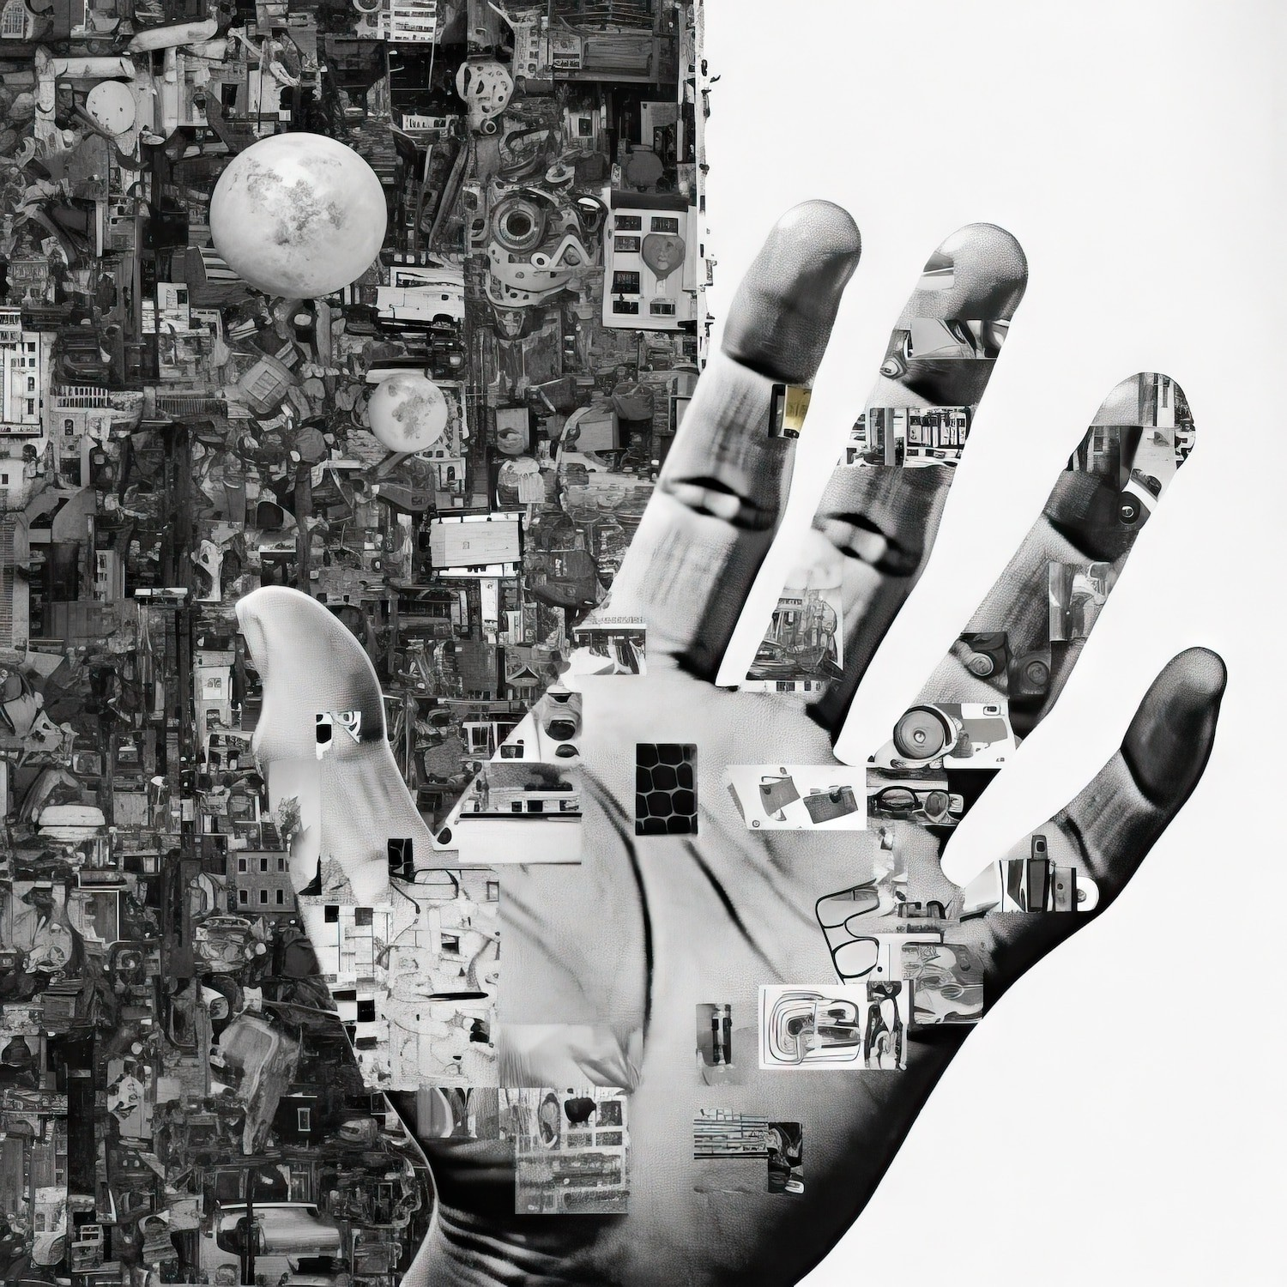
Data Preprocessing
Process:
Read image frames and prompts. Normalize images to prepare for GAN input.
Encode text prompts into embeddings using a vocabulary-based encoding.
Tools Used:
PyTorch for loading and transforming data.
Outcome:
Dataset ready for training.

Slide 6
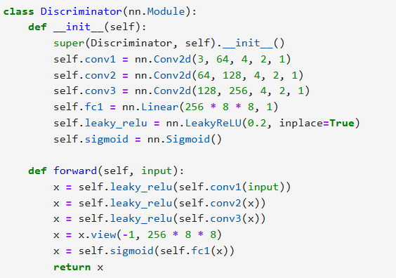
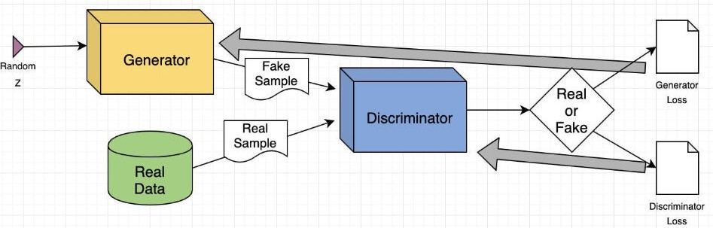
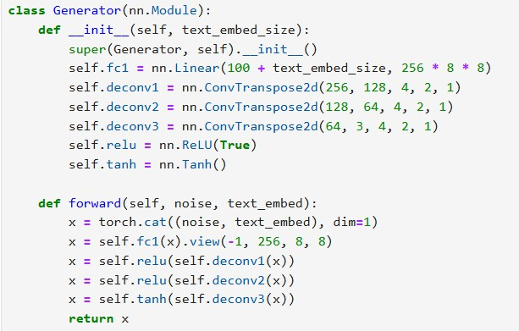
GAN Architecture
Generator:
Combines text embeddings with random noise. Upsamples features to generate 64x64 video frames.
Discriminator:
Distinguishes between real and fake frames. Uses convolutional layers for feature extraction.
Text Embedding:
Converts text prompts into numerical vectors using embedding layers.

Slide 7

Training Process
Overview:
GANs are trained in an adversarial setup: Generator tries to fool the Discriminator.
Discriminator distinguishes between real and fake data.
Parameters:
Batch size: 16.
Loss function: Binary Cross-Entropy Loss.Optimizer: Adam with a learning rate of 0.0002.
Number of epochs: 13.
Training Flow:
Update Discriminator with real and fake data. Update Generator based on Discriminator feedback.

Slide 8
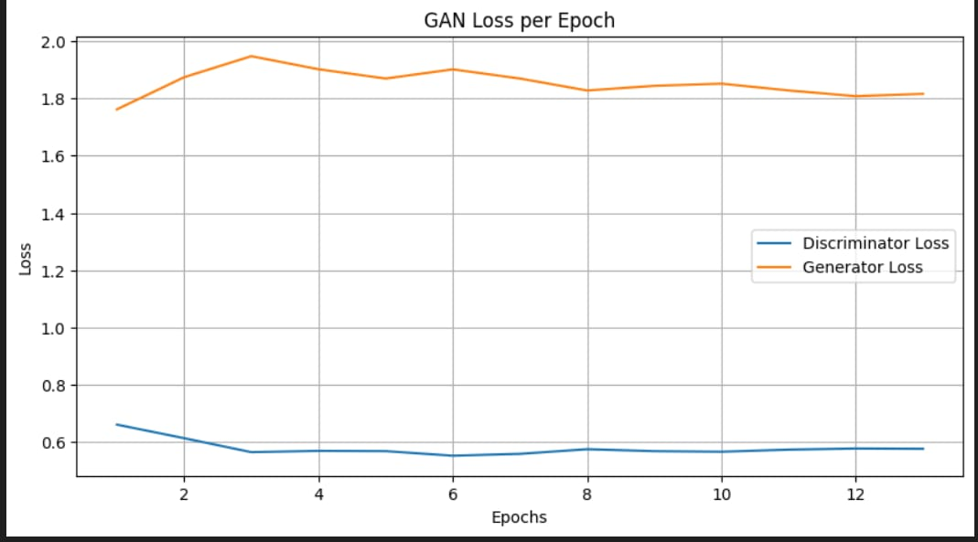
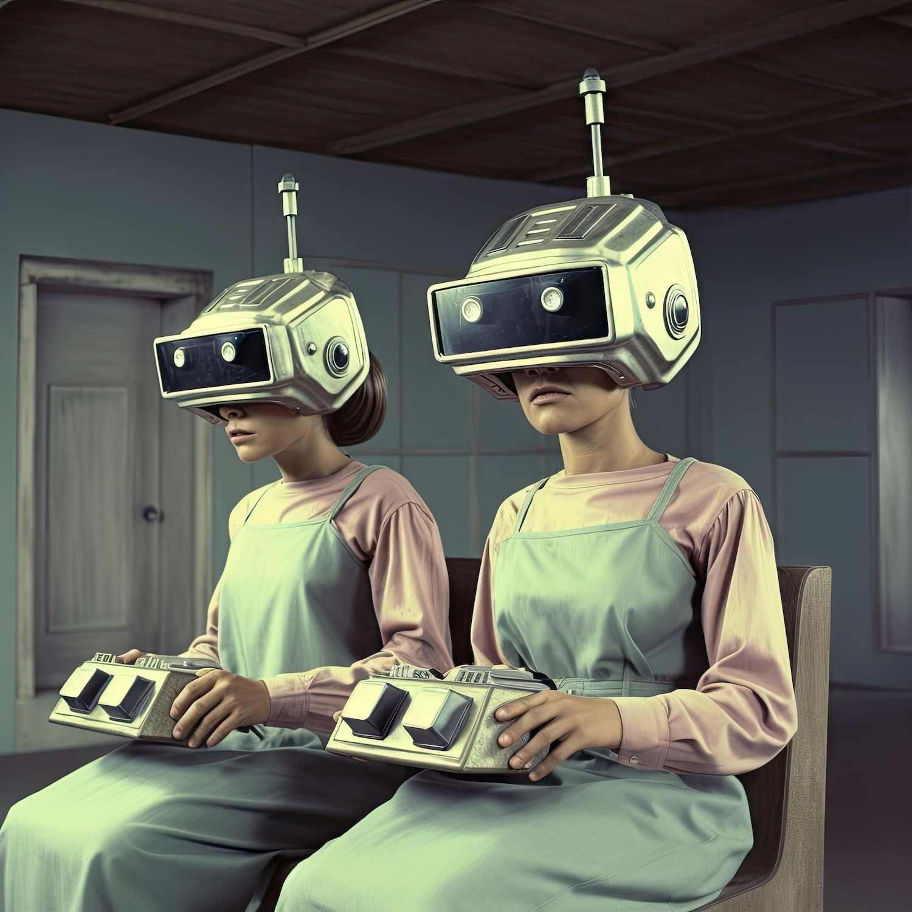
Results

Slide 9
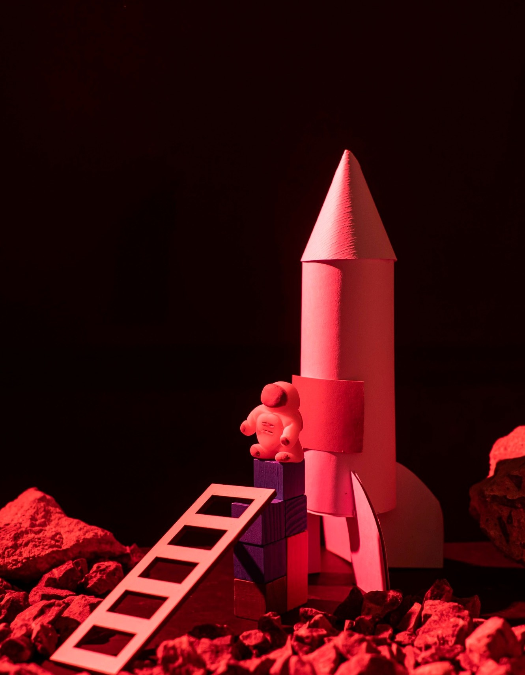
Generated Output
Example Prompt:
"Circle moving up-right."
Generated Frames:
Display a few frames from the generated video.

Slide 10
Future Work
Improved Dataset Diversity:
Incorporate a wider variety of motion patterns, shapes, and objects to increase the model's generalization ability.
Include more complex video sequences (e.g., multiple objects, interactions).
Higher Resolution Videos:
Extend the model to generate videos with higher resolution frames (e.g., 128x128, 256x256) for better visual quality.
Advanced Text Embeddings:
Experiment with more advanced text embedding techniques, such as using pre-trained language models like BERT or GPT, for richer text understanding.
Multi-Object Video Generation:
Extend the model to handle multi-object video generation, allowing for the synthesis of complex scenes (e.g., animals interacting, people in motion).

Slide 11
Thank You

