Slide 1





Car Insurance Risk & Strategy Dashboard
BDAT 1009 – Enterprise Analytics
Team: Hetkumar Patel, Dev Sompura, Krunal Solanki
Date: March 16, 2025

Slide 2
Background Information
Dataset: 10,000+ policyholders with demographics, vehicles, claims
1
Goal: Reduce risk, improve retention, upsell low-risk customers
2
Outcome: Predictive, data-driven insurance strategy
3

Slide 3
More Background Info
We analyzed a Car Insurance dataset consisting of over 10,000 customer records, including demographic data, vehicle specifications, claim history, driving behavior, and risk indicators.
This dataset plays a critical role in shaping strategic decisions around underwriting practices, premium pricing, customer segmentation, fraud detection, and policyholder retention.
By examining key attributes like claim frequency, revoked licenses, income levels, and vehicle type, we can: • Identify high-risk drivers for better risk adjustment • Discover long-term loyal customers for retention strategies • Segment high-income, low-risk individuals for targeted upselling
These insights empower the company to optimize its operations, reduce losses, and improve profitability through data-driven decision-making.

Slide 4
Business Problems
How to reduce claim rate and improve underwriting accuracy?
Which customer segments present upsell opportunities?
How can we improve retention of long-term customers?
What characteristics contribute to higher risk?
Can claim frequency be reduced through better policy matching?
How to identify early signs of fraudulent or high-risk claims?
Are there patterns in car type, age, or income that signal potential default?
What customer behaviors correlate with license revocation?
How do education and occupation influence insurance risk profiles?
What are the most profitable customer segments based on income and risk?

Slide 5
Strategy Development
• Reduce high-risk claims
• Increase customer retention
• Prevent license revocation
• Identify upsell opportunities
• Predict claims using vehicle and demographic data

Slide 6
Key Customer Insights
• Claim Rate: 26.66%, Avg Claim Frequency: 0.8
• 47.63% of customers are retained over 5 years (Avg TIF: 5.33 yrs)
• 12.24% have revoked licenses – monitor for risk
• Avg Income: ₹61,127, with 1,761 earning over ₹100K
• Education: 28.7% High School, 27.4% Bachelor’s, 20.2% Master’s
• Car Type: 28% SUV, 26% Minivan – top two types
• Gender: 53.8% Female, 46.2% Male
• Urbanicity: 79.9% Urban, 20.1% Rural
• Avg Age: 44.84 – mid/late-career, stable client base

Slide 7
SMART Objectives
1. Reduce Claim Rate by 15% → Target: 19.3%
1
2. Reduce Claim Frequency by 20% → Target: 0.64
2
3. Increase Retention (TIF > 5) → Target: 57.1%
3
4. Reduce Revoked Licenses by 10% → Target: 11.0%
4
5. Upsell to 100+ clients with Income > 100k and No Claims
5

Slide 8
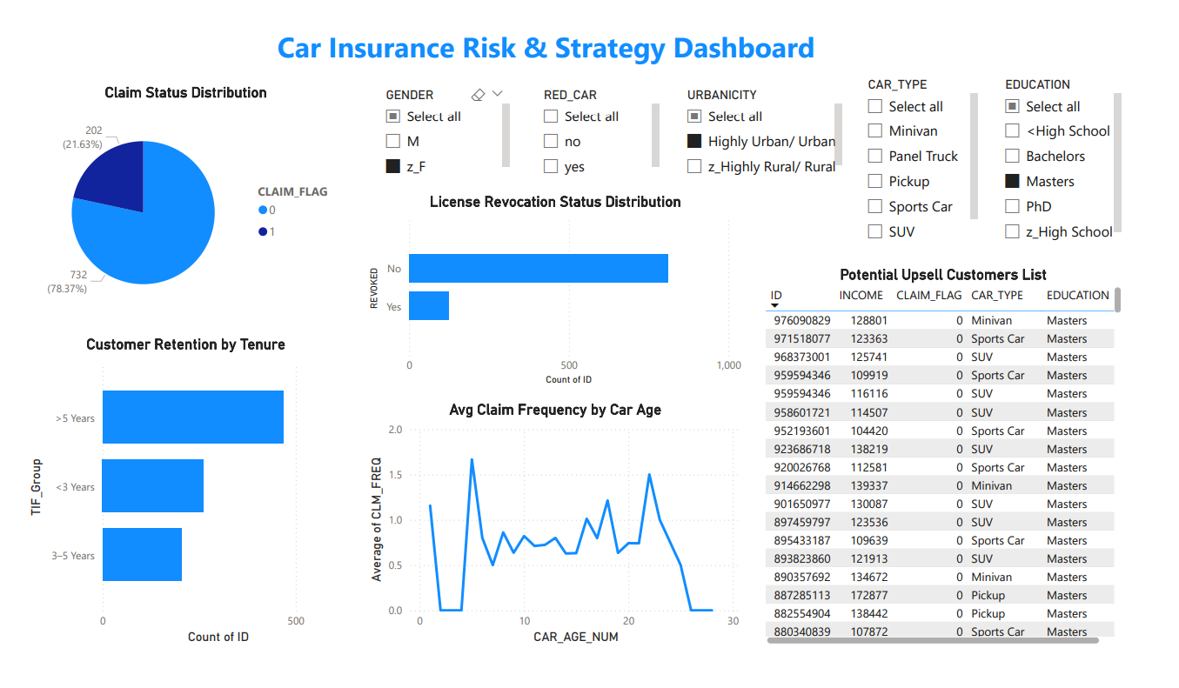
Dasboard

Slide 9
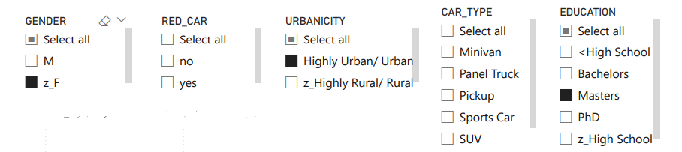
Slicer
The dashboard features slicers for key attributes such as Gender, Red Car Indicator, Urbanicity, Car Type, and Education.
These slicers allow users to filter the entire report interactively and explore patterns across different customer segments.
Including a “Select All” option makes it easy to reset and compare filtered views.

Slide 10
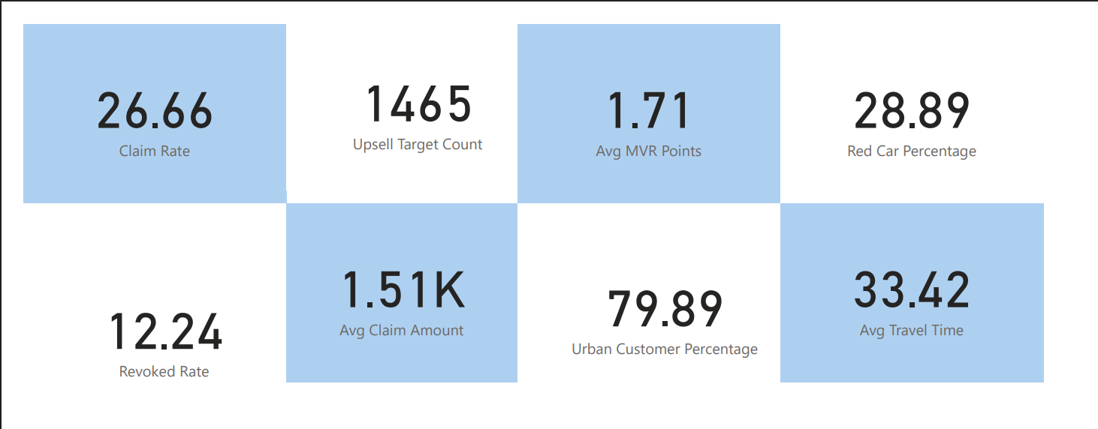
KPIs
🔍 Car Insurance KPIs Overview KPIs (Key Performance Indicators) help track customer behavior, risk, and business opportunities in insurance. These metrics support better pricing, targeting, and risk assessment.
Key Metrics:
✅ Claim Rate: 26.66% – Percentage of customers who filed a claim
📈 Upsell Targets: 1,465 – Customers eligible for cross-sell/upsell
🚦 Avg MVR Points: 1.71 – Average number of driving violations
🚗 Red Car %: 28.89% – Proportion of insured red cars
❌ Revoked Rate: 12.24% – Percentage of drivers with revoked licenses
💰 Avg Claim Amount: $1.51K – Average payout per claim

Slide 11
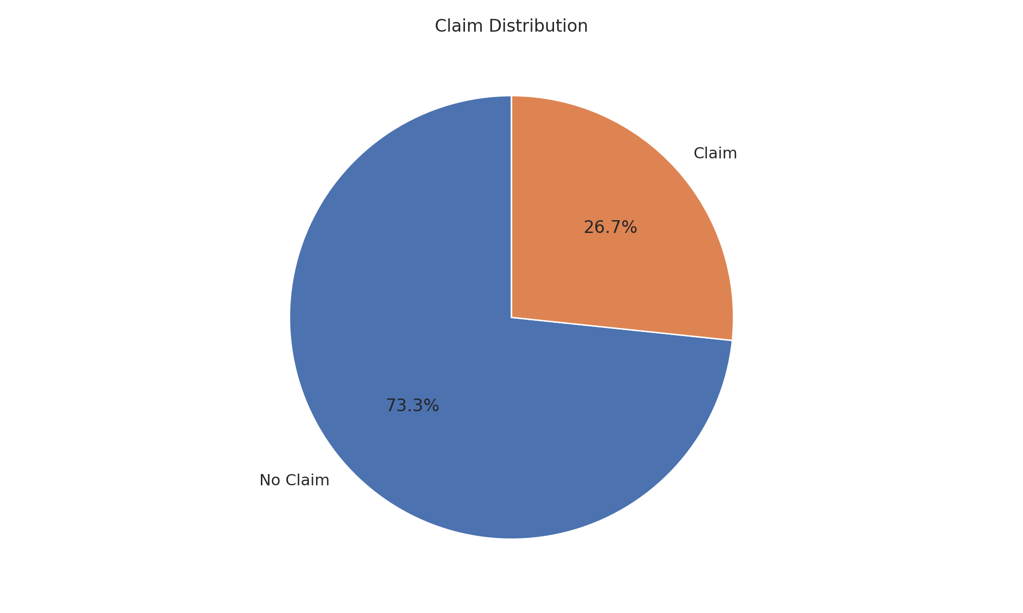
Claim Distribution
Claim Distribution: Shows the % of policyholders who have submitted a claim.
About 27% of policyholders have made at least one claim — indicating a moderate risk level across the customer base.

Slide 12
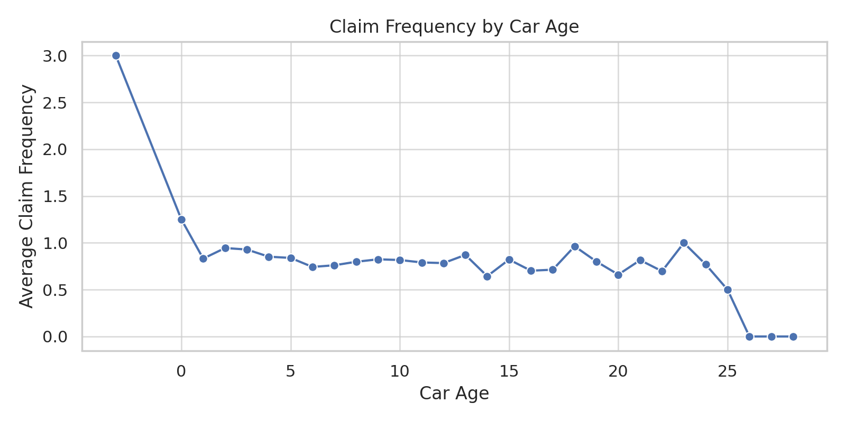
Claim Frequency by Car Age
Claim Frequency by Car Age: Analyzes average claim frequency across different car ages.
Claim frequency is highest among newer cars (0–5 years old), suggesting aggressive or less experienced driving behavior in newer vehicles

Slide 13
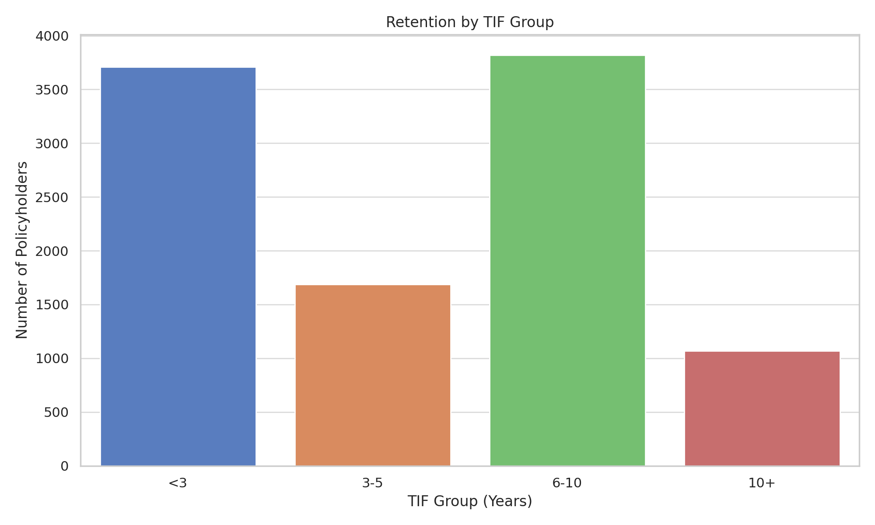
Retention by TIF Group
Retention by TIF Group: Groups customers by TIF (Time In Force) to highlight retention strength.
Customers with TIF over 5 years form a significant portion — nearly half the base — showing strong customer loyalty potential.

Slide 14
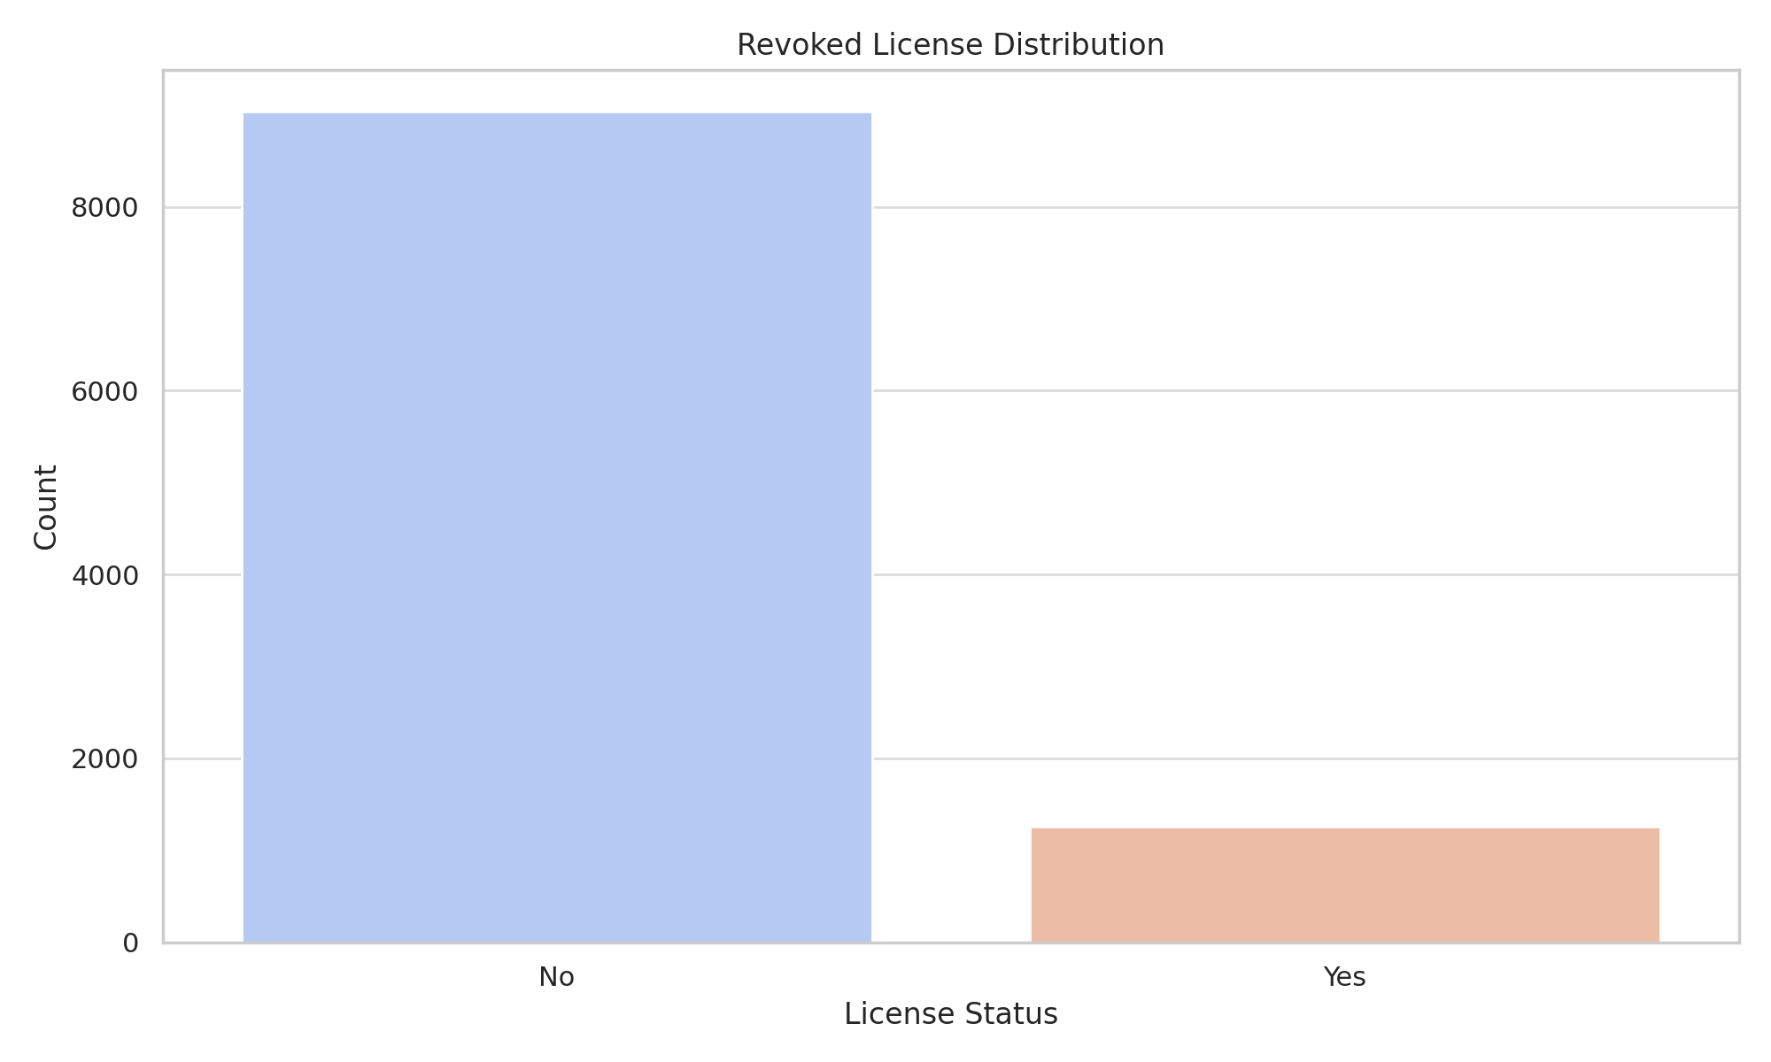
Revoked License Distribution
Revoked License Distribution: Displays the % of customers with revoked licenses.
Around 12% of the customer base has had their license revoked — a red flag for risk and possible underwriting adjustment.

Slide 15


Upsell Opportunities
✅ Filter Criteria
Income above ₹100,000
No history of claims (CLAIM_FLAG = 0)
TIF (Time In Force) > 3 years
📊 Key Insights
A total of 172 clients matched the criteria
Dominant car types: SUVs, Minivans, Sedans
Higher education profile: Bachelor’s, Master’s, PhD
Average TIF among this group is 6.2 years, indicating strong loyalty
All are low-risk, high-value prospects suitable for premium plans
🎯 Recommendation
Launch targeted campaigns with upsell offers
Promote exclusive benefits: accident forgiveness, loyalty rewards, bundled services
Position them for concierge-style premium upgrades or long-term policy lock-ins

Slide 16

Segment-Based Strategy Recommendations
• High-Risk Customers (Revoked License, Frequent Claims):
- Apply stricter underwriting
- Increase premiums
- Limit risky add-ons
• Low-Risk Customers (No Claims, High TIF):
- Offer loyalty discounts
- Upsell with premium plans
- Bundle with other insurance products
• New Customers (TIF < 1):
- Launch onboarding education campaigns
- Offer welcome offers to retain early

Slide 17
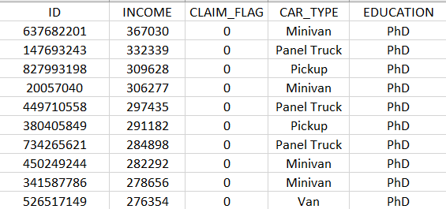
Top Upsell Candidates – High-Income, Low-Risk Segment
The table below highlights the top 10 high-value customers identified as ideal upsell opportunities based on:
High Income (₹270K–₹367K+)
Zero Claims History (CLAIM_FLAG = 0)
PhD Education Level
These individuals also own practical vehicles like Minivans, Panel Trucks, and Pickups — indicating family or business use, aligning well with premium coverage tiers.
🎯 Why They Matter: • Low risk = profitable retention • High education = better policy understanding • High income = affordability for premium plans
💡 Recommendation: Launch exclusive campaigns targeting this group with personalized offers such as loyalty rewards, bundled services, accident forgiveness, and policy lock-ins.

Slide 18
Recommendations
• Upsell premium plans to 100+ low-risk clients
• Launch safe driving workshops
• Adjust premiums for newer car models
• Reward loyalty for 3–5 year customers
• Implement ML-based claim risk prediction

Slide 19

Future Scope & Next Steps
Train ML models to predict claim risk
Link dashboards with CRM for personalized targeting
Monitor TIF and Claim history for automated plan adjustments
Expand segmentation using behavior and vehicle analytics
Run A/B tests on upsell campaign effectiveness

Slide 20
Thank You! Q&A?
Team: Hetkumar Patel, Dev Sompura, Krunal Solanki
Let’s Discuss!

