Slide 1
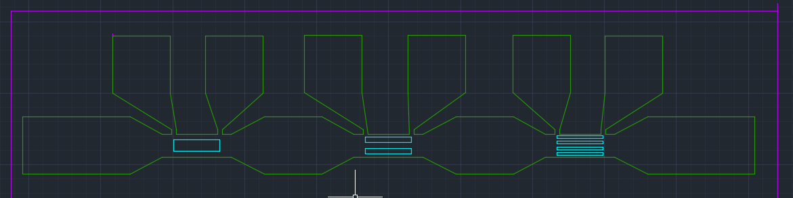
WO3196 Device 2 Hydrogen response and recovery
Measurement time was increased, so noise has been reduced
Drops and recoveries measured at 25 and 65 C
V+
V-
I+
I-
Probe location are given in white
Inside green area is crystalline WO3, outside of it is amorphous WO3 on top of LAO
Inside cyan areas there is 5 nm of Pt

Slide 2
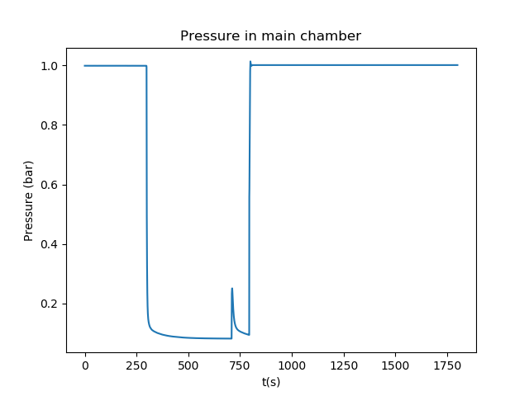
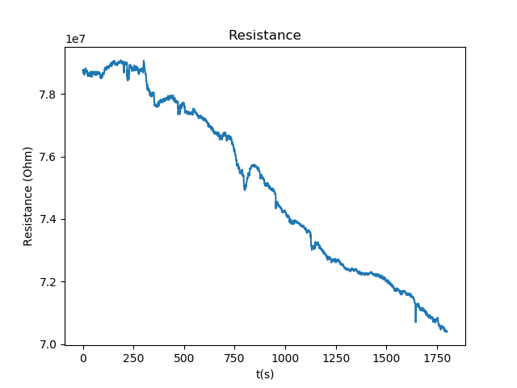
25 C Response
Peak during vacuum period caused by pumping down to Air chamber
Dip very small and not noticeable in the overall drift

Slide 3
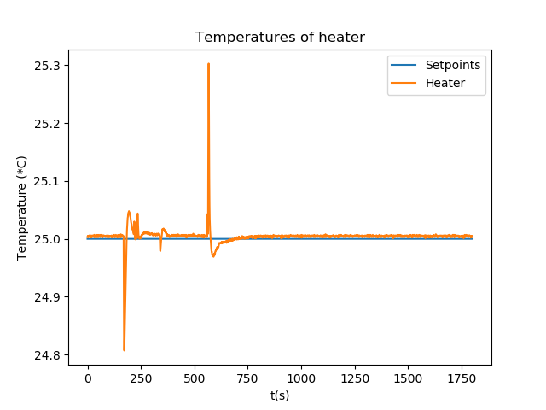
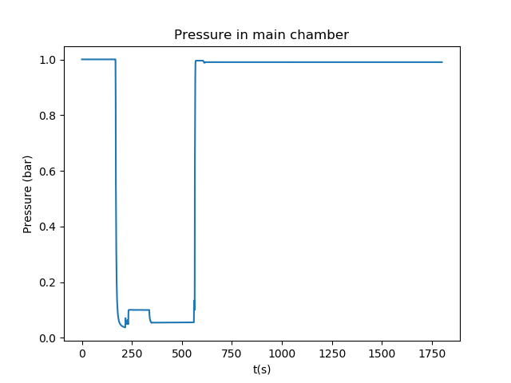
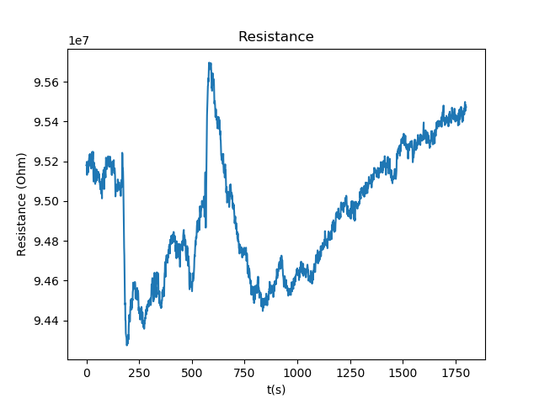
25 C recovery
Was left in H2 overnight, during which the resistance increased to even above the initial resistance in air

Slide 4
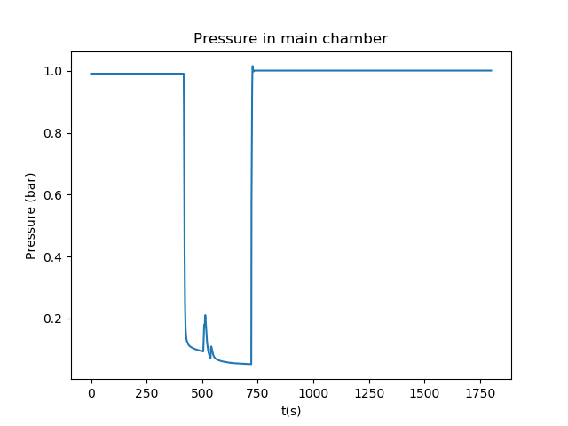
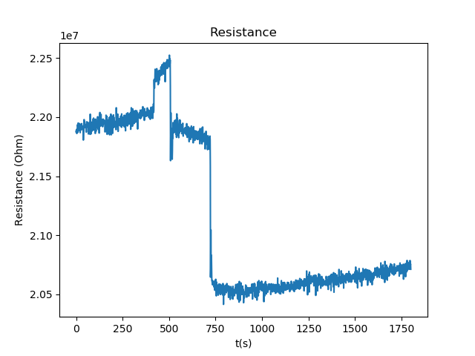
65 C Response

Slide 5
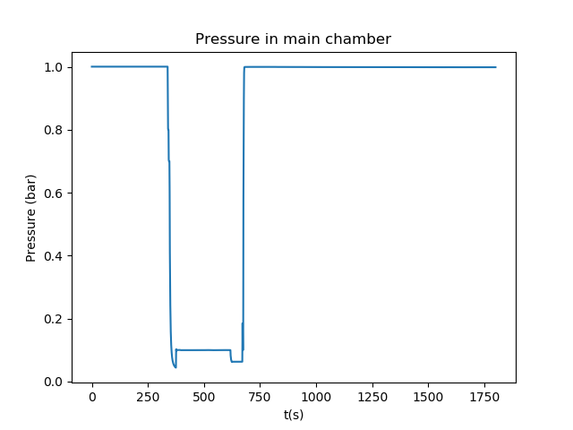
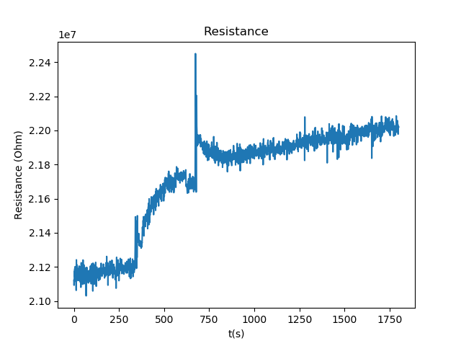
65 C Recovery

