Slide 1



ESPPA - Employee Skill & Project Performance Analyzer
A Django-based AI tool for analyzing employee performance and project productivity.
Academic Year: 2024–25

Slide 2
Meet the Team
Name
Enroll No
Branch
Roll No
SANTOKI HET
23002170210113
IT
106
GHEVARIYA VEDANT
23002170210032
IT
107
RAJODIYA RAJ
23002170210108
IT
118
GAJERA NIRBHAY
23002170210030
IT
123
JAIMIN BAMBHANIYA
23002170210039
IT
132

Slide 3

Project Overview
ESPPA is a web-based system designed to analyze employee performance and productivity.
It leverages machine learning models to provide smart predictions, aiding in proactive decision-making.
Managers can make data-driven HR decisions, optimizing workforce efficiency and retention.
The system is robustly built using Python (Django) and advanced Machine Learning Models.

Slide 4





Key Features
Real-Time Analytics Dashboard
ML Predictions
Employee Directory & Profiles
Anticipate employee performance trends and predict potential resignations with advanced machine learning algorithms.
Gain instant insights into key performance metrics with an intuitive and dynamic dashboard.
Centralized access to comprehensive employee profiles, skill sets, and historical performance data.
Role-based Secure Login
Comprehensive Visualizations
Ensuring data privacy and controlled access with secure, role-based authentication.
Visualize data effectively with various chart types, including Bar, Pie, Histogram, and Heatmap.

Slide 5





How ESPPA Works
Data Upload
The administrator securely uploads employee data into the system.
ML Processing
Machine learning models process the data to predict performance and identify trends.
Dashboard Display
The dashboard presents analytics, visual trends, and predictive insights.
User Interaction
HR and administrators can view and filter detailed employee information.
Secure Access
Role-based access ensures data integrity and confidentiality for all users.

Slide 6
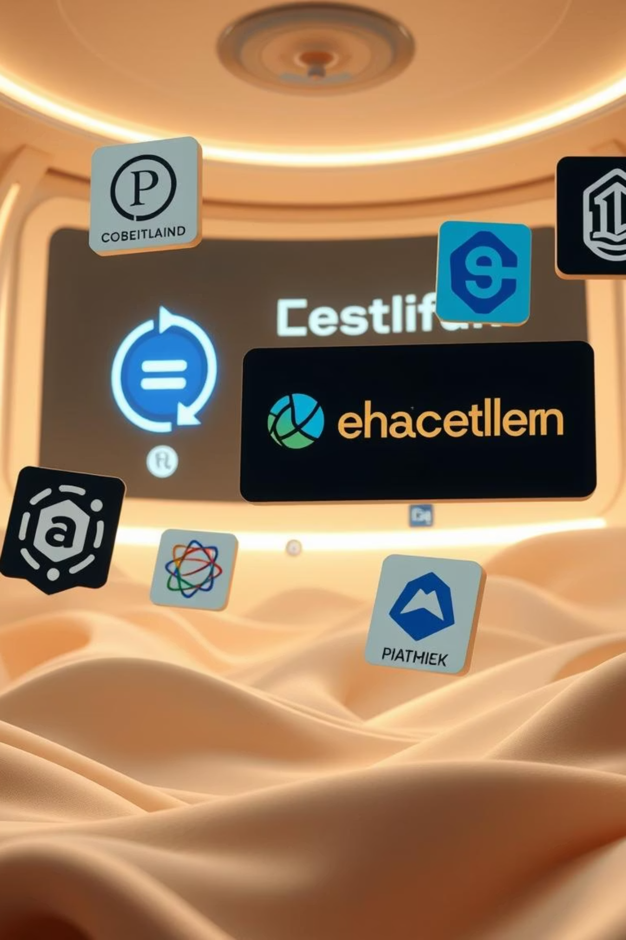
Our Robust Tech Stack
Backend
Machine Learning
Python 3.8+
Scikit-learn
Django 4.2.7
Pandas
SQLite
NumPy
Frontend
Seaborn
Matplotlib
HTML5
Development Tools
CSS3
Bootstrap 5
Jupyter Notebook
Chart.js
Git
Virtual Environment

Slide 7



Future Enhancements
Mobile App Integration
Advanced ML Models
API Endpoints
Developing native mobile applications using Flutter or React Native for on-the-go access.
Integrating sophisticated machine learning models like XGBoost and Neural Networks for enhanced prediction accuracy.
Creating robust API endpoints to allow seamless integration with other internal and external systems.
Custom Reporting
Real-time Monitoring
Implementing highly customizable dashboards and advanced reporting features to meet diverse analytical needs.
Introducing real-time performance monitoring to provide immediate insights and alerts.

Slide 8

Thank You!
We appreciate your time and attention.
Any Questions?

