Slide 1
CPSC 535: Advanced Algorithms
Instructor: Dr. Doina Bein

Slide 2
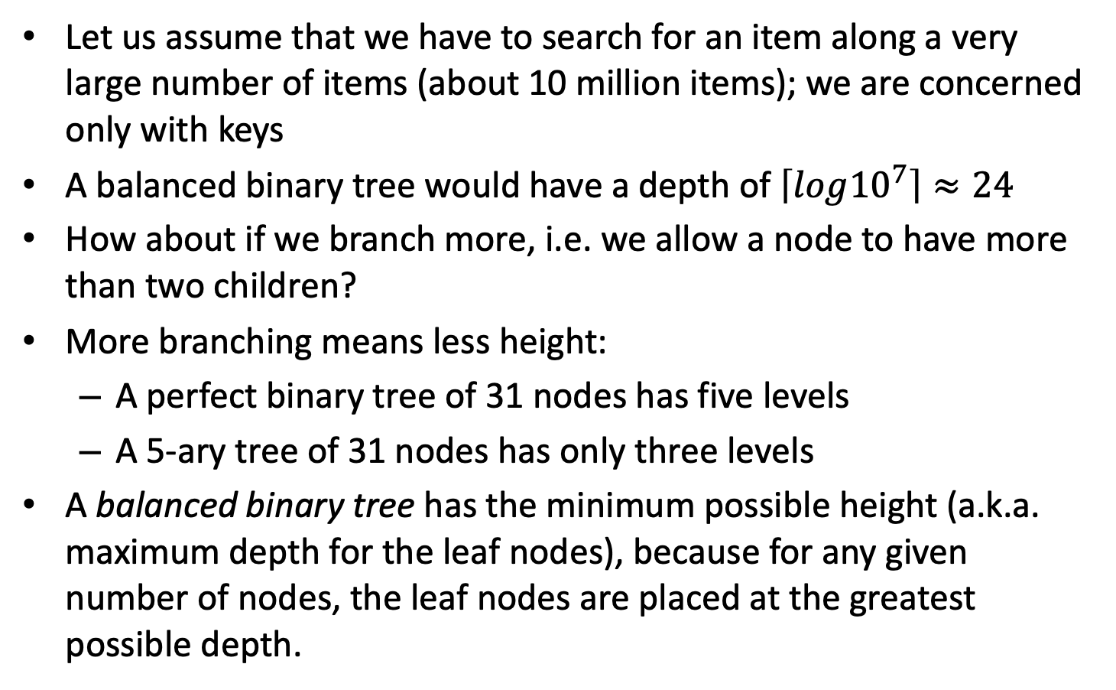
B-Trees
Notes:
Taken from Data Structures and Algorithm Analysis in C++” by Weiss

Slide 3
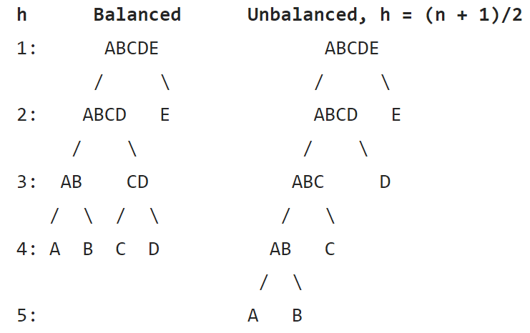
Notes:
Taken from wikipedia

Slide 4
Motivation for B-trees and B⁺-trees
A B-tree is a generalization of a binary search tree in that a node can have more than two children.
A B-tree is a self-balancing tree data structure that keeps data sorted and allows searches, sequential access, insertions, and deletions in log arithmetic time.
The major drawback of B-tree is the difficulty of traversing the keys sequentially.
A B+ tree retains the rapid random-access property of the B-tree while also allowing rapid sequential access.
Each node of the tree contains an ordered list of keys and pointers to lower-level nodes in the tree. These pointers can be thought of as being between each of the keys.
A B+ tree is a data structure often used in the implementation of database indexes.

Slide 5
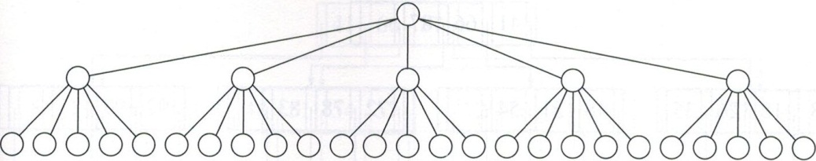
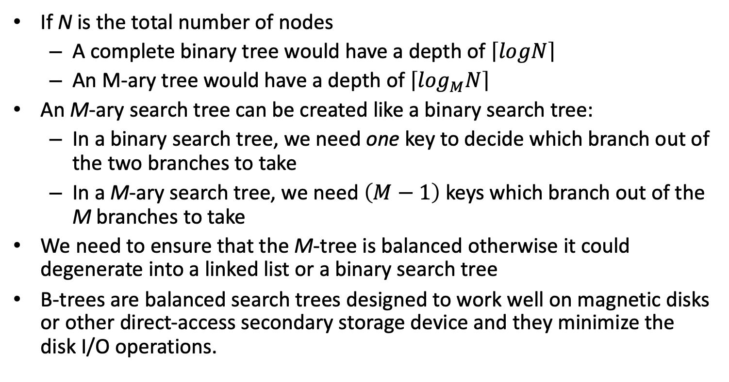
Notes:
Taken from Data Structures and Algorithm Analysis in C++” by Weiss

Slide 6
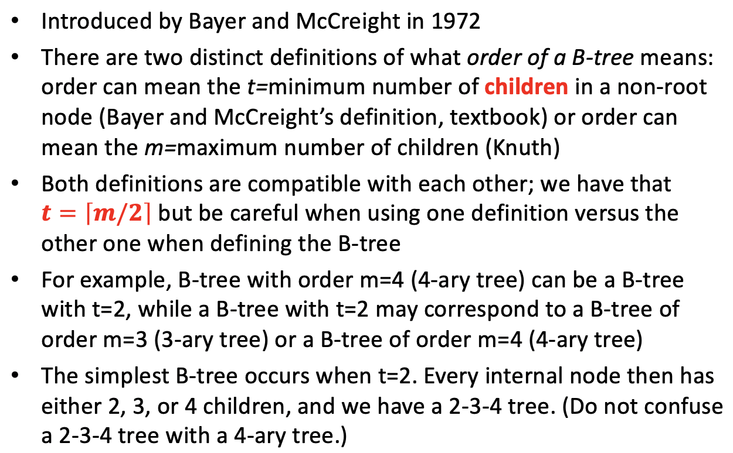
B-tree

Slide 7
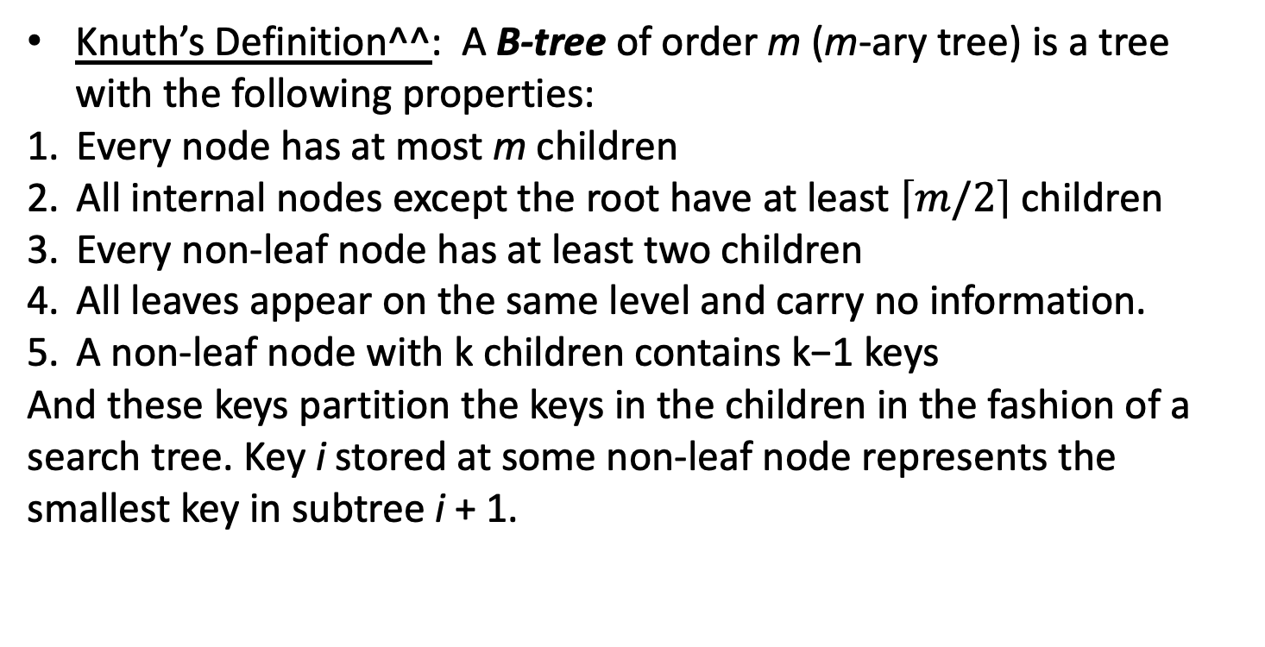
B-tree Definition (Knuth)
^^ https://en.wikipedia.org/wiki/B-tree#:~:text=In%20computer%20science%2C%20a%20B,with%20more%20than%20two%20children.

Slide 8
B-tree Definition (Kunth)
In Kunth’s definition, internal nodes (also known as inner nodes) are all nodes except for leaf nodes and the root node.
The root node has the same upper limit on the number of children as internal nodes but has no lower limit. For example, when there are fewer than L−1 elements in the entire tree, the root will be the only node in the tree with no children at all.
The leaf nodes do not carry any information.
The internal nodes that are one level above the leaves are what would be called "leaves" by other authors: these nodes only store keys (at most m-1, and at least m/2-1 if they are not the root) and pointers to nodes carrying no information.

Slide 9
B-tree (Bayer and McCreight, textbook)
Definition based on the minimum degree (from the textbook): A B-tree is a rooted tree with the following properties:
Each node has several keys, stored in non-decreasing order from left to right
For an internal node, the number of children is equal to 1 + number of keys stored at a node
Each key separates the ranges of keys stored in each subtree
All leaves have the same depth which is the tree’s height
Nodes have lower and upper bounds on the number of keys they can contain. We express these bounds in terms of a fixed integer t > 1 called the minimum degree of the B-tree:

Slide 10
B-tree (Bayer and McCreight, textbook)
(def, continue):
Every node other than the root must have at least t - 1 keys. Every internal node other than the root thus has at least t children. If the tree is nonempty, the root must have at least one key.
Every node may contain at most 2t - 1 keys. Therefore, an internal node may have at most 2t children. We say that a node is full if it contains exactly 2t-1 keys.
Bayer and McCreight considered the leaf level to be the lowest level of keys, so leaf nodes carry keys.

Slide 11
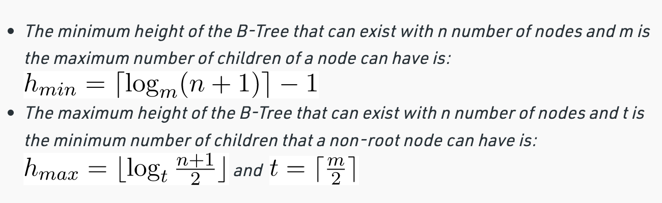
Restriction on the height (taken from https://www.geeksforgeeks.org/introduction-of-b-tree-2/)

Slide 12
An example B-Tree (taken from people.cs.pitt.edu/~injungkim/1004_lab_Btree)
Note: This is a B-tree of t=2 and m=4 containing 26 items
26
6
12
42
51
62
1
2
4
7
8
13
15
18
25
27
29
45
46
48
53
55
60
64
70
90
Note that all the leaves are at the same level

Slide 13
Example of B-trees (slides taken from http://people.cs.aau.dk/~simas/aalg04/)
Let’s draw a B-tree of t=2 and m=4 with the keys in the range A through Z
There are a total of 23 keys
P
C G M
T X
A B
D E F
J K L
N O
Q R S
U V
Y Z

Slide 14
B-tree operations
An implementation needs to support the following B-tree operations (corresponds to Dictionary ADT operations):
Search (simple)
Create an empty tree (trivial)
Insert (complex): depends on split and merge
Delete (complex): depends on merge

Slide 15
B-tree and B-node ADTs
B-tree ADT:
root():Bnode – T.root() gives a pointer to a root node of a tree T
B-node ADT:
n():int – x.n() the number of keys in node x
key(i:int):key_t – x.key(i) the i-th key in x
p(i:int):Bnode – x.p(i) the i-th pointer in x
leaf():bool - x.leaf() is true if x is a leaf
Simplified syntax for set methods:
e.g., x.n() ← 0, instead of x.setn(0)

Slide 16
Search
Straightforward generalization of searching in a BST:
Initial call BtreeSearch(T.root(), k)
BTreeSearch(x,k)
01 i ← 1
02 while i ≤ x.n() and k > x.key(i)
03 i ← i+1
04 if i ≤ x.n() and k = x.key(i) then
05 return (x,i)
06 if x.leaf() then
08 return NIL
09 else DiskRead(x.p(i))
10 return BTtreeSearch(x.p(i),k)

Slide 17
Analysis of Search
B-tree of a minimum degree t (t ≥ 2):
All nodes except the root node have between t and 2t children (i.e., between t–1 and 2t–1 keys).
The root node has between 0 and 2t children (i.e., between 0 and 2t–1 keys)

Slide 18
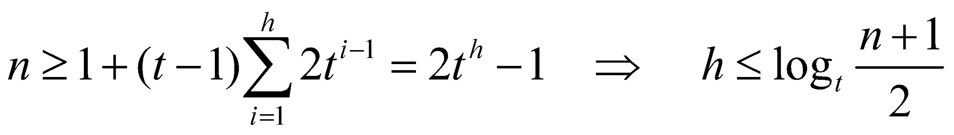
Thus, the worst-case running time is:
O(h) = O(log_{t}n) = O(log_{B}n)
Comparing with the “straightforward” balanced binary search tree (O(log₂n)):
a factor of O(log₂B) improvement

Slide 19
Splitting Nodes
If a node has m-1 keys (or 2t-1 keys where t is the order) then it cannot absorb another key
Before we can insert a new key, we have to “make room,” i.e., split a node

Slide 20
Splitting Nodes
When a non-leaf node is split, it gains a child
If the parent has reached the limit of the children, then we continue splitting nodes up the tree until either we find a parent that does not need to be split or we reach the root
If we need to split the root in two, then we create a new root that has the split roots as its two children. This is why a root has 2-child minimum exception
This is the only way a B-tree gains height

Slide 21
Result: one key of x moves up to parent and x splits into two nodes with about half the keys
x.key(i)
x.key(i-1)
x.key(i)
x.key(i-1)
x.key(i+1)
x
x
... N W ...
... N S W ...
y = x.p(i)
y = x.p(i)
z = x.p(i+1)
P Q R S T V W
P Q R
T V W
T₁
...
T₈
T₁
...
T₈

Slide 22
Splitting the Root
Splitting the root requires the creation of a new root
The tree grows at the top instead of the bottom
T.root()
T.root()
x
H
A D F H L N P
x
z
A D F
L N P
T₁
...
T₈

Slide 23
Merging two sibling nodes (taken from http://techieme.in/b-trees-split-and-merge/ )
Merging is like split in reverse
Consider two nodes y and z with a common parent node x
Find the key K in node x which separates the two nodes y and z
Shift all the keys of node z to node y (maintain the existing order) and free node z; if z is an internal node, transfer all its children to node y
Move down the key K from node x to node y

Slide 24
Result: key K is pushed down one level and node Z is removed hence, it might recursively gets pushed down to the leaves. In certain case, it may end up in overflow at some node and may require a split.
x.key(i)
x.key(i)
x.key(i-1)
x.key(i-1)
x.key(i+1)
x
x
... N S W ...
... N W ...
y = x.p(i)
y = x.p(i)
z = x.p(i+1)
P Q R S T V W
P Q R
T V W
T₁
...
T₈
T₁
...
T₈

Slide 25
Inserting into a B-Tree (taken from people.cs.pitt.edu/~injungkim/1004_lab_Btree)
Attempt to insert the new key into a leaf
If this would result in that leaf becoming too big, split the leaf into two, promoting the middle key to the leaf’s parent
If this would result in the parent becoming too big, split the parent into two, promoting the middle key to its own parent, so on
This strategy might have to be repeated all the way to the top
If necessary, the root is split in two and the middle key is promoted to a new root, making the tree one level higher

Slide 26
Insert
Insertion is always performed at the leaf level
Example: B-tree with t=2 and m=3:
We want to insert: H, J, P
The non-leaf nodes with deep blue have the maximum number of children
The leaf nodes with deep blue have the maximum number of keys so node split needs to be done
Q
G M
T X
D E F
I K L
N O
R S
U V
Y Z

Slide 27
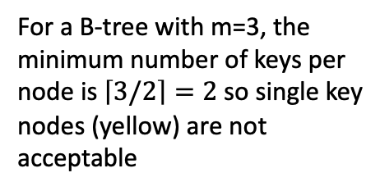
Insert H
The leaf where H should go is already full so we need to a split
Q
G M
T X
D E F
H
I K L
N O
R S
U V
Y Z
If we do the split of the node and promote K up
Q
For a B-tree with t=2, the minimum number of keys per node is 2-1=1 so single key nodes (yellow) are acceptable
G K M
T X
D E F
I
L
N O
R S
U V
Y Z

Slide 28
Insert H for B-tree with t=2
We do the split of the node and promote K up
Q
For a B-tree with t=2, the minimum number of keys per node is 2-1=1 so single key nodes (yellow) are acceptable
G K M
T X
D E F
I
L
N O
R S
U V
Y Z
H is inserted and done
Q
G K M
T X
D E F
H I
L
N O
R S
U V
Y Z

Slide 29
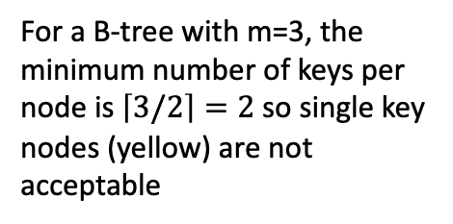
Insert H for B-tree with m=3
We cannot do the split of the node and promote K up because
Q
Additionally, the red node exceeds 3, the maximum number of children allowed
G K M
T X
D E F
I
L
N O
R S
U V
Y Z
So we proceed differently: H is inserted
Q
G M
T X
D E F
H I K L
N O
R S
U V
Y Z

Slide 30
Insert H for B-tree with m=3 (cont.)
L is moved up and M is moved down
Q
G L
T X
D E F
H I K
M N O
R S
U V
Y Z

Slide 31
Insert (contd.)
We see that we have different B-trees if we consider t or m as measures
Considering t as a measure is consistent with the textbook but I could not find websites with examples
Considering m as a measure is consistent with some of the websites I used where I could find examples

Slide 32
Insert
Skeleton of the algorithm:
Down-phase: recursively traverse down and find the leaf
Insert the key
Up-phase: if necessary, split and propagate the splits up the tree
Assumptions:
In the down-phase pointers to traversed nodes are saved in the stack. Function parent(x) returns a parent node of x (pops the stack)
split(y:Bnode):(zk:key_t, z:Bnode)

Slide 33
DownPhase(x,k)
01 i ← 1
02 while i ≤ x.n() and k > x.key(i)
03 i ← i+1
04 if x.leaf() then
05 return x
06 else DiskRead(x.p(i))
07 return DownPhase(x.p(i),k)
Insert(T,k)
01 x ← DownPhase(T.root(), k)
02 UpPhase(x, k, nil)

Slide 34
UpPhase(x,k,p)
01 if x.n() = 2t-1 then
02 (zk,z) ← split(x)
03 if k ≤ zk then InsertIntoNode(x,k,p)
04 else InsertIntoNode(z,k,p)
05 if parent(x)=nil then (Create new root)
06 else UpPhase(parent(x),zk,z)
07 else InsertIntoNode(x,k,p)
InsertIntoNode(x,k,p)
Inserts the hey k and the following pointer p (if not nil) into the sorted order of keys of x, so that all the keys before k are smaller or equal to k and all the keys after k are greater than k

Slide 35
Constructing a B-tree (using m) (taken from people.cs.pitt.edu/~injungkim/1004_lab_Btree)
order:1 12 8 2 25 6 14 28 17 7 52 16 48 68 3 26 29 53 55 45
Suppose we start with an empty B-tree and keys arrive in the following order:1 12 8 2 25 6 14 28 17 7 52 16 48 68 3 26 29 53 55 45
We want to construct a B-tree of order M=5
The first four items go into the root:
To put the fifth item in the root would violate condition 5
Therefore, when 25 arrives, pick the middle key to make a new root
1
2
8
12

Slide 36
Constructing a B-tree (contd.)
order:1 12 8 2 25 6 14 28 17 7 52 16 48 68 3 26 29 53 55 45
8
1
2
12
25
6, 14, 28 get added to the leaf nodes:
8
1
2
6
12
14
25
28

Slide 37
Constructing a B-tree (contd.)
order:1 12 8 2 25 6 14 28 17 7 52 16 48 68 3 26 29 53 55 45
Adding 17 to the right leaf node would over-fill it, so we take the middle key, promote it (to the root) and split the leaf
8
17
1
2
6
12
14
25
28
7, 52, 16, 48 get added to the leaf nodes
8
17
1
2
6
7
12
14
16
25
28
48
52

Slide 38
Constructing a B-tree (contd.)
order:1 12 8 2 25 6 14 28 17 7 52 16 48 68 3 26 29 53 55 45
Adding 68 causes us to split the right most leaf, promoting 48 to the root, and adding 3 causes us to split the left most leaf, promoting 3 to the root; 26, 29, 53, 55 then go into the leaves
3
8
17
48
1
2
6
7
12
14
16
25
26
28
29
52
53
55
68
Adding 45 causes a split of
25
26
28
29
and promoting 28 to the root then causes the root to split

Slide 39
Constructing a B-tree (contd.)
17
3
8
28
48
1
2
6
7
12
14
16
25
26
29
45
52
53
55
68

Slide 40
Removal from a B-tree (taken from people.cs.pitt.edu/~injungkim/1004_lab_Btree)
During insertion, the key always goes into a leaf. For deletion we wish to remove from a leaf. There are some possible ways we can do this:
1 - If the key is already in a leaf node, and removing it doesn’t cause that leaf node to have too few keys, then simply remove the key to be deleted.
2 - If the key is not in a leaf then it is guaranteed (by the nature of a B-tree) that its predecessor or successor will be in a leaf -- in this case we delete the key and promote the predecessor or successor key to the non-leaf deleted key’s position.

Slide 41
Deletion
Case 1: A key k is in a non-leaf node
Remove its predecessor (which is always in a leaf, thus case 2) and put it in k’s place.
Case 2: A key is in a leaf-node:
Just delete it and handle under-full nodes
Try: delete M, B, K (M =3)
P
C G M
T X
A B
D E F
J K L
N O
Q R S
U V
Y Z

Slide 42
Handling Under-full Nodes
Distributing:
Merging:
x
... k ...
x
... k’ ...
x.p(i)
...
k’ ...
x.p(i)
... k
...
A
B
A B
x
... l’ k m’...
x
... l’ m’ ...
x.p(i)
... l
m …
...l k m ...
A
B
A B

Slide 43
Sequential access
Other useful ADT operator: successor
For example, range queries: find all accounts with the amount in the range [100K – 200K].
How do you do that in B-trees?

Slide 44
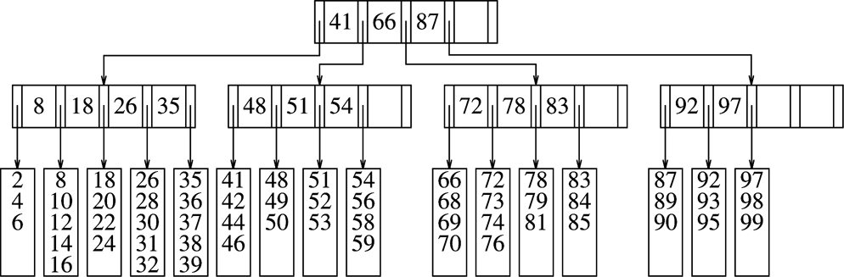
Another example for M=5
Notes:
Taken from Data Structures and Algorithm Analysis in C++” by Weiss

Slide 45
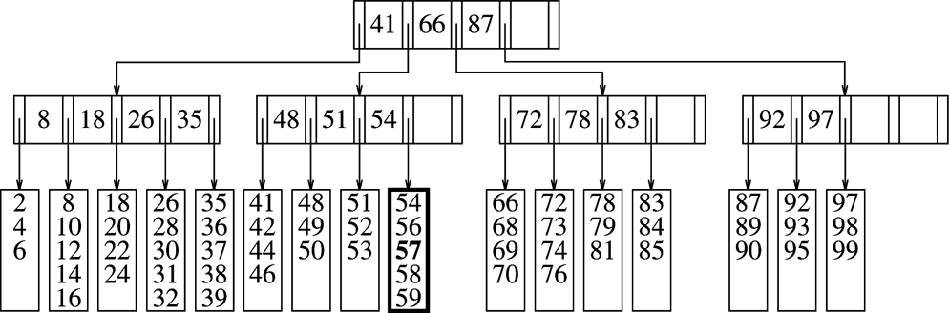
Adding Items to a B-tree
If the item can be added as a leaf, then we do so and we are done:
Insert 57
Notes:
Taken from Data Structures and Algorithm Analysis in C++” by Weiss

Slide 46
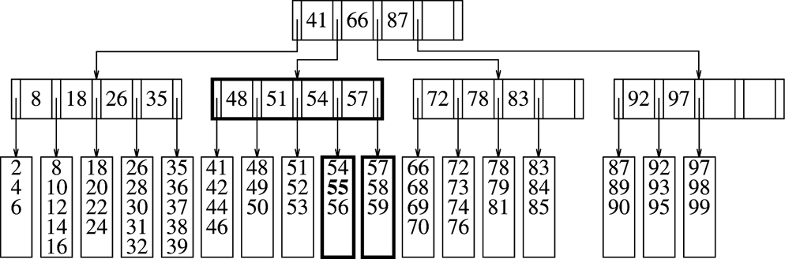
If the leaf is over-full (has L+1 items) but the parent can still have another leaf, then we split the leaf with L+1 items into 2 leaves and update the parent
Insert 55
Notes:
Taken from Data Structures and Algorithm Analysis in C++” by Weiss

Slide 47
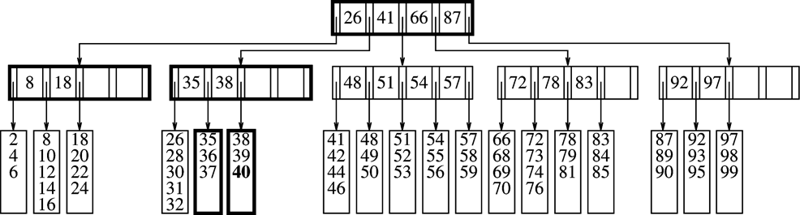
If the leaf is over-full (has L+1 items) and the parent cannot have another leaf, then we split the parent of the parent, we split the leaf with L+1 items into 2 leaves, and update the parent and the parent of the parent
Insert 40
Notes:
Taken from Data Structures and Algorithm Analysis in C++” by Weiss

Slide 48
Deleting items from a B-tree
If the item exists and can be removed without violating the B-tree properties (e.g. the leaf has enough items), we do so and we are done
If the leaf now has too few items, we adopt a neighboring item. If the neighbor also has now too few items, we combine with the neighbor to form a full leaf. In this case the parent loses a child. If this causes the parent to fall below minimum, we follow the same strategy.
Notes:
Taken from Data Structures and Algorithm Analysis in C++” by Weiss

Slide 49
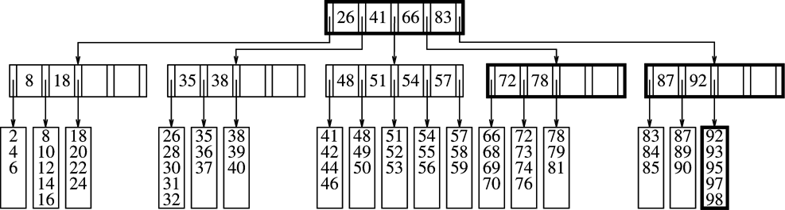
Delete 99
Notes:
Taken from Data Structures and Algorithm Analysis in C++” by Weiss

Slide 50
Complexity (taken from cs.smith.edu/Courses/Fall00/handin/Present)
If n >= 1, then for any n-key B-tree T of height h and minimum degree M >= 2:
h <= log_{M} (n+1)/2
Like red-black trees the height of B-trees grows as O(lg n) but for B-trees the base of the logarithm can be many times larger.
B-trees save a factor of about lg M over red-black trees in the number of nodes examined for most tree operations.

Slide 51
Complexity of Procedures (taken from cs.smith.edu/Courses/Fall00/handin/Present)
Searching a B-tree is similar to searching a binary search tree except that a multiway branching decision is made at each node according to the number of the node’s children.
Time complexity O(M log_{M} n) is the same for insertion and deletion.
Splitting a node O(M log_{M} n)

Slide 52
Accessing Secondary Storage (taken from cs.smith.edu/Courses/Fall00/handin/Present)
Primary memory storage is more expensive than secondary, so secondary storage for computers often exceeds the amount of primary by several orders of magnitude.
The access time for a page may be large while the time to read the information once it is accessed is small.
System can only keep a limited amount of information in main memory at any time.
The algorithm for B-trees is well suited to efficiently access secondary storage.

Slide 53
Suitability of B-trees (taken from cs.smith.edu/Courses/Fall00/handin/Present)
A large branching factor reduces the height of the tree and the number of disk accesses required to find any page
A B-tree can copy selected pages from disk to and from memory as needed so the size of the tree is not dependent on the size of main memory
The number of disk accesses required on a B-tree is proportional to the tree’s height.
For example, a B-tree with a branching factor of 1001 and height 2 stores over one billion pages and since the root is kept permanently in main memory only two disk accesses are required to find any page

Slide 54
B⁺-trees
B⁺-trees is a variant of B-trees:
All data keys are in leaf nodes
The split does not move the middle key to the parent but copies it to the parent!
Leaf-nodes are connected into a (doubly) linked list
How the range query is performed?
Compare with the B-tree

Slide 55
B⁺-trees (contd.)
Let’s draw a B⁺-tree (t =2):
A, B, C, D, E, F, G, H, I, J, K
How is the range query performed?
Compare with the B-tree

