Slide 1
CPSC 535: Advanced Algorithms
Instructor: Dr. Doina Bein

Slide 2
Hash Tables
A hash table is an ADT that
is an indexed sequence or array, i.e
a list of items for which the order does matter (sequence)
and supports directly addressing (i.e. accessing any item is done in O(1) steps) (indexed)
that supports only the dictionary operations Insert, Search and Delete
Each element has a key, but instead of using the key as the index of the array directly, the index is computed from the key using a so-called hash function
The domain of values for a hash function is a hash table

Slide 3
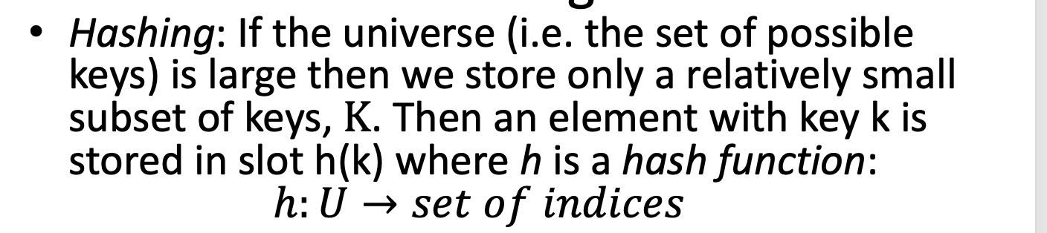
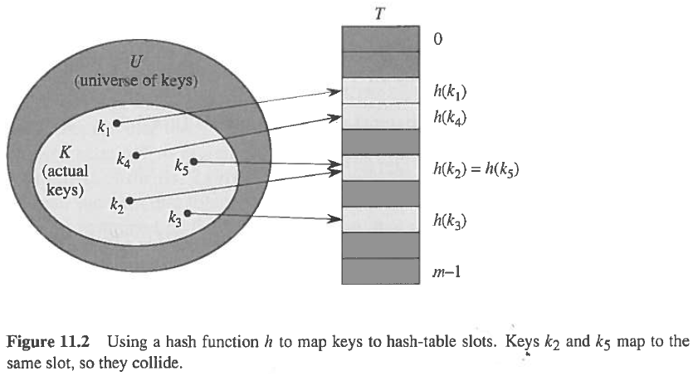
Hashing
element with key k hashes to slot h(k)
h(k) is the hash value of key k
Image taken from Cormen’s book
Notes:
figure 11.2 on page 225 Cormen book

Slide 4
Hash Functions (Taken from wikipedia, http://en.wikipedia.org/wiki/Hash_function)
A hash function is any function that can be used to map digital data of arbitrary size to digital data of fixed size, with slight differences in input data producing very big differences in output data
The hash function is used to map the search key to an index; the index gives the place in the hash table where the corresponding record should be stored
The values returned by a hash function are called hash values, hash codes, hash sums, or simply hashes
Thus, the hash function only hints at the record's location — it tells where one should start looking for it.
Still, in a half-full table, a good hash function will typically narrow the search down to only one or two entries.
Good hash functions, in the original sense of the term, are usually required to satisfy certain properties listed below:
Determinism: A hash procedure must be deterministic—meaning that for a given input value it must always generate the same hash value.

Slide 5
Uniformity: A good hash function should map the expected inputs as evenly as possible over its output range. That is, every hash value in the output range should be generated with roughly the same probability.
Defined range: It is often desirable that the output of a hash function have fixed size. Producing fixed-length output from variable length input can by accomplished by breaking the input data into chunks of specific size.
Data normalization: In some applications, the input may need to be normalized before hashing it, as by upper-casing all letters. For such data, one must use a hash function that is compatible with the data equivalence criterion being used: that is, any two inputs that are considered equivalent must yield the same hash value.
Non-invertible: In cryptographic applications, hash functions are typically expected to be non-invertible, meaning that it is not possible to reconstruct the input datum x from its hash value h(x) alone without spending great amounts of computing time.

Slide 6
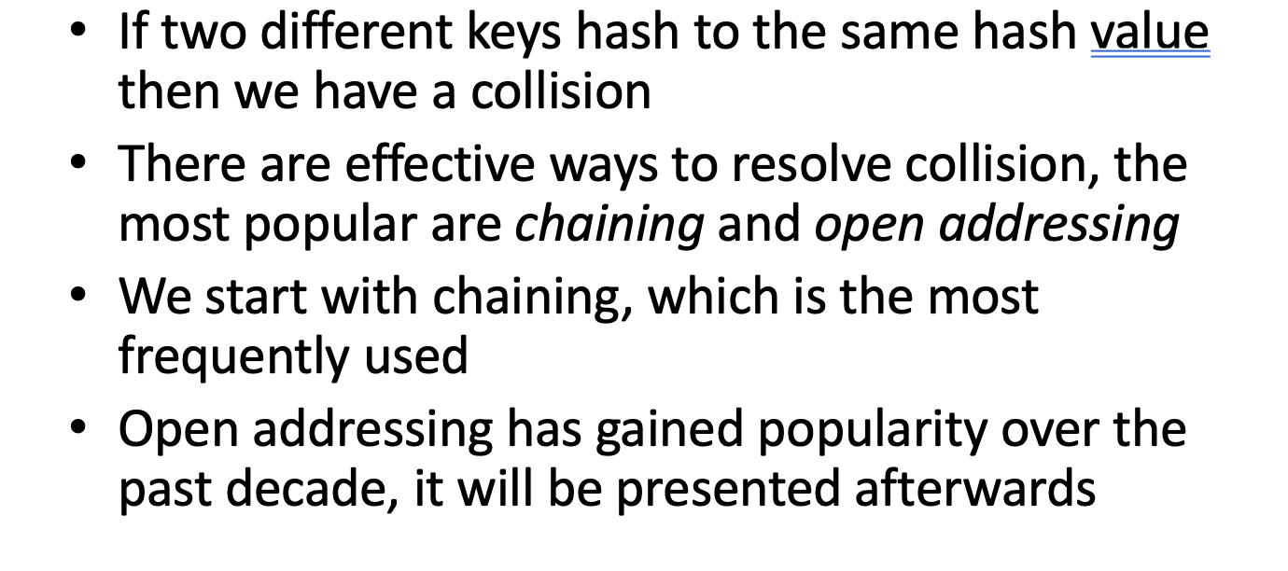
Collision

Slide 7
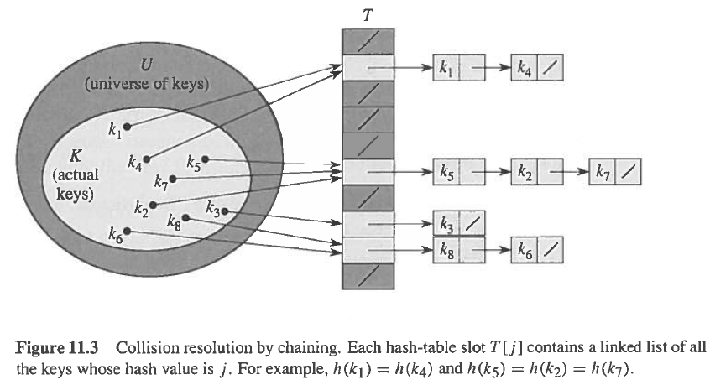
Solving Collision by Chaining
All the elements that share the same hash key are placed in a linked list.
An entry of the hash table is either NIL or contains the pointer to the first element of the linked list.
Notes:
figure 11.3 on page 225 Cormen book

Slide 8
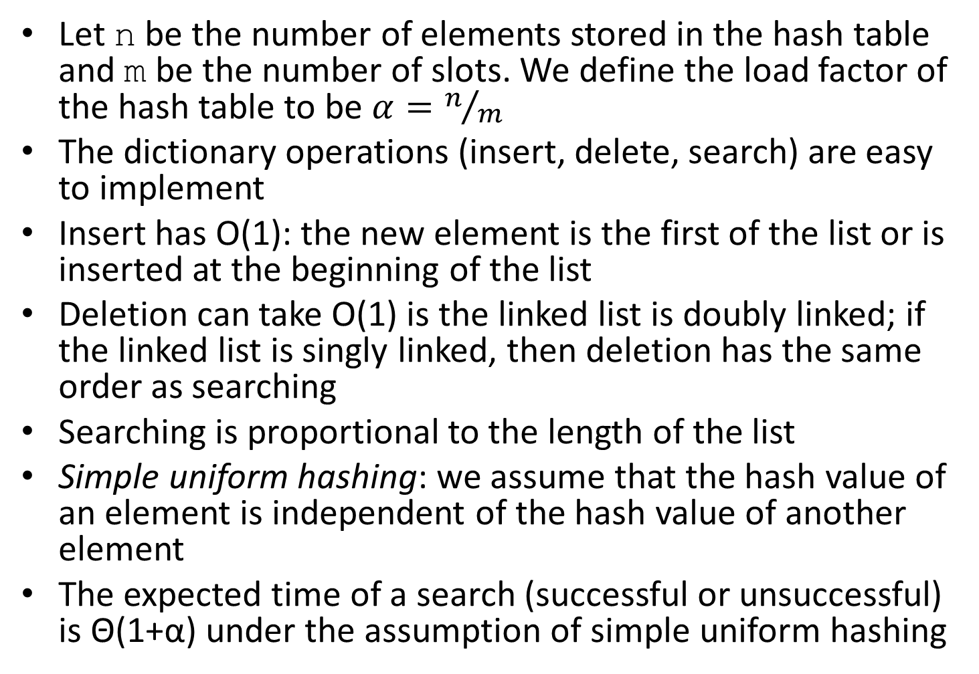
Analysis of Hashing with Chaining

Slide 9
Solving Collision by Chaining
All the elements that share the same hash key are placed in a linked list.
An entry of the hash table is either NIL or contains the pointer to the first element of the linked list.
Image taken from Cormen’s book
Notes:
figure 11.3 on page 225 Cormen book

Slide 10
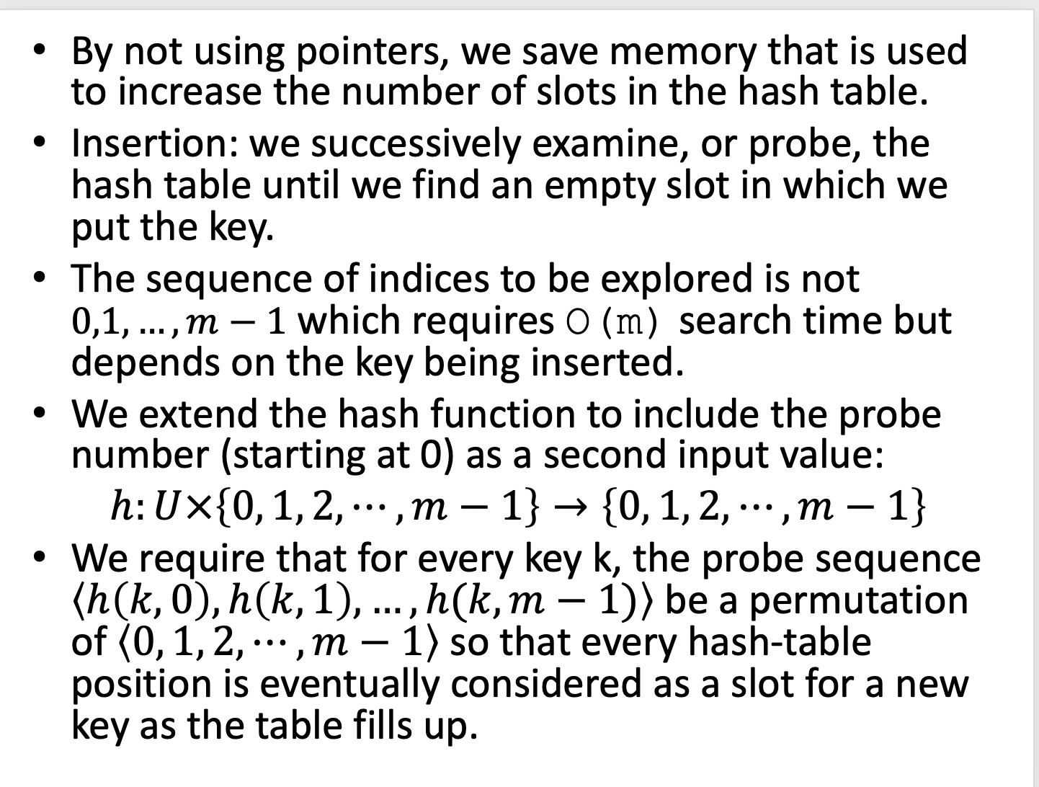

Slide 11
Open Addressing
Linear probing
Quadratic probing
Double hashing
Universal hashing
Cuckoo hashing

Slide 12
•A hash function maps/compresses messages of arbitrary lengths, typically strings, to a fix length (m-bit output), and is efficiently computable
–for a given input string, we can get the output in a reasonable amount of time, say, O(n), for an n-bit string
–output known as the fingerprint or the message digest
–There’s a generic method called the Merkle‐Damgard transform to convert it into a hash function that works on arbitrary‐length inputs.
•What is an example of hash functions?
–Given a hash function that maps strings to integers in [0,2³²-1]
•A hash function is a many-to-one function, not injective, but collisions though unlikely can happen.
•Hash functions are used to provide time efficient solutions to several problems or applications
–Good hash functions have few collisions
–Computationally infeasible to invert
•Cryptographic hash functions are hash functions with additional security requirements

Slide 13
Open Addressing Methods
Linear probing
Quadratic probing
Double hashing
Universal hashing
Cuckoo hashing

Slide 14
Hash Functions (changed from https://www.cs.purdue.edu/homes/ninghui/courses/555_Spring12/handouts/555_Spring12_topic14.ppt )
A hash function maps/compresses messages of arbitrary lengths, typically strings, to a fix length (m-bit output), and is efficiently computable
for a given input string, we can get the output in a reasonable amount of time, say, O(n), for an n-bit string
output known as the fingerprint or the message digest
There’s a generic method called the Merkle‐Damgard transform to convert it into a hash function that works on arbitrary‐length inputs.
What is an example of hash functions?
Given a hash function that maps strings to integers in [0,2³²-1]
A hash function is a many-to-one function, not injective, but collisions though unlikely can happen.
Hash functions are used to provide time efficient solutions to several problems or applications
Good hash functions have few collisions
Computationally infeasible to invert
Cryptographic hash functions are hash functions with additional security requirements

Slide 15
Cryptographic Hash Functions (taken from https://www.lopp.net/pdf/princeton_bitcoin_book.pdf)
Three additional security properties:
1. Collision resistance: it is infeasible to find two distinct values with the same hash value: x ≠ y, yet H(x) = H(y) No hash function has been proven collision-free.
2. Hiding: If r is chosen from a probability distribution that has high min-entropy, then given H(r || x), it is infeasible to find x.
min-entropy is a measure of how predictable an outcome is
||: concatenation
r: a secret random value, called a nonce
3. Puzzle-friendly: For every possible output value y, if k is chosen from a distribution with high min-entropy, then it is infeasible to find x such that H(k || x) = y in a given amount of time.
not a general requirement for cryptographic hash functions, but one that will be useful for cryptocurrencies specifically

Slide 16
Collision Resistance
Given a function h: X →Y, then we say that h is:
preimage resistant (one-way):
if given y ∈Y it is computationally infeasible to find a value x ∈X s.t. h(x) = y
2-nd preimage resistant (weak collision resistant):
if given x ∈ X it is computationally infeasible to find a value x’ ∈ X, s.t. x’≠x and h(x’) = h(x)
collision resistant (strong collision resistant):
if it is computationally infeasible to find two distinct values x’,x ∈ X, s.t. h(x’) = h(x)
Notes:
A good homework topic is to prove that collision resistant implies both 2-nd preimage-resistant and implies preimage-resistant.

Slide 17
Example of collision resistant hash fct (taken from https://www.lopp.net/pdf/princeton_bitcoin_book.pdf)
A hash function with a 256-bit output size: pick 2²⁵⁶ + 1 distinct values, compute the hashes of each of them, and check if there are any two outputs are equal
There is at least one collision, but to find it one would have to compute the hash function 2²⁵⁶ the worse case and 2¹²⁸ the average case.
If a computer calculates 10,000 hashes per second, it would take more than one octillion (10²⁷) years to calculate 2¹²⁸ hashes.

Slide 18
Example of hash function with hiding property
High min-entropy means that the distribution is “very spread out”, so that no particular value is chosen with more than negligible probability.
In cryptography, the term nonce is used to refer to a value that can only be used once.
If the nonce r is chosen uniformly from among all of the strings that are 256 bits long, then any particular string was chosen with probability 1/2²⁵⁶ which is an infinitesimally small value.

Slide 19
Example of hash function that is puzzle friendly
A search puzzle consists of a hash function H, a value r chosen from a high min-entropy distribution and a target set Y, |Y| << |X|.
A solution to this puzzle is a value x such that H(x||r)єY.
The size of Y determines how hard the puzzle is.
If H has an n-bit output, then it can take any of 2^{n} values. Solving the puzzle requires finding an input so that the output falls within the set Y, which is typically much smaller than the set of all outputs.
Puzzle-friendly property implies that no solving strategy is much better than trying random values of x.
If we want to pose a puzzle that’s difficult to solve, we can do it this way as long as we can generate r in a suitably random way.
Bitcoin mining is a sort of computational puzzle.

Slide 20
Well Known Hash Functions
MD5
output 128 bits
collision resistance completely broken by Prof. Xiaoyun Wang and others from in China in 2004
SHA1
output 160 bits
no collision found yet, but method exist to find collisions in less than 2^80
considered insecure for collision resistance
one-wayness still holds
SHA2 (SHA-224, SHA-256, SHA-384, SHA-512)
outputs 224, 256, 384, and 512 bits, respectively
No real security concerns yet

Slide 21
Using Hashing
Prevent forgery, modification
MAC (Message Authentication Code)
Hash as message digest: If we know H(x) = H(y), it’s safe to assume that x = y.
To recognize a file that we saw before, just remember its hash and no need to compare word by word.
DropBox auto synchronizes modified files.
Data Structures:
Hash list
Hash (Merkle) Tree
Hash Table
Hash table vs Hash list vs Hash tree? Article on StackOverflow: https://stackoverflow.com/questions/2974597/hash-table-vs-hash-list-vs-hash-tree

Slide 22
Hash pointer
Regular pointer: gives you a way to retrieve the information.
Example: char *str = new char [10];
Hash pointer: a pointer to where some info. is stored, together with a cryptographic hash of the info.
If we have a hash pointer, we can ask to get the info back, and verify that it hasn’t changed.
H( )
(data)

Slide 23
Data structures using hash pointers
We can use hash pointers to build all kinds of data structures.
We can take a familiar data structure that uses pointers such as a linked list or a binary search tree and implement it with hash pointers, instead of pointes as we normally would.
Linked list => Block chain
Sorted linked list => Hash list
Binary search tree => Hash tree / Merkle tree
One can use hash pointers in any pointer-based data structure that has no cycles.

Slide 24
Block chain
Pointer to B1
H( )
(data)
Pointer to B0
(data)
Hash of B1
(data)
Hash of B0
Block 1 (B1)
Block 2 (B2)
Block 0 (B0) (genesis block)
In a block chain, the previous block pointer will be replaced with a hash pointer.
So each block not only tells us where the value of the previous block was, but it also contains a digest of that value that allows us to verify that the value hasn’t changed.
If an adversary modifies data anywhere in the block chain, it will result in the hash pointer in the following block being incorrect.
If we store the head of the list, then even if the adversary modifies all of the pointers to be consistent with the modified data, the head pointer will be incorrect, and we will detect the tampering.

Slide 25
Hash List (taken from https://en.wikipedia.org/wiki/Hash_list and https://www.techopedia.com/definition/32921/hash-list)
A hash list is a list of hashes (aka a set of hash values) related to sets of data blocks in a file, set of files in a folder system or some other connective array format
Hash lists are used for many different purposes, such as fast table lookup (hash tables) and distributed databases (distributed hash tables).
A hash list shows how a set of hash values are related: how they collectively work to store data from a given “block” or unified collection.
A hash list is an extension of the concept of hashing an item (for instance, a file).
A hash list is a subtree of a Merkle tree.

Slide 26
Hash List
h₂1
h₁1
h₁2
h₁3
h₁4
h₁5
h₁6
h₁7
h₁8
m1
m2
m3
m4
m5
m6
m7
m8

Slide 27
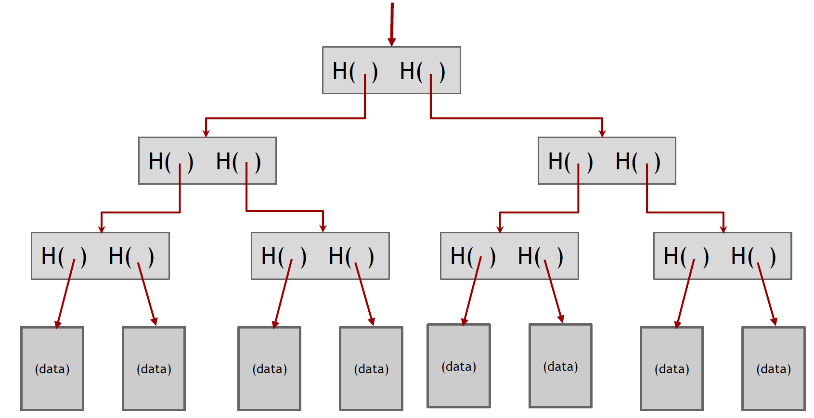
Merkle Tree (taken from https://www.lopp.net/pdf/princeton_bitcoin_book.pdf)
Suppose we have a number of blocks containing data, like blocks of a file.
Make these blocks to be the leaves of a binary tree then group them into pairs of two, and make the parent node have two hash pointers, one to each of these blocks.
Group parent nodes into groups of two with a single parent and have their parent node contain the hash of each.
Continue doing this until we reach a single block, the root of the tree.
Store only the hash pointer at the head of the tree.

Slide 28
Hash Tree / Merkle Tree / Merkle Hash Tree (taken from https://en.wikipedia.org/wiki/Merkle_tree)
Named after Ralph Merkle, who patented the concept in 1979
A hash tree (or Merkle tree) is a tree in which every leaf node is labelled with the cryptographic hash of a data block, and every non-leaf node is labelled with the hash of the labels of its child nodes.
Hash trees are a generalization of hash lists and block chains.
Usually, a cryptographic hash function such as SHA-2 is used for the hashing.
If the hash tree only needs to protect against unintentional damage, unsecured checksums such as CRCs can be used.
Advantages:
Tree holds many items but just need to remember the root hash
Hash trees allow efficient and secure verification of the contents of large data structures using hash-based cryptography.
Can verify membership in O(log n) time/space
Variant: sorted Merkle tree can verify non-membership in O(log n)

Slide 29
Hash Tree
h₄1
h₃1
h₃2
h₂1
h₂2
h₂3
h₂4
h₁1
h₁2
h₁3
h₁4
h₁5
h₁6
h₁7
h₁8
m1
m2
m3
m4
m5
m6
m7
m8

Slide 30
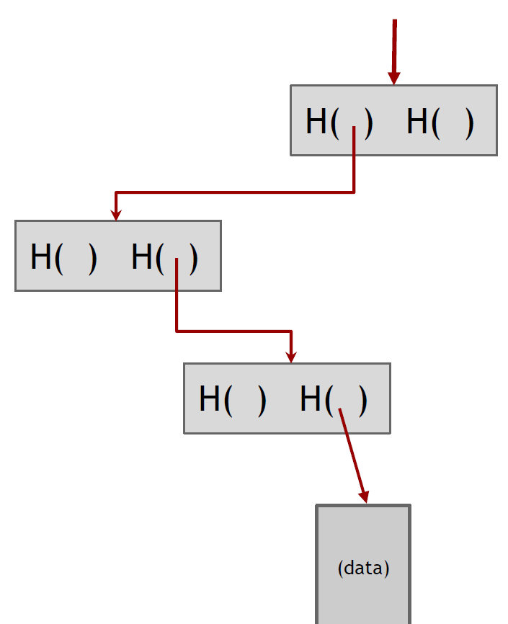
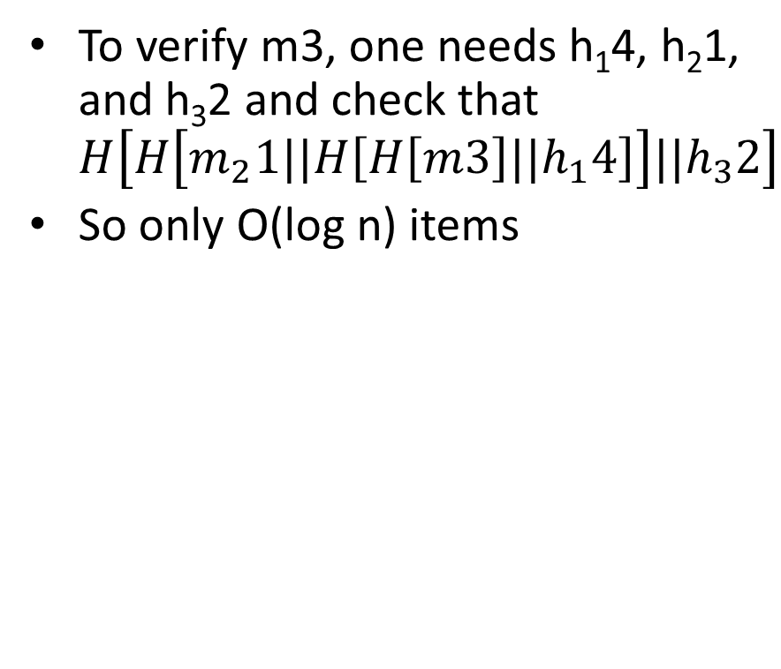
Verifying membership in a hash tree

Slide 31
Read more
Read more at https://blockonomi.com/merkle-tree/

