Slide 1
CPSC 535: Advanced Algorithms
Instructor: Dr. Doina Bein

Slide 2
Text-search Data Structures (slides taken from http://people.cs.aau.dk/~simas/aalg04/)
Goal of the lecture:
Dictionary ADT for strings:
to understand the principles of tries, compact tries, Patricia tries

Slide 3
Dictionary ADT for Strings
Creating a dictionary ADT for strings
Elements: text strings
Operations:
search(x) – checks if string x is in the set
insert(x) – inserts a new string x into the set
delete(x) – deletes the string equal to x from the set of strings
Assumptions, notation:
n strings, N characters in total
m – length of x
Size of the alphabet d = |Σ|

Slide 4
BST as dictionary for strings
Using binary search trees has some issues:
Keys are of varying length
A lot of strings share similar prefixes (beginnings) – potential for saving space
Let’s count comparisons of characters.
What is the worst-case running time of searching for a string of length m?

Slide 5
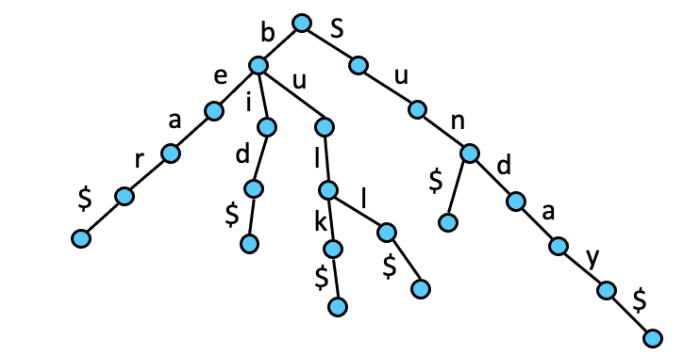
Tries
Trie – a data structure for storing a set of strings (name from the word “retrieval”):
Let’s assume, all strings end with “$” (not in Σ)
Set of strings: {bear, bid, bulk, bull, sun, Sunday}

Slide 6
Tries (cont.)
Properties of a trie:
A multi-way tree.
Each node has from 1 to d children.
Each edge of the tree is labeled with a character.
Each leaf node corresponds to the stored string, which is a concatenation of characters on a path from the root to this node.

Slide 7
Search and Insertion in Tries
Trie-Search(t, P[k..m]) //inserts string P into t
01 if t is leaf then return true
02 else if t.child(P[k])=nil then return false
03 else return Trie-Search(t.child(P[k]), P[k+1..m])
The search algorithm just follows the path down the tree (starting with Trie-Search(root, P[0..m]))
Trie-Insert(t, P[k..m])
01 if t is not leaf then //otherwise P is already present
02 if t.child(P[k])=nil then
03 Create a new child of t and a “branch” starting with that chlid and storing P[k..m]
04 else Trie-Insert(t.child(P[k]), P[k+1..m])
How would the delete work?

Slide 8
Trie Node Structure
“Implementation detail”
What is the node structure? = What is the complexity of the t.child(c) operation?:
An array of child pointers of size d: waste of space, but child(c) is O(1)
A hash table of child pointers: less waist of space, child(c) is expected O(1)
A list of child pointers: compact, but child(c) is O(d) in the worst-case
A binary search tree of child pointers: compact and child(c) is O(lg d) in the worst-case

Slide 9
Analysis of the Trie
Size:
O(N) in the worst-case
Search, insertion, and deletion (string of length m):
depending on the node structure: O(dm), O(m lg d), O(m)
Compare with the string BST
Observation:
Having chains of one-child nodes is wasteful

Slide 10
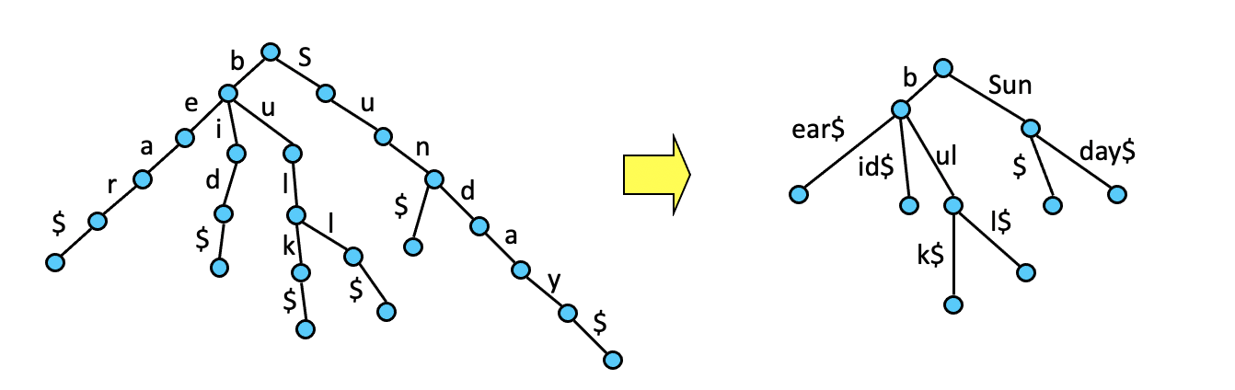
Compact Tries
Compact Trie:
Replace a chain of one-child nodes with an edge labeled with a string
Each non-leaf node (except root) has at least two children

Slide 11
Compact Tries (contd.)
Implementation:
Strings are external to the structure in one array, edges are labeled with indices in the array (from, to)
Can be used to do word matching: find where the given word appears in the text.
Use the compact trie to “store” all words in the text
Each child in the compact trie has a list of indices in the text where the corresponding word appears.

Slide 12
Word Matching with Tries
(31,34)
(17,18)
(1,2)
(22,24)
(14,16)
(19,19)
31
(3,3)
20
(8,11)
12
17
6
(4,5)
(28,30)
25,35
1
1 2 3 4 5 6 7 8 9 10 12 14 16 18 20 22 24 26 28 30 32 34 36 38 40
T:
they think that we were there and there
To find a word P:
At each node, follow edge (i,j), such that P[i..j] = T[i..j]
If there is no such edge, there is no P in T, otherwise, find all starting indices of P when a leaf is reached

Slide 13
Word Matching with Tries (contd.)
Building of a compact trie for a given text:
How do you do that? Describe the compact trie insertion procedure
Running time: O(N)
Complexity of word matching: O(m)
What if the text is in external memory?
In the worst-case we do O(m) I/O operations just to access single characters in the text – not efficient

Slide 14
Patricia trie
Patricia trie:
a compact trie where each edge’s label (from, to) is replaced by (T[from], to – from + 1)
(a,4)
(w,2)
(t,2)
(r,3)
(a,3)
(_,1)
31
(e,1)
20
(i,4)
12
17
6
(y,2)
(r,3)
25,35
1
1 2 3 4 5 6 7 8 9 10 12 14 16 18 20 22 24 26 28 30 32 34 36 38 40
T:
they think that we were there and there

Slide 15
Querying Patricia Trie
Word prefix query: find all words in T, which start with P[0..m-1]
Patricia-Search(t, P, k) // inserts P into t
01 if t is leaf then
02 j ← the first index in the t.list
03 if T[j..j+m-1] = P[0..m-1] then
04 return t.list // exact match
05 else if there is a child-edge (P[k],s) then
06 if k + s < m then
07 return Patricia-Search(t.child(P[k]), P, k+s)
08 else go to any descendent leaf of t and do the check of line 03, if it is true, return lists of all descendent leafs of t, otherwise return nil
09 else return nil // nothing is found

Slide 16
Analysis of the Patricia Trie
Idea of patricia trie – postpone the actual comparison with the text to the end:
If the text is in external memory only O(1) I/O are performed (if the trie fits in main-memory)
Build a Patricia Trie for word matching:
Usually binary patricia tries are used:
Consider binary encoding of text (and queries)
Each node in the tree has two children (left for 0, right for 1)
Edges are labeled just with skip values (in bits)
1 2 3 4 5 6 7 8 9 10 12 14 16 18 20 22 24 26 28 30 32 34 36 38 40
T:
føtex har haft en fødselsdag

Slide 17
Text-Search Problem
Input:
Text T = “carrara”
Pattern P = “ar”
Output:
All occurrences of P in T
Reformulate the problem:
Find all suffixes of T that has P as a prefix!
We already saw how to do a word prefix query.
carrara
arrara
rrara
rara
ara
ra
a

Slide 18
Suffix Trees
Suffix tree – a compact trie (or similar structure) of all suffixes of the text
Patricia trie of suffixes is sometimes called a Pat tree
a
r
(a,1)
(r,1)
r
carrara$
(r,1)
(c,8)
rara$
(r,5)
$
a
($,1)
(a,1)
rara$
a$
1
$
(r,5)
(a,2)
1
(r,3)
7
ra$
3
7
($,1)
3
2
5
6
4
2
5
6
4
1 2 3 4 5 6 7 8
carrara$

Slide 19
Pat Trees: Analysis
Text search for P is then a prefix query.
Running time: O(m+z), where z is the number of answers
Just O(1) I/Os if the text is in external-memory (independent of z)!
The size of the Pat tree: O(N)
Why?
Advantage of compression: the size of the simple trie of suffixes would be in the worst-case N + (N-1)+ (N-2) + … 1 = O(N²)

Slide 20
Constructing Suffix Trees
The naïve algorithm
Insert all suffixes one after another: O(N²)
Clever algorithms: O(N)
McCreight, Ukkonen
Scan the text from left to right, use additional suffix links in the tree
Question: How does the the Pat tree looks like after inserting the first five prefixes using the naïve algorithm?
1 2 3 4 5 6 7 8 9
Honolulu$

Slide 21
Full-Text Indices
What if the Pat tree does not fit in main memory?
A number of external-memory data structures were proposed:
SPat arrays
String B-trees
String B-tree:
A B-tree for strings, i.e., supports dictionary operations
Can be used for text-searching if all suffixes are stored in it

Slide 22
String B-tree
Rough idea:
Text is external to the tree, strings are represented in the B⁺-tree by the indices of where they begin in the text
This would mean doing O(lg B) I/Os when visiting each node – too much!
Idea – organize all keys in each node into a Patricia trie. When searching this trie (without any I/Os):
We reach a leaf. What then?
We stop in the middle. What then?
The total running time of text search:
O((m+z)/B + log_{B}N)

