Slide 1
CPSC 535: Advanced Algorithms
Instructor: Dr. Doina Bein

Slide 2
Text-search Algorithms (slides taken from http://people.cs.aau.dk/~simas/aalg04/)
Goals of the lecture:
Naive text-search algorithm and its analysis;
Horspool algorithm and its analysis.
Boyer-Moore algorithm and its analysis
Rabin-Karp algorithm and its analysis;
Knuth-Morris-Pratt algorithm ideas;
Comparison of the advantages and disadvantages of the different text-search algorithms.

Slide 3
Text Search (or String Matching) Problem
Input: Alphabet Σ and two strings T[0..n-1] and P[0..m-1], containing symbols from alphabet Σ
Output: a set S containing all “shifts” 0 ≤ s ≤ n-m such that T[s..s+m-1] = P
Example: Input: Σ = {a, b, …, z}, T[0..17]=“to be or not to be”, and P[0..1]=“be” Output: S = [3, 16]
Chapter 32 in the textbook

Slide 4

(taken from Levitin, page 105)
String P is called the pattern:
A brute-force algorithm:
Until string is exhausted do the following:
Align the pattern against the first m characters of the text and start matching the corresponding pairs of characters from left to right In the latter case
If a match, add index to the list of indices S
If not, shift the pattern one position to the right and resume the character comparisons, starting again with the first character of the pattern and its counterpart in the text.
Note that the last position in the text that can still be a beginning of a matching substring is n − m (provided the text positions are indexed from 0 to n − 1).
Beyond that position, there are not enough characters to match the entire pattern; hence, the algorithm need not make any comparisons there.

Slide 5
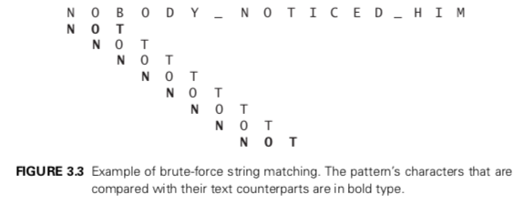
Simple Algorithm
Uses brute force
ALGORITHM BruteForceStringMatch(T [0..n − 1], P [0..m − 1] ) //Implements brute-force string matching
//Input: An array T [0..n − 1] of n characters representing a text and
// an array P [0..m − 1] of m characters representing a pattern //Output: The indices of the characters in the text that start a
// matching substring or [] (empty set) if the search is unsuccessful
S = [] // empty list
for i ← 0 to n − m do
match ← True
for j ← 0 to m-1 do
if P [j ] ≠ T [i + j ] then match ← False
break // exit the for loop
endif
endfor
if j == m then
S = S ○ i
endif
endfor
Return S

Slide 6
Time complexity
Worst case: O(nm)
Average case (random text): O(n)
Is it possible to obtain O(n) for any input?
Knutt-Morris-Pratt (1977): deterministic
Karp-Rabin (1981): randomized

Slide 7
Reverse naïve algorithm
Why not search from the end of P?
Boyer and Moore
Reverse-Naive-Search(T,P)
01 for s ← 0 to n – m
02 j ← m – 1 // start from the end
03 // check if T[s..s+m–1] = P[0..m–1]
04 while T[s+j] = P[j] do
05 j ← j - 1
06 if j < 0 return s
07 return –1
Running time is exactly the same as of the naïve algorithm…

Slide 8
Occurrence heuristic
Boyer and Moore added two heuristics to reverse naïve, to get an O(n+m) algorithm, but it’s complex
Horspool suggested just to use the modified occurrence heuristic:
After a mismatch, align T[s + m–1] with the rightmost occurrence of that letter in the pattern P[0..m–2]
Examples:
T= “detective date” and P= “date”
T= “tea kettle” and P= “kettle”

Slide 9
Input-enhancement Algorithms
Input enhancement: preprocess the pattern to get some information about it, store this information in a table, and use that information during an actual search for the pattern in a given text
The best-known algorithms:
Knutt-Morris-Pratt algorithm: compare characters of a pattern with their counterparts in a text from left to right
Boyer-Moore algorithm: compare characters of a pattern with their counterparts in a text from right to left
Before we proceed with Boyer-Moore, we start with a simplified version of Horspool

Slide 10
Horspool’s Algorithm (taken from Levitin, page 259)
When comparing a pattern against a position in the text, if a mismatch occurs, we need to shift the pattern to the right
The shift would be as large as possible without risking the possibility of missing a matching substring in the text
Idea: determine the size of the shift by looking at the character c of the text that is aligned against the last character of the pattern
Four cases:

Slide 11

Case 1
Case 1: There are no c’s in the pattern; for example if c is S
Then we can safely shift the pattern by its entire length

Slide 12

Case 2
Case 2: If there are occurrences of character c in the pattern but it is not the last one there; for example if c is letter B
Then the shift should align the rightmost occurrence of c in the pattern with the c in the text

Slide 13

Case 3
Case 3: If c happens to be the last character in the pattern but there are no c’s among its other m − 1 characters; for example if c is letter R
Similar to Case 1: the pattern should be shifted by the entire pattern’s length m

Slide 14

Case 4
Case 4: If c happens to be the last character in the pattern and there are other c’s among its first m − 1 characters; for example if c is letter R
Similar to Case 2: the rightmost occurrence of c among the first m − 1 characters in the pattern should be aligned with the text’s c

Slide 15
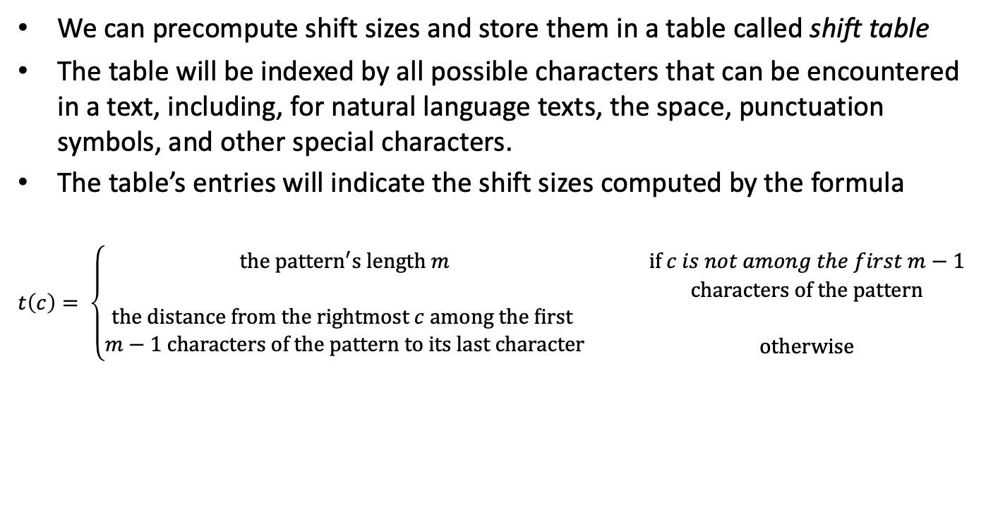
What we need to do

Slide 16
Example of shift table
Consider searching for the pattern BARBER in a text that comprises English letters and spaces (denoted by underscores).
The shift table, as we mentioned, is filled as follows:
Character c | A | B | C | D | E | F | … | R | … | Z | _
Shift t(c) | 4 | 2 | 6 | 6 | 1 | 6 | 6 | 3 | 6 | 6 | 6

Slide 17
Algorithm to construct the shift table
Initialize all the entries to the pattern’s length m and scan the pattern left to right repeating the following step m − 1 times: for the j th character of the pattern (0 ≤ j ≤ m − 2), overwrite its entry in the table with m − 1 − j , which is the character’s distance to the last character of the pattern.
Note that since the algorithm scans the pattern from left to right, the last overwrite will happen for the character’s rightmost occurrence - exactly as we would like it to be.
ALGORITHM ShiftTable(P [0..m − 1] )
//Fills the shift table used by Horspool’s and Boyer-Moore algorithms
//Input: Pattern P [0..m − 1] and an alphabet of possible characters //Output: Table[0..size − 1] indexed by the alphabet’s characters and // filled with shift sizes computed by formula (7.1)
1: for i ← 0 to size − 1 do
2: Table[i] ← m
3: for j ← 0 to m − 2 do
4: Table[P [j ]] ← m − 1 − j
5: return Table

Slide 18
Example
For the pattern BARBER, all the table’s entries will be equal to 6, except for the entries for E, B, R, and A, which will be 1, 2, 3, and 4, respectively.

Slide 19
Horspool’s Algorithm: Steps
Step 1 For a given pattern of length m and the alphabet used in both the pattern and text, construct the shift table as described above.
Step 2 Align the pattern against the beginning of the text.
Step 3 Repeat the following until either a matching substring is found or the pattern reaches beyond the last character of the text. Starting with the last character in the pattern, compare the corresponding characters in the pattern and text until either all m characters are matched (then stop) or a mismatching pair is encountered. In the latter case, retrieve the entry t (c) from the c’s column of the shift table where c is the text’s character currently aligned against the last character of the pattern, and shift the pattern by t(c) characters to the right along the text.
Here is pseudocode of Horspool’s algorithm.

Slide 20
Horspool’s Algorithm: pseudocode
HorspoolMatching(P [0..m − 1], T [0..n − 1] ) //Implements Horspool’s algorithm for string matching
//Input: Pattern P [0..m − 1] and text T [0..n − 1]
//Output: The index of the left end of the first matching substring // or −1 if there are no matches
ShiftTable(P [0..m − 1] )
1: i = m-1
2: while i <= n-1 do
3: k = 0
4: while k <= m-1 and P[m-1-k] == T[i-k] do
5: k = k+1
6: if k == m
7: return i-m+1
8: i = i + Table[T[i]]
9: return -1

Slide 21
Time Complexity of Horspool’s algorithm
The worst-case efficiency is in O(nm)
For random texts, it is in Θ(n)
Although in the same efficiency class, Horspool’s algorithm is obviously faster on average than the brute-force algorithm.

Slide 22

Example
Consider searching for the pattern BARBER in a text that comprises English letters and spaces (denoted by underscores).
The shift table, as we mentioned, is filled as follows:

Slide 23

Contd.
The actual search in a particular text proceeds as follows:

Slide 24

Boyer-Moore Algorithm
If the first comparison of the rightmost character in the pattern with the corresponding character c in the text fails, the algorithm does exactly the same thing as Horspool’s algorithm, namely, it shifts the pattern to the right by the number of characters retrieved from the shift table
The two algorithms act differently, however, after some positive number k (0 < k < m) of the pattern’s characters are matched successfully before a mismatch is encountered:

Slide 25

Determines the shift size by considering two quantities
Bad-symbol shift: If c is not in the pattern, we shift the pattern to just pass this c in the text. Conveniently, the size of this shift can be computed by the formula t₁(c) − k where t₁(c) is the entry in the shift table

Slide 26

For example, if we search for the pattern BARBER in some text and match the last two characters before failing on letter S in the text, we can shift the pattern by t₁(S) − 2 = 6 − 2 = 4 positions:

Slide 27
Good-suffix shift: a successful match of the last k > 0 characters of the pattern; we refer to the ending portion of the pattern as its suffix of size k and denote it suff (k). We now apply the reasoning that guided us in filling the bad-symbol shift table, which was based on a single alphabet character c, to the pattern’s suffixes of sizes 1, . . . , m − 1 to fill in the good-suffix shift table.
If there is another occurrence of suff(k) not preceded by the same character as in its rightmost occurrence, we can shift the pattern by the distance d₂ between such a second rightmost occurrence (not preceded by the same character as in the rightmost occurrence) of suff (k) and its rightmost occurrence.

Slide 28
If there is no other occurrence of suff (k) not preceded by the same character as in its rightmost occurrence, we need to find the longest prefix of size l < k that matches the suffix of the same size l. If such a prefix exists, the shift size d₂ is computed as the distance between this prefix and the corresponding suffix; otherwise, d₂ is set to the pattern’s length m.

Slide 29

Boyer-Moore Algorithm: Steps
Step 1 For a given pattern and the alphabet used in both the pattern and the text, construct the bad-symbol shift table as described earlier.
Step 2 Using the pattern, construct the good-suffix shift table as described earlier.
Step 3 Align the pattern against the beginning of the text.
Step 4 Repeat the following step until either a matching substring is found or the pattern reaches beyond the last character of the text. Starting with the last character in the pattern, compare the corresponding characters in the pattern and the text until either all m character pairs are matched (then stop) or a mismatching pair is encountered after k ≥ 0 character pairs are matched successfully. In the latter case, retrieve the entry t₁(c) from the c’s column of the bad-symbol table where c is the text’s mismatched character. If k > 0, also retrieve the corresponding d₂ entry from the good-suffix table. Shift the pattern to the right by the number of positions computed by the formula

Slide 30

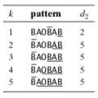
Example
Searching for the pattern BAOBAB in a text made of English letters and spaces.
The bad-symbol table looks as follows:
The good-suffix table:

Slide 31
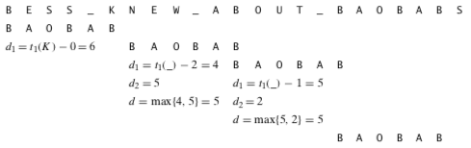
The actual search for this pattern in the text
After the last B of the pattern fails to match its counterpart K in the text, the algorithm retrieves t₁(K) = 6 from the bad-symbol table and shifts the pattern by d₁ = max{t1(K) − 0, 1} = 6 positions to the right.
The new try successfully matches two pairs of characters.
After the failure of the third comparison on the space character in the text, the algorithm retrieves t1( ) = 6 from the bad-symbol table and d2 = 5 from the good-suffix table to shift the pattern by max{d1, d2} = max{6 − 2, 5} = 5.
Note that on this iteration it is the good-suffix rule that leads to a farther shift of the pattern.
The next try successfully matches just one pair of B’s.
After the failure of the next comparison on the space character in the text, the algorithm retrieves t₁( ) = 6 from the bad-symbol table and d₂ = 2 from the good-suffix table to shift the pattern by max{d1,d2} = max{6 − 1, 2} = 5.
Note that on this iteration it is the bad-symbol rule that leads to a farther shift of the pattern. The next try finds a matching substring in the text after successfully matching all six characters of the pattern with their counterparts in the text.

Slide 32
Text-Search Problem
Input:
Text T = “at the thought of”
n = length(T) = 17
Pattern P = “the”
m = length(P) = 3
Output:
Shift s – the smallest integer (0 ≤ s ≤ n – m) such that T[s .. s+m–1] = P[0 .. m–1]. Returns –1, if no such s exists
0123 … n-1
at the thought of
s=3
the
012

Slide 33
Naïve Text Search
Idea: Brute force
Check all values of s from 0 to n – m
Naive-Search(T,P)
01 for s ← 0 to n – m
02 j ← 0
03 // check if T[s..s+m–1] = P[0..m–1]
04 while T[s+j] = P[j] do
05 j ← j + 1
06 if j = m return s
07 return –1
Let T = “at the thought of” and P = “though”
What is the number of character comparisons?

Slide 34
Analysis of Naïve Text Search
Worst-case:
Outer loop: n – m
Inner loop: m
Total (n–m)m = O(nm)
What is the input the gives this worst-case behaviuor?
Best-case: n-m
When?
Completely random text and pattern:
O(n–m)

Slide 35
Fingerprint idea
Assume:
We can compute a fingerprint f(P) of P in O(m) time.
If f(P)≠ f(T[s .. s+m–1]), then P ≠ T[s .. s+m–1]
We can compare fingerprints in O(1)
We can compute f’ = f(T[s+1.. s+m]) from f(T[s .. s+m–1]), in O(1)
f’
f

Slide 36
Algorithm with Fingerprints
Let the alphabet Σ={0,1,2,3,4,5,6,7,8,9}
Let fingerprint to be just a decimal number, i.e., f(“1045”) = 1*10³ + 0*10² + 4*10¹ + 5 = 1045
Fingerprint-Search(T,P)
01 fp ← compute f(P)
02 f ← compute f(T[0..m–1])
03 for s ← 0 to n – m do
04 if fp = f return s
05 f ← (f – T[s]*10^{m-1})*10 + T[s+m]
06 return –1
T[s]
new f
f
T[s+m]
Running time 2O(m) + O(n–m) = O(n)!
Where is the catch?

Slide 37
Using a Hash Function
Problem:
we can not assume we can do arithmetics with m-digits-long numbers in O(1) time
Solution: Use a hash function h = f mod q
For example, if q = 7, h(“52”) = 52 mod 7 = 3
h(S₁) ≠ h(S₂) ⇒ S₁≠ S₂
But h(S₁) = h(S₂) does not imply S₁=S₂!
For example, if q = 7, h(“73”) = 3, but “73” ≠ “52”
Basic “mod q” arithmetics:
(a+b) mod q = (a mod q + b mod q) mod q
(a*b) mod q = (a mod q)*(b mod q) mod q

Slide 38
Preprocessing and Stepping
Preprocessing:
fp = P[m-1] + 10*(P[m-2] + 10*(P[m-3]+ … … + 10*(P[1] + 10*P[0])…)) mod q
In the same way compute ft from T[0..m-1]
Example: P = “2531”, q = 7, what is fp?
Stepping:
ft = (ft – T[s]*10^{m-1} mod q)*10 + T[s+m]) mod q
10^{m-1} mod q can be computed once in the preprocessing
Example: Let T[…] = “5319”, q = 7, what is the corresponding ft?
T[s]
new ft
ft
T[s+m]

Slide 39
Rabin-Karp algorithm (https://users.cs.duke.edu/~reif/courses/alglectures/indyk.lectures/lecture_22.pdf)
Uses hashing:
Hash all substrings T[0..m-1], T[1..m], …T[n-m..n-1]
Hash the pattern P[0..m-1]
Report the strings that hash to the same value as P
Challenge: how to hash n-m substrings, each of length m, in O(n) time?

Slide 40
Converting strings to decimal values (textbook, pg 990-991)
For the pattern P[0..m-1] we need to produce a decimal value
Consider Σ ={0,1,…9} and consider each character to be a digital digit; e.g. “31415” will have the decimal value of 31,415
Otherwise we use polynomial coding with a =|Σ| to convert form any string to a decimal value
Let p be its decimal value of the pattern P[0..m-1] and let t_{s} be the decimal value of the substrings T[s..(m-1)+s]
The decimal value p can be computed in O(m) time and all t₀,t₁, …t_{n-m} can be computed in O(n-m+1) time; why?
Because t_{s+1} can be computed from t_{s} in constant time, since t_{s+1}=10(t_{s}-10^{m-1}T[s])+T[s+m] and computing 10^{m-1} can be done in O(log m)

Slide 41
We might get large decimal values, so we apply hashing by taking modulo some q, where q is a prime such that 10q fits within one computer word
In general, we choose q to be a prime such that q·|Σ| fits in a computer word
We need to compare p mod q with each t₀,t₁, …t_{n-m} where t_{s+1}=(10(t_{s}-(10^{m-1}mod q)T[s])+T[s+m]) mod q
Therefore we can find all occurrences of the pattern P[0..m-1] in the text T[0..n-1] with O(m) preprocessing time and O(n-m+1) matching time

Slide 42
Rabin-Karp Algorithm
Rabin-Karp-Searcher(T,P)
01 q ← a prime larger than m
02 h ← 10^{m-1} mod q // run a loop multiplying by 10 mod q
03 fp ← 0; ft ← 0
04 for i ← 0 to m-1 // preprocessing
05 fp ← (10*fp + P[i]) mod q
06 ft ← (10*ft + T[i]) mod q
07 for s ← 0 to n – m // matching
08 if fp = ft then // run a loop to compare strings
09 if P[0..m-1] = T[s..s+m-1] return s
10 ft ← ( (ft – T[s]*h)*10 + T[s+m]) mod q
11 return –1
How many character comparisons are done if
T = “2359023141526739921” and P = “31415”?
(see Fig. 32.5 on page 992 of the textbook)

Slide 43
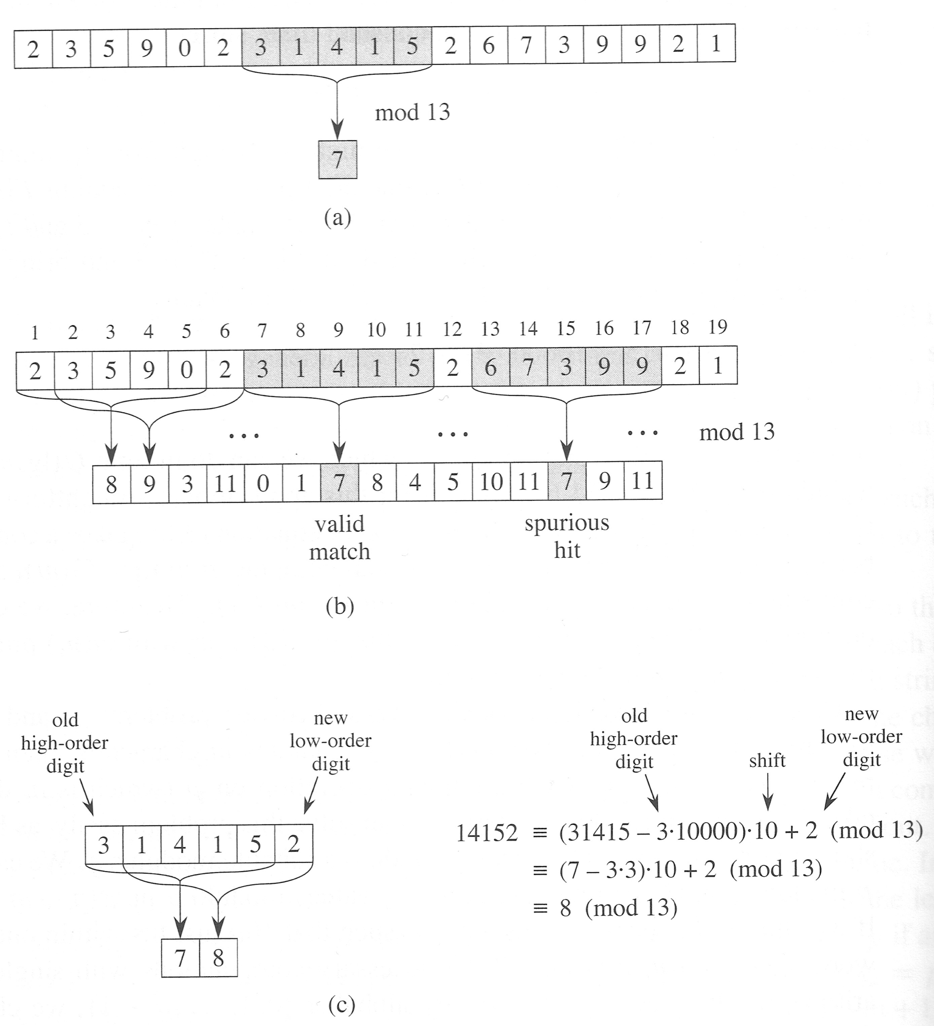

Slide 44
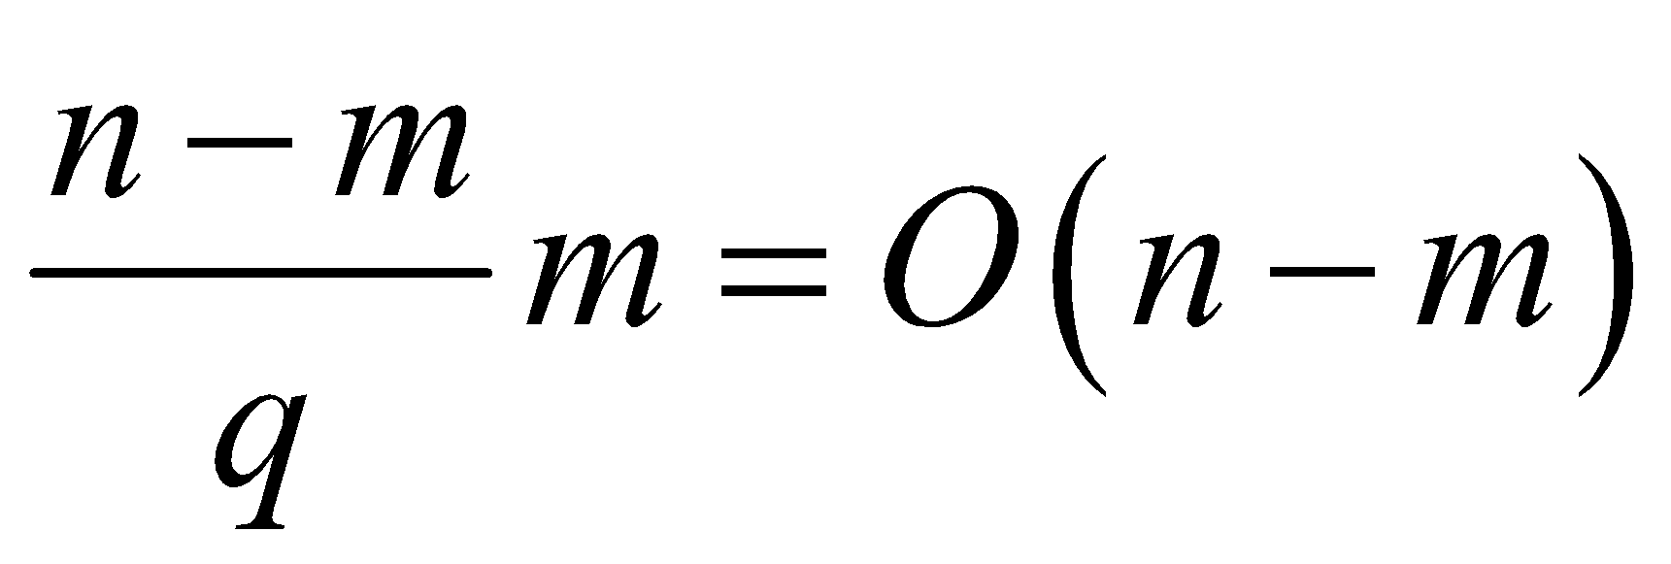
Analysis
If q is a prime, the hash function distributes m-digit strings evenly among the q values
Thus, only every q-th value of shift s will result in matching fingerprints (which will require comparing strings with O(m) comparisons)
Expected running time (if q > m):
Preprocessing: O(m)
Outer loop: O(n-m)
All inner loops:
Total time: O(n-m)
Worst-case running time: O(nm)

Slide 45
Rabin-Karp in Practice
If the alphabet has d characters, interpret characters as radix-d digits (replace 10 with d in the algorithm).
Choosing prime q > m can be done with randomized algorithms in O(m), or q can be fixed to be the largest prime so that 10*q fits in a computer word.
Rabin-Karp is simple and can be easily extended to two-dimensional pattern matching.

Slide 46
Searching in n comparisons
The goal: each character of the text is compared only once!
Problem with the naïve algorithm:
Forgets what was learned from a partial match!
Examples:
T = “Tweedledee and Tweedledum” and P = “Tweedledum”
T = “pappar” and P = “pappappappar”

Slide 47
General situation
State of the algorithm:
Checking shift s,
q characters of P are matched,
we see a non-matching character α in T.
Need to find:
Largest prefix “P-” such that it is a suffix of P[0..q-1]α:
q
P:
T:
α
T[s]
q’
P:
P[0..q-1]α:
α
q
New q’ = max{k ≤ q | P[0..k–1] = P[q–k+1..q–1]α}

Slide 48
Finite automaton search
Algorithm:
Preprocess:
For each q (0 ≤ q ≤ m-1) and each α ∈ Σ pre-compute a new value of q. Let’s call it σ(q,α)
Fills a table of a size m|Σ|
Run through the text
Whenever a mismatch is found (P[q] ≠ T[s+q]):
Set s = s + q - σ(q,α) + 1 and q = σ(q,α)
Analysis:
☺ Matching phase in O(n)
☹ Too much memory: O(m|Σ|), too much preprocessing: at best O(m|Σ|).

Slide 49
Prefix function
Idea: forget unmatched character (α)!
State of the algorithm:
Checking shift s,
q characters of P are matched,
we see a non-matching character α in T.
Need to find:
Largest prefix “P-” such that it is a suffix of P[0..q-1]:
q
P:
T:
α
T[s]
compare
this again
q’
P:
T[s..s+q]:
α
q
New q’ = π [q] = max{k < q | P[0..k–1] = P[q–k..q–1]}

Slide 50
Prefix table
We can pre-compute a prefix table of size m to store values of π[q] (0 ≤ q < m)
Compute a prefix table for: P = “dadadu”
P |  | p | a | p | p | a | r
q | 0 | 1 | 2 | 3 | 4 | 5 | 6
π[q] | 0 | 0 | 0 | 1 | 1 | 2 | 0

Slide 51
Knuth-Morris-Pratt Algorithm
KMP-Search(T,P)
01 π ← Compute-Prefix-Table(P)
02 q ← 0 // number of characters matched
03 for i ← 0 to n-1 // scan the text from left to right
04 while q > 0 and P[q] ≠ T[i] do
05 q ← π[q]
06 if P[q] = T[i] then q ← q + 1
07 if q = m then return i – m + 1
08 return –1
Compute-Prefix-Table is the essentially the same KMP search algorithm performed on P.

Slide 52
Analysis of KMP
Worst-case running time: O(n+m)
Main algorithm: O(n)
Compute-Prefix-Table: O(m)
Space usage: O(m)

