Slide 1
CPSC 535: Advanced Algorithms
Instructor: Dr. Doina Bein

Slide 2
Algorithm Framework (taken from https://github.com/kevinwortman/advanced-algorithms-slides/blob/master/07-max-flow.pdf)
Algorithm framework: an algorithm with modular parts that can be swapped in for different performance properties; or to solve different but related problems
Example: hash tables are a framework, can swap in
different collision resolution strategy (chaining, probing)
different hash function (universal hash, linear congruential hash, etc.)
A framework generalizes several algorithm ideas into one pattern; “chunking”

Slide 3
Iterative Pattern (taken from https://github.com/kevinwortman/advanced-algorithms-slides/blob/master/07-max-flow.pdf)
Recall greedy pattern: | Iterative pattern (a.k.a. fixed-point algorithm)
Initialize base-case result (variable) For each piece of input (variable todo), update result | Initialize base-case result (variable) While (result is not optimal): 2.1 Improve result in one step
The fixed point is when the result becomes optimal
Both greedy pattern and iterative pattern use a greedy heuristic: make a greedy choice to be executed in the next step

Slide 4
Review SSSP

Slide 5
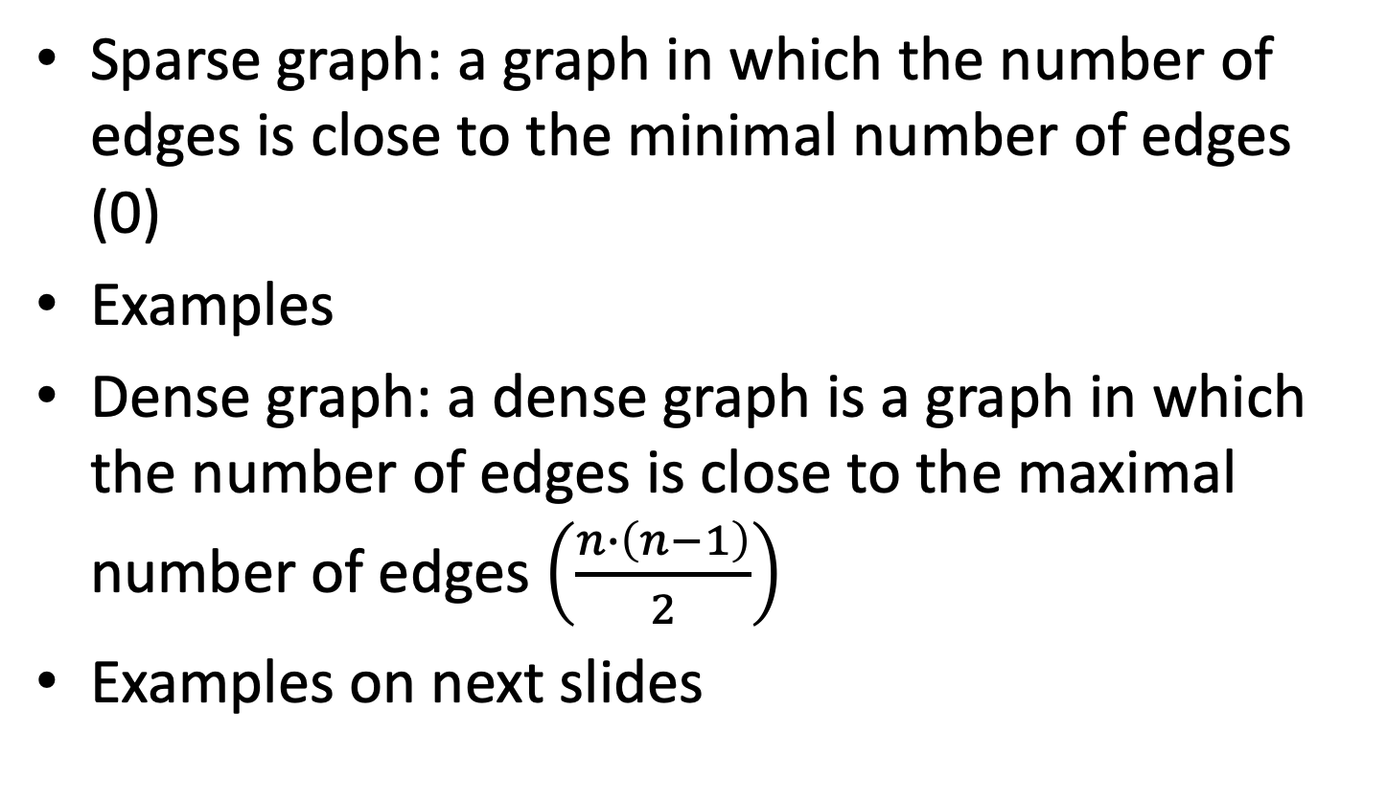
Sparse versus Dense Graphs
Sparse graph: a graph in which the number of edges is close to the minimal number of edges (0)
Examples
Dense graph: a dense graph is a graph in which the number of edges is close to the maximal number of edges $\left(\frac{n∙\left(n−1\right)}{2}\right)$
Examples on next slides

Slide 6
A
B
C
E
F
D
Sparse graph: |E|=1 < 6 (6 = maximal number of edges)
B
D
A
Sparse graph: |E|=5 < 15 (15=maximal number of edges)
C
E
E
A
B
C
A
B
C
D
D
Dense graph: |E|=9 (close to 10=maximal number of edges)
Dense graph: |E|=10 (close to 10=maximal number of edges)

Slide 7
E
A
A
B
C
B
C
C
A
B
D
D
D
sparse
dense
Dense
E
E
F
G
A
B
C
A
B
C
I
D
D
H
dense
sparse

Slide 8
Single-source Shortest Path
Shortest path problems involve computing minimal-weight paths between vertices in weighted graphs.
In a weighted graph, each edge may have a unit cost, or each may have a numeric weight.
Numeric weights may be unconstrained or be required to be non-negative.
Single source shortest path problems involve computing paths originating from a designated source (or start) vertex
All-pairs shortest path problems involve computing paths between all pairs of distinct vertices.

Slide 9
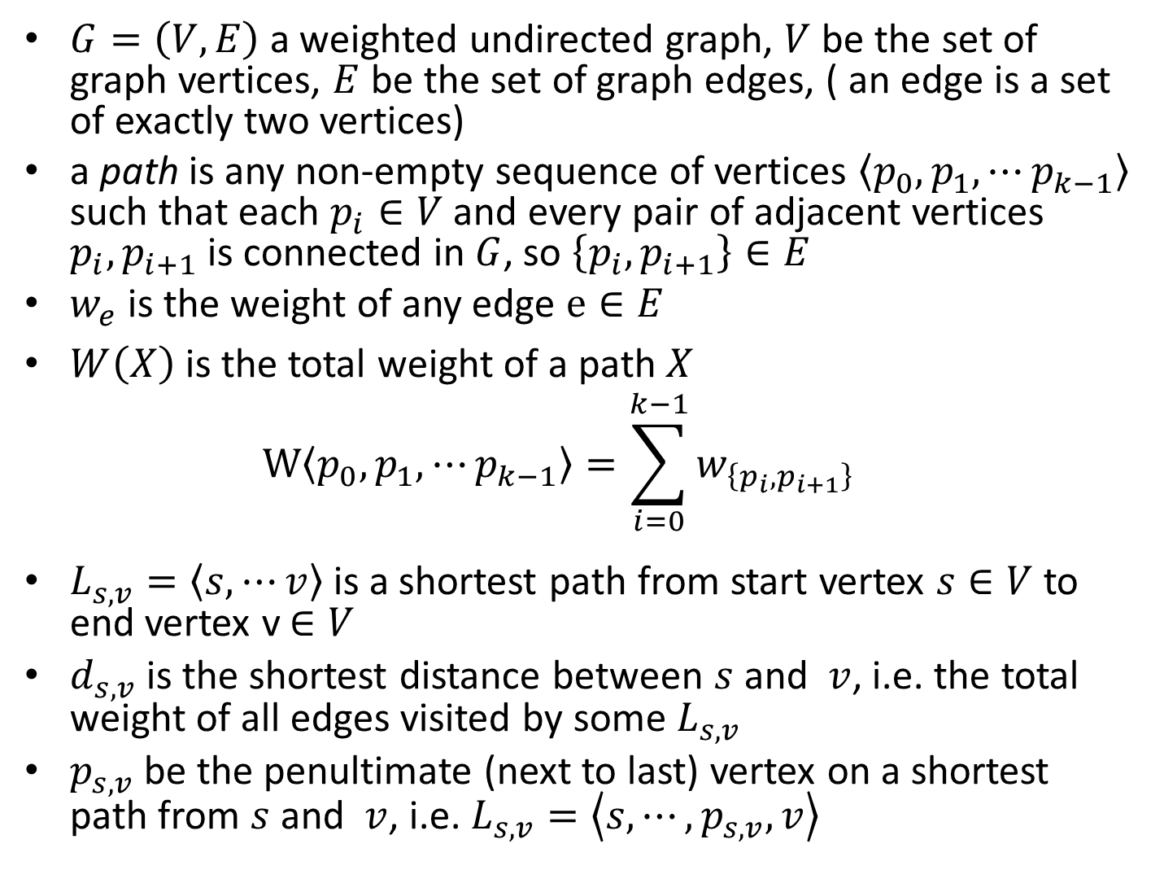
$G=\left(V,E\right)$ a weighted undirected graph, $V$ be the set of graph vertices, $E$ be the set of graph edges, ( an edge is a set of exactly two vertices)
a path is any non-empty sequence of vertices $\left\langle p_{0},p_{1},⋯p_{k−1}\right\rangle$ such that each $p_{i}∈V$ and every pair of adjacent vertices $p_{i},p_{i+1}$ is connected in $G$, so $\left\{p_{i},p_{i+1}\right\}∈E$
$w_{e}$ is the weight of any edge $e∈E$
$W\left(X\right)$ is the total weight of a path $X$ $W\left\langle p_{0},p_{1},⋯p_{k−1}\right\rangle =\sum_{i=0}^{k−1}{w_{\left\{p_{i},p_{i+1}\right\}}}$
$L_{s,v}=\left\langle s,⋯v\right\rangle$ is a shortest path from start vertex $s∈V$ to end vertex v$∈V$
$d_{s,v}$ is the shortest distance between $s$ and $v$, i.e. the total weight of all edges visited by some $L_{s,v}$
$p_{s,v}$ be the penultimate (next to last) vertex on a shortest path from $s$ and $v$, i.e. $L_{s,v}=\left\langle s,⋯,p_{s,v},v\right\rangle$

Slide 10
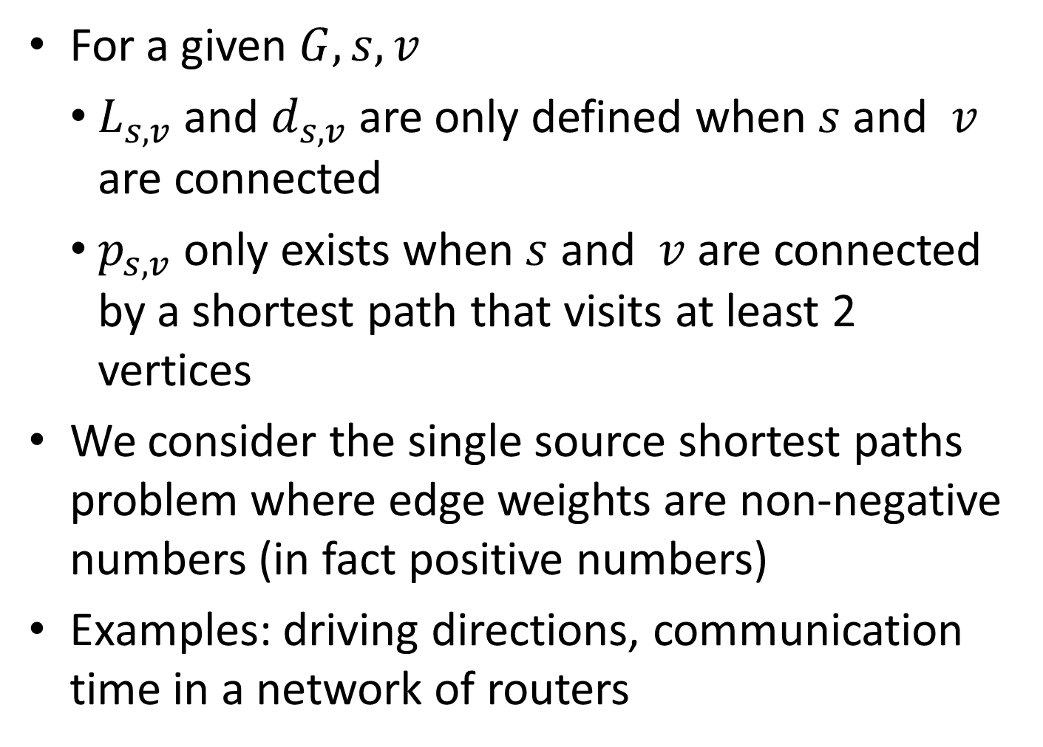
For a given $G,s,v$
$L_{s,v}$ and $d_{s,v}$ are only defined when $s$ and $v$ are connected
$p_{s,v}$ only exists when $s$ and $v$ are connected by a shortest path that visits at least 2 vertices
We consider the single source shortest paths problem where edge weights are non-negative numbers (in fact positive numbers)
Examples: driving directions, communication time in a network of routers

Slide 11
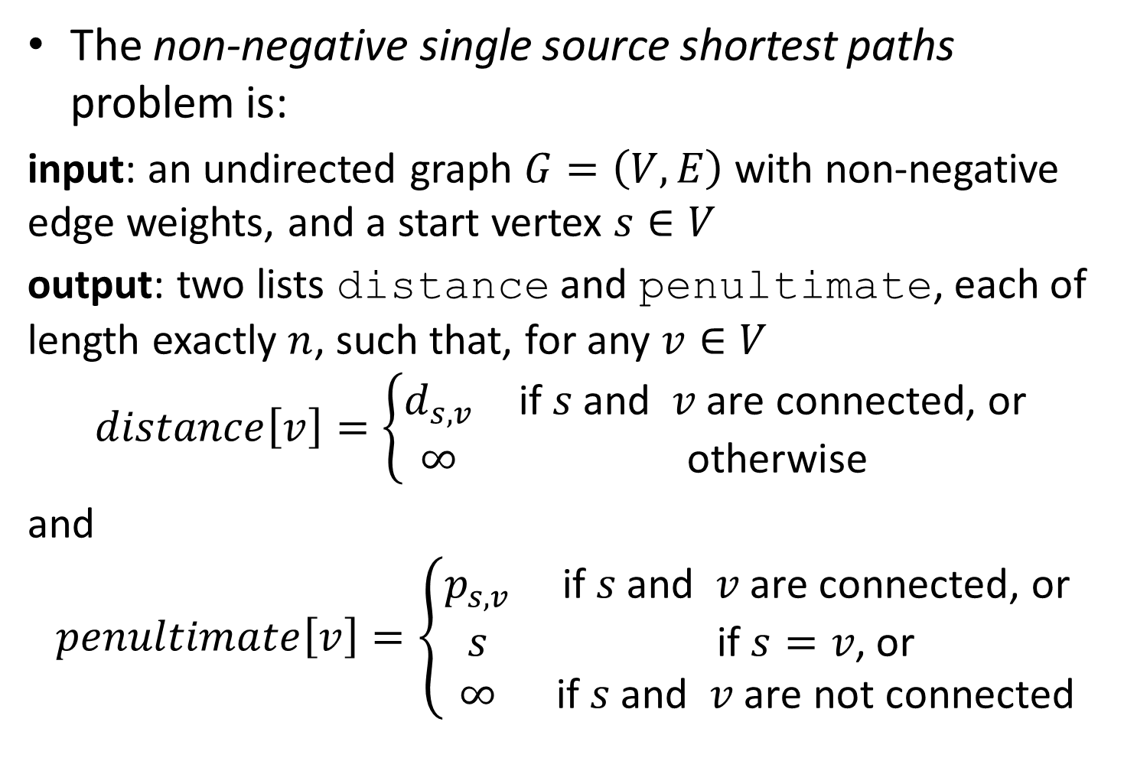
The non-negative single source shortest paths problem is:
input: an undirected graph $G=\left(V,E\right)$ with non-negative edge weights, and a start vertex $s∈V$
output: two lists distance and penultimate, each of length exactly $n$, such that, for any $v∈V$
$$distance\left[v\right]=\left\{\begin{matrix}d_{s,v} & \text{if} s \text{and} v \text{are} \text{connected}\text{, }\text{or} \\ ∞ & \text{otherwise}\end{matrix}\right.$$
and
$$penultimate\left[v\right]=\left\{\begin{matrix}p_{s,v} & \text{if} s \text{and} v \text{are} \text{connected}\text{, }\text{or} \\ s & \text{if} s=v\text{, }\text{or} \\ ∞ & \text{if} s \text{and} v \text{are} \text{not} \text{connected}\end{matrix}\right.$$

Slide 12
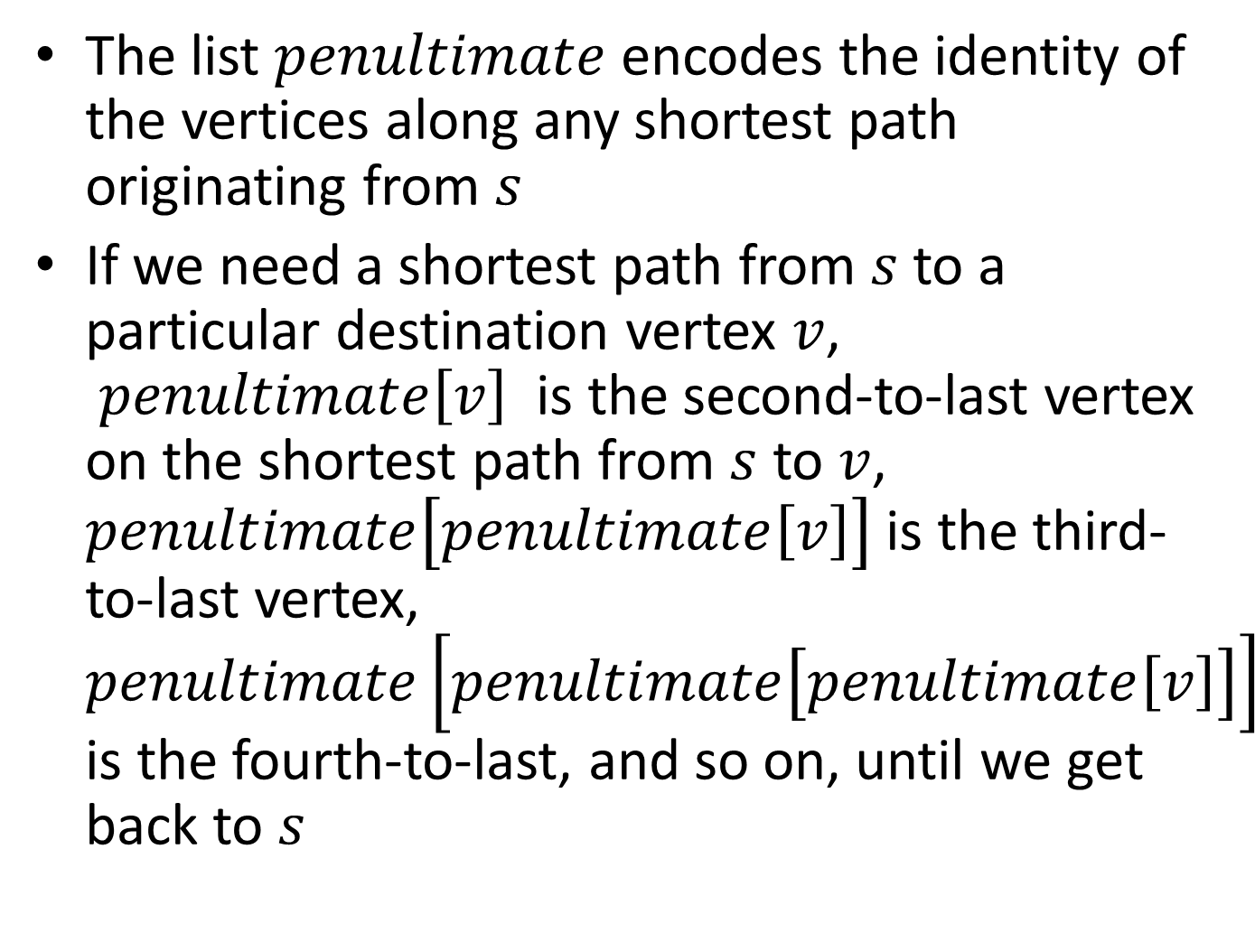
The list $penultimate$encodes the identity of the vertices along any shortest path originating from $s$
If we need a shortest path from $s$ to a particular destination vertex $v$, $penultimate\left[v\right]$ is the second-to-last vertex on the shortest path from $s$ to $v$, $penultimate\left[penultimate\left[v\right]\right]$ is the third-to-last vertex, $penultimate\left[penultimate\left[penultimate\left[v\right]\right]\right]$ is the fourth-to-last, and so on, until we get back to $s$

Slide 13
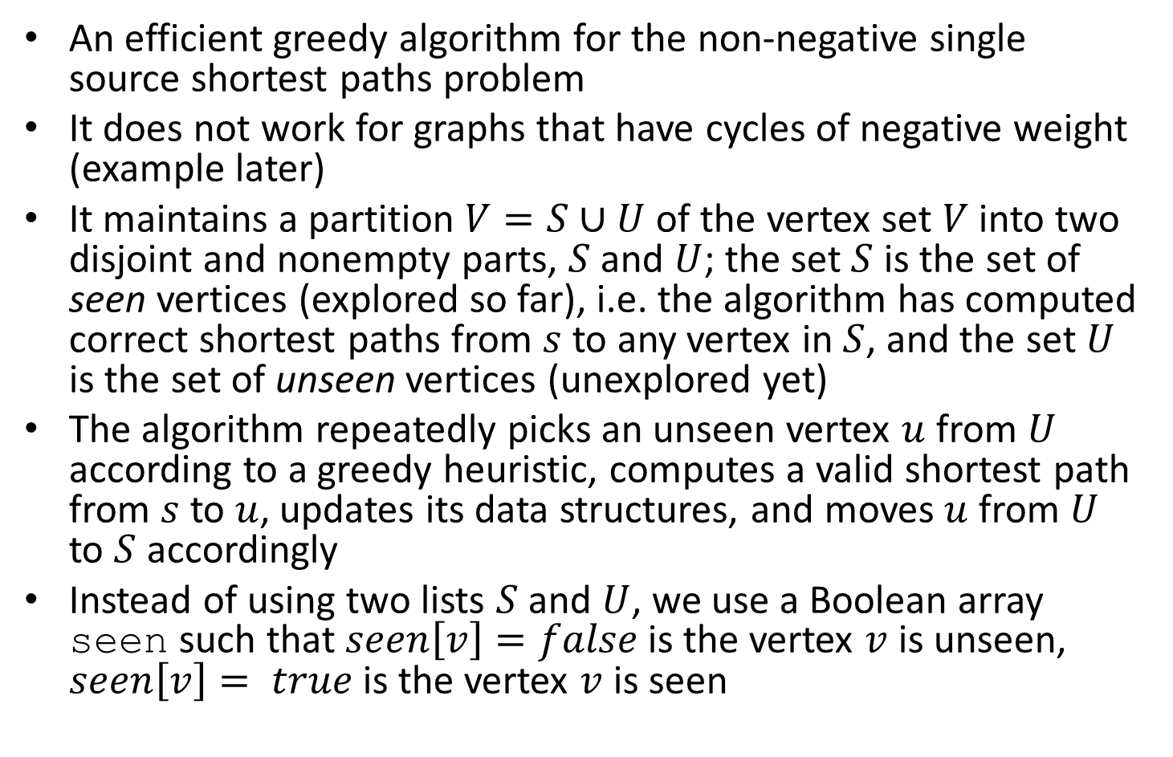
Dijkstra’s algorithm
An efficient greedy algorithm for the non-negative single source shortest paths problem
It does not work for graphs that have cycles of negative weight (example later)
It maintains a partition $V=S∪U$ of the vertex set $V$ into two disjoint and nonempty parts, $S$ and $U$; the set $S$ is the set of seen vertices (explored so far), i.e. the algorithm has computed correct shortest paths from $s$ to any vertex in $S$, and the set $U$ is the set of unseen vertices (unexplored yet)
The algorithm repeatedly picks an unseen vertex $u$ from $U$ according to a greedy heuristic, computes a valid shortest path from $s$ to $u$, updates its data structures, and moves $u$ from $U$ to $S$ accordingly
Instead of using two lists $S$ and $U$, we use a Boolean array seen such that $seen\left[v\right]=false$ is the vertex $v$ is unseen, $seen\left[v\right]= true$ is the vertex $v$ is seen

Slide 14
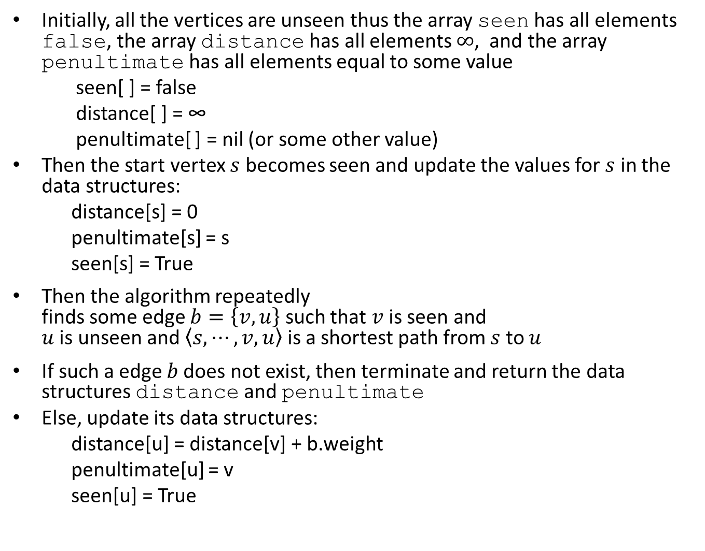
Initially, all the vertices are unseen thus the array seen has all elements false, the array distance has all elements $∞$, and the array penultimate has all elements equal to some value
seen[ ] = false
distance[ ] = ∞
penultimate[ ] = nil (or some other value)
Then the start vertex $s$ becomes seen and update the values for $s$ in the data structures:
distance[s] = 0
penultimate[s] = s
seen[s] = True
Then the algorithm repeatedly finds some edge $b=\left\{v,u\right\}$ such that $v$ is seen and $u$ is unseen and $\left\langle s,⋯,v,u\right\rangle$ is a shortest path from $s$ to $u$
If such a edge $b$does not exist, then terminate and return the data structures distance and penultimate
Else, update its data structures:
distance[u] = distance[v] + b.weight
penultimate[u] = v
seen[u] = True
Greedy step

Slide 15
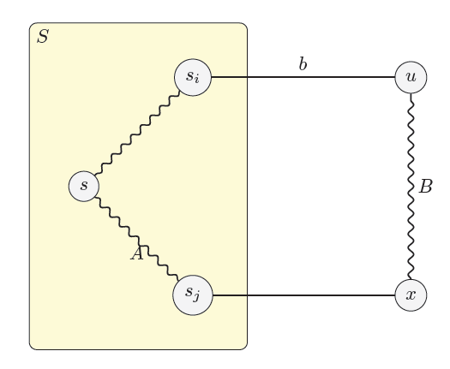
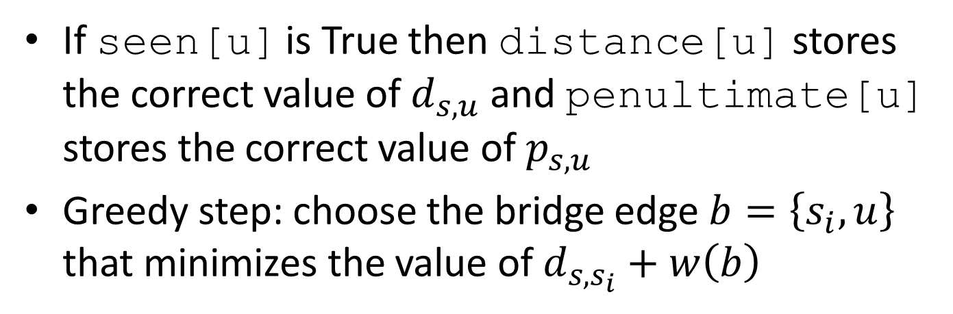
If seen[u] is True then distance[u] stores the correct value of $d_{s,u}$ and penultimate[u] stores the correct value of $p_{s,u}$
Greedy step: choose the bridge edge $b=\left\{s_{i},u\right\}$ that minimizes the value of $d_{s,s_{i}}+w\left(b\right)$

Slide 16
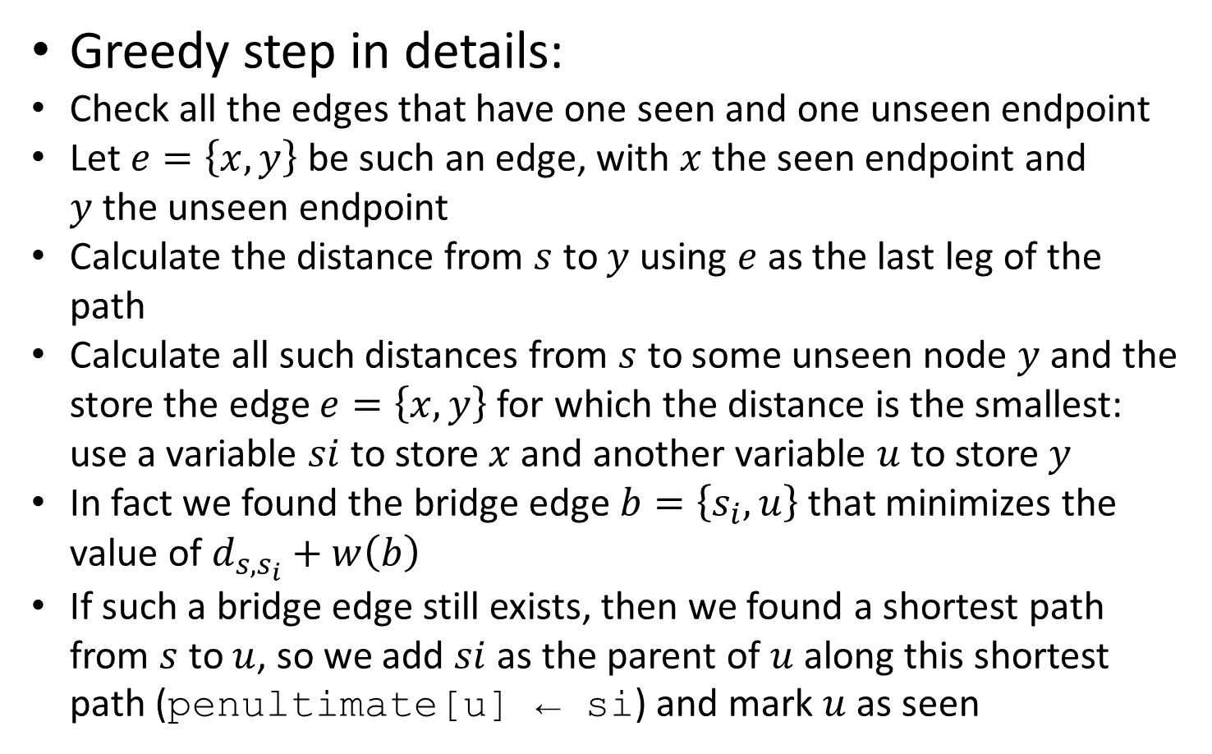
Greedy step in details:
Check all the edges that have one seen and one unseen endpoint
Let $e=\left\{x,y\right\}$ be such an edge, with $x$ the seen endpoint and $y$the unseen endpoint
Calculate the distance from $s$ to $y$using $e$as the last leg of the path
Calculate all such distances from $s$ to some unseen node $y$ and the store the edge $e=\left\{x,y\right\}$ for which the distance is the smallest: use a variable $si$ to store $x$ and another variable $u$ to store $y$
In fact we found the bridge edge $b=\left\{s_{i},u\right\}$ that minimizes the value of $d_{s,s_{i}}+w\left(b\right)$
If such a bridge edge still exists, then we found a shortest path from $s$ to $u$, so we add $si$as the parent of $u$along this shortest path (penultimate[u] ← si) and mark $u$as seen

Slide 17
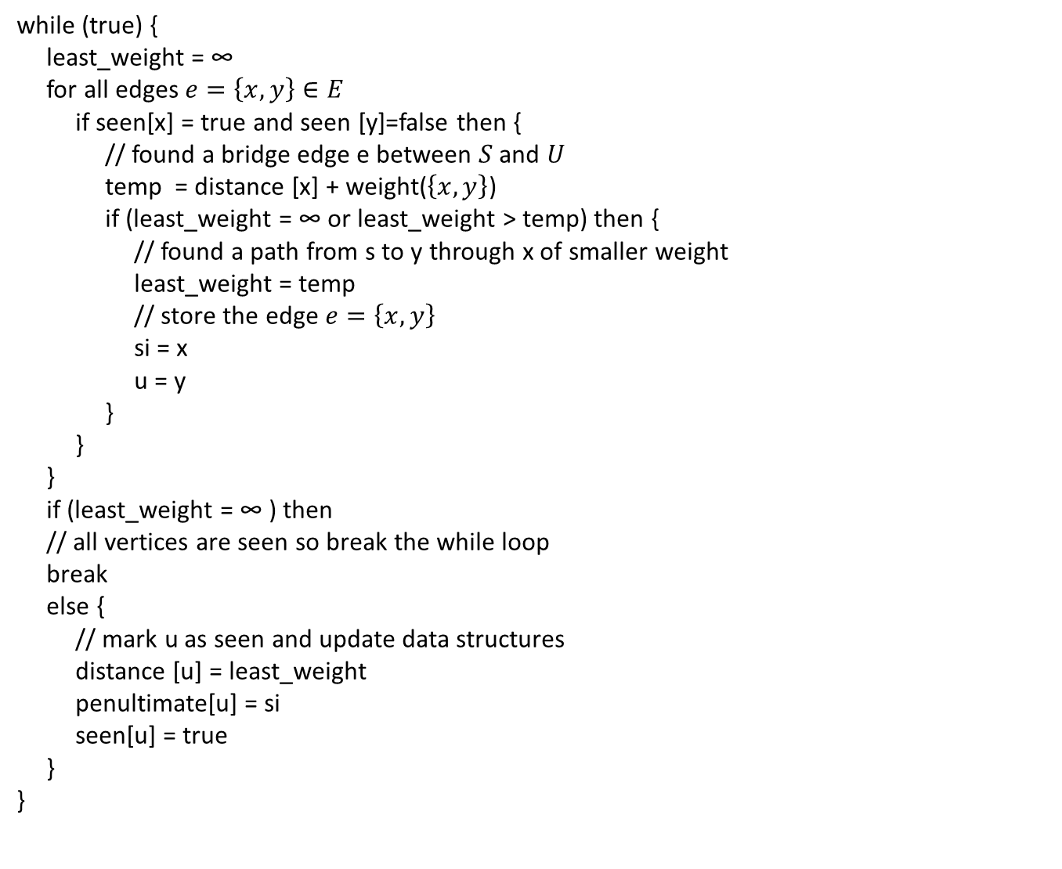
while (true) {
least_weight = ∞
for all edges $e=\left\{x,y\right\}∈E$
if seen[x] = true and seen [y]=false then {
// found a bridge edge e between $S$ and $U$
temp = distance [x] + weight($\left\{x,y\right\}$)
if (least_weight = ∞ or least_weight > temp) then {
// found a path from s to y through x of smaller weight
least_weight = temp
// store the edge $e=\left\{x,y\right\}$
si = x
u = y
}
}
}
if (least_weight = ∞ ) then
// all vertices are seen so break the while loop
break
else {
// mark u as seen and update data structures
distance [u] = least_weight
penultimate[u] = si
seen[u] = true
}
}

Slide 18

seen[ ] = false
distance[ ] = ∞
penultimate[ ] = nil (or some other value)
distance[s] = 0
penultimate[s] = s
seen[s] = True
while (true) {
least_weight = ∞
for all edges $e=\left\{x,y\right\}∈E$
if seen[x] = true and seen [y]=false then {
// found a bridge edge e between $S$ and $U$
temp = distance [x] + weight($\left\{x,y\right\}$)
if (least_weight = ∞ or least_weight > temp) then {
// found a path from s to y through x of smaller weight
least_weight = temp
// store the edge $e=\left\{x,y\right\}$
si = x
u = y
}
}
}
if (least_weight = ∞ ) then
// all vertices are seen so break the while loop
break
else {
// mark u as seen and update data structures
distance [u] = least_weight
penultimate[u] = si
seen[u] = true
}
}
Algorithm Dijkstra_least_weight

Slide 19
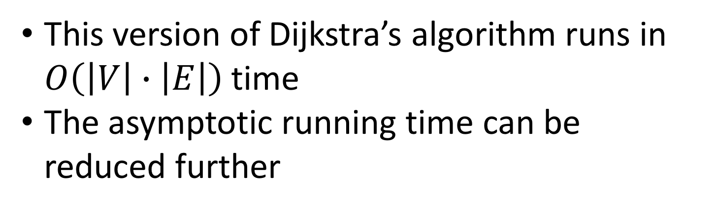
This version of Dijkstra’s algorithm runs in $O\left(\left|V\right|∙\left|E\right|\right)$ time
The asymptotic running time can be reduced further

Slide 20

Dijkstra’s algorithm with min-priority queue
Use a priority queue to greedily select the closest vertex not yet processed and perform the relaxation process on all its outgoing edges
When we calculate the distance from $s$ to $y$using $e$as the last leg of the path, if we found a value smaller than the currently stored value in distance[y], then we can consider the newly found path a better alternative than the current path from $s$ to $y$
Procedure Relax(x,y, distance, penultimate)
if (distance[y] = ∞ or distance[y] > distance [x] + weight({x,y})) then
distance [y] = distance [x] + weight({x,y})
penultimate [y] = x

Slide 21
Initialize(distance, penultimate, s)
seen [ ] = false
Q = V // Q is a min-priority queue
while Q ≠ Ø {
u = Extract-Min(Q)
seen [ u ] = true
for each vertex v adjacent to u
Relax (u, v, distance, penultimate)
}
Procedure Initialize(distance, penultimate, s)
distance[ ] = ∞
penultimate[ ] = nil (or some other value)
distance[s] = 0
penultimate[s] = s
See next slide
Algorithm Dijkstra_min_priority_queue

Slide 22
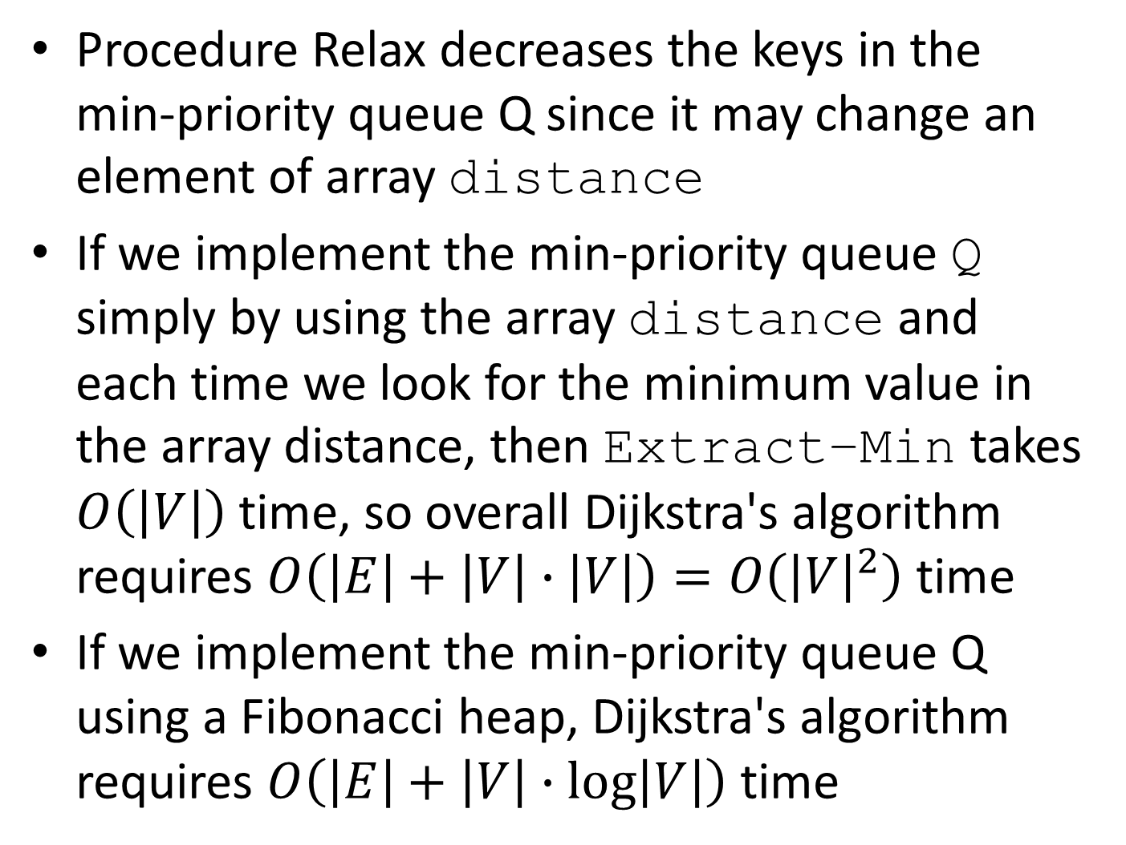
Procedure Relax decreases the keys in the min-priority queue Q since it may change an element of array distance
If we implement the min-priority queue Q simply by using the array distance and each time we look for the minimum value in the array distance, then Extract–Min takes $O\left(\left|V\right|\right)$ time, so overall Dijkstra's algorithm requires $O\left(\left|E\right|+\left|V\right|∙\left|V\right|\right)=O\left({\left|V\right|}^{2}\right)$ time
If we implement the min-priority queue Q using a Fibonacci heap, Dijkstra's algorithm requires $O\left(\left|E\right|+\left|V\right|∙\log\left|V\right|\right)$ time

Slide 23
Dijkstra’s algorithm (either Dijkstra_least_weight or Dijkstra_min_priority_queue) does not work for graphs that have cycles of negative weight
Example:
0
1
1
A
B
C
99
-300
D

Slide 24
Dijkstra_least_weight does not work for graphs that have cycles of negative weight
First, you set distances to ∞, seen [ ] to all false, and penultimate [ ] to all nil
Select node A: distance[A] = 0, penultimate[A]=A, seen[A] = true
Select the edge {A,C} and set distance[C]= 0, penultimate[C]=A, and seen[C]=true.
Select the edge {A,B} and set distance[B]=1, penultimate[B]=A, seen[B]=true
Select edge {B,D} and set distance[D]=-299, penultimate[D]=B, seen[D]=true
0
1
1
A
B
C
99
-300
D
 | A | B | C | D
distance | 0 | 1 | 0 | -299 | incorrect
distance | 0 | -201 | -200 | -299 | correct

Slide 25
Dijkstra_min_priority_queue does not work for graphs that have cycles of negative weight
0
First, set distance[A] = 0 and the other distances to ∞, array penultimate to all nil
Then set array seen to all false
Extract node A, set seen[A]=true and relax all edges incident to A: distance[B]= 1, distance[C]=0, distance[D]=99, array penultimate to all A
Extract node C, set seen[C]=true and relax all edges incident to A: no changes
1
1
A
B
C
99
-300
D
Extract node B, set seen[B]=true and relax all edges incident to B: distance[D]=-299, penultimate[D]=B
Extract node D, set seen[D]=true and relax all edges incident to D: no changes
 | A | B | C | D
distance | 0 | 1 | 0 | -299 | incorrect
distance | 0 | -201 | -200 | -299 | correct

Slide 26
Notice that at the end of Dijkstra's algorithm , distance[B] is still 1, even though the shortest path to B has length -201, and distance[C] is still 0, even though the shortest path to C has length -200, and Dijkstra’s algorithm thus fails to accurately compute distances for negative weights.
Dijkstra’s algorithm does not work for directed graphs that have negative weight edges

Slide 27
Dijkstra’s algorithm does not work for directed graphs that have negative weight edges
Example:
0
1
1
A
B
C
99
-300
D

Slide 28
Dijkstra_least_weight does not work for directed graphs with negative weight edges
First, you set distances to ∞, seen [ ] to all false, and penultimate [ ] to all nil
Select node A: distance[A] = 0, penultimate[A]=A, seen[A] = true
Select the edge {A,C} and set distance[C]= 0, penultimate[C]=A, and seen[C]=true.
Select the edge {A,B} and set distance[B]=1, penultimate[B]=A, seen[B]=true
Select edge {B,D} and set distance[D]=-299, penultimate[D]=B, seen[D]=true
0
1
1
A
B
C
99
-300
D
 | A | B | C | D
distance | 0 | 1 | 0 | -299 | incorrect
distance | 0 | -201 | -200 | -299 | correct

Slide 29
Dijkstra_min_priority_queue does not work for directed graphs with negative weight edges
First, set distance[A] = 0 and the other distances to ∞, array penultimate to all nil
Then set array seen to all false
Extract node A, set seen[A]=true and relax all edges incident to A: distance[B]= 1, distance[C]=0, distance[D]=99, array penultimate to all A
Extract node C, set seen[C]=true and relax all edges incident to A: no changes
0
1
1
A
B
C
99
-300
D
Extract node B, set seen[B]=true and relax all edges incident to B: distance[D]=-299, penultimate[D]=B
Extract node D, set seen[D]=true and relax all edges incident to D: no changes
 | A | B | C | D
distance | 0 | 1 | 0 | -299 | incorrect
distance | 0 | -201 | -200 | -299 | correct

Slide 30
Notice that at the end of Dijkstra's algorithm , distance[B] is still 1, even though the shortest path to B has length -201, and distance[C] is still 0, even though the shortest path to C has length -200, and Dijkstra’s algorithm thus fails to accurately compute distances for negative weights.
Example of a directed graph with negative and positive weights: the energy spent/gain when hiking various trails in a mountain
When hiking uphill, you lose energy so the uphill arc will have a negative value for the energy
When hiking downhill, you gain energy so the downhill arc will have a positive value for the energy

Slide 31
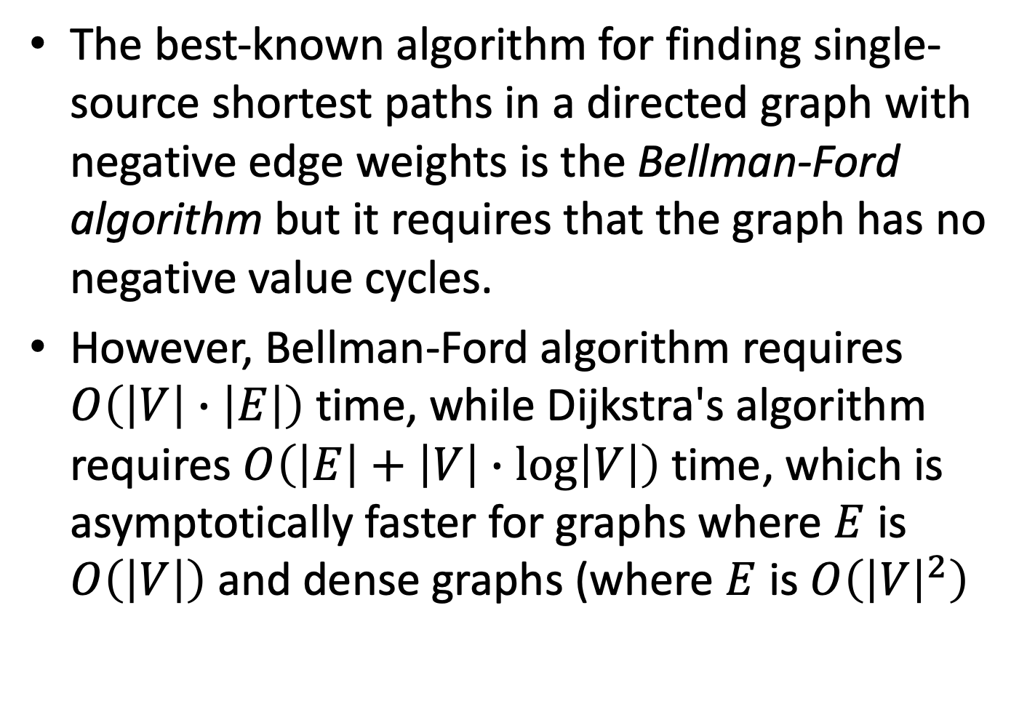
The best-known algorithm for finding single-source shortest paths in a directed graph with negative edge weights is the Bellman-Ford algorithm but it requires that the graph has no negative value cycles.
However, Bellman-Ford algorithm requires $O\left(\left|V\right|∙\left|E\right|\right)$ time, while Dijkstra's algorithm requires $O\left(\left|E\right|+\left|V\right|∙\log\left|V\right|\right)$ time, which is asymptotically faster for graphs where $E$ is $O\left(\left|V\right|\right)$ and dense graphs (where $E$ is $O\left({\left|V\right|}^{2}\right)$

Slide 32
Bellman-Ford-Moore (BFM) Algorithm
If a graph contains a negative weight cycle, then there is no shortest paths between any two points lying on the cycle: any path can be made cheaper by one more run around the negative cycle
BFM algorithm can detect negative cycles
BFM is based on the principle of relaxation, like Dijkstra’s algorithm: an approximation to the correct distance between two points is gradually replaced by smaller values until eventually reaching the smallest value (an optimum solution)
BFM algorithm relaxes all the edges, and does this |V|-1 times, where |V| is the number of vertices

Slide 33
BFM algorithm:
Initialize(distance, penultimate, s)
for i=1 to |V|-1 do {
for each vertex v adjacent to u in E do
Relax (u, v, distance, penultimate)
}
Procedure Relax(x,y, distance, penultimate)
if ( distance[y] = ∞ or distance[y] > distance [x] + weight({x,y}) ) then
distance [y] = distance [x] + weight({x,y})
penultimate [y] = x
Procedure Initialize(distance, penultimate, s)
distance[ ] = ∞
penultimate[ ] = nil (or some other value)
distance[s] = 0

Slide 34
Since the longest possible path without a cycle has no more than |V|-1 edges, the edges must be scanned |V|-1 times to ensure the shortest path has been found for all nodes.
Bellman-Ford-Moore’s algorithm uses dynamic programming to explore the graph.
Dijkstra’s algorithm uses the greedy approach to select the closest unvisited node to be explored next.

