Slide 1
CPSC 535: Advanced Algorithms
Instructor: Dr. Doina Bein

Slide 2
Max Flow (some slides taken from http://people.cs.aau.dk/~simas/aalg04/ , https://github.com/kevinwortman/advanced-algorithms-slides/blob/master/07-max-flow.pdf , and https://github.com/kevinwortman/advanced-algorithms-slides/blob/master/08-max-flow-formulations-and-matching.pdf)
Breakthrough results:
Solving max flow in almost linear time (June 8, 2022): https://www.quantamagazine.org/researchers-achieve-absurdly-fast-algorithm-for-network-flow-20220608/?fbclid=IwAR0AVavBo0vDc0O4uOl3zJ6cquk-TeCmkbFEcGlE-AC5O2TYb9RIQxti1So

Slide 3
Maximum flow (slides taken from http://people.cs.aau.dk/~simas/aalg04/)
Main goals of the lecture:
to understand how flow networks and maximum flow problem can be formalized;
to understand the Ford-Fulkerson method and to be able to prove that it works correctly;
to understand the Edmonds-Karp algorithm and the intuition behind the analysis of its worst-case running time.
to be able to apply the Ford-Fulkerson method to solve the maximum-bipartite-matching problem.
Chapter 26 of the textbook CLRS, pages 708-736

Slide 4
Flow networks
What if weights in a graph are maximum capacities of some flow of material?
Pipe network to transport fluid (e.g., water, oil)
Edges – pipes, vertices – junctions of pipes
Data communication network
Edges – network connections of different capacity, vertices – routers (do not produce or consume data just move it)
Concepts (informally):
Source vertex s (where material is produced)
Sink vertex t (where material is consumed)
For all other vertices – what goes in must go out
Goal: maximum rate of material flow from source to sink

Slide 5
Formalization
How do we formalize flows?
Graph G=(V,E) – a flow network
Directed, each edge has capacity c(u,v) ≥ 0
Two special vertices: source s, and sink t
For any other vertex v, there is a path s→…→v→…→t

Slide 6
Def. of a flow network (taken from https://github.com/kevinwortman/advanced-algorithms-slides/blob/master/07-max-flow.pdf)
flow network: graph representing resource flows
directed graph G = (V,E)
designated source vertex s ∈ V and sink vertex t ∈ V
no self-loop: ∀v ∈ V, (v,v) ∉ E
flow is possible through every vertex: ∀v ∈ V , there exists some path s ⇝ v ⇝ t
capacity: ∀(u, v ) ∈ E , there is a defined, non-negative real capacity c(u,v)
implies: G is connected and |E|≥|V|−1.
In most flow networks, there are no antiparallel edges: for any ∀(u,v) ∈ E,(v,u) ∉ E.

Slide 7
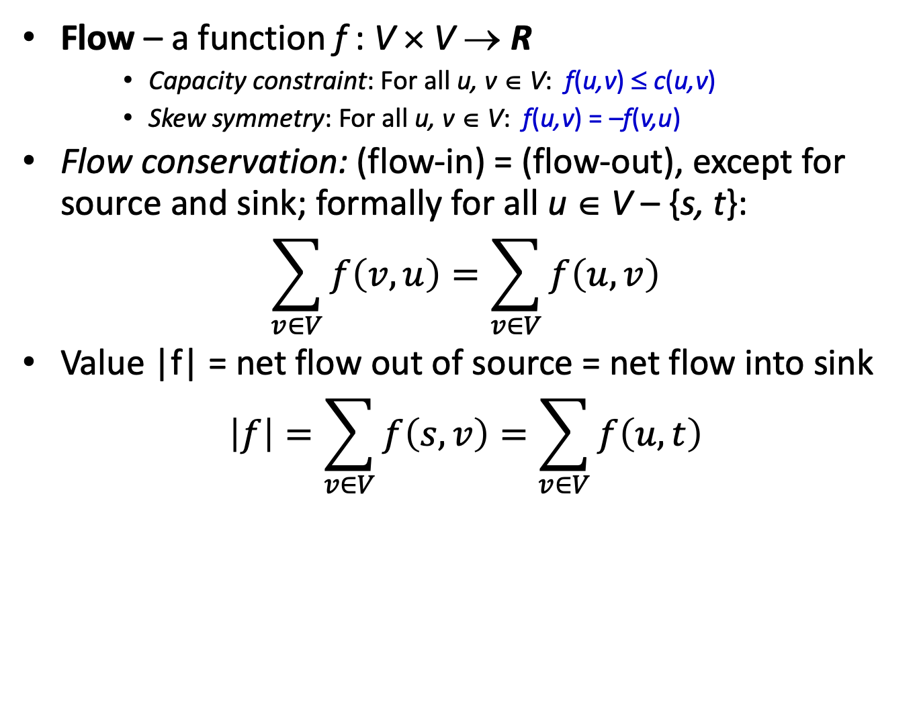
A flow

Slide 8
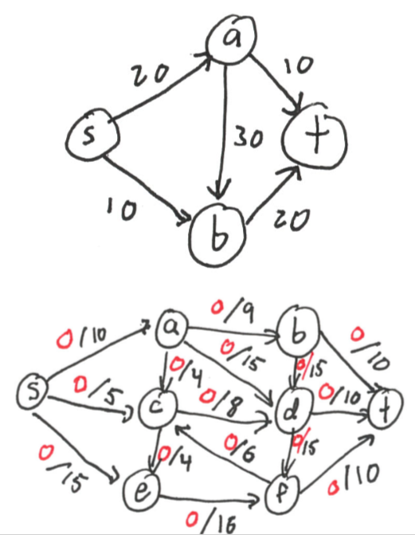

Slide 9
Cancellation of flows
Do we want to have positive flows going in both directions between two vertices?
No! such flows cancel (maybe partially) each other
Skew symmetry – notational convenience
13
a
13
b
a
b
19
15
19
15
3
10
3
t
s
10
9
5
t
s
4
9
5
4
6
3
3
6
2
5
3
14
11
3
14
c
11
d
3
c
d
6
6

Slide 10
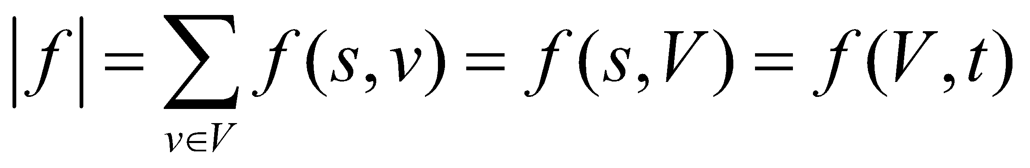
Maximum flow
What do we want to maximize?
Value of the flow f:
a
13
b
15
8
19
10
10
13
t
s
4
2
9
5
6
5
3
14
c
11
d
3
8
We want to find a flow of maximum value |f|!

Slide 11
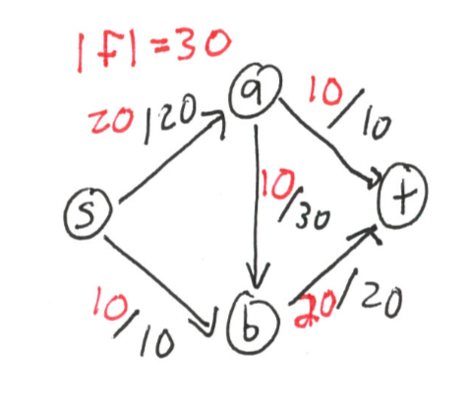
Maximum Flow Problem Definition
Maximum flow problem
input: a flow network G output: a flow f of maximum value |f |

Slide 12
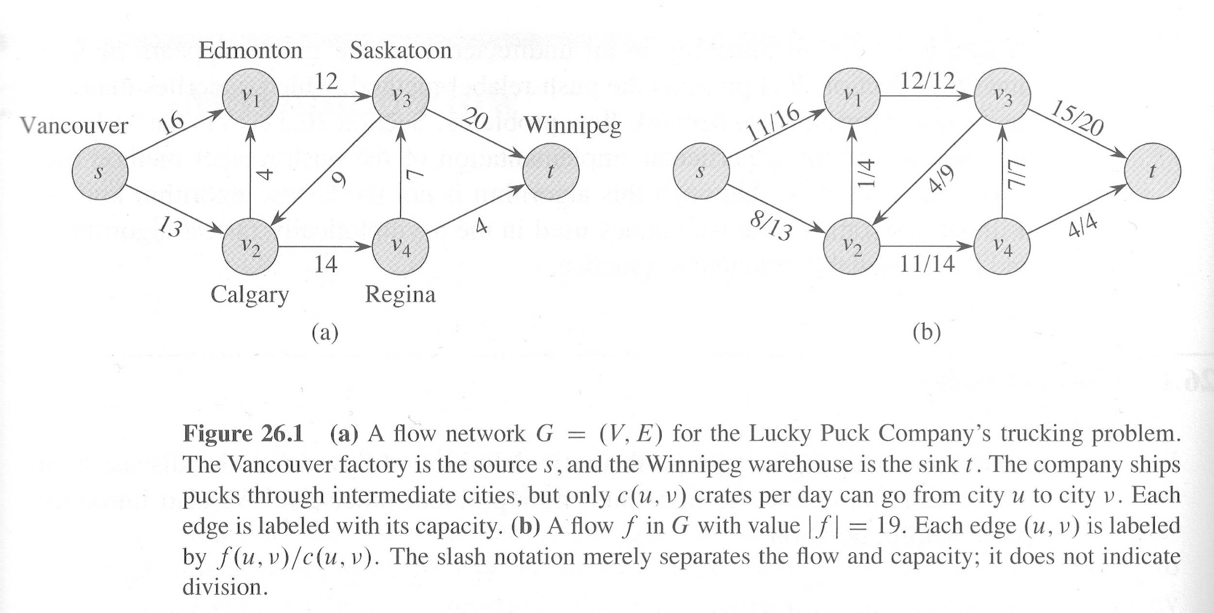
Vancouver is the source node (s)
Winnipeg is the sink node (t)
It can ship at most c(u,v) crates per day between cities u and v (weights in Fig. 26.1(a))
What is the largest number p of crates per day they can ship out of Vancouver?

Slide 13
Augmenting path
Idea for the algorithm:
If we have some flow,…
…and can find a path p from s to t (augmenting path), such that there is a > 0, and for each edge (u,v) in p we can add a units of flow: f(u,v) + a ≤ c(u,v)
Then just do it, to get a better flow!
Augmenting path in this graph?
a
13
b
15
8
19
10
10
13
t
s
4
2
9
5
6
5
3
14
c
11
d
3
8

Slide 14
Ford-Fulkerson Method
“method” because this is a pattern for specific max-flow algorithms
not a complete, clear alg. yet
based on iterative improvement pattern
1: function ITERATIVE-IMPROVEMENT(input) 2: result = base-case result 3: while result is not optimal do 4: improve result 5: end while 6: return result 7: end function

Slide 15
The Ford-Fulkerson method
Sketch of the method:
1: function FORD-FULKERSON-METHOD(G,s,t)
2: f = flow with every edge set to zero
3: initialize residual network Gf
4: while there exists an augmenting path p in Gf do
5: augment flow f along path p
6: end while
7: return f
8: end function
What is a residual network?
What is and how do we find an augmenting path p?
How much additional flow can we send through that path p?
Does the algorithm always terminates & finds the maximum flow?

Slide 16
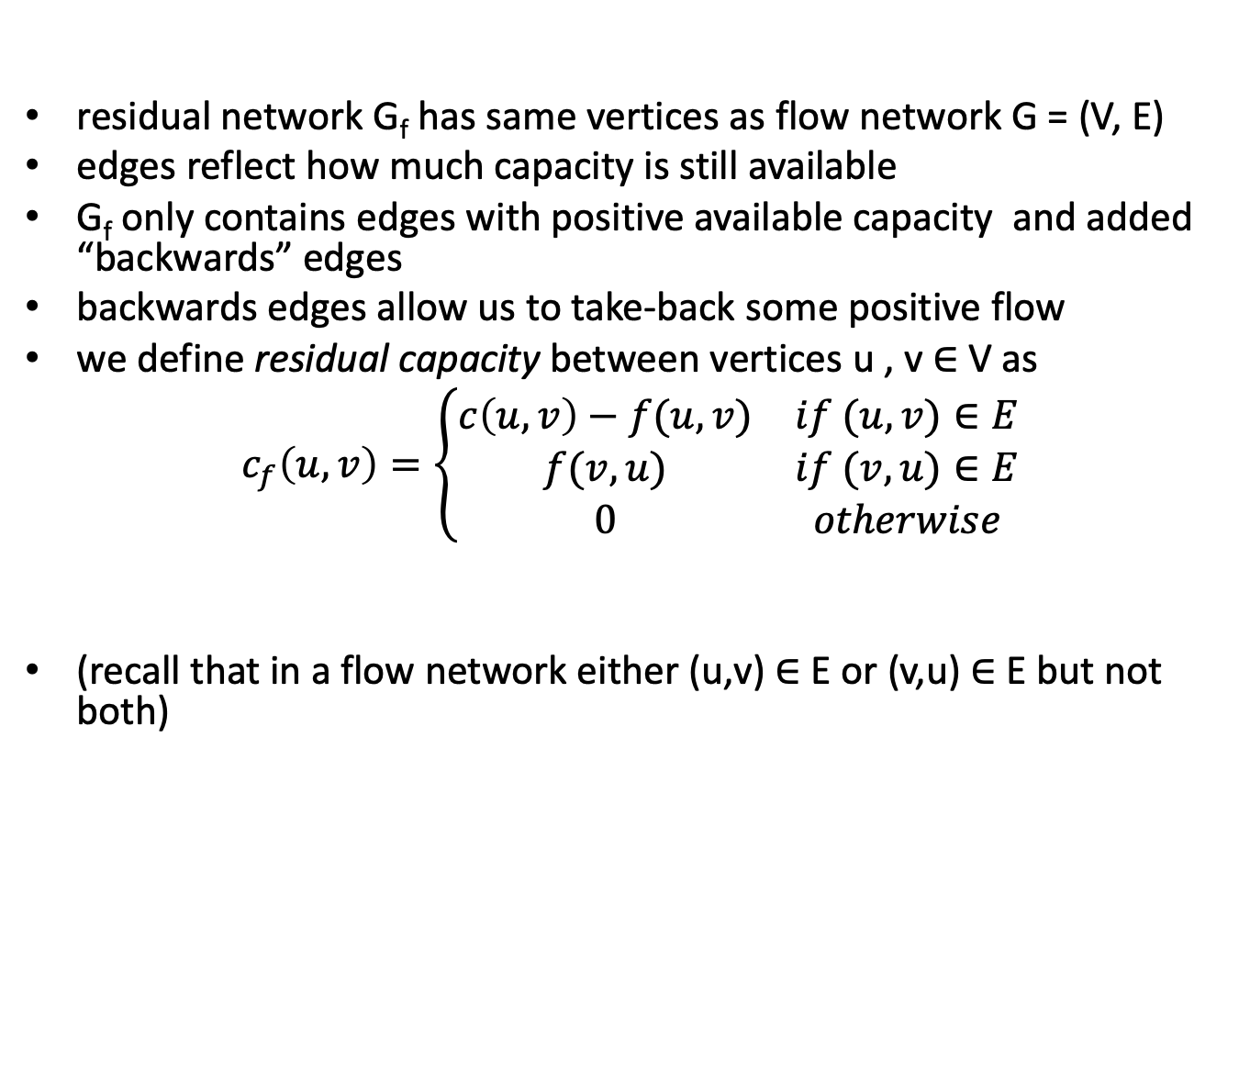
Residual Network

Slide 17
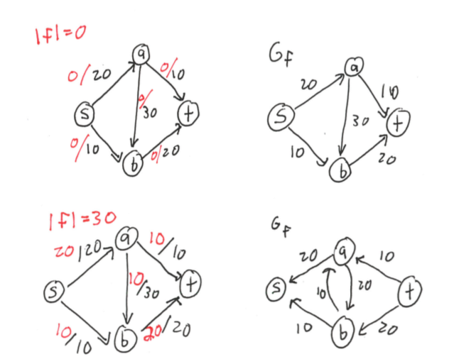
Residual Network Example

Slide 18
Augmenting Paths
augmenting path: simple path from source s to sink t in residual network c_{f} (simple ≡ no repeated vertices)
recall: residual network G_{f} only contains edges with leftover capacity
=⇒ if path p exists in G_{f} , then every edge along p has positive weight in G_{f}
=⇒ we can legally increase net s ⇝ t flow by increasing weights in G_{f}
i.e. increasing flow across the forwards edges in G_{f} , sometimes decreasing flow across the backwards edges
c_{f} (p) =residual capacity of p = minimum weight c_{f} (u,v) of an edge (u,v) in p

Slide 19
Residual network
How do we find augmenting path?
It is any path in residual network:
Residual capacities: c_{f}(u,v) = c(u,v) – f(u,v)
Residual network: G_{f}=(V,E_{f}), where
E_{f} = {(u,v) ∈ V × V : c_{f}(u,v) > 0}
What happens when f(u,v) < 0 (and c(u,v) = 0)?
Observation – edges in E_{f} are either edges in E or their reversals: |E_{f}| ≤ 2|E|
Compute residual network:
a
13
b
15
8
19
10
10
13
t
s
4
2
9
5
6
5
3
14
c
11
d
3
8

Slide 20
Residual capacity of a path
How much additional flow can we send through an augmenting path?
Residual capacity of a path p in G_{f} :
c_{f} (p) = min{c_{f}(u,v): (u,v) is in p}
Doing augmentation: for all (u,v) in p, we just add this c_{f} (p) to f(u,v) (and subtract it from f(v,u))
Resulting flow is a valid flow with a larger value.
What is the residual capacity of the path (s,a,b,t)?

Slide 21
The Ford-Fulkerson method
Ford-Fulkerson(G,s,t)
01 for each edge (u,v) in G.E do
02 f(u,v) ← f(v,u) ← 0
03 while there exists a path p from s to t in residual network G_{f} do
04 c_{f} = min{c_{f}(u,v): (u,v) is in p}
05 for each edge (u,v) in p do
06 f(u,v) ← f(u,v) + c_{f}
07 f(v,u) ← -f(u,v)
08 return f
The algorithms based on this method differ in how they choose p in step 03.

Slide 22
Correctness of Ford-Fulkerson
Max-flow min-cut theorem:
If f is the flow in G, the following conditions are equivalent:
1. f is a maximum flow in G
2. The residual network G_{f} contains no augmenting paths
3. |f| = c(S,T) for some cut (S,T) of G
1.
We must prove three parts:
From this we have 1.⇔2., which means that the Ford-Fulkerson method always correctly finds a maximum flow
3.
2.

Slide 23
But,
does not imply that the algorithm terminates
does not imply that the # loop iterations is small
need to decide how to pick paths carefully

Slide 24
Cuts
cut: a partition V = S ∪ T, where s ∈ S and t ∈ T
net flow across f is
f(S,T) = (total flow from S to T) − (total flow from T to S)
The capacity c(S,T)) of the cut = sum of capacities c(u,v), where u∈S and v∈T
Minimum cut – a cut with the smallest capacity of all cuts
Lemma: for any cut (S,T), net flow f(S,T)=|f|. Proof sketch: since s ∈ S and t ∈ T, total flow |f | must cross the S–T boundary.
a
13
b
15
9
19
10
10
13
t
s
4
1
9
5
6
1
5
3
14
c
11
d
3
8

Slide 25
Max-Flow Min-Cut Proof Sketch
Show all these are equivalent conditions: 1. f is a maximum flow 2. G_{f} contains no augmenting path 3. |f|=c(S,T) for some cut(S,T)
(1) =⇒ (2) : by definitions of residual network and augmenting path, a maximum flow has no capacity leftover so no paths in G_{f}
(2) =⇒ (3) : consider a cut where all vertices reachable from s in Gf are in S and the unreachable ones are in T; since there is no s ⇝ t path in Gf , all edges across the S–T boundary must already be at full capacity
(3) =⇒ (1): trivially |f| ≤ c(S,T), and if |f| = c(S,T) then this (S,T) is maximum

Slide 26
Ford-Fulkerson Detailed Pseudocode
1: function FORD-FULKERSON-METHOD(G = (V , E ), s , t )
2: for each edge (u, v) in E do
3: (u,v).f =0
4: end for
5: while there exists an augmenting path p in G_{f} do
6: cf (p) = min{cf (u,v) : (u,v) ∈ p} 7: for each edge(u,v)∈p do
8: if (u,v)∈E then 9: (u,v).f =(u,v).f +cf(p)
10: else
11: (u,v).f =(v,u).f −cf(p)
12: end if
13: end for
14: end while
15: return flow on .f fields
16: end function

Slide 27
Worst-case running time
What is the worst-case running time of this method?
Let’s assume integer flows.
Each augmentation increases the value of the flow by some positive amount.
Augmentation can be done in O(E).
Total worst-case running time O(E|f*|), where f* is the max-flow found by the algorithm.
Can we run into this worst-case?
Lesson: how an augmenting path is chosen is very important!

Slide 28
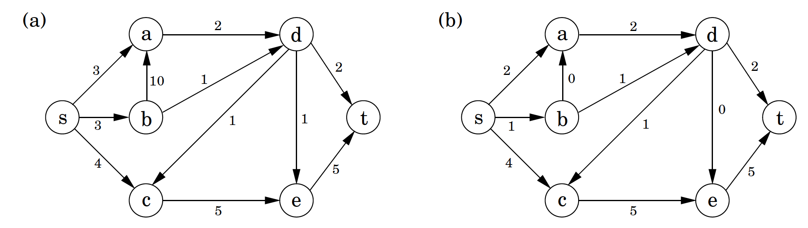
The Max Flow Problem
A network of pipes along which oil can be sent
Each pipeline has a maximum capacity
No opportunity for storing oil on route
Find the maximum flow possible from the source s to the sink t
Here is one solution
The edge labels show the final flow.
Next we show how we got there:
Flow is increased along paths from s to t
2 units
Total: 7 units
Maximum!
Because only two edges (capacity 2+5) enter t
4 units
1 unit

Slide 29
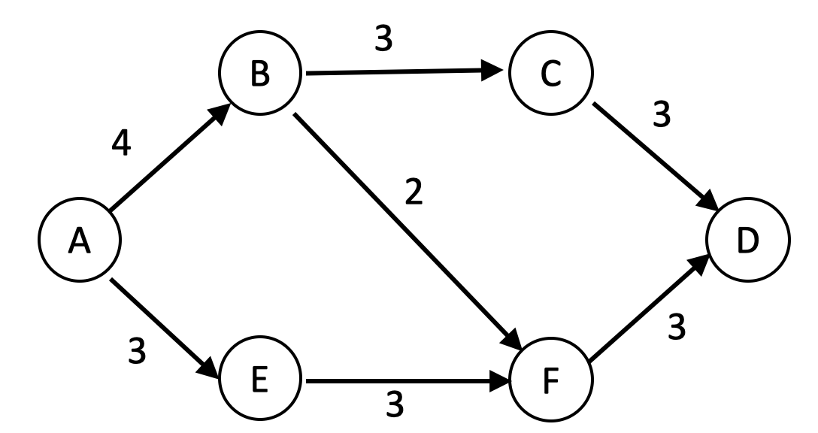
This method does not always give the maximum
1
2
1st Path: A B F D: 2 units
3
1
2
1
1
2nd Path A B C D: 1 unit
3
3rd Path: A E F D: 1 unit
3
3
1
2
0
2
We are not able to find any more s-t paths along which flow can be increased
2
2
2
3
2
3
We introduce the notion of back edges
4
1
1
1
4th Path: A E F ← B C D: 2units
3
1
2
1
Key concept: Augmenting Path
s-t path with
forward edges where flow is below capacity, i.e. flow can be increased
Back edges where flow can be decreased, i.e. flow > 0
2

Slide 30
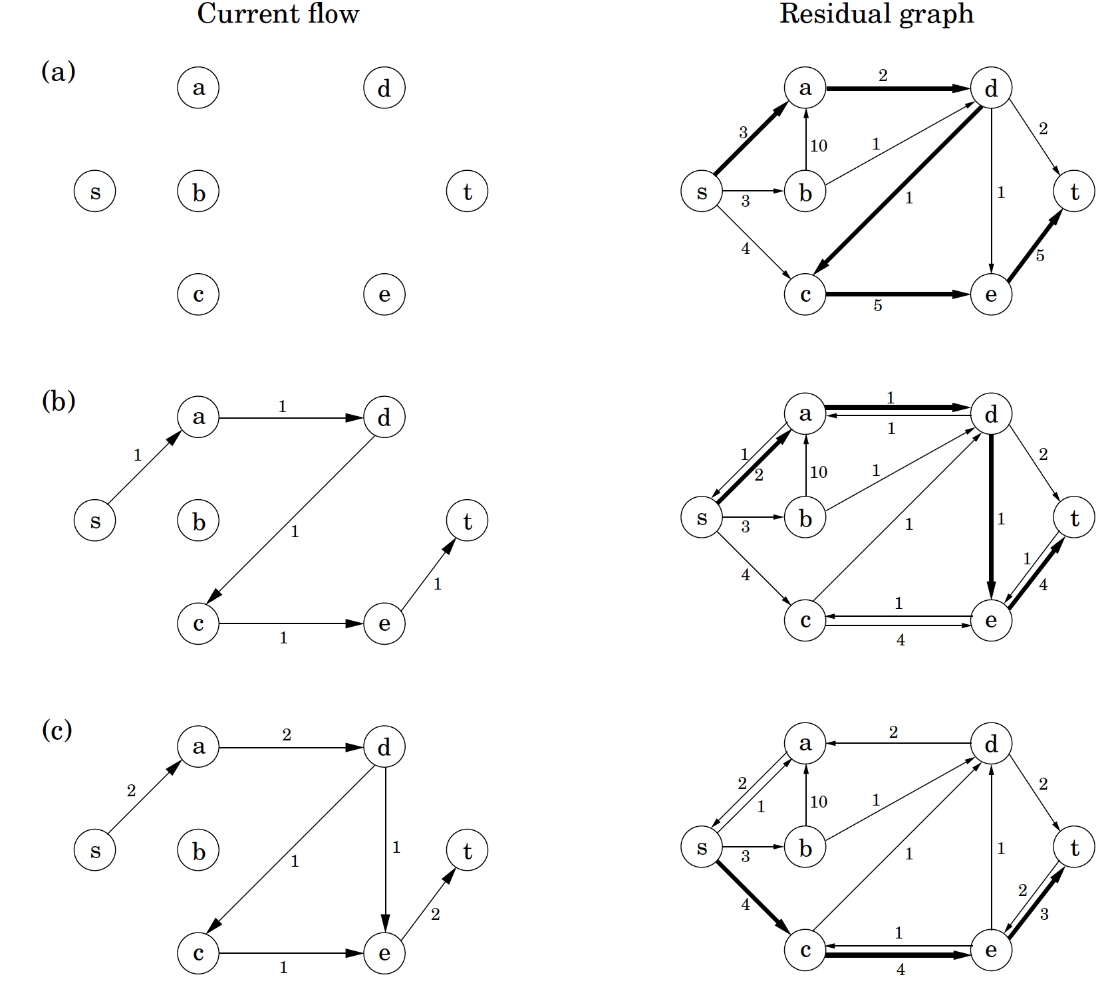
Use of a residual graph

Slide 31
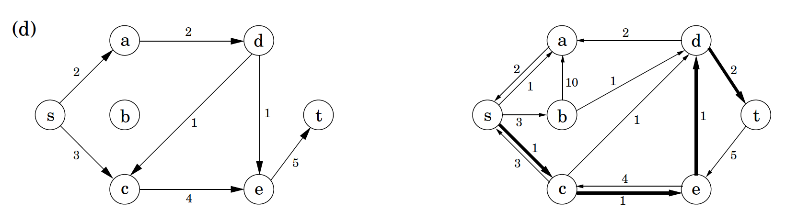
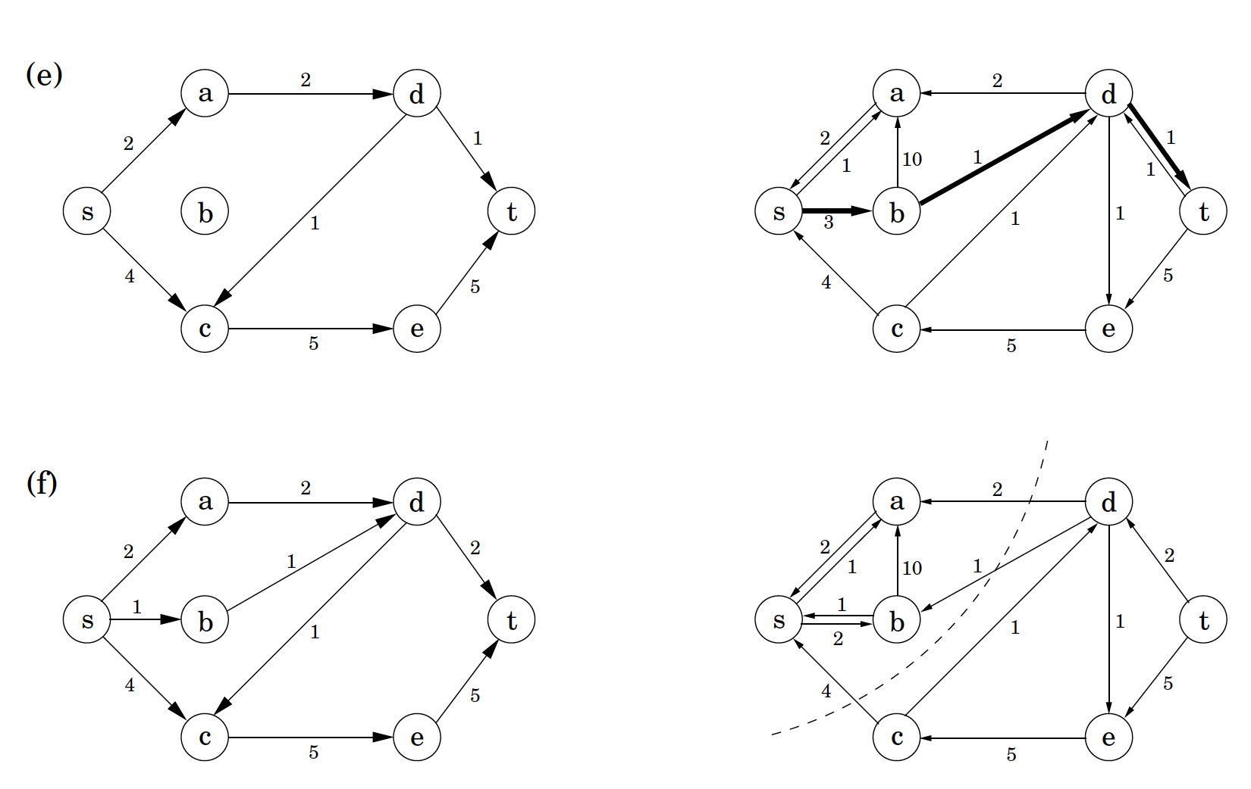
Use of a residual graph continued…

Slide 32
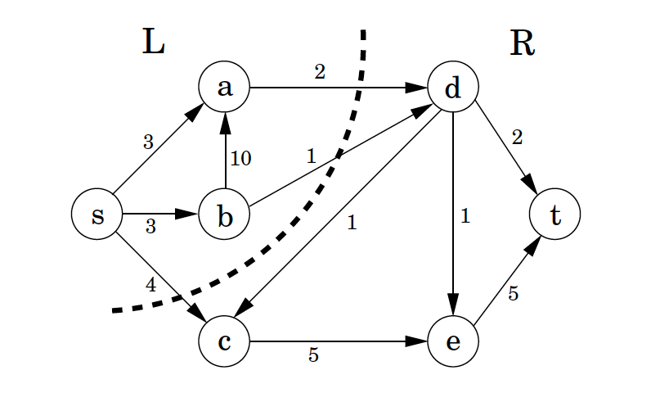
Max-Flow Min-Cut: Proof of optimality
Pick any flow f and any (s,t)-cut (L,R). Then size(f) ≦ capacity(L,R).
This means that if some flow value is equal to some cut value then they are both optimal.
Once the max-flow algorithm finishes L is the nodes reachable by an augmenting path, and R is the nodes not reachable by an augmenting path
L= {s,a,b} R={c,d,e,t}

