Slide 1
CPSC 535: Advanced Algorithms
Instructor: Dr. Doina Bein

Slide 2
Edmonds-Karp Algorithm (taken from https://github.com/kevinwortman/advanced-algorithms-slides/blob/master/07-max-flow.pdf)
Edmonds-Karp Algorithm is
Ford-Fulkerson method from previous page, and...
use breadth-first search (BFS) to find the shortest augmenting path
(shortest ≡ fewest vertices, irrespective of weights)
now a concrete, runnable, implementable algorithm
performs O(|V| · |E|) augmentations
takes O(|V|·|E|²) time
for n = |V|, this is O(n³) in a sparse graph and O(n⁵) in a dense graph
more complicated relabel-to-front algorithm takes O(|V|³) = O(n³) time

Slide 3
1: function EDMONDS-KARP(G = (V , E ), s , t ) 2: initialize each edge’s flow to 0 3: repeat 4: for k = 2,3,...,|V| do 5: if ∃ augmenting path p of length k then 6: cf (p) = minimum excess capacity of any edge in p 7: for edge e in p do 8: if p follows e forwards then 9: increase e’s flow by cf (p) 10: else 11: decrease e’s flow by cf (p) 12: end if 13: end for 14: break loop 15: end if
16: end for
17: until no path can be found
18: return flow based on current capacities
19: end function

Slide 4
Identifying Edge Capacity in G
When running this algorithm by hand,
you could sketch the residual network each time, but this is tedious
instead, when looking at edge e with flow x/c
If x <c, you may follow e forwards and add up to (c−x) flow
if x > 0, you may follow e backwards and subtract up to x flow

Slide 5
Edmonds-Karp algorithm
Take shortest path (in terms of number of edges) as an augmenting path – Edmonds-Karp algorithm
How do we find such a shortest path?
Running time O(VE²), because the number of augmentations is O(VE)
To prove this we need to prove that:
The length of the shortest path does not decrease
Each edge can become critical at most ~ V/2 times. Edge (u,v) on an augmenting path p is critical if it has the minimum residual capacity in the path:
c_{f}(u,v) = c_{f}(p)

Slide 6
Non-decreasing shortest paths
Why does the length of a shortest path from s to any v does not decrease?
Observation: Augmentation may add some edges to residual network or remove some.
Only the added edges (“shortcuts”) may potentially decrease the length of a shortest path.
Let’s supose (s,…,v) – the shortest decreased-length path and let’s derive a contradiction

Slide 7
Number of augmentations
Why each edge can become critical at most ~V/2 times?
Scenario for edge (u,v):
Critical the first time: (u,v) on an augmenting path
Disappears from the network
Reappears on the network: (v,u) has to be on an augmenting path
We can show that in-between these events the distance from s to u increased by at least 2.
This can happen at most V/2 times
We have proved that the running time of Edmonds-Karp is O(VE²).

Slide 8
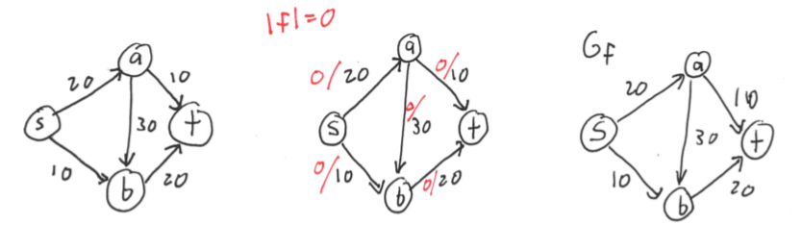
Edmonds-Carp Example 1

Slide 9
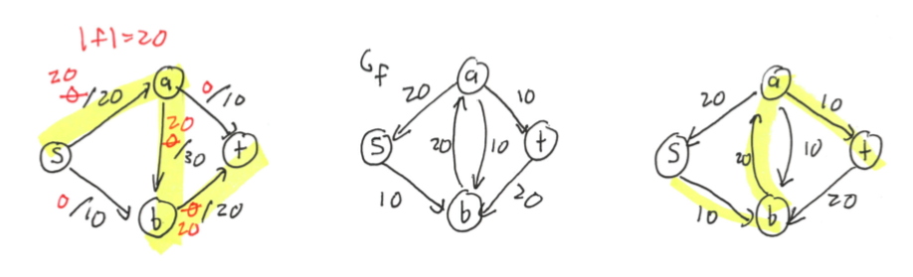

Slide 10
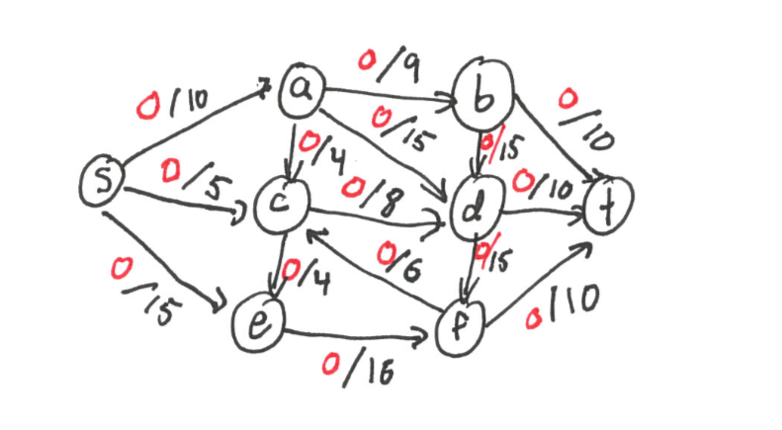

Slide 11
Edmonds-Carp Example 2

Slide 12
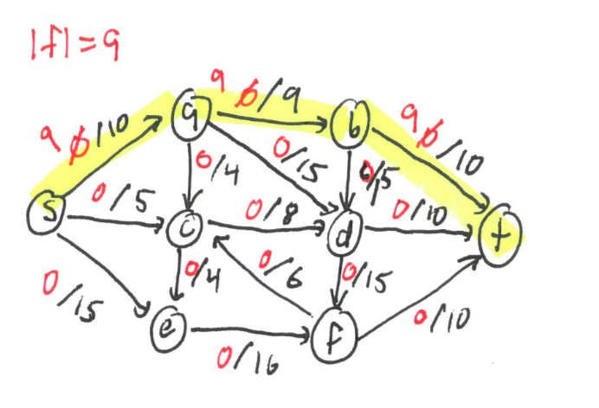

Slide 13
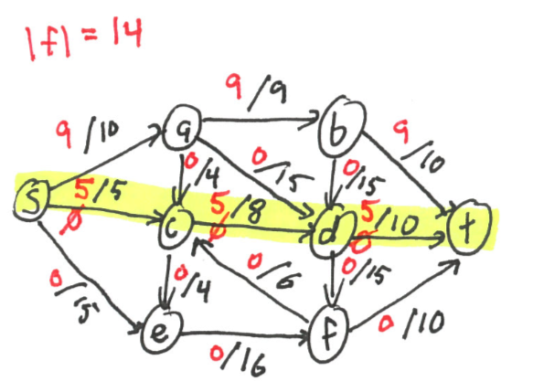

Slide 14
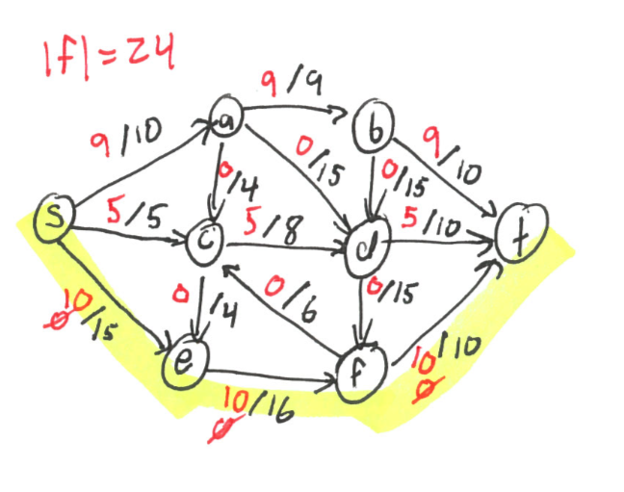

Slide 15
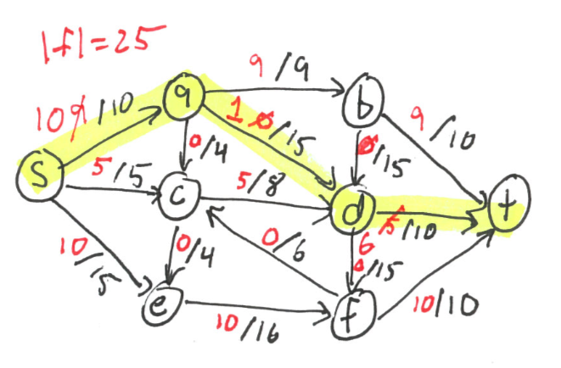

Slide 16
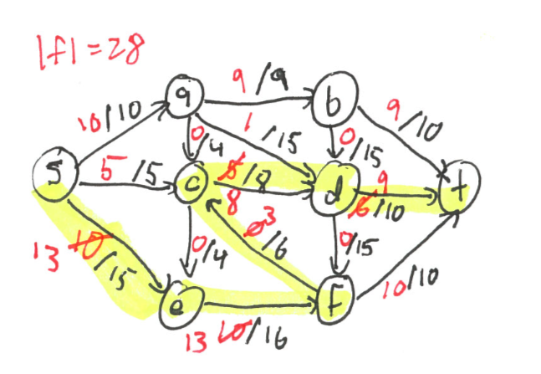

Slide 17
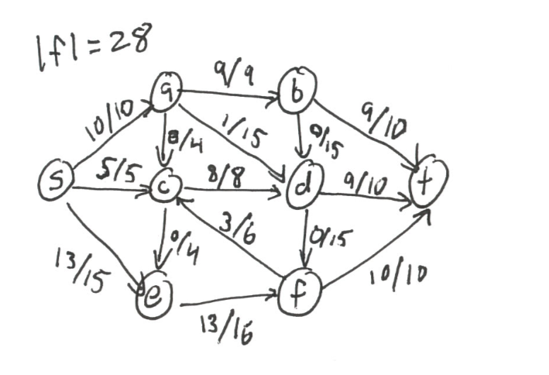
Final answer for Example 2

Slide 18
Example 3 of Edmonds-Karp
Run the Edmonds-Karp algorithm on the following graph:
a
13
b
15
19
s
10
9
5
t
4
14
c
11
d
3

Slide 19
Multiple sources or sinks
What if we have more sources or sinks?
Augment the graph to make it with one source and one sink!
s₁
13
t₁
s₁
13
t₁
7
11
∞
7
11
∞
4
9
5
4
9
5
10
s
∞
10
∞
t
s₂
11
t₂
s₂
11
t₂
4
8
∞
4
8
s₃
6
s₃
6

Slide 20
Application of max-flow
Maximum bipartite matching problem
Matching in a graph is a subset M of edges such that each vertex has at most one edge of M incident on it. It puts vertices in pairs.
We look for maximum matching in a bipartite graph, where V = L ∪ R, L and R are disjoint and all edges go between L and R
Dating agency example:
L – women, R – men.
An edge between vertices: they have a chance to be “compatible” (can be matched)
Do as many matches between “compatible” persons as possible

Slide 21
Bipartite Matching
bipartite maximum matching
input: an undirected bipartite graph G = (V , E ) where V = L ∪ R are the parts of G
output: a matching M ⊆ E where the number of matched vertices is maximum
bipartite: L, R are disjoint, and edges only go between L, R
matching: pick edges that “pair off” two vertices; goal is to
maximize # paired-off
intuitively, L is one kind of thing and R is another kind of thing

Slide 22
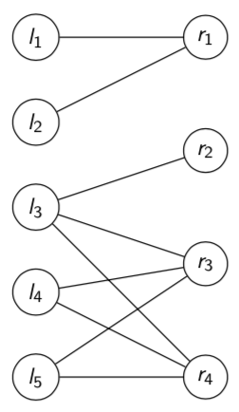
Example of Bipartite Matching
Input graph

Slide 23
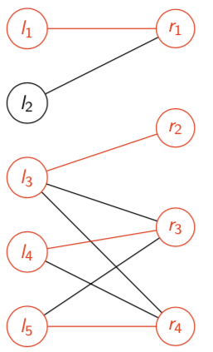
Maximum bipartite matching
matching
M = {included edges} = {{l1, r1}, {l3, r3}, {l4, r3}, {l5, r4}}
|M| = 4 (other optimal matchings exist)

Slide 24
Bipartite Matching Applications
any scenario where there are two kinds of things that can be paired
goal is simply to select the maximum number of pairings
casting for a play: L = set of actors; R = set of roles; edge {l,r} exists when l could play role r
packing leftover food (one item/container): L = set of food items; R = available containers; edge {l,r} exists when food l could fit in container r
scheduling appointments: L = set of clients; R = set of time slots; edge {l,r} exists when client l could meet appointment r
might feel NP-hard, but actually is in P

Slide 25
Maximum bipartite matching
How can we reformulate this problem to become a max-flow problem?
What is the running time of the algorithm if we use the Ford-Fulkerson method?

Slide 26
Formulating Bipartite Matching as Flow
let G = (V , E ) be bipartite matching instance
create G ′ = (V ′ , E ′ ) with V ′ = V ∪ {s , t } where s , t are new source/sink
create edges
(l,r) ∀l ∈L,r ∈R,{l,r}∈E
(s,l) ∀l∈L
(r,t) ∀r∈R
every edge (v,w) has capacity c(v,w) = 1
post-processing: edge(l,r)∈M ifff(l,r)=1
observe |V′| ∈ O(|V|),|E′| ∈ O(|E|), overhead is O(|V|+|E|)
=⇒ if this is correct, can solve bipartite matching in O(|V|³) time

Slide 27
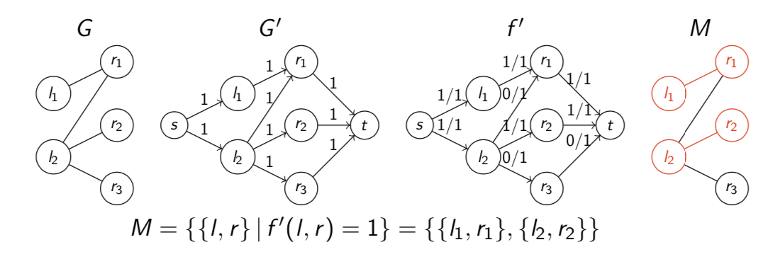
Example
M ={{l,r}|f′(l,r)=1}={{l₁,r₁},{l₂,r₂}}
(other max flows exists ⇔ other maximal matchings exist)

Slide 28
Correctness and Time Complexity
∃ matching M with cardinality k = |M| iff ∃ some flow f with value k = |f|
key idea: pairing two vertices in the matching adds exactly one flow from s ⇝ t
there are no opportunities for flow aside from matched vertices
=⇒ a maximum flow in G′ corresponds to a maximum matching in G
classical max-flow problem can be solved in O(|V|³) time, in P
robust max-flow problem (supports unreachable vertices, antiparallel edges, multiple sinks/sources) also in O(|V|³) time w/ worse constant factors, in P
bipartite matching reduces to max-flow, so bipartite matching can be solved in O(|V|³) time, in P
other practical, distinct problems reduce to max-flow or bipartite matching so take O(|V|³) time and are in P

