Slide 1
CPSC 535: Advanced Algorithms
Instructor: Dr. Doina Bein

Slide 2
Linear programming (LP) (taken from Levitin, pages 244-246)
A linear programming problem: a problem of optimizing a linear function of several variables subject to constraints in the form of linear equations and linear inequalities => an optimal decision problem
maximize (or minimize) c₁x₁ + . . . + c_{n}x_{n} (called objective function) subject to a_{i1}x₁+...+a_{in}x_{n} ≤ (or ≥ or = )b_{i} for i=1,...,m (called constraints)
x₁ ≥0,...,x_{n} ≥0 (called nonnegative constraints)
Integer linear programming (ILP) problem: the variables of a LP problem are required to be integers
Textbook CLRS section 29.3

Slide 3
History of LP (taken from https://github.com/kevinwortman/advanced-algorithms-slides/blob/master/10-linear-programming-problem.pdf , Wikipedia, and other sources)
Pioneered by Soviet economist Leonid Kantorovich circa 1930s (https://en.wikipedia.org/wiki/Leonid_Kantorovich , https://arxiv.org/abs/0707.0491); goal was to optimize supply/demand in a communist in lieu of prices
It is one of the most important achievements in the history of applied mathematics
It model a wide variety of important applications in business (operations research)
airline crew scheduling, transportation and communication network planning, oil exploration and refining, and industrial production optimization
scheduling UPS deliveries, optimizing farm production, allocating investment portfolios, etc.

Slide 4
Solving LP problems (taken from https://github.com/kevinwortman/advanced-algorithms-slides/blob/master/10-linear-programming-problem.pdf and Levitin, pages 245-246)
On the border of P: many tough problems in P, including max-flow, reduce to LP
The classic algorithm for this problem is called the simplex method, invented by the U.S. mathematician George Dantzig in the 1940s
simplex algorithm technically takes O(2^{n}) worst-case time, but is fast polynomial on most practical inputs
we have pseudo-polynomial algorithms with e.g. O(n^{2.5}W ) runtime and expensive constant factors
open question whether there is a strongly polynomial LP algorithm with runtime e.g. O(n³), not a function of W
A more recent algorithm by Narendra Karmarkar (1984) is polynomial and performed competitively with the simplex method in empirical tests

Slide 5
Standard versus general form of LP
standard form: restricted/simplified LP, easier for algorithms to solve
general form: more convenient for end-user formulations
general reduces to standard with constant overhead
Standard form | General form
maximize objective function | maximize or minimize objective function
all variables are non-negative | no restriction (may be negative)
every constraint is ≤ r.h.s. | constraint may be ≤ , = or ≥ r.h.s.

Slide 6
General form example
minimize x₁ −x₂
subject to
x₁ ≤ 100
x₂ ≥ 2
x₁+x₂ = 10
x₂ ≥ 0
Note that:
The objective function is minimizing objective function
mix of ≤, =, ≥ constraints
not all variables have x_{i} ≥ 0 non-negativity constraint (x₁ is missing so it could take any value in R)

Slide 7
Standard form
standard form with n variables and m constraints:
maximize c₁x₁ + . . . + c_{n}x_{n} subject to
a_{1,1}x₁+ a_{1,2}x₂+...+a_{1,n}x_{n} ≤ b₁
a_{2,1}x₁+ a_{2,2}x₂ +...+a_{2,n}x_{n} ≤ b₂
a_{m,1}x₁+ a_{m,2}x₂ +...+a_{m,n}x_{n} ≤ b_{m}
x₁,...,x_{n} ≥ 0

Slide 8
Example 1
maximize 2x₁ + x₂ − 1/3 x₃
subject to x₁+x₂ ≤ 10
−x₃ ≤ −2
x₁,x₂,x₃ ≥ 0

Slide 9
Example 2 (knapsack)
Knapsack problem: Given a knapsack of capacity W and n items of weights w₁, . . . , w_{n} and values v₁, . . . , v_{n}, find the most valuable subset of the items that fits into the knapsack.
Let x_{j}, j = 1, . . . , n, be a variable representing a fraction of item j taken into the knapsack. Obviously, x_{j} must satisfy the inequality 0 ≤ x_{j} ≤ 1. Since we are only allowed either to take a whole item or not to take it at all, x_{j} =0 or 1. Hence, we have the following integer linear programming problem (called the 0-1 version) of the knapsack problem:
maximize v₁x₁ + . . . + v_{n}x_{n} subject to w₁x₁+ w₂x₂+...+w_{n}x_{n} ≤ W
x₁,...,x_{n} ∈ {0,1}

Slide 10
Matrix notation of the standard form
Collect all variables into vector x=⟨x₁,...,x_{n}⟩,
objective coefficients into vector c = ⟨c₁, . . . , c_{n}⟩ r.h.s. of inequalities into vector b = ⟨b₁, . . . , b_{m}⟩
a_{i,j} coefficients into matrix A
LP can be written in terms of dot-product and matrix-vector multiplication as (and note the transpose c^{T} ):
maximize c^{T}x
subject to
Ax ≤ b
x≥0

Slide 11
Possible outcomes
LPs are not always solvable!
There are three outcomes:
solution: concrete values for x₁ , . . . , x_{n} that maximize c^{T}x (good, usually the goal)
unbounded: objective can be made arbitrarily large i.e. +∞ (bad, usually means there is a bug in your LP that makes it nonsensical)
infeasible: impossible to satisfy all constraints simultaneously (bad, usually means that either your LP is nonsensical; or your LP makes sense but meeting all your goals is impossible)

Slide 12
Visual representation
Read slides 11-19 of https://github.com/kevinwortman/advanced-algorithms-slides/blob/master/10-linear-programming-problem.pdf

Slide 13
Formulating General LP as Standard LP (taken from https://github.com/kevinwortman/advanced-algorithms-slides/blob/master/12-lp-formulations.pdf )
pre-processing: convert general LP to standard LP
need to get rid of any non-standard feature
want insignificant overhead
n = #variables, m = # constraints
space complexity of general LP is Θ(nm)
want size of resulting standard LP, and time overhead, to both be O(nm)
three features to deal with
minimization
negative variables
=, ≥ constraints

Slide 14
Converting “minimize” to Standard Form
minimize f (x) ≡ maximize −f (x) so if general LP says
minimize c₁x₁ +c₂x₂ +...+c_{n}x_{n}, replace that with
maximize −c₁x₁ − c₂x₂ −... − c_{n}x_{n}
size of LP unchanged
It takes O(n) time to negate coefficients

Slide 15
Converting negative variables to Standard Form
If x_{j} does not have a non-negativity constraint x_{j} ≥ 0, call x_{j} a negative variable
Handle each negative variable one at a time
Negative variable x_{j} becomes two non-negative variables x′_{j}, x′′_{j}
invariant: x_{j} = x′_{j} - x′′_{j}
x′_{j} = the “positive” part of x_{j}
x′′_{j} = the “negative” part of x_{j}
x_{j} positive ⇐⇒ x′_{j} >0 and x′′_{j} = 0
x_{j} negative ⇐⇒ x′_{j} =0 and x′′_{j} > 0

Slide 16
Converting Negative Variables to Standard Form
The algorithm becomes as follows:
add non-negativity constraints x′_{j} ≥ 0, x’’_{j} ≥ 0
substitute (x′_{j} − x’’_{j} ) = x_{j} into LP
obj. func: c_{j}x_{j} ⇒ c_{j}(x′_{j} − x’’_{j} ) = c_{j} x′_{j} −cj x’’_{j}
constraints: a_{i,j}x_{j} ⇒a_{i,j}(x′_{j} − x′’_{j} ) = a_{i,j}x′_{j} −a_{i,j} x′’_{j}
after solving standard LP, to complete general LP evaluate x_{j} = x′_{j} − x′’_{j}
The values for n, m at most double ⇒ still Θ(nm) space
Time complexity O(nm) time with care (do all substitutions in one pass)

Slide 17
Converting = constraints to inequalities
this step converts any = constraint to ≤, ≥ constraints
≥ constraints are eliminated in the next step
a=b ⇐⇒ a ≤ b and a ≥ b
replace each = constraint
a_{i,1}x₁+a_{i,2}x₂+...+a_{i,n}x_{n} =b_{n} with two constraints
a_{i,1}x₁+a_{i,2}x₂+...+a_{i,n}x_{n} ≥ b_{n} a_{i,1}x1+a_{i,2}x₂+...+a_{i,n}x_{n} ≤ b_{n}
The value of n unchanged, m at most doubles ⇒ still Θ(nm) space
O(nm) time

Slide 18
Converting ≥ constraints to ≤ constraints
a ≥ b ⇐⇒ −a ≤ −b
replace each ≥ constraint a_{i,1}x₁+a_{i,2}x₂+...+a_{i,n}x_{n} ≥ b_{n}
with
-a_{i,1}x₁-a_{i,2}x₂ - ... -a_{i,n}x_{n} ≤ −b_{n}
The values of n, m unchanged so still Θ(nm) space
O(nm) time

Slide 19
General-form LP problem
input:
Boolean for whether f is maximized/minimized
vector c ∈ R^{n}
vector b ∈ R^{m}
vector o ∈ {≤, =, ≥}^{m}
Matrix A of size m × n of real numbers
output: either
“unbounded”; or
“infeasible”; or
“solution” with a vector x ∈ R^{n} maximizing or minimizing the objective function

Slide 20
Formulating General LPs
Need to define
the variables, what they represent
the objective function, whether it is maximizing or minimizing
the constraints, what they represent
the entire LP in general form
how to interpret
infeasible result
unbounded result
solution result; how to interpret solution vector x in terms of business logic

Slide 21
Visual representation
Read slides 15-20 of https://github.com/kevinwortman/advanced-algorithms-slides/blob/master/12-lp-formulations.pdf

Slide 22
Slack form
standard form: constraint says l.h.s ≤ r.h.s. ⇒ the difference or “slack” between r.h.s. and l.h.s. is ≥ 0: r.h.s – l.h.s ≥ 0, so we call “slack” the difference slack = r.h.s – l.h.s
slack form: constraint says l.h.s. + slack = r.h.s.
increasing objective = decreasing slack
z = value of objective function
don’t bother writing “maximize” or “subject to”
introduce one new basic variable to represent slack in each constraint ; pre-existing variables are non-basic

Slide 23
Standard versus Slack Form
max x₁ +2x₂ − ½ x₃ z= x₁ +2x₂ − ½ x₃
subject to
1/3 x₁+x₃ ≤ 5 x₁+x₂+x₃ ≤ 100 x₁ − x₂ ≤ −3 x₁,x₂,x₃ ≥ 0 | x₄ = 5−1/3 x₁− x₃ x₅ = 100 − x₁− x₂− x₃ x₆ = −3− x₁+ x₂ x₁,x₂,x₃,x₄,x₅,x₆ ≥0 basic var’s: x₄, x₅, x₆ nonbasic var’s: x₁, x₂, x₃

Slide 24
High-level Simplex algorithm
convert standard form LP to slack form
find a feasible (probably non-optimal) initial solution
if this does not exist, return “infeasible”
repeat:
choose a nonbasic variable x_{i} with positive coefficient in objective function (increasing x_{i} increases z)
if no such x_{i} exists, return solution (it’s optimal)
increase x_{i} until some basic variable x_{j} is decreased to zero (“tighten” the slack until we’re up against a constraint)
if none exists, return “unbounded”
swap roles: rewrite slack form with x_{i} as basic variable and x_{j} as nonbasic variable
(for further details, see CLRS section 29.3 or Levitin section 10.1)

Slide 25
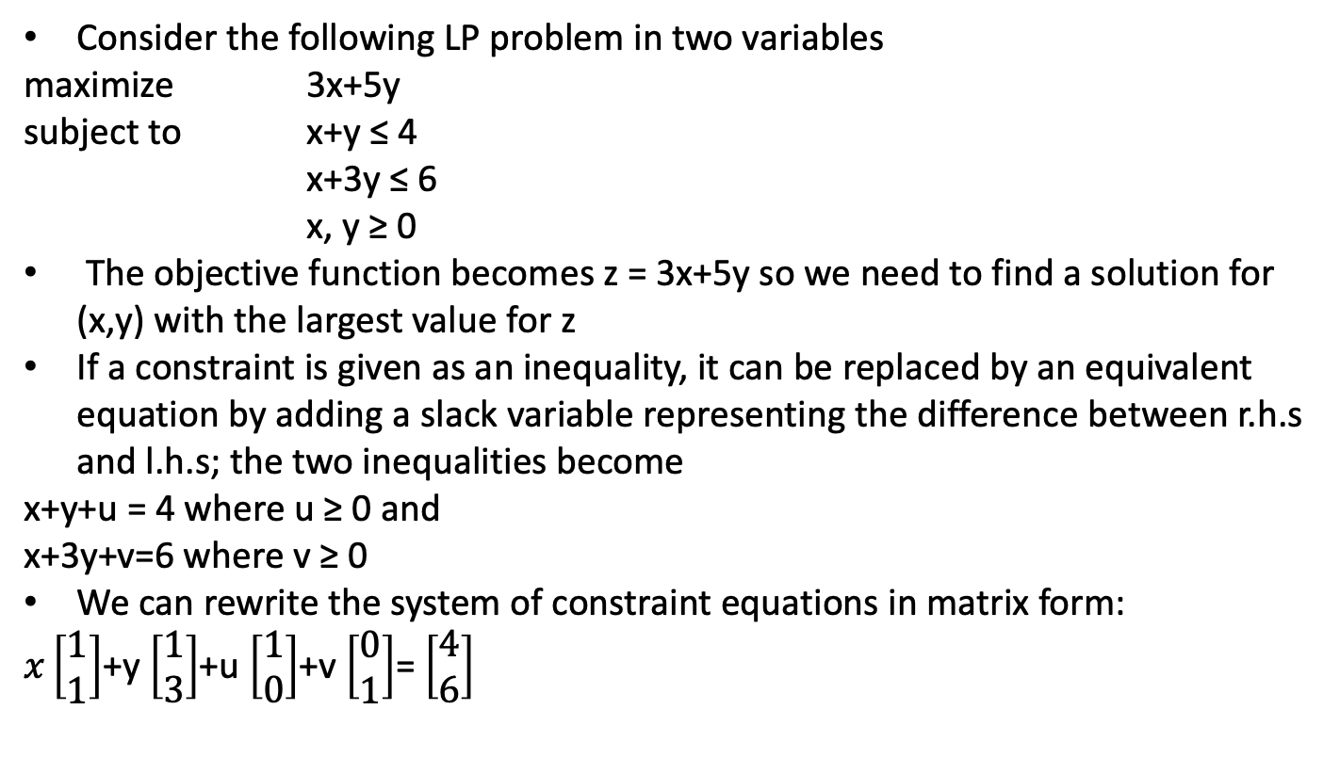
Example (taken from Levitin pages 347, 352-359)

Slide 26
The simplex method progresses through a series of adjacent extreme points (basic feasible solutions) with increasing values of the objective function
Each such point can be represented by a simplex tableau, a table storing the information about the basic feasible solution corresponding to the extreme point that achieves the largest value for objective function z
In general, a simplex tableau for a LP problem in standard form with n unknowns and m linear equations constraints (n ≥ m) has m+1 rows and n+1 columns.
 |  | x | y | u | v
 | u | 1 | 1 | 1 | 0 | 4
← | v | 1 | 3 | 0 | 1 | 6
 |  | -3 | -5 | 0 | 0 | 0
 |  |  | ↑

Slide 27
 |  | x | y | u | v
 | u | 1 | 1 | 1 | 0 | 4
← | v | 1 | 3 | 0 | 1 | 6
 |  | -3 | -5 | 0 | 0 | 0
 |  |  | ↑
The rows are labeled by the basic variables
Columns, except the last one, are labeled by the names of the variables: In the example above: nonbasic then basic
The first m rows and the first n columns contain the coefficients of the corresponding constraint equation
The last column of the first m rows contain the r.h.s of the constraint equations
The columns labeled by the basic variables form an m×m identify matrix, in the example above marked by the box
The last row is called the objective row and is initialized by the coefficients of the obj. funct. with the signs reversed (in the first n columns) and the value of the obj. funct. at the initial point (in the last column)

Slide 28
The objective row is used by the simplex method to check whether the current tableau represents an optimal solution
An optimal solution is obtained when all the entries of the objective row, except possibly the one in the last column, are nonnegative
If this is not the case, any of the negative entries indicates a nonbasic variable that can become a basic variable in the next tableau
If there are several negative entries in the objective row, a commonly used rule is to select the most negative one, i.e. the negative number with the largest absolute value
Such a choice yields the largest increase in the obj. funct.’s value per unit of change in a variable’s value
A new basic variable is called the entering variable, while its column is referred to as the pivot column; we mark it with ↑

Slide 29
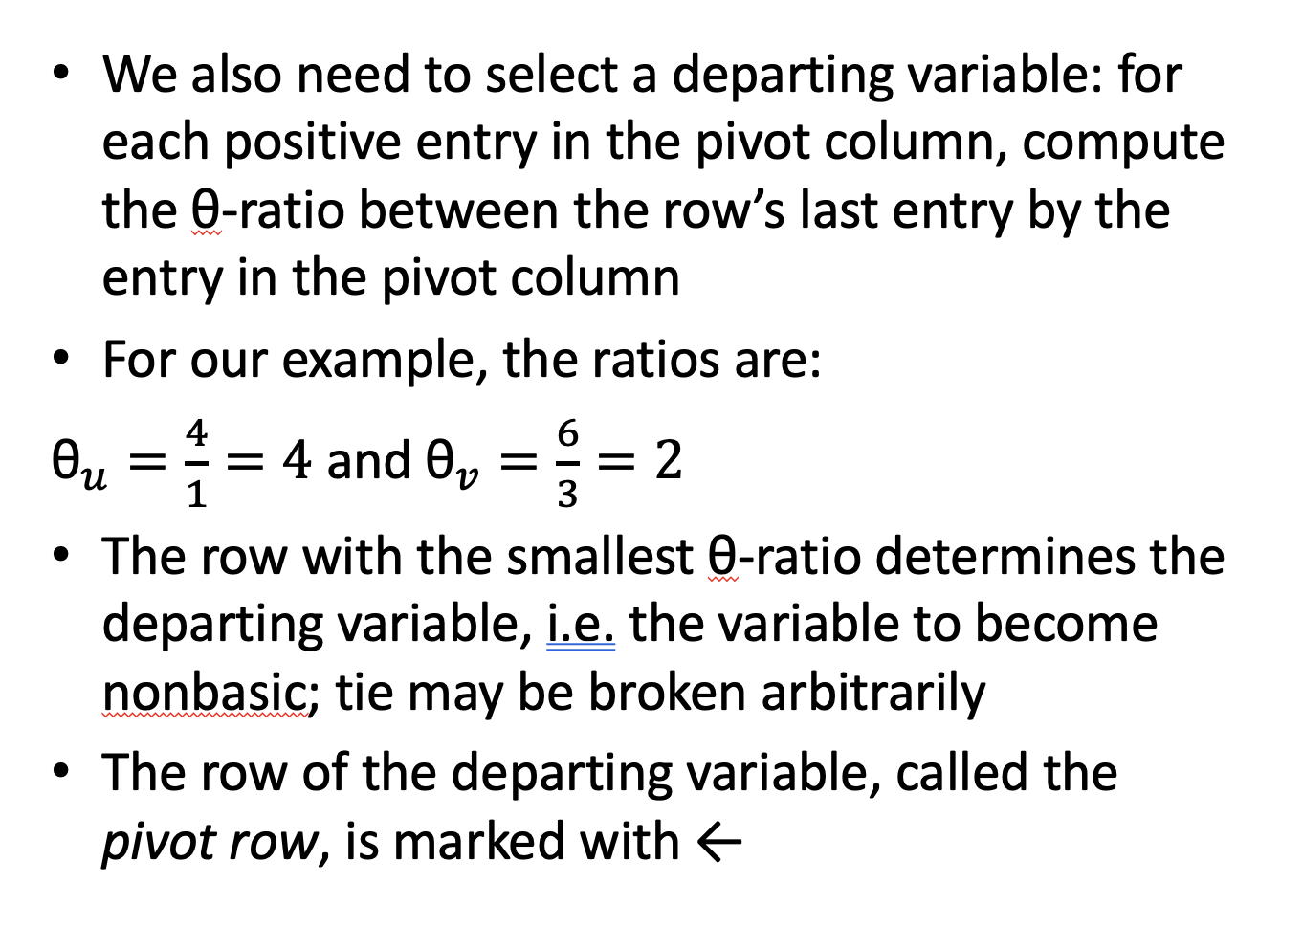

Slide 30
Transforming a Linear Program into “Normal Form”
maximize 3x+5y
subject to x+y ≤ 4
x+3y ≤ 6
x, y ≥ 0
Objective function becomes z = 3x+5y. Need to find a solution for (x,y) with the largest value for z.
Inequality replaced by an equivalent equation:
add a slack variable representing the difference between R.H.S and L.H.S;
x+y+u = 4 with u ≥ 0
x+3y+v=6 with v ≥ 0

Slide 31
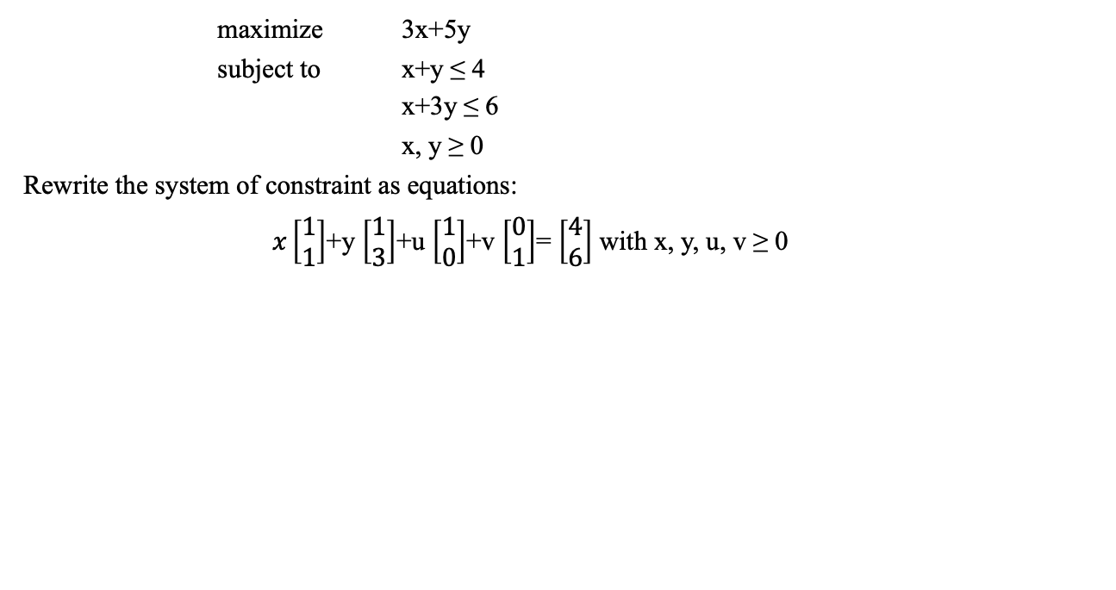
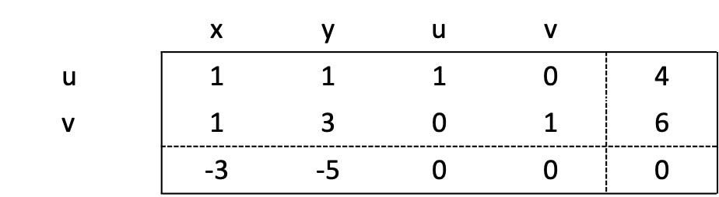
Simplex Tableau
LP:
Matrix Form:
and z - 3x - 5y = 0
Non-basic variables:
x = 0, y = 0
Basic variables:
u = 4, v = 6
Simplex Tableau:
Corresponding z-value:
z = 0

Slide 32
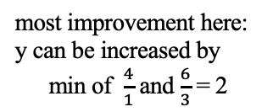

Pivot
Current solution:
x = 0, y = 0, u = 4, v = 6
Subtract 2nd row from 1st
Subtract 2nd row times -5 from 3rd row
 |  | x | y | u | v
 | u |  | 0 | 1 |  | 2
 | y |  | 1 | 0 |  | 2
 |  |  | 0 | 0 |  | 10
 |  | x | y | u | v
 | u | 1 | 1 | 1 | 0 | 4
 | v |  | 1 | 0 |  | 2
 |  | -3 | -5 | 0 | 0 | 0
 |  |  | ↑
Corresponds to solution (0,2,2,0)

Slide 33
Another pivot, and we are optimal
 |  | x | y | u | v
 | u |  | 0 | 1 |  | 2
 | y |  | 1 | 0 |  | 2
 |  |  | 0 | 0 |  | 10
 |  | x | y | u | v
 | x |  | 0 |  |  | 3
 | y |  | 1 |  |  | 1
 |  | 0 | 0 | 2 | 1 | 14
x₁= 3, x₂=1
all values are non-negative
maximum is 14

Slide 34
Simplex method summarized (taken from Levitin, pages 356-357)
Step 0 Initialization Present a given linear programming problem in standard form and set up an initial tableau with nonnegative entries in the rightmost column and m other columns composing the m × m identity matrix. (Entries in the objective row are to be disregarded in verifying these requirements.) These m columns define the basic variables of the initial basic feasible solution, used as the labels of the tableau’s rows.
Step 1 Optimality test If all the entries in the objective row (except, possibly, the one in the rightmost column, which represents the value of the objective function) are nonnegative—stop: the tableau represents an optimal solution whose basic variables’ values are in the rightmost column and the remaining, nonbasic variables’ values are zeros.
Step 2 Finding the entering variable Select a negative entry from among the first n elements of the objective row. (A commonly used rule is to select the negative entry with the largest absolute value, with ties broken arbitrarily.) Mark its column to indicate the entering variable and the pivot column.
Step 3 Finding the departing variable For each positive entry in the pivot column, calculate the θ-ratio by dividing that row’s entry in the rightmost column by its entry in the pivot column. (If all the entries in the pivot column are negative or zero, the problem is unbounded—stop.) Find the row with the smallest θ -ratio (ties may be broken arbitrarily) and mark this row to indicate the departing variable and the pivot row.
Step 4 Forming the next tableau Divide all the entries in the pivot row by its entry in the pivot column. Subtract from each of the other rows, including the objective row, the new pivot row multiplied by the entry in the pivot column of the row in question. (This will make all the entries in the pivot column 0’s except for 1 in the pivot row.) Replace the label of the pivot row by the variable’s name of the pivot column and go back to Step 1.

Slide 35
For further details, see CLRS section 29.3

Slide 36
Formulating Business Logic
you need to figure out how to model all these in parts of an LP
variables
objective function
constraints
every concept mentioned in the scenario needs to be modeled in the LP somehow
only works when the objective is a linear function (not squared, exponential, etc.)

Slide 37
Example 1: Plastic Recycling
Suppose Orange County has the following options for disposing of plastic waste:
December is expected to produce 700 tons of plastic and is required by law to emit no more than 1400 tons of carbon. The landfill can accommodate up to 100 tons per month and the other methods are effectively unlimited. The County Supervisors want you to minimize the cost of plastic disposal.
Method | Carbon/ton | Dollars/ton
Local incinerator | 2.9 | 800
Overseas incinerator | 3.2 | 600
Thermal recycling | .5 | 1200
Landfill | .3 | 1400

Slide 38
Formulate as LP problem
Variables: one variable for each method loc = tons incinerated locally ove = tons incinerated overseas rec = tons recycled lan = tons sent to landfill
Objective function: “minimize cost of plastic disposal” minimize 800loc + 600 ove + 1200 rec + 1400lan

Slide 39
Cont.
3. Constraints:
“produce 700 tons of plastic”: loc + ove + rec + lan = 700
“no more than 1400 tons of carbon”: 2.9loc + 3.2ove + .5rec + .3lan ≤ 1400
“landfill can accommodate up to 100 tons”: lan ≤ 100
use critical thinking, common sense to model implicit rules: loc, ove, rec, lan ≥ 0

Slide 40
Cont.
general-form LP:
minimize 800Ioc + 600ove + 1200rec + 1400lan
subject to loc + ove + rec + lan = 700 2.9loc + 3.2ove + .5rec + .3lan ≤ 1400
lan ≤ 100 loc, ove, rec, lan ≥ 0
Interpret results:
infeasible: never happens because there exists at least one feasible solution: rec = 700, Ioc = ove = lan = 0
unbounded: never happens because the non-negativity constraints lower-bound the objective at 0; it can’t approach −∞
solution: Tell the Supervisors to incinerate loc tons locally, incinerate ove tons overseas, recycle rec tons, and landfill lan tons.

Slide 41
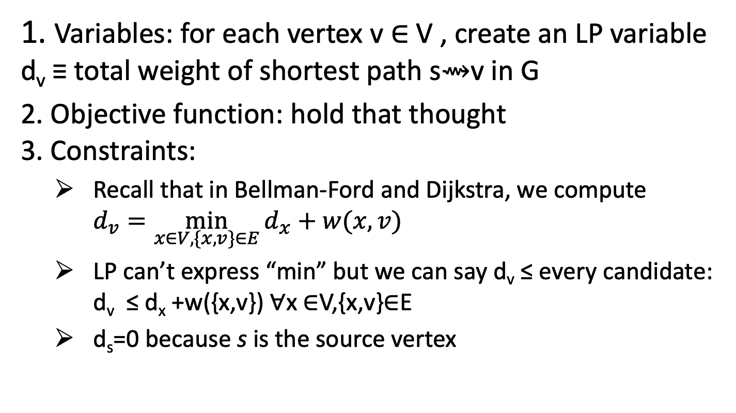
Single-Source Shortest Paths (taken from https://github.com/kevinwortman/advanced-algorithms-slides/blob/master/10-linear-programming-problem.pdf

Slide 42
SSSP as LP problem
2. Objective function: for some node (sink) t, we choose to maximize d_{t}
not minimize d_{t}
that would allow LP to just set every d_{v} = 0; no notion of edges adding to path weights
maximizing d_{t} forces LP to set each d_{v} to the d_{x} + w({x, v}) that is the minimum
now, when you use an edge, you add its weight

Slide 43
Cont.
4. General-form LP: given G = (V, E ), source s, sink t
create variable d_{v} ∀v ∈ V maximize d_{t} subject to
d_{v} ≤ d_{x} +w(x,v) ∀{x,v} ∈ E
d_{s} = 0
5. Interpreting result:
infeasible: never happens because setting every d_{v} = 0 is always feasible
unbounded: d_{t} = ∞ means that t is unreachable from s
solution:
need to identify path (list of vertices) s ⇝ t
i.e. identify edges defining the shortest path and d_{t}
find the constraints where d_{v} =d_{x} +w(x,v) (not ≤); these vertices x,v are part of the shortest path
use BFS or DFS, limited to on-path vertices, to order these vertices

Slide 44
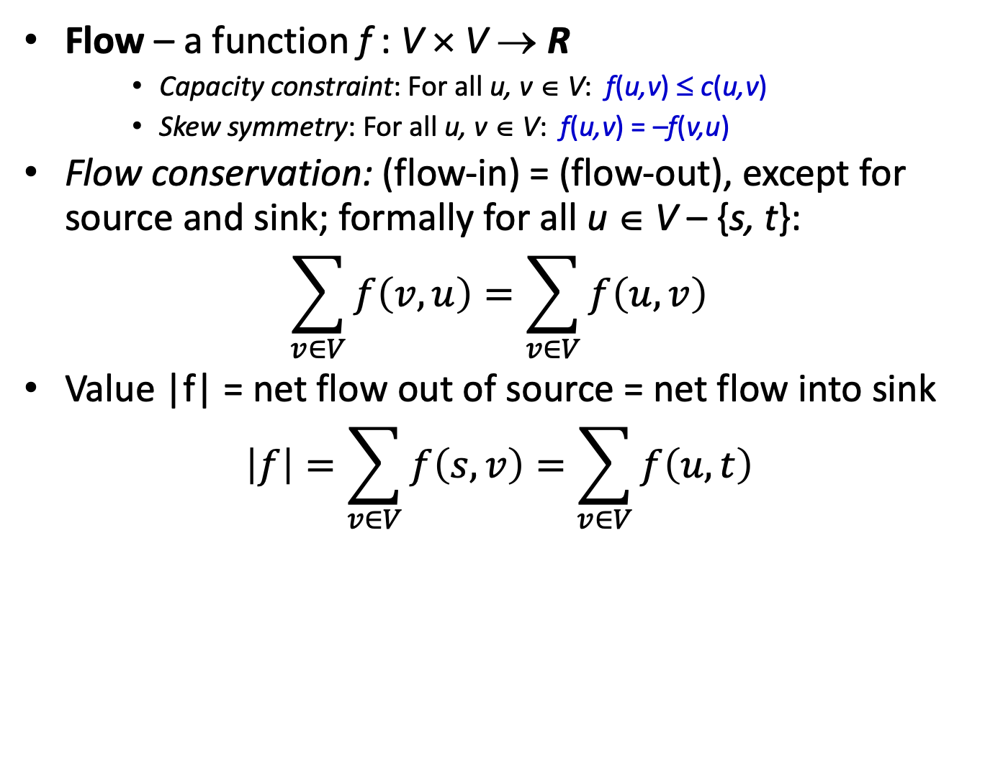
Formulating Max Flow

Slide 45
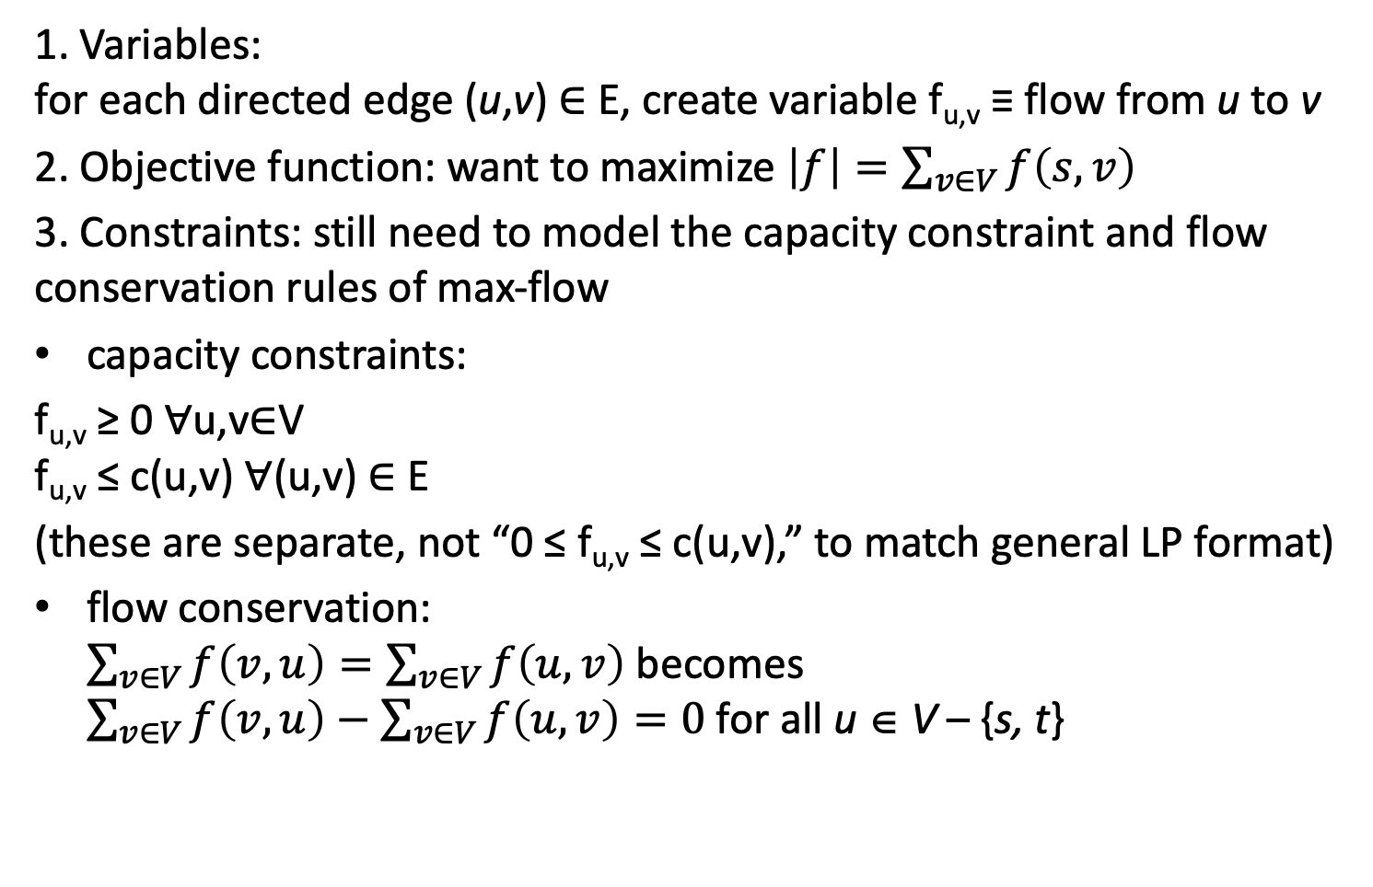
Formulating Max Flow as LP problem

Slide 46
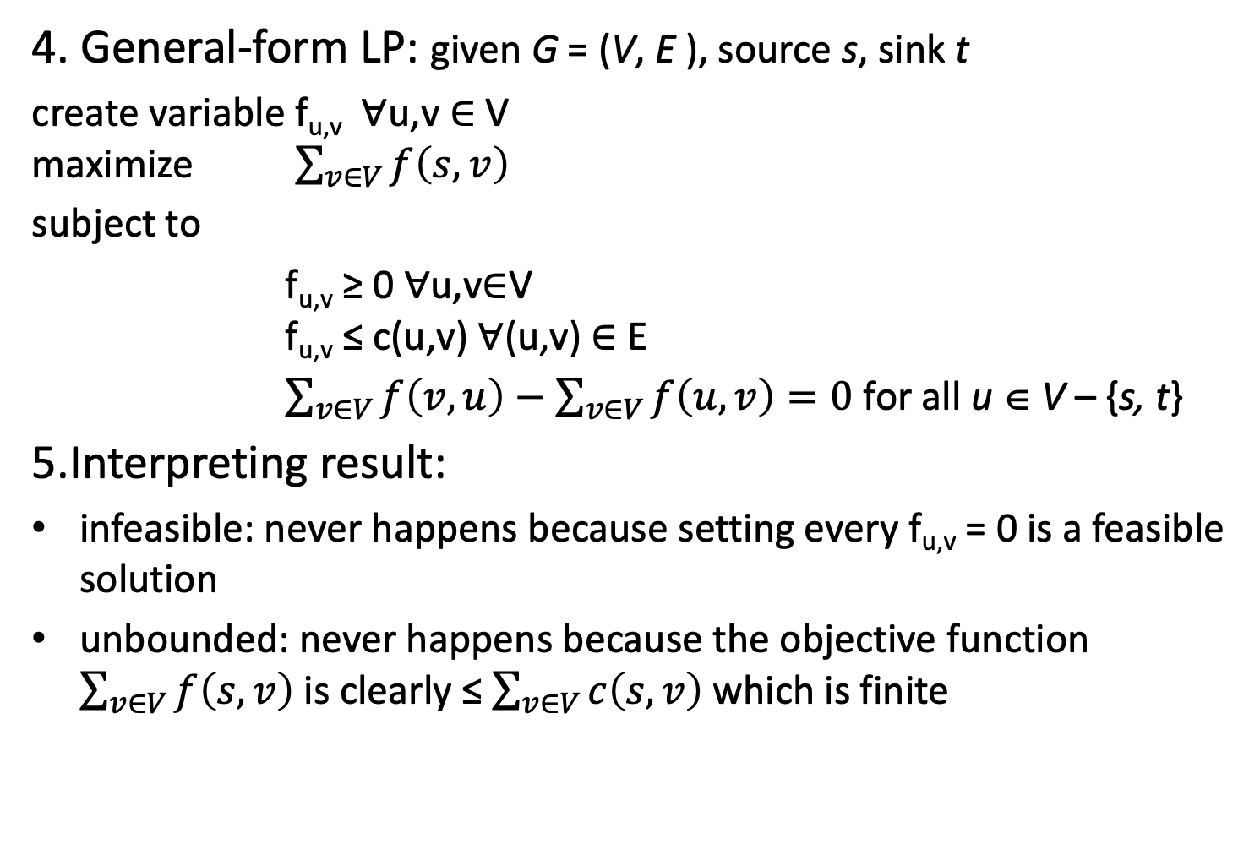
Cont.

Slide 47
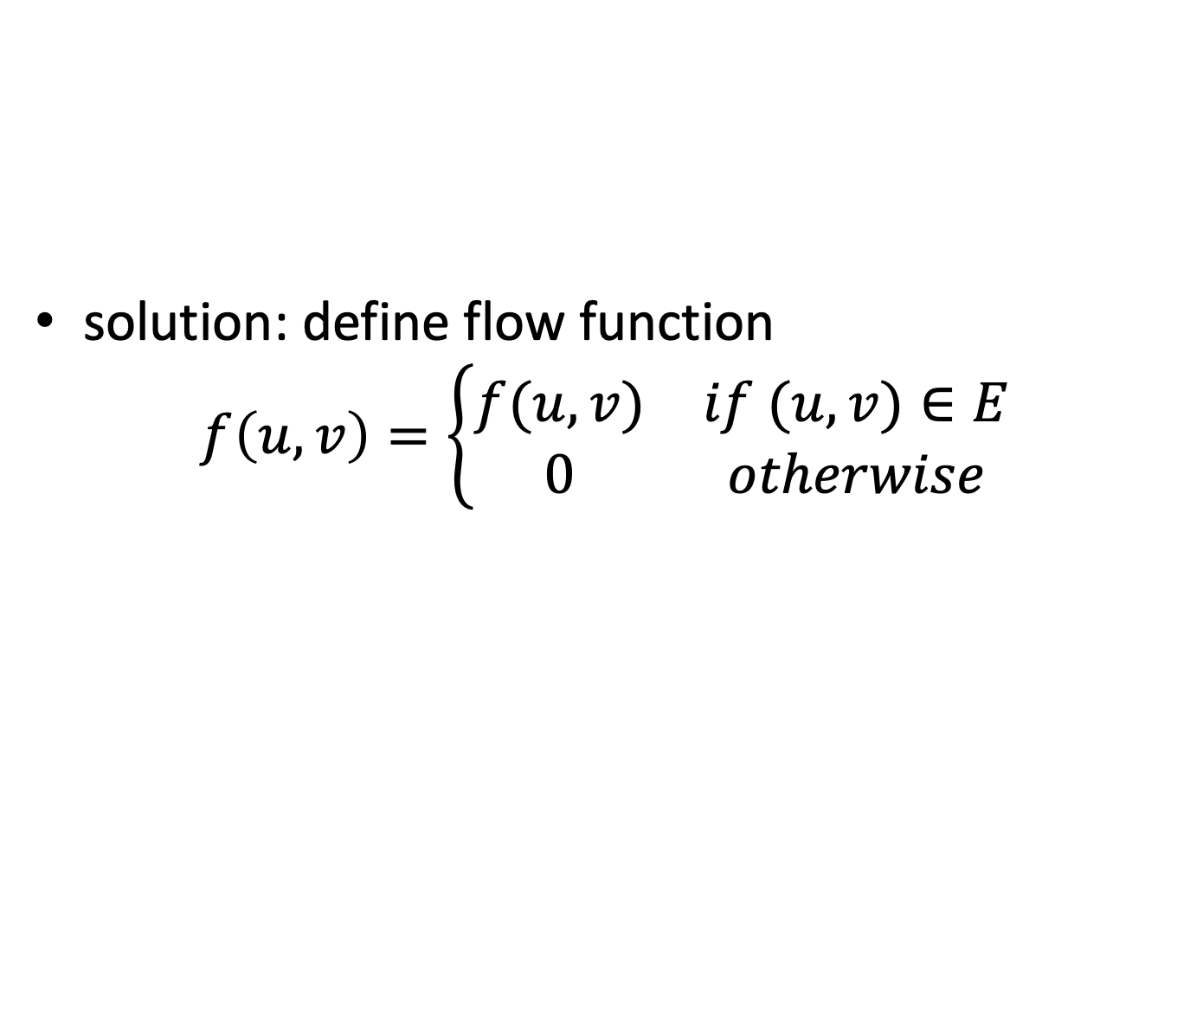
Cont.

