Slide 1
CPSC 535: Advanced Algorithms
Instructor: Dr. Doina Bein

Slide 2
Randomized Algorithms
Advantages over deterministic algorithms:
Execution time or space requirement of a randomized algorithm is smaller than that of the best deterministic algorithm that we know of for the same problem
It performs well with high probability on most of the input instances (but not an all)
Most randomized algorithms are extremely simple to understand and to implement
Are categorized according to which aspect is uncertain; the categories are named after cities that are famous as gambling destinations: Las Vegas and Monte Carlo

Slide 3
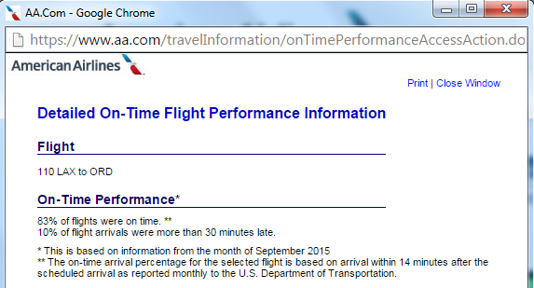
A Las Vegas algorithm has uncertain efficiency but produces output whose correctness is certain.
Example: frequency of on-time arrivals of commercial flights. The outcome is certain (travel from Los Angeles to Chicago) but the efficiency (time) is uncertain
We call this a Las Vegas process.
Figure taken from www.aa.com

Slide 4
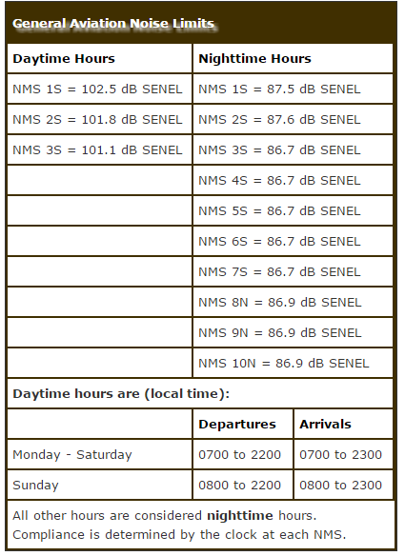
A Monte Carlo algorithm has certain efficiency but produces output whose correctness is uncertain.
Example: SNA airport landing curfew after 11 PM; if landing after 11 PM, then re-directed to LAX or other nearby airport
Model this situation mathematically: any flight scheduled to land around 11 PM lands at John Wayne with probability 0.95 (say), and lands at the nearby LAX airport with probability 0.05
Figure taken from http://www.ocair.com/generalaviation/noise/

Slide 5
In most practical applications, we take correctness over efficiency
Example: text editor problem
You need a text editor that saves the work (currently in RAM) to a file on a disk (external memory)
A Las Vegas algorithm: would always work properly, but once in a while might take more time than usual (unbounded running time)
A Monte Carlo algorithm: the saving time is bounded, but every once in a while, it might corrupt some or all of the text
What would be your preference?

Slide 6
Problem Complexity
Some problems cannot be solved in polynomial time: traveling salesman problem
Some problems cannot be solved at all: halting problem
Separate problems into three broad categories
Problems that can be solved in polynomial time; the technical term for this category is P (polynomial).
Problems that can be solved only by extremely slow algorithms; the term for this category is NP (nondeterministic polynomial), and the hardest of these problems are called NP-complete.
Problems that cannot be solved by algorithms; the term for this category is undecidable.
P and NP: decidable problems

Slide 7
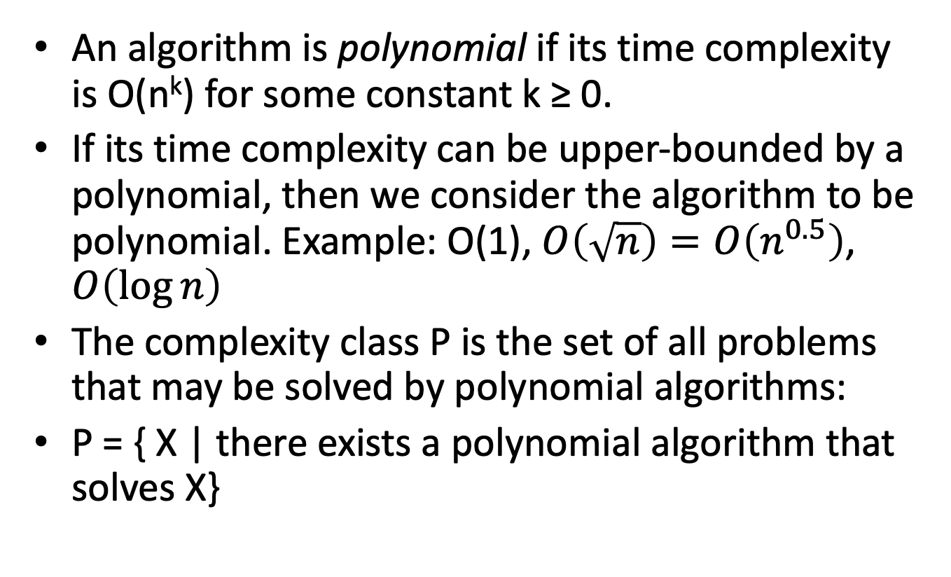
P Class Problems

Slide 8
Proving that a problem is in P
To prove that a problem is in P we must find a polynomial time algorithm that solves it.
The following problems are in P:
1. summation
2. sequential search
3. sorting
4. binary search
5. minimum spanning tree
6. single source shortest paths
7. median finding
8. set intersection and others
Circuit satisfaction and traveling salesperson do not have a polynomial time algorithm, so we cannot say that they are in P. But we cannot say that they are not in P either. Just because we tried to design a polynomial algorithm for these problems and failed to do so, does not mean that no such algorithm exists.

Slide 9
NP Class Problems
If an algorithm’s time complexity is exponential e.g. O(2^{n}), or factorial e.g. O(n!), the algorithm is not polynomial.
NP is the set of problems for which verifier algorithms have polynomial time and space complexity.
A verifier algorithm is an algorithm that verifies whether a given input is a correct output to a problem.
For example: the subset sum problem¹
Assume that we are given some integers, such as {−7, −3, −2, 5, 8}, and we wish to know whether some of these integers sum up to zero.
¹ https://en.wikipedia.org/wiki/NP_(complexity)

Slide 10
A problem E is said to be in NP if there exists a verifier algorithm verify_E for the problem such that:
verify_E takes as input a pair(instance, certificate)
instance is some instance of the problem E
certificate is some piece of data (called certificate)
verify_E checks whether certificate is a correct output for instance of problem E in polynomial time
The output of verify_E is “yes” or “no”
The output of verify_E is “yes” if certificate is a correct output for instance of problem E
The output of verify_E is “no” if certificate is an incorrect output for instance of problem E

Slide 11
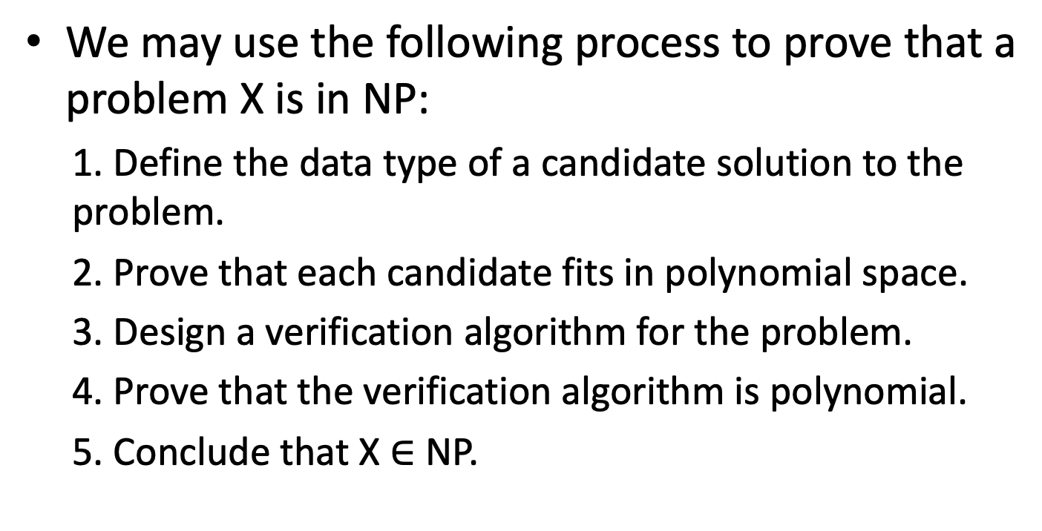
Proving that a problem is in NP

Slide 12
Decidable vs Undecidable Problems
Problem X is decidable if there exists an algorithm that solves X, or is undecidable if there does not exist an algorithm that solves X.
Every problem in P is decidable.
The circuit satisfaction and traveling salesperson problems are decidable.
Every problem in NP is decidable.

Slide 13
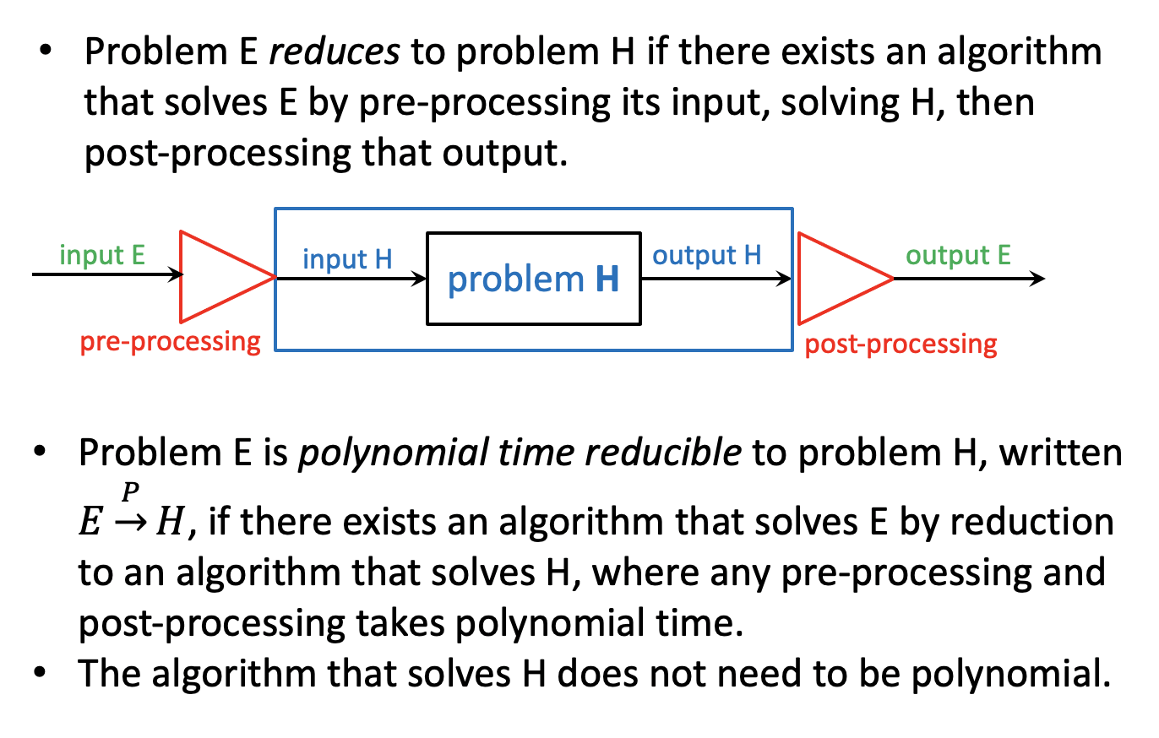
NP-Hard Problems

Slide 14
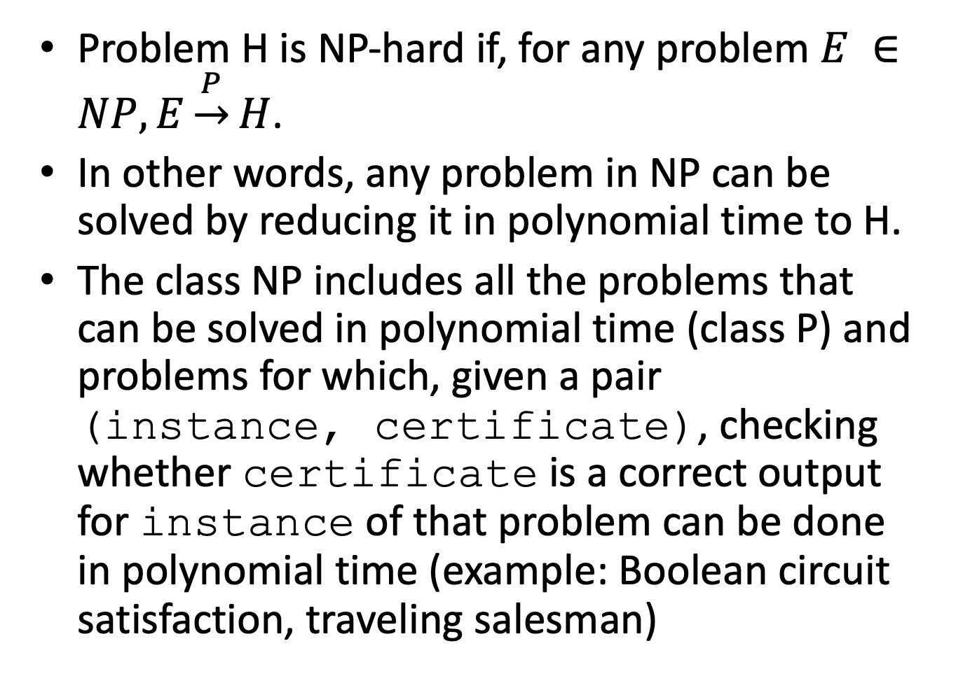

Slide 15
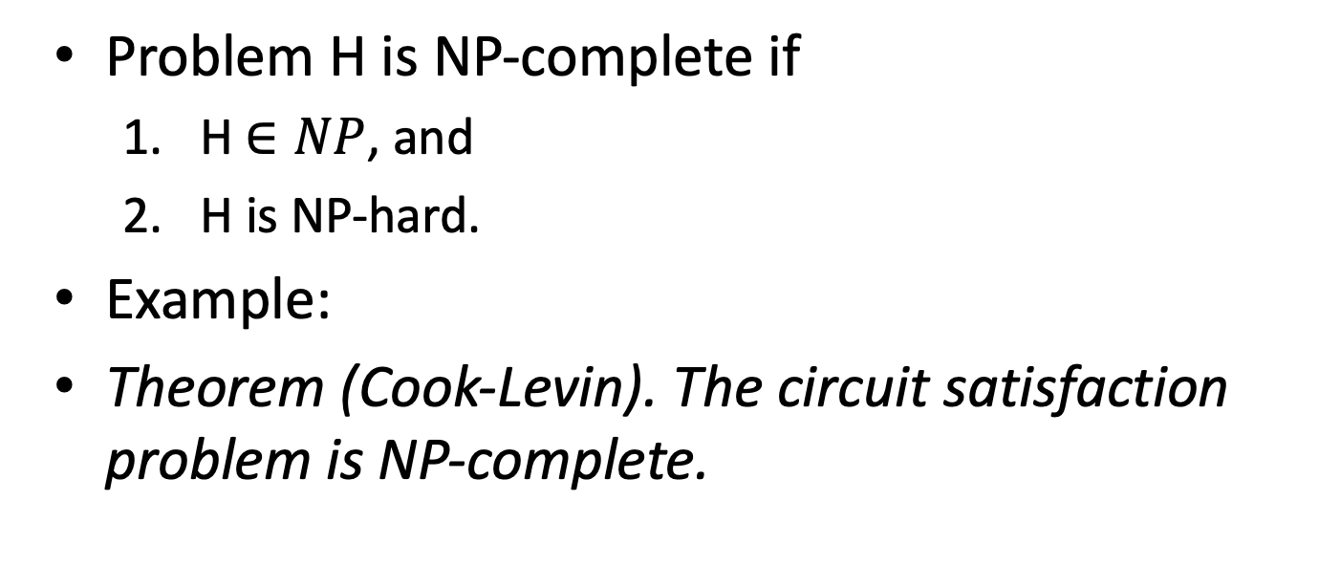
NP-complete

Slide 16
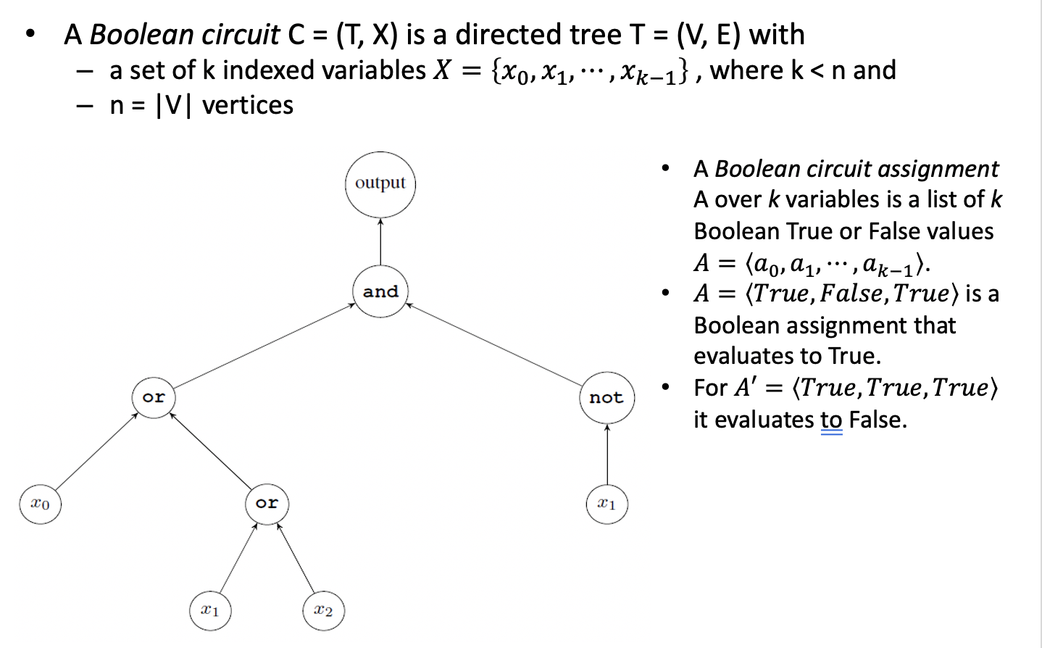
Boolean Circuit Evaluation

Slide 17
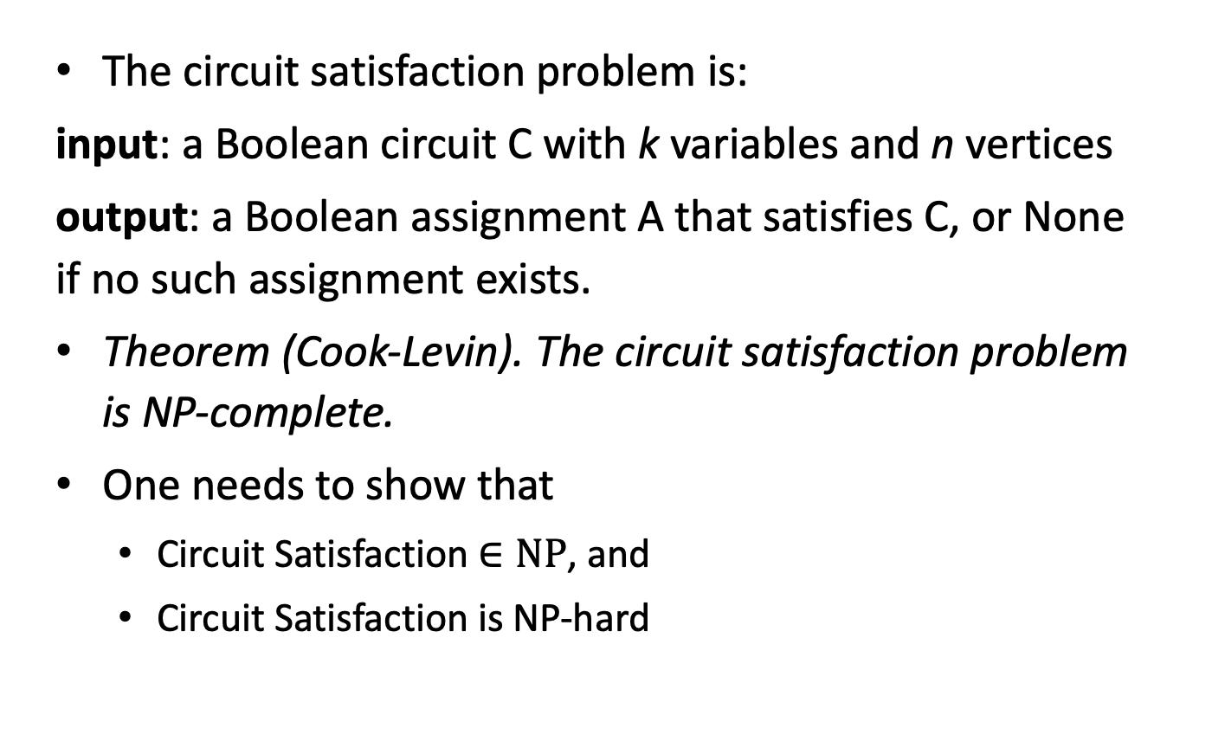
Circuit Satisfaction

Slide 18
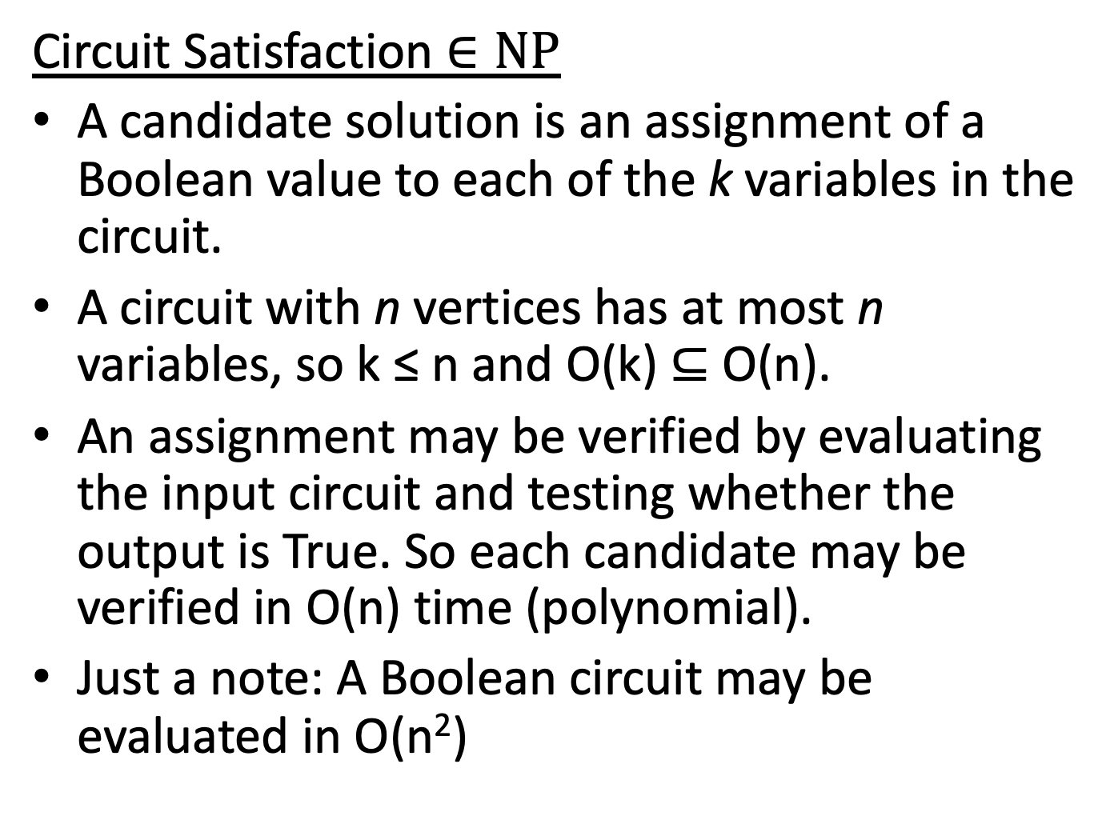

Slide 19
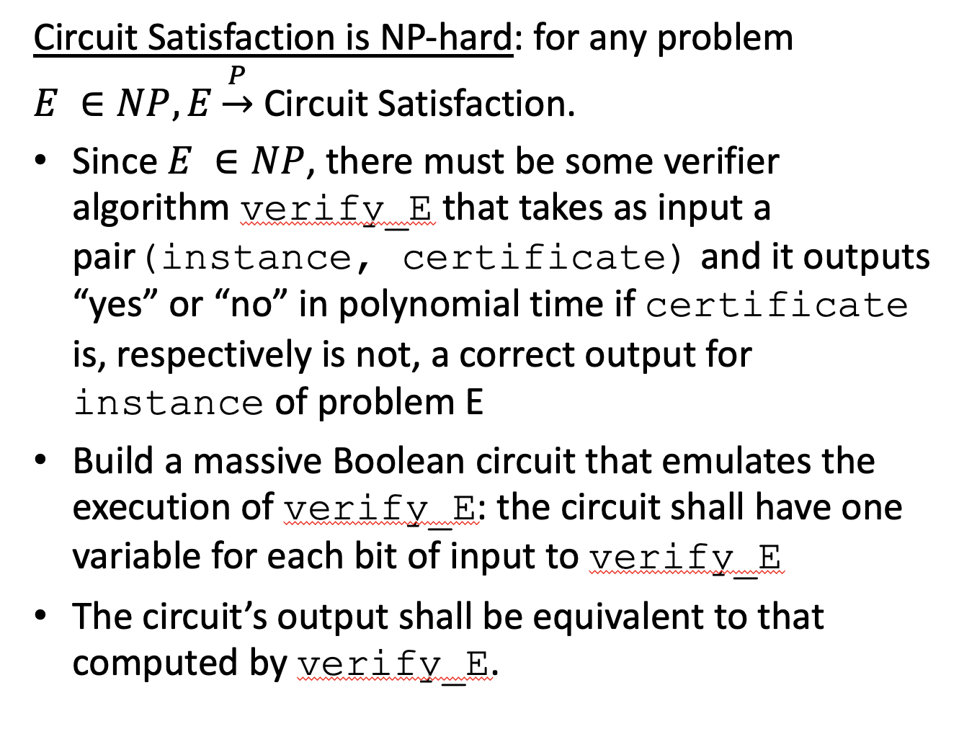

Slide 20
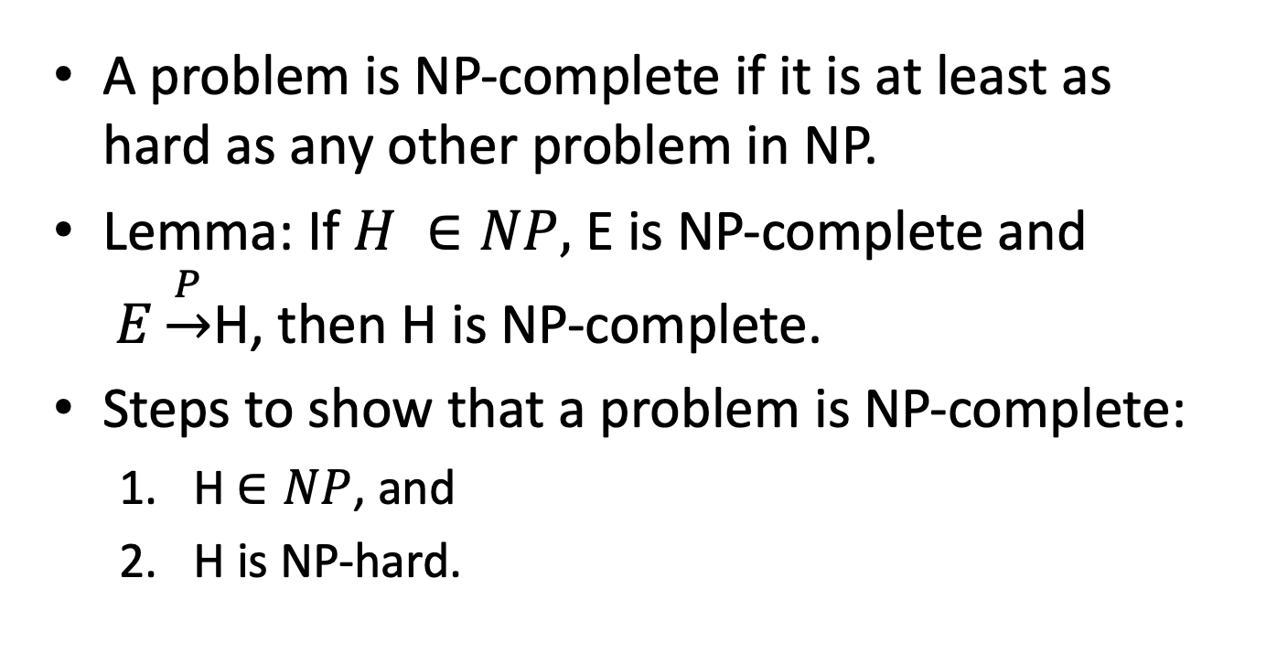
Proving NP-completeness

Slide 21
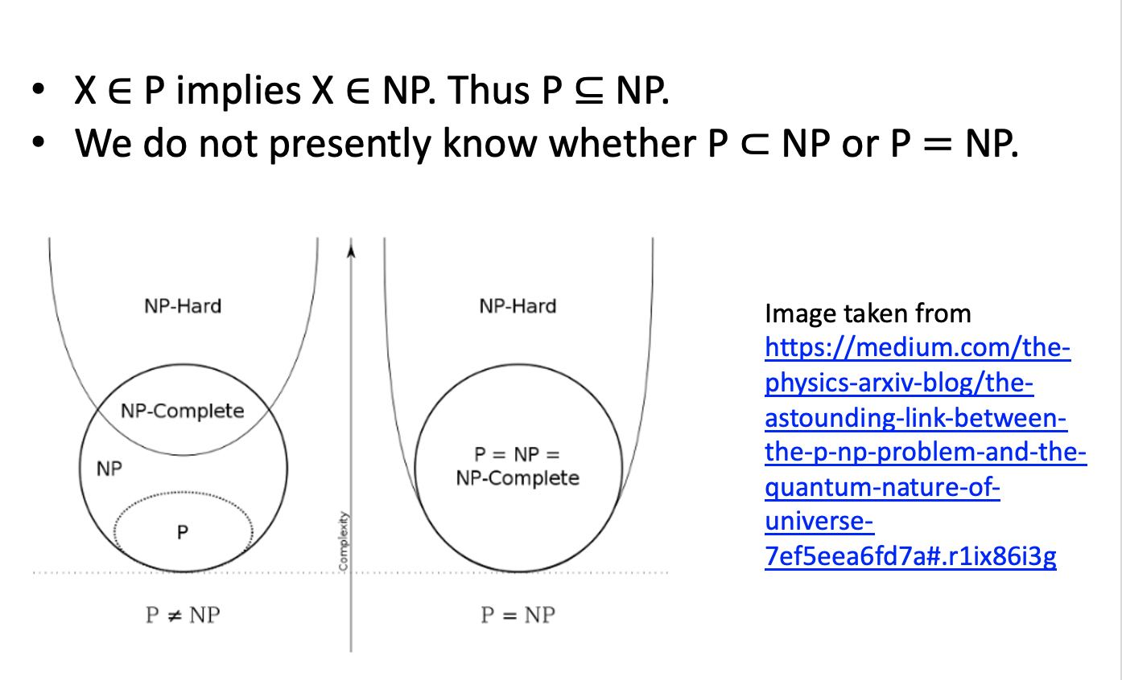
Is P=NP?

Slide 22
Approximation (some slides taken from https://github.com/kevinwortman/advanced-algorithms-slides/blob/master/13-approximation.pdf )

Slide 23
Approximation
output is proven nearly-optimal but not necessarily truly optimal.
suitable for use cases where approximate solutions are adequate
need to rewrite problem definition
every optimization problem has corresponding approximation problems; but these are distinct problems
Example: optimal vs. approximate problems

Slide 24
Example 1: graph coloring
Optimization problem: graph coloring input: connected graph G = (V , E ) output: coloring c using k colors, where each vertex v∈V is assigned color c (v ) ∈ {1, . . . k }, no pair of adjacent vertices are assigned the same color, and the number of colors k is minimal.
Approximation problem: 3-approximate graph coloring input: connected graph G = (V , E ) output: coloring c using k colors, where each vertex v ∈ V is assigned color c (v ) ∈ {1, . . . k }, no pair of adjacent vertices are assigned the same color, and the number of colors k* satisfied k ≤ 3k*, where k* is the fewest colors possible for G

Slide 25
Optimal number of colors = 3
Approximate number of colors = 5 ≤ 3*3=9

Slide 26
Strategies to solve NP-hard problems
when n is small enough, just use the exponential-time algorithm
Using heuristics: no proof of solution quality, but nonetheless sometimes good enough:
machine learning algorithms (also, in M.L. humans don’t need to precisely define what counts as “correct”)
fast heuristic algorithms
Monte Carlo algorithms
Approximation
pros: provable solution quality, often fast
con: human needs to design and analyze algorithm for each specific problem

Slide 27
Approximation ratio
Approximation ratio ρ(n): ratio between quality of algorithm’s output and optimal output; smaller is better
for a maximization problem: if optimal quality is C* and alg. produces quality C, by definition C* ≥ C , and define ρ(n) =C*/C
for a minimization problem: if optimal quality is C* and alg. produces quality C , by definition C* ≤ C and define ρ(n) =C/C*. For example, for the graph coloring problem the approximation ratio is 3.

Slide 28
Fixed Approximation Ratios
In general, better (smaller) ratios require slower algorithms.
Note: 1-approximation algorithms produce optimal solutions.
Deriving a different quality-vs.-time trade-off requires designing an entirely different approximation algorithm.

Slide 29
Approximation Schemes
Approximation scheme: family of related algorithms, such that, for any parameter ε > 0, scheme defines a (1 + ε)-approximate algorithm
think of ε as being a const variable
time-performance trade-off is fully tunable at compile time
Polynomial Time Approximation Scheme (PTAS): an approx. scheme where runtime is polynomial in n; nothing said of relationship to ε. Example: O(2^{1/ε} n log n)
Fully Polynomial Time Approximation Scheme : runtime is polynomial in n and 1/ε, e.g. O((1/ε)²n³)

Slide 30
Vertex Cover Problem
vertex cover problem (https://en.wikipedia.org/wiki/Vertex_cover) input: undirected graph G = (V , E ) output: set of vertices C ⊆ V , of minimal size ∣C∣, such that every edge in E is incident on at least one vertex in C
2-approximate vertex cover problem input: undirected graph G = (V , E ) output: set of vertices C ⊆ V , such that every edge in E is incident on at least one vertex in C, and ∣C∣ ≤ 2∣C*∣ where C* is a minimal vertex cover for G

Slide 31
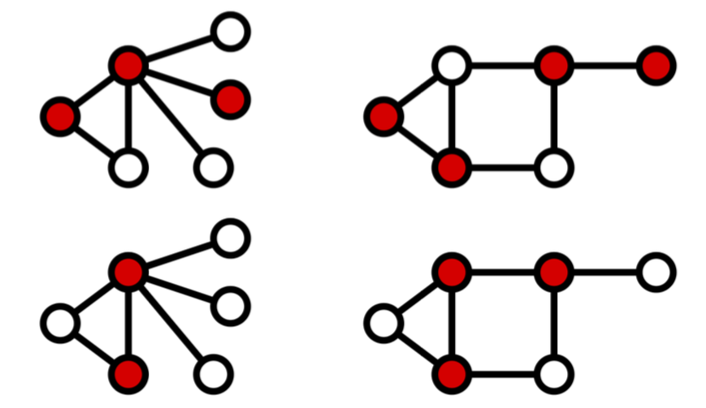
Vertex Cover Example
Images credit: Wikipedia user Miym, CC BY-SA 3.0, https://commons.wikimedia.org/wiki/File:Vertex- cover.svg, https://commons.wikimedia.org/wiki/File:Minimum- vertex- cover.svg

Slide 32
Solving Vertex Cover problem
vertex cover is NP-complete
baseline algorithm:
exhaustive search
for each subset C of vertices, check whether every edge has an endpoint in C
return the smallest C that is a valid cover
Θ(2^{n}m) time, exponential, slow
goal of a 2-approximate vertex cover algorithm:
get a decent (though imperfect) cover much faster

Slide 33
Greedy-based 2-approximation algorithm
Every edge e=(u,v) needs both u∈C and v∈C
so grab an edge e = (u,v) and include u and v in C
every other edge touching u or v is now covered, so eliminate them
continue until every edge is either grabbed or eliminated
good: definitely finds a correct cover C
bad: depending on the order of the “grabs”, heuristic can get tricked into picking sub-optimal vertices

Slide 34
2-Approximate Vertex Cover Pseudocode
1: function APPROX-VERTEX-COVER(G=(V,E))
2: C=∅
3: T=E // T =set of edges that may be selected
4: while T≠ ∅ do
5: Let e = (u,v) be an arbitrary edge in T 6: C =C ∪{u,v} 7: Remove from T any edge f that is incident on u or v
8: end while
9: return C
10: end function
Efficiency Analysis: O(m + n) time (assuming efficient data structures for G, T, and C)

Slide 35
Vertex Cover Performance Ratio
Lemma: APPROX-VERTEX-COVER is a 2-approximation algorithm. (Need to show that for any G,∣C∣ ≤ 2∣C*∣.)
Proof sketch:
Let A be the set of edges chosen inside the while loop
Compare ∣C∣,∣C*∣ with ∣A∣:
Part (1): we show that ∣C*∣ ≥ ∣A∣ :
C* is a vertex cover, so for every edge (u,v) ∈ A, we must have u∈C* and/or v∈C*
The step “Remove from T” guarantees that, after (u,v) is chosen, no other edge incident on u or v will be chosen and added to A
⇒ each x∈C* covers exactly one edge in A ⇒∣C*∣ ≥ ∣A∣

Slide 36
Contd.
Part (2): we compare ∣C∣ and ∣A∣
The step C =C ∪{u,v} step inserts 2 vertices into C
Due to the same “Remove from T” logic, neither u nor v was already in C
⇒ ∣C ∣ = 2∣A∣ (note exact equality)
By combining the results in parts (1) and (2), QED

Slide 37
Comments
Note that us analysts do not know concretely which vertices are in C*
the algorithm certainly doesn’t know what C* is, either
all we do know is that, due to the definition of vertex cover, and the logic of our algorithm, # vertices in optimal cover ≥ # iterations while loop
and, due to algorithm logic, # iterations while loop = # vertices chosen for approx. cover
in general, to prove an approx. ratio, we need to
to bound quality of arbitrary, opaque optimal solution; and
bound quality of approx. solution the same way

Slide 38
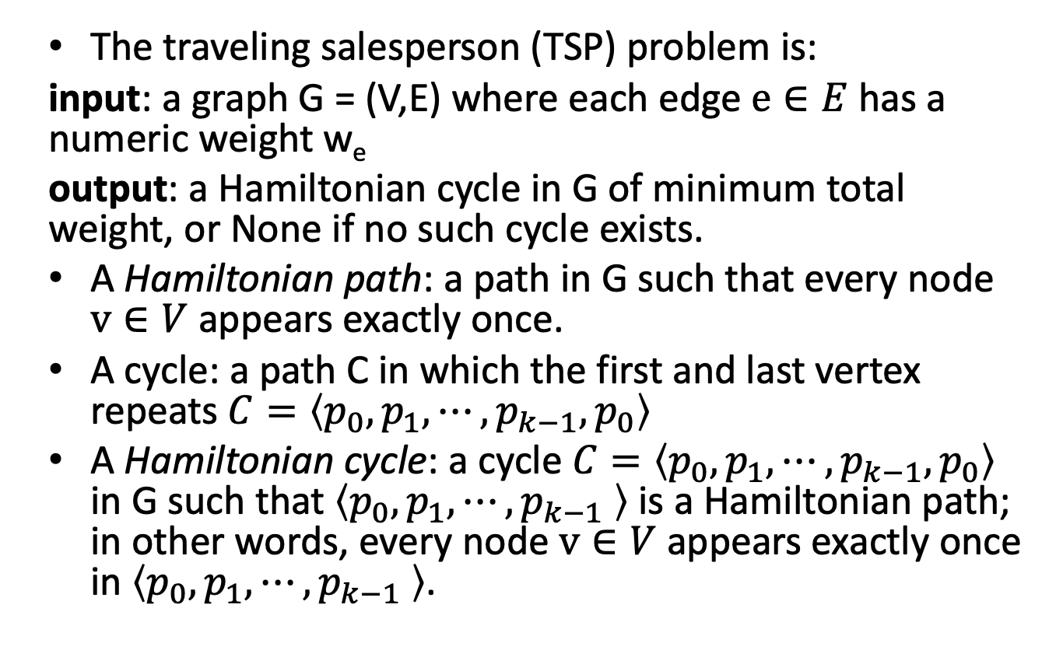
The Traveling Salesperson Problem (TSP)

Slide 39
Use exhaustive optimization:
Generating every Hamiltonian path in G and append the first vertex to the path to make it a cycle
A Hamiltonian path is a permutations of G’s vertices V.
So, generate all permutations of V
For each permutation, let the extended sequence be the permutation with the first element appended (at the end)
Check whether the extended sequence is a cycle: it is a path (i.e. there is an edge between any two adjacent vertices)
If it forms a path, we have a Hamiltonian cycle; a candidate solution
A cycle is optimal if its total weight is minimal.
A complete graph of n nodes will have n! Hamiltonian cycles.

Slide 40
TSP
Bad news:
TSP is NP-complete: if P ≠ NP, no polynomial-time optimization algorithm exists for TSP
TSP is also APX-complete, i.e if P ≠ NP, no PTAS: there is no constant factor approximation algorithm for TSP
Lemma: There is no α-approximation algorithm for Traveling Salesman Problem where α is a constant.
Approximation algorithms: The key to designing approximation algorithm is to obtain a bound on the optimal value OPT.
In the case of TSP, the minimum spanning tree gives a lower bound on OPT

Slide 41
Metric TSP
In the metric TSP, edge costs have to satisfy the triangle inequality, i.e. for any three vertices x, y, z, c_{xz} ≤ c_{xy} + c_{yz}
Metric TSP is still NP-complete but not APX-complete
There is a 2-approximation algorithm
Lemma: The cost of a Minimum Spanning Tree (MST) is no greater than the cost of an optimal tour.
Minimum spanning tree features:
minimizes weight of chosen edges
connects all vertices
can be computed fast

Slide 42
MST and TSP
but an MST is not a Hamiltonian cycle; MST is acyclic, for one thing
A (multi-) graph is Eulerian if it has a closed walk that uses every edge exactly once.
A connected graph is Eulerian if and only if every vertex has even degree.
Euler tour: cycle around a tree
build an MST; perform preorder traversal; treat that vertex order as Hamiltonian cycle
The algorithm is as follows:
Find a minimum spanning tree of G
Duplicate each edge in the MST to obtain a Eulerian graph
Find a Eulerian tour J of the Eulerian graph
Convert J to a tour T by going through the vertices in the same order of T , skipping vertices that were already visited

Slide 43
Approximate metric TSP Pseudocode
1: function APPROX-mTSP(G=(V,E),w)
2: T=PRIM−MST(G,w)
3: H = empty sequence of vertices
4: for vertex v in preorder traversal of tree T do
5: H .ADDBACK (v )
6: end for
7: H .ADDBACK (H [0])
8: return H
9: end function
Analysis: Prim’s algorithm takes O(m + n log n) (w/ Fibonacci heap), traversal takes O (m + n), total O (m + n log n) time

Slide 44
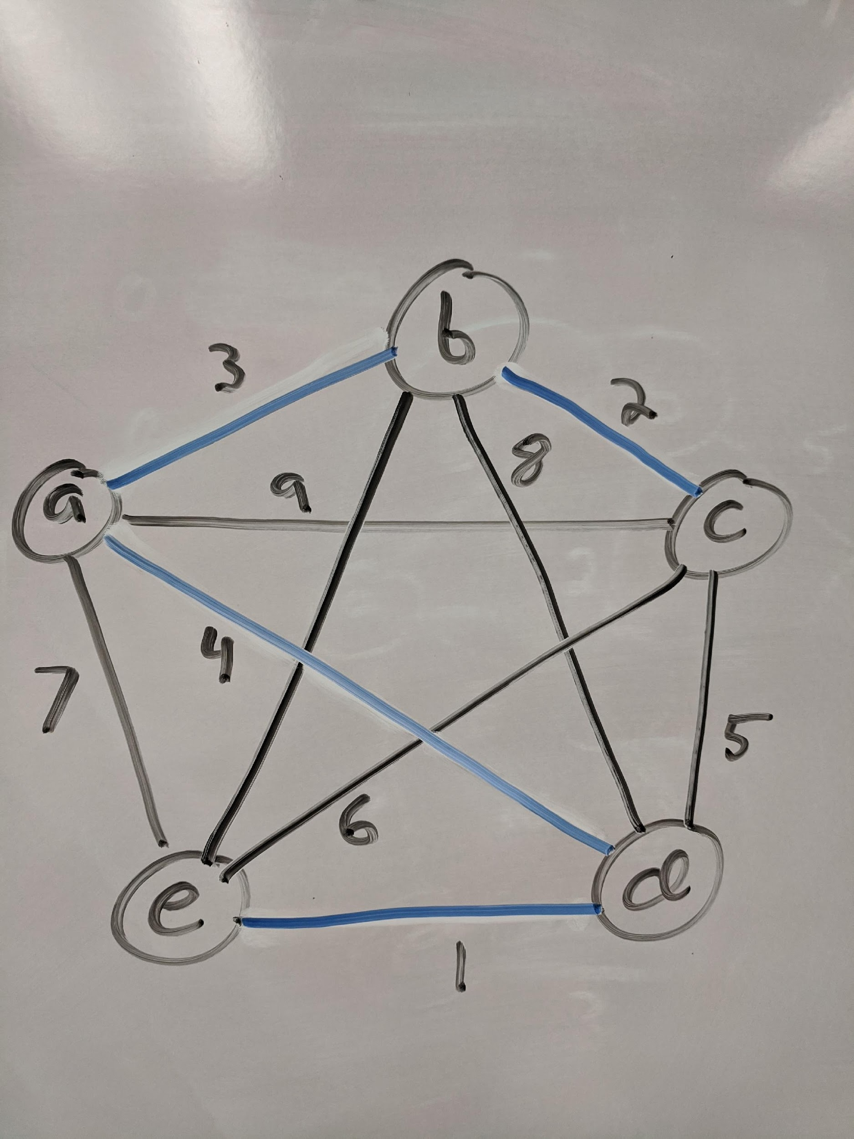
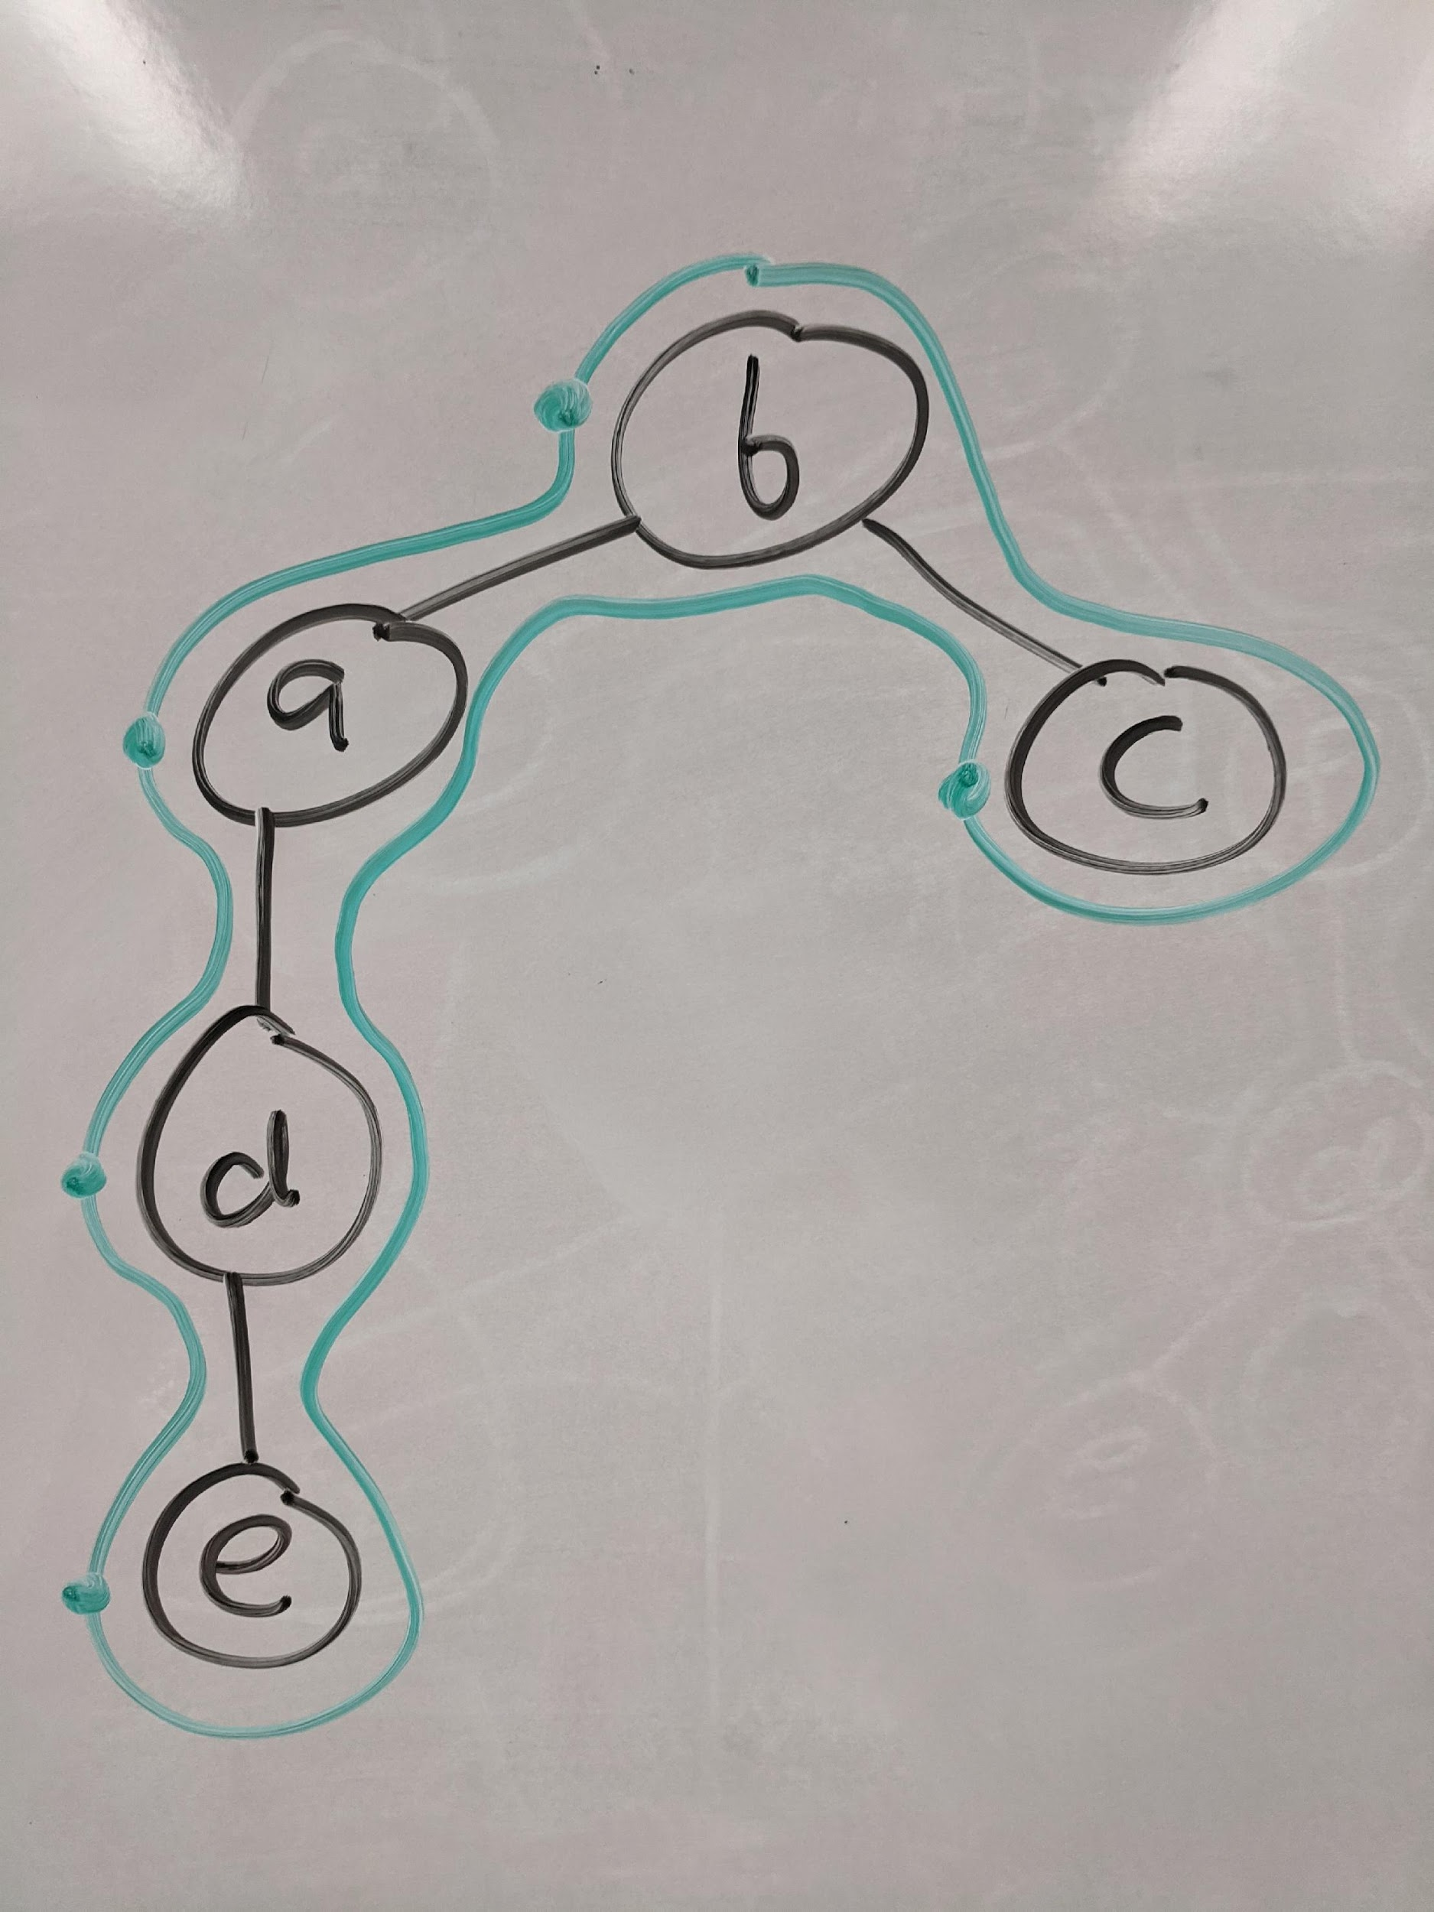
Example
Preorder Traversal of the duplicated MST

Slide 45
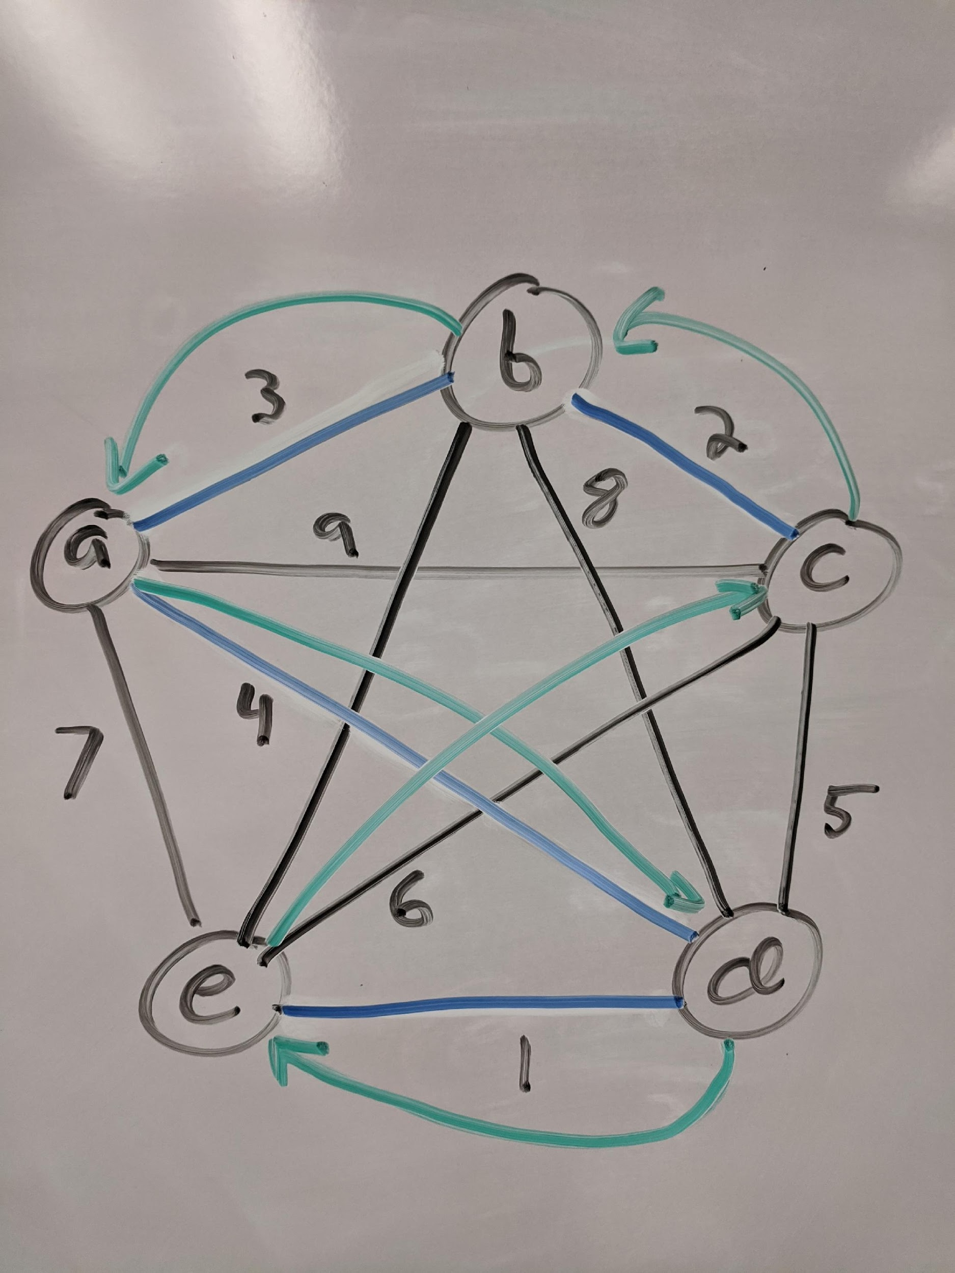
Contd.
Preorder Traversal of the duplicated MST

Slide 46
mTSP Performance
Lemma: APPROX-TSPTI is a 2-approximation algorithm.
Proof Sketch:
let H* be an optimal Hamiltonian cycle for G
(1) every spanning tree is one edge short of a cycle; and weights are nonnegative; so the weight of our tree T obeys w(T) ≤ w(H*)
(2) a full tour W is the sequence of vertices in both a preorder and postorder tour, and has weight w (W) = 2w(T)
(3) combining (1) and (2), we obtain w(W) ≤ 2w(H*)
(4) our H is like W with some vertices removed, so w(H) ≤ w(W)
▸ combining (3) and (4), we obtain
w(H) ≤ w(W) ≤ 2w(H*)

Slide 47
Christofides’ Algorithm
a 3/2-approximation algorithm for metric TSP, very similar to the previous 2-approximation algorithm.
The improvement comes from finding a better way to construct the Eulerian graph.
Since a graph is Eulerian iff every vertices has even degree, we only need to be concerned about the vertices that have odd degree in the MST.
If we add to the MST a minimum-cost perfect matching on V’, every vertex will have an even degree, and we get a Eulerian graph.
Christofides’ algorithm is as follows:
Find a minimum spanning tree of G
Compute a minimum cost perfect matching M on the set of odd-degree vertices of MST. Add M to MST to obtain a Eulerian graph
Find a Eulerian tour J of the Eulerian graph
Convert J to a tour T by going through the vertices in the same order of T , skipping vertices that were already visited.

Slide 48
Summary
Vertex cover:
NP-complete
exact exhaustive search alg. takes Θ(2^{n}m) time
a 2-approximate alg. takes Θ(n + m) time
Metric TSP:
NP-complete
exact exhaustive search alg. takes Θ(n!)
a 2-approximate algorithm takes O (m + n log n) time

