Slide 1
CPSC 535: Advanced Algorithms
Instructor: Dr. Doina Bein

Slide 2
Terminology
A (computational) problem describes what we want to compute.
It is defined by a type of input and a type of output, where any input and output may be represented by a finite digital data structure.
The definition of the problem may introduce mathematical variables whose scope is limited to that problem definition.
Notation:
The <problem name> problem is:
input: <definition of input objects>
Output: <definition of output objects>
Example:
The minimum problem is:
input: a list L of n > 0 comparable objects
output: the least element in L

Slide 3
A problem instance (or an instance) = a specific, concrete input to a problem.
Ex: lists [7, 2, 1, 9] is an instance of the minimum problem, as is [1, 2]; empty list [] is not a valid instance of that problem since the problem’s input statement requires that n > 0.
A process is a series of actions directed to some end.
Algorithm = an ordered sequence of finite number of steps – each of which can be executed in finite time
Example of algorithms:
Algorithm for adding two integers
Algorithm for finding the shortest path in a network
Algorithm to search for an article on the web

Slide 4
Remarks
There can be more than one algorithm to solve a given problem.
Sorting problem can be solved by using any of the following algorithms
Insertion sort
Heap sort
Quick sort
Etc.

Slide 5
Pseudocode
Pseudocode = a human-readable format for communicating algorithms that may include code-like syntax, math notation, and prose.
Pseudocode is similar to program source code in a language such as C or Java
The pseudocode for minimum problem is:
Let min = first element of L (there is one since n > 0) For each element in L do if (min > element) then let min = element Return min

Slide 6
Implementations
An implementation of an algorithm is executable computer code that follows the process defined by the algorithm.
A computer program describes one particular way of computing a solution to a problem.
A computer program does not truly solve a problem unless it terminates on all inputs, and produces a correct answer.
Ex: implementation in C++
float min; int i; min = L[0]; for (i=1; i < n; i++) if (min > L[i]) min = L[i]; return min;

Slide 7
How to measure the quality of an algorithm
Quality of an algorithm is measured in terms of the resources it consumes when it is executed on a computer
Example of such resources: memory, communication bandwidth, processor time
Of interest in this class are the execution (processor) time and the memory need
Shorter the execution time, better the quality of the algorithm – time complexity
Smaller the amount of memory needed for execution, better the quality of the algorithm – space complexity

Slide 8
The complexity of an algorithm A, with respect to a specific instance I and resource R, is a non-negative real number representing the amount R that is consumed by A when run on I.
It would be nice to quantify the ease-of-understanding of an algorithm. But this issue is not discussed in algorithm textbooks.
It is not useful to measure the execution time of an algorithm in absolute terms (like 10 sec, 30 μ sec, 1 hr, etc.) since the execution time depends on the processor’s speed

Slide 9
We measure the algorithm on a universal model of computation called RAM
The model of computation and implementation is the RAM (random access machine) model:
one memory (infinite),
one processor and
instructions are executed sequentially. The instructions are simple: assignment, addition, multiplication, comparison, etc.
For parallel computation, the model is called PRAM (parallel random-access machine) model

Slide 10
Step count (or Running Time) = the number of primitive operations or “steps”. For our RAM model, we assume that executing each instruction (or statement) takes a constant amount of time. The constant values may differ, but they are the same for two similar instructions: e.g. adding two numbers takes the same time if the numbers are integer/floating point, but addition may take less time than subtraction
Step count (or running time) of an algorithm is the sum of steps (or running times) for each statement executed

Slide 11
Example
Let us consider the following algorithms:
Which will require more space?
Which will require more processor time?
s = 0 for i =1 to n do s = s+ i*i | s = 0 for i =1 to n do for j =1 to n do s = s+ i*j

Slide 12
General Rules for Computing the S.C.
It takes one (1) unit time to do anything simple: addition, multiplication, assignment, comparison, read/write a value
Consecutive statements add up.
If/Else: for the fragment
If (condition)
S1
Else
S2
The s.c. is equal to the number of steps to evaluate the condition plus the maximum between the s.c. of S1 and S2
For loops: The s.c. of a for-loop is at most the s.c. of the statements inside the for-loop times the number of iterations.
Nested loops are analyzed inside out.

Slide 13
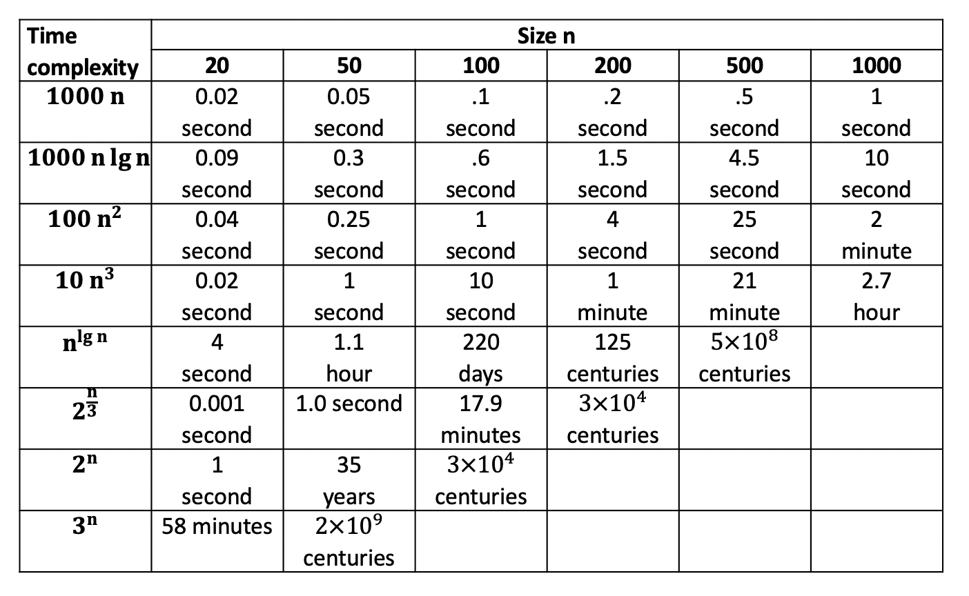
Running time estimates. One step takes one microsecond, lg n denotes log₂ n

Slide 14
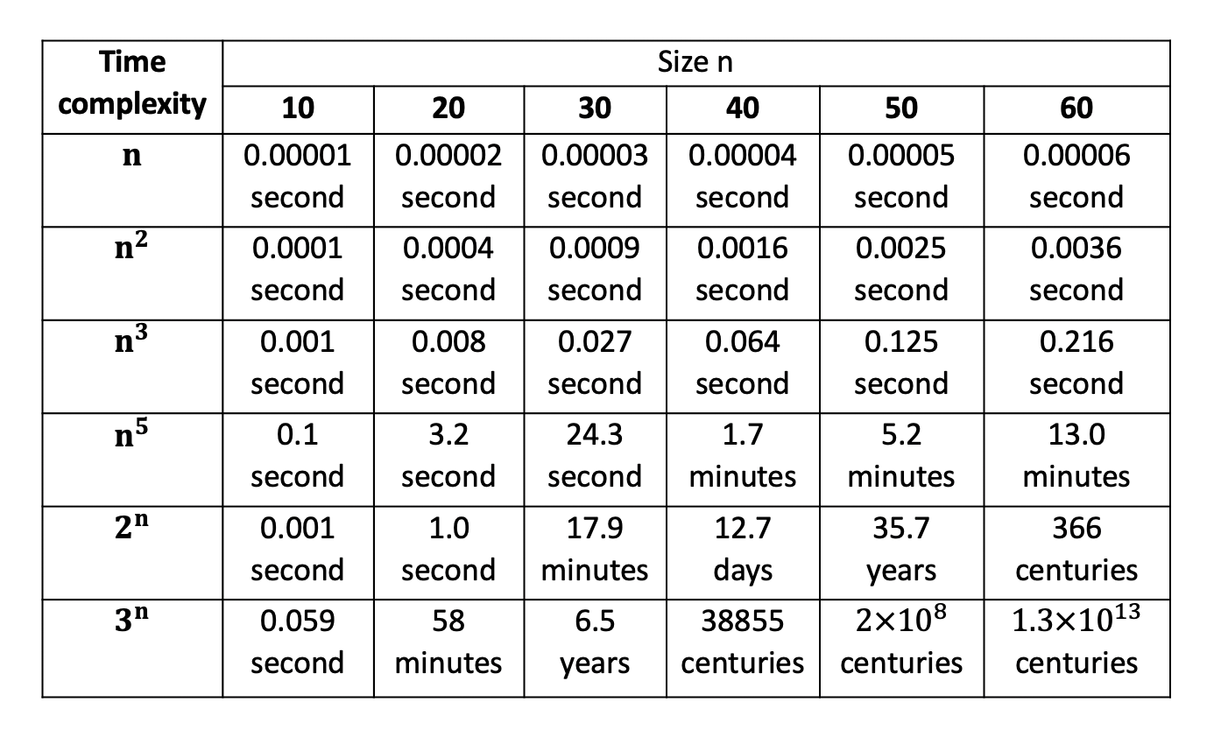
Increase in execution time as the time complexity and input size increases

Slide 15
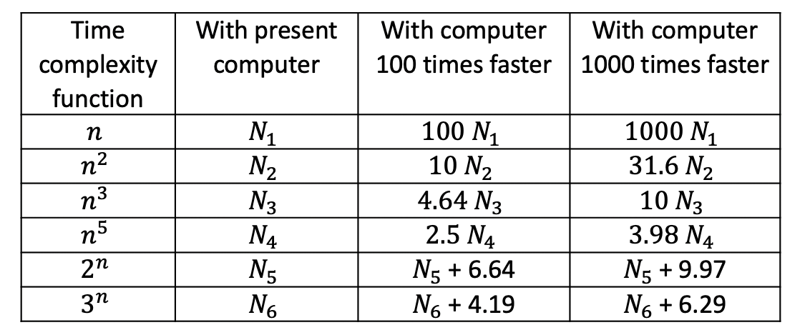
Relationship between space and time complexities on faster computers for bounded execution time
Size of Largest Problem Instance Solvable in 1 Hour

Slide 16
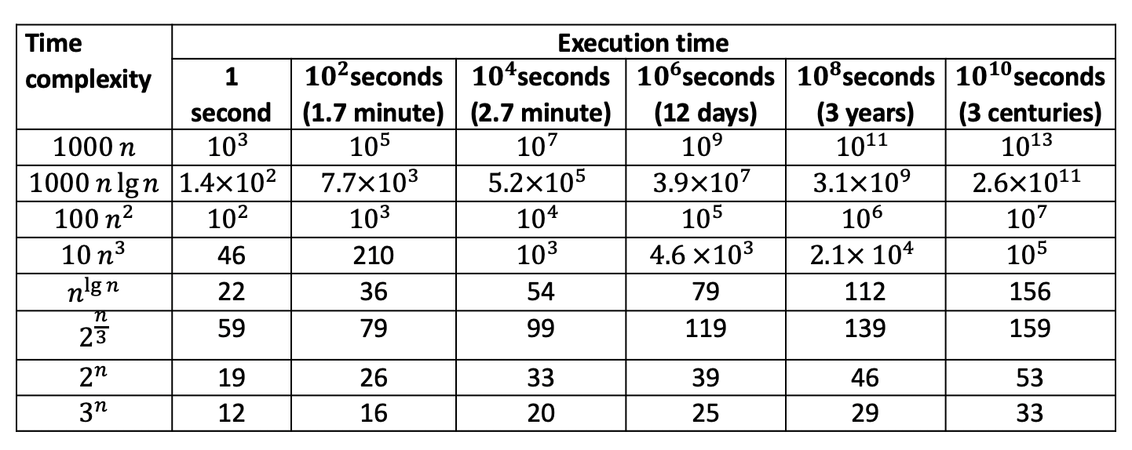
Maximum size of a solvable problem. A factor of 10 increase in machine speed corresponds to a factor of 20 increase in time.

Slide 17
Characterize the complexity of algorithms in general so that we can deduce how they might perform when run on unforeseen instances.
The worst-case complexity of algorithms = the worst (greatest) complexity of that algorithm, over all valid inputs to the algorithm.
worst case time complexity
worst case space complexity

Slide 18
Best case running time: minimum number of steps. For example, when sorting a sequence of numbers using insertion-sort and the sequence is already sorted
Worst-case running time: maximum number of steps. For example, when sorting a sequence of numbers using insertion-sort and the sequence is reversely sorted
Average case running time: the input is chosen at random, the average number of steps.
The worst-case running time of an algorithm is an upper bound on the running time for any input.
The average case running time is often as bad as the worst-case running time. E.g. insertion sort has a quadratic time for both, and a linear time for best case.
Expected running time is defined for randomized algorithms.

Slide 19
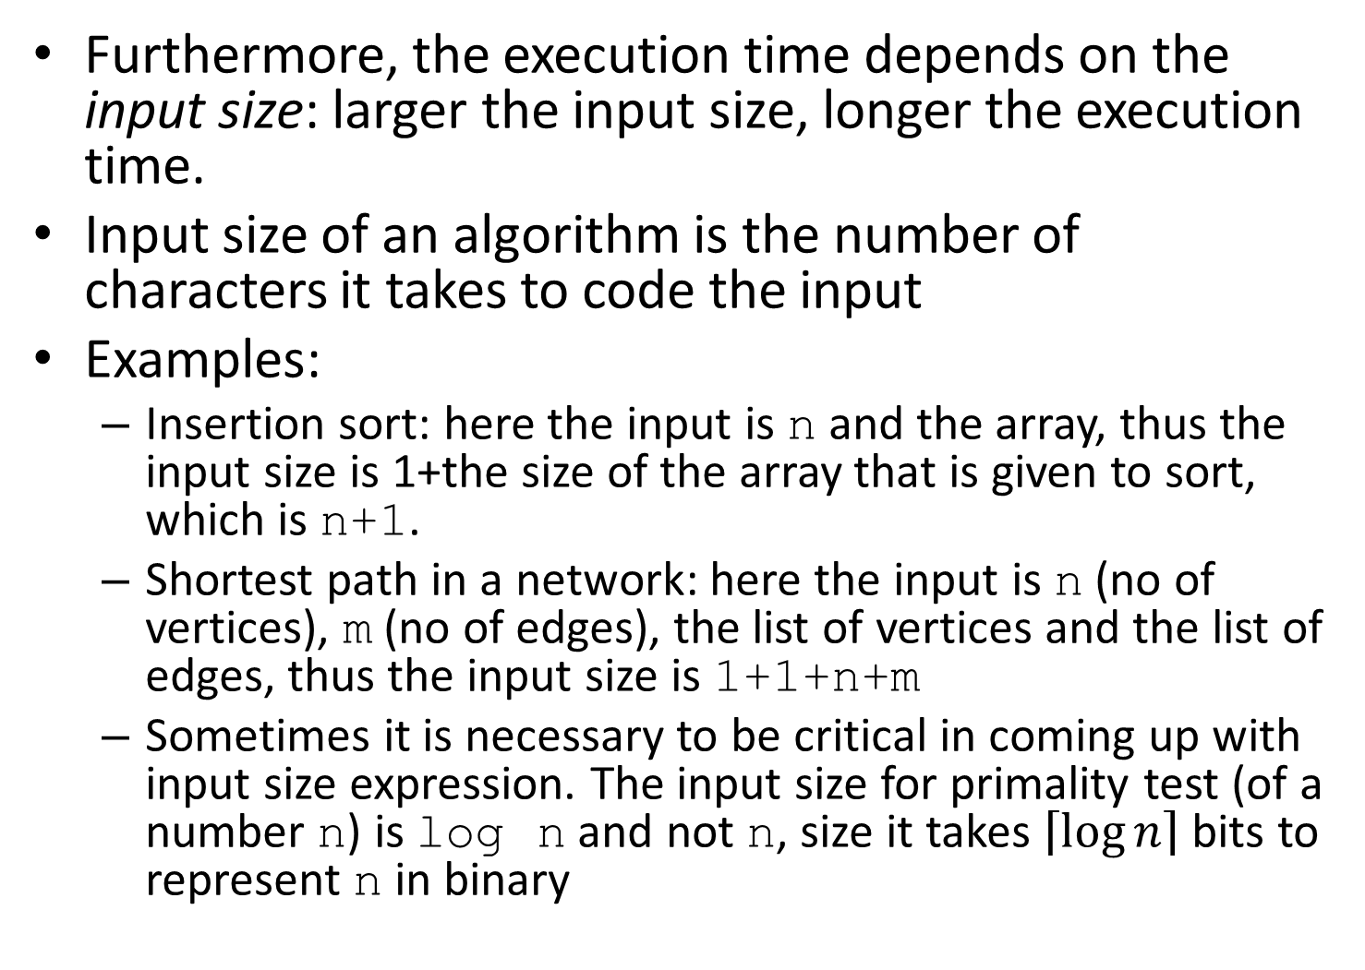

Slide 20
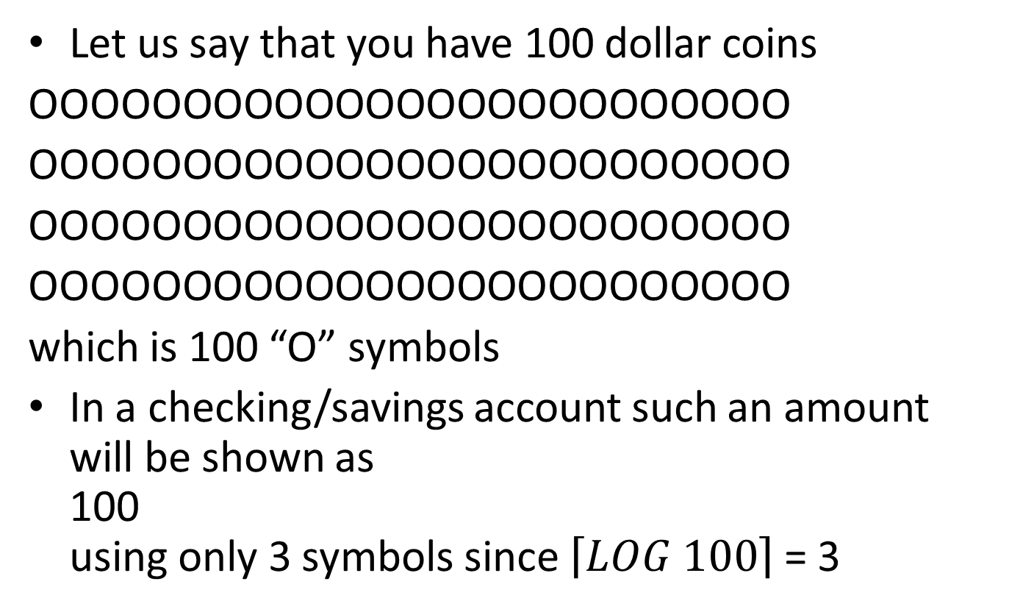
Being digital: From Pebbles to Logarithms

Slide 21
Your 100 dollar coins
OOOOOOOOOOOOOOOOOOOOOOOOO
OOOOOOOOOOOOOOOOOOOOOOOOO
OOOOOOOOOOOOOOOOOOOOOOOOO
OOOOOOOOOOOOOOOOOOOOOOOOO
which is 100 “O” symbols
In a checking/savings account such an amount will be stored digitally as
1100100
using only 7 symbols since [LOG_2 100] = 7

Slide 22
Order of Growth or Rate of Growth
The time complexity of an algorithm is measured in terms of its growth rate (i.e. order) as a function of input size
Sometimes computing the exact running time is not worth the effort
Ex.: Alg. for finding the smallest number in an array a[ ] of size n
Algorithm 1:
Input: Integer array a[ ] of size n ( input size of the above algorithm is n)
Output: Smallest entry in a[ ]
int small = a[0]
for i=1 to n-1
if (a[i] < small) then small = a[i]
output small
The execution time is proportional to n, the size of the input
Hence the execution time of Algorithm 1 is linear i.e. O(n)(“Big-Oh of n”)

Slide 23
We will define notation O (“Big-Oh”) soon
There are two simplifying assumptions that we make when analyzing the running time of an algorithm
1. Constants are ignored
2. Only the leading term is considered
A solution that takes constant time has r.t. of O(1).
An algorithm A is more efficient than another algorithm B if the w.c.r.t of A has a lower order of growth. Examples: n, log(n), n², n²log(n), n³, n^{n}

Slide 24
