Slide 1
CPSC 535: Advanced Algorithms
Instructor: Dr. Doina Bein

Slide 2

The complexity of some instances is less than or equal the worst-case complexity
Sometimes small instances do not follow the general trend
Example: the minimum selection problem
input: a list L of $n≥0$ numbers
output: the minimum value among all elements in L
Algorithm that solves the problem:
def naïve_min (n, L):
if L is empty, return 0 else
Let min = first element of L (there is one since n > 0)
For each element in L do
if (min > element) then let min = element
Return min

Slide 3
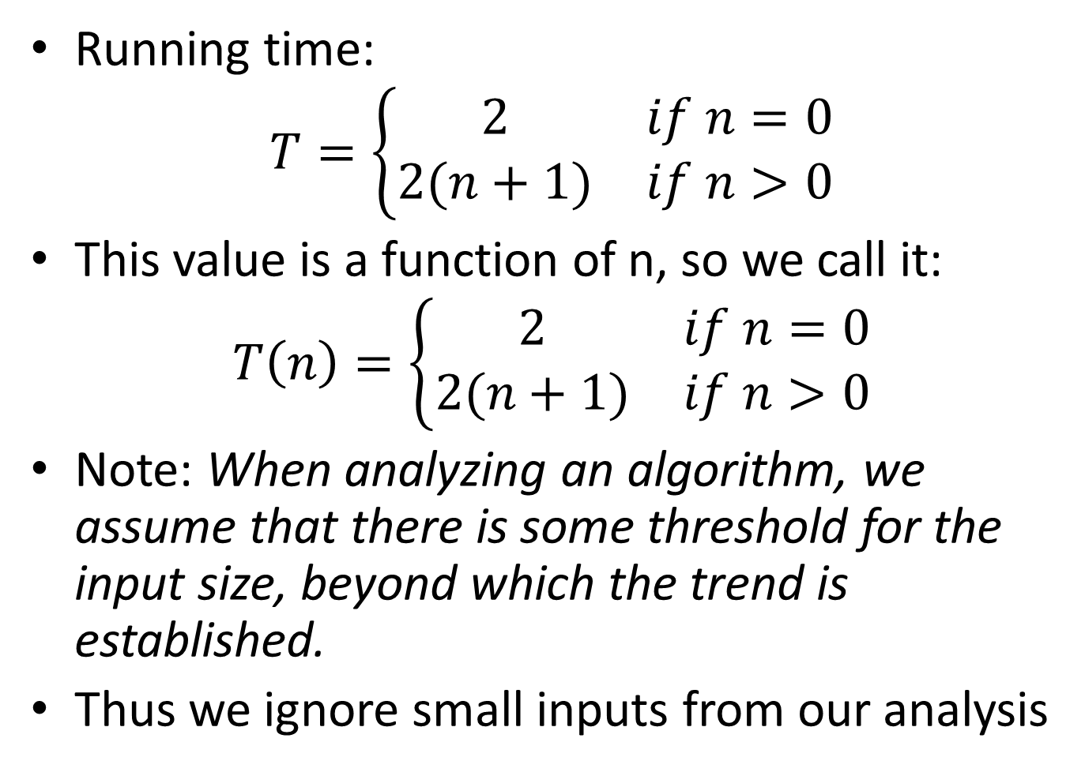
Running time:
$$T=\left\{\begin{matrix}2 & if n=0 \\ 2(n+1) & if n>0\end{matrix}\right.$$
This value is a function of n, so we call it:
$$T\left(n\right)=\left\{\begin{matrix}2 & if n=0 \\ 2(n+1) & if n>0\end{matrix}\right.$$
Note: When analyzing an algorithm, we assume that there is some threshold for the input size, beyond which the trend is established.
Thus we ignore small inputs from our analysis

Slide 4
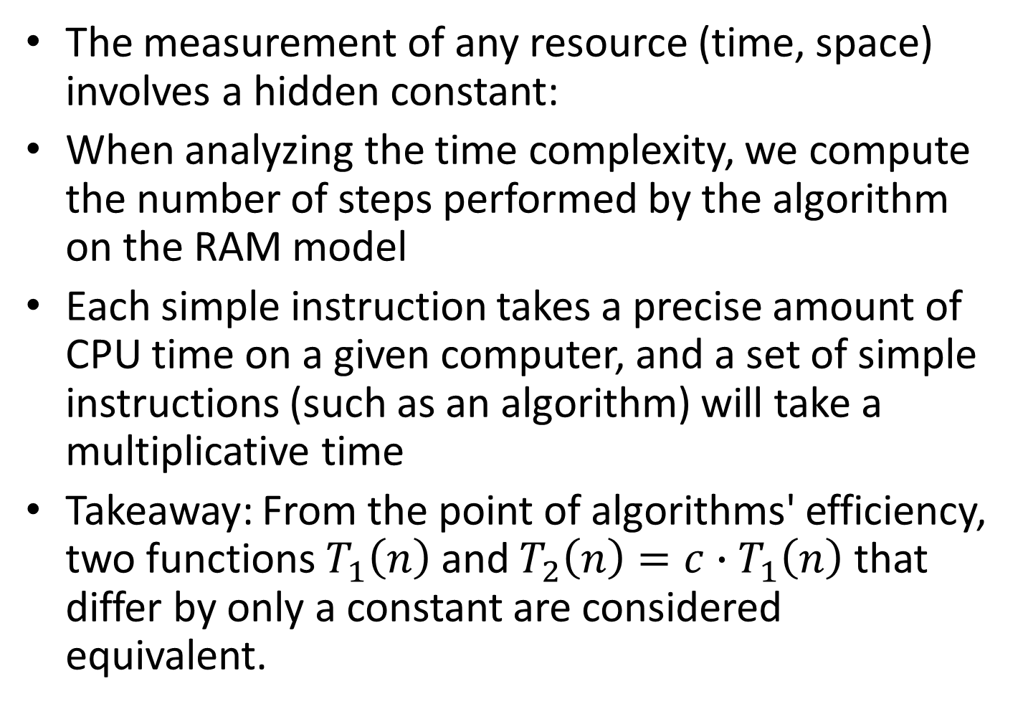
The measurement of any resource (time, space) involves a hidden constant:
When analyzing the time complexity, we compute the number of steps performed by the algorithm on the RAM model
Each simple instruction takes a precise amount of CPU time on a given computer, and a set of simple instructions (such as an algorithm) will take a multiplicative time
Takeaway: From the point of algorithms' efficiency, two functions $T_{1}\left(n\right)$ and $T_{2}\left(n\right)=c∙T_{1}\left(n\right)$ that differ by only a constant are considered equivalent.

Slide 5
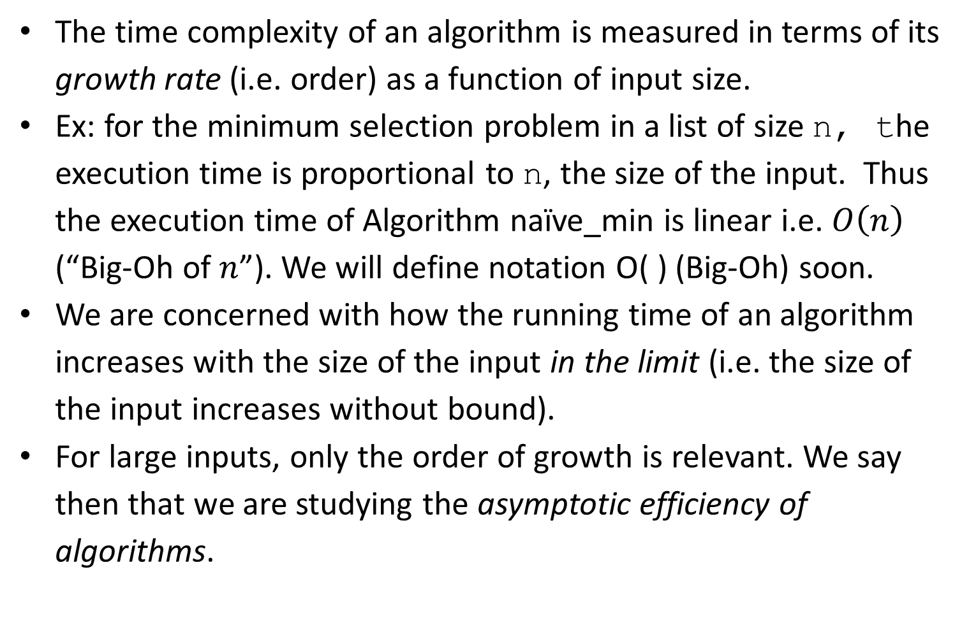
Order of Growth or Rate of Growth
The time complexity of an algorithm is measured in terms of its growth rate (i.e. order) as a function of input size.
Ex: for the minimum selection problem in a list of size n, the execution time is proportional to n, the size of the input. Thus the execution time of Algorithm naïve_min is linear i.e. $O\left(n\right)$ (“Big-Oh of $n$”). We will define notation O( ) (Big-Oh) soon.
We are concerned with how the running time of an algorithm increases with the size of the input in the limit (i.e. the size of the input increases without bound).
For large inputs, only the order of growth is relevant. We say then that we are studying the asymptotic efficiency of algorithms.

Slide 6
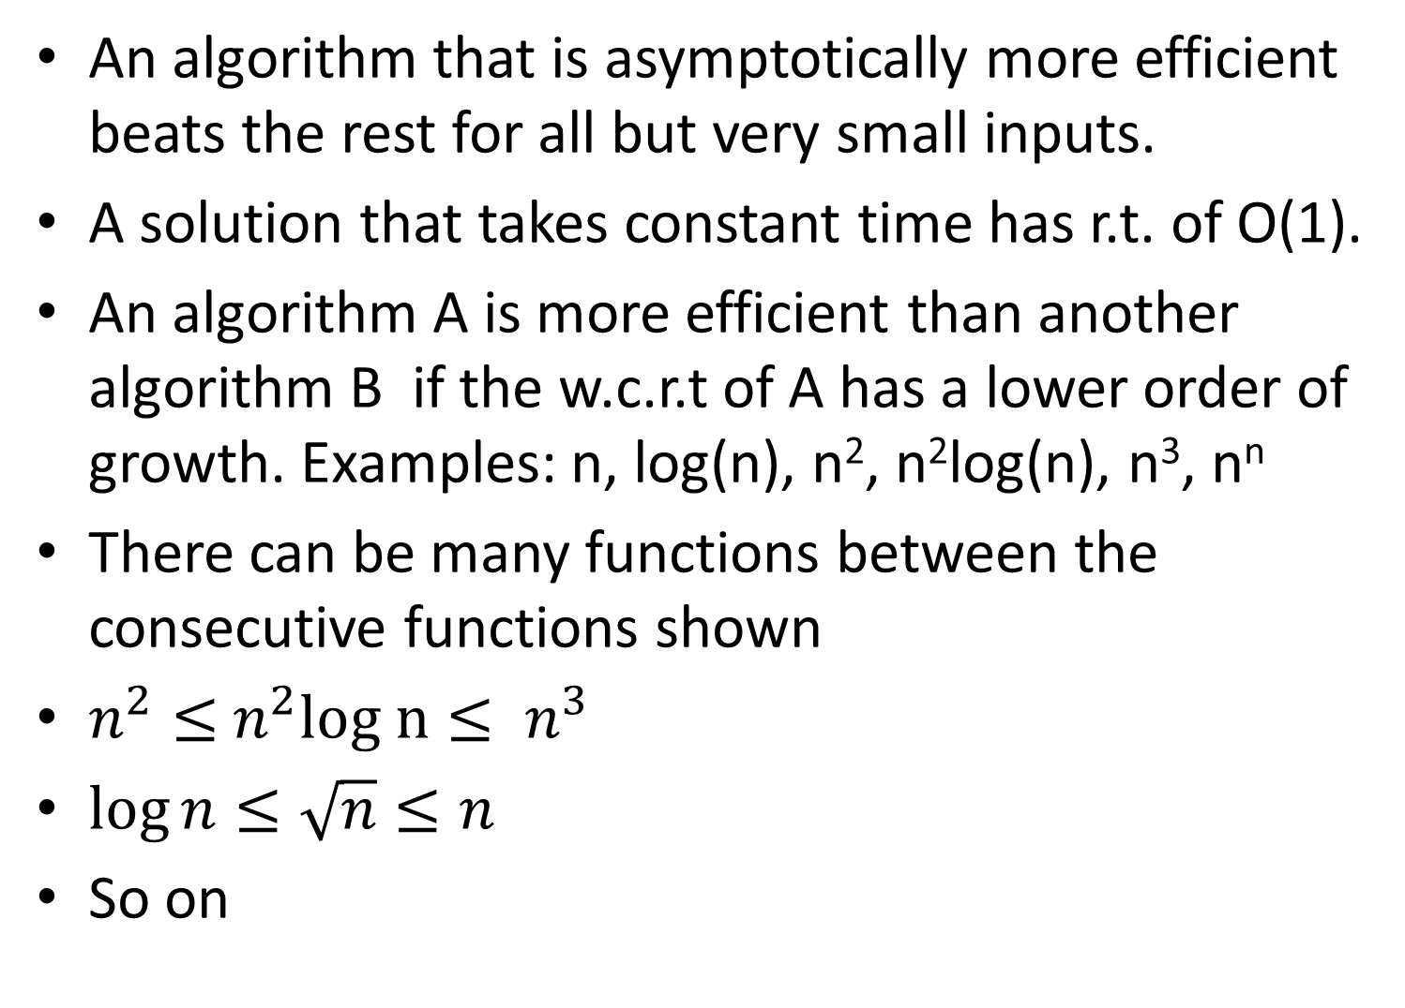
An algorithm that is asymptotically more efficient beats the rest for all but very small inputs.
A solution that takes constant time has r.t. of O(1).
An algorithm A is more efficient than another algorithm B if the w.c.r.t of A has a lower order of growth. Examples: n, log(n), n², n²log(n), n³, n^{n}
There can be many functions between the consecutive functions shown
$n^{2}≤$ $n^{2}log n≤ n^{3}$
$\log{n≤\sqrt{n}≤n}$
So on

Slide 7
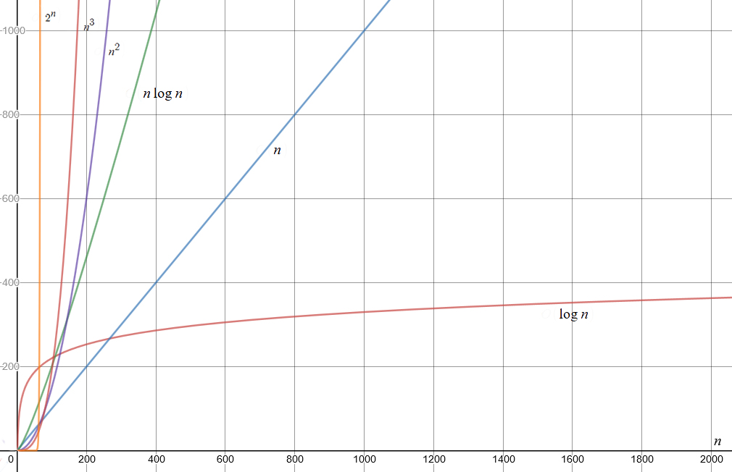

Slide 8
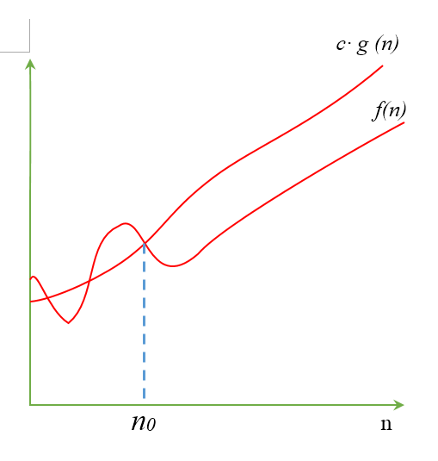
Big-Oh (O) Notation
For a given function g(n), a function t(n) is said to be in O(g(n)), denoted t(n) ∈ O(g(n)), if t(n) is bounded above by some constant multiple of g(n) for all large n
O(g(n)) denotes the set of functions f(n) for which there exist two positive constants, c and n₀ such that f(n) ≤ c⋅ g(n) for every n ≥ n₀.

Slide 9
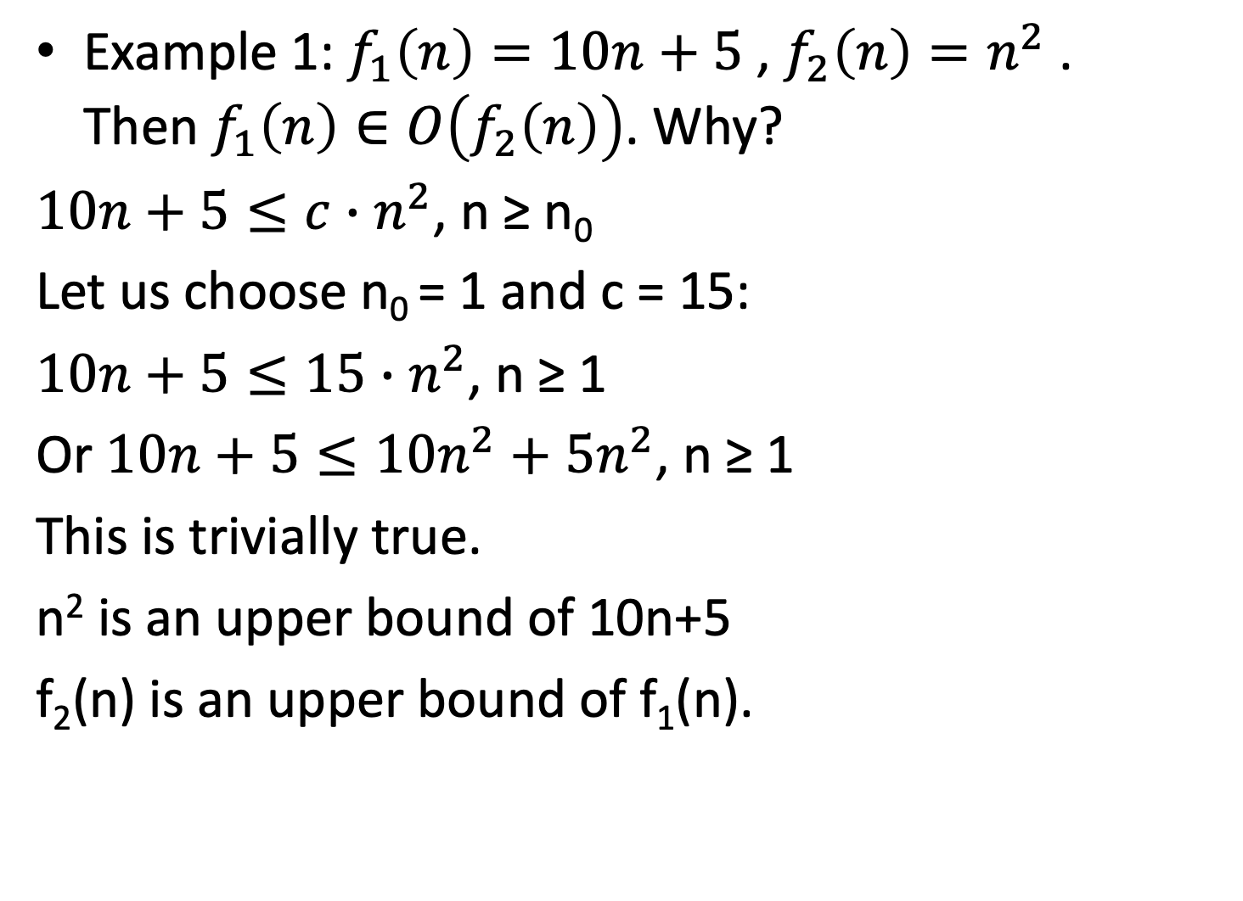
Example 1: $f_{1}\left(n\right)=10n+5$ , $f_{2}\left(n\right)=n^{2}$ . Then $f_{1}\left(n\right)∈O\left(f_{2}\left(n\right)\right)$. Why?
$10n+5≤c∙n^{2}$, n ≥ n₀
Let us choose n₀ = 1 and c = 15:
$10n+5≤15∙n^{2}$, n ≥ 1
Or $10n+5≤10n^{2}+5n^{2}$, n ≥ 1
This is trivially true.
n² is an upper bound of 10n+5
f₂(n) is an upper bound of f₁(n).

Slide 10
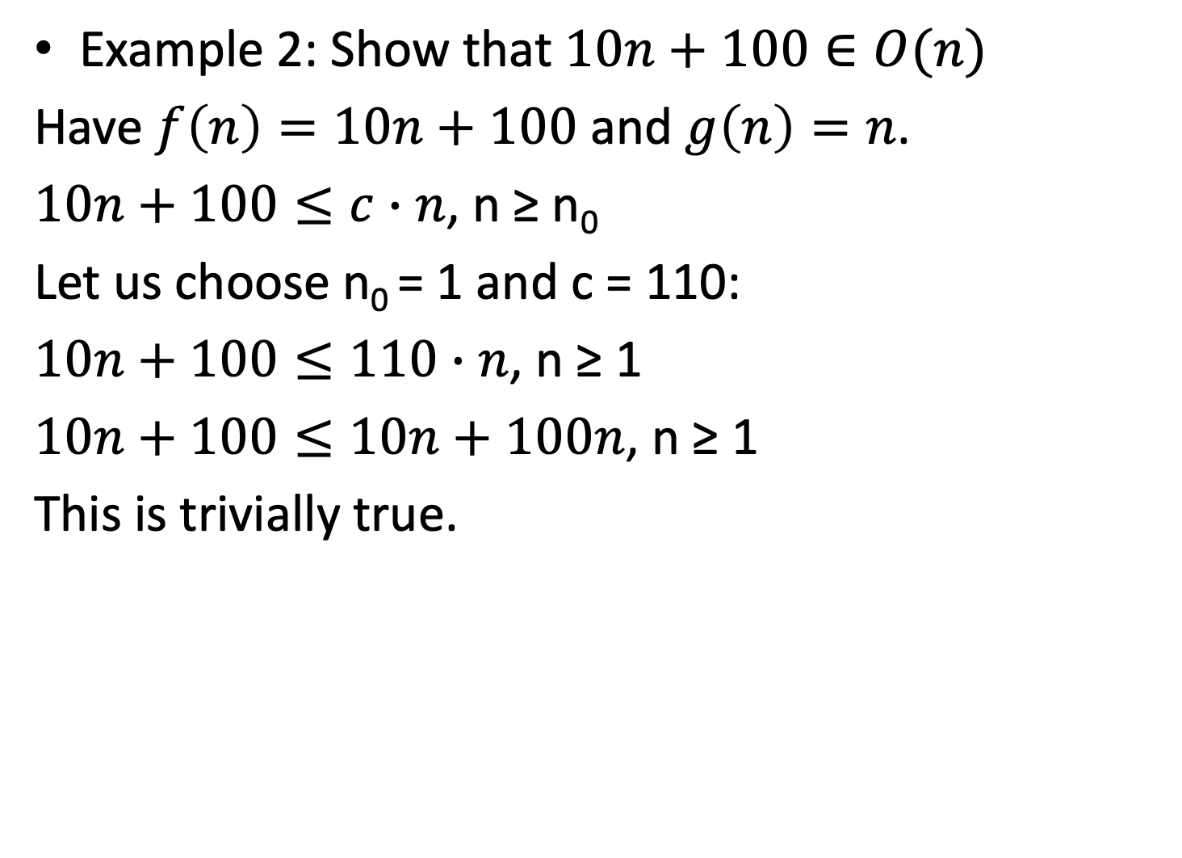
Example 2: Show that $10n+100∈O(n)$
Have $f\left(n\right)=10n+100$ and $g\left(n\right)=n$.
$10n+100≤c∙n$, n ≥ n₀
Let us choose n₀ = 1 and c = 110:
$10n+100≤110∙n$, n ≥ 1
$10n+100≤10n+100n$, n ≥ 1
This is trivially true.

Slide 11
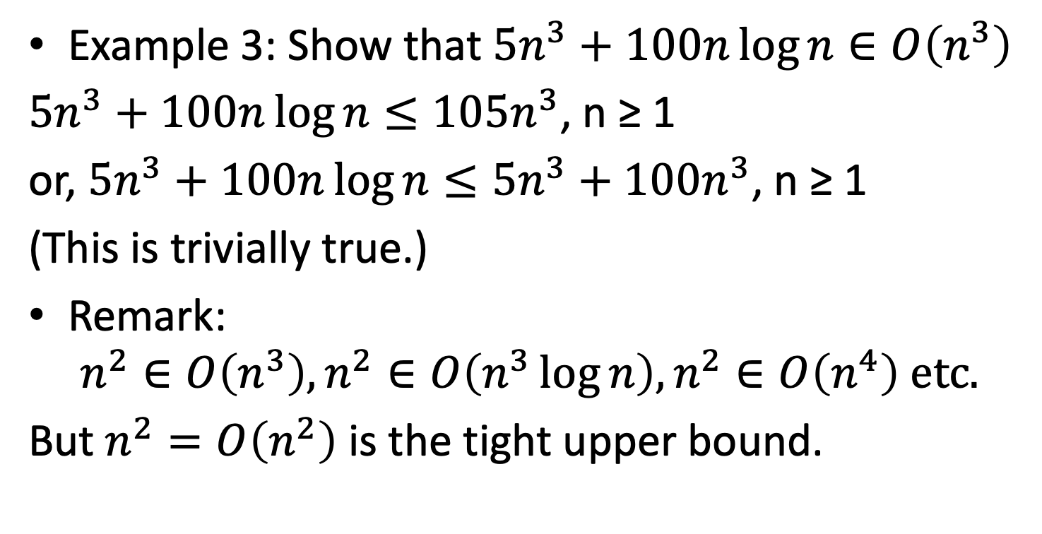
Example 3: Show that ${5n}^{3}+100n\log{n}∈O\left(n^{3}\right)$
${5n}^{3}+100n\log{n}≤105n^{3}$, n ≥ 1
or, ${5n}^{3}+100n\log{n}≤5n^{3}+100n^{3}$, n ≥ 1
(This is trivially true.)
Remark:
$$n^{2}∈O\left(n^{3}\right), n^{2}∈O\left(n^{3}\log{n}\right),n^{2}∈O\left(n^{4}\right) etc.$$
But $n^{2}=O\left(n^{2}\right)$ is the tight upper bound.

Slide 12
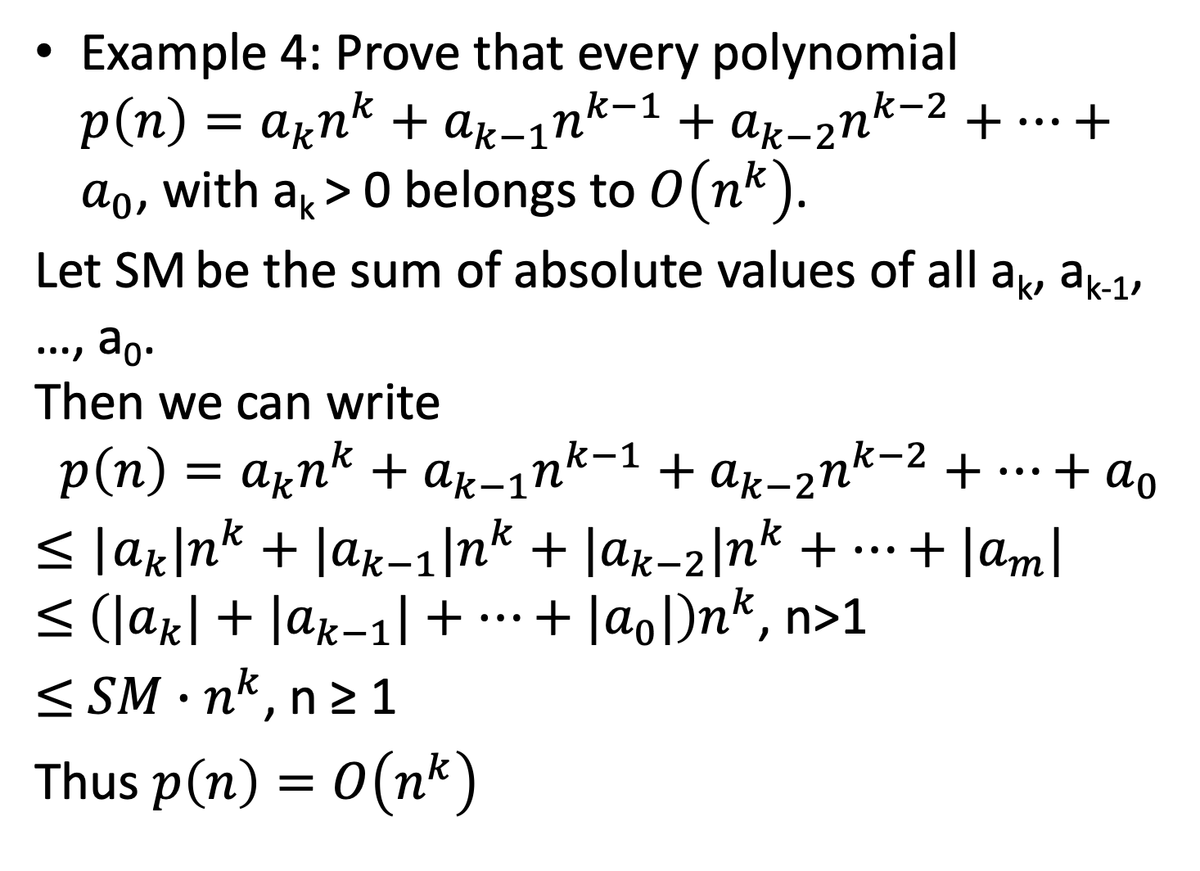
Example 4: Prove that every polynomial $p\left(n\right)=a_{k}n^{k}+a_{k−1}n^{k−1}+a_{k−2}n^{k−2}+⋯+a_{0}$, with a_{k} > 0 belongs to $O\left(n^{k}\right)$.
Let SM be the sum of absolute values of all a_{k}, a_{k-1}, …, a₀. Then we can write
$$p\left(n\right)=a_{k}n^{k}+a_{k−1}n^{k−1}+a_{k−2}n^{k−2}+⋯+a_{0}$$ $≤$ |$a_{k}|n^{k}+{|a}_{k−1}|n^{k}+|a_{k−2}{|n}^{k}+⋯+|a_{m}|$ $≤$ $\left({|a}_{k}|+{|a}_{k−1}|+⋯+{|a}_{0}|\right)n^{k}$, n>1
$≤$ $SM∙n^{k}\text{, }\text{n} \text{≥} \text{1}$
Thus $p\left(n\right)=O\left(n^{k}\right)$

Slide 13
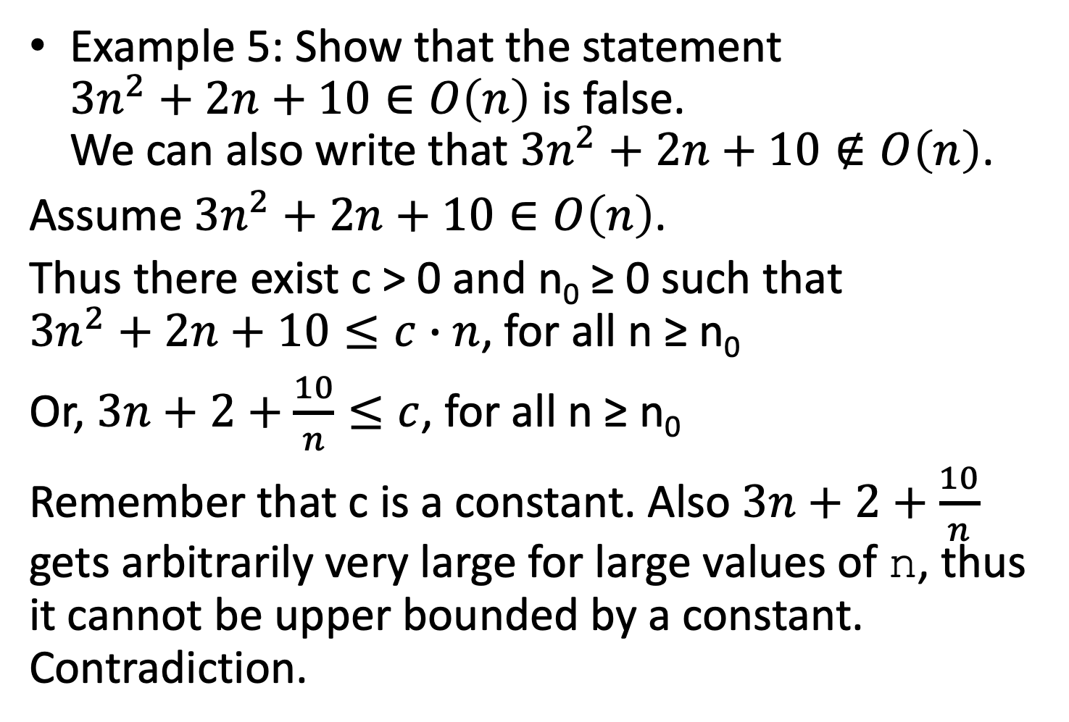
Example 5: Show that the statement ${3n}^{2}+2n+10∈O\left(n\right)$ is false. We can also write that ${3n}^{2}+2n+10∉O\left(n\right)$.
Assume ${3n}^{2}+2n+10∈O\left(n\right)$.
Thus there exist c > 0 and n₀ ≥ 0 such that ${3n}^{2}+2n+10≤c∙n$, for all n ≥ n₀
Or, $3n+2+\frac{10}{n}≤c$, for all n ≥ n₀
Remember that c is a constant. Also $3n+2+\frac{10}{n}$ gets arbitrarily very large for large values of n, thus it cannot be upper bounded by a constant. Contradiction.

Slide 14
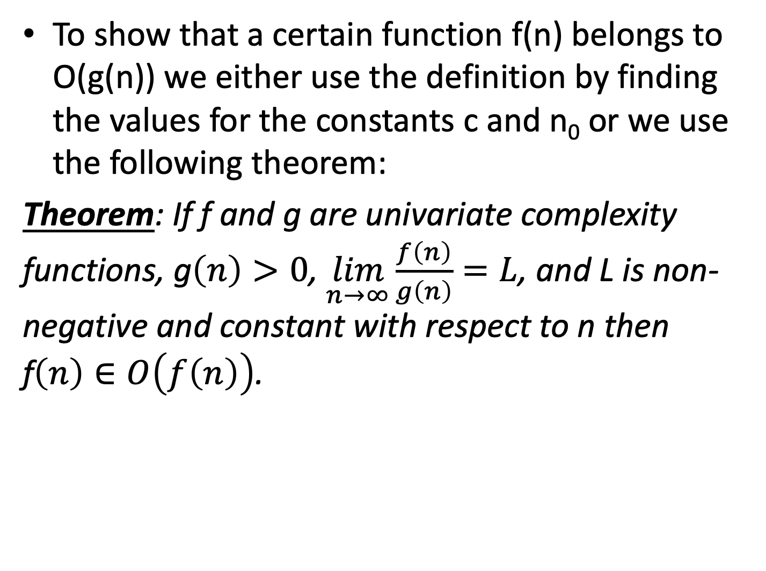
To show that a certain function f(n) belongs to O(g(n)) we either use the definition by finding the values for the constants c and n₀ or we use the following theorem:
Theorem: If f and g are univariate complexity functions, g$\left(n\right)>0$, $\lim_{n→∞}{\frac{f\left(n\right)}{g\left(n\right)}}=L$, and L is non-negative and constant with respect to n then f$\left(n\right)∈O\left(f\left(n\right)\right)$.

Slide 15
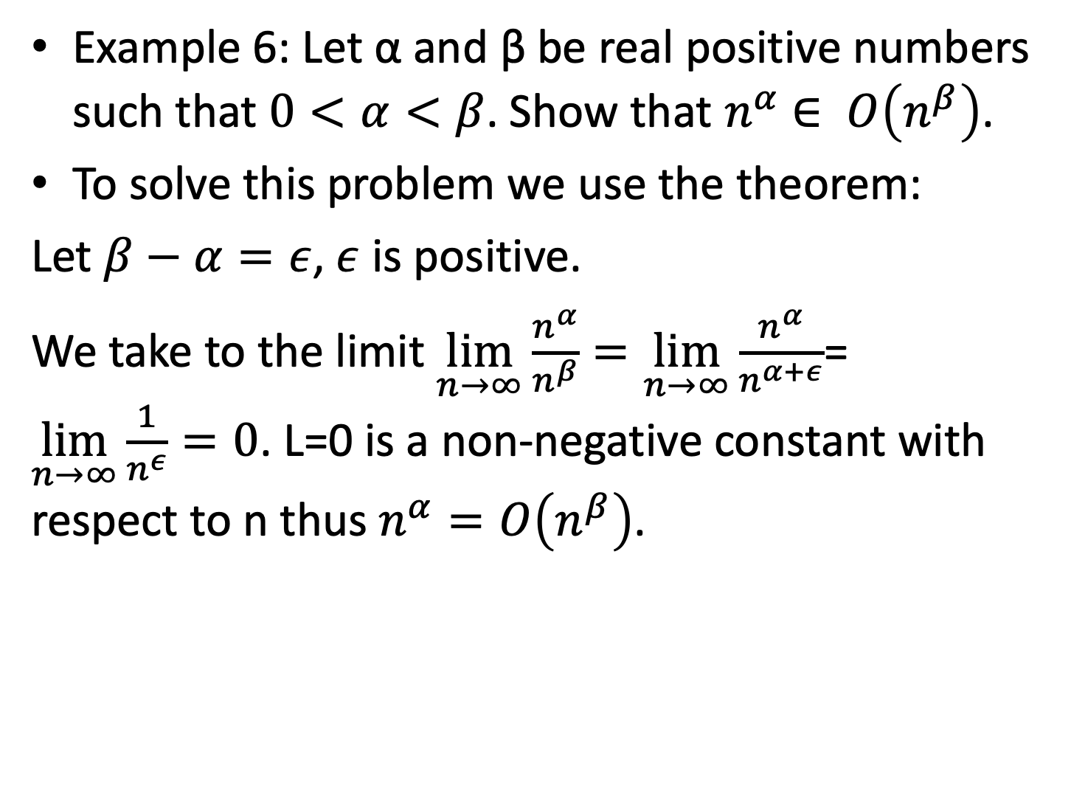
Example 6: Let α and β be real positive numbers such that $0<α<β$. Show that $n^{α}$ $∈ O\left(n^{β}\right)$.
To solve this problem we use the theorem:
Let $β−α=ε$, $ε$ is positive.
We take to the limit $\lim_{n→∞}{\frac{n^{α}}{n^{β}}}=\lim_{n→∞}{\frac{n^{α}}{n^{α+ε}}}$= $\lim_{n→∞}{\frac{1}{n^{ε}}}=0$. L=0 is a non-negative constant with respect to n thus $n^{α}=O\left(n^{β}\right)$.

Slide 16
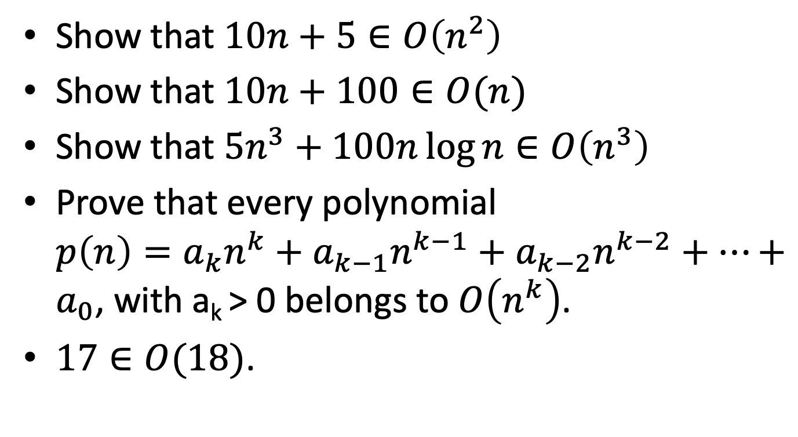
Using limits, show that:
Show that $10n+5∈O\left(n^{2}\right)$
Show that $10n+100∈O(n)$
Show that ${5n}^{3}+100n\log{n}∈O\left(n^{3}\right)$
Prove that every polynomial $p\left(n\right)=a_{k}n^{k}+a_{k−1}n^{k−1}+a_{k−2}n^{k−2}+⋯+a_{0}$, with a_{k} > 0 belongs to $O\left(n^{k}\right)$.
$17∈O(18)$.

Slide 17
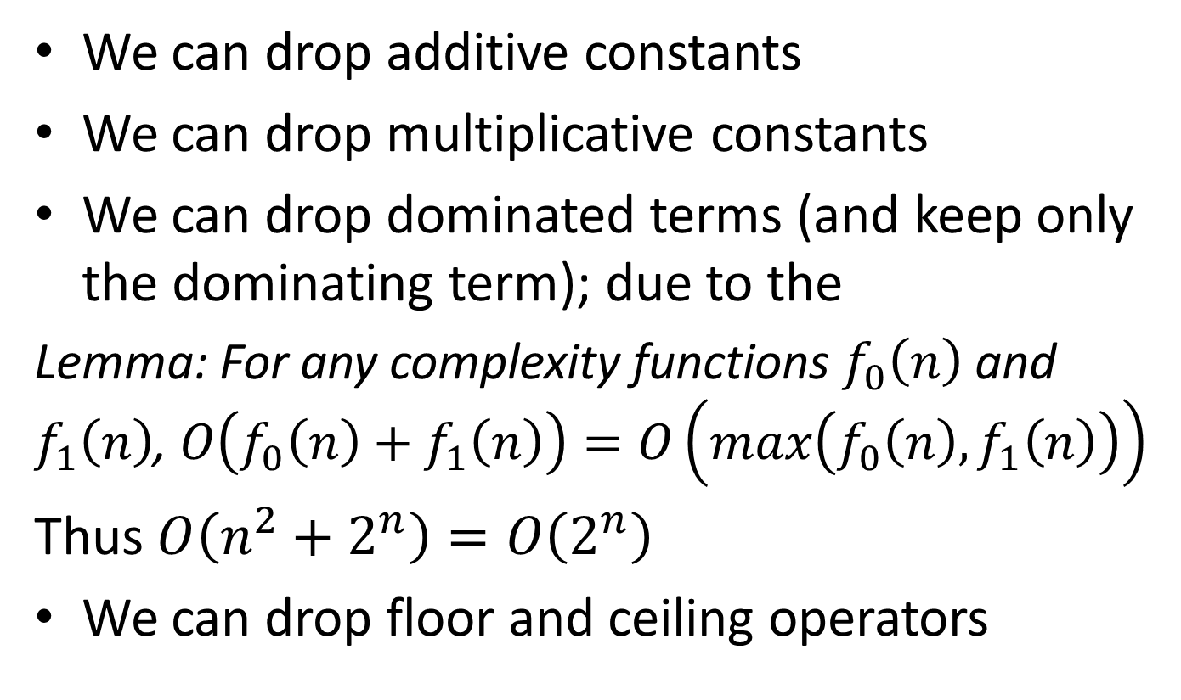
Remember that:
We can drop additive constants
We can drop multiplicative constants
We can drop dominated terms (and keep only the dominating term); due to the
Lemma: For any complexity functions $f_{0}\left(n\right)$ and $f_{1}\left(n\right)$, $O\left(f_{0}\left(n\right)+f_{1}\left(n\right)\right)=O\left(max\left(f_{0}\left(n\right),f_{1}\left(n\right)\right)\right)$
Thus $O\left(n^{2}+2^{n}\right)=O\left(2^{n}\right)$
We can drop floor and ceiling operators

Slide 18
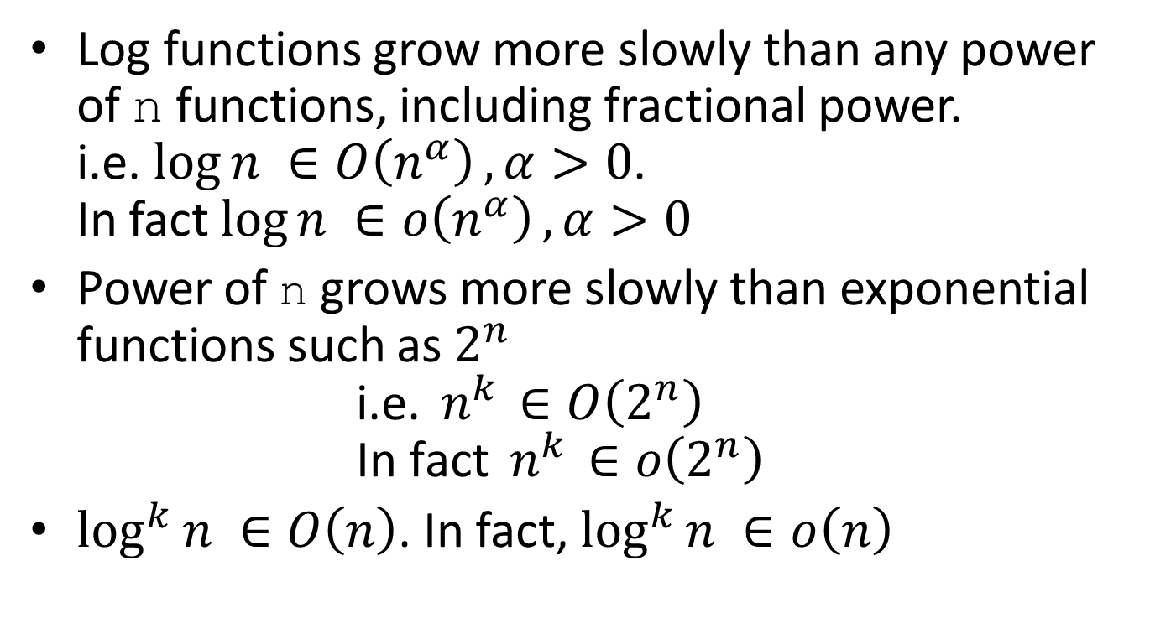
Remember that: (these can be proven by using calculus)
Log functions grow more slowly than any power of n functions, including fractional power. i.e. $\log{n ∈O\left(n^{α}\right)}, α>0$. In fact $\log{n ∈o\left(n^{α}\right)}, α>0$
Power of n grows more slowly than exponential functions such as $2^{n}$ $\text{i}\text{.}\text{e}\text{. }n^{k}{ ∈O\left(2^{n}\right)}$ $\text{In} \text{fact} n^{k}{ ∈o\left(2^{n}\right)}$
$\log^{k}{n ∈O\left(n\right)}$. In fact, $\log^{k}{n ∈o\left(n\right)}$

Slide 19
The top efficiency classes
Notation | Name | Example
O(1) | constant | Evaluating one statement
O(log n) | logarithmic | Searching a balanced search tree
O(n) | linear | For loop
O(n log n) | “n-log-n” | Fast sorting algorithms such as heap sort or merge sort
O(n²) | quadratic | Two nested for loops
O(n³) | cubic | Three nested for loops
O(2^{n}) | exponential | All subsets of an n-element set
O(n!) | factorial | All permutations of an n-element sequence

Slide 20
Upper bound is expressed as O(g(n)) (“Big-Oh”) and lower bound is expressed as Ω(g(n)) (“Big-Omega”)

Slide 21
Solving a problem
A problem has an input and an output
A solution to the problem can be an algorithm that takes the input and produces the output after a finite number of steps
We compare solutions by comparing algorithms, in terms of time and space complexity
The upper bound of a decidable problem is the time complexity of some particular algorithm that solves that problem:
Problem X with input n is solved by algorithm solve_{X} that has the time complexity f(n) and there is no algorithm with a lower asymptotic time complexity, so we say that problem X has the upper bound O(f(n))
A decidable problem has also a lower bound

Slide 22
Lower bound for a problem
A decidable problem has a lower bound
An algorithm DOES NOT have a lower bound
The lower bound for a particular problem is the best possible time complexity of any algorithm solving the problem
The notation for lower bound is 𝜴
If we know the lower bound for a given problem and succeed in designing an algorithm whose complexity matches that lower bound, then we are effectively done.
If a problem has the lower bound of is 𝜴 (t(n)) then any correct algorithm solving that problem will have the time complexity O(t(n)) or slower

Slide 23
Sorting problem
The sorting problem’s lower bound is 𝜴(n log n), which means that every algorithm that solves the sorting problem has time complexity O(n log n) or slower.
We will never see a sorting algorithm faster than O(n log n); O(n), for example, is out of the question
We have seen sorting algorithms with O(n log n) and O(n²) time complexities, which are compatible with this lower bound.
Even slower sorts, which take O(n³) time, say, are also conceivable and consistent with this lower bound.
When a problem’s upper and lower bounds match, we say that the problem has a tight bound.

Slide 24
Tight bound
When problem X has an upper bound of O(f(n)) and matching lower bound 𝜴(f(n)), we say that X has a tight bound of 𝜣(f(n)).
When there is a gap between the best known lower and upper bounds for a problem, there is an open question as to which bound can be improved on.
We emphasize that upper bounds and lower bounds are properties of problems, not algorithms.

Slide 25
Big-Omega (Ω) Notation
For a given function g(n), a function t(n) is said to be in Ω(g(n)), denoted t(n) ∈ Ω (g(n)), if t(n) is bounded below by some constant multiple of g(n) for all large n
Ω(g(n)) denotes the set of functions f(n) for which there exist two positive constants, c and n₀ such that f(n) ≥ c⋅ g(n) for every n ≥ n₀.

Slide 26
Big-Theta (Θ) Notation
For a given function g(n), a function t(n) is said to be in Θ(g(n)), denoted t(n) ∈ Θ(g(n)), if t(n) is bounded both above and below by some constant multiple of g(n) for all large n
Θ(g(n)) denotes the set of functions f(n) for which there exist three positive constants, c₁, c₂, and n₀ such that c₁ ⋅ g(n) ≥ f(n) ≥ c₂ ⋅ g(n) for every n ≥ n₀.

Slide 27
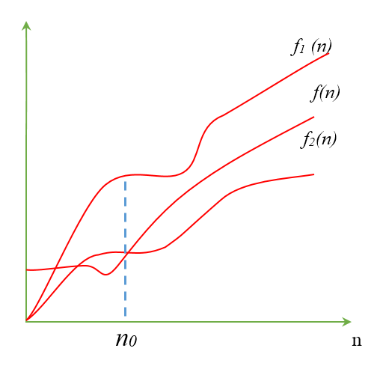
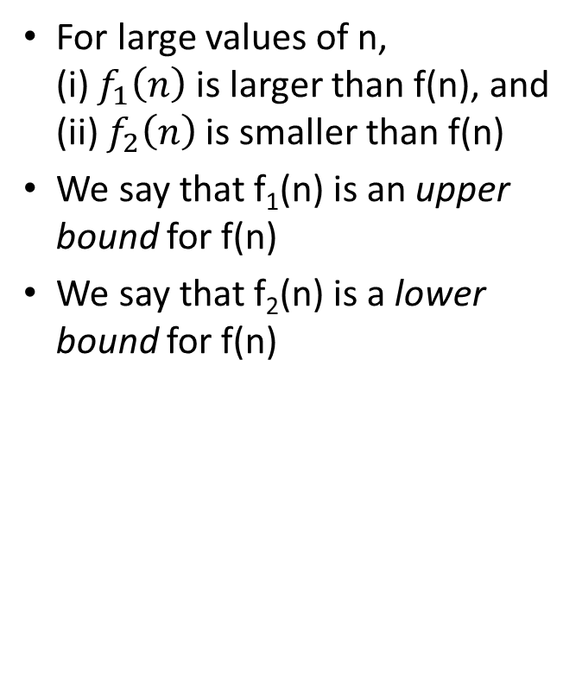
Understanding the upper bound & lower bound of a function
Consider three functions
For large values of n, (i) $f_{1}\left(n\right)$ is larger than f(n), and (ii) $f_{2}\left(n\right)$ is smaller than f(n)
We say that f₁(n) is an upper bound for f(n)
We say that f₂(n) is a lower bound for f(n)

Slide 28
Proving the lower bound for sorting
An upper bound, such as “there exists an algorithm that solves the sorting problem in O(n log n) time,” can be proven by example. To prove this claim, we only need to show one example of an algorithm that solves the sorting problem in O(n log n) time.
A lower bound, we need to prove that, for every algorithm that every has been or could be conceived, that algorithm’s time complexity is O(n log n) or slower

Slide 29
Trivial lower bounds in general
A correct algorithm must, at a minimum, initialize the data structures that hold its output:
Claim: If the space complexity of the output for problem X is O(f(n)), then X has a lower bound of 𝜴(f(n)).
For sorting problem, the output is a data structure with space complexity O(n), therefore, there is a trivial lower bound of 𝜴(n) time for the sorting problem
For the sequential search problem, from this Claim we get that the lower bound is 𝜴(1), a constant. Not helpful.
So we need other properties.

Slide 30
Trivial lower bounds in general (cont.)
A correct algorithm must interact with some amount of input data:
Claim: If every correct algorithm for problem X must observe O(f(n)) data, then X has a lower bound of 𝜴(f(n)).
Any correct sequential search algorithm must be capable of examining all n elements, in O(n) time, so we have a lower bound of 𝜴(n) for sequential search.

Slide 31
Binary Search Problem
Some algorithms are clever about examining only a small subset of their input which is relevant.
In the binary search problem, the classical binary search algorithm examines only O(log n) input elements, rules out half of the input at every step, and thereby ignore almost all of the input, n-O(log n) elements entirely.
The binary search algorithm has worst-case time complexity of O(log n), which establishes an upper bound of O(log n) time for that problem
Claim: The binary search problem has a tight bound of 𝜣(log n).

Slide 32
Tight bound for sorting
Every correct sort must be capable of starting from a (likely-unordered) vector V and “learning” which permutation will re-order V into non-decreasing order.
Any sorting algorithm must make a series of comparisons of the type “compare if a < b for two elements a, b ∈ V”, and uses the outcome of these comparisons to guide the sorting process
Nearly all practical sorting algorithms are comparison-based although radix sort is one notable exception.
Theorem: The sorting problem has a lower bound of 𝜴(n log n) that applies to all comparison-based sorting algorithms.

Slide 33
Proof: Let A be an arbitrary correct decision-based sorting algorithm that re-orders the elements of V into a sorted vector S in non-decreasing order.
We assume that all elements of V are distinct and there exists exactly one valid permutation p.
V has n elements, so there are n! candidate permutations that might possibly be a valid p.
Let a and b be the first two elements of V that are compared by algorithm A, and we have that a ≠ b
So either a < b or a > b.
When a < b, we know that a must precede b in S, so S has the form S =...a...b..... Of the n! permutations of V, exactly half fit this pattern where a comes before b.
When a > b,S has the form S =...b...a... , and only the other half of the permutations fit this pattern.

Slide 34
The first comparison (between a and b) gives to the algorithm A enough information to decrease the size of the set of candidate permutations by half.
The second comparison of elements could provide A enough information to halve the candidate set again to n!/4 permutations, the third comparison could halve the candidate set to n!/8 permutations, and so on.
From the master theorem and analysis of binary search, a decrease-by-half decision process narrows a field of k candidates down to one result after only O(log k) decisions. Therefore A makes O(log(n!)) comparisons.

Slide 35
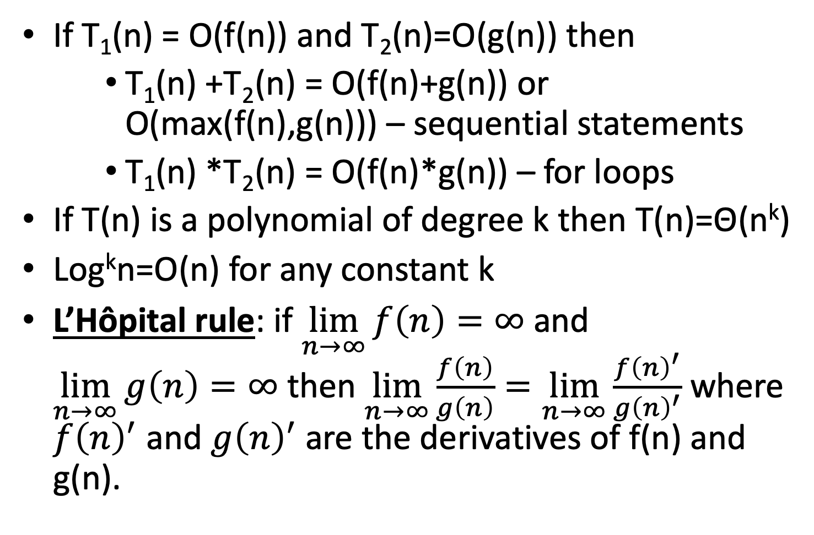
Rules
If T₁(n) = O(f(n)) and T₂(n)=O(g(n)) then
T₁(n) +T₂(n) = O(f(n)+g(n)) or O(max(f(n),g(n))) – sequential statements
T₁(n) *T₂(n) = O(f(n)*g(n)) – for loops
If T(n) is a polynomial of degree k then T(n)=Θ(n^{k})
Log^{k}n=O(n) for any constant k
L’Hôpital rule: if $\lim_{n→∞}{f\left(n\right)=∞}$ and $\lim_{n→∞}{g\left(n\right)=∞}$ then $\lim_{n→∞}{\frac{f\left(n\right)}{g\left(n\right)}=\lim_{n→∞}{\frac{{f\left(n\right)}^{′}}{{g\left(n\right)}^{′}}}}$ where ${f\left(n\right)}^{′}$ and ${g\left(n\right)}^{′}$ are the derivatives of f(n) and g(n).

Slide 36
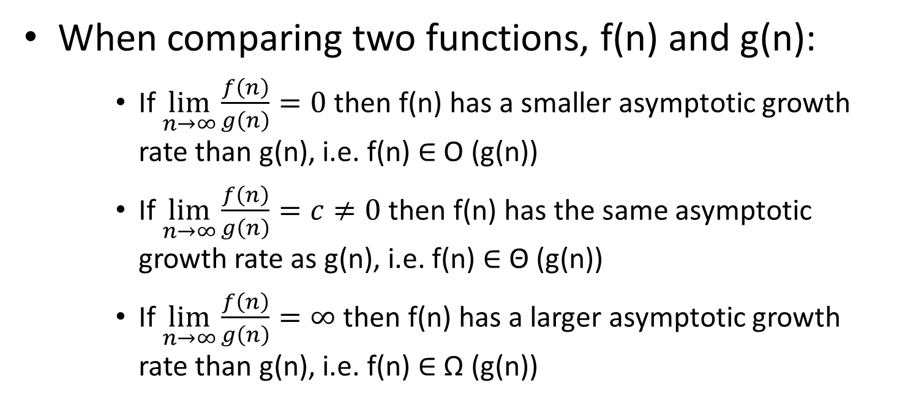
Using limits when comparing order of growth
When comparing two functions, f(n) and g(n):
If $\lim_{n→∞}{\frac{f\left(n\right)}{g\left(n\right)}=0}$then f(n) has a smaller asymptotic growth rate than g(n), i.e. f(n) ∈ O (g(n))
If $\lim_{n→∞}{\frac{f\left(n\right)}{g\left(n\right)}=c≠0}$then f(n) has the same asymptotic growth rate as g(n), i.e. f(n) ∈ Θ (g(n))
If $\lim_{n→∞}{\frac{f\left(n\right)}{g\left(n\right)}=∞}$then f(n) has a larger asymptotic growth rate than g(n), i.e. f(n) ∈ Ω (g(n))

Slide 37
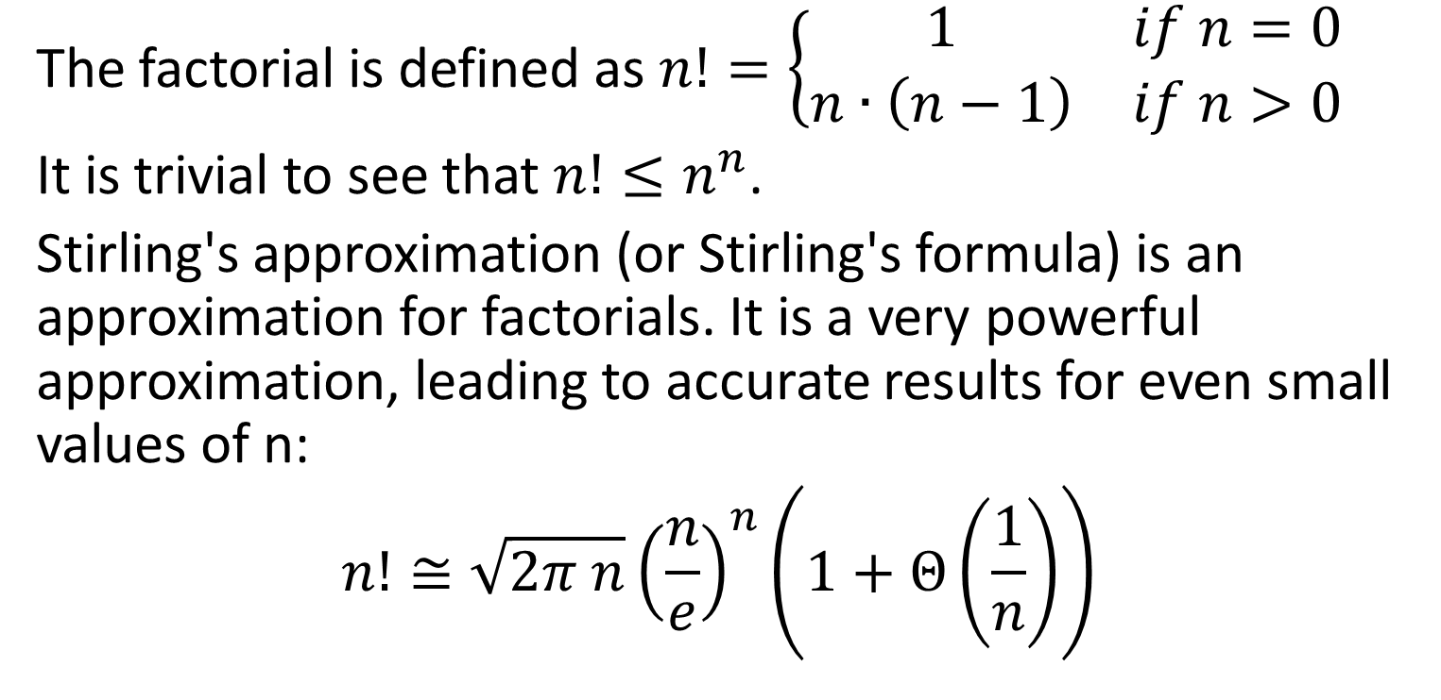
Approximation of the factorial function
The factorial is defined as $n!=\left\{\begin{matrix}1 & if n=0 \\ n∙\left(n−1\right) & if n>0\end{matrix}\right.$
It is trivial to see that $n!≤n^{n}$.
Stirling's approximation (or Stirling's formula) is an approximation for factorials. It is a very powerful approximation, leading to accurate results for even small values of n:
$$n!≅\sqrt{2π n}{\left(\frac{n}{e}\right)}^{n}\left(1+Θ\left(\frac{1}{n}\right)\right)$$

Slide 38
Little-Oh (o) Notation
f(n) = o(g(n)) if for any positive constant c, there exists a positive constant n₀ such that 0 ≤ f(n) < c g(n) when n ≥ n₀. Example: 2n=o(n²) but 2n² ≠o(n²)

