Slide 1
CPSC 535: Advanced Algorithms
Instructor: Dr. Doina Bein

Slide 2
General Computational Problems
A problem has an input and an output
A solution to the problem can be an algorithm that takes the input and produces the output after a finite number of steps
Def: Given an alphabet Σ, a computational problem is a function mapping strings defined on Σ to set of strings on Σ,
Computational problem ≠ decision problem
Any particular input to a problem is called an instance of the problem.

Slide 3
Categories
All the computational problems discussed in this course fit into the definition, but in real-world they are stated as questions or tasks, not functions
Based on their task, we divide them into:
Function problems
Search problems
Optimization problems
Threshold problems
Each computational problem may have an associated decision problem

Slide 4
Function Problems
A function problem is characterized by a function f(I) that returns a single string as output, where I is the input string, and is defined as follows:
Given input string I, compute f(I) (or return “no” if f(I) is not defined).
The output of a function problem is always a singleton string (we consider “no” to be a singleton string, too).

Slide 5
Example 1: Multiplication à la russe
Read more on Internet about it, also called “Ethiopian multiplication” or “Peasant multiplication” (https://en.wikipedia.org/wiki/Ancient_Egyptian_multiplication , https://www.wikihow.com/Multiply-Using-the-Russian-Peasant-Method)
The way most people learn to multiply large numbers looks something like this:
86
x 57
------
602
+ 4300
------
4902
This "long multiplication" is quick and relatively simple.
For the Ethiopian / à la russe / Russian peasant algorithm, one does not need multiplication; one only needs to double numbers, cut them in half, and add them up, but it will take longer to get the result.

Slide 6
How it works?
Follow the rules:
Write each number at the head of a column, it does not matter which column; let’s consider that the first number is in the left column and the second number in the right column.
Halve the number in the left column and double the number in the right column as follows:
If the number in the left column is odd, divide it by 2 and drop the remainder.
If the number in the left column is even, cross out that entire row.
Keep halving, doubling, and crossing out rows until the number in the left column is 1.
Add up the remaining (uncrossed) numbers in the right column.
The total is the product of your original numbers.

Slide 7
Why it works?
Let m and n be the two numbers
If m is even, then the first row will contain
m n
And the second row will contain
m/2 2*n
Note that m*n=(m/2)*(2*n).
The first row will be crossed out and the result will be computed based on second (possibly) and the subsequent rows.
If m is odd, then the first row will contain
m n
And the second row will contain
(m-1)/2 2*n
Note that m*n = m+((m-1)/2)*(2*n).
The first row will be kept and the result will be computed based on first, second (possibly) and the subsequent rows.

Slide 8
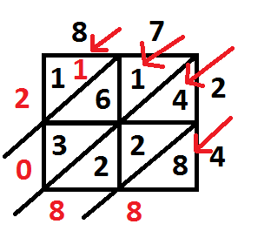
Example 2: Lattice Multiplication
Read more on Internet about it, known under many names, most common “lattice multiplication” (https://en.wikipedia.org/wiki/Lattice_multiplication)

Slide 9
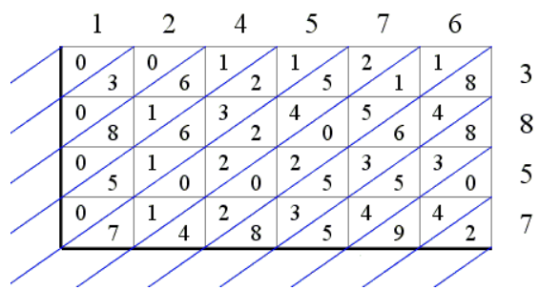
How it works? (https://www.cut-the-knot.org/Curriculum/Arithmetic/LatticeMultiplication.shtml)
The number with the smallest number of digits goes on the row and the number with the largest number of digits goes on the column, one digit per cell.
A grid is drawn up, and each cell is split diagonally.
The two multiplicands of the product to be calculated are written along the top and right side of the lattice, as below:

Slide 10
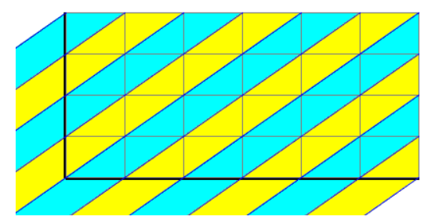
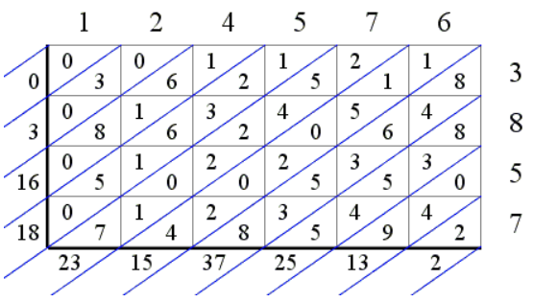
(contd.)
Note that the diagonals split the lattice into (diagonal) bands:
The algorithm requires to compute the sums of all the digits in a band and place the result next to the lattice, to the left or below the bottom, as the case may be.
The product 124576×3857 leads to the following diagram:

Slide 11
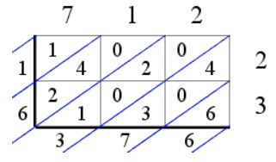
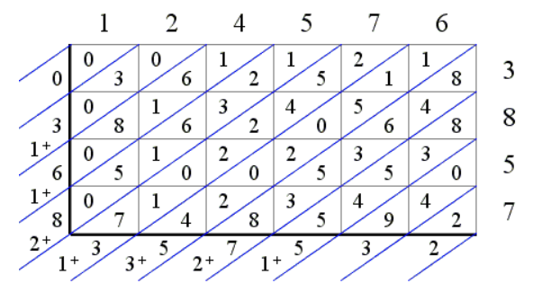
The sums are thought of as being ordered around the lattice, first from the top to the bottom and then left to right.
If all the sums are single digit numbers, the product of the two multiplicands can be read right away by following the sums around the lattice counterclockwise, so 712×23 = 16376:
The 2-digit sums cause a complication which is resolved by carrying their first digit to the previous band (counterclockwise) and adding it to what remains there of the sum placed there previously.
The product 124576×3857 leads to the following diagram:

Slide 12
The third intermediate sum 2 + 8 = 10 takes two digits leading to an additional carry of 1 which is added to the preceding sum 1 + 6 making it 1 + 6 + 1 = 8.
Once all the sums are single digit numbers, the product of the two multiplicands can be read right away by following the sums around the lattice counterclockwise.
We obtain 124576×3857 = 480489632.

Slide 13
Search Problems
A predicate is a function that returns true or false.
A search problem is characterized by a predicate Q(I,S) where I is the input string and S is some string, as follows:
Find a string S such that Q(I,S) is true (or return “no” if no such S exists).

Slide 14
Optimization Problems
A numerical function is a function that returns numbers, usually integer-valued.
An optimization problem is characterized by a numerical function V(I,S) where I is the input string and S is some string, as follows:
Find a string S such that V(I,S) is minimized (or maximized).

Slide 15
Threshold Problems
A threshold problem is characterized by a numerical function V(I,S) and a numerical threshold K, where I is the input string, K is an input numerical value, and S is some string, and is defined as follows:
Given I and K, find a string S such that V(I,S) ≤ K (or ≥, or =).
Another variant asks a decision version of the same question:
Given I and K, does there exist an S such that V(I,S) ≤ K (or ≥, or =)?

Slide 16
Decision Problems
A decision problem is a function problem with exactly two possible solutions, “yes” or “no”, i.e. it is characterized by a function f(I) that returns “yes” or “no”, where I is the input string, and is defined as follows:
Given the string I, returns “yes” if f(I) exists or “no” if f(I) is not defined.
Are rarely used in practical applications, but they are relatively easy to state and prove theorems about it.
Most general computational problems have a closely related decision problem that captures the same fundamental idea, and vice-versa.

Slide 17
Strategies to Design Algorithms https://github.com/kevinwortman/advanced-algorithms-slides/blob/master/01-problem-solving.pdf
Why?
novel scholarly research
industrial software development (algorithm engineering)
technical interviews
class exercises
exam questions
Follow a checklist (next)

Slide 18
Checklist https://github.com/kevinwortman/advanced-algorithms-slides/blob/master/01-problem-solving.pdf
Understand the problem definition
Baseline algorithm for comparison
Goal setting: improve on the baseline how?
Design a more sophisticated algorithm
Inspiration (if necessary) from patterns, bottleneck in the baseline algorithm, other algorithms
Analyze your solution; goal met? trade-offs?

Slide 19
1. Understand https://github.com/kevinwortman/advanced-algorithms-slides/blob/master/01-problem-solving.pdf
Read the problem definition (input/output) carefully and critically.
Make sure that you understand the data types involved, constraints on them, technical terms, and story of the problem.
Write out a straightforward input and output. Try additional examples involving non-obvious solutions.
What are the corner cases of input? Can the input be empty?
When is the solution obvious, and when is it not?
What is a use case for this algorithm in practical software?
Does this problem resemble other problems you know about?
If any of this is unclear, ask questions.

Slide 20
Example Problem: Word Find ¹
Problem description: A popular diversion in the United States, “word find” (or “word search”) puzzles ask the player to find each of a given set of words in a square table filled with single letters. A word can read horizontally (left or right), vertically (up or down), or along a 45 degree diagonal (in any of the four directions) formed by consecutively adjacent cells of the table; it may wrap around the table’s boundaries, but it must read in the same direction with no zigzagging. The same cell of the table may be used in different words, but, in a given word, the same cell may be used no more than once. Write an algorithm for solving this puzzle.
Quiz:
Data types of input and output, constraints on these data types (if any)
Problem instance, i.e. example of input and output
Are there any special cases, so called “Corner cases”?
Use case, i.e. where solving this problem can be useful
Similar to anything familiar?
¹ Introduction to the Design and Analysis of Algorithms. By Anand Levitin, ex. 10, page 107

Slide 21
2. Baseline https://github.com/kevinwortman/advanced-algorithms-slides/blob/master/01-problem-solving.pdf
Now that you understand the problem, quickly identify at least one algorithm that solves it.
(research context) literature review: CLRS, Wikipedia, Google Scholar
sketch a naive algorithm: brute force, exhaustive search, for loops
What is the efficiency of your baseline algorithm?
Baseline alg. almost always exists
in our contexts, problems are almost always in NP
→ exponential-time exhaustive search algorithm
In the unlikely event no alg. seems to exist, consider whether
the problem is provably undecidable.

Slide 22
Stop after the Baseline?
Consider: baseline algorithm is a working, but is possibly a very inefficient solution to your problem.
might be acceptable if efficiency is low priority
shows technical interviewer that you can communicate and think about algorithms
earns partial credit on class assignments
time/labor management
Pareto principle (80/20 rule): in many settings, spending 20% of maximum effort achieves 80% of maximum benefit.

Slide 23
3. Goal https://github.com/kevinwortman/advanced-algorithms-slides/blob/master/01-problem-solving.pdf
What about the baseline do we want to improve?
better time efficiency (most common goal)
better space efficiency
avoid randomization
avoid amortization
extra feature e.g. sort is in-place
simplicity; elegance; easier to implement/understand
better constant factors
(non-research contexts): goal may be dictated to you

Slide 24
4. Design https://github.com/kevinwortman/advanced-algorithms-slides/blob/master/01-problem-solving.pdf
Now, design an algorithm, hopefully achieving your goal.
Start with verbal discussion; informal sketches; snippets of
pseudocode, prose, equations
As ideas develop and become more concrete, move to pseudocode.
Finally write complete, clear pseudocode for the entire algorithm.
“Devil is in the details:" resist urge to avoid a tricky part, often that is the key to meeting your goal.

Slide 25
5. Inspiration https://github.com/kevinwortman/advanced-algorithms-slides/blob/master/01-problem-solving.pdf
Step 4. Design...
might come naturally, devise an algorithm effortlessly
more likely: not immediately apparent how to proceed; stuck at first
Inspiration:
more likely a learned skill
requires practice, effort, experience
point of class exercises
why algorithm design is an in-demand skill

Slide 26
Sources of Inspiration: algorithm design patterns
Patterns taught in CPSC 335:
greedy
divide-and-conquer
randomization
reduction to another algorithm (sorting) or data structure (hash table, search tree, heap, etc.)
dynamic programming
Run through the list; can you think of how to use any of these patterns to solve the problem at hand?
If a pattern doesn't seem to work, why is that? Might give a hint about what would work instead.

Slide 27
Sources of Inspiration: Identify Bottleneck
Review the analysis of your baseline algorithm (either from the literature, or what you just devised).
Identify the dominating term in the efficiency analysis.
Trace that term backwards to a part of the baseline algorithm; probably a particular loop or data structure operation.
How can we do less work there?
preprocessing (ex. maximum subarray)
use an appropriate data structure (ex. heap sort)
reuse work instead of repeating work (ex. Dijkstra's alg.)
dynamic programming

Slide 28
Sources of Inspiration: Other Algorithms
One reason we study specific algorithms in detail is to learn about clever “tricks" other designers have used, that we might be able to use in novel circumstances.
Examples:
define invariants to keep yourself organized (selection sort)
break down problem into simpler phases (heap sort)
use pointers so you can change many paths w/ one assignment; redirection (search trees)
use an array instead of pointers (heapsort, open addressing)
master theorem insights to refactor work out of dominating term (selection)
when almost all candidate solutions are clearly right/wrong,
randomize (quicksort, universal hashing)
compute word-at-a-time (hashing, radix sort)

Slide 29
6. Analyze https://github.com/kevinwortman/advanced-algorithms-slides/blob/master/01-problem-solving.pdf
Finally analyze your algorithm.
Does it meet your goal? (time efficiency, space efficiency,
randomization, etc.)
If yes, obviously done.
If not,
Is your algorithm still an improvement over your baseline?
Is more effort justified? (Pareto principle.)
If yes, go back to prior steps.

